Slide 1


Welcome!
Advanced Therapy: Biologic DMARDs
Wendy Grant, MD
November 13, 2023
RAE Initiative| Fall 2023

Slide 2
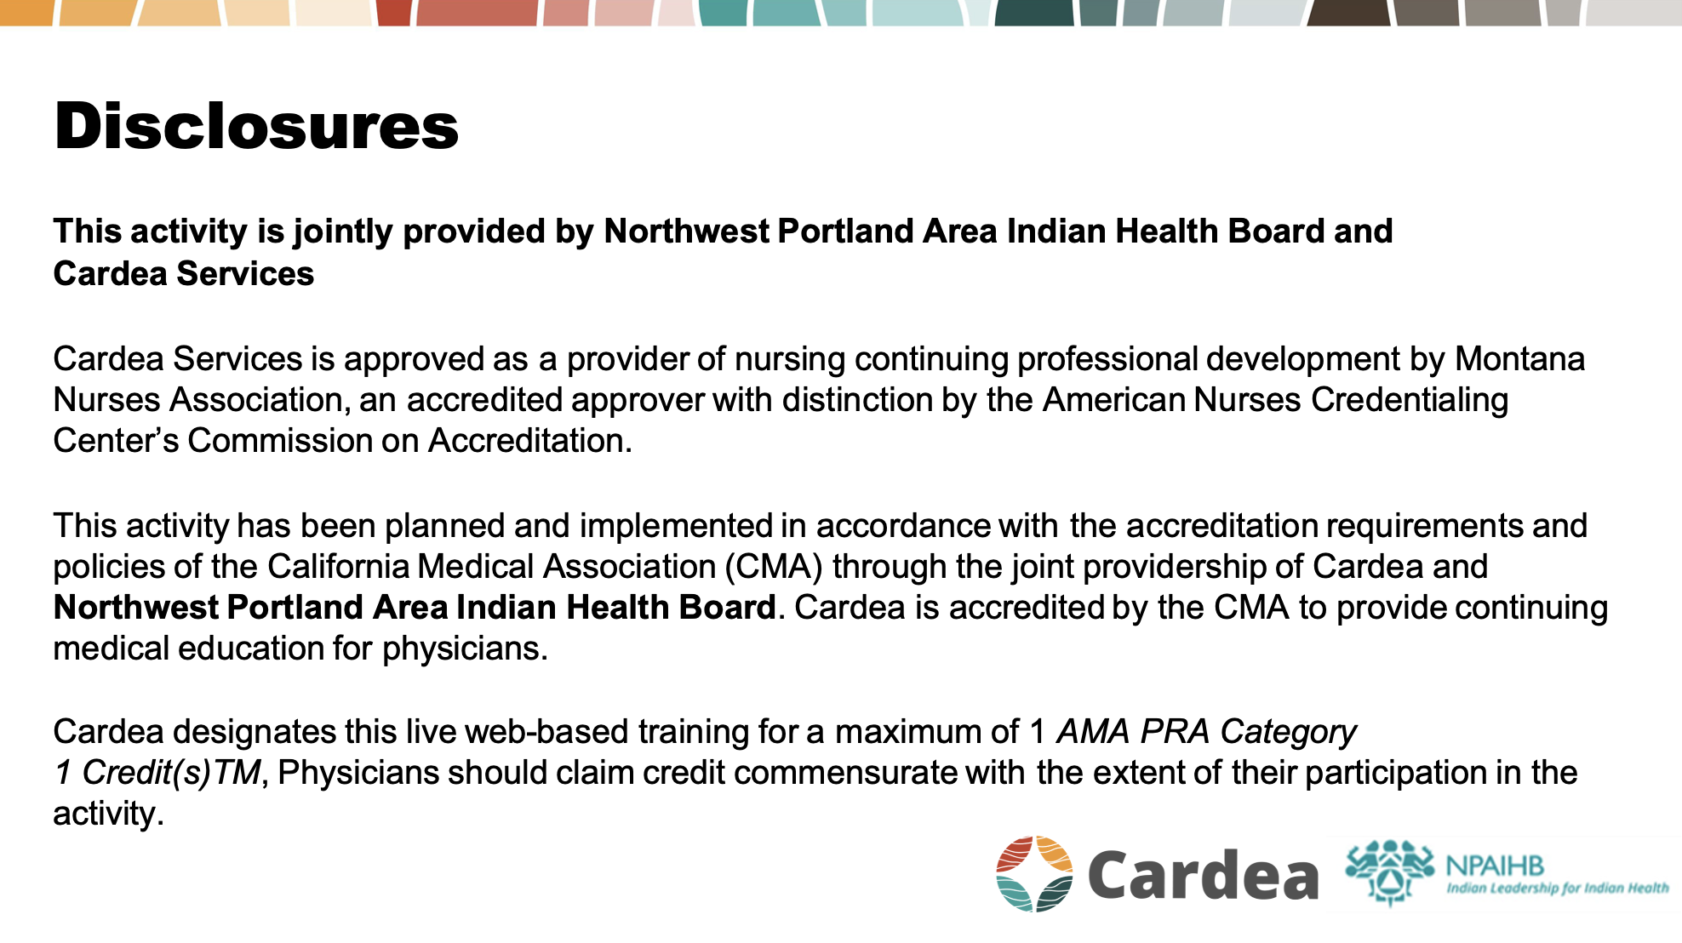

Slide 3
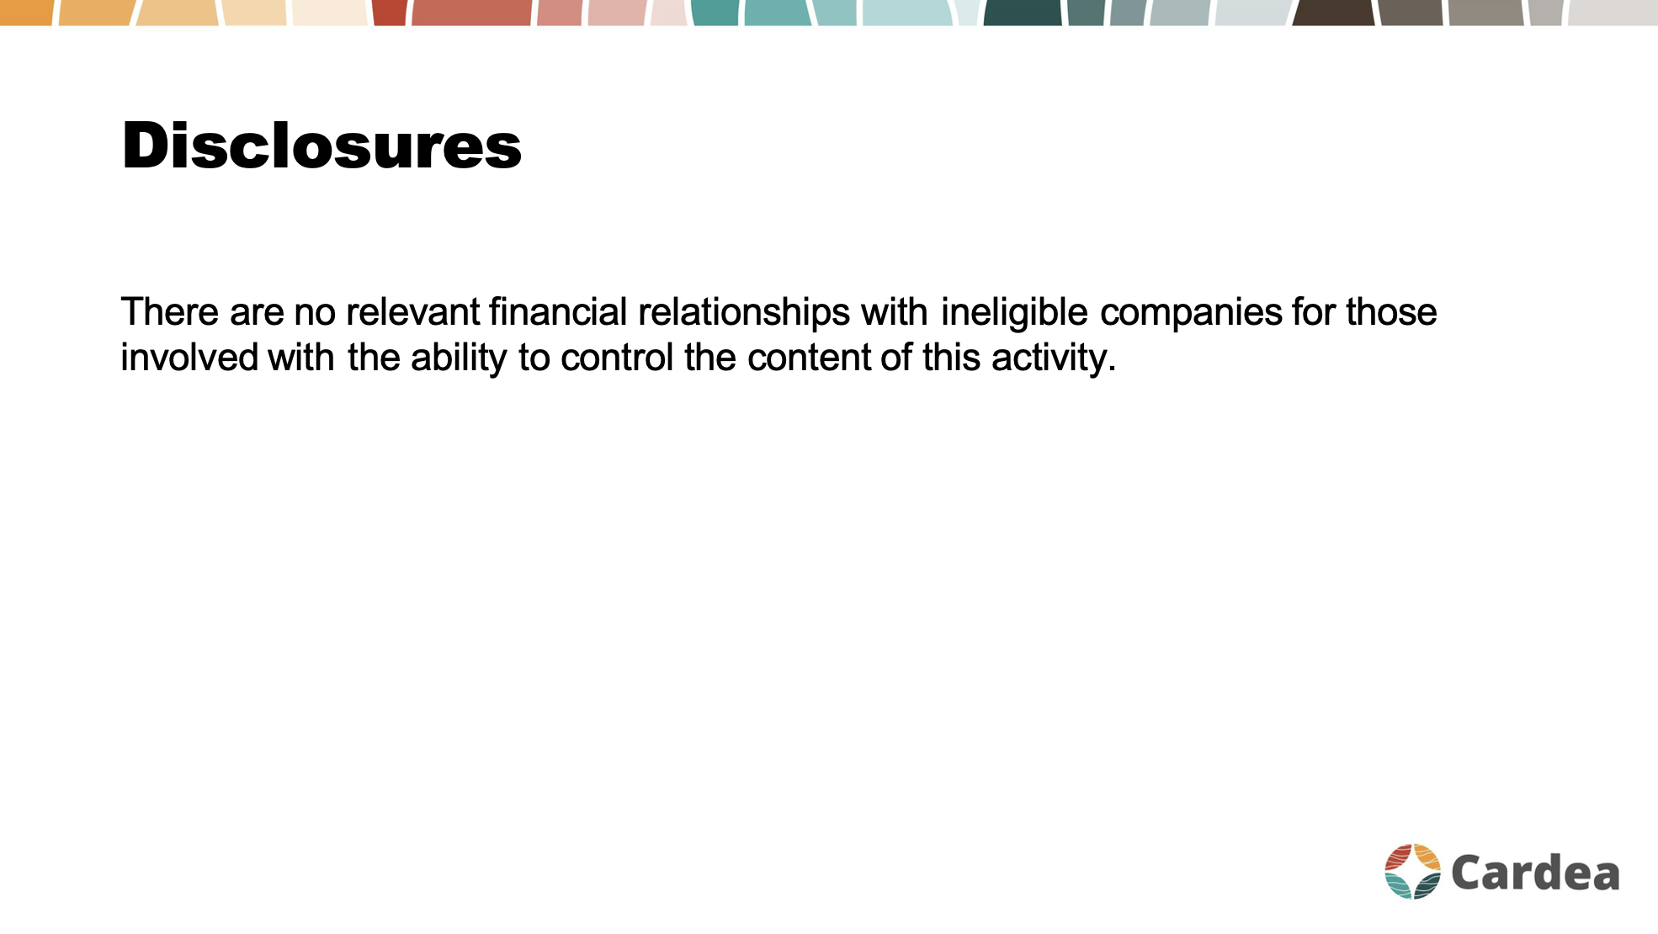

Slide 4
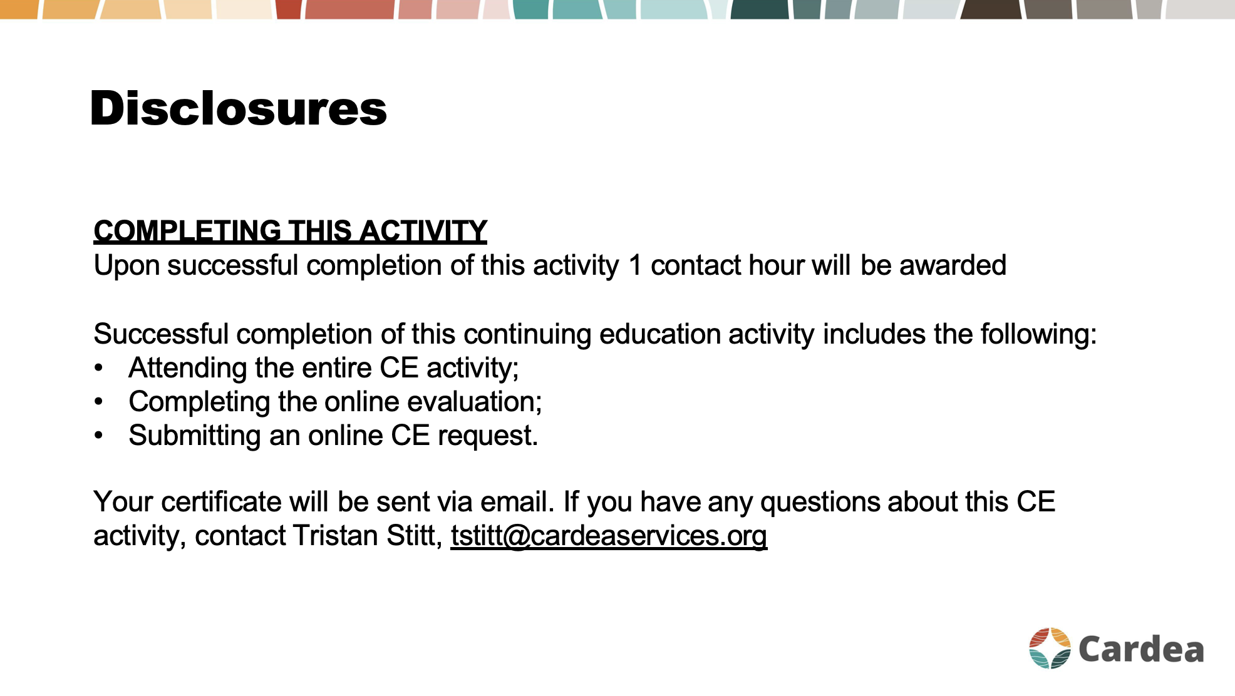

Slide 5
Nomenclature
“Biologic” agents are made using recombinant DNA techniques
They are large, unstable proteins that can only be administered parenterally
mab monoclonal antibody
ximab chimeric monoclonal antibody
umab humanized monoclonal antibody
cept fusion protein of a receptor and the Fc portion of IgG
RAE Initiative| Fall 2023

Slide 6
Biologic Agents:
Available Mechanisms
Cytokine inhibitors
Costimulatory blockers
B cell inhibitors
Kinase inhibitors
RAE Initiative| Fall 2023

Slide 7
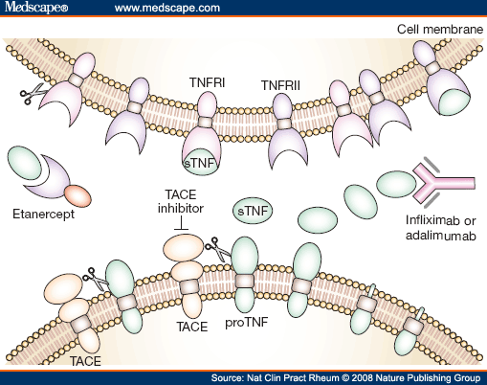
Available Biologic Agents for RA
CYTOKINE INHIBITORS
TNF inhibitors
(etanercept, adalimumab, infliximab, golimumab, certolizumab)

Slide 8
Available Biologic Agents for RA
CYTOKINE INHIBITORS
IL-1 inhibitor (anakinra “KINERET”)
IL-6 inhibitors
tocilizumab (“ACTEMRA”)
sarilumab (“KEVZARA”)
RAE Initiative| Fall 2023

Slide 9
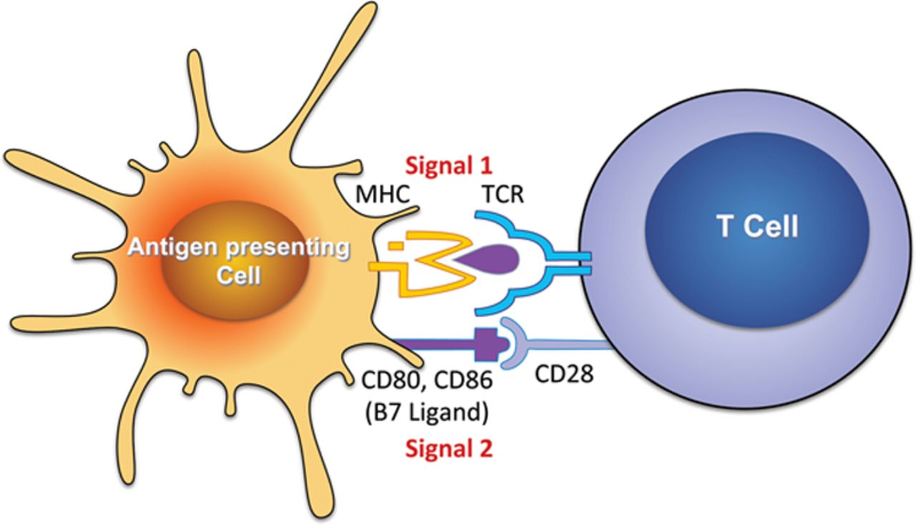
Available Biologic Agents for RA
COSTIMULATORY BLOCKERS
Abatacept (“ORENCIA”)
fusion protein of CTLA-4 and Fc portion of IgG
prevents CD28 binding to CD80/CD8 (blocks second signal binding between T cells and antigen presenting cells)
RAE Initiative| Fall 2023

Slide 10
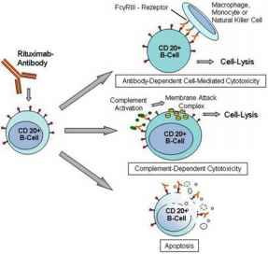
Available Biologic Agents for RA
B CELL INHIBITORS
Rituximab
anti CD 20
expressed on pre-B cells and pre-plasma cells
pro-B cells and plasma cells are not affected
RAE Initiative| Fall 2023

Slide 11
Available Biologic Agents for RA
KINASE INHIBITORS
“Small molecules” that are not proteins and technically not biologic agents
but are similar to biologics in that they are highly targeted therapies and have similar efficacies and side effects
Janus kinases are cytoplasmic proteins that relay information to the nucleus from IL receptors on the cell membrane
JAK inhibitors are oral agents
Tofacitinib, baricitinib, upadacitinib (Xeljanz, Olumient, Rinvoq)
RAE Initiative| Fall 2023

Slide 12
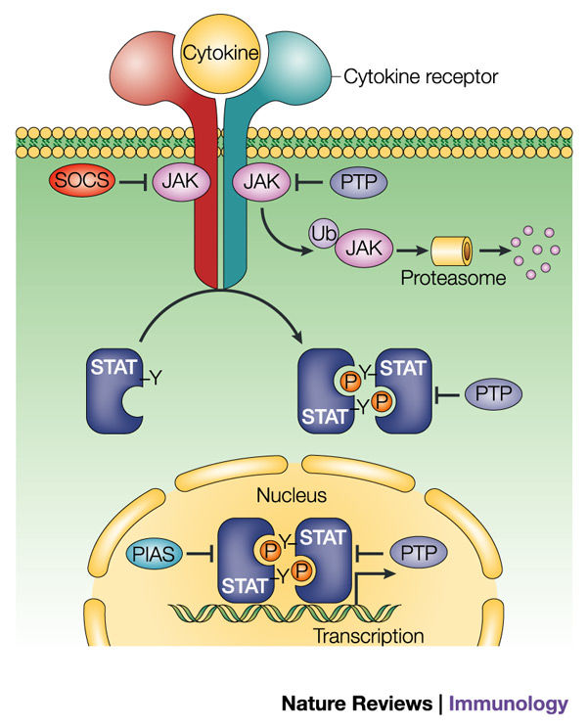
Available Biologic Agents for RA
KINASE INHIBITORS

Slide 13
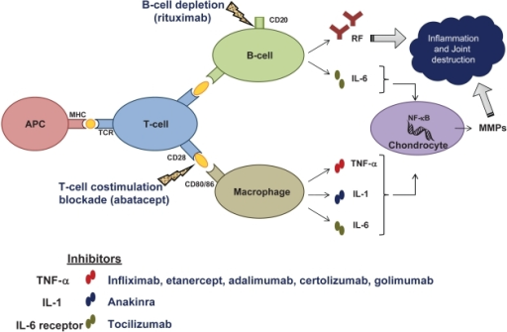
Available Biologic Agents for RA
Summary of Mechanisms
RAE Initiative| Fall 2023

Slide 14
Available Biologic Agents for RA
Summary
Trade Class Administration Frequency
Etanercept Enbrel TNFi SQ weekly
Adalimumab Humira TNFi SQ Q 14 d
Golimumab Simponi TNFi SQ monthly
Certolizumab Cimzia TNFi SQ monthly
Infliximab Remicade TNFi IV Q 4-8 weeks
Tocilizumab Actemra IL-6i SQ/IV weekly/monthly
Sarilumab Kevzara IL-6i SQ/IV
Abatacept Orencia Costim SQ/IV weekly/monthly
blocker
Rituximab Rituxan antiCD20 IV 2 IV Q 6 months
(B cell)
Tofacitinib Xeljanz JAKi PO daily
Baricitinib Olumient JAKi PO daily
Upadacitinib Rinvoq JAKi PO daily
RAE Initiative| Fall 2023

Slide 15
Indications for Targeted Therapy in RA
Inadequate response to conventional DMARD therapy
Contraindications to cDMARD therapy
Erosive disease at the time of diagnosis, or progression on imaging
RAE Initiative| Fall 2023

Slide 16
ACR and EULAR Guidelines
for Use of Biologics
Both recommend anti TNF therapy as first line agents but recognize that the data supports equivalent efficacy for other biologics
More long-term data exists for TNF inhibitors than for other agents
Most insurances will not approve use of other bDMARDs until anti TNF therapy has been tried
IHS has either etanercept or adalimumab on formulary
RAE Initiative| Fall 2023

Slide 17
ACR and EULAR Guidelines
for Use of Biologics
Inadequate response to initial TNF:
- second anti-TNF
OR
- alternative biologic agent (tocilizumab or abatacept) OR
- tofacitinib
In studies, the efficacies of the above treatment options are equivalent
RAE Initiative| Fall 2023

Slide 18
ACR and EULAR Guidelines
for Use of Biologics
When to consider a biologic OTHER THAN a TNF inhibitor as a first line agent
- recent lymphoma history
- h/o demyelinating disease
- LTBI with contra-indications to treatment
- class III/IV CHF
- co-existent lupus or lupus-like illness (”Rhupus”)
RAE Initiative| Fall 2023

Slide 19
Pros/cons of Individual Agents
Other Than Anti TNF
Abatacept
PRO IV - short infusion time
rare infusion reactions; well tolerated
fewer infectious complications
CON longer time to efficacy than other agents
Tocilizumab/Sarilumab
PRO well-tolerated
CON hyperlipidemia
intestinal perforation in elderly and in patients with prior diverticulitis, steroid use, NSAID use
RAE Initiative| Fall 2023

Slide 20
Pros/cons of Individual Agents
Other Than Anti TNF
Rituximab
PRO Q 6 month dosing regimen
possible benefit in RA-ILD
CON higher rate of infusion reactions
long duration of B cell inactivation (4-6 months +)
decreased response to COVID vaccination
Tofacitinib
PRO oral
patient support programs for Medicare (Xelsource)
CON higher rate of herpes zoster infection (2X compared with abatacept)
increased risk of CVE/VTE in at-risk patients
RAE Initiative| Fall 2023

Slide 21
Recommendations for High-Risk Comorbidities
CHF
Use combination DMARDs OR non-TNF biologics OR tofacitinib OVER TNFi
Hepatitis B
Received/receiving anti-viral treatment
Same recommendations as in patients without this condition
Hepatitis C
received/receiving anti-viral treatment
Same recommendation as in patients without this condition
untreated
Treat prior to initiating biologic therapy
RAE Initiative| Fall 2023

Slide 22
Recommendations for High-Risk Comorbidities
Treated or untreated skin cancers
Use DMARDs over biologics/tofa in melanoma
Previously treated lymphoproliferative disorders
Use Rituximab over TNFi
Previously treated solid organ malignancies
Same recommendations as in patients without this condition
Previous serious infection
Use combination DMARD over TNFi
Use abatacept over TNFi
RAE Initiative| Fall 2023

Slide 23
Biologic Agents in RA:
References
Arthritis Care & Research
DOI 10.1002/acr.22783
VC 2015, American College of Rheumatology
Smolen JS et al EULAR recommendations for the management of rheumatoid arthritis with synthetic and biological disease-modifying antirheumatic drugs: 2016 update Annals of the Rheumatic Diseases Published Online First: 06 March 2017. doi: 10.1136/annrheumdis-2016-210715
RAE Initiative| Fall 2023

Slide 24
Biologic Agents in RA:
References
Ann Rheum Dis. 2016 Oct;75(10):1843-7.Real-world comparative risks of herpes virus infections in tofacitinib and biologic-treated patients with rheumatoid arthritis.
Biological targets in the treatment of rheumatoid arthritis: a comprehensive review of current and in-development biological disease modifying anti-rheumatic drugs.Kukar M, Petryna O, Efthimiou P - Biologics (2009)
Strangfeld A, et al. Ann Rheum Dis 2016;0:1–7. doi:10.1136/annrheumdis-2016-209773
RAE Initiative| Fall 2023

Slide 25
Case presentation
22 year old woman, first presenting in November 2020 (at age 20) with a 2 year history of joint pain and swelling, gradually worsening over time. Joints involved: hands, wrists, feet primarily but also pain/stiffness in knees, ankles, elbows
PMH: unremarkable
Meds: OTC NSAIDs only
FH: mother with ITP; 2nd degree female relatives with RA
SH: lives with mother and helps out in her car detailing shop
no tobacco, alcohol or drug history
not sexually active
RAE Initiative| Fall 2023

Slide 26
Case presentation
EXAM
Synovitis: right 2nd and 3rd MCP joints, 3rd and 4th PIP joints
Left 2nd and 3rd MCP joints, 3rd PIP joint
Bilateral wrists
Bilateral knees (warm, small effusions)
All MTP joints
RAE Initiative| Fall 2023

Slide 27
Case presentation
Work-up to date:
RF 14
CRP 30
CBC: mild anemia
CMP: normal
TSH: normal
X-rays of feet: “erosions at MTP joints”
RAE Initiative| Fall 2023

Slide 28
Case presentation
Do you have enough information to make a diagnosis of rheumatoid arthritis?
RAE Initiative| Fall 2023

Slide 29
Case presentation
Do you have enough information to make a diagnosis of rheumatoid arthritis?
Duration > 6 weeks 1 pt
RF low pos 2 pts
CRP elevated 1 pt
Synovitis > 10 joints 5 pts
Total = 9
RAE Initiative| Fall 2023

Slide 30
Case presentation
How would you rate her disease activity?
Total swollen joints = 11
Total tender joints = 11
Patient global assessment = 7
Provider global assessment = 8
CDAI score = ?
RAE Initiative| Fall 2023

Slide 31
Case presentation
Total swollen joints = 11
Total tender joints = 11
Patient global assessment = 7
Provider global assessment = 8
CDAI score = 37 (high disease activity)
RAE Initiative| Fall 2023

Slide 32
Case presentation
Next steps?
Additional labs?
X-rays?
RAE Initiative| Fall 2023

Slide 33
Case presentation
CCP > 250
TB quant negative
Hep C ab negative
Hep B panel (SAg and cAb) negative
X-rays hands: periarticular osteoporosis; narrowing of radiocarpal articulations
x-rays feet: scattered erosive changes
Chest x-ray: normal
RAE Initiative| Fall 2023

Slide 34
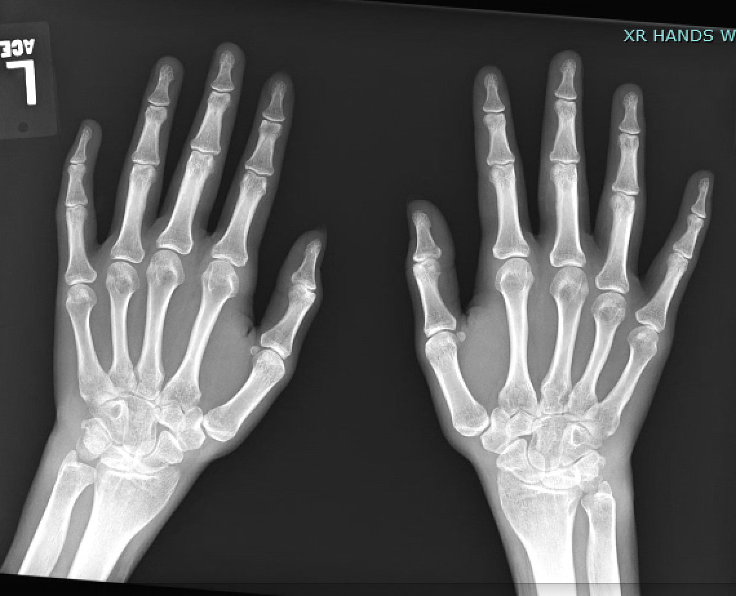

Slide 35
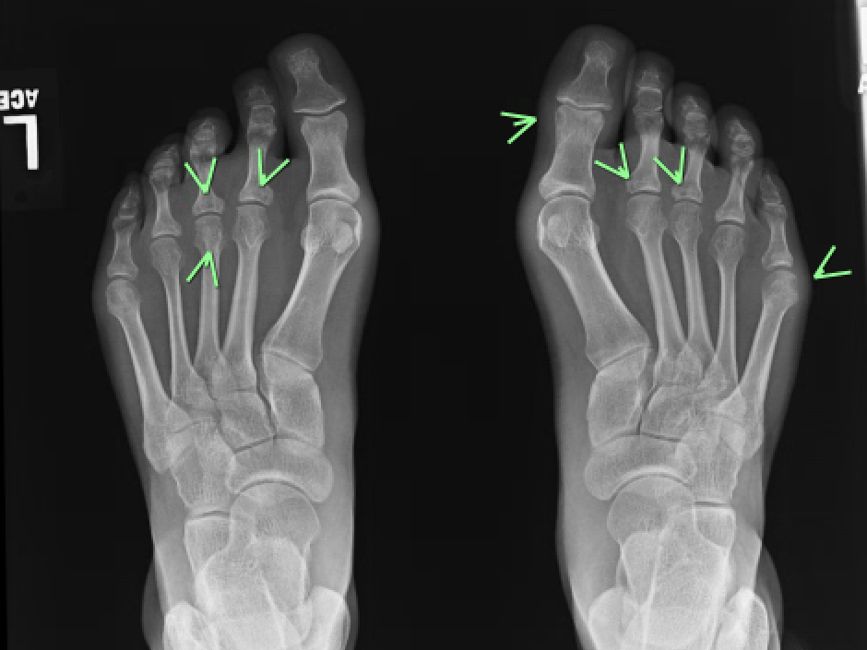

Slide 36
Case presentation
In summary:
20 year old woman with rheumatoid arthritis, symptoms present x 2 years, high disease activity, inflammatory changes on x-rays including erosive changes in the feet
What would be your first choice of therapy?
- Plaquenil?
- Methotrexate?
-Sulfasalazine?
- Triple therapy?
-TNF inhibitor?
RAE Initiative| Fall 2023

Slide 37
Case presentation
Started adalimumab 40 mg SQ Q 2 weeks
one year later,
Overall, greatly improved
Working in retail 5 days/week
New male SO
Now has an IUD
Still some wrist swelling; occasional flares
CDAI = 7.0 (low)
RAE Initiative| Fall 2023

Slide 38
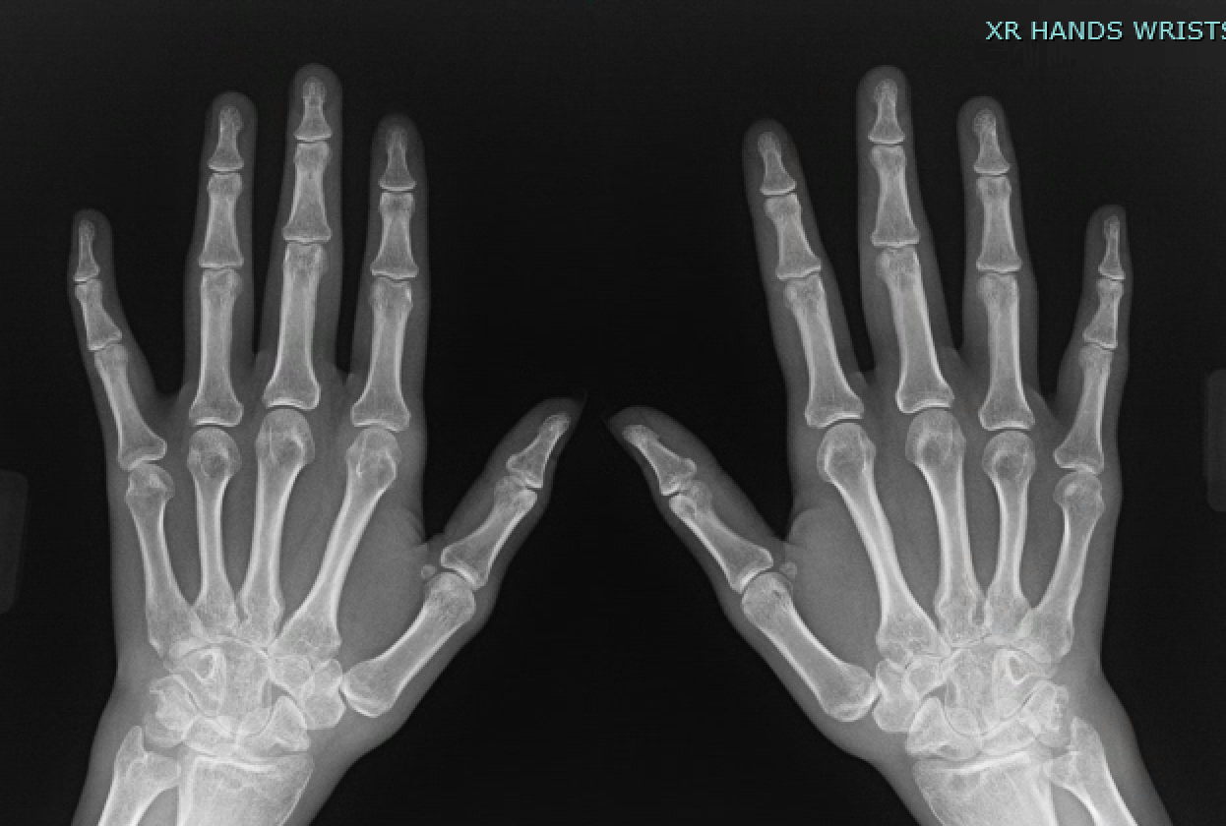

Slide 39
Case presentation
Further crowding of the carpal bones
New lucencies at the distal radii
Continue current therapy?
Add an agent?
Switch to a different drug?
RAE Initiative| Fall 2023

