Slide 1


Welcome!
Initial Therapy: Methotrexate
Jennifer Mandal, MD
November 6, 2023
RAE Initiative| Fall 2023

Slide 2
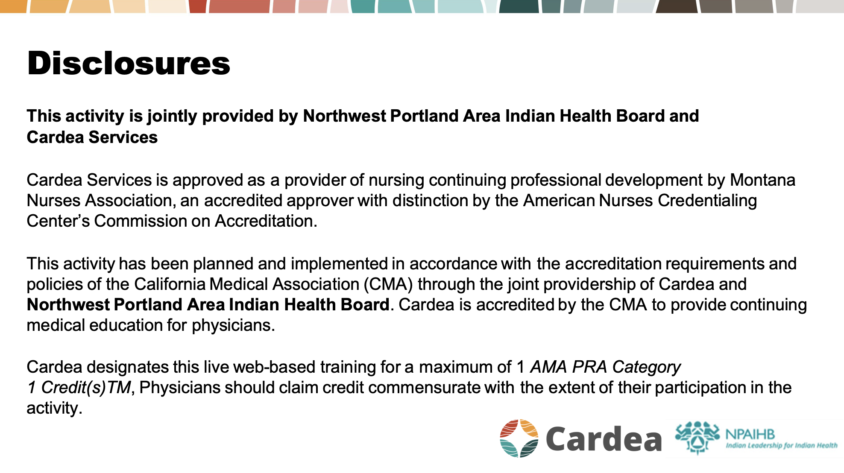

Slide 3


Slide 4


Slide 5
Terminology: DMARDs
Disease Modifying Anti-Rheumatic Drugs
“Conventional DMARDs”:
  Methotrexate, Hydroxychloroquine, Sulfasalazine, Leflunomide
“Biologic DMARDs”:
  TNF inhibitors: etanercept/Enbrel (SQ), adalimumab/Humira (SQ), infliximab/Remicade (IV)
  Others: abatacept (T cell costimulatory inhibitor), rituximab (anti-CD20), tocilizumab (IL-6 inhibitor), tofacitinib (JAK inhibitor)
RAE Initiative| Fall 2023

Slide 6
Diagnosis of RA
less common
common
VERY MILD RA
MODERATE or SEVERE RA
Hydroxychloroquine
or
Sulfasalazine
Methotrexate
(or Leflunomide)
After 3 months, if moderate or high disease activity
After 3 months, if moderate or high disease activity
preferred
“TRIPLE THERAPY”
Methotrexate + Sulfasalazine + Hydroxychloroquine
TNF inhibitor
(Add on top of MTX, if possible)
If still not controlled, discuss second-line biologic options with a rheumatologist

Slide 7
Methotrexate
MTX is the preferred first-line DMARD in patients with moderate-severe RA
First used to treat RA in the 1950s, but didn’t see widespread use until the 1980s
MTX is a structural analogue of folic acid – it competitively inhibits folic acid metabolism (disrupting B and T cell proliferation) and increases extracellular concentrations of adenosine (anti-inflammatory effects)
RAE Initiative| Fall 2023

Slide 8
Methotrexate
FDA-approved indications:
RA
Psoriasis
Off-label use:
Inflammatory arthritis in SLE, MCTD
Spondyloarthritis w/ peripheral joint involvement: Psoriatic arthritis, Reactive arthritis
ANCA vasculitis, PAN, Takayasu arteritis
Sarcoidosis
Dermatomyositis/Polymyositis
Scleroderma (skin/joints)
Scleritis, Uveitis
RAE Initiative| Fall 2023

Slide 9
Poll Question #1:
Which of the following is FALSE?
The liquid formulation of MTX (for SQ injections) can be mixed with juice and taken orally
Patients who don’t have adequate disease response to 25mg of PO MTX should switch to 25mg of SQ MTX
Typical starting dose of MTX is 7.5-10mg weekly
Patients on MTX should take folic acid 1mg daily, except on the day of the week that they take their MTX
RAE Initiative| Fall 2023

Slide 10
Poll Question #1: Answer
Which of the following is FALSE?
The liquid formulation of MTX (for SQ injections) can be mixed with juice and taken orally
Patients who don’t have adequate disease response to 25mg of PO MTX should switch to 25mg of SQ MTX
Typical starting dose of MTX is 7.5-10mg weekly
Patients on MTX should take folic acid 1mg daily, except on the day of the week that they take their MTX
RAE Initiative| Fall 2023

Slide 11
Methotrexate Dosing
ONCE A WEEK (not daily)
Pills, oral liquid, or SQ
Starting dose for RA:
Moderate disease: 7.5mg weekly for 1 month → check labs → 15mg weekly
Severe disease: 10mg weekly for 1 month → check labs →20mg weekly
Max dose = 25mg weekly
Oral bioavailability varies greatly (20-95%).
If 20-25mg PO is not getting adequate response, try splitting the PO dose AM/PM, or switch to SQ.
Everyone on MTX should also take folic acid 1mg daily (can increase to 2-5mg daily if needed)
RAE Initiative| Fall 2023

Slide 12
Poll Question #2:
Which of the following is TRUE?
Methotrexate typically achieves full effect within 1-2 months
Methotrexate should not be combined with NSAIDs due to decreased MTX metabolism
Methotrexate can be used in combination with sulfasalazine
Methotrexate should not be combined with TNF inhibitors (infliximab, adalimumab) due to increased risk of serious infections
RAE Initiative| Fall 2023

Slide 13
Poll Question #2: Answer
Which of the following is TRUE?
Methotrexate typically achieves full effect within 1-2 months
Methotrexate should not be combined with NSAIDs due to decreased MTX metabolism
Methotrexate can be used in combination with sulfasalazine
Methotrexate should not be combined with TNF inhibitors (infliximab, adalimumab) due to increased risk of serious infections
RAE Initiative| Fall 2023

Slide 14

Expectations
Can take 2-3 months to start seeing improvement. ~6 months for full effect.
May need to combine with other medications (ex: sulfasalazine, hydroxychloroquine, or biologic DMARDs) to achieve adequate disease control
When possible, MTX should be continued when adding a TNFi (especially adalimumab/Humira or infliximab/Remicade)
  Decreases the risk of forming anti-TNFi antibodies
RAE Initiative| Fall 2023

Slide 15
Poll Question #3:
Which of the following is TRUE?
Non-alcoholic fatty liver disease (NAFLD) is an absolute contraindication to MTX
MTX is contraindicated in pregnancy, but safe during breastfeeding
Patients taking MTX should be counseled to limit alcohol consumption to 2 drinks/week
Men who are planning to father a child should stop MTX 3 months prior to trying to conceive
RAE Initiative| Fall 2023

Slide 16
Poll Question #3: Answer
Which of the following is TRUE?
Non-alcoholic fatty liver disease (NAFLD) is an absolute contraindication to MTX
MTX is contraindicated in pregnancy, but safe during breastfeeding
Patients taking MTX should be counseled to limit alcohol consumption to 2 drinks/week
Men who are planning to father a child should stop MTX 3 months prior to trying to conceive
RAE Initiative| Fall 2023

Slide 17

Avoid methotrexate if:
Person of childbearing age considering pregnancy or not using birth control. (Pregnancy Category X)
Breastfeeding
Pre-existing liver disease, hepatitis B or C
  Mild NAFLD with normal liver enzymes is ok
Heavy alcohol use
  US guideline is ≤2 drinks/week, European guideline more lenient…
CKD stage 4 or 5 (caution w/ stage 3)
Consider alternatives if they also have lung disease
RAE Initiative| Fall 2023

Slide 18
Potential side effects
GI upset (splitting the dose AM/PM can help)
Oral ulcers
Hepatotoxicity (transaminitis, cirrhosis)
Infections
Bone marrow suppression (cytopenias)
Macrocytosis
Brain fog
Pneumonitis (very rare)
Safety Pearl:
MTX is renally cleared, thus any impairment of GFR will result in ↑ serum levels of MTX and higher risk of toxicities
RAE Initiative| Fall 2023

Slide 19
Medication Monitoring
Before starting MTX:
  CBC
  CMP
  Pre-immunosuppression labs: HBV Surface Ag/Surface Ab/Core Ab, HCV, Quant Gold/PPD
  CXR
Once on MTX:
  CBC, LFTs, Cr every month for the first 3 months, then q3 months if stable dose
RAE Initiative| Fall 2023

Slide 20
Typical MTX Timeline
Diagnose w/ RA
Assess disease activity → high
Labs: CBC, CMP, HBV, HCV, Quant Gold, CXR, baseline hand/foot xrays
Ask open-ended questions to check if pt is taking MTX correctly
Side effects?
Labs: CBC, LFTs, Cr → if reassuring, increase MTX to 20mg weekly
Assess RA activity
Side effects?
Labs: CBC, LFTs, Cr
1 month
1 month
1 month
1 month
3 months
MTX med counseling
Discuss birth control, alcohol use, plan for lab monitoring
Start MTX 10mg weekly + folic acid 1mg daily
Continue to assess RA activity and check labs q 3 months
Assess RA activity
Side effects?
Labs: CBC, LFTs, Cr
RAE Initiative| Fall 2023

Slide 21
Poll Question #4:
A 78F with h/o diabetes and mild dementia was newly diagnosed with RA and prescribed 15mg (6x 2.5mg tablets) once weekly. The pharmacy dispensed a 3-month supply of pills. 7 days later, she presents to the ER with severe nausea, diarrhea, bleeding oral ulcers, leukopenia (WBC 1.9), thrombocytopenia (platelets 70K), and transaminitis (AST 510, ALT 720). She is admitted to the hospital. What therapeutic intervention is most appropriate?
A. Empiric broad-spectrum antibiotics
B. IV leucovorin
C. IV methylprednisolone
D. IVIG
RAE Initiative| Fall 2023

Slide 22
Poll Question #4: Answer
A 78F with h/o diabetes and mild dementia was newly diagnosed with RA and prescribed 15mg (6x 2.5mg tablets) once weekly. The pharmacy dispensed a 3-month supply of pills. 7 days later, she presents to the ER with severe nausea, diarrhea, bleeding oral ulcers, leukopenia (WBC 1.9), thrombocytopenia (platelets 70K), and transaminitis (AST 510, ALT 720). She is admitted to the hospital. What therapeutic intervention is most appropriate?
A. Empiric broad-spectrum antibiotics
B. IV leucovorin
C. IV methylprednisolone
D. IVIG
RAE Initiative| Fall 2023

Slide 23
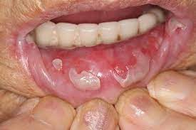
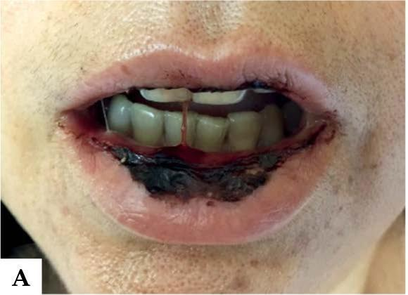
MTX overdose
Causes:
  Misunderstanding of med instructions (i.e. taking dose daily instead of weekly)
  Decreased GFR leading to increased serum levels of MTX
Treatment:
  Admit to hospital
  Stop MTX
  IV leucovorin (folinic acid) 5-10mg every 12 hours until recovery (improvement in cytopenias to safe range, improvement in transaminitis to <2x ULN, resolution of GI symptoms)
RAE Initiative| Fall 2023

Slide 24
Prevention is better than cure
Dispense only a 1-month supply of MTX, especially for new starts
Provide easy-to-read instructions w/ a specific day of the week, e.g. “Take 4 pills every Sunday for rheumatoid arthritis”
Emphasize that MTX should not be taken as-needed for symptom control
At first follow-up appointment, ask open-ended questions (“How are you taking your methotrexate?”)
Monitor Cr: If GFR <50, downtitrate or consider stopping MTX, if GFR<30, stop MTX
RAE Initiative| Fall 2023

