Slide 1


Welcome!
Wrap-Up + Key Pearls
Jennifer Mandal, MD
November 20, 2023
RAE Initiative| Fall 2023

Slide 2
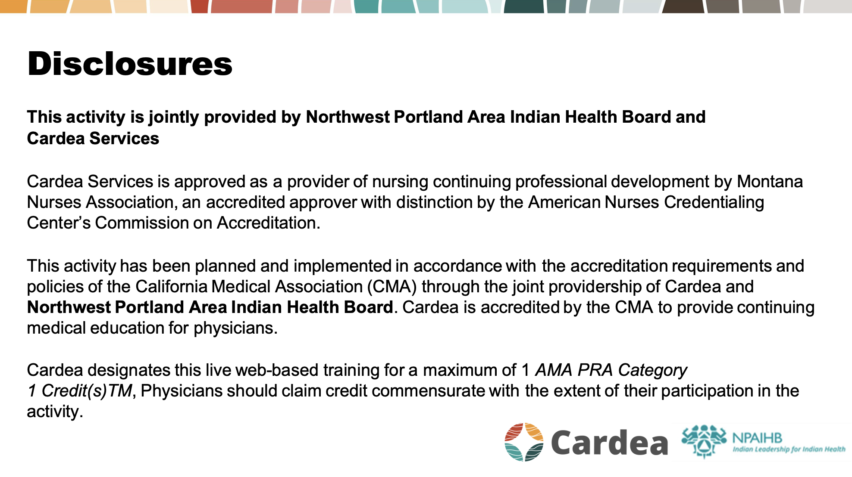

Slide 3
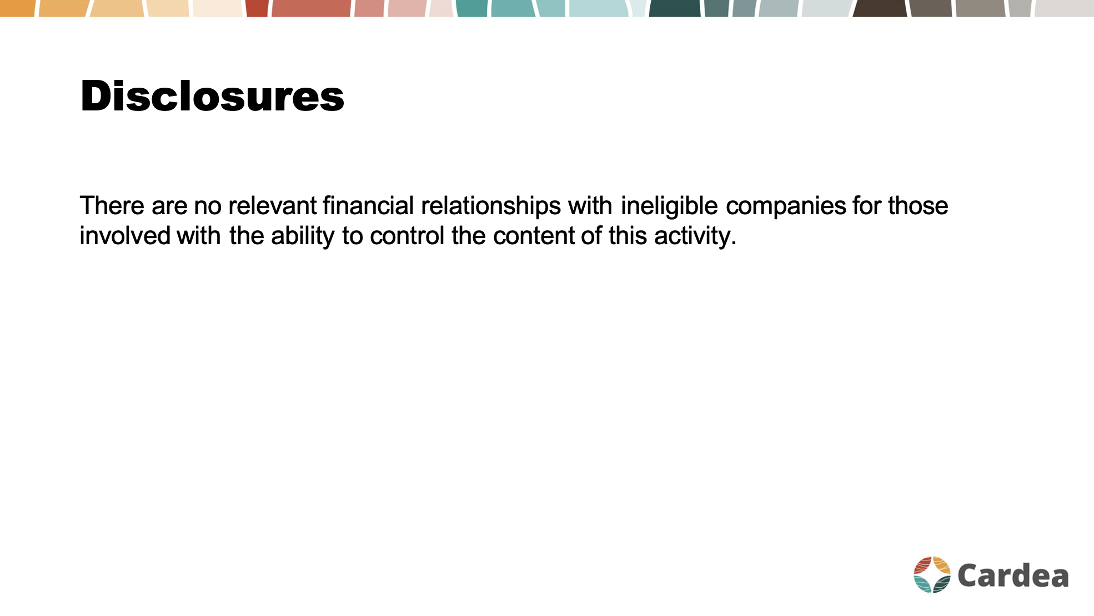

Slide 4
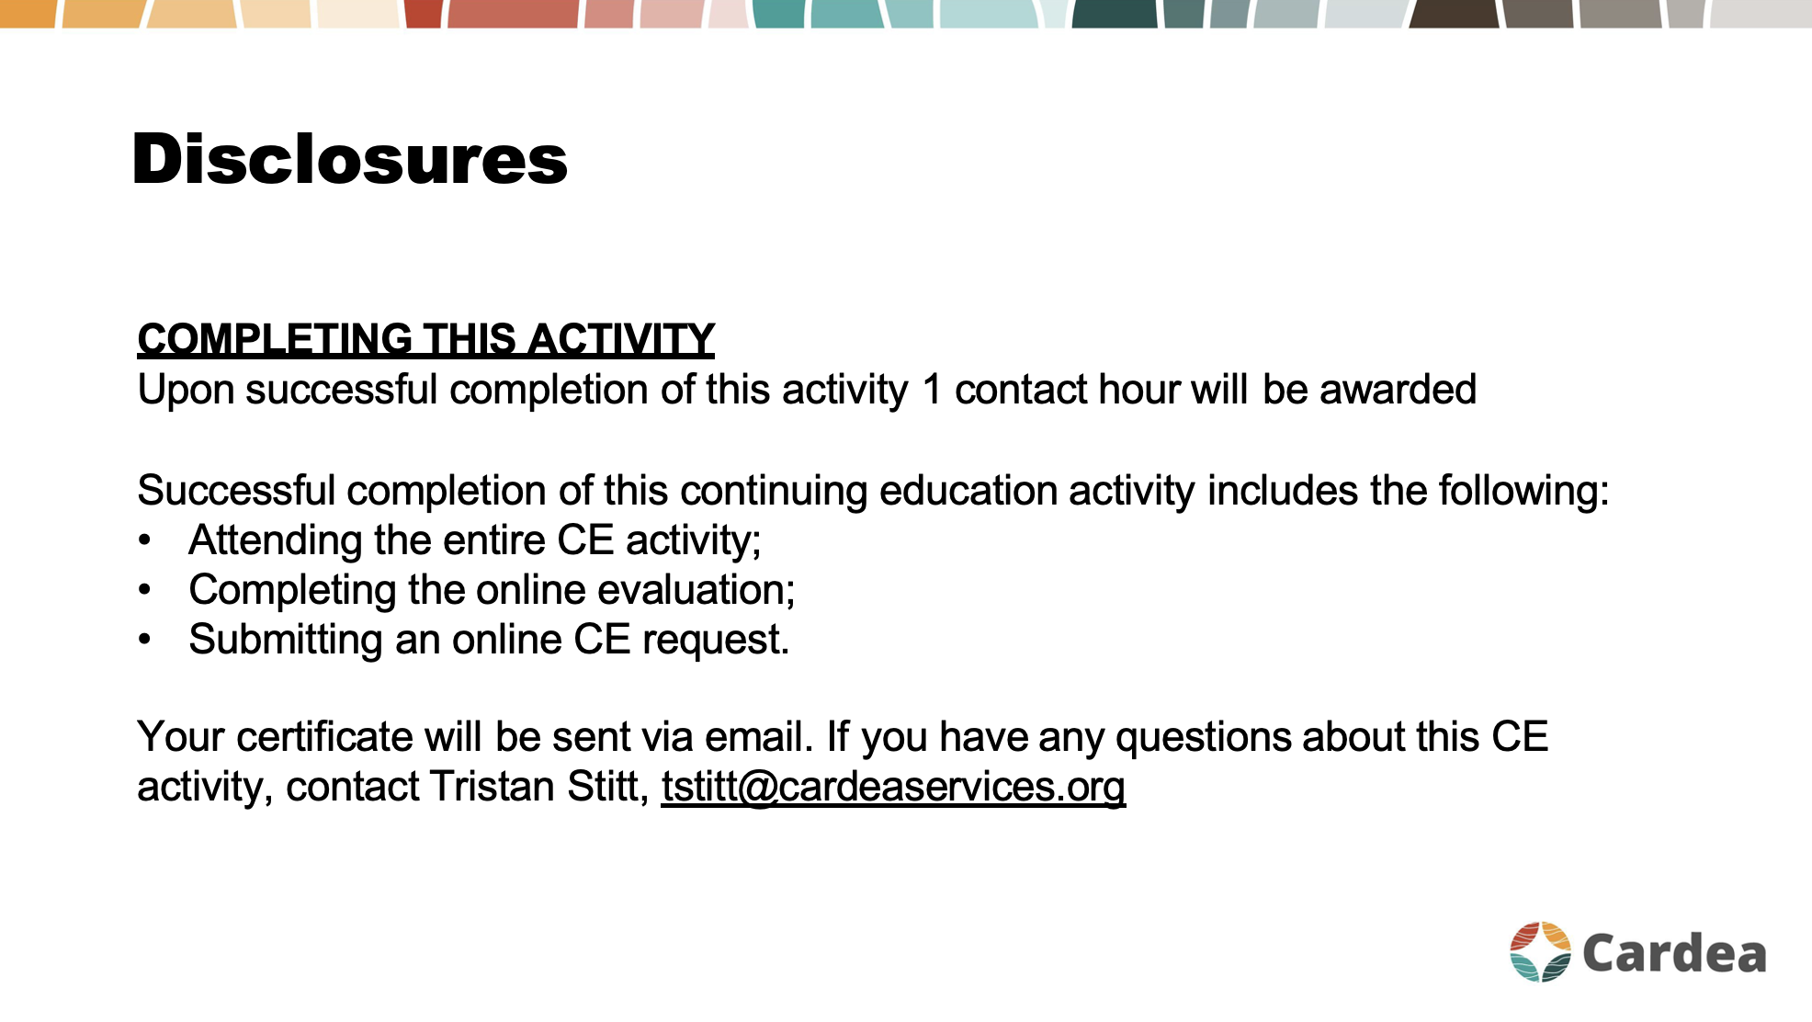

Slide 5
RA Joint Exam Videos
RAE Initiative| Fall 2023

Slide 6

RA ECHO Journey
Labs & Imaging
Treatment
Epidemiology
Differential Dx
Clinical Manifestations
RAE Initiative| Fall 2023

Slide 7

RA Clinical Pearls
RAE Initiative| Fall 2023

Slide 8
Distinguishing RA from OA
Inflammatory arthritis (like RA) may be characterized by prolonged morning stiffness (>1 hour), and it tends to get better with activity.
Helpful questions to ask your patient with joint pain:
“Does your joint pain get better with activity, or worse?”
“What time of day is your joint pain and stiffness the worst?”
How long does the stiffness usually last in the morning?”
RAE Initiative| Fall 2023

Slide 9
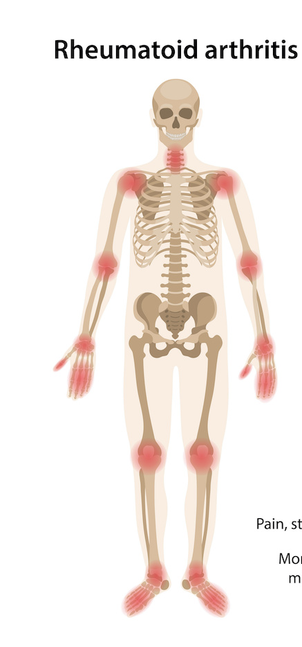
Joint Distribution in RA
Neck
Shoulders
Elbows
Wrists
Hands (MCPs, PIPs)
Knee
Toes
Spares the:
Low back
DIPs
RA can affect nearly any synovial joint in the body, however it usually SPARES the low back and the DIPs.
RAE Initiative| Fall 2023

Slide 10
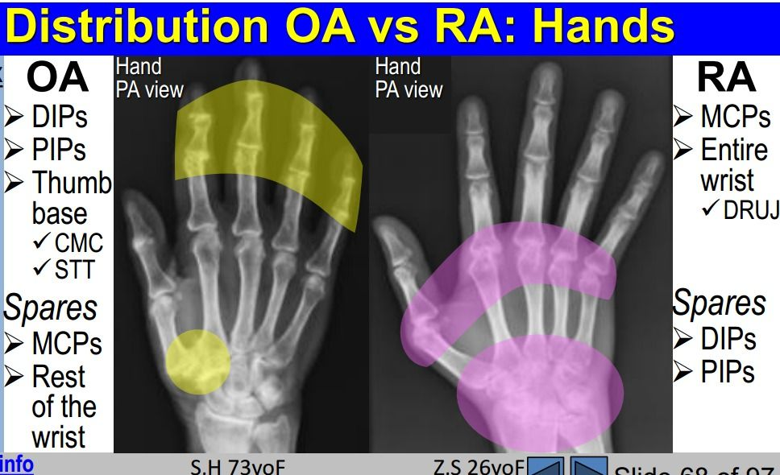
Hand involvement in RA vs OA
Quick Pearl: DDx for DIP arthritis
OA
Psoriatic Arthritis
Gout
RA
OA
DIPs
PIPs
PIPs
MCPs
CMC
Wrist
RAE Initiative| Fall 2023

Slide 11
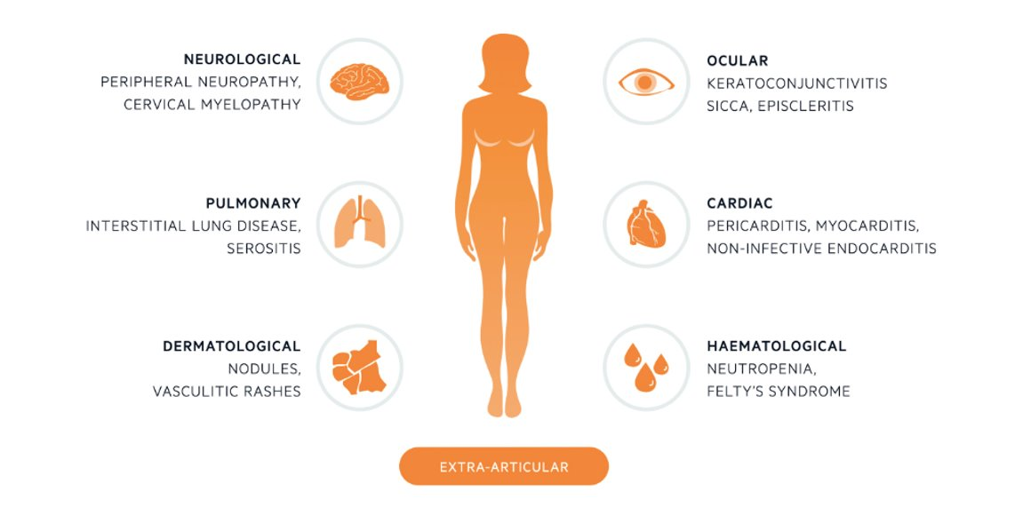
Extra-Articular Manifestations of RA
RAE Initiative| Fall 2023

Slide 12
RF and CCP in Rheumatoid Arthritis
If you suspect RA, always send RF and CCP
RF and CCP are both about 70-80% sensitive for RA. But CCP is MUCH more specific (>95%) compared to RF.
Causes of positive RF other than RA:
  Chronic infections (especially HCV; also HIV, osteomyelitis, dental infections, SBE)
  Malignancy
  Other Autoimmune Conditions (SLE, Sjogren’s, Cryoglobulinemia​)
  Other fibrotic/infiltrative diseases (IPF, Cirrhosis, Sarcoidosis​)
  5-10% of healthy US population; prevalence in healthy individuals rises with age
RAE Initiative| Fall 2023

Slide 13
RF and CCP in Rheumatoid Arthritis
Be suspicious!
RAE Initiative| Fall 2023

Slide 14
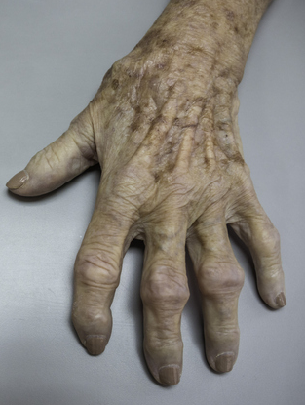
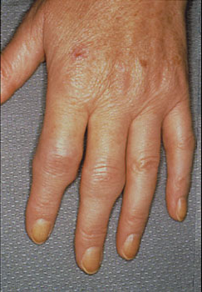
Monitoring Disease Activity
Practice performing the RA joint exam, assessing for tenderness and for swelling (synovitis)
Use a RA disease activity score like the CDAI
Actively inflamed RA joints (synovitis) feel soft/squishy (ripe grape, yoga mat)
RA
OA
Synovitis (“squishy”, “bouncy”)
“Squaring off” at base of thumb
Bouchards node
Bony enlargement without synovitis
Heberdens node

Slide 15
General Principles of RA Treatment:
Start DMARD therapy ASAP to slow disease progression and prevent irreversible joint damage
Choose initial DMARD based on disease severity
  Very mild disease: hydroxychloroquine
  Most people: Methotrexate
  MTX contraindicated or very severe erosive/extra-articular dz: biologic
Goal is clinical remission or low disease activity
Evaluate patient q3 months until this is achieved
Majority of patients will require life-long medication
RAE Initiative| Fall 2023

Slide 16
Pre-Immunosuppression Testing
TIP: Send these tests as soon as possible, to avoid delays in initiating treatment. If your clinical suspicion for RA is high, send these labs at the same time you send the RF and CCP.
Order on all patients with newly diagnosed RA:
CBC, Cr, LFTs
HCV screen: HCV Ab
HBV screen: HBV surface Ag, HBV surface Ab, HBV core Ab
TB screen: Quantiferon Gold or PPD
For people who may become pregnant:
Discuss contraception and plans for future pregnancy
TIP: Low-dose prednisone (5-10mg) and/or hydroxychloroquine can be started while awaiting the results of these tests. For all other DMARDs, wait for the lab results before initiating.
RAE Initiative| Fall 2023

Slide 17

Vaccine Considerations in Patients on DMARDs
Recommended vaccines for all patients starting or currently taking immunosuppressive therapy for RA (conventional or biologic DMARDs):
  Pneumococcal
  Flu (annually, high dose)
  HBV
  HPV
  Zoster (Shingrix)
  COVID19 (including latest booster)
Live vaccines are contraindicated in patients on immunosuppressive therapy:
  MMR
  Yellow Fever
  Inhaled/nasal flu
RAE Initiative| Fall 2023

Slide 18

Avoid methotrexate if:
Woman of childbearing age considering pregnancy or not using birth control. (Pregnancy Category X)
Breastfeeding
Pre-existing liver disease, hepatitis B or C
  Mild NAFLD with normal liver enzymes is ok
Heavy alcohol use
  US guideline is ≤2 drinks/week, European guideline more lenient…
CKD stage 4 or 5 (caution w/ stage 3)
Consider alternatives if they also have lung disease
RAE Initiative| Fall 2023

Slide 19
Lab Monitoring on Methotrexate
Once a month for first 3 months, then q3 months thereafter once on a stable dose:
CBC (monitoring for cytopenias. Significant macrocytosis can be a warning sign of MTX toxicity)
LFTs (monitor for hepatoxicity)
Creatinine (MTX is renally cleared, so if GFR goes down, MTX may need to be dose-reduced)
ESR/CRP (for disease activity monitoring)
RAE Initiative| Fall 2023

Slide 20
Prednisone in RA
Use the lowest dose possible, for the least amount of time (if at all)
Best reserved for short-term use:
  At the time of initial diagnosis (while waiting for the DMARD to take effect)
  During acute RA flares
Typically 5-15mg daily is enough to calm a RA flare
RAE Initiative| Fall 2023

Slide 21
RA Biologics
ACR/EULAR Guidelines
TNFi is typically first line biologic.
Inadequate response to initial TNF:
- second anti-TNF
OR
- alternative biologic agent (tocilizumab or abatacept) OR
- tofacitinib
In studies, the efficacies of the above treatment options are equivalent
RAE Initiative| Fall 2023

Slide 22
RA Biologics
ACR/EULAR Guidelines
TNFi (ex: etanercept/Enbrel or adalimumab/Humira) is typically first choice biologic.
Inadequate response to initial TNF:
- second anti-TNF
OR
- alternative biologic agent (tocilizumab or abatacept) OR
- tofacitinib
In studies, the efficacies of the above treatment options are equivalent
RAE Initiative| Fall 2023

Slide 23
RA Biologics
ACR/EULAR Guidelines
When to consider a biologic OTHER THAN a TNF inhibitor as a first line agent
- recent lymphoma history
- h/o demyelinating disease
- LTBI with contra-indications to treatment
- class III/IV CHF
- co-existent lupus or lupus-like illness (”Rhupus”)
RAE Initiative| Fall 2023

