Slide 1

Substance Use Disorder Treatment in Pregnancy
Michelle Debbink, MD, PhD and Katie Casper, MD
11/2/2023

Slide 2

Acknowledgment
We acknowledge that this land, which is named for the Ute Tribe, is the traditional and ancestral homeland of the Shoshone, Paiute, Goshute, and Ute Tribes. The University of Utah recognizes and respects the enduring relationship that exists between many Indigenous peoples and their traditional homelands. We respect the sovereign relationship between tribes, states, and the federal government, and we affirm the University of Utah’s commitment to a partnership with Native Nations and Urban Indian communities through research, education, and community outreach activities.

Slide 3
Topics
Screening
Methamphetamine use disorder
Opioid use disorder
Alcohol use disorder
Co-existing mental health condition treatment
How to implement

Slide 4
Key Points
Limited data on safety in pregnancy
Patients are going to have the same safety concerns
What is the real alternative to different treatment options?
Notes:
Patients are going to google these things
Alternative = Active use, not non-exposure... Risk to fetus and mother. So while we don't always know the exact safety or how things cross the placenta, we do know the effects of ongoing substance use... Remember that death also crosses the placenta

Slide 5
Identification of substance use
Universal screening
Minimizes stereotyping and stigma
Screening tools
4 P's
NIDA Quick Screen
CRAFFT – Substance Abuse Screen for Adolescents and Young Adults
Permission before drug screen
ACOG CO 711, 2017
Notes:
Opioid use and opioid use disorder in pregnancy. Committee Opinion No. 711. American College of Obstetricians and Gynecologists. Obstet Gynecol 2017;130:e81–94.

Slide 6
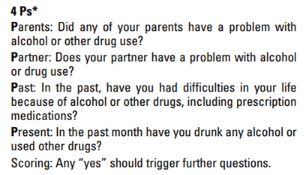
Screening – 4 P's
Notes:
Opioid use and opioid use disorder in pregnancy. Committee Opinion No. 711. American College of Obstetricians and Gynecologists. Obstet Gynecol 2017;130:e81–94.

Slide 7
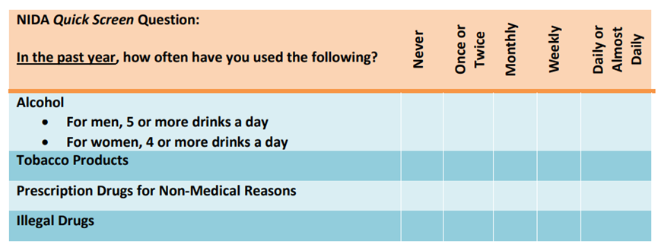
Screening – NIDA Quick screen
Notes:
Opioid use and opioid use disorder in pregnancy. Committee Opinion No. 711. American College of Obstetricians and Gynecologists. Obstet Gynecol 2017;130:e81–94.

Slide 8
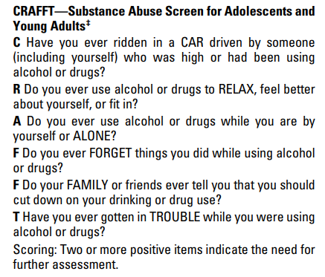
Screening – CRAFFT
Notes:
Opioid use and opioid use disorder in pregnancy. Committee Opinion No. 711. American College of Obstetricians and Gynecologists. Obstet Gynecol 2017;130:e81–94.
Age 26

Slide 9
Methamphetamine Use Disorder

Slide 10
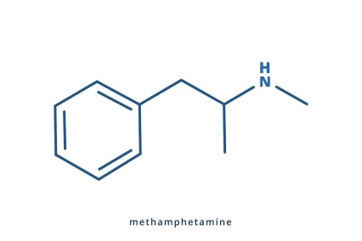
Methamphetamine use
Potential complications:
Arrhythmia, hypertension, seizures and hyperthermia
Amphetamine and byproducts cross the placenta

Slide 11
Risks in Pregnancy
Fetal
Fetal growth restriction
IUFD, neonatal death, infant death
Neonatal and childhood neurodevelopmental abnormalities
Maternal
Hypertensive disorders
Abruption
Preterm Birth
Gorman et al, 2014
Notes:
Gorman et al, AM J OB/GYN 2014 – Outcomes in pregnancies complicated by methamphetamine use
Large retrospective cohort study (8542 pregnancies with methamphetamine use)
Difficult to know what is meth specific as there is often polysubstance use
IUFD, neonatal death rates were overall rate, but 5x the general population. 0.3 > 1.4% IUFD, 0.1 > 0.5% neonatal death
Rate of SGA infants was 3.5 times higher with meth exposure after adjusting for other substances
Neurodevelopmental abnormalities – learning and memory difficulties, persistent motor delays
Results
Fetal Growth Restriction
IUFD - 1.4% vs 0.3%; P < .001
Neonatal death – Term infants 0.5% vs 0.1%; P < .001 ** Overall rare, but 5x the general population**
Infant Death – OR 2.5
Results – Maternal
HTN disorders - pregnancy-associated hypertension (11.6% vs 5.8%; P < .001), gestational hypertension (5.6% vs 3.2%; P < .001), preeclampsia (6.8% vs 2.9%; P < .001), severe preeclampsia (2.5% vs 0.8%; P < .001), and eclampsia (0.3% vs 0.1%; P < .001)
Abruption - 5.2% vs 0.8%; P < .001
Preterm Birth - 23.4% vs 8.9%; P < .001
RESULTS: After adjustment for multiple confounding variables on multivariable regression analysis, results indicated that compared with control subjects, methamphetamine users had greater odds of gestational hypertension (odds ratio [OR], 1.8; 95% confidence interval [CI], 1.6-2.0), preeclampsia (OR, 2.7; 95% CI, 2.4-3.0), intrauterine fetal death (OR, 5.1; 95% CI, 3.7-7.2), and abruption (OR, 5.5; 95% CI, 4.9-6.3). Additionally, these patients had higher odds of preterm birth (OR, 2.9; 95% CI, 2.7-3.1), neonatal death (OR, 3.1; 95% CI, 2.3-4.2), and infant death (OR, 2.5; 95% CI, 1.7-3.7).

Slide 12
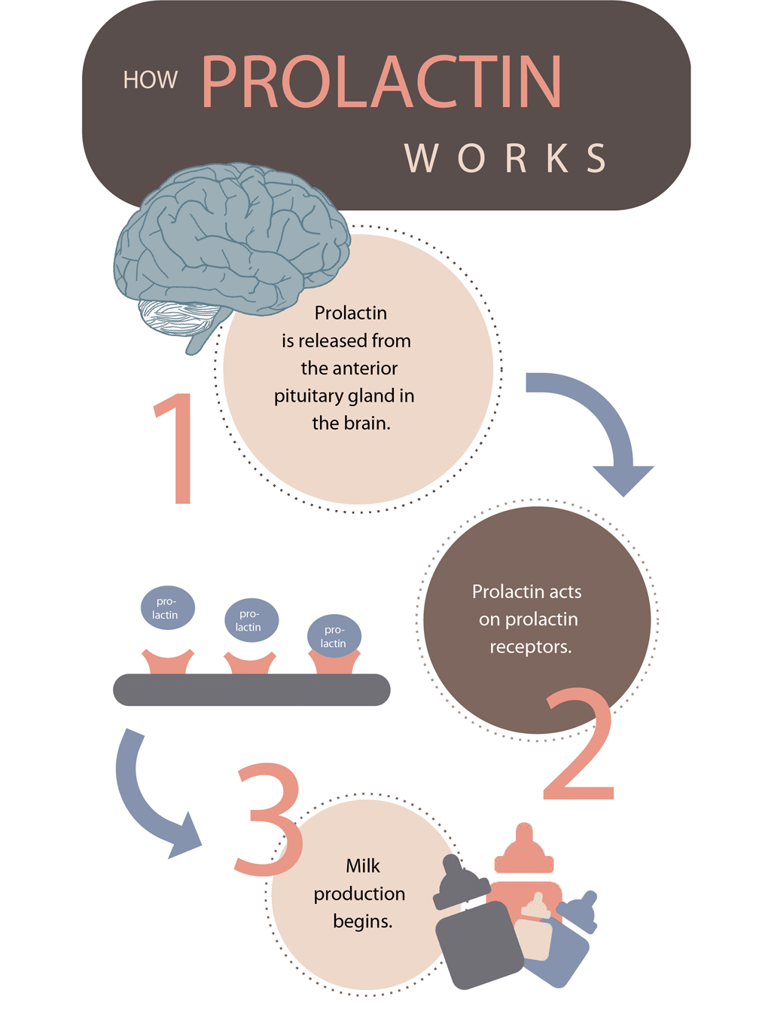
Methamphetamine use and breastfeeding
Inhibits prolactin release and reduces milk supply
Concentration in breast milk 2.8-7.5 times higher than maternal plasma
Increased infant irritability, agitation and crying
Freyer et al, 2009, AAP Committee on Drugs, 2001
Notes:
Recommendation: Women who are actively using methamphetamines should not breastfeed
Don't encourage breast feeding because the increased rate in breast milk is so high compared to maternal plasma, possibly leading to harm in the infant
Freyer AM. Drugs in Pregnancy and Lactation 8th Edition: A Reference Guide to Fetal and Neonatal Risk. Obstet Med. 2009 Jun;2(2):89. doi: 10.1258/om.2009.090002. Epub 2009 May 22. PMCID: PMC4989726.
American Academy of Pediatrics Committee on Drugs. Transfer of drugs and other chemicals into human milk. Pediatrics. 2001;108(3):776-789. doi:10.1542/peds.108.3.776

Slide 13


Treatment options
Counseling
Individual or group drug counseling
Intense outpatient therapy
Cognitive behavioral therapy
Pharmacotherapy
Bupropion with Naltrexone
Mirtazapine
Notes:
Counseling options are going to be limited on geographic location and resources

Slide 14
Bupropion and naltrexone
First choice
Mechanism
Naltrexone: pure opioid antagonist
Bupropion: weak inhibitor of the neuronal reuptake of dopamine and norepinephrine
Outpatient initiation
Initial urine drug screen
Notes:
Naltrexone – Check urine drug screen for fentanyl and opioids before giving opioid antagonist

Slide 15
Bupropion and Naltrexone dosing
Target dosing
Bupropion 450 mg daily (starting dose of 150 mg increased over 3 days)
Naltrexone 380 mg q4 weeks IM injection
Naltrexone initiation: Start with oral then transition to IM(Vivitrol)
Day 1: Take 12.5 mg, if tolerated, take another 12.5 mg 2 hrs later
Day 2: Take 25 mg
Day 3-7: Take 50 mg daily
Day 7: Start Vivitrol injections
Notes:
Naltrexone taper is ideal, but immediate IM injection is reasonable for the right patient. Just make sure negative utox
Intolerances: nausea, headache, dizziness, or fatigue. Watch for signs of opioid withdrawal!
Injection site pain, tenderness, swelling - Abscess, cellulitis or necrosis
The American Society of Addition Medicine – In cases of breakthrough cravings, LAI Naltrexone may be given every 3 weeks. NO CURRENT STUDIES TO SUPPORT THIS, NOT ROUTINE PRACTICE

Slide 16
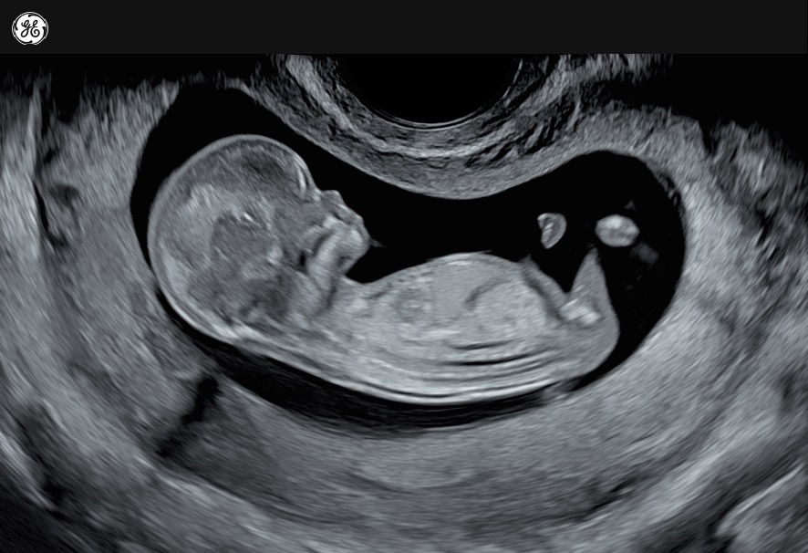
Naltrexone safety in pregnancy
Not expected to increase risk of congenital malformations
No difference in rates of congenital anomalies, stillbirths and neonatal mortality
Kelty et al, 2017
Notes:
Kelty et al – Retrospective cohort study of birth outcomes – Control vs naltrexone vs methadone vs buprenorphine
Kelty E, Hulse G. A Retrospective Cohort Study of Birth Outcomes in Neonates Exposed to Naltrexone in Utero: A Comparison with Methadone-, Buprenorphine- and Non-opioid-Exposed Neonates. Drugs. 2017;77(11):1211-1219. doi:10.1007/s40265-017-0763-8

Slide 17

Naltrexone safety in breastfeeding
Minimally excreted in breast milk
Likely safe to breastfeed
Chan et al, 2004
Notes:
VERY LIMITED DATA
A single case report looked at naltrexone in breastfeeding – Showed no adverse effect and minimal excretion in breast milk
Chan CF, Page-Sharp M, Kristensen JH, O'Neil G, Ilett KF. Transfer of naltrexone and its metabolite 6,beta-naltrexol into human milk. J Hum Lact. 2004;20(3):322-326. doi:10.1177/0890334404266881

Slide 18
Bupropion safety in pregnancy
Caution in patients with eating disorder and seizure disorder
No increase in congenital malformations
Prior concern for increased cardiovascular defects with exposure during pregnancy
Theoretical increased risk of miscarriage
Possible increased risk of ADHD in children
Cole et al, 2007; Chun-Fai-Chan et al, 2005; Figueroa et al, 2010
Notes:
Cole et al
NO teratogenic effect of first trimester bupropion exposure. No increase in congenital malformations relative to the comparison group
Studies that showed it had varying cardiac lesions
Chun-Fai-Chan
- 136 women with bupropion exposure
SAB rate for bupropion group 14.7% compared with nTC 4.5%, P 0.009.
SAB rate matches the risk with other antidepressants
However, there are studies on antidepressant use in pregnancy that have suggested that most depressed pregnant women are not adequately treated for their condition.20 Thus, it is difficult to separate whether the higher rate of spontaneous abortions in the women taking antidepressants is associated with the medication or the disease.
** mental health conditions also have an increased rate of pregnancy loss**
** long term behavioral data is difficult to tease apart the risk factors from the exposure **
Figueroa R. Use of antidepressants during pregnancy and risk of attention-deficit/hyperactivity disorder in the offspring. J Dev Behav Pediatr. 2010;31(8):641-648. doi:10.1097/DBP.0b013e3181e5ac93
Study used a health care claims database to identify mothers who used bupropion during pregnancy (n = 114) or an SSRI during pregnancy (n = 916), as well as depressed mothers who did not use antidepressants during pregnancy (n = 3532) [45]. After controlling for potential confounding factors (eg, sex of the child, parental psychiatric diagnoses, and perinatal complications), the analyses found that ADHD occurred more often with in utero exposure to bupropion than exposure to an SSRI or no exposure (4.4 versus 2.5 and 2.5 percent of offspring).
Cole JA, Modell JG, Haight BR, Cosmatos IS, Stoler JM, Walker AM. Bupropion in pregnancy and the prevalence of congenital malformations. Pharmacoepidemiol Drug Saf. 2007;16(5):474-484. doi:10.1002/pds.1296
Chun-Fai-Chan B, Koren G, Fayez I, et al. Pregnancy outcome of women exposed to bupropion during pregnancy: a prospective comparative study. Am J Obstet Gynecol. 2005;192(3):932-936. doi:10.1016/j.ajog.2004.09.027
Figueroa R. Use of antidepressants during pregnancy and risk of attention-deficit/hyperactivity disorder in the offspring. J Dev Behav Pediatr. 2010;31(8):641-648. doi:10.1097/DBP.0b013e3181e5ac93

Slide 19
Bupropion safety in breastfeeding
Doses up to 300 mg daily produce low levels in breastmilk
Case reports of seizures in neonates
Increase monitoring if combined with SSRI
Chaudron et al, 2004; Neuman et al, 2014
Notes:
Case report - a single case report described a seizure in a breastfed infant that was possibly related to bupropion [66]. Another case report described tonic seizure-like symptoms as well as emesis in an infant that was probably due to exposure to bupropion plus escitalopram through lactation
Infant monitoring – vomiting, diarrhea, jitteriness or dehydration and if concerned. Measure serum levels to rule out toxicity if there is a concern
Chaudron LH, Schoenecker CJ. Bupropion and breastfeeding: a case of a possible infant seizure. J Clin Psychiatry. 2004;65(6):881-882. doi:10.4088/jcp.v65n0622f
Neuman G, Colantonio D, Delaney S, Szynkaruk M, Ito S. Bupropion and Escitalopram During Lactation. Ann Pharmacother. 2014;48(7):928-931. doi:10.1177/1060028014529548

Slide 20
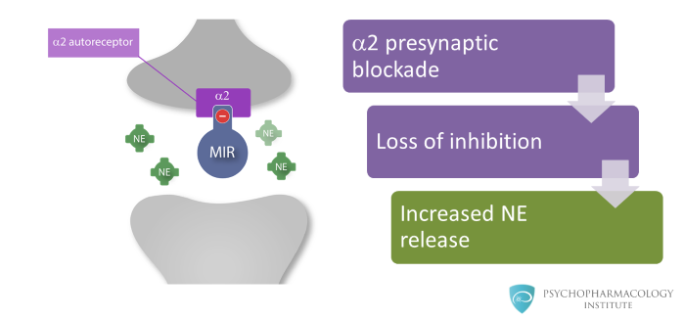
Mirtazapine
2nd line agent
Target dose is 30 mg nightly
Dosing regimen
Initial dose of 15 mg nightly
Increase to 30 mg nightly after 1 week
Mechanism of action
Central presynaptic alpha2-adrenergic antagonist effect
Notes:
Mechanism of action
Central presynaptic alpha2-adrenergic antagonist effect
- Leads to increased release of norepinephrine and serotonin

Slide 21
Mirtazapine safety in pregnancy
No increased incidence of major congenital malformations
Increased risk of spontaneous abortion
Smit et al, 2016; Kjaersgaard et al, 2013
Notes:
Smit – Literature review
No data to support increased risk of congenital malformation
Kjaersgaard et al, 2013 – Large retrospective cohort study looking at SAB risk with anti-depressants
suggested increased risk of spontaneous abortion (RR 2.23)
Elevated risk also seen with Venlafaxine and duloxetine
Authors suggest that this may be a reflection of depression severity
Smit M, Dolman KM, Honig A. Mirtazapine in pregnancy and lactation - A systematic review. Eur Neuropsychopharmacol. 2016;26(1):126-135. doi:10.1016/j.euroneuro.2015.06.014
Kjaersgaard MI, Parner ET, Vestergaard M, et al. Prenatal antidepressant exposure and risk of spontaneous abortion - a population-based study. PLoS One. 2013;8(8):e72095. Published 2013 Aug 28. doi:10.1371/journal.pone.0072095

Slide 22
Mirtazapine safety in breastfeeding
Doses up to 120 mg daily produce low levels in milk
Likely no adverse effects
Case report of infant sedation and weight gain
Tonn et al, 2009
Notes:
Low expectation fo adverse effects, especially if older than 2 months
Case reports – exposure during pregnancy and first 2 months of breast feeding > concern for sedation and excess weight gain. Infant serum concentration was 37 percent of mother's serum concentration.
Tonn P, Reuter SC, Hiemke C, Dahmen N. High mirtazapine plasma levels in infant after breast feeding: case report and review of the literature. J Clin Psychopharmacol. 2009;29(2):191-192. doi:10.1097/JCP.0b013e318199f17e

Slide 23
Treatment monitoring
Directly observed therapy
Monitoring driven by symptom control
Visit schedule
Q2 weeks after initiation
Standard visit schedule
Notes:
Directly observed therapy – No risk of diversion
All or none phenomenon in clinical practice

Slide 24
Opioid Use Disorder

Slide 25

Opioid use
Potential complications
Respiratory depression, overdose, death
Infection
Association with fentanyl use
Notes:
Infection – Cellulitis, abscess formation, sepsis, endocarditis, osteomyelitis, hepatitis, HIV

Slide 26
Risks in Pregnancy
Perinatal risks
Fetal growth restriction
Placental abruption
IUFD
Preterm birth
Neonatal abstinence syndrome (NAS)
Untreated OUD associated with high-risk activities
Prostitution
Trading sex for drugs
Criminal activities
ACOG CO 711, Azuine et al, 2019; Maeda et al, 2014
Notes:
Perinatal risks are increased with chronic heroin usage compared to oral narcotics
Opioid use and opioid use disorder in pregnancy. Committee Opinion No. 711. American College of Obstetricians and Gynecologists.
Azuine RE, Ji Y, Chang HY, et al. Prenatal Risk Factors and Perinatal and Postnatal Outcomes Associated With Maternal Opioid Exposure in an Urban, Low-Income, Multiethnic US Population. JAMA Netw Open. 2019;2(6):e196405. Published 2019 Jun 5. doi:10.1001/jamanetworkopen.2019.6405
Included methadone use
Results: This study included 8509 Boston Birth Cohort mother-newborn pairs for prenatal and perinatal analyses. Of those, 3153 children continued to receive pediatric care at Boston Medical Center and were included in assessing postnatal outcomes. Overall, 454 of the 8509 children (5.3%) in the Boston Birth Cohort had in utero opioid exposure. At birth, opioid exposure was associated with higher risks of fetal growth restriction (odds ratio [OR], 1.87; 95% CI, 1.41-2.47) and preterm birth (OR, 1.49; 95% CI, 1.19-1.86). Opioid exposure was associated with increased risks of lack of expected physiological development (OR, 1.80; 95% CI, 1.17-2.79) and conduct disorder/emotional disturbance (OR, 2.13; 95% CI, 1.20-3.77) among preschool-aged children. In school-aged children, opioid exposure was associated with a higher risk of attention-deficit/hyperactivity disorder (OR, 2.55; 95% CI, 1.42-4.57).
Maeda A, Bateman BT, Clancy CR, Creanga AA, Leffert LR. Opioid abuse and dependence during pregnancy: temporal trends and obstetrical outcomes. Anesthesiology. 2014;121(6):1158-1165. doi:10.1097/ALN.0000000000000472
RESULTS: The prevalence of opioid abuse or dependence during pregnancy increased from 0.17% (1998) to 0.39% (2011) for an increase of 127%. Deliveries associated with maternal opioid abuse or dependence compared with those without opioid abuse or dependence were associated with an increased odds of maternal death during hospitalization (adjusted odds ratio [aOR], 4.6; 95% CI, 1.8 to 12.1, crude incidence 0.03 vs. 0.006%), cardiac arrest (aOR, 3.6; 95% CI, 1.4 to 9.1; 0.04 vs. 0.01%), intrauterine growth restriction (aOR, 2.7; 95% CI, 2.4 to 2.9; 6.8 vs. 2.1%), placental abruption (aOR, 2.4; 95% CI, 2.1 to 2.6; 3.8 vs. 1.1%), length of stay more than 7 days (aOR, 2.2; 95% CI, 2.0 to 2.5; 3.0 vs. 1.2%), preterm labor (aOR, 2.1; 95% CI, 2.0 to 2.3; 17.3 vs. 7.4%), oligohydramnios (aOR, 1.7; 95% CI, 1.6 to 1.9; 4.5 vs. 2.8%), transfusion (aOR, 1.7; 95% CI, 1.5 to 1.9; 2.0 vs. 1.0%), stillbirth (aOR, 1.5; 95% CI, 1.3 to 1.8; 1.2 vs. 0.6%), premature rupture of membranes (aOR, 1.4; 95% CI, 1.3 to 1.6; 5.7 vs. 3.8%), and cesarean delivery (aOR, 1.2; 95% CI, 1.1 to 1.3; 36.3 vs. 33.1%).

Slide 27
Treatment options
Opioid agonist pharmacotherapy
Methadone
Buprenorphine
Medically supervised withdrawal
Not recommended
High rates of relapse
Former concern for fetal stress and death
Naltrexone
Initiation vs continuation in pregnancy
Zupan et al, 1975; Rementeria et al, 1973, Ecker et al, 2019
Notes:
** risk of relapse is not just relapse but also risk of overdose/death*
Case reports discuss the concern – more recent studies find no clear evidence of association between supervised withdrawal and fetal death. Long-term data is lacking
Naltrexone – Oral form has poor adherence. Injection form is more effective than placebo in maintaining abstinence
Although the US Food and Drug Administration (FDA) has approved naltrexone for the treatment of OUD, data are insufficient to support the initiation of naltrexone therapy during pregnancy. Naltrexone may be continued for those patients who already are taking this medication and who become pregnant after a careful assessment and communication of the risks of discontinuing naltrexone (eg, risk of relapse) and the limitations of data surrounding its use in pregnancy.
** Hard to taper off agonist enough to start naltrexone**
Zuspan FP, Gumpel JA, Mejia-Zelaya A, Madden J, Davis R. Fetal stress from methadone withdrawal. Am J Obstet Gynecol. 1975;122(1):43-46. doi:10.1016/0002-9378(75)90613-4
Rementeriá JL, Nunag NN. Narcotic withdrawal in pregnancy: stillbirth incidence with a case report. Am J Obstet Gynecol. 1973;116(8):1152-1156. doi:10.1016/0002-9378(73)90953-8
Ecker J, Abuhamad A, Hill W, et al. Substance use disorders in pregnancy: clinical, ethical, and research imperatives of the opioid epidemic: a report of a joint workshop of the Society for Maternal-Fetal Medicine, American College of Obstetricians and Gynecologists, and American Society of Addiction Medicine. Am J Obstet Gynecol. 2019;221(1):B5-B28. doi:10.1016/j.ajog.2019.03.022

Slide 28

Medication for OUD goal
Goals:
Manage withdrawal
Decrease cravings
Reduce the risk of illicit substance abuse
Benefits:
Improved adherence to prenatal care and addiction treatment programs
Reduced risk of obstetrical complications
More predictable NAS course
Notes:
Substance Abuse and Mental Health Services Administration. A collaborative approach to the treatment of pregnant women with opioid use disorders. HHS Publication No. (SMA) 16-4978 . Rockville (MD): SAMHSA; 2016.
** Medication for OUD **- New terminology, previously medication assisted treatment

Slide 29
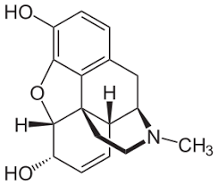
Which Medication to choose
Methadone
Full mu-opioid receptor agonist
Administered at federally accredited treatment programs
Associated with NAS
Buprenorphine
Partial mu-opioid receptor agonist
Outpatient treatment options
Associated with NAS (decreased compared to methadone)
Jones et al, 2012
Notes:
Methadone
Access to methadone may be limited in certain geographic areas, need reliable transportation
*Women should not be switched from methadone to buprenorphine, as this might precipitate withdrawal.- If stable,
Subutex is significantly cheaper
Jones HE, Finnegan LP, Kaltenbach K. Methadone and buprenorphine for the management of opioid dependence in pregnancy. Drugs. 2012;72(6):747-757. doi:10.2165/11632820-000000000-00000

Slide 30
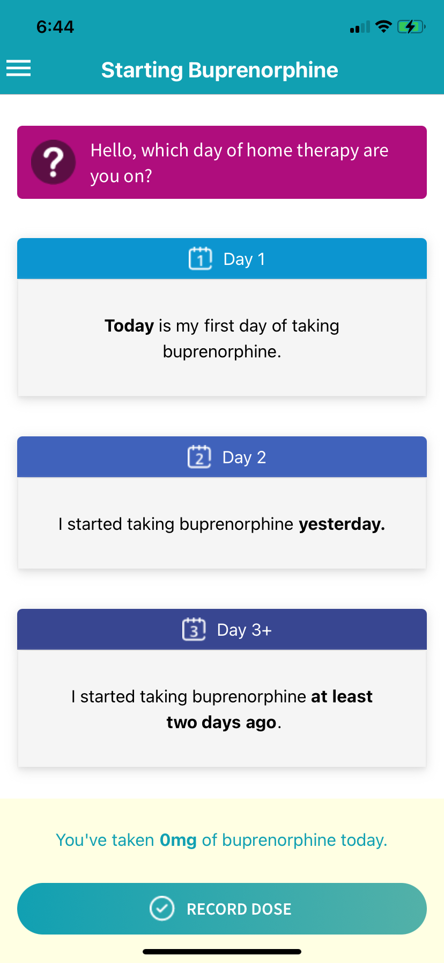
Inpatient vs outpatient initiation
Outpatient initiation
Buprenorphine initiation
More availability
App tracking –Buprenorphine Home Induction App
Inpatient initiation
Fentanyl Use
Methadone initiation

Slide 31
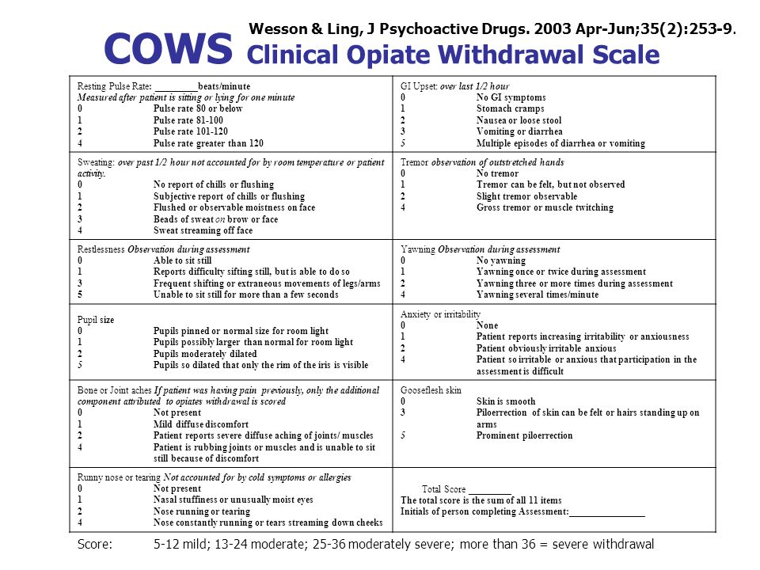
Withdrawal Monitoring

Slide 32
Buprenorphine Initiation – Outpatient (Standard/no Fent)
Most successful among those who have previously successfully initiated medication
Use an app or paper log to monitor COWS at home
Dosing: Send home w/ 1 week of 24mg daily
Start w/ 2-4mg buprenorphine for COWS>12
Add additional 2mg q 2-4h for withdrawal up to 8mg total first day
Take previous days' total dose in AM of day 2.
Add additional 2mg q 2-4h for withdrawal up to 16mg second day
Take previous days' total dose in two divided doses on day 3 (renal clearance)
Add additional 2mg during the day PRN
Return to office 1 week.
Many pt stabilize at 8mg TID in pregnancy – can go up to 32 PRN

Slide 33
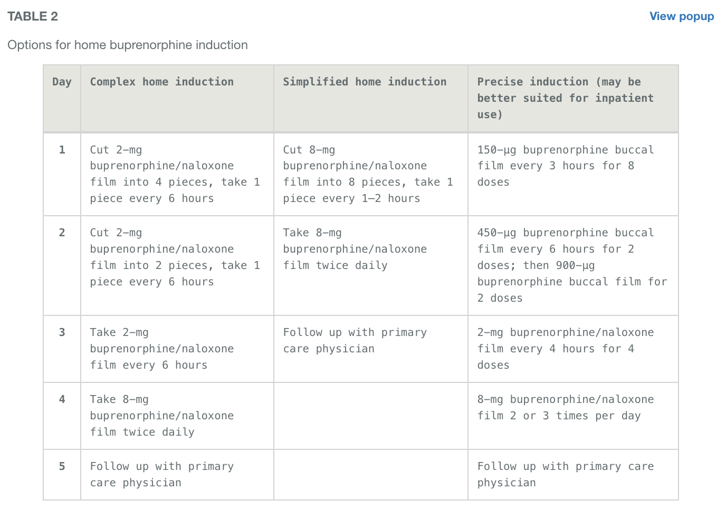
Buprenorphine Initiation – Outpatient (Low dose/fent)
Penn Center for Addiction Medicine & Policy
https://penncamp.org/clinical/micro-dosing/

Slide 34
Buprenorphine Initiation – Inpatient
SUPeRAD Protocol is basically the same as outpatient protocol:
Start with 2-4mg for COWS 8+
Titration as described outpatient
Divide second day dose to BID
May end up at TID dosing
Most stabilized within 72h
Attempt discharge to residential, intensive outpatient, or close outpatient follow up (within 1 week)

Slide 35
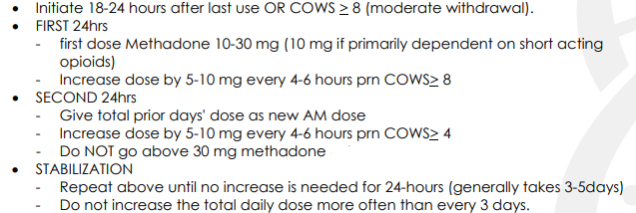
Methadone – Inpatient (SUPeRAD protocol)
Notes:
If on methadone prior to pregnancy, may need dose adjustment due to physiologic changes that decrease levels of methadone during 2nd and 3rd trimester
30 mg is not hard stop anymore
Rapid titration is now more frequently done in the setting of fentanyl use

Slide 36

Adjunctive Medications during initiation
Clonidine 0.1 mg PO q6hrs PRN – Withdrawal symptoms (hold if systolic BP <105)
Hydroxyzine HCl 50 mg PO q6hr PRN – Anxiety
Diphenhydramine 50 mg PO nightly PRN – Sleep

Slide 37
Adjunctive Medications during initiation
Dicyclomine 20 mg PO q6hr PRN – Abdominal cramping
Loperamide 2 mg PO q6hr PRN – Diarrhea
Acetaminophen 650 mg PO q6hr PRN – Pain rated as 1-5
Acetaminophen 975 mg PO q8hr PRN – Pain rated as 6-10

Slide 38
Practice Case
Jane is a 35 yo G2P1001 who presents for a NOB visit. She has a history of daily heroine usage (smoking and IV) and is interested in outpatient buprenorphine initiation.
Infectious disease labs negative
Urine drug screen positive for opioids and fentanyl
What are your next steps? How would you counsel Jane?

Slide 39
Fentanyl use... It changes everything
Increasing evidence of fentanyl use and contamination
Need to test for fentanyl on admission
Different physiology
Longer period of abstinence needed
More severe withdrawals
Increased precipitated withdrawals
Morris 2022
Notes:
Fentanyl:
Stored in adipose tissue with chronic use > longer renal clearance
Longer time of abstinence needed (36 to 48 hrs > 3+ days)
Can experience bup precipitated withdrawal even after prolonged abstinence > relapse or drop out
Morris NP. Opioid Use Disorder Treatment in the Age of Fentanyl. JAMA Intern Med. 2022;182(3):249–250. doi:10.1001/jamainternmed.2021.8114

Slide 40
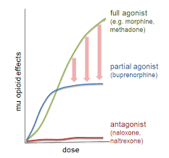
Treatment options with fentanyl Use
Goal: Avoid precipitated withdrawal
Differences from standard initiation
Don't need to wait until withdrawal symptoms develop
Variety of protocols available
Buprenorphine microinduction
Buprenorphine macroinduction
Methadone induction
High dose methadone induction
Methadone > Buprenorphine

Slide 41
Microdosing example protocol (SUPeRAD protocol)
Day 1
Start 20 mcg Butrans patch on admission
Administer 30 mg methadone once COWS >/= 8
Continue COWS score q4hr with additional 10 mg methadone prn for COWS >/=10
Day 2
Continue Butrans patch
Administer 24hr cumulative dose of methadone as single dose in the morning
Discontinue q4hr COWS, switch to PRN COWS if pt experiences withdrawal sx
Give 6-8mg oral Dilaudid q4hr for COWS >/= 10
Notes:
Patch + Bup/methadone + PRN Dilaudid = more frequently used now in era of fentatnyl

Slide 42
Microdosing example protocol (SUPeRAD protocol)
Day 3
Discontinue methadone
Start buprenorphine naloxone 8-2mg BID to TID
Okay to remove butrans patch once first 8 mg of buprenorphine given
Throughout the process
Ongoing communication with nursing staff
Consider adjunctive medications for symptoms of withdrawal
Notes:
Ongoing communication and attention to symptoms = key to not leave

Slide 43
Treatment Monitoring
Monitoring driven by symptom control
Visit frequency depends on stability
Urine drug screen at every visit
Outpatient initiation
Q1-2 weeks visits
Inpatient initiation
1 week after discharge
Q2-3 weeks visits
Notes:
Q1-2 week visits
Q2-3 appointments (within 1 week after discharge)

Slide 44
Buprenorphine safety in pregnancy
Potentially lower placental transfer
Less severe NAS compared to methadone
No association with increase in birth defects
Increased fetal birth weight compared to methadone
Inconsistent evidence on long-term infant consequences
Dose does not affect NAS risk
Jones et al, 2012; Zedler et al, 2016; Salo et al, 2009; Whitham 2012
Notes:
Less severe NAS
Jones et al
No increase in birth defects – Zedler et al (Cochrane review)
Increased fetal birth weight – Zedler et al
Inconsistent evidence of longterm infant consequences.
studies assessing the impact of buprenorphine on pregnancy outcomes are limited by a multitude of factors, including concomitant exposures to medications and illicit drugs, comorbidities, nutritional factors, and sociodemographic factors, which may confound any association between buprenorphine and adverse pregnancy outcomes.
benefits of pharmacotherapy for OUD during pregnancy outweigh the risks of untreated OUD
One study reported lower scores on cognitive and language scales at 3yo - Salo et al
One study found no difference in neurologic development or temperament at 2years of life – Whitham J, Prenatal exposure to buprenorphine or methadone 2012.
Jones HE, Finnegan LP, Kaltenbach K. Methadone and buprenorphine for the management of opioid dependence in pregnancy. Drugs. 2012;72(6):747-757. doi:10.2165/11632820-000000000-00000
Zedler BK, Mann AL, Kim MM, et al. Buprenorphine compared with methadone to treat pregnant women with opioid use disorder: a systematic review and meta-analysis of safety in the mother, fetus and child. Addiction. 2016;111(12):2115-2128. doi:10.1111/add.13462
Salo, S., Kivistö, K., Korja, R., Biringen, Z., Tupola, S., Kahila, H., & Kivitie-Kallio, S. (2009). Emotional availability, parental self-efficacy beliefs, and child development in caregiver-child relationships with buprenorphine-exposed 3-year-olds. Parenting: Science and Practice, 9(3-4), 244–259. https://doi.org/10.1080/15295190902844563

Slide 45
Buprenorphine safety in breastfeeding
More limited data compared to methadone
Overall small amount in breastmilk
Monitor infant for drowsiness, adequate weight gain and developmental milestones
Breastfeeding encouraged if no other contraindications
Reece-Stremtan et al, 2015
Notes:
Multiple small case series have looked at maternal buprenorphine concentrations in human milk and it is small. Unlikely to have short-term negative effects on developing infant.
Monitoring recommended by Lactmed
"Opioid use disorder: Pharmacotherapy with methadone and buprenorphine during pregnancy"- UTD
Monitoring infant – due to limited data, more relavent to exclusively breastfed infants
Lactmed. Buprenorphine: National Library of Medicine. http://toxnet.nlm.nih.gov
Reece-Stremtan S, Marinelli KA. ABM clinical protocol #21: guidelines for breastfeeding and substance use or substance use disorder, revised 2015. Breastfeed Med. 2015;10(3):135-141. doi:10.1089/bfm.2015.9992

Slide 46
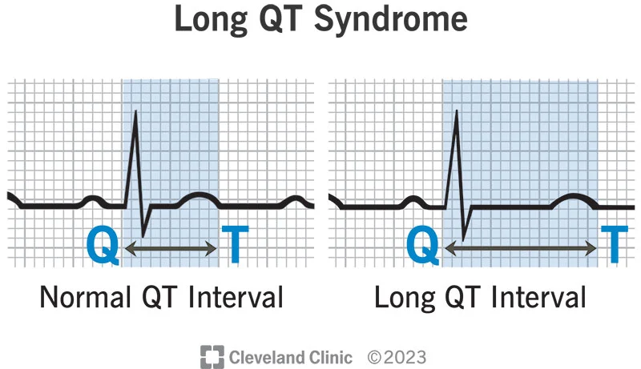
Methadone safety in pregnancy
Compared to untreated heroin dependence – Increased fetal growth, reduced fetal mortality, decreased risk of HIV, decreased risk of Preeclampsia
Effect on fetal monitoring
Prolonged QTc
Martin et al, 2009; Jones et al, 2012, Zedler et al, 2016; Monnelly et al, 2019
Notes:
Compared to untreated heroin dependence – Increased fetal growth, reduced fetal mortality, decreased risk of HIV, decreased risk of Preeclampsia – Martin et al, 2009
Affect on fetal monitoring – Jones et al
Fetal monitoring – methadone showed reduced FHR, accelerations and variability = Increased incidence of non-reactive NST
Higher percentage of respiratory distress symptoms at delivery (compared to buprenorphine group) - Jones et al
A recent secondary analysis of data from the MOTHER study showed a significantly (p = 0.05) higher percentage of respiratory distress symptoms at delivery in neonates in the methadone condition than in the buprenorphine condition.[34] This higher incidence of respiratory distress symptoms in the methadone condition remained significant even after controlling for co-variates (e.g. prematurity <37 weeks and gestational age at delivery)
Prolonged QTc
Care taken if >450-499 msec, avoid if >500 msec
No association with increase in birth defects – Zedler et al, 2016
Possible effect on visual development - *** increased childhood strabismus and nystagmus. Most studies lack adequate controls.
No clear knowledge on long-term neurodevelopmental impact
Emphasize the clear benefit of treatment of OUD
Jones HE, Finnegan LP, Kaltenbach K. Methadone and buprenorphine for the management of opioid dependence in pregnancy. Drugs. 2012;72(6):747-757. doi:10.2165/11632820-000000000-00000
Monnelly VJ, Hamilton R, Chappell FM, Mactier H, Boardman JP. Childhood neurodevelopment after prescription of maintenance methadone for opioid dependency in pregnancy: a systematic review and meta-analysis. Dev Med Child Neurol. 2019;61(7):750-760. doi:10.1111/dmcn.14117
Martin PR, Arria AM, Fischer G, Kaltenbach K, Heil SH, Stine SM, Coyle MG, Selby P, Jones HE. Psychopharmacologic management of opioid-dependent women during pregnancy. Am J Addict. 2009 Mar-Apr;18(2):148-56. doi: 10.1080/10550490902772975. PMID: 19283567; PMCID: PMC2777700.

Slide 47
Methadone safety in pregnancy
Higher percentage of respiratory distress symptoms at delivery (compared to buprenorphine group)
No association with increase in birth defects
Possible effect on visual development
Risk of neurodevelopmental impact
Dose does not affect NAS risk
Martin et al, 2009; Jones et al, 2012, Zedler et al, 2016; Monnelly et al, 2019
Notes:
No association with increase in birth defects – Zedler et al, 2016
Possible effect on visual development - *** increased childhood strabismus and nystagmus. Most studies lack adequate controls.
Risk neurodevelopmental impact – Monnelly et al, 2019
Reduced MDI (mental development index) and PDI (psychomotor development index) scores
Emphasize the clear benefit of treatment for OUD
Jones HE, Finnegan LP, Kaltenbach K. Methadone and buprenorphine for the management of opioid dependence in pregnancy. Drugs. 2012;72(6):747-757. doi:10.2165/11632820-000000000-00000
Monnelly VJ, Hamilton R, Chappell FM, Mactier H, Boardman JP. Childhood neurodevelopment after prescription of maintenance methadone for opioid dependency in pregnancy: a systematic review and meta-analysis. Dev Med Child Neurol. 2019;61(7):750-760. doi:10.1111/dmcn.14117
Martin PR, Arria AM, Fischer G, Kaltenbach K, Heil SH, Stine SM, Coyle MG, Selby P, Jones HE. Psychopharmacologic management of opioid-dependent women during pregnancy. Am J Addict. 2009 Mar-Apr;18(2):148-56. doi: 10.1080/10550490902772975. PMID: 19283567; PMCID: PMC2777700.

Slide 48

Methadone safety in breastfeeding
Overall small amount of methadone in breastmilk
No correlation on maternal methadone dose
Breastfeeding recommended if...
On stable methadone dose
No use of nonprescription opioids or misuse of other prescription drugs
Benefits:
Improved maternal-infant attachment
Favorable effects on NAS
Jansson et al, 2008; Abdel et al, 2006
Notes:
Favorable effects on NAS – unclear if related to breast milk, skin-to-skin contact or act of breastfeeding in general
Abdel-Latif ME, Pinner J, Clews S, Cooke F, Lui K, Oei J. Effects of breast milk on the severity and outcome of neonatal abstinence syndrome among infants of drug-dependent mothers. Pediatrics. 2006;117(6):e1163-e1169. doi:10.1542/peds.2005-1561
Breast milk intake is associated with reduced neonatal abstinence syndrome severity, delayed onset of neonatal abstinence syndrome, and decreased need for pharmacologic treatment, regardless of the gestation and the type of drug exposure.
Jansson LM, Choo R, Velez ML, et al. Methadone maintenance and breastfeeding in the neonatal period. Pediatrics. 2008;121(1):106-114. doi:10.1542/peds.2007-1182
- No correlation on dose and breast milk amount

Slide 49
Naltrexone
Primarily used to maintain abstinence
Injection has better rates of abstinence
If breakthrough cravings, consider q3 week injections
Lower rates of NAS
Compared to buprenorphine exposed neonate
See prior slides for safety
Jones et al, 2013, Kelty et al, 2017
Notes:
Oral form demonstrates poor adherence, the injectable is more effective than placebo in maintaining abstinence
The American Society of Addition Medicine – In cases of breakthrough cravings, LAI Naltrexone may be given every 3 weeks. NO CURRENT STUDIES TO SUPPORT THIS, NOT ROUTINE PRACTICE
Lower rates of NAS – Ketly et al
Lower scores 7.5 vs. 41.8% compared to bupe
Jones HE, Chisolm MS, Jansson LM, Terplan M. Naltrexone in the treatment of opioid-dependent pregnant women: the case for a considered and measured approach to research. Addiction. 2013;108(2):233-247. doi:10.1111/j.1360-0443.2012.03811.x

Slide 50
Alcohol Use Disorder

Slide 51
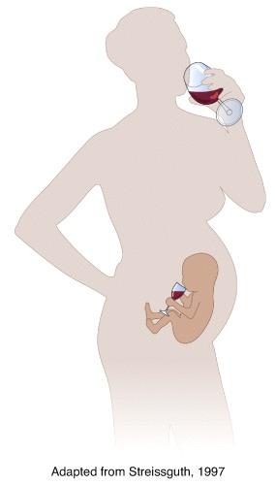
Alcohol use
Alcohol freely crosses the placenta
Impaired decision making
Acute intoxication
Multiple metabolic derangements
Hypotension and tachycardia
Notes:
Signs and symptoms of acute ethanol intoxication vary and can include slurred speech, nystagmus, disinhibited behavior, incoordination, unsteady gait, memory impairment, stupor, or coma. Hypotension and tachycardia may occur as a result of ethanol-induced peripheral vasodilation, or secondary to volume loss [13,14].
metabolic derangements including hypoglycemia, hyperlactatemia, hypokalemia, hypomagnesemia, hypocalcemia, and hypophosphatemia

Slide 52
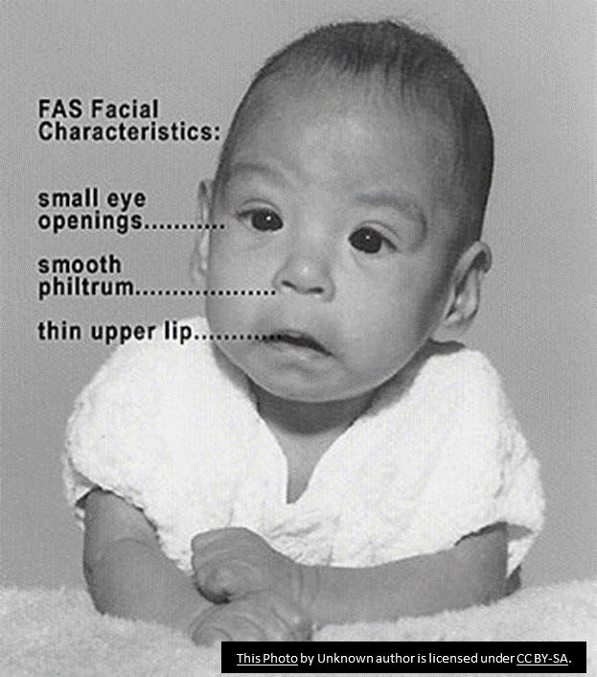
Risk in pregnancy
Increased rate of miscarriage
Increased rate of stillbirth
Alcohol is a known teratogen
FAS
Facial malformations
Cardiac and skeletal dysplasia
Renal defects
Ocular and auditory defects
Neurodevelopmental effects
Fetal growth restriction
Kesmodel et al, 2002, Ornoy et al, 2010
Notes:
Miscarriage
Greater than 5 drinks a week in first trimester > 5 fold increase in SAB
No significant difference in 2nd and 3rd trimester
Stillbirth
The rate of stillbirth due to fetoplacental dysfunction increased across alcohol categories, from 1.37 per 1,000 births for women consuming <1 drink/week to 8.83 per 1,000 births for women consuming > or = 5 drinks/week.
FAS Preterm birth? - lots of varying data on this
Kesmodel U, Wisborg K, Olsen SF, Henriksen TB, Secher NJ. Moderate alcohol intake during pregnancy and the risk of stillbirth and death in the first year of life. Am J Epidemiol. 2002;155(4):305-312. doi:10.1093/aje/155.4.305
Kesmodel U, Wisborg K, Olsen SF, Henriksen TB, Secher NJ. Moderate alcohol intake in pregnancy and the risk of spontaneous abortion. Alcohol Alcohol. 2002;37(1):87-92. doi:10.1093/alcalc/37.1.87

Slide 53
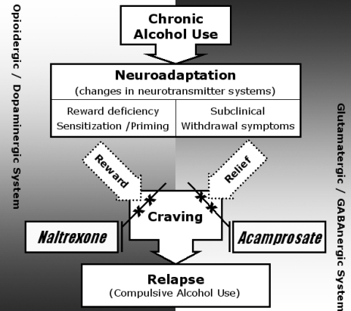
AUD treatment
Acute withdrawal
Phenobarbital Taper
Pharmacologic management of AUD
Naltrexone
Acamprosate
Yung et al, 2006
Notes:
Jung YC, Namkoong K. Pharmacotherapy for alcohol dependence: anticraving medications for relapse prevention. Yonsei Med J. 2006 Apr 30;47(2):167-78. doi: 10.3349/ymj.2006.47.2.167. PMID: 16642544; PMCID: PMC2687624.

Slide 54
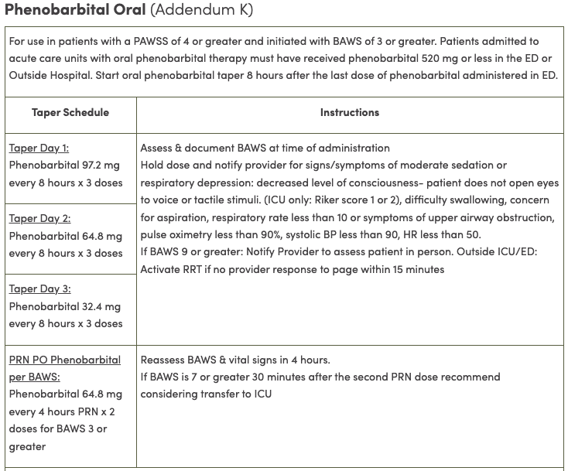
Phenobarbital Taper
University of Utah PULSE
Notes:
** PULSE oral taper
Valium option for people with liver dysfunction

Slide 55
Naltrexone therapy
1st line therapy
Avoid in patients with acute hepatitis or hepatic failure
Avoid in patients with ongoing opioid use
Limitations regarding opioid use around delivery
Benefit of long acting injectable
See prior slide for safety
Jones et al, 2013
Notes:
Oral form demonstrates poor adherence, the injectable is more effective than placebo in maintaining abstinence
Jones HE, Chisolm MS, Jansson LM, Terplan M. Naltrexone in the treatment of opioid-dependent pregnant women: the case for a considered and measured approach to research. Addiction. 2013;108(2):233-247. doi:10.1111/j.1360-0443.2012.03811.x

Slide 56
Acamprosate therapy
2nd line therapy
Mechanism:
GABA agonist/Glutamate antagonist
Avoid in individuals with moderate renal dysfunction
Started when abstinence is achieved
No limitation of opioid usage around delivery
Usual dosing: 666 mg TID
Notes:
Helps to restore GABA and glutamate activies which are disrupted in AUD

Slide 57
Acamprosate safety in pregnancy
No clear association with poor maternal or neonatal health outcomes
Kelty et al, 2019
Notes:
Kelty E, Tran D, Lavin T, Preen DB, Hulse G, Havard A. Prevalence and safety of acamprosate use in pregnant alcohol-dependent women in New South Wales, Australia. Addiction. 2019;114(2):206-215. doi:10.1111/add.14429
Exposure to acamprosate occurred in 7.7 [95% confidence interval (CI) = 6.0-9.7] in every 100 000 pregnancies. Rates of hospital admissions during pregnancy and 42 days post-partum in acamprosate-treated women were not significantly different from women in the community comparison group [adjusted rate ratio (RR) = 0.85, 95% CI = 0.65-1.11], but were significantly lower compared with the alcohol comparison group (adjusted RR = 1.26, 95% CI = 1.00-1.60). Acamprosate-exposed neonates were not significantly different from the alcohol comparison group or the community comparison group in terms of birth weight or proportion of small-for-gestational-age neonates or incidence of congenital abnormalities (including FAS).

Slide 58

Acamprosate safety in breastfeeding
Unknown safety in breastfeeding
Effect of alcohol on breastfeeding
Small percentage of alcohol is transferred in breast milk
No "safe amount of alcohol" while breastfeeding
Need to wait to nurse
Notes:
We suggest that a breastfeeding woman avoid exposing the infant to alcohol by waiting to nurse for two hours after a single serving of alcohol (12 ounces of beer, 5 ounces of wine, or 1.5 ounces of 80-proof liquor). If a woman drinks more than this amount, she should refrain from breastfeeding for an additional two hours for each serving of alcohol

Slide 59
Treatment monitoring
Monitoring driven by symptom control
Urine ethanol screen at every visit
Q1-2 week visit frequency

Slide 60
Additional Considerations

Slide 61
Co-existing mental health conditions
Overall risk of psychiatric meds is outweighed by benefit of treatment
Significant for pt with history of depression/suicide attempt
Uncontrolled mental health conditions are associated with
Relapse in symptoms
Compromised maternal-infant bonding
Premature delivery
Decreased breastfeeding initiation
Grigoriadis et al, 2013
Notes:
- premature delivery, odds ratio [OR] = 1.37; 95% CI, 1.04 to 1.81; P = .024; and decrease in breastfeeding initiation, OR = 0.68; 95% CI, 0.61 to 0.76; P < .0001) (Grigoriadis et al. 2013, The impact of maternal depression during pregnancy on perinatal outcomes: a systematic review and meta-analysis J Clin Psychiatry 2013 Apr;74(4):e321-41).

Slide 62

Integrated care
Prenatal provider and SUD medication provider = SAME (or in same place at same time)
Prenatal care and SUD care = SAME
Improved patient relationship
ANYONE can prescribe buprenorphine now
Increased access to/willingness to accept additional care
Peer support
Counseling
Social work
Recovery support
Notes:
More discrete care
Less appointment burden

Slide 63
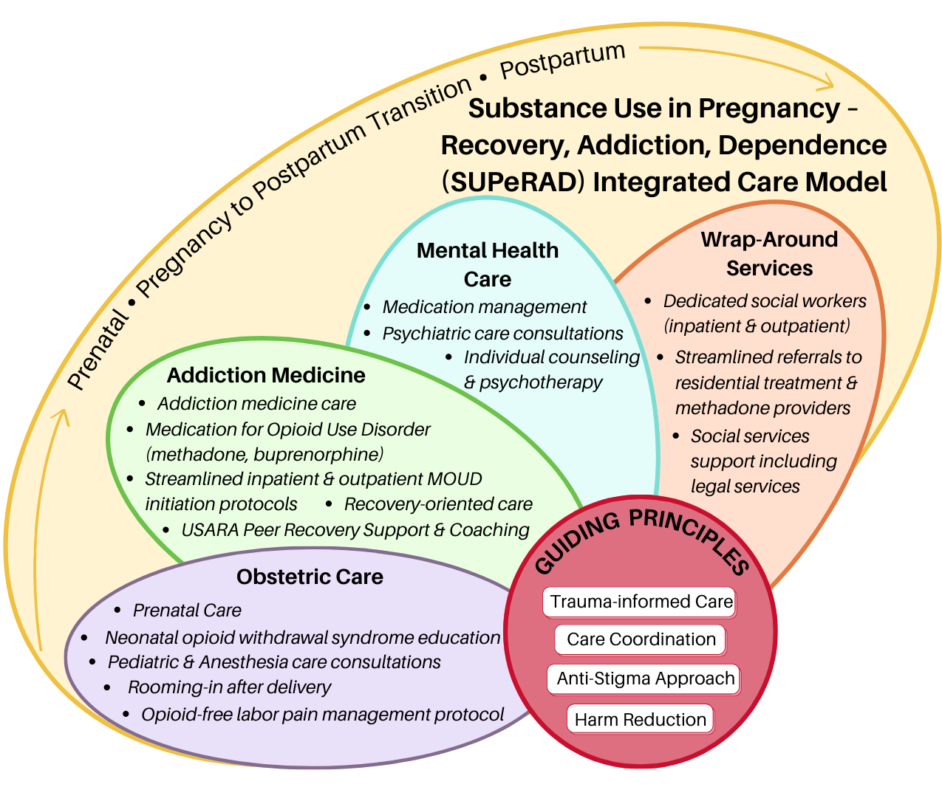
Integrated care
Notes:
More discrete care
Less appointment burden

Slide 64

Decreasing the stigma of SUD
Integrated care
Emphasis on patient centered care
Understanding the context
Emphasis on patient safety
Medications are far less harmful than ongoing usage
Risk/benefit balance in favor of medication therapy

Slide 65



Resources for providers
Opioid use and opioid use disorder in pregnancy. Committee Opinion No. 711. American College of Obstetricians and Gynecologists.
Methamphetamine Abuse in Women of Reproductive Age. Committee Opinion No. 479. American College of Obstetricians and Gynecologists.
Alliance for innovation on maternal health - Care for pregnant and postpartum people with substance use disorder
https://saferbirth.org/psbs/care-for-pregnant-and-postpartum-people-with-substance-use-disorder/
SMFM Special Report - Substance use disorder in pregnancy
Buprenorphine Home Induction App
https://apps.apple.com/us/app/buprenorphine-home-induction/id1449302173
Notes:
Include link to bup app and AIM bundle

Slide 66
References
Abdel-Latif ME, Pinner J, Clews S, Cooke F, Lui K, Oei J. Effects of breast milk on the severity and outcome of neonatal abstinence syndrome among infants of drug-dependent mothers. Pediatrics. 2006;117(6):e1163-e1169. doi:10.1542/peds.2005-1561
American Academy of Pediatrics Committee on Drugs. Transfer of drugs and other chemicals into human milk. Pediatrics. 2001;108(3):776-789. doi:10.1542/peds.108.3.776
Azuine RE, Ji Y, Chang HY, et al. Prenatal Risk Factors and Perinatal and Postnatal Outcomes Associated With Maternal Opioid Exposure in an Urban, Low-Income, Multiethnic US Population. JAMA Netw Open. 2019;2(6):e196405. Published 2019 Jun 5. doi:10.1001/jamanetworkopen.2019.6405
Chan CF, Page-Sharp M, Kristensen JH, O'Neil G, Ilett KF. Transfer of naltrexone and its metabolite 6,beta-naltrexol into human milk. J Hum Lact. 2004;20(3):322-326. doi:10.1177/0890334404266881
Chaudron LH, Schoenecker CJ. Bupropion and breastfeeding: a case of a possible infant seizure. J Clin Psychiatry. 2004;65(6):881-882. doi:10.4088/jcp.v65n0622f
Chun-Fai-Chan B, Koren G, Fayez I, et al. Pregnancy outcome of women exposed to bupropion during pregnancy: a prospective comparative study. Am J Obstet Gynecol. 2005;192(3):932-936. doi:10.1016/j.ajog.2004.09.027
Cole JA, Modell JG, Haight BR, Cosmatos IS, Stoler JM, Walker AM. Bupropion in pregnancy and the prevalence of congenital malformations. Pharmacoepidemiol Drug Saf. 2007;16(5):474-484. doi:10.1002/pds.1296
Ecker J, Abuhamad A, Hill W, et al. Substance use disorders in pregnancy: clinical, ethical, and research imperatives of the opioid epidemic: a report of a joint workshop of the Society for Maternal-Fetal Medicine, American College of Obstetricians and Gynecologists, and American Society of Addiction Medicine. Am J Obstet Gynecol. 2019;221(1):B5-B28. doi:10.1016/j.ajog.2019.03.022
Figueroa R. Use of antidepressants during pregnancy and risk of attention-deficit/hyperactivity disorder in the offspring. J Dev Behav Pediatr. 2010;31(8):641-648. doi:10.1097/DBP.0b013e3181e5ac93
Freyer AM. Drugs in Pregnancy and Lactation 8th Edition: A Reference Guide to Fetal and Neonatal Risk. Obstet Med. 2009 Jun;2(2):89. doi: 10.1258/om.2009.090002. Epub 2009 May 22. PMCID: PMC4989726.
Gorman MC, Orme KS, Nguyen NT, Kent EJ 3rd, Caughey AB. Outcomes in pregnancies complicated by methamphetamine use. Am J Obstet Gynecol. 2014;211(4):429.e1-429.e4297. doi:10.1016/j.ajog.2014.06.005
Grigoriadis et al. 2013, The impact of maternal depression during pregnancy on perinatal outcomes: a systematic review and meta-analysis J Clin Psychiatry 2013 Apr;74(4):e321-41).
Jansson LM, Choo R, Velez ML, et al. Methadone maintenance and breastfeeding in the neonatal period. Pediatrics. 2008;121(1):106-114. doi:10.1542/peds.2007-1182

Slide 67
References (CONT)
Jones HE, Finnegan LP, Kaltenbach K. Methadone and buprenorphine for the management of opioid dependence in pregnancy. Drugs. 2012;72(6):747-757. doi:10.2165/11632820-000000000-00000
Jones HE, Chisolm MS, Jansson LM, Terplan M. Naltrexone in the treatment of opioid-dependent pregnant women: the case for a considered and measured approach to research. Addiction. 2013;108(2):233-247. doi:10.1111/j.1360-0443.2012.03811.x
Kelty E, Hulse G. A Retrospective Cohort Study of Birth Outcomes in Neonates Exposed to Naltrexone in Utero: A Comparison with Methadone-, Buprenorphine- and Non-opioid-Exposed Neonates. Drugs. 2017;77(11):1211-1219. doi:10.1007/s40265-017-0763-8
Kesmodel U, Wisborg K, Olsen SF, Henriksen TB, Secher NJ. Moderate alcohol intake during pregnancy and the risk of stillbirth and death in the first year of life. Am J Epidemiol. 2002;155(4):305-312. doi:10.1093/aje/155.4.305
Kesmodel U, Wisborg K, Olsen SF, Henriksen TB, Secher NJ. Moderate alcohol intake in pregnancy and the risk of spontaneous abortion. Alcohol Alcohol. 2002;37(1):87-92. doi:10.1093/alcalc/37.1.87Kjaersgaard MI, Parner ET, Vestergaard M, et al. Prenatal antidepressant exposure and risk of spontaneous abortion - a population-based study. PLoS One. 2013;8(8):e72095. Published 2013 Aug 28. doi:10.1371/journal.pone.0072095
Lactmed. Buprenorphine: National Library of Medicine. http://toxnet.nlm.nih.gov
Maeda A, Bateman BT, Clancy CR, Creanga AA, Leffert LR. Opioid abuse and dependence during pregnancy: temporal trends and obstetrical outcomes. Anesthesiology. 2014;121(6):1158-1165. doi:10.1097/ALN.0000000000000472
Martin PR, Arria AM, Fischer G, Kaltenbach K, Heil SH, Stine SM, Coyle MG, Selby P, Jones HE. Psychopharmacologic management of opioid-dependent women during pregnancy. Am J Addict. 2009 Mar-Apr;18(2):148-56. doi: 10.1080/10550490902772975. PMID: 19283567; PMCID: PMC2777700.
Monnelly VJ, Hamilton R, Chappell FM, Mactier H, Boardman JP. Childhood neurodevelopment after prescription of maintenance methadone for opioid dependency in pregnancy: a systematic review and meta-analysis. Dev Med Child Neurol. 2019;61(7):750-760. doi:10.1111/dmcn.14117
Morris NP. Opioid Use Disorder Treatment in the Age of Fentanyl. JAMA Intern Med. 2022;182(3):249–250. doi:10.1001/jamainternmed.2021.8114
Neuman G, Colantonio D, Delaney S, Szynkaruk M, Ito S. Bupropion and Escitalopram During Lactation. Ann Pharmacother. 2014;48(7):928-931. doi:10.1177/1060028014529548
Opioid use and opioid use disorder in pregnancy. Committee Opinion No. 711. American College of Obstetricians and Gynecologists. Obstet Gynecol 2017;130:e81–94.
Ornoy A, Ergaz Z. Alcohol abuse in pregnant women: effects on the fetus and newborn, mode of action and maternal treatment. Int J Environ Res Public Health. 2010 Feb;7(2):364-79. doi: 10.3390/ijerph7020364. Epub 2010 Jan 27. PMID: 20616979; PMCID: PMC2872283.

Slide 68
References (CONT)
Reece-Stremtan S, Marinelli KA. ABM clinical protocol #21: guidelines for breastfeeding and substance use or substance use disorder, revised 2015. Breastfeed Med. 2015;10(3):135-141. doi:10.1089/bfm.2015.9992
Salo, S., Kivistö, K., Korja, R., Biringen, Z., Tupola, S., Kahila, H., & Kivitie-Kallio, S. (2009). Emotional availability, parental self-efficacy beliefs, and child development in caregiver-child relationships with buprenorphine-exposed 3-year-olds. Parenting: Science and Practice, 9(3-4), 244–259. https://doi.org/10.1080/15295190902844563
Smit M, Dolman KM, Honig A. Mirtazapine in pregnancy and lactation - A systematic review. Eur Neuropsychopharmacol. 2016;26(1):126-135. doi:10.1016/j.euroneuro.2015.06.014
Substance Abuse and Mental Health Services Administration. A collaborative approach to the treatment of pregnant women with opioid use disorders. HHS Publication No. (SMA) 16-4978 . Rockville (MD): SAMHSA; 2016.
Tonn P, Reuter SC, Hiemke C, Dahmen N. High mirtazapine plasma levels in infant after breast feeding: case report and review of the literature. J Clin Psychopharmacol. 2009;29(2):191-192. doi:10.1097/JCP.0b013e318199f17e
Jung YC, Namkoong K. Pharmacotherapy for alcohol dependence: anticraving medications for relapse prevention. Yonsei Med J. 2006 Apr 30;47(2):167-78. doi: 10.3349/ymj.2006.47.2.167. PMID: 16642544; PMCID: PMC2687624.
Zedler BK, Mann AL, Kim MM, et al. Buprenorphine compared with methadone to treat pregnant women with opioid use disorder: a systematic review and meta-analysis of safety in the mother, fetus and child. Addiction. 2016;111(12):2115-2128. doi:10.1111/add.13462

