Slide 1
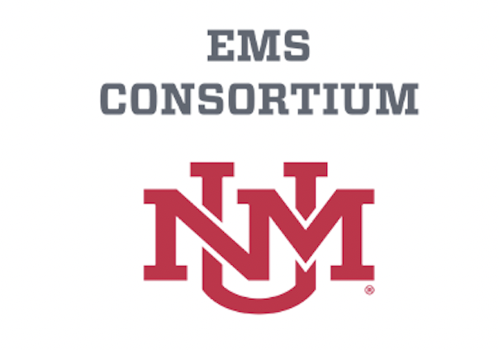

Accidental Hypothermia and Cold Injuries
Michael T. Mozer, DO
EMS Fellow
UNM Health EMS Consortium
11/16/2023

Slide 2
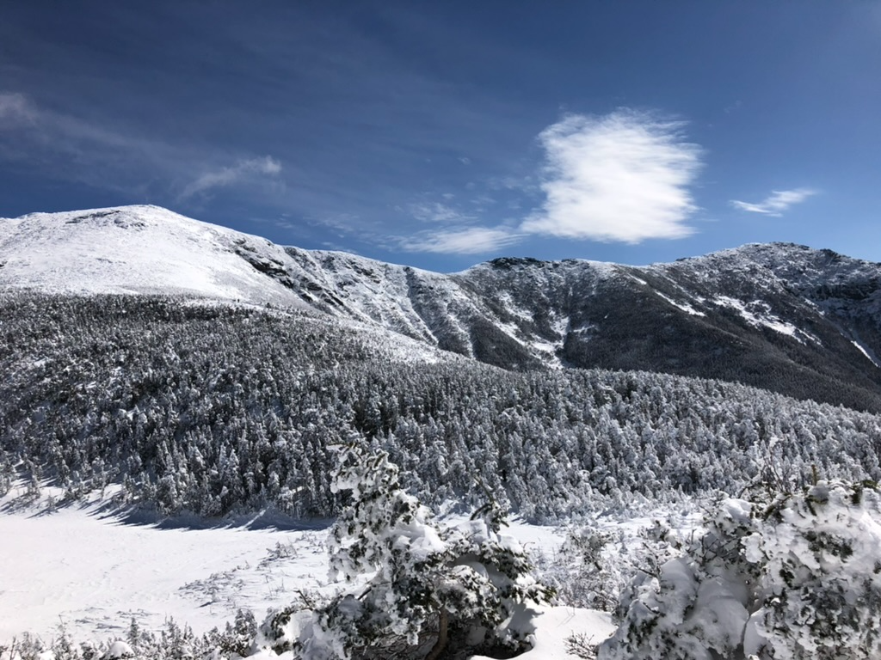


Presenter Biography
Medical school at the University of New England in Maine
Completed residency in Phoenix, AZ (Valleywise Health Medical Center, formerly Maricopa Medical Center)
Emergency Medicine physician
EMS Fellow at University of New Mexico
Professional interest in EMS, austere/rural emergency care, medical education, and delivery of high quality emergency care.

Slide 3
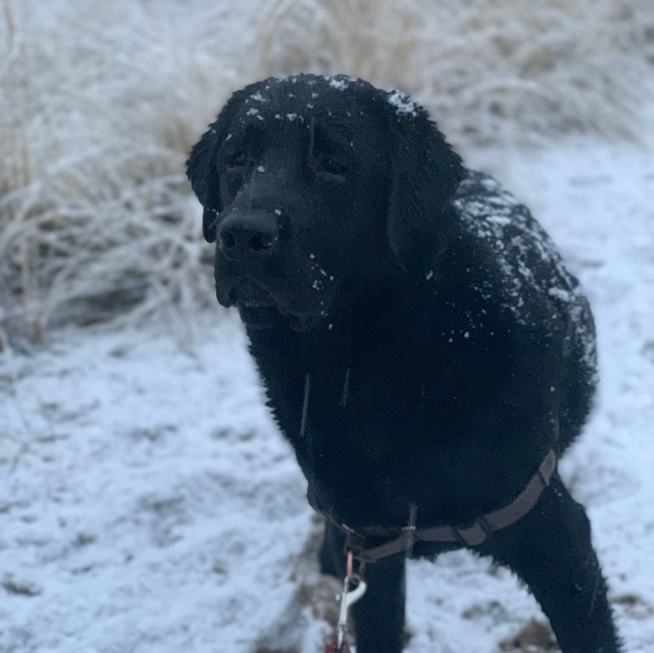
Disclosures
No financial disclosures

Slide 4
Outline
Assessment and management of hypothermic patients
A) Definitions
B) Signs and Symptoms
C) Approach to treatment
D) Treatment considerations
2. Cold Injuries
A) Evaluation
B) Pre-Hospital Treatment

Slide 5
Case #1
In February, a 22F is rescued from a hiking expedition gone awry in the Taos Ski Area. The rescue team reports that she was lost on the mountain overnight without proper equipment or clothing. On EMS arrival she is found to be awake but lethargic, bradycardic, and hypotensive. Pulses were present, and she is not shivering. She mumbles words to questioning, but cannot follow commands.
Based on the Swiss System, how would you classify the severity of this patient’s cold exposure?
What interventions (if any) would you initiate on scene?

Slide 6
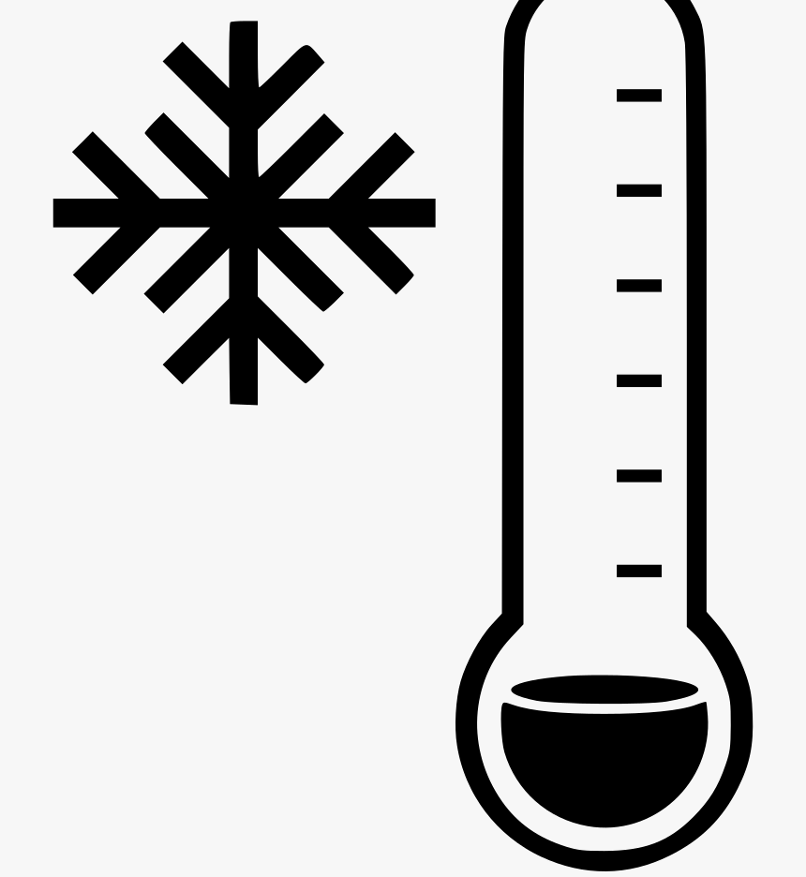
Hypothermia Definition
Unintentional drop in core body temp below 35 ℃
What are the different classifications of hypothermia?
  Mild: 32 - 35 ℃
  Moderate: 28 – 32 ℃
  Severe: <28 ℃
Notes:
From CDC numbers
Mild: 32 - 35 ℃
Moderate: 28 – 32 ℃
Severe: <28 ℃

Slide 7
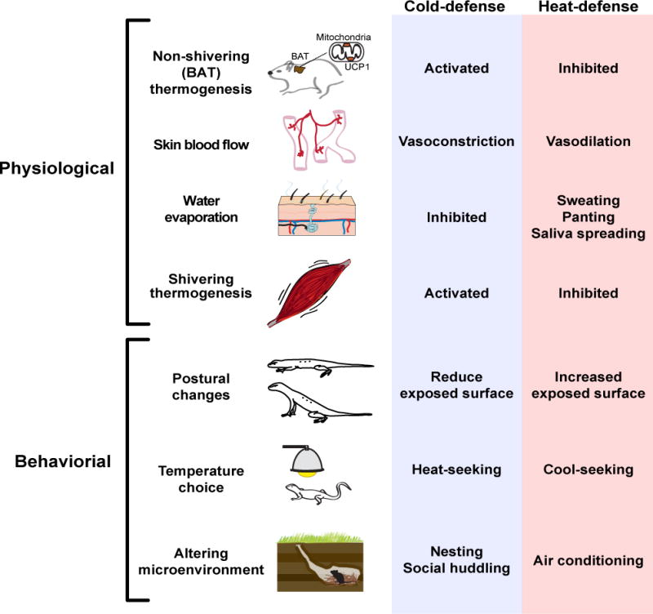
Response to Cold Stress
Notes:
Tan CL, Knight ZA. Regulation of Body Temperature by the Nervous System. Neuron. 2018 Apr;98(1):31-48. DOI: 10.1016/j.neuron.2018.02.022. PMID: 29621489; PMCID: PMC6034117.
Severe Hypothermia -> paradoxical undressing

Slide 8
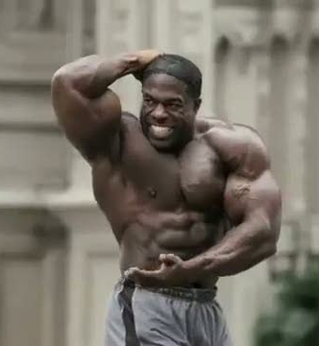
Pathophysiology of Hypothermia
<35 ℃ (95F), shivering begins
Depletion of energy stores = worsening hypothermia
Risk factors deplete or limit shiver response
Absence of shivering and continued presence of cold stress
  Further progression of hypothermia
Notes:
How does shivering improve physiologic response to cold?
- increases muscular activity, increases heat production (its all about the muscles)
So how do patients become severely hypothermic? – cessation of the shivering response
https://www.ncbi.nlm.nih.gov/pmc/articles/PMC5025630/
Paal P, Gordon L, Strapazzon G, et al. Accidental hypothermia-an update : The content of this review is endorsed by the International Commission for Mountain Emergency Medicine (ICAR MEDCOM). Scand J Trauma Resusc Emerg Med. 2016;24(1):111. Published 2016 Sep 15. doi:10.1186/s13049-016-0303-7

Slide 9
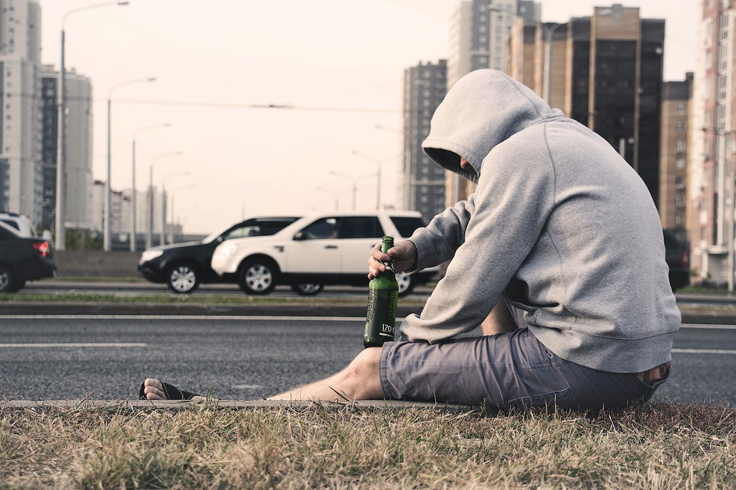
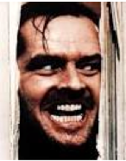
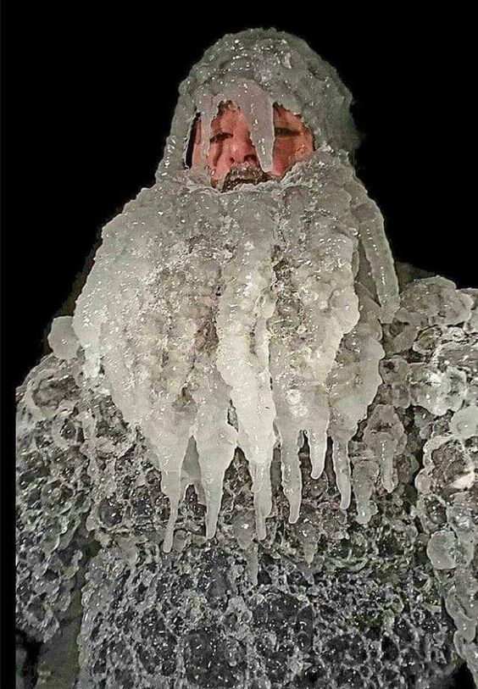
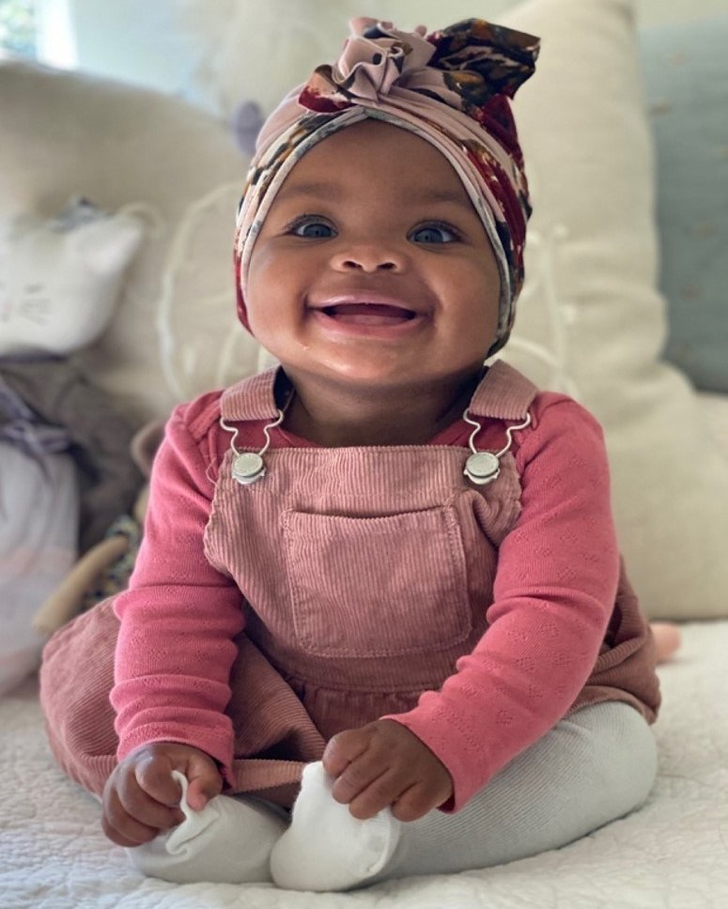
Demographics
High Risk groups
  Homeless
  Sick
  Young and old
  Concomitant Psychiatric disease
  Substance abuse
  Trauma*
Notes:
**>50% of deaths from hypothermia are in the elderly
Story from Skidmore – EtOH abuse; not always chronic EtOH issues

Slide 10
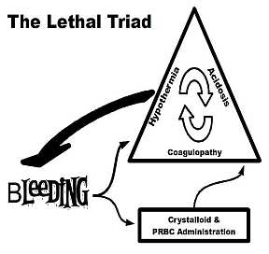
Notes:
https://www.tamingthesru.com/blog/prehospital-medicine/lessons-in-transport-the-lethal-triad
Hypothermia -> caused by exposure to the elements, dysfunctional thermic regulation and blood loss (decreasing cellular activity)
Hypothermia decreases coagulation factor activity by 10% for each degree decrease in core temperature
Acidosis, caused by poor organ perfusion and increased use of anaerobic metabolism to drive cellular function
Acidosis reduces fibrinogen levels, platelet counts, and Factor Xa
All work in tandem to increase bleeding
Coagulopathy (thinning of the blood) -> caused by inflammatory markers, worsened by the above
All leading to more blood loss, worsening the triad

Slide 11
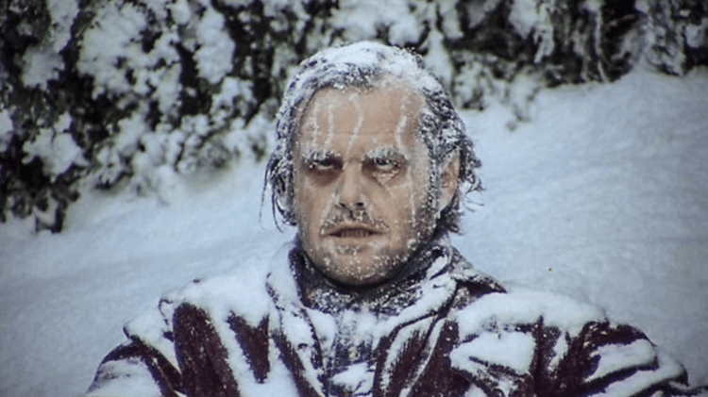
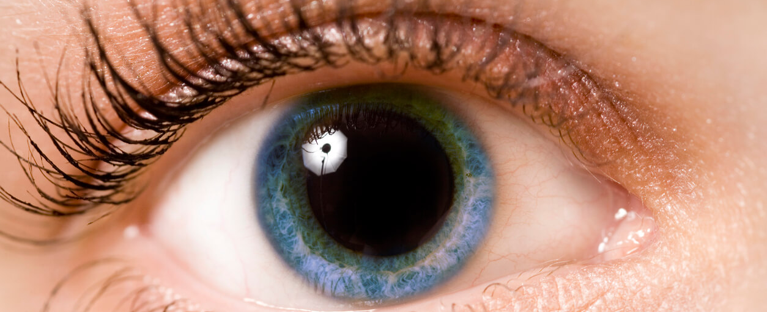
Physical Exam Considerations
ABCs v H&P
Pulse Oximetry
Temp - Tympanic probe
Pupils
    Dilated with temp <27 ℃
    Fixed and dilated <22 ℃
Notes:
Esophagus probe preferred (assess cardiac temp, no temp lag)
make sure that it is not placed proximally which can cause Inappropriate readings due to heated/humidified O2
Rectal/Bladder probes can have interference from lavage if ongoing
Tympanic thermometer: Walpoth BH, Galdikas J, Leupi F, Muehlemann W, Schlaepfer P, Althaus U. Assessment of hypothermia with a new "tympanic" thermometer. J Clin Monit. 1994 Mar;10(2):91-6. doi: 10.1007/BF02886820. PMID: 8207458.

Slide 12
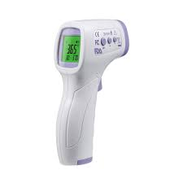
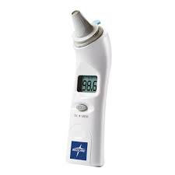
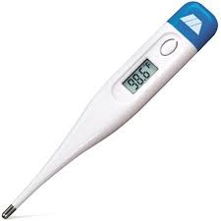
So what thermometer should we use!?
For EMS and prehospital providers, core temperature is not timely nor available
External temp – for trends and use until a core temp can be obtained

Slide 13

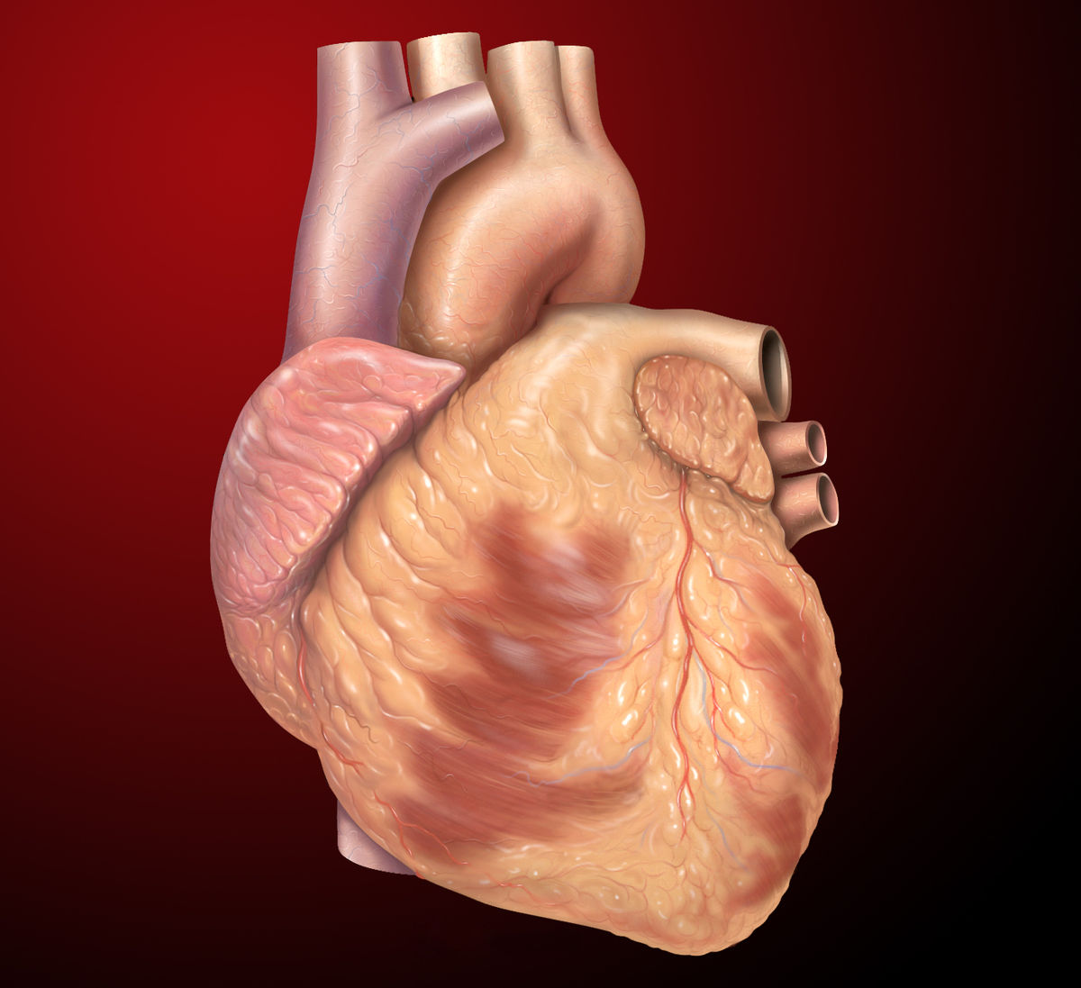
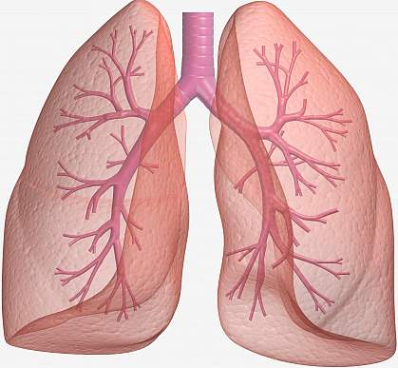
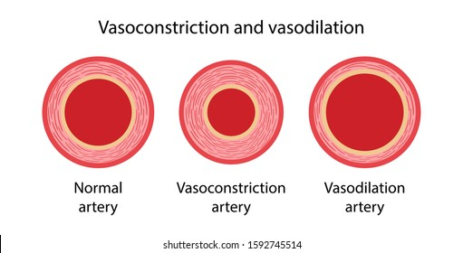
Mild Hypothermia
Catecholamine surge
Notes:
With initial catecholamine surge – “Fight or flight”

Slide 14
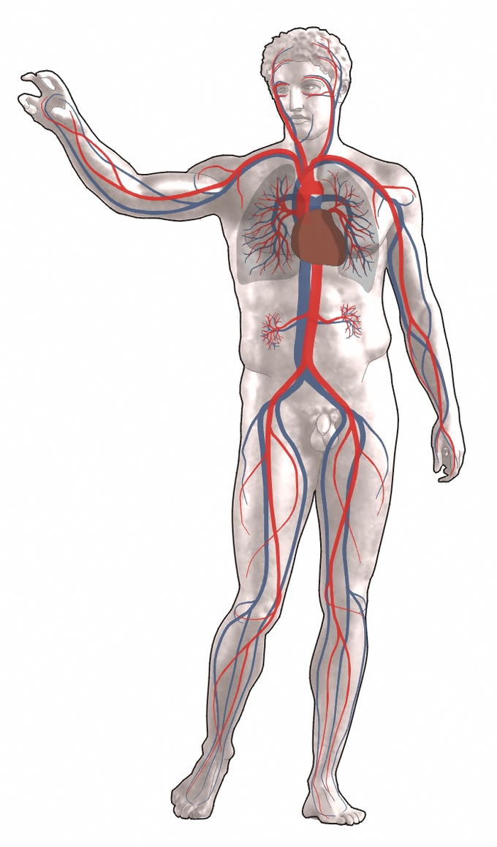
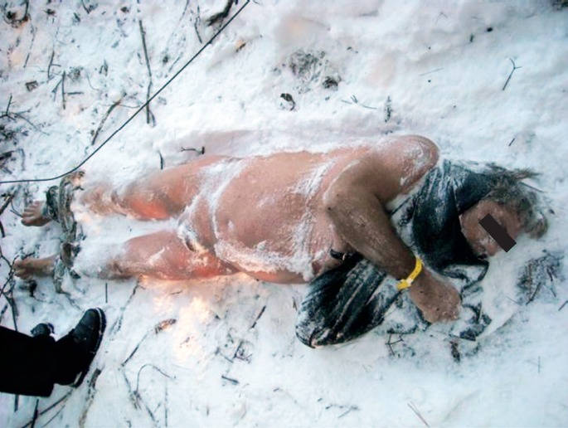
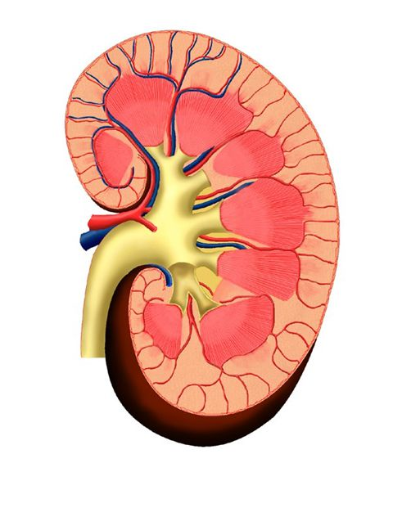
Moderate Hypothermia
Depleted catecholamines
“Paradoxical undressing”
Notes:
Depleted catecholamines – peripheral vasoconstriction with shunting of blood to the core
Increased BF to the kidneys and decreased ADH secretion = cold diuresis (increased urine output)
AMS – paradoxical undressing
Paradoxical Undressing picture:
Rolf CM, Gallagher KE. Hypothermic Death in the Arctic State. Academic Forensic Pathology. 2018 Mar;8(1):64-82. DOI: 10.23907/2018.005. PMID: 31240026; PMCID: PMC6474461.

Slide 15
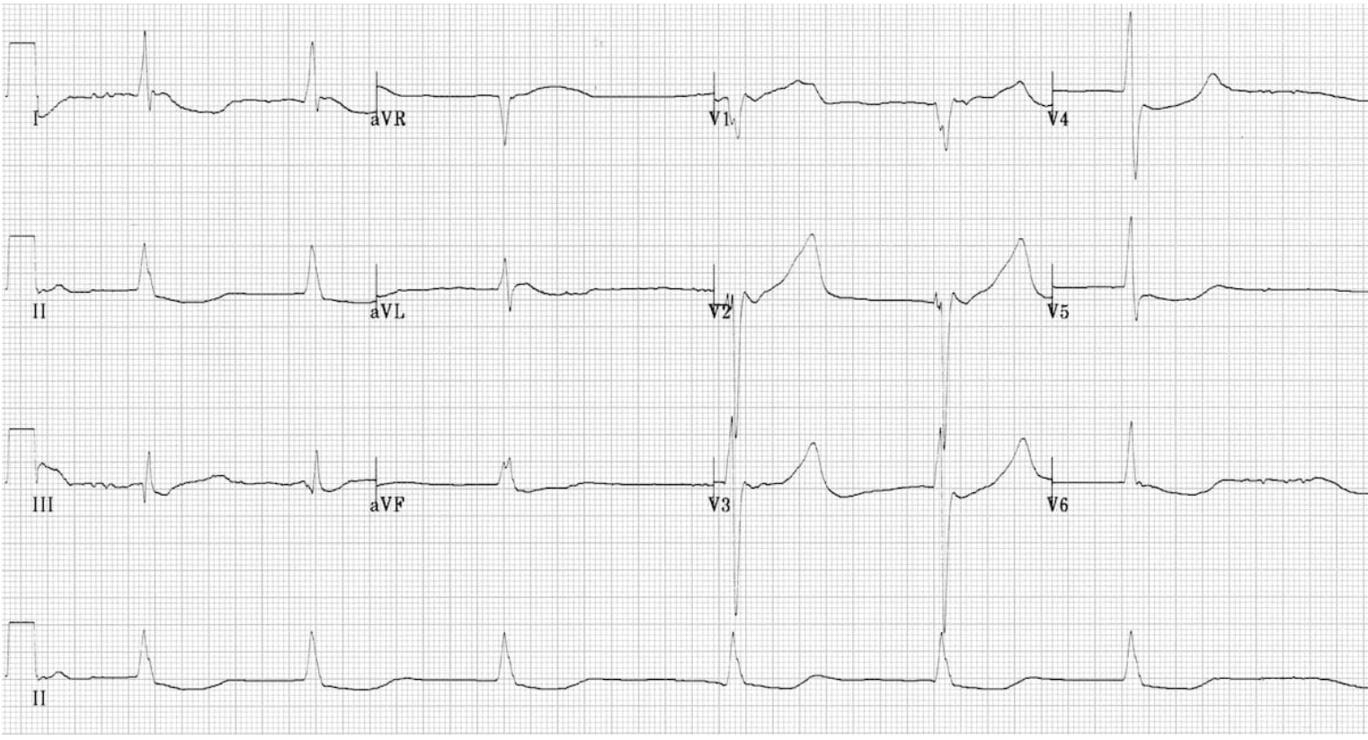
External Signs of Hypothermia - Severe
Severe CNS depression
Dysrhythmias common
Notes:
Severe AMS might require intubation for airway protection
V and A junctional dysrhythmias
Junctional bradycardia – no P waves, no significant widening of QRS
https://litfl.com/hypothermia-ecg-library/

Slide 16
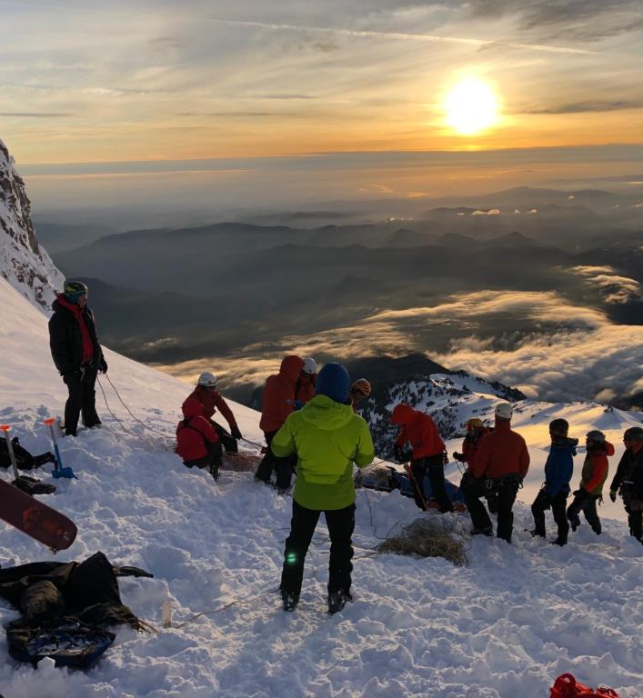
“The Swiss System”
Mild hypothermia (32 – 35 ℃)
  Shivering + no AMS
Moderate hypothermia (28 – 32 ℃)
  No shivering, AMS
Severe hypothermia (24 – 28 ℃)
  Unconsciousness
Very severe (13.7 – 24 ℃)
Apparent death
Fatal (<13.7 ℃)
Notes:
Not cut and dry, the physiologic response to hypothermia varies significantly but this is a helpful fallback
Designed for use by prehospital providers by the International Commission for Mountain Emergency Medicine in 2003
Pic: https://www.columbian.com/news/2020/may/25/climbers-swarm-mount-hood-despite-coronavirus-and-poor-conditions-rescue-team-leader-sounds-alarm/

Slide 17
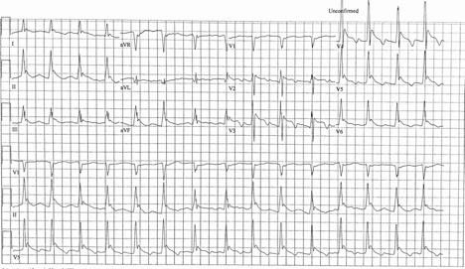
Classic EKG Findings
Notes:
From Phoenix Hypothermia case study
What do you see?
What subtle findings can assist you in assessing the severity of hypothermia here? (i.e. rate, shivering)

Slide 18
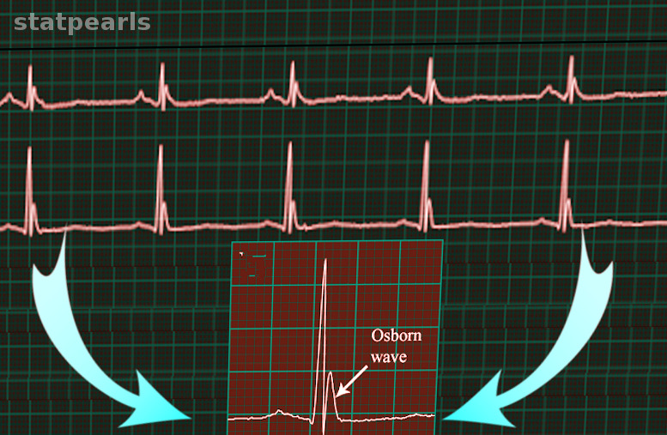
Osborn Waves

Slide 19
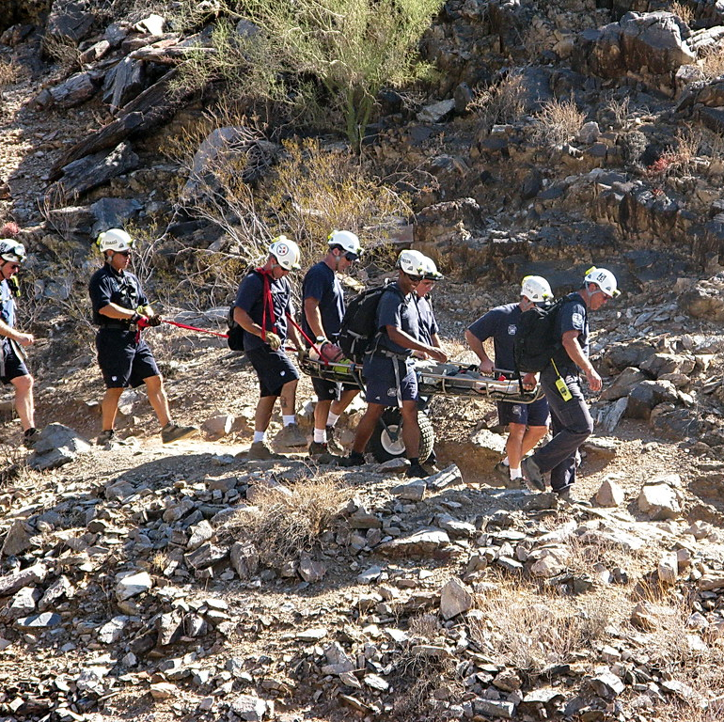
Initial therapy for hypothermia
Exposure – remove cold and wet clothing
Package for warmth
Warm, humidified O2
Active warming if moderate or severe*
Airway management for severe/comatose
  Special considerations
    Trauma
    Sepsis/infection
    High risk groups

Slide 20
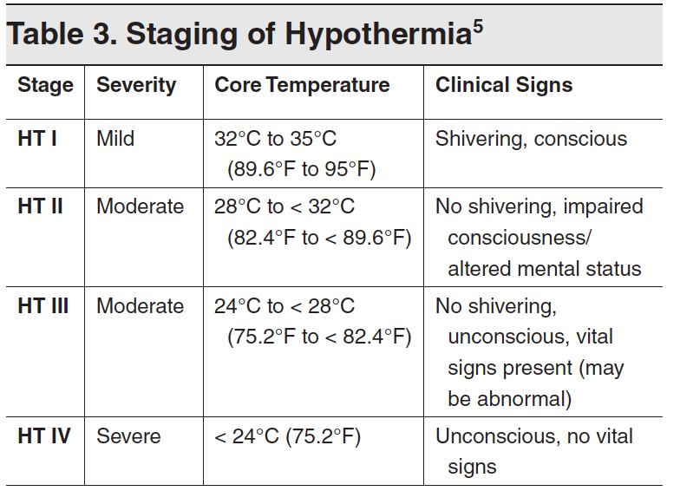
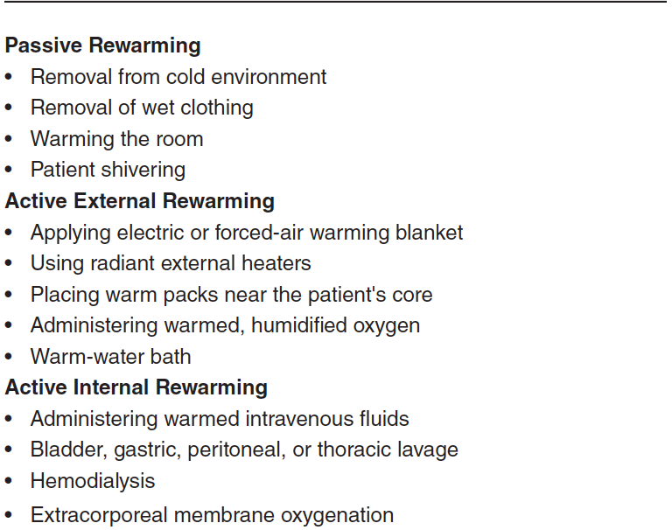
Rewarming
Notes:
HT II and III should go to hospital with ICU/PICU (preferentially with ECMO)
HT I – passive external
HT II - passive external, internal and minimally invasive internal
HT III-IV – Everything
Not cut and dry rules, generalized rules. Consider HD stability in your choice

Slide 21
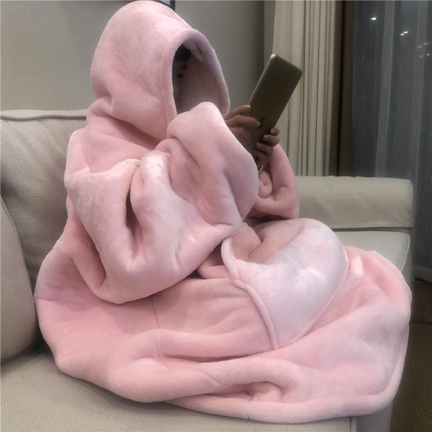
Passive rewarming
Packaging patient
Utilize intact shiver response
Rewarm at 0.5-2.0 ℃ /hr.

Slide 22
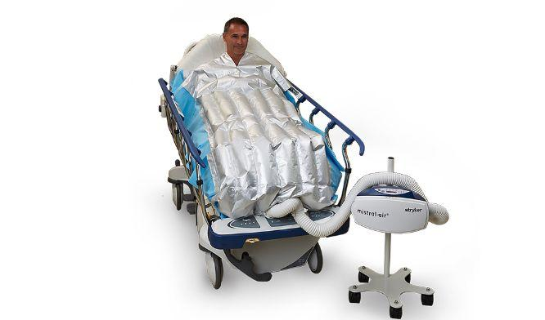
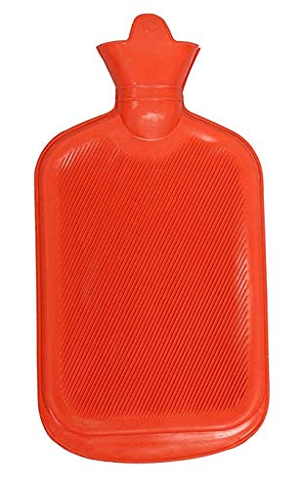
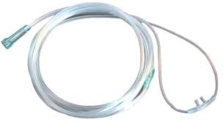
Active External rewarming
Notes:
Heated air – decreases heat lost to atmosphere
Bair hugger – 2.4C/hr with shivering
(Goheen MS, Ducharme MB, Kenny GP, et al. Efficacy of forced-air and inhalation rewarming by using a human model for severe hypothermia. J Appl Physiol. 1997;83(5):1635- 1640. ) Retro with 8 patients

Slide 23
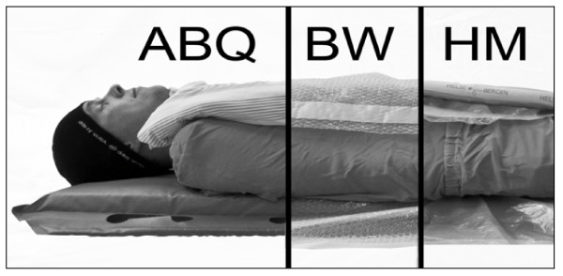
Insulation/packing Pre-hospital
Notes:
ABQ – Ambulance blankets/quilts
BW – Bubble wrap
HM (Hibler’s Method) of packaging – vapor tight layer and dry insulating layer
Hibler’s method: least heat loss (skin temp)
Citation: Thomassen Ø, Færevik H, Østerås Ø, et al. Comparison of three different prehospital wrapping methods for preventing hypothermia--a crossover study in humans. Scand J Trauma Resusc Emerg Med. 2011;19:41. Published 2011 Jun 23. doi:10.1186/1757-7241-19-41
patient packaging should include a sealed impermeable vapour barrier [114, 117] (if the patient is wet) excluding the face [118, 119], an external heat source, dry insulation (the thicker, the better), and a wind barrier that also reflects heat [114].

Slide 24
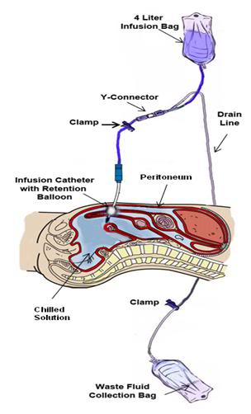
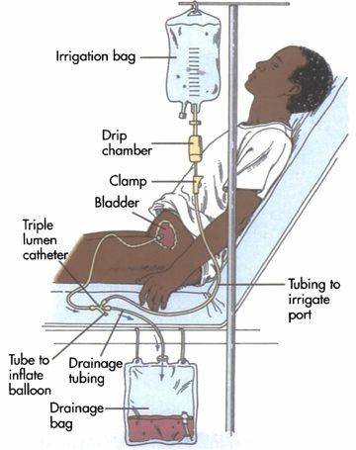
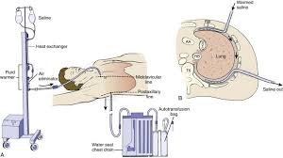
*Hospital Rewarming: Lavage
Thoracic
Peritoneal
Bladder
Notes:
Thoracic – 3-6C/hr
Peritoneal – 2-4C/hr
Bladder – No significant core change found

Slide 25
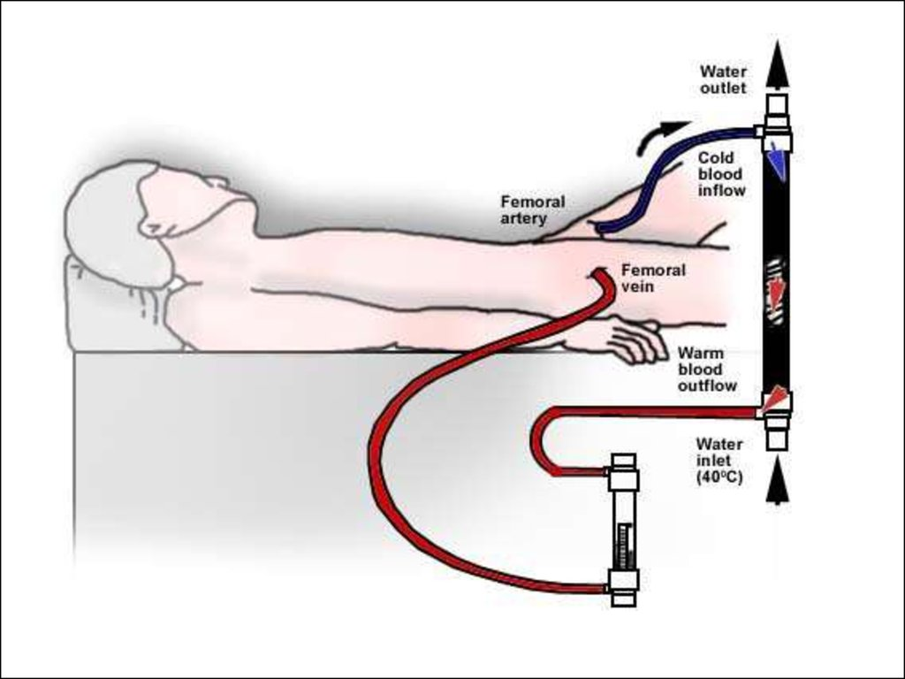
Extracorporeal Mechanical Oxygenation (ECMO)
A-V ECMO is the gold standard
Most rapid rewarming method
Downside:
  Availability
  Invasive
  Expensive
Notes:
Another form of active internal rewarming
Rewarms 7-10C/hr

Slide 26
ECMO Indications/Contraindications
Indications
Cardiac Arrest
Non-perfusing rhythm
Moderate hypothermia with HD instability
Severe hypothermia
Pulse and core temp <28 ℃ (avoid Vfib)
Contraindications
Uncontrolled hemorrhage
pH <6.6
K > 8
Lactate > 225

Slide 27
Case #2
You are dispatched to a nearby park where an unidentified middle-aged woman was found on the ground near a bench. She has no palpable pulse, and there is an unknown downtime. On exam, her pupils are fixed and dilated, and her body feels cold to the touch.
  Should you start CPR?
  For a frozen heart, what are the indications for defibrillation?
  If you do initiate resuscitation, are there specific changes for ACLS?
Notes:
Futile – obvious lethal injury, stiff/frozen chest, avalanche burial >35min from rescue with airway impacted with snow
Give 1 round of Epi until 30C, then continue per protocol to avoid toxic accumulation
Defib – – if indicated, single shock at full power
some case reports of success at ~24C although previous convention was to not shock below 30C
Repeat shocks when >30C
ACLS – Epi considerations (American vs European)

Slide 28
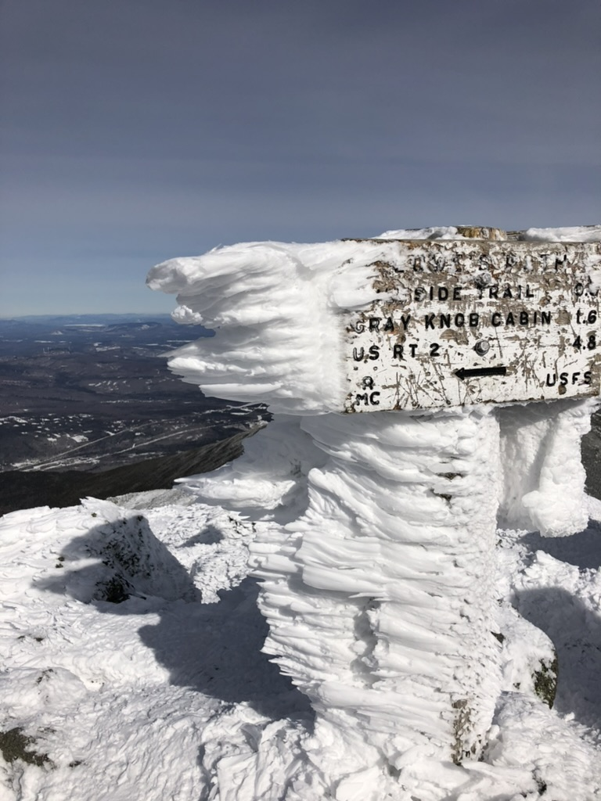
CPR in Hypothermic Patients
Best chance of full recovery:
Witnessed arrest
Ventricular fibrillation*
Do Not Resuscitate:
Death prior to hypothermia
K+ >12
Lethal condition
Frozen chest Wall
Core temp <14 ℃
Notes:
*Vfib and PEA are the most common presenting rhythyms
Lethal condition = packed airway, severe traumatic injury
Note that most of these values were based on previous survival, not set in stone
Brain O2 consumption: decreases ~6% per 1C to 16% at 15C = increased success for neurological recovery from CPR
Cerebral metabolic suppression during hypothermic circulatory arrest in humans.McCullough JN, Zhang N, Reich DL, Juvonen TS, Klein JJ, Spielvogel D, Ergin MA, Griepp RB
Ann Thorac Surg. 1999 Jun; 67(6):1895-9; discussion 1919-21.
According to European Resus council (2016) – “At 18 °C the brain tolerates CA for up to 10 times longer than at 37 °C ”

Slide 29
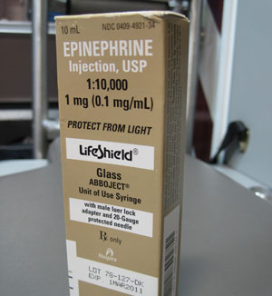
HT Modifications in ACLS
Epinephrine
  Once when <30 ℃
Defibrillation
  1 dose at maximal charge
  When to repeat?
*Pick of Zoll
Notes:
1x dose for Epi
Defibrillation - if not responsive to shock, can repeat if indicated once >30C

Slide 30
Outline
Assessment and management of hypothermic patients
A) Definitions
B) Signs and Symptoms
C) Approach to treatment
D) Treatment considerations
2. Cold Injuries
A) Evaluation
B) Pre-Hospital Treatment

Slide 31
Cold injuries
Assessment and Management
Frostnip
Frostbite
  Superficial/partial
  Deep
*Find pic of climber from Instagram with frostbite

Slide 32
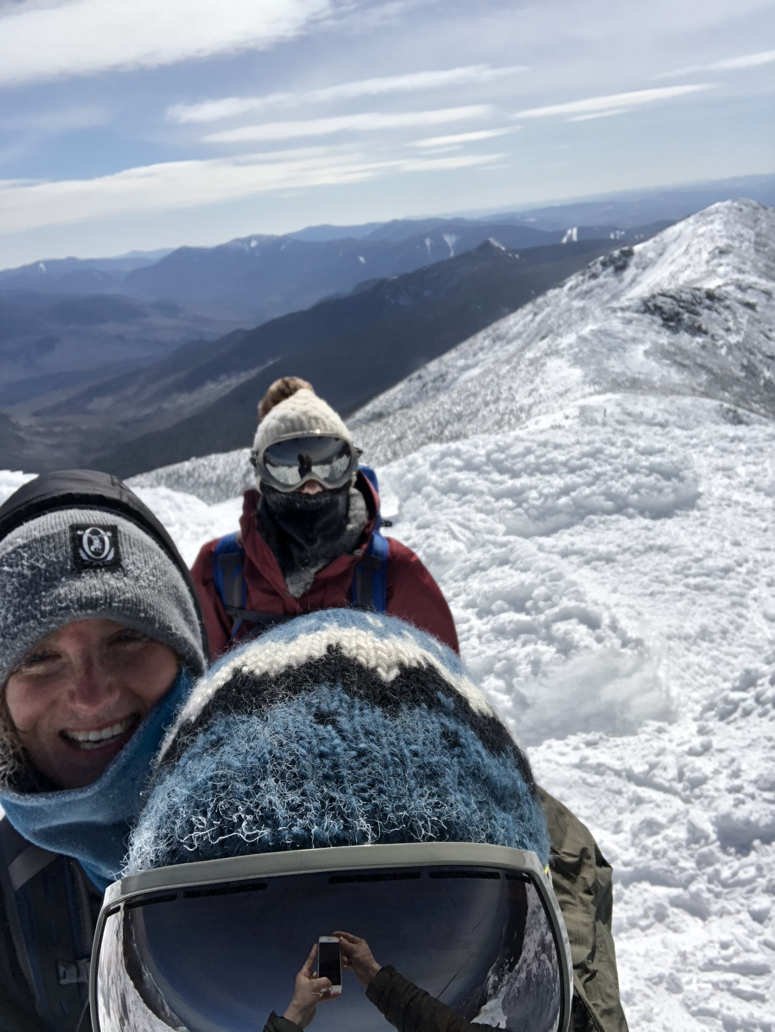
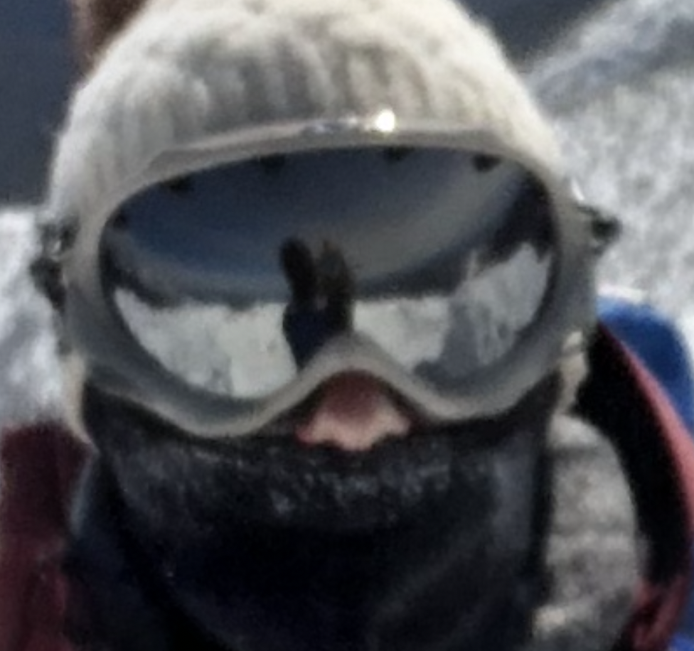
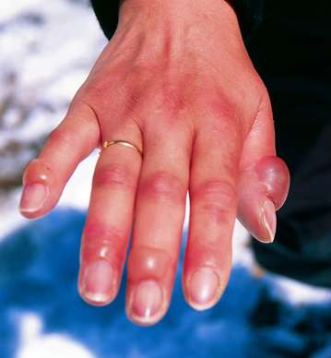
Frost Nip
Pale/erythema
Symptoms of paresthesias, numbness or discoloration
Blistering and peeling are common
Notes:
Similar presentation to superficial burns
Most often affects nose, ears, hands and feet
Hemorrhagic blisters might indicate underlying injury, can leave them for hospital management

Slide 33
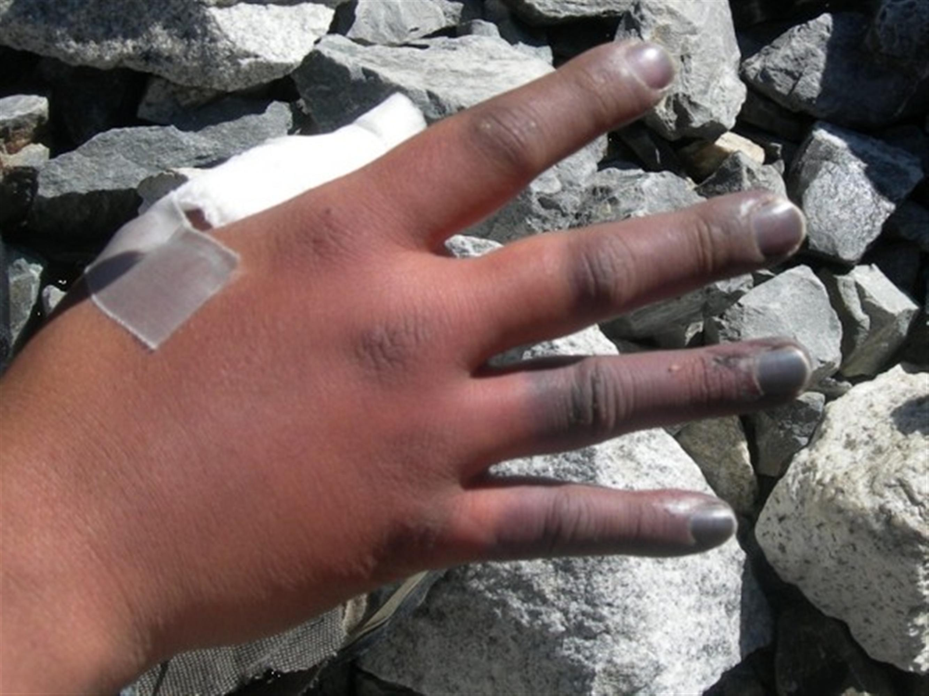
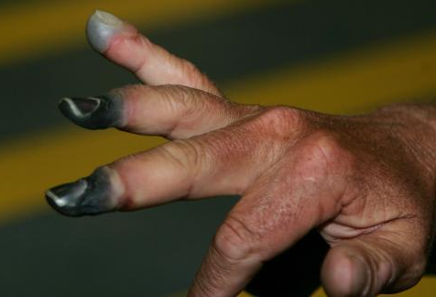
Frost Bite
Pathophysiology
  Pre-freeze
  Freeze-thaw
  Vascular stasis
  Late ischemic
Risk of permanent injury
  Amputation when severe
Notes:
Top superficial
Bottom deep
Initially pain, hardening, paresthesia, and numbness that progresses to hemorrhagic vesicle formation
Superficial – nonblanching with cold skin, rewarming can lead to flushing, pain and edema with blister formation
Deep – involves muscles, tendons and NV structures; can become frozen, firm, numb, blue/gray or mottled without change with rewarming

Slide 34
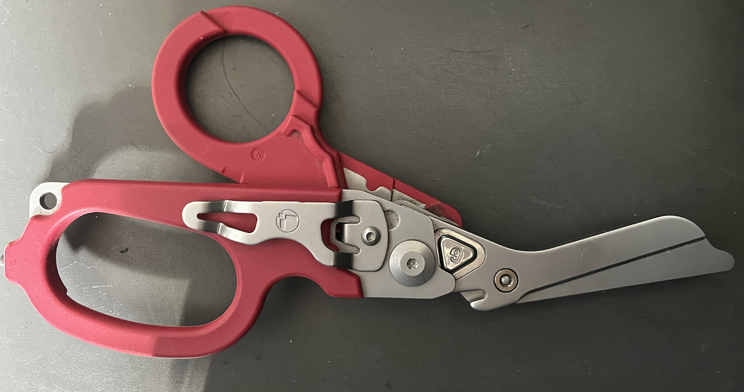
Management of cold injuries
Initial treatment
  Remove cold/wet clothing, cover with dry sheet
  Place on a warm body part
Body temp water (37-39 ℃) +Chlorhexadine/Iodine solution
  30 min to 1 hour
Frostbite
  Pain relief, gradual rewarming
Notes:
Dressings – topical moisturizers/antibiotic ointment and splinting
Broad spectrum Abx for deep tissue layers
Murphy JV, Banwell PE, Roberts AH, et al. Frostbite: pathogenesis and treatment. J Trauma. 2000;48(1):171-178. (Review)

Slide 35
Note on Dry Rewarming
Dry rewarming (i.e. heater in vehicle)
  Pt. unable to respond to overheating
  Can lead to secondary burn injury*

Slide 36
Summary
HT is a result of failure of the body’s intrinsic warming mechanism
Without shivering, the body will not rewarm in moderate hypothermia
Prompt ABC and rewarming in hospital is life saving
Initiate ACLS with modified Epi, shock delivery and adjusted CPR considerations
Cold injuries should be rewarmed in room temperature water gradually
NSAIDs should be used to pain control and clotting from cold injuries

Slide 37
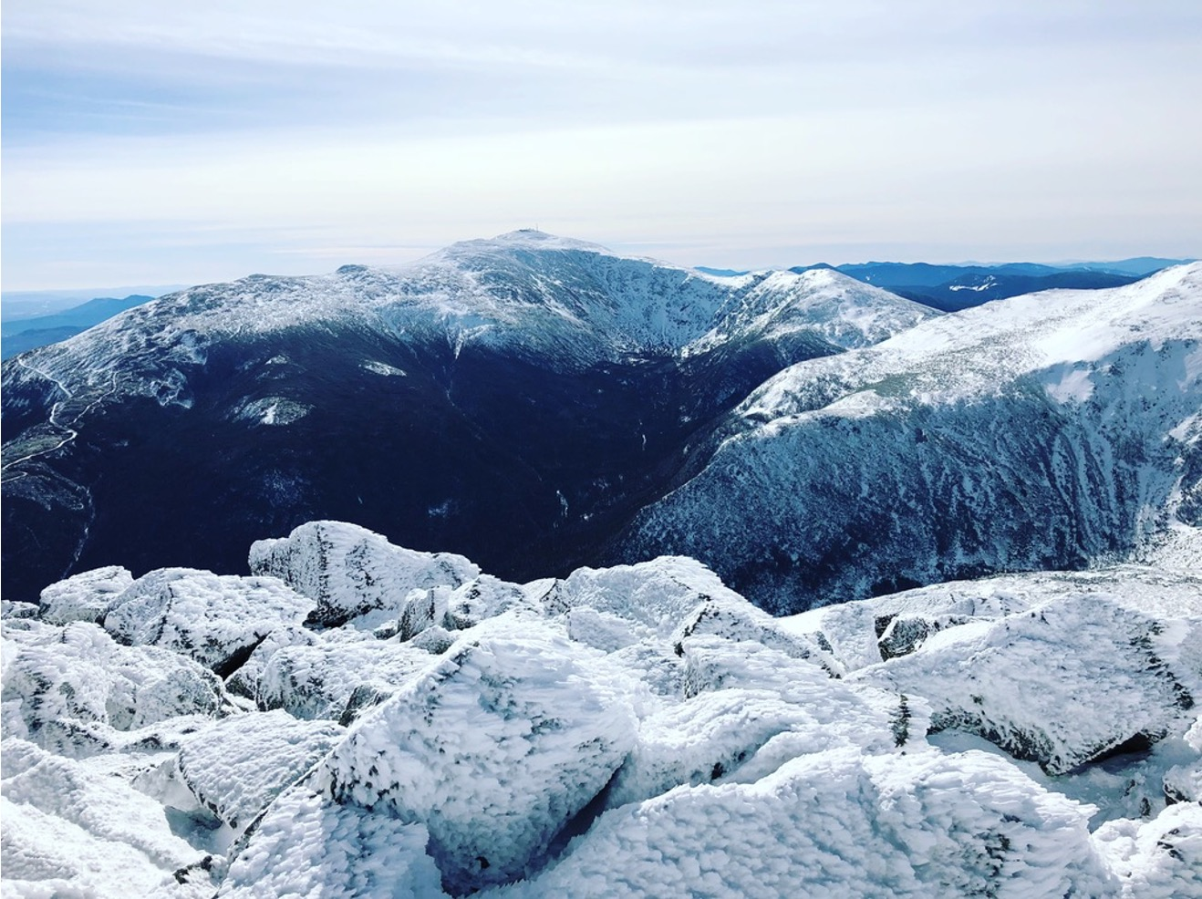
Questions?
Email: mmozer@salud.unm.edu

Slide 38
References
Duong H, Patel G. Hypothermia. [Updated 2021 Jan 27]. In: StatPearls [Internet]. Treasure Island (FL): StatPearls Publishing; 2021 Jan-. Available from: https://www.ncbi.nlm.nih.gov/books/NBK545239/
Handford C, Buxton P, Russell K, et al. Frostbite: a practical approach to hospital management. Extrem Physiol Med. 2014;3:7.
Martin RS, Kilgo PD, Miller PR, et al. Injury-associated hypothermia: an analysis of the 2004 National Trauma Data Bank. Shock. 2005;24(2):114-118.
Murphy JV, Banwell PE, Roberts AH, et al. Frostbite: pathogenesis and treatment. J Trauma. 2000;48(1):171-178.
Okada M. The cardiac rhythm in accidental hypothermia. J Electrocardiol. 1984;17(2):123-128.
Paal P, Gordon L, Strapazzon G, et al. Accidental hypothermia-an update : The content of this review is endorsed by the International Commission for Mountain Emergency Medicine (ICAR MEDCOM). Scand J Trauma Resusc Emerg Med. 2016;24(1):111. Published 2016 Sep 15. doi:10.1186/s13049-016-0303-7
Rischall M., Rowland-Fisher A. Evidence-based management of Hypothermia in the Emergency Department. EBMedicine. Vol 18.1.Published Jan 2016.
Shah A, Madhok M. Management of Pediatric Hypothermia and Peripheral Cold Injuries in the Emergency Department. [Pub 2019 Jan 2]. In: EBMEdicine [Internet]. Available from: https://www.ebmedicine.net/topics/toxicology-environmental/pediatric-hypothermia

