Slide 1

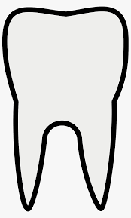


Indian Health Service
Triaging and Treating Dental Conditions in the Emergency Department
Hands-On Training for Emergency Departments

Slide 2
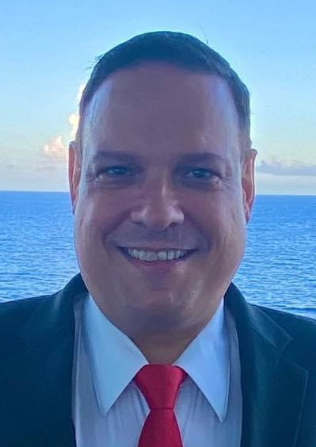
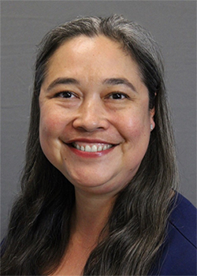
Presenters
  Tim Ricks, DMD, MPH, FICD, FACD, FPFA
Dental Public Health Specialist, Indian Health Service Division of Oral Health
IHS Oral Health Promotion/Disease Prevention Consultant
  Tamana (Bunny) Begay, DDS
Dental Director, Gallup Indian Medical Center
Gallup, New Mexico (Navajo Area)

Slide 3
Learning Objectives
Describe the impact of non-traumatic dental pain (NTDP) on patients, emergency rooms, and urgent care centers;
Learn and teach the Emergency Department Protocol for NTDP in your emergency departments; and
Develop skills in anesthetic block administration to facilitate referrals to dental programs.

Slide 4
Acknowledgments
The Indian Health Service Division of Oral Health wishes to thank Russell Dunkel, DDS, FPFA, FICD, FACD for his subject matter expertise throughout this initiative and for providing the training materials for the initiative.
This initiative is modeled after the Wisconsin Dental Pain Protocol Project developed by Dr. Dunkel.
The IHS ED Dental Triage/Treatment Algorithm was developed by a 3-person team including CAPT Brandy Larson, Dr. Damon Pope, and CAPT Nathan Mork. It was modeled after the Wisconsin algorithm provided by Dr. Dunkel.

Slide 5
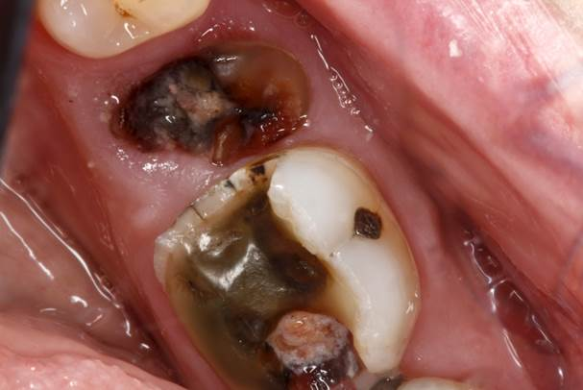
Background
Photo from https://www.mccarldentalmillersville.com/blog/wp-content/uploads/2019/07/tooth-abcsess.jpg

Slide 6
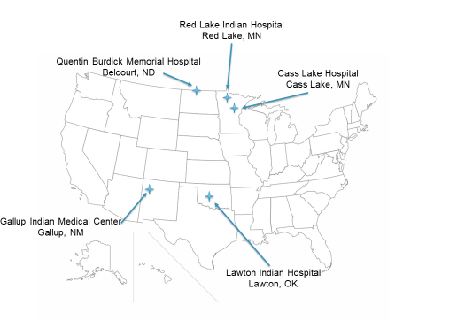
Triaging and Treating Dental Conditions in the Emergency Department – Participating Sites (Phase I, 2023)
Why these sites?
Each was seeking Bronze Level Pain and Addiction Care in the ED (PACED) Accreditation from the American College of Emergency Physicians (ACEP), and this initiative fit right into that!

Slide 7
Emergency Departments & Oral Problems
Each year in the U.S. there are over 2 million Emergency Department visits related to dental conditions.
Of these, 110,000 result in hospital admissions.
26.1% of dental-related ED visits are from patients who self-pay (do not have a third-party payer, compared to 11.8% of non-dental related ED visits.
42.2% of dental-related ED visits are from patients with Medicaid, compared to 32.4% of non-dental related ED visits.
Owens PL (AHRQ), Manski RJ (AHRQ), Weiss AJ (IBM Watson Health). Emergency Department Visits Involving Dental Conditions, 2018. HCUP Statistical Brief #280. August 2021. Agency for Healthcare Research and Quality, Rockville, MD. www.hcup-us.ahrq.gov/reports/statbriefs/sb280-Dental-ED-Visits2018.pdf.

Slide 8
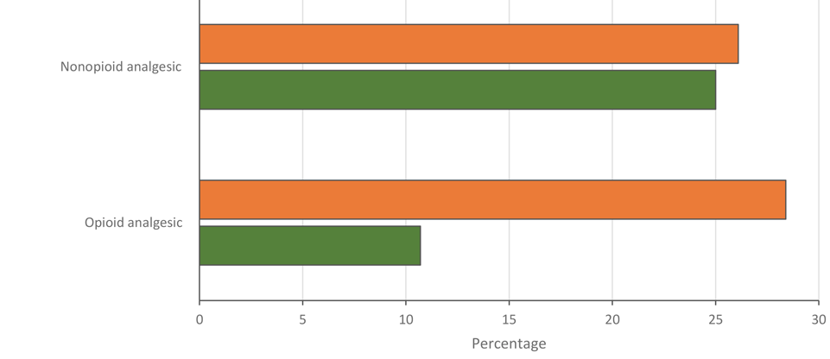
ED Opioid Rx for Dental Conditions
Dental ED visits had a significantly higher likelihood than non-dental visits of receiving an opioid prescription (Relative Risk = 4.76) than no analgesic after controlling for demographic and clinical characteristics, insurance status, pain scores, and other covariates.
Dental
Non-Dental
Naavaal S, Kelekar U, Shah S. Opioid and Nonopioid Analgesic Prescriptions for Dental Visits in the Emergency Department, 2015–2017 National Hospital Ambulatory Medical Care Survey. Prev Chronic Dis 2021;18:200571. DOI: http://dx.doi.org/10.5888/pcd18.200571

Slide 9
Is an antibiotic needed?
An antibiotic, most often a narrow-spectrum penicillin or clindamycin, was prescribed in 65% of ED visits with any dental diagnosis.
The most common dental diagnoses seen in the ED for all ages were unspecified disorder of the teeth and supporting structures (44%, ICD-9-CM code 525.9), periapical abscess without sinus (21%, ICD-9-CM code 522.5) and dental caries (18%, ICD-9-CM code 521.0 ).
Recommended treatments for these conditions are usually dental procedures rather than antibiotics.
The common use of antibiotics for dental conditions in the ED indicates the need for greater access to both preventative and urgent care from dentists and other related specialists as well as the need for clearer clinical guidance related to oral infections.
Roberts R, Hersh A, Shapiro D, Fleming-Dutra K, Hicks L. Antibiotic Prescriptions Associated with Dental-Related Emergency Department Visits.Ann Emerg Med. 2019 Jul; 74(1): 45–49. DOI: https://www.ncbi.nlm.nih.gov/pmc/articles/PMC6943909/

Slide 10
Initiative Objectives
Improve the recognition of specific dental conditions of patients presenting to IHS and tribal emergency departments (EDs).
Increase timely referrals from EDs to IHS and tribal dental programs.
Through recognition and triage of patients with dental conditions, promote antibiotic stewardship and reduce opioid prescriptions in the ED for dental conditions.
Enhance skills of ED medical providers in administering local anesthesia for patients presenting with dental pain.

Slide 11
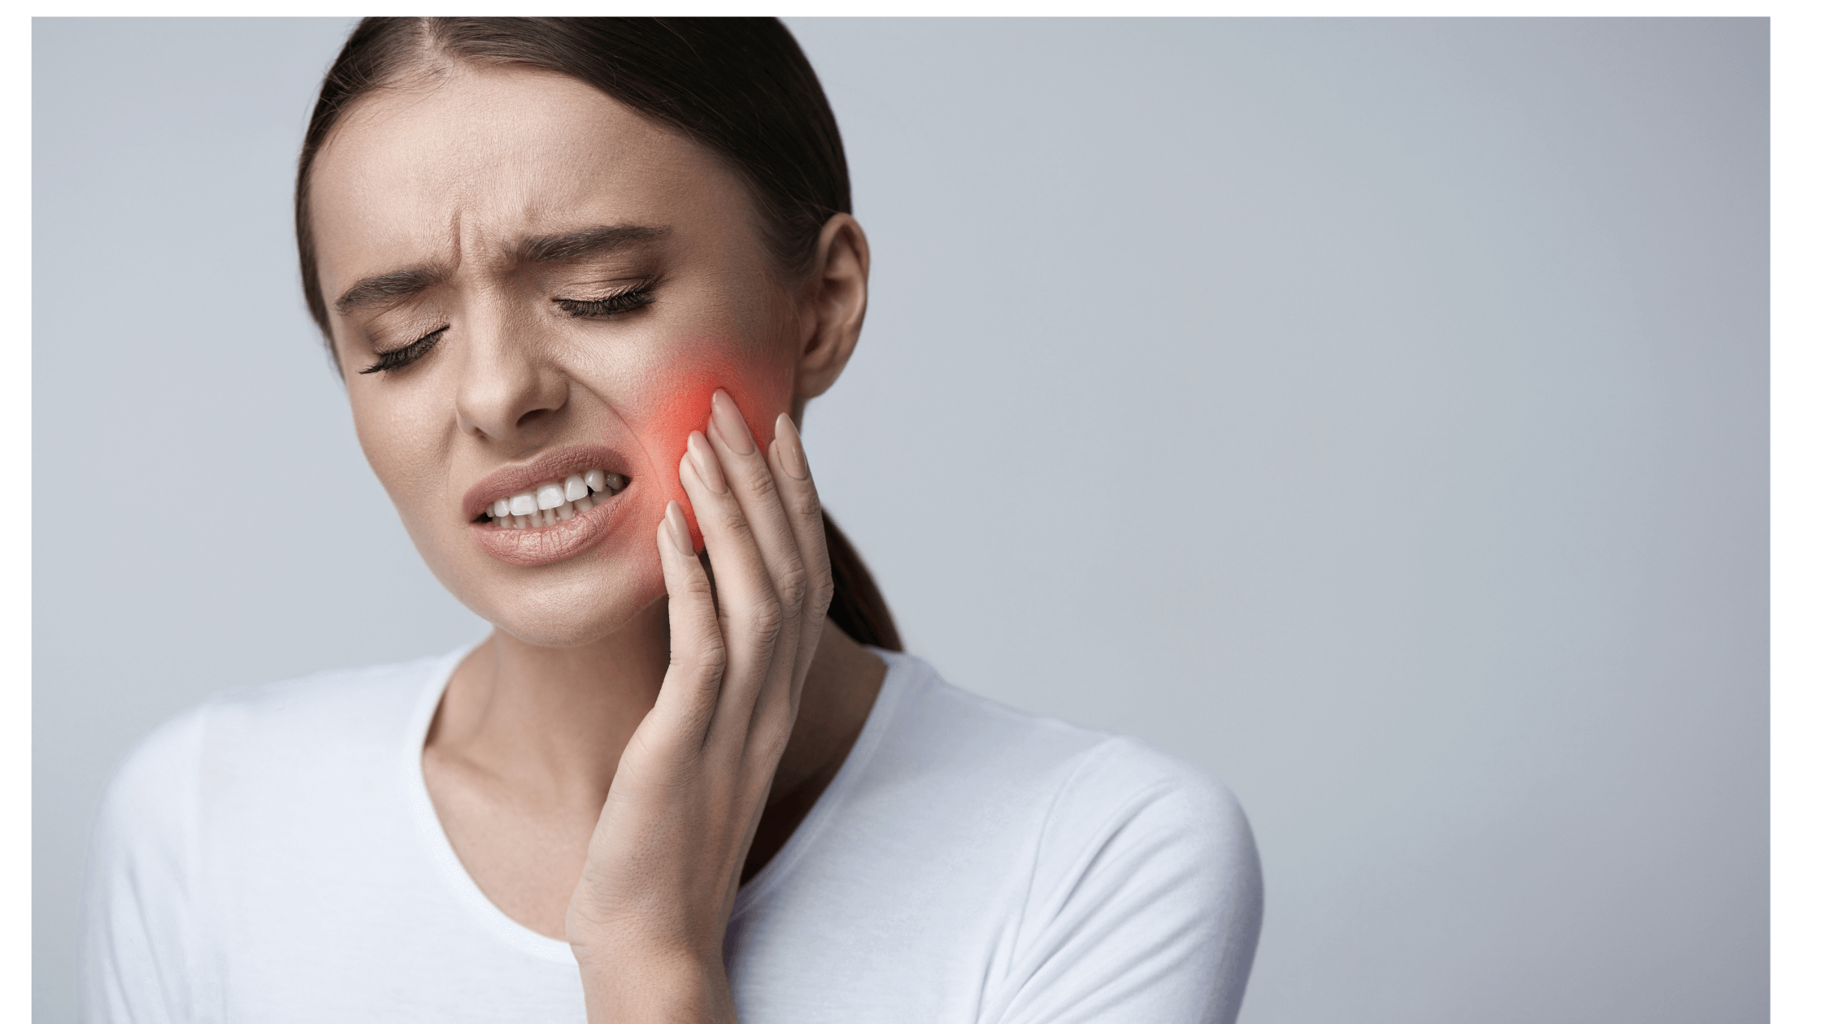
Dental Pain & Infection Protocol
Photo from https://www.thedentalexpress.com/dental-blog/8-dentist-approved-remedies-to-treat-tooth-pain-at-home/

Slide 12
IHS Acute Dental Pain Protocols in ED Settings

Slide 13
Pain Control Guidance
First Line Pain Therapy
  6 x Day Dosing = 400mg Ibuprofen + 650mg Acetaminophen
  4 x Day Dosing = 600-800mg Ibuprofen + 650-1,000mg Acetaminophen
If additional pain control is needed for severe pain w/ clinical signs of infection, consider Hydrocodone + Acetaminophen 5/325mg, but Acetaminophen in the first line pain therapy must be reduced to 325mg dose. Only prescribe enough opioids to get patient out of pain until they can get into their dentist or for antibiotics to take effect (48 hours), whichever is the lesser.

Slide 14
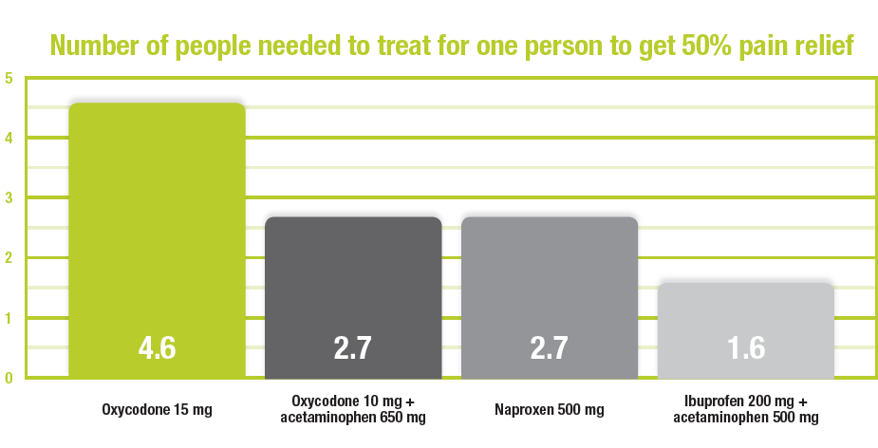
Pain Control Guidance
An Ibuprofen and Acetaminophen combination is more effective for pain relief than opioids!

Slide 15
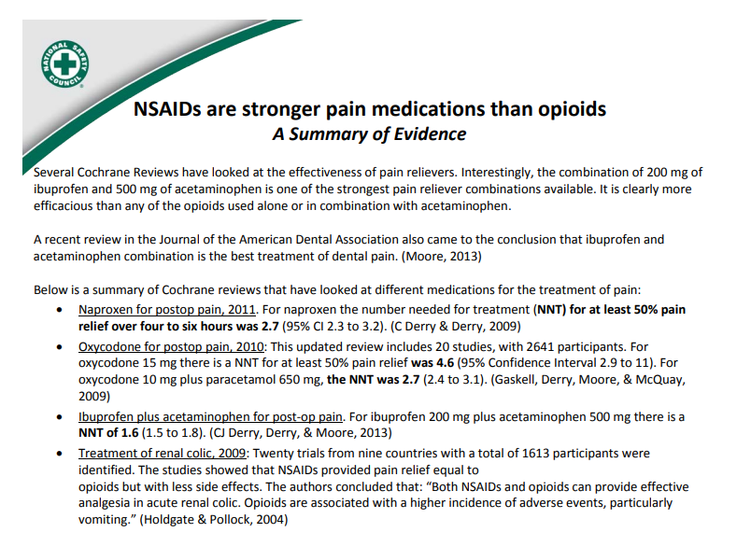
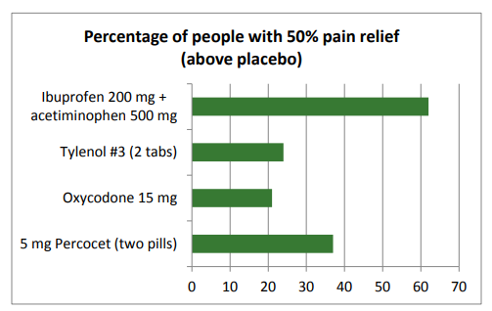
Pain Control Guidance

Slide 16
Dental Infection Management
Mild Infections (extra-oral or significant intraoral swelling + pain (spontaneous and/or to percussion & palpation).
  Amoxicillin 500mg – TID
  Penicillin VK 500mg – QID
  Cephalexin 500mg – QID
  Azithromax 250mg – 2 tabs first day, then 1 tab until gone (5 days)

Slide 17
Dental Infection Management
Moderate Infections (localized intra-oral swelling (non-draining) + pain (spontaneous and/or to percussion).
  Clindamycin 300mg – QID
  Amoxicillin 500mg + Clavulanate 125mg – TID
  Amoxicillin 500mg + Metronidazole 500mg – TID
Dry Socket (significant/severe pain that begins 3-4 days post-extraction [no fever])
Bupivacaine injection, irrigate socket with sterile saline, place Eugenol impregnated sterile, dissolvable foam. Rx NSAID + Acetaminophen (no antibiotics or opioids).

Slide 18
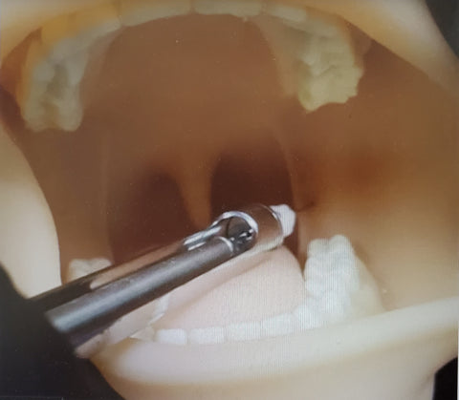
Intraoral Local Anesthesia Guidelines

Slide 19
Local Anesthesia Guidance
Pregnant Women: 2% Lidocaine (w/ 1:100,000 Epinephrine). Expect 60 mins. of pulpal anesthesia.
For I&D Procedures: 2% Mepivacaine (w/ 1:20,000 Neo-Cobefrin). Expect 60 mins. of pulpal anesthesia.
Long Lasting Anesthetic: 0.5% Bupivacaine (w/ 1:200,000 Epinephrine). Expect 90 mins. (infiltration) or 360 mins.(block) of pulpal anesthesia.

Slide 20
Local Anesthesia Guidance
It is strongly recommended that providers receive training on injection technique prior to utilizing local anesthetic injections. See “Management of Dental Pain in the Emergency Room for ED and UCC Personnel” training link. The time stamps offer targeted information and guidance for review. Other recommended resources: “Handbook of Local Anesthesia” (Stanley Malamed) and “Lexicomp Drug Information Handbook for Dentistry”.
Link: www.youtube.com/watch?v=spwoD4x79Tw
Time Stamps:
Opioid Prescribing and Its Impact (2:52)
Local Anesthetic and Use of Vasoconstrictors (7:32)
Anesthetics for Dental Pain (14:52)
Anesthesia Injection Techniques (25:35)
Delivering Local Anesthetic Demonstration (29:05)
Types of Analgesia (46:08)
Dental Infection and Antibiotic Selection (1:02:28)

Slide 21
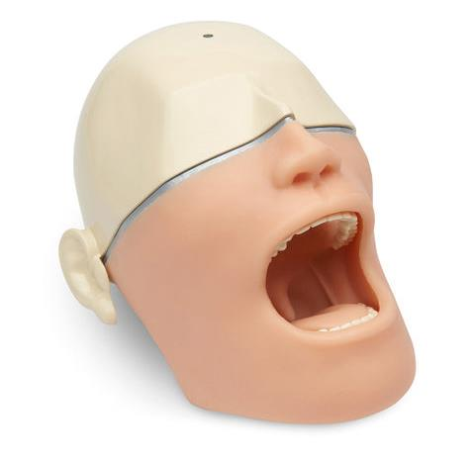
Guide to Local Anesthesia
Manikin allows for hands-on practice. Just remember to NOT actually inject anesthetic/liquids into the manikin!

Slide 22
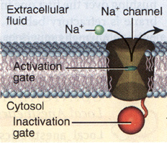
How Local Anesthesia Works
Prevent the generation and propagation of nerve-action potentials
Blocking the sodium channel to prevent sodium influx
LA
LA
*LA
*LA

Slide 23
Why is the pKa important?
pKa of selected anesthetic agents
Mepivacaine 7.6
Lidocaine 7.7
Articaine 7.8
Etidocaine 7.9
Prilocaine 7.9
Bupivacaine 8.1
Procaine 9.1
To be effective, local anesthetics must penetrate the nerve.
pKa helps determine how well an anesthetic can penetrate a nerve.

Slide 24
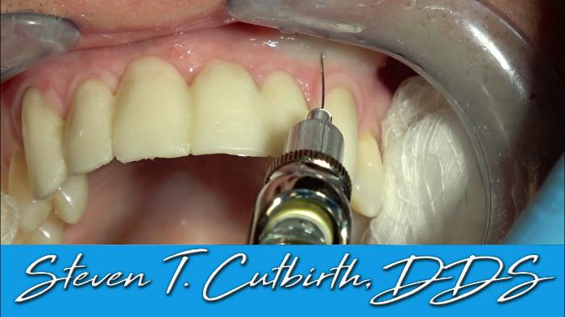
Maxillary Anesthesia -
Primarily infiltration
The cortical plate is not very dense and the bone is highly vascular.
Pulpal anesthesia can usually be achieved with simple infiltration.

Slide 25
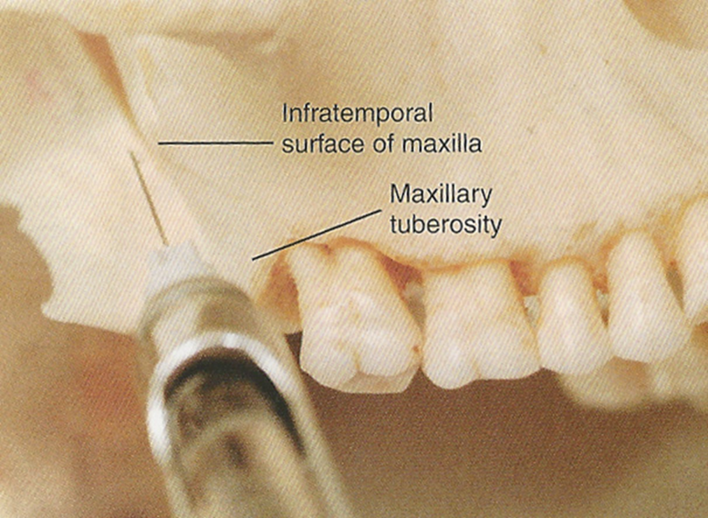
Posterior Superior Alveolar (PSA) Nerve Block
Landmarks
Zygomatic Buttress (injection point is posterior to it)
Depth of Vestibule
Tuberosity of Maxilla
Direction is posterior, medial and superior
Source: Malamed, Stanley F. Handbook of Local Anesthesia

Slide 26
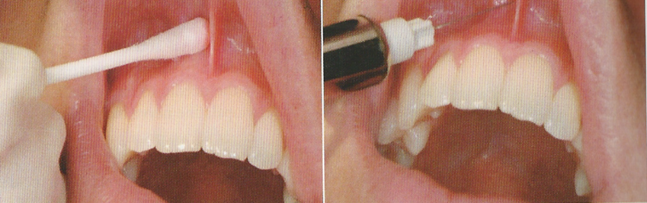
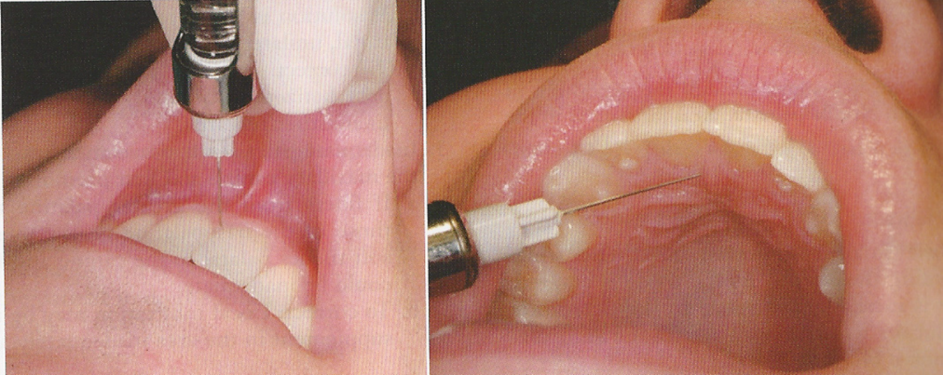
Incisive Canal Nerve Block
Source: Malamed, Stanley F. Handbook of Local Anesthesia

Slide 27
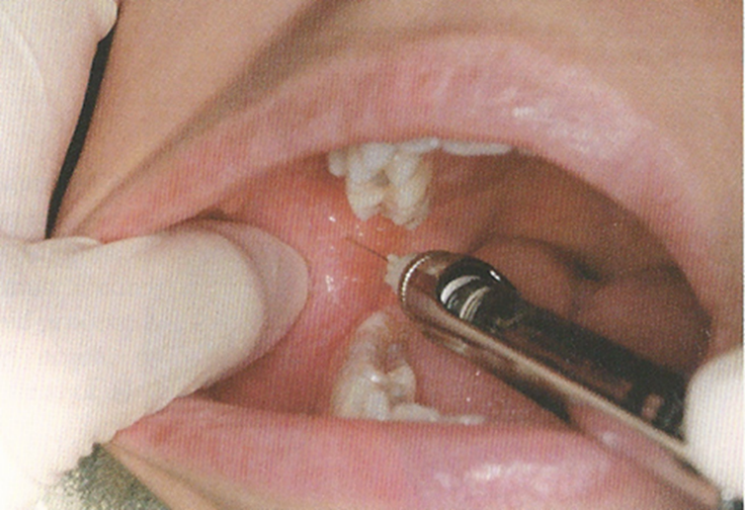
Inferior Alveolar Nerve Block
Landmarks
Depth of the coronoid notch
Pterygomandibular raphe
Contra lateral premolars
Bisection of thumbnail lying in coronoid notch (or higher)
Occlusal plane
Contact bone with needle almost fully in tissue
Source: Malamed, Stanley F. Handbook of Local Anesthesia

Slide 28
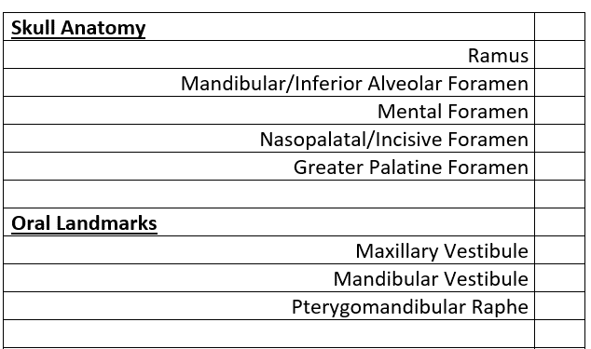
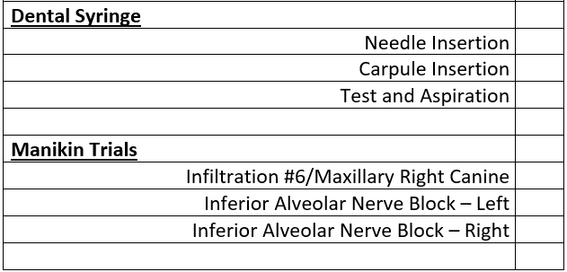
Hands-On Training

Slide 29
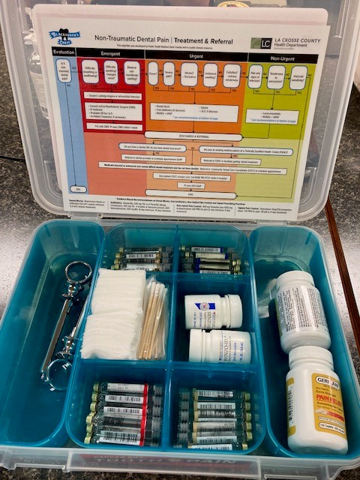
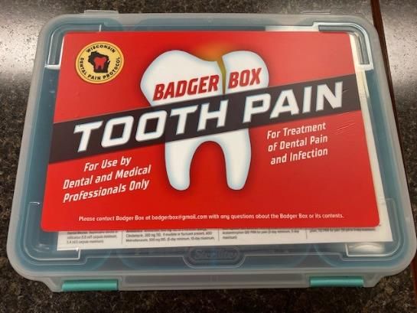
Emergency Department Dental Supplies
Should be sterilized and in sterilization pouch

Slide 30

Photo from https://unsplash.com/s/photos/next-steps

Slide 31
Recommendations for Emergency Departments
Review IHS Triage/Treatment Algorithm, be prepared to answer questions from ED staff
Review anesthetic and pain management videos
Teach ED providers how to administer local anesthetics
Work with the ED to set up a referral system for patients (what works in one ED and dental program may not work in another)
Collaboration between dental and the ED is the key!

Slide 32
Recommendations for Dental Programs
Following a Rx and/or local anesthetic injection in the Emergency Department, it is critically important to get the patient to dental for treatment.
  Warm handoff is IDEAL
  Referral & follow-up by a care coordinator (provided by the ED or by dental) is GOOD
  Referral through only the EHR or paper referral is usually NOT GOOD (high chance of no-show & return to ED)

Slide 33
Resources
Videos
  https://www.youtube.com/watch?v=spwoD4x79Tw
  https://www.youtube.com/watch?v=CrnV_G1GzMg
  https://www.youtube.com/watch?v=MgNIwdQJJHg
  https://vimeo.com/684769651/6dc0b356ee
IHS Triage/Treatment Algorithm (available as PDF and printable)
Wisconsin Dental Pain Protocol
  https://www.widentalpainprotocol.com/

Slide 34
Funding Opportunity
We will select up to 10 IHS, tribal, and urban (ITU) dental and hospital ED programs to participate in this project, where we will provide a 30-minute overview, which will be followed by a longer presentation by the local dental program, about this project.
Dental programs will be part of this training and will assist the EDs throughout the project, including providing the follow-up training, ordering manikins, and carrying out a hands-on demonstration and practice by ED medical providers.
Funding Amount: $5,000 per selected program to cover the cost of the anesthetic manikin, costs of supplies for the ED dental box, and training time.
Funding Deadline: Thursday, December 1st
More information: E-mail tim.ricks@ihs.gov or nathan.mork@ihs.gov.

Slide 35


