Slide 1

A Prehospital Approach to Abdominal Pain
Michael T. Mozer, DO
University of New Mexico EMS Consortium EMS Fellow
10/3/2023

Slide 2




Presenter Biography
Medical school at the University of New England in Maine
Completed residency in Phoenix, AZ (Valleywise Health Medical Center, formerly Maricopa Medical Center)
Emergency Medicine physician
EMS Fellow at University of New Mexico
Professional interest in EMS, austere/rural emergency care, medical education, and delivery of high quality emergency care.

Slide 3

Disclosures
No financial disclosures

Slide 4
Outline
Introduction
Anatomy Orientation
History and Physical Exam
Pathophysiology Review
  RUQ and Epigastric Pain
Prehospital Evaluation, Treatment and Monitoring
Knowledge Application: Select disease cases
Conclusions/Questions

Slide 5

911 Abdominal Pain Response
“I was a good paramedic, so I had a two-part assessment for [abdominal pain];
  What is your blood pressure?
  Where are your shoes”

Slide 6
Abdominal pain
Most common complaint for any patient requesting emergency services (ED or EMS)
Wide variability in presentation and severity
Historical/Medical risk factors play a key role
Three categories based on pathophysiology
  Visceral Pain
  Parietal Pain
  Referred Pain

Slide 7



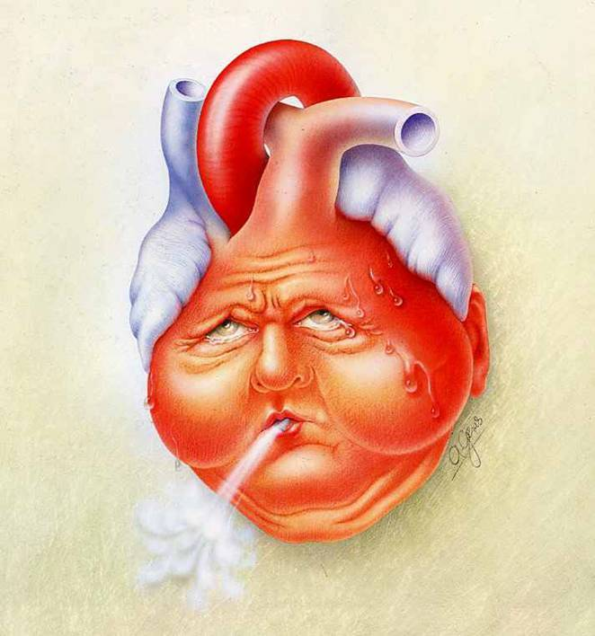
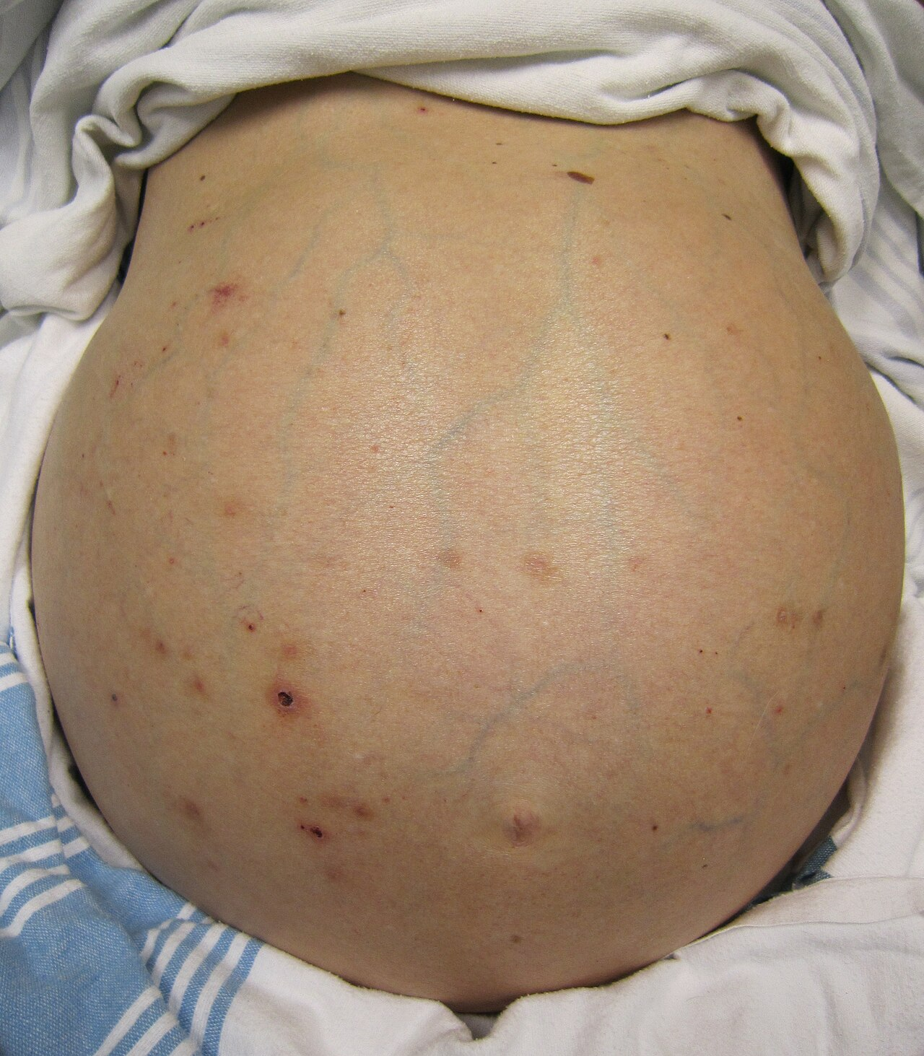

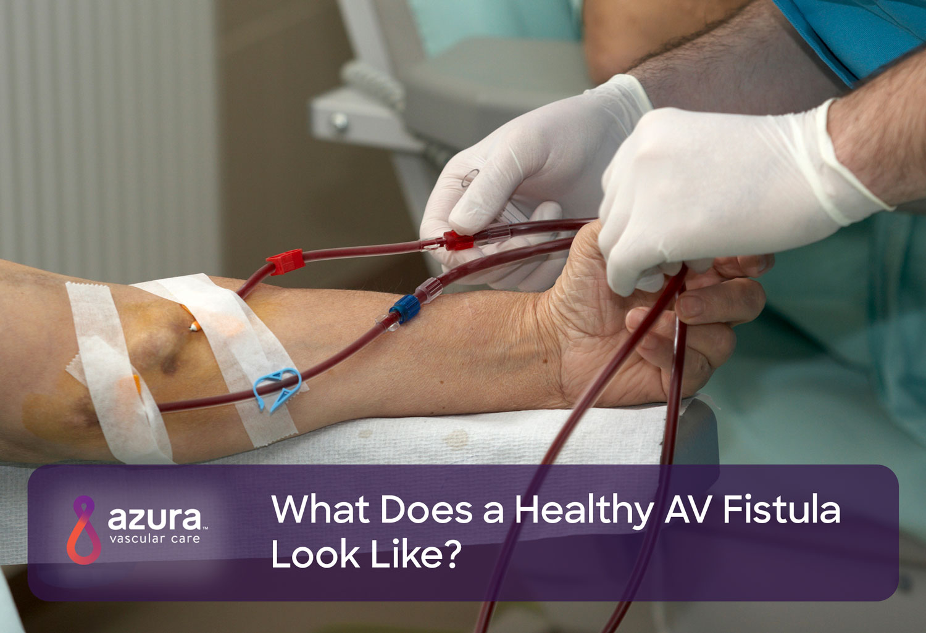
Special Populations
Notes:
Woman/Pregnancy, Elderly, Pediatrics/infants, Bariatric Surgery/Post-op, End-organ failure
*Mortality 10% for elderly patients presenting with abdominal pain during their hospital stay
Spangler R, Van Pham T, Khoujah D, Martinez JP. Abdominal emergencies in the geriatric patient. Int J Emerg Med. 2014 Oct 21;7:43. doi: 10.1186/s12245-014-0043-2. PMID: 25635203; PMCID: PMC4306086.
https://myheart.net/articles/what-is-heart-failure-everything-you-need-to-know/ (heart pic)
By James Heilman, MD - Own work, CC BY-SA 3.0, https://commons.wikimedia.org/w/index.php?curid=15335623 (liver failure pic)

Slide 8
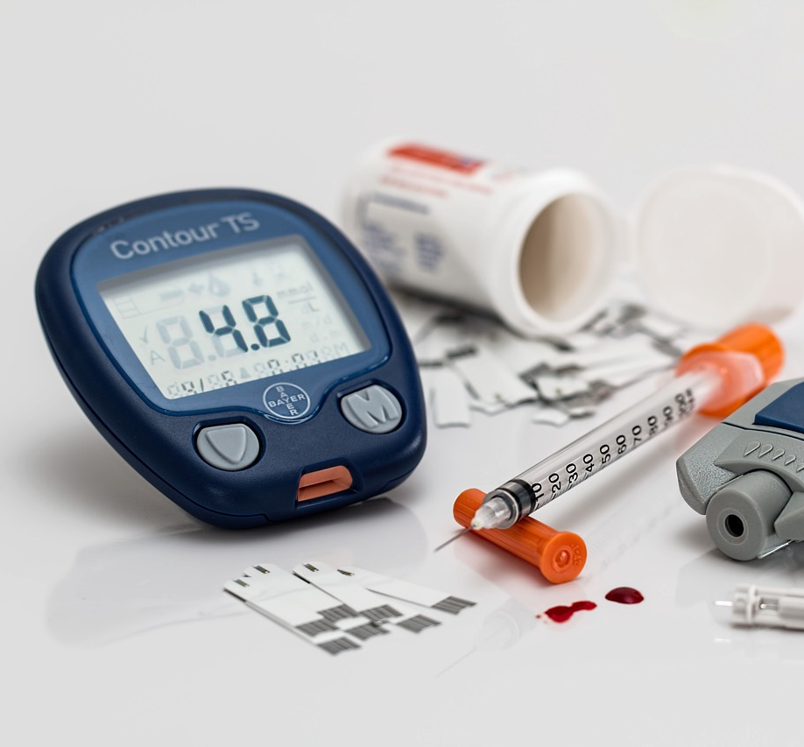

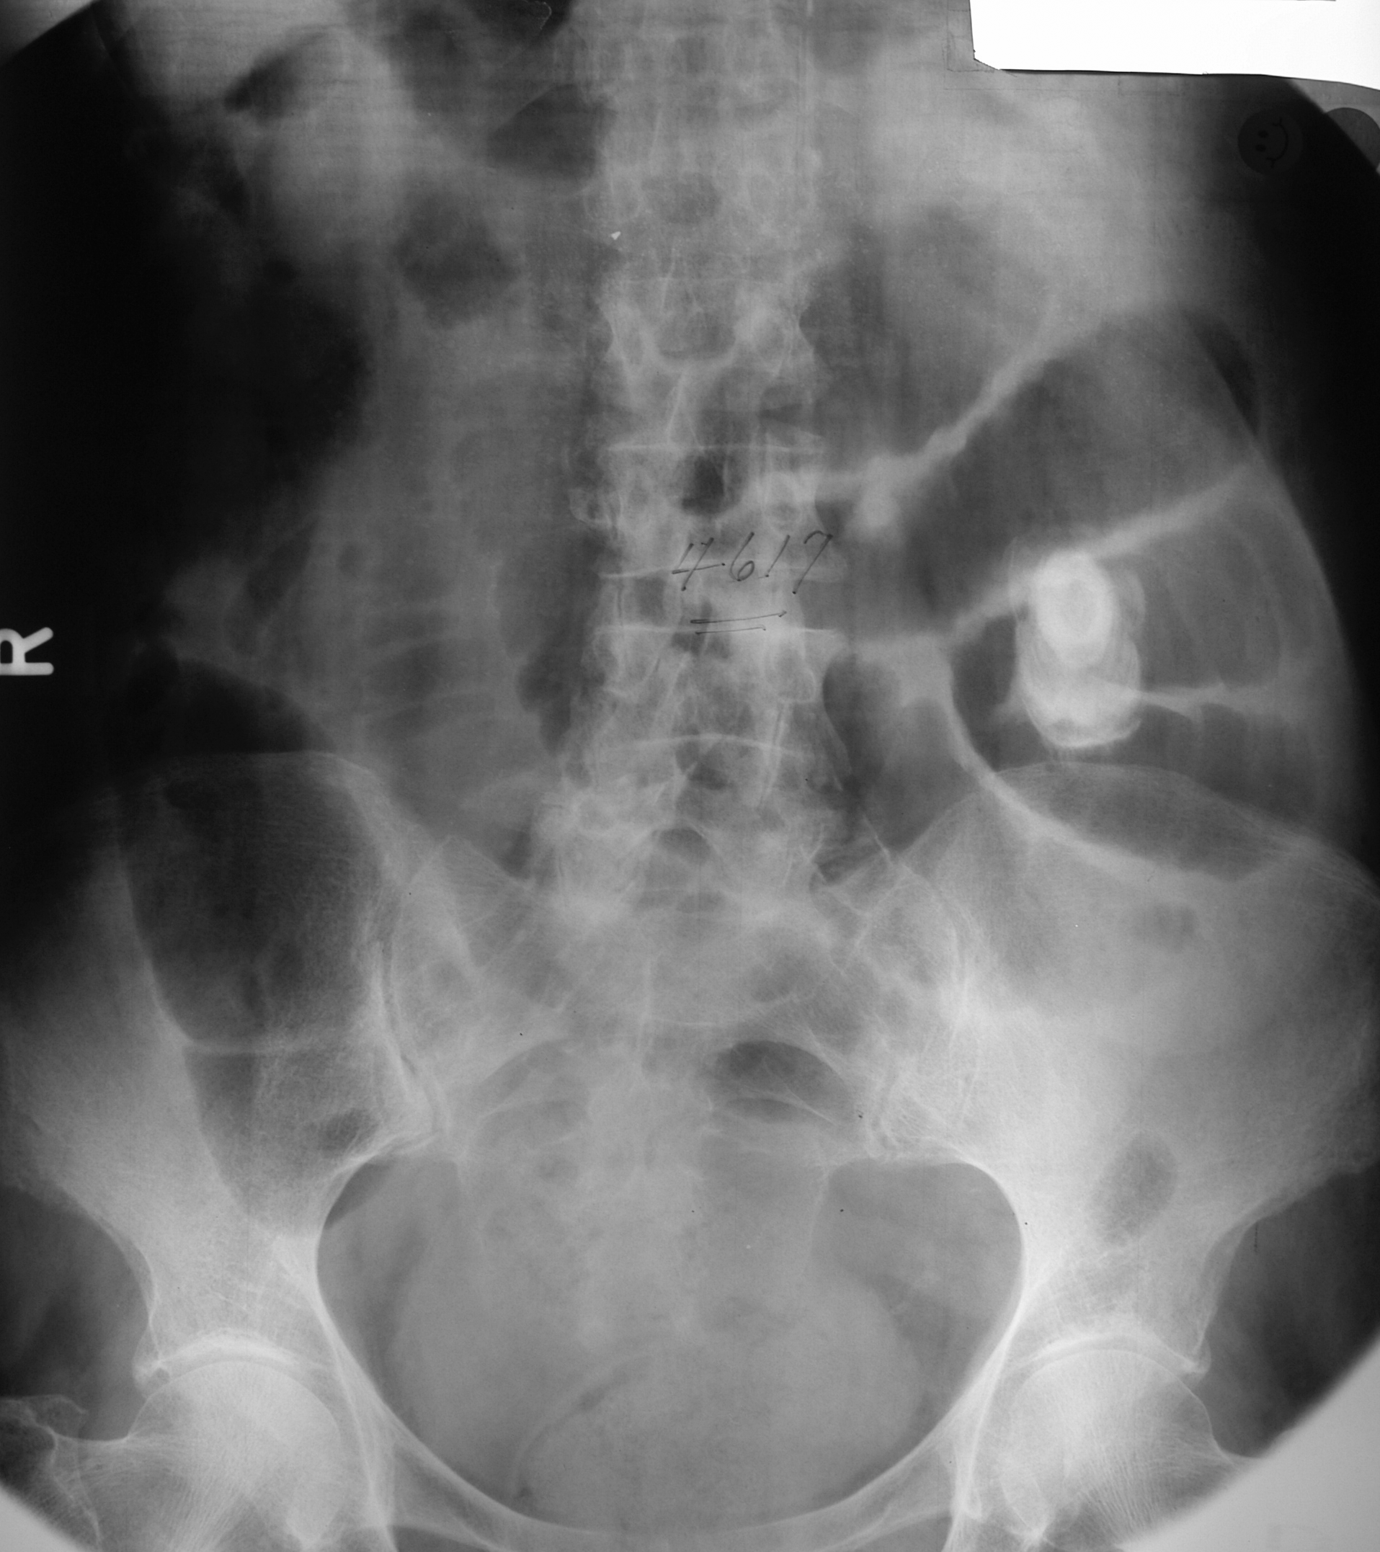
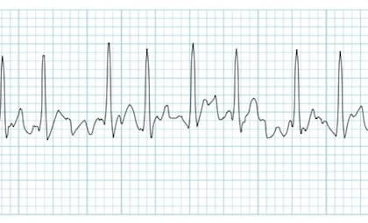
Historical considerations
Previous episodes (similar or different)
Vascular disease/arrhythmias
Post-Op (early or late)
Last PO intake/ability to tolerate PO
Change in quality or location of pain
History of diabetes/neuropathy
Social history (Tobacco, EtOH, drugs)
History of immune suppression (transplant, HIV, chronic steroid use etc.)
Notes:
A-fib on anticoagulation?
https://litfl.com/atrial-fibrillation-ecg-library/
Radiograph courtesy Dr. Frank Willard

Slide 9
Where to start?
Goal to assist in narrowing diagnosis and avoiding unnecessary testing/procedures
Most diagnostics are unavailable in the prehospital setting
  But there is still a lot you can do!
Screening measures -> “can’t miss” diagnoses
Stay organized and structured in your approach
  Quadrant
  Anatomical
  Symptom

Slide 10

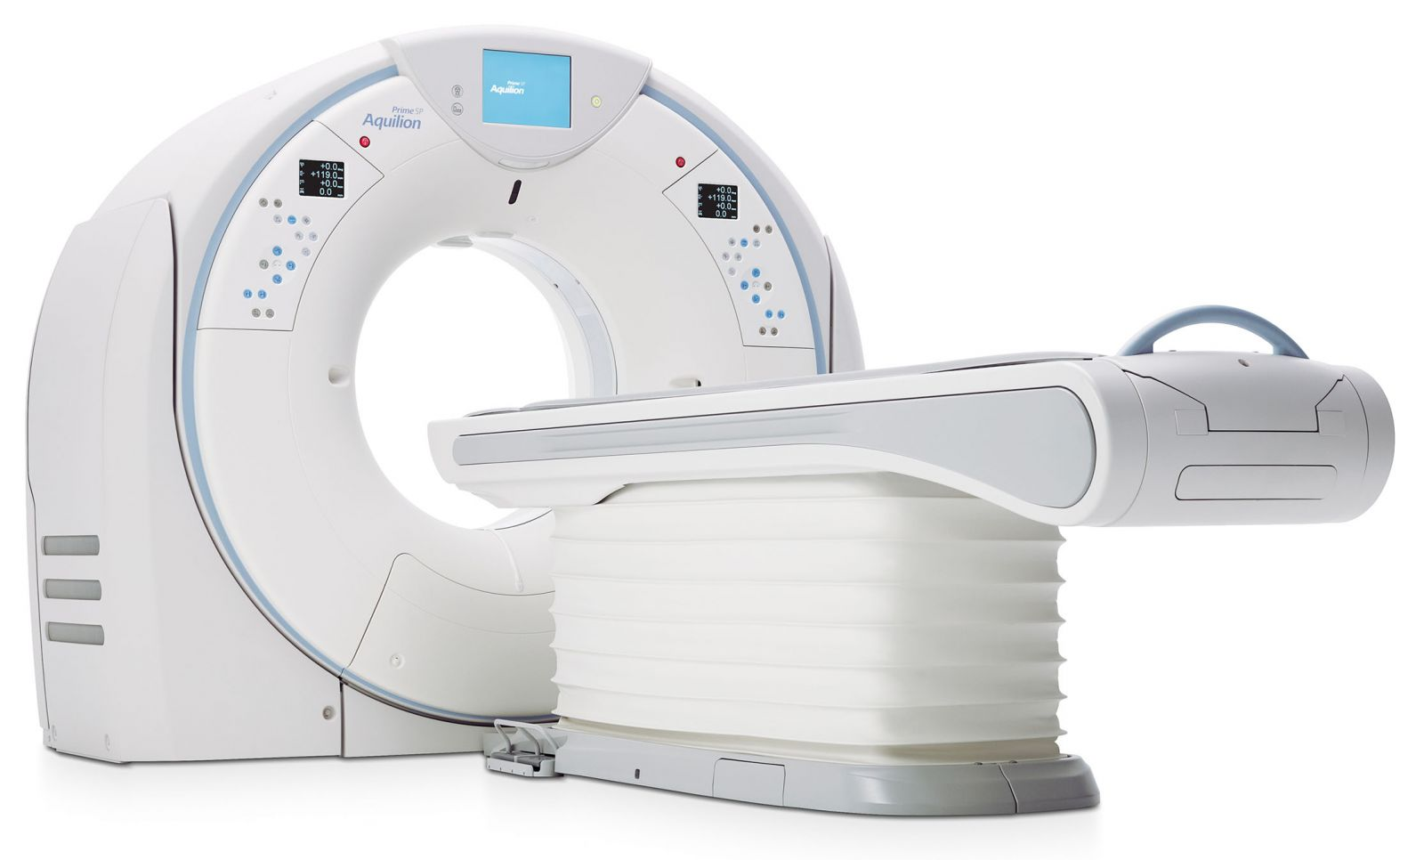
Abdominal Exam
Notes:
https://www.freepik.com/free-photos-vectors/black-hole

Slide 11
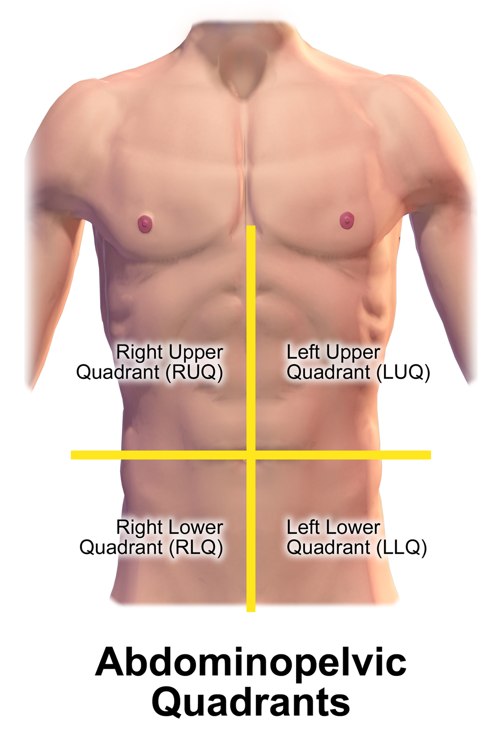
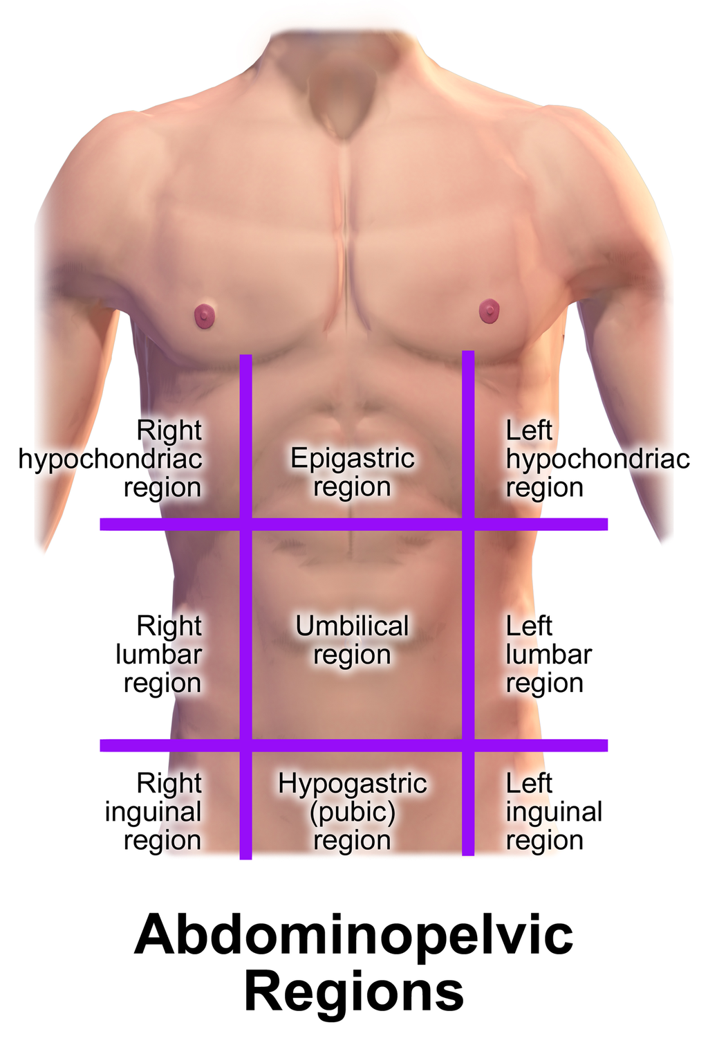
Quadrant Approach +
Anatomically based
Common separations
  Quadrants
  Regions
Notes:
Blausen.com staff (2014). "Medical gallery of Blausen Medical 2014". WikiJournal of Medicine 1 (2). DOI:10.15347/wjm/2014.010. ISSN 2002-4436.

Slide 12
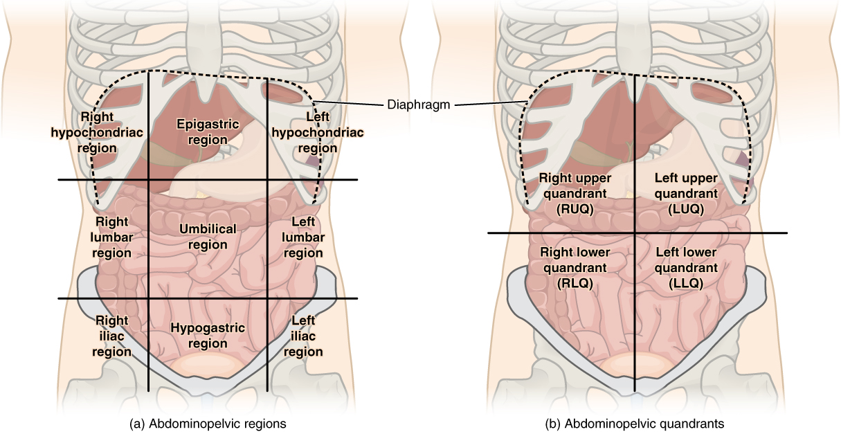
Notes:
By OpenStax. Download for free at http://cnx.org/contents/17e4eea8-a005-45af-b835-f756a014cd48@3., CC BY 3.0, https://commons.wikimedia.org/w/index.php?curid=29624324
What is the potential downfall of this approach?
- non-localized abdominal pain
- referred abdominal pain

Slide 13
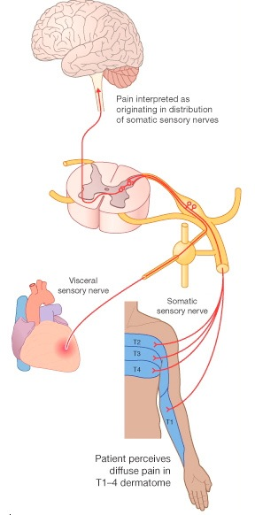
How does referred pain work?
Notes:
The fibers that come off the wall of the stomach follow the splanchnic nerve with cell bodies in dorsal root ganglia and fibers into dorsal horn
Over fibers that synapse in the same area will be stimulated, which will lead to the referral of pain into the abdominal muscles of T6-T9 and paraspinal muscles in the back at the same level
Can also lead to paraspinal muscle spasms

Slide 14
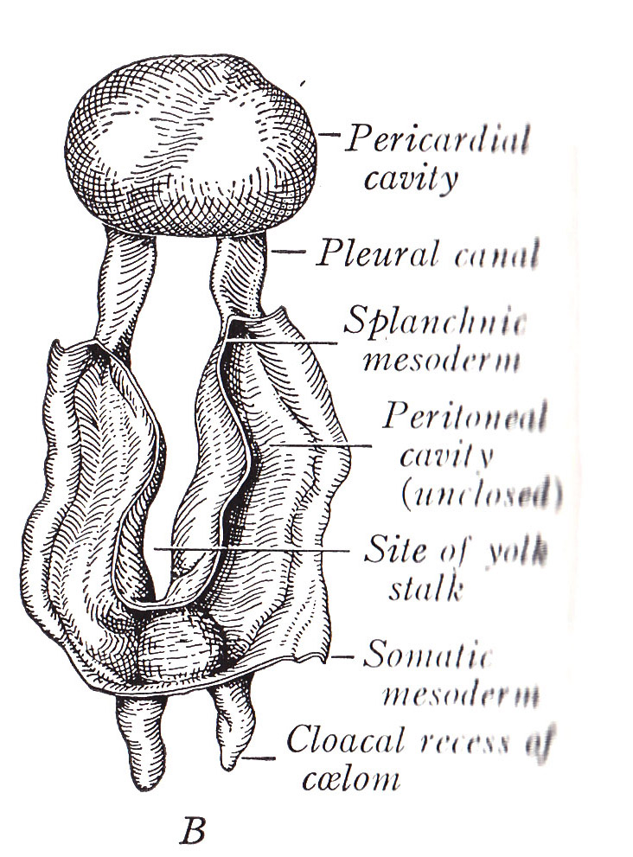
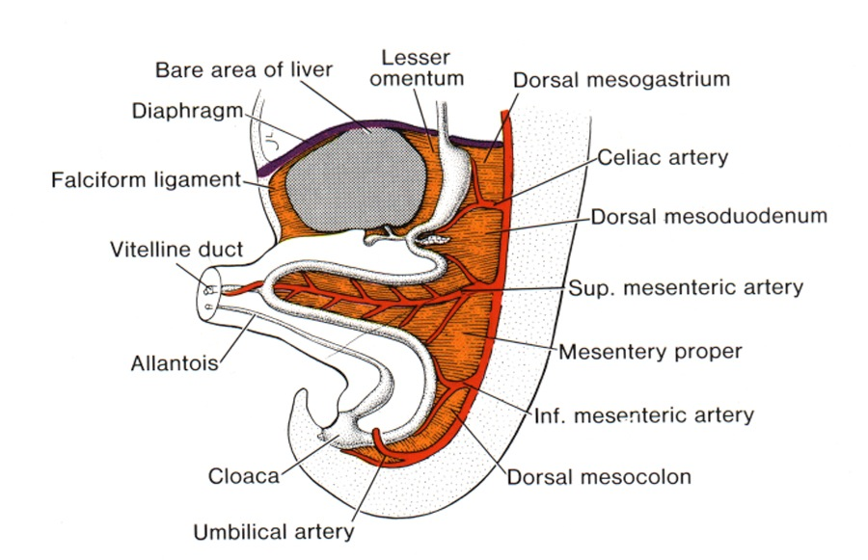
Neuro-vascular companionship
Notes:
Blood vessels supplying particular regions of the abdomen carry nerves to the organs within that space
With the home base of these neurovascular bundles based in the same regional position in the spine, the referred pain follows that same pattern of distribution

Slide 15
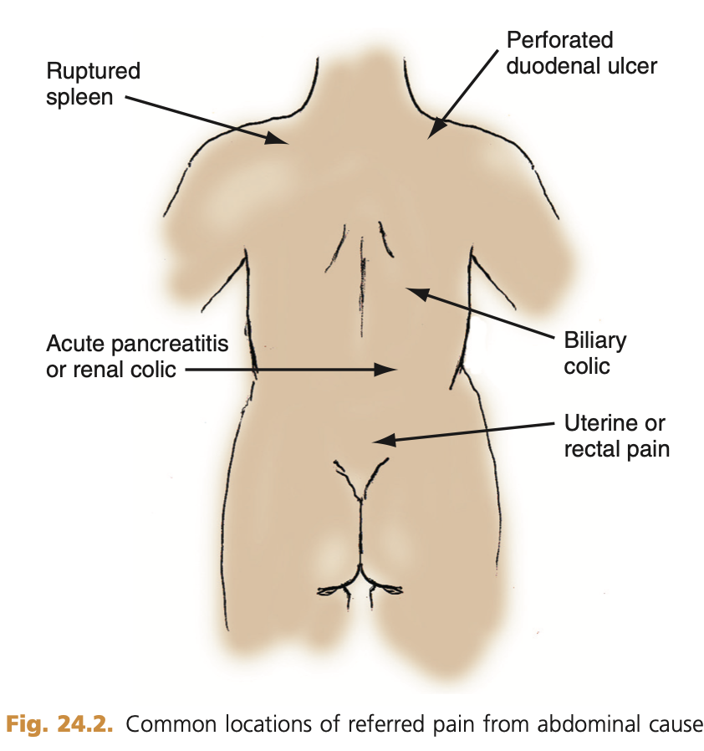
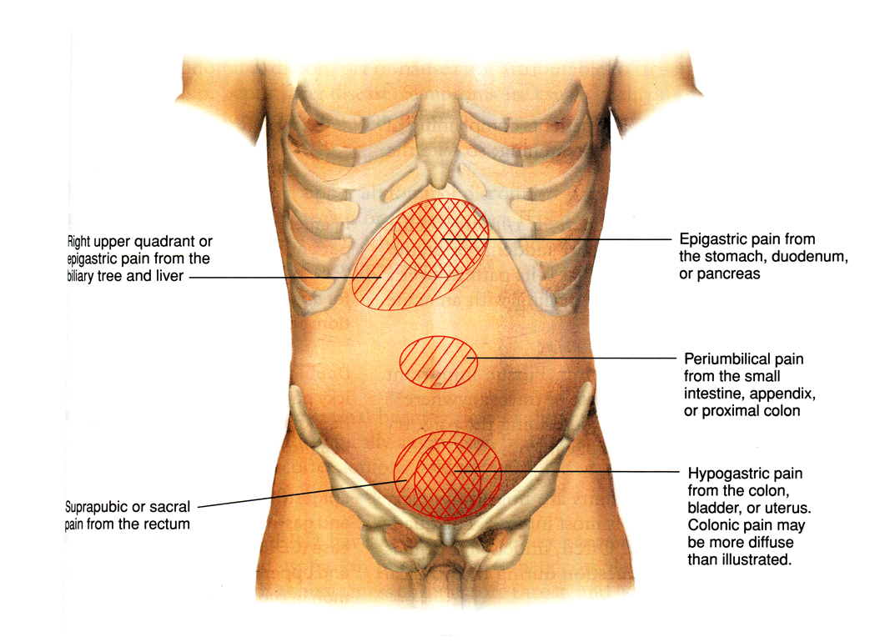
Referred pain regional distribution
Notes:
This is in reference to “Visceral Pain”
Visceral pain – pain originating from a specific organ/covering around the organ
Parietal pain – pain caused by irritation of the tissue surrounding the abdominal cavity
“Peritonitis”
Left: Rosen’s
Right: Dr. Frank Willard

Slide 16
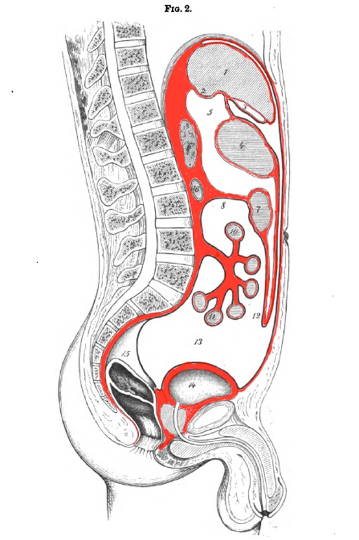
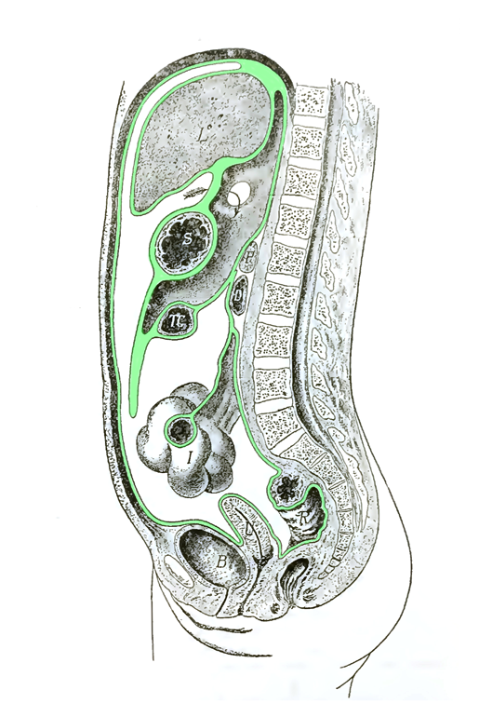
Peritoneum
Notes:
Highlighted in red is the fascial covering that lines all of the organs in the peritoneal cavity -> the parietal peritoneum
The parietal peritoneum is connected to the abdominal wall by suspensory ligaments
As the parietal peritoneum extends and covers the organs of the abdominal cavity, it becomes the visceral peritoneum
Visceral pain is “referred” where parietal pain is “localized” as the internal wall of the abdomen becomes inflammed

Slide 17
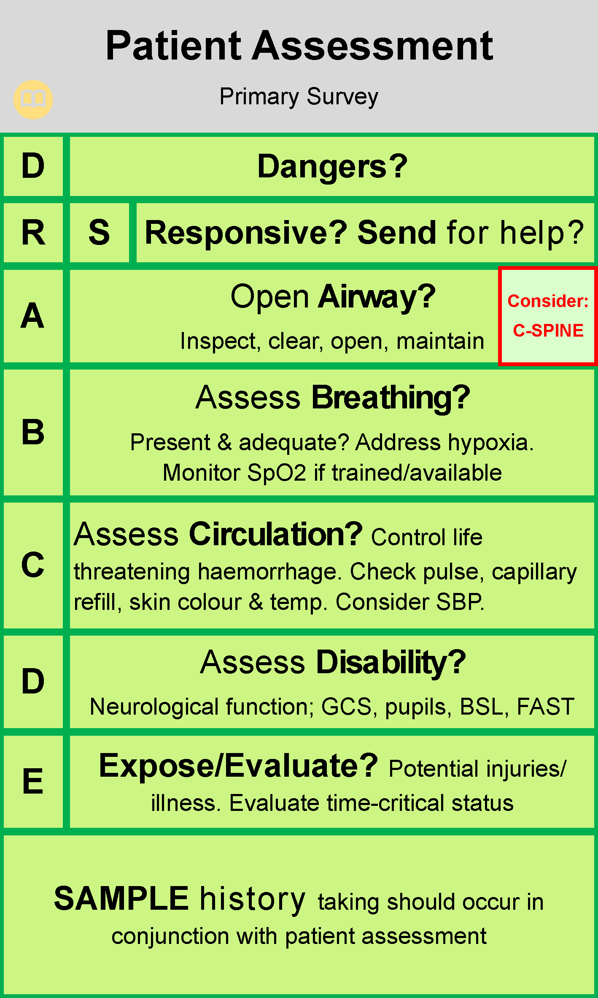
Initial Evaluation - ABCs
Establish scene safety
Collateral information/history
Address immediate life threats
  ABCs* vs H&P
  Eval for traumatic vs atraumatic
  Screen for pregnancy if applicable
  Glucose
Address hemodynamic instability
  Telemetry, ECG?
  IVF?
Notes:
Most patients with abdominal pain will appear relatively stable although uncomfortable
Reference: St John of Western Australia workflow for primary assessment
https://clinical.stjohnwa.com.au/clinical-skills/assessment/primary-survey

Slide 18
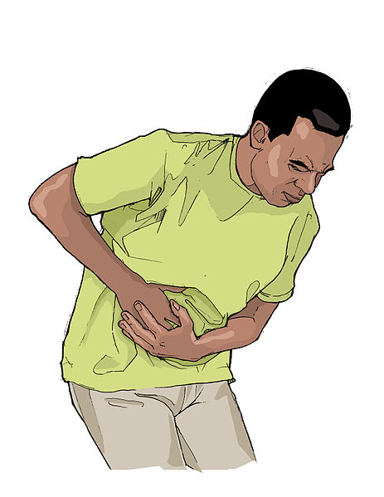
Generalized abdominal pain
What could be life-threatening?
Consider
  Vascular/Aortic injuries
  Metabolic disease/Acidosis
  Toxins
  Peritonitis
Notes:
Vascular – Mesenteric ischemia, aortic injuries/disease, venous thrombus
Metabolic – DKA, AKA, uremia, narcotic withdrawal, Addison crisis
Toxins – lead,/heavy metals
Peritonitis – any cause

Slide 19
Outline
Introduction
Anatomy Orientation
History and Physical Exam
Pathophysiology Review
  RUQ and Epigastric Pain
Prehospital Evaluation, Treatment and Monitoring
Knowledge Application: Select disease cases
Conclusions/Questions

Slide 20
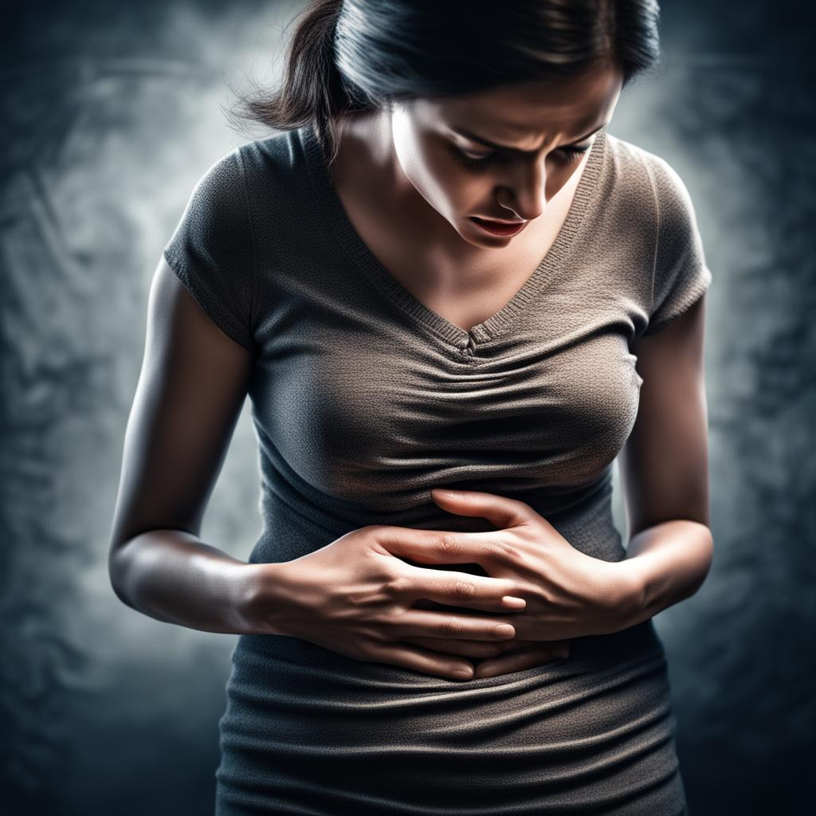
Case Presentation #1
You are called to the home of a 54 year old female. The patient called 911 after she had sudden worsening of a dull RUQ abdominal pain that has been ongoing for approximately 2 weeks. The patient has a history of diabetes, hypertension and hyperlipidemia. Her pain worsened significantly last night about an hour after dinner, and kept her up all night with persistent nausea and vomiting. She appears uncomfortable, VS with a HR of 116, BP of 132/84, RR of 22, T 101.4F, SpO2 94% on RA. She is tender in the RUQ without rebound tenderness with an otherwise reassuring exam.
  Would you perform any additional tests at this time?
  Would you provide this patient with any treatments in transport?
Notes:
Tests - BGL = 196
ECG – Sinus tachycardia
Treatments – IVF, pain medications, anti-emetics

Slide 21
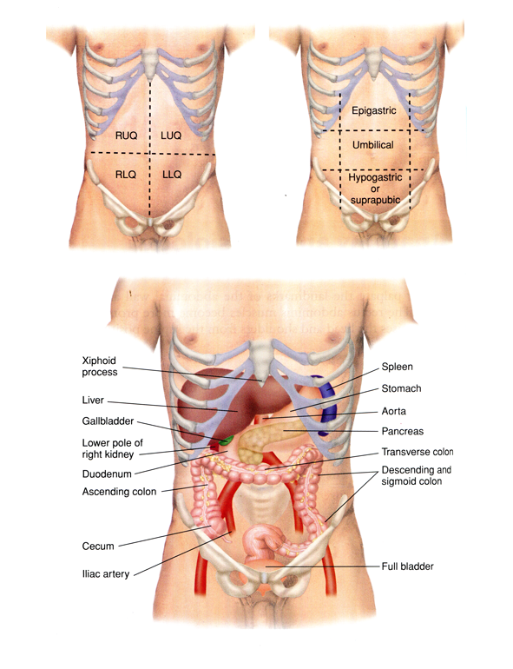
Who lives where?
Notes:
Lung, Liver, Gall bladder, Biliary tree, Hepatic flexure of colon (ascending), Right kidney, diaphragm

Slide 22
RUQ pain - Differential Diagnosis
Biliary disease
  Colic, Cholecystitis, cholangitis
Liver Disease
  Hepatitis, Hepatic abscess, Congestion, Fitz-Hugh-Curtis
Bowel disease
  Appendicitis?, perforated ulcer
Lung disease
  Pulmonary Embolus, pneumonia
Others
  Cardiac ischemia, herpes zoster, kidney stones, pyelonephritis/UTI
Notes:
Absolutely not a complete list
Other thoughts, ideas?

Slide 23
Diagnosis?
Notes:
https://creator.nightcafe.studio/studio?open=creation&panelContext=%28jobId%3Ayh21tw0uXvjXo3uDcjAf%29

Slide 24
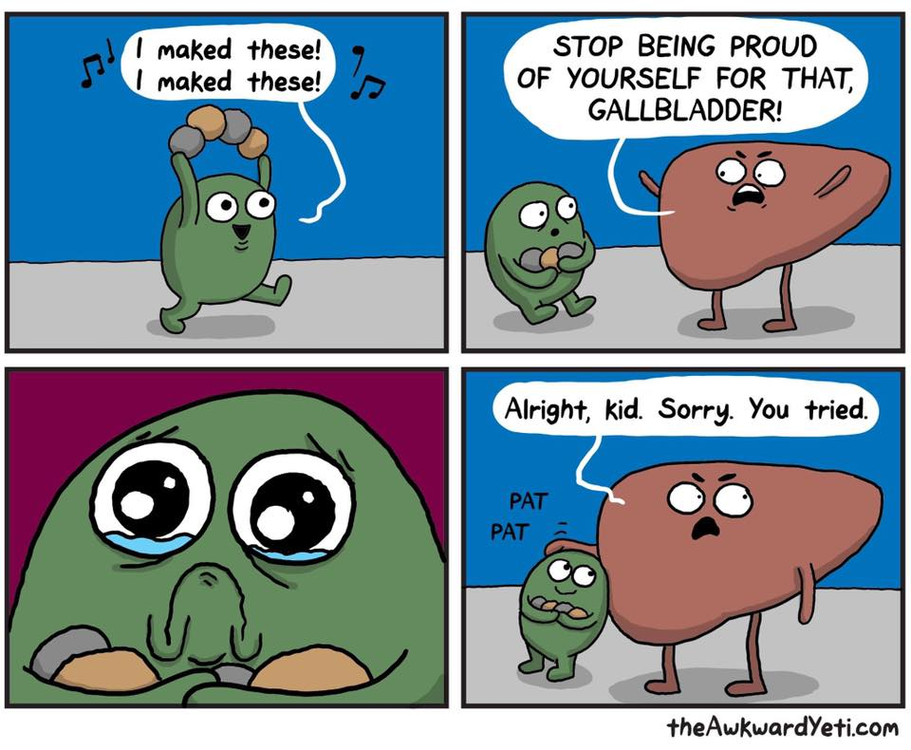
Acute Cholecystitis
#1 cause -> gallstones
Prevalence of gallstones is high in the general populace (8% men, 17% women)
  Common cause of abdominal pain in pregnancy
Biliary colic
Persistent obstruction -> inflammation -> acute cholecystitis
Notes:
Theawkwardyeti.com
Biliary Colic – pain derived from intermittent obstruction of gallbladder (lasts for a few hours)

Slide 25
Diagnosis
Mostly clinical + laboratory and imaging findings
Combination of local and systemic symptoms with imaging studies (+/-)
+Murphy’s sign: How do we do this?
  https://www.youtube.com/watch?v=2T0XUQ1M-x0

Slide 26
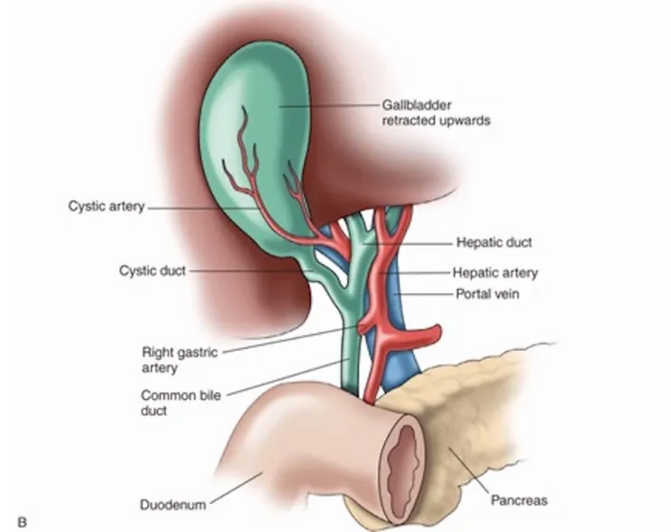
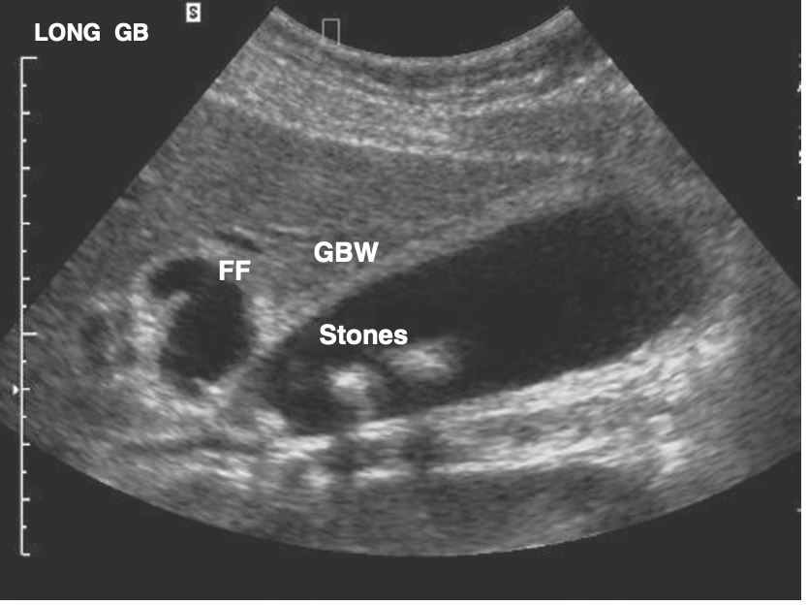
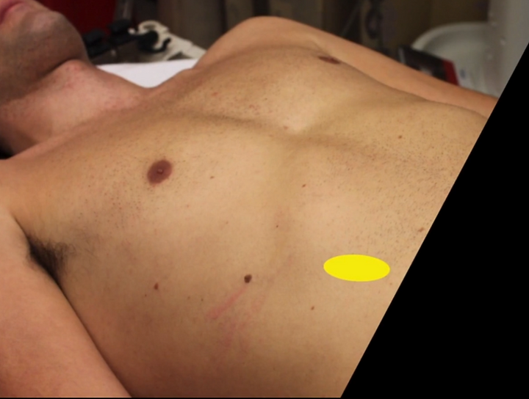
Ultrasound of Acute Cholecystitis
Notes:
FF = free fluid
GBW = gallbladder wall
Ref: Rosen’s Emergency Medicine
https://www.stonybrookem.org/post/an-approach-to-biliary-ultrasound

Slide 27
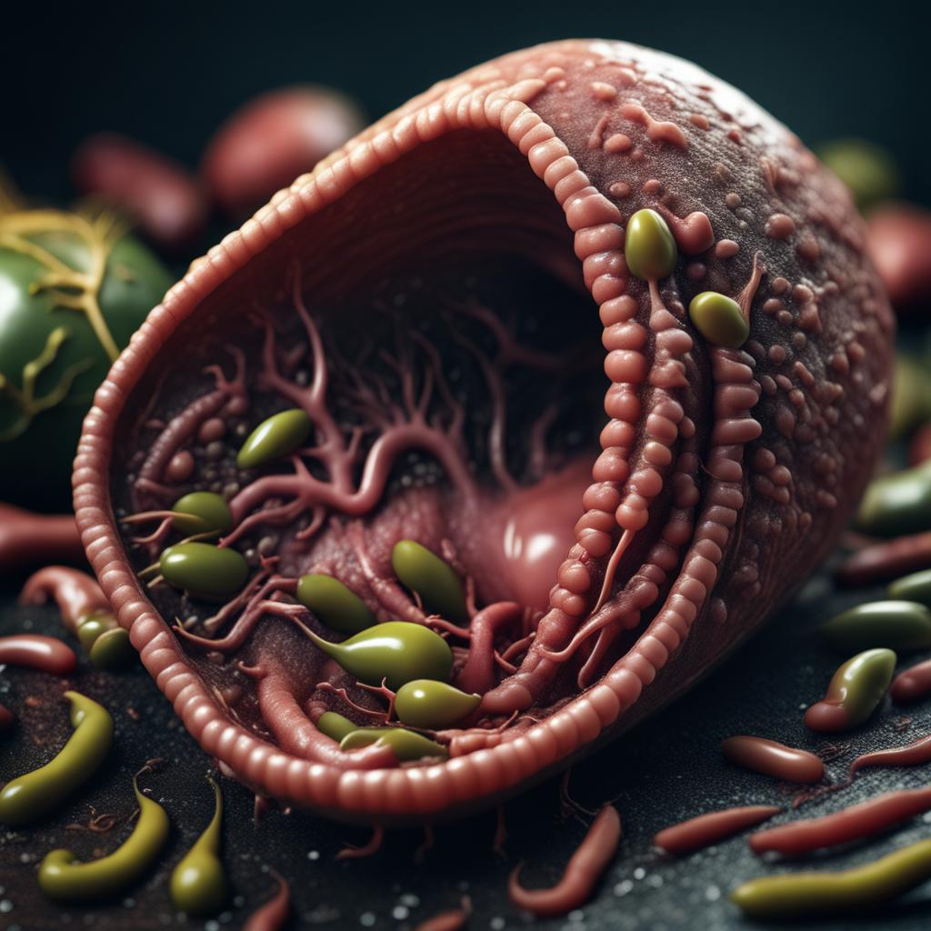
Acute Calculus Cholecystitis Treatment
IV fluids, pain control, antibiotics, surgery consultation
  +/- anti-emetics (often needed)
Most of these can be done in the prehospital setting
Tx WILL NOT alter the patient’s hospital course
Notes:
https://creator.nightcafe.studio/studio?open=creation&panelContext=%28jobId%3AImAYPIMNswhlU2xygJ8Z%29
“Sick Gallbladder Vomiting bile”

Slide 28
Pain control for general abdominal pain
Previous teachings suggested with-holding pain management
  “Alters abdominal exam” – but does not alter diagnostic certainty
Recent literature does not support this practice
Diagnosis is made through a multitude of tests
  Pain can be reproduced despite IV medications for diagnostic purposes
Keep your patient’s comfortable!
Notes:
Simel DL, Ranji SR, Goldman L, Simel DL, Shojania KG. Opiates and Abdominal Pain. In: Simel DL, Rennie D. eds. The Rational Clinical Examination: Evidence-Based Clinical Diagnosis. McGraw Hill; 2009. Accessed September 29, 2023. https://jamaevidence.mhmedical.com/content.aspx?bookid=845&sectionid=61357636

Slide 29
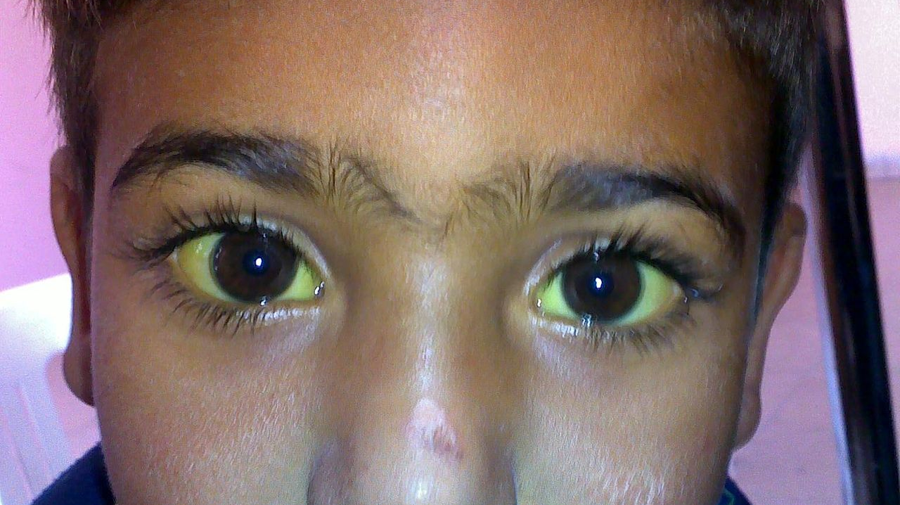
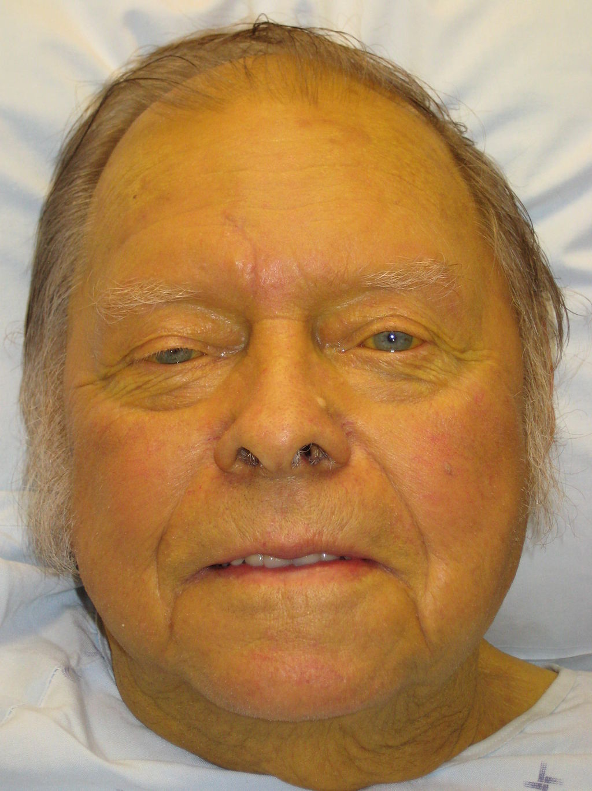
Ascending Cholangitis
Severe, life-threatening infection
Consider Charcot’s triad -> fever, RUQ pain, jaundice
  With altered mental status and hypotension = Reynold’s pentad
By James Heilman, MD - Own work, CC BY 3.0, https://commons.wikimedia.org/w/index.php?curid=9389660
By Sab3el3eish - Own work, CC BY 3.0, https://commons.wikimedia.org/w/index.php?curid=9609147
Notes:
Severe, life-threatening infection of the biliary system, often due to persistent untreated acute cholecystitis
By Sab3el3eish - Own work, CC BY 3.0, https://commons.wikimedia.org/w/index.php?curid=9609147

Slide 30
Case presentation #2
You are called to the home of a 54 year old female. The patient called 911 after she had sudden epigastric abdominal pain this AM. The patient has a history of diabetes, hypertension and hyperlipidemia. Her pain worsened significantly this morning while walking her dog approximately 30 minutes ago. She states her pain radiates to her bilateral shoulders and reports associated nausea. She appears uncomfortable, diaphoretic and speaks in 5-7 word sentences. VS with HR of 84, BP 102/64, RR 18, SpO2 89% on RA, Temp 98.6F. Her abdominal exam is benign.
  Would you perform any additional tests at this time?
  Would you provide this patient with any treatments in transport?
Notes:
Blood glucose - 190

Slide 31
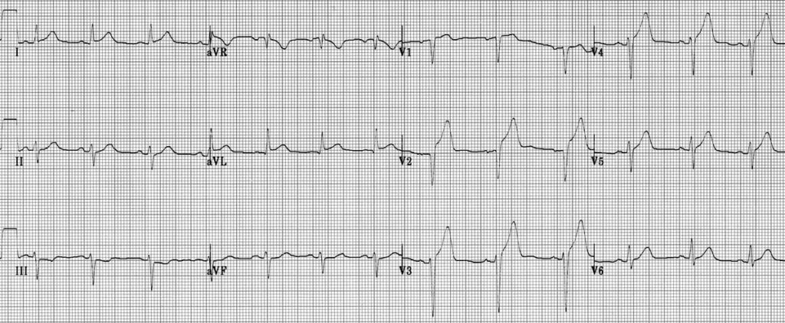
EKG
Notes:
ST elevation and hyperacute T waves in V2-4
ST elevation in I and aVL with reciprocal ST depression in lead III
Q waves are present in the septal leads V1-2
These features indicate a hyperacute anteroseptal STEMI
From LITFL: https://litfl.com/anterior-myocardial-infarction-ecg-library/

Slide 32

Diabetics with RUQ/epigastric pain
Have diffuse nerve and vascular damage
High Risk
  Cardiac Disease
  Vascular Disease
Obtain screening EKG
Obtain blood glucose
Associated symptoms to guide your approach
  Dyspnea
  Diaphoresis
  Intractable Nausea and vomiting
  Pain out of proportion to exam
Notes:
Nerve damage = atypical presentation of underlying disease
Vascular damage = heart disease, aortic disease etc.

Slide 33
Case presentation #3
You are called to the home of a 36 year old male. The patient reports no significant medical history but admits to daily EtOH use of at least 1/5 of hard liquor. The patient has had epigastric pain with nausea and vomiting since he woke up this AM. Last drink was at 7am to try to alleviate his pain which worsened it. VS with HR of 112, BP 90/64, RR 24, SpO2 94% on RA, Temp 98.6F. He has significant tenderness in his epigastrium with involuntary guarding.
  Would you perform any additional tests at this time?
  Would you provide this patient with any treatments in transport?
Notes:
Blood glucose – 390
EtCO2 – 24
Tx – IVF, pain medications, anti-emetics

Slide 34
Who lives where?
Notes:
Stomach, spleen, pancreas, left lower lung, diaphragm, colon, +/- small bowel

Slide 35
LUQ/Epigastric pain - Differential Diagnosis
Pancreas
  Pancreatitis, blocked pancreatic duct (stone, mass)
Stomach
  Ulcer, perforated ulcer, gastritis
Spleen
  Ruptured spleen, congestion
Bowel disease (colon/small intestine)
  Perforated ulcer, inflammatory bowel disease
Lung disease
  Pulmonary Embolus, pneumonia
Others
  Cardiac ischemia, herpes zoster, kidney stones, pyelonephritis/UTI
Notes:
Absolutely not a complete list
Other thoughts, ideas?

Slide 36
Diagnosis?
https://www.cdc.gov/vhf/ebola/resources/infographics.html

Slide 37
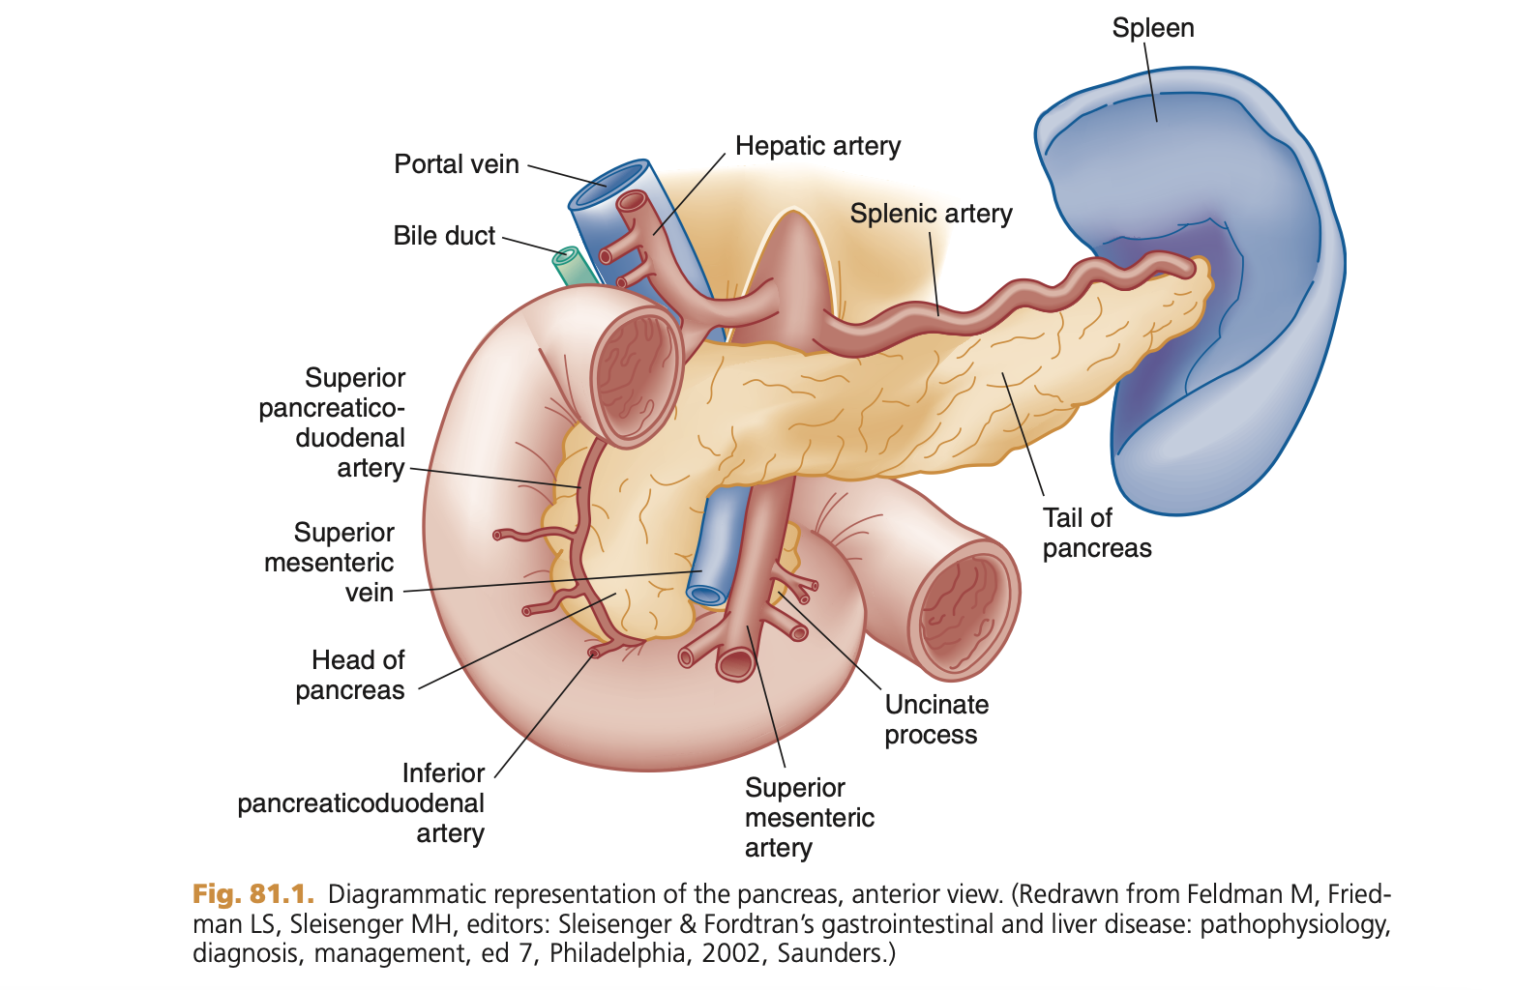
Acute Pancreatitis
#1 gallstones, #2 EtOH
  3rd ERCP (Endoscopy)
Rapidly worsening epigastric/LUQ pain
  +nausea/vomiting
Can be complicated by poor insulin production (hyperglycemia)
Can cause significant widespread inflammatory disease
Notes:
Gallstones more common for women, EtOH for men
Ref: Rosen’s

Slide 38
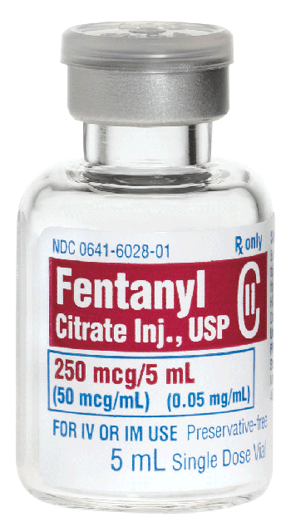
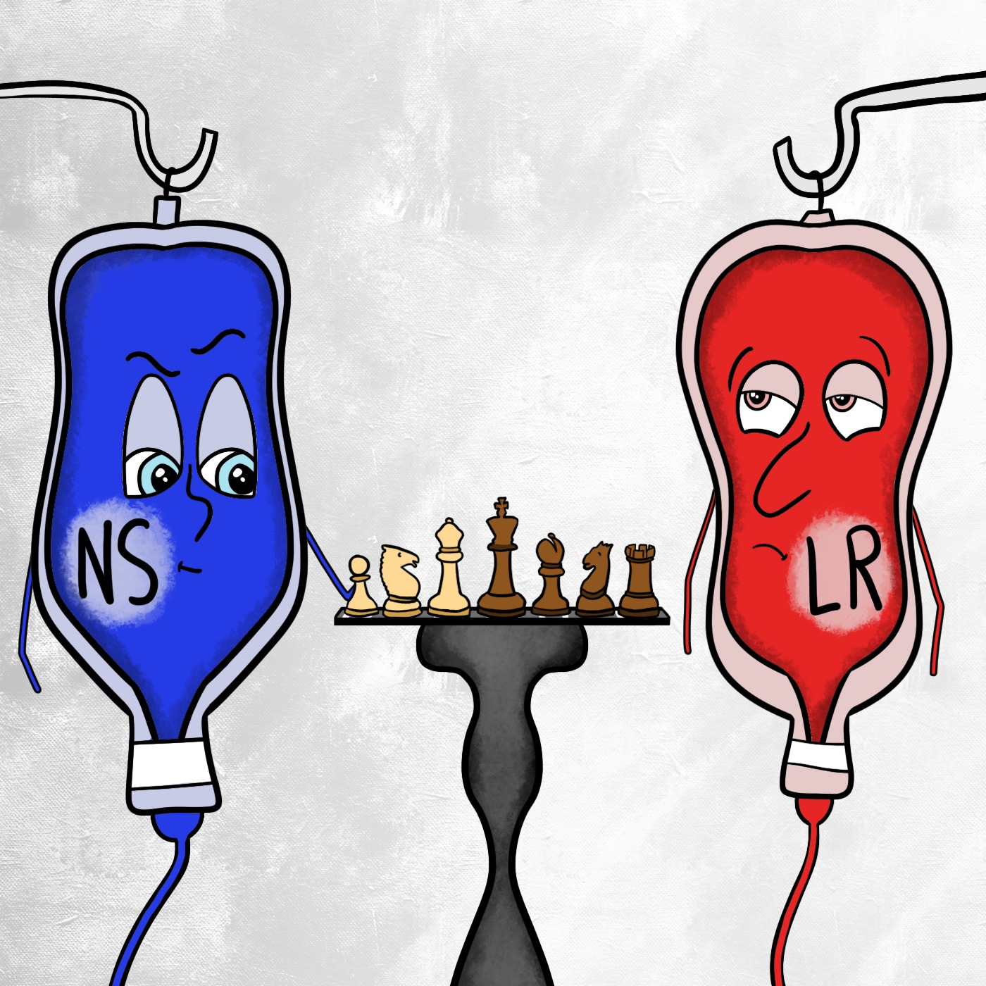
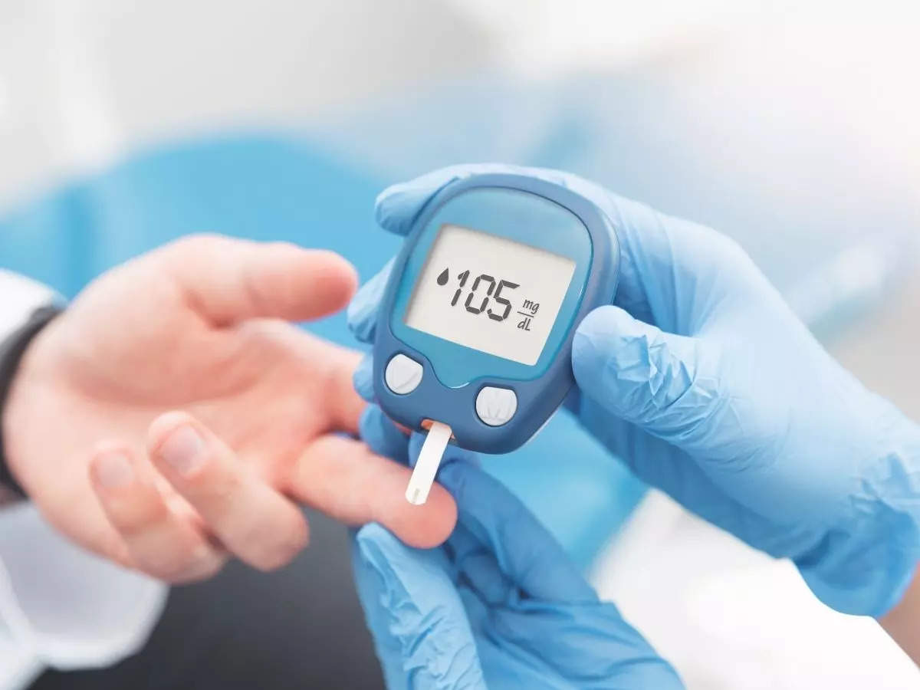
Pancreatitis – Prehospital Treatment
IV fluids, pain control, anti-emetics
Obtain screening glucose, ?EKG
Monitor/Screen for signs of EtOH withdrawal if suspected primary cause
Notes:
Tongue Fasciculations:
https://www.youtube.com/watch?v=xuwdvBXcr30

Slide 39
Case Presentation #4
You are called to the home of a 56 year old male construction worker. The patient has a history of back pain and arthritis and has been suffering a flare over the past 3 weeks. He reports taking “a lot” of ibuprofen as well as naproxen in the morning and evening. The patient has had epigastric pain with nausea for 1 week, worsening in the last 48 hours. He called because his pain suddenly worsened and he had 3 episodes of dark brown coarse vomit. VS with HR of 96, BP 122/76 RR 18, SpO2 96% on RA, Temp 98.6F. He has significant tenderness in his epigastrium with involuntary guarding and rebound. His abdomen is tense on palpation.
  Would you perform any additional tests at this time?
  Would you provide this patient with any treatments in transport?

Slide 40
Who lives where?
Notes:
Stomach, spleen, pancreas, left lower lung, diaphragm, colon, +/- small bowel

Slide 41
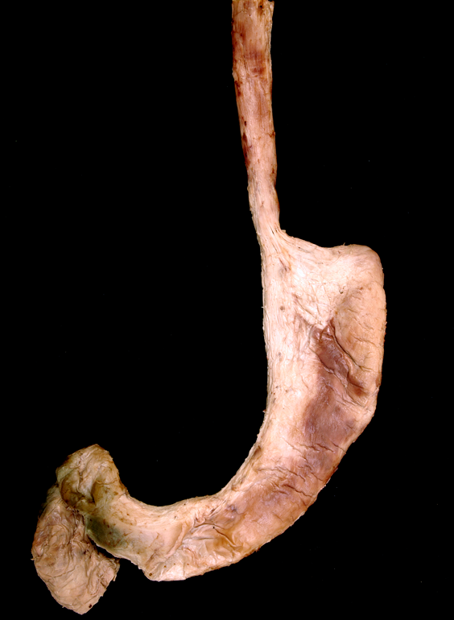
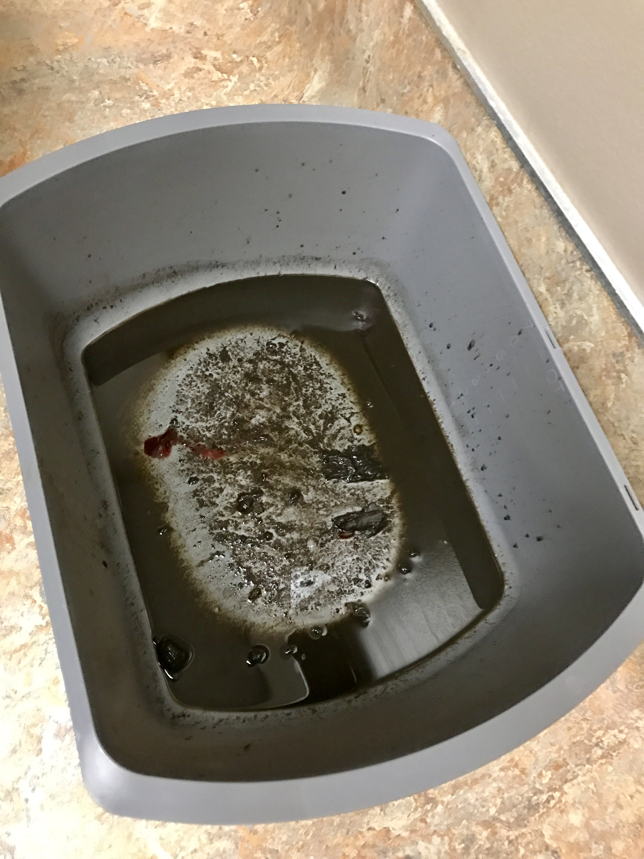
Perforated Ulcer
Erosion of stomach or duodenal mucosal lining
Most commonly caused by H. pylori infection or NSAID overuse
Can cause bleeding/hematemesis
Perforation is a surgical emergency
  Pain initially epigastric, then diffuse
Prehospital Treatment
  Large bore IVs*
  Pain control, NPO
  Transport to surgery center
Notes:
https://www.grepmed.com/images/2203/coffeeground-clinical-emesis-photo-ucsdh
Photo/Dissection courtesy Dr. Frank Willard, UNECOM Human Anatomy Program

Slide 42
Takehome points – Abdominal Pain
Can appear benign, but can have high rates of mortality
History and physical exam are key for diagnosis
Use a standardized, thoughtful approach to your evaluation
Beware of referred pain, consider screening ECG in high-risk groups
Get a screening glucose
Control symptoms in transport, keep your patients comfortable!
*Follow-up on your patient outcomes, you will be surprised what you find out and it will inform your future care!

Slide 43

Thank you for your attention!
Any questions or comments?
Feel free to contact me: mmozer@salud.unm.edu

Slide 44
References
Hansen, J. T., Netter, F. H. 1., & Machado, C. A. G. (2019). Netter's clinical anatomy. 4th edition. Philadelphia, PA, Elsevier.
Simel DL, Ranji SR, Goldman L, Simel DL, Shojania KG. Opiates and Abdominal Pain. In: Simel DL, Rennie D. eds. The Rational Clinical Examination: Evidence-Based Clinical Diagnosis. McGraw Hill; 2009. Accessed September 29, 2023. https://jamaevidence.mhmedical.com/content.aspx?bookid=845&sectionid=61357636
Tintinalli J.E., & Stapczynski J, & Ma O, & Yealy D.M., & Meckler G.D., & Cline D.M.(Eds.), (2016). Tintinalli’s Emergency Medicine: A Comprehensive Study Guide, 8e. McGraw Hill.
Walls RM Hockberger RS Gausche-Hill M. Rosen's Emergency Medicine : Concepts and Clinical Practice. Ninth ed. Philadelphia PA: Elsevier; 2018.
Pictures: Pixabay.com
Life in the Fastlane; www.litfl.com
UNECOM Department of Anatomy
SAEM ”Approach to Abdominal Pain”; https://www.saem.org/about-saem/academies-interest-groups-affiliates2/cdem/for-students/online-education/m4-curriculum/group-m4-approach-to/approach-to-abdominal-pain
Notes:
SAEM ”Approach to Abdominal Pain”; https://www.saem.org/about-saem/academies-interest-groups-affiliates2/cdem/for-students/online-education/m4-curriculum/group-m4-approach-to/approach-to-abdominal-pain

