Slide 1


Welcome!
Distinguishing
Rheumatoid Arthritis
from Osteoarthritis
Jennifer Mandal, MD
September 18, 2023

Slide 2


Disclosures
This activity is jointly provided by Northwest Portland Area Indian Health Board and Cardea Services
Cardea Services is approved as a provider of nursing continuing professional development by Montana Nurses Association, an accredited approver with distinction by the American Nurses Credentialing Center’s Commission on Accreditation.
This activity has been planned and implemented in accordance with the accreditation requirements and policies of the California Medical Association (CMA) through the joint providership of Cardea and Northwest Portland Area Indian Health Board. Cardea is accredited by the CMA to provide continuing medical education for physicians.
Cardea designates this live web-based training for a maximum of 1 AMA PRA Category
1 Credit(s)TM, Physicians should claim credit commensurate with the extent of their participation in the activity.

Slide 3
Disclosures
There are no relevant financial relationships with ineligible companies for those involved with the ability to control the content of this activity.

Slide 4
Disclosures
COMPLETING THIS ACTIVITY
Upon successful completion of this activity 1 contact hour will be awarded
Successful completion of this continuing education activity includes the following:
Attending the entire CE activity;
Completing the online evaluation;
Submitting an online CE request.
Your certificate will be sent via email. If you have any questions about this CE activity, contact Tristan Stitt, tstitt@cardeaservices.org

Slide 5
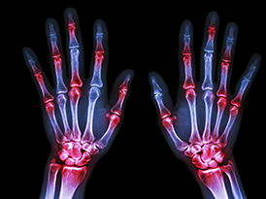
Distinguishing RA from OA
Jennifer Mandal, MD
UCSF Division of Rheumatology
RA ECHO, Session #2
9/18/23

Slide 6
Roadmap
A rheumatologist’s approach to joint pain
RA vs. OA
Erosive/Inflammatory OA
Case Presentation
RAE Initiative| Spring 2023

Slide 7
Approach to the patient with joint pain:
Clinical Clues
Demographics: age, sex
Duration of symptoms: acute, subacute, chronic
Number of joints involved: monoarticular, oligoarticular, polyarticular
Pattern of joints involved: size, symmetry, distribution
Inflammatory vs. non-inflammatory features
RAE Initiative| Spring 2023

Slide 8
Approach to the patient with joint pain:
Clinical Clues
Demographics: age, sex
Duration of symptoms: acute, subacute, chronic
Number of joints involved: monoarticular, oligoarticular, polyarticular
Pattern of joints involved: size, symmetry, distribution
Inflammatory vs. non-inflammatory features
RAE Initiative| Spring 2023

Slide 9
RA vs. OA
RAE Initiative| Fall 2022
 | RA | OA
Description
Demographics

Slide 10
RA vs. OA
RAE Initiative| Fall 2022
 | RA | OA
Description | Most common form of autoimmune, inflammatory arthritis | Degenerative arthritis, characterized by progressive wearing down of cartilage*
Demographics

Slide 11
RA vs. OA
 | RA | OA
Description | Most common form of autoimmune, inflammatory arthritis | Degenerative arthritis, characterized by progressive wearing down of cartilage*
Demographics | US prevalence = 0.8% (1-10% among AI/AN depending on tribe) Female (2:1) Onset at any age (30-50 most common) Environmental risk factors: smoking, gingivitis First degree relative w/ seropositive RA → 3-5x lifetime risk | Most common form of arthritis by far. Lifetime risk of symptomatic knee OA: 45%; hip OA: 25%; Hand OA: 40% Female (1.7 to 1) Age >50 Risk factors: obesity, prior joint injury, physically demanding job, joint malalignment

Slide 12
Approach to the patient with joint pain:
Clinical Clues
Demographics: age, sex, ethnicity
Duration of symptoms: acute, subacute, chronic
Number of joints involved: monoarticular, oligoarticular, polyarticular
Pattern of joints involved: size, symmetry, distribution
Inflammatory vs. non-inflammatory features
RAE Initiative| Spring 2023

Slide 13
RA vs. OA
 | RA | OA
Duration of symptoms | Gradual, insidious onset over months Rarely, RA can present w/ “explosive” onset | Gradual, insidious onset over months-years
RAE Initiative| Spring 2023
Notes:
Symptom duration >6 weeks is a diagnostic criteria for RA

Slide 14
Approach to the patient with joint pain:
Clinical Clues
Demographics: age, sex, ethnicity
Duration of symptoms: acute, subacute, chronic
Number of joints involved: monoarticular, oligoarticular, polyarticular
Pattern of joints involved: size, symmetry, distribution
Inflammatory vs. non-inflammatory features

Slide 15
Poll Question #1
Rheumatoid arthritis is a symmetric polyarthritis that almost always SPARES the:
Cervical spine
Distal interphalangeal joints (DIPs)
Elbows
Hips
Metacarpophalangeal joints (MCPs)
RAE Initiative| Spring 2023

Slide 16
Poll Question #1
Rheumatoid arthritis is a symmetric polyarthritis that almost always SPARES the:
Cervical spine
Distal interphalangeal joints (DIPs)
Elbows
Hips
Metacarpophalangeal joints (MCPs)
RAE Initiative| Spring 2023

Slide 17
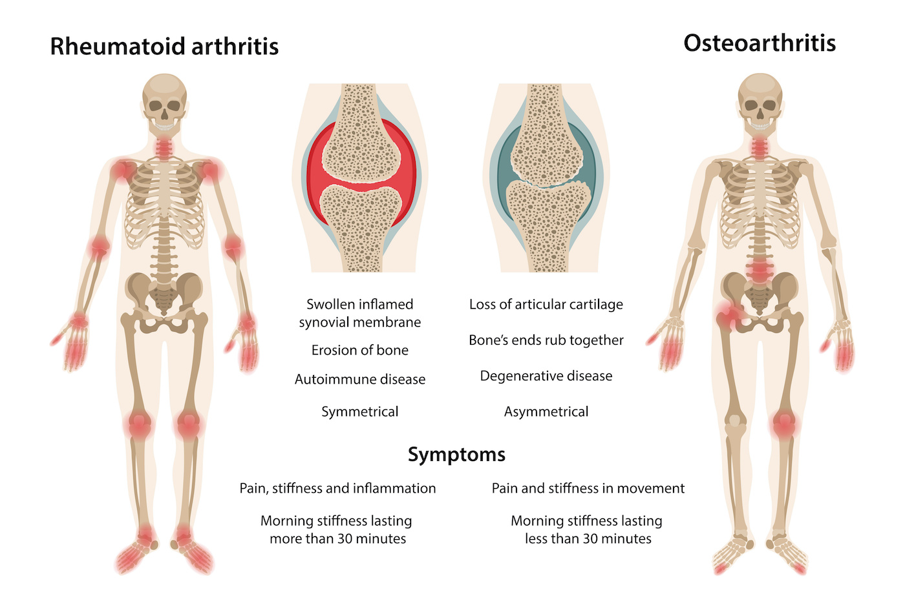
Joint Distribution
Polyarticular, symmetric arthritis affecting small, medium, and large joints
Oligo- or polyarticular arthritis, affecting mostly large joints + fingers, can be symmetric or asymmetric
Neck
Shoulders
Elbows
Wrists
Hands (MCPs, PIPs)
Knee
Toes
Spares the:
Low back
DIPs
Fingers (PIPs, DIPs)
Low back
Hip
Knee
Spares the:
MCPs
Wrists

Slide 18
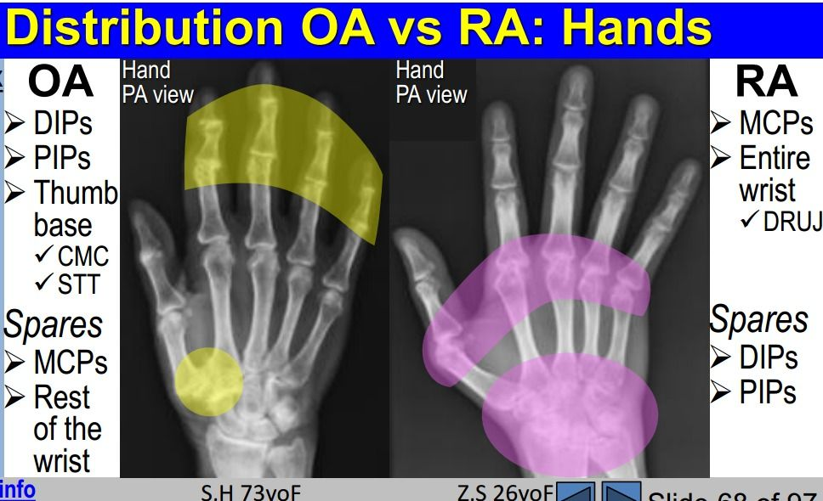
Give me a hand….
Quick Pearl: DDx for DIP arthritis
OA
Psoriatic Arthritis
Gout/CPPD
RA
OA

Slide 19
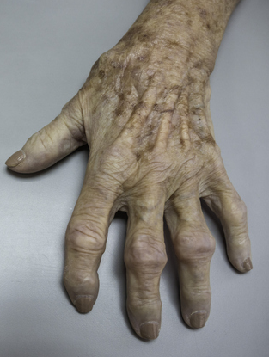
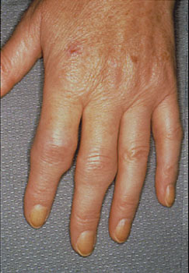
Give me a hand….
RA
OA
Synovitis (“squishy”, “bouncy”)
“Squaring off” at base of thumb
Bouchards node
Bony enlargement without synovitis
Heberdens node

Slide 20
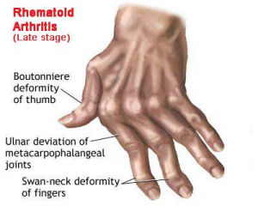
Give me a hand….
RA
OA
Synovitis (“squishy”, “bouncy”)
“Squaring off” at base of thumb
Ulnar deviation
Swan neck deformities
Bouchards node
Bony enlargement without synovitis
Boutonniere deformity
Rheumatoid nodules
Heberdens node

Slide 21
Approach to the patient with joint pain:
Clinical Clues
Demographics: age, sex, ethnicity
Duration of symptoms: acute, subacute, chronic
Number of joints involved: monoarticular, oligoarticular, polyarticular
Pattern of joints involved: size, symmetry, distribution
Inflammatory vs. non-inflammatory features

Slide 22
Poll Question #2
If you are trying to distinguish between INFLAMMATORY vs NON-INFLAMMATORY joint pain, which is the highest yield question to ask your patient?
A. Have you noticed joint swelling?
B. Does your joint pain getter better with activity, or worse?
C. Do your joints feels stiff when you wake up in the morning?
D. How long has your joint pain been going on?

Slide 23
Poll Question #2
If you are trying to distinguish between INFLAMMATORY vs NON-INFLAMMATORY joint pain, which is the highest yield question to ask your patient?
A. Have you noticed joint swelling?
B. Does your joint pain getter better with activity, or worse?
C. Do your joints feels stiff when you wake up in the morning?
D. How long has your joint pain been going on?

Slide 24
Inflammatory vs. non-inflammatory joint pain
 | Inflammatory (RA, SpA, SLE, etc) | Non-inflammatory (OA)
Prolonged morning stiffness (>1hr)
Improves or worsens with activity?
Constitutional sx
ESR/CRP
Extra-articular manifestations

Slide 25
Inflammatory vs. non-inflammatory joint pain
 | Inflammatory (RA, SpA, SLE, etc) | Non-inflammatory (OA)
Prolonged morning stiffness (>1hr) | + | _
Improves or worsens with activity?
Constitutional sx
ESR/CRP
Extra-articular manifestations

Slide 26
Inflammatory vs. non-inflammatory joint pain
 | Inflammatory (RA, SpA, SLE, etc) | Non-inflammatory (OA)
Prolonged morning stiffness (>1hr) | + | _
Improves or worsens with activity? | Improves | Worsens
Constitutional sx
ESR/CRP
Extra-articular manifestations

Slide 27
Inflammatory vs. non-inflammatory joint pain
 | Inflammatory (RA, SpA, SLE, etc) | Non-inflammatory (OA)
Prolonged morning stiffness (>1hr) | + | _
Improves or worsens with activity? | Improves | Worsens
Constitutional sx | + | _
ESR/CRP
Extra-articular manifestations

Slide 28
Inflammatory vs. non-inflammatory joint pain
 | Inflammatory (RA, SpA, SLE, etc) | Non-inflammatory (OA)
Prolonged morning stiffness (>1hr) | + | _
Improves or worsens with activity? | Improves | Worsens
Constitutional sx | + | _
ESR/CRP | Elevated | Normal
Extra-articular manifestations

Slide 29
Inflammatory vs. non-inflammatory joint pain
 | Inflammatory (RA, SpA, SLE, etc) | Non-inflammatory (OA)
Prolonged morning stiffness (>1hr) | + | _
Improves or worsens with activity? | Improves | Worsens
Constitutional sx | + | _
ESR/CRP | Elevated | Normal
Extra-articular manifestations | + | _

Slide 30
Inflammatory vs. non-inflammatory joint pain
 | Inflammatory (RA, SpA, SLE, etc) | Non-inflammatory (OA)
Synovitis (ex: hands, wrist)
Joint effusion (ex: knee)
Warmth
Erythema

Slide 31
Inflammatory vs. non-inflammatory joint pain
 | Inflammatory (RA, SpA, SLE, etc) | Non-inflammatory (OA)
Synovitis (ex: hands, wrist) | + | _
Joint effusion (ex: knee)
Warmth
Erythema

Slide 32
Inflammatory vs. non-inflammatory joint pain
 | Inflammatory (RA, SpA, SLE, etc) | Non-inflammatory (OA)
Synovitis (ex: hands, wrist) | + | _
Joint effusion (ex: knee) | + | +/-
Warmth
Erythema

Slide 33
Inflammatory vs. non-inflammatory joint pain
 | Inflammatory (RA, SpA, SLE, etc) | Non-inflammatory (OA)
Synovitis (ex: hands, wrist) | + | _
Joint effusion (ex: knee) | + | +/-
Warmth | +/- | _
Erythema

Slide 34
Inflammatory vs. non-inflammatory joint pain
 | Inflammatory (RA, SpA, SLE, etc) | Non-inflammatory (OA)
Synovitis (ex: hands, wrist) | + | _
Joint effusion (ex: knee) | + | +/-
Warmth | +/- | _
Erythema | +/- | _

Slide 35
Useful screening questions for inflammatory arthritis
“Is there a particular time of day when your joint pain and stiffness is the worst?”
  [If they report AM stiffness → “How long does it take before your joints start to loosen up?”]
”Does being active (walking around, using your hands, etc) generally make your joints feel better or worse?”
RAE Initiative| Spring 2023

Slide 36
The plot thickens…

Slide 37
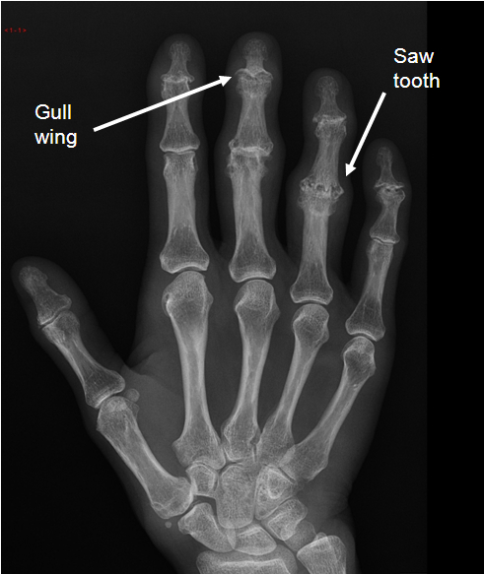
So what is Erosive OA??
A form of OA that is characterized by inflammation and erosions.
Wait, what???
Affects the hands (DIPs, PIPs)
Peri/postmenopausal women
Warmth, swelling, synovitis, AM stiffness
Can cause central erosions in the DIPs/PIPs
NOT autoimmune, does not benefit from immunosuppression
DDx = psoriatic arthritis, gout/CPPD
Less debilitating than RA, tends to “burn out” over time

Slide 38
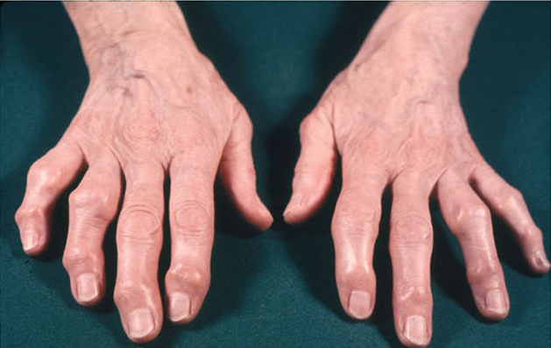
RAE Initiative| Spring 2023

Slide 39
 | Erosive OA | RA
Demographics | F>>>M (12:1), often starts around menopause, family history common | F>M (2:1), typical onset age 30-50 but can occur at any age
Joints involved | Fingers: DIPs, PIPs | Widespread: small/med/large joints. Spares the DIPs.
Erosions | Central (“gull-wing deformity”) | Marginal
Warmth, synovitis, AM stiffness | Yes | Yes
ESR, CRP | Normal | Elevated
RF, CCP | Negative | Usually positive
Natural history | Worsens in each joint for ?2-5 years, then plateaus | Chronic, progressive
Treatment | Typical OA treatments, intra-articular steroid injections, ?hydroxychloroquine | Immunosuppression: conventional DMARDs, biologics, steroids
Notes:
2 RCTs looking at hydroxychloroquine – no benefit in pain reduction, pehaps some role in eOA patients with ore robust synovitis? TNFi trials were negative.

Slide 40
Case Presentation

Slide 41
Next week….
Labs & Xray Findings in RA
RAE Initiative| Spring 2023

Slide 42

Thank
you!
Please reach out to
raeinitiative@gmail.com with any inquiries or comments.
RAE Initiative| Spring 2023

