Slide 1
HIV PrEP and PEP in Primary Care
Jorge Mera, MD, FACP
October 17, 2023
Whitney Essex
September 2023

Slide 2
Outline
HIV PrEP
HIV PEP
Oral
Injectable
DoxyPEP

Slide 3

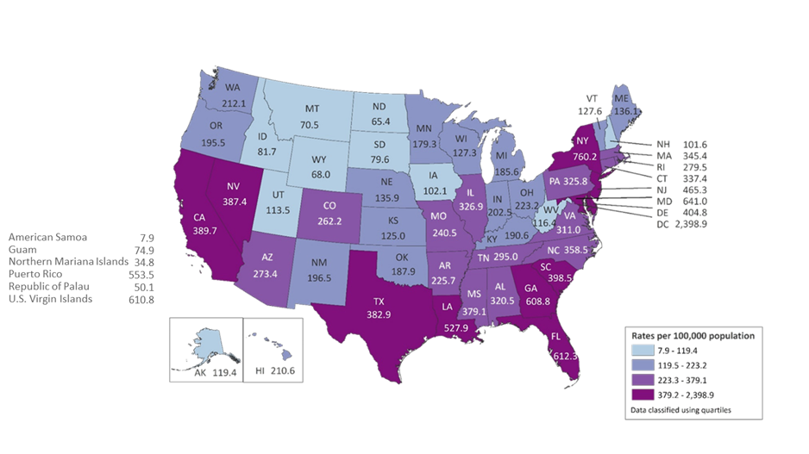

Slide 4
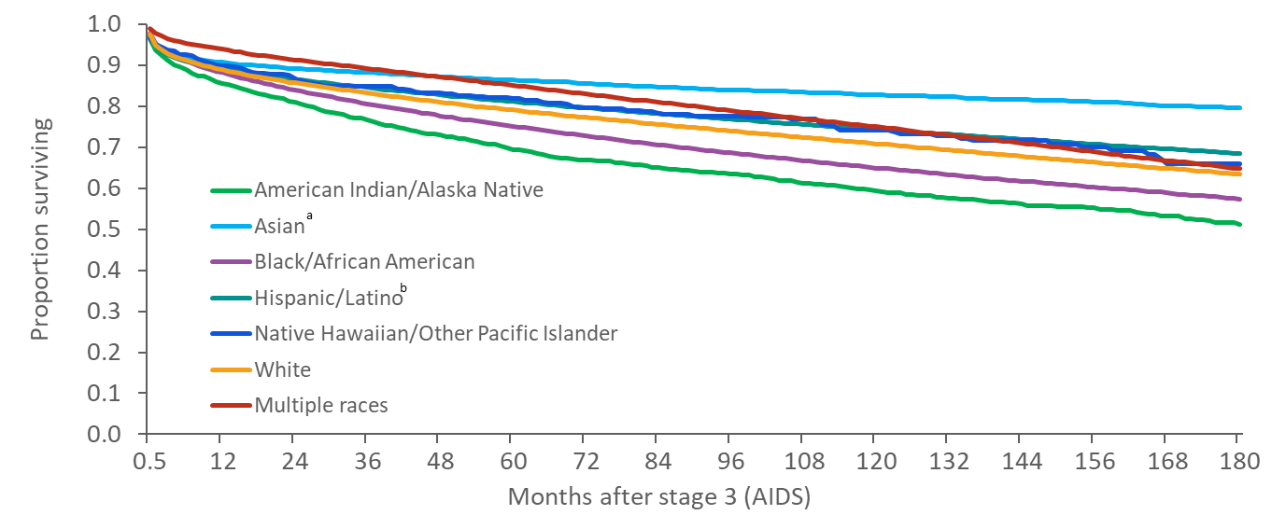
Survival after Classification of Stage 3 (AIDS) during 2000—2013, by Months Survived and Race/Ethnicity—United States and 6 Dependent Areas
Note. Data exclude persons whose month of diagnosis or month of death is unknown.
ª Includes Asian/Pacific Islander legacy cases.
^{b} Hispanics/Latinos can be of any race.
Notes:
This slide presents the proportion of persons with diagnosed HIV infection surviving after a classification of stage 3 (AIDS) during 2000–2013 in 12 month increments, by race/ethnicity, in the United States and 6 dependent areas.
Survival was greatest among Asians. Survival was greater among Asians, Hispanics/Latinos, whites, and persons of multiple races than among blacks/African Americans. Results should be interpreted with caution for American Indians/Alaska Natives and Native Hawaiians/other Pacific Islanders because the numbers of persons in these groups were small.
Data exclude persons whose month of diagnosis or month of death is unknown.
The Asian category includes Asian/Pacific Islander legacy cases (cases that were diagnosed and reported under the pre-1997 Office of Management and Budget race/ethnicity classification system).
Hispanics/Latinos can be of any race.

Slide 5
Which of the Following Best
Describes your Experience with PrEP?
A. Never heard of PrEP
B. Familiar with PrEP but have never recommended it
C. Prescribed PrEP a few times before
D. Extensive experience prescribing PrEP to patients

Slide 6
HIV Prevention Strategies
Sexual behavior modification
Condom use
Test and treat STIs
HIV treatment as prevention (U=U)
PrEP: Pre-Exposure Prophylaxis
PEP: Post-Exposure Prophylaxis
Offer sterile, personalized injection drug use equipment for people who inject drugs
https://aidsinfo.nih.gov/understanding-hiv-aids/fact-sheets/20/48/the-basics-of-hiv-prevention

Slide 7
HIV Prevention Strategies
Sexual behavior modification
Condom use
Test and treat STIs
HIV treatment as prevention (U=U)
PrEP: Pre-Exposure Prophylaxis
PEP: Post-Exposure Prophylaxis
Offer sterile, personalized injection drug use equipment for people who inject drugs
https://aidsinfo.nih.gov/understanding-hiv-aids/fact-sheets/20/48/the-basics-of-hiv-prevention

Slide 8
Which of the following patients would benefit from PrEP?
A person who injects drugs, shares needles and the last injection was 2 months ago
A man who has sex with men (MSM), has a stable HIV negative partner and uses condoms systematically
A heterosexual female recently diagnosed with syphilis
A 23 yo male who is asking for PrEP but denies any risk factors for HIV

Slide 9
What is PrEP?
PrEP is not a substitution for other HIV prevention interventions!
PrEP does not protect against other STIs!
Pre-exposure prophylaxis (or PrEP) is when people at very high risk for HIV take antiretroviral medication to lower their chances of HIV infection
  Helps prevent an HIV-negative person from getting HIV from a sexual or injection-drug-using partner who is HIV positive
Medication
  Tenofovir and emtricitabine combo pill (Truvada®) or (Descovy®) taken daily
  OR
  Cabotegravir extended-release injectable suspension (Apretude®) taken intramuscularly as two initiation injections administered one month apart, and then every two months thereafter
https://www.cdc.gov/hiv/pdf/risk/prep/cdc-hiv-prep-guidelines-2021.pdf

Slide 10
Why PrEP?
PrEP is highly effective
When taking oral PrEP daily or consistently (at least 4 times per week) the risk of acquiring HIV is reduced by:
about 99% among MSM (men who have sex with men)
an estimated 74 – 84% among PWID
https://www.cdc.gov/hiv/risk/estimates/preventionstrategies.html

Slide 11
Who should be offered PrEP?
Anyone who is at risk for acquiring HIV
The federal guidelines recommend that PrEP be considered for people who are HIV negative and:
  Have had anal or vaginal sex in the past 6 months and:
    Have a sexual partner with HIV (especially if the partner has an unknown or detectable viral load), or
    Have not consistently used a condom, or
    Have been diagnosed with an STI in the past 6 months
  PrEP is also recommended for people who inject drugs and
    have an injection partner with HIV, or
    share needles, syringes, or other equipment to inject drugs (for example, cookers).
  PrEP should also be considered for people who have been prescribed non-occupational post-exposure prophylaxis (PEP) and
    report continued risk behavior, or
    have used multiple courses of PEP
https://www.cdc.gov/hiv/pdf/risk/prep/cdc-hiv-prep-guidelines-2021.pdf

Slide 12
Oral PrEP

Slide 13
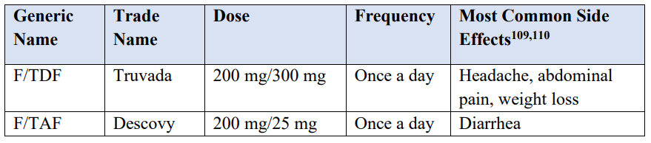
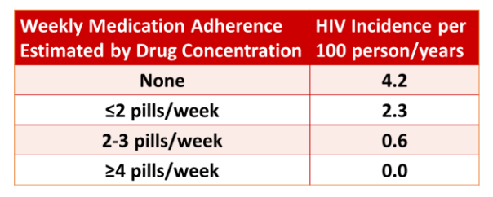
Oral PrEP
Recommended Oral PrEP Medications
Adherence and F/TDF PrEP Efficacy in MSM
https://www.cdc.gov/hiv/pdf/risk/prep/cdc-hiv-prep-guidelines-2021.pdf

Slide 14
Baseline Labs for Oral PrEP
Plus other STI Screening
Renal function
Hepatitis B serology:
Hep B Surface Ab
Hep B Surface Ag
Hep B Core Ab
Lipid profile (F/TAF)
HIV 1/2 Ab/Ag
Add on HIV RNA (Viral Load) for anyone who has taken oral PrEP in the last 3 months and/or has received a CAB injection in the last 12 months
HIV RNA (Viral Load)
Anyone who has taken oral PrEP in the last 3 months and/or has received a CAB injection in the last 12 months
https://www.cdc.gov/hiv/pdf/risk/prep/cdc-hiv-prep-guidelines-2021.pdf

Slide 15
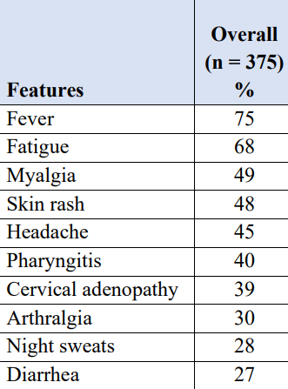
Oral PrEP Follow-up
Every 3 months:
  Repeat HIV testing
  Assess for signs or symptoms of acute HIV infection
  Provide RX for no more than 90 days (until the next HIV test)
  Assess medication adherence and risk-reduction behaviors
  Conduct STI testing if symptoms of infection
  Conduct STI screening for asymptomatic MSM at high risk for syphilis, gonorrhea, or chlamydia
https://www.cdc.gov/hiv/pdf/risk/prep/cdc-hiv-prep-guidelines-2021.pdf

Slide 16
Oral PrEP Follow-up
Every 6 months:
  Monitor eCrCl for persons age ≥50 years or who have an eCrCl <90 ml/min at PrEP initiation
    If other threats to renal safety are present (e.g., hypertension, diabetes), renal function may require more frequent monitoring or may need to include additional tests (e.g., urinalysis for proteinuria)
    A rise in serum creatinine is not a reason to withhold treatment if eCrCl remains ≥60 ml/min for F/TDF or ≥30 for F/TAF
    If eCrCl is declining steadily (but still ≥60 ml/min for F/TDF or ≥30 ml/min for F/TAF), ask if the patient is taking high doses of NSAID or using protein powders; consultation with a nephrologist or other evaluation of possible threats to renal health may be indicated
  Conduct STI screening for sexually active persons (i.e., syphilis, gonorrhea, for all PrEP patients and chlamydia for MSM and TGW even if asymptomatic)
  Assess need for continuing or discontinuing PrEP
https://www.cdc.gov/hiv/pdf/risk/prep/cdc-hiv-prep-guidelines-2021.pdf

Slide 17
Oral PrEP Follow-up
At least every 12 months:
  Monitor eCrCl for all patients continuing on PrEP medication
  Monitor triglyceride, cholesterol levels, and weight for patients prescribed F/TAF for PrEP
  Conduct chlamydia screening for heterosexual women and men even if asymptomatic
https://www.cdc.gov/hiv/pdf/risk/prep/cdc-hiv-prep-guidelines-2021.pdf

Slide 18
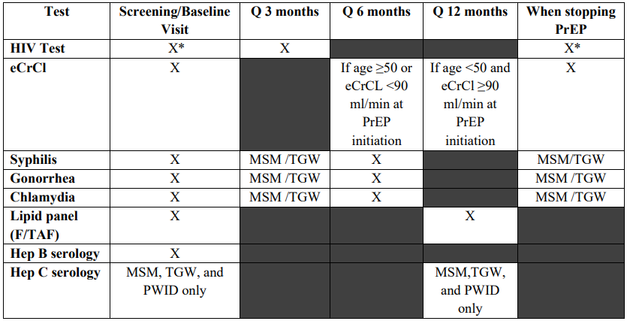
Timing of Oral PrEP-associated Lab Tests
* Assess for acute HIV infection
https://www.cdc.gov/hiv/pdf/risk/prep/cdc-hiv-prep-guidelines-2021.pdf

Slide 19
Discontinuing Oral PrEP
Provider should document:
HIV status at the time of discontinuation
Reason for discontinuation
Recent medication adherence and reported sexual risk behavior
Restarting PrEP requires same initial evaluation, minus the Hep B serology
https://www.cdc.gov/hiv/pdf/risk/prep/cdc-hiv-prep-guidelines-2021.pdf

Slide 20
Injectable PrEP

Slide 21
Injectable PrEP
Cabotegravir (CAB) 600 mg (brand name Apretude®)
Only for patients whose risk factors for HIV include sexual transmission only (not for PWID)
Adults and adolescents who weigh at least 35 kg (77 lb)
CAB injections may be a good option for PrEP for people who
  Have problems taking oral PrEP as prescribed
  Prefer getting a shot every 2 months instead of taking oral PrEP
  Have serious kidney disease that prevents use of oral PrEP medications
https://www.cdc.gov/stophivtogether/library/topics/prevention/brochures/cdc-lsht-prevention-brochure-clinicians-quick-guide-what-is-injectable-hiv-prep.pdf

Slide 22
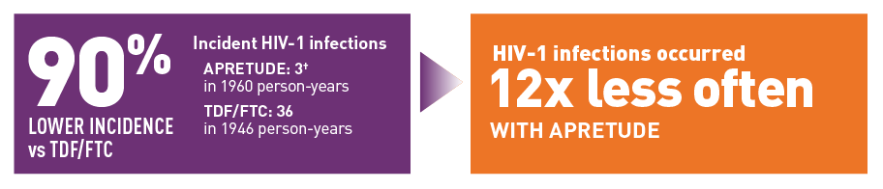
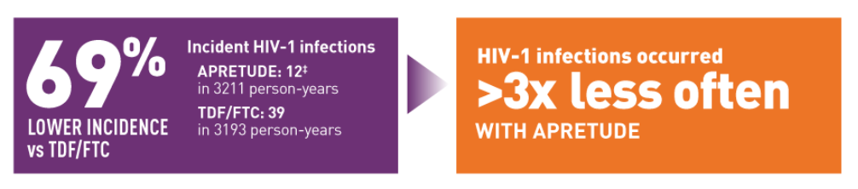
CAB: Significantly Lower Incidence of HIV-1 Infection vs Daily Oral PrEP
Women
18-45 yo
MSM/TGW
>18 yo
https://apretudehcp.com/efficacy/

Slide 23
Contraindications – CAB
Unknown or positive HIV-1 status
Previous hypersensitivity reaction to CAB
Taking medications that reduce concentrations of CAB
Anticonvulsants: Carbamazepine, oxcarbazepine, phenobarbital, phenytoin
Antimycobacterials: Rifampin, rifapentine
https://www.accessdata.fda.gov/drugsatfda_docs/label/2023/215499s002lbl.pdf

Slide 24
CAB – Side Effects
Injection site reactions
Headache
Fever
Fatigue
Diarrhea
Nausea
Rash
https://www.accessdata.fda.gov/drugsatfda_docs/label/2023/215499s002lbl.pdf

Slide 25
How Is Injectable PrEP Administered?
IM – ventro- (preferred) or dorso- gluteal – 3mL at room temp – must be given within 2 hours of drawing it up in syringe – use long enough needle based on body habitus – 1.5-2”
First dose – IM injection of CAB 600mg
1 month later – IM injection of CAB 600mg
Every 2 months after - IM injection of CAB 600mg
If concern for side effects:
  A 4-week lead-in period of 30 mg daily oral CAB prior to the first injection is optional
https://www.cdc.gov/stophivtogether/library/topics/prevention/brochures/cdc-lsht-prevention-brochure-clinicians-quick-guide-what-is-injectable-hiv-prep.pdf; https://www.accessdata.fda.gov/drugsatfda_docs/label/2023/215499s002lbl.pdf

Slide 26
Baseline Assessment for PrEP with CAB
Visit #1
HIV testing: Confirm that the patient does not have HIV before prescribing PrEP
Sexually transmitted infection (STI) testing: Screen injectable PrEP candidates who are sexually active for chlamydia, gonorrhea, and syphilis
Tests not indicated with CAB that are indicated with F/TAF or F/TDF:
Creatinine, eCrCl, hepatitis B serology, lipid panels
https://www.cdc.gov/stophivtogether/library/topics/prevention/brochures/cdc-lsht-prevention-brochure-clinicians-quick-guide-what-is-injectable-hiv-prep.pdf
Notes:
Because of the long duration of drug exposure following injection, exclusion of acute HIV infection is necessary with the most sensitive test available, an HIV-1 RNA assay. Ideally, this testing will be done within 1 week prior to the initiation visit. If clinicians wish to provide the first injection at the first PrEP evaluation visit based on the result of a rapid combined antigen/antibody assay, blood should always be drawn for laboratory confirmatory testing that includes an HIV RNA assay

Slide 27
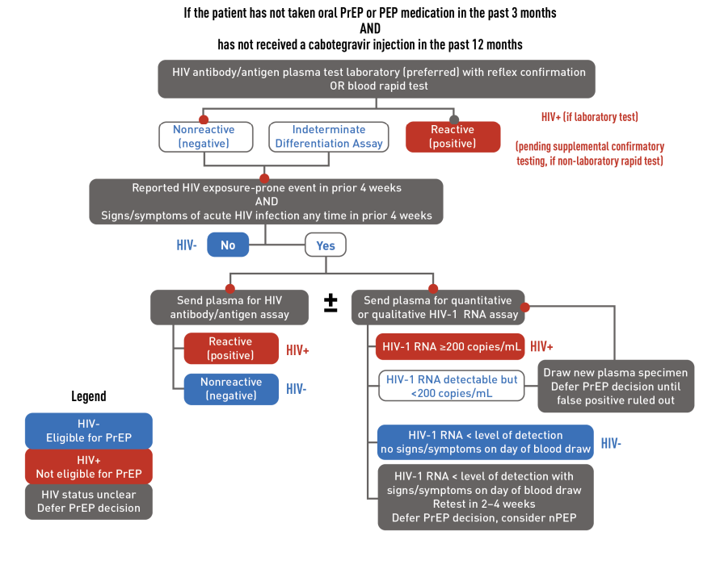
https://www.cdc.gov/stophivtogether/library/topics/prevention/brochures/cdc-lsht-prevention-brochure-clinicians-quick-guide-what-is-injectable-hiv-prep.pdf

Slide 28
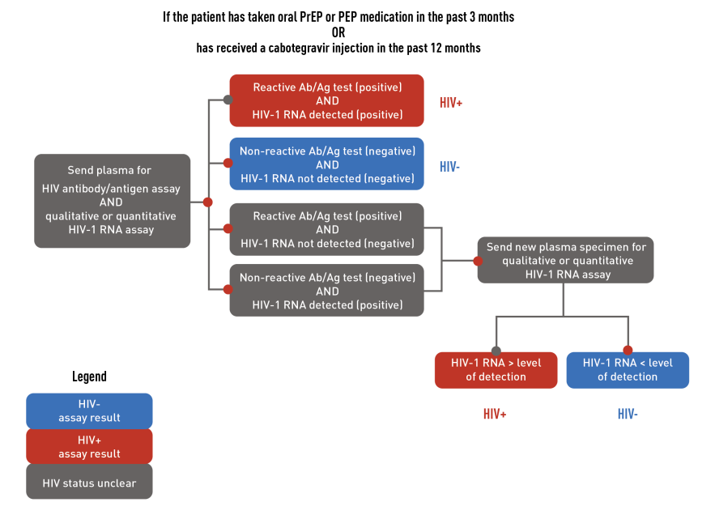
https://www.cdc.gov/stophivtogether/library/topics/prevention/brochures/cdc-lsht-prevention-brochure-clinicians-quick-guide-what-is-injectable-hiv-prep.pdf

Slide 29
Visit #2 – Month 1
Test for HIV with antigen/antibody and HIV-1 RNA assays
Assess for signs or symptoms of acute HIV infection
Administer 2nd CAB injection
Respond to new questions
Provide medication adherence and behavioral risk-reduction support
https://www.cdc.gov/stophivtogether/library/topics/prevention/brochures/cdc-lsht-prevention-brochure-clinicians-quick-guide-what-is-injectable-hiv-prep.pdf

Slide 30
Visit #3 – Month 3 – Repeat Bimonthly
Test for HIV with antigen/antibody and HIV-1 RNA assays
Assess for signs or symptoms of acute HIV infection
Administer CAB injection
Provide access to sterile needles or syringes and substance use disorder treatment services for people who inject drugs
Respond to new questions and provide any new information about CAB for PrEP
Discuss the benefits of persistent CAB for PrEP use and adherence to scheduled injection visits
https://www.cdc.gov/stophivtogether/library/topics/prevention/brochures/cdc-lsht-prevention-brochure-clinicians-quick-guide-what-is-injectable-hiv-prep.pdf

Slide 31
Bacterial STI Testing with CAB
For gay, bisexual, and other MSM or TGW who have sex with men:
At least every 4 months, and as often as needed
Oral, rectal, urine, blood
For heterosexually active people:
At least every 6 months, and as often as needed
Vaginal, oral, rectal, urine, as indicated; blood
Screen for:
Gonorrhea
Chlamydia
Syphilis
https://www.cdc.gov/stophivtogether/library/topics/prevention/brochures/cdc-lsht-prevention-brochure-clinicians-quick-guide-what-is-injectable-hiv-prep.pdf

Slide 32
Discontinuing CAB
Educate patients about the “tail” and the risks during declining CAB levels
Assess ongoing risk/indications
If PrEP is indicated, prescribe daily oral F/TDF or F/TAF beginning within 8 weeks after last injection
Educate about nPEP
Continue follow-up visits quarterly for 12 months
  Conduct HIV-1 RNA tests at each quarterly follow-up visit after discontinuing CAB injections
https://www.cdc.gov/stophivtogether/library/topics/prevention/brochures/cdc-lsht-prevention-brochure-clinicians-quick-guide-what-is-injectable-hiv-prep.pdf
Notes:
CAB levels slowly wane over many months after injections are discontinued. In the HPTN 077 trial, the median time to undetectable CAB plasma levels was 44 weeks for men and 67 weeks for women with a wide range for both sexes. At some point during this “tail” phase, CAB levels will fall below a protective threshold and persist for some time at nonprotective levels exposing the patient to the risk of HIV acquisition. These lower levels of CAB may however be sufficient to apply selective pressure that selects for existing or de-novo viral strains with mutations that confer resistance to CAB or other INSTI medications. Infection with INSTI-resistant virus may complicate HIV treatment.

Slide 33
Unplanned Missed CAB Injections
If a scheduled injection visit is missed or delayed by more than 7 days:
 | Time since Last Injection | Recommendation
If second injection is missed and time since first injection is: | Less than or equal to 2 months | Administer CAB as soon as possible, then continue to follow the every-2-month dosing schedule.
 | Greater than 2 months | Restart CAB from the beginning - with monthly doses x 2, then every-2-month dosing schedule.
If third or subsequent injection is missed and time since prior injection is: | Less than or equal to 3 months | Administer CAB as soon as possible, then continue with the every-2-month injection dosing schedule.
 | Greater than 3 months | Restart CAB from the beginning - with monthly doses x 2, then every-2-month dosing schedule.
https://www.accessdata.fda.gov/drugsatfda_docs/label/2023/215499s002lbl.pdf

Slide 34
Do not….with CAB
Do not give other antiretroviral medications with CAB for PrEP
Do not administer at any site other than gluteal muscle
Do not dispense for home administration
Do not prescribe ongoing daily oral CAB (other than for lead-in prior to initiating or restarting injections)
https://www.cdc.gov/stophivtogether/library/topics/prevention/brochures/cdc-lsht-prevention-brochure-clinicians-quick-guide-what-is-injectable-hiv-prep.pdf

Slide 35
Role of the PCP in PrEP
Consider PrEP for at-risk individuals
  Take a good sexual health history to find at-risk individuals
  Ask about injection drug use
Discuss with the patient the principles of PrEP
Offer brochures for PrEP in your office
Decide:
  Is this something I will offer my patient?
  If not me, who? If not now, when?

Slide 36
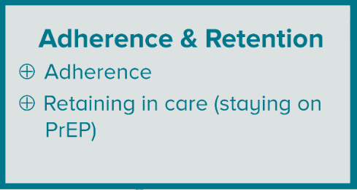
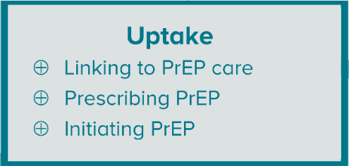
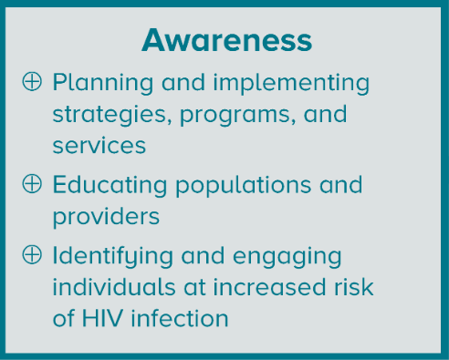
PrEP Care

Slide 37
Post-exposure Prophylaxis (PEP)

Slide 38
Exposure to HIV is an Emergency!
The ideal time to administer PEP – within 2 hours of exposure!
  Consider giving the first dose, aka emergency dose, immediately upon presentation
Can be given up to 72 hours after exposure
After 72 hours, it should not be given
Sooner = Better

Slide 39
Who should be offered PEP?
Individuals who are HIV negative or unknown HIV status who:
May have been exposed to HIV during sex
Shared needles or other equipment (works) to inject drugs
Were sexually assaulted
May have been exposed to HIV at work

Slide 40
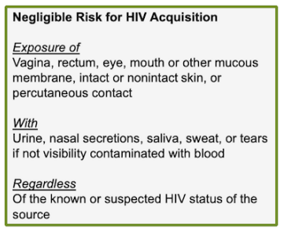
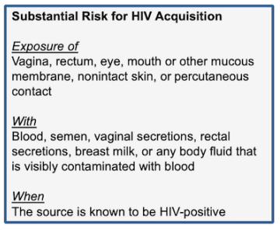
Determining Exposure Risk
https://www.hiv.uw.edu/pdf/prevention/nonoccupational-postexposure-prophylaxis/core-concept/all

Slide 41
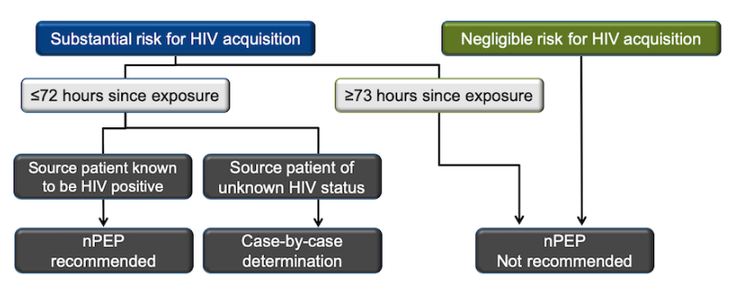
Algorithm for Evaluation and Treatment of possible nonoccupational HIV exposures
HIV test at baseline,
4 weeks, and 12 weeks
https://www.hiv.uw.edu/pdf/prevention/nonoccupational-postexposure-prophylaxis/core-concept/all

Slide 42
Recommended Labs for nPEP evaluation
Baseline
HIV Ab/Ag test
Hep B Surface Ab
4-6 weeks
HIV Ab/Ag test
Cr/AST/ALT**
3 months
HIV Ab/Ag test
Hep B Surface Ag
Hep B core Ab
Hep C Ab
Syphilis serology*
Gonorrhea*^
Chlamydia*^
Pregnancy*
Cr/AST/ALT
Syphilis serology*
Gonorrhea*^
Chlamydia*^
Pregnancy*
6 months
Syphilis serology*
HIV Ab/Ag test if acquired HCV from the exposure
Hep B serologies if not immune
Hep C Ab
*Sexual exposure only; ^Screen all sites of contact; **Only if taking oral PEP
Notes:
6 month testing caveats:
HIV test at 6 months is only if hepatitis C infection was acquired during the original exposure because there can be a delay in HIV seroconversion in persons who simultaneously acquire HIV and hepatitis C infection.

Slide 43
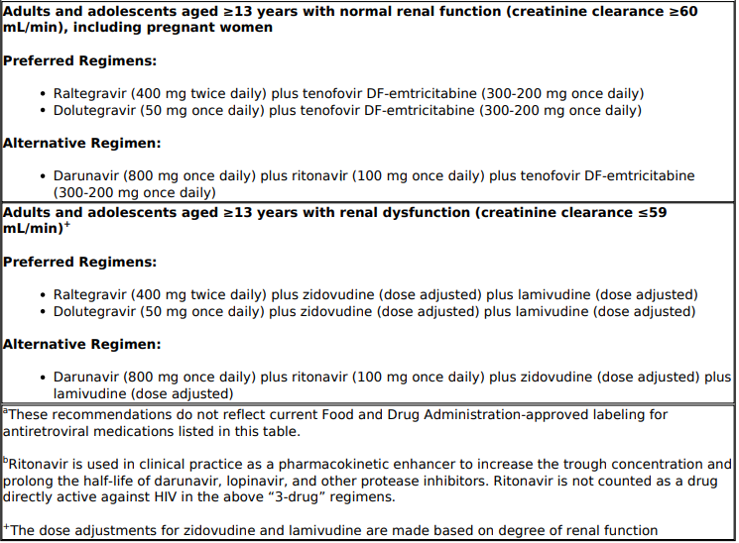
Recommended Regimens for PEP
Centers for Disease Control and Prevention: U.S. Department of Health and Human Services. Updated Guidelines for Antiretroviral Postexposure Prophylaxis After Sexual, Injection Drug Use, and Other Nonoccupational Exposure to HIV—United States, 2016. [CDC]

Slide 44
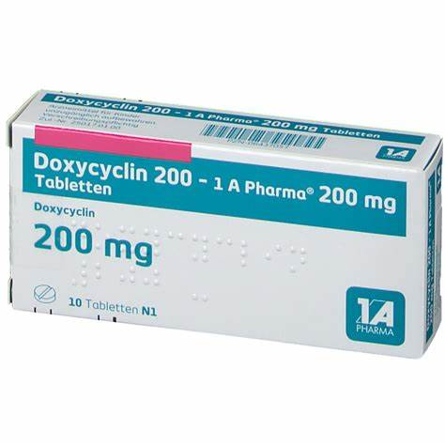
STI PEP
(Post-Exposure Prophylaxis)
Take 1 dose, Doxycycline 200mg within 72 hours of exposure
  Not to exceed 1 dose every 24 hours
Bacterial STI prevention
Reduces chlamydia, gonorrhea, and syphilis
New approach for individuals at increased risk for these infections
Doxycycline PEP, when offered, should be implemented in the context of a comprehensive sexual health approach including risk reduction counseling, STI screening and treatment, recommended vaccination, and linkage to HIV pre-exposure prophylaxis (PrEP), HIV care, or other services, as appropriate.
https://www.federalregister.gov/documents/2023/10/02/2023-21725/guidelines-for-the-use-of-doxycycline-post-exposure-prophylaxis-for-bacterial-sexually-transmitted

Slide 45
STI PEP (Post-Exposure Prophylaxis)
Take 1 dose, Doxycycline 200mg within 72 hours of having condomless sex
Repeat as needed, but no more than 1 dose within 24 hours

Slide 46
DoxyPEP
Open-label DoxyPEP study (2022): 501 MSM and TGW living with HIV (N=174) or on HIV PrEP (N=327) in San Francisco and Seattle
Randomized to either take DoxyPEP up to once daily (intervention group) vs no medication prophylaxis (control group).
Primary endpoint was incidence of at least 1 STI per follow-up quarter
Study ended early after the data safety monitoring board found a 66% reduction in STIs overall for the intervention group
In the intervention arm, 86% reported taking doxycycline always/often and 71% reported never missing doxycycline
Notes:
Luetkemeyer AF, Donnell D, Dombrowski JC, Cohen S, Grabow C, Brown CE, et al. Postexposure Doxycycline to Prevent Bacterial Sexually Transmitted Infections. N Engl J Med. 2023 Apr 6;388(14):1296–306.

Slide 47
DoxyPEP is Off-Label
CDC has acknowledged that providers and patients have started to use DoxyPEP off-label and provided considerations for its use:
  Reminder that current studies with promising results are only inclusive of MSM and transgender women
  Only Doxycycline has been studied, no other antibiotics
IHS acknowledges that any current use of DoxyPEP or DoxyPrEP is considered off-label
  IHS does not yet officially endorse use of DoxyPEP or DoxyPrEP as the standard of care. Any use of DoxyPEP or DoxyPrEP will be made at the individual provider level
  Currently awaiting CDC to publish guidelines

Slide 48
Barriers to PrEP/PEP
What barriers do you have or foresee to starting PrEP at your site?

Slide 49
What do I do if a patient tests positive for HIV (confirmed)?
Get to know the patient
Destigmatize HIV and normalize HIV care
Explain the basics
Focus on the effectiveness of HIV treatment
Get labs
Start medication on the same day

Slide 50
Initial HIV+ Evaluation - Labs
CD4 cell count | At baseline Every 3 to 6 months (may be extended to ≥12 months in clinically stable patients on ART*)
HIV viral load | At baseline After ART initiation: At 4 to 8 weeks Every 4 to 8 weeks until the viral load is suppressed Every 3 to 4 months thereafter (may be extended to every 6 months in patients who have suppressed viral loads for ≥1 year)
Genotypic resistance testing | At baseline
Notes:
Up to Date: Initial Evaluation of Adults with HIV: https://www.uptodate.com/contents/initial-evaluation-of-adults-with-hiv?search=new%20hiv%20diagnosis&source=search_result&selectedTitle=1~150&usage_type=default&display_rank=1#

Slide 51
Treatment (DHHS recommendation)
Tenofovir/Emtricitabine/Bictegravir 1 po daily
Or
Tenofovir + (Emtricitabine or Lamivudine) + Dolutegravir
Or
Abacavir/Lamivudine/Dolutegravir 1 po daily
  (only if HLA B*5701 negative and HBV negative)
Or
Dolutegravir/Lamivudine 1 po daily
  Only (if HIV VL< 500K, HBV negative, sensitive on GART)
DHHS Adult and Adolescent Antiretroviral HIV Guidelines: https://clinicalinfo.hiv.gov/en/guidelines/adultand-adolescent-arv/hhs-adults-and-adolescents-antiretroviral-guidelines-panel
Notes:
DHHS Adult and Adolescent Antiretroviral HIV Guidelines: https://clinicalinfo.hiv.gov/en/guidelines/adultand-adolescent-arv/hhs-adults-and-adolescents-antiretroviral-guidelines-panel

Slide 52
Screen for other infections
Syphilis serology | At baseline Annually for sexually active persons (or more frequently if at high risk)
Chlamydia and gonorrhea testing (at all sites of potential exposure) | At baseline Annually for sexually active persons (or more frequently if at high risk)
Trichomonas | At baseline for all women Annually for sexually active women
TB testing (TST or IGRA) | At baseline unless there is a history of a prior positive test Annually in patients at ongoing risk for TB unless there is a history of a prior positive test
HAV and HBV serologies | At baseline, with vaccination(s) in persons not immune
HCV serology, with reflex viral level for positive result | At baseline Annually in patients at risk (eg, persons who inject drugs, men who have sex with men, transgender women)
Up to Date: Initial Evaluation of Adults with HIV: https://www.uptodate.com/contents/initial-evaluation-of-adults-with-hiv?search=new%20hiv%20diagnosis&source=search_result&selectedTitle=1~150&usage_type=default&display_rank=1#
Notes:
Up to Date: Initial Evaluation of Adults with HIV: https://www.uptodate.com/contents/initial-evaluation-of-adults-with-hiv?search=new%20hiv%20diagnosis&source=search_result&selectedTitle=1~150&usage_type=default&display_rank=1#

Slide 53
Screen for past infections
Test | Frequency | Comment
Toxoplasma Ab | Once | Prophylaxis if CD4<100
CMV Ab | Once | Test only if low risk (nonMSM/transgender/PWID)
Varicella Ab | Once if no h/o Chickenpox or Shingles | Consider vaccination if negative and CD4>200
Notes:
Up to Date: Initial Evaluation of Adults with HIV: https://www.uptodate.com/contents/initial-evaluation-of-adults-with-hiv?search=new%20hiv%20diagnosis&source=search_result&selectedTitle=1~150&usage_type=default&display_rank=1#

Slide 54
Assess CV risk
Blood pressure check | At baseline and annually (or more frequently as indicated)
Random or fasting glucose and/or hemoglobin A1c | At baseline 1 to 3 months following ART initiation or modification and then annually¶
Fasting lipid profile | At baseline 1 to 3 months following ART initiation or modification and then every 12 months
Weight assessment | At baseline and follow-up visits
Tobacco use assessment | At baseline and annually
Aortic aneurysm screening (abdominal ultrasonography) | Once in men 65 to 75 years old who have ever smoked
Notes:
Up to Date: Initial Evaluation of Adults with HIV: https://www.uptodate.com/contents/initial-evaluation-of-adults-with-hiv?search=new%20hiv%20diagnosis&source=search_result&selectedTitle=1~150&usage_type=default&display_rank=1#

Slide 55
Other assessments/screenings
Assessing other risks
Bone densitometry | At baseline in postmenopausal women and men ≥50 years old Subsequent testing frequency depends on findings on baseline exam
Screening for neuropsychiatric disorders
Depression screening | At baseline and annually
Screening for cognitive deficits | At baseline and annually
Notes:
Up to Date: Initial Evaluation of Adults with HIV: https://www.uptodate.com/contents/initial-evaluation-of-adults-with-hiv?search=new%20hiv%20diagnosis&source=search_result&selectedTitle=1~150&usage_type=default&display_rank=1#

Slide 56
Follow-up tests for monitoring ART toxicity
Complete blood count with differential | At baseline Complete blood count with differential every 3 to 6 months when monitoring CD4 count and every year once the CD4 count is no longer monitored
CMP | At baseline 4 to 8 weeks after ART initiation and every 6 months thereafter
Urinalysis | At baseline After ART initiation or change Every 12 months on ART (every 6 months while on tenofovir disoproxil fumarate or tenofovir alafenamide-containing regimens)
Notes:
Up to Date: Initial Evaluation of Adults with HIV: https://www.uptodate.com/contents/initial-evaluation-of-adults-with-hiv?search=new%20hiv%20diagnosis&source=search_result&selectedTitle=1~150&usage_type=default&display_rank=1#

Slide 57
Screening for cancer
Colonoscopy | At 45 years old in asymptomatic patients at average risk Earlier screening may be warranted for those with strong family history of colon cancer Subsequent testing frequency depends on findings on baseline exam
Mammography | Every other year or annually in women 50 to 74 years old^{Δ}
Cervical Pap smear (with or without HPV testing in women ≥30 years) | At baseline; interval for repeat testing depends on results and whether HPV co-testing was performed◊ Additional testing may be warranted for those with abnormal results
Anal Pap smear | Consider at baseline and annually More frequent or additional testing may be warranted for those with abnormal results
Prostate-specific antigen | For men aged 55 to 69 years, the decision to undergo periodic prostate-specific antigen (PSA)-based screening for prostate cancer should be individualized§
Low-dose helical chest CT | Adults age 50 to 80 years old who are at risk of lung cancer due to smoking (at least a 20 pack-year smoking history and are either current smokers or former smokers having quit within the past 15 years)
Notes:
Up to Date: Initial Evaluation of Adults with HIV: https://www.uptodate.com/contents/initial-evaluation-of-adults-with-hiv?search=new%20hiv%20diagnosis&source=search_result&selectedTitle=1~150&usage_type=default&display_rank=1#

Slide 58
Resources
HIV/PrEP Warm Line: (800) 933-3413
  HIV/AIDS Management | National Clinician Consultation Center (ucsf.edu)
  Clinicians are available Monday through Friday, 9:00 a.m. to 8:00
  p.m. EST. Voice mail is available 24 hours a day.
Indian Country ECHO
  http://www.indiancountryecho.org
  HIV ECHO, 2nd Wednesday of every month
      2-3 pm ET
Notes:
Primary Care Guidance for Persons With Human Immunodeficiency Virus: 2020 Update by the HIV Medicine Association of the Infectious Diseases Society of America, Thompson et al., https://www.idsociety.org/practice-guideline/primary-care-management-of-people-with-hiv/
DHHS Adult and Adolescent Antiretroviral HIV Guidelines: https://clinicalinfo.hiv.gov/en/guidelines/adultand-adolescent-arv/hhs-adults-and-adolescents-antiretroviral-guidelines-panel

Slide 59
Questions?

