Slide 1


BOP Pharmacy Residential MAT Training
CDR Anna Santoro
LCDR Trey Draude
Notes:
Welcome all to todays series on Medication Assisted Treatment.

Slide 2
Learning Objectives
Provide background/historical information and challenges with MAT/MOUD in the BOP.
Describe the format of the MAT Residential Training.
Analyze outcomes and areas of future improvement for MAT/MOUD Trainings.
Notes:
Today we will continue to follow the patient case you just saw started and see an example case go from initial screening to being stable on treatment. The objectives of the day are to…

Slide 3
Disclaimer
Opinions expressed in this presentation are those of the authors and do not necessarily represent the opinions of the U.S. Public Health Service, Federal Bureau of Prisons or the Department of Justice.

Slide 4

Opioid Use Disorder in the Correctional Setting
Incarcerated individuals have been estimated to have a 40 to 100 times greater risk of death from drug overdose in the first 2 weeks after release.
A NEJM study found that overdose was the number one leading cause of death within the first year after release.

Slide 5

Access to MOUD
In 2016, SAMHSA estimated that of the 21.7 million identified in need of Substance Use Disorder (SUD) treatment, only 2.35 million (10.8%) were receiving treatment in the community setting.
In 2015, it was estimated that fewer than 1% of jails and prisons in the United States provided access to MOUD.⁵
This Photo by Unknown Author is licensed under CC BY-SA-NC

Slide 6

Advocacy for MOUD in Correctional Settings
According to the American Civil Liberties Union (ACLU), denying MOUD to incarcerated people with OUD is “cruel and unusual punishment” under the Eighth Amendment.
Denying this treatment or restricting which medications for OUD are offered in a jail or prison, has been characterized as a violation of the American Disabilities Act (ADA), a federal law.

Slide 7
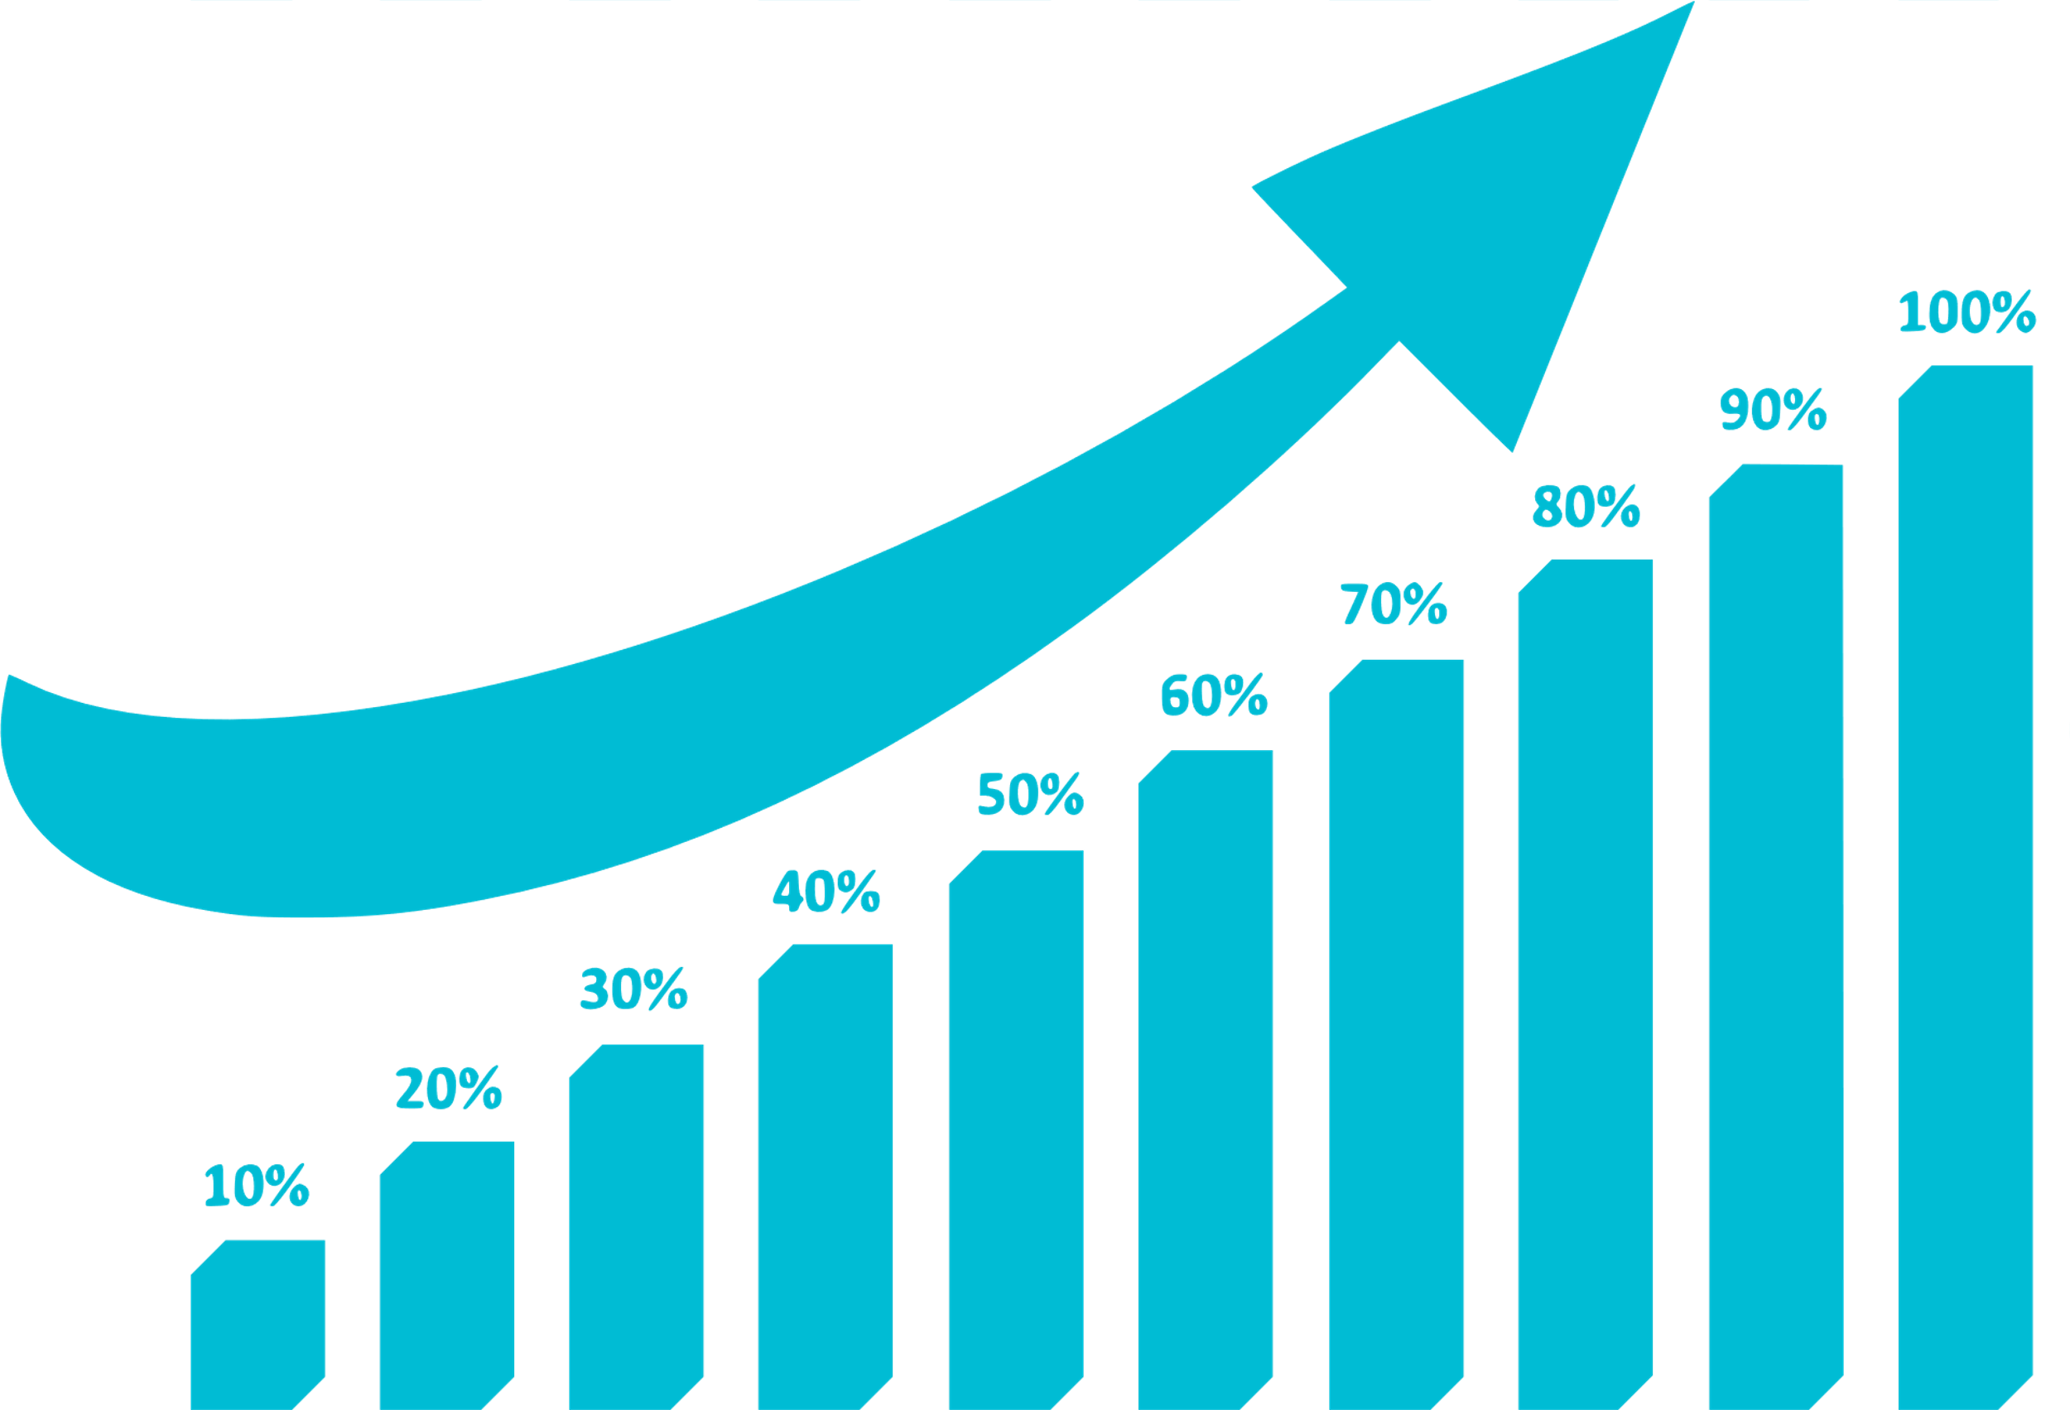
First Step Act
In 2018, the First Step Act required expanding access to MOUD for people with opioid use disorder incarcerated in the federal prison system.
Notes:
DOJ will submit reports to Congress on various aspects of the FSA including a report on treatment of opioid and heroin abuse and plans on how to implement those treatment methods.

Slide 8
Federal Bureau of Prisons
159,127 incarcerated individuals
122 Institutions across 35 States and Puerto Rico
It is estimated that as much as 16% of incarcerated individuals could have an indication for MOUD.
Therefore, the BOP estimates that up to ~25,500 incarcerated individuals may be indicated to receive MOUD across its patient population.
Notes:
Studies show that up to 65% of incarcerated individuals may meet the criteria for a substance use disorder and up to one-quarter of these incarcerated individuals may have OUD.

Slide 9


Expanding on Past Success
21 Hepatitis C Clinical Pharmacy Consultants
YEAR NFR APPROVALS
2020 2039 1875
2021 2532 2337
2022 2561 2362
2023 969 (YTD) 805 (YTD)
Pharmacists have previously been the missing link to expanding access to care.
16 HIV Clinical Pharmacy Consultants
Provide therapeutic review of all patients with HIV/AIDS. 96% of patients are virally suppressed.
Notes:
Present how pharmacists have been instrumental in improving education and access to care for other challenging disease states in the BOP and highlight overall success with these pharmacy led programs
*Pharmacists are involved in HEP C treatment process from start to finish including:
-Initial consults, ordering labs, counseling patients about the disease, determine treatment plans, screen for drug interactions, prescribing and acquiring the medication, monitoring compliance and follow up labs

Slide 10

Training for Pharmacists
To take place during Semiannual BOP Residential Pharmacy Training
  >100 pharmacists from across all BOP regions
Prepare pharmacists to engage in a CPA to expand access to care for OUD in the BOP.
Provide a unique education platform that would allow learners to observe, learn, and practice in real time.
This Photo by Unknown Author is licensed under CC BY-NC
Notes:
Today we will continue to follow the patient case you just saw started and see an example case go from initial screening to being stable on treatment. The objectives of the day are to…

Slide 11
Learning Objectives for Training
Describe evidence-based reasons for providing MAT in, outside, and during transition to and from a correctional environment.
Demonstrate the process for screening patients with opioid use disorder and creating an evidence-based treatment plan to include lab monitoring, initiating medications for opioid use disorder, documentation, and discussing treatment goals.
Incorporate preventative health and risk reduction strategies for patients with opioid use disorder, including special populations (pregnancy, hepatitis, medication diversion, etc).

Slide 12
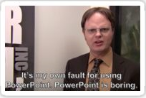
Format of Training
Observe
Learn
Practice
Notes:
What we will see today is a patient case that will take use from Screening the patient for MAT to having the patient STABLE on MAT.
The style of today will be to observe a portion of a patient encounter, review didactic material related to what we observed, and then have time to practice our own patient encounter with a partner. We will continue to go through the day using the same observe, learn, and practice. Observe, learn practice. Until we have our patient stable on MAT.
The primary purpose of this course is to provide a foundation for any pharmacist interested in pursuing a collaborative practice agreement for MAT or for those interested in taking what we learn today to provide education to your institution staff.

Slide 13
What We Will NOT See
One size fits all approach to treatment selection
A patient case applicable to ALL patients
One size fits all approach to clinic style
Limitations in MAT options
Notes:
What we will NOT see today is a one size fits all approach to treatment. Treatment selection for MAT is individualized and although we will reference the BOP’s clinical guidance and other recommendations to consider, we will NOT provide an algorithmic approach to treatment selection.
Also recognize that the patient case we see today is only ONE example. As you will soon see, inmate Summers is going to be a relatively straight forward patient with limited concerns throughout the screening and treatment process. This is intentional to allow us to cover the necessary material in one day and provide a general idea of how a MAT clinic may look.
We also recognize that not every pharmacist here may be interested in pursuing a MAT collaborative practice agreement. Today’s course may change your mind, but if nothing else, today should provide insight as to how a pharmacist or perhaps other providers at your institutions should consider approaching the treatment of opioid use disorder.
There will be opportunities throughout the day to ask questions at the end of each lecture, as well, at the end of the day, we will all have an opportunity to ask any questions to the panel of presenters that may not have been addressed or are outstanding from the day.
In addition, the end of your workbook has a long list of frequently asked questions that we anticipated to come up, we are happy to address any of those in further detail at the end of the day with the panel if not addressed by the workbook.
Finally, we want to recognize that not every pharmacist may have the opportunity to participate in a CPA for MAT based on the availability of X waivered or interested providers at your institution. The options may be limited by the collaborating physicians credentials or comfortability with offering certain forms of MAT. Today, we are going to see a patient case from a pharmacist who’s CPA can provide ALL forms of MAT in order to provide information on all FDA approved medications. Simply adjust your own clinic accordingly to the MAT options you’re authorized to provide or that your institution is comfortable offering.

Slide 14

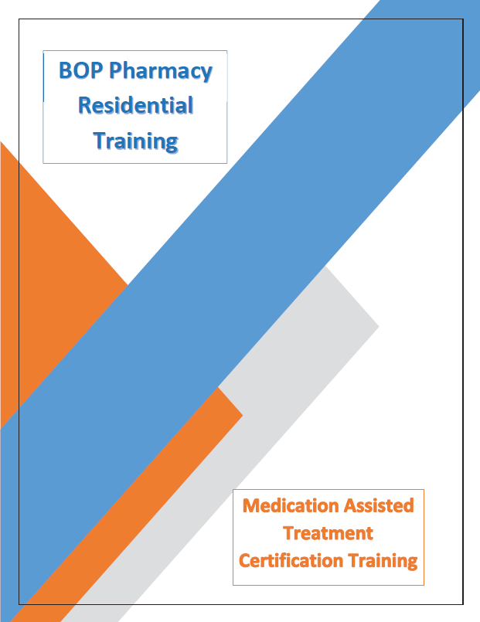
Workbooks
Resource tool provided to all participates to fill out and use in their own clinic for educational reference long term.
Contains counseling tips, FAQs, and information on MOUD
Notes:
Again each of you should have been provided a work book, let your instructors know if that is not the case. The workbook will follow along with the presentations provided throughout the day and has space for you to take notes. As well, each section will have example phrases and BEMR notes on how to address or document specific aspects of an encounter note. The patient case we see, the example BEMR notes, and phrases provided in your workbook are not meant to limit or dictate how you conduct your own clinic style. They are simply recommendations on how to phrase some of the more challenging conversations or counseling points with our patients.

Slide 15
Training Outcomes
Percentage of Respondents with >Moderate Confidence
Notes:
89% reported moderate or higher confidence in understanding OUD Medication specifics
90% reported moderate or higher confidence in addressing stigma around OUD
56% reported moderate or higher confidence in conducting a MAT clinic using a CPA
63% reported moderate or higher confidence in initiating a patient on MAT
84-88% reported moderate or high confidence in evaluating medication appropriateness based on patient specific factors for sublocade, suboxone, vivitrol.
Barriers to Clinic: ongoing major barrier to treatment for OUD
12% reported Stigma
15% reported lack of familiarity with OUD treatment clinical guidance
16% reported lack of familiarity with administrative process for OUD treatment
2 % reported hesitancy from medical staff toward pharmacist participation (Only 2%!!)
21% reported hesitancy from non-medical staff

Slide 16
Training Outcomes
Percentage of Respondents with Moderate or Higher Confidence

Slide 17
Training Outcomes
Percent reporting concern for barriers related to OUD treatment
Notes:
89% reported moderate or higher confidence in understanding OUD Medication specifics
90% reported moderate or higher confidence in addressing stigma around OUD
56% reported moderate or higher confidence in conducting a MAT clinic using a CPA
63% reported moderate or higher confidence in initiating a patient on MAT
84-88% reported moderate or high confidence in evaluating medication appropriateness based on patient specific factors for sublocade, suboxone, vivitrol.
Barriers to Clinic: ongoing major barrier to treatment for OUD
12% reported Stigma
15% reported lack of familiarity with OUD treatment clinical guidance
16% reported lack of familiarity with administrative process for OUD treatment
2 % reported hesitancy from medical staff toward pharmacist participation (Only 2%!!)
21% reported hesitancy from non-medical staff

Slide 18
Training Outcomes
Major concern for potential barriers related to OUD treatment

Slide 19
Training Outcomes
After completing the Training:
75 % reported moderate or higher interest in conducting a MAT clinic using a CPA
83% report increased confidence in working under a MAT CPA as a result of the MAT certificate program
Notes:
Update metrics

Slide 20
Pharmacists with MOUD CPAs
Notes:
When looking at overall Pharmacy involvement,
Whether through CPA, screening, or Narcan for example, number of pharmacists seeing patients for MAT increased year over year.
Doubling of CPAs for MAT/OUD- No increase from 2021 to 2022, however after training see significant increase

Slide 21
Pharmacy Encounters for MOUD
Notes:
Encounters almost doubles (167% growth) from before and after program
Prescriptions show overall (due to cosignature, can’t separate pharmacy from non-pharmacy prescribing)
09/01/20-08/31/21
1066 Pharmacy encounters for MAT
25 pharmacists
11 Collaborative Practice Agreements
4212 prescriptions total
09/01/21-08/31/22
3783 Pharmacy encounters for MAT
40 pharmacists
11 Collaborative Practice Agreements
15290 prescriptions total
09/1/22-08/31/23
6311 Pharmacy encounters for MAT
51 Pharmacists
24 Collaborative Practice Agreements
32365 prescriptions total

Slide 22
Lessons learned
Practice
Be sensitive to time
Provide workbooks
Ensure all those who took the training were able to complete the pre/post survey
Notes:
Again each of you should have been provided a work book, let your instructors know if that is not the case. The workbook will follow along with the presentations provided throughout the day and has space for you to take notes. As well, each section will have example phrases and BEMR notes on how to address or document specific aspects of an encounter note. The patient case we see, the example BEMR notes, and phrases provided in your workbook are not meant to limit or dictate how you conduct your own clinic style. They are simply recommendations on how to phrase some of the more challenging conversations or counseling points with our patients.
Data limitation

Slide 23


Questions?
Notes:
With that, lets jump back to our patient case. Please help us break up the room in to sections so we can break out into smaller groups. This is meant to increase comfortability with small group discussion and questions.

