Slide 1

Welcome!
Extra-Articular Manifestations
of RA
Wendy Grant, MD
October 2, 2023
RAE Initiative| Spring 2023

Slide 2
DISCLOSURES
AMA Designation Statement
The University of California, San Francisco School of Medicine (UCSF) is accredited by the Accreditation Council of Continuing Medical Education (ACCME) to provide continuing medical education for physicians. UCSF designates this live activity for a maximum of 1 AMA PRA Category 1 Credit™. Physicians should claim only the credit commensurate with the extent of their participation in the activity.
Disclosure Statement
Planners Jennifer Mandal, MD, Leslie Dexheimer Gleason, RN, and Tabitha Carroway, MPH have stated they have no relationships to disclose. Speaker Wendy Grant, MD has stated she has no relationships to disclose.
RAE Initiative | Spring 2023

Slide 3
RAE Initiative | Spring 2023
Please remember to sign in:
Type your name, service unit, and email into the chat

Slide 4
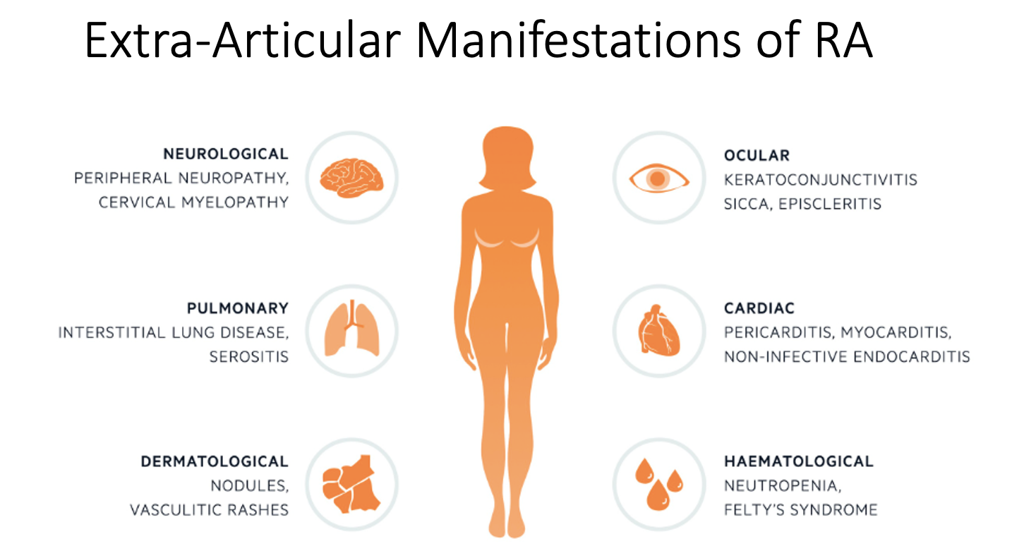

Slide 5
Extra articular manifestations of rheumatoid arthritis
can be seen in almost any organ system
0ccur in 40% of patients at some point in their disease history
Tend to be associated with high titer serologies and more active, long-standing disease
However, can occasionally be the presenting symptom
Occur about equally in men and women (proportionately more common in men)
RAE Initiative | Spring 2023

Slide 6
Extra articular manifestations of rheumatoid arthritis
Two broad categories:
  True disease manifestations: effects of the immunologic process on neurologic, cutaneous, ocular, pulmonary systems driven by the same cytokines that cause joint disease
  “complications” or “comorbid conditions” - drug effects, associated conditions such as anemia of chronic disease, ischemic heart disease, osteoporosis, infection
  If we include both of these categories, the average RA patient has at least one manifestation at any given time
RAE Initiative | Spring 2023

Slide 7
Poll Question #1
Which of the following statements about rheumatoid nodules is incorrect?
They occur more frequently in smokers
They occur exclusively in patients with positive serologies (RF, CCP)
They can be found in the lungs and myocardium
They are always seen in conjunction with severe active joint disease
They are the most common extra articular manifestation of RA
RAE Initiative | Spring 2023

Slide 8
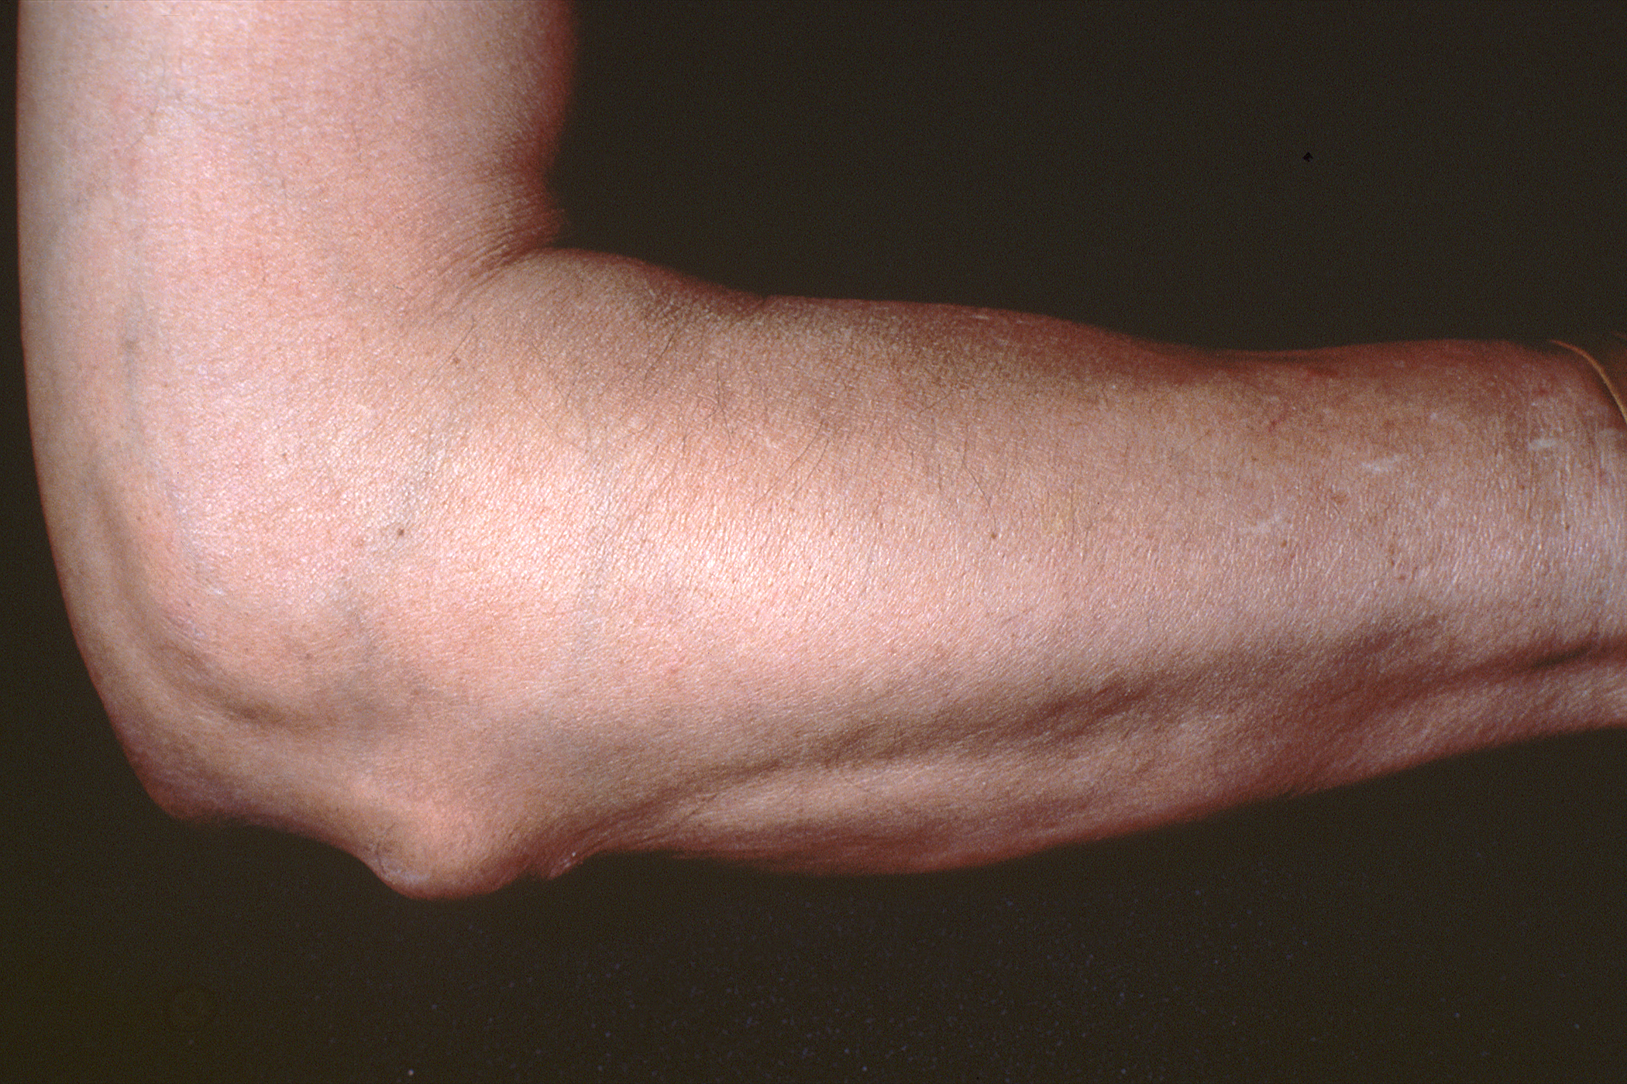
Rheumatoid nodules
RAE Initiative | Spring 2023

Slide 9
Rheumatoid nodules
Nodules occur in about 30% of RA patients at some point in their disease history
Associated with tobacco use, positive serologies (RF, CCP)
Higher incidence in males > females
Occur at areas of pressure
Also can be seen in the lungs and heart (myocardium, valves - rare)
“Rheumatoid nodulosis” refers to the presence of rheumatoid nodules in the absence of significant synovitis
Pathology: focal central fibrinoid necrosis with surrounding fibroblasts

Slide 10
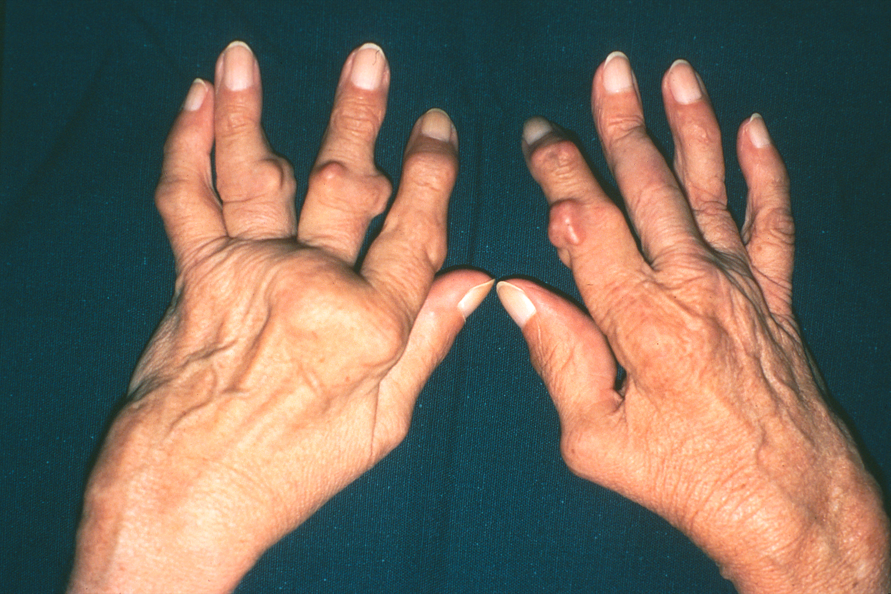
Rheumatoid nodules
RAE Initiative | Spring 2023

Slide 11
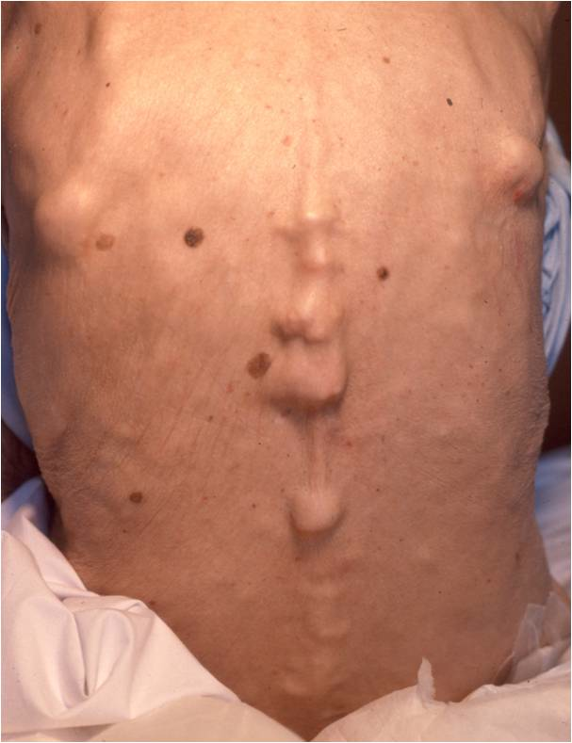
Rheumatoid nodules
RAE Initiative | Spring 2023

Slide 12
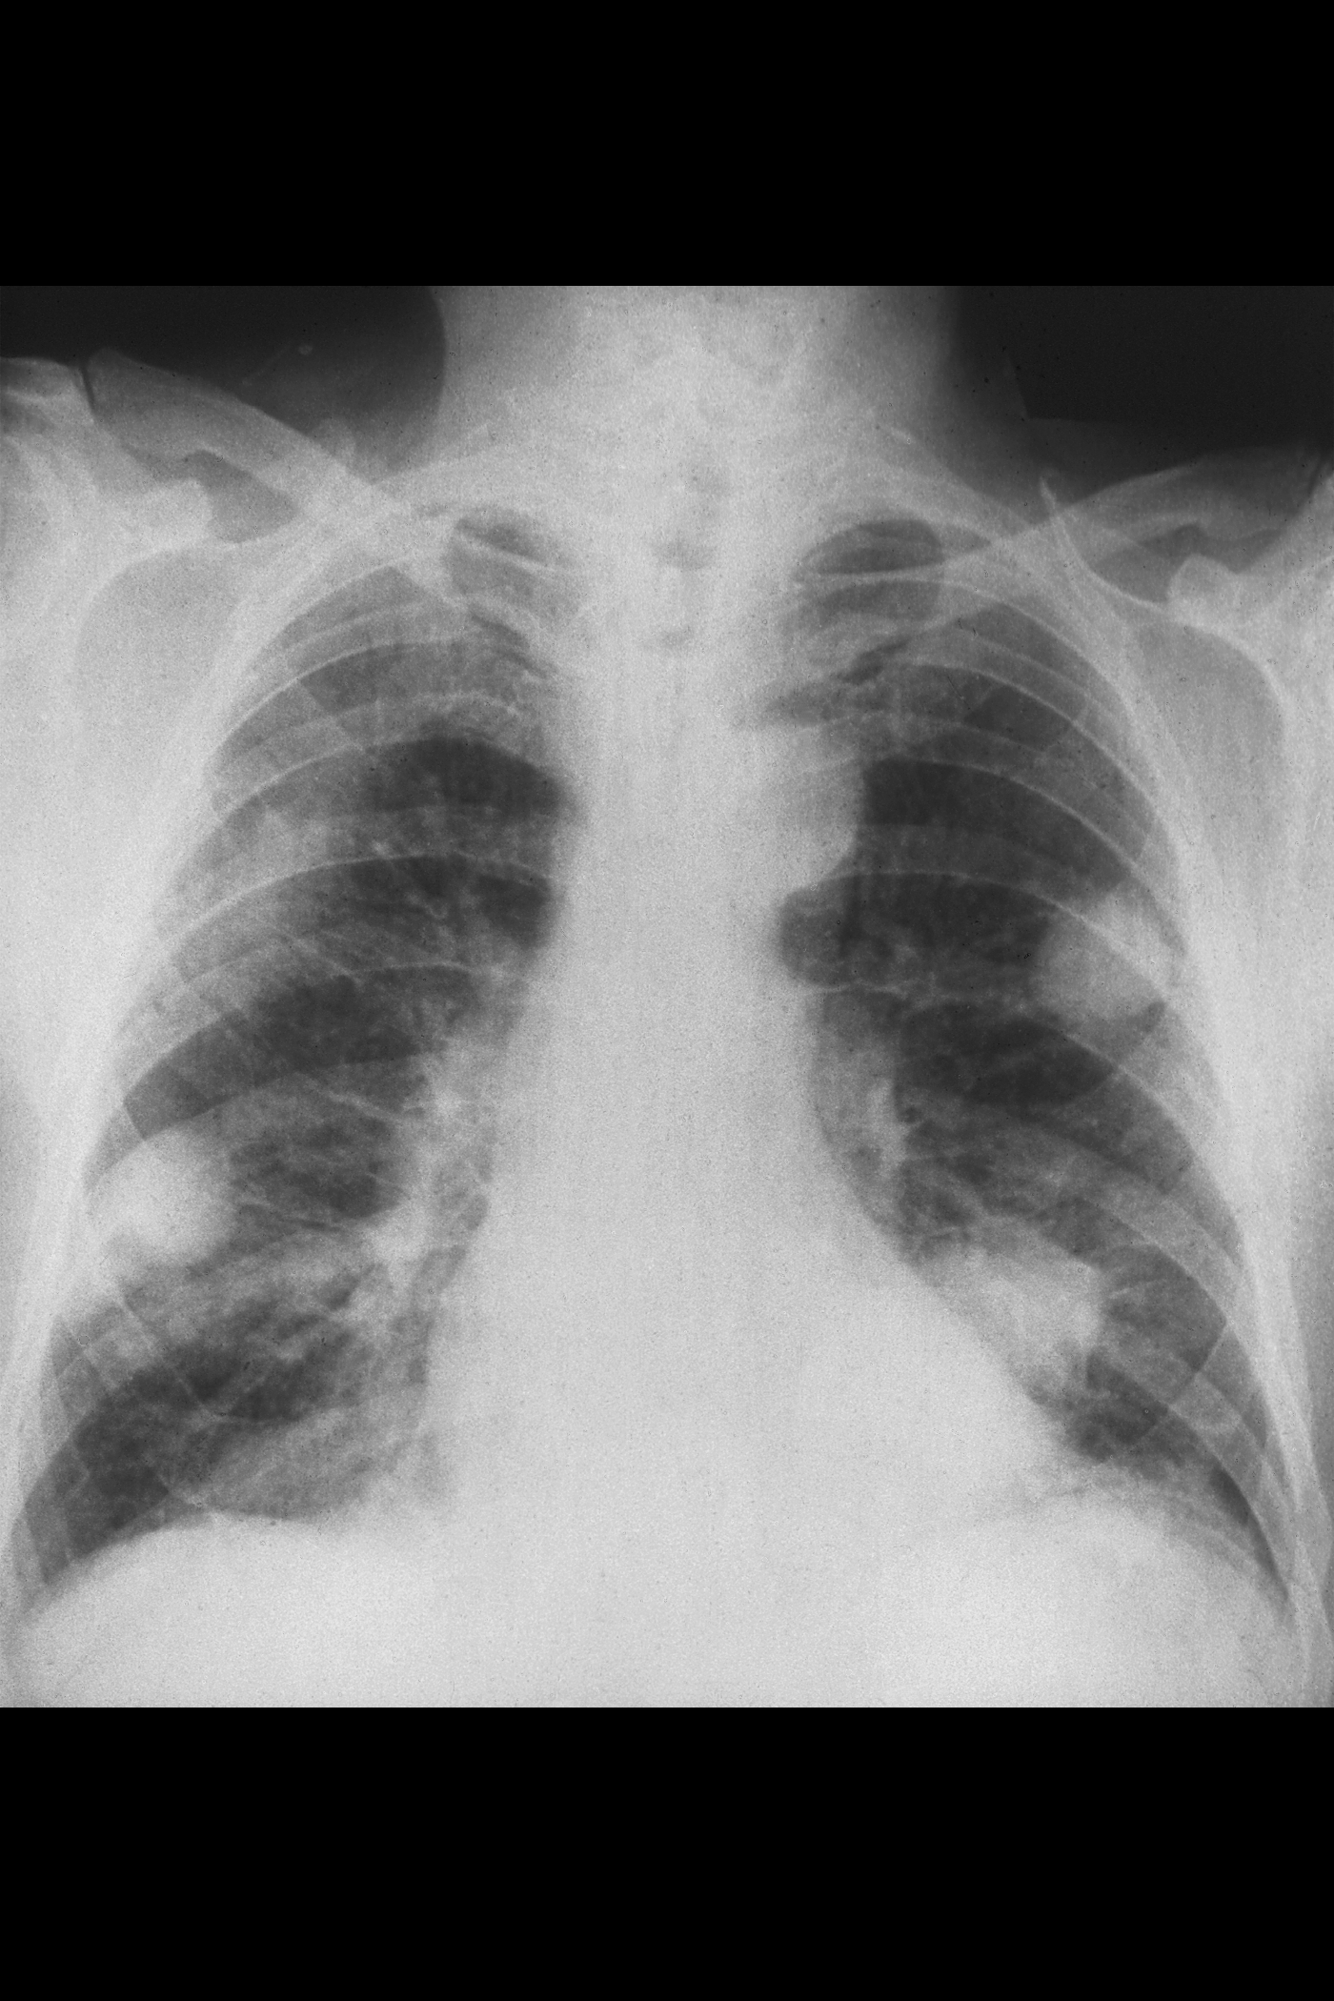
Rheumatoid nodules
RAE Initiative | Spring 2023

Slide 13
Poll Question #1
Which of the following statements about rheumatoid nodules is incorrect?
They occur more frequently in smokers
They occur almost exclusively in patients with positive serologies (RF, CCP)
They can be found in the lungs and myocardium
They are always seen in conjunction with severe active joint disease
They are the most common extra articular manifestation of RA
“Rheumatoid nodulosis" can occur in quiescent joint disease; sometimes seen in association with methotrexate use
RAE Initiative | Spring 2023

Slide 14
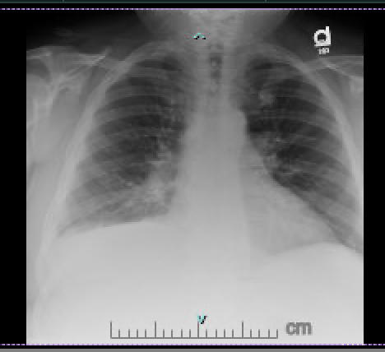
Extra articular RA: Case #1
60 year old man with history of “gout” presents with shortness of breath
RAE Initiative | Spring 2023

Slide 15
Poll Question #2
Which of the following is true of rheumatoid pleural effusions?
They are transudative
They occur only in long-standing, poorly controlled disease
They are characterized by low glucose levels
They are more common in women
RAE Initiative | Spring 2023

Slide 16
Extra articular RA: Case #1
Hospital evaluation
CT scan: large pleural effusion; no other findings
Thoracentesis: pleural fluid analysis
  Glucose 50 (low); pH 7.26 (low); LDH 844 (high); total protein 3.6 (high)
Other lab evaluation
  CRP 167
  RF 21
  ANA negative
  Discharged with ? Diagnosis but sent to rheumatology
RAE Initiative | Spring 2023

Slide 17
Extra articular RA: case # 1
      Outpatient evaluation
      H & P: daily indomethacin for hand pain and stiffness
      Exam: MCP fullness/tenderness
      Additional labs?
      CCP ab> 250
RAE Initiative | Spring 2023

Slide 18
Poll Question #2
Which of the following is true of rheumatoid pleural effusions?
They are transudative
They occur only in long-standing, poorly controlled disease
They are characterized by low glucose levels
They are more common in women
Rheumatoid pleural effusions are more common in men; can be precede joint disease; are exudative
Glucose levels of < 60 are characteristic of RA pleural effusions
RAE Initiative | Spring 2023

Slide 19
Pulmonary Manifestations of RA
Respiratory disease in rheumatoid arthritis (6 – 10%)
Interstitial
Interstitial pneumonitis/fibrosis (RA-ILD)
Usual interstitial pneumonitis (UIP)
Nonspecific interstitial pneumonitis (NSIP)
Lymphocytic interstitial pneumonitis (LIP)
Desquaminative interstitial pneumonitis (DIP)
Mixed morphology
Bronchiolitis obliterans with organizing pneumonia (Cryptogenic organizing pneumonia)
Rheumatoid nodules
Rheumatoid pneumoconiosis (Caplan's syndrome)
Apical fibrobullous disease
RAE Initiative | Spring 2023

Slide 20
Pulmonary Manifestations of RA
Airway
Cricoarytenoid arthritis/central airway obstruction
Obliterative bronchiolitis
Bronchiectasis
Bronchiolitis obliterans with organizing pneumonia
Chronic small airway obstruction
Pleural
Pleuritis
Pleural effusion
Pleural thickening
Chyliform effusion
Pulmonary vascular
Pulmonary hypertension
Vasculitis
RAE Initiative | Spring 2023

Slide 21
Interstitial lung disease in RA
The most common pulmonary manifestation
Clinically significant in about 8% of patients
May be present but clinically silent in up to 30- 40% of RA patients
Not one single disease but a collection of radiographic patterns and severity
ILD can occasionally pre-date joint manifestations

Slide 22
Interstitial lung disease in RA
DMARDs have generally decreased the risk of extra-articular manifestations in RA, but the effect on RA-ILD is less clear
Risk factors for ILD
  Male sex
  Smoking
  More severe RA
  High titer antibodies (RF and CCP)

Slide 23
Interstitial lung disease in RA
To complicate matters, drug-induced lung toxicity is associated with many RA medications
  Methotrexate
  NSAIDs
  Leflunomide
  Anti TNF agents
  Rituximab
  Tocilizumab

Slide 24
Interstitial lung disease in RA
Low threshold to evaluate pulmonary symptoms in an RA patient (cough, dyspnea, new crackles on lung exam)
Evaluation:
  PFTs
  High resolution CT scan
  Consultation with pulmonary

Slide 25
Extra articular RA: Case #2
39 year old woman with RA for 20 years
poorly controlled on adalimumab, methotrexate, 10-15 mg prednisone
Prior treatments with gold, hydroxychloroquine, sulfasalazine, other TNF inhibitors
RAE Initiative | Spring 2023

Slide 26
Extra articular RA: Case #2
CBC over a two-year period
  WBC 5.3 → 2.45 -> 1.0
  % neutrophils 49 → 4.0 → 0
RAE Initiative | Spring 2023

Slide 27
Poll Question #3
Which of the following is NOT a hematologic complication of rheumatoid arthritis?
Anemia of chronic disease
Hemolytic anemia
Thrombocytosis
Large granular lymphocytosis
Medication-induced cytopenias
RAE Initiative | Spring 2023

Slide 28
Hematologic manifestations of RA
Causes of neutropenia in an RA patient
  Felty Syndrome: neutropenia, splenomegaly, lower extremity ulcers
  - RF +/CCP+
  - long-standing severe RA
  Large granular lymphocytic leukemia
  Medication effect (MTX, leflunomide, SSZ, TNF inhibitors, IL-6 inhibitors, JAK inhibitors)
RAE Initiative | Spring 2023

Slide 29
Hematologic manifestations of RA
Common
Anemia
  Medication: methotrexate, azathioprine, leflunomide, SSZ, NSAIDs
  Anemia of chronic disease: mild, normocytic, very common
  Iron, B12 and folate deficiency are also more common in RA
RAE Initiative | Spring 2023

Slide 30
Hematologic manifestations of RA
Rare
Non Hodgkin Lymphoma: 2 fold increased risk in RA
Felty syndrome
  Associated with severe seropositive RA, splenomegaly, other extra-articular manifestations (vasculitis), recurrent infection
Large granular lymphocytic leukemia
  Can occur early in RA
  Indolent course
RAE Initiative | Spring 2023

Slide 31
Extra articular RA: Case #2
Bone marrow biopsy → large granular lymphocytosis (polyclonal)
Resolved with optimal treatment of RA
RAE Initiative | Spring 2023

Slide 32
Poll Question #3
Which of the following is NOT a hematologic complication of rheumatoid arthritis?
Anemia of chronic disease
Hemolytic anemia
Thrombocytosis
Large granular lymphocytosis
Medication-induced cytopenias
Hemolysis is not a typical feature of RA
RAE Initiative | Spring 2023

Slide 33
Ocular disease in RA
18% incidence in RA
Corneal disease (most common)
  Dry eye (KCS)
  Sjogren’s with positive SSA/SSB (high incidence of RA/Sjogren’s overlap in Navajo population)
RAE Initiative | Spring 2023

Slide 34
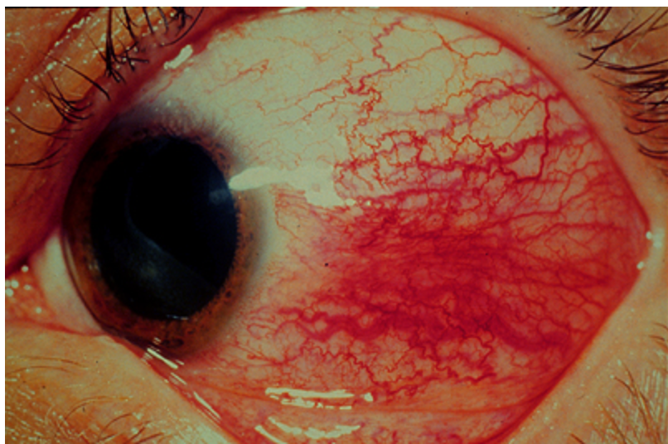
Ocular disease in RA
Scleral disease
  Episcleritis: usually acute in onset; discomfort rather than pain; usually benign and self-limited
RAE Initiative | Spring 2023
Notes:
Episcleritis; not painful, but red
Scleritis: painful, often req systemic rx
Scleromalacia perforans:

Slide 35
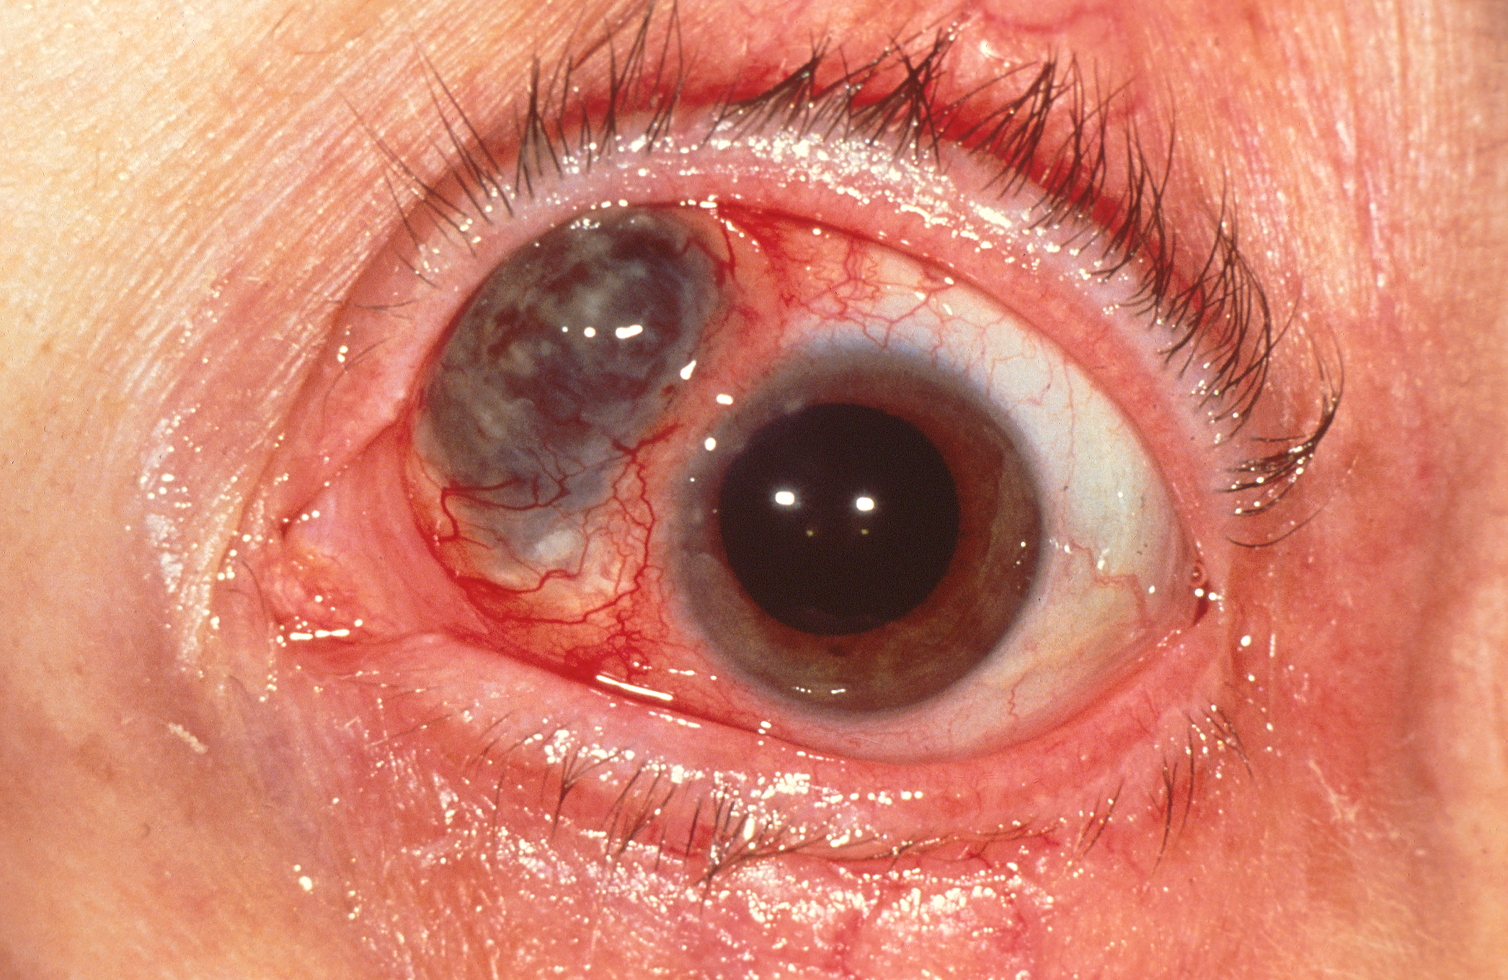
Ocular disease in RA
Scleral disease
  Scleritis: severe pain; usually requires systemic therapy; potential for severe complications, including scerlomalacia perforans
RAE Initiative | Spring 2023
Notes:
Episcleritis; not painful, but red
Scleritis: painful, often req systemic rx
Scleromalacia perforans:

Slide 36
Other extra articular manifestations of RA
Cardiovascular
Estimated risk of CV disease is 50% higher in RA patients
Contributing factors
Chronic inflammation ---> increased atherosclerosis
Metabolic syndrome is more common in RA
Use of steroids and NSAIDs
Inactivity secondary to physical limitations
Risk of cardiovascular mortality in patients with rheumatoid arthritis: a meta-analysis of observational studies.Aviña-Zubieta. ArthritisRheum. 2008;59(12):1690.
RAE Initiative | Spring 2023
Notes:
Amyloid from chronic inflammation

Slide 37
Other extra articular manifestations of RA
Skin: pyoderma gangrenosum; ulcers due to vasculitis
GI: tend to be secondary to medication
rare incidence of vasculitis
Renal: very rare to see glomerular disease, interstitial disease. In long-standing RA, secondary AA amyloid can cause proteinuria and renal insufficiency
Metabolic: increased risk of osteoporosis and metabolic syndrome
Psychiatric: increased incidence of depression/chronic pain
Neurologic: mononeuritis multiplex (really a vasculitic process)
RAE Initiative | Spring 2023

Slide 38
Extra articular manifestations of RA
Nodules are most common (30%)
Ocular complications are common (18%)
Pulmonary complications occur in 8-9 %, with ILD being most the most common; up to 60% with subclinical disease
Some combination of disease-specific manifestations and comorbid conditions occur in most patients
Treatment of RA almost always involves addressing more than the joints
RAE Initiative | Spring 2023

Slide 39
References
Extra-articular Manifestations in Rheumatoid Arthritis Manole Cojocaru, Inimioara Mihaela Cojocaru, Isabela Silosi, Camelia Doina Vrabie, R Tanasescu. Maedica (Bucur) 2010 Dec; 5(4): 286–291
Turk MA, Hayworth JL, Nevskaya T, Pope JE. Ocular Manifestations in Rheumatoid Arthritis, Connective Tissue Disease, and Vasculitis: A Systematic Review and Metaanalysis. J Rheumatol. 2021 Jan 1;48(1):25-34. doi: 10.3899/jrheum.190768. Epub 2020 May 1. PMID: 32358156.
Young A, Koduri G. Extra-articular manifestations and complications of rheumatoid arthritis. Best Pract Res Clin Rheumatol. 2007 Oct;21(5):907-27. doi: 10.1016/j.berh.2007.05.007. PMID: 17870035.
RAE Initiative | Spring 2023

Slide 40

Thank
you!
Please reach out to
raeinitiative@gmail.com
with any feedback or questions.
RAE Initiative | Spring 2023

