Slide 1
LOW dose Buprenorphine Induction
Jonathan L. Robbins MD (but mostly Jenny Hartley MD)
Section of Addiction Medicine
Oregon Health & Science University
Aug 3, 2023

Slide 2
Disclosures
Jonathan Robbins and Jennifer Hartley have nothing to disclose.

Slide 3

A sneak attack …

Slide 4
LEARNING OBJECTIVES
Define low dose induction and become familiar with several protocols
01
Review case studies on low dose induction from the inpatient and outpatient settings
02
Implement low dose inductions in the outpatient setting
03
Notes:
This is a work in progress – will leave a good amount of time at the end of presentation for discussion – and also would like feedback in preparation for presenting “how to” didactic at Thursday’s ECHO.

Slide 5

Buprenorphine Inductions
Bup Induction
In opioid withdrawal
Not in opioid withdrawal
Standard
Low Dose (Microinduction)

Slide 6
Standard Induction & Stabilization Dosing Schedule
 | Suggested Dosing* | Maximum Dose
Day 1 | 2-4mg (wait 45 min) + 4mg if needed | 8-16mg
Day 2 | Day 1 dose + 4mg if needed (single dose) | 16-20mg
Day 3 | Day 2 dose + 4mg if needed (single dose) | 20-24mg
Day 3-28 | Adjust as needed | 24mg
Notes:
OR, you can have patients do this at home.

Slide 7
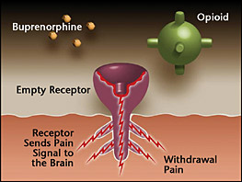
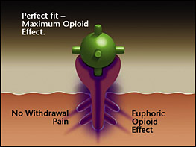
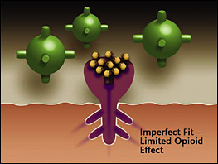
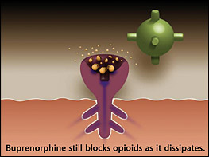
Review of standard induction
Notes:
Buprenorphine, a partical agonist at the mu receptors, is a higher affinity binder than full agonists. In a traditional induction empty mu receptors are required in order to avoid precipitating withdrawal by kicking full agonists off receptors.

Slide 8
What is Low dose induction?
(No, it does not involve psychedelics.)
Low dose buprenorphine induction remains loosely defined as there are not yet widely validated standardized protocols.
Essentially, it is an approach to starting buprenorphine that introduces the medication onto the receptors so slowly that no withdrawal of any kind is involved in the process.

Slide 9
Low dose Bup induction: an important development
Removes the need for patients to be in any degree of withdrawal when starting SL bup/nlx
Allows opioid pain medications to be administered simultaneously with induction
Lower risk for precipitating withdrawal

Slide 10
Two primary methods
1. Start a 20 mcg buprenorphine transdermal patch and gradually introduce SL bup/nlx. Then stop/taper full agonist.
2. Start sublingual bup/nlx at very low doses and uptitrate. Then stop/taper full agonist.

Slide 11
The literature
First research done in Switzerland using 0.2 mg compounded doses yielded the “Bernese Method” starting with 0.5 mg doses and titrating up.
Rapidly growing number of published case reports in US and Canada have used a variety of protocols with both patches and SL dosing.
Have transitioned from methadone doses as high as 100 mg methadone.
Notes:
Bernese method 2016

Slide 12
STANDARD VS. Low dose
COWS of > 12 | REMAIN ON FULL AGONISTS (COWS of 0)
4 mg + 4 mg | 0.5 mg + 0.5 mg
8 mg + 4 mg + 4 mg | 1 mg + 1 mg
 | 2 mg + 2 mg
 | 4 mg + 4 mg

Slide 13
Low dose (Micro) Induction
Approach for patients who cannot tolerate a standard induction due to opioid withdrawal.
Day 1: bup/nlx 0.5 mg (1/4 tab)
Day 2: 0.5 mg BID
Day 3: 1 mg BID (1/2 tabs)
Day 4: 2 mg TID
Day 5: 4 mg TID
Day 6: Up to 24 mg
Stop or taper full agonists
Hammig, Subs Abuse Rehab 2016
Raheemullah, JAMA IM 2019
Lee, AA Pract 2019
Klaire, Am J Addiction
Martin, Can J Add 2019
Notes:
Dana button med student at OHSU 1st author of the best low dose induction hospital paper EVER

Slide 14
Fastest protocol to date: Lembke & Raheemullah in JAMA, March 2019
20 mcg bup patch for 24 hours
Day 1, give 2 mg SL bup/nlx + 2-4 mg prn doses q 2-4 hours for maximum dose of 8 mg.
Day 2, give total from Day 1 + 2-4 mg prn doses q 2-4 hours for max dose of 16 mg.
Remove patch after 48 hours. Discontinue full agonists not yet tapered.
Notes:
Stanford University Hospital: 21 yo woman with IV heroin use, admitted with abscess, sepsis, endocarditis, had surgery to replace pulmonic valve, receiving 220 morphine equivalents of full agonists post-surgery, staying in hospital for completion of abx. Transitioned to bupe for SUD and pain. Full agonists were tapered as tolerated prior to induction (no specifics given).

Slide 15
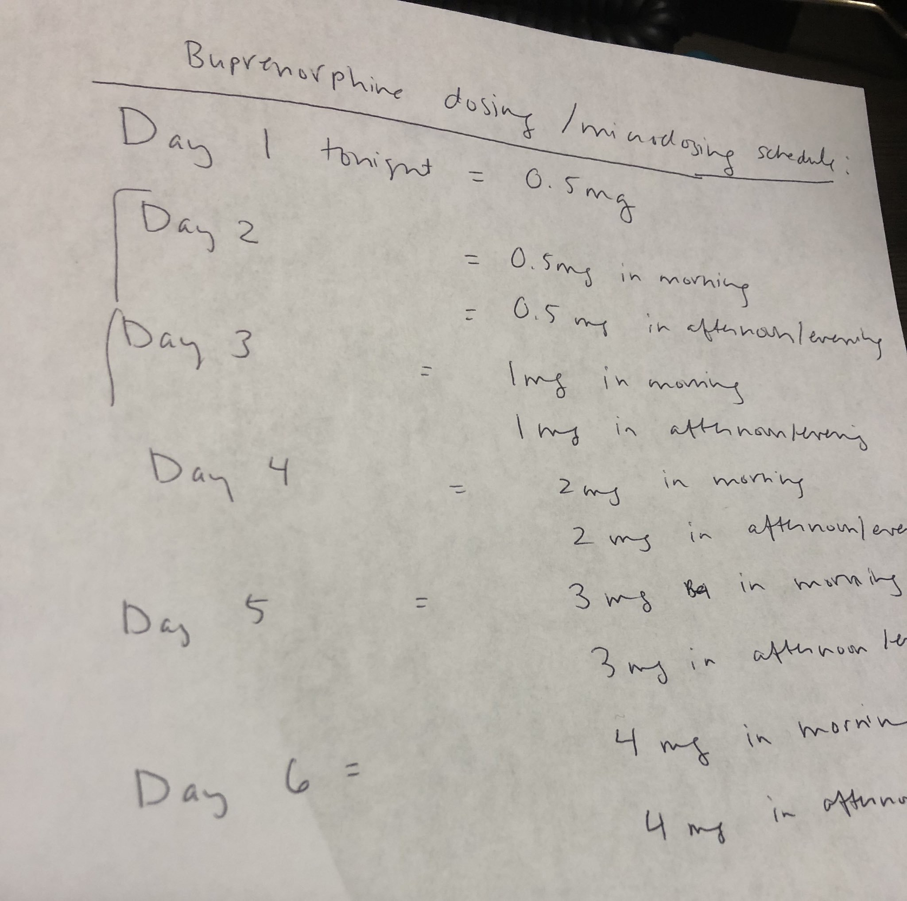
How we started the process at ohsu (Thanks to twitter)
Notes:
62 year old man, admitted with multifactorial chronic pain, inadvertently taken off Belbuca buccal films
Could not tolerate withdrawal or increased pain. PCP had worked hard over months to taper of opioid pain meds.
Pt had multiple reasons why full agonists were not appropriate to continue.

Slide 16
IMPACT Transdermal Patch Protocol:
Place two 10 mcg bup transdermal patches (= 20 mcg patch)
Continue both long and short-acting opioids.
For short-acting, can start SL bup/nlx at 24 hours; for long-acting, wait 48 hours.
Begin SL dosing with 1 mg BID (1/2 tab).
Day 2: 1 mg BID
Day 3: 2 mg BID
Day 4: 4 mg BID
Day 5: 6 mg BID
Day 6: 8 mg BID
Notes:
We stop full agonists at 16 mg but could probably stop sooner, and we have frequently tapered sooner.

Slide 17
Rapid low dose induction
 | Bup/nlx Dosing Schedule | Total Daily Dose
Day 1 | Buprenorphine 20mcg/hr patch | ~0.48mg
Day 2 | 1mg TID | 3mg
Day 3 | 1mg q3hr (8am – 11 pm) | 6mg
Day 4 | 1mg at 6am, followed-by 8mg at 9am | 9mg

Slide 18
IMPACT Case: Chronic Pain & OUD Transitioning to SNF
44 yo woman w/ severe meth use disorder, OUD in sustained remission.
Admitted for disarticulation of R hip 2/2 chronic RLE osteomyelitis, cellulitis.
Initially on hydromorphone PCA and oxycodone with ketamine after surgery.
Discussion of SL bup/nlx for long-term pain control initiated early in hospitalization with pt in agreement.
Notes:
OUD involved prescribed opioid pain meds for a rare form of fibromatosis. Pt very much identified with the diagnosis of OUD and did not want to be on opioid pain medications outside of the hospital.

Slide 19
Induction deferred due to pt feeling overwhelmed
Turnover of team, high census led to pt being ready for discharge to SNF without suboxone having been started. Still on oxycodone.
SNF will not manage standard induction and microdose induction had already been offered to pt.
Patch to the Rescue! ☺

Slide 20
Primary team holds pt for an extra day to get induction underway.
SNF will administer remaining SL up-titration doses and then oxycodone taper.
Patch placed for 24 hours
SL bup/nlx started 1 mg bid
Pt discharged to SNF the following day. Suboxone titration and oxycodone taper went smoothly.
Notes:
This patient was notable as she was the first patient to transition to a SNF early in the induction process.
At this point we were confident enough in the process to know it would go smoothly.
Prior to her, another pt had gone home with a patch – she lived in Medford and had a pain doc, who was comfortable with bupe and agreed to oversee induction.

Slide 21
Case Study: Return to Use in Setting of Covid
26 yo woman who had lost job and moved to a rural area after losing employment.
Living with parents and 4 yo daughter
Returned to use of heroin
Had 8 mg bup/nlx (Suboxone) tabs but no access to pharmacy for adjuncts that had helped with prior induction.
Wanted to get back on bup/nlx but worried her parents (with whom she was living) would find out she was using.

Slide 22
Avoiding withdrawal
Talked through cutting 8 mg tab into 8ths on phone, then crushing 1/8ths and putting under tongue 2 x daily for 2 days
Day 1: 1/8 tab BID x 2 days (1 mg BID)
Day 2: ¼ tab BID (2 mg BID)
Day 3: ½ tab BID (4 mg BID)
Day 4: 1 tab + ½ tab (8 mg + 4 mg)
Day 5: 1 tab BID (8 mg BID)

Slide 23
Outcome
Planned to quit heroin on Day 8
Quit on Day 9 instead
Was able to continue caring for young daughter throughout induction process
Continued remote prescribing of bup/nlx via telehealth.
“I never would have done this otherwise. I failed so many times on my own.”

Slide 24
Outpatient Case Study, methadone to bup/nlx
55 year-old woman h/o TMJ with Teflon implants in 1980s and mult surgeries to remove material, diabetic neuropathy, untreated OSA.
Rx: methadone 180 mg per day by PCP (MEDD = 540)
Case identified by chronic opioid therapy registry of all PCP patients at OHSU internal medicine.
Patient amenable to starting taper, felt emotional clouding on methadone but no other side effects.

Slide 25
Outpatient Case Study
Tapered from methadone 180 mg to 140 mg, then patient had increase in pain and some withdrawal symptoms.
Plan: Suboxone Microinduction (using 2 mg films)
Day 1: 1/4 film under tongue ONCE
Day 2: 1/4 film under tongue AM and PM
Day 3: 1/2 film under tongue AM and PM
Day 4: 1 film under tongue AM and PM
Day 5: 2 film under tongue AM, 2 tablets PM
Day 6: 2 films under tongue AM, 2 films PM, 2 films at NIGHT
Day 7: You can increase to 8 mg films three times daily
Continue at this dose until you see Dr. Robbins
Please call our office if you need a refill
Please let us know ASAP if any issues

Slide 26
Case Study Outcome
Decided to stop methadone 140 mg after completing microinduction
1 week of insomnia, bone aches, crying, then felt better
“I wasn’t aware of how sedated I was, I feel more aware of what’s going on.”
Few months later…
“I am trying to cope with my pain. I know it won't all go away with magic pills."

Slide 27
Potential Limitations of low dose inductions
Withdrawal symptoms
  To date, the only symptoms have been mild, vague and non-specific
  include insomnia, restless legs and irritability
  none can be definitively attributed to precipitated withdrawal
Complexity and patient compliance – need for more discussion of process
Duration of low dose inductions
Cost, insurance coverage of buprenorphine patch as outpatient
Notes:
Out of approx 30 microdose inductions, we have had 4 patients elect to stop; in each case patients had been less motivated to be on buprenorphine for a variety of reasons.

Slide 28
Pro tips: 2023
Keep it simple
Pick ONE protocol, and ONE patient handout
Offer adjunct medications for withdrawal
Frequent check-ins
If inpatient setting can use full agonist opioids for pain/withdrawal
Go up to 32 mg if necessary for heavy use
Don’t worry about monoproduct vs dual product

Slide 29
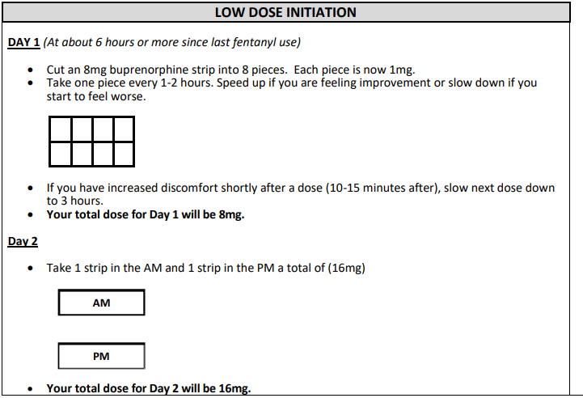

Slide 30
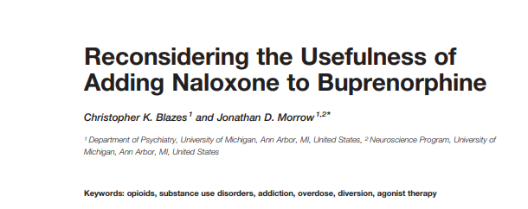
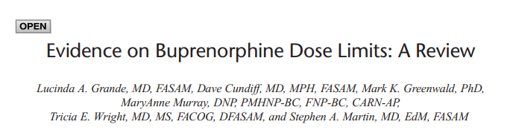
“Based on the evidence outlined above, we cannot unambiguously conclude that naloxone is an effective deterrent to parenteral misuse of buprenorphine.”
“Robust evidence that buprenorphine’s dose-dependent benefits for treating OUD extend up to 32 mg/day.”
“Evidence for diversion harm is minimal.”
Blazes, Morrow in Frontiers in Pysch, 2020
Grande et al. in JAM, 2023

Slide 31
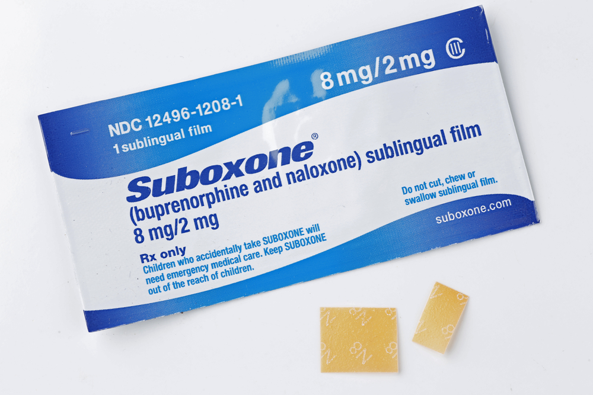
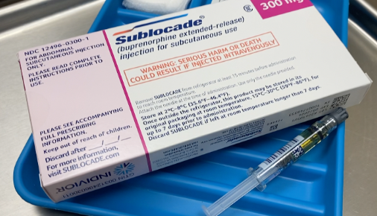
“Initiating BUP-XR 300 mg following a single BUP-TM 4 mg dose was well tolerated.” - Hassman et al
Hassman et al in Am J Drug Alc Abuse 2023
Seval et al. in JAM, 2023
Mariani et al in Am J Add 2020
Notes:
Initiating BUP-XR 300 mg following a single BUP-TM 4 mg dose was well tolerated

Slide 32
Future directions & Discussion
Transitioning from fentanyl
SL bup to long-acting bup protocols
More research is needed on use for transitioning from methadone > 100 mg
Use in opioid treatment programs
Choosing “classic” over low dose
Notes:
What are the parameters for transitioning a patient from methadone – ie – should protocol be altered for those on >100 mg methadone? (or other long acting opioids)
Is it necessary to wait more than 24 hours after patch is placed to start SL dosing?
Should we start SL at a higher dose in patients on lower doses of opioids – (Lembke protocol is faster).
Can we start using the Bernese method in the outpatient setting by having patients cut their 2 mg tabs into quarters? (Which many are already doing, themselves, but without guidance.)
How can we advocate for insurance coverage of transdermal patch in outpatient setting?

Slide 33
Conclusions
1. Low dose inductions are safe and feasible for inpatient and outpatient settings
2. The main benefits are avoiding planned withdrawal and minimizing risk of precipitated withdrawal associated with conventional buprenorphine induction – more flexible in a variety of settings
3. Downsides of low dose buprenorphine induction include the duration of induction, issues of complexity and compliance in outpatient settings

