Slide 1

The SUD/HCV/HIV/STI Syndemic
Jorge Mera, MD
ECHO Clinic Director
Northwest Portland Area Indian Health Board

Slide 2
Learning Objectives
Participants will be able to:
Recognize the impact of the opioid epidemic in relation to the HIV and HCV epidemics
Describe interventions to mitigate the syndemic at a macro, micro and individual level
Explain the concept of a syndemic
Notes:
,

Slide 3
Outline
Syndemic Concepts
Clinical Case
The SUD/HCV/HIV/STI Syndemic in Indian Country
Interventions to Mitigate the Syndemic:
Societal (Macro), Health System (Micro), Health Professional (Individual)
Notes:
,

Slide 4
Unconscious Bias Disclosure
I recognize that language is constantly evolving, and while I make every effort to avoid bias and stigmatizing terms, I acknowledge that unintentional lapses may occur in my presentation.
I value your feedback and encourage you to share any concerns related to language, images, or concepts that may be offensive or stigmatizing.
Your input will help me refine and improve my presentations, ensuring they remain inclusive and respectful to participants.

Slide 5

SYNDEMIC
Core principles:
Clustering of two or more conditions in a specific population
Their synergism in producing excess burden of disease in a population
Precipitation and propagation by large scale behavioral, structural and social forces
Structural Factors
The lack of access to housing, transportation, health facilities, SSP programs
Social Factors
STIGMA, Lack of education, employment, access to healthy food, health coverage
Behavioral Factors
Social Norms, Tradition, Shared Beliefs
COVID-19
HIV
STI
HCV
SUD
Singer, M. and Clair, S. (2003), Syndemics and Public Health: Reconceptualizing Disease in Bio‐Social Context. Medical Anthropology Quarterly, 17: 423-441. https://doi.org/10.1525/maq.2003.17.4.423

Slide 6

SYNDEMIC
Linkage to Care
Screening
Quality of Care
HCV/HIV/STI
SUD Behavior Risk
Harm Reduction Strategies
Access to Care
Poverty
Domestic Violence
Mental Illness
Historical Trauma*
Cultural
Disconnection
Incarceration
others
Prevention
*Maria Yellow Horse Brave Heart Journal of Psychoactive Drugs Vol. 35, Iss. 1, 2003

Slide 7
HIV Syndemic Outcomes
HIV 14%
Syphilis 1%
Gonorrhea 2%
Chlamydia 2%
LTBI 2%
Active TB 1%
HCV 4%
HBV 4%
Viral suppression rates by number of co-infections
Syndemics are associated with poorer HIV health outcomes among PLWHA
Significant “dose-response relationship” between the number of co-infections and mean VLs
In addition to numbers of co-infections, particular demographic subgroups, and certain geo-clusters were also
associated with poorer health outcomes, underscoring the need to address multiple conditions in tandem in an I
integrated health system
Chu PL, Santos GM, Vu A et al. Journal of the International AIDS Society 2012. 15:102-103

Slide 8
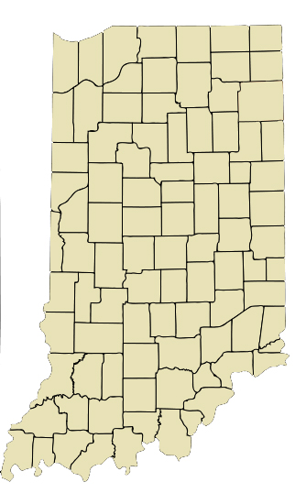
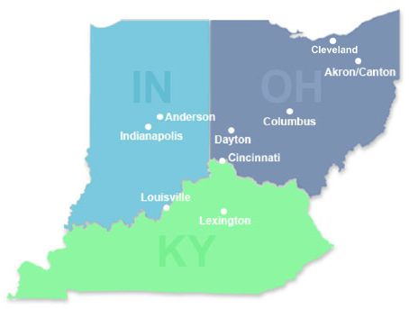
Indiana HIV/HCV/SUD Outbreak
From 2004-2013
In late 2014
By mid-January 2015
< 5 HIV infections reported annually in Austin, Indiana
3 new HIV diagnoses in Austin IN, 2 of them had shared needles
Through contact tracing ISHD identified 8 more new infections
As of June 14, 2015:
170 new HIV infections and 115 co-infected with HCV in a Community of 4200 people
All epidemiologically linked to Austin, IN
Infections were recent and from a single HIV strain
The source of infection: Injection of the opioid oxymorphone (semi-synthetic opioid analgesic)
Scott County: Among the state’s 92 counties,
ranked 92nd in a variety of health and
social indicators, including life expectancy

Slide 9
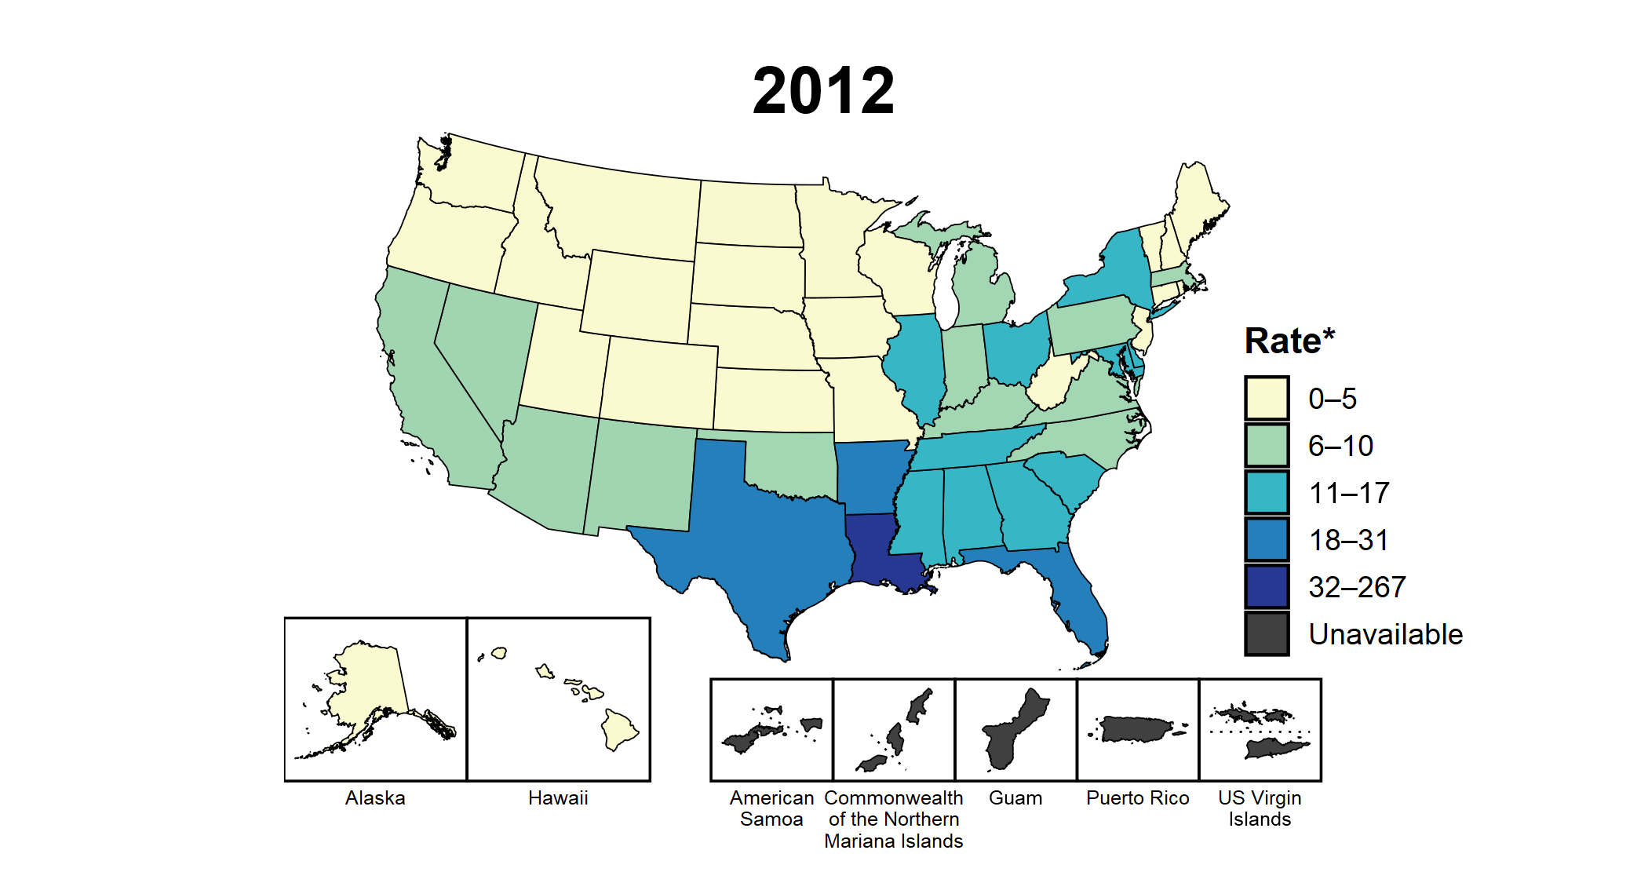
Primary and Secondary Syphilis — Rates of Reported Cases Among Women Aged 15–44 Years by State, United States and Territories, 2012–2021
* Per 100,000
Sexually Transmitted Disease Surveillance 2021

Slide 10
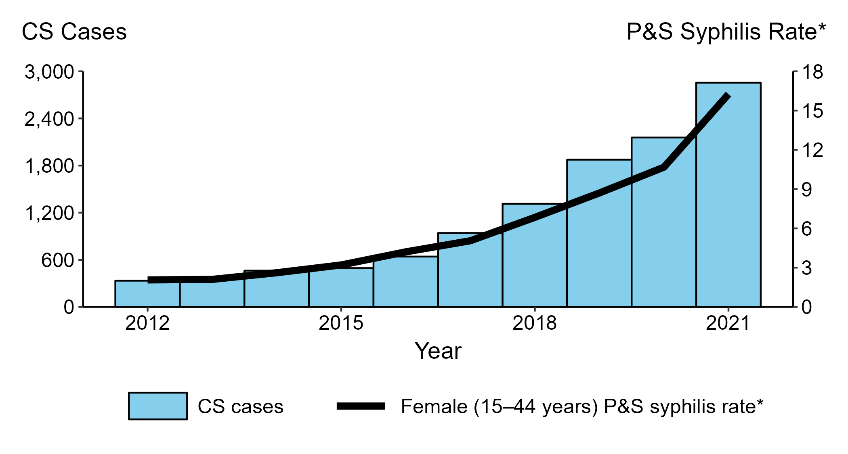
Congenital Syphilis — Reported Cases by Year of Birth and Rates of Reported Cases of Primary and Secondary Syphilis Among Women Aged 15–44 Years, United States, 2012–2021
* Per 100,000
ACRONYMS: CS = Congenital syphilis; P&S Syphilis = Primary and secondary syphilis
Sexually Transmitted Disease Surveillance 2021
Notes:
The 2013 rate of congenital syphilis (9.2 cases per 100,000 live births) marked the first increase in congenital syphilis since 2008. Since 2013, the rate of congenital syphilis has increased each year. In 2021, 2,855 cases of congenital syphilis were reported, including 220 congenital syphilis-related stillbirths and infant deaths. Although the majority of congenital syphilis cases were reported from a few states, in 2021, almost all jurisdictions (46 states and the District of Columbia) reported at least one case of congenital syphilis; 37 states and the District of Columbia had increases in congenital syphilis during 2020 to 2021.
The national congenital syphilis rate of 77.9 cases per 100,000 live births in 2021 represents a 30.5% increase relative to 2020 and 219.3% increase relative to 2017. These increases mirror increases in syphilis among reproductive aged women. During 2020 to 2021 the rate of P&S syphilis increased 52.3% among women aged 15–44 years and rates increased in 45 states. Further, in 2012, there were only three states that had over 100 cases of P&S syphilis among women aged 15–44 years; in 2021, 29 states reported over 100 cases.

Slide 11
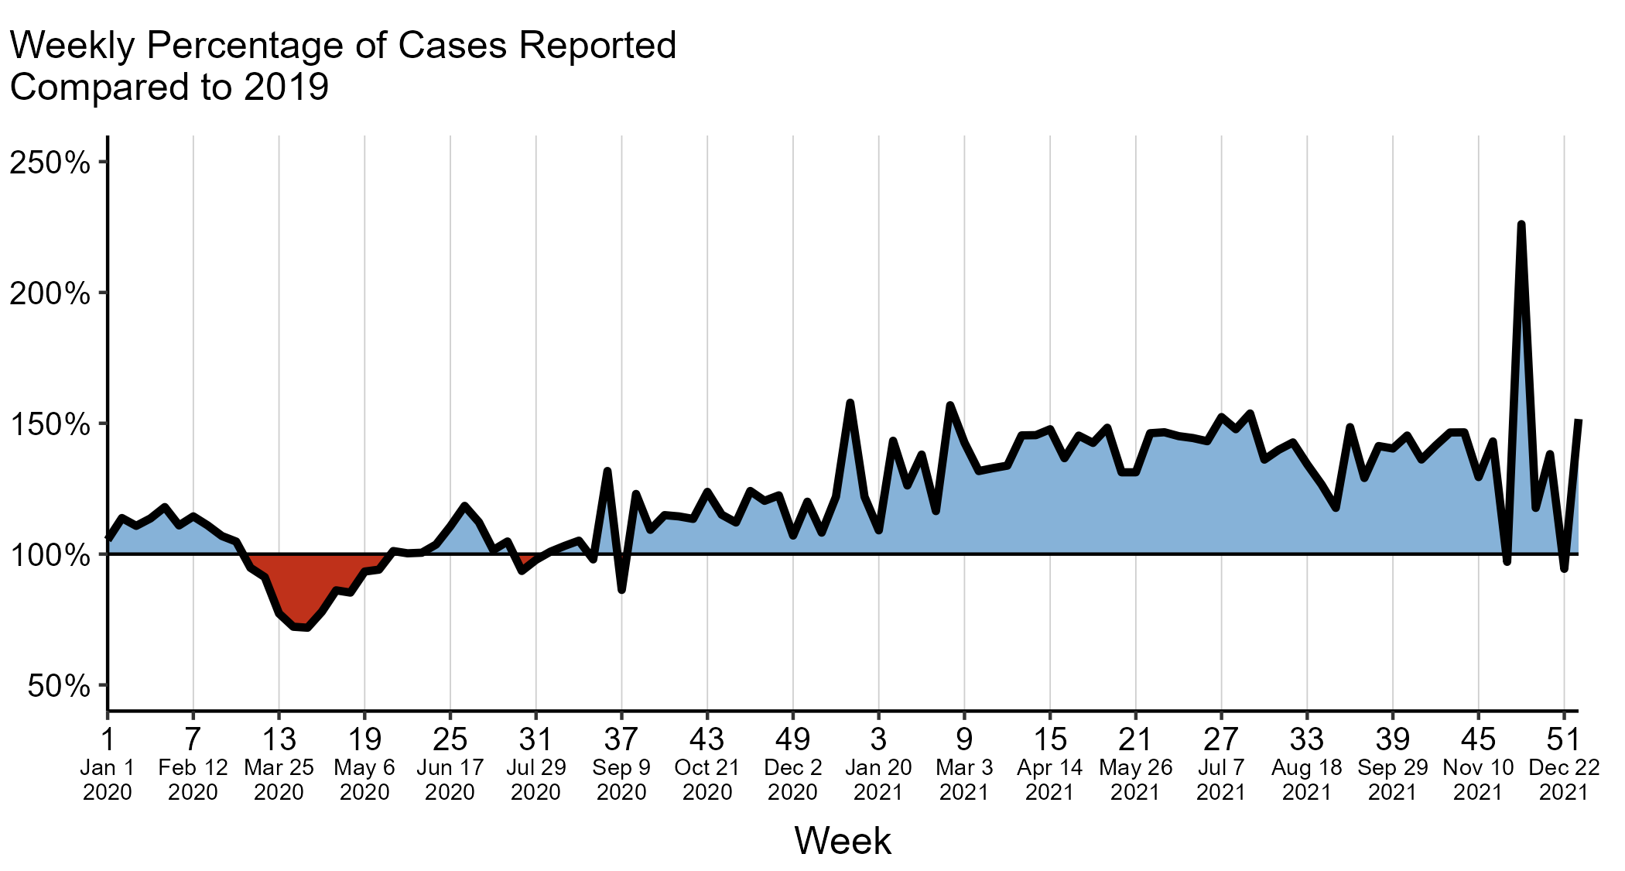
Primary and Secondary Syphilis — Reported 2020 and 2021 Cases as a Percentage of 2019 by MMWR Week, United States
NOTE: The MMWR week is the week of the epidemiologic year for which the case is assigned by the reporting local or state health department. For the weeks displayed, the midpoint of the date range (i.e., the Wednesday of the week) is provided for reference.
Adapted from Pagaoa et al., Sexually Transmitted Diseases, 2021
Notes:
To quantify the COVID-19 pandemic’s potential impact on reported STDs, the number of 2020 and 2021 cases reported for a given MMWR week was compared to the number of cases reported in the same week in 2019. The comparison is expressed in terms of the percentage of 2019 cases that were reported. Percentages lower than 100% denote when 2020 or 2021 cases were less than 2019 cases, while percentages higher than 100% indicate when 2020 or 2021 cases were higher than 2019 cases.
In 2020, during MMWR weeks 1–11 (December 29, 2019–March 14, 2020), the 2020 cumulative total of reported primary and secondary syphilis cases (8,848 cases) was higher than the 2019 cumulative total for the same number of weeks (8,074 cases). In week 12 (week of March 15–21, 2020; the first full week of the emergency declaration for the COVID-19 pandemic), the weekly number of 2020 primary and secondary syphilis cases was 91.2% compared to the cases reported by the same MMWR week in 2019.
Following week 12 of 2020, the deficit of 2020 cases compared to 2019 cases increased, reaching the lowest relative number of cases reported at week 15 (71.9%; week of April 5–11, 2020). The highest relative number of cases in 2020 after week 12 was in week 36 (131.8%; week of August 30–September 5, 2020). The final number of reported cases of primary and secondary syphilis for 2020 (41,655 cases) was 106.8% of the 2019 total (38,992 cases).
In 2021, the deficit of cases compared to 2019 reached the lowest relative number of cases reported at week 51 (94.4%; week of December 19–25, 2021), while the highest relative number of cases was in week 48 (226.1%; week of November 28–December 4, 2021). The final number of reported cases of primary and secondary syphilis for 2021 (53,767 cases) was 137.9% of the 2019 total (38,992 cases).
The COVID-19 pandemic has introduced uncertainty and difficulty in interpreting STD data collected during 2020 and 2021. See Impact of COVID-19 on STDs (https://www.cdc.gov/std/statistics/2021/impact.htm) for more information.
See Technical Notes (https://www.cdc.gov/std/statistics/2021/technical-notes.htm) for information on syphilis case reporting.
Data points are available at https://www.cdc.gov/std/statistics/2021/data.zip.

Slide 12
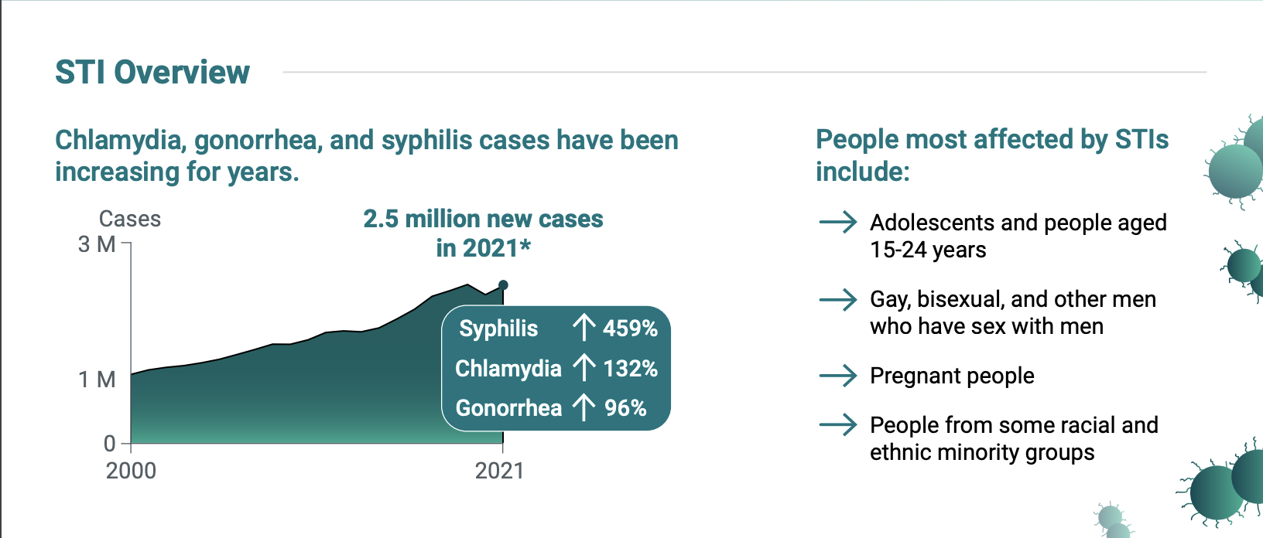
Reversing the Rise in STIs: Integrating Services to Address the Syndemic of STIs, HIV, Substance Use, and Viral Hepatitis
A holistic, whole-of-society approach, including addressing social and economic barriers, is required to
improve this syndemic and America’s health

Slide 13
Outline
Syndemic Concepts
Clinical Case
The SUD/HCV/HIV/STI Syndemic in Indian Country
Interventions to Mitigate the Syndemic:
Societal (Macro), Health System (Micro), Health Professional (Individual)
Notes:
,

Slide 14

Clinical Case: Mr. S
Mr. S is a 24-year-old AI/AN male who suffered a right femur fracture (MVA) 6 years ago. Unfortunately, pain management training or policies were not available in the institution, and he was discharge from the hospital with oxycodone hydrochloride for pain control.

Slide 15
Clinical Case: Mr. S
Two years ago, his new medical provider refused to refill the oxycodone. Unfortunately, the provider was not trained in screening for SUDs. Nor did he have an MAT waiver. The patient then turned to his friends who gave him oxycodone, but later he had to purchase it in the streets.

Slide 16
Clinical Case: Mr. S
One year ago, he started injecting heroin since it was cheaper. Unfortunately, SSPs are not available where he lives, and he has been sharing needles and syringes. Unfortunately, he lost his job and health insurance and is homeless.

Slide 17
Clinical Case: Mr. S
Three days ago, he presented to the ED with opioid withdrawal symptoms (nausea, vomiting, diarrhea, restlessness, abdominal pain).

Slide 18
Clinical Case: Mr. S: Questions
For the Public Health Participants:
Name 2 structural and 2 Social factors that were drivers in Mr. S outcomes
For the Clinical Participants
Name 1 medical intervention that could have prevented this patient from ending up in the ED and 4 interventions you would have done for Mr. S in the ED

Slide 19
Clinical Case: Mr. S: Questions
For the Public Health Participants:
Name 2 structural and 2 Social factors that were drivers in Mr. S outcomes
For the Clinical Participants
Name 1 medical intervention that could have prevented this patient from ending up in the ED and 4 interventions you would have done for Mr. S in the ED
Structural:
Access to housing and SSP
Social:
Stigma, Health Coverage
Preventive Medical Intervention:
Pharmacotherapy/SSP
ED Interventions:
Screening for HCV/HIV/Syphilis/HBV
Buprenorphine Induction
Behavioral health evaluation
Social services
HIV PrEP

Slide 20
Missed Opportunities
Individual Provider
Orthopedic surgeon did not recognize that opioids are not the first line of treatment for management of pain in the outpatient setting
The patient’s PCP did not recognize that the patient has an SUD
Health System
Should have had guidelines/policies in place for pain management, pharmacotherapy and screening for SUD, HIV, HCV and STIs
Society
Should recognize that SSP are evidence-based practice
Notes:
,

Slide 21
Clinical Case: Mr. S
Fortunately, the ED medical provider was trained in SUD management and induced him with Buprenorphine/Naloxone and gave him a 3-day prescription, enough until he could be evaluated and placed on maintenance therapy.

Slide 22
Clinical Case: Mr. S
In addition, the provider was also trained in screening for STIs, HCV, HIV, and HIV PrEP. During the ED visit he was screened and tested positive for HCV. HIV and other STIs screens were negative, and he was referred to the Primary Care clinic for HIV PrEP, HCV treatment and pharmacotherapy follow-up.

Slide 23
Outline
Syndemic Concepts
Clinical Case
The SUD/HCV/HIV/STI Syndemic in Indian Country
Interventions to Mitigate the Syndemic:
Societal (Macro), Health System (Micro), Health Professional (Individual)
Notes:
,

Slide 24
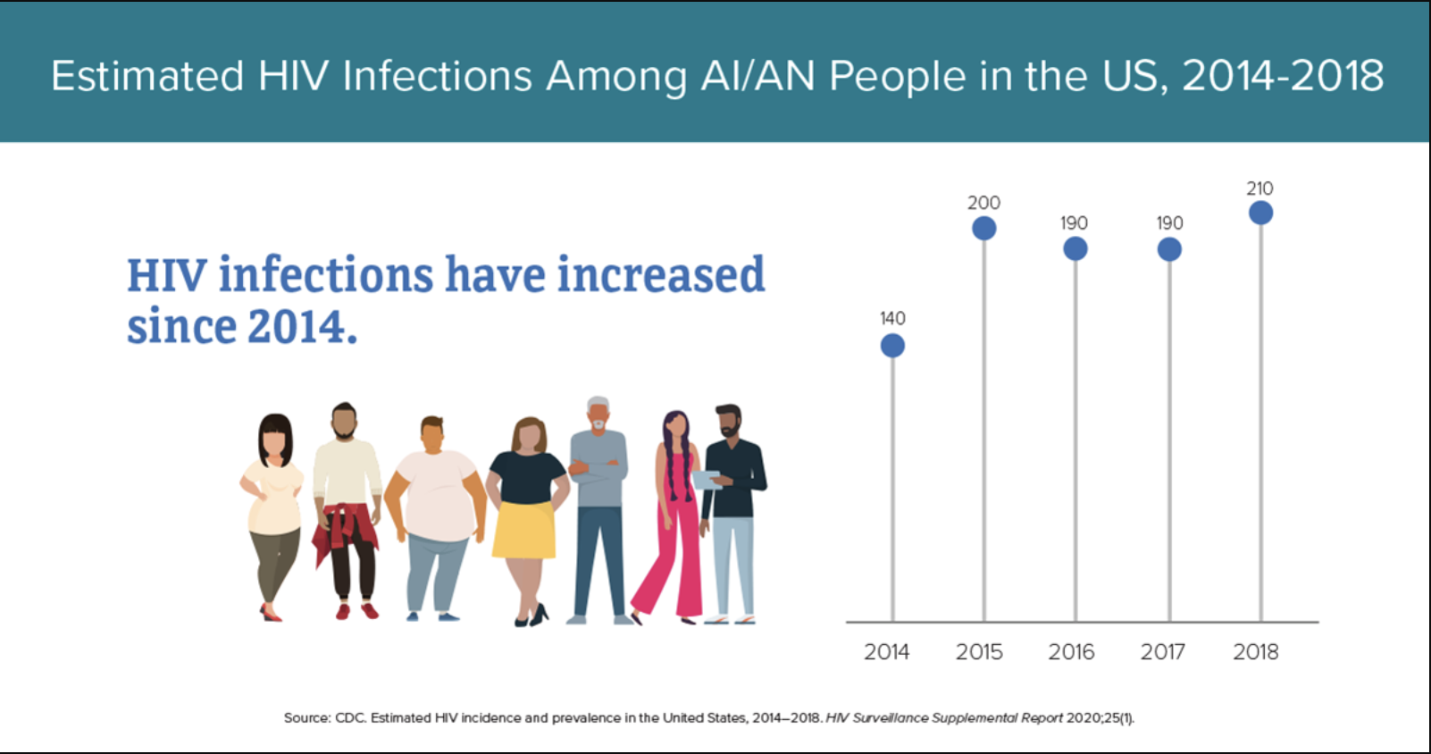
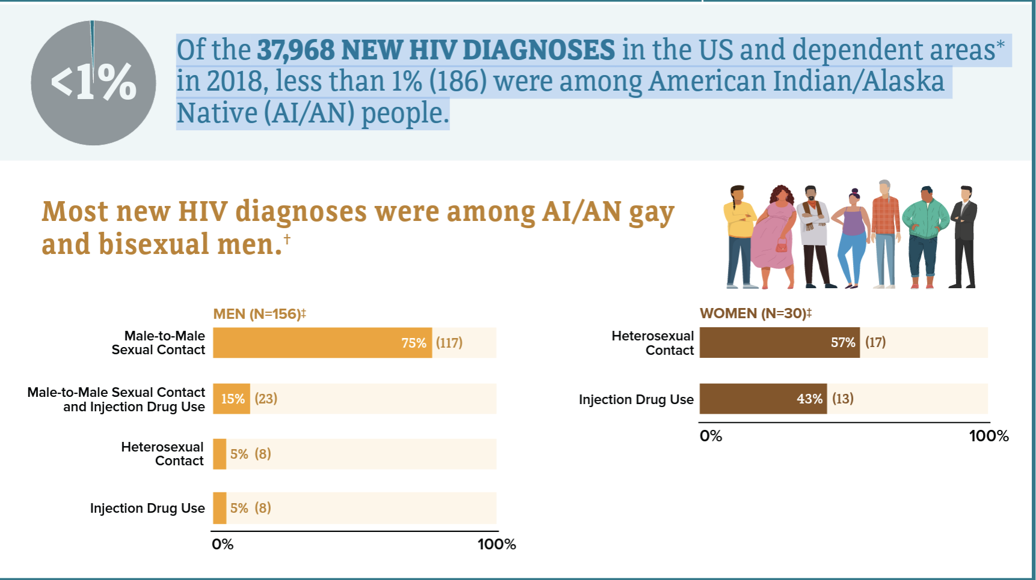
HIV in American Indian/Alaska Native Populations
In the U.S. in 2018, both male and female AI/AN had the highest percent of estimated diagnoses of HIV infection attributed to injection drug use, compared with all races/ethnicities.
Among men, 15% (23) of new HIV diagnoses were attributed to injection drug use, and 11% (21) were attributed to both male-to-male sex and injection drug use.
Among women, 43% (13) of new HIV diagnoses were attributed to injection drug use.

Slide 25
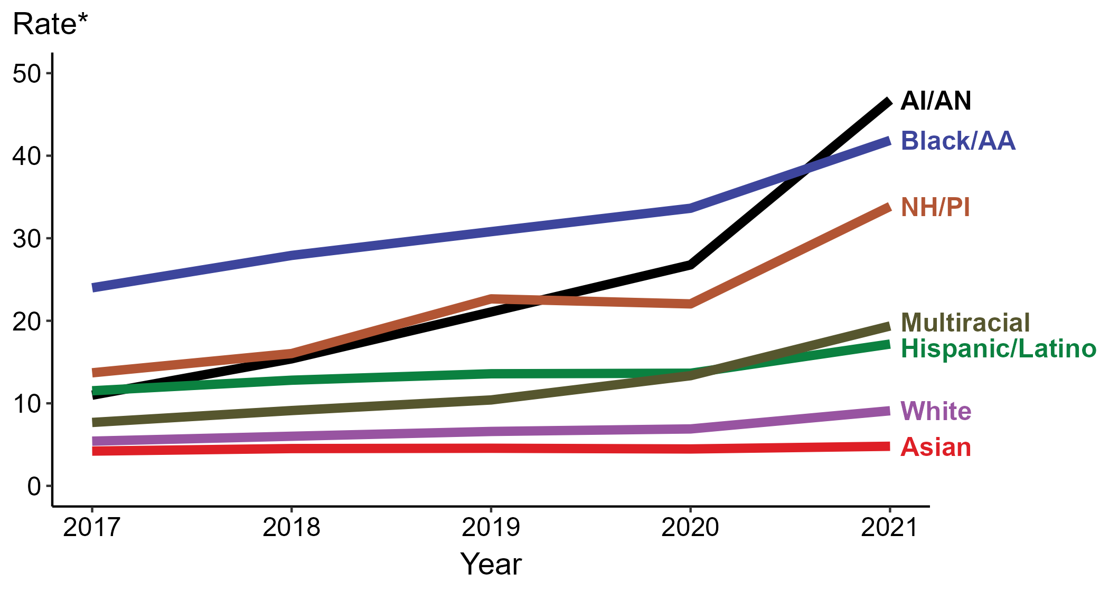
Primary and Secondary Syphilis — Rates of Reported Cases by Race/Hispanic Ethnicity, United States, 2017–2021
* Per 100,000
ACRONYMS: AI/AN = American Indian or Alaska Native; Black/AA = Black or African American; NH/PI = Native Hawaiian or other Pacific Islander
Sexually Transmitted Disease Surveillance 2021

Slide 26
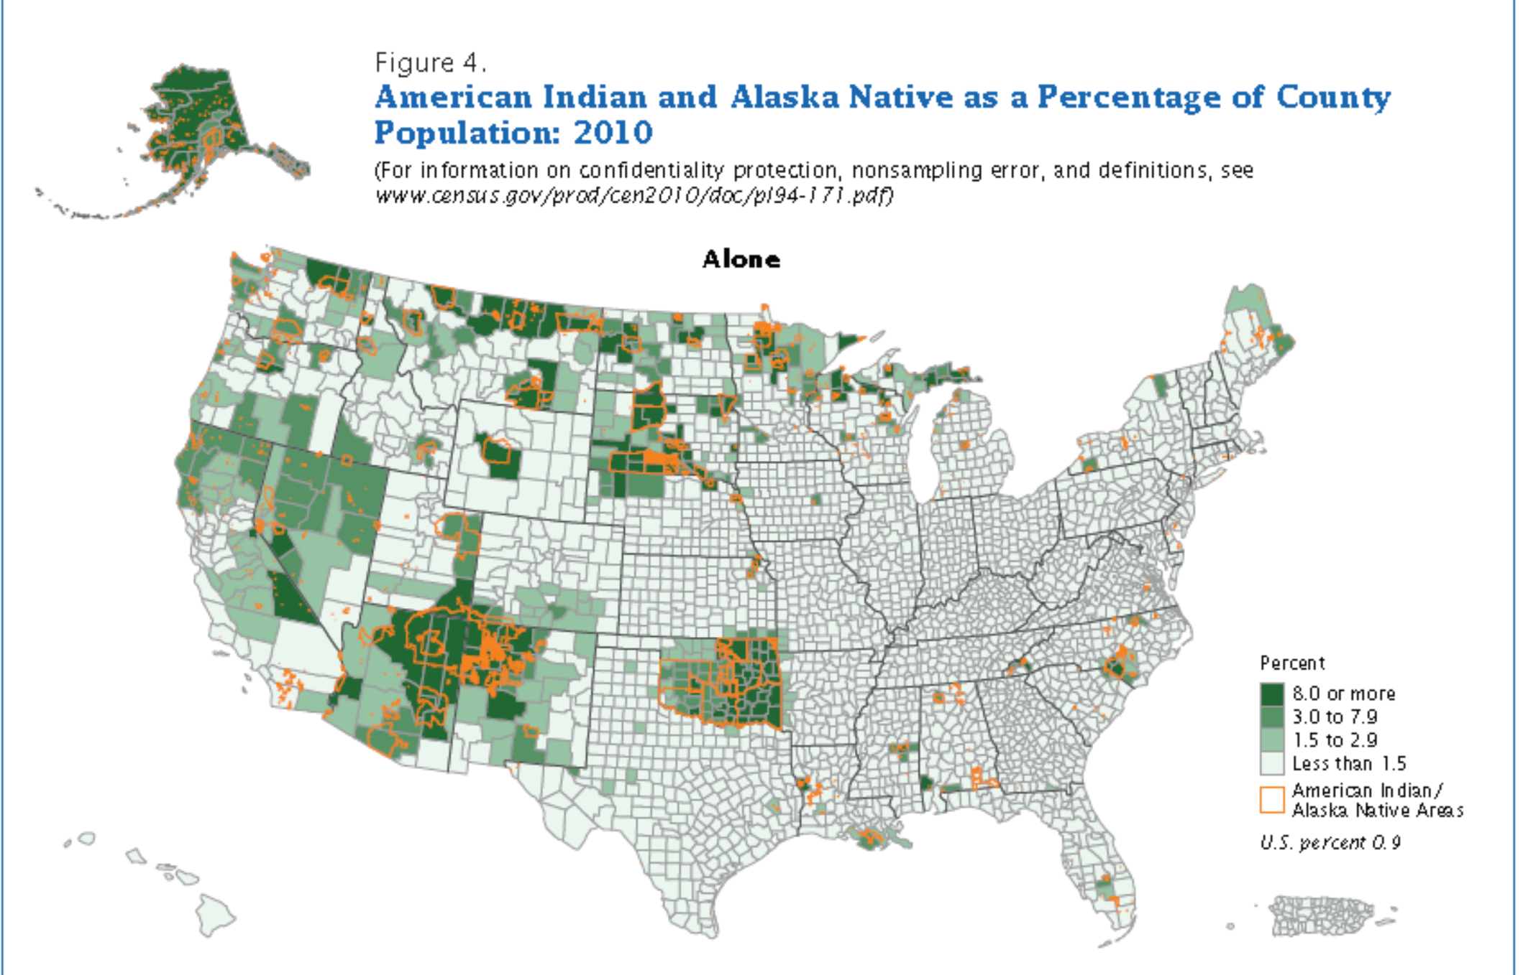
American Indian/Alaska Native (AI/AN) Statistics in the United States
573 Federally recognized tribes
5.2 million AI/AN alone or in combination
California and Oklahoma have the highest rate of AI/AN population
Hepatitis C in AI/AN in the US
HCV disproportionately affects AI/AN^{1,2}
The AI/AN HCV mortality rate is 10.8 deaths per 100,000, compared to 4.5 per 100,000 nationally.
From 2015 to 2016, incidence rates of acute HCV among AI/ANs rose from 1.8 to 3.1 cases per 100,000.
Rates of chronic liver disease and cirrhosis deaths are 2.3 times higher among AI/ANs than Whites.
Centers for Disease Control and Prevention. Surveillance for Viral Hepatitis: United States, 2016. Retrieved from https://www.cdc.gov/hepatitis/statistics/2016surveillance/commentary.htm
Center for Disease Control and Prevention. Deaths: Final Data for 2014. http://www.cdc.gov/nchs/data/nvsr/nvsr65/nvsr65_04.pdf
US Census Bureau. https://www.census.gov/www. Accessed Nov 2, 2019

Slide 27
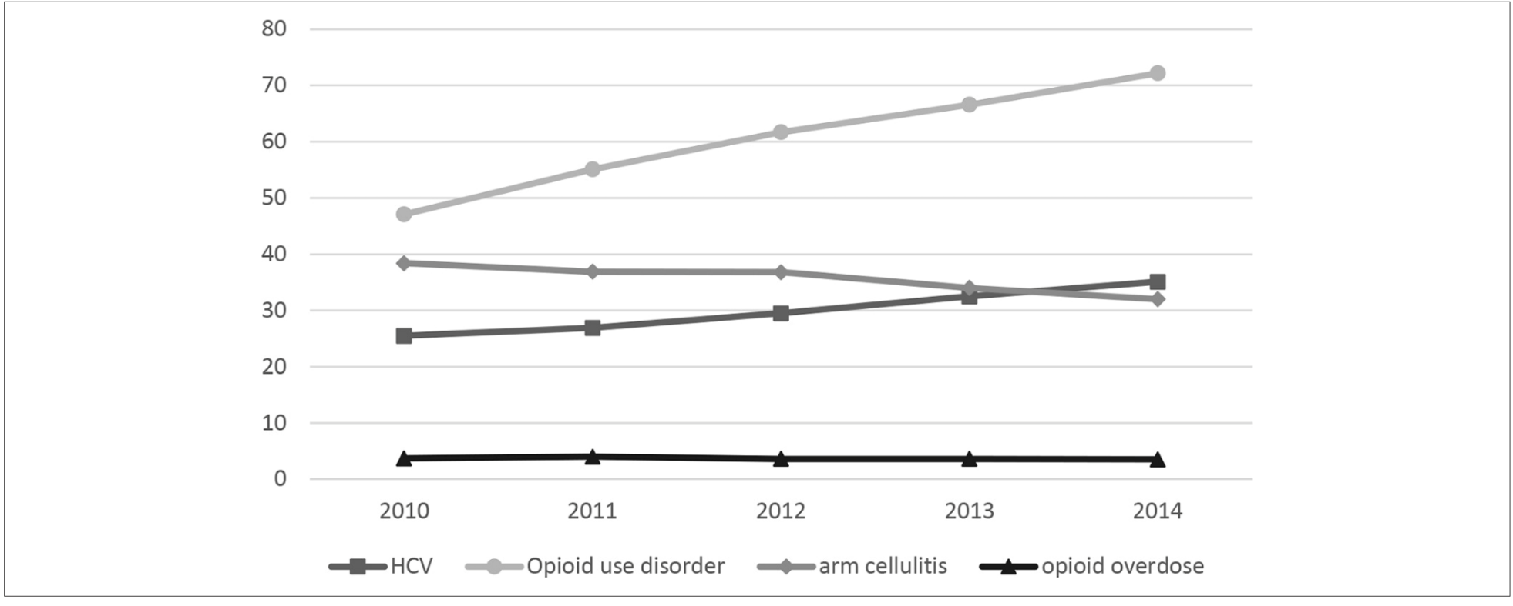
Trends in Indicators of Injection Drug Use, Indian Health Service, 2010-2014: A Study of Health Care Encounter Data
Overall national annual rates (per 10 000 adults) of diagnoses among American Indian/Alaska Native persons for hepatitis C virus (HCV) infection, opioid use disorder, arm cellulitis and abscess, and opioid-related overdose, Indian Health Service, 2010-2014. Rates of diagnoses represent 1 health care encounter per person per year. Data for HCV infections are for adults aged 18-35; all other data are for adults aged ≥18. Arm cellulitis was counted only among adults with no diabetes on or before the health care encounter for arm cellulitis visit (since 2001). Data source: National Patient Information Reporting System.
Evans ME, Person M, Reilley B, Leston J,. Public Health Rep. 2020 Jul/Aug;135(4):461-471.
Notes:
,

Slide 28
HIV, HCV, STIs, Drug Use Among AI/AN
AI/AN had the highest percent of estimated diagnoses of HIV infection attributed to injection drug use
Syphilis rates rapidly increasing
Exacerbates HIV transmission
Drug use is increasing nationwide and in Indian Country
AI/AN have greatest rates of new HCV diagnoses
Over 2x national rate of HCV-related mortality
Rates are decreasing with greater availability of treatment

Slide 29
What can we do for Mr. S?
as a primary care health worker?
(Individual)
as health system Leadership?
(Micro)
As a Society
(Macro)

Slide 30

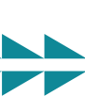
Actions to Address the Syndemics Among People Who Inject Drugs as a Primary Care Health Care Worker
Screening patients for SUDs and mental health disorders
Testing patients and their sexual or drug-injection partners for HIV, HCV, and STIs
With appropriate pre and post-test counseling
Offering immediate treatment according to established guidelines for patients who test positive
Threading the Needle — How to Stop the HIV Outbreak in Rural Indiana Steffanie A. Strathdee, Ph.D., and Chris Beyrer, M.D., M.P.H. NEJM 373;5 nejm.org July 30, 2015

Slide 31
Actions to Address the Syndemics Among People Who Inject Drugs as a Primary Care Health Care Worker
Providing Hep B vaccinations
Even one dose can be effective!
Providing naloxone to opioid users and their families/partners
Providing opioid agonist therapy

Slide 32
Actions to Address the Syndemics Among People Who Inject Drugs as a Primary Care Health Care Worker
Supporting injection-drug users by providing sterile syringes or referring them to SSP
Supporting legislative reforms to expand Medicaid and allow federal funds to support SSPs
Using PDMPs in clinical decision making involving opiate prescribing
SSPs: Syringe Service Program, PDMPs: Prescription Drug Monitoring Programs

Slide 33
What can the Healthcare Worker do for Mr. S?
Medication Assisted Treatment
PREP for PWUDs
HCV/HIV Testing and Treatment
Naloxone, Syringe Service Programs, and Safer Injection Practices
Mental Health Services
“Using trauma terminology implies that the individual is responsible for the response, rather than the broader systemic force caused by the state’s abuse of power”
Linklater, R. (2014). Decolonizing trauma work : Indigenous stories and strategies. Black Point, Nova Scotia: Fernwood Publishing.

Slide 34
What can the Health Care system (Leadership)
do for Mr. S (Micro level)
Recognize
the problem and embrace it as a syndemic
Have
SUD/HCV/HIV/STI policies in place
Enforce Policies
Encourage, facilitate and motivate SUD, HCV, HIV and STI screening and treatment
Allow provider time
Create
Performance-based outcomes around SUD/HCV/HIV/STI
For training and participation in these activities
“Using trauma terminology implies that the individual is responsible for the response, rather than the broader systemic force caused by the state’s abuse of power”
Linklater, R. (2014). Decolonizing trauma work : Indigenous stories and strategies. Black Point, Nova Scotia: Fernwood Publishing.

Slide 35
What Can Society Do For Mr. S (Macro level)?
Decrease Injection Drug Use and/or make it safer
Make SSP available
Easy access to pharmacotherapy
Easy access to behavioral health
Eliminate social and structural determinants associated with injection drug use
Poverty (Decrease the economic inequality gap)
Housing
Lack of education
Racism
Stigma
Mass incarceration (Reform drug laws)
Addressing the root of the problem is critical for the elimination of present SUD/HCV/HIV/STI syndemic and the prevention of future ones
A coordinated approach between society, government, public health will be needed
“Using trauma terminology implies that the individual is responsible for the response, rather than the broader systemic force caused by the state’s abuse of power”
Linklater, R. (2014). Decolonizing trauma work : Indigenous stories and strategies. Black Point, Nova Scotia: Fernwood Publishing.

Slide 36
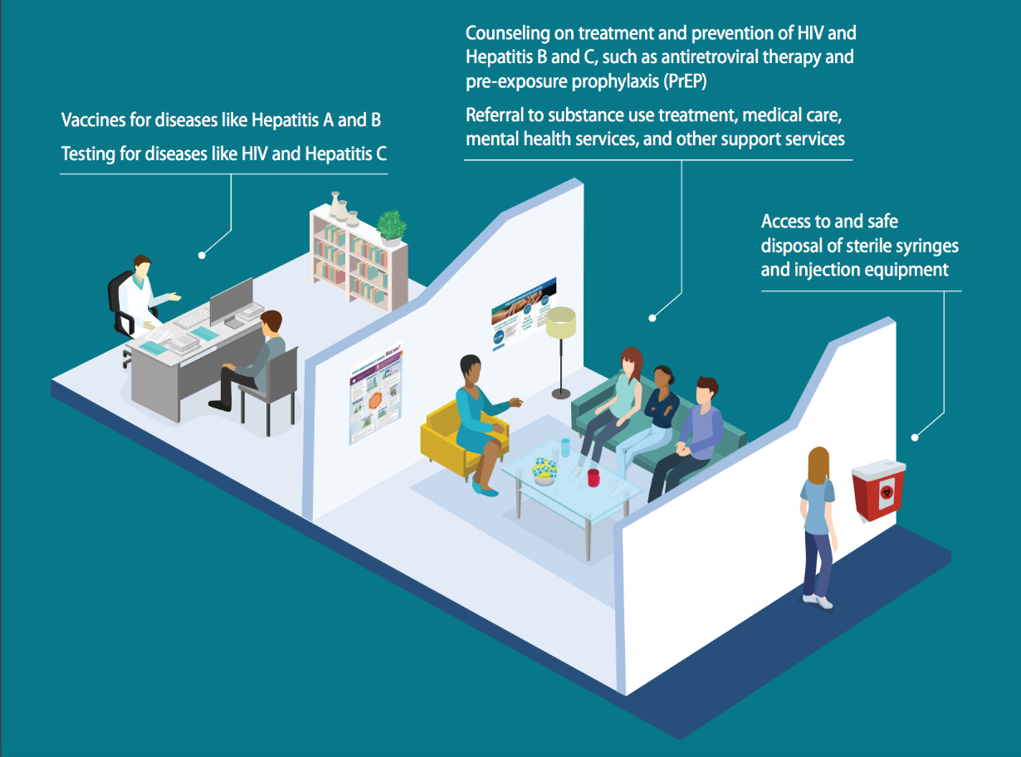
Syringe Services Programs
SSPs adapt to local needs by providing comprehensive support services, such as ways to get treatment, medicines to prevent overdoses, and tools to prevent HIV and viral hepatitis. Many support services may be operated in partnership with federal government funding¹
Combined use of OST and high coverage of NSP was associated with a 74% risk reduction in HCV acquisition ²
1. HIV.gov: Syringe Serviece Programs. https://www.hiv.gov/federal-response/policies-issues/syringe-services-programs

Slide 37
Holistic, Coordinated Care Is Critical for Addressing These Overlapping Epidemics
A “no-wrong-door” approach
Providing services that meet the persons needs wherever they seek care
Provide spaces for people who are uninsured, need flexible appointments, need low- or no-cost services, or are looking for expert and confidential services.
Address the social determinants of health
Key contributors to negative health outcomes, including STI transmission.
Providing patients with housing, food, transportation, and employment.
Integrating existing programs
Such as SSP, SUD treatment programs, and HIV testing and pre-exposure prophylaxis programs in the same clinic
Source: Division of STD Prevention, National Center for HIV, Viral Hepatitis, STD, and TB Prevention, Centers for Disease Control and Prevention

Slide 38
Conclusions
Ending the syndemic will require a multipronged approach
SUD services should be integrated into primary care – barriers for harm reduction should be removed
The efficacy of PrEP and HIV treatment has been established – access for the most vulnerable is critical
Syphilis is taking a toll in AI/AN communities – zero tolerance for congenital syphilis should be the standard

Slide 39
References
Singer, M. and Clair, S. (2003), Syndemics and Public Health: Reconceptualizing Disease in Bio‐Social Context. Medical Anthropology Quarterly, 17: 423-441. https://doi.org/10.1525/maq.2003.17.4.423
Chu PL, Santos GM, Vu A et al. Journal of the International AIDS Society 2012. 15:102-103
Community Outbreak of HIV Infection Linked to Injection Drug Use of Oxymorphone — Indiana, 2015 MMWR May 1, 2015 / 64(16):443-444
US Census Bureau. https://www.census.gov/www. Accessed March 22, 2021
Evans ME, Person M, Reilley B, et al. Trends in Indicators of Injection Drug Use, Indian Health Service, 2010-2014 : A Study of Health Care Encounter Data. Public Health Rep. 2020 Jul/Aug;135(4):461-471. doi: 10.1177/0033354920937284. Epub 2020 Jul 7. PMID: 32633599; PMCID: PMC7383762.
Viral Hepatitis Surveillance Report 2018 — Hepatitis C https://www.cdc.gov/hepatitis/statistics/2018surveillance/HepC.htm
Melkonian SC, Jim MA, Haverkamp D, et al. Disparities in Cancer Incidence and Trends among American Indians and Alaska Natives in the United States, 2010-2015. Cancer Epidemiol Biomarkers Prev. 2019;28(10):1604-1611. doi:10.1158/1055-9965.EPI-19-0288
National Center for HIV/AIDS, Viral Hepatitis, STD, and TB Prevention Division of HIV/AIDS Prevention. https://www.cdc.gov/hiv/group/racialethnic/aian/index.html

Slide 40
References
Sordo L, Barrio G, Bravo M J, Indave B I, Degenhardt L, Wiessing L et al. Mortality risk during and after opioid substitution treatment: systematic review and meta-analysis of cohort studies BMJ 2017; 357 :j1550 doi:10.1136/bmj.j1550
Haffajee RL, Lin LA, Bohnert ASB, Goldstick JE. Characteristics of US Counties With High Opioid Overdose Mortality and Low Capacity to Deliver Medications for Opioid Use Disorder. JAMA Netw Open. 2019;2(6):e196373. doi:10.1001/jamanetworkopen.2019.6373
Reilley B, Haberling DL, Person M, Leston J, Iralu J, Haverkate R, Siddiqi AE. Assessing New Diagnoses of HIV Among American Indian/Alaska Natives Served by the Indian Health Service, 2005-2014. Public Health Rep. 2018 Mar/Apr;133(2):163-168. doi: 10.1177/0033354917753118. Epub 2018 Mar 8. PMID: 29517957; PMCID: PMC5871137.
Lauren Canary, Susan Hariri, Cecily Campbell, et al., Geographic Disparities in Access to Syringe Services Programs Among Young Persons With Hepatitis C Virus Infection in the United States, Clinical Infectious Diseases, Volume 65, Issue 3, 1 August 2017, Pages 514–517
Paquette CE, Pollini RA. Injection drug use, HIV/HCV, and related services in nonurban areas of the United States: A systematic review. Drug Alcohol Depend. 2018 Jul 1;188:239-250. doi: 10.1016/j.drugalcdep.2018.03.049. Epub 2018 May 8. PMID: 29787966; PMCID: PMC5999584.
Jon E. Zibbell, Alice K. Asher, Rajiv C. Patel, et al. Increases in Acute Hepatitis C Virus Infection Related to a Growing Opioid Epidemic and Associated Injection Drug Use, United States, 2004 to 2014. J Public Health. 2018 Feb; 108(2): 175–181.

Slide 41
Questions?
Thank You

