Slide 1
STIs among AI/AN populations and penicillin shortages
Division of STD Prevention
Michelle Johnson Jones, MPH
Epidemiologist
August 8, 2023

Slide 2
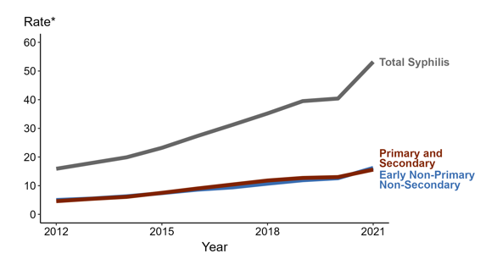
Syphilis is increasing nationally
* Per 100,000
ACRONYMS: AI/AN = American Indian or Alaska Native; Black/AA = Black or African American; NH/PI = Native Hawaiian or other Pacific Islander
Notes:
In 2021, the highest rate of reported primary and secondary syphilis cases per 100,000 persons was among non-Hispanic American Indian or Alaska Native persons (46.7), followed by non-Hispanic Black or African American persons (41.9).
During 2020 to 2021, the greatest increase in rate of reported primary and secondary syphilis cases per 100,000 persons was among non-Hispanic American Indian or Alaska Native persons (26.8 to 46.7; 74.3% increase). Non-Hispanic American Indian or Alaska Native persons also had the greatest five-year increase in rate of reported primary and secondary syphilis (11.0 to 46.7; 324.5% increase from 2017).
There were no decreases in the rate of reported primary and secondary syphilis cases per 100,000 persons among any race/ethnicity group during 2020 to 2021. There were also no decreases in the rate of reported primary and secondary syphilis among any race/ethnicity group during 2017 to 2021.
For this figure, race/Hispanic ethnicity is categorized first by reported Hispanic ethnicity, then by reported race. Therefore, cases categorized as Hispanic/Latino can be of any race(s); cases categorized into a race group include both non-Hispanic persons and persons of unknown Hispanic ethnicity. Not all US jurisdictions reported cases in Office of Management and Budget compliant race categories during 2017 to 2021. This may minimally under- or overestimate rates for Asian, Native Hawaiian or other Pacific Islander, or multiracial individuals. No population data exist for unknown or other race; therefore, rates are not calculated. For completeness, data in this figure include cases reported from all jurisdictions.
The COVID-19 pandemic has introduced uncertainty and difficulty in interpreting STD data collected during 2020 and 2021. See Impact of COVID-19 on STDs (https://www.cdc.gov/std/statistics/2021/impact.htm) for more information.
See Technical Notes (https://www.cdc.gov/std/statistics/2021/technical-notes.htm) for information on syphilis case reporting and reporting of race/Hispanic ethnicity for STD cases.
Data points are available at https://www.cdc.gov/std/statistics/2021/data.zip.

Slide 3
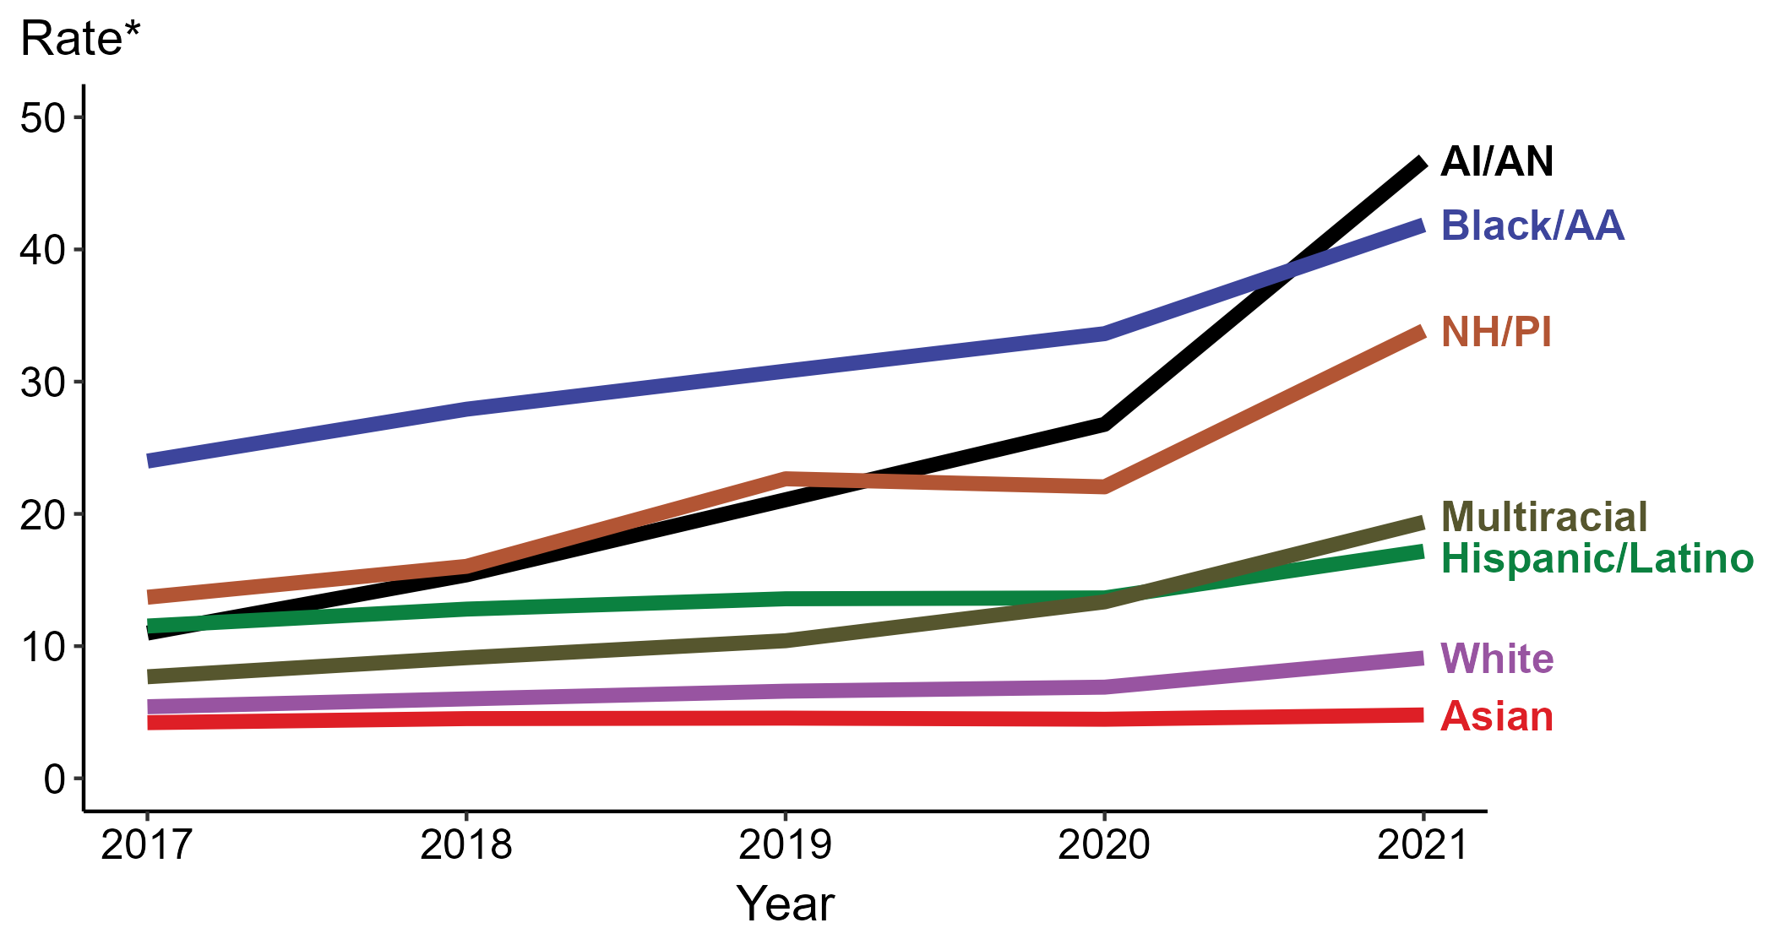
In 2021, the highest rate of primary and secondary syphilis cases was among American Indians and Alaska Natives
46.7
cases per
100,000 population
* Per 100,000
ACRONYMS: AI/AN = American Indian or Alaska Native; Black/AA = Black or African American; NH/PI = Native Hawaiian or other Pacific Islander
Notes:
In 2021, the highest rate of reported primary and secondary syphilis cases per 100,000 persons was among non-Hispanic American Indian or Alaska Native persons (46.7), followed by non-Hispanic Black or African American persons (41.9).
During 2020 to 2021, the greatest increase in rate of reported primary and secondary syphilis cases per 100,000 persons was among non-Hispanic American Indian or Alaska Native persons (26.8 to 46.7; 74.3% increase). Non-Hispanic American Indian or Alaska Native persons also had the greatest five-year increase in rate of reported primary and secondary syphilis (11.0 to 46.7; 324.5% increase from 2017).
There were no decreases in the rate of reported primary and secondary syphilis cases per 100,000 persons among any race/ethnicity group during 2020 to 2021. There were also no decreases in the rate of reported primary and secondary syphilis among any race/ethnicity group during 2017 to 2021.
For this figure, race/Hispanic ethnicity is categorized first by reported Hispanic ethnicity, then by reported race. Therefore, cases categorized as Hispanic/Latino can be of any race(s); cases categorized into a race group include both non-Hispanic persons and persons of unknown Hispanic ethnicity. Not all US jurisdictions reported cases in Office of Management and Budget compliant race categories during 2017 to 2021. This may minimally under- or overestimate rates for Asian, Native Hawaiian or other Pacific Islander, or multiracial individuals. No population data exist for unknown or other race; therefore, rates are not calculated. For completeness, data in this figure include cases reported from all jurisdictions.
The COVID-19 pandemic has introduced uncertainty and difficulty in interpreting STD data collected during 2020 and 2021. See Impact of COVID-19 on STDs (https://www.cdc.gov/std/statistics/2021/impact.htm) for more information.
See Technical Notes (https://www.cdc.gov/std/statistics/2021/technical-notes.htm) for information on syphilis case reporting and reporting of race/Hispanic ethnicity for STD cases.
Data points are available at https://www.cdc.gov/std/statistics/2021/data.zip.

Slide 4
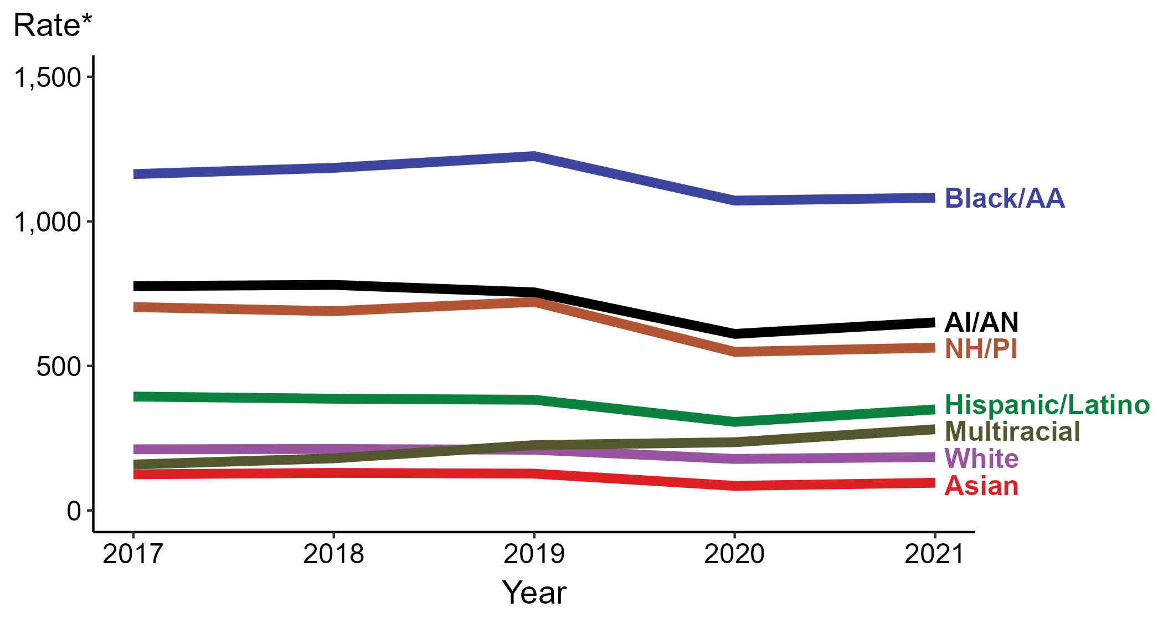
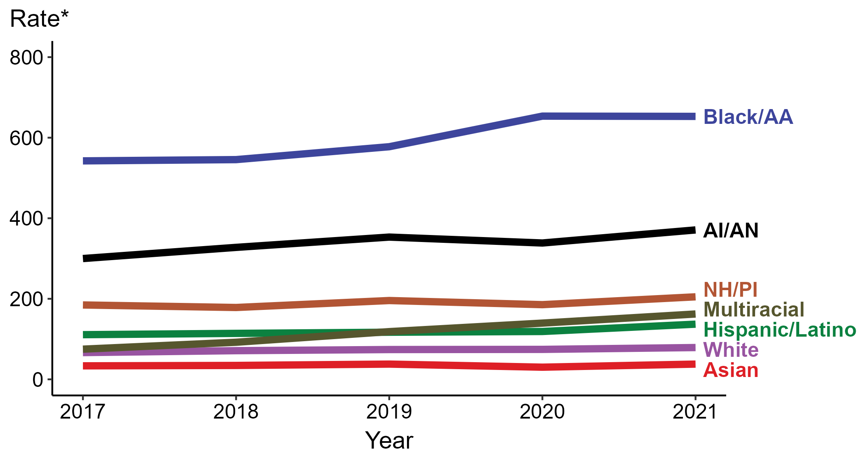
We do not see the same increase with gonorrhea and chlamydia rates
Chlamydia
Gonorrhea
* Per 100,000
ACRONYMS: AI/AN = American Indian or Alaska Native; Black/AA = Black or African American; NH/PI = Native Hawaiian or other Pacific Islander
Notes:
In 2021, the highest rate of reported primary and secondary syphilis cases per 100,000 persons was among non-Hispanic American Indian or Alaska Native persons (46.7), followed by non-Hispanic Black or African American persons (41.9).
During 2020 to 2021, the greatest increase in rate of reported primary and secondary syphilis cases per 100,000 persons was among non-Hispanic American Indian or Alaska Native persons (26.8 to 46.7; 74.3% increase). Non-Hispanic American Indian or Alaska Native persons also had the greatest five-year increase in rate of reported primary and secondary syphilis (11.0 to 46.7; 324.5% increase from 2017).
There were no decreases in the rate of reported primary and secondary syphilis cases per 100,000 persons among any race/ethnicity group during 2020 to 2021. There were also no decreases in the rate of reported primary and secondary syphilis among any race/ethnicity group during 2017 to 2021.
For this figure, race/Hispanic ethnicity is categorized first by reported Hispanic ethnicity, then by reported race. Therefore, cases categorized as Hispanic/Latino can be of any race(s); cases categorized into a race group include both non-Hispanic persons and persons of unknown Hispanic ethnicity. Not all US jurisdictions reported cases in Office of Management and Budget compliant race categories during 2017 to 2021. This may minimally under- or overestimate rates for Asian, Native Hawaiian or other Pacific Islander, or multiracial individuals. No population data exist for unknown or other race; therefore, rates are not calculated. For completeness, data in this figure include cases reported from all jurisdictions.
The COVID-19 pandemic has introduced uncertainty and difficulty in interpreting STD data collected during 2020 and 2021. See Impact of COVID-19 on STDs (https://www.cdc.gov/std/statistics/2021/impact.htm) for more information.
See Technical Notes (https://www.cdc.gov/std/statistics/2021/technical-notes.htm) for information on syphilis case reporting and reporting of race/Hispanic ethnicity for STD cases.
Data points are available at https://www.cdc.gov/std/statistics/2021/data.zip.

Slide 5
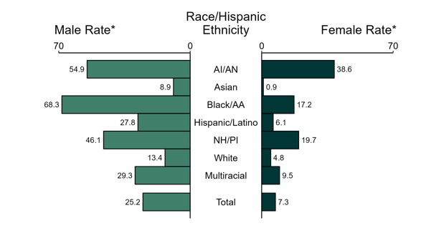
Among AI/AN, the male-to-female ratio of primary and secondary syphilis cases was 1.4, suggesting largely heterosexual transmission in 2021
United States
* Per 100,000
ACRONYMS: AI/AN = American Indian or Alaska Native; Black/AA = Black or African American; NH/PI = Native Hawaiian or other Pacific Islander
NOTE: Total includes all cases including those with unknown race/Hispanic ethnicity.
Notes:
In 2021, there were a total of 2,855 cases of congenital syphilis reported for a rate of 77.9 per 100,000 live births.
During 2020 to 2021, the number of women reported with syphilis (all stages) who were pregnant increased 36.4% (from 5,726 in 2020 to 7,812 in 2021). During the same time period, the number of reported cases of congenital syphilis increased 32.4% (from 2,157 in 2020 to 2,855 in 2021).
During 2017 to 2021, the number of women reported with syphilis (all stages) who were pregnant increased 140.7% (from 3,245 in 2017 to 7,812 in 2021). During the same time period, the number of reported cases of congenital syphilis increased 203.4% (from 941 in 2017 to 2,855 in 2021).
The COVID-19 pandemic has introduced uncertainty and difficulty in interpreting STD data collected during 2020 and 2021. See Impact of COVID-19 on STDs (https://www.cdc.gov/std/statistics/2021/impact.htm) for more information.
See Technical Notes (https://www.cdc.gov/std/statistics/2021/technical-notes.htm) for information on syphilis case reporting.
Data points are available at https://www.cdc.gov/std/statistics/2021/data.zip.

Slide 6
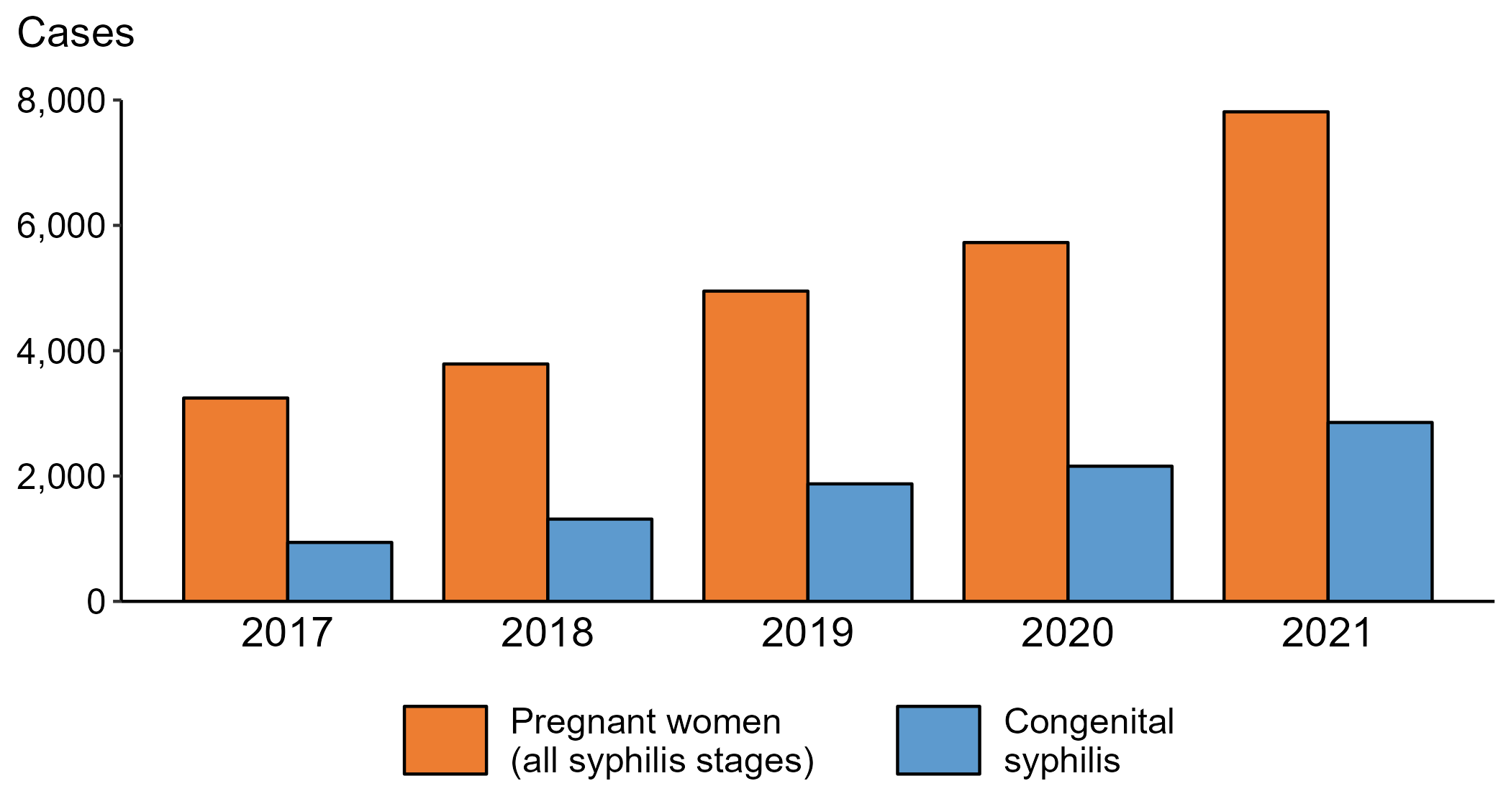
Over 5 years, reported cases of syphilis among pregnant women (all stages) and reported cases of congenital syphilis are increasing
2.4X
3X
United States
NOTE: The percent of cases missing information on pregnancy status decreased from 14.0% in 2017 to 9.3% in 2021.
Notes:
In 2021, there were a total of 2,855 cases of congenital syphilis reported for a rate of 77.9 per 100,000 live births.
During 2020 to 2021, the number of women reported with syphilis (all stages) who were pregnant increased 36.4% (from 5,726 in 2020 to 7,812 in 2021). During the same time period, the number of reported cases of congenital syphilis increased 32.4% (from 2,157 in 2020 to 2,855 in 2021).
During 2017 to 2021, the number of women reported with syphilis (all stages) who were pregnant increased 140.7% (from 3,245 in 2017 to 7,812 in 2021). During the same time period, the number of reported cases of congenital syphilis increased 203.4% (from 941 in 2017 to 2,855 in 2021).
The COVID-19 pandemic has introduced uncertainty and difficulty in interpreting STD data collected during 2020 and 2021. See Impact of COVID-19 on STDs (https://www.cdc.gov/std/statistics/2021/impact.htm) for more information.
See Technical Notes (https://www.cdc.gov/std/statistics/2021/technical-notes.htm) for information on syphilis case reporting.
Data points are available at https://www.cdc.gov/std/statistics/2021/data.zip.

Slide 7
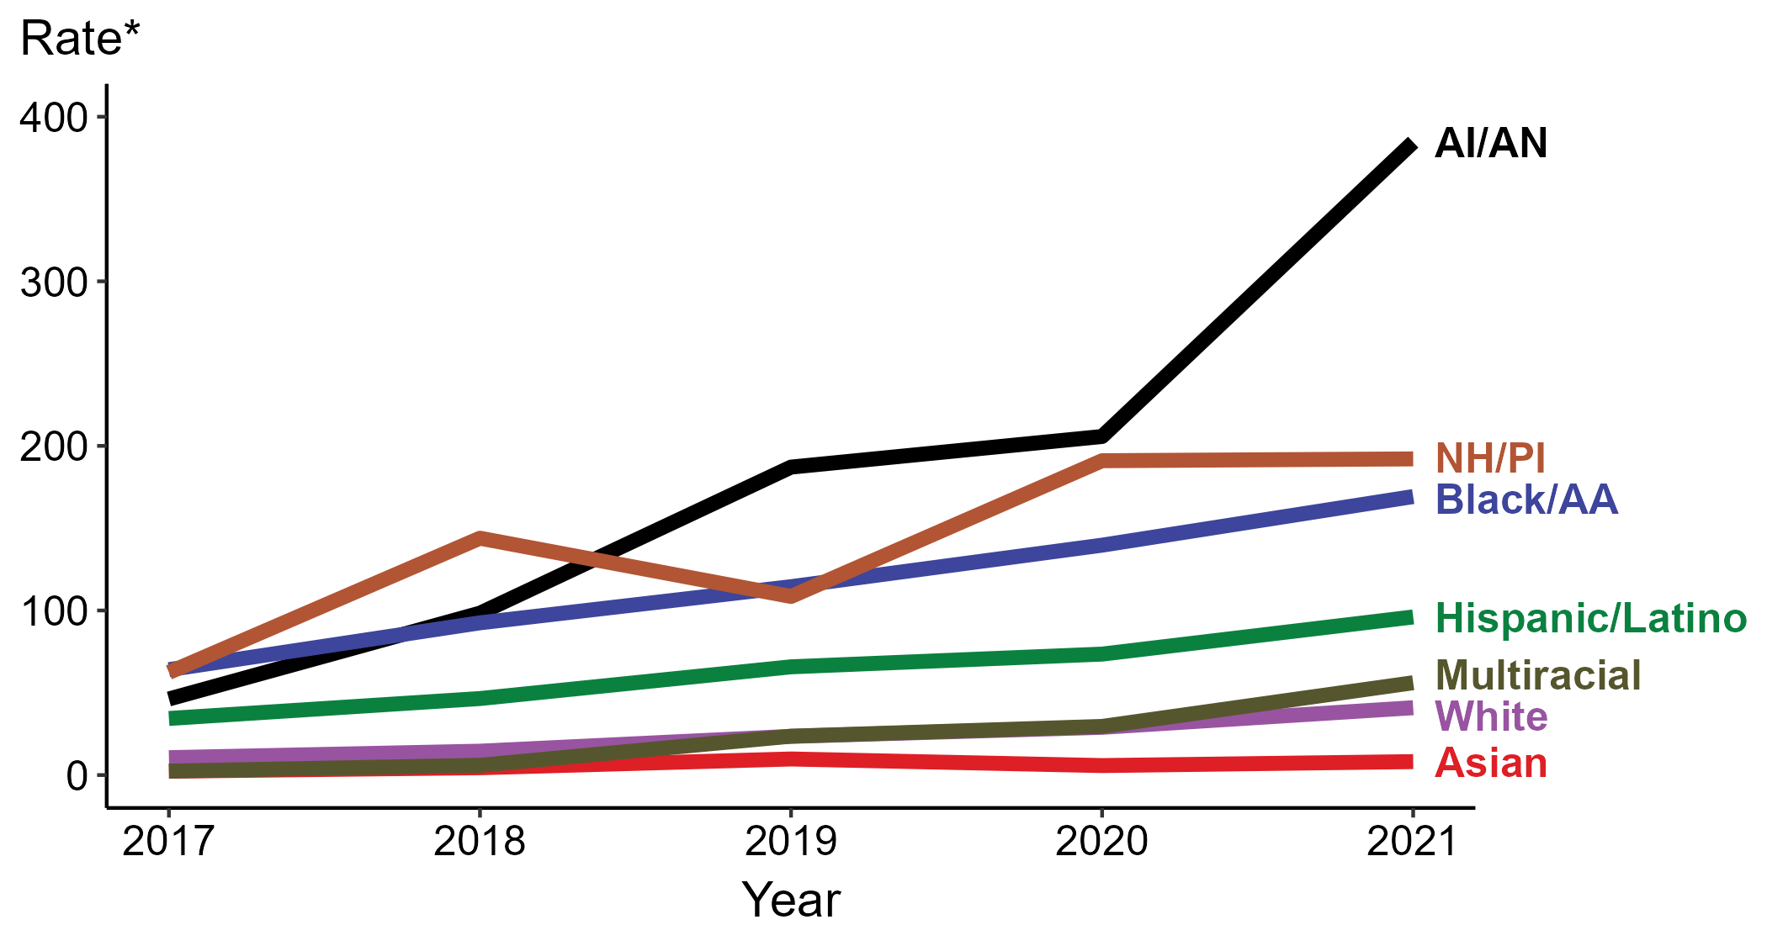
Starting in 2019, the highest congenital syphilis rates were among infants born to American Indian & Alaska Native mothers
1 in 260
live births to
AI/AN mothers
United States
* Per 100,000 live births
ACRONYMS: AI/AN = American Indian or Alaska Native; Black/AA = Black or African American; NH/PI = Native Hawaiian or other Pacific Islander
Notes:
In 2021, there were a total of 2,855 cases of congenital syphilis reported for a rate of 77.9 per 100,000 live births.
In 2021, the highest rate of reported cases of congenital syphilis per 100,000 live births was among mothers who were non-Hispanic American Indian or Alaska Native (384.5), followed by mothers who were non-Hispanic Native Hawaiian or other Pacific Islander (192.1).
During 2020 to 2021, the greatest increase in rate of reported cases of congenital syphilis per 100,000 live births was among mothers who were non-Hispanic and of multiple races (29.6 to 56.1; 89.5% increase). Mothers who were non-Hispanic and of multiple races also had the greatest five-year increase in rate of congenital syphilis (2.4 to 56.1; 2,237.5% increase from 2017).
There were no decreases in the rate of reported cases of congenital syphilis per 100,000 live births among any race/ethnicity group during 2020 to 2021. There were also no decreases in the rate of congenital syphilis among any race/ethnicity group during 2017 to 2021.
For this figure, race/Hispanic ethnicity is categorized first by reported Hispanic ethnicity of the mother, then by reported race of the mother. Therefore, cases categorized as Hispanic/Latino can be of any race(s); cases categorized into a race group include both non-Hispanic persons and persons of unknown Hispanic ethnicity. Not all US jurisdictions reported cases in Office of Management and Budget compliant race categories during 2017 to 2021. This may minimally under- or overestimate rates for Asian, Native Hawaiian or other Pacific Islander, or multiracial individuals. No population data exist for unknown or other race; therefore, rates are not calculated. For completeness, data in this figure include cases reported from all jurisdictions.
The COVID-19 pandemic has introduced uncertainty and difficulty in interpreting STD data collected during 2020 and 2021. See Impact of COVID-19 on STDs (https://www.cdc.gov/std/statistics/2021/impact.htm) for more information.
See Technical Notes (https://www.cdc.gov/std/statistics/2021/technical-notes.htm) for information on syphilis case reporting and reporting of race/Hispanic ethnicity for STD cases.
Data points are available at https://www.cdc.gov/std/statistics/2021/data.zip.

Slide 8
Benzathine penicillin G
is the recommended treatment for syphilis
Primary, secondary, early non-primary non-secondary syphilis (acquired in the last 12 months), or sex partner of an early syphilis case
Benzathine penicillin G 2.4 million units IM in a single dose
Late latent or unknown duration syphilis
Benzathine penicillin G 7.2 million units total, administered as 3 doses of 2.4 million units IM each at 1-week intervals
STI Treatment Guidelines, 2021: https://www.cdc.gov/std/treatment-guidelines/default.htm

Slide 9
Benzathine penicillin G
is the recommended treatment for syphilis
Benzathine penicillin G is the only recommended treatment for syphilis in pregnant people
Penicillin G is the only known effective antimicrobial for treating fetal infection and preventing congenital syphilis
Pregnant women who are allergic to penicillin should be desensitized and treated with penicillin G.
STI Treatment Guidelines, 2021: https://www.cdc.gov/std/treatment-guidelines/default.htm

Slide 10
Doxycycline is the alternative treatment
for syphilis in non-pregnant people
Doxycycline
Had syphilis ≤1 year: 100 mg orally 2 times/day for 14 days
Had syphilis >1 year: 100 mg orally 2 times/day for 28 days
Tetracycline
Had syphilis ≤1 year: 500 mg orally 4 times/day for 14 days
Had syphilis >1 year: 500 mg orally 4 times/day for 28 days
STI Treatment Guidelines, 2021: https://www.cdc.gov/std/treatment-guidelines/default.htm
Notes:
Compliance is likely to be better with doxycycline than tetracycline because tetracycline can cause more gastrointestinal side effects and requires more frequent dosing.
Azithromycin as a single 2-g oral dose has been effective for treating primary and secondary syphilis among certain populations (602,604,605). However, because of T. pallidum chromosomal mutations associated with azithromycin and other macrolide resistance and documented treatment failures in multiple U.S. geographic areas, azithromycin should not be used as treatment for syphilis (606–608). Thorough clinical and serologic follow-up of persons receiving any alternative therapy is essential.

Slide 11
U.S. is currently experiencing a penicillin G shortage
Limited supply due to increased demand for Penicillin G benzathine injectable suspension products
Penicillin G procaine has been discontinued by the manufacturer.
As we await resolution of this issue, it remains critical that limited inventory be used to treat the patients who need it most
Choose doxycycline for non-pregnant people to help preserve Bicillin L-A® supplies
CDC Dear Colleague Letter Pfizer Dear Customer Letter (fda.gov)
Notes:
The supply interruption is the result of a complex combination of factors including significant increases in demand, due to an increase in syphilis infection rates as well as competitive shortages. In order to meet this increased demand, Pfizer has prioritized manufacturing capacity to Bicillin® L-A (penicillin G benzathine injectable suspension) 1.2 million Units/2 mL and 2.4 million Units/4 mL (600,000 units/mL) Prefilled Syringes.

Slide 12
U.S. is currently experiencing a penicillin G shortage
Bicillin® L-A (penicillin G benzathine injectable suspension) Pediatric (600,000 units/mL) Prefilled Syringes are estimated to deplete by end of Q2 2023
All Bicillin® C-R (penicillin G benzathine and penicillin G procaine injectable suspension) are estimated to deplete in Q3 2023
CDC Dear Colleague Letter Pfizer Dear Customer Letter (fda.gov)
Notes:
limited supply and impending stock out situation for select Bicillin® L-A (penicillin G benzathine injectable suspension) and Bicillin® C-R (penicillin G benzathine and penicillin G procaine injectable suspension) Prefilled Syringes.

Slide 13
Congenital syphilis increases
Increased syphilis transmission
PCN shortage
Vulnerable population
Recognition of the problem
Collaborations
Where do
we go from
here?
Syphilis

Slide 14

Michelle Johnson Jones
HUK3@cdc.gov

Slide 15




Benzathine penicillin G
is the recommended treatment for syphilis
STI Treatment Guidelines, 2021: https://www.cdc.gov/std/treatment-guidelines/default.htm

Slide 16
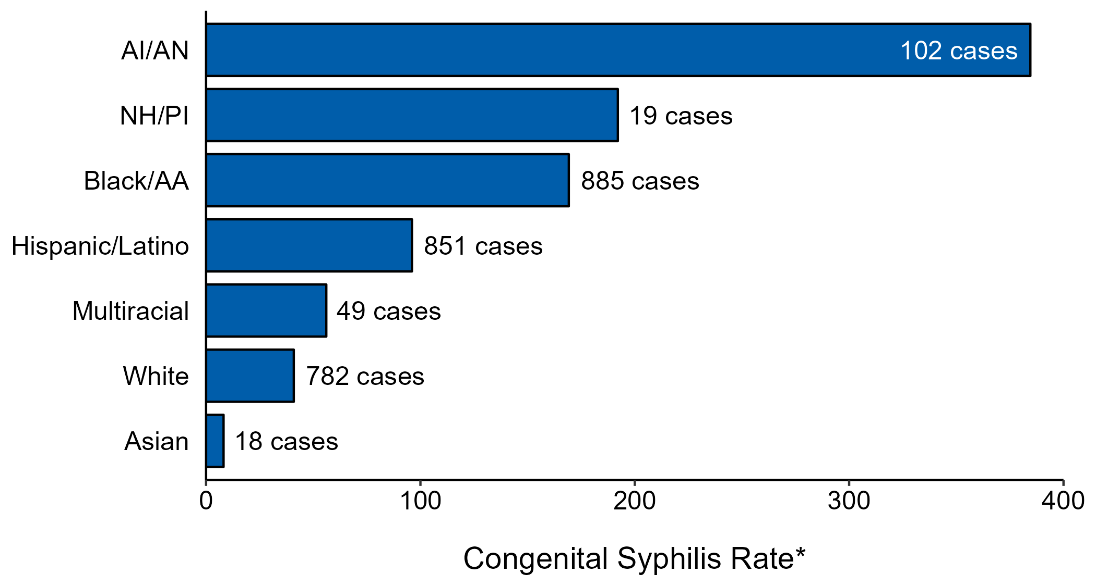
In 2021, the highest congenital syphilis rates were among infants born to American Indian & Alaska Native mothers
1 in 260
live births
United States
* Per 100,000 live births
NOTE: In 2021, a total of 149 congenital syphilis cases (5.2%) had missing, unknown, or other race and were not reported to be of Hispanic ethnicity.
ACRONYMS: AI/AN = American Indian or Alaska Native; Black/AA = Black or African American; NH/PI = Native Hawaiian or other Pacific Islander
Notes:
In 2021, there were a total of 2,855 cases of congenital syphilis reported for a rate of 77.9 per 100,000 live births.
In 2021, rates of congenital syphilis were highest among mothers who were non-Hispanic American Indian or Alaska Native (384.5 per 100,000 live births), followed by mothers who were non-Hispanic Native Hawaiian or other Pacific Islander (192.1 per 100,000 live births) and mothers who were non-Hispanic Black or African American (169.2 per 100,000 live births). The greatest number of reported cases was among mothers who were non-Hispanic Black or African American (885 cases), followed by mothers who were Hispanic or Latino and of any race(s) (851 cases) and mothers who were non-Hispanic White (782 cases).
For this figure, race/Hispanic ethnicity is categorized first by reported Hispanic ethnicity of the mother, then by reported race of the mother. Therefore, cases categorized as Hispanic/Latino can be of any race(s); cases categorized into a race group include both non-Hispanic persons and persons of unknown Hispanic ethnicity. Not all US jurisdictions reported cases in Office of Management and Budget compliant race categories in 2021. This may minimally under- or overestimate rates for Asian, Native Hawaiian or other Pacific Islander, or multiracial individuals. No population data exist for unknown or other race; therefore, rates are not calculated. For completeness, data in this figure include cases reported from all jurisdictions.
The COVID-19 pandemic has introduced uncertainty and difficulty in interpreting STD data collected during 2020 and 2021. See Impact of COVID-19 on STDs (https://www.cdc.gov/std/statistics/2021/impact.htm) for more information.
See Technical Notes (https://www.cdc.gov/std/statistics/2021/technical-notes.htm) for information on syphilis case reporting and reporting of race/Hispanic ethnicity for STD cases.
Data points are available at https://www.cdc.gov/std/statistics/2021/data.zip.

Slide 17
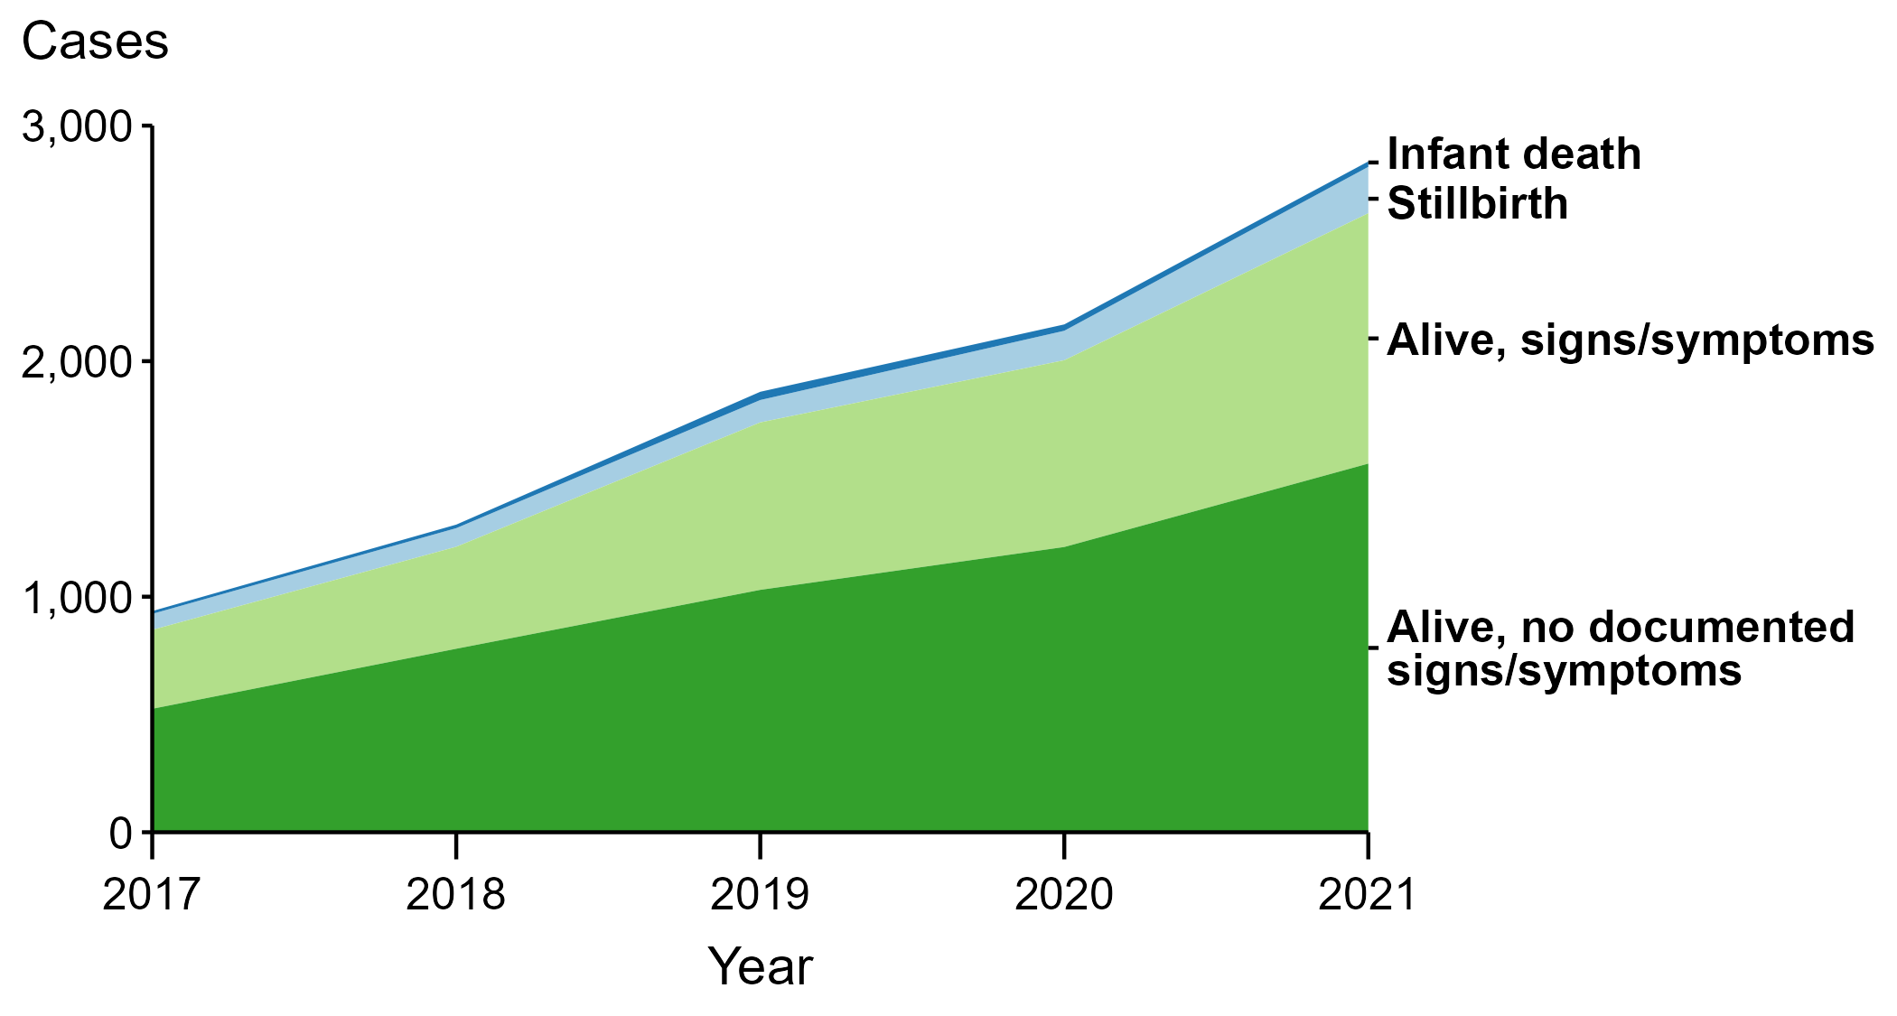
Congenital Syphilis — Reported Cases by Vital Status and Clinical Signs and Symptoms* of Infection, United States, 2017–2021
* Infants with signs/symptoms of congenital syphilis have documentation of at least one of the following: long bone changes consistent with congenital syphilis, snuffles, condylomata lata, syphilitic skin rash, pseudoparalysis, hepatosplenomegaly, edema, jaundice due to syphilitic hepatitis, reactive CSF-VDRL, elevated CSF WBC or protein values, or evidence of direct detection of T. pallidum.
NOTE: Of the 9,141 congenital syphilis cases reported during 2017 to 2021, 22 (0.2%) did not have sufficient information to be categorized.
Notes:
In 2021, there were a total of 2,855 cases of congenital syphilis reported for a rate of 77.9 per 100,000 live births.
In 2021, 23 congenital syphilis cases (0.8%) were infant deaths, 197 cases (6.9%) were stillbirths, 1,063 cases (37.2%) were born alive with congenital syphilis-related signs or symptoms, 1,565 cases (54.8%) were born alive with no documented congenital syphilis-related signs or symptoms, and 7 cases (0.2%) were missing information on vital status.
In 2021, there were 220 congenital syphilis-related deaths (197 stillbirths and 23 infant deaths), an increase of 44.7% from 2020 (152 in 2020 to 220 in 2021) and an increase of 175.0% from 2017 (80 in 2017 to 220 in 2021).
The number of infants reported with congenital syphilis who were born alive with congenital syphilis-related signs and symptoms increased 34.0% from 2020 to 2021 (793 in 2020 to 1,063 in 2021) and increased 217.3% from 2017 to 2021 (335 in 2017 to 1,063 in 2021).
The COVID-19 pandemic has introduced uncertainty and difficulty in interpreting STD data collected during 2020 and 2021. See Impact of COVID-19 on STDs (https://www.cdc.gov/std/statistics/2021/impact.htm) for more information.
See Technical Notes (https://www.cdc.gov/std/statistics/2021/technical-notes.htm) for information on syphilis case reporting.
Data points are available at https://www.cdc.gov/std/statistics/2021/data.zip.

