Slide 1
ECHO Diabetes Case Discussion
August 10, 2023

Slide 2
ADA Standards of Care 2023 – ASCVD Risk Assessment
For prevention and management of both ASCVD and heart failure, cardiovascular risk factors should be systematically assessed at least annually in all people with diabetes.
These risk factors include
duration of diabetes
obesity/overweight
hypertension
dyslipidemia
smoking
a family history of premature coronary disease
chronic kidney disease (CKD)
the presence of albuminuria

Slide 3
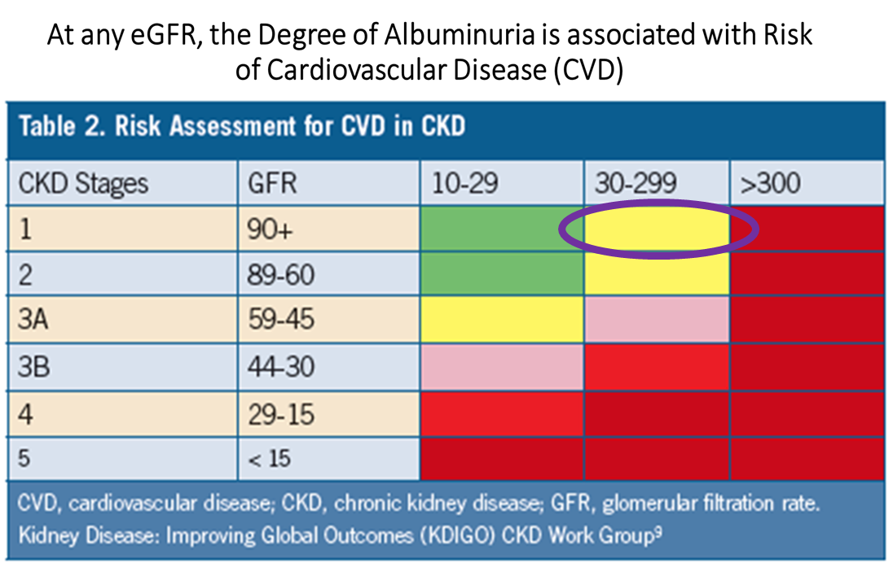
What advice & medication is recommended considering his high Insulin Resistance score and high CV risk ?
38-year-old male with early onset (<40 years old) T2D x 7 years
Marked Diabetes Dyslipidemia
TC 198, HDLc 35, TG 597, direct LDLc 85, nonHDLc 163, apolipoprotein B 99 (moderate risk level), increased number of LDL particles and high number of small LDL particles
Insulin resistance (“Insulin Resistance score” = 100 )
Marked hyperglycemia with A1c 10%, average glucose 334 – TIR 3% with no TBR
Metformin 2000 mg/d: Ozempic 1 mg/d; Farxiga 10 mg/d, Lantus 1-10 mg/d
Weight loss from 312# in 2/2021 to 267# (BMI 39) current
Cr 0.68 w/ eGFR 123 - UACR 71
Current smoker
Intermittently works out
On the road / out of town often

Slide 4
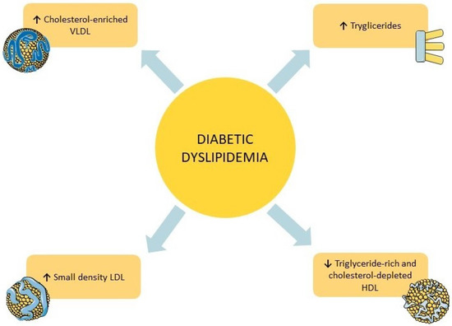
Diabetic Dyslipidemia, includes
hypertriglyceridemia,
decreased high-density lipoprotein (HDL) cholesterol levels and
a shift towards small dense low-density lipoprotein (LDL) cholesterol.
This pathological triad, frequently observed in patients with DM
promotes atherosclerosis and increases CV risk

Slide 5
Recommendations to Consider
Improve glycemia
Ask about any issues or concerns with the medication – how often does he take vs miss
Consider glucotoxicity – high dose insulin; SGLT2i (if not taking regularly); ~ GLP1 RA
Stop smoking
Ensure low intake of Ultra-processed foods/refined carbs & Sat Fat/processed meats (diet composition vs just reduced calories)
proposed “fructose pathway” explains association w/IR, Dyslipidemia, weight gain, Metabolic Syndrome, NAFLD, etc.
Physical activity – aerobic & resistance exercise (may need more regular participation)
Medication considerations
Tirzepatide in place of semaglutide for potentially greater glycemic improvements, lipid effects & weight loss
Low dose pioglitazone for reducing IR, TG lowering +/- other lipid changes
Statin (goal non-HDL cholesterol <100, LDL cholesterol <70)
? Pancreatitis risk – fenofibrate (Tricor) (TG levels can fluctuate widely, quickly)
Concerns regarding polypharmacy – emphasis on lifestyle

Slide 6
Recommendation - Stop Use of Commercial Tobacco
Several prospective studies on the relationship between smoking and insulin resistance have shown that smoking is a risk factor for insulin resistance Short-term smoking increases the risk of insulin resistance | Scientific Reports (nature.com)
Cigarette smoking is associated with increases in plasma triglycerides and decreases in plasma high density-lipoprotein-cholesterol concentration.
These changes not only increase risk of coronary heart disease but also are secondary to
resistance to insulin-stimulated glucose uptake or hyperinsulinaemia.
Smokers had significantly
higher very-low-density-lipoprotein triglycerides (0.66 vs 0.39 mmol/l, p less than 0.02)
higher cholesterol (0.45 vs 0.23 mmol/l, p less than 0.005) concentrations
lower high-density-lipoprotein cholesterol concentrations (1.16 vs 1.51 mmol/l, p less than 0.001).
The findings show that chronic cigarette smokers are insulin resistant, hyperinsulinaemic, and dyslipidaemic compared with a matched group of non-smokers, and may help to explain why smoking increases risk of coronary heart disease. Insulin resistance and cigarette smoking - PubMed (nih.gov)

Slide 7
Recommendation – Diet Composition
Acute Effects of a DASH Diet and Whole Food Plant-Based Diet on Insulin Requirements and Related Cardiometabolic Markers in Individuals With Insulin-Treated Type 2 Diabetes Diabetes Research and Clinical Practice
This nonrandomized crossover trial assessed the acute changes in insulin requirements and associated markers among individuals with insulin-treated type 2 diabetes using two plant-based diets — DASH and whole food plant-based (WFPB) diets.
Compared with the baseline diet, there was a significant reduction in daily insulin usage with both DASH and WFPB diets.
There was a significant improvement in insulin sensitivity and reduction in insulin resistance
There was a significant reduction in total, LDL, and HDL cholesterol levels as well as leptin and CRP levels
Both plant-based diets resulted in significant changes in insulin requirements, insulin sensitivity, and other markers of insulin resistance in individuals with insulin-treated type 2 diabetes. The magnitude of change was larger with large dietary changes.
[The main difference between the DASH and the WFPB diet was the amount of fiber. The WFPB diet contained 32 g/1000 kcal versus 20 g/1000 kcal in the DASH diet. The baseline fiber intake before dietary intervention was 11 g/1000 kcal.
Fiber can have a significant effect on reducing HbA1C and improving insulin sensitivity. Diets found to have the greatest effect at reducing inflammation and insulin resistance have been found to be high in fiber and are plant-based.]
Notes:
The acute effects of a DASH diet and whole food, plant-based diet on insulin requirements and related cardiometabolic markers in individuals with insulin-treated type 2 diabetes - Diabetes Research and Clinical Practice (diabetesresearchclinicalpractice.com)

Slide 8
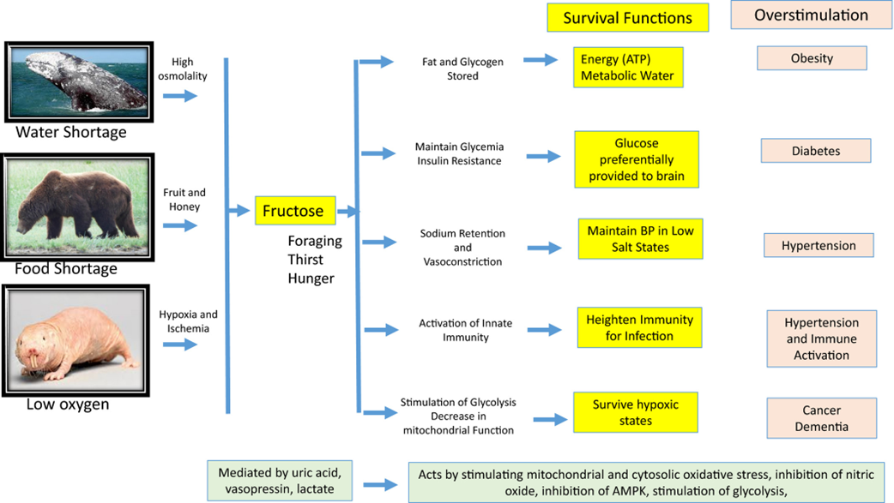
Recommendation – Diet Composition
Fructose Pathway
High-Fructose Corn Syrup
Excess sucrose
Ultra-processed Carbs
Processed meats
High salt intake
Not most fruit
Journal of Internal Medicine, Volume: 287, Issue: 3, Pages: 252-262, First published: 17 October 2019, DOI: (10.1111/joim.12993)

Slide 9
Recommendation – Ensure Physical Activity /Exercise
Physical activity can reduce cardiometabolic risk through non-lipid mechanisms.
Single exercise sessions, e.g., a 45-minute moderate pace walk, can significantly reduce postprandial triglyceride levels and improve arterial endothelial function.
Endothelial dysfunction contributes to the initiation and progression of atherosclerotic disease, and improved arterial function is thought to be one of the primary mechanisms responsible for reduced cardiovascular disease morbidity and mortality with exercise training.
Exercise can also induce significant favorable changes in the lipid and lipoprotein profile, partly as a result of moderate reductions in adiposity, but more so for the physical activity’s direct effect on the lipoproteins.
Exercise improves serum lipids in patients with hyperlipidemia by
lowering serum triglyceride levels, total cholesterol (TC), and low-density lipoprotein cholesterol (LDL-C) levels
increasing high density lipoprotein cholesterol (HDL-C) levels
Research indicates that lipoprotein lipase is increased with aerobic exercise.
Even intermittent or several short exercise sessions can positively alter serum lipids. In sedentary individuals, lipoprotein and lipid changes can even occur after a single exercise session when one expends at least 350 kcal
Notes:
exercise_podcast_2_boost_w_intro (ihs.gov)

Slide 10
Recommendation – Ensure Physical Activity /Exercise
Both aerobic and resistance exercise training improve insulin sensitization and glucose transport mechanisms, which help to improve cardiometabolic health
Even brief bouts of physical activity, e.g., two-to-five-minute of physical activity, at moderate intensities, activate AMP kinase, glucose transport mechanisms, and insulin signaling.
Each intentional walking step is an AMP kinase activator, which works very similarly to metformin and the PPAR-gamma-activating diabetes drugs like pioglitazone.
Exercise training can reverse skeletal muscle mitochondrial abnormalities from lipid overload induced by high-fat diets and inactivity
Sufficient weekly exercise over the course of three or four months can reduce the intramuscular stores of lipid which affect mitochondrial abnormalities and reduce cardiometabolic risk
The addition of resistance exercise training increases muscle mass and increases in muscle mass help improve insulin sensitization.
Resistance training combined with aerobic exercise may increase the loss of body fat, but not necessarily body weight. Many people will gain a kilogram or two of body weight once they embark upon a six-to-eight-week resistance training program.
Notes:
exercise_podcast_2_boost_w_intro (ihs.gov)

Slide 11
Ensure Physical Activity /Exercise – not just about weight loss
Even when there is no weight loss, exercise training is an effective method of improving body composition (increased muscle mass and reduced fat) as well as increasing insulin sensitivity and cardiorespiratory fitness.
Regular exercise with minimal weight change has broad beneficial effects on the lipoprotein profile, even without changes in total cholesterol
A study from Duke demonstrated that exercise at moderate volumes and intensities, e.g., walking about 12 miles a week at 40-55% of aerobic capacity, can significantly reduce LDL particle number even when total cholesterol & calculated LDLc remained unchanged.
A very promising metabolic mechanism of physical activity is its ability to up-regulate PPAR-delta receptors in skeletal muscle.
PPAR-delta receptors are involved in fatty acid transport, inflammation, and increased HDL cholesterol, essentially improving multiple aspects of the metabolic syndrome.
Future development of the diabetes drugs will target PPAR-delta essentially mimicking many of the benefits of exercise.
Notes:
exercise_podcast_2_boost_w_intro (ihs.gov)
Effect of Exercise Training on Fat Loss—Energetic Perspectives and the Role of Improved Adipose Tissue Function and Body Fat Distribution - PMC (nih.gov)

Slide 12
Ensure Physical Activity /Exercise – How much?
The amount of exercise required for weight loss for most people is significantly more than it is to reduce diabetes and cardiometabolic risk.
The American College of Sports Medicine recommends 250-300 minutes per week, or about an hour a day, five or more days a week, (approximately 2,000-3,000 calories of physical activity per week) to lose significant body weight.
The amount of weekly exercise to reduce overall cardiometabolic risk would be about 150 minutes of exercise a week, or about a half-an-hour a day on most days of the week (~ 1,000-1,500 calories of exercise per week.
Can increase energy expenditure up to at least 2,000 calories of exercise a week for associated fat weight loss in addition to reducing cardiometabolic risk
For resistance training - a general principle is two to three times per week is adequate.
Two to three times a week of two to three sets of each of 10-12 repetitions of exercise is adequate.
Notes:
exercise_podcast_2_boost_w_intro (ihs.gov)

Slide 13
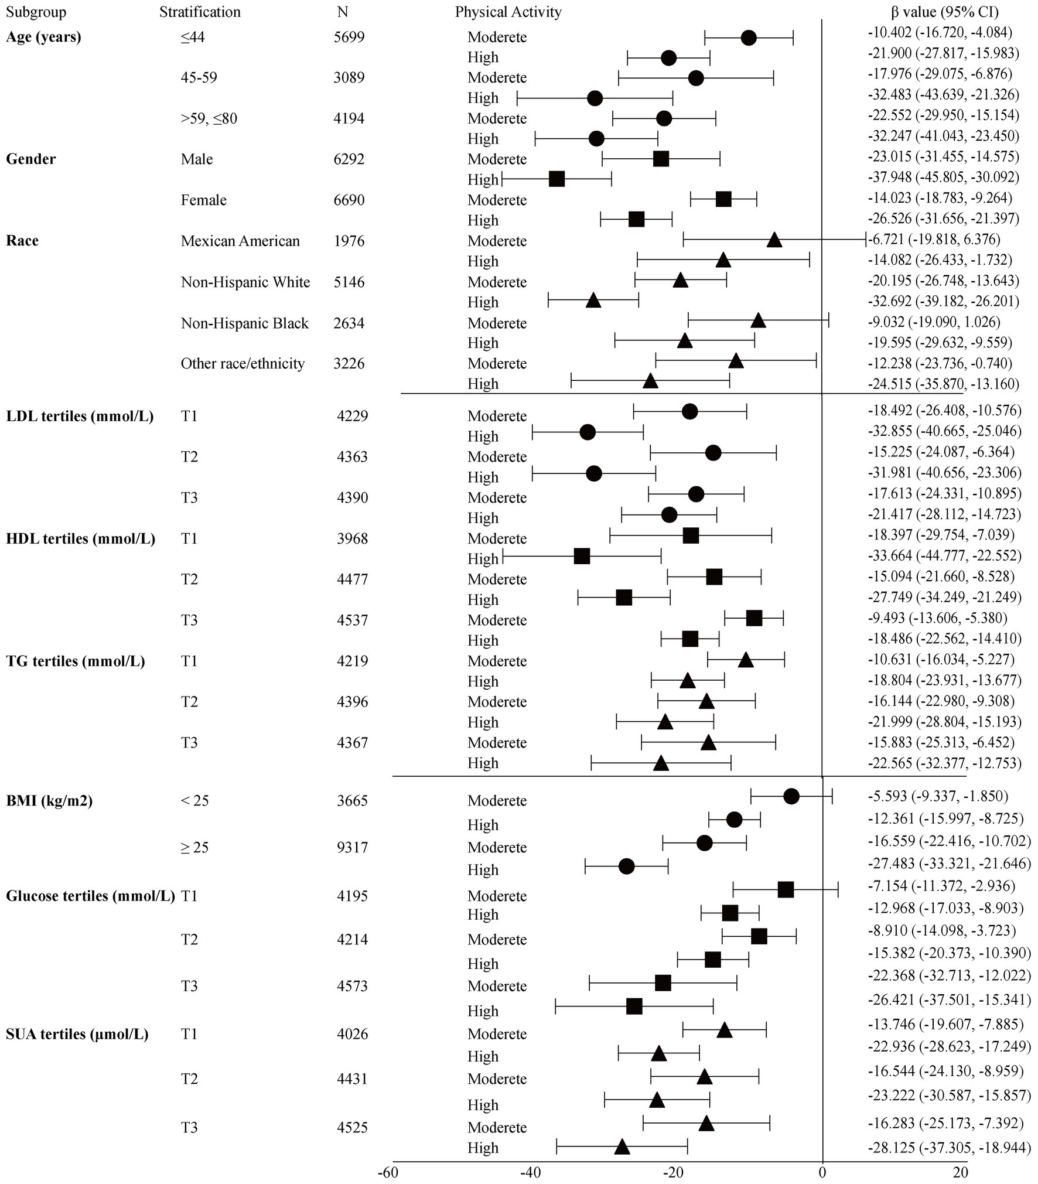
Using NHANES data – greater reduction in insulin with higher intensity activity
FIGURE 1. Crude subgroup analyses on effect of physical activity on insulin.
Notes:
https://www.frontiersin.org/articles/10.3389/fphys.2022.809669/full

Slide 14
ADA Standards of Care 2023 – Lipid Management
Lifestyle Intervention Recommendations
Lifestyle intervention, including
weight loss in people with overweight or obesity (when appropriate)
increased physical activity and
nutrition therapy ----- allows some patients to reduce ASCVD risk factors.
Recommendations should focus on
application of a Mediterranean or Dietary Approaches to Stop Hypertension (DASH) eating pattern
reducing saturated and trans fat intake
increasing plant stanols/sterols, n-3 fatty acids, and viscous fiber (such as in oats, legumes, and citrus) intake.
Glycemic control may also beneficially modify plasma lipid levels, particularly in patients with very high triglycerides and poor glycemic control.
10.14 Lifestyle modification focusing on weight loss (if indicated); application of a Mediterranean or Dietary Approaches to Stop Hypertension (DASH) eating pattern; reduction of saturated fat and trans fat; increase of dietary n-3 fatty acids, viscous fiber, and plant stanols/sterols intake; and increased physical activity should be recommended to improve the lipid profile and reduce the risk of developing atherosclerotic cardiovascular disease in people with diabetes. A
10.15 Intensify lifestyle therapy and optimize glycemic control for patients with elevated triglyceride levels (≥150 mg/dL [1.7 mmol/L]) and/or low HDL cholesterol (<40 mg/dL [1.0 mmol/L] for men, <50 mg/dL [1.3 mmol/L] for women). C

Slide 15
Medication Considerations

Slide 16
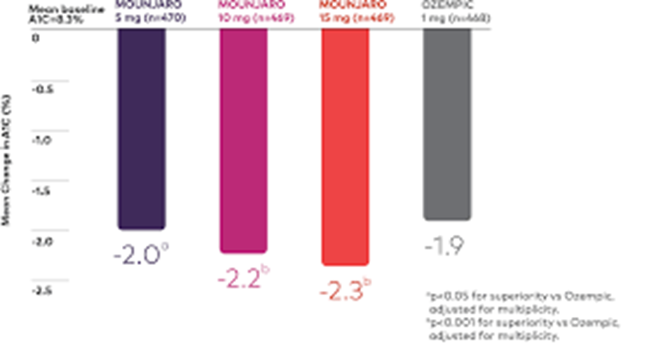
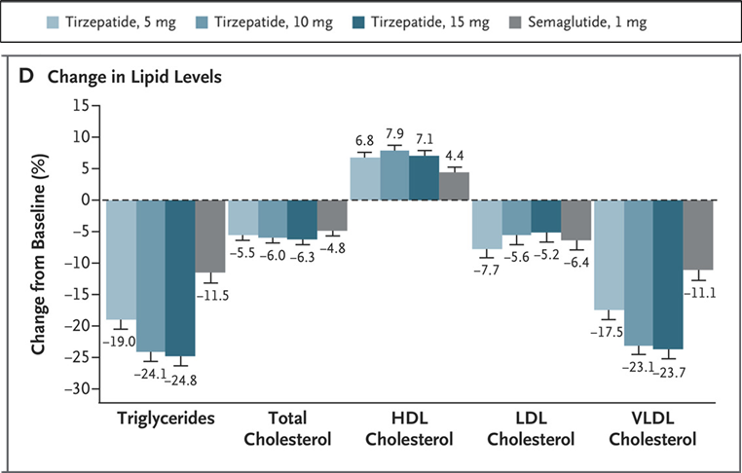
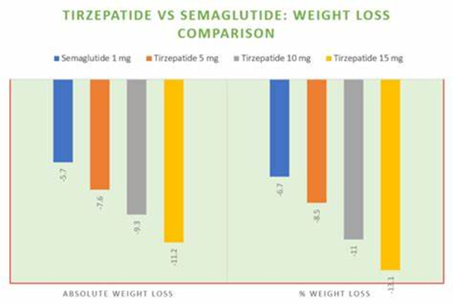
Consider Replacing Semaglutide with Tirzepatide

Slide 17
Consider low dose (15-30 mg) pioglitazone to reduce IR & TGs
Studies show increased insulin sensitivity with pioglitazone
An important link between obesity and insulin resistance involves lipid deposition in ectopic sites, such as skeletal muscle, islets, and liver, with resulting functional impairment that has been called lipotoxicity.
Because peripheral insulin resistance occurs early in the development of diabetes, and most peripheral glucose disposal occurs in skeletal muscle, intramyocellular lipid (IMCL) accumulation has been the focus of much research into diabetes treatment and prevention.
Previous studies have demonstrated a strong correlation between IMCL content and insulin resistance. In a recent study increased IMCL was accompanied by decreased mitochondrial oxidative phosphorylation, suggesting that a defect in some component of muscle lipid oxidation is present .
Pioglitazone improved glucose tolerance and insulin sensitivity by reducing IMCL. This reduction in IMCL was not due to an increase in muscle lipid oxidation but to a diversion of lipid from ectopic sites into subcutaneous adipose tissue.
Notes:
https://journals.physiology.org/doi/full/10.1152/ajpendo.00522.2004#:~:text=Pioglitazone%20improved%20glucose%20tolerance%20and,sites%20into%20subcutaneous%20adipose%20tissue.

Slide 18
ADA Standards of Care 2023 -Primary Prevention in T2D with Age <40 Years
10. Cardiovascular Disease and Risk Management: Standards of Care in Diabetes—2023 | Diabetes Care | American Diabetes Association (diabetesjournals.org)
Very little clinical trial evidence exists for people with type 2 diabetes under the age of 40 years.
Patients <40 years of age have lower risk of developing a cardiovascular event over a 10-year horizon; however, their lifetime risk of developing cardiovascular disease and suffering an MI, stroke, or cardiovascular death is high.
Early onset type 2 diabetes mellitus: a harbinger for complications in later years--clinical observation from a secondary care cohort - PubMed (nih.gov)
Early onset T2DM subjects are at substantial risk of developing diabetes complications in later years but at an earlier stage than later onset cohort and prolonged exposure to adverse diabetic milieu is an important contributing factor.
Management of risk factors for diabetes complications was inadequate among early onset subjects.

Slide 19
ADA Standards of Care 2023 – Statin Therapy
Primary Prevention Recommendations
10.18 For people with diabetes aged 40–75 years without atherosclerotic cardiovascular disease, use moderate-intensity statin therapy in addition to lifestyle therapy. A
10.19 For people with diabetes aged 20–39 years with additional atherosclerotic cardiovascular disease risk factors, it may be reasonable to initiate statin therapy in addition to lifestyle therapy. C
10.20 For people with diabetes aged 40–75 at higher cardiovascular risk, including those with one or more atherosclerotic cardiovascular disease risk factors, it is recommended to use high-intensity statin therapy to reduce LDL cholesterol by ≥50% of baseline and to target an LDL cholesterol goal of <70 mg/dL. B
10.21 For people with diabetes aged 40–75 years at higher cardiovascular risk, especially those with multiple atherosclerotic cardiovascular disease risk factors and an LDL cholesterol ≥70 mg/dL, it may be reasonable to add ezetimibe or a PCSK9 inhibitor to maximum tolerated statin therapy. C

Slide 20
High-intensity and moderate-intensity statin therapy
High-intensity statin therapy (lowers LDL cholesterol by ≥50%) | Moderate-intensity statin therapy (lowers LDL cholesterol by 30–49%)
Atorvastatin 40–80 mg | Atorvastatin 10–20 mg
Rosuvastatin 20–40 mg | Rosuvastatin 5–10 mg
 | Simvastatin 20–40 mg
 | Pravastatin 40–80 mg
 | Lovastatin 40 mg
 | Fluvastatin XL 80 mg
 | Pitavastatin 1–4 mg

Slide 21
Is a Fibrate needed to Reduce Risk of Acute Pancreatitis?
Hypertriglyceridemia should be addressed with dietary and lifestyle changes including weight loss and abstinence from alcohol.
Severe hypertriglyceridemia (fasting triglycerides ≥500 mg/dL and especially >1,000 mg/dL) may warrant pharmacologic therapy (fibric acid derivatives and/or fish oil) and reduction in dietary fat to reduce the risk of acute pancreatitis.
Moderate- or high-intensity statin therapy should also be used as indicated to reduce risk of cardiovascular events.
In people with moderate hypertriglyceridemia, lifestyle interventions, treatment of secondary factors, and avoidance of medications that might raise triglycerides are recommended.
10.28 For individuals with fasting triglyceride levels ≥500 mg/dL, evaluate for secondary causes of hypertriglyceridemia and consider medical therapy to reduce the risk of pancreatitis. C
10.29 In adults with moderate hypertriglyceridemia (fasting or nonfasting triglycerides 175–499 mg/dL), clinicians should address and treat lifestyle factors (obesity and metabolic syndrome), secondary factors (diabetes, chronic liver or kidney disease and/or nephrotic syndrome, hypothyroidism), and medications that raise triglycerides. C
10.31 Statin plus fibrate combination therapy has not been shown to improve atherosclerotic cardiovascular disease outcomes and is generally not recommended. A

Slide 22
Recommendations to Consider
Improve glycemia
Ask about any issues or concerns with the medication – how often does he take vs miss
Consider glucotoxicity – high dose insulin; SGLT2i (if not taking regularly); ~ GLP1 RA
Stop smoking
Ensure low intake of Ultra-processed foods/refined carbs & Sat Fat/processed meats (diet composition vs just reduced calories)
proposed “fructose pathway” explains association w/IR, Dyslipidemia, weight gain, Metabolic Syndrome, NAFLD, etc.
Physical activity – aerobic & resistance exercise (may need more regular participation)
Medication considerations
Tirzepatide in place of semaglutide for potentially greater glycemic improvements, lipid effects & weight loss
Low dose pioglitazone for reducing IR, TG lowering +/- other lipid changes
Statin (goal non-HDL cholesterol <100, LDL cholesterol <70)
? Pancreatitis risk – fenofibrate (Tricor) (TG levels can fluctuate widely, quickly)
Concerns regarding polypharmacy – emphasis on lifestyle

