Slide 1
A Review of Cannabis and Cannabinoids
LT Victoria Fenton
Notes:
Skipping medical efficacy today, and focusing on from a use disorder perspective instead

Slide 2
Objectives
Examine the endocannabinoid system and how phytocannabinoids and synthetic cannabinoids work in the body
Identify opportunities for patient counseling focused on cannabinoid pharmacokinetics, drug interactions, and adverse effects
Apply current pain guidelines and cannabis knowledge to synthesize urine drug screening recommendations and patient treatment plans
Notes:
Not covering: Medical efficacy and side effects

Slide 3
Regulatory Considerations

Slide 4
Current Federal Status
Schedule 1
  No accepted medical use
  Highly addictive
  Likely to lead to abuse
Walters V. Conant - Petition. The United States Department of Justice. (2014, October 22). Retrieved March 18, 2023, from https://www.justice.gov/osg/brief/walters-v-conant-petition

Slide 5
Legal Updates
October 2022
  President Biden: “I am asking the Secretary of Health and Human Services and the Attorney General to initiate the administrative process to review expeditiously how marijuana is scheduled under federal law.”
December 2022: Cannabidiol and Marijuana Research Expansion Act
  “Directs the Drug Enforcement Administration (DEA) to follow specified procedures to register (1) practitioners to conduct marijuana research, and (2) manufacturers to supply marijuana for the research
  Allow physicians to discuss the potential harms and benefits of marijuana and its derivatives (including CBD) with patients”
The United States Government. (2022, October 6). Statement from president Biden on marijuana reform. The White House. Retrieved February 14, 2023, from https://www.whitehouse.gov/briefing-room/statements-releases/2022/10/06/statement-from-president-biden-on-marijuana-reform/
Text - S.253 - 117th Congress (2021-2022): Cannabidiol and marihuana ... (n.d.). Retrieved March 11, 2023, from https://www.congress.gov/bill/117th-congress/senate-bill/253/text
Notes:
In October 2022, President Biden asked the Secretary of Health and Human Services and the Attorney General to review, expeditiously, how cannabis is scheduled under federal law
In December 2022 President Biden signed the Cannabidiol and Marijuana Research Act, which
Directs the DEA to register 1. practitioners to conduct cannabis research and
2. Manufacturers to supply cannabis for the research
It also allows physicians to discuss the potential harms and benefits of cannabis and its derivatives with patients
Direct quotes to prevent legal misinterpretation by someone who is not a lawyer

Slide 6
Tribal Considerations
Important to be mindful of tribal preferences and to take a balanced approach

Slide 7
The Endocannabinoid system

Slide 8
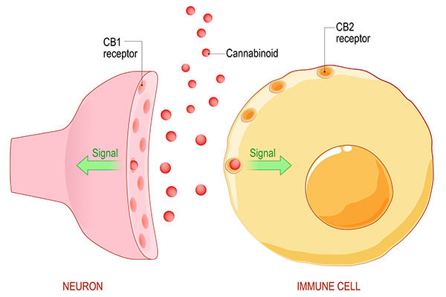
The Endocannabinoid System
Endocannabinoids are neuromodulators that bind to cannabinoid receptors throughout body
Homeostatic regulatory system
Present from the earliest stages of gestation
Involved in response to cellular stress, pain, inflammation, perception, mood, learning, sleep, memory, and reward
Di Marzo, V., et al. (1998). Endocannabinoids: endogenous cannabinoid receptor ligands with neuromodulatory action. Trends in neurosciences, 21(12), 521–528. https://doi.org/10.1016/s0166-2236(98)01283-1
Grinspoon, P (2021, August 11). The endocannabinoid system: Essential and mysterious. Harvard Health. Retrieved February 14, 2023, from https://www.health.harvard.edu/blog/the-endocannabinoid-system-essential-and-mysterious-202108112569

Slide 9
CB1 and CB2 Receptors
CB1
Mostly in CNS, also in gonads, connective tissue, glands, and organs
Brain stem does not contain many CB1 receptors
Agonist binding inhibits neurotransmitter release
CB2
Mostly in immune system and GI tract
Controls release of cytokines linked to inflammation and general immune function
Analgesia, euphoria, anticonvulsive
Stimulation does not cause a “high”
Inflammation and digestion
Stimulation causes “high”
Di Marzo, V., et al.(1998). Endocannabinoids: endogenous cannabinoid receptor ligands with neuromodulatory action. Trends in neurosciences, 21(12), 521–528. https://doi.org/10.1016/s0166-2236(98)01283-1
Notes:
CB1 and CB2 receptors are the primary endocannabinoid receptors
CB1 receptors are mostly in the CNS, but also the gonads, connective tissue, glands, and organs. When thinking about where these receptors are, it is equally important to take note of where they are not. The brain stem is an important location because it is responsible for respiration and circulation. Since it does not contain many CB1 receptors, current data on cannabis overdoses does not suggest that respiratory depression and death are possible (in contrast to opioids).
When endocannabinoids bind to CB1 receptors, this modulates release of inhibitory and excitatory NT across synapse. They’re responsible for the analgesia, euphoria, and anticonvulsive properties. Stimulation of the CB1 receptors causes that classis “high”.
CB2 receptors are mostly in the immune system and GI tract. When endocannabinoids bind, it controls release of cytokines linked to inflammation and general immune function. Involved in reward, but does not cause that “high.”
We will be referring back to these receptors throughout the presentation.
Think, CB1- thinner, in CNS
CB2, 2 is a wider number, out in periphery
That is the most important takeaway from this slide
So now that we’ve reviewed the endocannabinoid receptors, let’s discuss the endocannabinoids themselves

Slide 10
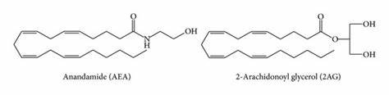
Endocannabinoids
Structurally similar to molecules in the cannabis plant
Synthesized on-demand from polyunsaturated fatty acids
Two most widely understood groups of endocannabinoids:
  Arachidonylethanolamide (Anandamide) (AEA) → Partial agonist at CB1
  2-Arachidonylglycerol (2-AG) → Full agonist at CB1
Di Marzo V., et al. (n.d.). Endocannabinoids: Endogenous cannabinoid receptor ligands with neuromodulatory action. Trends in neurosciences. Retrieved February 14, 2023, from https://pubmed.ncbi.nlm.nih.gov/9881850/
Baggelaar, M, et al. (2018). 2-Arachidonoylglycerol: A signaling lipid with manifold actions in the brain. Progress in lipid research, 71, 1–17. https://doi.org/10.1016/j.plipres.2018.05.002
Structures of AEA and 2-Ag Glycerol, the two best known ... (n.d.). Retrieved February 14, 2023, from https://www.researchgate.net/figure/Structures-of-AEA-and-2-AG-glycerol-the-two-best-known-endocannabinoids_fig1_288917658
Backes, M., Weil, A., McCue, J. D. (2017). Cannabis Pharmacy: The practical guide to medical marijuana. Black Dog &amp; Leventhal Publishers.
Notes:
Similar to molecules in cannabis plant, but our bodies make these ourselves
Not water soluble, not intended to travel throughout body, work locally
Ananda- Sanskirt word meaning bliss

Slide 11
Page, R. L., et al. (2020, August 5). Medical marijuana, recreational cannabis, and ... - circulation. Circulation. Retrieved February 14, 2023, from https://www.ahajournals.org/doi/full/10.1161/CIR.0000000000000883

Slide 12
Phytocannabinoids
Notes:
So Endocannabinoids are the cannabinoids that our body makes ourselves
Phytocannabinoids are the cannabinoids that are produced by plants

Slide 13
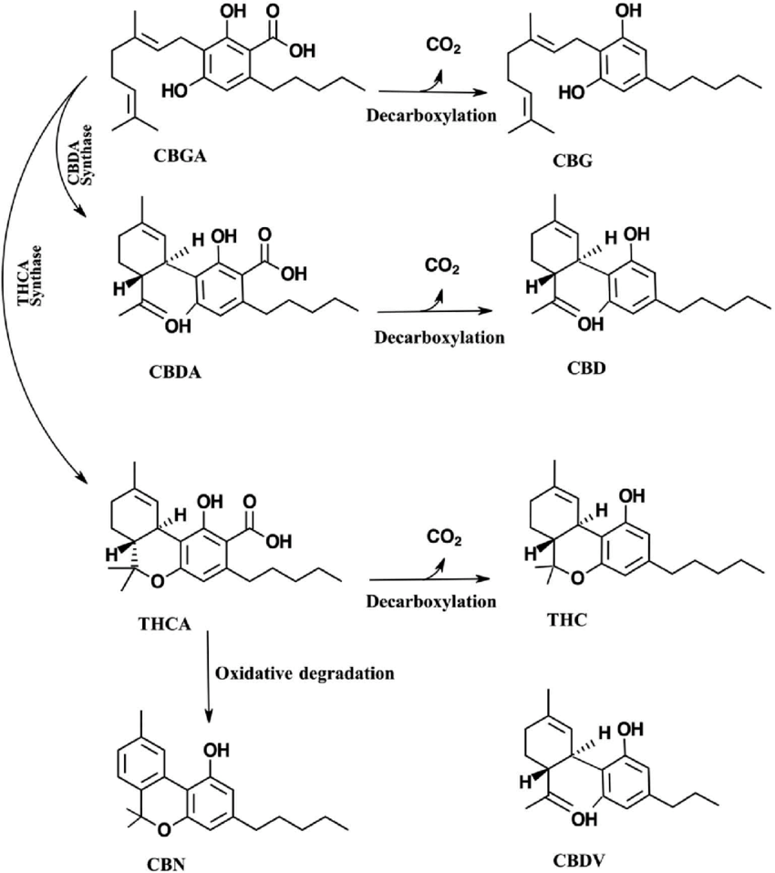
Phytocannabinoids
Over 200 in a cannabis plant
Produced by the cannabis plant as carboxylic acids (ex. THCA, CBDA, etc.)
Upon heating, converted to chemically neutral form by decarboxylation
  THC: Tetrahydrocannabinol
  CBD: Cannabidiol
Backes, M., Weil, A., McCue, J. D. (2017). Cannabis Pharmacy: The practical guide to medical marijuana. Black Dog &amp; Leventhal Publishers.
Russo E. B. (2011). Taming THC: potential cannabis synergy and phytocannabinoid-terpenoid entourage effects. British journal of pharmacology, 163(7), 1344–1364. https://doi.org/10.1111/j.1476-5381.2011.01238.x
Hampson, A., et al. (1998). Cannabidiol and (-)Delta9-tetrahydrocannabinol are neuroprotective antioxidants. Proceedings of the National Academy of Sciences of the United States of America, 95(14), 8268–8273. https://doi.org/10.1073/pnas.95.14.8268
Major cannabinoids present in cannabis sativa L.: Biosynthesis and ... (n.d.). Retrieved February 14, 2023, from https://www.researchgate.net/figure/Major-cannabinoids-present-in-Cannabis-sativa-L-Biosynthesis-and-conversion-pathways_fig1_332566538
Notes:
When heated (smoking, vaporizing, cooking, or even being stored at RT for long enough), cannabinoids decarboxylate
THC, CBD, can be degraded further with light and oxygen
Previously “phytocannabinoids” only referred to cannabinoids produced by cannabis plant. Now definition has been expanded to other plants that interact with cannabinoid receptor.
Technically, black pepper can be considered a phytocannabinoid, because it comes from a plant and interacts with our cannabinoid receptors

Slide 14
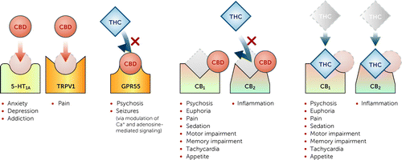
Phytocannabinoids
Phytocannabinoid | CB1 | CB2
THC | Partial Agonist | Partial Agonist
CBD | Antagonist | Negative Allosteric Modulator
Risks and Benefits of Cannabis and Cannabinoids in Psychiatry. American Journal of Psychiatry. (2021, December 8). Retrieved February 14, 2023, from https://ajp.psychiatryonline.org/doi/full/10.1176/appi.ajp.23180001?af=R
Notes:
Don’t only work individually, CBD decreases THC’s affinity for CB2, it is thought to decrease the negative side effects.
Remember, CB1 is in the CNS. Psychoactive. High.
CB2 is in the periphery. Immune system and digestion.

Slide 15
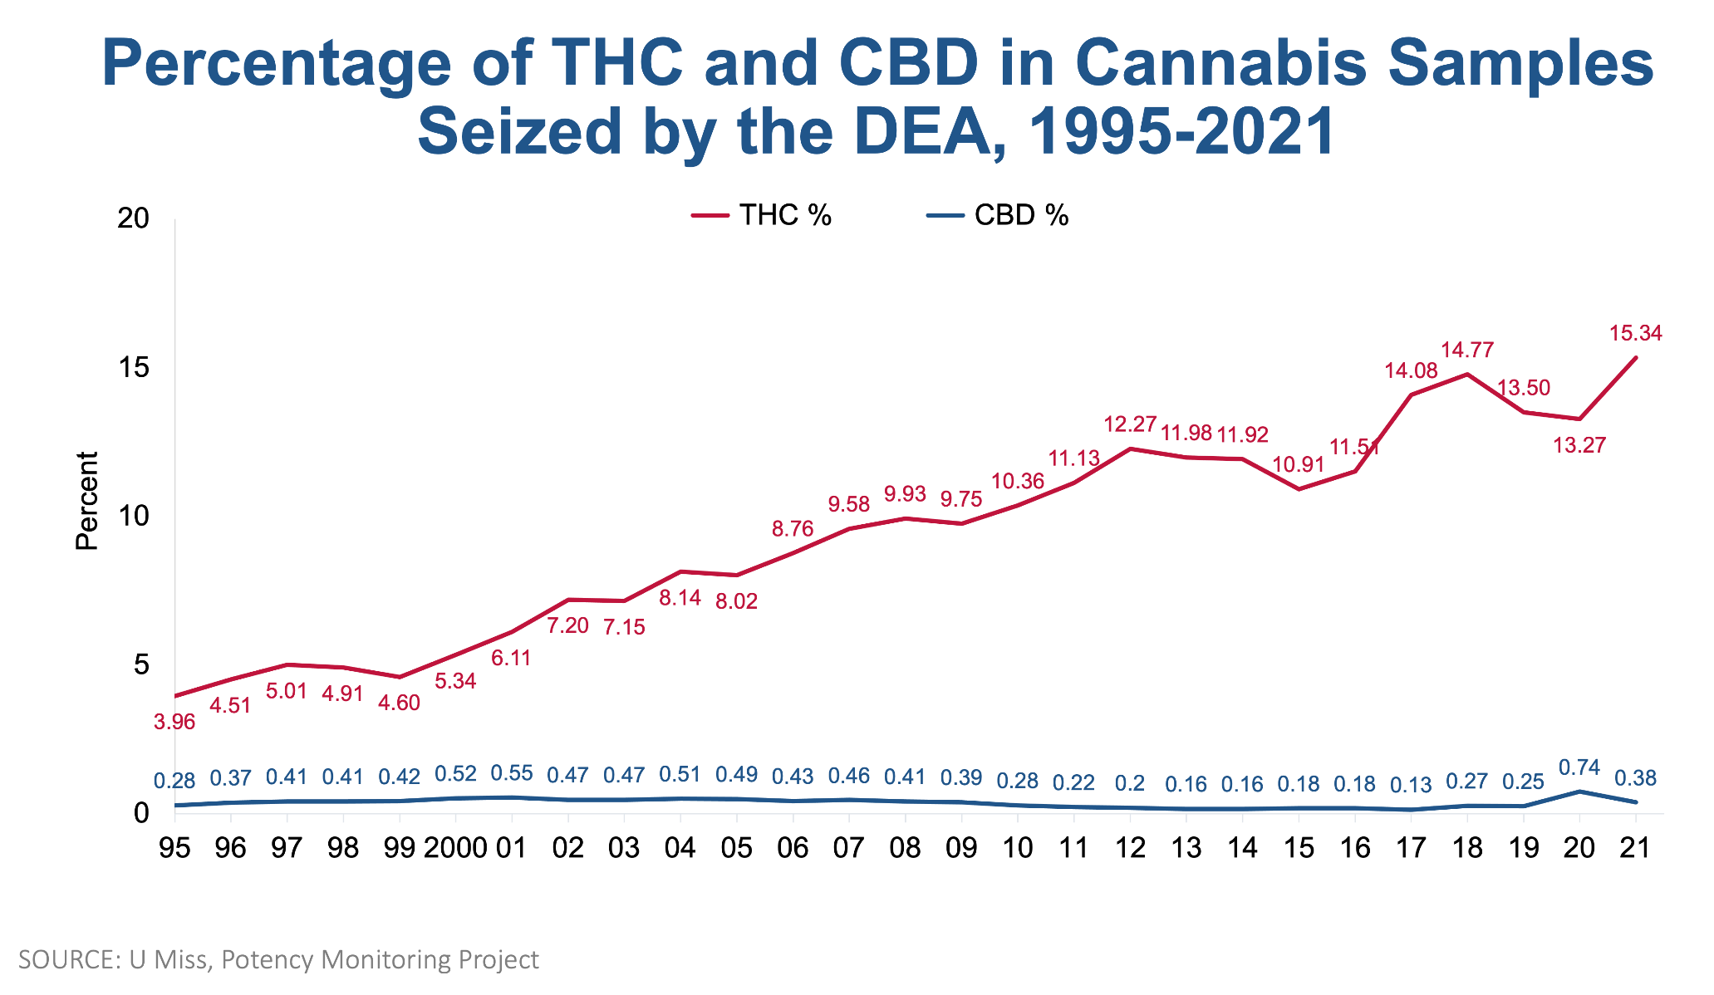
U.S. Department of Health and Human Services. (2022, November 23). Cannabis (marijuana) potency. National Institutes of Health. Retrieved February 14, 2023, from https://nida.nih.gov/research-topics/marijuana/cannabis-marijuana-potency
Caron, C. (2022, June 23). Psychosis, addiction, chronic vomiting: As weed becomes more potent, teens are getting sick. The New York Times. Retrieved February 14, 2023, from https://www.nytimes.com/2022/06/23/well/mind/teens-thc-cannabis.html
Notes:
In order to consider long term side effects, we have to consider the changes that have occurred over the years
Describe chart
Trend appears to be ~1% per year for last few years. Possible we are at above 17% now?
This chart is one of the more conservatives once I’ve found
Concentrates, such as oils and extracts, are typically 90% THC, sometimes exceeding 95%
If we look at someone who started heavy cannabis use in the late 90’s, it won’t be the same as someone who started heavy cannabis use today
So just keep that in the back of your mind.

Slide 16
Terpenes and Terpenoids
Aromatic
Over 200 in a cannabis plant
Synergy with cannabinoids, involved in the range of effects
  Ratio may affect pharmacologic outcomes
Thought to optimize effect of cannabis cannabinoids- “entourage effect”
Backes, M., Weil, A., McCue, J. D. (2017). Cannabis Pharmacy: The practical guide to medical marijuana. Black Dog &amp; Leventhal Publishers.
Notes:
Cannabis plants also contain terpenes and terpenoids
Terms often used interchangeably
Cannabinoids have no scent, terpenes are what you can smell
Many benefits, including protecting the brain from short-term memory effects of THC, anti depressant, anti inflammatory, antioxidant…. But a lot we still don’t know

Slide 17
Synthetic Cannabinoids
Notes:
The last type of cannabinoid we will discuss are synthetic cannabinoids

Slide 18
Synthetic Cannabinoids
K2, Spice, AK-47, Mr. Happy, Scooby Snax, Kush, Kronic → Synthetic THC
Thought to bind more strongly to receptors than phytocannabinoids
  Usually full agonists at CB1 receptors
  Stronger effects, less predictable
Prescription: Cannabidiol (Epidiolex®) oral solution, dronabinol (Marinol®) capsules (CIII) or (Syndros®) oral solution (CII), Nabilone (Cesamet®) (CII)
Centers for Disease Control and Prevention. (2021, March 23). About synthetic cannabinoids. Centers for Disease Control and Prevention. Retrieved February 14, 2023, from https://www.cdc.gov/nceh/hsb/chemicals/sc/About.html
NIDA. 2018, February 5. Synthetic Cannabinoids (K2/Spice) DrugFacts. Retrieved from https://nida.nih.gov/publications/drugfacts/synthetic-cannabinoids-k2spice on 2023, February 14
Tai S, Fantegrossi WE. Synthetic Cannabinoids: Pharmacology, Behavioral Effects, and Abuse Potential. Curr Addict Rep. 2014 Jun 1;1(2):129-136. doi: 10.1007/s40429-014-0014-y. PMID: 26413452; PMCID: PMC4582439.
FDA label Search. Proprietary Name. (n.d.). Retrieved February 14, 2023, from https://labels.fda.gov/proprietaryname.cfm
Notes:
Remember CB1- CNS, psychoactive
Cannabidiol- Nearly 100% purified CBD, not synthetic
Dronabinol: Synthetic THC
Nabilone: Synthetic THC

Slide 19
Pharmacokinetics
Notes:
And now everybody’s favorite class from pharmacy school… pharmacokinetics

Slide 20
Absorption
Cannabinoid acids (ex. THCA) cannot be easily absorbed
Once heated and decarboxylated, much more bioavailable
Route | Psychotropic Onset | Psychotropic Peak | Other information
Pulmonary | A few seconds- minutes | 15-30 minutes | Avoids 1st pass metabolism
GI | 30-90 minutes (inconsistent) | 2-7 hours (inconsistent) | Portion of cannabinoid and nearly all terpenes destroyed in 1st pass. Formulation tricks to bypass this.
Topical | Typically do not absorb into blood stream. May have peripheral effects. Not very effective. Can increase by blending into appropriate base.
Newmeyer MN., et al. Free and Glucuronide Whole Blood Cannabinoids' Pharmacokinetics after Controlled Smoked, Vaporized, and Oral Cannabis Administration in Frequent and Occasional Cannabis Users: Identification of Recent Cannabis Intake. Clin Chem. 2016 Dec;62(12):1579-1592. doi: 10.1373/clinchem.2016.263475. Epub 2016 Oct 10. PMID: 27899456.
Grotenhermen F. Pharmacokinetics and pharmacodynamics of cannabinoids. Clin Pharmacokinet. 2003;42(4):327-60. doi: 10.2165/00003088-200342040-00003. PMID: 12648025.
Notes:
Inhalation:
Absorption of smoked and vaporized is similar
Experienced users appear to absorb twice the amount of THC as occasional users
Holding breath increases absorption, but increases deposition of tar
GI:
Safety
Topical:
The most common topical cannabinoid we see is CBD. Topical CBD unlikely to absorb into blood stream, must apply high concentration liberally for local effect. However, CBD is less lipophilic than THC, so more likely to absorb

Slide 21
Bioavailability
Inhalation: THC 10-35%, CBD 31%
  Depends on intra- and inter-subject inhalation characteristics, device, and particle size
Oral: Both THC and CBD as low as 6%
Lucas CJ, Galettis P, Schneider J. The pharmacokinetics and the pharmacodynamics of cannabinoids. Br J Clin Pharmacol. 2018 Nov;84(11):2477-2482. doi: 10.1111/bcp.13710. Epub 2018 Aug 7. PMID: 30001569; PMCID: PMC6177698.
Notes:
Ranges based on individual characteristics, like how deep you’re breathing in, how long you’re holding that breath, and what device you’re using
Poor oral BA, due to an extensive hepatic first pass metabolism

Slide 22
Distribution
Cannabinoids are ~90% protein bound
Distributed to tissues with many blood vessels (heart, liver, lung, fat)
May accumulate in adipose tissue with frequent use
1% of administered THC distributed to the brain
Backes, M., Weil, A., &amp; McCue, J. D. (2017). Cannabis Pharmacy: The practical guide to medical marijuana. Black Dog &amp; Leventhal Publishers.
Notes:
*Think about drug interactions here

Slide 23
Metabolism
Primarily hepatic
Metabolized by CYP450
Initial metabolite of THC, 11-hydroxyl-THC, is at least twice as intoxicating and effects last twice as long
Further metabolized into non-psychoactive compounds
Single dose of THC detectable in urine for up to 12 days, urinary metabolites may appear up to 30 days in chronic users or obese patients
Backes, M., Weil, A., &amp; McCue, J. D. (2017). Cannabis Pharmacy: The practical guide to medical marijuana. Black Dog &amp; Leventhal Publishers.
Notes:
Individual CYP profiles will impact metabolism

Slide 24
Elimination
Within 50 hours of ingestion, THC and psychoactive metabolite typically eliminated
Non-psychoactive metabolites can stay in body for weeks in heavy users
Excreted 30% urine, 70% feces (5% of oral dose in feces unchanged)
Backes, M., Weil, A., McCue, J. D. (2017). Cannabis Pharmacy: The practical guide to medical marijuana. Black Dog &amp; Leventhal Publishers.
Notes:
Now that we have a grasp on the pharmacokinetics, let’s dive into medical efficacy

Slide 25
Adverse Effects

Slide 26
Interactions: Medications and Diseases
Notes:
As a pharmacist, I will dial it back in to my focus. How will a patient’s cannabis use affect the medications I am giving them, and how will it affect the disease states they have

Slide 27
Drug Interactions
Utilize Micromedex/UpToDate
Cannabinoid | 3A4 | 2C9 | 2C19 | 2D6 | 1A2
THC | Substrate/ Inhibitor | Substrate/ Inhibiter | Inhibitor | Inhibitor | Inducer
CBD | Substrate/ Inhibitor | Substrate/ Inhibitor | Substrate/ Inhibitor | Inhibitor | Inhibitor
Smoking |  |  |  |  | Inducer
Alsherbiny MA, Li CG. Medicinal Cannabis-Potential Drug Interactions. Medicines (Basel). 2018 Dec 23;6(1):3. doi: 10.3390/medicines6010003. PMID: 30583596; PMCID: PMC6473892.
Notes:
You can plug cannabis in just like you would any other medications. Won’t be 100% perfect, as we are still learning a lot, but has a lot of great information.
Majority of research focused on THC and CBD
Potential risk for other cannabinoids and components of cannabis
Some conflicting data

Slide 28
Cannabis-Opioid Synergy
Meta-analysis of pre-clinical studies
Median effective dose (ED50) of morphine administered in combination with THC is 3.6 times lower (95% confidence interval (CI) 1.95, 6.76; n=6) than ED50 of morphine alone
The ED50 for codeine administered in combination with THC was 9.5 times lower (95% CI 1.6, 57.5, n=2) than the ED50 of codeine alone
Nielsen, S., et al. (2017). Opioid-Sparing Effect of Cannabinoids: A Systematic Review and Meta-Analysis. Neuropsychopharmacology : official publication of the American College of Neuropsychopharmacology, 42(9), 1752–1765. https://doi.org/10.1038/npp.2017.51
Notes:
One of the potential interactions that healthcare providers are the most concerned about is cannabis and opioids
Looking at rodents, only pre-clinical
Don’t recommend extrapolating to humans, but does set the scene for us

Slide 29
Cannabis-Opioid Synergy
Double-blind, placebo-controlled
Healthy cannabis smokers (N = 18) were administered oxycodone (0, 2.5, and 5.0 mg, PO) with smoked cannabis (0.0, 5.6% THC)
Analgesia assessed using the Cold-Pressor Test
  Participants immersed hand in cold water (4 °C); times to report pain (pain threshold) and withdraw the hand from the water (pain tolerance) recorded
5 mg oxycodone increased pain threshold and tolerance (p ≤ 0.05)
Active cannabis and 2.5 mg oxycodone failed to illicit analgesia alone, but combined increased pain threshold and tolerance (p ≤ 0.05)
Cooper ZD, et al. Impact of co-administration of oxycodone and smoked cannabis on analgesia and abuse liability. Neuropsychopharmacology. 2018 Sep;43(10):2046-2055. doi: 10.1038/s41386-018-0011-2. Epub 2018 Feb 5. PMID: 29463913; PMCID: PMC6098090.
Notes:
5.6% THC, potentially lower than typical recreational concentrations
Small study

Slide 30
Cannabis: Opioid Sparing?
Online survey of patients from three medical cannabis sites who reported using opioids
1181 responded, 525 included (must have used medical cannabis in combination with opioids, and must meet definition of chronic pain)
  40.4% (n=204) reported that they stopped all opioids
  45.2% (n=228) reported some decrease in their opioid usage
  65.3% (n=299) reported that they sustained the opioid change for over a year
  48.2% (n=241) reported a 40-100% decrease in pain
  80.0% (n=420) improved ability to function
  87.0% (n=457) improved quality of life
  62.8% (n=323) did not want to take opioids in the future
Takakuwa KM, Sulak D. A Survey on the Effect That Medical Cannabis Has on Prescription Opioid Medication Usage for the Treatment of Chronic Pain at Three Medical Cannabis Practice Sites. Cureus. 2020 Dec 2;12(12):e11848. doi: 10.7759/cureus.11848. PMID: 33409086; PMCID: PMC7781576.
Notes:
Helps us see things from the patient’s perspective
Over 40% stopped all opioids or had some decrease in their usage
Over 65% sustained that change for over a year
About half had a 40-100% reduction in pain
Over 80% reported an improved ability to function and QOL
Over 60% did not want to take opioids in the future
Tells me that a lot of patients seeking medical cannabis don’t want to be taking opioids, and the medical cannabis is allowing them to reach that goal, feel pain relief, and have an improved ability to function and quality of life.
That is important to me

Slide 31
Cannabis and Opioid Respiratory Depression
Single center, double-blind, placebo controlled RCT in the Netherlands
Dec 2021-Aug 2022
18 healthy volunteers, aged 18-45, cannabis experience but opioid naive
100mg of high-THC cannabis variant vaporized and inhaled (21.8% THC, 0.1% CBD) after placebo or 20mg oxycodone
No effect on ventilator control after cannabis inhalation with placebo or oxycodone
Rogers, A. H., et al. (2019). Opioid and Cannabis Co-Use among Adults With Chronic Pain: Relations to Substance Misuse, Mental Health, and Pain Experience. Journal of addiction medicine, 13(4), 287–294. https://doi.org/10.1097/ADM.0000000000000493
Notes:
Patient safety is also important to me. As a pharmacist, my patient safety is my top priority.
Very realistic THC concentration
Small study. Patients may be taking higher concentrations, high quantitess, higher doses of opioids. Older patients may be different. But when we pair this with our physiology and pharmacology, nothing that indicates concern here.

Slide 32
Pregnancy and Lactation
Pregnancy
  Endocannabinoids play key roles in organ development, including brain and nervous system
  Cannabis use while pregnant associated with:
    Lower birth weight
    Greater risk of preterm birth or stillbirth (2.3x increased risk)
    Abnormal neurological development impacting memory, learning, and behavior
Lactation
  Cannabinoids are passed through breast milk
Rogers, A. H., et al. (2019). Opioid and Cannabis Co-Use among Adults With Chronic Pain: Relations to Substance Misuse, Mental Health, and Pain Experience. Journal of addiction medicine, 13(4), 287–294. https://doi.org/10.1097/ADM.0000000000000493
Marijuana and pregnancy. SAMHSA. (n.d.). Retrieved February 14, 2023, from https://www.samhsa.gov/marijuana/marijuana-pregnancy
U.S. Department of Health and Human Services. (2013, December 11). Tobacco, drug use in pregnancy can double risk of stillbirth. Eunice Kennedy Shriver National Institute of Child Health and Human Development. Retrieved February 14, 2023, from https://www.nichd.nih.gov/newsroom/releases/121113-stillbirth-drug-use
Rogers, A. H., et al. (2019). Opioid and Cannabis Co-Use among Adults With Chronic Pain: Relations to Substance Misuse, Mental Health, and Pain Experience. Journal of addiction medicine, 13(4), 287–294. https://doi.org/10.1097/ADM.0000000000000493
Notes:
Correlation does not equal causation
Not all the effects are known, but reasonable to assume disrupting this homeostatic system that is in place from the earliest stages of gestation can have negative consequences on developing baby

Slide 33
Urine Drug Screening

Slide 34
Screening vs. Confirmatory
Immunoassay testing is primarily used for initial screening
  Relatively rapid results, screens for a wide variety of drug metabolites
  Antibodies may detect drug metabolites with similar structure and characteristics, leading to false-positive results
  Preliminary and presumptive
Consider confirmatory testing following a presumptive positive screening test, taking into account patient’s history, clinical judgement, and the potential impact on patient care
  More timely and costly
  Gas chromatography/mass spectrometry (GC-MS) is the gold standard
  More specific than immunoassay testing, as it detects drugs by molecular structure
  Quantifies the amount of drug present in a sample
Drug Information Group. What drugs are likely to interfere with urine drug screens? | Drug Information Group | University of Illinois Chicago. (n.d.). Retrieved March 23, 2023, from https://dig.pharmacy.uic.edu/faqs/2021-2/may-2021-faqs/what-drugs-are-likely-to-interfere-with-urine-drug-screens/
Notes:
Immunoassay technology uses antibodies to detect drug metabolites

Slide 35
False Positives and Negatives
False positives
  Dronabinol
  NSAIDs (ibuprofen/naproxen)
  Efavirenz
  Proton pump inhibitors
  Promethazine
False negatives
  Newer, synthetic cannabinoids (“spice,” “K2”) are not detected by the standard urine drug screen
Algren DA, Christian MR. Buyer Beware: Pitfalls in Toxicology Laboratory Testing. Mo Med. 2015 May-Jun;112(3):206-10. PMID: 26168592; PMCID: PMC6170116.
Notes:
Due to some structural similarities
Ibuprofen causing false positives, this was mostly in an older technology
Good practice: “When in doubt, or when it matters, call the lab”

Slide 36
CDC Guidelines for Prescribing Opioids for Chronic Pain
2016
  Recommended that clinicians do not test for substances for which implications for patient management are unclear
    For example, experts noted that there might be uncertainty about the clinical implications of a positive urine drug test for THC
2022
  Recommended that toxicology testing should not be used in a punitive manner but should be used in the context of other clinical information to inform and improve patient care
  Recommended clinicians do not dismiss patients from care on the basis of a toxicology test result
Dowell D, Haegerich TM, Chou R. CDC Guideline for Prescribing Opioids for Chronic Pain — United States, 2016. MMWR Recomm Rep 2016;65(No. RR-1):1–49. DOI: http://dx.doi.org/10.15585/mmwr.rr6501e1.
Dowell D, Ragan KR, Jones CM, Baldwin GT, Chou R. CDC Clinical Practice Guideline for Prescribing Opioids for Pain — United States, 2022. MMWR Recomm Rep 2022;71(No. RR-3):1–95. DOI: http://dx.doi.org/10.15585/mmwr.rr7103a1.
Notes:
Ultimately, use clinical judgement and consider patient safety. What are the risks of abrupt discontinuation or quick titration. What are the risks of having a patient with pain that is not treated adequately.
I ask that you consider the information I discussed today, use your clinical judgement, but ultimately keep patient safety at the center of your decision making.

Slide 37
Acute Intoxication and Cannabis Use disorder

Slide 38
Acute Intoxication
Physiologic signs
  Tachycardia, blood pressure changes, conjunctival injection (“red eye”), dry mouth, slowed or slurred speech, ataxia
Psychological manifestations
  Euphoria (“high”), relaxation, sedation, increased appetite
Neuropsychological
  Impairment in attention, concentration, episodic memory, and associative learning
Additional undesired effects
  Depression, anxiety (panic attacks), perceptual disturbances, and changes in thought content (including transient paranoia or psychosis)
Noble, M. J., Hedberg, K., & Hendrickson, R. G. (2019). Acute cannabis toxicity. Clinical toxicology (Philadelphia, Pa.), 57(8), 735–742. https://doi.org/10.1080/15563650.2018.1548708
Bloomfield, M. A. P., Hindocha, C., Green, S. F., Wall, M. B., Lees, R., Petrilli, K., Costello, H., Ogunbiyi, M. O., Bossong, M. G., & Freeman, T. P. (2019). The neuropsychopharmacology of cannabis: A review of human imaging studies. Pharmacology & therapeutics, 195, 132–161. https://doi.org/10.1016/j.pharmthera.2018.10.006

Slide 39
Acute Intoxication Management
Mild
Dimly lit room, reassurance, decreased stimulation
Consider short acting benzodiazepine (ex. lorazepam) to help control anxiety
Severe
Consider co-ingestion of other substances or co-existing mental illness
Chest pain
Consider acute coronary syndrome, pneumothorax or pneumomediastinum, or asthma exacerbation
UpToDate. (n.d.). Retrieved March 8, 2023, from https://www.uptodate.com/contents/cannabis-marijuana-acute-intoxication
Notes:
Severe intoxication not common
Chest pain: Treat the condition, not the cause.
Cannabis use has been rarely associated with ACS
Inhalation and breath-holding during cannabis use may cause a pneumothorax or pneumomediastinum with sharp, pleuritic chest pain and subcutaneous crepitus
Cannabis use can trigger an asthma exacerbation
No role for gastrointestinal decontamination
Gastrointestinal decontamination: Activated charcoal has limited efficacy with symptomatic intoxication because symptoms can be hours after ingestion (oral effects take much longer than inhalation). Even in children, risk of nausea/vomiting and altered mental status, concerns for risk of aspiration. Generally self limiting.

Slide 40
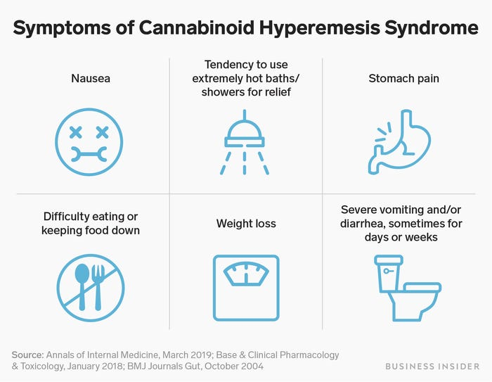
Emergency Room Visits
Cannabinoid Hyperemesis Syndrome
  Resolves with cannabis cessation (only cure)
  Antihistamines, antipsychotic medications (haloperidol, olanzapine), capsaicin cream, pain relievers (APAP or ibuprofen), IV hydration
Cannabis-Induced Psychotic Disorder
  24hr-1wk after use
  Sudden mood lability with schizophrenia-like features
  Lasts days-weeks, warrants clinical attention
Acute Intoxication Syndrome
  Dimly lit room, reassurance, decreased stimulation
  Consider short acting benzodiazepine (ex. lorazepam) to help control anxiety
Cannabis hyperemesis syndrome: What is it, symptoms &amp; treatment. Cleveland Clinic. (n.d.). Retrieved February 14, 2023, from https://my.clevelandclinic.org/health/diseases/21665-cannabis-hyperemesis-syndrome
Brodwin, E. (2019, April 13). A mysterious condition can make marijuana users violently ill, and it reveals a hidden downside to the drug's growing popularity. Business Insider. Retrieved February 14, 2023, from https://www.businessinsider.com/marijuana-syndrome-vomiting-nausea-symptoms-do-i-have-chs-2019-4
D'Souza, et al. (2004). The psychotomimetic effects of intravenous delta-9-tetrahydrocannabinol in healthy individuals: implications for psychosis. Neuropsychopharmacology : official publication of the American College of Neuropsychopharmacology, 29(8), 1558–1572. https://doi.org/10.1038/sj.npp.1300496
Pearson NT, Berry JH. Cannabis and Psychosis Through the Lens of DSM-5. Int J Environ Res Public Health. 2019 Oct 28;16(21):4149. doi: 10.3390/ijerph16214149. PMID: 31661851; PMCID: PMC6861931.
UpToDate. (n.d.). Retrieved March 8, 2023, from https://www.uptodate.com/contents/cannabis-marijuana-acute-intoxication
Notes:
Hyperemesis:
Subset of cyclic vomiting syndrome
Excessive vomiting, up to 5 times per hour
Tends to occur in people who use cannabis at least once a week, usually at least 4x/week, chronic use (>2 years), and high dose
Showers help symptoms, people often compulsively bathe for hours a day to relieve symptoms
Often resistant to standard antiemetics
Psychotic:
Positive and negative symptoms, delusions and/or hallucinations.
Often triggered by increase in potency
Acute intoxication:
Severe- consider co-ingestion of other substances. No role for activated charcoal.
If chest pain, consider condition itself (acute coronary syndrome, pneumothorax or pneumomediastinum, or asthma exacerbation), not cause

Slide 41
Cannabis Use Disorder- DSM 5
11 criteria
Using cannabis in larger amounts or for longer than you meant to
Unsuccessful attempts to quit or cut down
Spending excessive time acquiring, using, or recovering from use
Cravings and urges to use cannabis
Failure to fulfill major personal obligations (work, school or home)
Continued use despite consistent social or interpersonal problems
Important social, occupational, or recreational activities are given up or reduced because of cannabis use
Recurrent use in hazardous situations
Using despite negative effects (physical or psychological)
Needing increased levels of cannabis to get the same effect (tolerance)
Development of withdrawal symptoms, which can be relieved by taking more of the substance
Mild (2-3 symptoms), moderate (4-6 symptoms), severe (7 or more symptoms)
Ciccarelli, S. K., & White, J. N. (2014). Psychology: Dsm 5. Pearson.
Notes:
As defined by DSM-5: A problematic pattern of cannabis use leading to clinically significant impairment or distress, as manifested by at least two of the following, occurring in a 12-month period

Slide 42
Cannabis Withdrawal – DSM 5
Cessation of cannabis use that has been heavy and prolonged (i.e, usually daily or almost daily use over a period of at least a few months).
Three (or more) of the following signs/symptoms develop within approximately 1 week after Criterion A:
Irritability, anger, or aggression
Nervousness or anxiety
Sleep difficulty (e.g., insomnia, disturbing dreams)
Decreased appetite or weight loss
Restlessness
Depressed Mood
At least one of the following physical symptoms causing significant discomfort: Abdominal pain, shakiness/tremors, sweating, fever, chills, or headache
The signs/symptoms in Criterion B cause clinically significant distress or impairment in social, occupational, or other important areas of functioning
The signs and symptoms are not attributable to another medical condition and are not better explained by another mental disorder, including intoxication or withdrawal from another substance
Ciccarelli, S. K., & White, J. N. (2014). Psychology: Dsm 5. Pearson.

Slide 43
Withdrawal
Regular cannabis intake results in desensitization and downregulation of CB1 receptors
Loss of exogenous agonist activation leaves CB1 receptors in a hypoactive state
Starts to reverse in two weeks, return to normal function in 4 weeks

Slide 44
Treatment of Cannabis Use Disorder
Cognitive-behavioral therapy
Contingency management
Motivational enhancement therapy
Currently, no FDA medications for the treatment of cannabis use disorder, but research is active in this area
  Medications that have shown promise in early studies include:
    Zolpidem
    Buspirone
    Gabapentin
  Other agents being studied:
    Nutritional supplement N-acetylcysteine
    FAAH inhibitors
  Future directions: Allosteric modulators that interact with cannabinoid receptors to inhibit THC’s rewarding effects
NIDA. 2021, April 13. Available Treatments for Marijuana Use Disorders. Retrieved from https://nida.nih.gov/publications/research-reports/marijuana/available-treatments-marijuana-use-disorders on 2023, August 8
Notes:
Cognitive-behavioral therapy: A form of psychotherapy that teaches people strategies to identify and correct problematic behaviors in order to enhance self-control, stop drug use, and address a range of other problems that often co-occur with them.
Contingency management: A therapeutic management approach based on frequent monitoring of the target behavior and the provision (or removal) of tangible, positive rewards when the target behavior occurs (or does not).
Motivational enhancement therapy: A systematic form of intervention designed to produce rapid, internally motivated change; the therapy does not attempt to treat the person, but rather mobilize his or her own internal resources for change and engagement in treatment.
NAC: Helps restore levels of glutamate, which is associated with compulsive, drug seeking behaviors
FAAH inhibitors: Inhibit breakdown of body’s own cannabinoids

Slide 45
Discussion and patient cases

Slide 46
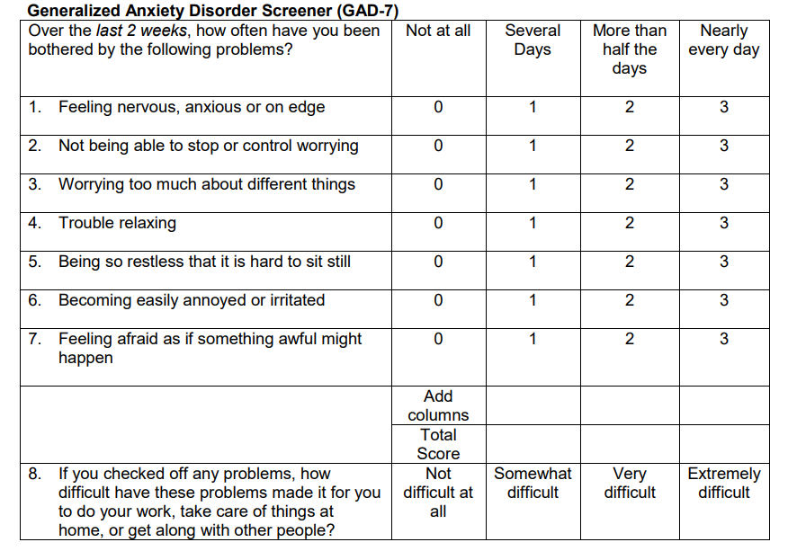
26 YO female with a PMH of anxiety presents to your behavioral health clinic. She reports that she has never taken a prescription for her anxiety because she does not like taking medications. She has always controlled her anxiety with daily cannabis smoking. She stopped using cannabis 1 week ago because she is applying for a federal government job and is worried about UDS results. She has noticed a worsening in her anxiety since. 3 months ago, her GAD7 score was 3. Today, she presents with the following results:
Notes:
Discussion: Withdrawal vs. cannabis control over anxiety

Slide 47
35 YO male with PMH of schizophrenia and cannabis use disorder presents to your behavioral health clinic. He has failed risperidone (3mg daily x1 year) and aripiprazole LAI (400mg monthly x6 months). The psychiatrist would like to try clozapine. What do you recommend?
Cannabinoid | 3A4 | 2C9 | 2C19 | 2D6 | 1A2
THC | Substrate/ Inhibitor | Substrate/ Inhibiter | Inhibitor | Inhibitor | Inducer
CBD | Substrate/ Inhibitor | Substrate/ Inhibitor | Substrate/ Inhibitor | Inhibitor | Inhibitor
Smoking |  |  |  |  | Inducer
Notes:
Cannabis may decrease clozapine levels.
Clozapine is a 1A2 substrate
This is concerning because clozapine is used for treatment resistant schizophrenia. If clozapine isn’t working, there may not be any other good options. But it may not be the clozapine, it may be the interaction.

Slide 48
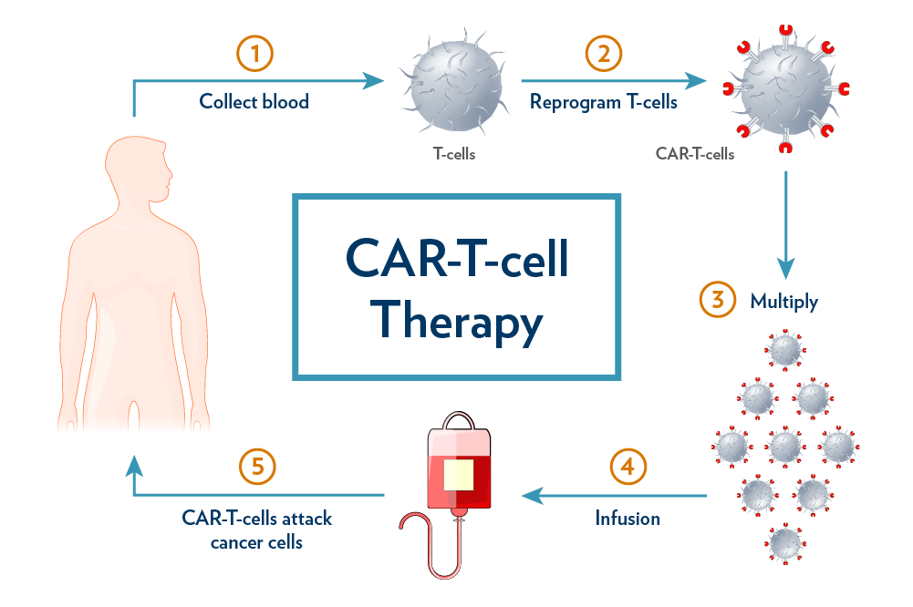
70 YO female presents to your oncology clinic. She is being treated with ciltacabtegene autoleucel (Carvykti), a Car-T Cell Therapy for her leukemia. She has lost 10 pounds in the last month due to nausea and poor appetite, and has severe pain. She is interested in trialing medical cannabis. What do you tell her?
Cancer patients get second chance at life, thanks to new car-T-cell therapy. MUSC Hollings Cancer Center. (n.d.). https://hollingscancercenter.musc.edu/news/archive/2021/06/18/cancer-patients-get-second-chance-at-life-thanks-to-new-car-t-cell-therapy
Notes:
Immunotherapy is when we harness the body’s own immune system to fight cancer. There is a possible interaction between the cannabis and the immunotherapy, which may make the immunotherapy less effective.

Slide 49
A patient with cannabis use disorder comes into the ED complaining of vomiting. They vomited three times in the past hour. Hot showers relieve the symptoms. What is the most effective treatment?
Brodwin, E. (2019, April 13). A mysterious condition can make marijuana users violently ill, and it reveals a hidden downside to the drug's growing popularity. Business Insider. Retrieved February 14, 2023, from https://www.businessinsider.com/marijuana-syndrome-vomiting-nausea-symptoms-do-i-have-chs-2019-4

Slide 50

Questions?
Victoria.fenton@ihs.gov

