Slide 1
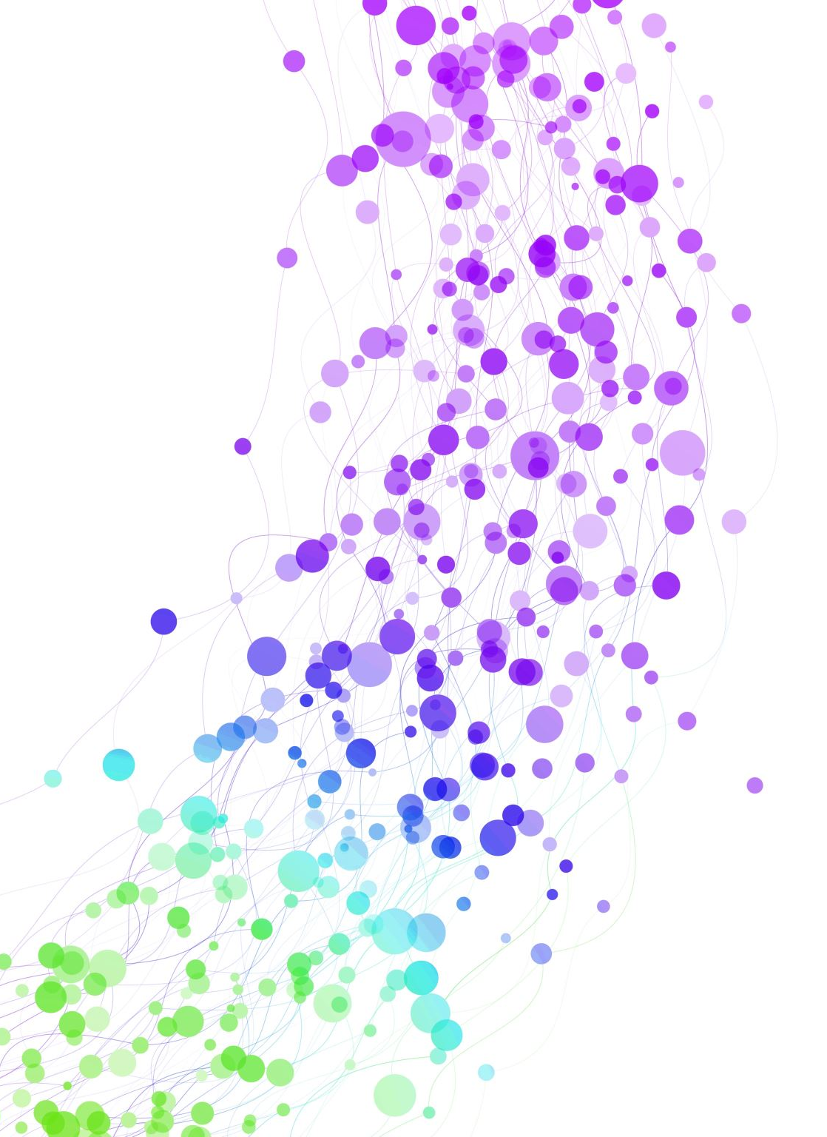
HIV PrEP and PEP in Primary Care
Jorge Mera, MD
ECHO Clinic Director, NPAIHB
December 5, 2023

Slide 2
Outline
Outline
HIV PrEP
HIV PEP
Oral
Injectable
DoxyPEP

Slide 3
Which of the Following Best Describes your Experience with PrEP?
A. Never heard of PrEP
B. Familiar with PrEP but have never recommended it
C. Prescribed PrEP a few times before
D. Extensive experience prescribing PrEP to patients

Slide 4
HIV Prevention Strategies
HIV Prevention Strategies
Sexual behavior modification
Condom use
Test and treat STIs
HIV treatment as prevention (U=U)
PrEP: Pre-Exposure Prophylaxis
PEP: Post-Exposure Prophylaxis
Offer sterile, personalized injection drug use equipment for people who inject drugs
https://aidsinfo.nih.gov/understanding-hiv-aids/fact-sheets/20/48/the-basics-of-hiv-prevention

Slide 5
HIV Prevention Strategies
HIV Prevention Strategies
Sexual behavior modification
Condom use
Test and treat STIs
HIV treatment as prevention (U=U)
PrEP: Pre-Exposure Prophylaxis
PEP: Post-Exposure Prophylaxis
Offer sterile, personalized injection drug use equipment for people who inject drugs
https://aidsinfo.nih.gov/understanding-hiv-aids/fact-sheets/20/48/the-basics-of-hiv-prevention

Slide 6
Which of the following patients
would benefit from PrEP?
A person who injects drugs, shares needles and the last injection was 2 months ago
A man who has sex with men (MSM), has multiple partners and inconsistent condom use
A heterosexual female recently diagnosed with syphilis
A 23 yo male who is asking for PrEP but denies any risk factors for HIV
A and B are correct
All are correct

Slide 7
What is PrEP?
PrEP: Definition
PrEP is not a substitution for other HIV prevention interventions!
PrEP does not protect against other STIs!
Pre-exposure prophylaxis (or PrEP) is when people at very high risk for HIV take antiretroviral medication to lower their chances of HIV infection
Helps prevent an HIV-negative person from getting HIV from a sexual or injection-drug-using partner who is HIV positive
Medication
Tenofovir and emtricitabine combo pill (Truvada®) or (Descovy®) taken daily
OR
Cabotegravir extended-release injectable suspension (Apretude®) taken intramuscularly as two initiation injections administered one month apart, and then every two months thereafter
https://www.cdc.gov/hiv/pdf/risk/prep/cdc-hiv-prep-guidelines-2021.pdf

Slide 8
Why PrEP?
Why PrEP?
PrEP is highly effective
When taking oral daily PrEP the risk of acquiring HIV is reduced by:
~ 99% among men who have sex with men (MSM)
~ 74 – 84% among people who inject drugs (PWID)
https://www.cdc.gov/hiv/risk/estimates/preventionstrategies.html

Slide 9
PrEP Should be Offered to People Who are
HIV Negative and:
Anyone who is at risk for acquiring HIV
Have had anal or vaginal sex in the past 6 months and:
Sexual partner is HIV + and not virally suppressed OR
Does not consistently use condoms OR
Has been diagnosed with an STI in the past 6 months
Inject drugs and
Have an injection partner with HIV, or
Share needles, syringes, or other equipment to inject drugs (for example, cookers).
Have been prescribed non-occupational post-exposure prophylaxis (PEP) and
report continued risk behavior, or
have used multiple courses of PEP
https://www.cdc.gov/hiv/pdf/risk/prep/cdc-hiv-prep-guidelines-2021.pdf

Slide 10

Oral PrEP

Slide 11
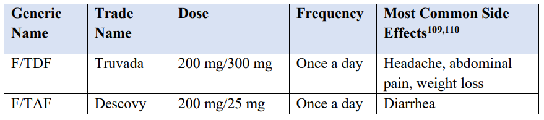
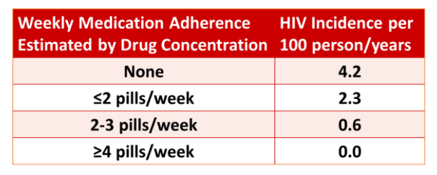
Oral PrEP
Oral PrEP
Adherence and F/TDF PrEP Efficacy in MSM
https://www.cdc.gov/hiv/pdf/risk/prep/cdc-hiv-prep-guidelines-2021.pdf

Slide 12
Baseline Labs for Oral PrEP
Renal function
Hepatitis B serology:
Hep B Surface Ab
Hep B Surface Ag
Hep B Core Ab
Lipid profile (F/TAF)
HIV 1/2 Ab/Ag
Add on HIV RNA (Viral Load) for anyone who has taken oral PrEP in the last 3 months and/or has received a CAB injection in the last 12 months
Plus other STI Screening
https://www.cdc.gov/hiv/pdf/risk/prep/cdc-hiv-prep-guidelines-2021.pdf

Slide 13
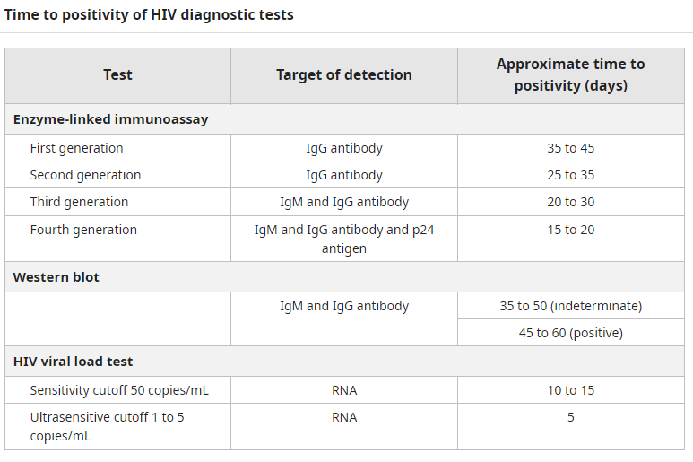
IgG sensitive tests
IgM/IgG-sensitive tests
Ag/Ab Immunoassays
13
Notes:
In the United States, the Food and Drug Administration (FDA)-approved HIV serologic tests have historically been categorized as first-, second-, third-, and fourth-generation tests, based on evolving techniques and significant improvement in assay sensitivity.^{[20,21]} With many of the new and improved HIV assays, a clear distinction between the HIV generations has blurred and use of the HIV test “generation” nomenclature is no longer recommended.^{[22]} The first- and second-generation antibody assays are now referred to as IgG-sensitive tests, third-generation assays as IgM/IgG-sensitive tests, and fourth-generation as antigen-antibody immunoassays (Figure 5).^{[14,20,21,23]} Further, the use of the term rapid HIV test to describe point-of-care tests is no longer recommended since a number of instrumented, laboratory-based tests now have the capacity to generate HIV test results in less than one hour. Instead, the type of test is considered either laboratory-based or point-of-care.^{[21,22]}
Branson BM, Stekler JD. Detection of acute HIV infection: We can't close the window. J Infect Dis 2012; 205:521.
Owen SM. Testing for acute HIV infection: implications for treatment as prevention. Curr Opin HIV AIDS 2012; 7:125.
Cohen MS, Gay CL, Busch MP, et al. The detection of acute HIV infection. J Infect Dis 2010; 202:S270.

Slide 14
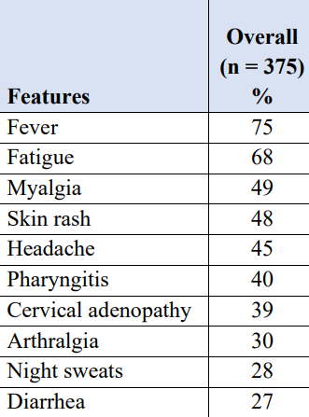
Oral PrEP Follow-up
Every 3 months:
Repeat HIV testing
Assess for signs or symptoms of acute HIV infection
Provide RX for no more than 90 days (until the next HIV test)
Assess medication adherence and risk-reduction behaviors
Conduct STI testing if symptoms of infection
Conduct STI screening for asymptomatic MSM at high risk for syphilis, gonorrhea, or chlamydia
https://www.cdc.gov/hiv/pdf/risk/prep/cdc-hiv-prep-guidelines-2021.pdf

Slide 15
Oral PrEP Follow-up
Oral PrEP Follow-up
Every 6 months:
eCrCl for persons age ≥50 years or had eCrCl <90 ml/min at PrEP initiation
More frequently if at risk for renal diseases (e.g., hypertension, diabetes),
A rise in serum creatinine is not a reason to withhold treatment if eCrCl remains ≥60 ml/min for F/TDF or ≥30 for F/TAF
If eCrCl is declining steadily (but still ≥60 ml/min for F/TDF or ≥30 ml/min for F/TAF), evaluate for other nephrotoxic medicadions and consider nephrologist consultation
Conduct STI screening for sexually active persons (i.e., syphilis, gonorrhea, for all PrEP patients and chlamydia for MSM and TGW even if asymptomatic)
Assess need for continuing or discontinuing PrEP
https://www.cdc.gov/hiv/pdf/risk/prep/cdc-hiv-prep-guidelines-2021.pdf

Slide 16
Oral PrEP Follow-up
Oral PrEP Follow-up
At least every 12 months:
Monitor eCrCl for all patients continuing on PrEP medication
Monitor lipid panel, and weight for patients prescribed F/TAF
Conduct chlamydia screening for heterosexual women and men even if asymptomatic
https://www.cdc.gov/hiv/pdf/risk/prep/cdc-hiv-prep-guidelines-2021.pdf

Slide 17
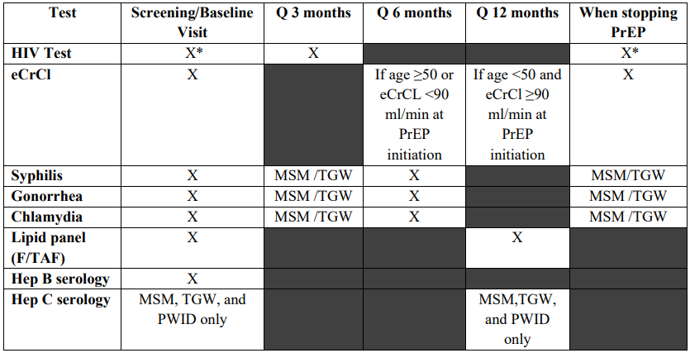
Timing of Oral PrEP-associated Lab Tests
* Assess for acute HIV infection
https://www.cdc.gov/hiv/pdf/risk/prep/cdc-hiv-prep-guidelines-2021.pdf

Slide 18
Discontinuing Oral PrEP
Provider should document:
HIV status at the time of discontinuation
Reason for discontinuation
Recent medication adherence and reported sexual risk behavior
Restarting PrEP requires same initial evaluation, minus the Hep B serology
https://www.cdc.gov/hiv/pdf/risk/prep/cdc-hiv-prep-guidelines-2021.pdf

Slide 19
Injectable PrEP

Slide 20
Injectable PrEP
Cabotegravir (CAB) 600 mg (brand name Apretude®)
Only for prevention of HIV sexual transmission patients whose risk factors for HIV include sexual transmission only (not for PWID)
Adults and adolescents who weigh at least 35 kg (77 lb)
CAB injections may be a good option for PrEP for people who
Have problems taking oral PrEP as prescribed
Prefer getting a shot every 2 months instead of taking oral PrEP
Have serious kidney disease that prevents use of oral PrEP medications
https://www.cdc.gov/stophivtogether/library/topics/prevention/brochures/cdc-lsht-prevention-brochure-clinicians-quick-guide-what-is-injectable-hiv-prep.pdf

Slide 21
How Is Injectable PrEP Administered?
How:
IM – ventro- (preferred) or dorso- gluteal – 3mL at room temp – must be given within 2 hours of drawing it up in syringe – use long enough needle based on body habitus – 1.5-2”
When:
First dose – IM injection of CAB 600mg
1 month later – IM injection of CAB 600mg
Every 2 months after - IM injection of CAB 600mg
If concern for side effects:
A 4-week of 30 mg daily oral CAB prior to the first injection is optional
https://www.cdc.gov/stophivtogether/library/topics/prevention/brochures/cdc-lsht-prevention-brochure-clinicians-quick-guide-what-is-injectable-hiv-prep.pdf; https://www.accessdata.fda.gov/drugsatfda_docs/label/2023/215499s002lbl.pdf

Slide 22
Differences with Oral PrEP
Careful with medications that reduce concentrations of CAB
Anticonvulsants: Carbamazepine, oxcarbazepine, phenobarbital, phenytoin Anti mycobacterials: Rifampin, rifapentine
Side effects
Injection site reactions, headache, fever, fatigue, diarrhea, nausea, rash
Tests not needed with CAB that are indicated with F/TAF or F/TDF:
Creatinine, eCrCl, hepatitis B serology, lipid panels
Testing for STIs adapted to CAB injection appointments
https://www.accessdata.fda.gov/drugsatfda_docs/label/2023/215499s002lbl.pdf
Notes:
Because of the long duration of drug exposure following injection, exclusion of acute HIV infection is necessary with the most sensitive test available, an HIV-1 RNA assay. Ideally, this testing will be done within 1 week prior to the initiation visit. If clinicians wish to provide the first injection at the first PrEP evaluation visit based on the result of a rapid combined antigen/antibody assay, blood should always be drawn for laboratory confirmatory testing that includes an HIV RNA assay

Slide 23
Discontinuing CAB
Educate patients about the “tail” and risks during declining CAB levels
Assess ongoing risk/indications
If PrEP is indicated, prescribe daily oral F/TDF or F/TAF beginning within 8 weeks after last injection
Educate about nPEP
Continue follow-up visits quarterly for 12 months
Conduct HIV-1 RNA tests at each quarterly follow-up visit after discontinuing CAB injections
https://www.cdc.gov/stophivtogether/library/topics/prevention/brochures/cdc-lsht-prevention-brochure-clinicians-quick-guide-what-is-injectable-hiv-prep.pdf
Notes:
CAB levels slowly wane over many months after injections are discontinued. In the HPTN 077 trial, the median time to undetectable CAB plasma levels was 44 weeks for men and 67 weeks for women with a wide range for both sexes. At some point during this “tail” phase, CAB levels will fall below a protective threshold and persist for some time at nonprotective levels exposing the patient to the risk of HIV acquisition. These lower levels of CAB may however be sufficient to apply selective pressure that selects for existing or de-novo viral strains with mutations that confer resistance to CAB or other INSTI medications. Infection with INSTI-resistant virus may complicate HIV treatment.

Slide 24
Unplanned Missed CAB Injections
If a scheduled injection visit is missed or delayed by more than 7 days:
 | Time since Last Injection | Recommendation
If second injection is missed and time since first injection is: | Less than or equal to 2 months | Administer CAB as soon as possible, then continue to follow the every-2-month dosing schedule.
 | Greater than 2 months | Restart CAB from the beginning - with monthly doses x 2, then every-2-month dosing schedule.
If third or subsequent injection is missed and time since prior injection is: | Less than or equal to 3 months | Administer CAB as soon as possible, then continue with the every-2-month injection dosing schedule.
 | Greater than 3 months | Restart CAB from the beginning - with monthly doses x 2, then every-2-month dosing schedule.
https://www.accessdata.fda.gov/drugsatfda_docs/label/2023/215499s002lbl.pdf

Slide 25
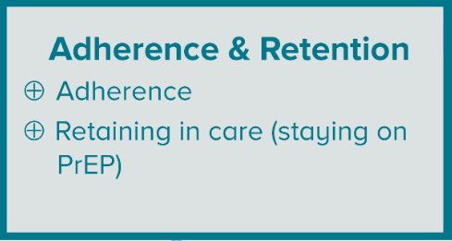
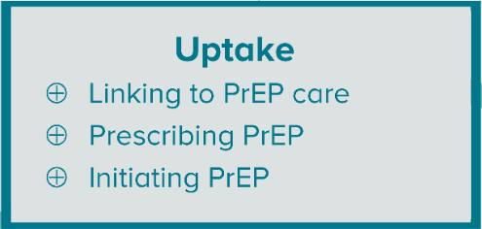
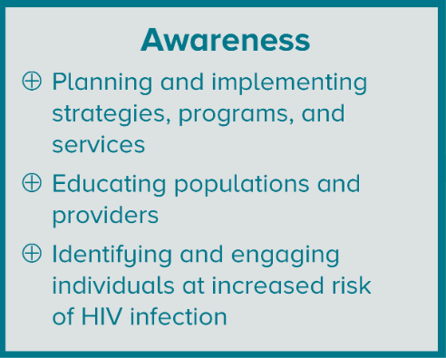
PrEP Care

Slide 26
If a patient tests positive (confirmed)
for HIV: What now?
Get to know the patient
Destigmatize HIV and normalize HIV care
Explain the basics
Focus on the effectiveness of HIV treatment
Get labs
Start medication on the same day or warm hand off

Slide 27
Role of the PCP in PrEP
Consider PrEP for at-risk individuals
Take a good sexual health history to find at-risk individuals
Ask about injection drug use
Discuss with the patient the principles of PrEP
Offer brochures for PrEP in your office
Decide:
Is this something I will offer my patient?
If not me, who? If not now, when?

Slide 28
HIV Post-exposure Prophylaxis (PEP)

Slide 29
Exposure to HIV is an Emergency!
Sooner = Better
Science is based on other similar scenarios, animal data and expert recommendations
The ideal time to administer PEP – within 2 hours of exposure!
Consider giving the first dose, immediately upon presentation
Can be given up to 72 hours after exposure
After 72 hours, it should not be given

Slide 30
Who should be offered PEP?
Individuals who are HIV negative or unknown HIV status who:
May have been exposed to HIV during sex
Shared needles or other equipment (works) to inject drugs
Were sexually assaulted
May have been exposed to HIV at work

Slide 31
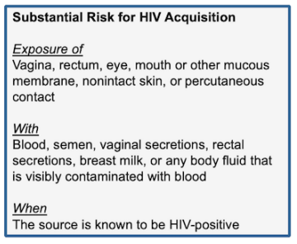
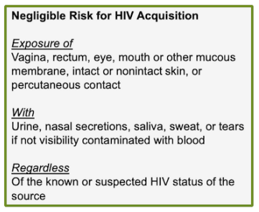
Determining Exposure Risk
https://www.hiv.uw.edu/pdf/prevention/nonoccupational-postexposure-prophylaxis/core-concept/all

Slide 32
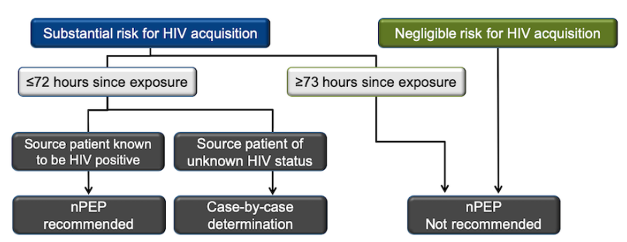
Algorithm for Evaluation and Treatment of possible nonoccupational HIV exposures
HIV test at baseline, 4 weeks, and 12 weeks
https://www.hiv.uw.edu/pdf/prevention/nonoccupational-postexposure-prophylaxis/core-concept/all

Slide 33
Recommended Labs for nPEP evaluation
Baseline
HIV Ab/Ag test
Hep B Surface Ab
4-6 weeks
HIV Ab/Ag test
Cr/AST/ALT**
3 months
HIV Ab/Ag test
Hep B Surface Ag
Hep B core Ab
Hep C Ab
Syphilis serology*
Gonorrhea*^
Chlamydia*^
Pregnancy*
Cr/AST/ALT
Syphilis serology*
Gonorrhea*^
Chlamydia*^
Pregnancy*
6 months
Syphilis serology*
HIV Ab/Ag test if acquired HCV from the exposure
Hep B serologies if not immune
Hep C Ab
*Sexual exposure only; ^Screen all sites of contact; **Only if taking oral PEP
Notes:
6 month testing caveats:
HIV test at 6 months is only if hepatitis C infection was acquired during the original exposure because there can be a delay in HIV seroconversion in persons who simultaneously acquire HIV and hepatitis C infection.

Slide 34
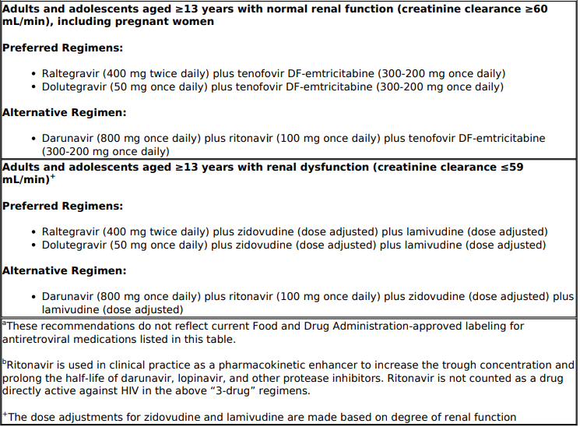
Recommended PEP Regimens
Centers for Disease Control and Prevention: U.S. Department of Health and Human Services. Updated Guidelines for Antiretroviral Postexposure Prophylaxis After Sexual, Injection Drug Use, and Other Nonoccupational Exposure to HIV—United States, 2016. [CDC]

Slide 35
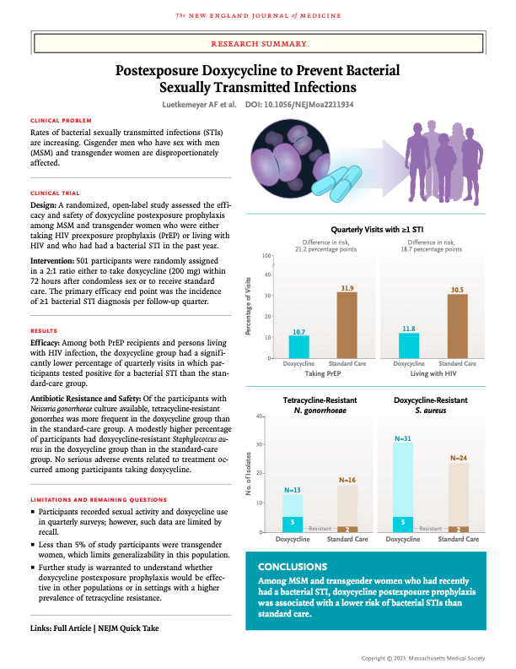
DoxyPEP
Take 1 dose, Doxycycline 200mg within 72 hours of having condomless sex
Repeat as needed, but no more than 1 dose within 24 hours
Reduces the incidence of STIs
RR 0.45 (95% CI, 0.32 to 0.65) for gonorrhea
RR 0.12 (95% CI, 0.05 to 0.25) for chlamydia
RR 0.13 (95% CI, 0.03 to 0.59) for syphilis

Slide 36
DoxyPEP
Doxy PEP
Doxy PEP
Open-label DoxyPEP US study (2022)*:
501 MSM and TGW living with HIV (N=174) or on HIV PrEP (N=327) in San Francisco and Seattle
Randomized to either take DoxyPEP up to once daily (intervention group) vs no medication prophylaxis (control group)
Primary endpoint was incidence of at least 1 STI per follow-up quarter
Results
66% reduction in STIs overall for the intervention group
In the intervention arm
*N Engl J Med. 2023 Apr 6;388(14):1296–306.
Notes:
Luetkemeyer AF, Donnell D, Dombrowski JC, Cohen S, Grabow C, Brown CE, et al. Postexposure Doxycycline to Prevent Bacterial Sexually Transmitted Infections. N Engl J Med. 2023 Apr 6;388(14):1296–306.

Slide 37
Doxy PEP Guidelines
DoxyPEP after oral, anal or vaginal sex should be considered for gay, bisexual and other MSM and for transgender women who have had GC/Chlamydia or syphilis at least once during the past year.
This is a strong recommendation supported by data from clinical trials.
DoxyPEP “could be considered” for MSM and TG women who have not been diagnosed with an STI if they “will be participating in sexual activities that are known to increase likelihood of exposure to STIs, e.g., during weekend events, cruises and festivals
No clinical trial data

Slide 38
Doxy PEP Guidelines
No recommendation on the use of doxyPEP for cisgender women, cisgender heterosexual men, TG men or other queer or non-binary people
“Doxy PEP should be implemented in the context of a comprehensive sexual health approach including risk reduction counselling, STI screening and treatment, recommended vaccination and linkage to HIV pre-exposure prophylaxis (PrEP), HIV care or other services”

Slide 39
Barriers to PrEP/PEP
Barriers to PrEP and PEP
What barriers do you have or foresee
to starting PrEP at your site?

Slide 40
Resources
HIV/PrEP Warm Line: (800) 933-3413
HIV/AIDS Management | National Clinician Consultation Center (ucsf.edu)
Clinicians are available Monday through Friday, 9:00 a.m. to 8:00 p.m. EST. Voice mail is available 24 hours a day.
Indian Country ECHO
http://www.indiancountryecho.org
HIV ECHO, 2nd Wednesday of every month
2-3 pm ET
Notes:
Primary Care Guidance for Persons With Human Immunodeficiency Virus: 2020 Update by the HIV Medicine Association of the Infectious Diseases Society of America, Thompson et al., https://www.idsociety.org/practice-guideline/primary-care-management-of-people-with-hiv/
DHHS Adult and Adolescent Antiretroviral HIV Guidelines: https://clinicalinfo.hiv.gov/en/guidelines/adultand-adolescent-arv/hhs-adults-and-adolescents-antiretroviral-guidelines-panel

