Slide 1
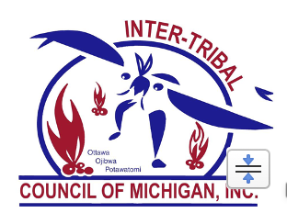

Care Along the Continuum of Cancer - Supporting AI/AN Patients in a Primary Care Setting
Emily Mackler, PharmD, BCOP
Beth Sieloff, MPH, E-RYT

Slide 2

American Indian Cancer Survivorship
Across cancer types, Native people have the worst 5-year survival rates of any U.S. racial or ethnic group.
Less likely to receive optimal treatment
Are less likely to undergo surgery (breast, colon, prostate)
Lower rate of post treatment surveillance and adjuvant therapy
https://youtu.be/-7CoU1utpLE?si=58kLpoOp5ksbPGrv
Javid et al., 2014
Notes:
Emily, I am trying to decide which video

Slide 3
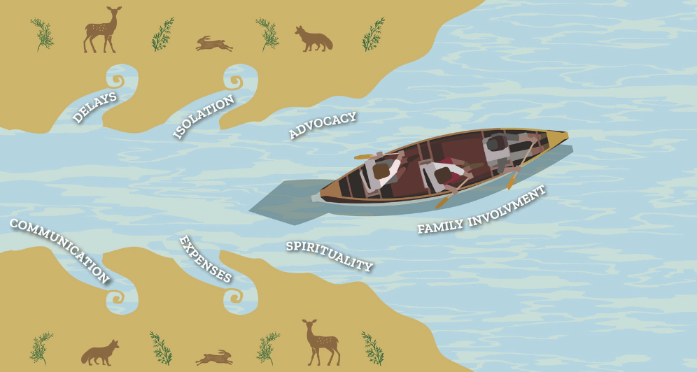
Notes:
This 1 digital story represents many American Indians and families impacted by cancer. With advocacy, respect for culture, and informed family members, the individuals that we dedicate our careers to serving can thrive, survive and live on to ensure support systems are in place to serve future generations. Today's discussion is going to take us on an informative journey that spans the cancer continuum, to inform, advocate, and provide resources for you to support American Indian populations.

Slide 4

The Cancer Continuum
Early Detection
Diagnosis
Treatment
Prevention
Survivorship
End of Life Care
Studies including both rural and urban AI cancer survivors revealed barriers to receipt of optimal cancer symptom management and proportionally lower hospice utilization among AI/AN populations.
"Support Systems in a Rural Indigenous Community is Vital for Our Survival"
Amanda Hess, Hannahville Indian Community
Guadagnolo BA, Petereit DG, Coleman CN. Cancer Care Access and Outcomes for American Indian Populations in the United States: Challenges and Models for Progress. Semin Radiat Oncol. 2017 Apr;27(2):143-149. doi: 10.1016/j.semradonc.2016.11.006. Epub 2016 Nov 24. PMID: 28325240; PMCID: PMC5363281.
Notes:
Culturally-tailored programs in targeted communities have been shown to mitigate the observed cancer-related health disparities among AI/AN communities.

Slide 5
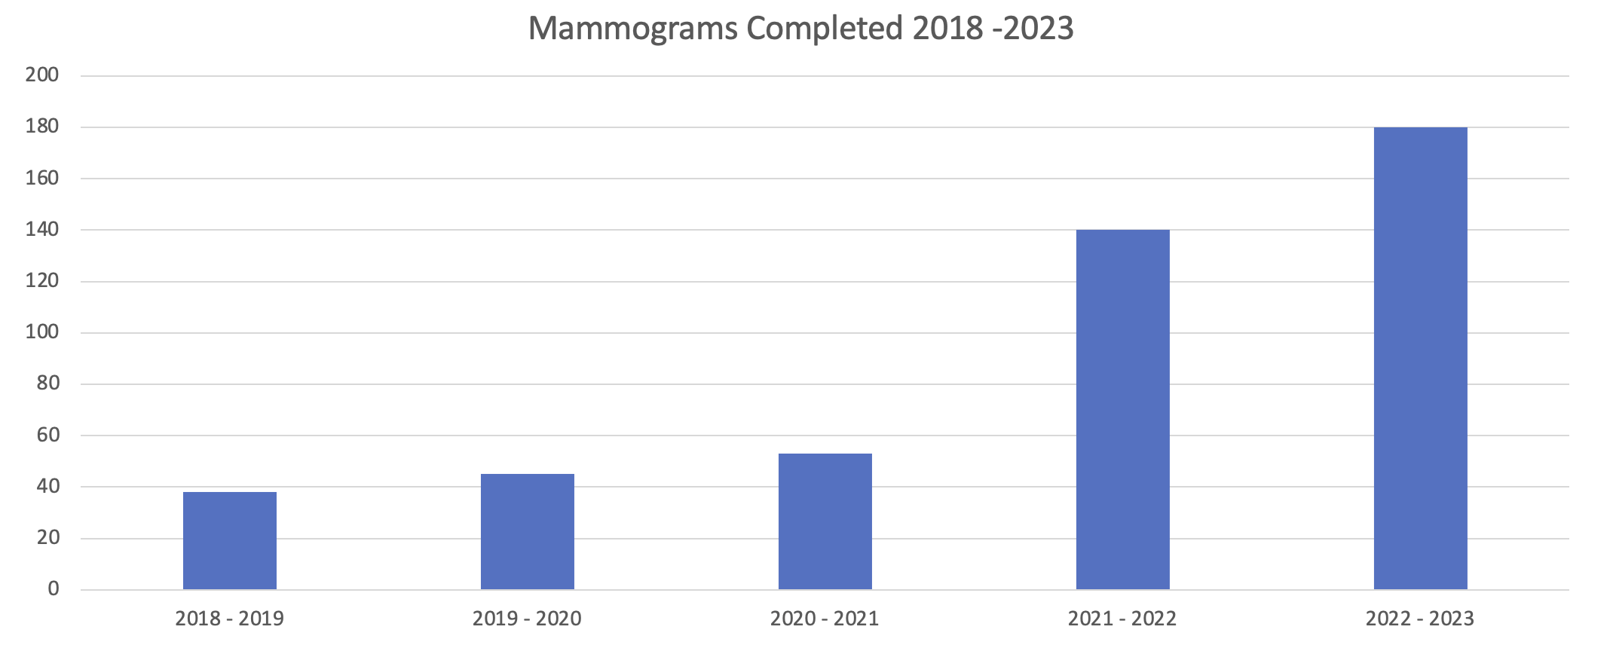
Prevention & Early Detection
Factors that Influence Uptake of Cancer Screening
Multi-Component Interventions
Utilization of EHR Screening Reminders
Utilization of Appointment Reminders
Providing Navigation Support
at the Point of Referral
Community Outreach and Engagement
Increase in Mammogram Completion Rate
EHR & Patient Reminders – Navigation Support Community Outreach and Engagement

Slide 6
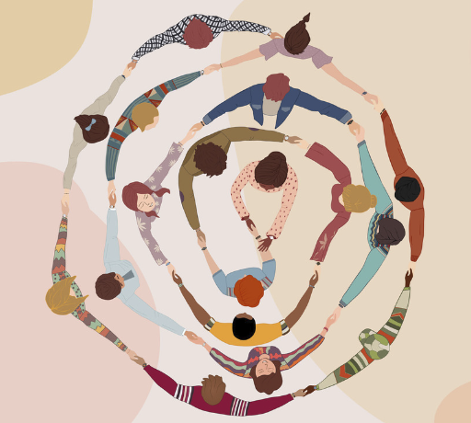
Cultural Needs of American Indians Undergoing
Cancer Treatment
American Indians most often step outside their cultural norms during cancer treatment (Haozous, E., et al, 2016)
  Survivorship support requires bidirectional learning by oncologists and primary care providers to understand the mind, body, spirit and social relationships of indigenous cultures
  Culturally focused education programs at the community level to inform AI/AN patients about cancer therapies could potentially increase their acceptance among AI/AN populations (Javid, S., et al., 2014)

Slide 7
Treatment
Cancer Treatment Changes
Classic cytotoxic --> molecular targeted treatment
Average median duration of cancer treatment:
  4 months (1995 – 1999)
  9 months (2010 – 2014)
Oral Anticancer Agents (OAAs) taken for years
  Drug-drug interactions
  Side effects that worsen comorbid conditions

Slide 8

Cultural Aspects
Long-Term and Late Effects in AI patients
It is not a cultural norm to discuss many of the long-term and late effects of cancer treatment
  Primary care provider inquiry to patients well being
  Regular screening for long-term and late effects of cancer treatment
  Development of survivor social networks within tribal communities

Slide 9
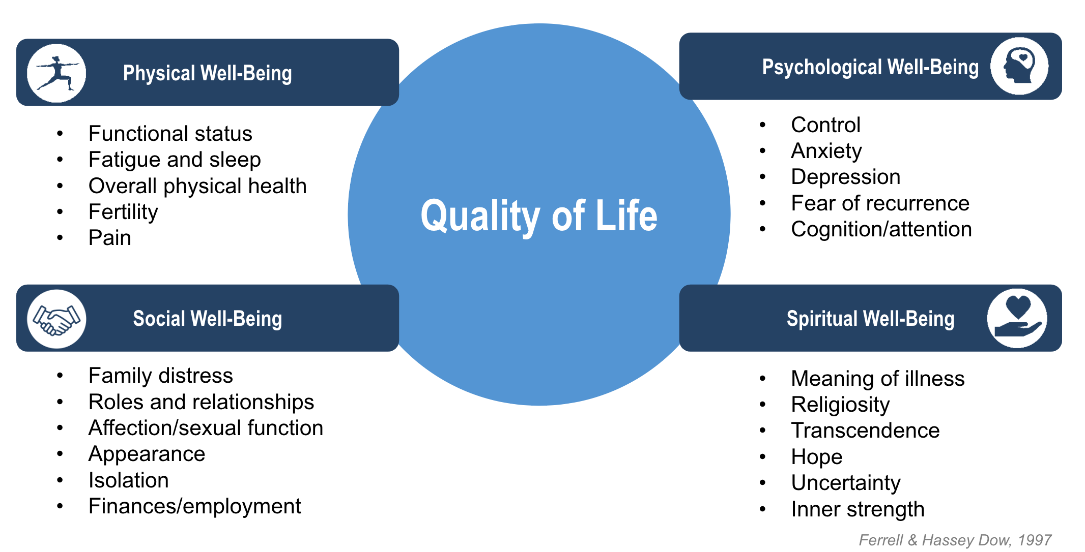
Survivorship: The Needs of a Cancer Survivor
Notes:
Just like you and I cancer survivors need the homeostasis in these 4 areas to

Slide 10
Psychosocial Impacts of Cancer
Long-Term and Late Effects of Cancer Treatment
Depression, depressive symptoms
Distress
Worry, anxiety
Fear of recurrence
Pain-related concerns
End-of-life concerns: death and dying
Changes in sexual function and/or desire
Challenges with body image
Challenges with self-image
Relationship and other social role difficulties
Return to work concerns and financial challenges

Slide 11
Resources and Community Support Along the Cancer Continuum
Screening
Inquiry
Referral
Navigation
Follow-up
Three Fires Cancer Journey Resource Guide
Notes:
At Your Table is the Three Fires Cancer Journey Resource Guide. This is an editable template that allows your health system to navigate and inform your patients of the resources immediately available in your community. Inspired by the painting Rough Waters and adapted for the Anishinaabe Region, this resource provides you or a member of your health team to sit down with newly diagnosed cancer patients to identify the resources available in your community and at the same time take the time to document any barriers they are having in securing treatment, understanding their treatment plan, or most importantly keeping their treatment appointments, and set EHR reminders to follow-up with the patient and their oncology team. https://www.ncbi.nlm.nih.gov/pmc/articles/PMC5546748/

Slide 12
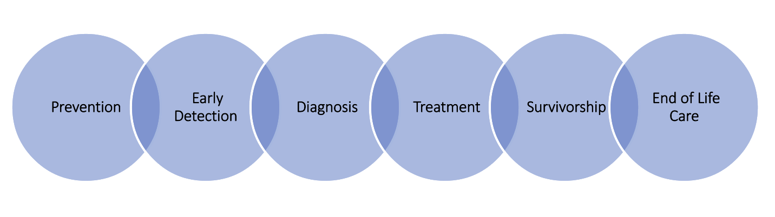
Supporting Diagnosis and Survivorship
Palliative care

Slide 13
Empowering Survivors to Live Well
The Role of Primary Care
Prevention
Cancer
Comorbidities
Hypertension, Type 2 Diabetes, Cardiovascular Disease
General Wellness
Diet
Exercise
Psychological well-being
Surveillance and Screening

Slide 14
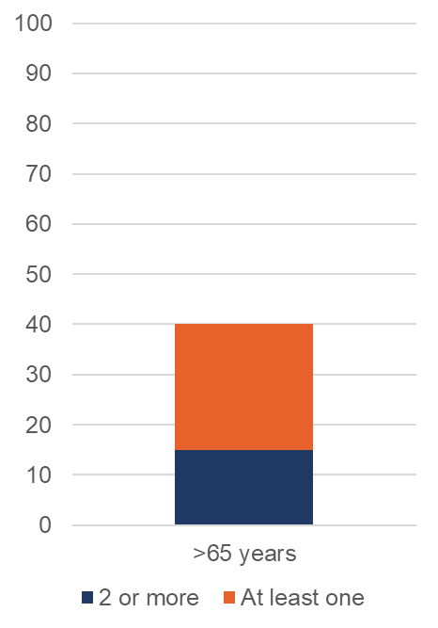
Cancer and Co-Morbidities
Prevalence of chronic comorbidities in Medicare beneficiaries with cancer over age 65
Top chronic conditions
Cardiovascular disease Type 2 diabetes mellitus Mental health disorder
Percent
Number of comorbidities

Slide 15
Cancer and Co-Morbidities
Cancer effects on the comorbidity
  New targeted therapies, endocrine therapy, and corticosteroids can adversely affect comorbid conditions – in particular, diabetes mellitus and cardiovascular disease – in patients with cancer
Comorbidities affect cancer outcomes
  Management of comorbidities are an important component of cancer care and may impact treatment toxicities and effectiveness, as well as survival.

Slide 16
Cancer and Co-Morbidities – Communication
Coordination of care for oncology patients is complicated, and in some cases, the oncologist serves as the primary provider during cancer treatment. Treatment of comorbid conditions may be suboptimal.
Management of comorbidities are an important component of cancer care and may impact treatment toxicities and effectiveness, as well as survival.
The literature is replete with evidence that lapses in communication between oncology specialty providers and primary care providers may provide opportunity for improvements in care and thus patient outcomes.

Slide 17
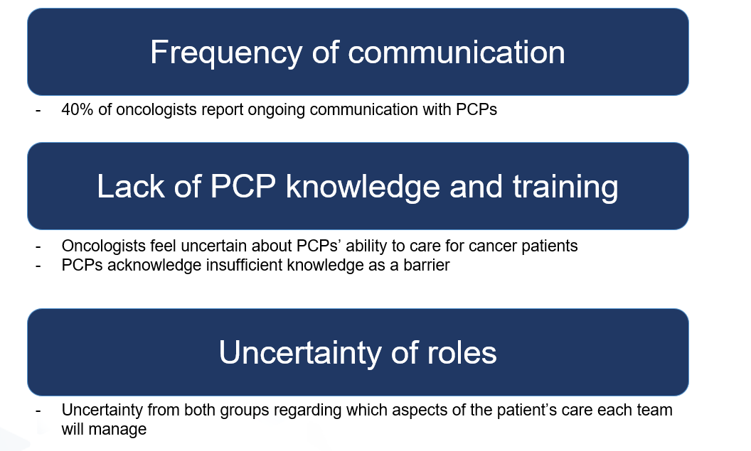
Cancer and Co-Morbidities
Communication Barriers

Slide 18
Patients taking Oral Anti-Cancer Agents (OAA)
Increased importance in patient and caregiver confidence – managing symptoms at home
Increased barriers to receive the OAA (due to insurance requirement, prior authorizations, limited distribution, and high cost)
Risk factors predicting need for medication modifications
  Living in a rural community or small town increased the number of medication modifications by 73% (compared to more urban areas)
OAA medication adherence directly links to clinical outcome

Slide 19

Primary Care Team Member Role
Screening patients who are receiving active treatment and supporting them in coordination of care, symptom management, and medication access
Collaboration with oncology clinic
Utilization of risk model(s) to identify patients at increased risk of developing treatment-related toxicities
Incorporating a Screening for the Long-Term and
Late Effects of Cancer Treatment
3-Fires Long-Term and Late Effects Screening Tool

Slide 20
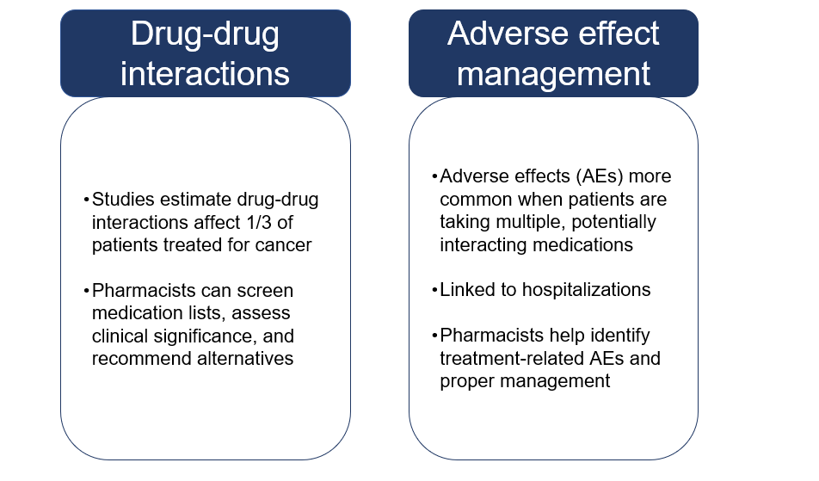
Pharmacist Role
Notes:
●There are several other key ways that pharmacists are well-equipped to bridge the gap.
●DDI checking – DDIs are increasingly common among cancer patients as more people end up on long-term maintenance oral anticancer agents.
●Management of AEs – Pharmacists can recognize side effects as well as effects of a potential drug interaction. Aes in patients on long lists of medications have been linked to increased risk of hospitalization.

Slide 21
Collaboration with Treatment Facilities
Incorporation of spiritual practices, traditional medicines and culture helps patient with chronic illness, better quality of life and end-of-life
Increases one’s will to live
Improves coping skills, sense of coherence, meaning
Improves stress management (meditation, spiritual practices, mindfulness)
Improves pain management
Enables patient to have more realistic sources of hope (meaning in life, reconciliation, hope for finishing important goals—i.e., not cure-focused)
Increases satisfaction with care
Is a patient need
Notes:
It is important for the primary care provider to include and collaborate supporting patient needs during cancer treatment. If you reference back to pages 3 and 8 of the navigation packet you will see there is space to refer patients to the traditional healer, and a reminder that it is the advocacy, spirituality and family involvement that improve outcomes for cancer patients.

Slide 22
Survivorship
Palliative Care vs End of Life Care
Advance Practice Providers
Social Workers
Spiritual Care
Pain Management
Patients Doctor
Partnerships in Care
Tribal Community
Private Insurance Organizations
Traditional &
Lay Healers
Pharmaceutical Support Organizations
Cancer Center
Patients in palliative care may receive medical care for their symptoms, or palliative care, along with treatment intended to cure their serious illness.
Patient
and Caregivers
NIH, Institute on Aging, May 2021

Slide 23
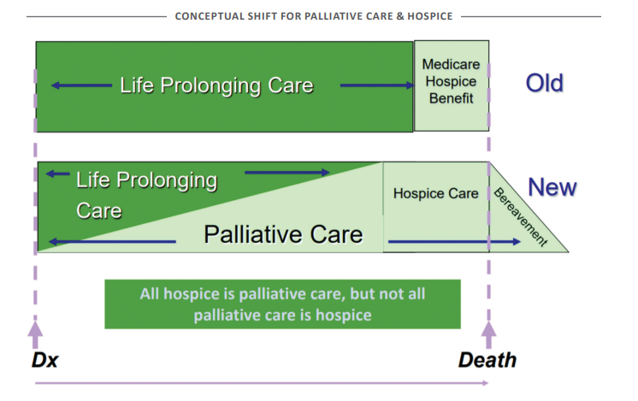
Incorporating Hospice into Your Community
Partnerships in Care
Tribal Community
Private Insurance Organizations
Traditional & Lay Healers
Pharmaceutical Support
Organizations
Cancer Center
www.moqc.org

Slide 24
Resources

Slide 25
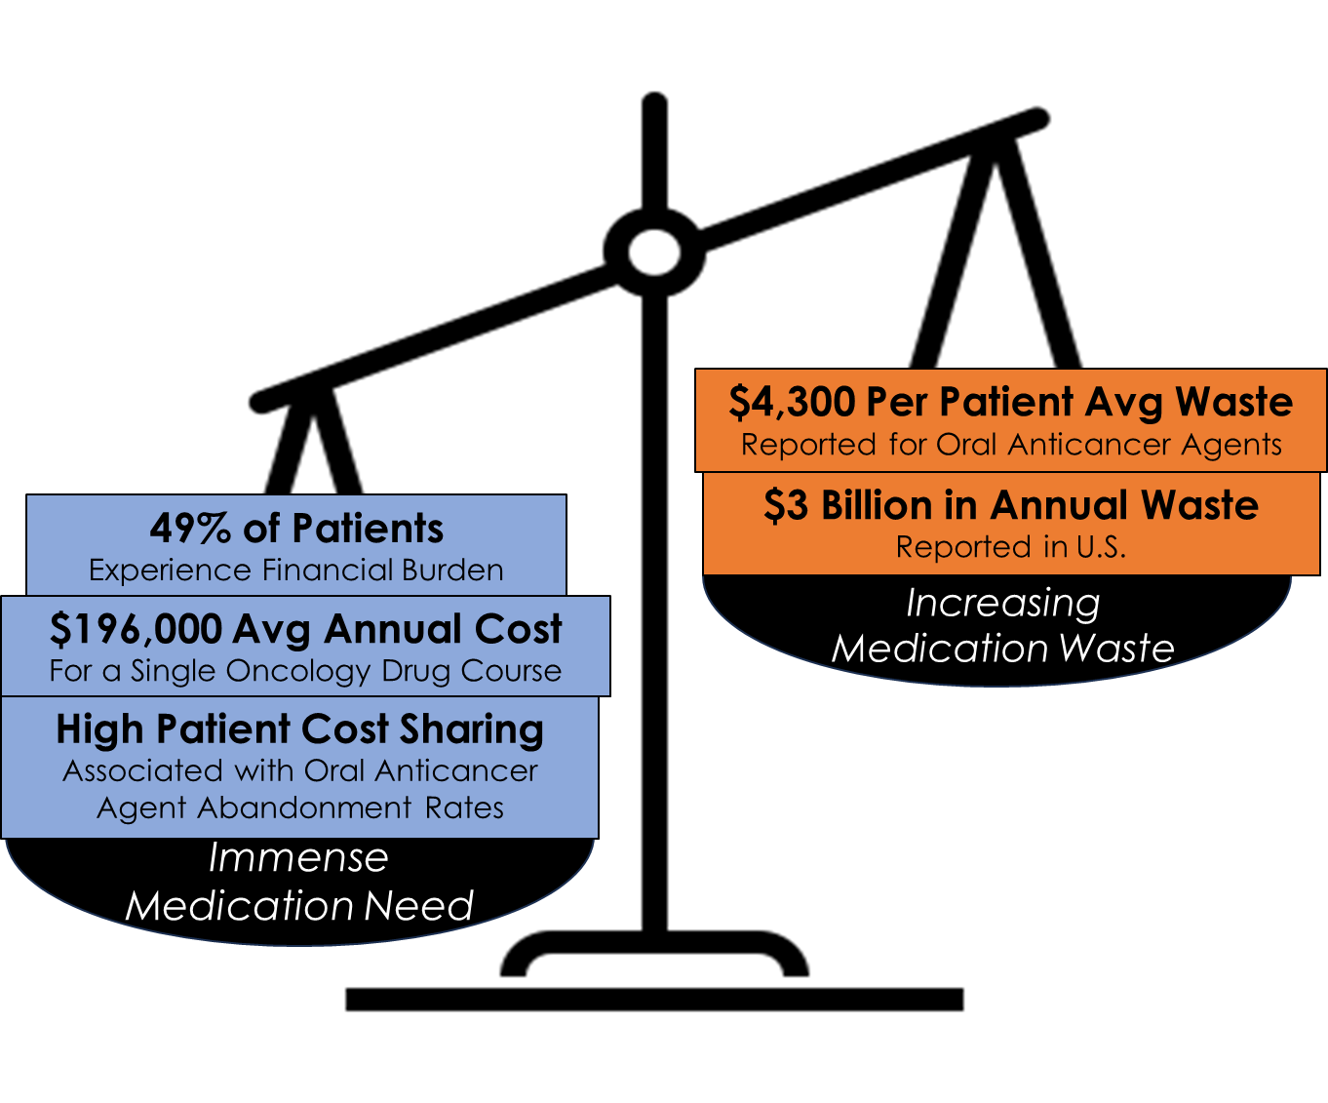

Juxtaposition of Cancer Medication Need and Waste

Slide 26

Cancer Drug Repositories
Established for medication donation and redistribution
14 states including Michigan have legislation
Respond to medication affordability, access, and waste
YesRx – charitable organization founded in June 2023, to remove barriers to medication access for vulnerable and underserved people and communities via a State-wide Cancer Drug Repository
Notes:
●There are several other key ways that pharmacists are well-equipped to bridge the gap.
●DDI checking – DDIs are increasingly common among cancer patients as more people end up on long-term maintenance oral anticancer agents.
●Management of AEs – Pharmacists can recognize side effects as well as effects of a potential drug interaction. Aes in patients on long lists of medications have been linked to increased risk of hospitalization.

Slide 27

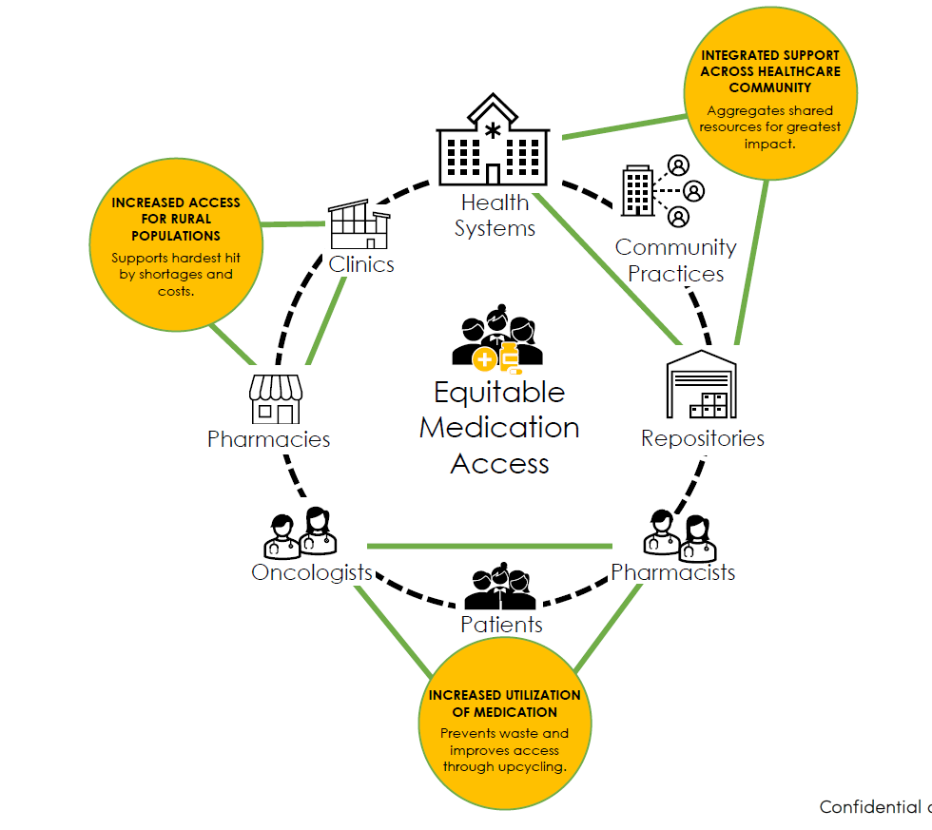
Ecosystem Approach
Notes:
●There are several other key ways that pharmacists are well-equipped to bridge the gap.
●DDI checking – DDIs are increasingly common among cancer patients as more people end up on long-term maintenance oral anticancer agents.
●Management of AEs – Pharmacists can recognize side effects as well as effects of a potential drug interaction. Aes in patients on long lists of medications have been linked to increased risk of hospitalization.

Slide 28
Maamwi Gda' monobmaadizzi' mi
Let us gather for a good way of life
24-months
Tribal GONA (1st 90 Days)
GONA Themes (Year 1)
Attitudes
Beliefs
Needs in Cancer Center Setting
Assemble Consortium (1st 60 Days)
Cancer Survivors and Caregivers, Community Members
Traditional Healers
All Tribal Health Ctr Staff
Experiences
Learning Bi-Monthly
Anishinaabe History
History of Colonialism
Tribal Sovereignty
Findings of GONAs
Identify Care Priorities
Diagnosis
Screening
Treatment
Survivorship Long Term/Late Effects
Palliative Care
PCOR/CER Training continues over the 24 month period
Anishinaabe Traditions
Hospice
Validate Priorities of AI stakeholders
Acknowledgement of Health Systems and External Stakeholders
State GONA
Identify Presenters
Identify Existing Capacity
Publish Research Priorities
Tribes & Consortium
Discuss Findings with Tribes and Consortium Members
Prioritize Research Agenda
Establish Goals, Objectives, Timeline, and Learning Activities
Identify Research Partners
Secure CMEs
Knowledge Gaps/Needs of Oncology Professionals
Knowledge Surveys
Webinars
On-line Meetings
Photo Voice Products
Develop Focus Group Questions
CMEs/CEUs for Learning Session Participants
Publication
Recorder/Transcription Svc
Matt Lamphier Photo Voice
Space, Travel, Honorarium
Objectives from LOI
Educate tribal and state health systems stakeholders
Facilitate GONA to identify PCOR/CER cancer priorities, including rural AI tribal traditional practices and palliative care use
Discuss AI history/culture/tradition with healthcare stakeholders to prepare for future PCOR/CER tribal engagement in MI
Prioritize and publish oncology/palliative care PCOR/CER research agenda for rural AI
Recorder/Transcription Svc
Matt Lamphier Photo Voice
Space, Travel, Honorarium
GONA
Interviews/Focus Groups/PCOR CER Orientation/Training
Consortium: Tribal Providers/Cancer Centers Staff/Survivors/Caregivers/other Private and Govt stakeholders
Notes:
This is based on the content of the LOI, not everything is exactly specific, but it does give us something to design/build the application.

Slide 29
Where do you need Resources and Community Support Along the Cancer Continuum?
Notes:
At Your Table is the Three Fires Cancer Journey Resource Guide. This is an editable template that allows your health system to navigate and inform your patients of the resources immediately available in your community. Inspired by the painting Rough Waters and adapted for the Anishinaabe Region, this resource provides you or a member of your health team to sit down with newly diagnosed cancer patients to identify the resources available in your community and at the same time take the time to document any barriers they are having in securing treatment, understanding their treatment plan, or most importantly keeping their treatment appointments, and set EHR reminders to follow-up with the patient and their oncology team. https://www.ncbi.nlm.nih.gov/pmc/articles/PMC5546748/

Slide 30
