Slide 1
Responding to the Rise of Syphilis in Indigenous Communities
Amy DeLong, MD, MPH
Ho-Chunk Nation Department of Health
Northwest Portland Area Indian Health Board
Expanding Clinical Services and Professional Roles within Primary Care
Traverse City MI
December 5 2023

Slide 2
Objectives
Review current epidemiology of syphilis and congenital syphilis and its disproportionate burden on American Indian/Alaska Native communities
Better understand syphilis and its stages
Treatment of syphilis
Describe a multidisciplinary approach

Slide 3
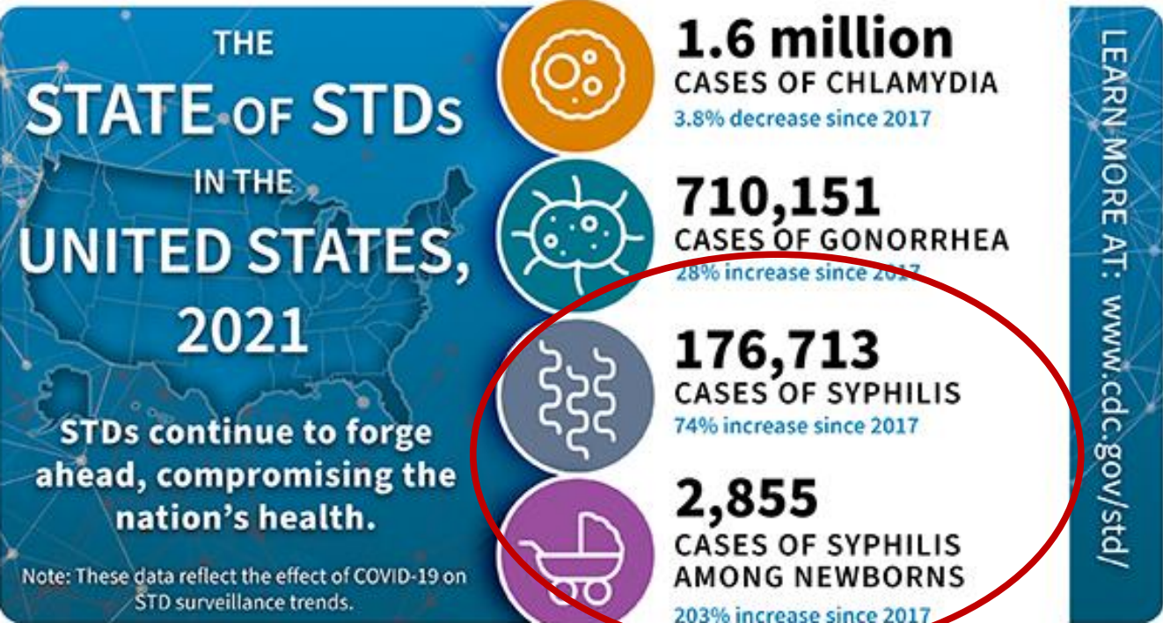
Notes:
While the teen pregnancy rate continues to decline in the US, the rates of STDs are going up. This is a true PH crisis

Slide 4
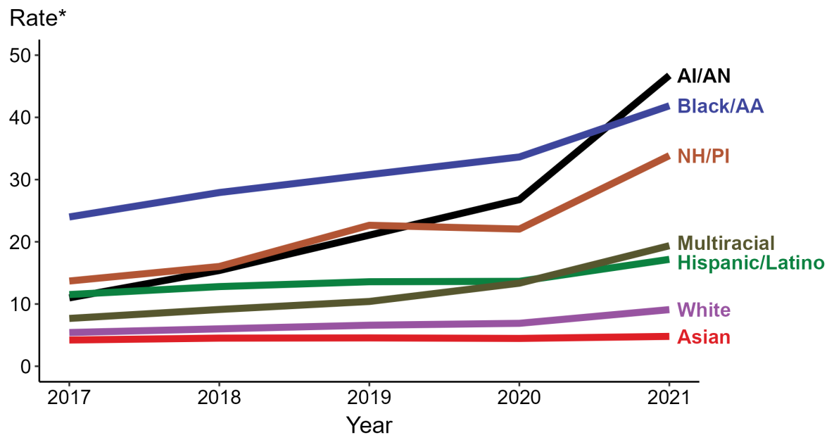
Primary and Secondary Syphilis — Rates of Reported Cases by Race/Hispanic Ethnicity, United States, 2017–2021
National Overview of STDs, 2021 (cdc.gov)
Notes:
In 2021, the highest rate of reported primary and secondary syphilis cases per 100,000 persons was among non-Hispanic American Indian or Alaska Native persons (46.7), followed by non-Hispanic Black or African American persons (41.9). Non-Hispanic American Indian or Alaska Native persons also had the greatest five-year increase in rate of reported primary and secondary syphilis (11.0 to 46.7; 324.5% increase from 2017).

Slide 5
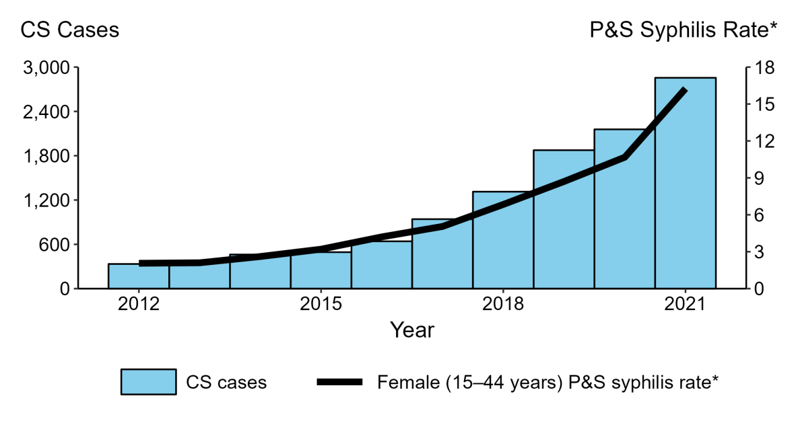
Congenital Syphilis: Reported Cases by Year of Birth and Rates of Reported Cases of Primary and Secondary Syphilis Among Women Aged 15–44 Years, United States, 2012–2021
National Overview of STDs, 2021 (cdc.gov)
Notes:
During the nine year time period 2012 to 2021, the number of cases of congenital syphilis increased 754.8% (334 to 2,855 cases), concurrent with a 676.2% increase (2.1 to 16.3 per 100,000) in the rate of primary and secondary syphilis among women aged 15 to 44 years
During 2020 to 2021, the number of cases of congenital syphilis increased 32.4% (2,157 to 2,855 cases), concurrent with a 52.3% increase (10.7 to 16.3 per 100,000) in the rate of primary and secondary syphilis among women aged 15 to 44 years.

Slide 6
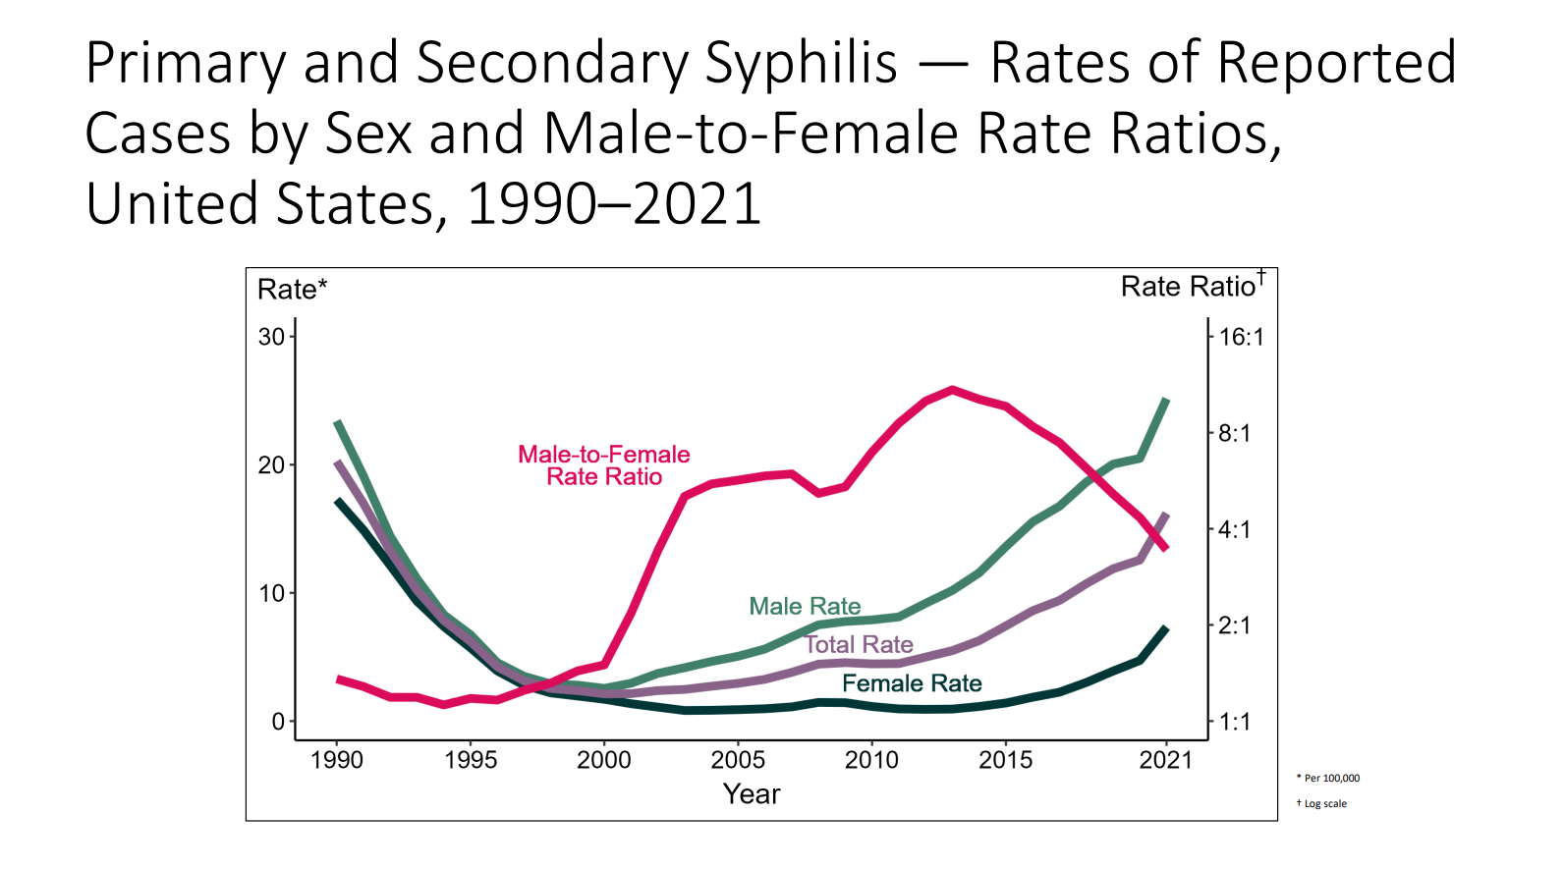
Notes:
Although the male-to-female rate ratio for primary and secondary syphilis increased from 1990 to 2013, the rate ratio is now declining due to the increasing rate of syphilis among women. During 2017 to 2021, the rate of primary and secondary syphilis among women more than doubled (2.3 per 100,000 in 2017 to 7.3 per 100,000 in 2021).

Slide 7
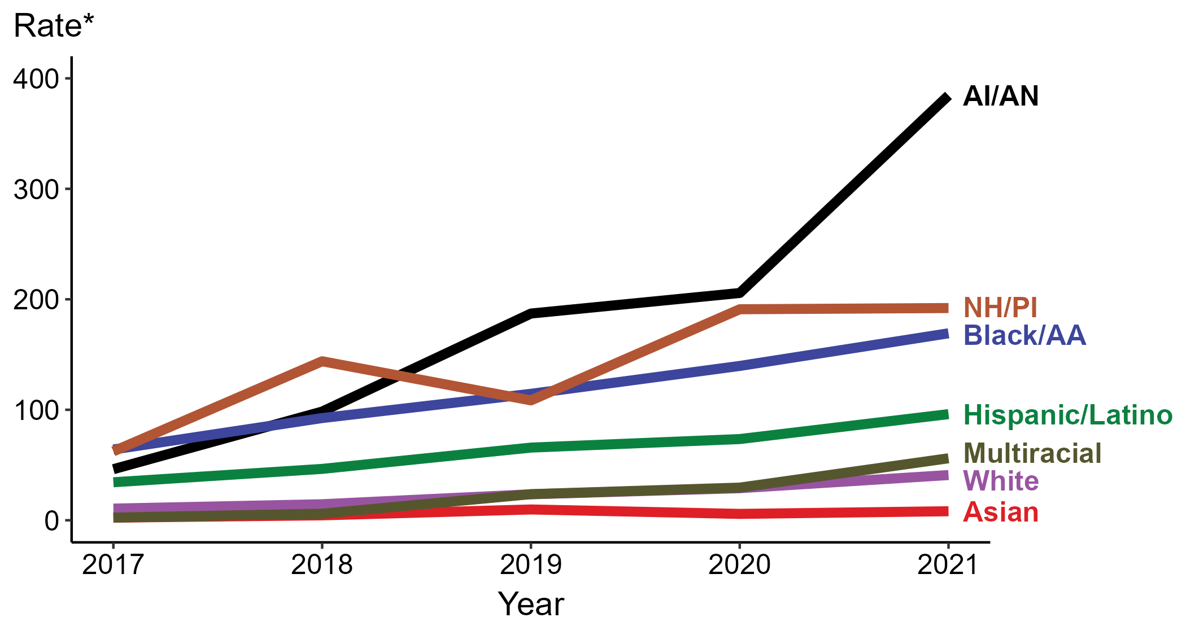
Congenital Syphilis-Rates of Reported Cases by Year of Birth, Race/Hispanic ethnicity of Mother, United States, 2017-2021
Notes:
In 2021, the highest rate of reported cases of congenital syphilis per 100,000 live births was among mothers who were American Indian or Alaska Native (384.5), followed by mothers who were Native Hawaiian or other Pacific Islander (192.1). Mothers who were non-Hispanic and of multiple races also had the greatest five-year increase in rate of congenital syphilis (2.4 to 56.1; 2,237.5% increase from 2017).
Where are these cases of syphilis and CS occurring?

Slide 8
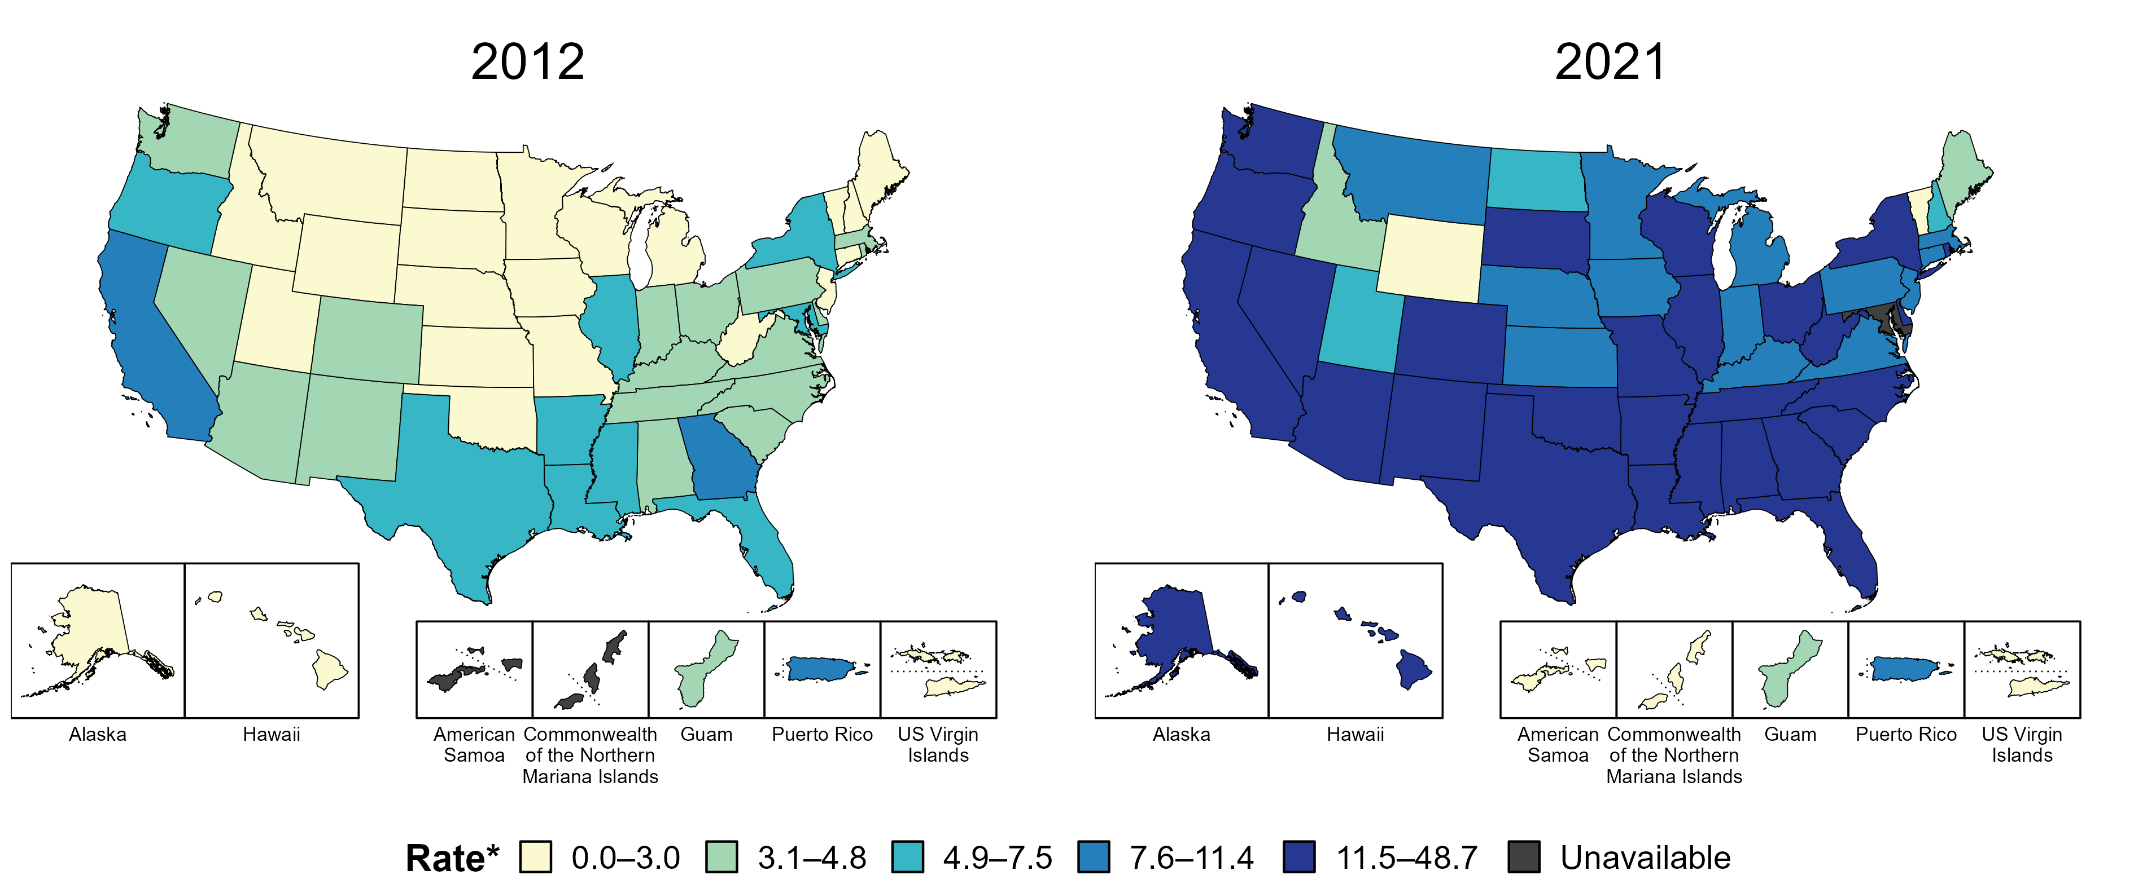
Primary and Secondary Syphilis — Rates of Reported Cases by State, United States and Territories, 2012 and 2021
* Per 100,000
Notes:
In 2012, two states, the District of Columbia (DC), and one US territory (7.4% of areas with available data) had a rate of reported primary and secondary syphilis greater than or equal to 7.6 cases per 100,000 population. This increased to 42 states, DC, and one US territory (80.0% of areas with available data) in 2021.
American Samoa and the Commonwealth of the Northern Mariana Islands began reporting data on primary and secondary syphilis cases to CDC in 2018; data are not available for those areas prior to that year. Due to a network security incident in December 2021, the Maryland Department of Health could not finalize their 2021 STD case notification data. 2021 data from Maryland have been suppressed for this figure; however, they are included in national and regional case counts and rates displayed in other figures.
The COVID-19 pandemic has introduced uncertainty and difficulty in interpreting STD data collected during 2020 and 2021. See Impact of COVID-19 on STDs (https://www.cdc.gov/std/statistics/2021/impact.htm) for more information.
See Technical Notes (https://www.cdc.gov/std/statistics/2021/technical-notes.htm) for information on syphilis case reporting and on interpreting reported rates in US territories.
Data points are available at https://www.cdc.gov/std/statistics/2021/data.zip.

Slide 9
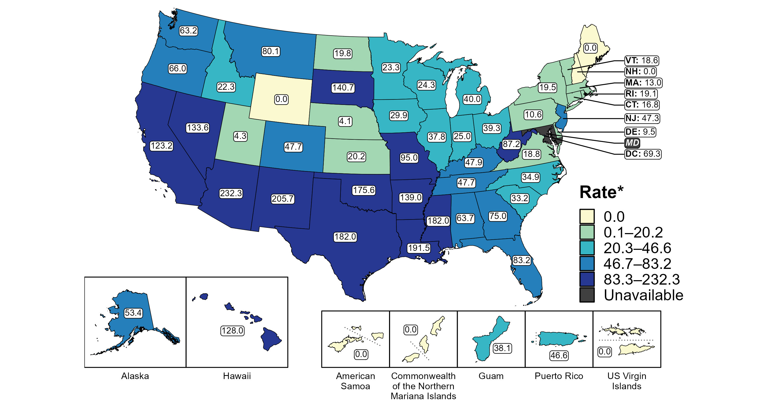
Congenital Syphilis — Rates of Reported Cases by State, United States and Territories, 2021
* Per 100,000 live births
Notes:
In 2021, there were a total of 2,855 cases of congenital syphilis reported among states and the District of Columbia (DC) for a rate of 77.9 per 100,000 live births. Rates of reported congenital syphilis among states reporting any cases ranged from 4.1 cases per 100,000 live births in Nebraska to 232.3 cases per 100,000 live births in Arizona. No cases of congenital syphilis were reported in Maine, New Hampshire, or Wyoming. The rate of reported congenital syphilis in DC was 69.3 per 100,000 live births. Due to a network security incident in December 2021, the Maryland Department of Health could not finalize their 2021 STD case notification data. 2021 data from Maryland have been suppressed for this figure; however, they are included in national and regional case counts and rates displayed in other figures.
Including data from US territories, there were a total of 2,865 cases of congenital syphilis reported for a rate of 77.7 per 100,000 live births in 2021. Among US territories reporting any cases, rates of reported congenital syphilis ranged from 38.1 cases per 100,000 live births in Guam to 46.6 cases per 100,000 live births in Puerto Rico. No cases of congenital syphilis were reported in American Samoa, the Commonwealth of the Northern Mariana Islands, or the US Virgin Islands.
The COVID-19 pandemic has introduced uncertainty and difficulty in interpreting STD data collected during 2020 and 2021. See Impact of COVID-19 on STDs (https://www.cdc.gov/std/statistics/2021/impact.htm) for more information.
See Technical Notes (https://www.cdc.gov/std/statistics/2021/technical-notes.htm) for information on syphilis case reporting and on interpreting reported rates in US territories.
Data points are available at https://www.cdc.gov/std/statistics/2021/data.zip.

Slide 10
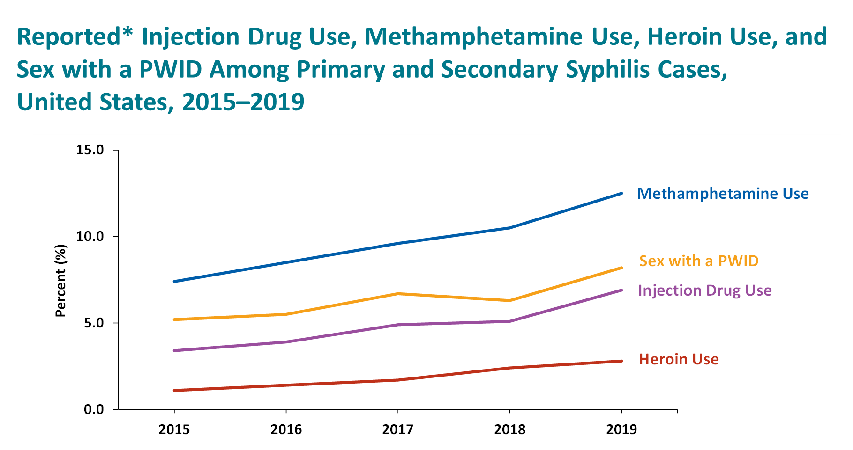
Notes:
In addition to shifts in the gender distribution of syphilis, we’re also witnessing increased association between syphilis and drug use. We suspect these numbers are underestimates, notably though in 2019:
>10% of persons diagnosed with primary and secondary syphilis reported methamphetamine use, and this risk factor is even more significant among women with primary or secondary syphilis, where more than 1in5 women diagnosed with primary/secondary syphilis reported meth use.
Additional figure information:
During 2015–2019, the proportion of primary and secondary syphilis cases that reported methamphetamine use increased from 7.4% to 12.5%, the proportion that reported sex with a person who injects drugs (PWID) increased from 5.2% to 8.2%, the proportion that reported injection drug use increased from 3.4% to 6.9% and the proportion that reported heroin use increased from 1.1% to 2.8%.
Data points for the figures presented in these slides as well as Technical Notes about data sources, data collection and reporting practices, and case definitions are available at https://www.cdc.gov/std/statistics/2019/syphilis/default.htm.

Slide 11
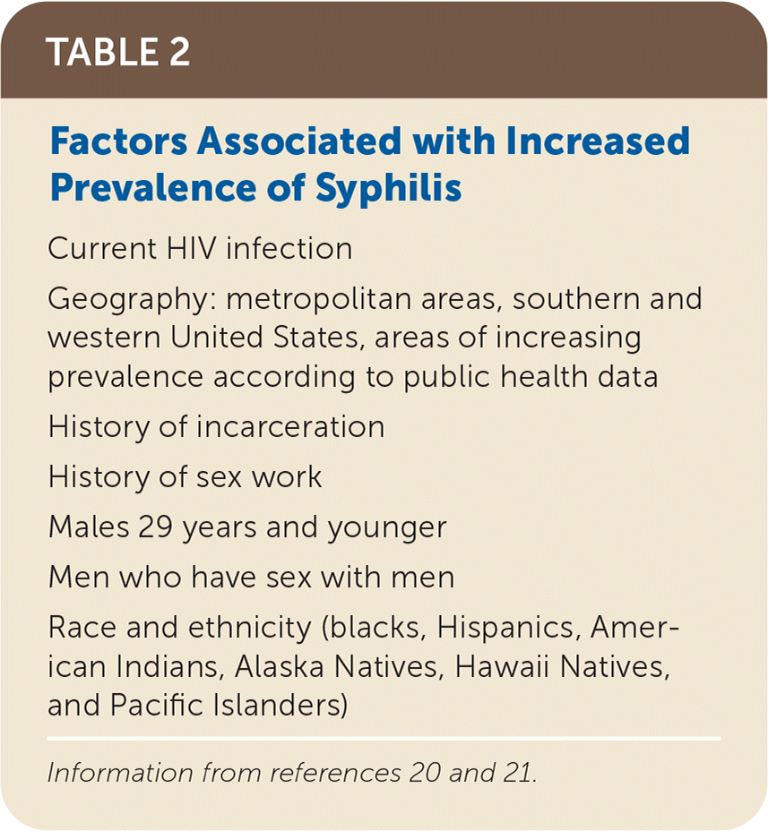

Slide 12

Notes:
In order to stop these trends, as with any serious PH issue, it is important to have a multidisciplinary team approach: public health nurses, epidemiologists, trained clinicians and nursing staff, laboratory staff, pharmacists, educators, community health representatives. As the picture depicts, it is an uphill journey. Fortunately, indigenous communities are resilient and are already doing what it takes to address this PH crisis.

Slide 13
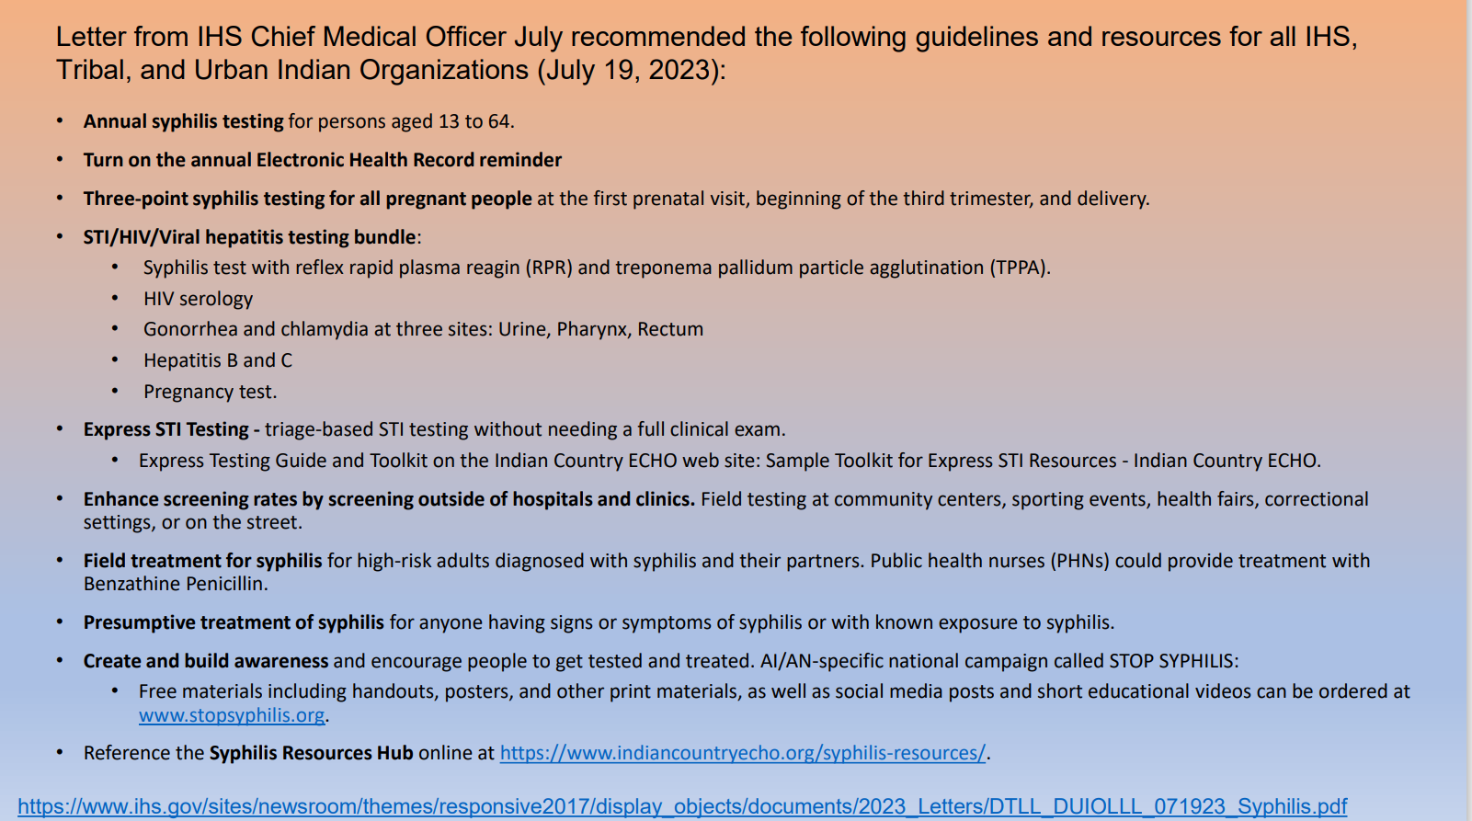
Notes:
This is a letter that came out from the IHS CMO in July of this year, outlining the important steps that IHS, tribal, and urban Indian Health organizations should take to address syphilis and CS.
In brief, annual syphilis testing for persons 13-64, reminders in the electronic health record, screening pregnant people at their initial prenatal visit, at the 28th week (when also being screened for GDM, and at delivery for high risk populations, Bundle STD testing, Express STI testing (without needing to see a provider and needing a full clinical exam), screening outside of clinics, such as at pow wows, health fairs, basketball tournaments. Field screening and treatment for syphilis for high risk adults. Often this means going into homes, homeless shelters, jails or prisons. Presumptive tx for someone with known exposure or having s and sx of syphilis, increased awareness of community members and health staff.

Slide 14
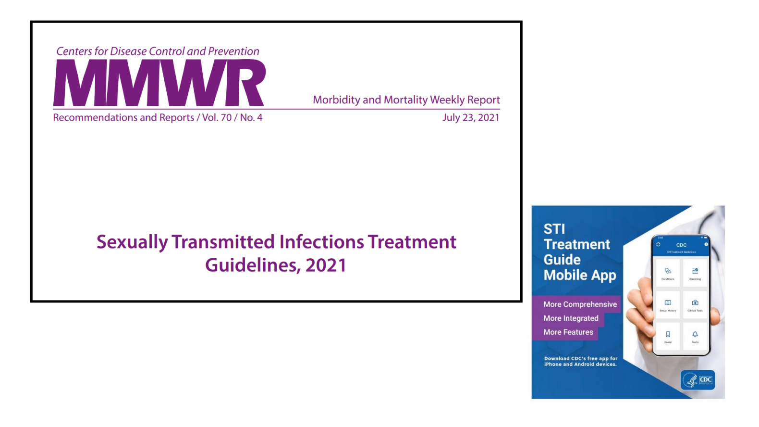
Notes:
As a clinician myself, I appreciate easy access to the most current clinical guidelines. The CDC updated their STI tx guidelines in 2021 as I’m sure you’re aware. They also have a mobile app that is automatically updated as the updates occur. If you have not already, strongly encourage this app.

Slide 15
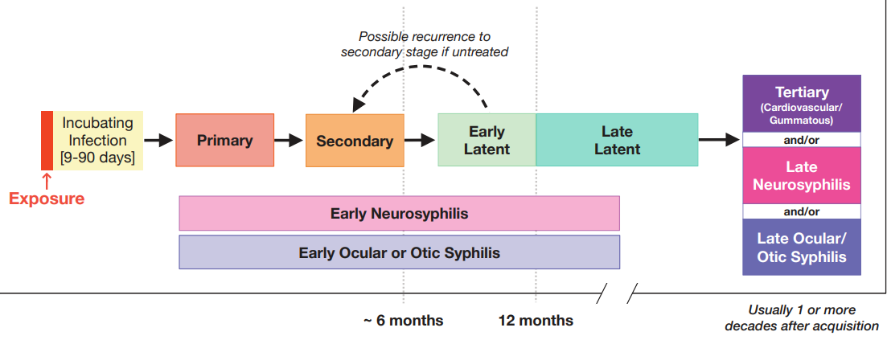
The Natural History of Untreated Syphilis
The Diagnosis, Management and Prevention of Syphilis (nycptc.org)
Notes:
Ok, let’s delve into syphilis. Syphilis is transmitted by all forms of sex; it enters the body thru a micro breakage in the skin. Site of inoculation can be in the genitals, mouth, or anus. Treponema pallidum proliferates at the infection site and within days, enters the lymphatic system and blood stream, all the while multiplying and spreading throughout the entire body and the organs. This is why invasion of the central nervous system can happen at any stage of the disease. It is a common misconception that neurosyphilis occurs during secondary syphilis; but really otic, ocular, and neurosyphilis can occur at any time. About 2-6 wks after exposure, a chancre can appear, usually on the genitals. Average time between syphilis acquisition
and start of symptoms is 21 days (can range from 10-90 days). A chancre can happen anywhere on the body, even in areas not easily seen by the patient and can be easily missed. The chancre will resolve spontaneously. If it goes unnoticed and untreated, then secondary syphilis ensues about 6 months after the infection or 1-2 months after primary infections. Presents as a rash on chest, palms, soles, and genitals. Also HA, fatigue, patchy alopecia, myalgias. This is when most people present b/c they have a rash and don’t feel well. If untreated, manifestations of secondary syphilis usually resolve within a few weeks, but in some cases may take months. After resolving, a relapse of secondary syphilis s or sx can occur, especially during the first year of infection. A person who acquired their infection within the previous 12 months is considered to be infectious, even if asymptomatic at the time of diagnosis. If not treated, the symptoms eventually resolve and then infection enters a latent phase, which can last decades. Although the patient does not have any s or sx, the treponema pallidum are multiplying. During the latent phase, testing is the only way to detect syphilis. If syphilis continues to go untreated, it goes onto tertiary syphilis, defined by destructive tumors of the skin and bones called gummas. Before antibiotics, 1/3 to ½ patients would progress to tertiary syphilis. The syphilitic gummas would destroy noses, leading to the saddle nose pe finding. It can also cause weakened vasculature, which can lead to aneurysms. Although neurosyphilis can occur at any stage, tertiary syphilis of CNS can lead to paralysis, blindness, deafness, and mental incapacitation.

Slide 16
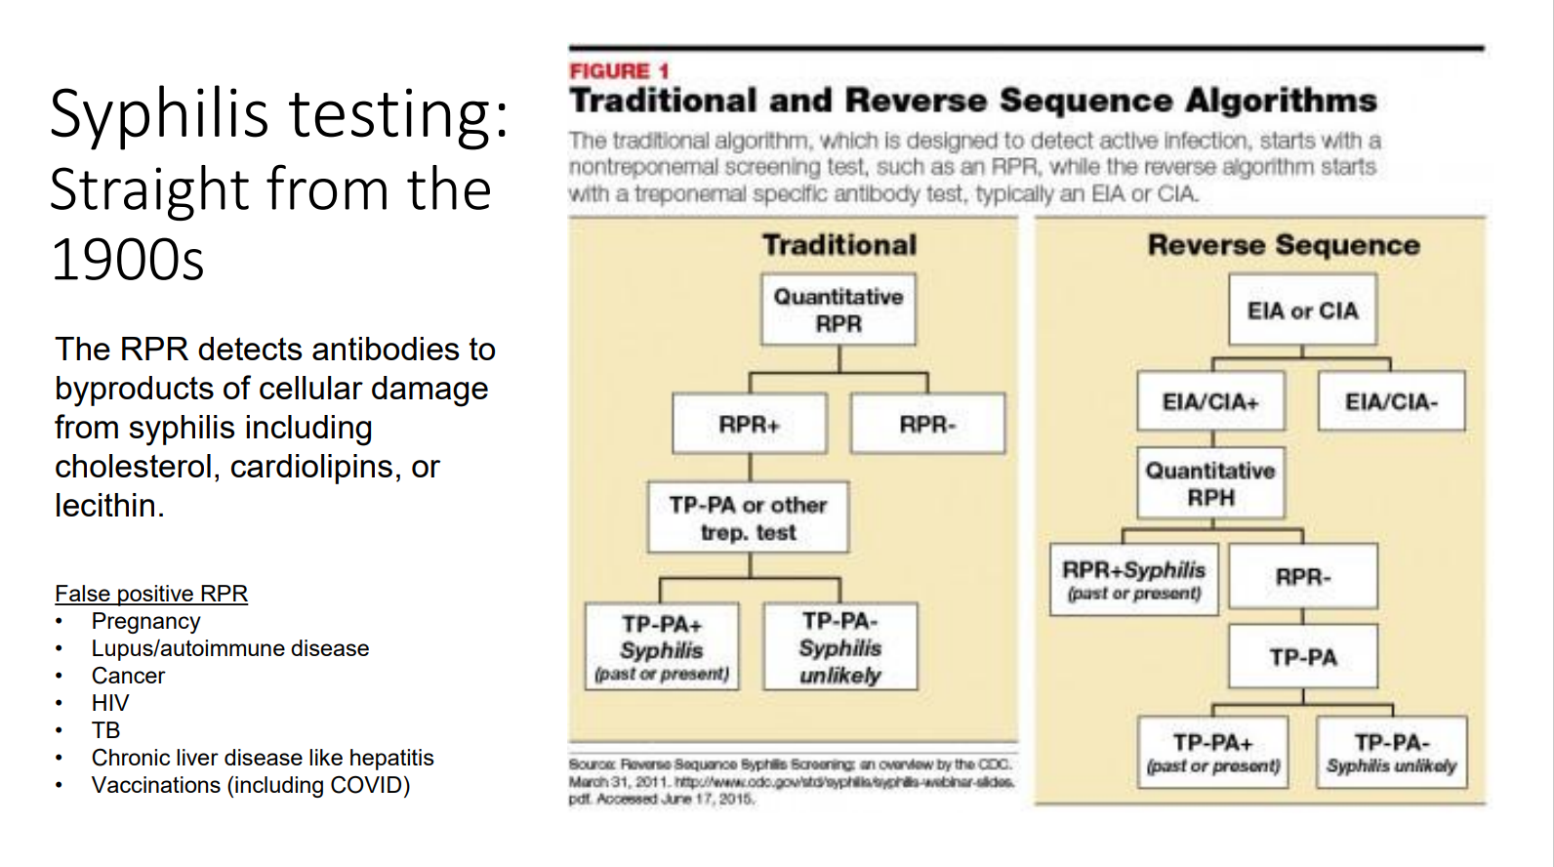
Notes:
Since most patients diagnosed with the infection lack any signs or symptoms consistent with primary or secondary syphilis, asymptomatic screening remains a crucial means of early case detection and prompt treatment.
On the right are the 2 testing algorithms. At our clinic, we use the traditional one by screening with an RPR. If positive, then a TPPA would be done. The RPR detects antibodies to byproducts of cellular damage from syphilis including cholesterol, cardiolipins, or lecithin.
RPR: Performed manually with visual interpretation; therefore, can be more labor and time intensive and subjective than treponeme-specific testing
EIA: Immunoassays can be automated, resulting in cost-savings for large volume laboratories and have more objective results

Slide 17
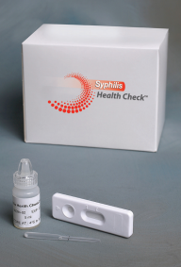
Rapid/Point of Care Testing
Health Check: rapid syphilis test (results in 10 minutes)
Treponemal antibody test
Diagnostics Direct VSC-11-01 - McKesson Medical-Surgical
Notes:
1 kit contains 20 rapid tests, CLIA waived. Finger poke. Stored at room temp. Cost is $312.00
The utility of these tests in the diagnosis of syphilis is limited to patients with no history of previously treated infection, since treponemal tests tend to remain positive even after treatment

Slide 18

Make Testing for Syphilis as Accessible as Possible
Standing orders (bundle STDs)
Express STI Testing (via triage, pharmacy, laboratory)
Home - IWTK (iwantthekit.org)
In-home specimen collection then mail out
Tests for GC, Chlamydia, trichomonas for women (14yo), HIV (17yo) for Baltimore residents
Available in certain states
FREE
Notes:
States include MD, OK, KS, AK, NM, UT, NV, SD, ND, NE, IA, ID, OR, AZ. Using testing locator to find a testing site near you if you don’t live in one of these states

Slide 19
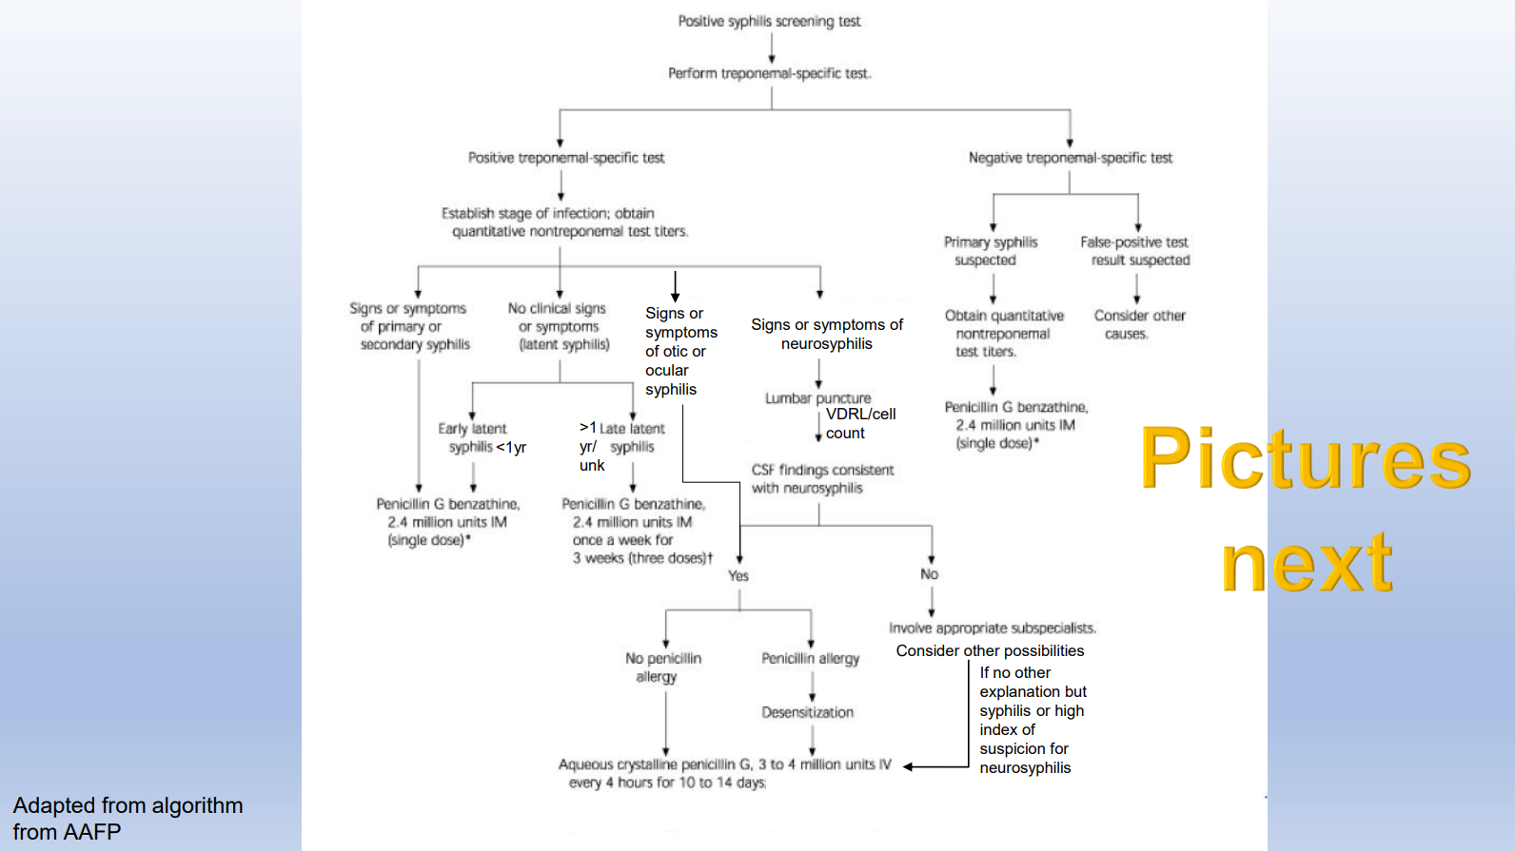
Notes:
This algorithm outlines the steps after a screening test is done. Highlights the importance of staging syphilis as it guides the treatment.

Slide 20
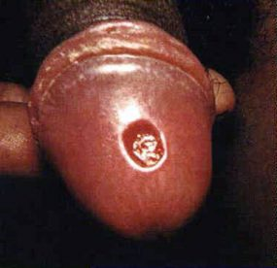
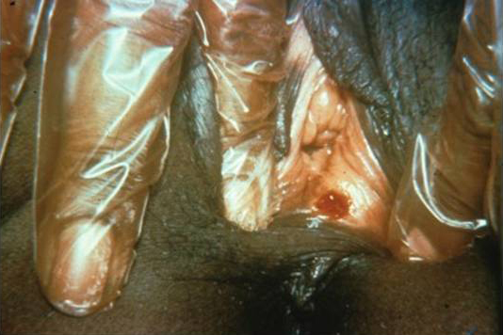
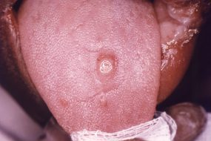
Primary syphilis
A single chancre marks the onset of primary syphilis (can be multiple)
Usually firm, round, and painless Located where syphilis enters the body
Can appear in locations that are difficult to notice (anus, vagina)
Lasts 3 to 6 weeks and heals regardless of whether a person receives treatment
If untreated, will progress to the secondary stage
New in 2021: Atypical presentations are more common, like painful chancres and superinfected
Notes:
A chancre is the hallmark of primary syphilis. They can be multiple. This is a visual or clinical diagnosis and not a laboratory diagnosis, just like herpes and genital warts.

Slide 21
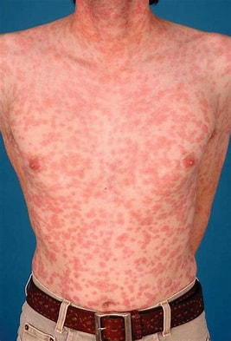
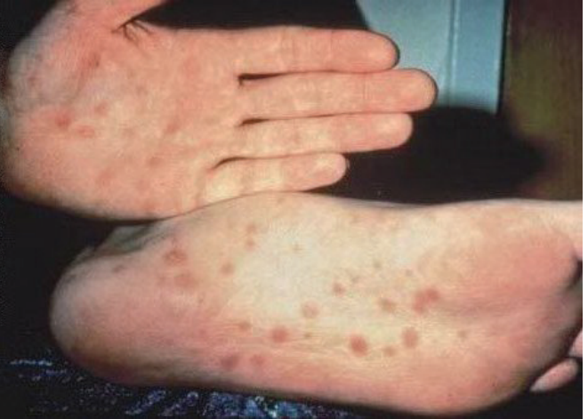
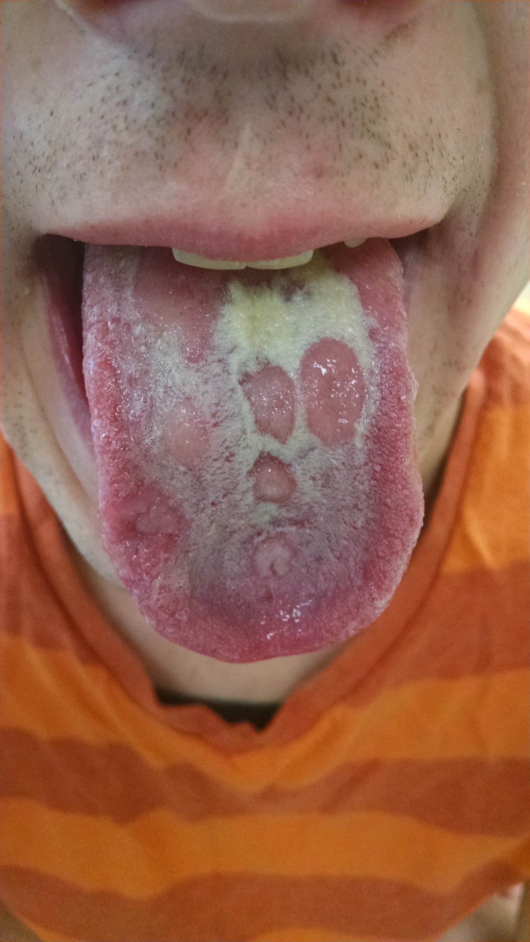
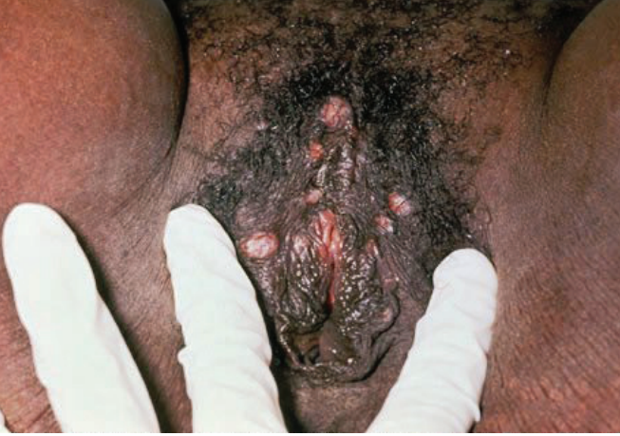
Secondary syphilis
Skin rashes and/or mucous membrane lesions (sores in the mouth, vagina or anus=condyloma lata) mark the second stage of symptoms
Usually does not itch, may appear as rough, red, brown spots
May be accompanied by fever, sore throat, lympadenopathy, myalgias, and patchy hair loss
Resolves regardless of whether a person receives treatment
If untreated, will progress to the latent and possible tertiary stage
Notes:
At this stage, there is 100% sensitivity for RPR/EIA.

Slide 22
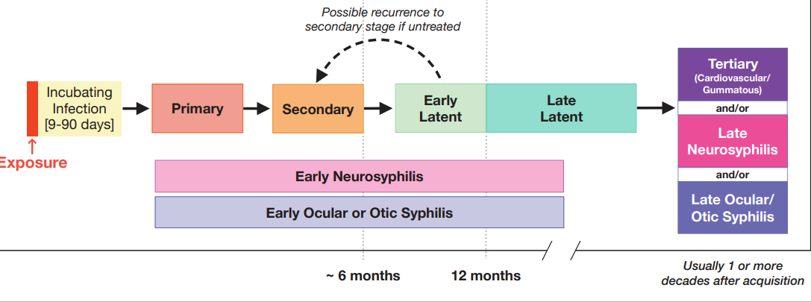
Latent syphilis
Latent (hidden) stage of syphilis is when there are no visible signs or symptoms of syphilis
Early latent syphilis is latent syphilis where infection occurs within the past 12 months
Late latent syphilis is latent syphilis where infection occurs more than 12 months ago
Latent syphilis of unknown duration is when there is not enough evidence to confirm initial infection was within the previous 12 months
Notes:
Important to collaborate with PH departments to determine if and when other syphilis tests have been done.

Slide 23
Neurologic manifestations of syphilis CAN OCCUR AT ANY STAGE
Neurosyphilis
Severe headache
Ocular syphilis
Eye pain or redness
Floaters
Otosyphilis
Tinnitus
Myalgias
Paralysis
Numbness
Altered mental status
Photophobia
Can lead to permanent blindness
Balance difficulties
Vertigo
Can lead to permanent deafness
Notes:
As mentioned previously, neurologic manifestations can occur AT ANY STAGE. Early neurosyphilis occurs as a result of acute inflammation of the meninges and associated vasculature and includes acute syphilitic meningitis (often with subtle headache and cranial nerve abnormalities) and meningo-vascular syphilis, which can cause stroke and altered mental status. This is why it is VERY IMPORTANT to do a thorough neuro exam on patients with a reactive RPR and treponemal serology and clinical signs of early syphilis.
Conduct eye exam for patients with syphilis and ocular complaints. • Evaluate and manage patients with syphilis and otologic symptoms in collaboration with an otolaryngologist.
Central nervous system, ocular and otic infection are not sexually transmissible

Slide 24
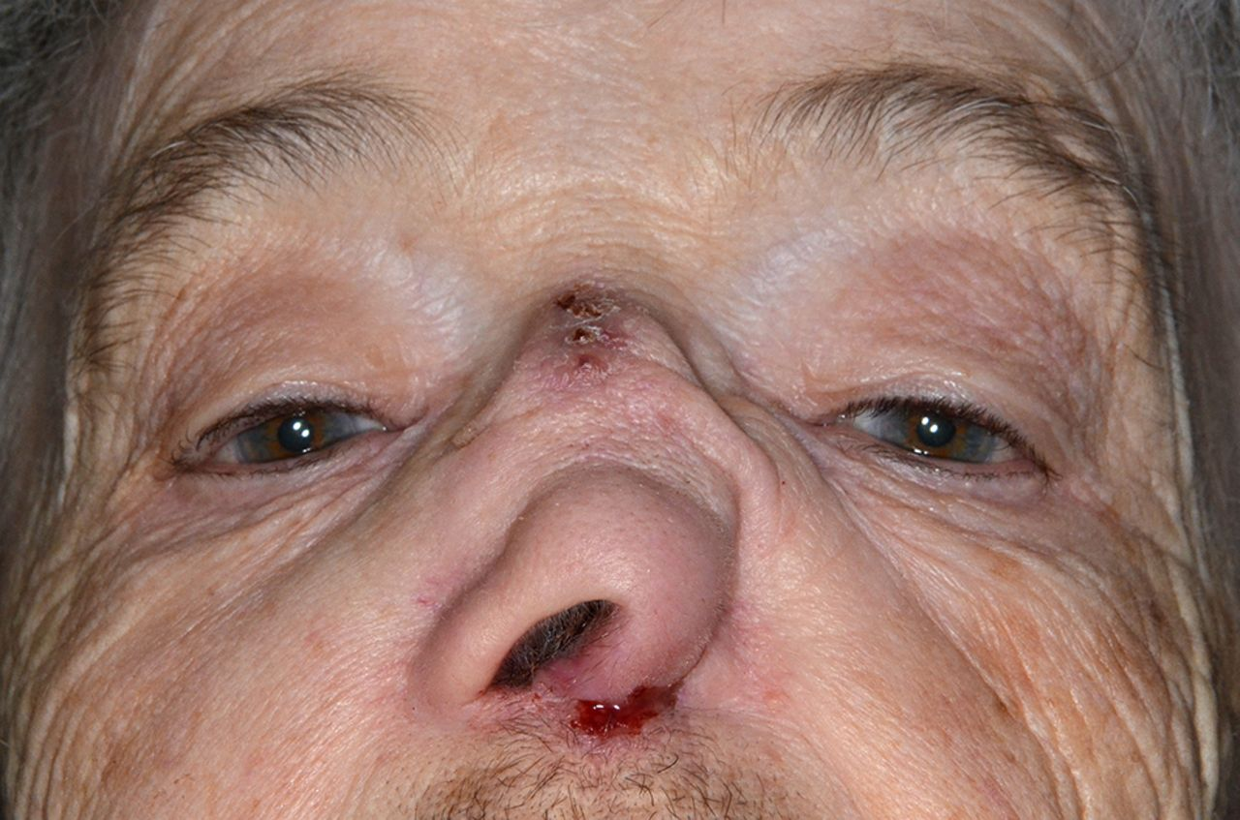
Tertiary syphilis
Rare, develops in a subset of untreated syphilis infections
Appears 10-30 years after infection, can be fatal
Can affect multiple organ systems including: brain, nerves, heart, blood vessels, eyes, liver, bones, joints
Notes:
Late neurosyphilis usually presents one or more decades after the initial infection and is considered to be part of tertiary syphilis. This form of neurosyphilis is a result of chronic inflammation and includes general paresis and tabes dorsalis, which can present with a wide variety of neurologic symptoms. Tabes dorsalis is the degeneration of the dorsal columns of the spinal cord and leads to disturbances in position sense.
Tertiary syphilis usually presents as: • Cardiovascular disease – including aortic aneurysm, aortic valve insufficiency, coronary stenosis, or myocarditis • Late neurologic complications – including general paresis, tabes dorsalis, and gummatous disease of the brain or spina
Not considered infectious.

Slide 25
Treatment of Syphilis
Primary & Secondary &
EARLY Latent
Benzathine penicillin G 2.4 million units IM SINGLE DOSE
Doxycycline 100mg 100mg PO BID x 14 days
Late Latent or Unknown Duration
Benzathine penicillin G 2.4 million units Q week x 3 weeks
Doxycycline 100mg PO BID x 28 days
Neuro-, ocular, or otosyphilis
Aqueous crystalline penicillin G IV for 10-14 days
Procaine PCN G 2.4million units IM QD PLUS probenecid 500mg QID x 10-14 days
Notes:
The mainstay of treatment is PCN. Syphilis is curable!! Important to stage it correctly then treat appropriately. Use your CDC STI app.

Slide 26
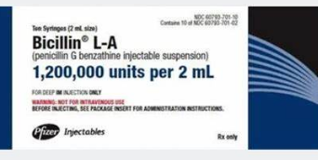
Treatment of Syphilis
IM Benzathine penicillin G (Bicillin L-A) is ALWAYS first line treatment
Doxycycline for true penicillin allergies
Or for nonpregnant persons in setting of Bicillin shortage
MDCalc has PCN allergy decision rule (PEN-FAST), identifies low risk penicillin allergies
IV penicillin for neuro-, ocular, and otosyphilis
Bicillin Shortage
stdshortage@cdc.gov
Contact CDC directly if unable to find a solution with Pfizer
Medical providers can call Pfizer to request Bicillin for pregnant persons at 1-844-646-4398
Notes:
As with other STIs, Patients should be advised to avoid all sexual contact (including oral sex) until after the completion of treatment and the resolution of all symptoms.
In addition, every effort should be made to reach their sex partners and presumptively treat them, esp if exposure occurred in the last 90 days.
They should also be advised to avoid contact with any ongoing sexual partners until those partners seek medical evaluation for possible infection and receive post-exposure prophylaxis (S
Meta analyses have shown that doxycycline is as effective as PCN if it must be used

Slide 27
IHS National Pharmacy and Therapeutics Committee 9/29/2023
Priorities outlined
Pregnant persons, HIV infected persons (and contacts), infants with congenital syphilis should receive Bicillin priority
Other persons with early syphilis (and their partners if there is enough supply)
If supply is inadequate to cover #2, then treat early syphilis with doxy x 14 days and latent syphilis/unknown duration with doxy x 28 days
Ceftriaxone may be an acceptable 2nd line for primary and secondary-consult ID
https://www.ihs.gov/sites/nptc/themes/responsive2017/display_objects/documents/guidance/NPTC%2DMed%2DUpdate%2DLimited%2DSupply%2Dof%2DBenzathine%2DPenicillin%2DG%2DSyphilis%2DUPDATED.pdf
Notes:
Due to the shortage of Bicillin in some areas, the IHS has issued a priority statement and protocol. At the top of the list are pregnant persons…

Slide 28
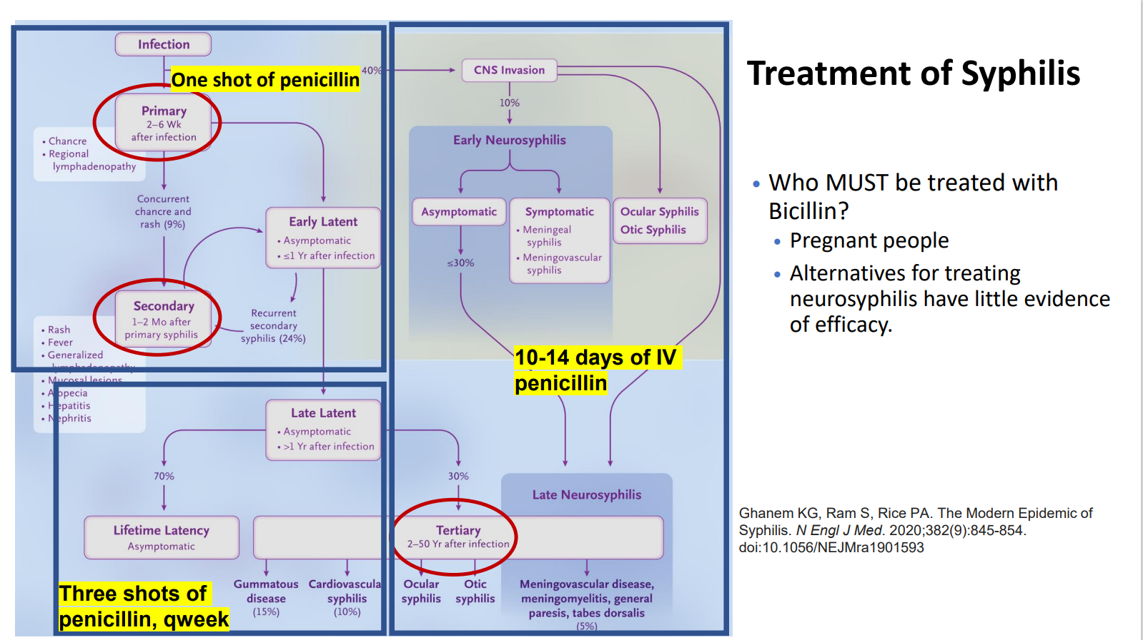

Slide 29
Primary and Secondary Syphilis Treatment Follow up
RPR (quantitative) obtained at the time of treatment should be used to establish a baseline titer against which serologic response to treatment can be monitored
Clinical and serologic evaluation should be performed at 6 and 12 months
Failure of RPR titers to decrease fourfold within 12 months after treatment might indicate treatment failure
These persons should receive neurologic exams, clinical and serologic f/u annually. Treat again if f/u cannot be ensured with benzathine penicillin G 2.4mu Q wk x 3wks
Persons who have symptoms* that persist/recur and those with at least a fourfold increase in RPR titer were likely reinfected or experienced treatment failure
Notes:
*persons who have neurologic findings, a CSF analysis is recommended.
For retreatment, use the weekly regimen x 3 wks UNLESS neurosyphilis is present

Slide 30

Congenital syphilis

Slide 31
Prevention of Congenital Syphilis
Screen ALL women in early pregnancy
Screen again twice in third trimester “for communities and populations in which the prevalence of syphilis is high, and for women at high risk of infection”
Screen at 28 weeks
Screen at delivery
STI Treatment Guidelines (cdc.gov)

Slide 32
Syphilis in Pregnancy
Management is the same as non-pregnant people
No alternatives to IM Bicillin– if penicillin allergic, must desensitize
For P and S, early latent, some give an additional IM dose 1 week after treatment
Goal is 7 days between doses of IM bicillin but if a dose is missed, effort focused on getting the dose within 2 days
Ultrasound is used to monitor in second half of pregnancy but should not delay treatment
For patients with early syphilis or high titers, Jarisch-Herxheimer reaction counseling is advised
Recheck RPR 8 weeks after treatment
Notes:
Jarisch-Herxheimer reaction is an acute febrile reaction frequently accompanied by headache, myalgia, and fever that can occur within the first 24 hours after the initiation of any syphilis therapy; it is a reaction to treatment and not an allergic reaction to penicillin. Patients should be informed about this possible adverse reaction and how to manage it if it occurs. The Jarisch-Herxheimer reaction occurs most frequently among persons who have early syphilis, presumably because bacterial loads are higher during these stages. Antipyretics can be used to manage symptoms; however, they have not been proven to prevent this reaction. The Jarisch-Herxheimer reaction might induce early labor or cause fetal distress in pregnant women; however, this should not prevent or delay therapy

Slide 33
Diagnosis of Congenital Syphilis
An RPR titer that is four or more times higher than the maternal titer is suggestive of congenital syphilis
Congenital syphilis is associated with a high rate of stillbirth
Women with intrauterine fetal demise after 20 weeks' gestation should be tested for syphilis
Notes:
Because maternal nontreponemal and treponemal immunoglobulin G antibodies pass through the placenta to the fetus, a positive serum test result in a newborn may reflect passive maternal antibodies.

Slide 34
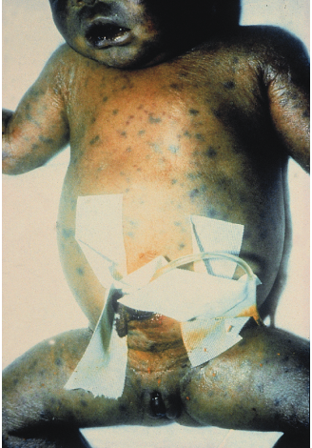
Treatment of Congenital Syphilis
Penicillin-based regimen that differs based on probability of infection (determined by serology and CSF testing)
4 Scenarios
Confirmed Proven or Highly Probable Congenital Syphilis
Possible Congenital Syphilis
Congenital Syphilis Less Likely
Congenital Syphilis Unlikely
Notes:
The following scenarios describe the recommended congenital syphilis evaluation and treatment of neonates born to women who had reactive nontreponemal and treponemal serologic tests for syphilis during pregnancy (e.g., RPR reactive, TP-PA reactive or EIA reactive, RPR reactive) and have a reactive nontreponemal test at delivery (e.g., RPR reactive). Maternal history of infection with T. pallidum and treatment for syphilis should be considered when evaluating and treating the neonate for congenital syphilis in most scenarios, except when congenital syphilis is proven or highly probable.
Any neonate who has a normal physical examination and a serum quantitative nontreponemal serologic titer equal or less than fourfold of the maternal titer at delivery (e.g., maternal titer = 1:8, neonatal titer ≤1:16) and both of the following are true:
The mother was treated during pregnancy, treatment was appropriate for the infection stage, and the treatment regimen was initiated ≥30 days before delivery.
The mother has no evidence of reinfection or relapse.
Recommended Evaluation
No evaluation is recommended. Benzathine penicillin G 50,000 units/kg body weight/dose IM in a single dose*
* Another approach involves not treating the newborn if follow-up is certain but providing close serologic follow-up every 2–3 months for 6 months for infants whose mothers’ nontreponemal Any neonate who has a normal physical examination and a serum quantitative nontreponemal serologic titer equal to or less than fourfold of the maternal titer at delivery§ and both of the following are true:
The mother’s treatment was adequate before pregnancy.
The mother’s nontreponemal serologic titer remained low and stable (i.e., serofast) before and during pregnancy and at delivery (e.g., VDRL ≤1:2 or RPR ≤1:4).
Recommended Evaluation
No evaluation is recommended
titers decreased at least fourfold after therapy for early syphilis or remained stable for low-titer, latent syphilis (e.g., VDRL <1:2 or RPR <1:4) No treatment is required. However, any neonate with reactive nontreponemal tests should be followed serologically to ensure the nontreponemal test returns to negative (see Follow-Up). Benzathine penicillin G 50,000 units/kg body weight as a single IM injection might be considered, particularly if follow-up is uncertain and the neonate has a reactive nontreponemal test.

Slide 35
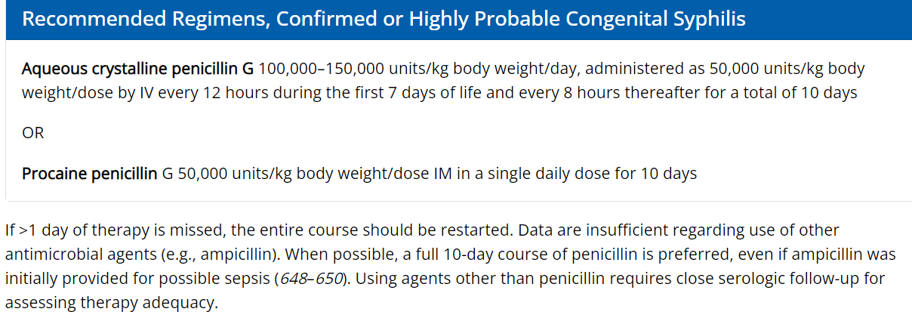
Treatment of Proven or Highly Probable CS

Slide 36
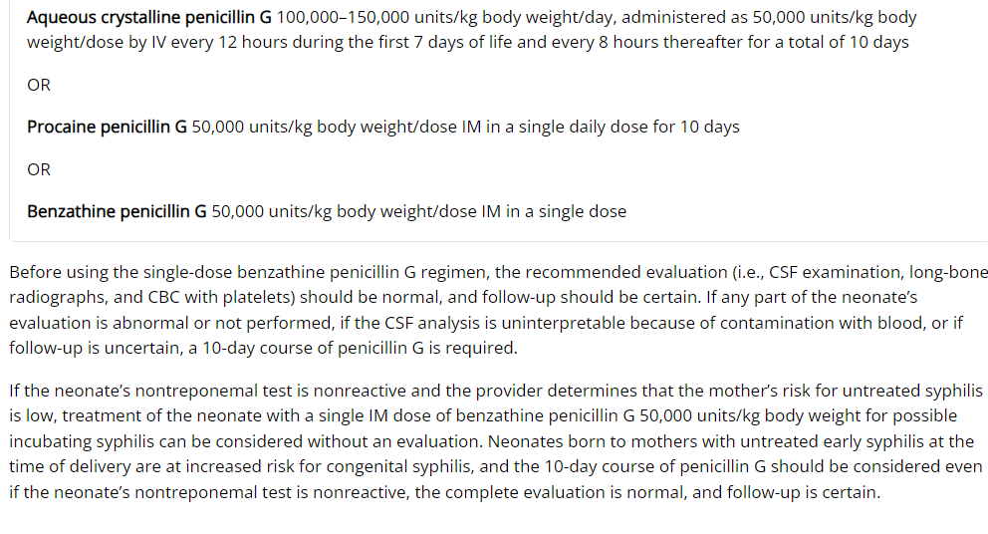
Treatment of Possible Congenital Syphilis
Notes:
Congenital Syphilis - STI Treatment Guidelines (cdc.gov)
All neonates with reactive nontreponemal tests should receive thorough follow-up examinations and serologic testing (i.e., RPR or VDRL) every 2–3 months until the test becomes nonreactive.
Neonates with a negative nontreponemal test at birth and whose mothers were seroreactive at delivery should be retested at age 3 months to rule out serologically negative incubating congenital syphilis at the time of birth. Treponemal tests should not be used to evaluate treatment response because the results are qualitative, and passive transfer of maternal IgG treponemal antibody might persist for >15 months.

Slide 37
Syndemic Approach to Syphilis and Congenital Syphilis
Bundle STI testing
Embrace team management: clinician, community health, public health, and pharmacy
Assess for social vulnerabilities
Field testing and treating are our STANDARD OF CARE
Learn from programs that are doing the same work
Collaborate
Involve community!
Always address prevention and stigma
Notes:
A syndemic is a synergistic epidemic.
The difference between "comorbid" and "syndemic" …syndemic research focuses on communities experiencing co-occurring epidemics that additively increase negative health consequences
Syndemic – Wikipedia

Slide 38
Clinical Pearls
Keep syphilis on your differential
Staging is critical to choose correct treatment
Use penicillin whenever possible
Offer HIV PrEP to EVERY PATIENT with syphilis

Slide 39
Case
Mom has adequate prenatal care with RPR NR at 8wks gestation
She presents with vaginal lesions at 35 weeks gestation
HSV testing is negative
No other STI testing
Treated with valacyclovir
Presents in labor at 37 weeks
No RPR at delivery
Baby has work up at 5 months for slow weight gain and developmental delay
Hip x-rays indicate periosteal abnormalities and CS is diagnosed
Notes:
What was missed? Syphilis was not on differential; RPR testing was not done three times

Slide 40
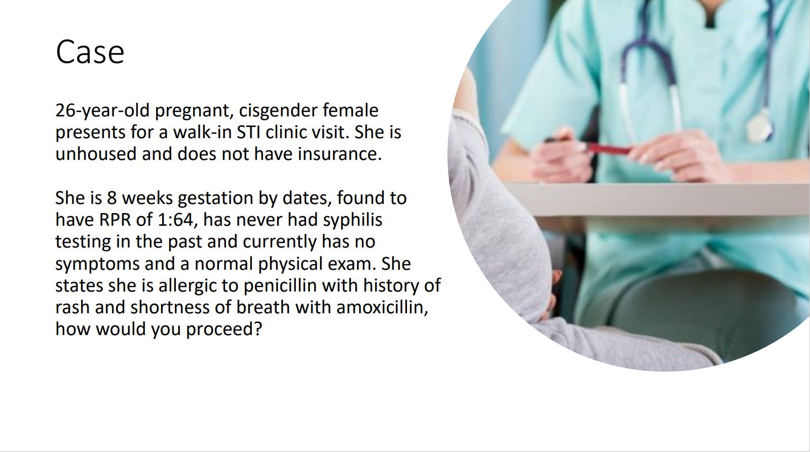
Notes:
Allergy sx are legitimate.
Desensitize and treat with PCN!

Slide 41
Case
25yo cisgender woman who presents for STI workup with no complaints
She reports 2 cisgender male sexual partners in the last 3 months, condoms used occasionally
Her exam is normal. Her RPR is reactive at 1:256, with reactive TP-PA, nonreactive HIV, negative G/C NAAT
You call the health department, no previous RPRs on file
What stage of syphilis does she have?
What would you give for treatment?

Slide 42
Case continued
With her return to clinic, she is not pregnant but with a complete review of neurological symptoms, she states that she has been having some vision changes which she describes as floaters and double vision at times. She also notes that she has had a headache more frequently with the last month. The rest of her neuro ROS is benign.
Now what should her treatment be?
Notes:
Admit for LP and IV PCN x 2 wks.
What if she had no HA? Then what is tx? Admit for IV PCN for 2 wks without LP

Slide 43
Resources
www.stdccn.org
No cost, online clinical consultation on the prevention, diagnosis, and treatment of STDs by your regional Prevention Training Center (PTC) Clinical Faculty
www.stopsyphilis.org
Handouts, posters, other print materials as well as social media posts and short educational videos
www.indiancountryecho.org/syphilis-resources/

Slide 44
Acknowledments
Philana Liang, Physician Assistant with the Washington University Infectious Disease Clinic and Core Program Manager at the St. Louis STI/HIV Prevention Training Center
Andrew Yu, MS, BSN with the National HIV/HCV/STI clinical coordinator

Slide 45
Pinagigi
Thank you!
Amy.delong@ho-chunk.com
Policy for express STI testing available if interest

