Slide 1
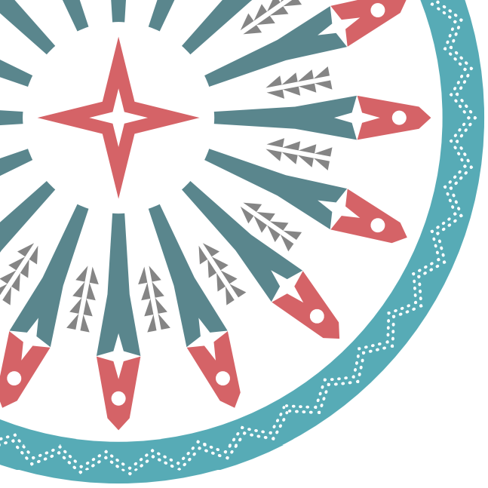

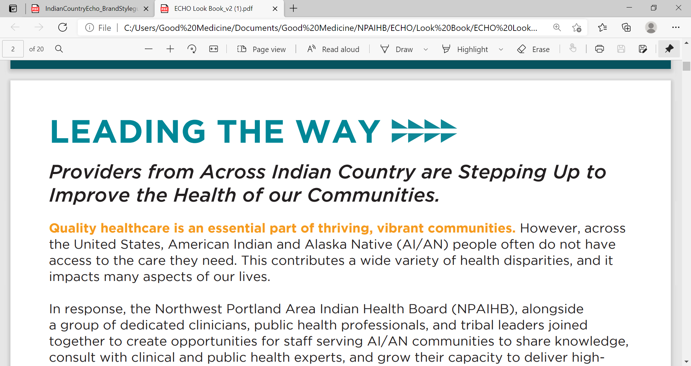
SCREENING BEST PRACTICES
Brigg Reilley, MPH
Northwest Portland Area Indian Health Board
Technical Advisor HIS National HIV/HCV/STI Program
Indian Country ECHO – Expanding Clinical Services

Slide 2

Clinical Case

Slide 3
Case Study
Tiffany
65 year old woman has bleeding in throat urgently transported to IHS emergency room
Transported by helicopter to more advanced hospital
Diagnosed with esophageal varices and late-stage liver disease due to chronic HCV infection

Slide 4
Case Study
Tiffany
She had no known exposures to HCV, lived in remote location, did not drink or smoke and led a very healthy life
Looking at her own history, she remembered she had experimented with drugs in her 20s for a short time with a boyfriend who used, including snorting and injecting

Slide 5
Case Study
Tiffany
Patient was successfully treated for HCV and cured
Got well enough to travel to see grandchildren

Slide 6

Epidemiologic Overview
of Hepatitis C

Slide 7
Disparity
American Indian/Alaska Native HCV-related mortality rate is highest of all races, over 3x US average
Mortality curves starting to decline with impact of Direct Acting Antivirals

Slide 8
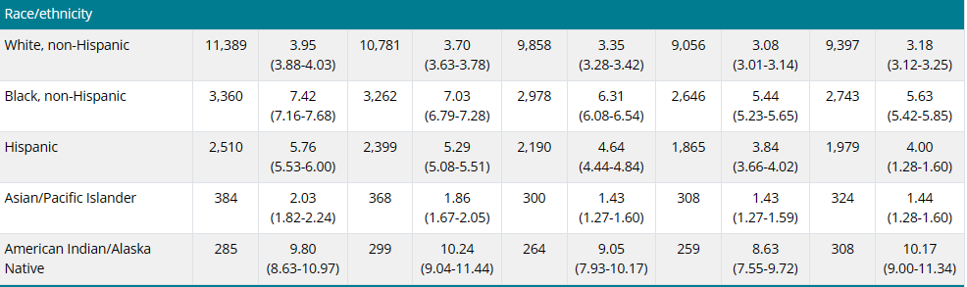
Numbers and Rates* of deaths with hepatitis C virus infection listed as a cause of death among residents, by demographic characteristics – United States, 2016-2020
2016-2020 Numbers & Rates of Deaths with Hepatitis C Listed as Cause by Demographics | CDC

Slide 9
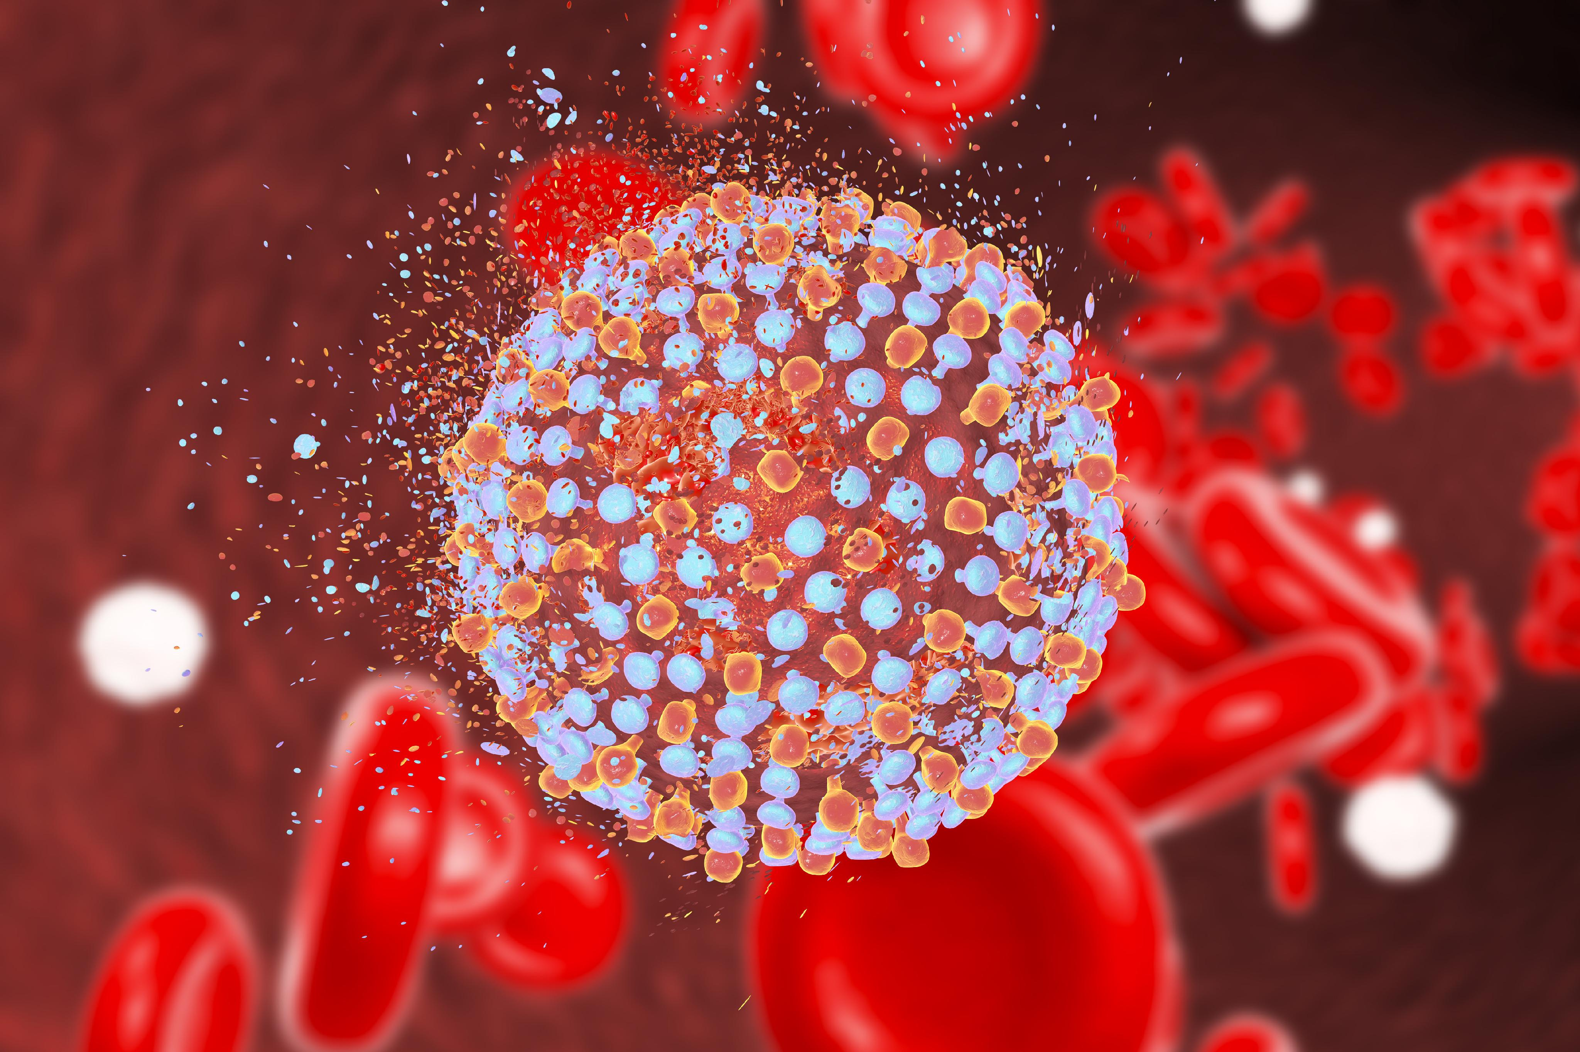
Chronic HCV in Michigan
Consistently about 3x in AI/AN than NHWs
Likely racial misclassification leads to underreporting

Slide 10
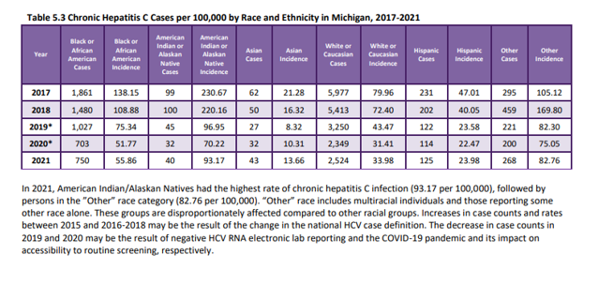
Chronic Hepatitis C Cases per 100,000 by Race and Ethnicity in Michigan, 2017-2021

Slide 11
Hepatitis C Screening

Slide 12
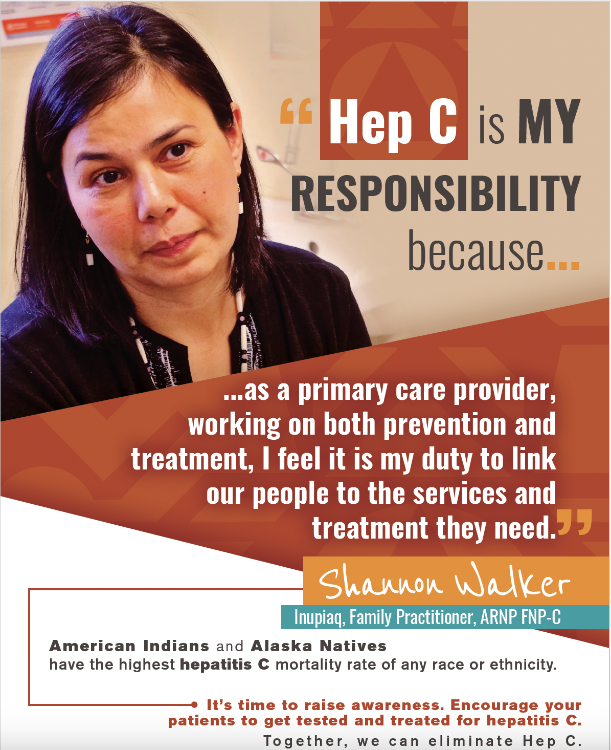
Screening: When is it Recommended?
Must have test that is reliable, inexpensive, noninvasive
Condition often asymptomatic/no clinical manifestations
Early detection can have a significant impact on patient outcomes

Slide 13
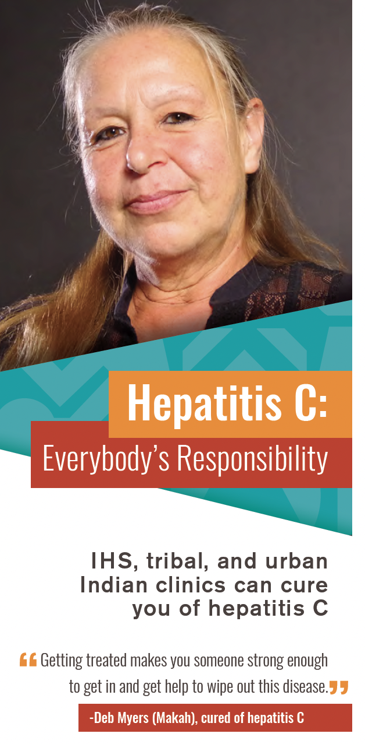
Evolution of HCV Screening
2012 Screening of Persons ages 1945-1965 at least once
2018 Screening all persons ages 18+ at least once
Changes: biomedical options improved, scale and mortality of HCV found to be greater than initial estimates

Slide 14
Evolution of HCV Screening
Facility level testing and treatment policy
Delegate test order away from provider via standing protocol
Use of clinical reminder
National Program has templates and informatics support (often peer to peer via facilities) for all of these interventions

Slide 15
IHS Published HIV Screening Best Practices
Methods:
Survey of clinical directors of 61 federal health facilities on use of ECRs, testing policies/standing orders, and other factors associated with HIV screening. These results were correlated with HIV screening performance results for each facility as derived from the IHS national database.
Results:
A total of 51 (84%) of 61 facilities were interviewed. In univariate analysis, factors that were correlated with higher rates of HIV screening were having an HIV screening standing order (unadjusted odds ratio [UOR] 8.7, 95% confidence interval [CI] 2.0-37.3), sexually transmitted disease (STD) screening standing order (UOR 5, CI 1.1-21.7), having an HIV ECR in place for a year or longer (UOR 10.2, CI 2.8-37.5), and inclusion of both providers and nurses in offering HIV screening (UOR 4.8, CI 1.4-16.7). In multivariate analysis, ECRs (adjusted odds ratio [AOR] 9.1, 95% CI 1.8-45.1) and STD standing orders (AOR 7.4, 95% CI 1.1-51.0) remained significantly associated with higher HIV screening.
https://journals.sagepub.com/doi/full/10.1177/2325957415570744

Slide 16
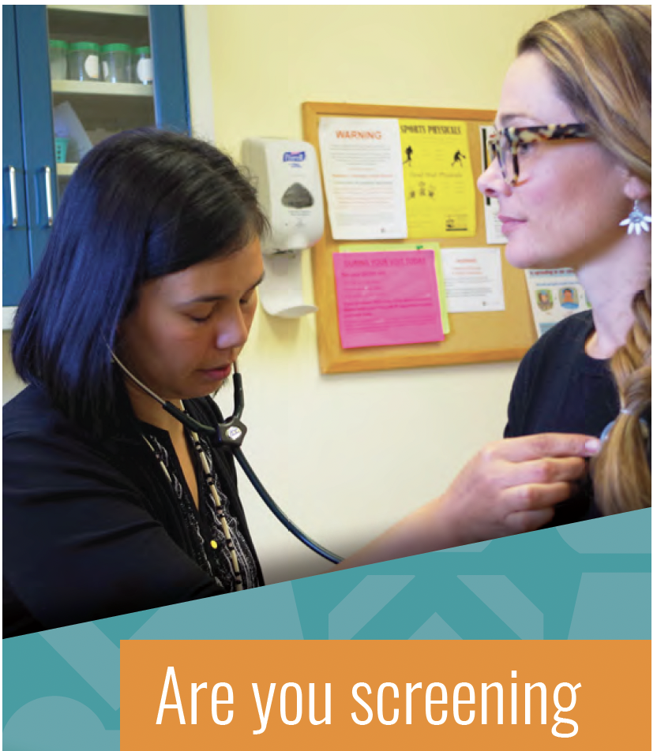
It’s All About the Ask
Two colleagues who used the same IHS facility as patients were asked in very different ways by nurses. One accepted, one declined
“National recommendations say that everyone between the ages of 13 and 64 should get an HIV test, so I’d like to add that to your visit today”
“Technically I should ask you for an HIV test but you probably don’t want one, do you?”

Slide 17
Universal HCV Screening Rates IHS
2018: 8%
IHS Nationwide
2022: 50.2%
IHS Nationwide

Slide 18
HCV Screening Coverage %, Birth Cohort, Federal Sites by Area, 2012-2021

Slide 19
HCV Screening Coverage %, Birth Cohort, Federal Sus, 2022

Slide 20
Exceptional: Highest Screening Rates
HIV 13-64: 79%
Warm Springs
HCV Birth Cohort: 97%
Ft Washakie
HCV 18+: 91%
Ft Washakie

Slide 21
HIV Screening

Slide 22


HIV Screening
Test is routine, reliable, inexpensive
Patients can be asymptomatic for many years, and may not disclose risk factors or histories that would lead to targeted testing
Early detection can have a major impact on patient outcomes and interrupt further transmission to the community
--Screening does not replace risk based/clinical testing--

Slide 23

HIV Screening recommendations expanded with improved medical options
1992 Blood Donors
1995 Prenatal Patients
2006 Adolescents and Adults

Slide 24

What We Want to Avoid
45 y.o. female patient recurring headaches and pain
Monogamous relationship last 15 years
Multiple PCP and ER visits, no resolution of symptoms
Multiple nights in hospital for observation
After several visits, considered non-compliant, med-seeking behavior
Months later, external referral to neurologist diagnosed advanced infection secondary to HIV infection

Slide 25
Results
IHS HIV Screening Coverage 13-64 year olds:
Increase from 30% in 2012 to 57% in 2020
IHS HCV Screening Coverage of persons born 1945-1965:
Increase from 8.0% in 2012 to 67% in 2020

Slide 26
Ongoing Challenges
Sites tend to ‘plateau’ screening coverage at 55%-65% once they’ve reached all active primary care patients, although some sites have reached 80%+
Testing/screening in urgent care and behavioral health settings. Often requires that a positive test be followed up by a PCP, and is not the ‘responsibility’ of UC or BH

Slide 27
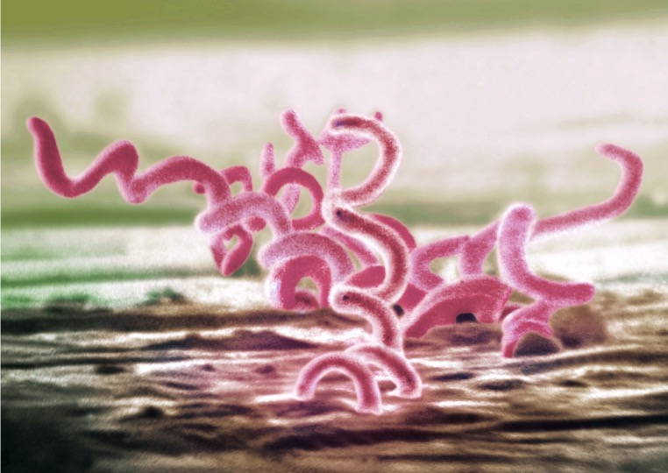
New Recommendation: Syphilis Screening
Annual Screening via email from CMO in October 2022
Clinical Reminder in early deployment
Express STI testing packet developed
Case Management and Contact Tracing Challenges

Slide 28

Screening → Treatment
Panel patients
Prioritize patients
Case management/coordination proportional to community need

Slide 29

Thank You
More resources and many community facing resources (StopSyphilis.org), Syphilis Resource Hub - Indian Country ECHO, HCV Resource Hub - Indian Country ECHO, HIV Resource Hub - Indian Country ECHO

