Slide 1
Necrotizing Fasciitis
Jonathan Vilasier Iralu, MD, MACP, FIDSA
Indian Health Service Chief Clinical Consultant
for Infectious Diseases

Slide 2
Epidemiology
Incidence ranges from 4 to 15.5 cases per 100,000 per year (Stevens, IDCNA, 2021)
American Indians are at higher risk for necrotizing fasciitis
  Ten-Fold Increase in PIMA county, AZ study (Hoge et al, JAMA 1993):
    Annual age-adjusted incidence was 4.3 per 100,000 for the population as a whole but was 46.0 per 100,000 among Native Americans
https://jamanetwork.com/journals/jama/article-abstract/4028417

Slide 3
Epidemiology of Necrotizing Fasciitis
Community-Acquired Invasive GAS Disease among Native Americans, Arizona, USA, Winter 2013; A Harris, D Yazzie, R Anton-Nez;,et al, Emerging Infectious Diseases; January 2015
  11 Cases of invasive Group A Strep Disease
    Mean Age of 63 years
    73% were female
    100% AI/AN
    All were community onset
    8 of the 11 had critically ill and 3 died
    9 had underlying conditions: obesity, diabetes, chronic kidney or heart disease, alcohol use disorder
    https://doi.org/10.3201%2Feid2101.141148

Slide 4
Etiology of necrotizing fasciitis
Type I necrotizing fasciitis
  Polymicrobial mixture of aerobes and anerobes
  Bacteroides, Prevotella, Fusobacterium necrophorum plus aerobic enteric gram negative rods, peptostreptoccus, etc
Type 2 necrotizing fasciitis
  Monomicrobial infection usually due to Gp A Strep
  Other organisms include Clostridia, Aeromonas, Vibrio vulnificus and MRSA

Slide 5
Type I Necrotizing fasciitis:
Clinical manifestations
Polymicrobial infection due to breach in mucosal or skin integrity
  Decubitus ulcers, hemorrhoids, rectal fissures, episiotomies, and GI/GU/GYN surgery
Gas is usually present in tissue, like clostridial gangrene
Commonly seen in diabetic foot infections
Ludwigs angina (submandibular space) and Lemierre’s syndrome (jugular vein septic phlebitis are caused by Fusobacterium necrophorum after dental surgery
Fournier’s Gangrene after GI/GU surgery: anterior abdominal wall extending to scrotum and penis in males

Slide 6
Type I Necrotizing fasciitis:
Clinical manifestations
Occurs in elders with underlying illness such as diabetes
Severe pain is typical often with minimal skin manifestations initially
Manifests as sepsis with tachycardia, leukocytosis, hyperglycemia and acidosis
Progresses rapidly to skin and fat necrosis down to the muscular fascial surface.

Slide 7
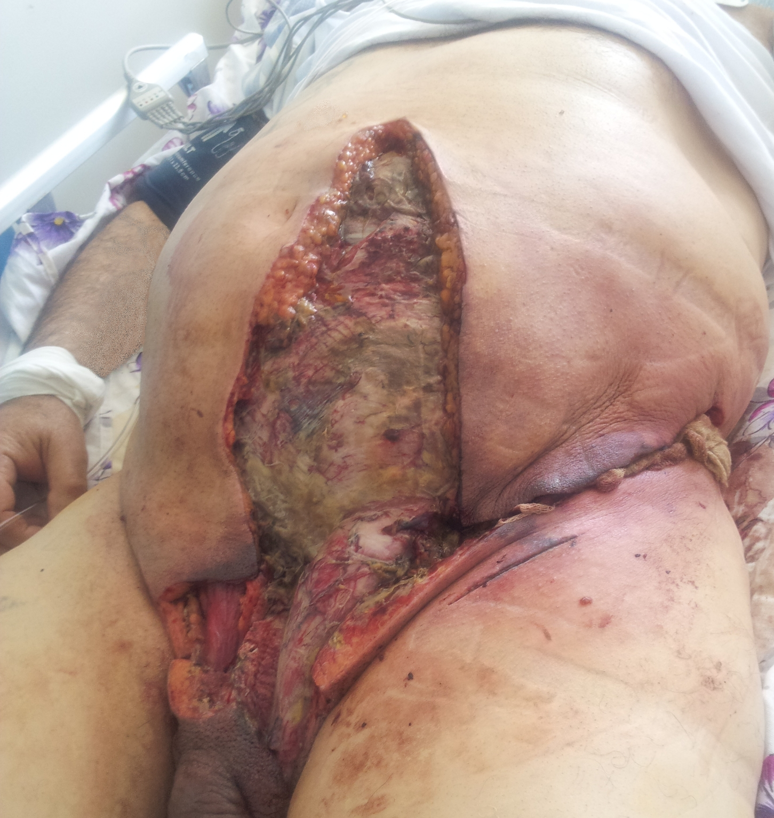
Fournier’s Gangrene
By Hayk Margaryan - Own work, CC BY-SA 3.0, https://commons.wikimedia.org/w/index.php?curid=26370622

Slide 8
Type II Necrotizing fasciitis:
Clinical manifestations
Caused most often by Group A Streptococcus
Other causes of monomicrobial necrotizing fasciitis
  MRSA
  Aeromonas hydrophila: fresh water exposure
  Vibrio vulnificus: salt water or seafood exposure with underlying liver disease

Slide 9
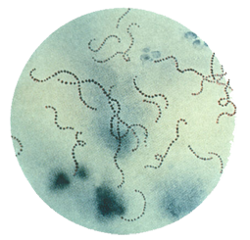
Gp A Streptococcus

Slide 10
Type II Necrotizing fasciitis:
Clinical manifestations
Occurs at any age without underlying medical conditions
Happens after superficial trauma often non-penetrating
Starts off with fever and crescendo pain followed mild erythema
  Malaise, myalgia, diarrhea and anorexia are common in the first 24 hours
  Often misdiagnosed as DVT or muscle strain
  NSAIDS prescribed at this point lead to accelerated infection
    Ketorolac and ibuprofen are the most common accelerants

Slide 11
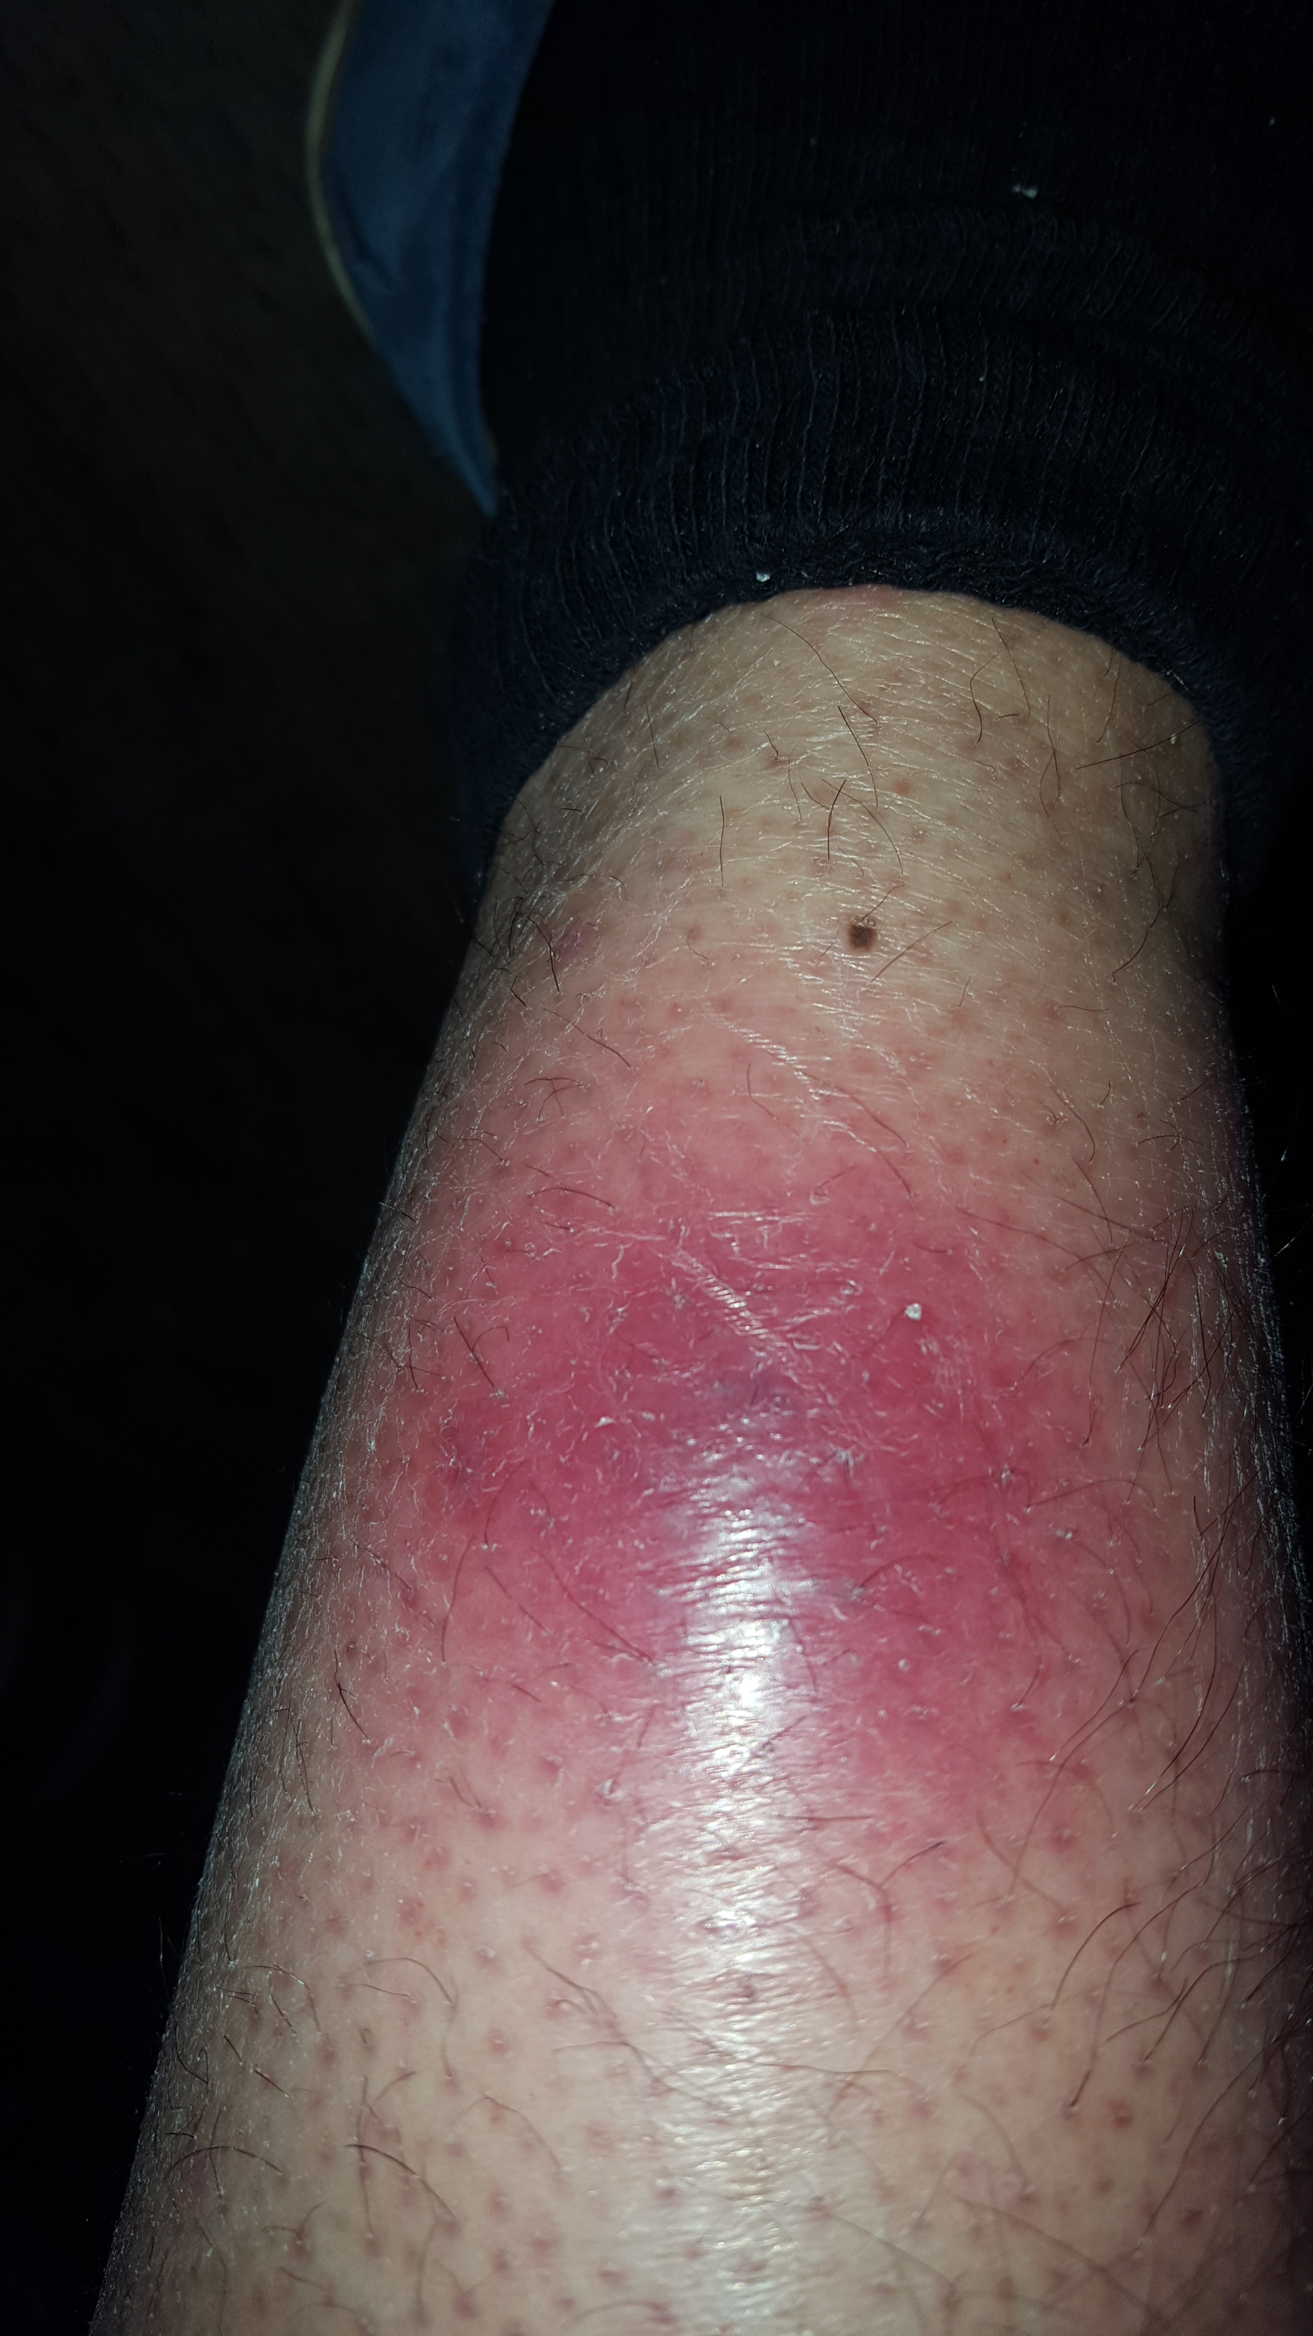
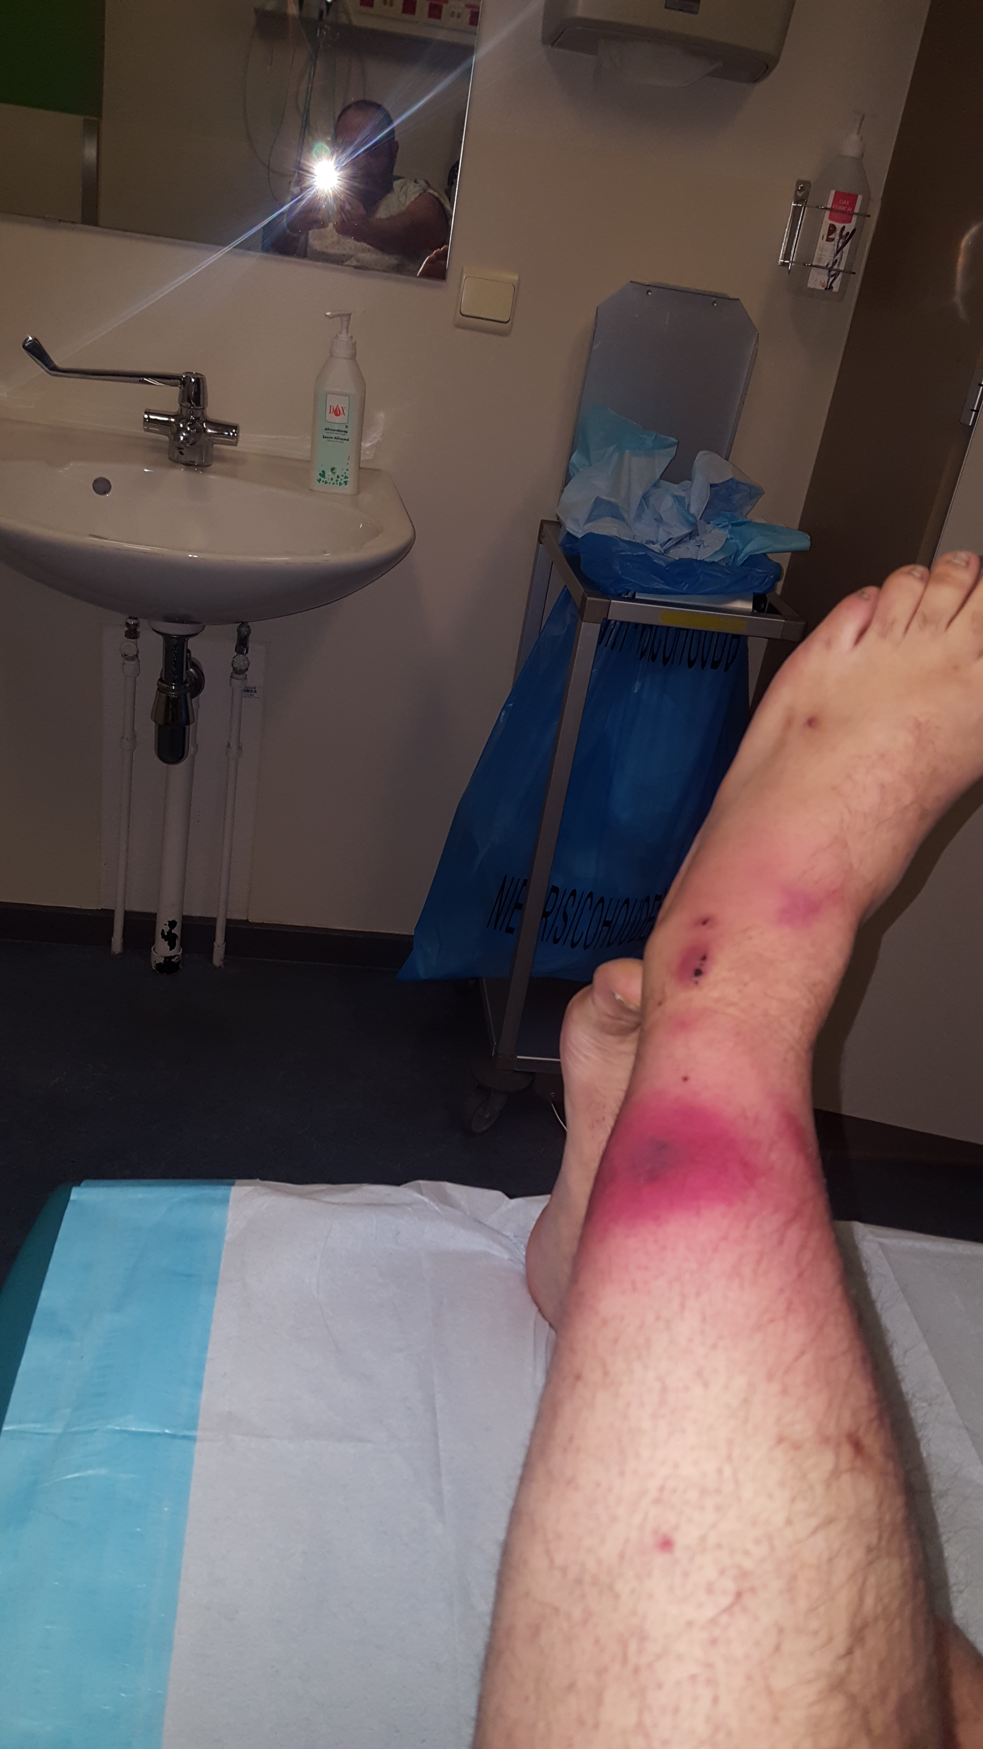
Early necrotizing fasciitis
By Morphx1982 - Own work, CC BY-SA 4.0, https://commons.wikimedia.org/w/index.php?curid=72207766

Slide 12
Type II Necrotizing fasciitis:
Clinical manifestations
At 24-72 hours, the skin first turns dusky then purple then bullae develop followed by frank gangrene and sloughing
Bacteremia is common with toxic shock syndrome
In the deep tissue, there is necrosis of the skin, fat and surface of the muscular fascia
  → There is no pus!

Slide 13
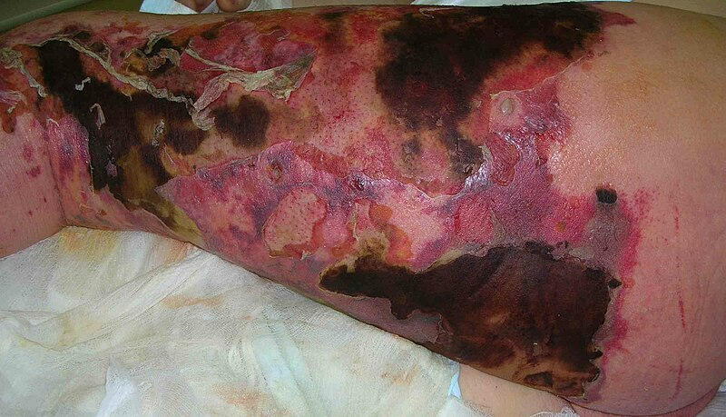
Severe Necrotizing fasciitis

Slide 14
Necrotizing Clostridial Infections
Gas Gangrene
Necrotizing infection of muscle with gas formation in tissue
Types
  Traumatic: Deep penetrating trauma with compromised blood supply creates an anerobic environment.
    Clostridium perfringens is the usual
    Amputation is usually required
  Spontaneous: comes from a gastrointestinal portal of entry (adenocarcinoma) or in neutropenic patients (chemo or cyclic)
    Clostridium septicum
  Clostridium sordelli: Fever is absent but hypotension and capillary leak are the rule with HCT 50-80% and WBC 50-150K.
    Post childbirth, abortion, GYN surgery
    Skin popping black tar heroin

Slide 15
Clinical Evaluation of necrotizing fasciitis
Classic findings:
  Soft tissue edema
  Erythema
  Severe pain: “Out of proportion to clinical findings”
  Tenderness
  Fever
  Bullae, blebs necrosis

Slide 16
Clinical Evaluation
Imaging
  Plain films and CT show
    Gas with type 1 mixed aerobe/anerobe NF and gas gangrene
    Swelling only in type II Gp A Strep infections
Biopsy:
  Type 1 NF: mixed GNR and GPC with necrosis gas in tissue
  Gp A Strep: tissue destruction, few neutrophils, many GPC in chains

Slide 17
LRINEC score
Laboratory Risk Indicator for NECrotizing fasciitis
  Labs
    WBC
    Hgb
    Sodium
    Glucose
    Creatinine
    CRP
  Score 5.8 or higher is positive
    57-92% PVPT and 86-96% PVNT
    Not useful for children
    Don’t use this test to rule out necrotizing fasciitis
    https://www.mdcalc.com/calc/1734/lrinec-score-necrotizing-soft-tissue-infection

Slide 18
Therapeutic Approach to Necrotizing Fasciitis:
Surgery
Urgent surgery is paramount
  Determine extent
  Decide between debridement and amputation
  Get a microbiological diagnosis
Surgery within 6 hours is optimal for survival

Slide 19
Therapeutic Approach to Necrotizing fasciitis:
Antibiotics
What to start empirically in the ED
  Vancomycin to achieve AUC/MIC ratio of 400-600
  PLUS
  Piperacillin-Tazobactam or Meropenem
    high-dose extended infusion is best → over 4 hours/dose or continuous
    PLUS
  Clindamycin at maximal dosing 900 mg IV q6-8h

Slide 20
Therapeutic Approach to Necrotizing fasciitis:
Antibiotics
How to modify once you have a Dx and they’re still in the ED
  Group A Streptococcus: high dose PCN and Clindamycin
  Clostridium species: high dose PCN and Clindamycin
  Aeromonas: Doxycycline plus Ciprofloxacin or Ceftriaxone
  Vibrio: Doxycycline plus Ceftriaxone or Cefotaxime
  MRSA: Vancomycin

Slide 21
Therapeutic Approach to Necrotizing Fasciitis:
Critical Care
Supportive Care:
  IV fluid resuscitation
  Monitor for hemolysis (Gp a Strep and Clostridia)
  Be vigilant for cardiomyopathy caused by streptococcal exotoxins and keep MAP not more than 65mm Hg

Slide 22
Adjunctive therapies for Necrotizing Fasciitis
  Hyperbaric oxygen for Clostridium:
  One review in 2003 of 57 studies showed no benefit in NF Wang et al, Arch Surg. 2003 Mar;138(3):272-9
    A US/Australian study showed reduced mortality Devaney et al, Anaesth Intensive Care. 2015 Nov;43(6):685-92.
    Still controversial
    Don’t let transfer delay surgery!
  IVIG for Gp A Strep:
    also controversial but many experts recommend it for streptococcal toxic shock syndrome
    One metanalysis showed mortality dropped from 33% to 15.7% with IVIG
    Parks et al Clin Infect Dis. 2018 Oct 15;67(9):1434-1436

Slide 23
Necrotizing Fasciitis Clinical Pearls
Severe pain out of proportion to appearance is the hallmark
Skin necrosis, bullae, ecchymoses are a late finding
Consider using the LRINEC but don’t hang your hat on it
Urgent operation is the key
Start Vancomycin/Pip-Tazo/Clindamyin ASAP in the ED

Slide 24
References
Stevens D, Bryant A; Necrotizing Soft-Tissue Infections; N Engl J Med 2017; 377:2253-2265
DOI: 10.1056/NEJMra1600673
Stevens D, Bryant A, Goldstein E. Necrotizing Soft Tissue Infections; Inf Dis Clin N America, https://www.id.theclinics.com/issue/S0891-5520(20)X0005-5

