Slide 1
An Organized Approach to Life Threatening Pulmonary Embolism
Sundeep Guliani, MD
UNM H.E.L.P. N.M Team Co-Director
Associate Professor Division of Vascular Surgery, Critical Care, and Acute Care Surgery
Co-Director of Cardiothoracic Intensive Care Unit
Director of ECMO Surgery

Slide 2
Outline
Epidemiology/pathophysiology of PE
Classifications and Risk Stratifications
PE toolkit
  ECMO
  Catheter-Directed Thrombolysis (CDT)
  Inari FlowTriever Thrombectomy Catheter
Evolution of PE Program at UNM
Cases

Slide 3
Epidemiology
PE accounts for approximately 100,000 deaths annually in the USA
Consistently ranks in the top 5 causes of sudden death
Estimated to cost our health system $10 billion annually
“Most preventable cause of death in hospitalized patients” (US Department of Health Surgeons General Report, 2008)

Slide 4
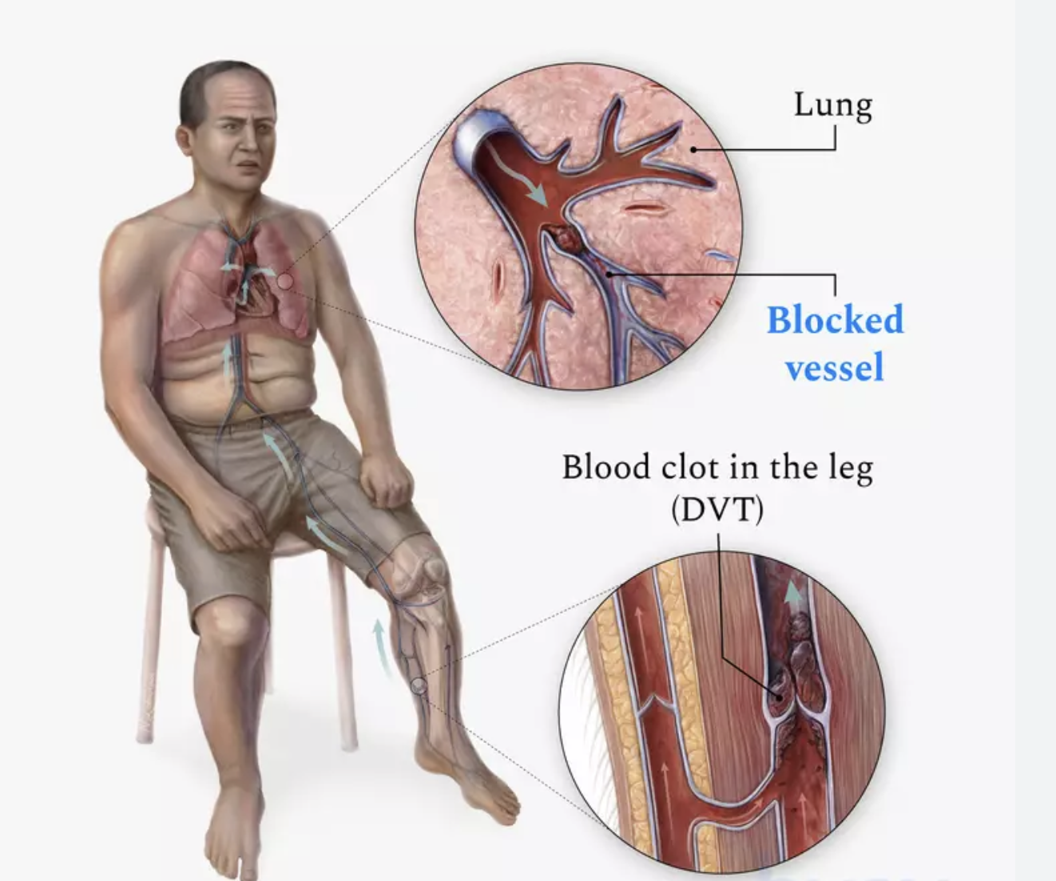
Pathophysiology of PE morbidity and death
Clots typically originate in the lower extremities
Large occlusive clot burden in pulmonary vasculature causing acute pulmonary hypertension and increase in RV afterload
This leads to acute right ventricular dilation/dysfunction/ischemia
Acute RV dysfunction then causes bulging of the interventricular septum, leading to left ventricular dysfunction
If untreated, progresses to cardiogenic shock and eventual death

Slide 5
Classification of PEs
Non-life threatening
  Minimally symptomatic
  Therapeutic anticoagulation
  No cardiac dysfunction
    Troponin and BNP
Life threatening
  Submassive: PE with evidence of right heart strain without hypotension
  Massive: PE with evidence of right heart dysfunction with hypotension
    Hypotension: Systolic BP < 90 for greater than 15 minutes or vasopressor requirement, vasopressor requirement, or systolic > 40 drop than baseline in a patient with known hypertension

Slide 6
Massive vs Submassive
Submassive and Massive delineations are NOT dependent upon magnitude of clot burden, but rather effect clot is having on the heart
Is a hemodynamic finding not an imaging finding

Slide 7
Massive PE
25-50% mortality
Patients commonly present in cardiac arrest or in extremis to an emergency room
Historically first line treatment was systemic TPA
Open Pulmonary embolectomy and catheter directed therapies have been advocated as adjuncts to systemic TPA in past decades

Slide 8
Submassive PE
5-8% in hospital mortality
Persistent RV dysfunction after a PE however associated with:
  Increase risk of 90-day mortality from PE
  Increased risk of recurrent PE
  Increased incidence of CTEPH
  Increase risk of hospital re-admission
Evolving body of literature that demonstrates severe long-term morbidities associated with submassive PE including detrimental effects on exercise tolerance and quality of life metrics

Slide 9
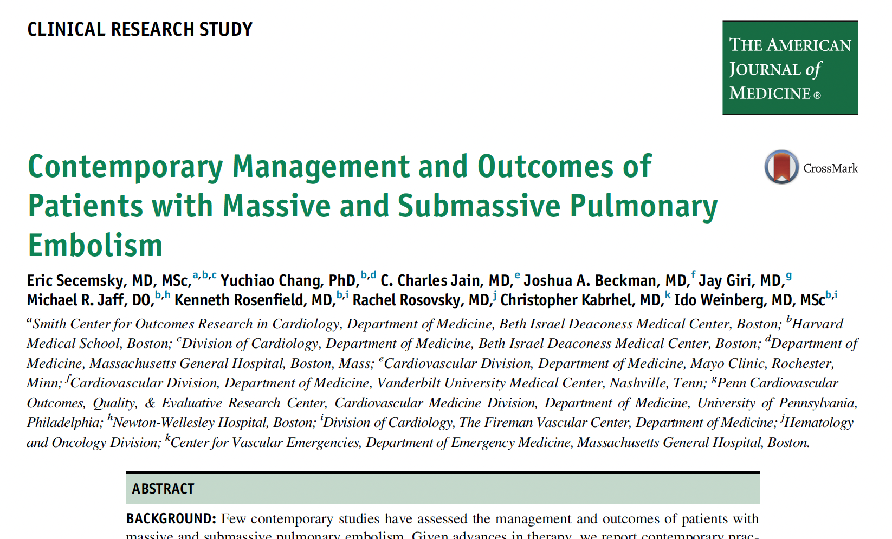
Nearly half of all 90-day deaths in submassive PE patients occurred after patient had been discharged
  45% of these deaths directly attributed to PE

Slide 10
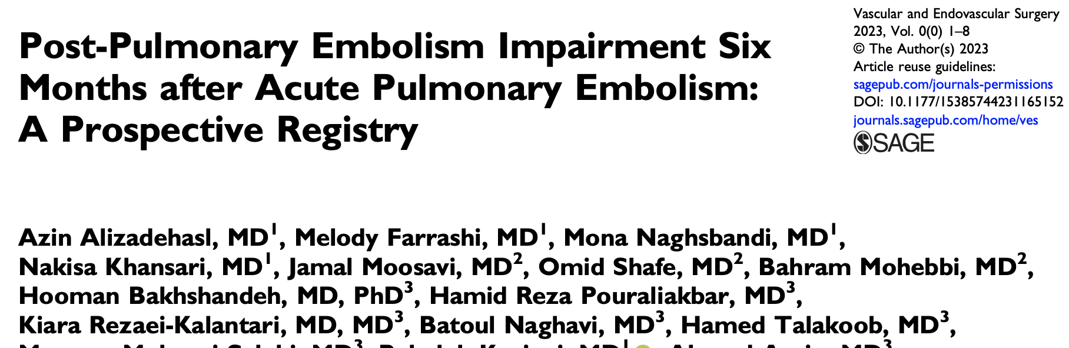
Prospective registry that evaluated exercise intolerance and RV recovery in submassive PE patients at 6 months
170 patients

Slide 11
Results
At 6 months
  Exercise limitations observed in 45.7% of patients
  Incomplete RV recovery observed in 58.6% of patients
  Intermediate to high echo findings of pulmonary hypertension in 32.1% of patients

Slide 12
Measuring RV strain
EKG
  Right bundle branch block
  Not always consistently abnormal
Labwork: Troponin and BNP
  Troponin: Identifies acuity
  BNP: Helps gauge severity of heart failure
Imaging (CT or Echo)
  RV/LV ratio

Slide 13
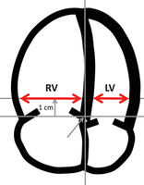
Measuring RV strain: RV/LV ratio
Most common initial tool to gauge magnitude of right heart strain after a PE
Diameter measurement of the right ventricle in relation to the left ventricle
  Can be measured on CT or ECHO
Normal: < 0.9 (i.e., left ventricle greater in size than right ventricle)
Elevated: >1.0 (i.e., interventricular septum shifted, with larger RV compressing a smaller LV

Slide 14
Normal RV/LV Ratio: < 0.9
RV: 37.9 mm
LV 47.6 mm
RV/LV ratio: 0.79

Slide 15
Abnormal RV/LV ratio: >1.0
RV Diameter 58.4 mm
RV/LV ratio:
1.84
LV diameter
31.7 mm

Slide 16
RV/LV ranges
<0.9 normal
0.9-1.1 – mild RV dysfunction
1.1-1.3 – Moderate RV dysfunction
>1.3 – Severe RV dysfunction
Elevated CT RV/LV ratio on admission are highly predictive of short-term and long-term morbidities from PE

Slide 17
Trends in PE management
From non-targeted (systemic TPA) to targeted treatments (catheter-based therapies)
From more invasive (open pulmonary embolectomy) to less invasive (endovascular thrombectomy)

Slide 18
Initial Management of all PEs
Systemic anticoagulation
Supplemental Oxygen
High index of Suspicion in hypotensive or hypoxic patient
  Bedside echo if available to gauge RV function
Early diagnosis
Clear delineation of type of PE (submassive vs massive vs neither)
Early arterial line placement for accurate hemodynamic management if larger PE

Slide 19
PE Toolkit
ECMO
Catheter-directed thrombolysis (CDT)
Inari Flowtriever Thrombectomy Catheter

Slide 20
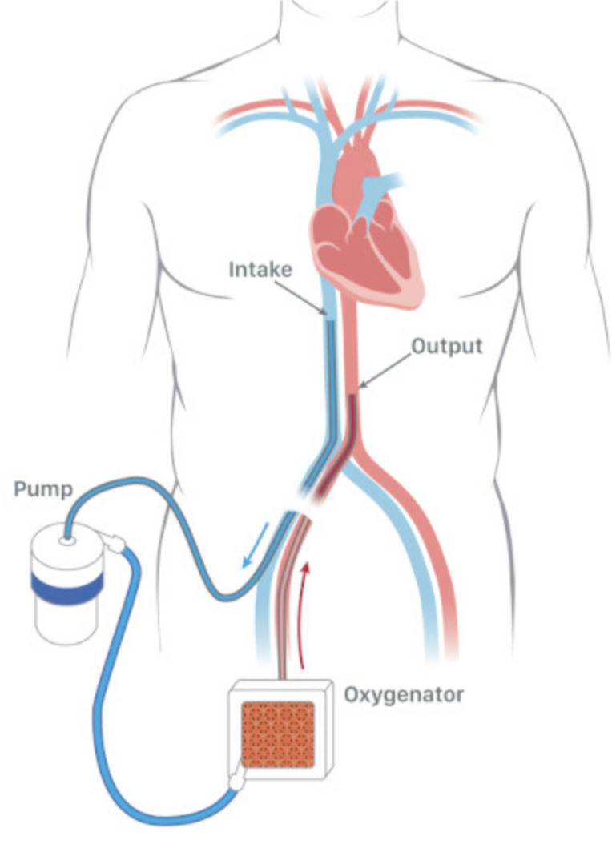
ECMO
”Heart-Lung bypass”
Large venous cannula drains blood into an oxygenator which is then pumped back into the arterial system through a large arterial cannula
Requires a perfusionist/ECMO specialist
Resource intensive
Risk of access complications and/or limb loss

Slide 21
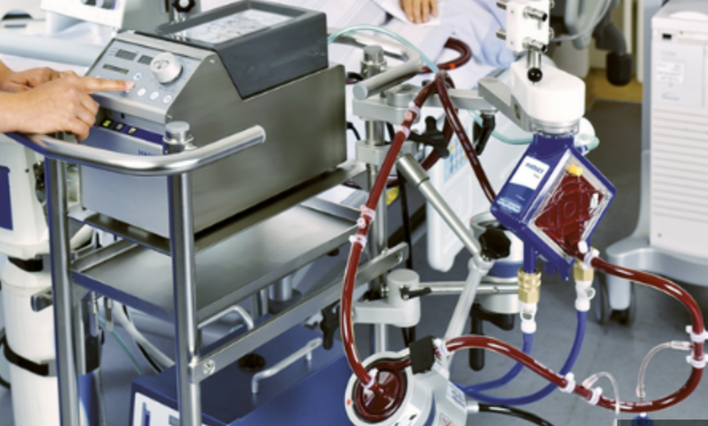
ECMO for PE
UNM cannulated first massive PE patient in 2017
Benefits of ECMO in setting of massive PE:
  Immediate RV decompression
  Augmentation of cardiac output in patients with cardiogenic shock
  Mitigates the life-threatening nature of malignant arrythmias that occur with massive PE

Slide 22
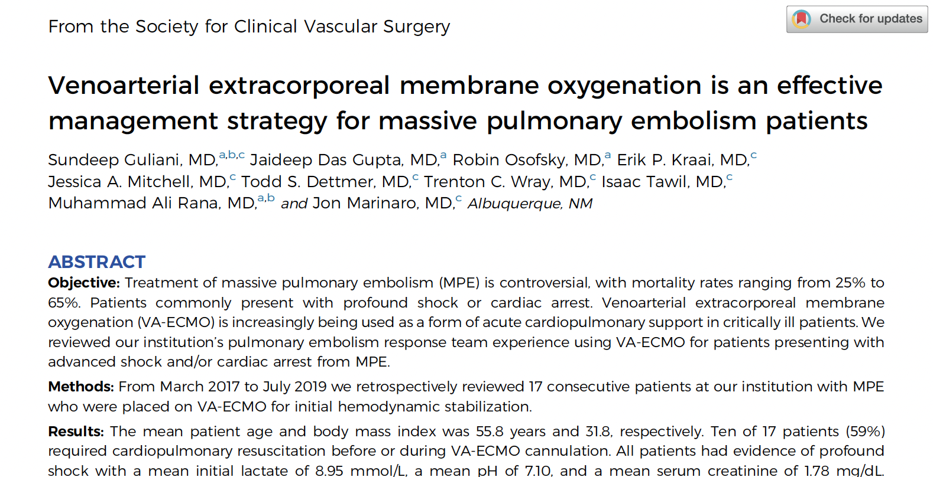
17 consecutive massive PE patients placed on VA-ECMO as first line treatment
Mean initial lactate 8.95, mean ph 7.1
41% of patients cannulated either during or after CPR
Overall survival 76%
  100% survival in patients that did not require CPR prior to cannulation

Slide 23
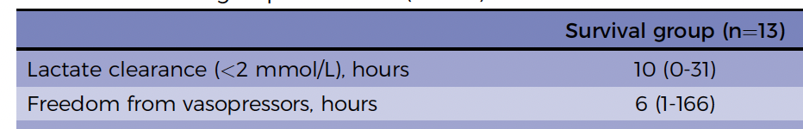
Continued
VA-ECMO was effective at reversing PE-related cardiogenic shock in survivors

Slide 24
UNM protocol for Massive PE
Patients are cannulated utilizing local analgesia only
Intubation is avoided owing to risk of cardiovascular decline and/or cardiac arrest
In patients receiving CPR, ECMO is used to clear shock state then neurologically prognosticate patients and re-assess RV function in 3-5 days

Slide 25
Catheter-directed Thrombolysis
EKOS is a thrombolysis catheter with FDA indication for PE
Uses ultrasound-produced mechanical vibrations combined with local fibrinolytic infusion to lyse clots

Slide 26
EKOS (Continued)
Catheters are placed in bilateral pulmonary arteries, with TPA infusion of 1/mg total per hour
2017 to 2021 mainstay of treatment at UMM for submassive pulmonary embolism

Slide 27
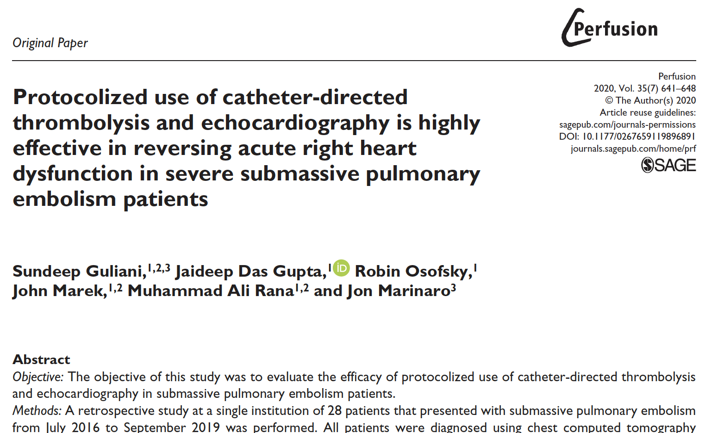
3-year study of 28 submassive PE patients that received CDT
Protocolized to receive 24-hour echocardiogram during lysis to assess RV improvement
Mean RV/LV ratio 1.7 in patient population

Slide 28
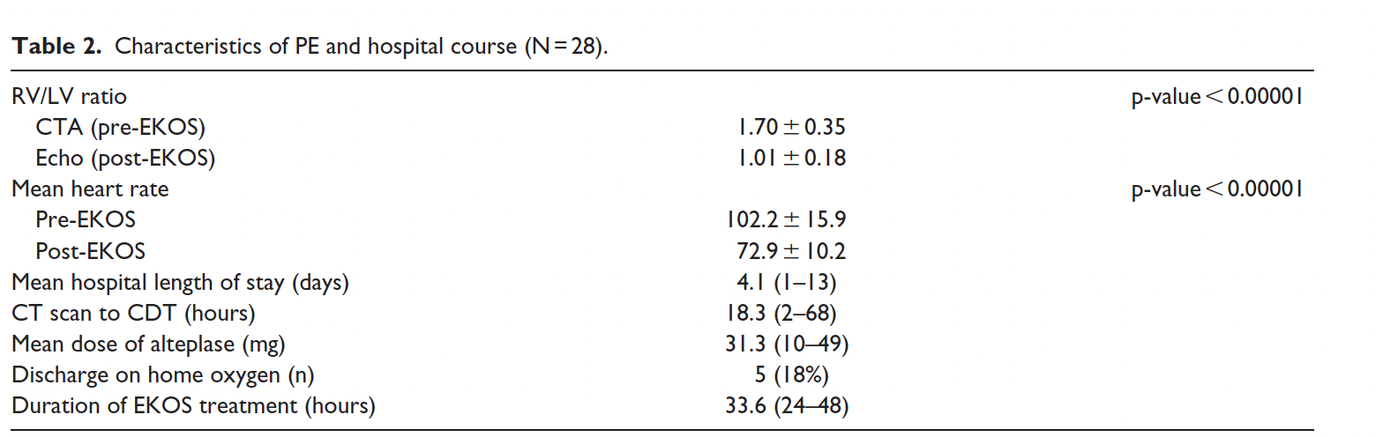
Continued

Slide 29
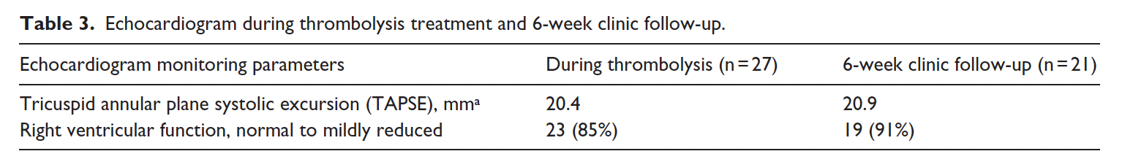
CDT was effective at normalizing RV function

Slide 30
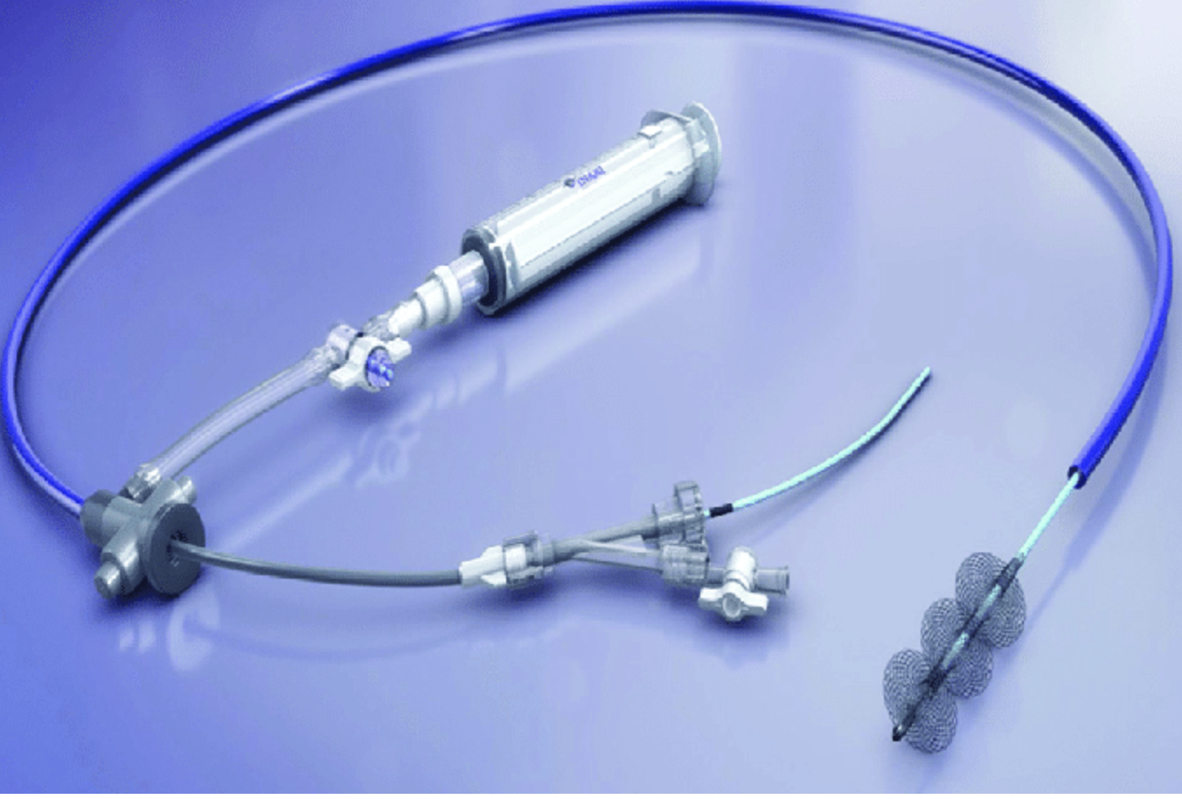
Inari Flowtriever Thrombectomy Catheter
Large bore thrombectomy catheter
24 fr
Suction catheter

Slide 31
Continued
Device is navigated from the groin through the heart and into pulmonary vasculature and then used to aspirate clot

Slide 32
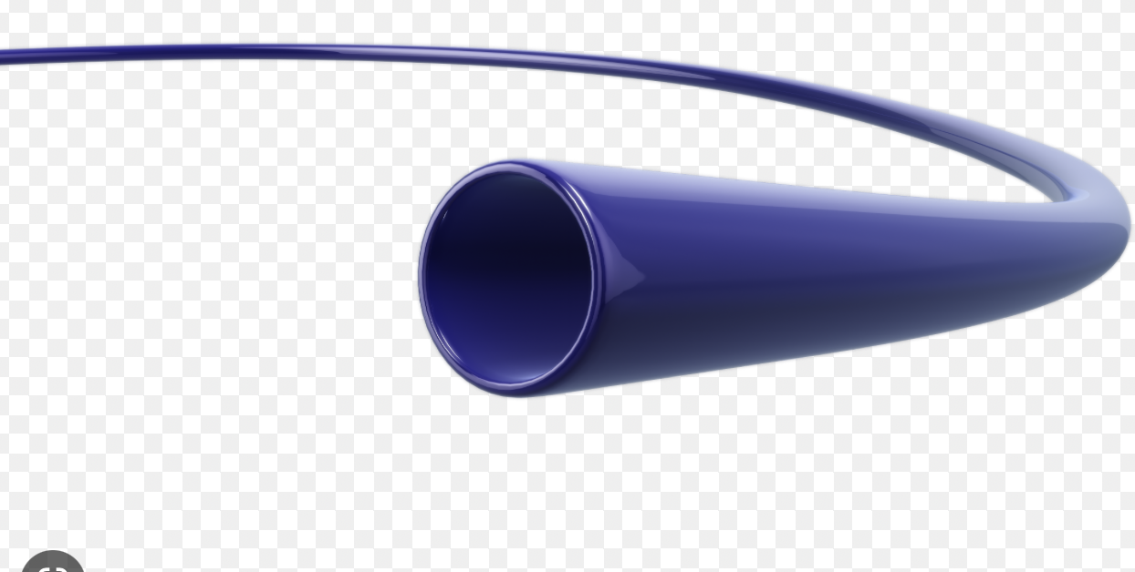
Flowtriever
Advantages
  Single session intervention
  No thrombolytic requirement
  No prolonged ICU stay required
Disadvantage
  New device
  Comfort with large bore catheter advancement through the heart

Slide 33
Evolution of PE Program at UNM
2019: Transition of first responder for PE from Vascular Surgery to the ECMO-trained ICU intensivist
2017: Utilization of ECMO for life-threatening PE
2021: Inari Thrombectomy Catheter added to treatment algorithm
2016
2023
2018: ECMO-based ACLS approach created to rapidly place patients in extremis on ECMO
2020: Creation of H.E.L.P N.M Program (Heart Embolism Lung Program)
Multidisciplinary team for PE management and state-wide ECMO transport
2016: Vascular Division began offering CDT to PE patients at UMN

Slide 34
UNM 2021-2022 PE data: 39 procedures
26
13

Slide 35
2023

Slide 36
PE patients
Standard Criteria
  “Bread and Butter” PE patients
Expanded Criteria
  Recent Neurologic Events, Massive PE, Index Hospitalization Surgery, Age >75
  Ie, Criteria that would exclude a patient from CDT

Slide 37
Standard vs non-standard patients?

Slide 38
Risk stratification prior to UNM H.E.L.P NM Consultation
UPLOAD CHEST CT TO LIFEIMAGE
Age and medical comorbidities (including specifically any history of DVT/PT, malignancy, or cardiac abnormalities)
Current vitals including oxygen requirement
BNP and Troponin levels (if patient is stable – if patient is unstable can forgo this lab to expediate care)
CT scan RV/LV ratio (either radiologist impression or provider calculation)
Code status
Wishes to have a procedure

Slide 39
High Risk PE Patients
Massive PE
  Candidates for either ECMO team retrieval vs emergency transfer for ECMO cannulation based on patient’s clinical status
Saddle PE
Submassive PE patients who are symptomatic, high clot burden, with elevated RV/LV ratio

Slide 40
Patients UNM has accepted and not accepted recently
72 yo from Texas, on vacation in Santa Fe, syncopal event in square
Hypotensive on scene, resolved by arrival to OSH
CT: Saddle PE, RV/LV 1.5

Slide 41
UNM
Arrives at midnight to ICU
9 am Percutaneous thrombectomy
Weaned off of oxygen within 24 hours of arrival
Discharge POD 2 on a DOAC

Slide 42
Cases

Slide 43
(continued)
Transferred to UNM with dx of submassive PE + aortic thrombus
Shortly after arrival in ICU had a cardiac arrest
Placed on VA-ECMO during code event
Bilateral lower extremity ischemia after ECMO
  Bilateral reperfusion cannulas placed

Slide 44
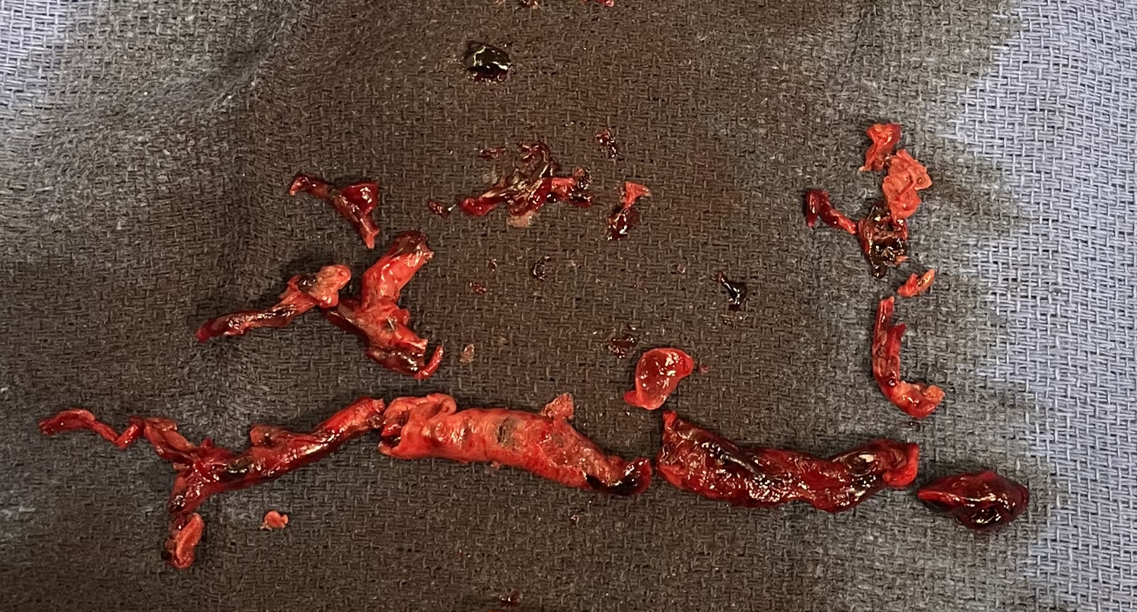
Continued
HD 0-1: Clear shock, patient neurologically intact
HD2: Inari Thrombectomy in OR
Pre-thrombectomy
Post-thrombectomy

Slide 45
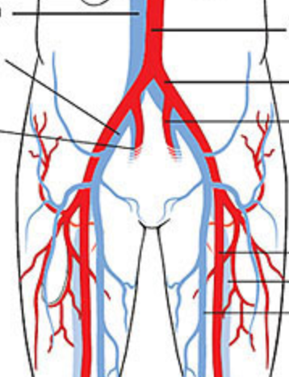
HD#3-4
HD#3: closure of his PFO by cardiology
HD#4 OR:
Bilateral groin cutdown
ECMO decannulation
Aortoiliac embolectomy
Bilateral thigh cutdown
Bilateral SFA repair and reperfusion cannula removal
Aortoiliac
thrombus
Arterial cannula
Reperfusion
cannulas

Slide 46
Continued
Spend the next 2 weeks in the hospital and then discharged home

Slide 47
Case #2
48 yo lady admitted with large left MCA stroke
Required decompressive craniotomy after unsuccessful thrombectomy
In Neuroscience ICU for a week

Slide 48
HD#8
Awaiting transfer out of Neuroscience ICU to floor bed
Developed acute hemodynamic instability
Max dose of 3 vasopressors over an hour period
H.E.L.P team activated: Bedside ultrasound demonstrated severe RV dysfunction
Cannulated in extremis for VA ECMO shortly after with a presumed diagnosis of Massive PE
Leg ischemia: Reperfusion cannula placed

Slide 49
CT
Large Saddle Embolus
RV/LV: 2.6

Slide 50
ECMO day 0-1
Utilized ECMO to clear severe shock and wean vasopressors to off over next 12 hours
Lowered anticoagulation goals; q1 neurologic checks, q 6-12 hour CT head scans
ECMO day1: OR for Inari Flowtriever Percutaneous Thrombectomy

Slide 51
Continued
ECMO day 2: ECMO decannulation + IVC filter
Post decannulation CT: Caval free-floating thrombus above the IVC filter
Next day: Percutaneous caval thrombectomy (from the neck)
  Positive HIT panel reported intra-operative
Bivalirudin

Slide 52
Continued
ICU next several days
Eventually discharged HD 24
Recovered well
Skull placed back on head last week
Will receive IVC filter removal in next few weeks

Slide 53
Case #3
69 yo lady with syncopal event in the morning while cooking
History of colon cancer s/p colon resection and ostomy
Admitted in AM with new onset hypoxia and tachycardia
Large saddle PE on CT

Slide 54
Conclusion
Pulmonary Embolism has a high morbidity and mortality
We have advanced capabilities in our state to manage this problem that has demonstrated good clinical outcomes
Every facility in the state has different abilities and resources to manage complex PE issues
UNM is a safety-net for the state to mitigate these differences, and has resources available for providers who need help and/or transfer for sicker PE patients

