Slide 1
SpecID Clinic
A Closer Look at Hepatitis C Program
GIMC HIV/HCV Pharmacy
By (Jade) Ngoc T Brookfield

Slide 2
Financial Disclosure
No financial disclosure

Slide 3
Objectives
Describe SpecID program and how collaborative practice can improve patient care
Describe Hepatitis C clinic program
Identify challenges and collaborate with different teams on interventions

Slide 4
Special ID Clinic-Program Overview
HIV clinic: ID physicians, pharmacists, registered nurses, and health techs
Hepatitis C clinic: ID physicians, pharmacists, public health nurses
PrEP and PEP clinic led by pharmacists under collaborative practice agreement
Tuberculosis Chest clinic: ID physicians, pharmacists, and DOT health techs

Slide 5
Hepatitis C Clinic Program
Patients are referred from Emergency Room, Internal Medicine, Family Medicine, Inpatient, Four Corners Rehab, or from other IHS Service Units.
First visit occurs with the ID physician to determine treatment eligibility and initiate appropriate treatment if patient is ready.
Follow up visits with laboratory monitoring follow with either physician or pharmacy during, at the end of, and 12 weeks after treatment for SVR12.

Slide 6
Pharmacists’ Roles in HCV Clinic
Review medication coverage and assist with patient assistance program or prior authorization.
Medication reconciliation at initial and follow-up visits
Dispense medications and counsel patients at every visit/med refill
Review laboratory monitoring as indicated per guideline

Slide 7
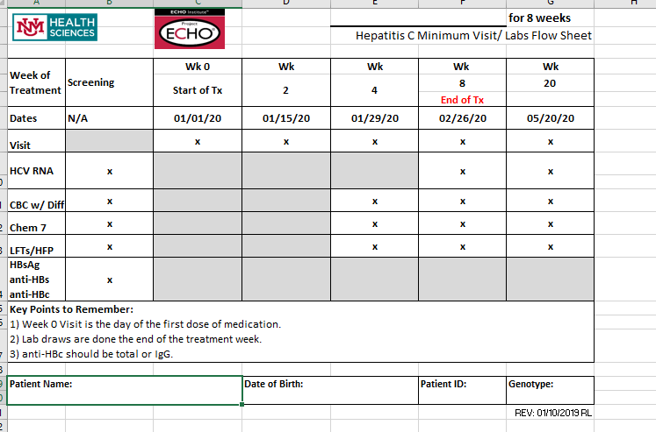
HCV Follow-up Template
Notes:
\

Slide 8
Challenges of HCV Treatment
Non-adherence
  Alcohol/Substance Abuse
  Mental/Behavioral Health
  Lack of support
Access to healthcare facilities
  Remote area
  No transportation

Slide 9
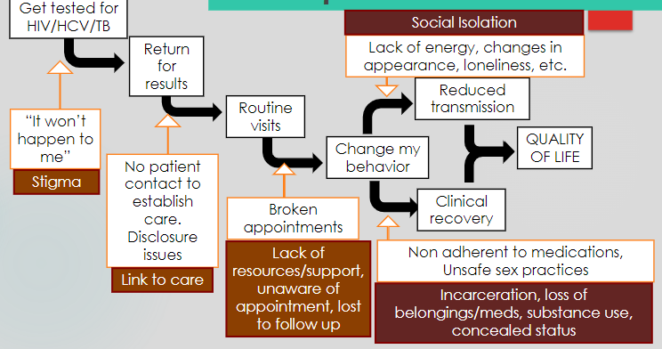
Challenges of HCV Treatment

Slide 10
Overcoming Challenges to Cure HCV
Linkage to Care
Multidisciplinary team
Pharmacy Mail Out Program

Slide 11
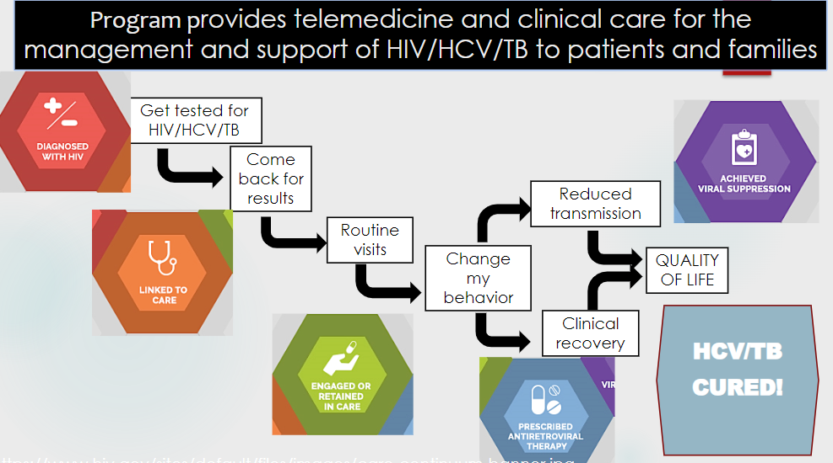

Slide 12
Other Clinics

Slide 13
PrEP and PEP Clinic by Pharmacists
Entirely led by pharmacists under CPA
Referral from other departments
Review patients’ eligibility, obtain required labs, and set up initial visit
Follow up every 3 months for oral PrEP meds
Long-acting injectable medication also available for qualified patients

Slide 14
Pharmacists’ Roles in HIV Clinic
Medication reconciliation, immunization recommendations, and conducting visits with patients prior to their visit with provider
Medication adherence tracking
Monthly chart review and medication refills
Home visit with clinic nurse

Slide 15
Chest Clinic
Once a month clinic for active tuberculosis or latent tuberculosis infection.
Pharmacists to review specifically for medication interactions, and process all orders and coordinate with TB tech for dispensing.
Tracking refills and/or therapy modifications

Slide 16
Outreach
Clinic cellphone: both providers and patients can contact the clinic pharmacist on duty during business hours.
Rapid testing: Clinic pharmacist on duty can provide rapid, point-of-care HIV test upon request.
STI testing: patients often reach out to pharmacists to obtain STI tests and follow up if needed.
Community events: Hepatitis Month, Pride Month

Slide 17
References
https://www.hiv.gov/sites/default/files/images/care-continuum-banner.jpg
https://www.hiv.gov/sites/default/files/images/care-continuum-banner.jpg

Slide 18
Questions?

