Slide 1

Prehospital sedation
A continuum
Whitney Barrett MD
EMS Consortium
University of New Mexico

Slide 2
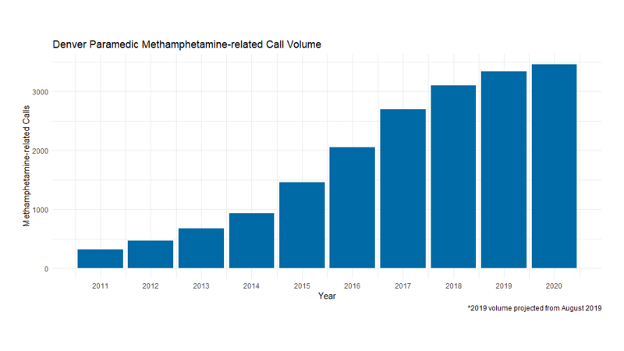

I jumped at the opportunity to cover this topic…
Notes:
Been talking about this since before it was cool

Slide 3
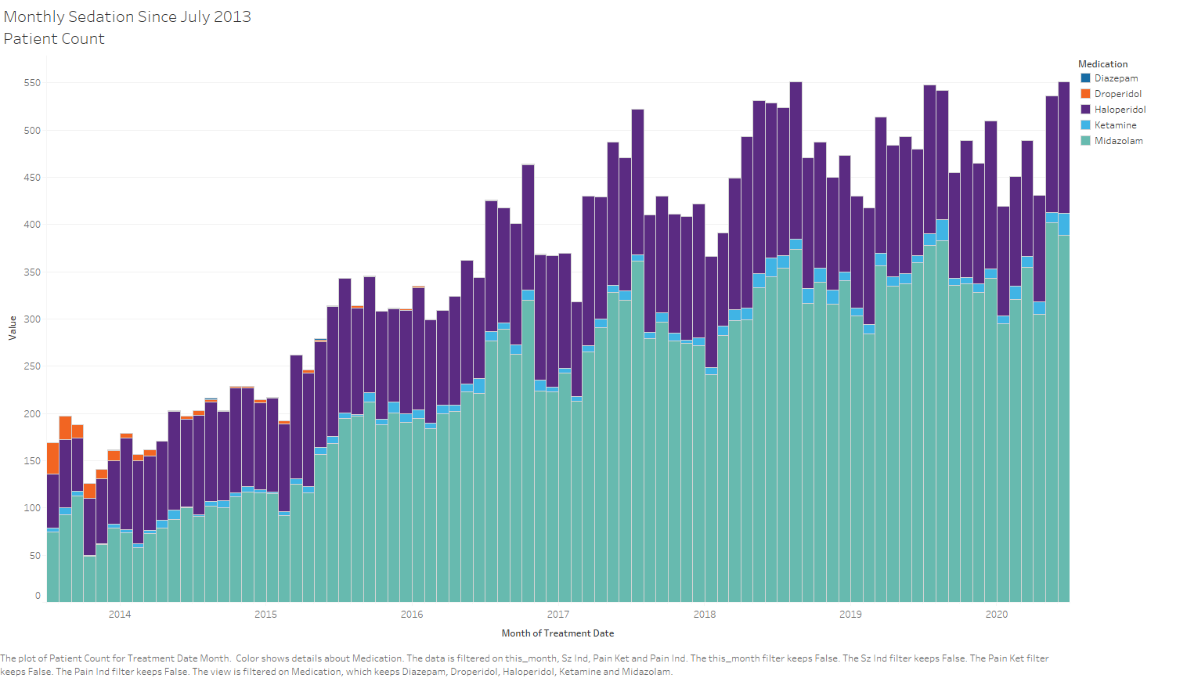

Slide 4
This patient… Patient X
What would be your initial thoughts if you arrived on this scene?
What are your options for management of this patient?
What medications do you have?
What medications have you heard of?
What makes you concerned about managing this patient?

Slide 5
Things I will say that you (and Kenny Rogers) already know
Know when to hold ‘em
Know when to fold ‘em
Know when to walk away
Know when to run
Your safety is a priority
These scenes can be dynamic
You are not expected to put yourself in unnecessary risk

Slide 6
What we are and aren’t talking about today
Are
Aren’t
Why agitation is bad for patients
The continuum of agitation
Medications that can be used
The importance of a coordinated approach
Management of the agitated-now sedated patient
Verbal de-escalation
How to physically restrain a patient
Specific causes of agitation
Your specific protocols/guidelines for the agitated patient

Slide 7
The spectrum of the problem
And some pathophysiology of why its bad

Slide 8
Categories (that can change)
Agitated but cooperative
Disruptive without danger
Delirium with severe agitation

Slide 9

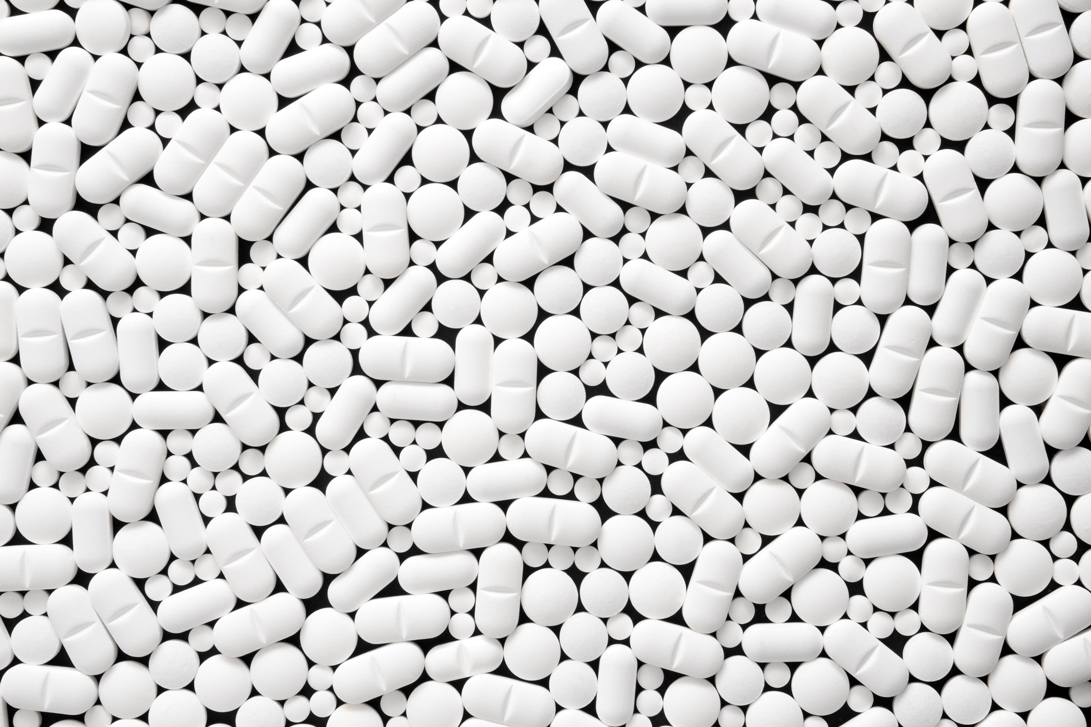
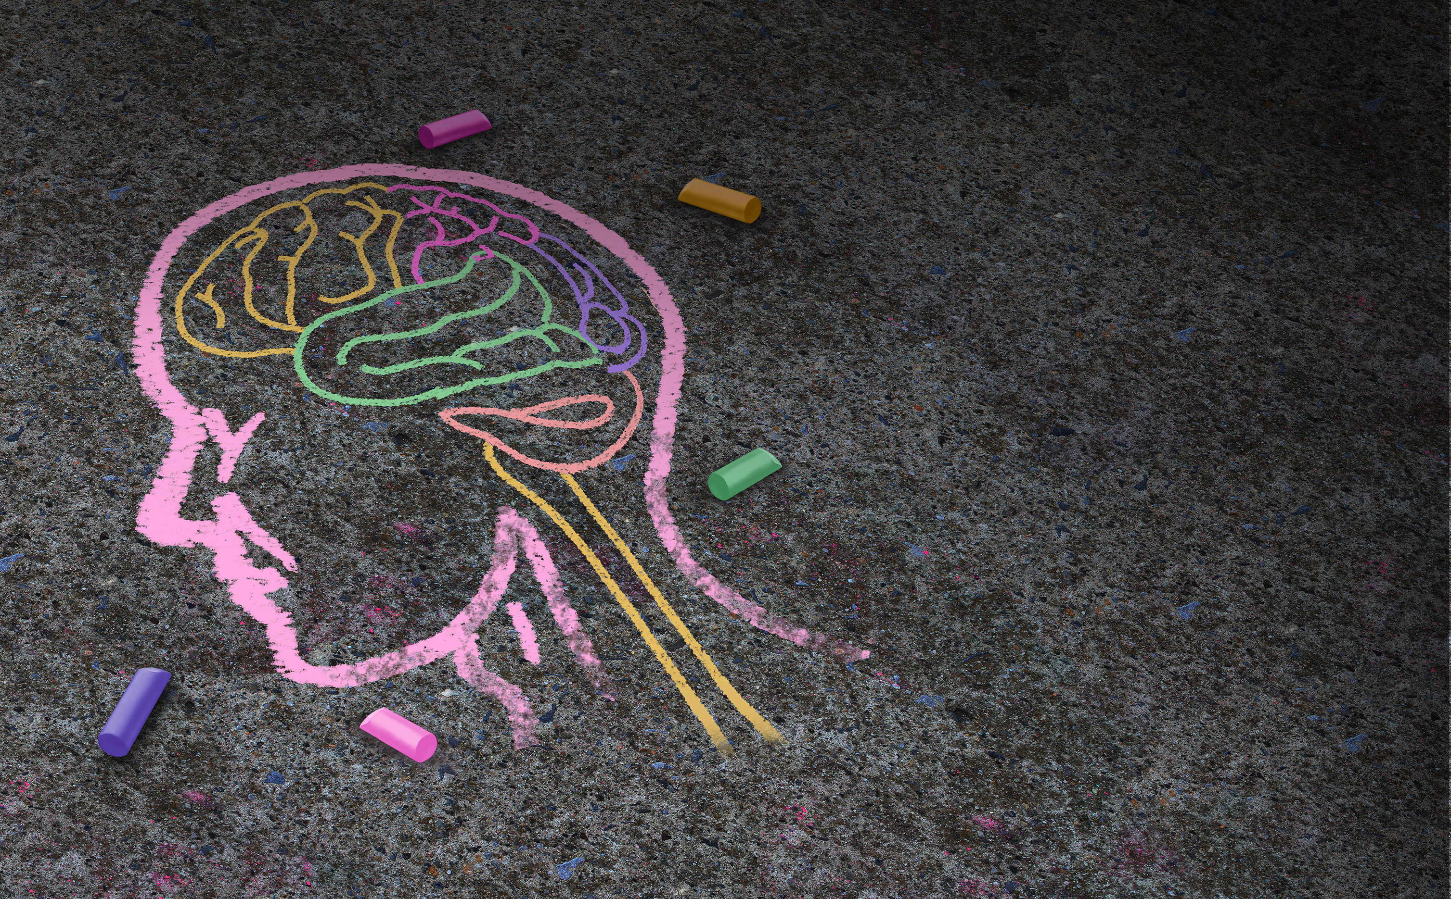
Reasons people are agitated

Slide 10
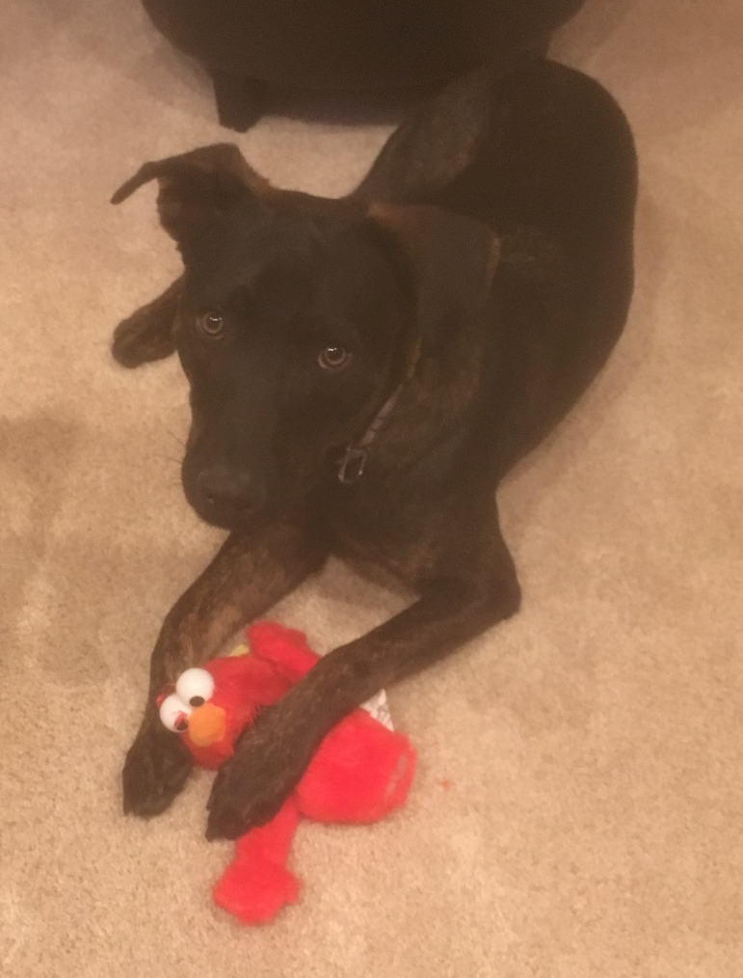
Agitated but cooperative
What types of patients are like this?
Granny with dementia
17 yo that drank just a little too much
Moderate head injury perseverating

Slide 11
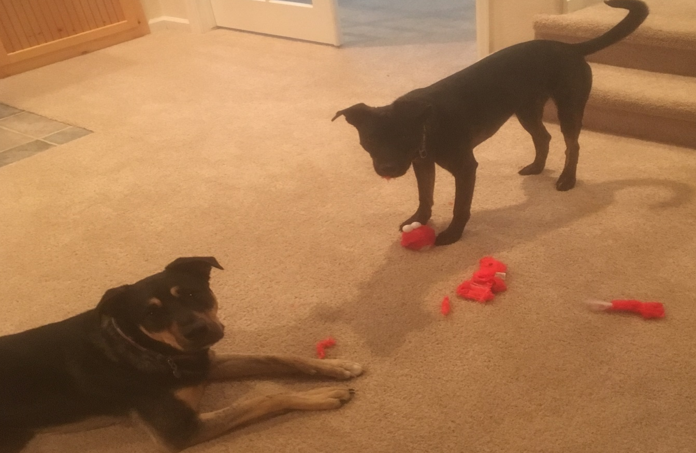
Disruptive without danger (maybe for elmo)
Patient types
33 yo who drank way too much
On something + altercation
Psychiatric disease + substance
Prehospital challenges

Slide 12
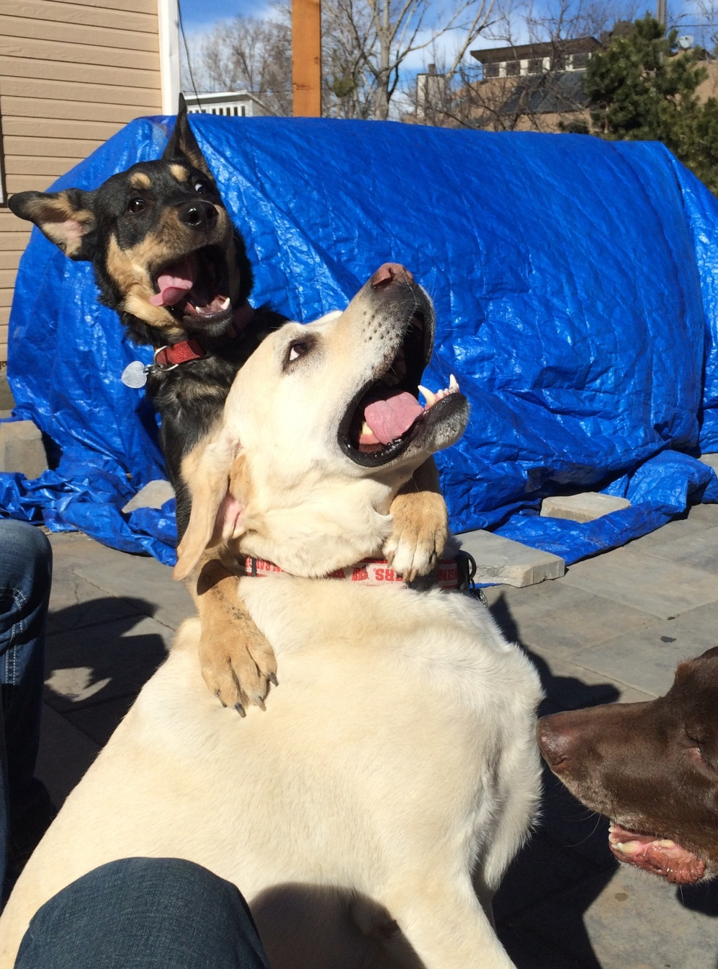
Delirium with severe agitation

Slide 13
Characteristics
Chemical imbalances result in tachycardia, tachypnea, and hyperthermia
Hyperthermia becomes a harbinger of death in this syndrome
Patients at high risk of sudden fatal arrhythmia and respiratory arrest
Patients lack the capacity to understand the consequences of their behavior

Slide 14
Why this is life threatening
Profound acidosis (sprinting a marathon)
Dependent on ventilation
They cannot understand instruction
Our options are limited
Usually start with what?

Slide 15

The challenge this presents
Patients that are combative and dangerous
Intersection of law enforcement (public safety) and medical care (medical emergency)
Safety for providers and patient
Somebody must identify this person as a patient

Slide 16
Philosophy
Somebody must identify the agitated person as a patient- that is You

Slide 17
Tension
Autonomy: we shouldn’t sedate people against their will
Beneficence: we should help our patients

Slide 18
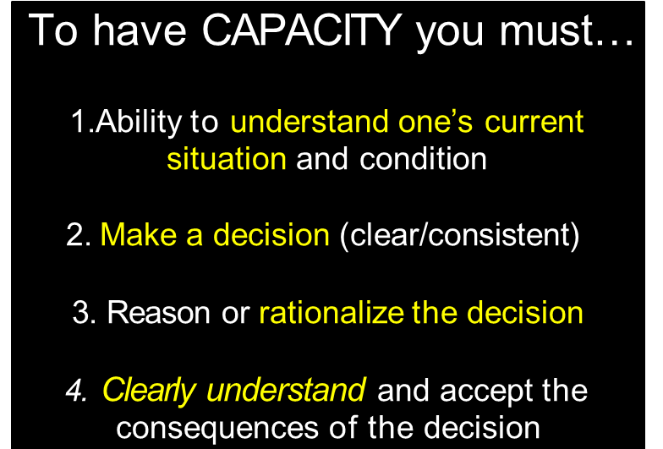
Agitated patients…
Frequently state they don’t want to go to the hospital
Are variable degrees of combative about it
Lack Capacity:

Slide 19
For patients experiencing a behavioral emergency, sedating them is our medical treatment

Slide 20
Coordinated approach when possible

Slide 21
Medications

Slide 22

What options do you have?

Slide 23
Non-meds
Seatbelts
Restraints
Verbal redirection/de-escalation

Slide 24
There isn’t a behavioral emergency that magically gets better by driving to the hospital. Make sure your patient is restrained +/- sedated before departure

Slide 25
Benzodiazepine

Slide 26
Antipsychotic

Slide 27
QTc prolongation
Ziprasidone IM
Ondansetron
~15msec
Droperidol/Haloperidol IV
<5msec
Olanzapine IV
<2msec

Slide 28
Akathisia/Dystonia
Incidence:
- olanzapine: ~2-4%
- Droperidol/haloperidol: ~5-10%
Risk factors:
- higher doses
- concomitant anti-DA agents
- pediatric patients

Slide 29
Ketamine

Slide 30
Ketamine Onset
Time 5, 10, 15 mins
Ketamine 3mg/kg IM >> Lorazepam, Midazolam, haloperidol
Mean time to agitation resolution
Ketamine: 6.5 mins (prehospital 4mins)
Midazolam: 15 mins
Lorazepam: 17 mins
Haloperidol: 23 mins
Hopper et al. 2017

Slide 31
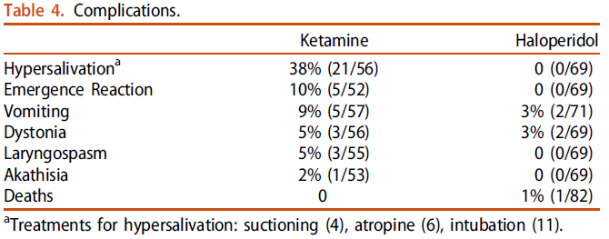
Adverse drug effects with Ketamine for severe agitation
Cole. Clin Tox 2016

Slide 32
Emergence
Incidence: ~25% (procedural sedation)
5% with ExDs
Risk factors:
- Age >15, doses >2mg/kg IV, personality disorders
Treatment: Midazolam 0.03mg/kg (2-4mg) IV

Slide 33
Laryngospasm
Incidence: <1% of procedural sedation
10% in ExDS
Risk factors: none identified
- Not ASA class, dose, route, procedure type
Treatment: Jaw thrust, PPV, Larson’s maneuver, RSI

Slide 34
Agitated but cooperative
Low dose medications:
Benzodiazepines
*What’s your underlying pathophysiology*

Slide 35
Agitated & Disruptive
IV/IM medications
Benzodiazepines
Midazolam
Diazepam
Antipsychotics
Droperidol
Haldol
*What’s your underlying pathophysiology*

Slide 36
ETOH and sedatives
Risk of O₂ desaturation (not intubation) with + ETOH:
Wilson et al 2012, Cole 2017: Olanzapine > haloperidol > Ketamine
Isbister et al 2010: Midazolam > combo > droperidol
*Consider using droperidol or haloperidol if + ETOH and agitated.
** Olanzapine + benzo’s increase airway ADE’s

Slide 37
Delirium with severe agitation
Midazolam
Droperidol
Ketamine
Dissociative

Slide 38
Key management steps
Identify the patient is a patient and is at risk
Talk about a coordinated effort with law enforcement
Have a plan for restraint and sedation
NEVER prone a patient
Minimize the amount of time a patient is held down with force
Manage the patient like a patient with critical illness

Slide 39
Onset
Midazolam 4-6 mg IV
<5 mins
Haloperidol 10 mg IV/IM + benzo IV/IM
Droperidol 5 mg IV/IM
Midazolam 5-10 mg IM
5-10mins
Olanzapine/ziprasidone IM (10-20mg)
Haloperidol 10 mg IM
10+ mins

Slide 40
Duration
Midazolam
<90min
Droperidol
Lorazepam
90-180min
Haloperidol +/- benzo
Ziprasidone
Olanzapine
>180mins
*Wash-out of other substances significantly affect duration of sedation

Slide 41
Summary
Identify
Identify the spectrum of agitation
Agitated but cooperative
Agitated and disruptive
Delirium with severe agitation
Treat
Treat agitation
Know
Know your options and the potential complications of the meds

