Slide 1


Psych Emergencies
Petter Overton-Harris, DO
University of New Mexico EMS Consortium

Slide 2
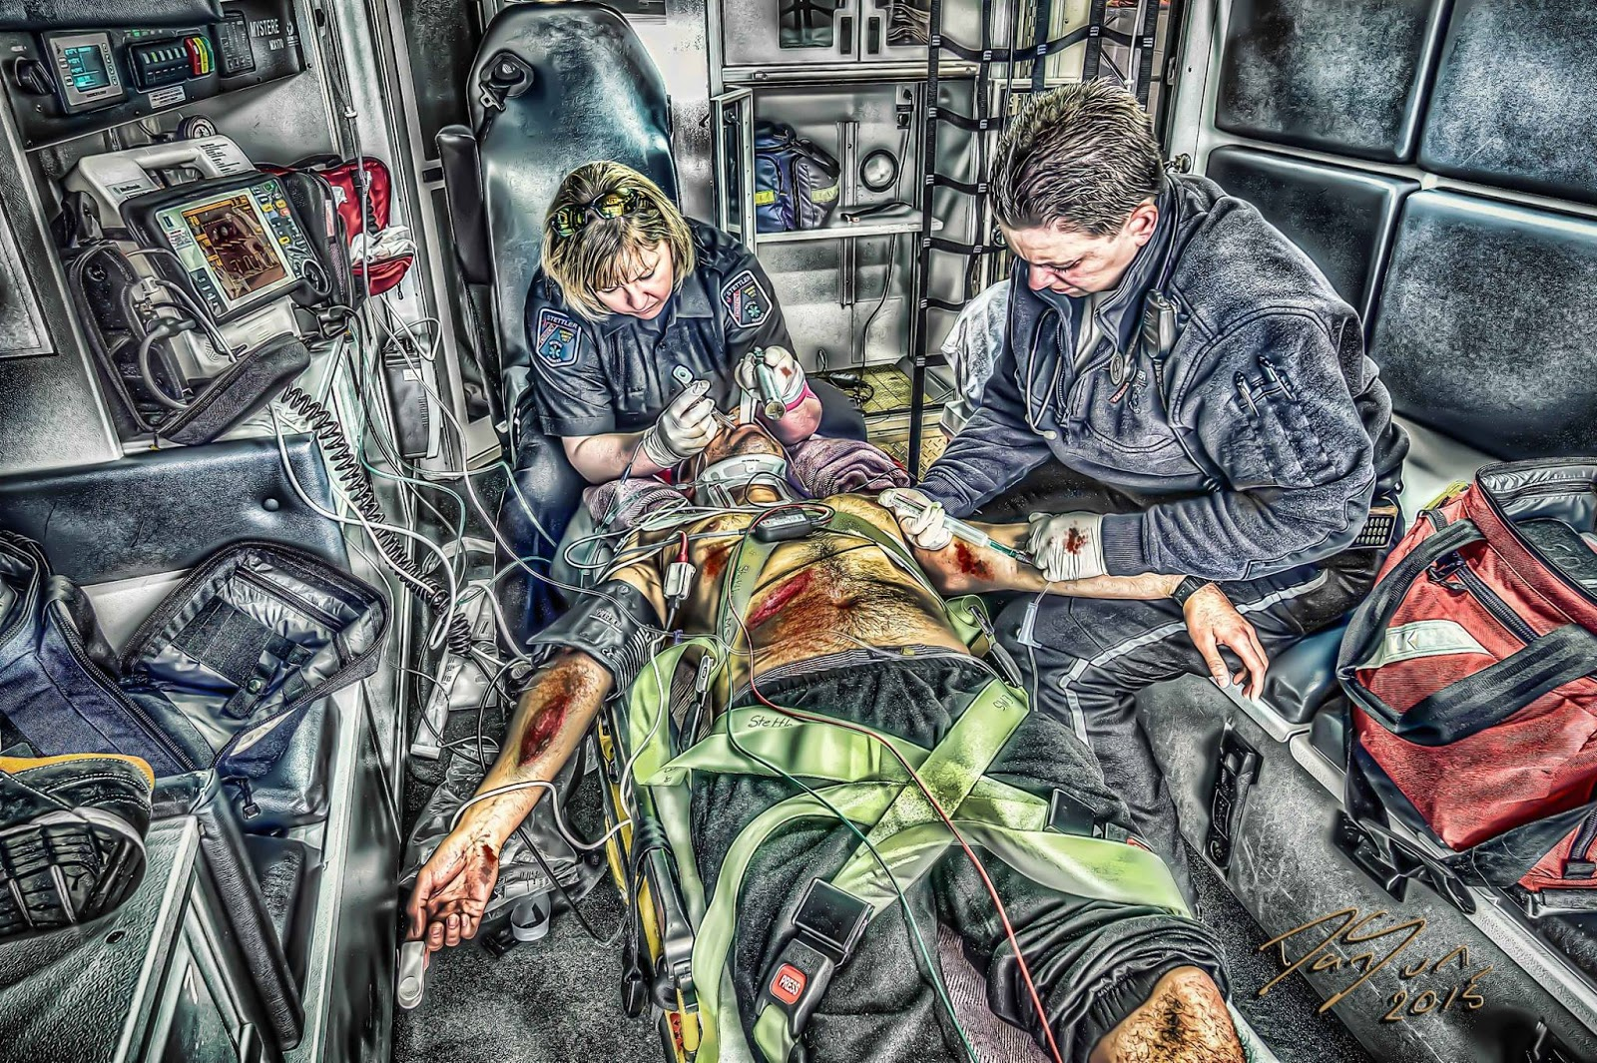
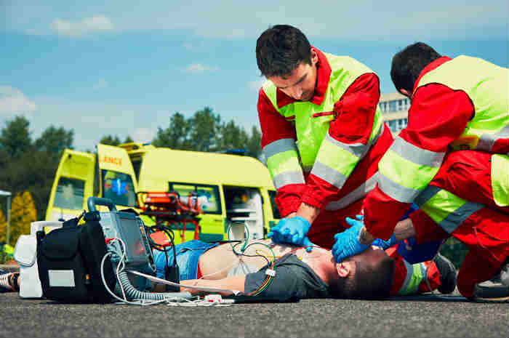

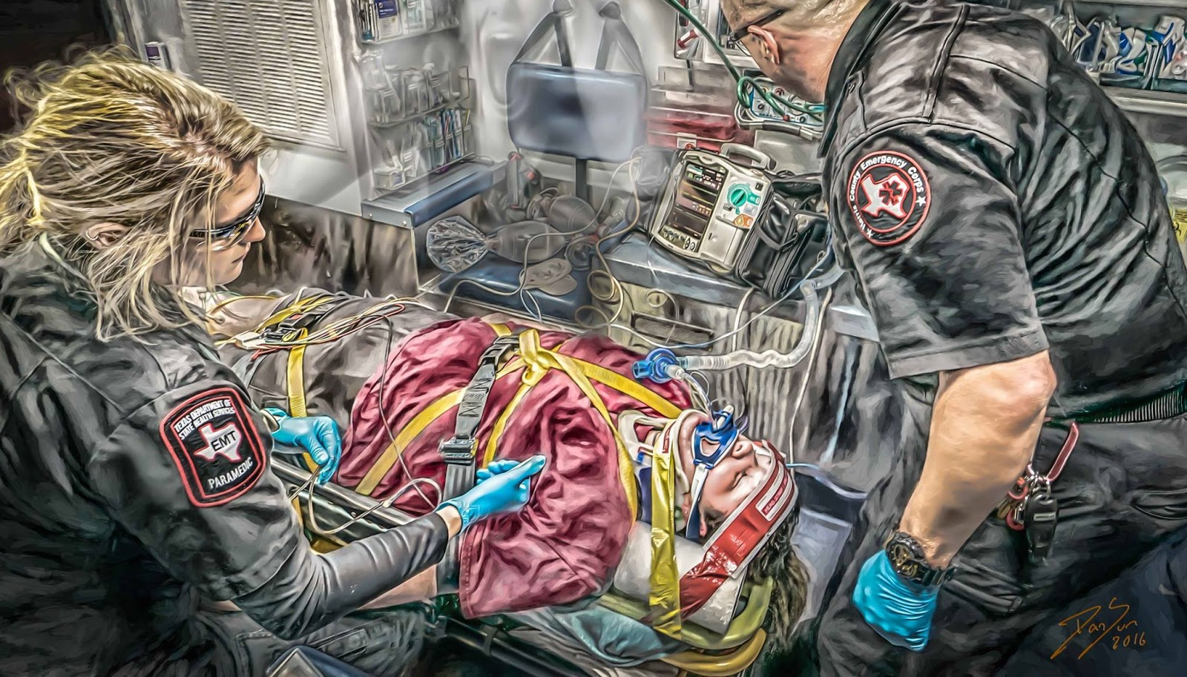
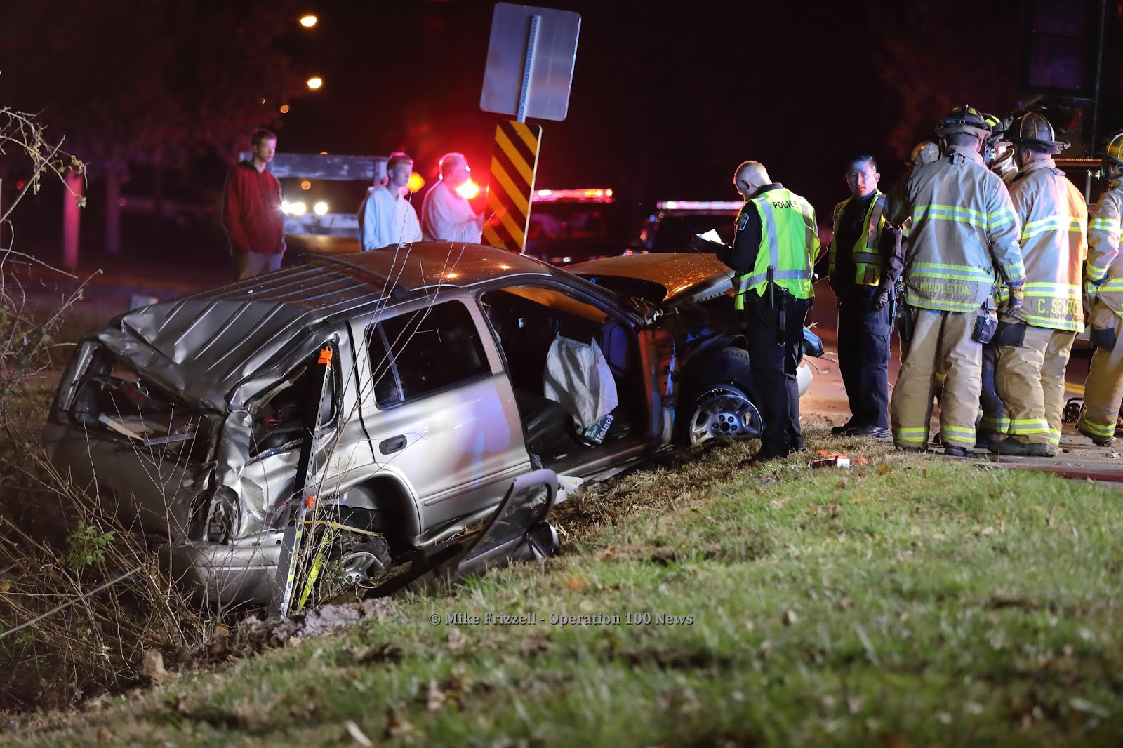
This Photo by Unknown Author is licensed under CC BY-NC-ND
This Photo by Unknown Author is licensed under CC BY-NC-ND
This Photo by Unknown Author is licensed under CC BY-NC-ND
Notes:
Y’all do amazing work and probably love this part of the job, arrests, trauma, helping people

Slide 3
Psych is here to stay
In 2018 data from over 1,000 agencies saw almost 6% of all calls be psych related
  That’s a lot!
Diabetic emergencies = 2%!
Cardiac arrests < 1% of total calls!
Notes:
So we need to give psych the same if not more energy as it is an increasing and very common call

Slide 4

What is a psych emergency?
Acute behavioral, thought or mood disturbance that if untreated may result in harm to the patient or others in the environment
Psychiatric emergencies can include suicidal and homicidal behavior, psychosis, agitation, anxiety, substance use disorders, depression, mania, and a host of related and overlapping medical problems, such as delirium and dementia
Notes:
2011 article from india and then the ACEP definition – very broad and quite unhelpful

Slide 5

Refusals
Capacity vs competence
Capacity is the ability to understand the nature and effect of one’s acts. Capacity is a fluid concept; an individual may have the requisite capacity in one moment and lack capacity in another. The determination to be made is whether an individual has the ability to understand the nature and effect of his/her acts in a specific moment of time.
Competency is categorical in nature; one either is or is not competent. A person is competent if he or she possesses certain qualities or characteristics that allow him or her to function in a particular circumstance
This Photo by Unknown Author is licensed under CC BY
Notes:
How do you assess capacity?

Slide 6
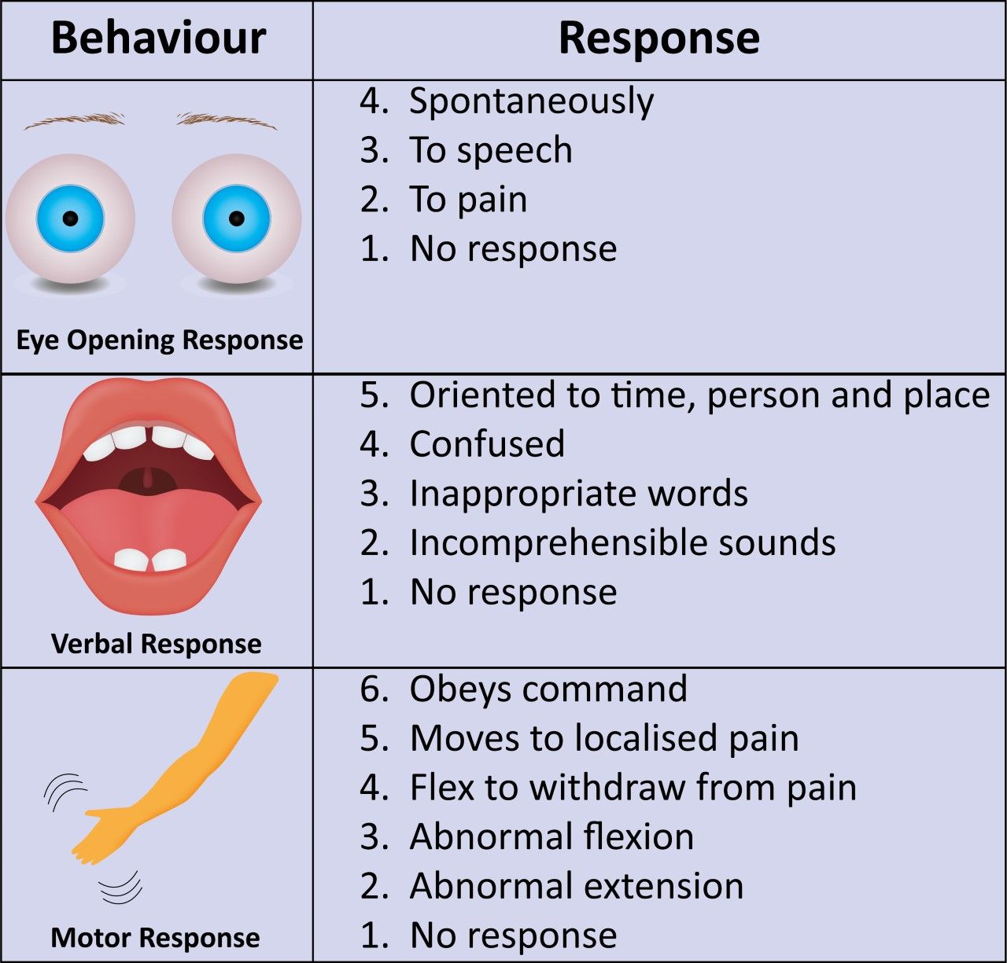
This Photo by Unknown Author is licensed under CC BY
Notes:
What about gcs does this count?

Slide 7

Notes:
A&Ox4 does this count???

Slide 8
Suicidal/Homicidal Ideation

Slide 9
Depression

Slide 10
Panic/anxiety

Slide 11
Bipolar

Slide 12
Psychosis

Slide 13
Intoxication/Withdrawal

Slide 14
Questions

