Slide 1
Treatment of Alcohol Use Disorder in the ED
Jordan Cohen, MD
Chief of Emergency Medicine
Tsehootsooi Medical Center

Slide 2
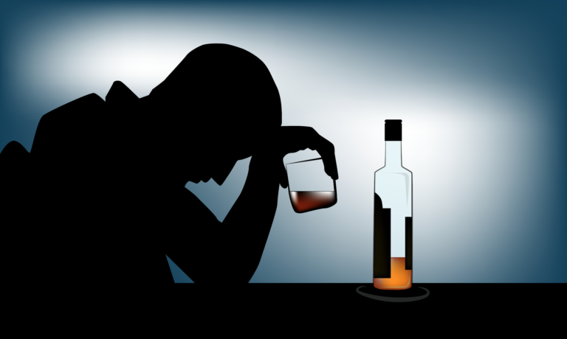
Notes:
Who has worked a shift this week
Who saw a patient with an ETOH related complaint during that shift

Slide 3
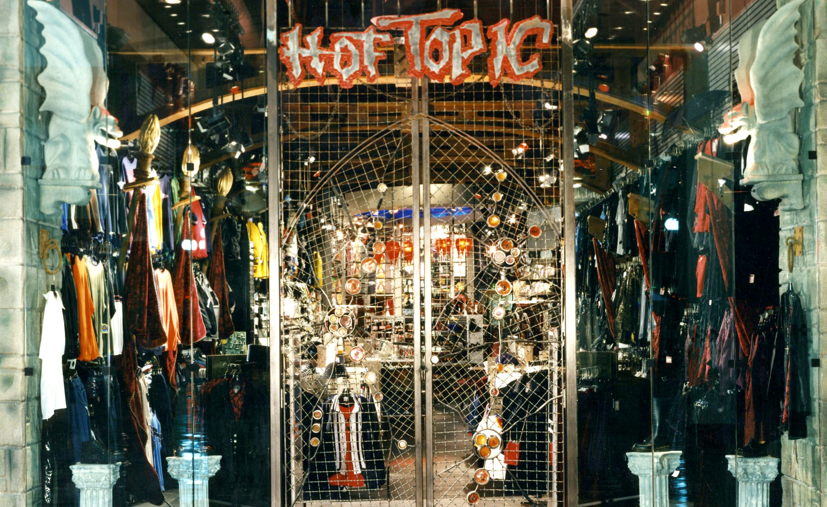
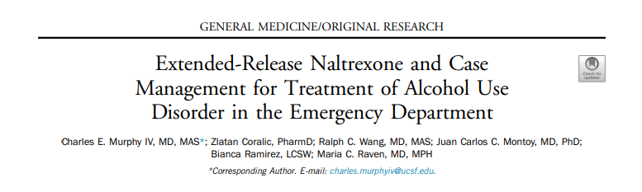

Slide 4
Annals of EM April 2023
32 of 178 approached were enrolled
IM naltrexone plus case management
22/32 followed up
7.5 less drinks per day
Notes:
12 week intervention
AUDIT-C score >4, actively drinking, >21 years
August to April 2021

Slide 5
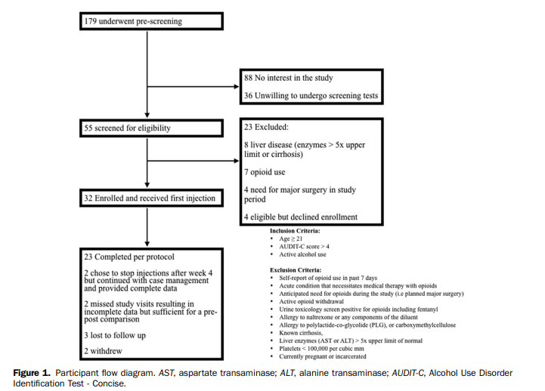

Slide 6
History
Naloxone (1961)
  Short acting Mu Opioid Receptor Antagonist
  FDA approval (1984)
Naltrexone (1963)
  Long acting MOR antagonist
  FDA approval (2006/2010)
Notes:
Naloxone short acting (half life 3 hours), started IV only, reversal for opiates, ONLY REVERSAL (like epi pen, doesn’t deal with ISSUE just reverses acute life threatening emergency)
1971 FDA approval for reversal opiate overdose
1984: FDA approval for heroine abuse, non compliance huge issue
Large success when person is mandated to get clean (physicians)
2014: IM injectable naloxone
2017: intranasal naloxone (NARCAN)
Methadone: needs monitoring, can be abused, can cause euphoria since agonist
Naloxone more office based approach
Naltrexone 13 hours (oral)
1986: mice drink more after a shock, not if given naltrexone (endogenous endorphin pathway)
Prompted studies in ETOH abuse, prevents relapse
FDA approval from one RCT on naltrexone

Slide 7
The Great Debate
Agonists
Antagonists
Methadone, Suboxone
Potential for abuse, diversion
Highly regulated
Licensing requirements
Naloxone, naltrexone
Non-compliance (oral form)
Less evidence than methadone
Can prescribe in office based practice

Slide 8
Initial RCT
Naltrexone in the Treatment of Alcohol Dependence (1992) Volpicelli et al
  Reduction in cravings
  Reduction in heavy drinking days
  Reduction in relapse
  Reduction in relapse after ETOH use
  Few side effects
Notes:
70 patients, male, ETOH abuse, 12 week double blinded to IM naltrexone or placebo
Overall relapse: 23% vs. 54%
Of those who drank ETOH while in outpatient therapy, 95% of placebo relapsed, 50% of naltrexone group

Slide 9
More Studies
IM vs. Oral: improved retention
380mg vs. 190mg dosage
15 month treatment program
  Reduced drinks per day
  Increased abstinence days
  Decreased heavy drinking days
Notes:
2x treatment retention
380 mg 25% reduction in heavy drinking days, 190mg 17% reduction in heavy drinking days
15 month treatment program: reduced drinks per day (0.2 vs. 6) abstinence days (82% vs. 38%) and heavy drinking days (11% vs. 61%)

Slide 10
Other Addiction Studies
Tobacco
Pornography/Hypersexuality
Gambling
Compulsive Eating
Methamphetamines

Slide 11
Our ED Based Program
Suspected AUD, over 18 years
Exclusions
  Opiate use past 7 days
  Need for surgery in 30 days
  Suspected admission and need for IV narcotics
  Pregnant
  Platelets <100K
  Cirrhosis or LFTs >5x normal

Slide 12
ED Pathway
Verbal consent
Give injection in ED
Tag mental health provider
Discharge with follow up appointment if possible
Repeat injections with MH

Slide 13
Practical considerations
Concentration declines at 14 days, cleared around 33-35 days
At 3 weeks, may have return of cravings
Bridge at 3 weeks
Notes:
Oral therapy x 1 week or earlier injection than 28 days

Slide 15
Frequency of second dosing of Vivitrol (6/22)
40 patients given first dose in ED
4 (10%)
Patients who received second dose
6 (15%)
Patients scheduled for second dose
29 (72.5%)
Patients who did not receive second dose
1 (2.5%)
Unclear outcome
15 (37.5%)
Did not show for second appointment
11 (27.5%)
Failed to contact patient
3 (7.5%)
Declined due to side effects

Slide 16
Frequency of second dosing of Vivitrol (12/22)
104 patients given first dose in ED
9 (9%)
Patients who received second dose
15 (14%)
Patients scheduled for second dose
56 (54%)
Patients who did not receive second dose
24 (23%)
Unclear outcome
19 (18%)
Did not show for second appointment
28 (27%)
Failed to contact patient
9 (9%)
Declined due to side effects

Slide 17
FAQs
Can I use naltrexone with phenobarbital?
Do I need special licensing to administer?
Can patients drink while on this medication?

