Slide 1



Alcohol use disorder treatment: Focus on medications
Joji Suzuki MD
Director, Division of Addiction Psychiatry, Department of Psychiatry, Brigham and Women’s Hospital
Program Director, Brigham and Women’s Hospital Addiction Medicine Fellowship Program
Assistant Professor of Psychiatry, Harvard Medical School

Slide 2
I receive research funding from the following: National Institute on Drug Abuse (R21DA056799; R21DA058119) National Institute on Alcohol Abuse and Alcoholism (R21AA030372) Indivior I have no other relevant financial conflicts of interest to disclose
Notes:
a

Slide 3
Outline
Epidemiology AUD
Approach to AUD treatment
MAUD evidence base
SBIRT?
Bridge Clinic model

Slide 4
AUD epidemiology

Slide 5
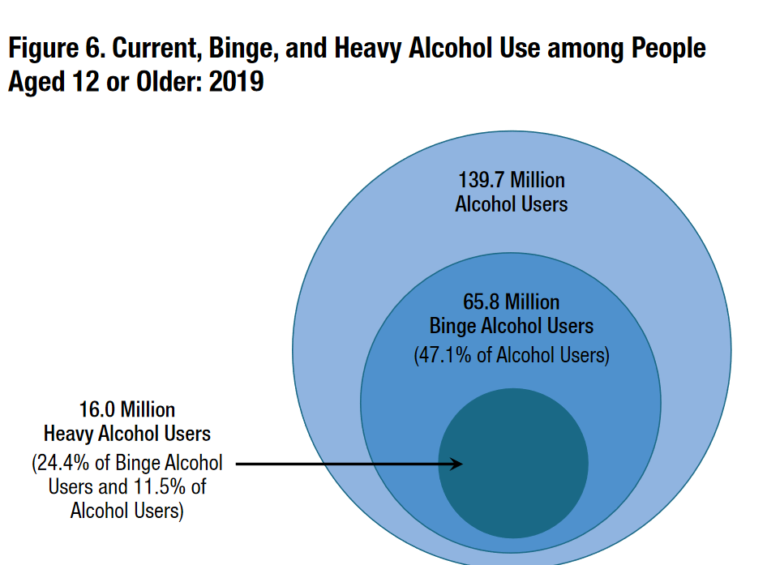
Spectrum of unhealthy alcohol use
DSM5 criteria
Physiologic tolerance
Loss of Control
Cravings
Negative Consequences
Alcohol use disorder
At-risk drinking
“Safe” drinking limits
Daily limits
5 for men age<65
4 for women or men age>65
Weekly limits
14 for men age<65
4 for women or men age>65
Low-risk (or no) drinking
Saitz NEJM 2005; NSDUH 2020

Slide 6
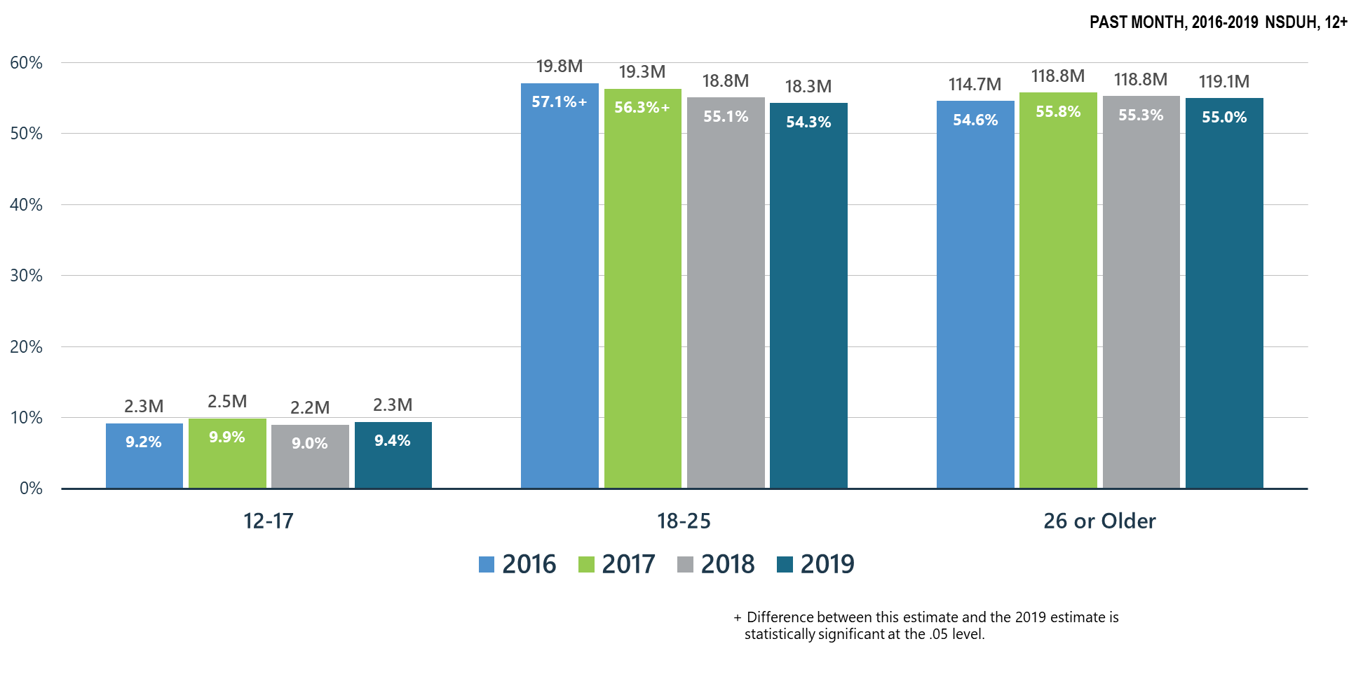
Alcohol Use
NSDUH 2020
Notes:
Slide ID: Nat19-5
SOURCE: 2019 DT 7.6, 7.12, and 7.15

Slide 7
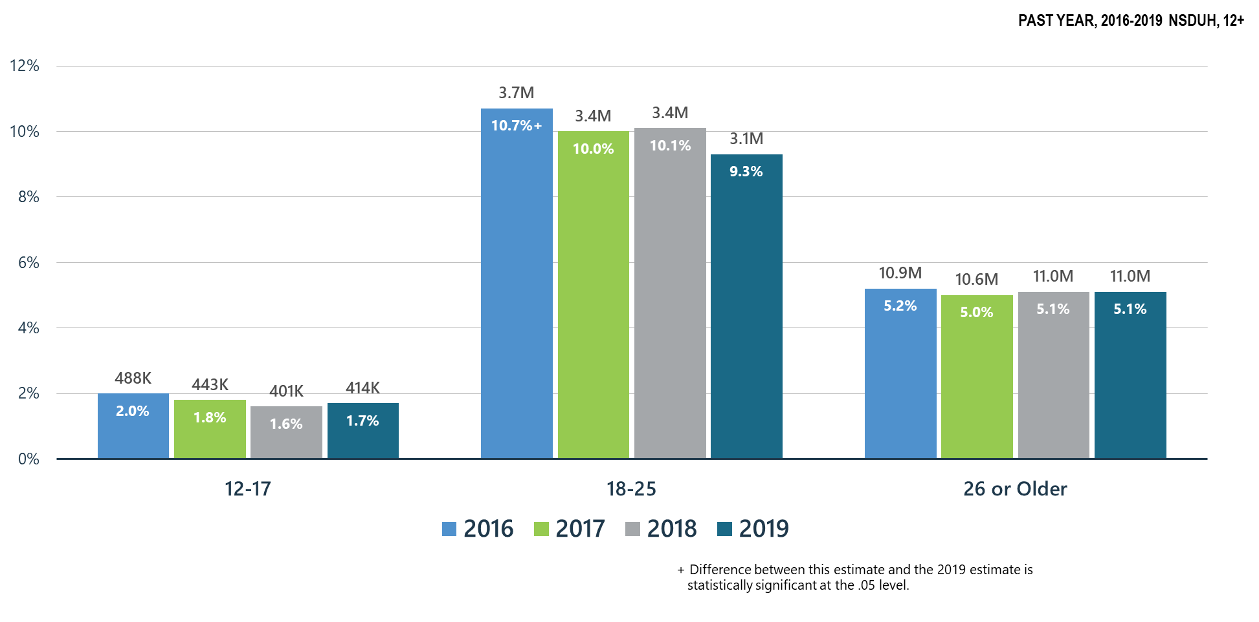
Alcohol Use Disorder
NSDUH 2020
Notes:
Slide ID: Nat19-6
SOURCE: 2019 DT 7.47, 7.49, and 7.50

Slide 8
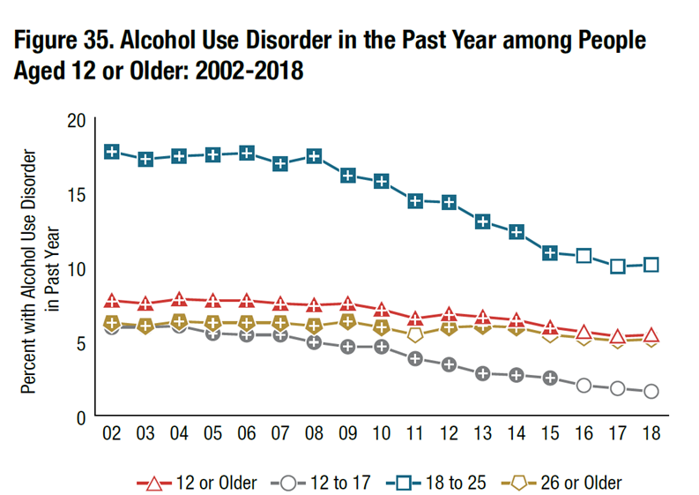
Alcohol Use Disorder
NSDUH 2020

Slide 9
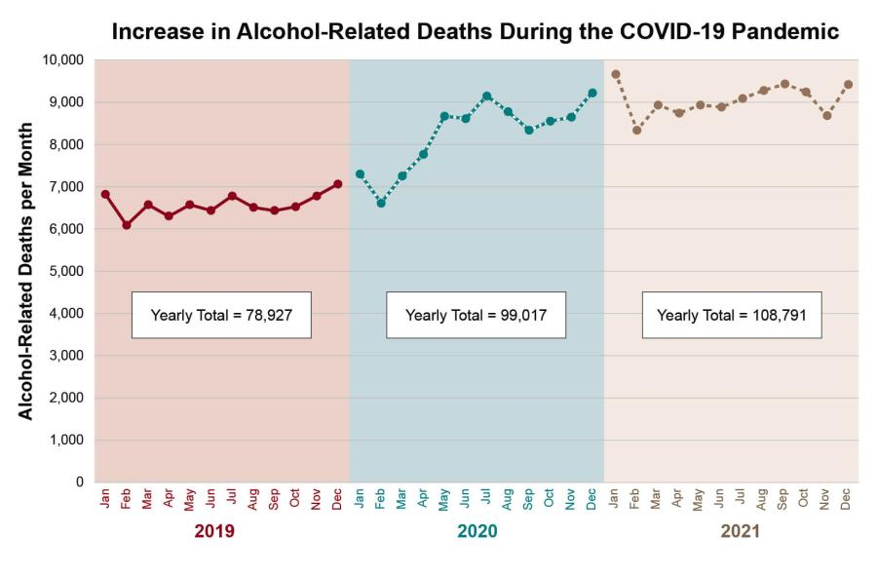
NIAAA 2023

Slide 10
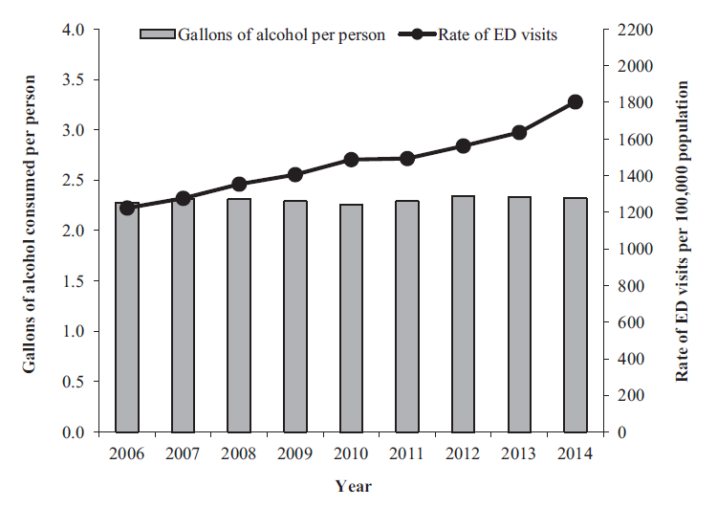
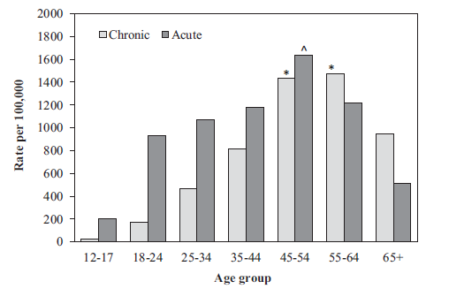
Increase in ED visits for alcohol in last two decades
White et al Alc: Clin Exp Res 2018

Slide 11
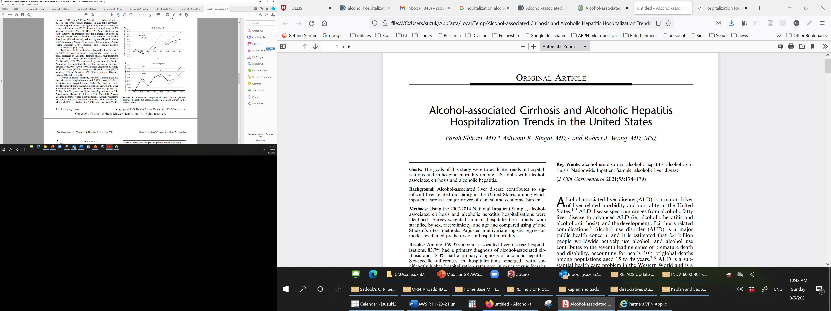
More individuals hospitalized with alcoholic liver cirrhosis and hepatitis
Shirazi et al J Clin Gastroenterol 2021

Slide 12
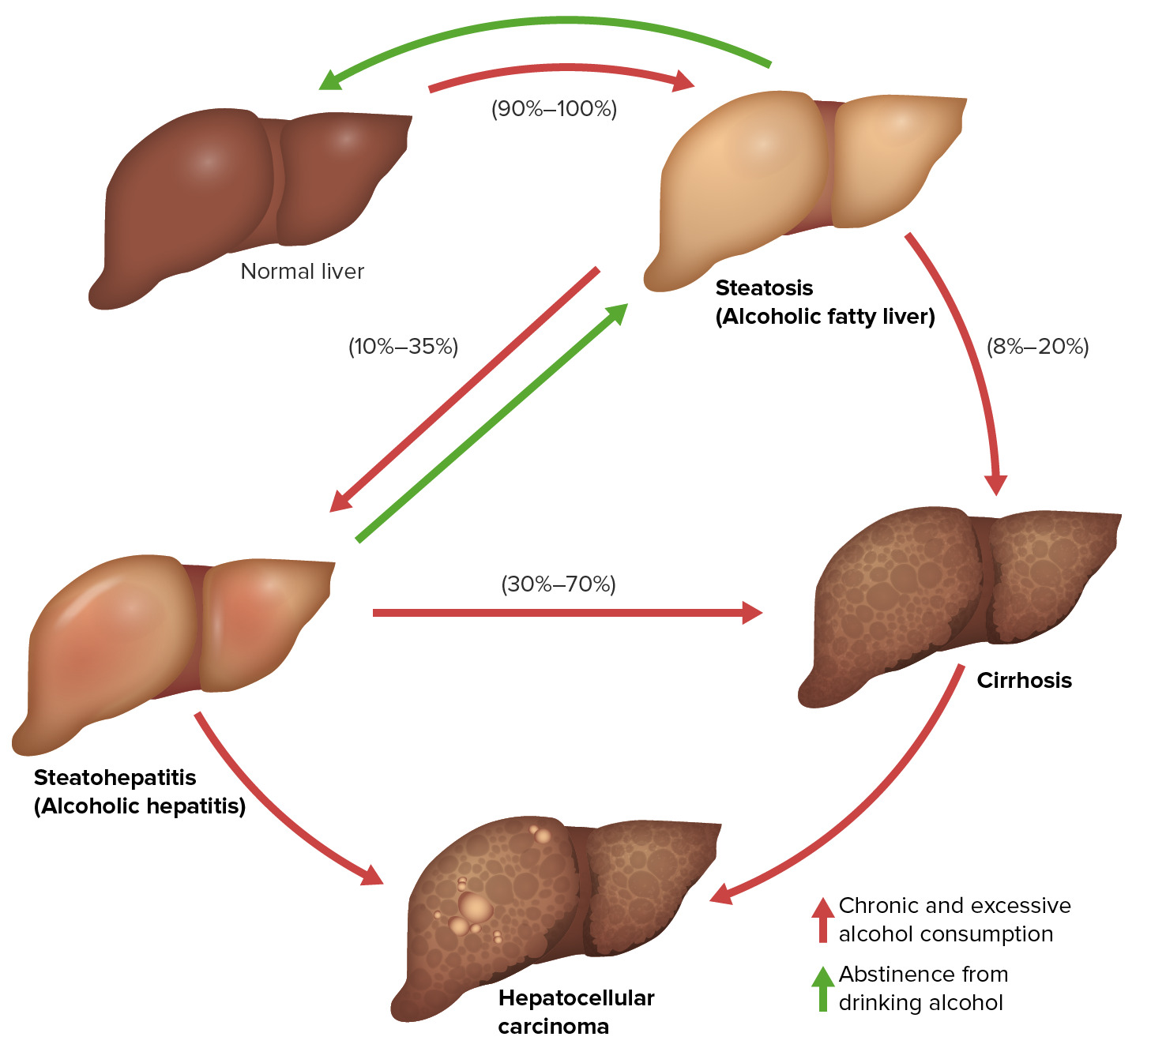
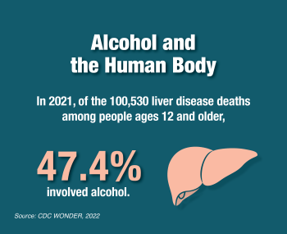

Slide 13
Approach to AUD treatment

Slide 14
Approach to treating AUD: Bio-psycho-social approach
Medications
Oral naltrexone
IM naltrexone
Acamprosate
Disulfiram
Gabapentin
Topiramate
Baclofen
Ketamine?
Social/ peer support
Psychological support
Inpatient/outpatient treatment
Motivational enhancement
CBT
Twelve-step facilitation
Treatment of co-morbid psychiatric disorders
AA/SMART
Peer support
Creating a sober social network

Slide 15
Medications for AUD (MAUD)
Naltrexone
Mu-opioid antagonist
Acamprosate
Glutamate modulator
AE: GI
Disulfiram
Inhibits ALDH
Flushing reaction upon consumption of ethanol
Attenuate euphoric effects of alcohol
PO (50mg) or IM (380mg)
Attenuate cravings
666mg PO TID
SE: liver, fatigue, anhedonia (?), GI
Contraindicated: Opioid use
Contraindicated: Renal impairment
AE: Liver, psychosis/delirium
250mg PO daily
Contraindicated: psychotic d/o

Slide 16
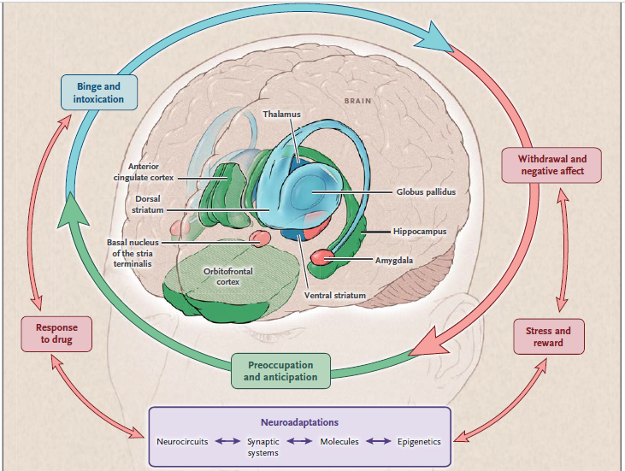
Neurobiology of substance use disorders
Binge/intoxication
Predisposing factors
Initiation
10-20%
Withdrawal/
negative affect
Risk factors
Pre-occupation/
anticipation
Volkow, Koob, & McLellan NEJM 2016

Slide 17
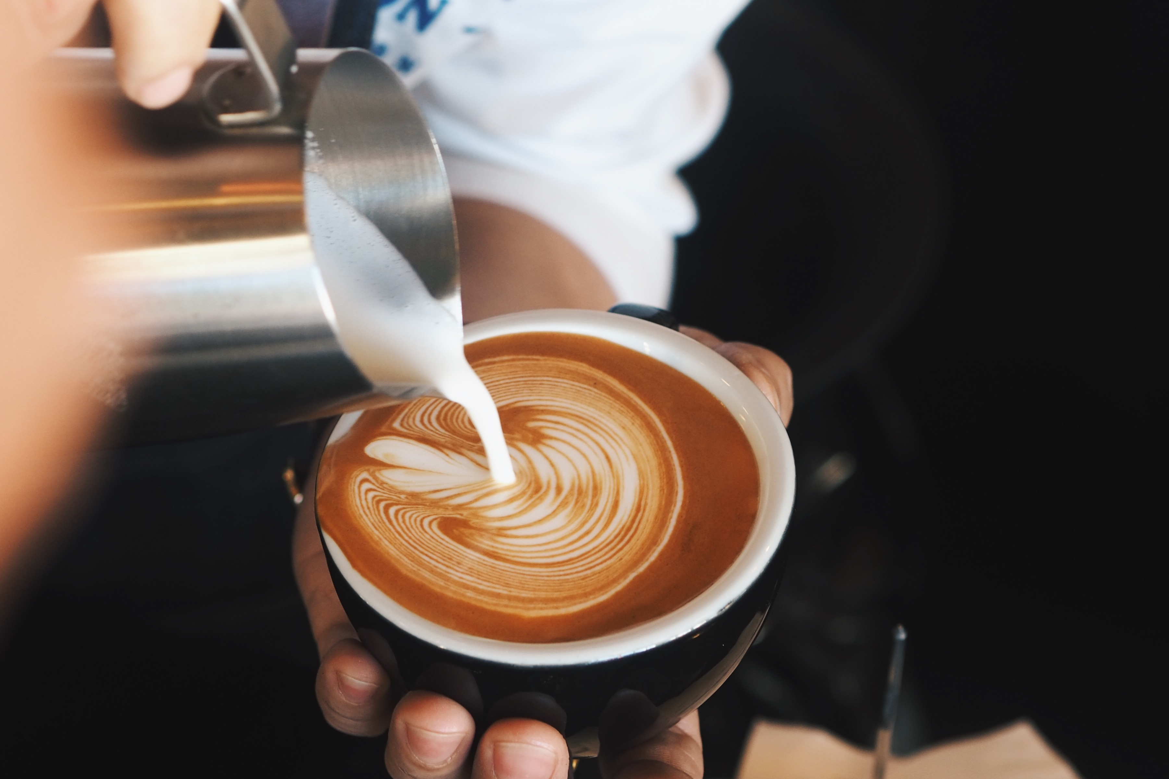
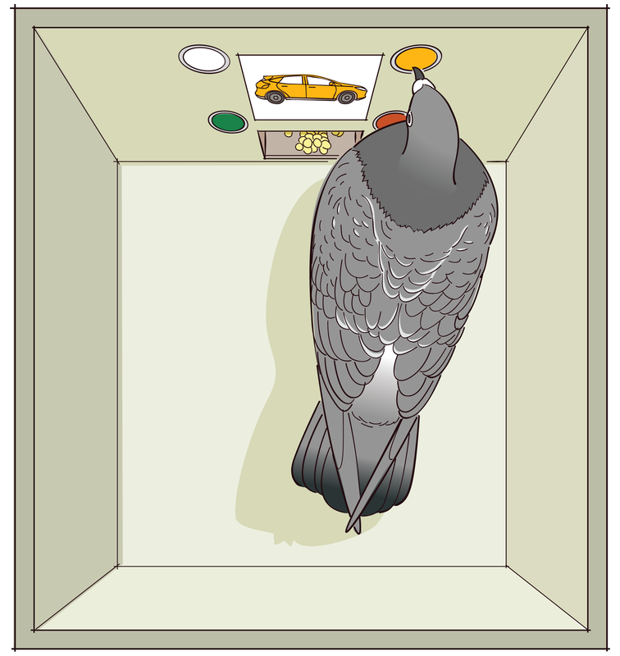
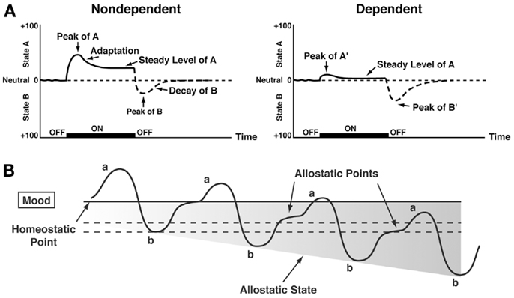
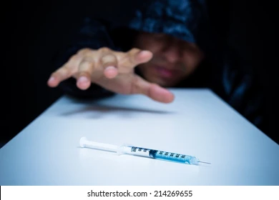

Theoretical models of addiction
Habit
Reflexive behavior
“Low entropy”
Operant Conditioning
Positive and negative reinforcement
“Liking”
Binge-intoxication stage
Opponent-process
Reward vs anti-reward
Withdrawal-negative affect stage
Incentive sensitization
“Craving”
Pre-occupation and anticipation stage
Impaired cognitive control
Poor inhibitory control
Risk taking despite harm

Slide 18
Treatment entry
Acamprosate and naltrexone reduces cravings (block negative reinforcement)
Exposure to drug-related cues
(People, places and things)
Cue-induced cravings
Counseling, peers, and AA/NA help with avoiding risky situations and managing cravings/stressors
(block negative reinforcement)
Subjective Cravings
Relapse
Stress-induced cravings
Exposure to stressors
(Internal, external)
Alcohol-induced cravings
Naltrexone address this by blocking the euphoric effects of alcohol; disulfiram causes adverse reaction
(block positive reinforcement)

Slide 19
Evidence-base for MAUDs

Slide 20
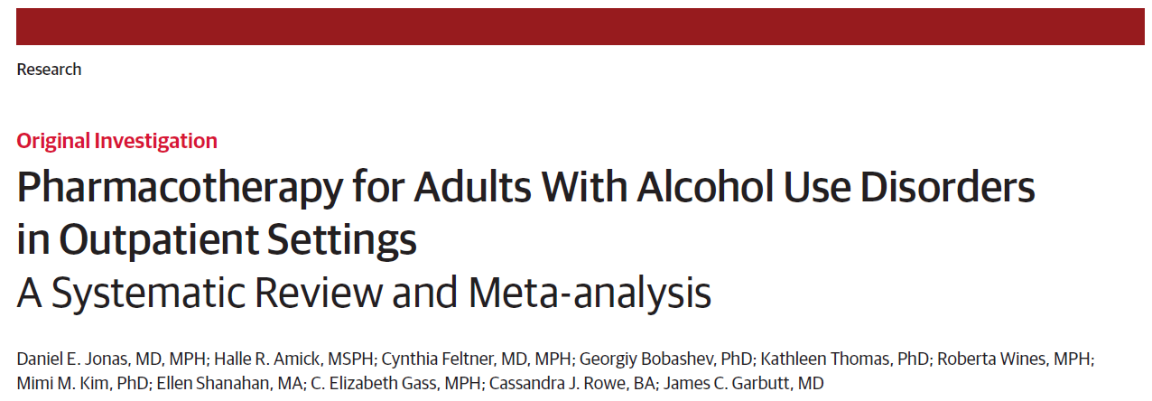
Naltrexone and acamprosate associated with reduction in return to drinking
RESULTS:
Included 122 RCTs and 1 cohort study, total 22,803 participants
Most assessed acamprosate (27 studies, n=7519) or naltrexone (53 studies, n=9140); only 2 trials of IM naltrexone
NNT to prevent return to any drinking
Acamprosate: 12 (RD -0.09, 95%CI -0.14 to -0.04)
Oral naltrexone: 20 (RD -0.05, 95%CI -0.10 to -0.002)
NNT to prevent return to heavy drinking
Oral naltrexone: 12 (RD -0.09, 95%CI -0.13 to -0.04)
No statistically significant difference b/w acamprosate and naltrexone for return to any/heavy drinking
IM naltrexone associated with reduction in heavy drinking (WMD -4.6%, 95%CI -8.5% to -0.56%)
DESIGN:
Systematic review and meta-analysis
Include RCTs with at least 12-week duration and head-to-head prospective cohorts
Calculate NNT and NNH
OUTCOMES:
Alcohol consumption (return any drinking; return to heavy drinking)
MVA, injuries, QoL, function, mortality, harms
CONCLUSION:
Acamprosate/naltrexone associated with reduction in return to drinking
Naltrexone (PO/IM) may have greater impact on reducing heavy drinking
Jonas et al JAMA Network 2014

Slide 21
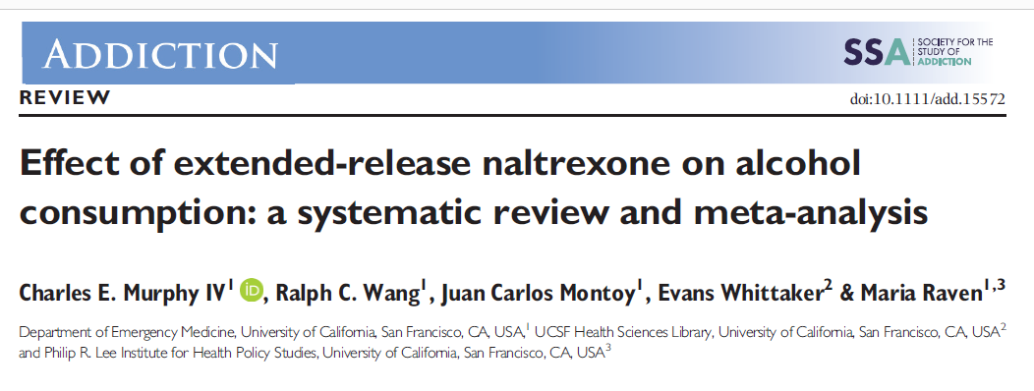
Growing evidence-base for IM Naltrexone for AUD in reducing drinking
RESULTS:
Included 7 trials (n=1,500 individuals)
Drinking days per month WMD: -2.0 (95%CI -3.4 to -0.6)
Heavy drinking days per month WMD: -1.2 (95%CI -0.2 to -2.1)
2 fewer drinking days per month
1.2 fewer heavy drinking days per month
Larger response when:
NO abstinence lead-in
trial longer than 3 months
DESIGN:
Systematic review and meta-analysis of RCTs of IM naltrexone vs placebo for AUD in outpatient clinics
IM naltrexone 150-400mg for 2-6 months + psychotherapy
OUTCOMES:
Alcohol consumption, pooled WMD in:
Drinking days/month
Heavy drinking days/month
1-2-day reduction in HDD represents 15-25% of possible benefit compared to reduction seen in placebo
CONCLUSION:
IM naltrexone reduces any drinking
Longer treatment with larger effect, and no abstinence required
Murphy et al Addiction 2021

Slide 22
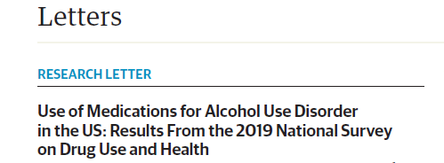
Despite decent evidence-base, MAUDs under-utilized
RESULTS:
Past year prevalence of AUD → 5.6%
Receipt of ANY AUD treatment → 7.3% of those with AUD
Receipt of MAUD of those with AUD → 1.6%
DESIGN:
NSUDH data from 2019 (n=42,739)
Assess past-year receipt of AUD treatment including MAUDs
EXPOSURE:
US adults with AUD
OUTCOMES:
Receipt of any MAUD (naltrexone PO/IM, acamprosate, disulfiram)
CONCLUSION:
MAUDs rarely used to treat AUD
Han et al JAMA Psychiatry 2021

Slide 23
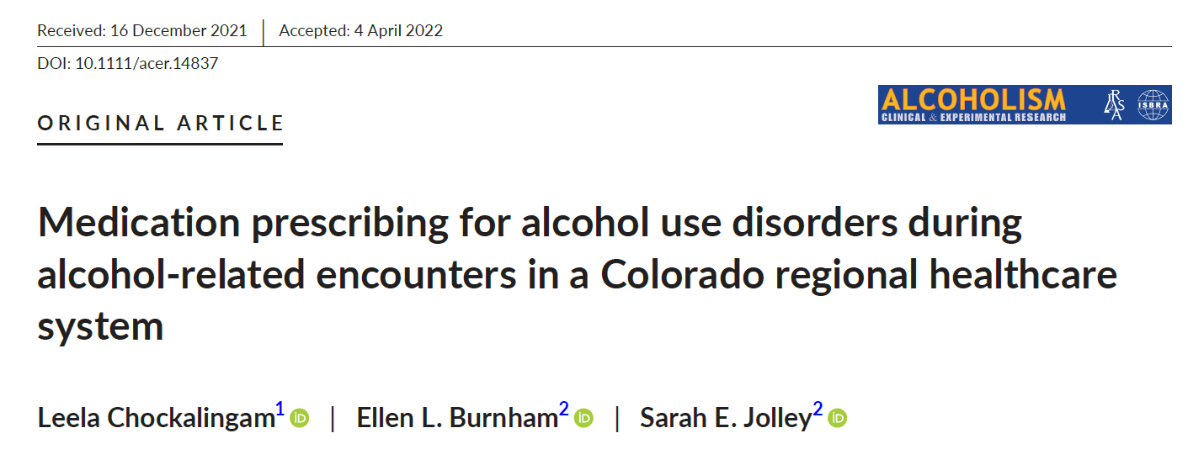
AUD-related encounters occur disproportionately in acute care settings
RESULTS:
Cohort = 48,421 individuals with AUD representing 134,441 encounters
MAUD prescribed to 2,270 individuals (5%) during 5,964 encounters (4%)
DESIGN:
EHR database review of all alcohol-related health care encounters at University of Colorado Health system from Jan 2016- Dec 2019
Include patients from throughout Colorado, southern Wyoming, and western Nebraska; and data from acute care hospitals, EDs, outpatient primary and specialty clinics, inpatient SUD programs, and urgent care center
EXPOSURE:
Alcohol-related disorder
OUTCOMES:
Prescribing of any MAUD (naltrexone, acamprosate, disulfiram)
CONCLUSION:
Enormous burden of AUD in the ED and hospital
Leveraging ED encounter to initiate MAUD critically important
Chockalingam et al Alc Clin & Exp Res 2021

Slide 24
SBIRT?

Slide 25
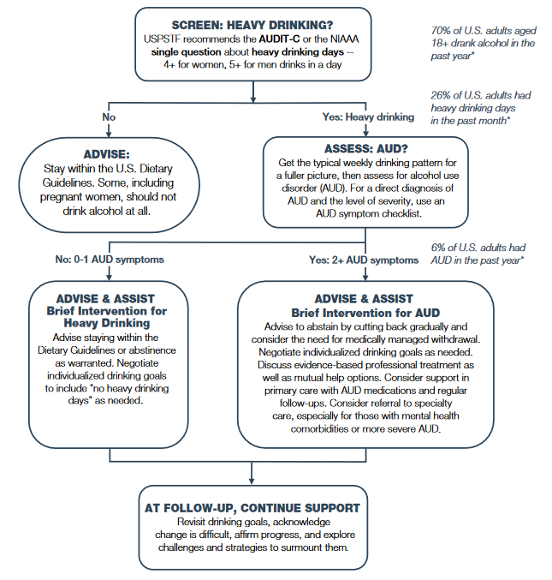
SBIRT for AUD
NIAAA

Slide 26
Current SBIRT recommendation
US Preventative Services Task Force recommends screening for unhealthy alcohol use in primary care settings in adults 18 years and older, including pregnant women and providing persons engaged in risky or hazardous drinking with brief behavioral counseling interventions to reduce unhealthy alcohol use (B recommendation).
USPSTF JAMA 20108:320(18)

Slide 27
Screening, Treatment Initiation, and Referral (STIR)
SBIRT?
Hawk and D’Onofrio 2022

Slide 28
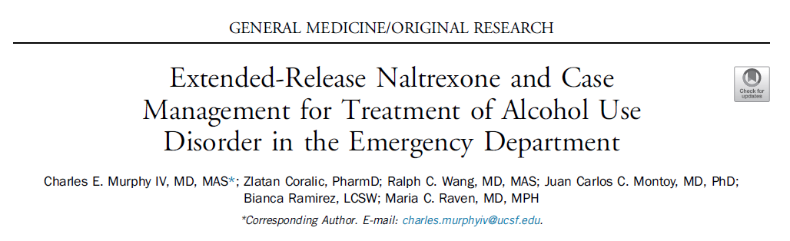
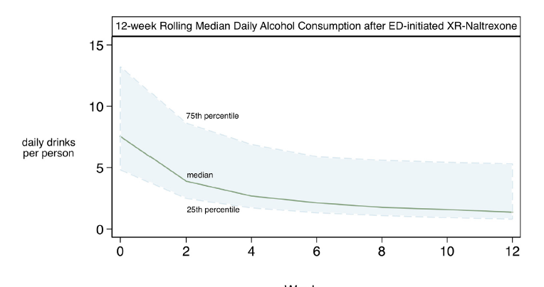
IM Naltrexone for AUD in the ED might be effective
RESULTS:
179 met inclusion, 25 provided f/u data
Median AUDIT-C score: 11; WHO Risk: 4
Attending 12-week follow-up: 84%
Change in alcohol consumption:
Drinks per day: -7.5
WHO risk: -2
DESIGN:
Open-label, single-arm, 12-week prospective study
AUD patients in academic ED with AUDIT-C score greater than 4
INTERVENTION:
IM Naltrexone at weeks 0, 4, and 8
Case management (MI, triggers, coping skills, med management, transportation, scheduling, housing referrals, etc.)
OUTCOMES:
Alcohol consumption: Drinks per day, change in QoL
CONCLUSION:
IM naltrexone reduces drinking after ED-initiation
Case management?
Murphy et al Addiction 2022

Slide 29
Bridge Clinic model

Slide 30
Linkage to treatment after buprenorphine initiation in the hospital
Typical outpatient treatment
Yale ED bup RCT
MGH consult
BWH consult
BMC bup RCT
BMC consult
Suzuki et al 2014; Liebschutz et al 2016; Trowbridge et al 2016; Wakeman et al 2017; D’Onofrio et al 2015; Suzuki et al 2015

Slide 31
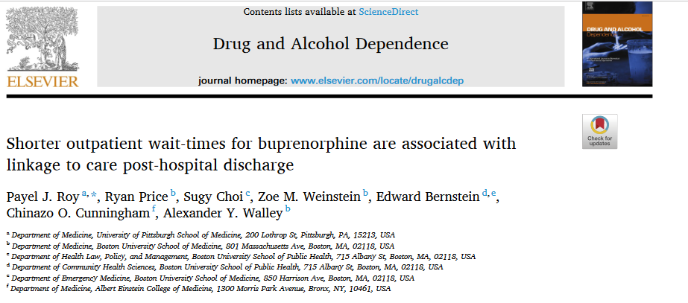
Shorter wait-times may be critical for OUD patients leaving the hospital
Results:
Total 142 charts included
For 0-1 day wait times: 63% successfully arrived
For 2+ days wait times: 42% successful arrived
Shorter wait time had 2.6 times the odds of successful linkage (aOR 2.6; 95%CI 1.3-5.5)
Design: Retrospective of hospitalized OUD patients initiated on SL buprenorphine
Method: Assess whether shorter wait-times (either 0-1 vs 2+ days) were associated with improved linkage to treatment
Conclusion:
Same day or next appointment increases odds of linkage
Roy et al Drug Alcohol Dep 2021

Slide 32

The Bridge Clinic model (low barrier, low threshold)
Objective: Allow on-demand, rapid-access to outpatient treatment for patients with SUDs and connect them to long-term, community-based treatment & resources
Hospital inpatients needing timely SUD care after discharge
Bridge Clinic
In heart of hospital, 50 ft from ED
Staffed by Addiction CL, primary care, and ID physicians
On-demand treatment including walk-ins (AUD/OUD)
Recovery coaches / Resource specialist
Longer-term SUD treatment
ED patients who presented seeking care or had non-fatal overdose

Slide 33
Conclusions
AUD remains highly prevalent in the US, with increasing alcohol-related mortality, rivaling that of OUD
MAUDs a critical element of treatment of AUD, but highly under-utilized
Growing evidence-base in support of all MAUDs including IM naltrexone
AUD-related encounters occur disproportionately in the EDs
SBIRT is ok, but we should prefer STIR whenever possible
Bridge model will likely further improve outcomes

