Slide 1
Pain Management
C. Mateo Garcia, MD
UNM EMS Consortium

Slide 2
Objectives
Define Pain.
Discuss key features to document and assess w/ regards to pain.
Discuss the primary modalities of pain control in the prehospital setting.
  Splinting - Immobilization of injured extremities.
  Elevation
  Ice
  Position of comfort
  Pharmacology – common medications and contraindications
Discuss disparities in treatment of in the prehospital setting.

Slide 3

What is Pain Really?
Definition: Pain is an unpleasant sensory and emotional experience associated with actual or potential tissue damage, or described in terms of such damage
  A symptom of an underlying condition
  The most common reason for physician consultation in most developed countries
  Can be Acute vs. chronic
  Characterizations/Types: neuropathic, phantom, nociceptive, psychogenic, breakthrough

Slide 4
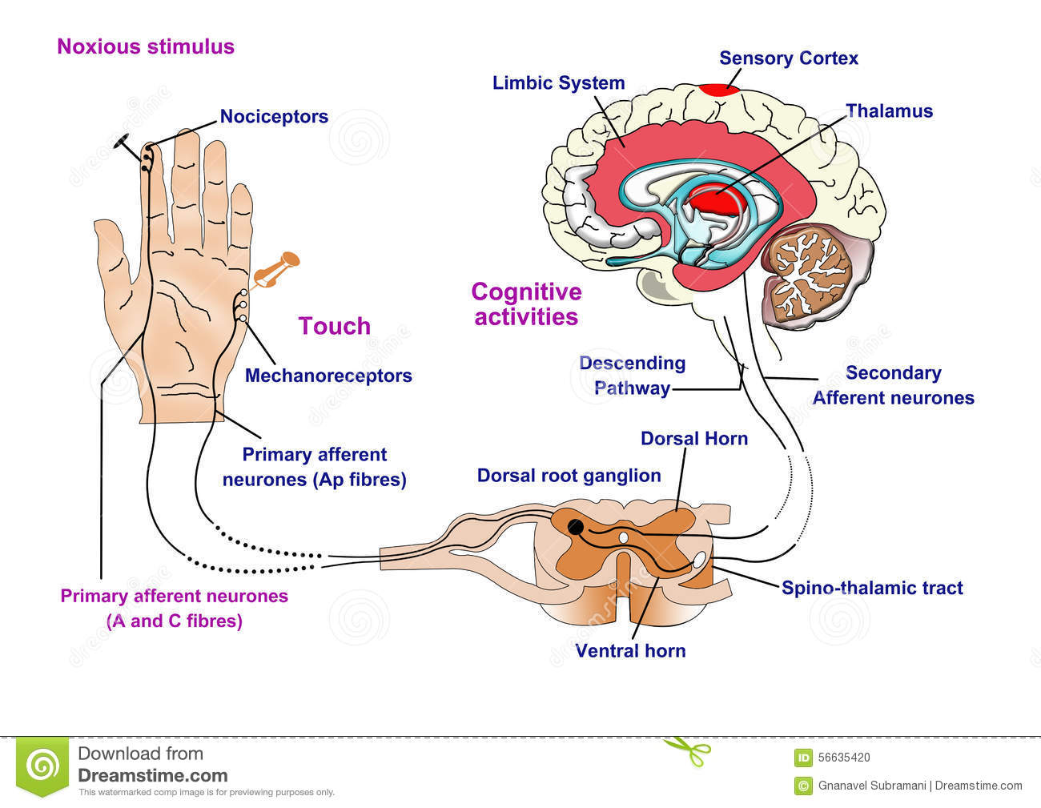
What is Pain?

Slide 5
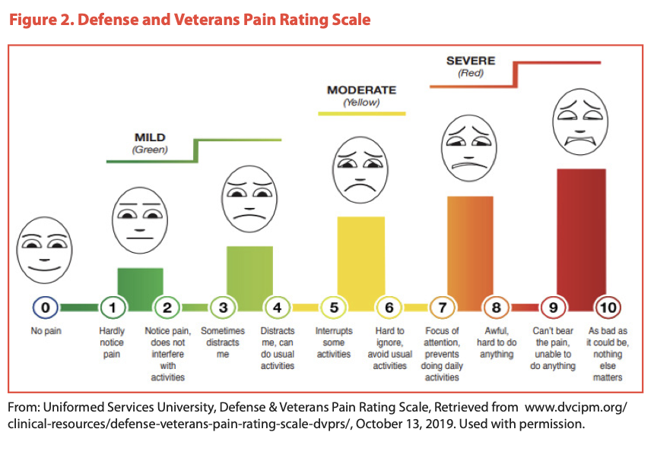
What Is pain?

Slide 6
Assessment
Story – What factors should you inquire about?
Vitals – What abnormalities do we see with Pain?
Visualize– What are you looking at and documenting on Visual assessment?
Palpation – What are you feeling for and noting on exam and in chart when palpating?
→ Interventions
Reassess – What are important factors in Reassessing post intervention?

Slide 7




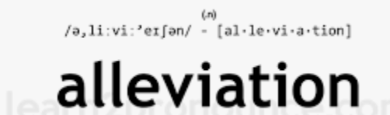
Story

Slide 8
Pain Scale?

Slide 9


Vitals

Slide 10
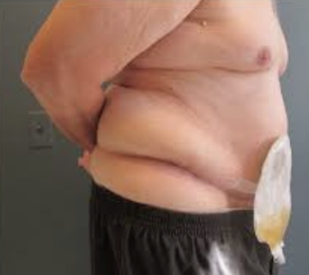
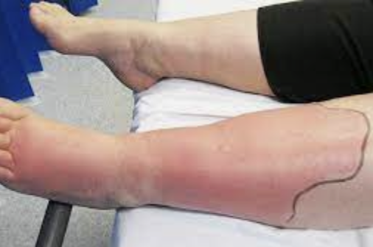
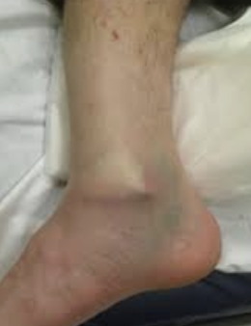
Visual inspection
Color
Deformity
Swelling
Rashes
Size

Slide 11
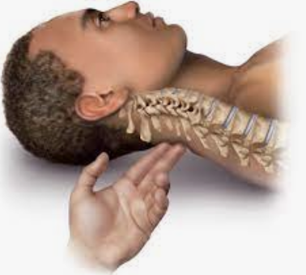
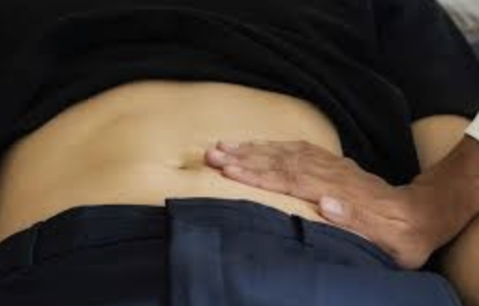
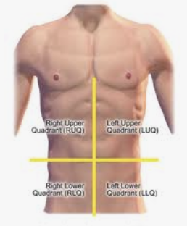
Palpation

Slide 12
Objective #2
Discuss the primary modalities of pain control in the prehospital setting.
  Splinting - Immobilization of injured extremities.
  Elevation
  Ice?
  Position of comfort
  Pharmacology – common medications and contraindications

Slide 13

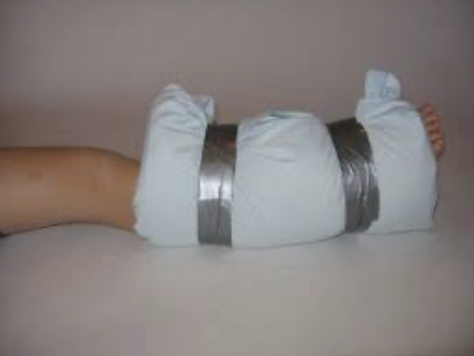
Splinting

Slide 14
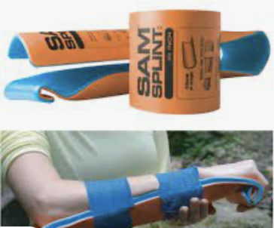


Splinting

Slide 15

Elevation

Slide 16

Position of Comfort

Slide 17

ICE?

Slide 18

Pharmacology

Slide 19
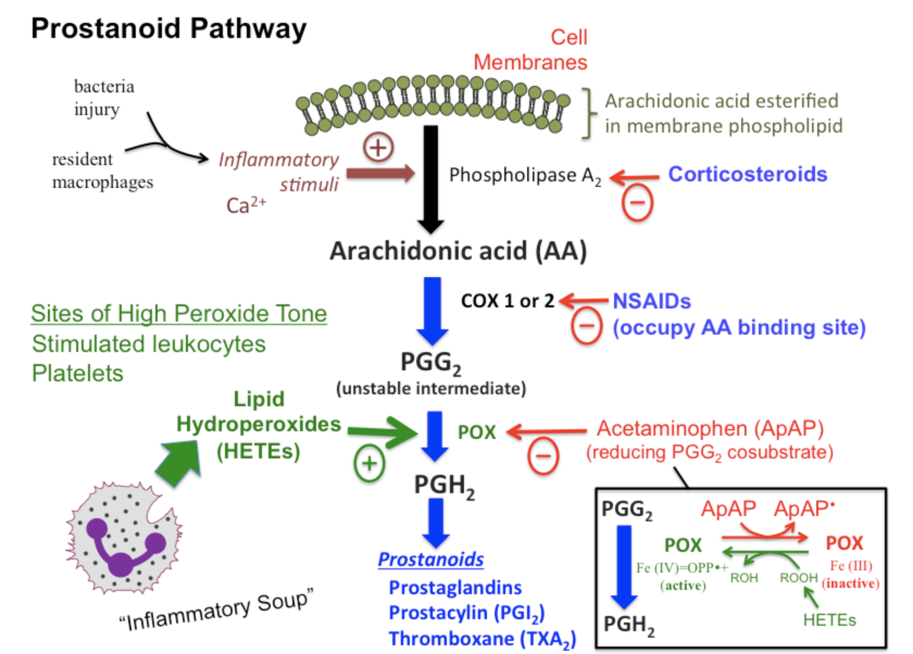
NSAIDS: Ibuprofen
Class: NSAID
MOA: Inhibits prostaglandin synthesis via Inhibition of COX enzyme resulting in analgesia, antipyretic and anti-inflammatory properties.
Adverse effects: N/V/D, GI upset and gastritis.
Indications: pain caused by inflammatory pathways, fever, osteoarthritis, RA.
Contraindications: Hepatic and renal disease, CHF, hypertension, cardiac diseases or cardiomyopathies.

Slide 20
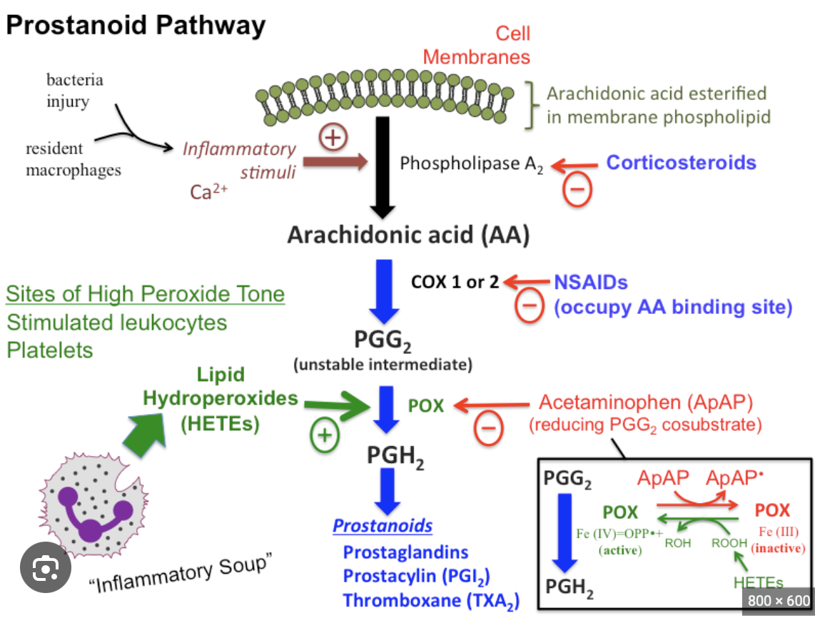
Acetaminophen
Class: Analgesic/ Antipyretic
MOA: Inhibits prostaglandin synthesis via Inhibition of POX enzyme resulting in analgesia, antipyretic and anti-inflammatory properties.
Adverse effects: N/V/D, GI upset, liver injury.
Indications: pain caused by inflammatory pathways, fever, osteoarthritis, RA.
Contraindications: Hepatic/Liver disease, chronic use or ingestions.

Slide 21
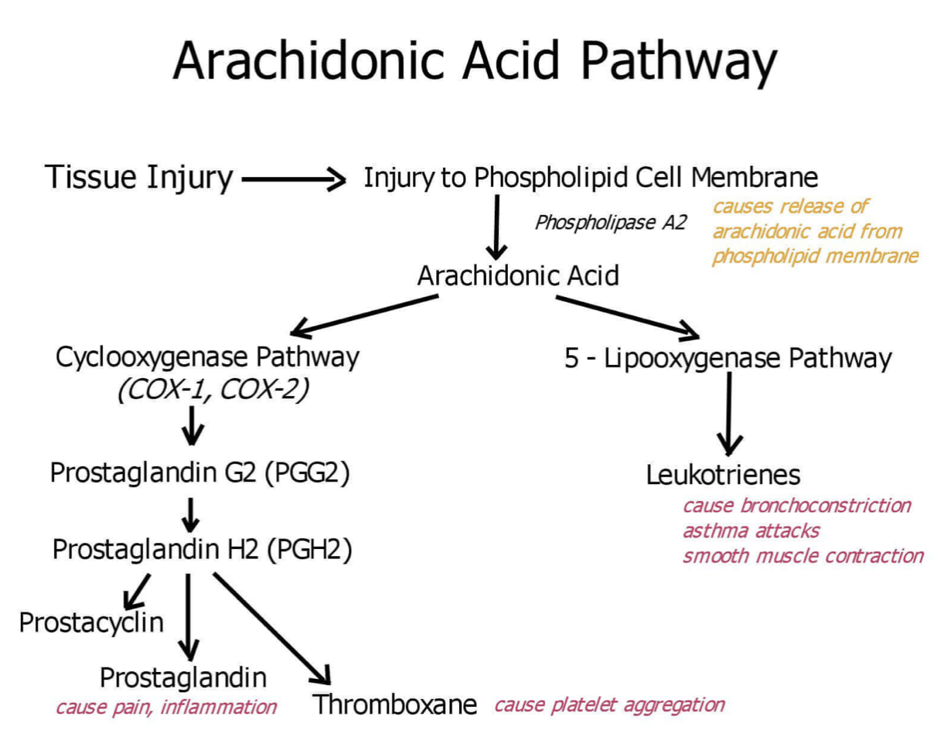

Slide 22
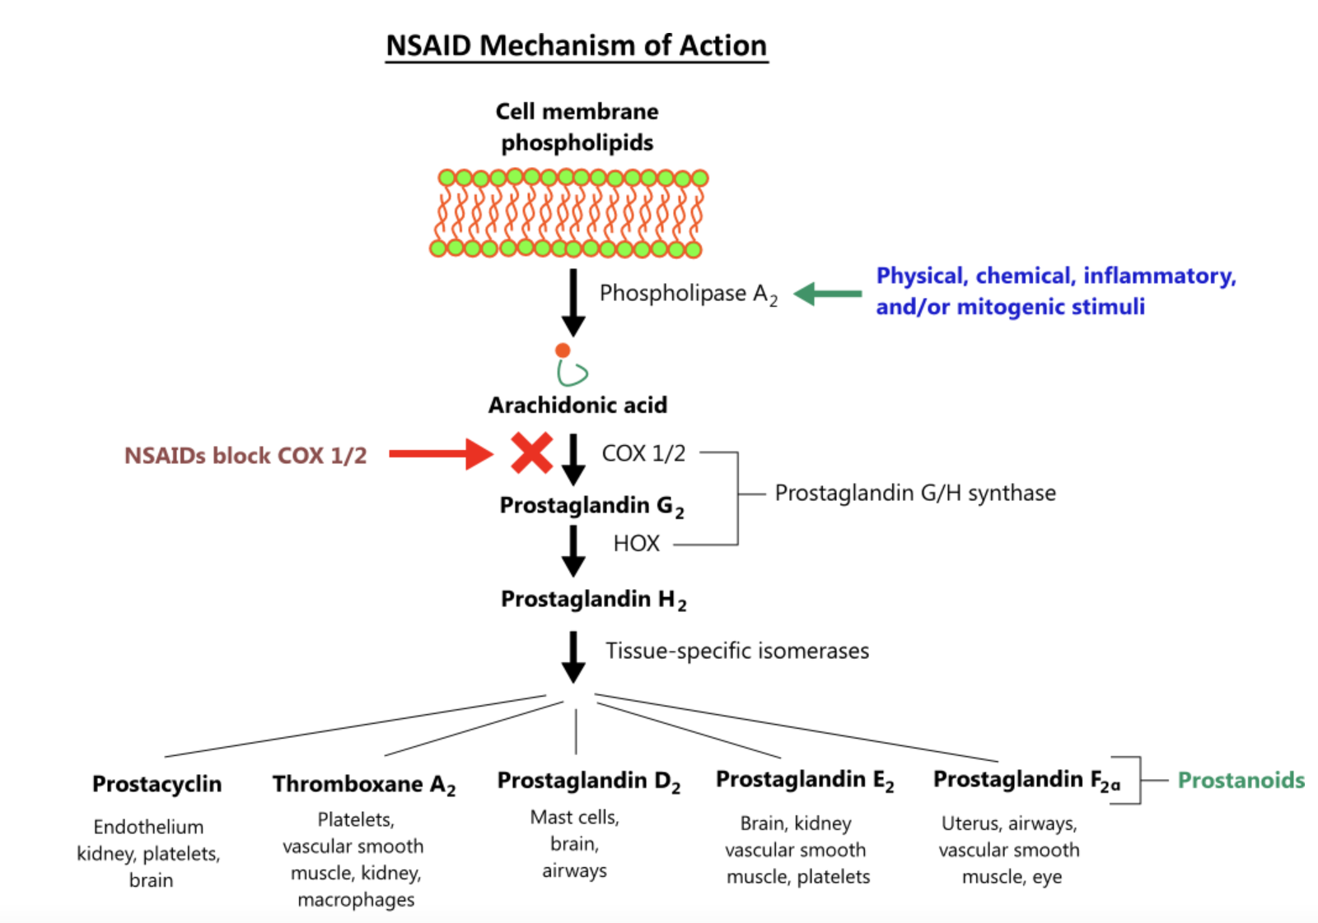
NSAIDS : Ketorolac
Class: NSAIDS
MOA: inhibits prostaglandin production
Indications: moderate to severe pain. Works extremely well for nephrolithiasis
Dosing: Adult 15mg to 30mg IV or IM
Contraindications: Hepatic and renal disease, CHF, hypertension, cardiac diseases or cardiomyopathies. Suspected stroke, head trauma, nursing mothers.
Pregnancy Class C

Slide 23
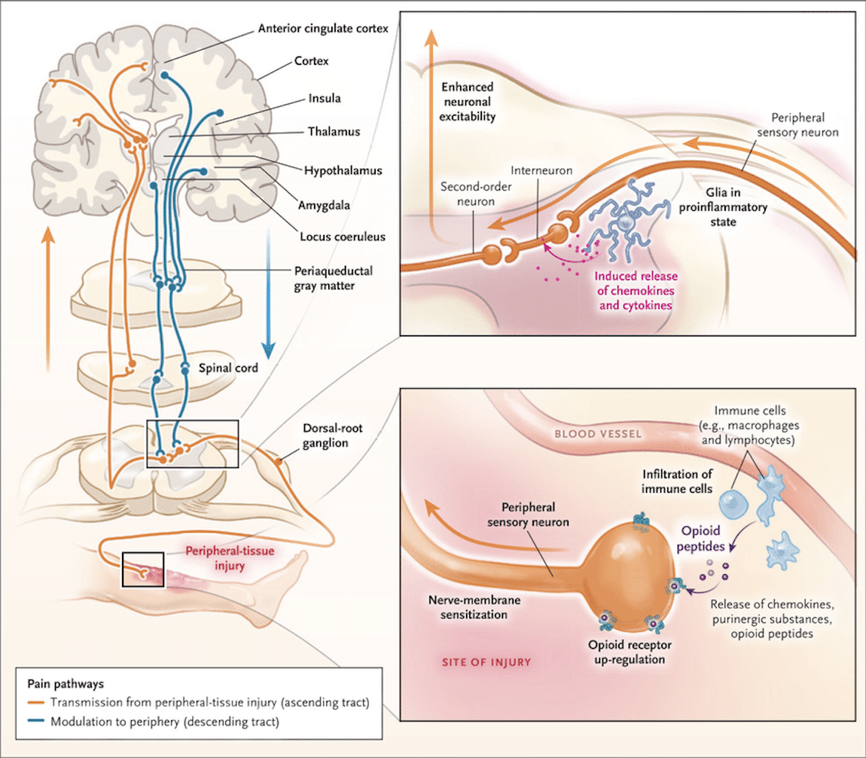
Opiates - Morphine
Class: Opiate agonist, Schedule C
Action: binds Mu opioid receptors, acts on CNS, can result in histamine release, reduces sympathetic drive.
Indications: moderate to severe pain. Including chest pain from ACS, CHF and pulmonary edema.
Adverse effects: hypotension, CNS depression, respiratory depression, worsening bradycardia and hypotension in patient with inferior wall infarct, anaphylaxis.
Contraindications: Respiratory depression, Shock, hypotension, acute asthma or respiratory insufficiency, head trauma.

Slide 24
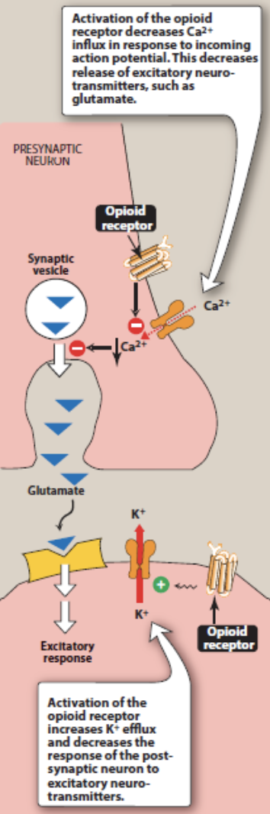
Opiates - Fentanyl (Sublimaze)
Class: narcotic analgesic
Action: opiate receptor agonist producing analgesia and euphoria
Indications: really all types of pain.
Adverse effects: Respiratory depression, apnea, hypotension, nausea/V, sedation, dizziness, pain at injection site.
Routes: IV, IN, IM
Dose 1-2 mcg/kg IM or slow IV push, IO.
Contraindications: TBI, respiratory insufficiency, or compromise.

Slide 25
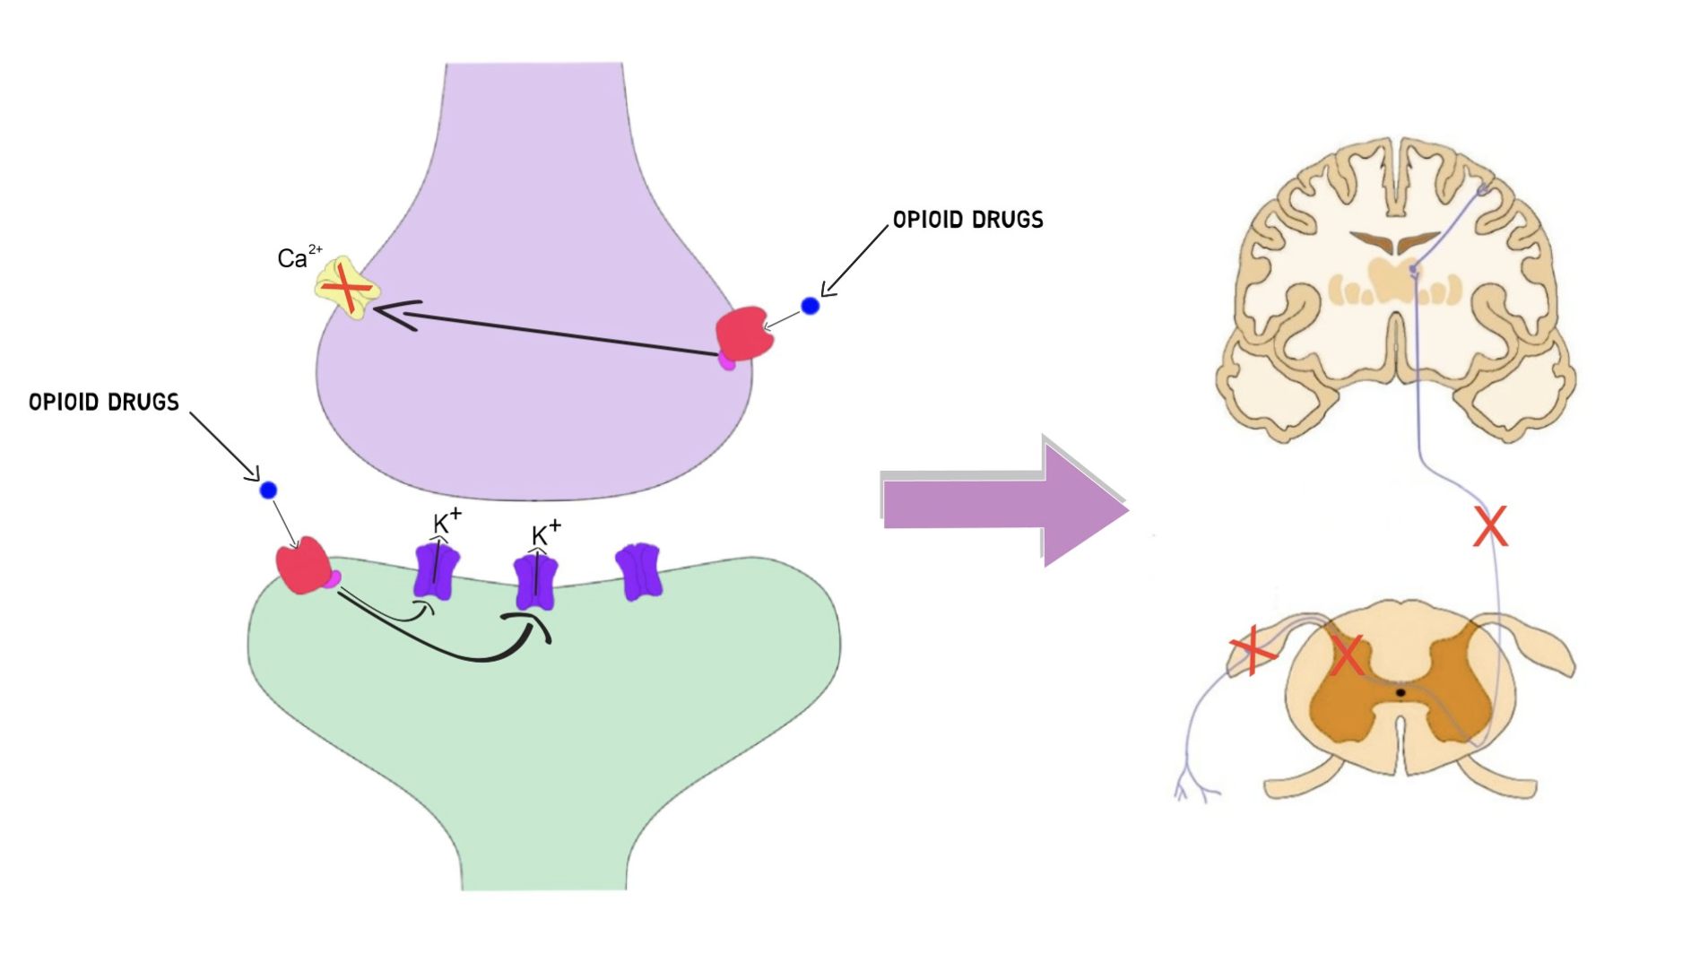

Slide 26
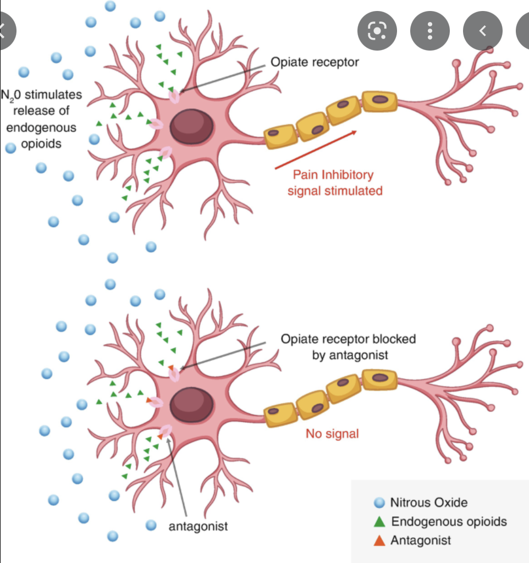
Nitrous Oxide
Class: inorganic gas, inhaled anesthetic
Exact mechanism still unclear but partially facilitated by endogenous opioid release
Indications: Mild to severe pain
Adverse Effects: Delirium, hypoxia, Respiratory depression, N/V
Dosage: inhaled 20-50% concentration with blended O2
Contraindications: Caution in head trauma, pneumothorax, COPD, Bowel obstruction.

Slide 27
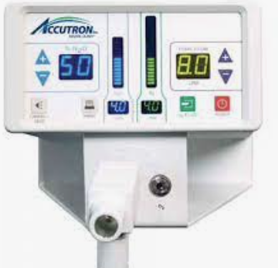
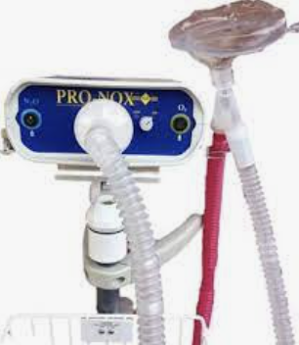

Slide 28
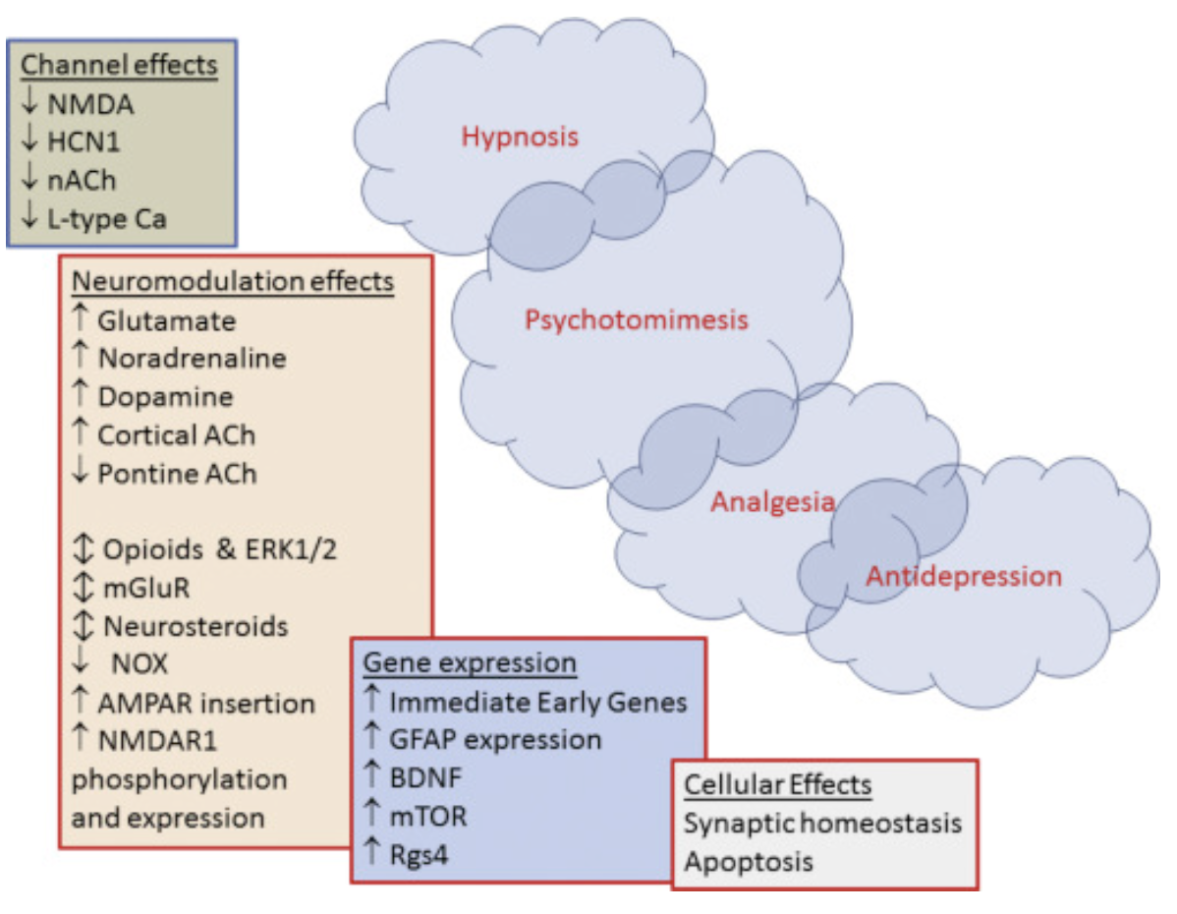
Ketamine (Ketalar)
Class: General Anesthetic, analgesic, sedative.
MOA: NMDA receptor antagonist / modulator, Complex.
Indications: pain, anesthesia for short procedures.
Adverse effects: Emergence phenomena, hypertension, sinus tachycardia, hypotension, sinus bradycardia, Laryngospasm, respiratory depression.
Contraindications: severe hypertension, stroke, head trauma, increased ICP

Slide 29
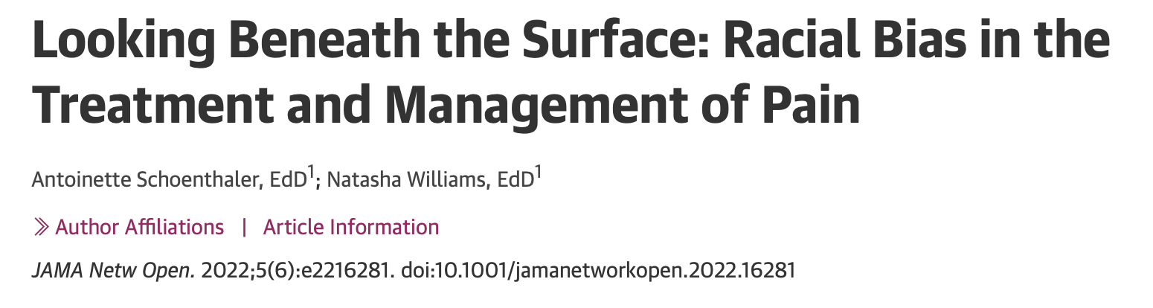
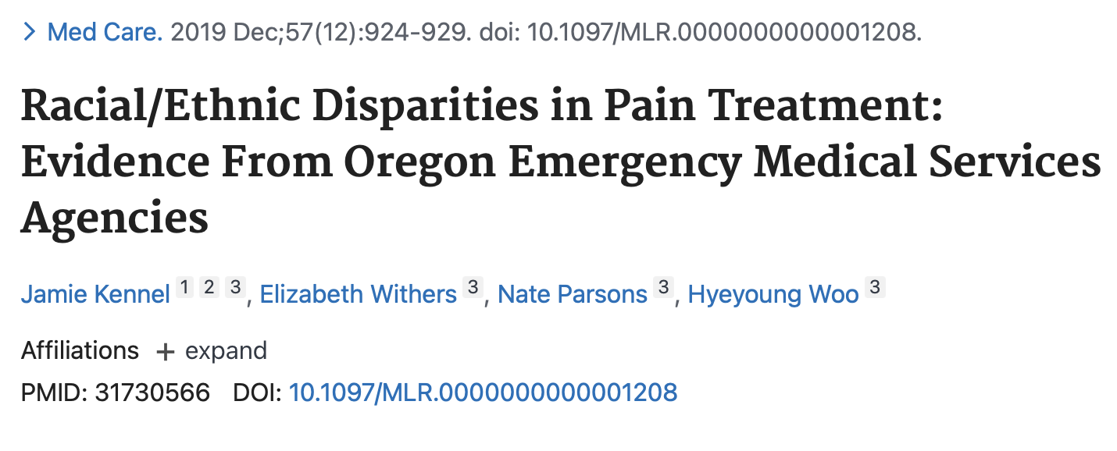
Disparities in pain treatment

Slide 30
Disparities in pain treatment:
The Good News
Patients who are treated for pain by EMS are reportedly more likely to have better pain management while in the ER.
Evidence suggests that by us talking about these disparities, we can improve and affect change in addressing these disparities.
Using a standardized pain assessment tool can help provide better pain management, BUT requires re assessment

Slide 31

What Questions do you have?

