Slide 1

Management of SUDs: Clinical Application & Key Pearls
Wei Sum Li, MD
Adult Medicine Primary Care Physician, Charlestown Healthcare Center, Massachusetts General Hospital
Inpatient Consult, MGH Addiction Consult Team
Instructor in Medicine, Harvard Medical School
May 25, 2023

Slide 2
I have no financial disclosures

Slide 3
Acknowledgements
Massachusetts General Hospital Internal Medicine Residency Substance Use Disorder Ambulatory Lecture Series
  CAMPER (Council for Addiction Medicine and Psychiatry Education for Residents)
  James Morrill, MD, PhD and Evan Gale, MD
How to Implement Low Dose Buprenorphine Initiation in Your Practice: A Case-Based Workshop. ASAM 2022
  Shawn Cohen, MD, FASAM
  Kenneth Morford, MD, FASAM
  Melissa B. Weimer, DO, MCR, FASAM
Harm reduction: a patient centered approach to caring for people who use drugs
  Dinah Applewhite, MD
Providers Clinical Support System

Slide 4
Learning Objectives
Develop framework for discussion, evaluation, and management of substance use disorders as a chronic disease
Recognize the clinical importance of accurate patient-centered language
Diagnose and formulate a treatment plan for opioid use disorder using evidence-based and patient-centered approaches
Understand how to initiate buprenorphine in a primary care patient
Describe the role of harm reduction and identify practical strategies to reduce harm in the ​care of individuals who use substances
Notes:
Define stigma as a concept and review different domains of stigma against patients with substance use disorders
Identify stigmatizing language and non-stigmatizing alternatives
Be ready to prescribe evidence based medications, treatment, and therapies in accordance with the patient’s values, preferences, and needs
Understand the essential elements of on-boarding a new buprenorphine patient in your primary care practice​
​Review the medication options for treating opioid use disorder and understand the inequities in access to these medications​
Understand how to initiate buprenorphine in a primary care patient​
​Practice interpretation of toxicology studies and responding to unexpected results
Review mechanisms and properties of stimulants ​
Understand why individuals use stimulants in adaptive and maladaptive ways ​
Identify key harm reduction messaging for inhalational and per-rectal cocaine and methamphetamine use​
Develop a clinical approach to patients using non-prescribed stimulants that centers patients’ goals and priorities​
Identify interventions with evidence for treatment of stimulant use disorders

Slide 5
Tuesday morning in clinic
A 45-year-old woman drinks two 12 packs of soda a week. Her A1c is 12.1%. She has peripheral neuropathy that is worsened over the past 6 months. She is
  prescribed a medication.
  referred to a diabetes group.
  offered a nutritionist referral.
  encouraged to set up a short interval follow-up.

Slide 6
Tuesday morning in clinic
A 35-year-old man uses intranasal heroin on Fridays and Saturdays. He has never used IV and has never had an overdose.
A: Send him to acute inpatient medically-monitored withdrawal (“Detox”)
B: Explore his reasons for his use
C: Prescribe naloxone (Narcan)
D: Prescribe buprenorphine
E: Send him to an outpatient treatment program (OTP) for methadone
F: Refer to behavioral health
Notes:
Your next patient comes into the office.
Thinking about all of the treatment and resources you were able to offer your first patient, what would you do for this patient?
I’d like for you to actually select what you are doing currently. Perhaps what you have done in the past and what you would do if presented with this patient right now.
You can select more than one option if possible
If you feel uncomfortable managing this patient in comparison to the first patient, it might be because there are many myths and baggage that come up.
In order to discuss, evaluate, and manage this patient in the same way you would approach your first patient, we’ll now go through several myths which might come to mind.

Slide 7
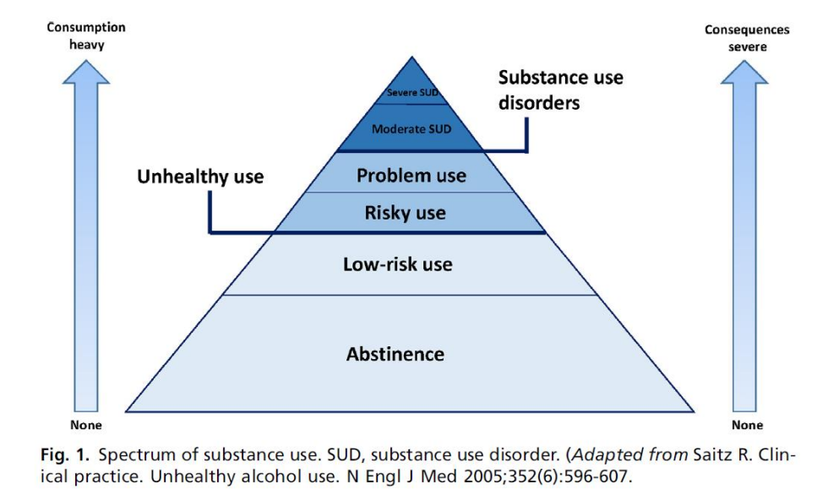
Myth: “All substance use is a use disorder”
Notes:
This is a classic image from Dr. Saitz
The National Institute on Alcohol Abuse and Alcoholism (NIAAA) defines risky alcohol use for men aged 65 years or younger as having more than 4 drinks on any day or more than 14 standard drinks per week. For women or men older than 65 years, risky alcohol use is defined as having more than 3 drinks on any day or more than 7 standard drinks per week. A standard drink is 12 oz of beer, 8 to 9 oz of malt liquor, 5 oz of wine, or 1.5 oz of distilled spirits. Binge drinking is when blood alcohol concentration meets or exceeds 0.08%, which typically occurs when women have 4 or more drinks and men have 5 or more drinks within about 2 hours.

Slide 8
Who has a use disorder?
21-year-old woman who drinks 5 cocktails most Fridays and Saturdays
37-year-old man who injects heroin every other week
45-year-old woman who snorts cocaine one weekend a month
65-year-old man who drinks a 6-pack of beer every day
Notes:
Understanding the spectrum of substance use then, who then has a use disorder?
Can you tell only from the amount consumed?
Can you diagnose any of these patients with this information?

Slide 9
DSM 5 Criteria for Substance Use Disorders
3C’s + Dependence
Cravings
Craving, or a strong desire or urge to use substance
Control
Substance is taken in larger amounts or over longer periods than was intended.
There is a persistent desire or unsuccessful effort to cut down or control substance use.
Consequences
A great deal of time is spent in activities necessary to obtain, use, or recover from substance.
Recurrent use is resulting in a failure to fulfill major role obligations at work, home, or school.
Continued use despite having persistent or recurrent social or interpersonal problems caused or exacerbated by the effects of the substance.
Important social, occupational, or recreational activities are given up or reduced because of use.
Recurrent use in situations in which it is physically hazardous.
Continued use despite knowledge of having a persistent or recurrent physical or psychological problem
Tolerance
Withdrawal
Dependence
+
2-3 = Mild
4-5 = Moderate
6+ = Severe
Early remission = no use <12 months
Sustained remission = no use >12 months
Notes:
This is the American Psychiatric Association Diagnostic and Statistical Manual of Mental Disorders- 11 criteria
The key to this framework is that the focus is not on the FACT that a person is using substances but the WHY and HOW
The dx of a use disorder is not about USE and more about the DISORDERED USE
For some cases, there are significant consequences of use even at lower levels of consumptions. That might be because of the substance used, but it might also be because of the individual.
sometimes lumped into 4 categories- sometimes with categories such as risky use, social problems, impaired control, and physical dependence

Slide 10
Who has a use disorder?
20-year-old woman who drinks 5 cocktails most Fridays and Saturdays
37-year-old man who injects heroin every other week
45-year-old woman who snorts cocaine one weekend a month
65-year-old man who a 6-pack of beer every day
Cravings
Control
Consequences
Dependence
Notes:
So using this framework, who can you diagnose with a use disorder?
Trick question, none of the above until you ask more questions.
Not all use is a use disorder
Many individuals are abstinent, and many are not
By definition, one does not have a use disorder simply because they use

Slide 11
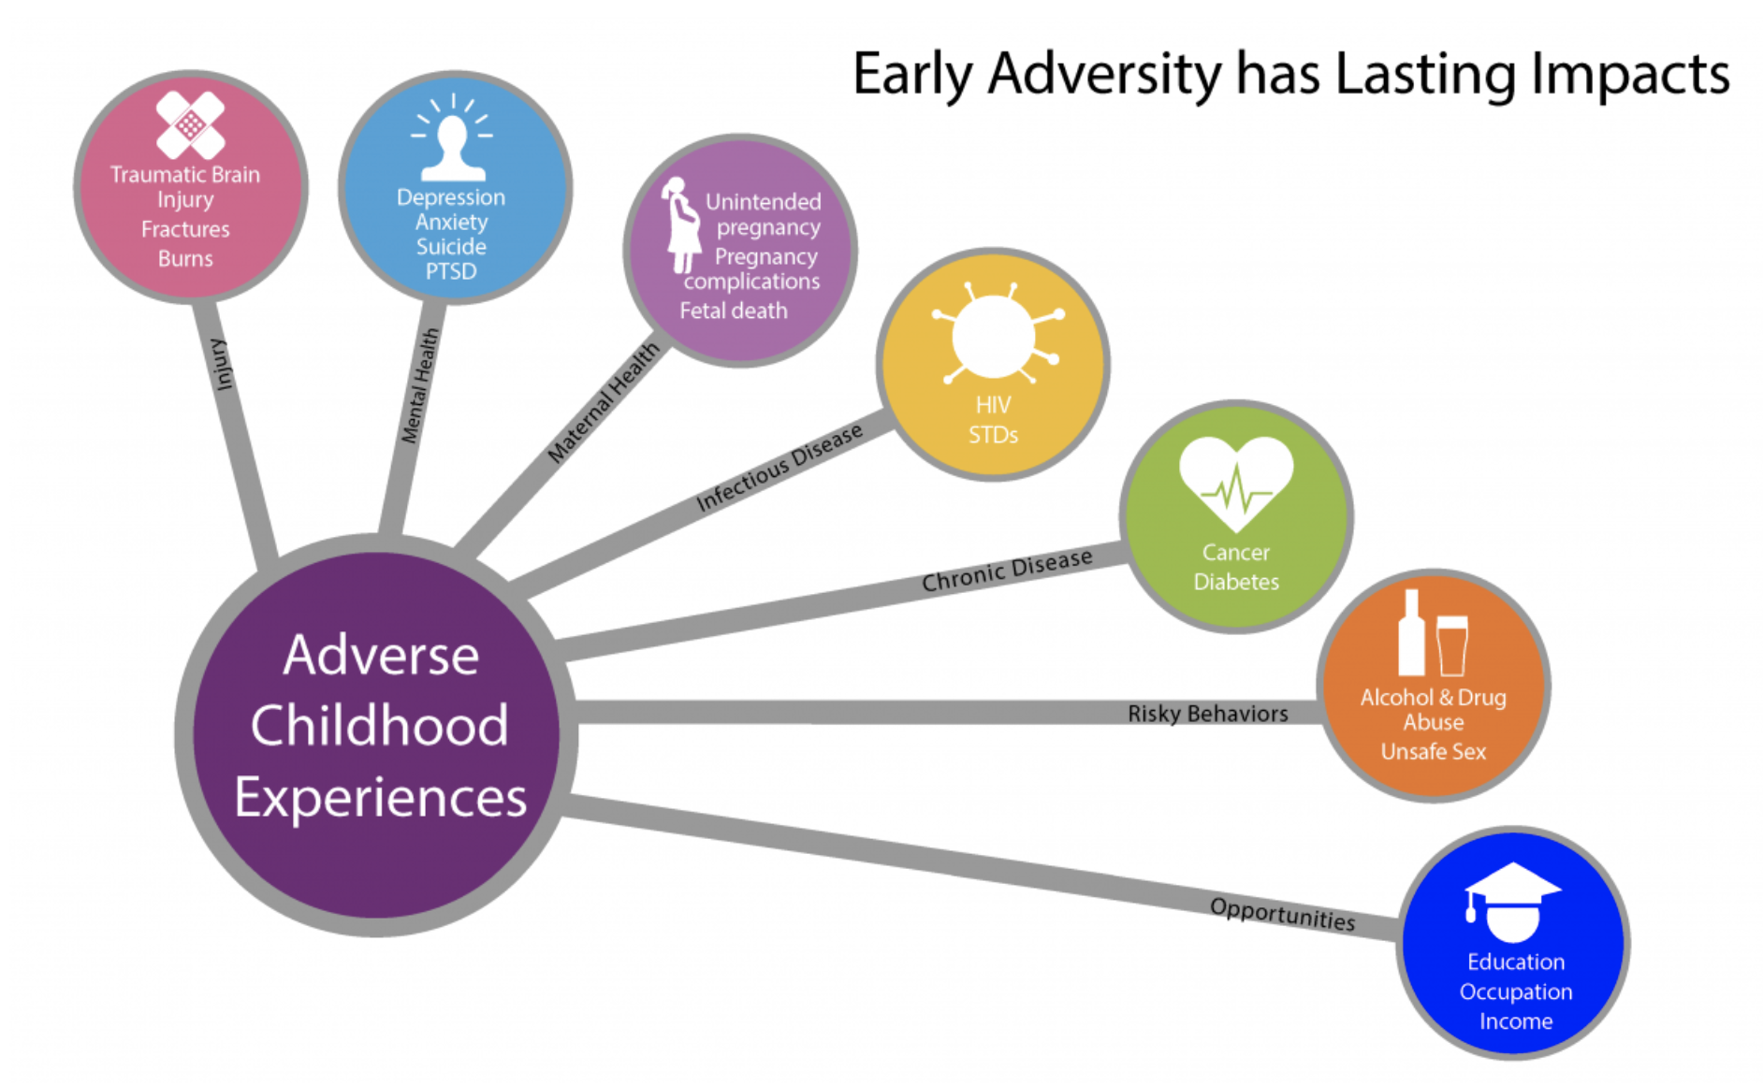
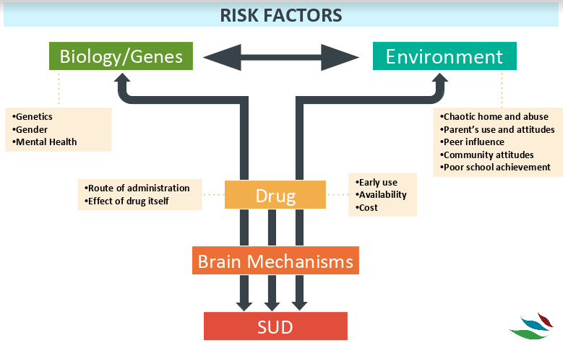
Myth: “Addiction is a choice/ Addiction is a fate”
Notes:
So that leads us to our next myth.
Some of you are still thinking about that last slide and thinking, a 37-year-old man injects heroin every other week, he will eventually develop a use disorder right?
Even if he doesn’t have consequences, anyone who injects something is going to have consequences right?
Addiction like any other chronic disease is Multifactorial in etiology (heritable, influenced by environment, behavior)
-We know that 40-60% of risk of developing addiction is genetic (but this is a complicated issue)-
-Certainly to say the patient has full control and any failure is a choice by the patient to fail is wrong
-At the same time, to say the patient has no control and its all genetic/bio, takes away people’s autonomy in seeking treatment and help and does not reduce stigma
-What can we say affects addiction? Trauma and ACEs: Strong relationship between ACE score and drug use problems, drug addiction, and IVDU. Compared with people with 0 ACEs, people with >=5 ACEs were 7-10x more likely to report illicit drug use problems. ACEs estimated to account for 1/2-2/3 of substance problems
We should recognize here, too, that consequences of use are extremely subjective to levels of privilege that are not equitable. We know there are significant racial and socioeconomic factors that play into how consequences are distributed in this country.
We’ll talk about this some more, but let’s focus for now on this fatalistic idea around addiction that is built on multiple layers of stigma and not on biopsychosocial evidence around this disease.

Slide 12
Myths and SUD-related Stigma
People who use drugs (PWUD)
  will do or say anything to get more of the drug/”drug-seeking”​
  are untrustworthy, lying or criminal​
  don’t have “willpower”
  have an “addictive personality”
Problem with one substance = problem with all substances​
​
MOUD = “replacing one addiction with another”​
​
Different treatment for licit vs. illicit substance use​
The Person
The Substance
Types of Stigma
SUD is (a)​
Moral failure​
Choice​
Fate​
Untreatable phenomenon​
​
People have to “hit rock bottom” before getting help/are beyond help​
The Disorder
Notes:
While we have started to discuss some large myths around addicition, there are layers upon layers of stigmatizing beliefs around substance use
This framework divides types of stigmatizing beliefs that we see related to drug use into three different categories - person, substance & disorder.
You might have heard some of these, you might currently believe some these
People who use drugs are inherently the problem
All drugs are a problem
There’s only one way to treat addiction- you MUST hit rock bottom
Etc
These beliefs are all placing a stigmatizing morality based belief system onto a disease process
Note, that this is a very simple representation of the complexity of stigma, and most stigmatizing beliefs intertwine between these categories & larger oppressive systems (racism, classism, xenophobia).

Slide 13
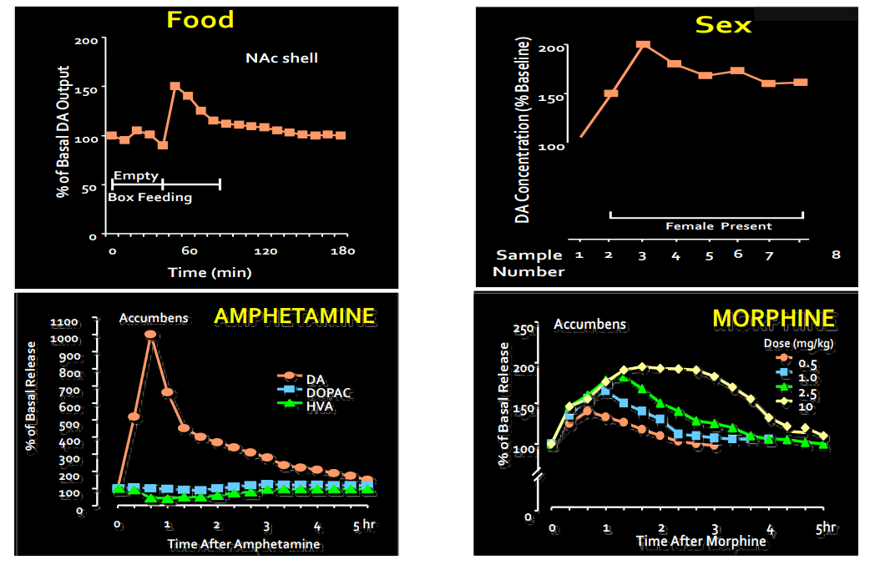
Drugs and Natural Rewards Elevate Dopamine Levels
Bassareo, 1999; Fiorino, 1997; Di Chiara 1988
Notes:
I’m not going to go into the deep biochemistry here
But just as a reminder, everything in life is a stimuli or everything has some sort of effect
Some of these things in the world are good
Animals need dopamine

Slide 14
Biologic and environmental factors affect manifestation of disease
Notes:
But as we discussed there is an extremely high correlation between trauma, ACEs and substance use.
Compared with people with 0 ACEs, people with >=5 ACEs were 7-10x more likely to report illicit drug use problems
So it’s not that drugs are evil or that a person is inherently bad
SUDs are just complex- it’s the bio-psycho-social aspects that are inherent to the disorder

Slide 15
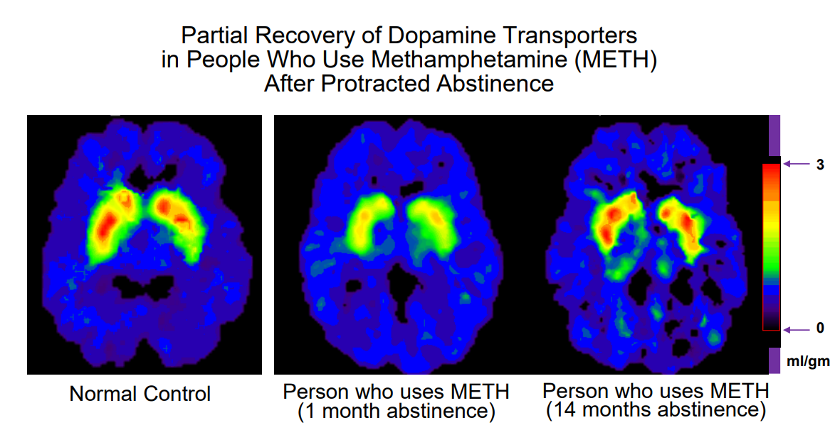
Brain Function CAN Recover
Volkow et al, 2001
Notes:
Despite the complex background of this disease process, there is evidence that like any other disease, patients CAN recover.
It is estimated that between 42%-66% of people with substance use disorder achieve full remission, although it can take time to reach that point.
A systematic review and meta-analysis in 2016 suggested that 35-54% achieved remission after a mean follow-up of 17 years.
Pooled estimated annual remission rates (PEARRs) suggested that 35.0% to 54.4% of individuals with SUDs achieved remission, and this occurred after a mean follow-up period of 17 years
Fleury, Marie-Josée & Djouini, Akram & Huynh, Christophe & Tremblay, Joël & Ferland, Francine & Menard, jean marc & Belleville, Geneviève. (2016). Remission from substance use disorders: A systematic review and meta-analysis. Drug and Alcohol Dependence. 168. 10.1016/j.drugalcdep.2016.08.625.
Remission for substance use disorder occurs at 5 years, which is the point at which the risk for relapse is no greater than that of anyone else in the general population.
Compared to many other medical and psychiatric illnesses, substance use disorder is a disorder with a good prognosis. It is estimated that between 42%-66% of people with substance use disorder achieve full remission, although it can take time to reach that point.

Slide 16
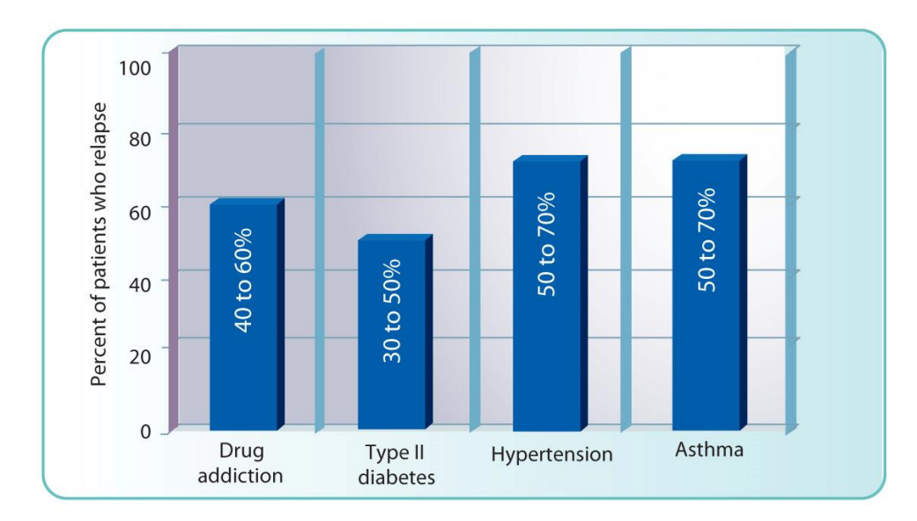
Like any other chronic disease
Has a mechanism (though complex)
Has genetic predisposition
Can be treated
Can have high morbidity and mortality if untreated
McLellan, Lewis, O’Brien & Kleber (2000) JAMA, 284: 1689-1695.
Notes:
Comparison to chronic conditions like depression, type 2 diabetes, hypertension, and asthma ▪ Similar treatment adherence and relapse rates ▪ Responds to ongoing treatment ▪ Some will have to engage in lifelong management of the condition
A systematic review and meta-analysis in 2016 suggested that 35-54% achieved remission after a mean follow-up of 17 years.
Pooled estimated annual remission rates (PEARRs) suggested that 35.0% to 54.4% of individuals with SUDs achieved remission, and this occurred after a mean follow-up period of 17 years
Fleury, Marie-Josée & Djouini, Akram & Huynh, Christophe & Tremblay, Joël & Ferland, Francine & Menard, jean marc & Belleville, Geneviève. (2016). Remission from substance use disorders: A systematic review and meta-analysis. Drug and Alcohol Dependence. 168. 10.1016/j.drugalcdep.2016.08.625.
Remission for substance use disorder occurs at 5 years, which is the point at which the risk for relapse is no greater than that of anyone else in the general population.
Compared to many other medical and psychiatric illnesses, substance use disorder is a disorder with a good prognosis. It is estimated that between 42%-66% of people with substance use disorder achieve full remission, although it can take time to reach that point.

Slide 17
Myth: Emphasis on avoiding stigmatizing language is just “woke”
“Substance abuser”
“Addict”
“Individual with substance use disorder”
Notes:
Unfortunately, a key are of ongoing stigma in this disease is much of the language that we use to discuss this disease
Some people might have noticed my emphasis on the word drug use rather than abuse
Am I just being woke? Is this relevant?

Slide 18
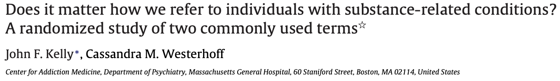
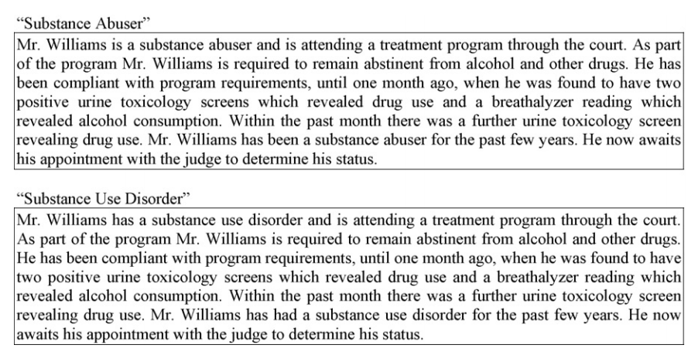
Language We Use - Does It Matter?
Compared to those who read the “substance use disorder” case, those who read in the “substance abuser” case agreed with the notion that the character was personally culpable and that punitive measures should be taken.
Notes:
728 mental health care providers attending two mental health/addiction-focused conferences in October, 2008
Method: A randomized, between-subjects, cross-sectional design was utilized. Participants were asked to read a vignette containing one of the two terms and to rate their agreement with a number of related statements. The questionnaire distributed with the vignette asked participants to rate the extent to which they agreed with various causes of the character’s substance-related problem and whether the character should receive more therapeutic or punitive action, was a social threat, and was capable of regulating his substance use behavior.
Clinicians (N = 516) attending two mental health conferences (63% female, 81% white, M age 51; 65% doctoral-level) completed the study (71% response rate).
A Likert-scaled questionnaire with three subscales [“perpetrator-punishment” (˛= .80); “social threat” (˛= .86); “victim-treatment” (˛= .64)] assessed the perceived causes of the problem, whether the character was a social threat, able to regulate substance use, and should receive therapeutic vs. punitive action. Results: No differences were detected between groups on the social threat or victim-treatment subscales. However, a difference was detected on the perpetrator-punishment scale.
Compared to those in the “substance use disorder” condition, those in the “substance abuser” condition agreed more with the notion that the character was personally culpable and that punitive measures should be taken. Conclusions: Even among highly trained mental health professionals, exposure to these two commonly used terms evokes systematically different judgments. The commonly used “substance abuser” term may perpetuate stigmatizing attitudes.

Slide 19
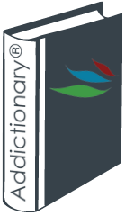

Language Does Matter - Words Have Power
“Research shows that the language we use to describe this disease can either perpetuate or overcome the stereotypes, prejudice and lack of empathy that keep people from getting the treatment they need.”
MICHAEL BOTTICELLI, FORMER DIRECTOR OF THE OFFICE OF NATIONAL DRUG CONTROL POLICY
https://www.recoveryanswers.org/addiction-ary/
Notes:
So it’s not just wokeness
There is actual research that shows that the language used to describe this disease matters and can affect treatment

Slide 20
Language Does Matter
What Terms Should We Use?
Stigmatizing Term | Appropriate Term
Substance abuser, user, junkie, addict | Person with a substance use disorder
Alcoholic, drunk | Person with an alcohol use disorder
Ex-addict, former alcoholic | Person in recovery
Clean/dirty (drug test) | Negative/positive results
Opioid replacement/substitution therapy | Opioid agonist therapy/medication for OUD
Habit | Addiction, substance use disorder
Medication assisted treatment | Medication for OUD/AUD, medication for addiction treatment
Detox | Medically supervised withdrawal
Dope sick | Opioid withdrawal
Lapse/relapse | Recurrence of symptoms, return to use
Getting high | Using drugs, using to get well
Getting clean | In recovery, abstinent
Drug seeking | Help seeking, suffering
Agitated, escalating | Distressed, overwhelmed, frustrated
AMA | Pt-directed premature discharge/Self discharge
Notes:
If time, try to fill in

Slide 21
Pearls of avoiding stigmatizing language
Use of stigmatizing terms can evoke negative thoughts, associations and feeling.
Person-first language puts emphasis on person’s humanity and individual experience rather than the issue or diagnosis.
Lanaguage can emphasize that the person “has” a condition/problem rather than “is” the problem/condition (eg. an alcoholic).
Notes:
Language affects thoughts on treatment rather than punishment

Slide 22
Myth: “Methadone & suboxone are just replacement addictions”
“With this medication (methadone), and a comprehensive program of rehabilitation, patients have shown marked improvement; they have returned to school, obtained jobs, and have become reconciled with their families.”
- Vincent Dole, Marie Nyswander, A Medical Treatment for Diacetylmorphine (Heroin) Addiction: A Clinical Trial With Methadone Hydrochloride, JAMA 1965
Notes:
We are better able to describe the person, the substance, and the disease
Let’s talk about treatment
There is no one size fits all treatment
But let’s recognize that treatment works
Going back to my chart on language, we don’t use opioid replacement , but rather we use MOUD
Before the mainstream western medical establishment, before ASAM, invidiuals were dealing with SUD
But before Dole and nyswander’s original work, there were no specific medications for OUD

Slide 23
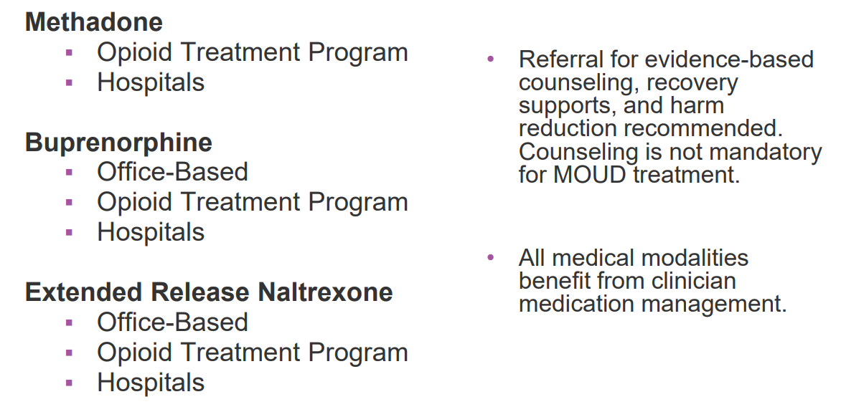
Medication options for OUD
Weimer PCSS Medications for Opioid Use Disorder

Slide 24
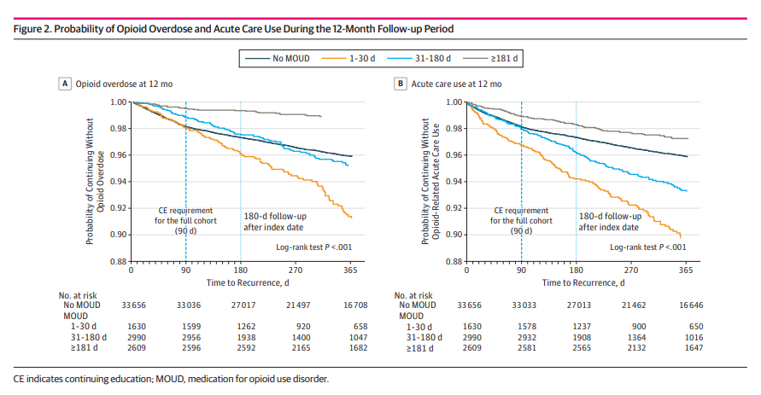
“Methadone & suboxone are just replacement addictions”
Wakeman et al 2020
Notes:
- Remind about the definition of addiction – the 3 C’s (control, cravings, consequences of use) are the main components of a SUD, and these resolve with MOUD
This is a busy slide but basically, look at the grey line. Individuals in this study who stayed on MOUD were less likely to overdose or require acute care.
- Sordo L, Barrio G, Bravo MJ, et al. BMJ. 2017;357:j1550. Published 2017 Apr 26.
All cause mortality rates (per 1000 person years): • In methadone treatment: 11.3 • Out of methadone treatment: 36.1 • In buprenorphine treatment: 4.3 • Out of buprenorphine treatment: 9.5
Overdose mortality rates: • In methadone treatment: 2.6 • Out of methadone treatment: 12.7 • In buprenorphine treatment: 1.4 • Out of buprenorphine treatment: 4.6

Slide 25
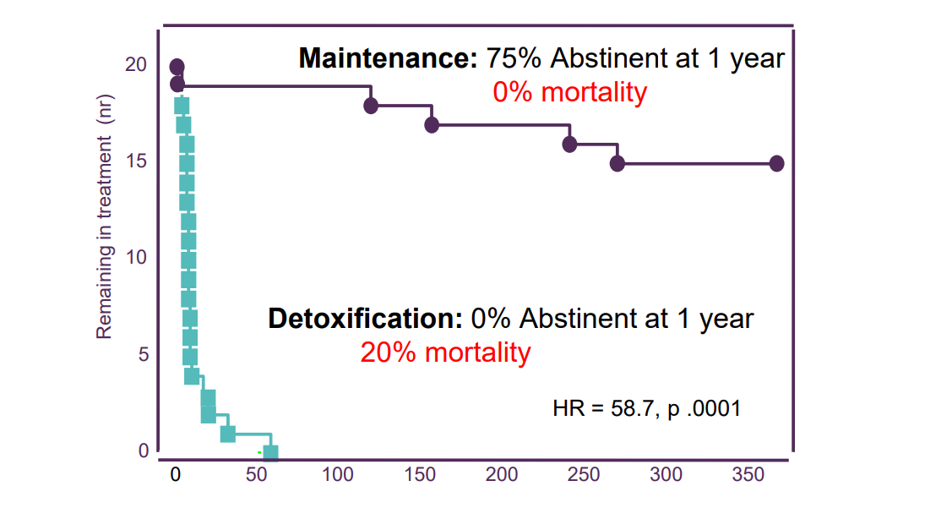
Treatment Retention: Buprenorphine Detoxification vs. Maintenance
Kakko, Lancet 2003, curtesy of Dr. Weimer PCSS Medications for Opioid Use Disorder
Notes:
Invidivuals on bup maintence are less likely to DIE

Slide 26
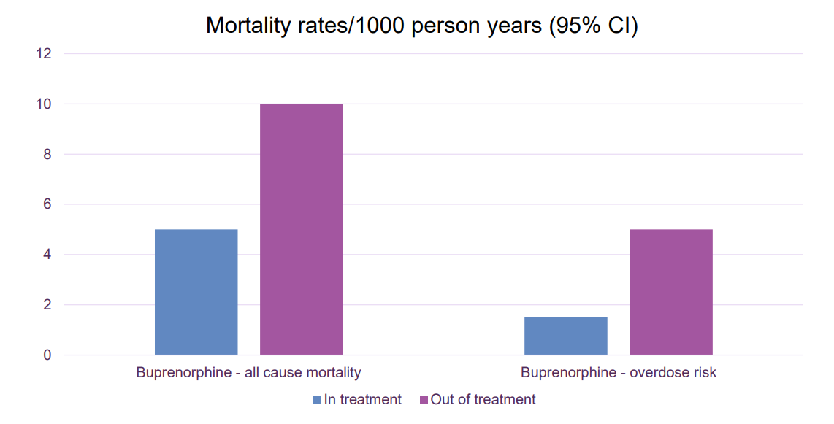
Mortality Risk During and After Buprenorphine Treatment
Sordo, et al. BMJ 2017, curtesy of Dr. Weimer PCSS Medications for Opioid Use Disorder.

Slide 27
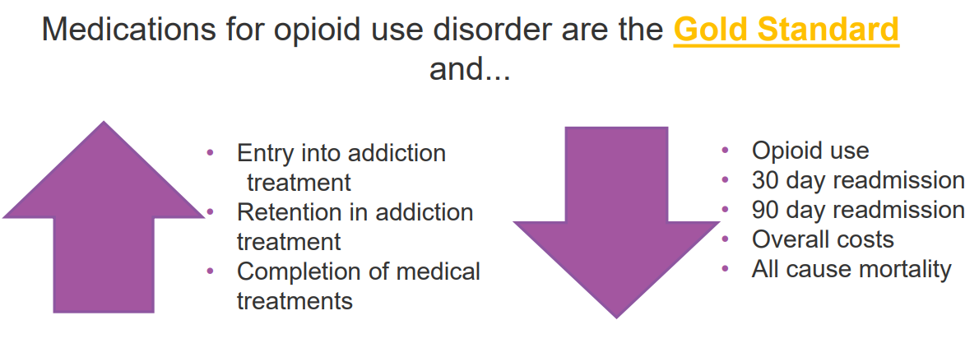
Englander, JHM, 2017 Wakeman, JGIM, 2017 Moreno, J Addict Med, 2019, Trowbridge, JSAT, 2017 Liebschutz, JAMA, 2014 Englander, JGIM, 2019 Wakeman, JGIM, 2020 Barocas, Lancet Public Health, 2021 GJGIM2021 , curtesy of Dr. Weimer PCSS Medications for Opioid Use Disorder
Notes:
Reduce mortality ▪ All cause and substance-related mortality • Reduce associated morbidity ▪ Transmission of blood-borne viruses ▪ Infectious complications from injection drug use • Reduce and/or discontinue opioid use • Increase retention in addiction treatment • Improve general health, well-being, and quality of life
Individuals with opioid use disorder • Individuals with opioid use disorder and chronic pain • Individuals with chronic pain with opioid misuse • Adolescents >16 years of age • Pregnant persons • Individuals involved with the criminal legal system

Slide 28
Medications
Recovery Support
Methadone
Buprenorphine
Naltrexone
Psychosocial Counseling
Mutual support groups
CBT
Contingency management
Peer recovery coaches
Wrap around services

Slide 29
Myth: Buprenorphine is hard to prescribe
Notes:
Ok you’re on board with the idea that MOUD is the gold standard but it seems hard.

Slide 30
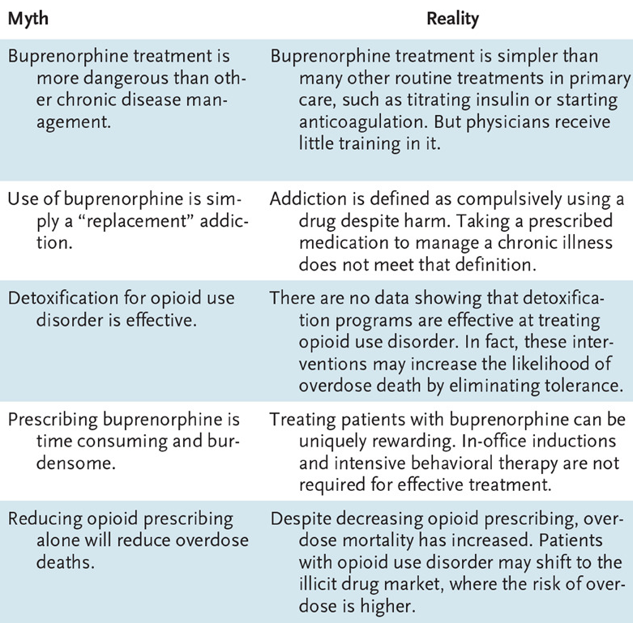
Buprenorphine prescribing myths
Regulatory changes:
4.2021– Long, specialized opioid-focused training requirements (8 hrs for MDs, 24 hrs for APPs) removed, X-waiver process streamlined
12.2022– X waiver requirement removed
6.2023– Basic 8 hr SUD training requirement for all prescribers begins
From: Wakeman and Barnett (2018) NEJM 379: 1.
Notes:
A major part of that myth is the regulatory burden around MOUD
Why was there significant regulatory burden?
Is it because it’s more dangerous?
No
Is it because it doesn’t work?
No
I hope I’ve laid some foundation to suspect that it’s due to stigma
The good news is that the regulatory burdens have improved

Slide 31
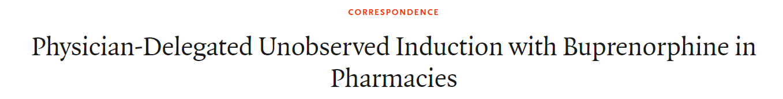
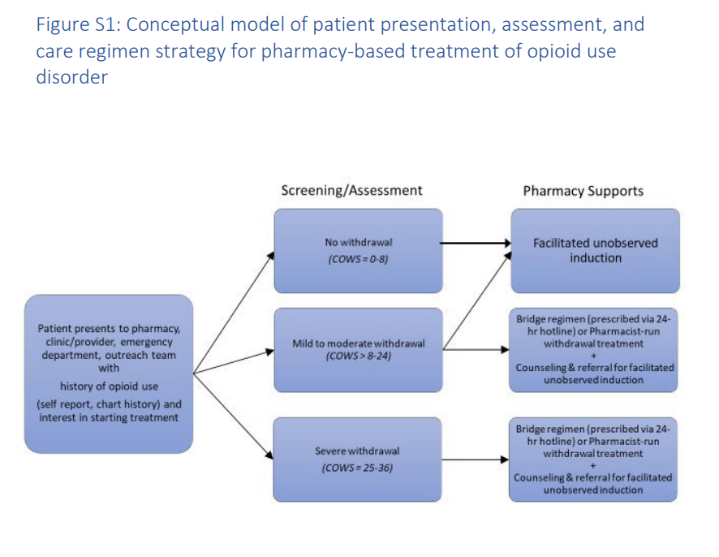
Green et al NEJM 2023
Notes:
There are a lot of models of how to treat OUD- we just talked about our OBAT model
I would like to highlight this study out of Brown where I trained
I know there are pharmacists here
Pharmacist supported induction on buprenorphine

Slide 32
Case 1:
Ana is a 64-year-old woman with PMH depression, anxiety, ADHD, insomnia not currently established with a psychiatrist, also with chronic pain on oxycodone presents for first meeting upon transfer to new PCP
Previously prescribed oxycodone 5mg #84 for 28 day supply, clonazepam 0.5mg BID prn, and dextroamphetamine-amphetamine 10mg 20mg BID
Note that clonazepam and dextroamphetamine-amphetamine were prescribed by an outside psychiatrist until a few months ago

Slide 33
2022 CDC guidelines
Five core principles to guide implementation:
Acute, subacute, and chronic pain needs to be appropriately assessed and treated.
Pain should be addressed with a multimodal and multidisciplinary approach.
Care should be patient-centered, and guidelines should support, not supplant, that goal.
Special attention should be given to avoid misapplying recommendations beyond their intended use.
Clinicians, practices, health systems, and payers should vigilantly attend to health inequities in pain care.
Notes:
So here’s this pt who has been prescribed chronic opioids
I’d like to take a quick second to talk about the CDC guidelines in 2016 that lead to a lot of aggressive opioid deprescribing
If you haven’t heard, the CDC did come out with 2022 guidelines that addresses some of these issues
Note this is about PAIN not about use disorders

Slide 34
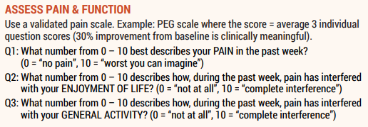
Clinical Tools:
PEG scale
  Validated in primary care (Krebs, 2009)
  Change of ~30% average score on subscales is considered clinically meaningful (Ostelo, 2008)
PEG Scale for monitoring response to pain treatment
Above from: Clinical Tools for Primary Care Providers | CDC's Response to the Opioid Overdose Epidemic | CDC
Notes:
Ana gives a PEG score of 10, 1, 3
So this pt has isn’t actually benefiting from this chronic prescription

Slide 35
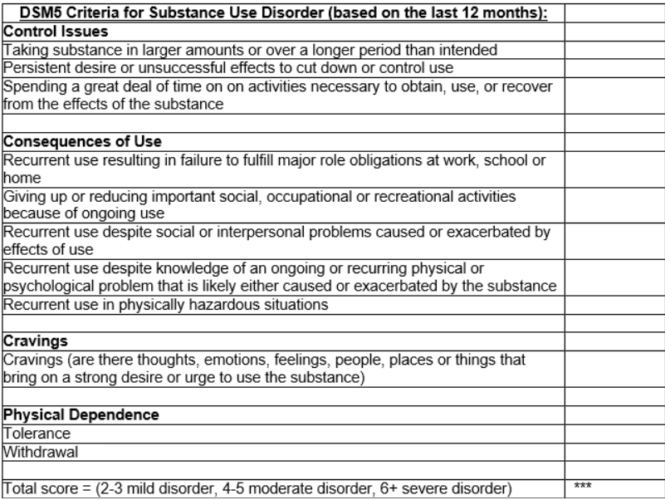

“I want to be normal”
Reports she has been supplementing prescribed oxycodone
Taking 60-90mg/day
Has read about buprenorphine and thinks it might be helpful for her
Notes:
In fact, given that you are using empathetic and non-stigmatizing language, she admits she’s actually been buying more than prescribed
Substance use initiation and timeline-2020 after torn meniscus. No one would give her rx
Started taking more than rx'd late 2020 and early 2021.
As of last week cut off ties with the person who provided her oxycodone.
Has experienced withdrawal. Fever, diarrhea.
History of medical complications- never
Overdose history-never
Injection practices- never
Treatment history- never
Pharmacotherapy tried- never tried

Slide 36
Do you…?
A: Send her to acute inpatient medically-monitored withdrawal (“Detox”)
B: Explore her reasons for use and prescribe naloxone (Narcan)
C: Do not prescribe buprenorphine because she is also taking benzodiazepines
D: Prescribe buprenorphine
E: Send her to an outpatient treatment program (OTP) for methadone
F: Refer to behavioral health

Slide 37
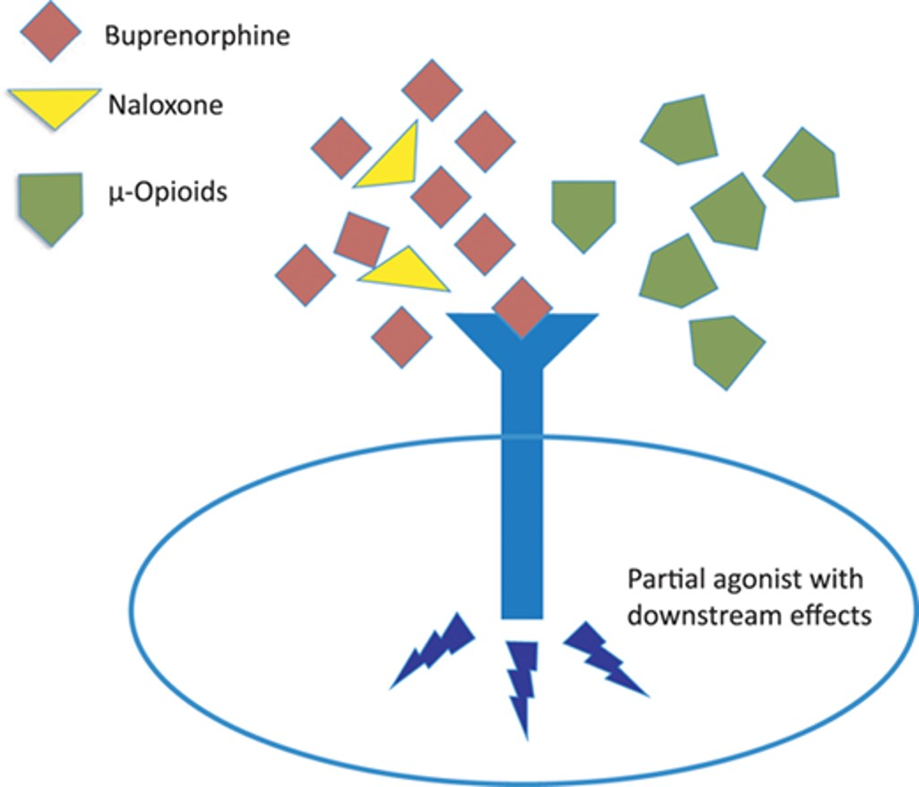
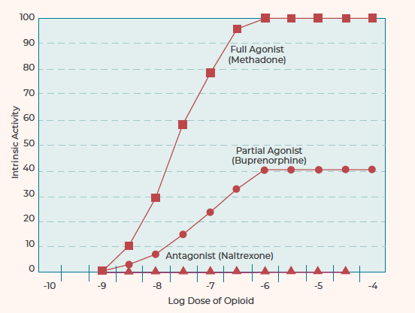
Buprenorphine is a partial agonist
Volpe: Regulatory Toxicology and Pharmacology : RTP, 06 Jan 2011, 59(3):385-390
Chen L, Mao J; Anesthesiology 05 2014, Vol.120, 1262-1274

Slide 38
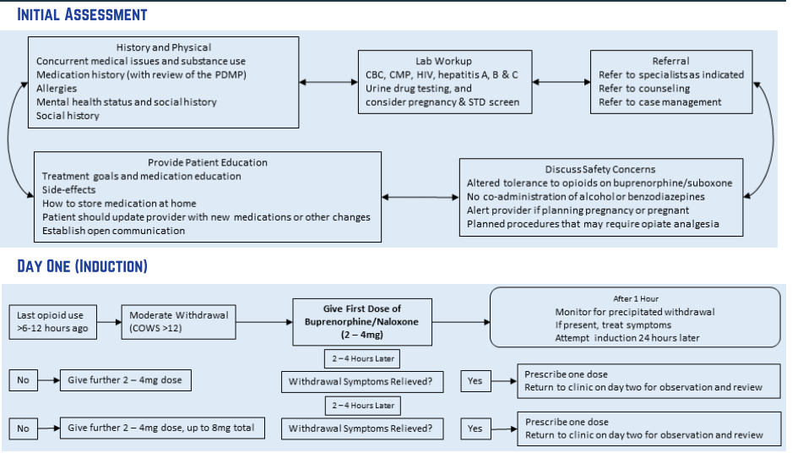
“Classic” Induction
SAMHSA Buprenorphine Quick Start Guide

Slide 39
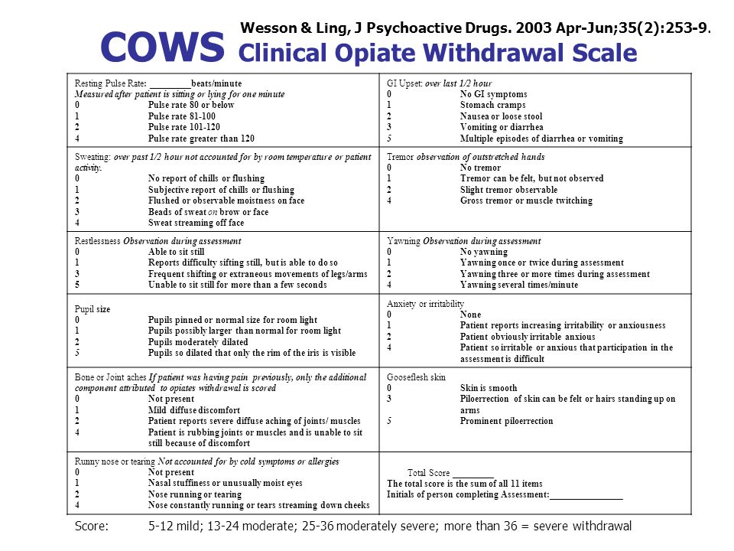


Slide 40


Slide 41
What is precipitated withdrawal?
Notes:
Ana has never experienced it but most of my patients and many of yours who use opioids will be very familiar with it.

Slide 42
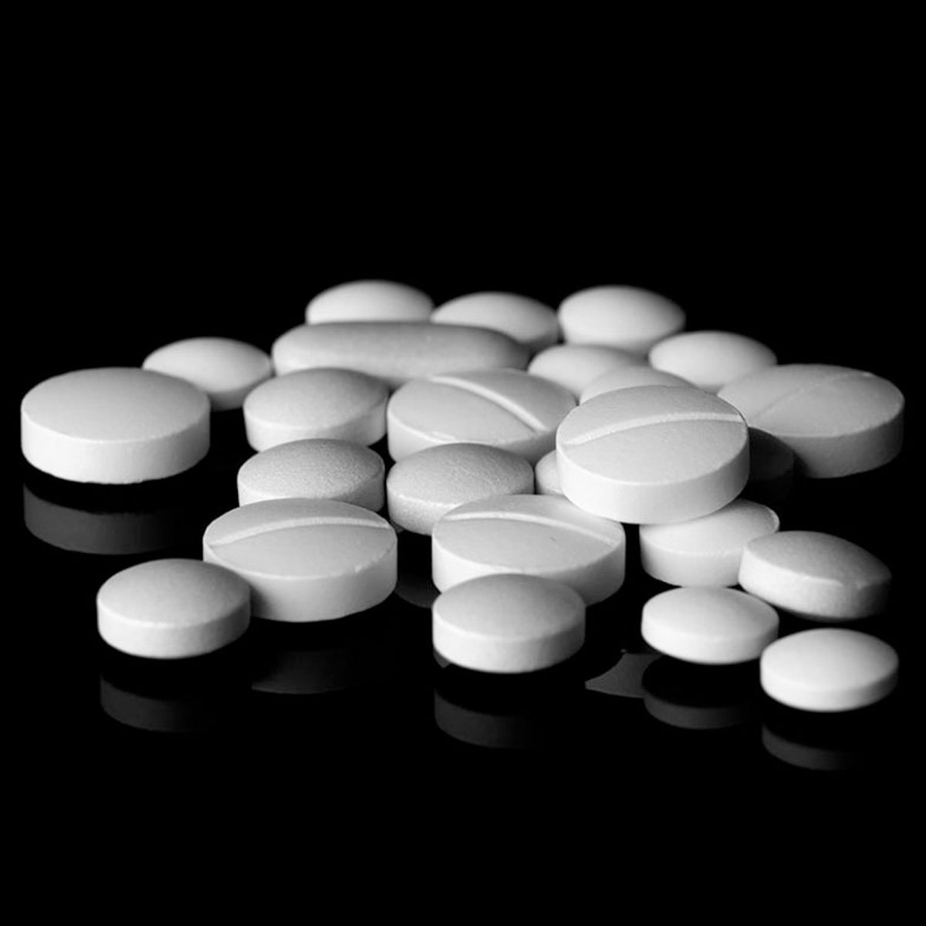
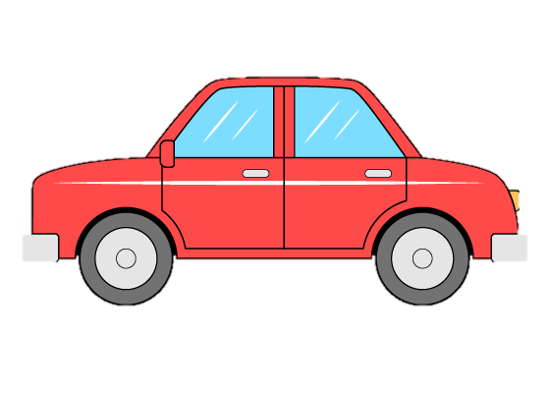
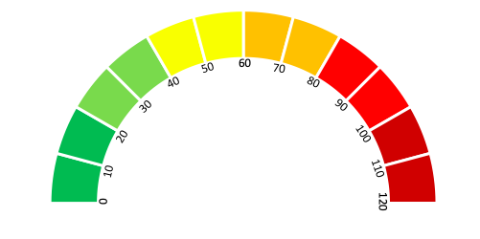
Full Opioid Agonist

Slide 43

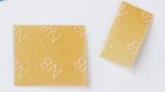

Introduce buprenorphine 4mg

Slide 44
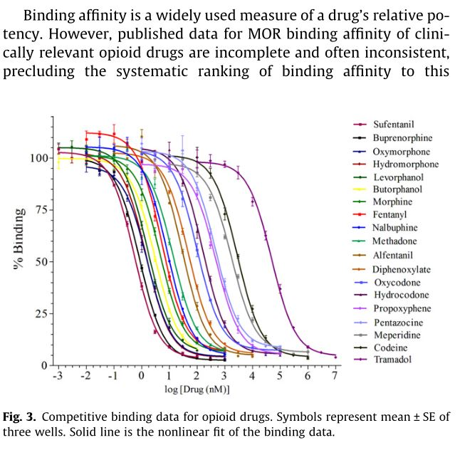
Buprenorphine has a very high affinity
Volpe: Regulatory Toxicology and Pharmacology : RTP, 06 Jan 2011, 59(3):385-390
Notes:
If you can remember this chart, you can understand buprenorphine induction

Slide 45
Case:
Stop full agonists
Wait for withdrawal
Give 1st dose
Repeat in 1-2 hours
Uptitrate to effective dose over 1-3d
COWS > 8-12
2-4 mg buprenorphine each dose depending on tolerance
Discuss options of buprenorphine, methadone, naltrexone
Discuss symptoms of withdrawal
Make appointment with OBAT RN
Connect to Recovery Coach
“need to be in moderate to moderately severe withdrawal by having at least three symptoms of withdrawal (arthralgias/myalgias, diaphoresis/chills, irritability, piloerection, restlessness, yawning, enlarged pupils, rhinorrhea/lacrimation, GI distress”
Notes:
The gradual induction with overlapping full agonist

Slide 46
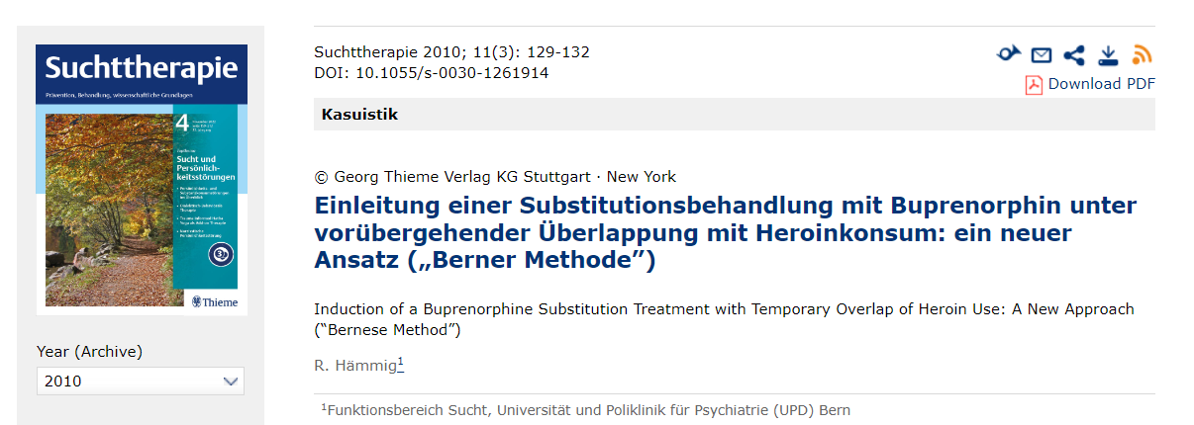
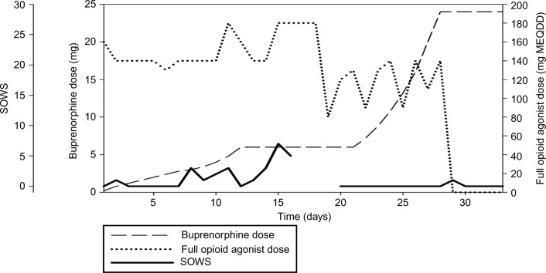
Notes:
Hämmig R, Kemter A, Strasser J, von Bardeleben U, Gugger B, Walter M, Dürsteler KM, Vogel M. Use of microdoses for induction of buprenorphine treatment with overlapping full opioid agonist use: the Bernese method. Subst Abuse Rehabil. 2016 Jul 20;7:99-105. doi: 10.2147/SAR.S109919. PMID: 27499655; PMCID: PMC4959756.

Slide 47
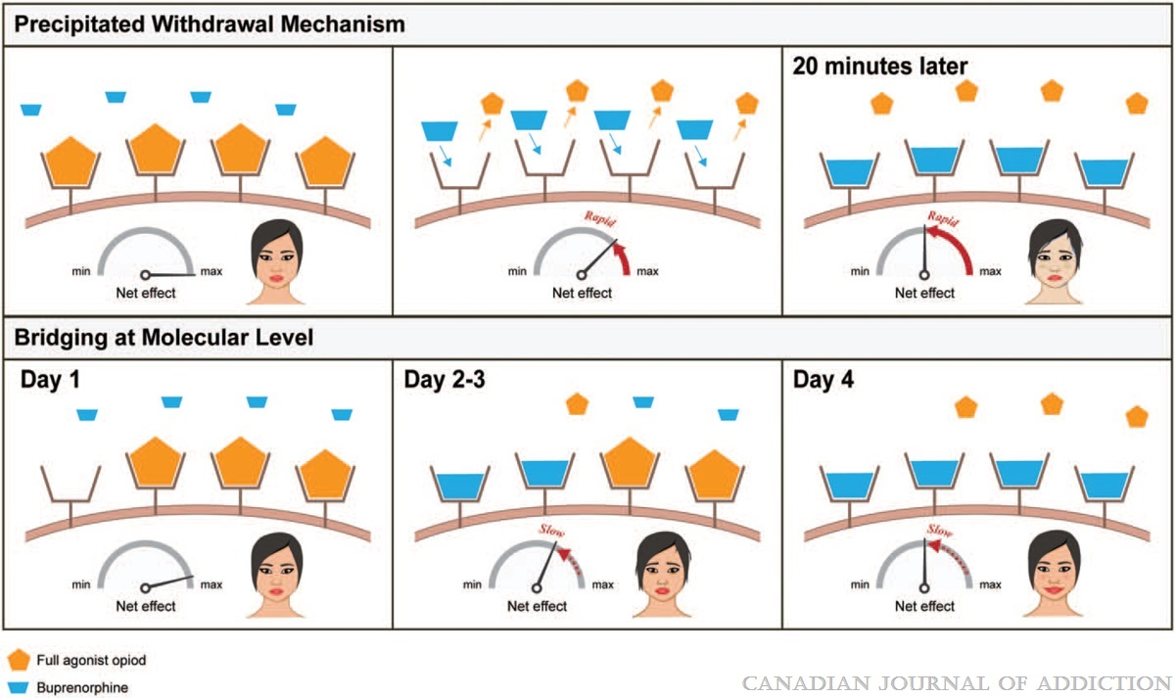
Precipitated opioid withdrawal
Ghosh et al, “A Review of Novel Methods To Support The Transition From Methadone and Other Full Agonist Opioids To Buprenorphine/Naloxone Sublingual In Both Community and Acute Care Settings,” Canadian Journal of Addiction, 2019
Notes:
Mechanism behind precipitated withdrawal mechanism as well as bridging: Partial agonist opioid with high affinity for μ-receptors replaces the full opioid agonist rapidly over a short period of time causing a massive change in the net μ-receptor activation leading to rapid precipitated withdrawal. This can be mitigated by bridging, where the gradual introduction of higher affinity partial agonist opioids can help minimize withdrawal symptoms.

Slide 48
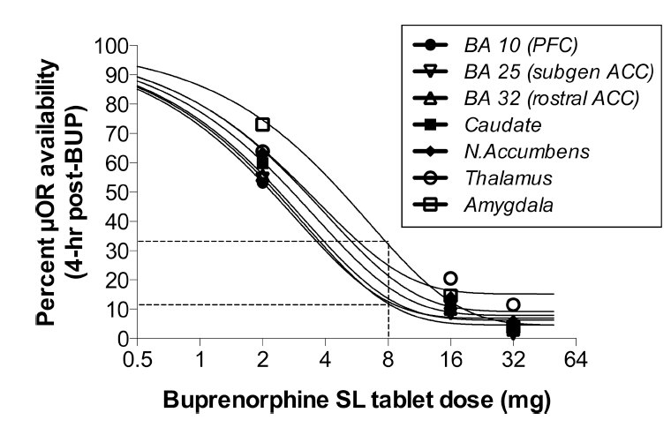
Buprenorphine has a very high affinity
Greenwald M, Comer S, Fiellin D. Buprenorphine maintenance and mu-opioid receptor availability in the treatment of opioid use disorder: implications for clinical use and policy. Drug Alcohol Depend. 2014 Nov 1;144:1-11. doi: 10.1016/j.drugalcdep. 2014.07.035

Slide 49
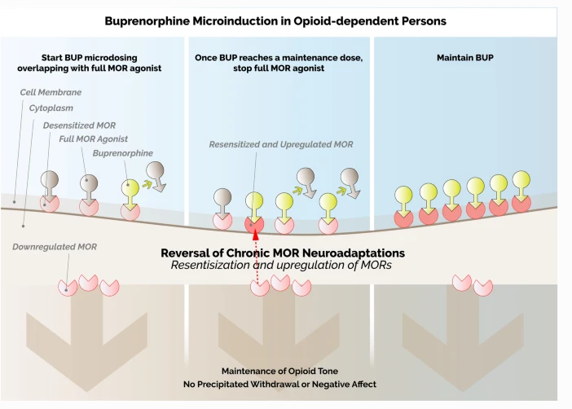
Low-dose buprenorphine induction theory
De Aquino. Clin Drug Investig, 2021
Notes:
When using full agonists, the body deregulates mu receptors
I like to imagine a field of empty receptors, mostly filled with full agonists then physically going in a replacing one.
One receptor at a time please.
Go as slow as you want. You’ve only replaced one receptor.
Buprenorphine causes “re-sensitization” of the opioid receptors
Low dose approach allows Up-regulation of opioid Receptors to prevent opioid withdrawal
You might have heard this protocol called a microinduction- see here where De Aquino calls it a micro induction and the Swiss in Bern call it the Bernese method

Slide 50
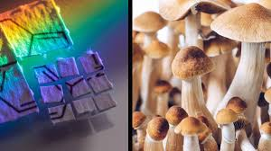
Language Matters
Avoid “Microdose”
“Micro-induction” if needed
Preferred
“Low dose”
“Ultra low dose”
“Bernese Method”
Weimer, Fiellin. Addiction, January 2022
Notes:
To microdose has lay and pharmacologic connotations
Most often associated with LSD and psylocibin
In the pharmacology literature, ‘microdoses’ are those, often in the range of micrograms, that are designed to have no therapeutic effect or benefit.
Bernese method, ie, gradual induction overlapping with full agonist use

Slide 51
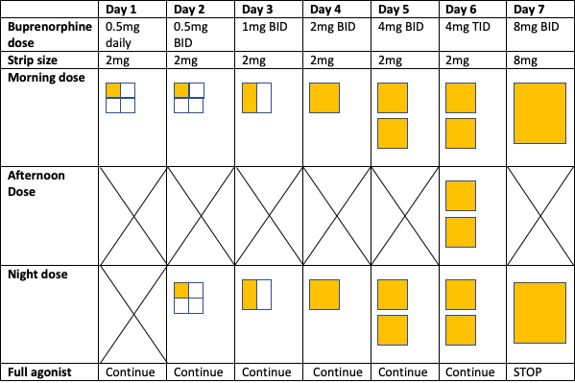
Notes:
Field of receptors filled with agonist or car speedometer
Choose a metaphor that works for you
My car gas tank is filled with receptors

Slide 52
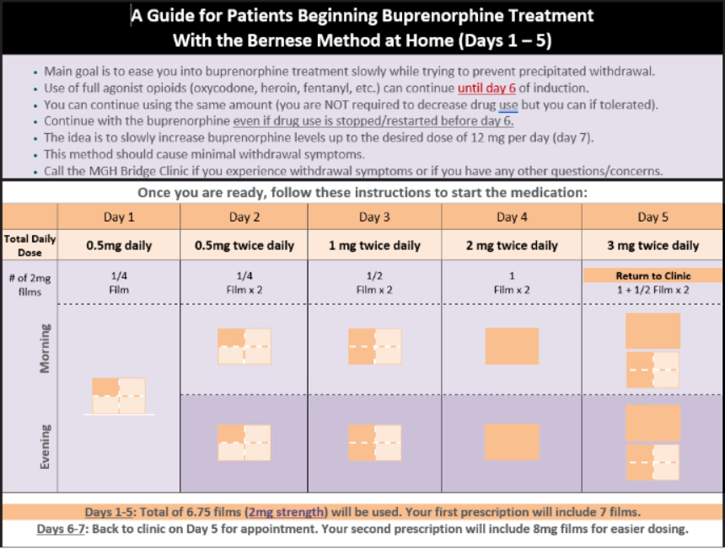
Notes:
Minimal withdrawal symptoms
Not no withdrawal symptoms

Slide 53
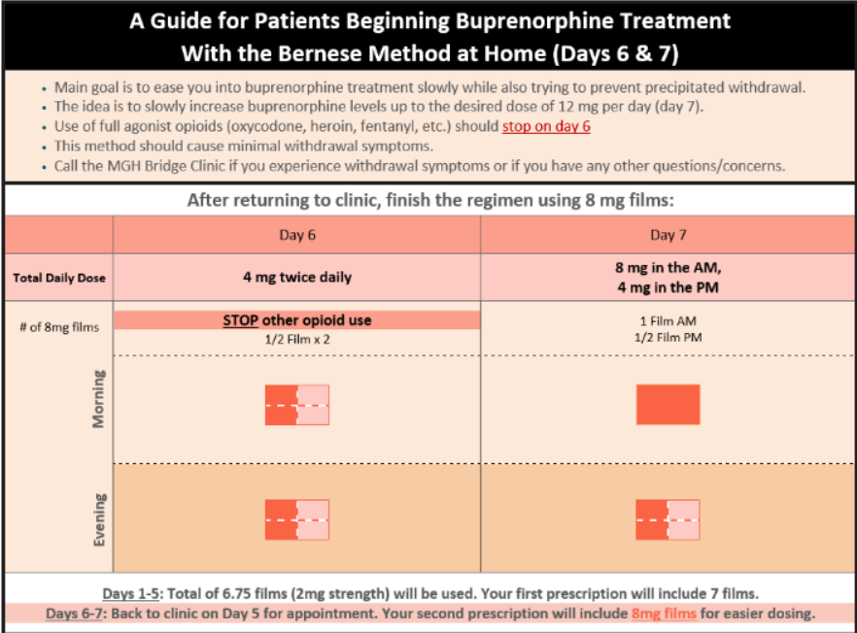

Slide 54
Dispense #7 bup/nal 2mg films
AND at least 3 films of bup/nal 8mg

Slide 55
But isn’t there a “blocker” in Suboxone…?
Naloxone is present in attempt to decrease misuse or diversion
Naloxone is mostly inactive unless injected
  Very low bioavailability when medication used sublingually
  If patient with opioid dependence and not in opioid withdrawal, injection of buprenorphine/naloxone can precipitate withdrawal
  If patient in opioid withdrawal, injection of buprenorphine/naloxone can have opioid withdrawal relieving effects
Some debate on this topic
Use of combination product is typically recommended
SAMHSA TIP 63: https://store.samhsa.gov/system/files/sma18-5063pt3.pdf

Slide 56
Low-dose initiation
Pros
Cons
  Start buprenorphine without waiting for withdrawal
  Allows patients to continue full-opioid agonists for pain
  May reduce the risk of precipitated withdrawal from synthetic opioids with unpredictable clearance
  Patient-centered
Still developing evidence
Protocols less clear
Slower
Still risk of precipitated withdrawal

Slide 57
Low dose decision aid
 | What it means: | Reasons to choose: | Reasons NOT to choose:
Standard start | We stop all opioids and wait 8-72 hours for the opioids to wash out of your body before starting buprenorphine We keep you comfortable with non-opioid medications | More evidence Sometimes faster | Need to stop opioids and wait for withdrawal Could worsen withdrawal
Low-dose, overlapping start | We continue methadone or opioids for pain At the same time, we start buprenorphine at a low dose and slowly increase the dose over a few days Once buprenorphine is built up in your body, we stop other opioids In our experience, this will not cause withdrawal | Designed to minimize withdrawal You continue methadone or opioids for pain at the same time | Less evidence Might cause withdrawal, especially if we don’t follow the process Sometimes slower and might mean you stay in the hospital for longer
Thakrar, Ashish Low-Dose Decision Aid link

Slide 58
Clinical reasons for low dose initiation
Transitioning from Methadone to Buprenorphine
Patients with severe acute pain and OUD
Previous unsuccessful attempts at buprenorphine initiation
  More patient centered
Nonprescribed fentanyl use
  Given current street supply, fentanyl exposure is expected
Notes:
if symptoms of withdrawal, repeat that day’s dose for an additional day then begin gradually increasing again (eg if withdrawal symptoms on day 4, repeat day 4’s dose on day 5, if tolerated increase dose the following day) ---can also slow down protocol for more gradual dose increases if repeated symptoms of withdrawal
Pain clinic is doing extremely slow, 1 month long induction

Slide 59
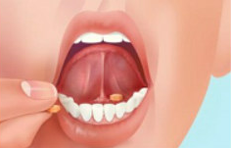
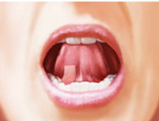
Instructions for patients
Patient was educated on the following administration technique for sublingual buprenorphine products.
1. Drink a few sips or a cup of water to moisten your mouth. This helps the medication dissolve more easily
2. For film, hold between two fingers by the outside edges of the strip
3. Place tablet or film underneath the tongue, either to the left or right of center (DO NOT CHEW OR SWALLOW)
Tablet: Film:
4. If your doctor tells you to take two tablets or films at a time, place the second tablet or film on the opposite side underneath the tongue
5. Keep the tablet(s) or film(s) in place and allow to dissolve completely (2 – 15 minutes; films take slightly less time to dissolve than tablets)
6. If a third tablet or film is needed, wait until the first two have dissolved and then repeat steps 1 through 5 for the third tablet or film
7. Avoid talking and swallowing saliva to help the medication absorb (tilting the head forward can help prevent swallowing saliva)

Slide 60
Comfort Meds
Ibuprofen 600mg q6h prn for joint aches
Clonidine 0.1mg TID prn for anxiety, autonomic symptoms
Dicyclomine 20mg Q6H for abdominal cramping
Loperamide as needed for diarrhea
Famotidine 40mg daily for dyspepsia
Insomnia: melatonin 5 mg PO qHS PRN, quetiapine 25-50 mg PO qHS PRN, trazodone 25 mg PO qHS PRN
Notes:
Some symptoms

Slide 61
Case
Patient given instructions for home low dose induction and comfort medications
Scheduled with OBAT RN for Day 6 of protocol
  Taking buprenorphine/naloxone 8mg-2mg without issue
  Increased to 8mg BID

Slide 62
Patient-Centered Approach to Medication
Offer all FDA-approved medication
Offer flexible induction if possible
Treat co-occurring disorders
Avoid uniform abstinence requirements
Approach urine/oral drug testing as a tool*
Notes:
Harm reduction is a spectrum of strategies from safer use, to managed use, to abstinence - to meet users of drugs “where they’re at,” addressing conditions of use along with the use itself
“Has been proven to:
Support people who to choose to reduce or stop their opioid use stop using drugs
Increase the likelihood that a person will continue to not use drugs
Reduce opioid use and symptoms related to opioid use disorder
Reduce the risk of infectious disease transmission
Reduce the chances of an overdose related death”

Slide 63
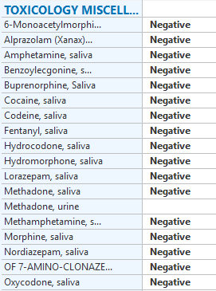
Case continued
You see this result in your inbox.
A- Call patient and discuss right now!
B- Ask front desk to book your next available opening (next week maybe?)
C-Patient is not using buprenorphine, stop refill
D-Continue prescribing

Slide 64
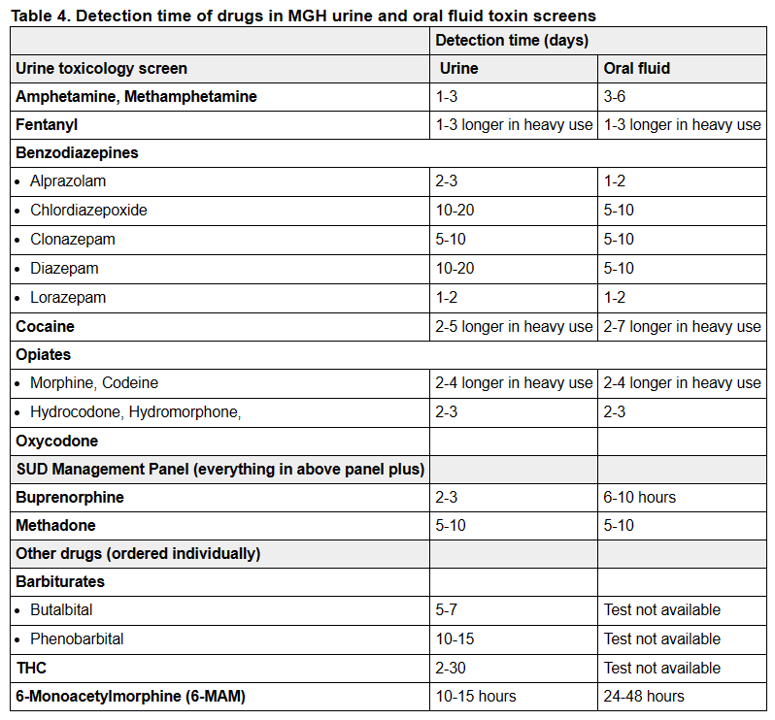
Detection time windows in urine and oral fluid tox screens
Above from: MGH PCOI (Primary Care Office Insite) clinical practice guideline on Toxicology Testing.
Notes:
Know what is in your system’s toxicology order
Many may not include buprenorphine at all
Many do not include fentanyl
If they do, what are the detection times?

Slide 65
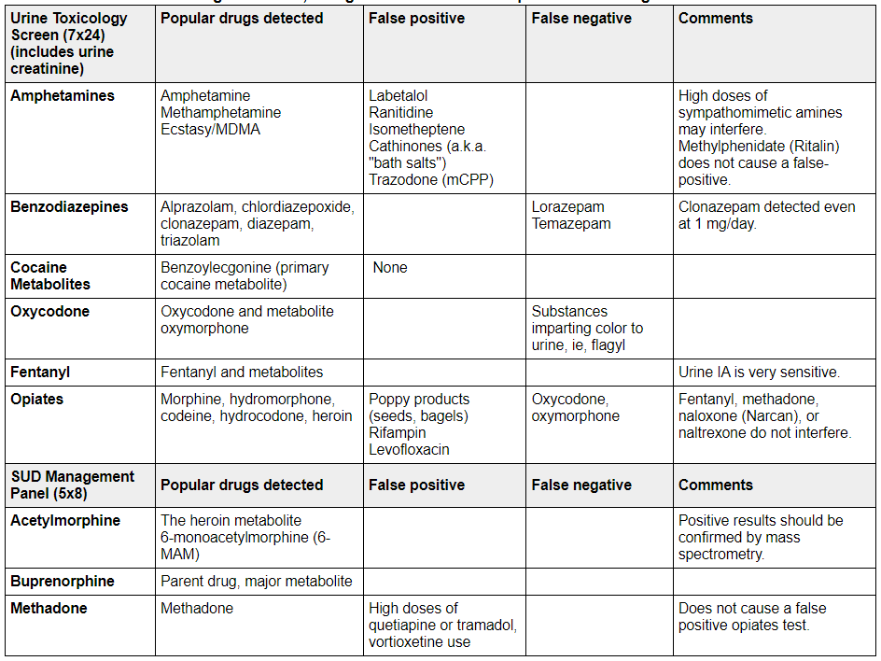
False positives and negatives in tox screens
Above from: MGH PCOI (Primary Care Office Insite) clinical practice guideline.

Slide 66
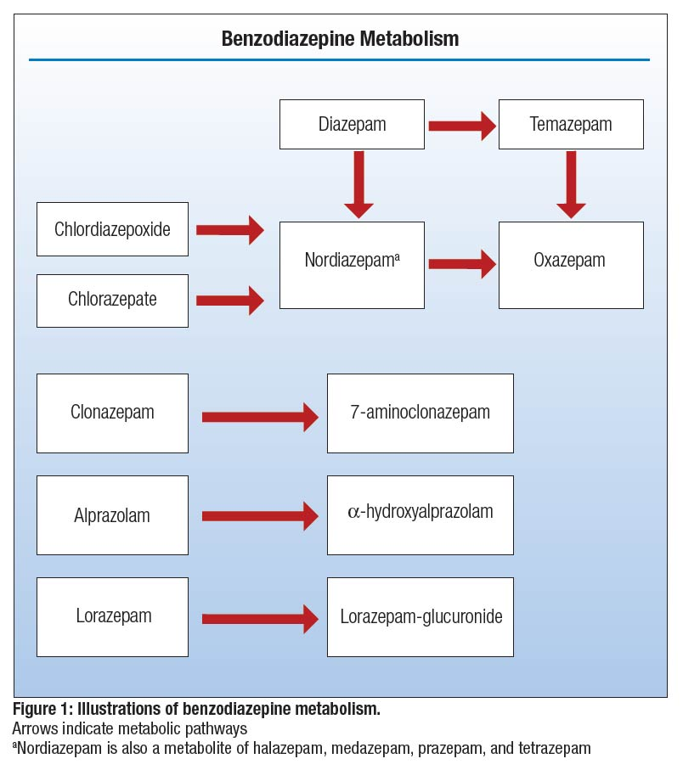
Craven et al 2019
Notes:
Know what is in your tox screen
Many ONLY test for nordiazepam family

Slide 67
Benzodiazepines and Buprenorphine Treatment
Buprenorphine + benzodiazepines, other sedatives, alcohol increases risk of respiratory depression
Do not consider co-occurring benzodiazepine use an absolute contraindication to buprenorphine treatment
  Risk of not treating opioid use disorder (e.g. opioid overdose) outweighs likely risks of low dose benzodiazepines
As with any substance, assess therapeutic vs misuse
In general
  Agents with higher lipophilicity and a shorter half-life appear to possess greater misuse potential¹
  Diazepam, alprazolam, and lorazepam had the highest subjective ratings for euphoria
  Alprazolam and clonazepam are the two BZDs associated with the most use-related ED visits; the rate of alprazolam involvement is more than double that of clonazepam²
Adapted from Nunes PCSS Management of Other Substance Use Co-occurring with Opioid Use Disorder
1. Bezchlibnyk-Butler KZ et al 2016
2. Centers for Disease Control and Prevention (CDC). Emergency department visits involving nonmedical use of selected prescription drugs--United States, 2004-2008. MMWR Morb Mortal Wkly Rep. 2010; 59 23: 705- 9
Notes:
Buprenorphine has less respiratory depression than full agonists
Distinguish:
Low dose benzodiazepine therapeutic use (look for anxiety, mood or sleep disorders), or misuse of relatively low doses (may be self treatment)
Higher dose misuse or binge use

Slide 68
Case epilogue
Seen 1 week later by OBAT RN
  Not tolerating films due to nausea
  Transitioned to 2.5 tablets daily (equivalent of 20mg)
Seen by new PCP 1 week later
  Stable on bup/nal 20mg daily (8mg, 8mg, 4mg)
  No further oxycodone use!
  (Complaining of opioid induced constipation)
Notes:
Good place for a pause-

Slide 69
Help! My patient isn’t ready to quit!

Slide 70
Case 2
Kira is a 27-year-old woman with severe OUD (on buprenorphine/naloxone), HCV, mood disorder NOS (two hospitalizations for psychosis) who presents for refill on her buprenorphine/naloxone. She is experiencing unsheltered homelessness, sleeps under a bridge. Her last three toxicology screens have been positive for buprenorphine and methamphetamine. When she walks into the room, she tells you that she hasn’t used any heroin/fentanyl for over 3 months since starting buprenorphine. “I have no dope cravings at all; my problem right now is uppers.”
Notes:
General reflection question: Have you seen a patient in a similar situation before?
Key Points

Slide 71
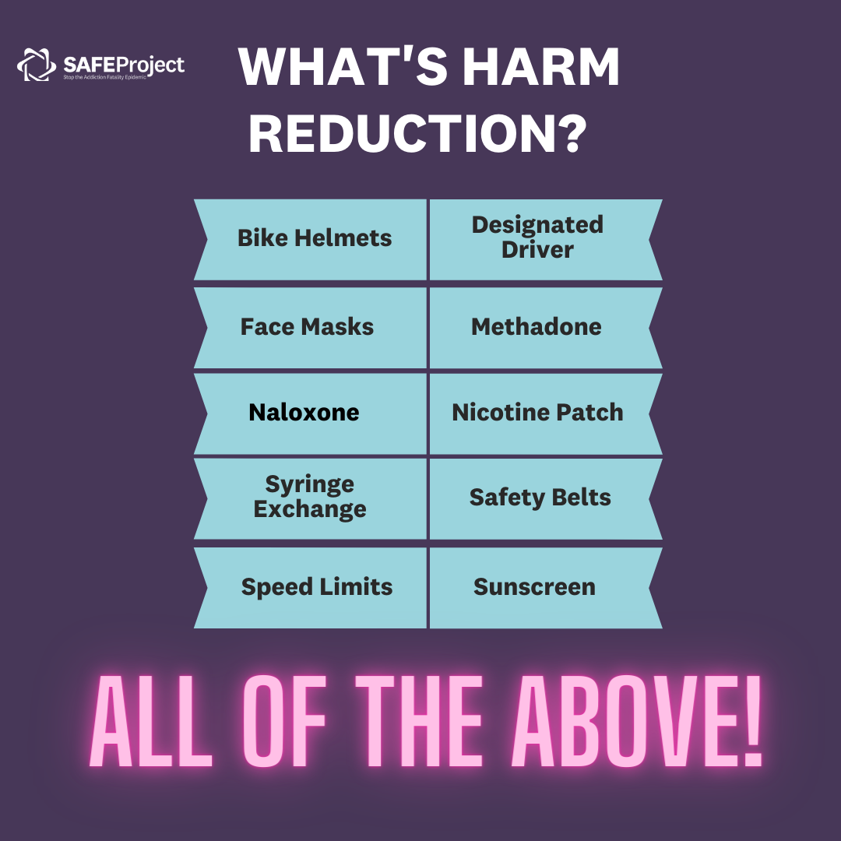
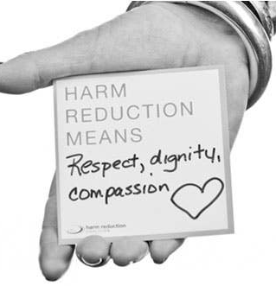
What is harm reduction?
Harm reduction is a set of practical strategies and ideas aimed at reducing negative consequences associated with a behavior
Harm Reduction (capitalized) is a movement for social justice built on a belief in, and respect for, the rights of people who use drugs
Notes:
There is a social movement focused on drug use
Based in a foundation of work done by activists and leaders many of whom were from marginalized communities, often people of color who recognized the dignity of individuals who used substances
Origins in 1980s during AIDS epidemic

Slide 72
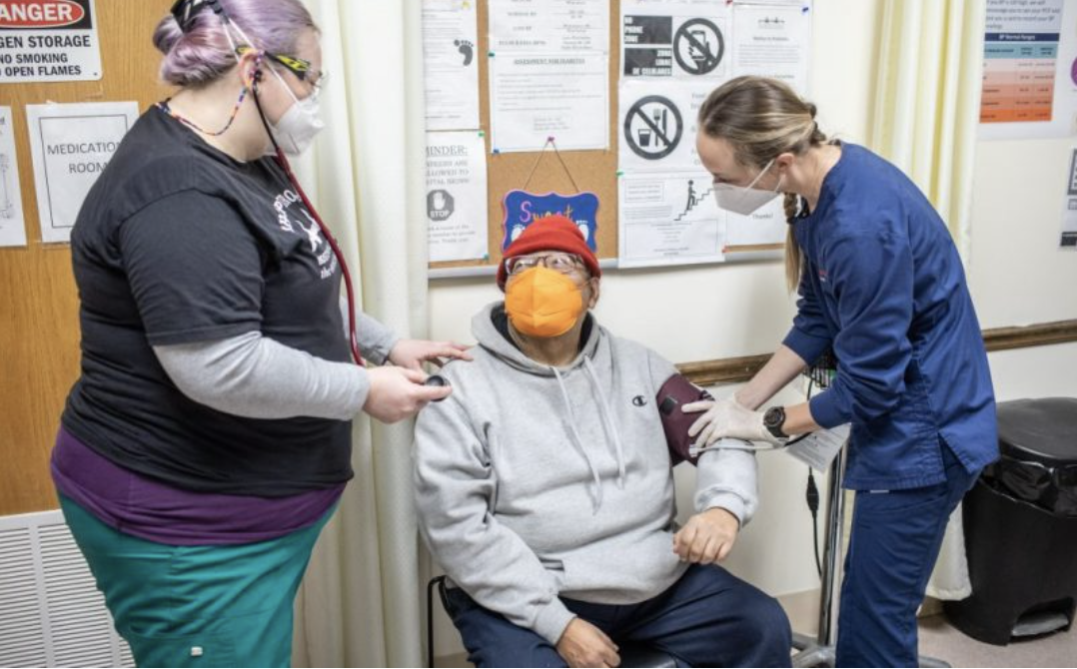
Reframing as health promotion and risk reduction
Management
Insulin
Screenings
Colonoscopies
Sun exposure
Counseling
Exercise
Pap smears
Casting a broken arm
Seat belts
A1c
Notes:
Some of you are familiar with harm reduction (HR)
Some of you are uncomfortable with the idea and maybe thinking of radical ideas but all of primary care is harm reduction

Slide 73
Harm reduction as a clinical approach
Medications
Decrease/stabilizing use: OAT for opioids, naltrexone for alcohol
Screenings
Infectious disease (route dependent)
Motivational interviewing
Counseling
Harm reduction messaging
Other healthcare preventive medicine- lipids, a1c, malignancy
Comorbid conditions
Prevent/treat complications: naloxone, vitamins (eg thiamine), antivirals (HCV tx, PEP/PrEP), vaccines (Hepatitis, PPSV23)
St Francis House Clinic, Boston, 2022
https://stfrancishouse.org/medical-clinic/

Slide 74
Myth: Harm Reduction is enabling
Example | Purpose | evidence
Syringe service programs | Provide injection equipment & collect used equipment; may provide or link to other services | ↓ HIV/HCV incidence (Aspinall et al. 2014)
Overdose Education & Naloxone Distribution | Community based naloxone training & distribution programs | ↓ unintentional overdose (Walley et al. 2013)
Injectable OAT (Heroin assisted Treatment) | IV opioids (eg diacetylmorphine) provided to pts w/ severe OUD in a controlled environment | ↓non-prescribed drug use; ↑ QoL (Oviedo-Joekes et al. 2009)
Supervised Consumption Spaces (Overdose Prevention Center) | Places where people can consume substances under trained supervision | ↓ in overdose; ↑ safer injection, link to care (Marshall et al. 2011)

Slide 75
Myth: The drugs themselves are the problem
Drug related harm
Criminalization
Inequities
Racism
Trauma
Discrimination
Stigmatization
Principles of Harm Reduction - Harm Reduction Coalition. http://harmreduction.org/about-us/principles-of-harm-reduction/
Notes:
Principles of Harm Reduction for Medical Providers
Accepts that drug use is part of our world, and works to minimize its harm​
Understands drug use as a continuum of behaviors from severe abuse to total abstinence, and acknowledges that some ways of using drugs are safer than others​
Establishes quality of life - not necessarily cessation of all drug use - as the criteria for successful interventions and policies ​
Practices non-judgmental, non-coercive provision of services and resources ​
Affirms drug users themselves as the primary agents of reducing harm, and seeks to empower users in strategies which meet their actual conditions of use ​
Does not attempt to minimize or ignore the real and tragic harm associated with drug use ​
7. Recognizes that the realities of poverty, racism, trauma, and other social inequalities affect vulnerability to and capacity for dealing with drug-related harm​

Slide 76
How do you approach this patient?
Kira is a 27-year-old woman with severe OUD (on buprenorphine/naloxone), HCV, mood disorder NOS (two hospitalizations for psychosis) who presents for refill on her buprenorphine/naloxone. She is experiencing unsheltered homelessness, sleeps under a bridge. Her last three toxicology screens have been positive for buprenorphine and methamphetamine. When she walks into the room, she tells you that she hasn’t used any heroin/fentanyl for over 3 months since starting buprenorphine. “I have no dope cravings at all; my problem right now is uppers.”
Notes:
General reflection question: Have you seen a patient in a similar situation before?
Key Points

Slide 77

Counseling: Guiding principles
With permission- okay if patient doesn’t want to discuss
Done with humility- the patient is the expert
Tailored- recognizes broader context of use

Slide 78
History taking
Topic | Examples
Reasons for use? | Relax, treat pain/WD, stay awake, seek new experience, pleasure
Downsides of use? | Cost, health, social harms, tolerance, carceral-legal
Practices/patterns? | Context (where, when, w/whom), amount/frequency, route
Goals (if any?) | Cut back, abstain, use in safer ways, avoid arrest
Notes:
What are some of your reasons for use? Instead of just stop or even why are you using? Shows that there are reasons. Those reasons are real.

Slide 79
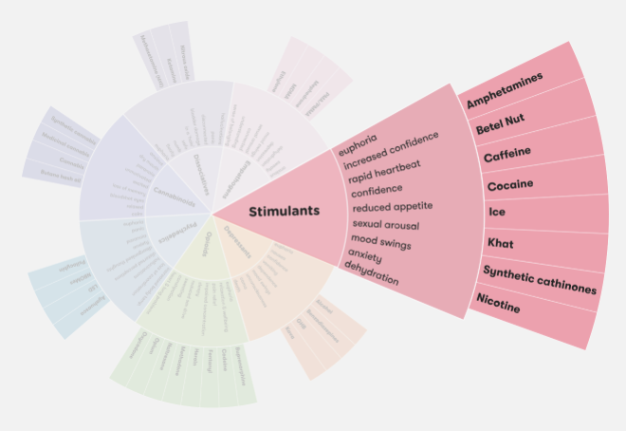
Reasons for use
Kira:
  maintain hypervigilance
  ?Stimulant use disorder
Other reasons:
  Pleasure- Dopamine release feels good
  Performance enhancement
  Elation/euphoria
  ↓Appetite
  ↓ Inhibitions, ↑ confidence
  ↑ Sexual arousal
The Drugs Wheel by Mark Adley
Notes:
There are MANY reasons people use stimulants
important to identify motivators for use, especially if you are planning to engage in behavior change discussions
- For this patient who lives on the street, she reports using stimulants to stay awake and maintain hypervigilance.
- Her continued use is likely driven by an underlying substance use disorder as well; cocaine is powerfully reinforcing for people with a predisposition.
Other reasons stimulants are used include:
performance enhancement (sex, studying)
elation/euphoria
decreased appetite
decreased inhibitions, increased confidence, and increased sexual arousal
Stimulants are also often used alone or in combination with sexual activity (eg “Party and Play”/chemsex refers to use of methamphetamine, GHB, and mephedrone generally by MSM, in part driven by social stigma experienced by sexual minorities).

Slide 80
Motivational interviewing
“…a collaborative, goal-oriented style of communication with particular attention to the language of change…designed to strengthen personal motivation for and commitment to a specific goal by eliciting and exploring the person’s own reasons for change within an atmosphere of acceptance and compassion.”
Miller W, Rollnick S. Motivational Interviewing: Helping People Change. 3rd ed. New York, New York: The Guilford Press; 2013.

Slide 81
How can we reduce harm?
Prevent overdose
Prevent and treat infection
Provide harm reduction supplies
  Discuss safer use
Pragmatism
Autonomy
Humanism
Adapted from Taylor et al “Integrating Harm Reduction into Outpatient Opioid Use Disorder Treatment Settings” 2021
Notes:
spectrum of strategies from safer use, to managed use, to abstinence - to meet drug users “where they’re at,” addressing conditions of use along with the use itself

Slide 82
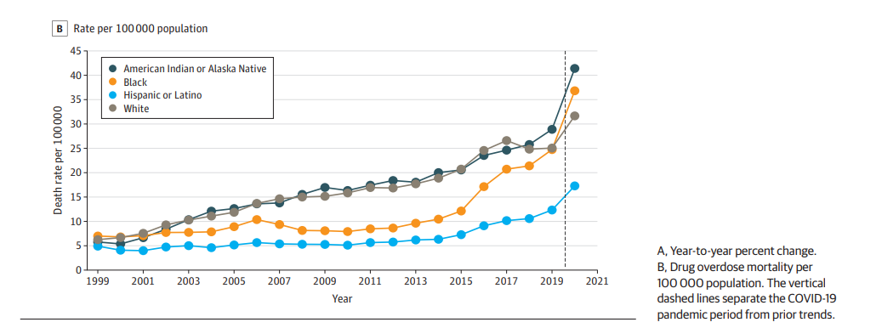
Drug Overdose Mortality Rates by Race and Ethnicity, 1999 to 2020
Friedman and Hansen 2022

Slide 83
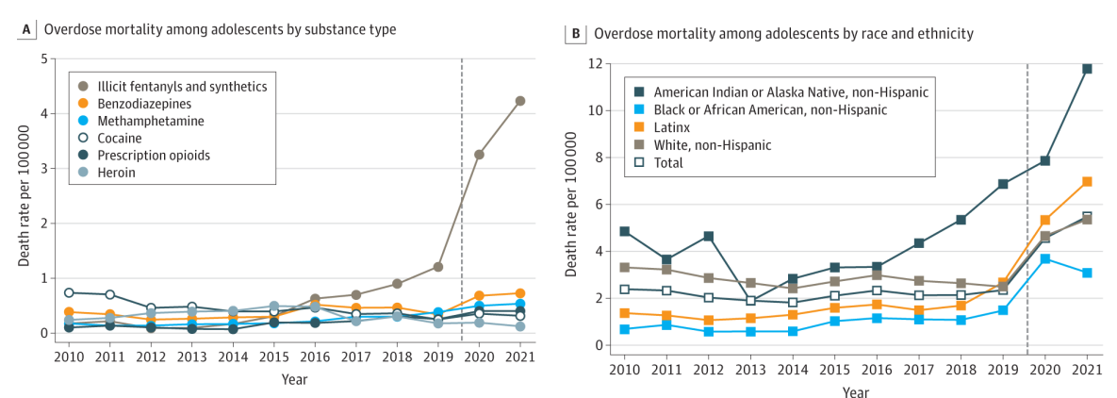
Demographics of overdose among adolescents
Friedman, Godvin, Schriger et al, 2022

Slide 84
Overdose Prevention
Carry Naloxone
Never Use Alone
Avoid Mixing
Consider supply
Consider tolerance

Slide 85
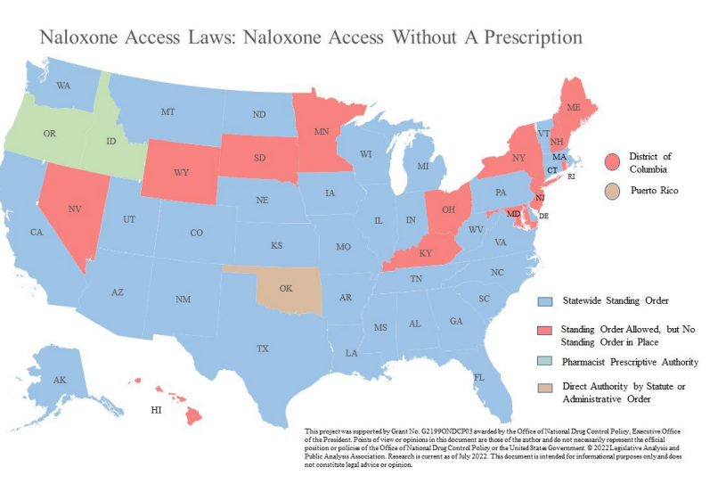
Naloxone
Notes:
as of July 2022. As of that date, all 50 states and the District of Columbia have some form of a naloxone access law. The laws vary significantly by jurisdiction
Massachusetts was the first state have a state-wide standing order for Naloxone
the expansion of access to naloxone dispensing between 2014 and 2018 following the allowance of pharmacists to directly dispense the medication without a prescription has been a success for people that may not otherwise have access to it

Slide 86


Bystander Overdose Counseling
HelplineMA.org

Slide 87




Never use alone
National: 800-484-3731
Spanish: 800-928-5330
New England: 800-972-0590
New York: 800-997-2280
Mandy: 800-943-0540
Notes:
Bathroom sensors

Slide 88
Who is at high risk of overdose?
A. Sam is a 20-year-old man who is using heroin IV daily
B. Mateo is a 43-year-old man who has recently been abstinent from cocaine and occasional non-prescribed oxycodone for two months
C. Nikki is a 36-year-old woman recently incarcerated for 6 months and returns to care in your clinic
Notes:
Not highest.
Just high risk.

Slide 89
Factors that increase risk of overdose
Change in tolerance
  Following a period of abstinence
  After incarceration
Change in supply
  “test shot” or “slow shot”
Effect of mixing substances
  Association of fatal overdose with co-occurring substance

Slide 90




Drug Supply
Sold As | Concern for
Heroin/“Dope” | Fentanyl, Fentanyl- analogues, xylazine, tramadol
Percocet | Fentanyl
Xanax | Clonazolam, etizolam, bromazolam, flualprazolam
Adderall | Methamphetamine, caffeine
Crack | Cocaine, levamisole
Ecstasy/MDMA | MDA, methamphetamine, caffeine
DrugsData.org
Notes:
3,4-Methylenedioxyamphetamine
4-anilino-N-phenethylpiperidine, 4-aminophenyl-1-phenethylpiperidine, or despropionyl fentanyl

Slide 91

Drug contamination
Fentanyl analogues
Benzodiazepine analogues
Xylazine (alpha-agonist)
Levamisole (anti-helmith)
Notes:
. Of the drug samples tested by the Massachusetts Drug Supply Data Stream between January and June 2022, 28 percent tested positive for xylazine.
Levamisole-adulterated cocaine induced skin necrosis

Slide 92
Case 2
For Kira, continued engagement in a judgement-free destigmatized environment and remaining on buprenorphine IS harm reduction and reduces her risk.
She feels welcome and sees you 4 weeks later.

Slide 93
How can we reduce harm?
Prevent overdose
Prevent and treat infection
Provide harm reduction supplies
  Discuss safer use
Pragmatism
Autonomy
Humanism
Adapted from Taylor et al “Integrating Harm Reduction into Outpatient Opioid Use Disorder Treatment Settings” 2021
Notes:
spectrum of strategies from safer use, to managed use, to abstinence - to meet drug users “where they’re at,” addressing conditions of use along with the use itself

Slide 94
Screen and Prevent
Labs
Vaccinations
CMP
bhCG
HIV (Ab/Ag)
Hep C Ab (with reflex to PCR VL)
Hep B sAb, sAg, cAb
Hep A IgG
Chlamydia and gonorrhea
Syphilis
Tuberculosis
Hep A/Hep B
Tetanus
PCV20
HPV
Influenza
COVID

Slide 95
PEP vs PrEP
<72h since exposure
>10-14d since exposure
PEP (post-exposure)
  3-drug regimen
    Tenofovir disoproxil fumarate 300mg/emtricitabine 200mg (TDF/FTC Truvada) + Dolutegravir 50mg DTG Tivicay) x28 days
PrEP (pre-exposure)
  2-drug regimen
    Tenofovir disoproxil fumarate 300mg/emtricitabine 200mg (TDF/FTC Truvada) daily ongoing
    Tenofovir alafenamide/emtricitabine (TAF/FTC) Descovy if eGFR 30-60
Notes:
HIV Ag/Ab
HIV RNA
HBV sAb/sAg/cAb
Cr
PEP: Monitor at 4-6w, 3 mo, 6 mo
PrEP: HIV q3mo, Cr q6mo

Slide 96
How can we reduce harm?
Prevent overdose
Prevent and treat infection
Provide harm reduction supplies
  Discuss safer use
Pragmatism
Autonomy
Humanism
Adapted from Taylor et al “Integrating Harm Reduction into Outpatient Opioid Use Disorder Treatment Settings” 2021
Notes:
spectrum of strategies from safer use, to managed use, to abstinence - to meet drug users “where they’re at,” addressing conditions of use along with the use itself

Slide 97

Facilitate access to safer use supplies
The Policy Surveillance Program
Notes:
Syringe Services Programs (SSPs) provide low-barrier access to sterile supplies for safer substance use, naloxone and overdose prevention tools like fentanyl test strips and drug checking services. SSPs also provide a range of other services, such as options for safe syringe disposal, overdose recognition and response training and help accessing services for HIV, substance use disorders and more
SSPs provide a safe environment for PWIDs who are not ready for treatment and will not access other support or medical services.
National research has shown the efficacy of syringe service programs:
• Eight federal studies have shown that SSPs do not promote or result in increased drug use.
• SSPs help people who inject drugs to access substance use disorder treatment programs, increasing substance use treatment enrollment, and are associated with “substantially reduced injecting or cessation of injecting.”
• Programs are a proven cost-effective approach for preventing transmission of HIV and viral hepatitis among injection drug users and engaging injection drug users in substance use disorder treatment programs.
• SSPs also help clients infected with HIV or hepatitis C learn their status: in 2010, 67 percent of SSPs surveyed nationally offered hepatitis C testing, and 87 percent offered HIV testing and counseling.
People get from SSPs like AHOPE (Boston); AIDS Action (Central Square) and/or pharmacy (in MA), but barriers to both
41% of pts say “very convenient” to go to SSP
Participants report getting syringes from SSPs more comfortable than pharmacies
44% of our patients say “somewhat” or “very” true that need ID at pharm
<half of our patients can afford enough syringes at the pharmacy→ those pts less likely to get syringes at pharmacy
If not near SSP or can’t afford syringes at pharmacy, consider RX ; covered by Masshealth (downside– not anonymous)
Insulin syringes, no detachable needle
Most common size= 28G, ½”, 1cc, “biggie smalls.”
After that, 31G, 5/16”, “shorts.”
Kits available at Bridge/ACT/primary care OBAT
*people have brand preferences*
https://www.mass.gov/info-details/syringe-service-program-locator
https://nasen.org/sep/ahope-boston-public-health-commission
https://aac.org/programs-services/needle-exchange/
https://harmreduction.org/issues/syringe-access/landscape-report/state-by-state/
Arizona Facts
Criminalization
Syringes are included in the state’s drug paraphernalia laws with no exemption for SSP participants. There is no protection against prosecution for drug residue on returned syringes.
Program Authorization
SSPs are not allowed to operate in this state.
New Hampshire Facts
Criminalization
Syringes are not included in the state’s drug paraphernalia laws. There is a protection against prosecution for drug residue on returned syringes.
Program Authorization
SSPs are explicitly allowed to operate in this state. The approval process specifies extra restrictions on eligible entities.
The operation of SSPs is constrained by requirements for referrals and services offered and data collection requirements.
New Mexico Facts
Criminalization
Syringes are included in the state’s drug paraphernalia laws with an exemption for SSP participants. There is no protection against prosecution for drug residue on returned syringes.
Program Authorization
SSPs are explicitly authorized to operate in this state.
The operation of SSPs is constrained by requirements for referrals and services offered.
Oregon Facts
Criminalization
Syringes are not included in the state’s drug paraphernalia laws. There is no protection against prosecution for drug residue on returned syringes.
Program Authorization
SSPs are not prevented from operating in this state.
Texas Facts
Criminalization
Syringes are included in the state’s drug paraphernalia laws with no exemption for SSP participants. There is no protection against prosecution for drug residue on returned syringes.
Program Authorization
SSPs are not allowed to operate in this state, except for an authorized pilot program in Bexar county.
Washington Facts
Criminalization
Syringes are included in the state’s drug paraphernalia laws with an exemption for SSP participants. There is no protection against prosecution for drug residue on returned syringes.
Program Authorization
SSPs are explicitly authorized to operate in this state.

Slide 98


Safer injection counseling
Wash hands
  Provide alcohol wipes
Aim for safer water sources
  Sterile water > unopened bottled water > boiled > running tap water
Avoid reusing/sharing supplies
  Acid (crack cocaine)
    Vitamin C >lemon juice> vinegar
  Reservoir/cooker
    Single use container>bottle cap>spoon>soda can
  Filter
    A matrix that separates out solids that do not dissolve
    Cotton>cigarette filters>qtips>lint
Notes:
Syringes
Needle: length, gauge (up to 40% of PWID share supplies J viral hep)
Sterile water: required to dissolve
Cooker: small container to mix/dissolve solid to liquid
Tourniquets
Alcohol swabs
Adhesive bandages
Filters: filter out particulates/contaminates)
Vit c: acid to neutralize & dissolve crack cocaine into solution
Two terms to know:
Cotton shots: resuspending drugs from used cottons (73% of our patients have done this past 3 months)
Cotton fever: SIRS response 15-30 minutes after injection; 6-24 hrs, no bacteremia (more likely from endotoxins from GNR bacteria that has colonized cotton)

Slide 99


Notes:
More in harm reduction lecture
“I inject less as I have easier access to pipes”: Injecting, and sharing of crack-smoking materials, decline as safer crack-smoking resources are distributed
Declining rates of health problems associated with crack smoking during the expansion of crack pipe distribution in Vancouver, Canada
https://www.ncbi.nlm.nih.gov/pmc/articles/PMC5292004/

Slide 100

Fentanyl Test Strips
https://www.cdc.gov/stopoverdose/fentanyl/fentanyl-test-strips.html

Slide 101



Know (Be) your local resources
10 syringes
16 alcohol swabs
1 Tourniquet
1 bag of cottons
5 cookers
5 sterile waters
Sharps container (fit pack)
+/-
Vitamin C (crack cocaine)
Bleach bottle
Fentanyl test strips
Condoms

Slide 102




Ask for help
https://www.indiancountryecho.org/sud-resource-hub/
https://nccc.ucsf.edu/clinician-consultation/substance-use-management
855-300-3595
https://harmreduction.org/

Slide 103




Resources
https://www.cdc.gov/opioids/healthcare-professionals/prescribing/guideline/index.html
https://www.scopeofpain.org
https://www.mcstap.com
1-833-PAIN-SUD
https://www.pcssnow.org

Slide 104


Massachusetts General Hospital Substance Use Disorders Initiative
https://www.massgeneral.org/substance-use-disorders-initiative
MGH Charlestown Health Center
73 High Street
Charlestown, MA 02129
Wei Sum Li, MD wsli@mgh.Harvard.edu

Slide 105
Learning Objectives
Develop framework for discussion, evaluation, and management of substance use disorders as a chronic disease
Recognize the clinical importance of accurate patient-centered language
Diagnose and formulate a treatment plan for opioid use disorder using evidence-based and patient-centered approaches
Understand how to initiate buprenorphine in a primary care patient
Describe the role of harm reduction and identify practical strategies to reduce harm in the ​care of individuals who use substances

Slide 107
References
Cohen S, Morford K, Weimer M. How to Implement Low Dose Buprenorphine Initiation in Your Practice: A Case-Based Workshop. ASAM 2022
Dowell D, Ragan KR, Jones CM, Baldwin GT, Chou R. CDC Clinical Practice Guideline for Prescribing Opioids for Pain — United States, 2022. MMWR Recomm Rep 2022;71(No. RR-3):1–95. DOI: http://dx.doi.org/10.15585/mmwr.rr7103a1
Dowell D, Haegerich TM, Chou R. CDC Guideline for Prescribing Opioids for Chronic Pain — United States, 2016. MMWR Recomm Rep 2016;65(No. RR-1):1–49. DOI: http://dx.doi.org/10.15585/mmwr.rr6501e1
Ghosh et al, “A Review of Novel Methods To Support The Transition From Methadone and Other Full Agonist Opioids To Buprenorphine/Naloxone Sublingual In Both Community and Acute Care Settings,” Canadian Journal of Addiction, 2019
Green TC, Serafinski R, Clark SA, Rich JD, Bratberg J. Physician-delegated unobserved induction with buprenorphine in pharmacies. N Engl J Med. 2023;388(2):185-186.
Hämmig R, Kemter A, Strasser J, von Bardeleben U, Gugger B, Walter M, Dürsteler KM, Vogel M. Use of microdoses for induction of buprenorphine treatment with overlapping full opioid agonist use: the Bernese method. Subst Abuse Rehabil. 2016 Jul 20;7:99-105. doi: 10.2147/SAR.S109919. PMID: 27499655; PMCID: PMC4959756.
John F. Kelly, Cassandra M. Westerhoff, Does it matter how we refer to individuals with substance-related conditions? A randomized study of two commonly used terms. International Journal of Drug Policy. Volume 21, Issue 3, 2010. Pages 202-207. ISSN 0955-3959. https://doi.org/10.1016/j.drugpo.2009.10.010.
Miller W, Rollnick S. Motivational Interviewing: Helping People Change. 3rd ed. New York, New York: The Guilford Press; 2013.
Principles of Harm Reduction - Harm Reduction Coalition. http://harmreduction.org/about-us/principles-of-harm-reduction/
Saitz R. Unhealthy alcohol use. N Engl J Med. 2005;352(6):596-607.
SAMHSA Quick Start Guide: https://www.samhsa.gov/sites/default/files/quick-start-guide.pdf
SAMHSA TIP 63: https://store.samhsa.gov/system/files/sma18-5063pt3.pdf
Taylor et al. “Integrating Harm Reduction into Outpatient Opioid Use Disorder Treatment Settings” 2021
Wakeman SE, Larochelle MR, Ameli O, et al. Comparative Effectiveness of Different Treatment Pathways for Opioid Use Disorder. JAMA Netw Open. 2020;3(2):e1920622. doi:10.1001/jamanetworkopen.2019.20622

Slide 108
Bassareo V, Di Chiara G. Differential responsiveness of dopamine transmission to food-stimuli in nucleus accumbens shell/core compartments. Neuroscience. 1999 Mar;89(3):637-41. doi: 10.1016/s0306-4522(98)00583-1. PMID: 10199600.
Bezchlibnyk-Butler KZ et al. Anxiolytic agents. Allison Schmitz. Benzodiazepine use, misuse, and abuse: A review. Mental Health Clinician. 2016. Jun; 6(3): 120–126
Centers for Disease Control and Prevention (CDC). Emergency department visits involving nonmedical use of selected prescription drugs--United States, 2004-2008. MMWR Morb Mortal Wkly Rep. 2010; 59 23: 705- 9
Chen KY, Chen L, Mao J. Buprenorphine-naloxone therapy in pain management. Anesthesiology. 2014 May;120(5):1262-74. doi: 10.1097/ALN.0000000000000170. PMID: 24509068; PMCID: PMC3999180.
Craven C, Fileger M, Woster P. Demystifying Benzodiazepine Urine Drug Screen Results. Pract Pain Manag. 2014;14(1).
Di Chiara G, Imperato A. Drugs abused by humans preferentially increase synaptic dopamine concentrations in the mesolimbic system of freely moving rats. Proc Natl Acad Sci U S A. 1988 Jul;85(14):5274-8. doi: 10.1073/pnas.85.14.5274. PMID: 2899326; PMCID: PMC281732.
Greenwald M, Comer S, Fiellin D. Buprenorphine maintenance and mu-opioid receptor availability in the treatment of opioid use disorder: implications for clinical use and policy. Drug Alcohol Depend. 2014 Nov 1;144:1-11. doi: 10.1016/j.drugalcdep. 2014.07.035
Fleury, Marie-Josée & Djouini, Akram & Huynh, Christophe & Tremblay, Joël & Ferland, Francine & Menard, jean marc & Belleville, Geneviève. (2016). Remission from substance use disorders: A systematic review and meta-analysis. Drug and Alcohol Dependence. 168. 10.1016/j.drugalcdep.2016.08.625.
Fiorino DF, Coury A, Phillips AG. Dynamic changes in nucleus accumbens dopamine efflux during the Coolidge effect in male rats. J Neurosci. 1997 Jun 15;17(12):4849-55. doi: 10.1523/JNEUROSCI.17-12-04849.1997. PMID: 9169543; PMCID: PMC6573325.
Friedman JR, Hansen H. Evaluation of Increases in Drug Overdose Mortality Rates in the US by Race and Ethnicity Before and During the COVID-19 Pandemic. JAMA Psychiatry. 2022;79(4):379–381. doi:10.1001/jamapsychiatry.2022.0004
Friedman J, Godvin M, Shover CL, Gone JP, Hansen H, Schriger DL. Trends in Drug Overdose Deaths Among US Adolescents, January 2010 to June 2021. JAMA. 2022 Apr 12;327(14):1398-1400. doi: 10.1001/jama.2022.2847. PMID: 35412573; PMCID: PMC9006103.

Slide 109
Kakko J, Svanborg KD, Kreek MJ, Heilig M. 1-year retention and social function after buprenorphine-assisted relapse prevention treatment for heroin dependence in Sweden: a randomised, placebo-controlled trial. Lancet. 2003 Feb 22;361(9358):662-8. doi: 10.1016/S0140-6736(03)12600-1. PMID: 12606177.
McLellan AT, Lewis DC, O'Brien CP, Kleber HD. Drug dependence, a chronic medical illness: implications for treatment, insurance, and outcomes evaluation. JAMA. 2000 Oct 4;284(13):1689-95. doi: 10.1001/jama.284.13.1689. PMID: 11015800.
Thakrar A. Low-Dose Decision Aid . https://docs.google.com/document/d/1CJ8tz12K9Mn9-utSH3n8nRy6djrN7eGn/edit
Sordo L, Barrio G, Bravo M J, Indave B I, Degenhardt L, Wiessing L et al. Mortality risk during and after opioid substitution treatment: systematic review and meta-analysis of cohort studies BMJ 2017; 357 :j1550 doi:10.1136/bmj.j1550
Volkow ND, Chang L, Wang GJ, Fowler JS, Franceschi D, Sedler M, Gatley SJ, Miller E, Hitzemann R, Ding YS, Logan J. Loss of dopamine transporters in methamphetamine abusers recovers with protracted abstinence. J Neurosci. 2001 Dec 1;21(23):9414-8. doi: 10.1523/JNEUROSCI.21-23-09414.2001. PMID: 11717374; PMCID: PMC6763886.
Volpe DA, McMahon Tobin GA, Mellon RD, Katki AG, Parker RJ, Colatsky T, Kropp TJ, Verbois SL. Uniform assessment and ranking of opioid μ receptor binding constants for selected opioid drugs. Regul Toxicol Pharmacol. 2011 Apr;59(3):385-90. doi: 10.1016/j.yrtph.2010.12.007. Epub 2011 Jan 6. PMID: 21215785.

