Slide 1
ID Clinical Update
Jonathan Vilasier Iralu, MD, MACP, FIDSA
Indian Health Service Chief Clinical Consultant for Infectious Diseases

Slide 2
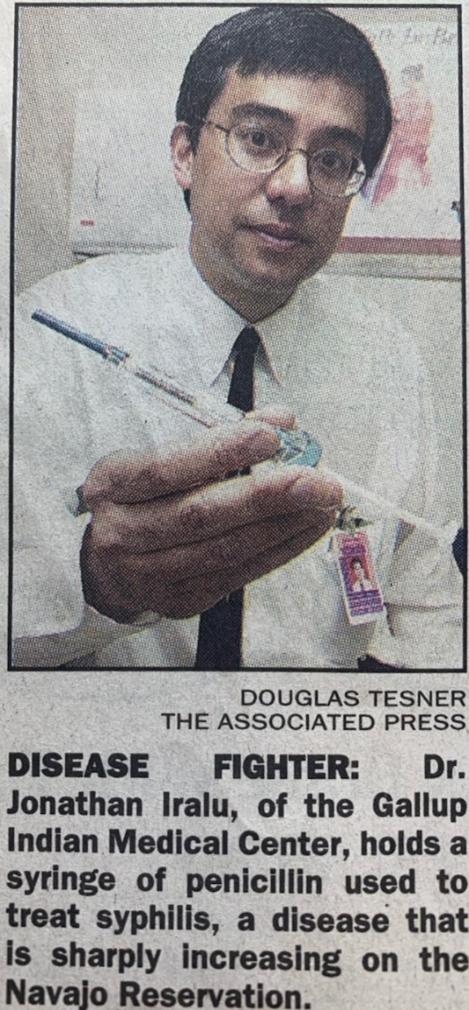

Disclosures
  I Hate Syphilis!

Slide 3


The latest variants
XBB.1.15 the Kracken
XBB.1.16 Arcturus

Slide 4
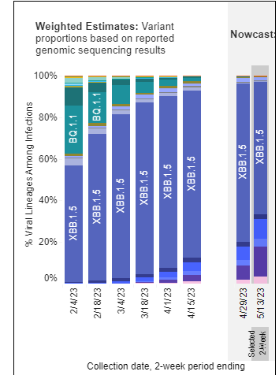
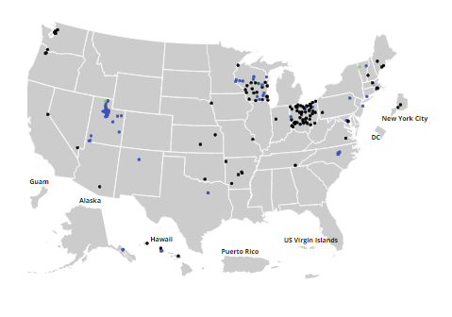
Virology

Slide 5
End of the COVID-19 Public Health Emergency
IHS recommendation from the Director 3/15/2023
  Mask mandate ended
  Exceptions include
    Communities with high level of transmission
    Care of patients with COVID-19
Community level/transmission level tracking has stopped
Many IHS sites have made masking optional except for the care of confirmed or suspect COVID-19 patients (following tribal guidance)

Slide 6
WHO Ends the Mpox Public Health Emergency
Cluster of 13 Mpox cases reported in Chicago April 2023
Treatment:
  TPOXX is the drug of choice (use current supply until expired)
  Offer enrollment in STOMP trial 1-855-876-9997
  If not eligible, obtain TPOXX from CDC Investigational New Drug program
  Urgently alert distribution team lead at IHS (Kara King or Andrea Klimo)

Slide 7
End of the Mpox Public Health Emergency
Advice from IHS Vaccine program on who to give Jynneos x 2:
  Potential exposure: known or suspected exposure to someone with Mpox or partner diagnosed in last 2 weeks with Mpox
  Gay, bisexual or other man who has sex with men, transgender, non-binary or gender diverse persons in last 6 months who has a new STI diagnosis or more than one sex partner
  Sex within 6 months at commercial sex venue, large commercial event or area with transmission, sex for money, or has a partner with these risks
  Individual anticipates any of the above risk scenarios
  HIV or other immunosuppression with recent or anticipated exposure

Slide 8
Syphilis Penicillin Shortage
National IHS Treatment priorities 4/19/2023
Pregnant persons and HIV infected persons with syphilis as well as infants with congenital syphilis should receive priority for treatment with Benzathine penicillin G.
Other persons with early syphilis (primary, secondary, early latent) and sexual partners should be treated with Benzathine penicillin G if supplies are adequate to cover high risk patients listed under priority #1.
If Benzathine penicillin G supplies are inadequate to cover patients listed as priority #2, treat early
syphilis (primary, secondary, early latent) with doxycycline 100 mg po bid for 14 days and late latent syphilis or latent syphilis of uncertain duration with doxycycline 100 mg po bid for 28 days.
4. Ceftriaxone may be an acceptable second-line alternate treatment for primary and secondary syphilis

Slide 9

Post exposure Doxycycline to prevent bacterial STIs
Leutkemeyer et al NEJM April 6, 2023
  510 MSM and Trans Women on HIV PrEP and 173 on HIV antiretroviral therapy randomized to Doxycycline 200 mg po vs placebo within 72h of sex
  Relative risk of acquiring STIs diminished dramatically with doxycycline:
  No serious events attributed to doxycycline
 | Gonorrhea | Chlamydia | Syphilis
PrEP | 0.45 | 0.12 | 0.13
ART | 0.43 | 0.26 | 0.23
N Engl J Med 2023; 388:1296-1306
DOI: 10.1056/NEJMoa2211934

Slide 10


