Slide 1
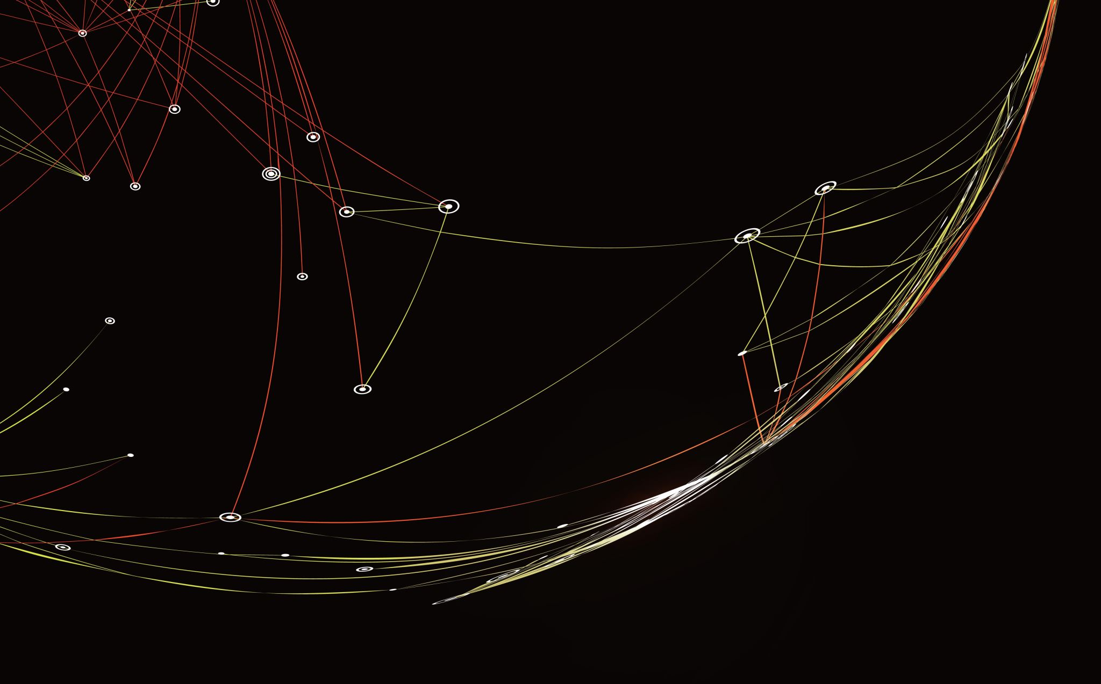
Death Notification/Delivering Hard News
Petter Overton-Harris, DO
Neal Nettesheim, MD
UNM EMS Consortium

Slide 2
What is death notification?
The process by which we notify friends/family of someone’s death
In our world often termination of resuscitation/trauma/obvious death
Burden often falls to the prehospital provider
Notes:
It’s a great privilege

Slide 3

So with such a big topic we get good training right?
Well….
Notes:
Show of hands for formal ed on death notification/hard news in p school, b school even med school?
That’s ok, we may not get great training, but at least it’s only for advanced providers

Slide 4

Really this is something Docs and Paramedics deal with, right?
Well….

Slide 5

Death touches all providers and in impactful ways
One study shows of 1500+ providers surveyed over 55% of respondents were EMT-B
EMT-B made up 33% of total death notifications (67% for ALS crews)
***KEY*** Only approximately 50% of all clinicians reported ANY training in Death notification during schooling
Notes:
Skill we’ve had to pick up as we go
How are we doing with this???

Slide 6
How are we (you) doing?
That same study shows huge correlation between clinician burnout and death notification in the last year
EMS professionals with 1-5 incidents in the last 12 months had 36% higher rates of burnout
EMS professionals with greater than 5 incidents in the last 12 months had 73% higher rates

Slide 7

Ok Ok so what do we do?
This Photo by Unknown Author is licensed under CC BY-SA
Notes:
GOOD NEWS!!! Having training and a framework for delivering death notifications and bad news, greatly reduces risk of burnout-→30%
This makes sense- if we never practiced splinting, IV’s, taking a patient history, airway skills→of course we would be terrible at it if the only time we used it was on a real patient
We lay a framework for continuing education and improve not only for us as clinicians and most importantly our patients

Slide 8

Delivering bad news strategies
Communication is key:
Be direct, clear, honest, and as specific as possible.
Designate a family liaison
Be consistent
Remain calm and focus on objective components of the case
Always debrief, look for things done well and identify things that could go more smoothly
Notes:
Liason should be experienced in medicine and patient interaction…not for junior members
There are lots of communication strategies to use…

Slide 9
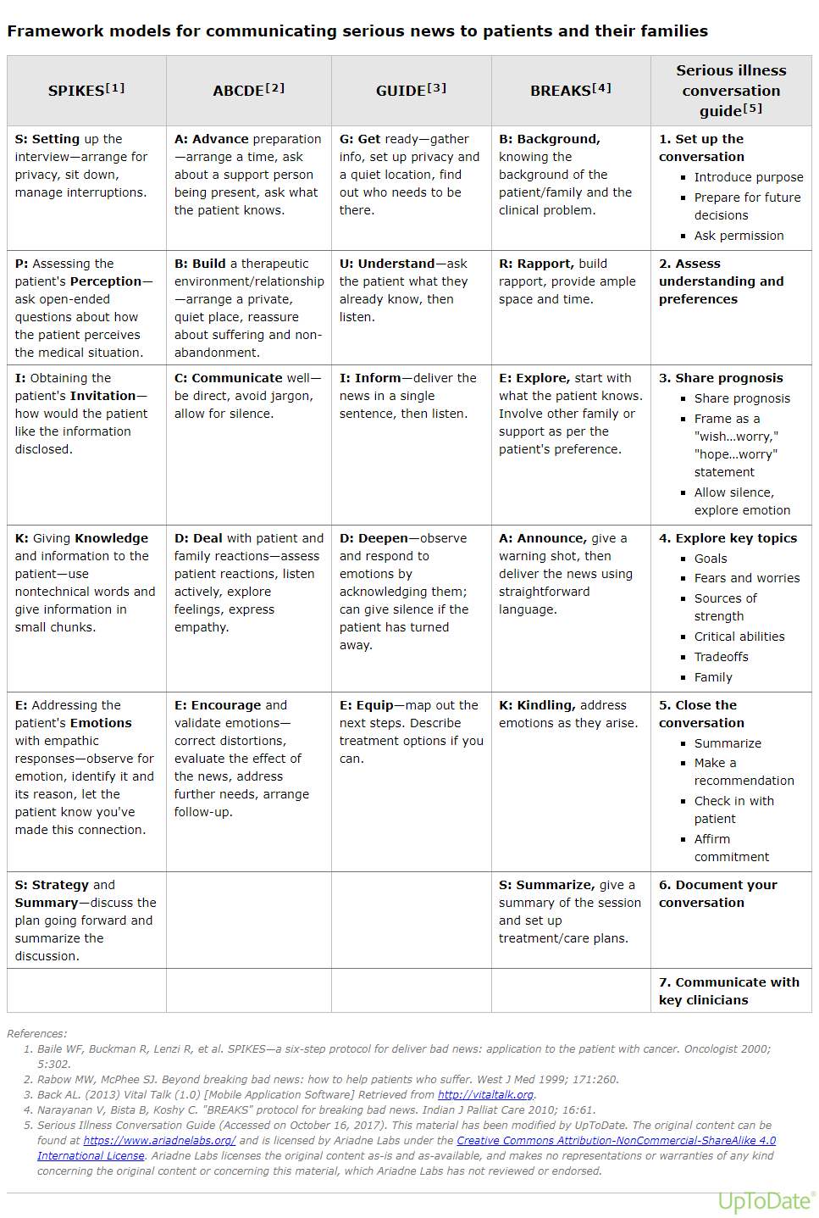
Notes:
Uptodate strategies: Consistent themes being direct, clear and consistent, avoid medical jargon. Start by assessing families knowledge of the situation, allow time for serious news to be absorbed and responded to.

Slide 10
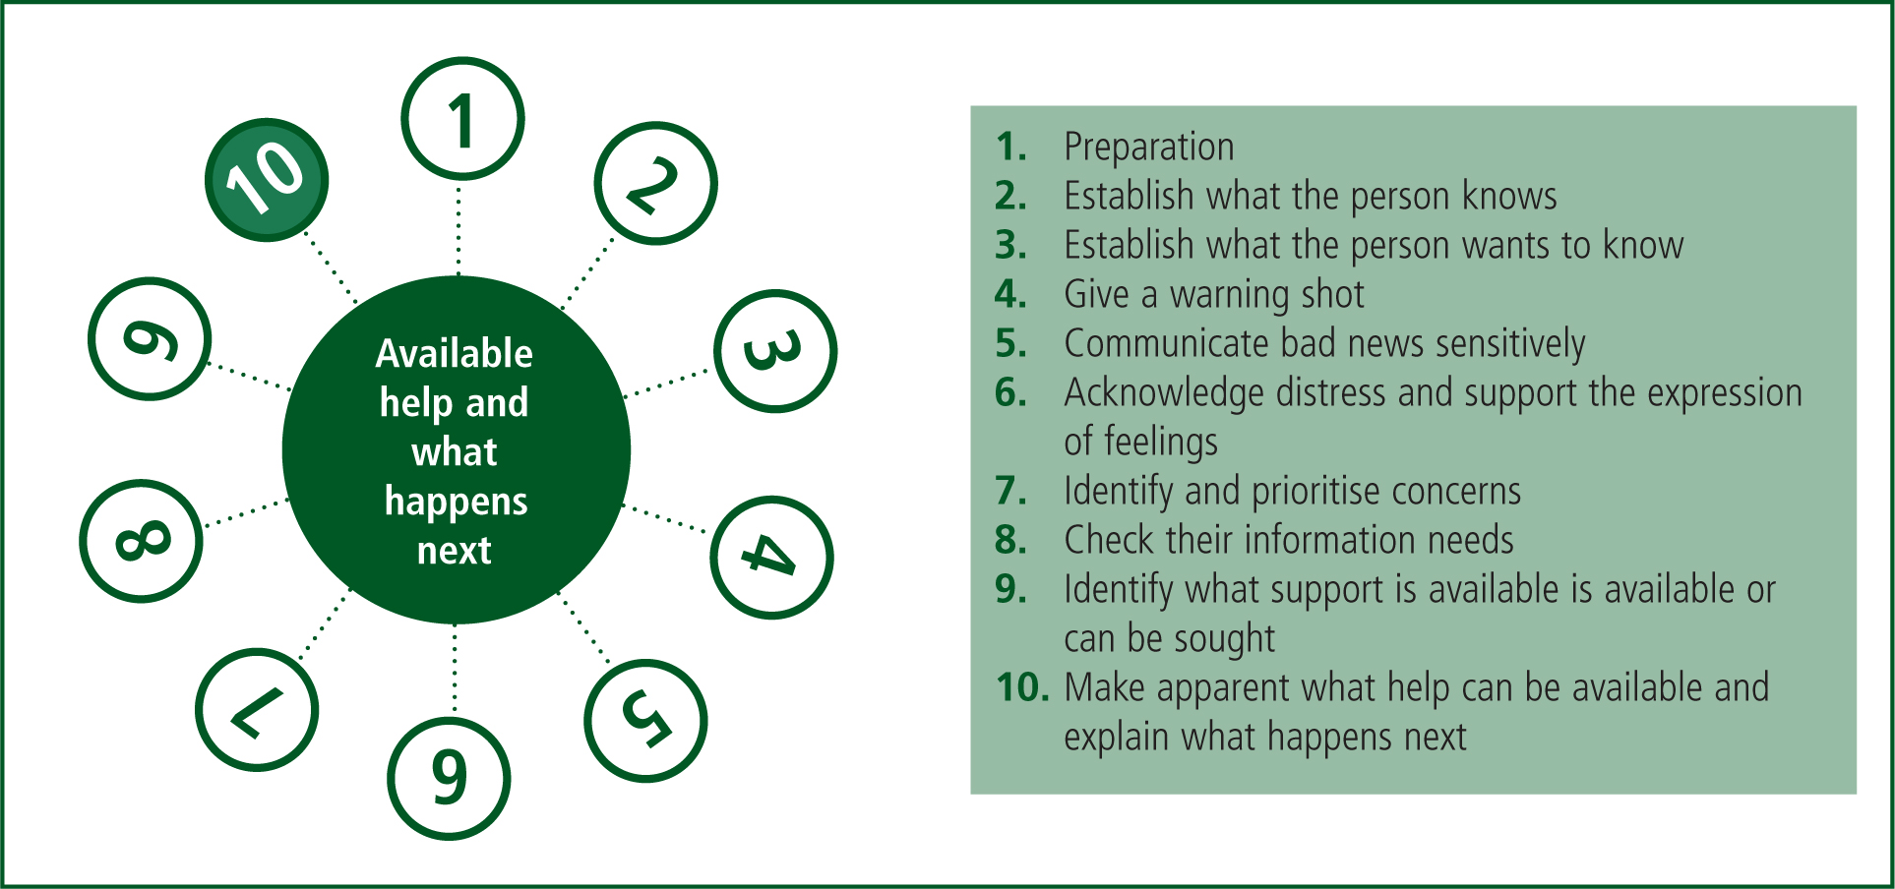
College of Paramedics Framework
Notes:
1- What do you need to get ready? If you’re the one talking-->Patient status, who the family is, where should you talk
2- What do you know about what’s going on right now?
3- Challenging

Slide 11
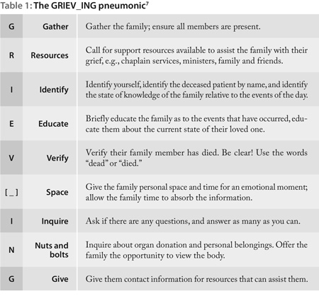
JEMS Model
Notes:
The moral is there are a bunch of different models, find the one that works for you and learn the common themes of direct, open, consistent communication
GRIEVING is studied and practiced in the prehospital/EMS environment
You’re not going to be giving cancer diagnosis or spinal cord injury
Lot’s focus on this

Slide 12
Scenario: Cardiac Arrest
We’re 28 minutes into the code
Unknown downtime
Bystander CPR
All EMS interventions went smoothly
Non-shockable rhythm throughout
Notes:
What do you think the survival is of this patient in the next 2 mins?
Lets work through the GRIEVING mnemonic

Slide 13
G: Gather
Key Family members
Spouse
Children
Support system
Notes:
”Who should be here right now?”
What are some other considerations?
Is there a time limit?- may not be able to wait for Uncle Jim for 30 mins
Is there a space limit?- Consider scene safety, personal safety, the effect that too little space has on

Slide 14
R: Resources
Ask for support: chaplain, social worker, family/friends
Consider asking for police assistance
Who in your community can help?
Notes:
Police/Fire Chaplain
Patient/Family religious figure
Friends
Again, consider scene safety—I terminated a code on the street in ABQ with family nearby, they were super agitated

Slide 15
I: Identify
Identify yourself
Identify deceased/injured patient by name
Identify how much family knows about what’s going on
Notes:
We’ve prepared and set the stage, now we can talk to people
Can I have a volunteer tell me what that would sound like?
My name is Neal Nettesheim, I'm a doctor working with the ambulance service.
Patient name, and relation if you know it.
What do you know about what’s going on right now?
Now we have a sense of what family knows and what they need to know

Slide 16
E: Educate
Educate family as to events that occurred
Use plain speak
Educate them about the state of their loved one
Plain speak
Intubation/LMA=
Defibrillation=
Compressions=
Arrhythmia=
Stroke=
Cardiac Arrest=
Multi-system Trauma=
Notes:
Walk them through what happened in plain speak
Tell them how their loved one is doing→how would you describe this patient at 25mins of a code?
There is a plain speak quiz
Ok so we’ve brought the family up to speed

Slide 17
V: Verify
Lead with Warning Shot
Verify family member has died
USE THE WORD “DEAD” OR ”DIED”
Nothing you say after this will be heard
Notes:
Warning Shot- "I'm so sorry" "I have terrible news"
Use word dead/died
GIVE EXAMPLE
We’ve tried everything we can do, but (Name) has died/is dead
OMI pronounces death legally—we stop resuscitation medically

Slide 18
__: Space
Allow family to have space and time to absorb and have emotion
Don't talk
Don’t fidget
Don't respond
Notes:
Allow reaction
Be present and in the moment with the family→don’t let your mind wander(importance of liason)
Usually is ok, but be on alert→ lots of coping mechanism including violence
(wait for 20 seconds)

Slide 19
What TO say
Cry as much as you need
I can't imagine how you must feel
Who can I call to be with you
I can tell how much (patient) was loved
I wish there was something I could to make it better
You did everything right

Slide 20
What NOT to say
Be strong
I understand how you feel
You're going to be ok
They are in a better place
At least....
Everything happens for a reason
Notes:
If you’ve seen it on the internet or a movie…don’t say it

Slide 21
I: Inquire
Ask if there are any questions and answer them all
Don't guess or speculate
Don't overexplain
Good Phrase: "I don't know"
Notes:
-This isn't about you or your ability to answer questions as much as families ability to try to come to grips with what is going on
“I don't know, but I can find out” is earnest and honest, it connects you to the family
WHAT ARE SOME WAYS TO ASK THIS?
I know there's a lot going on but I'm here for you, and I can answer any questions you may have

Slide 22
N: Nuts and Bolts
Inquire about organ donation, funeral services, personal belongings. Offer family to view body
Plant Seeds for the future
Notes:
THE FAMILY CAN ASK QUESTIONS, BUT NOW WE CAN ASK QUESTIONS
THIS IS A TOUGHER ONE TO ASK, BUT HOW WOULD YOU ASK THIS?
What are your family members wishes about....
How can we help you...
Plant seeds, They may not know the answer right now, but it’ll be something they need

Slide 23
G: Give
Give card and access information. Offer to answer questions that arise later. Return calls.
Notes:
Be available, you’re the expert in the field to our patients.
Talk to your medical director or service chief.
WE TAKE CARE OF OUR PATIENTS AND FAMILY…HOW ABOUT OURSELVES?

Slide 24

Most importantly!
Debrief, find a way for you and your team to cope
Notes:
I cannot stress the importance of a moment of silence not just for the families but also the providers,
take a moment of silence,
WHEN YOU STARE INTO THE ABYSS, THE ABYSS WILL STARE BACK INTO YOU

Slide 25
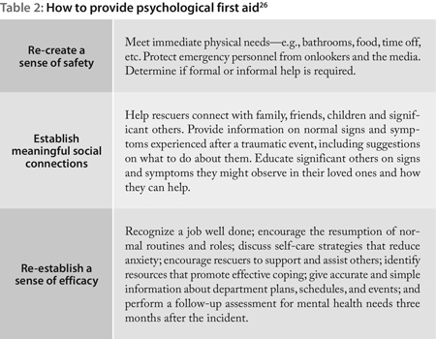
Give Grace

Slide 26
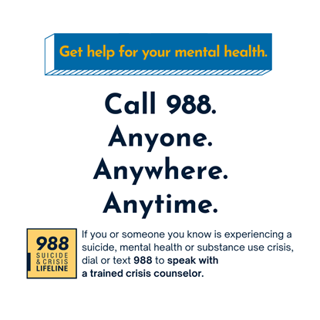
This is a hard job and society thanks you
But if it gets too hard please do not hesitate to reach out or use 988. We need you and the amazing work you do.

Slide 27

Questions?
References
https://www.paramedicpractice.com/features/article/death-notification-delivery-and-training-methods
https://www.ems1.com/ems-training/articles/article-bites-measuring-the-impact-of-death-notification-training-on-burnout-9Tsd1rrUU3G2hRwI/
https://www.jems.com/patient-care/performing-and-emotionally-surviving-notifications-of-death-to-a-patient-s-family/
https://www.uptodate.com/contents/discussing-serious-news?search=delivering%20bad%20news&source=search_result&selectedTitle=1~150&usage_type=default&display_rank=1#H6928175
https://www.uptodate.com/contents/challenging-interactions-with-patients-and-families-in-palliative-care?search=delivering%20bad%20news&source=search_result&selectedTitle=2~150&usage_type=default&display_rank=2#H1048638809
https://www.uptodate.com/contents/palliative-care-for-adults-in-the-ed-goals-of-care-communication-consultation-and-patient-death?search=delivering%20bad%20news&source=search_result&selectedTitle=3~150&usage_type=default&display_rank=3

