Slide 1


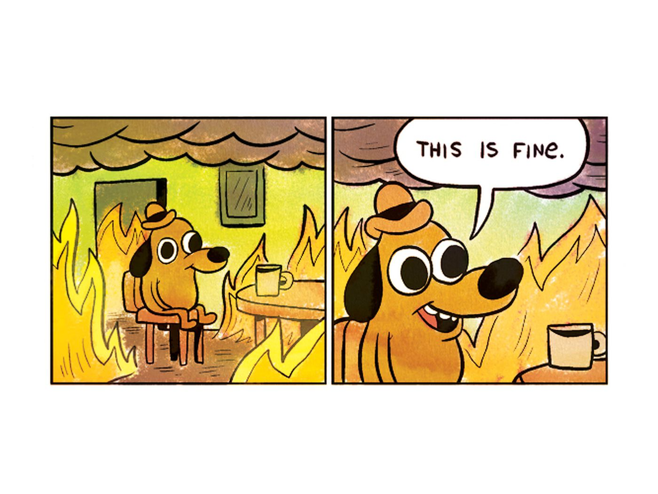
Xylazine
Blue Valentine
Image by K C Green

Slide 2



Agenda
What is Xylazine?
Xylazine Withdrawal
Xylazine and Overdose
Safer Injection
Xylazine Wounds
Is Xylazine in Oregon?

Slide 3
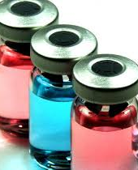

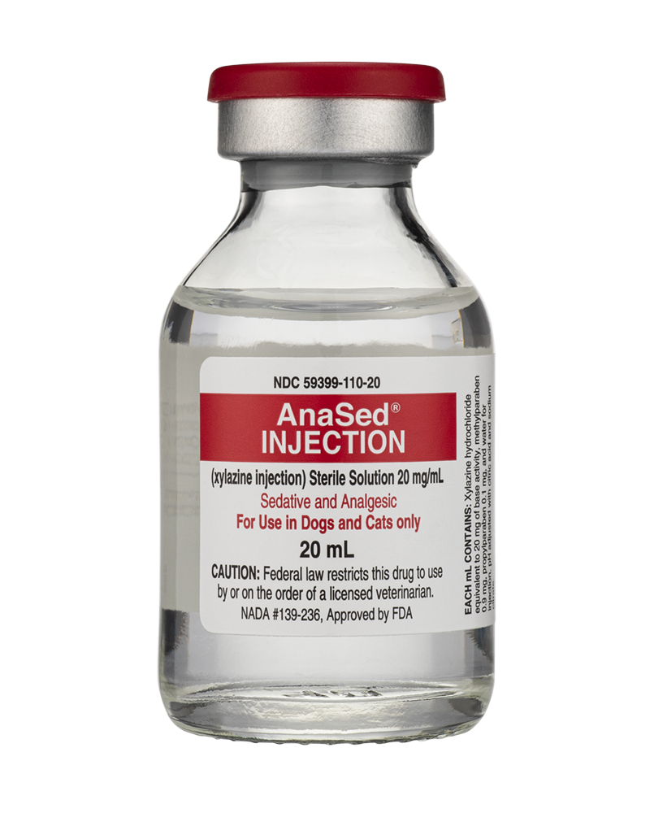

What is Xylazine?
Xylazine is a non-opioid veterinary sedative that is NOT approved and NOT safe in any amount for humans.
Xylazine complicates overdoses, causes serious wounds, and use can create dependency

Slide 4

Xylazine Withdrawal
Xylazine causes physical dependence and withdrawal independently from opioids.
People can develop dependence on Xylazine. Withdrawal from Xylazine can be a critical medical event requiring hospitalization.
Xylazine can also cause severe symptoms such as anxiety and high blood pressure as a person clears the drug from their body.

Slide 5
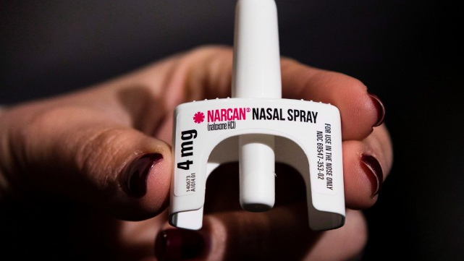
Xylazine and Overdose
Xylazine is a central nervous system (CNS) depressant.
Xylazine can cause overdose death by itself, but is usually found in combination with other drugs such as heroin, fentanyl, and cocaine.
Xylazine is not an opioid, and will not be affected by naloxone. This can complicate overdose reversal.

Slide 6
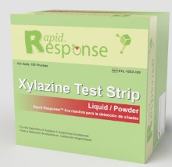
Preventing Xylazine Overdose
The only way to know if there is Xylazine in drugs is to use a drug-checking machine or Xylaxine test strips.
When using, start low and go slow; use a small test sample and wait to check effect;.
Stagger use with others, so that at least one person can administer naloxone and call 911 for help.
Never use alone; if you don’t have anyone that can sit with you, use a service like Never Use Alone (800) 484-3731
Image from https://www.btnx.com/HarmReduction

Slide 7

When Overdose is Suspected
  Give at least one dose of naloxone, even if the cause of the overdose is unknown.
  Call 911
  Stay with the person until emergency responders arrive
  Check breathing and give rescue breathing if needed
    Rescue breathing is CRITICAL.
    If someone is unresponsive, it’s very important to check their breathing.
    Breathing less than 10 times per minute is a medical emergency.
    Severely impaired or ineffective breathing needs rescue breathing.
Image from @CelestialHeartbreak on Instagram

Slide 8
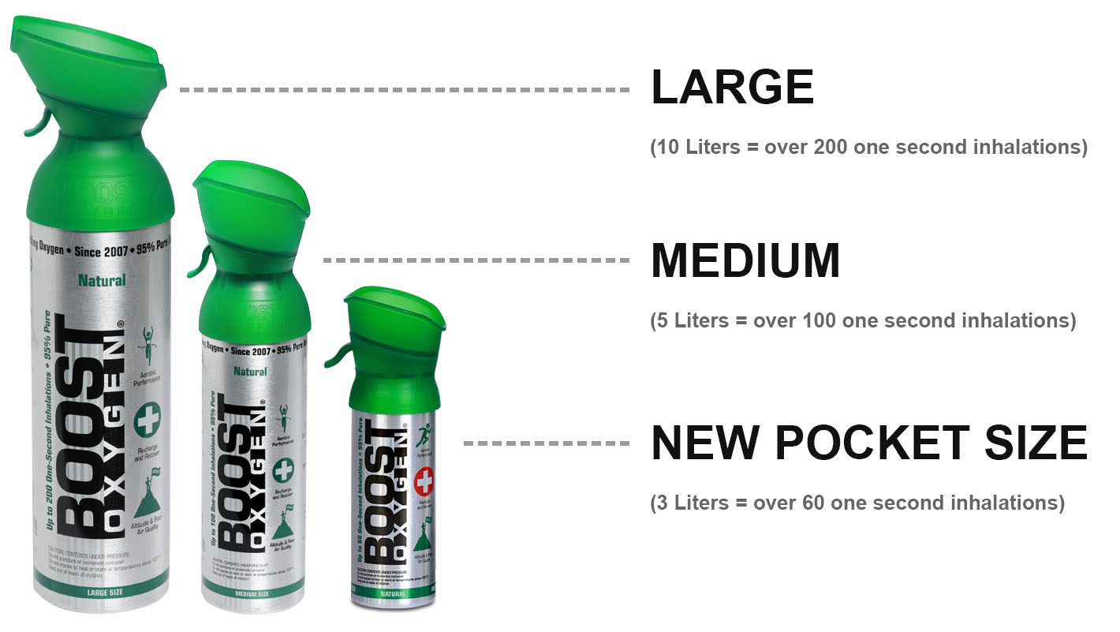
Responding to Xylazine Overdose
When a person survives an overdose, it’s because someone was there and responded.
Rescue breathing is critical for Xylazine overdose but often not done by bystanders.
Xylazine may impact overdose reversal; if a person is breathing shallowly, they may just need more oxygen and not more naloxone.
Some organizations on the East Coast have started using supplemental oxygen, to help get oxygen to the brain while waiting for EMS.
Image from https://www.boostoxygen.com/

Slide 9
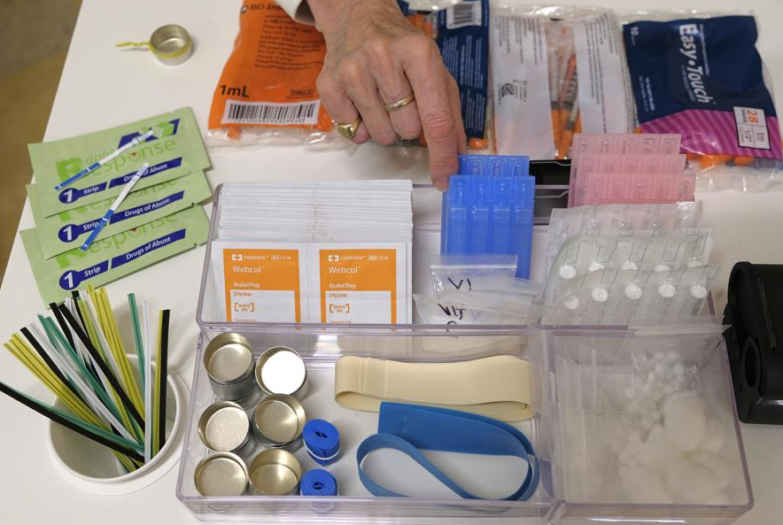
Safer Injection Information
Use sterile equipment and safer injection practices.
Muscling and skin popping increase risk of wounds, and are a high risk for Xylazine wounds.
Never inject into a wound, it will make it more difficult to heal.
Rotate limbs and sites for injection. If a limb has a wound, give that limb a break.
Go slow and be as careful as possible.
Avoid leaking outside of a vein. One way to do this is to leave the needle inserted after injection, and count to 3 before removing it.
Image from https://apnews.com/article/business-health-new-york-c4e6d999583d7b7abce2189fba095011

Slide 10
Xylazine Wounds
Xylazine wounds have been reported from injecting, smoking and snorting, and they need medical care.
Wounds can start anywhere there is open skin, and often start as shallow looking blisters and ulcers that can progress rapidly.
Wounds differ from abscesses and can rapidly spread into muscles, tendons, and bones, requiring prolonged medical care to heal.
If a wound goes necrotic, the tissue will look discolored and dead. Seek emergency care immediately.
Seek care for unusual wounds, wounds that look infected, or if a person has symptoms of sepsis (high or low body temp, confusion, slurred speech, clammy skin, trouble breathing, fast heartbeat)

Slide 11

Xylazine Wound Care
Clean all wounds and ulcers regularly with soap and water or saline.
Wounds should be kept clean, moist, temperature regulated, and covered.
The goal is for the wound bed to stay moist so the dead skin softens or falls on its own.
Avoid alcohol and hydrogen peroxide.
Antibiotics may not be needed.
Image from: https://en.wikipedia.org/wiki/Enema_of_the_State#/media/File:Blink-182_-_Enema_of_the_State_cover.jpg

Slide 12

Is Xylazine in Oregon?
While Xylazine is not yet widespread in Oregon, it has been found in drug samples in Oregon.
There is concern that use of Xylazine alone and mixed with other drugs may rapidly increase in Oregon.
It is impossible to know how common Xylazine is without widespread drug checking.
The urban supply and rural supply varies greatly.

Slide 13


Thank You
Blue Valentine
Blue.Valentine@bentoncountyOR.gov

Slide 14
References
https://nida.nih.gov/research-topics/xylazine#:~:text=Also%20known%20as%20%E2%80%9Ctranq%2C%E2%80%9D,pressure%20to%20dangerously%20low%20levels
https://nextdistro.org/resources-collection/xylazine-quick-guide
https://www.substanceusephilly.com/tranq
https://ncurbansurvivorunion.org/
https://www.perinatalharmreduction.org/opioids
https://drive.google.com/u/0/uc?id=1KZyDuh4NPAHLcAnZDR4eIidZZitoNP43&export=download (Webinar by National Harm Reduction Coalition)
https://www.healthvermont.gov/sites/default/files/documents/pdf/ADAP-XylazineBrief.pdf
https://neverusealone.com/
https://www.health.ny.gov/publications/12044.pdf
https://hip.phila.gov/document/3154/PDPH-HAN_Update_13_Xylazine_12.08.2022.pdf/
https://www.btnx.com/HarmReduction

