Slide 1

4/11/22
Patient Refusal and Capacity Assessment
Michael Lauria, MD, NRP, FP-C Captain, US Air Force Reserve Emergency Medical Services Fellow
University of New Mexico School of Medicine
1
2

Slide 2
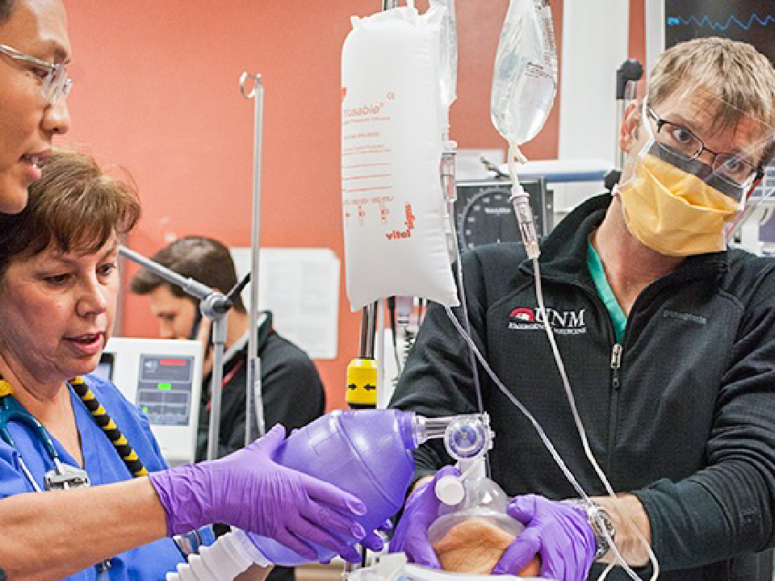
Can’t refuse…
5
6

Slide 3

Refuses to go

Slide 4
What we will cover
4/11/22
Ethics and legality
Allowing refusal or forcing transport
Capacity assessment
Mental health and refusal
Management
7
8

Slide 5
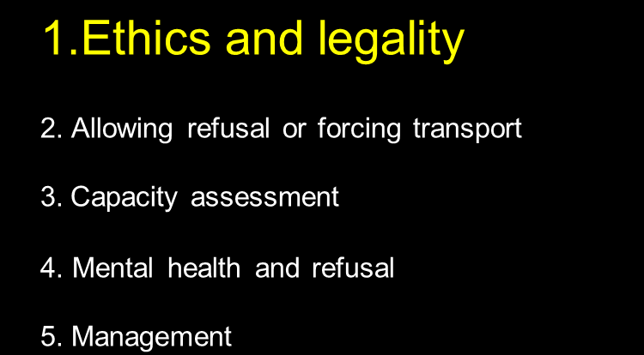

Slide 6


4/11/22
9
10

Slide 7
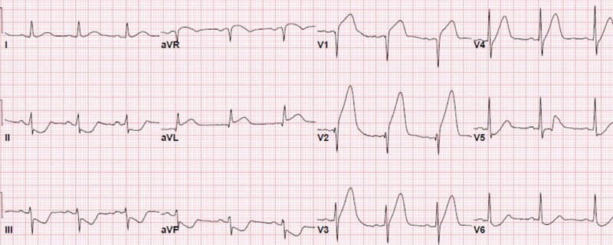
4/11/22
Patients are allowed to make ”bad“ decisions if they understand the risks associated with their decision
11
12

Slide 8

4/11/22
Justice Beneficence Nonmaleficence Autonomy
13
14

Slide 9

Justice Beneficence Nonmaleficence Autonomy
4/11/22
15
Autonomy:
The legal right of competent adults to make informed decisions about their care
16

Slide 10
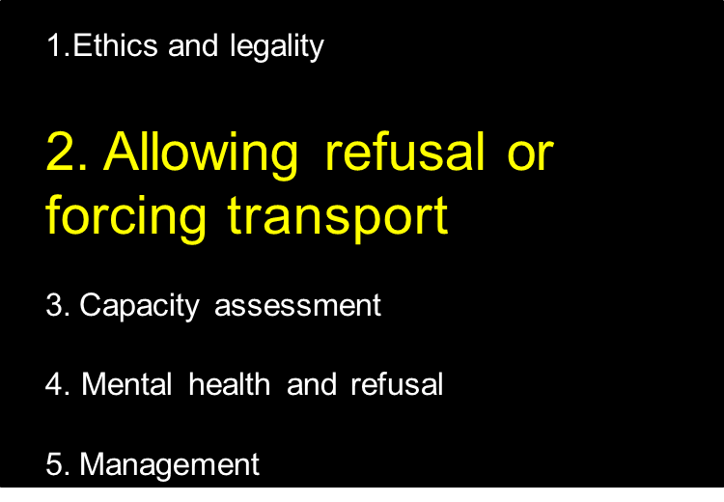

Part 2

Slide 11
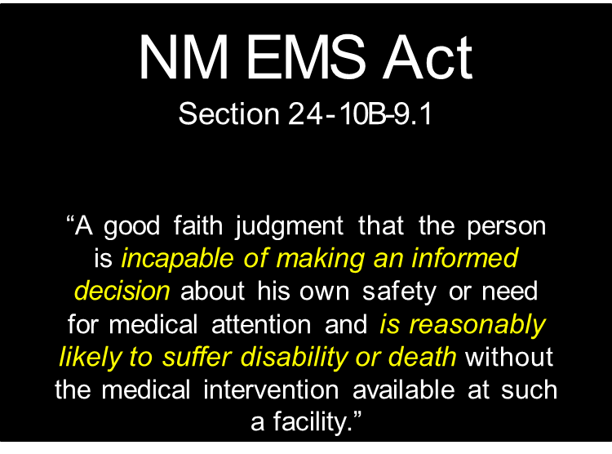

What does the law say?

Slide 12
You do not need physician “permission” to transport somebody against their will

Slide 13

Question 1: Life threat?
Life threat exists or is suspected AND
Patient DOES NOT have capacity to make informed decision

Slide 14

Question 2
Capacity vs. Competence

Slide 15

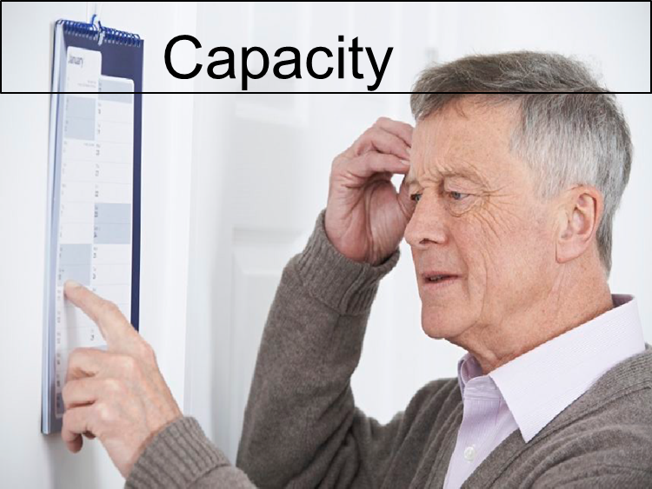

Slide 16

Question 3:
Ethics and legality
Allowing refusal or forcing transport
Capacity assessment
Mental health and refusal
Management
29
30

Slide 17

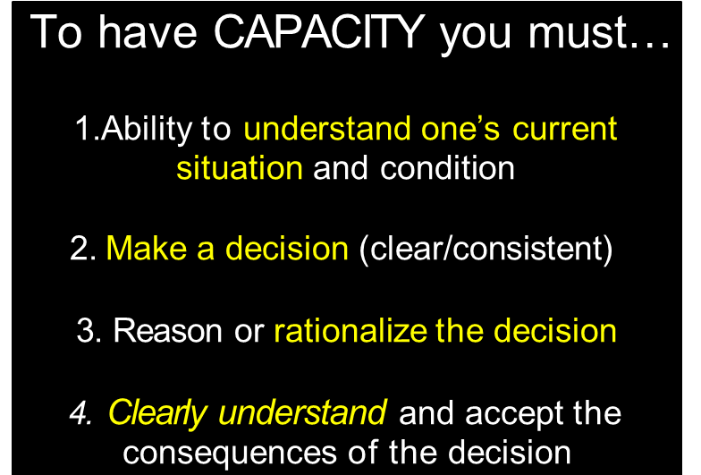
Capacity
Not intoxicated (clinically)
Not under the influence
AND…

Slide 18
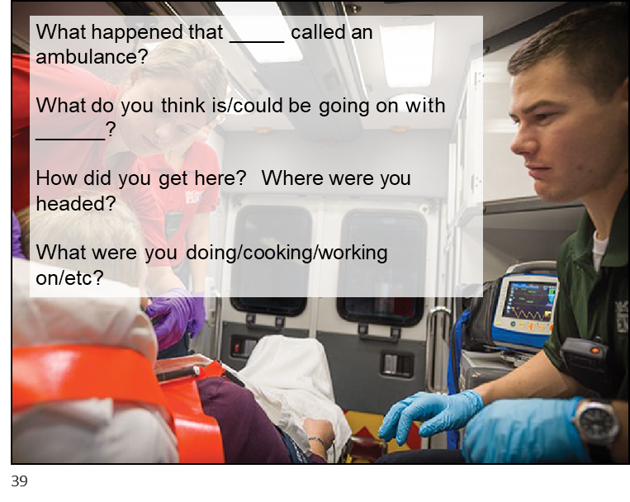
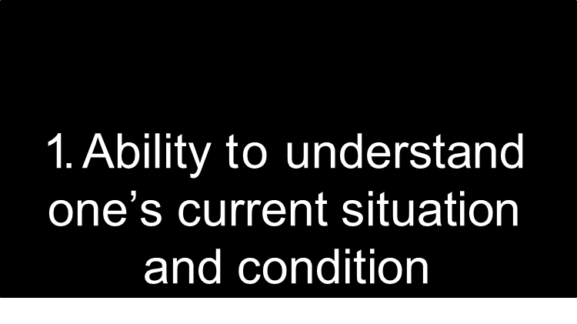

Slide 19

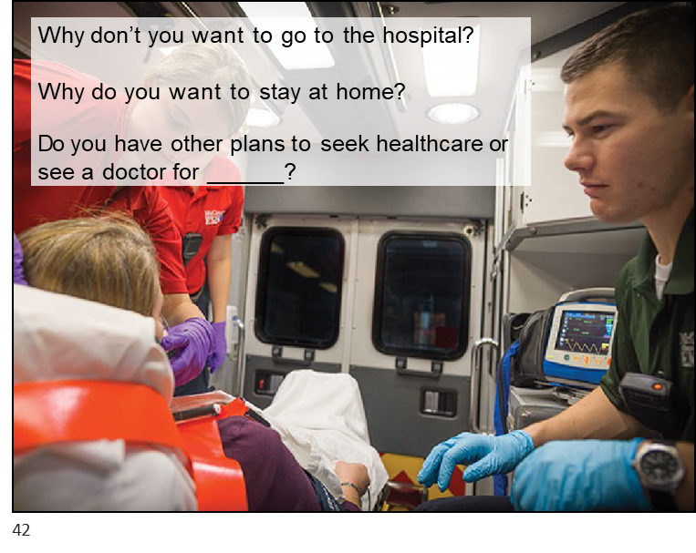
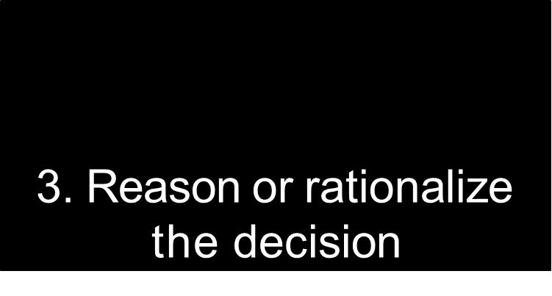
4/11/22
40

Slide 20

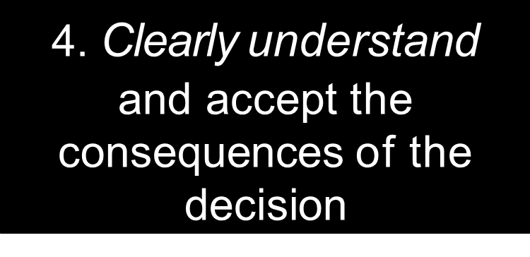
4/11/22
43
44

Slide 21

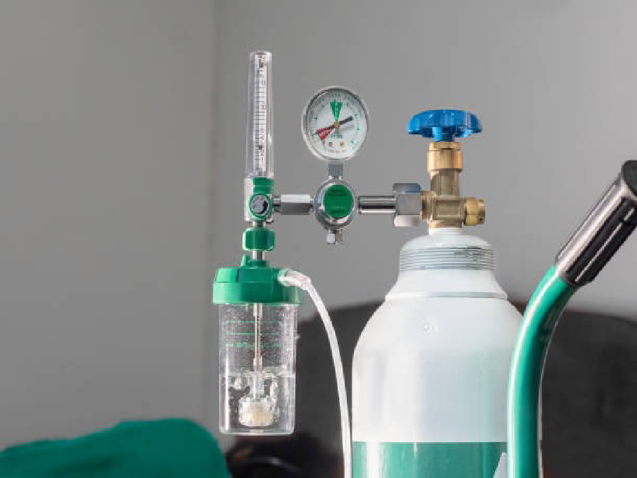
But…what about…?
4/11/22
45
47

Slide 22

4/11/22
48
49

Slide 23
Life threat?
Not Intoxicated?
Capacity?

Slide 24


Life threat?
Not Intoxicated?
Capacity?

Slide 25
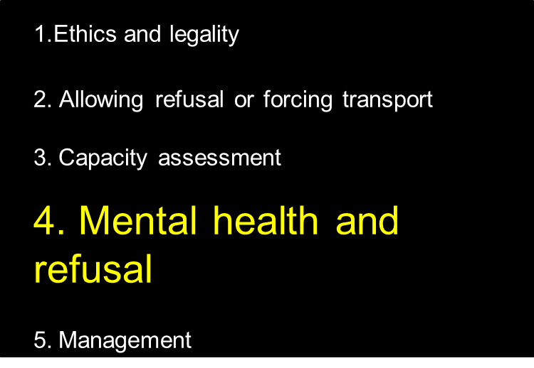
Homicide
Suicide
Aggression

Slide 26


Safety
4/11/22
54
”He said _____.“.. “
”No I didn’t“
55

Slide 27
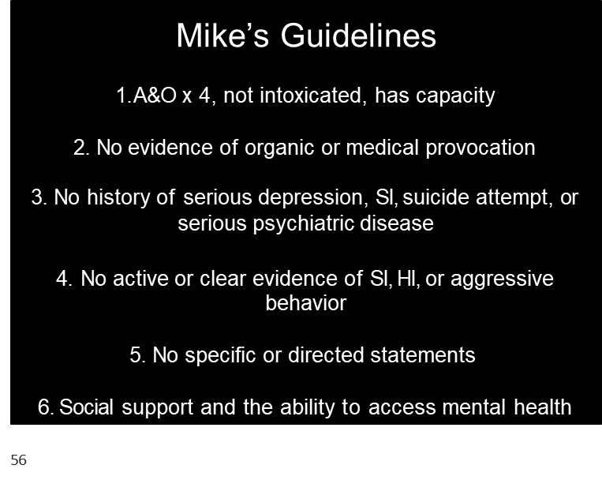

Mental Health Refusals…

Slide 28
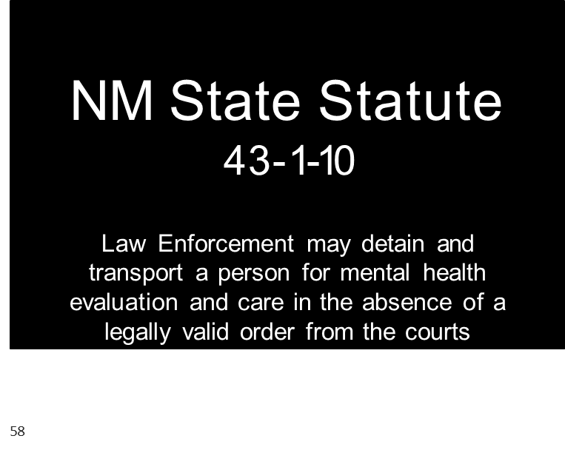

Slide 29

If in doubt, phone a friend BUT have an opinion

Slide 30
Summary
4/11/22
People can refuse
Demonstrate capacity
Capacity is not just A+Ox4
Aware
Force transport?
Be safe
Manage them like critical patients if sedation used
Not intoxicated
Consistent
Reasonable
78
79

