Slide 1
Opioid Withdrawal Management
James J. Gasper, PharmD, BCPP
National Clinician Consultation Center
Substance Use Warmline
University of California, San Francisco at Zuckerberg San Francisco General Hospital
San Francisco, CA
April 18, 2023

Slide 2
Opioid Withdrawal
Physical Dependence
Opioid Exposure
(Dosed < half-life for ~2 wks)
Interruption of opioid exposure
antagonist
partial agonist
agonist-antagonist
cessation of use
decrease in dose/frequency
Precipitated Withdrawal
Spontaneous Withdrawal

Slide 3
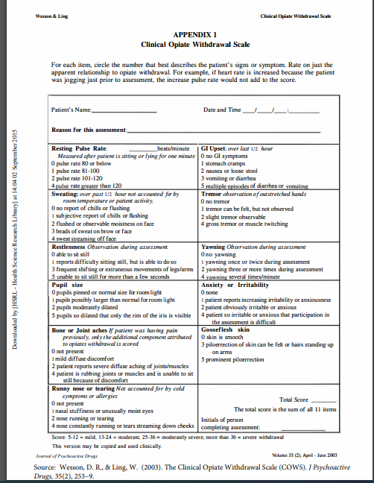
Withdrawal Symptoms
Autonomic hyperactivity
Tachycardia
Sweating
Piloerection
Mydriasis
Rhinorrhea
Lacrimation
Psychomotor
Yawning
Tremor
Restlessness
General
Diarrhea
Vomiting
Insomnia
Musculoskeletal pain
Anxiety
Irritability
COWS: Mild 5-12, Moderate 13-24, Severe > 36

Slide 4
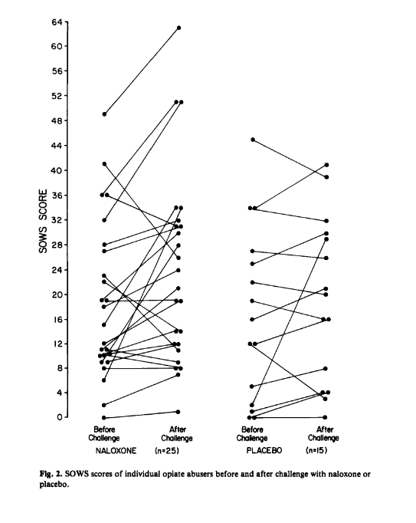
Withdrawal Symptoms
Study designed to validate two different rating scales for opioid withdrawal
Subjects administered blinded naloxone 0.4mg SQ or 1ml saline
Group | Scale | Pre | Post | P
Naloxone | SOWS | 18.5 | 23.6 | 0.01
 | Global | 0.28 | 0.88 | 0.001
Placebo | SOWS | 18.1 | 20.4 | NS
 | Global | 0.21 | 0.57 | 0.01
Withdrawal symptoms are driven by expectation
Handelsman et al. Am J Drug Alcohol Abuse 1987;13:293-308

Slide 5
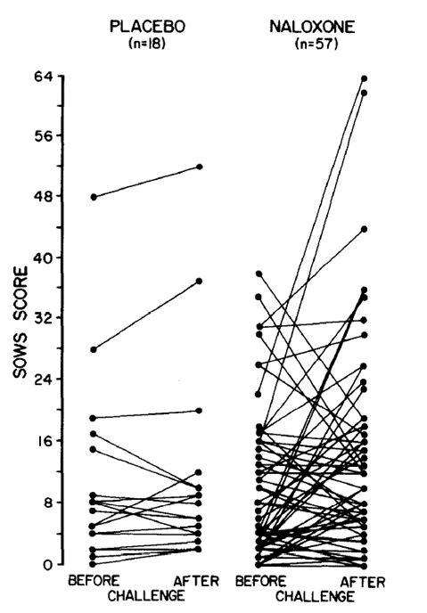
Withdrawal Symptoms
Heroin use 13.3 ± 5.5 years
30% regular use once daily
70% regular use >1 per day
Given 0.4mg IM naloxone or placebo
61% no subjective symptoms
74% no objective symptoms
Some placebo patients experience withdrawal
Many naloxone patients did not
Physical dependence is overestimated ?
Kanof et al. Drug Alcohol Depend 1991;27:253-262

Slide 6
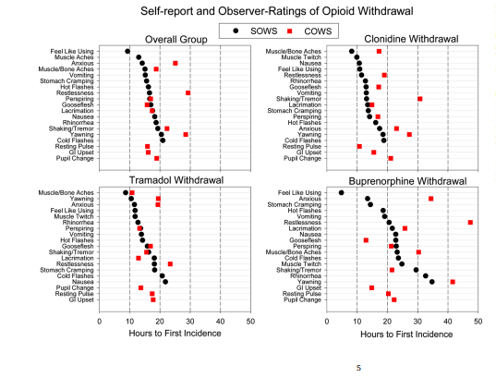
Time Course of Withdrawal
N=103 subjects entered residential unit and maintained on morphine 30mg QID for 7-10 days before transition to buprenorphine, tramadol, clonidine or placebo
Dunn K. Drug Alcohol Depend 2020;215:108212

Slide 7
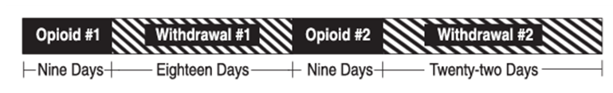
Time Course and Severity of Withdrawal
Non-treatment seeking opioid dependent volunteers entered 59 day residential protocol (N=12)
Stabilized on 32mg/day buprenorphine IM or morphine 120mg/day IM for 9 days (split QID) (N=7)
Tompkins A et al. J Pharm Exp Ther 2014;348:217-226

Slide 8
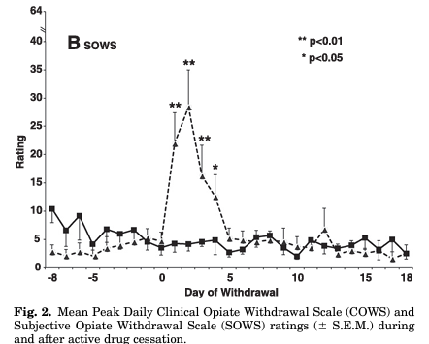

Time course and Severity of Withdrawal
Morphine withdrawal peaked on day 2 and resolved by day 7
Only minimal symptoms of buprenorphine withdrawal
Tompkins A et al. J Pharm Exp Ther 2014;348:217-226

Slide 9
Withdrawal is better avoided than Managed
Proper timing of buprenorphine initiation can avoid most interventions for withdrawal management
  Adequate COWS and opioid free period
  Low dose initiations for methadone/fentanyl transitions
Slow taper of opioid analgesics/methadone/buprenorphine
Early transition to MOUD for patients who can not control intake of prescribed opioids

Slide 10
General Principles of Managing Withdrawal
Prescription opioids should be tapered slowly and not discontinued abruptly
  No more than 20% dose reduction per month
  Avoid tapering multiple substances concurrently
Transition to methadone or buprenorphine
  Target a period of stabilization before tapering
    At least 3 weeks, longer is better
    Use therapeutic doses
  Maintenance is the standard of care
  Completion rates for tapered methadone > alpha 2 agonists, withdrawal symptoms present at tail end when doses drop below 10mg/day
* Look for other withdrawal states such as SSRIs, nicotine, alcohol, cannabis, benzodiazepines
Gowing LR et al. Drug Alcohol Rev 2000;19:309-318

Slide 11
Management of Precipitated Withdrawal
Naloxone
Ready for buprenorphine/methadone
Buprenorphine
Pause and treat symptomatically OR
Ready for more buprenorphine
Naltrexone PO
Symptomatic management
Short term full agonists (supervised setting)
Symptomatic management
Short term full agonists (supervised setting)
Naltrexone IM
Notes:
Case Report Severe opioid withdrawal precipitated by Vivitrol® Author links open overlay panelR.S. Wightman MD ª, L.S. Nelson MD ^{b}, J.D. Lee MD, MSc ^{c}, L.M. Fox MD ^{b}, S.W. Smith MD ^{d} ^{e}

Slide 12
Transition to Long-acting Naltrexone (XR-NTX)
General Strategy
Standard approach is 7-10 days opioid free prior to induction
Prior to opioid free period stabilization on buprenorphine or methadone can be employed
If opioid free period is less than 7 days or recent exposure to long-acting opioid such as methadone is suspected may use naloxone or naltrexone challenge prior to first dose
Standard vs NTX assisted?
Bup taper over 7 days followed by 7-day washout vs 7-day po NTX titration (1mg to 25mg) “rapid induction”
Both groups receive 8mg bup on day 2 and adjunctive medications (clonidine, clonazepam, prochlorperazine, trazodone, zolpidem)
Received first dose of XR-NTX: 33% Bup taper vs 56% NTX titration
Sullivan M et al. Am J Psych 2017;174:459-467

Slide 13
Transition to XR-NTX
Sunday
Stop opioids
N=44
Monday
COWS > 6
Bup 2mg x3
Adjunct
Bup 2mg
Tuesday
Bup
Adjunct
Wednesday
Adjunct
NTX 1mg
NTX 2mg
N=36
Thursday
Adjunct
NTX 3mg
NTX 3-9mg
Friday
Adjunct
NTX 6mg
NTX 6mg
NTX 12mg
XR-NTX
N= 25 (59%)
Adjunctive medications: clonidine, clonazepam, prochlorperazine Insomnia: trazodone, zolpidem
Sibai M et al. Am J Drug Alcohol Abuse 2020;46;289-296

Slide 14
Transition to XR-NTX
Day | NTX | Bup
1 | 0.25mg x 2 | 2mg x 2 ± 2mg
2 | 0.25mg x 2 | 2mg
3 | 0.5mg x 2 | 2mg
4 | 1.5mg x 2
5 | 3 mg x2
6 | 7.5mg x 2
7 | 15mg x 2
8 | Naloxone challenge XR-NTX
8-day protocol, N=378, 1:1:1
XR-NTX Induction
NTX/Bup 46%
NTX/PBO-B 40.5%
PBO-N/PBO-B 46%
Adjunctive medications: clonidine, clonazepam, trazodone
Bisaga A et al. Drug Alcohol Depend 2018;187:171-178

Slide 15
Alpha 2 Agonists
Drug | Common Formulations | Dosing | Considerations
Clonidine | Tablets 0.1, 0.2, 0.3mg TDS 0.1mg, 0.2mg, 0.3mg/24hr ER Tab 0.1, 0.17mg | 0.1-0.2mg tab Q6-8h | TDS 7 days
Guanfacine | Tablets 1, 2mg ER Tab 1, 2, 3, 4mg | 1mg BID | Equally effective to clonidine
Tizanidine | Tablets 2, 4mg Capsule 2, 4, 6mg | 8mg TID | Less impact on BP, potentiates NSAIDS
Lofexadine | Tablets | 0.54mg QID (up to 16 tabs per day) | Tolerability not much different than clonidine ~ $24/tab
Gowing L et al. Cochrane Database of Systematic Reviews 2016;5:CD002024
Kuszmaul AK et al. JAPhA 2020;60:145-152
Notes:
Clonidine patch SS 24-48 hrs out, cover with oral first 2 days, cut dose in half 2nd day
Clonidine minimum BP 110mmHg systolic, orthostatic hypotension common, drowsiness, dry mouth, SE’s improve with time are dose related
D/c or hold for BP <80/50 or symptomatic syncope
Bone pain and insomnia poorly responsive
Efficacy for clonidine and guanfacine identical
Peak withdrawal days 2 and 3, with clonidine or lofexidine pts reported mod or sever w/d sx’s of irritability, agitation, muscle cramping, back pain, yawning, lacrimation
Orv Hetil. 2000 Apr 9;141(15):783-6. [Tizanidine in the treatment of acute withdrawal symptoms in heroin dependent patients]
[Article in Hungarian] I Sós ¹, N Kiss, J Csorba, J Gerevich PMID: 10808729
Guanfacine- San L et al. JSAT 1994;11:463-469

Slide 16
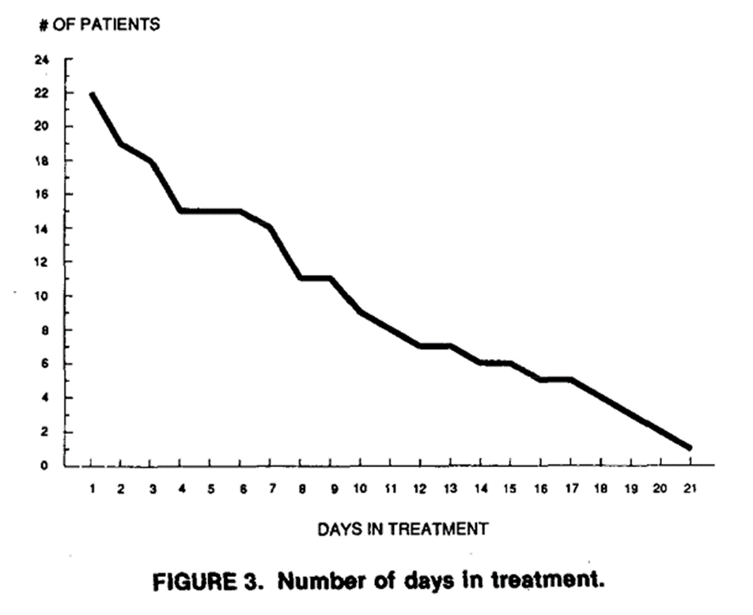
Alpha 2 Agonists and Treatment Retention
Study of clonidine TDS at Haight Ashbury Free Clinic
Spencer L, Gregory M. JSAT 1989;6:113-117

Slide 17
Other Adjunctive Strategies
Only initiate upon presentation of symptoms (and after prioritizing opioid replacement and alpha 2 agonists)
Insomnia- trazodone, benzodiazepine
Anxiety- benzodiazepine, antihistamine
Nausea- ondansetron, promethazine
Diarrhea- loperamide
Muscle cramps- ibuprofen, naproxen, APAP
Avoid: unnecessary adjunctive treatments, unnecessary polypharmacy, opioid antagonists, antipsychotics (low dose quetiapine), gabapentinoids, skeletal muscle relaxers

Slide 18
NCCC Case

Slide 19
Case Summary
58 yo F with a h/o chronic pain, subsequently developed OUD involving street-obtained oxycodone.
Patient thinks each tablet is 30mg and usually takes 3-4 tablets per day. Has tried to decrease use/quit on own without success -- finds it challenging to manage/tolerate withdrawal.
Husband also has h/o chronic pain, also uses street-obtained pain medications but not as much or as often as patient.

Slide 20
Case Summary
Patient completed phone intake with clinic staff yesterday and was motivated to start buprenorphine/naloxone.
Prescribed limited number of bup/nx films (4/1mg) with plan to come for in-person follow-up evaluation tomorrow after home induction today.
Pt took last dose of oxycodone yesterday afternoon 2pm local time and then started induction this morning. Tolerated first dose (4mg), then took second dose (another 4mg) 30min after the first -- had been instructed to take second dose after waiting an hour but took it a little earlier than instructed.
Nurse called patient to check on home induction and patient reports she's feeling "horrible", like "nerves are on fire" and head feels "foggy". Current symptoms feel different from usual withdrawal symptoms.
Patient did not calculate SOWS this morning prior to starting induction -- does recall experiencing withdrawal symptoms last night.

Slide 21
Main Questions
Is this precipitated withdrawal?
How best to evaluate patient and manage symptoms?
Should the induction be abandoned, or should the patient keep going with more bup/nx?
If the care team and patient opt to move forward with additional bup/nx, how much should the next dose(s) be and when should they be taken?

Slide 22



The National Clinician Consultation Center is a free telephone advice service for clinicians, by clinicians.
Go to nccc.ucsf.edu for more information.
HIV/AIDS Warmline
800-933-3413
HIV treatment, ARV management, complications, and co-morbidities
Perinatal HIV Hotline
888-448-8765
Pregnancy, breastfeeding and HIV
Hepatitis C Warmline
844-HEP-INFO/
844-437-4636
HCV testing, staging, monitoring, treatment
Substance Use
Warmline
855-300-3595
Substance use evaluation and management
PrEPline
855-HIV-PrEP
HIV Pre-exposure prophylaxis
PEPline
888-448-4911
Occupational & non-occupational exposure management
This National Clinician Consultation Center program is supported by the Health Resources and Services Administration (HRSA) of the U.S. Department of Health and Human Services (HHS) as part of an award totaling $2,633,756 with 0% financed with non-governmental sources.
The content in this presentation are those of the author(s) and do not necessarily represent the official views of, nor an endorsement, by HRSA, HHS, or the U.S. Government. For more information, please visit HRSA.gov.

