Slide 1
Benzodiazepine De-prescribing
NPAIHB SUD ECHO
Jasen Christensen, DO
Associate Professor
UNM School of Medicine
Department of Psychiatry and Behavioral Sciences

Slide 2
Disclosures:
Nothing to Disclose

Slide 3
Learning Objectives
Be aware of host and medication factors that influence withdrawal
Be aware of new data about Buprenorphine + Benzodiazepine overdose risk
Be able to employ outpatient Benzodiazepine taper strategy, and…
Utilize supportive medications in outpatient setting.

Slide 4
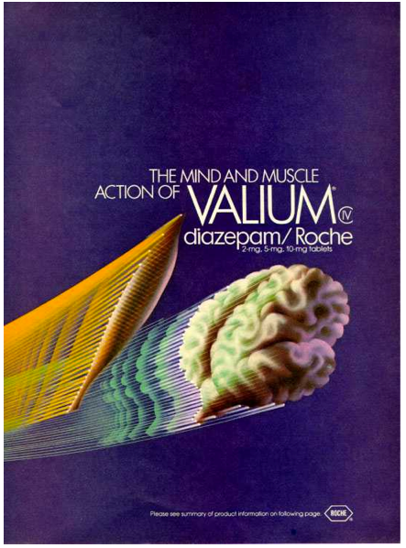


Slide 5
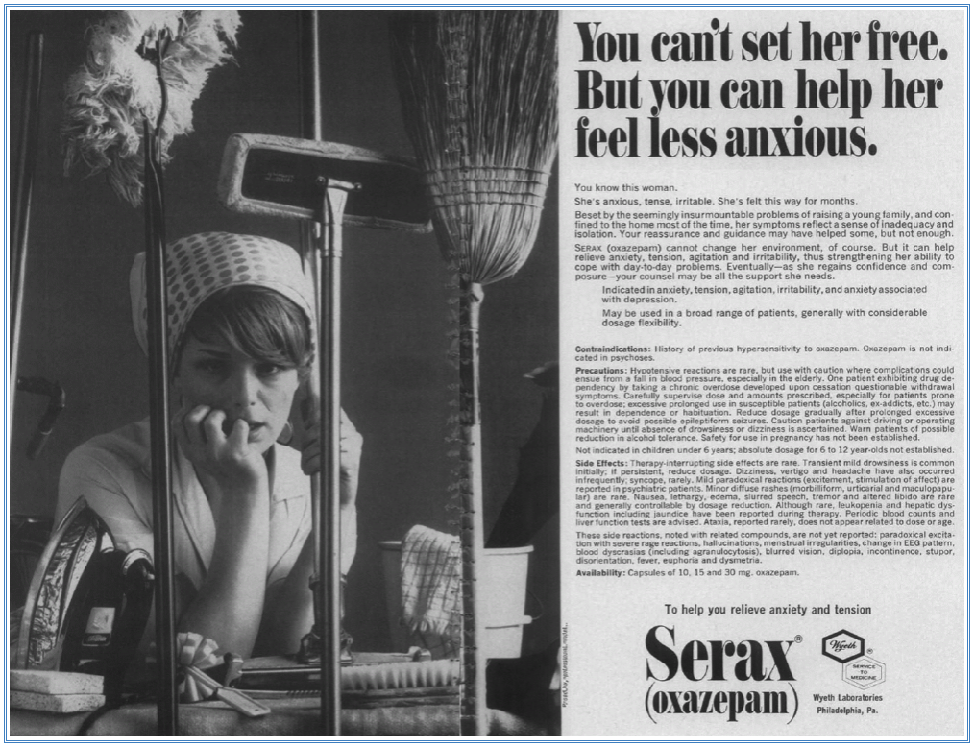
JAMA 1967; 200(8):206-207

Slide 6
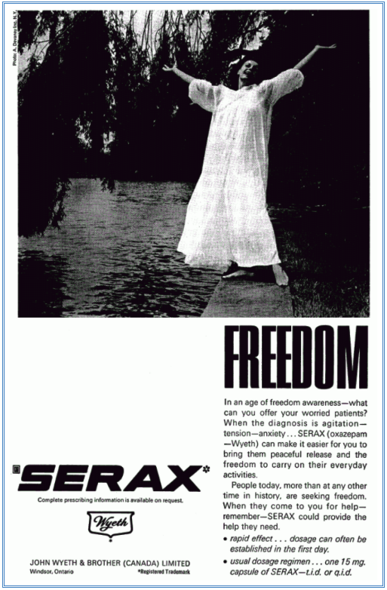
Canadian Family Physician 1969, 15(7):42

Slide 7
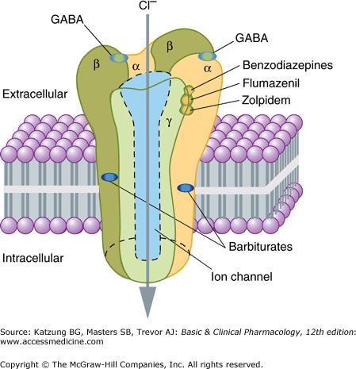
GABA-A
Receptor

Slide 8
Guidelines for Use (anxiety)
“Benzodiazepines are indicated for the short-term relief (two to four weeks only) of anxiety that is severe, disabling, or causing the patient unacceptable distress, occurring alone or in association with insomnia or short-term psychosomatic, organic, or psychotic illness. “
      - British NHS Benzodiazepine Prescribing Guidance
“Guidelines and formularies typically give durations of 1–4 weeks for benzodiazepine therapy, depending on the indication. Short-term therapy is generally advised to reduce the risk of dependence and withdrawal, as well as other potential harm such as cognitive impairment.”
  - Royal Australian College of General Practitioners Clinical Guidelines 2015

Slide 9
Guidelines for Use (anxiety)
“The benefit of more rapid response to benzodiazepines must be balanced against the possibilities of troublesome side effects (e.g., sedation) and physiological dependence that may lead to difficulty discontinuing the medication.”
- American Psychiatric Association Practice Guideline for Panic Disorder

Slide 10
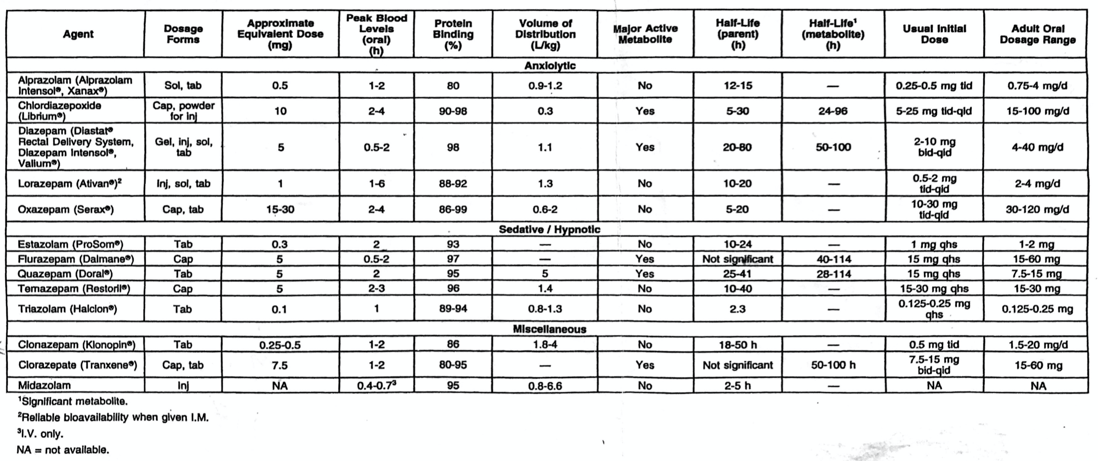
Pharmacokinetics

Slide 11
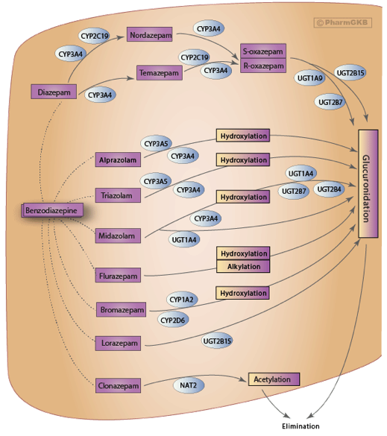
Benzodiazepine
Metabolism
Most undergo oxidation through Cytochrome P450 first.
Most then undergo glucuronidation before renal elimination.
Clonazepam is most likely to demonstrate false negative on Enzyme Immunoassay Tests due to separate metabolic pathway

Slide 12
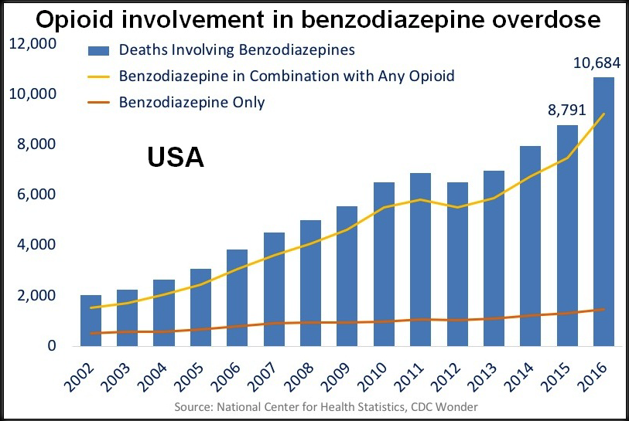
Pharmacodynamic Interactions

Slide 13
Should Buprenorphine be Prescribed to Patients on a Benzodiazepine?
In 2016 the CDC recommended:
“Avoid prescribing opioid pain medication and benzodiazepines concurrently whenever possible” (CDC’s Guideline for Prescribing Opioids for Chronic Pain, 2016)
In 2017 the FDA advised:
“Opioid addiction medications buprenorphine and methadone should not be withheld from patients taking benzodiazepines…careful medication management can reduce risks” (FDA Safety Announcement: 9-20-2017)

Slide 14
Buprenorphine + Benzo/Z-drug Overdose Risk
Does overdose risk increase with the combination?
23,000 persons age 12-64
14,000,000 person-days of observation time
Exposures were Buprenorphine prescriptions, Benzodiazepine prescriptions and Z-Drug prescriptions.
Outcome of interest was any nonfatal drug-related poisonings
Xu K, et al. Association Between Benzodiazepine or Z-Drug Prescriptions and Drug-Related Poisonings Among Patients Receiving Buprenorphine Maintenance:
A case-crossover analysis. American Journal of Psychiatry 2021;178(7):651-659.

Slide 15
Buprenorphine + Benzo/Z-drug Overdose Risk
Does overdose risk increase with the combination?
Low dose defined as:
< 3mg of Alprazolam
< 6mg of Lorazepam
< 3mg of Clonazepam
< 30mg of Diazepam
Buprenorphine treatment vs non-treatment days 40% reduction in poisoning events (OR=0.63)
Poisoning Odds Ratios for benzodiazepine or Z-drug treatment without buprenorphine: low dose Benzo or Z-drug: OR=1.69 high dose Benzo or Z-drug: OR=2.23
Low-dose Benzo or Z-drug treatment + buprenorphine: OR=1.11
High-dose Benzo or Z-drug treatment + buprenorphine: OR=1.64
Xu K, et al. Association Between Benzodiazepine or Z-Drug Prescriptions and Drug-Related Poisonings Among Patients Receiving Buprenorphine Maintenance:
A case-crossover analysis. American Journal of Psychiatry 2021;178(7):651-659.

Slide 16
Mechanisms of Tolerance and Dependence
Decreased responsiveness of GABA-A receptors to benzodiazepines
“Internalization” of GABA-A receptors into sequestration sites
As GABA receptor activity is down-regulated, NMDA receptors activation is up-regulated.
Increased hepatic metabolism is NOT thought to play a major role

Slide 17
Addiction Liability
All are controlled substances (DEA schedule 4)
Lowest positive reinforcing effects in humans:
      Clonazepam
      Chlordiazepoxide
      Oxazepam
Highest addiction potential are those with fast-onset:
      Diazepam
      Alprazolam

Slide 18
Groups at Higher Risk for Long-Term use and Addiction
Those who report positive mood enhancement with Benzodiazepines
                Moderate or heavy alcohol users
                Abstinent alcoholics
                People with strong family histories of AUD
Those with history of Opioid Use

Slide 19
Principal Medical Complications
Overdose
          CNS depression
          Impaired gag reflex
          Respiratory depression
Withdrawal
          Usually mild when given for short periods at typical doses
          Can be severe and fatal when given long-term
          Great variability to withdrawal sensitivity among patients

Slide 20
Sedative Hypnotic Withdrawal
Recognition and Management of sedative hypnotic withdrawal is crucial to patient care and safety.
Withdrawal characteristics are similar between EtOH and sedative-hypnotics.
History of withdrawal is strong predictor of future withdrawal.
Case reports exist of Z-drug withdrawal - described similarly to Benzo withdrawal.

Slide 21
Characteristics of Withdrawal
Typical Symptoms
Anxiety
Insomnia
Restlessness
Agitation
Irritability
Muscle Tension
Tachycardia
Less Frequent Symptoms
Nausea
Diaphoresis
Lethargy
Myalgias
Arthralgias
Coryza
Blurred Vision
Dysphoria
Hyperreflexia
Ataxia
Severe Symptoms
Psychosis
Seizures
Delirium
Persistent Tinnitus

Slide 22
Medication Characteristics Affecting Withdrawal
First-order kinetics determine rate of serum level declines
Which in turn correlates with withdrawal onset
Short-acting agents:
    withdrawal can start within 24 hours / peak in 1-5 days / duration up to 21 days
Longer-acting agents:
    Withdrawal starting after 5 days / peak 5-9 days / duration 10-28 days
Patients using shorter-acting agents (alprazolam) develop tolerance more rapidly and report more intense withdrawal syndrome

Slide 23
Host Factors Affecting Withdrawal
Dependence liability correlated with increased psychiatric comorbidities
Use of multiple substances contributes to heightened withdrawal severity and less course predictability
Medical comorbidities (arrhythmias, IBS, asthma) may complicate withdrawal course and should be considered when planning.
Younger age is associated with more favorable withdrawal course.
Severe withdrawal can jeopardize fetus - potential for SAB or preterm labor.

Slide 24
Management Challenges Regarding BZD Discontinuation
Symptom Recurrence/Relapse
    Recurrence of symptoms for which med was initially intended to treat.
    Can occur without existence of benzodiazepine dependence.
Rebound Anxiety
    Development of symptoms (within hours or days) of discontinuation, which are similar in quality but more severe than those before medication treatment. These are usually short duration (which differentiates from recurrence)
    Commonly occurs with each down step in a taper regimen
Pseudowithdrawal
    Expectation of withdrawal leads to experience of abstinence symptoms before dose is decreased or med is stopped
True Withdrawal
    Occurs when benzodiazepines are discontinued from an individual with physical dependence.
    Marked by psychological and somatic signs/symptoms that can be suppressed with a dose of the benzodiazepine or cross-tolerant agent.

Slide 25
Determination of Treatment Setting
for Treatment of Withdrawal
Outpatient withdrawal treatment is reasonable if patient does not appear at risk for severe withdrawal - - slow taper strategy.
Involve family and other supportive persons if possible.
Give clear instructions: go to ER if severe sx emerge / arrange for close follow-up
——————————————————————————————————————————————
Inpatient or supervised detox treatment may be optimal
But this is often infeasible due to limited accessibility and cost considerations
So is usually reserved for medically complex patients or those at high risk for severe withdrawal.

Slide 26
Outpatient Tapering
      Gradual dose decrease using a schedule (consider a contract with patient).
      Long-acting benzodiazepines are ideal for this method (so change from short-acting to long-acting equipotent agent may be necessary).
      Dose decreased weekly or every other week
      Discontinuation after long-term use should not exceed Diazepam 5mg equivalent per week or 10% of starting dose per week (whichever is smaller)
      Consider slowing rate during last 25% of the taper
      In some cases taper may require 6 - 12 months
      Frequent office visits
      Consider use of other medications to support patient (hydroxyzine, trazodone, clonidine, topiramate, mirtazapine, possibly SSRIs)

Slide 27
Prolonged Withdrawal (Postacute Withdrawal Syndrome)
After prolonged benzodiazepine use, some patients experience a prolonged syndrome (weeks to months)
Syndrome is unpredictable/intermittent
Characterized by insomnia, perceptual disturbances, sensory hypersensitivities, anxiety, muscle tension or sense of muscle fullness
Most common in response to higher doses and longer duration of treatment (usually more than 1 year)

Slide 28
Thank you

