Slide 1
When One is Not Enough – Vaccine Series & Booster Shots
Notes:
Hello everyone! Being up to date on our vaccines is important for preventing certain illnesses, but did you know that some vaccines require more than one shot?
This presentation is designed to help you understand the ins and outs of vaccines that require more than one shot, including vaccine series and booster shots. We are offering this information so you can protect yourself, your family, and our community.

Slide 2
Your Presenter
HEADSHOT HERE
Title
Organization
Email Address
Notes:
[Introduce yourself and any co-presenters if applicable]
Speaker recommendation: You can add your headshot onto this slide by doing the following:
1) Click the “Insert” button on the toolbox above.
2) Then, click the “Pictures” button and select “This Device.”
3) A pop-up box with access to the folders on your computer will open. Look for the image you’d like to add.
4) Once you select the image, it should come up on the slide. Use your mouse to move and place the image over the “HEADSHOT HERE” place holder. That’s it!

Slide 3

Presentation Overview
How vaccines work
What a vaccine series is
What booster shots are
Where to get vaccinated
Notes:
During this presentation, we will discuss how vaccines work generally. Then, we will talk about what vaccine series and booster shots are and how they protect us from illness. Lastly, we will share important information about where you and your loved ones can get vaccinated.

Slide 4
How Vaccines Work
Notes:
So, how exactly do vaccines work?

Slide 5
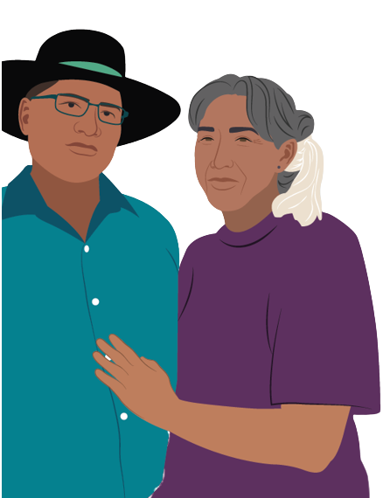
How Vaccines Work
We all have warrior cells that protect us from illnesses
For example, the flu vaccine tells our warrior cells how to recognize and fight flu
Certain illnesses require more than one shot so our warrior cells can more fully protect us from illness
Notes:
Within our bodies, each of us has warrior cells that stand guard and attack diseases when they try to infect us.
For example, the flu shot provides instructions to our warrior cells on how to identify and fight the flu.
In some cases, we need more than one shot so our warrior cells can more fully protect us from illness.

Slide 6
Vaccine Series
Notes:
First, let’s talk about vaccine series.

Slide 7
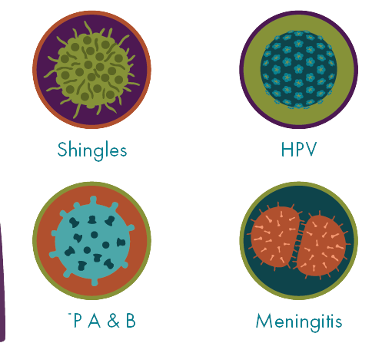
Vaccine Series
Require more than one shot within a certain timeframe
Examples of vaccine series include:
  Shingles • Hepatitis A and B
  HPV • Meningitis
Notes:
Sometimes we need multiple shots against a disease within a certain timeframe to be more fully protected. This is known as a vaccine series.
Illnesses that require a vaccine series include shingles, HPV, hepatitis A and B, and meningitis.

Slide 8
How Vaccine Series Works
Each shot in a vaccine series:
Provides a piece of information your warrior cells need to defend you
Helps your body recruit more warrior cells
Once complete, you will have more warrior cells that can more fully protect you from disease
Notes:
Now that we know what a vaccine series is and examples of vaccine series, let’s discuss how vaccine series work.
Each shot in a vaccine series:
Provides a piece of information your warrior cells need to defend you
Helps your body recruit more warrior cells
Once the series is complete, you will have more warrior cells that can more fully protect you from disease.

Slide 9


”Think of each shot in a vaccine series as being just one part. The number of shots you need to be protected can depend on your age and other factors. To be better protected, work with your healthcare team to schedule every shot you need.”
– Dr. Kali Dale, PhD|White Earth Ojibwe I Researcher
Notes:
As Dr. Kali Dale, PhD, Researcher and White Earth Ojibwe Tribal member, says: "Think of each shot in a vaccine series as being just one part. The number of shots you need to be protected can depend on your age and other factors. To be better protected, work with your healthcare team to schedule every shot you need.”

Slide 10
Hepatitis B Vaccine Series
Notes:
An example of an illness that requires a vaccine series is hepatitis B. Let’s discuss how the hepatitis B vaccine series works.

Slide 11
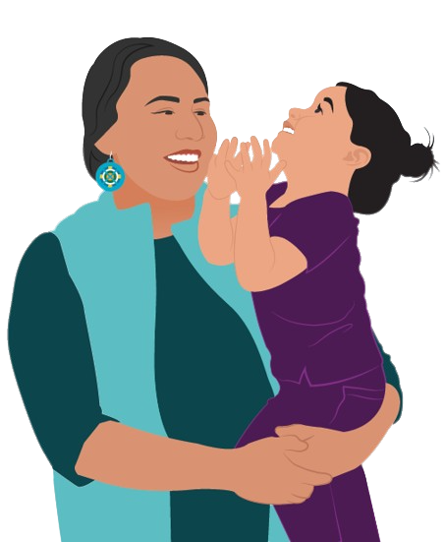
Hepatitis B Vaccine Series
Hepatitis B is a virus that can cause liver disease.
Hep B Vaccine Schedule
3 vaccines to complete the series for children and adults
Notes:
Hepatitis B is a virus that can cause liver disease. The hepatitis B vaccine schedule for children and adults includes three vaccines to complete the series.

Slide 12





Hepatitis B Vaccine Series
1 Month After First Shot
5 Months After Second Shot
Warrior cells are more fully prepared to fight!
First shot
  Second shot
Third shot
Notes:
You get the first shot. Then, 1 month after the first shot, you get a second shot. Finally, 5 months after the second shot, you get a third shot. After completing the hepatitis B series, your warrior cells are prepared to identify and fight hepatitis B.

Slide 13
Booster Shots
Notes:
Another instance where we need more than one shot are booster shots. Let’s talk about what booster shots are and how they work.

Slide 14
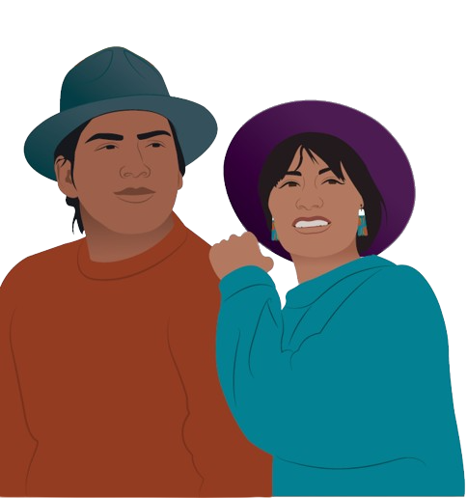
Booster Shots
Diseases can change over time
Makes it hard for your warrior cells to recognize them
Booster shots carry the latest instructions to fight the most current version(s) of a disease
Notes:
Over time diseases can change. This can make it hard for your warrior cells to recognize them. Booster shots carry the latest instructions for fighting the most current version (or versions) of a disease.

Slide 15
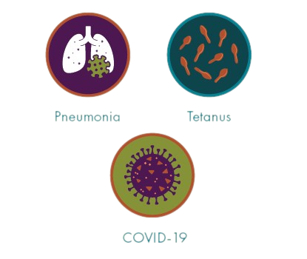
Some Illnesses that Require Booster Shots
Pneumonia
Tetanus
COVID-19
Notes:
Some illnesses that require booster shots include:
Pneumonia
Tetanus, and
COVID-19
Note to presenter: If someone asks if the flu shot is a booster shot, respond with: “When you get your annual flu shot, this is not considered a booster shot. Why? The flu shot changes each year depending on the latest strands of flu. So, each year it really is a different shot. That being said, some people who have weak immune systems may need a flu shot booster after receiving their initial dose to help “boost” the effect of the first shot. This is done so that people whose immune systems are weak are able to recruit and train enough warrior cells to more fully protect them from illness.

Slide 16
Getting Vaccinated
Notes:
Finally, let’s talk about where you and your loved ones can get vaccinated.

Slide 17
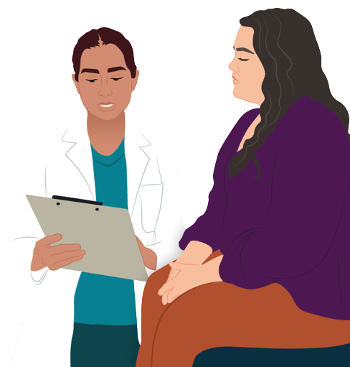
How to Get Vaccinated
Contact your local Tribal clinic or IHS facility
Visit a local pharmacy or clinic
Contact your state health department
Check local news outlets
Notes:
If you are uncertain about where to get vaccinated, you can contact your local Tribal clinic, IHS facility, or visit a local pharmacy or clinic. You can also check your local pharmacy’s website to see if vaccination appointments are available.
You can learn more information about where to find vaccine locations in your area by contacting your state health department. Finally, your local news outlets often have information on how to get a vaccination appointment.
Note to presenter: Personalize this slide with information specific to your community.

Slide 18

Getting Vaccinated
How to get vaccinated
Visit Vaccines.gov
Text your ZIP code to 438829 or call 1-800-232-0233.
Source: Vaccines.gov
Notes:
You can also visit Vaccines.gov to find vaccination providers near you. Another way to find vaccination providers near you is by texting your zip code to 438829 or calling 1-800-232-0233.

Slide 19
Any Questions?
Notes:
Does anyone have any questions about what we’ve discussed today? Was anything unclear?

Slide 20
For More Information
Notes:
Thank you for the time you’ve spent listening to this presentation. If you’d like more information about what we’ve discussed today…

Slide 21
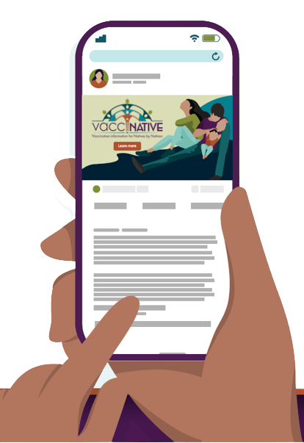

For More Vaccine Information
Visit
www.IndianCountryECHO.org/VacciNative
Notes:
Please visit the VacciNative website at: www.IndianCountryECHO.org/VacciNative
VacciNative is a project dedicated to creating accurate vaccine information for Native people by Native people. VacciNative does this by gathering info from trusted Elders, Native health professionals, and other experts. Plus, all of VacciNative’s materials are reviewed by the VacciNative Alliance, a collaboration of staff from Tribal Epidemiology Centers across the nation.

Slide 22
Your Presenter
HEADSHOT HERE
Title
Organization
Email Address
Notes:
If you have any additional questions about anything we’ve discussed, please feel free to contact me. My contact information is listed in the slide above.

Slide 23
Notes:
Thank you for taking the time to come together to discuss this important topic!

