Slide 1
Protecting Yourself,
Your Family, and
Your Community From Flu
Notes:
Hello! Today we are going to discuss how to protect yourself, your family, and your community from the flu.

Slide 2
Your Presenter
HEADSHOT HERE
Title
Organization
Email Address
Notes:
[Introduce yourself and any co-presenters if applicable]
Speaker recommendation: You can add your headshot onto this slide by doing the following:
1) Click the “Insert” button on the toolbox above.
2) Then, click the “Pictures” button and select “This Device.”
3) A pop-up box with access to the folders on your computer will open. Look for the image you’d like to add.
4) Once you select the image, it should come up on the slide. Use your mouse to move and place the image over the “HEADSHOT HERE” place holder. That’s it!

Slide 3
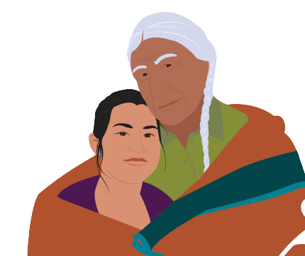
Presentation Overview
General flu information
How flu spreads
How flu vaccines work
Why you should get a flu vaccine each year
Vaccine side effects & safety
Where to get vaccinated
Notes:
During this presentation, we will discuss general information about the flu, such as how flu spreads. We will also share important information about how flu vaccines work, why you should get a flu vaccine each year. Then, we will talk about typical vaccine side effects and flu shot safety. Finally, we will discuss where you and your loved ones can get vaccinated.

Slide 4
General Flu Information
Notes:
So, what exactly is the flu?

Slide 5

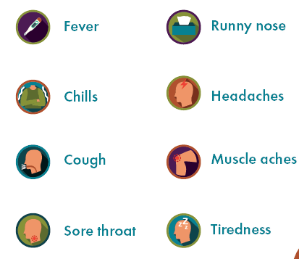
What is Flu?
An infection that attacks your whole body.
Symptoms may include:
  Fever
  Chills
  Cough
  Sore throat
  Runny nose
  Headaches
  Muscle aches
  Tiredness
Notes:
The flu is an infection caused by a virus that attacks your whole body. Symptoms of flu include fever, chills, cough, sore throat, runny nose, headaches, muscle aches, and tiredness.

Slide 6

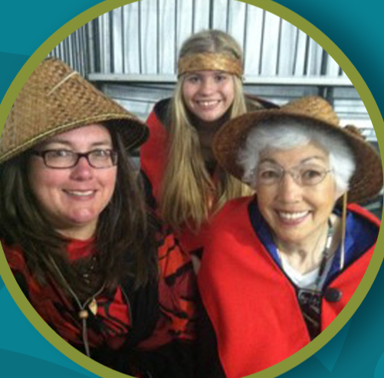
“My great grandma lost multiple children to the flu. Before we had the flu shot, it was common for people to get very sick or die from the flu.”
– Tam Lutz | Lummi Nation Tribal Elder
Notes:
The flu can also result in hospitalization and death – especially for those most vulnerable, like people with certain medical conditions and Elders. In this quote, Tam Lutz, a Lummi Nation Tribal Elder, shares her thoughts. She says “my great grandma lost multiple children to the flu. Before we had the flu shot, it was common for people to get very sick or die from the flu.”
Note to presenter: Take this opportunity to share your own story related to the dangers of flu if you have one.

Slide 7
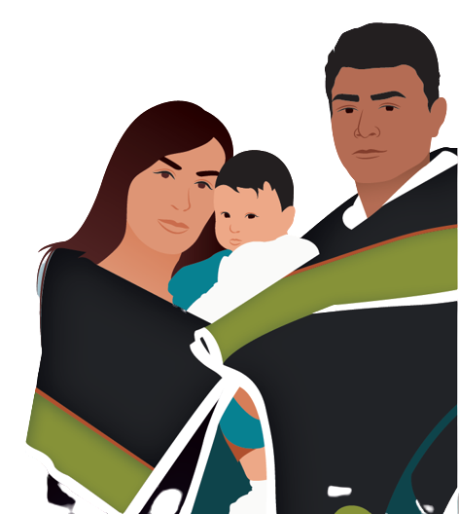
Flu Can Be Serious
Several generations ago, many died from flu
Flu is still deadly
We need to get vaccinated
To protect ourselves, our families, and our communities
Notes:
Our ancestors faced many serious illnesses, like the flu, and some died from these. Flu can still be very serious today. However, these days, we are fortunate to have access to vaccines that can help us protect ourselves, our families, and our communities. Everyone 6 months and older needs to get vaccinated against the flu – including young, healthy people. Pregnant people can also safely get vaccinated against flu at any time during pregnancy. When everyone who is able gets vaccinated, it makes it less likely that healthy people spread the flu to those that are more vulnerable.

Slide 8
How Flu Spreads
Notes:
How exactly does the flu spread?

Slide 9
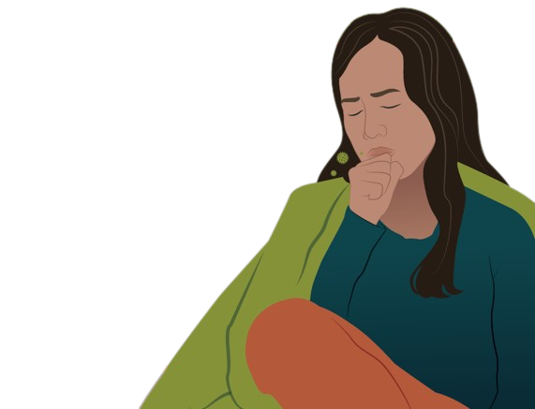
How Flu Spreads
Droplets in the air
When droplets are breathed in
Droplets on surfaces
When you touch your eyes, nose, or mouth after touching surface
Notes:
The flu is spread in two ways: through droplets in the air and droplets on surfaces. When you breathe in droplets in the air, you may get sick with the flu. When you touch something that has flu droplets on it, like a doorknob or light switch, then you touch your eyes, nose, or mouth, you can also get sick.

Slide 10
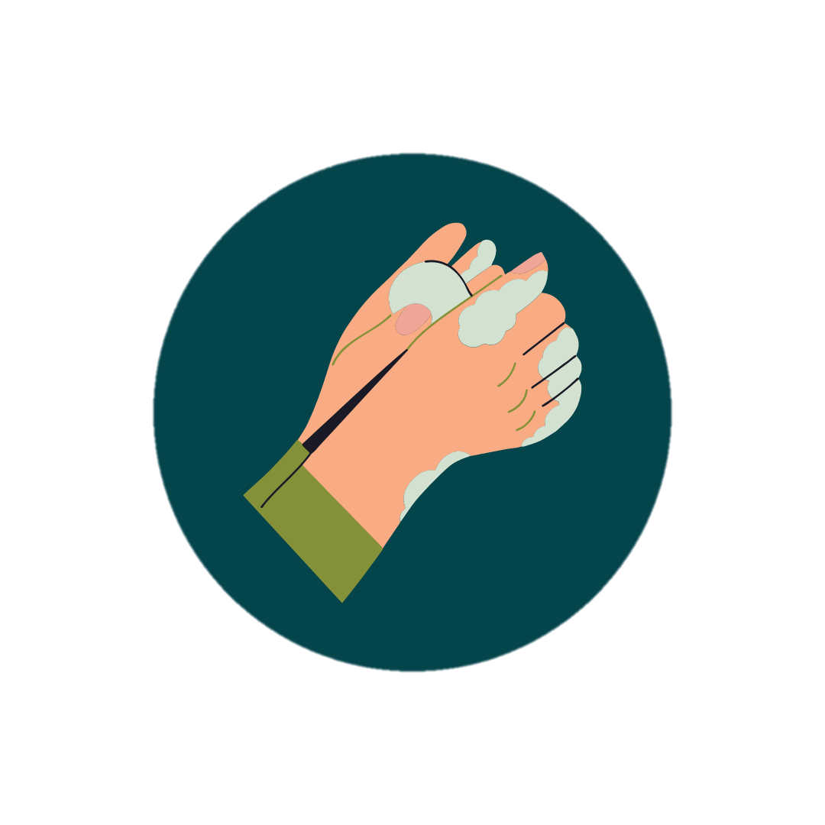

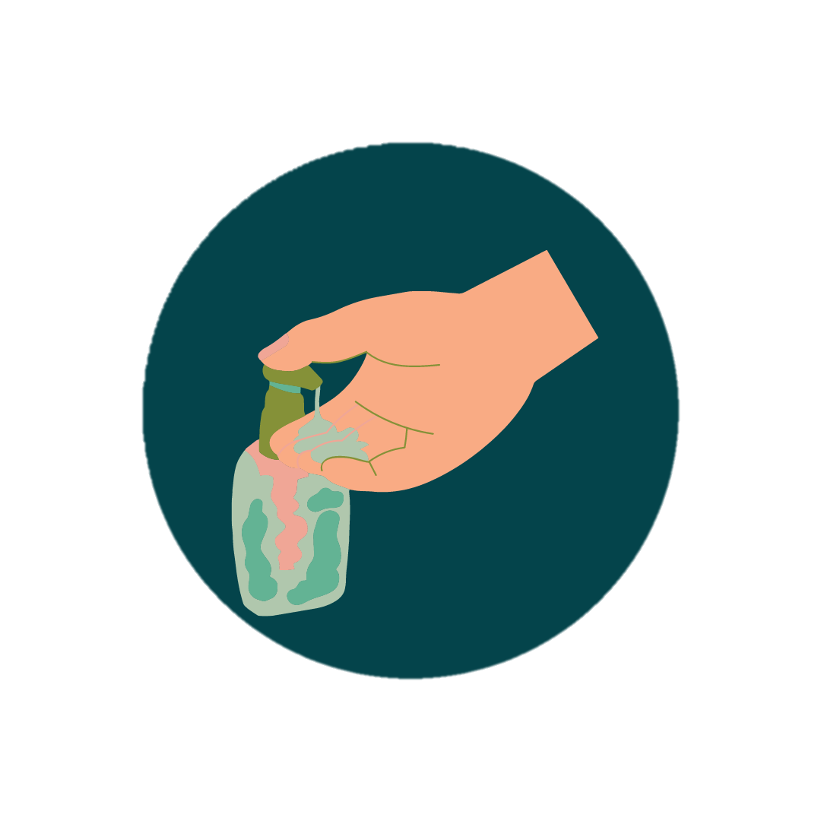
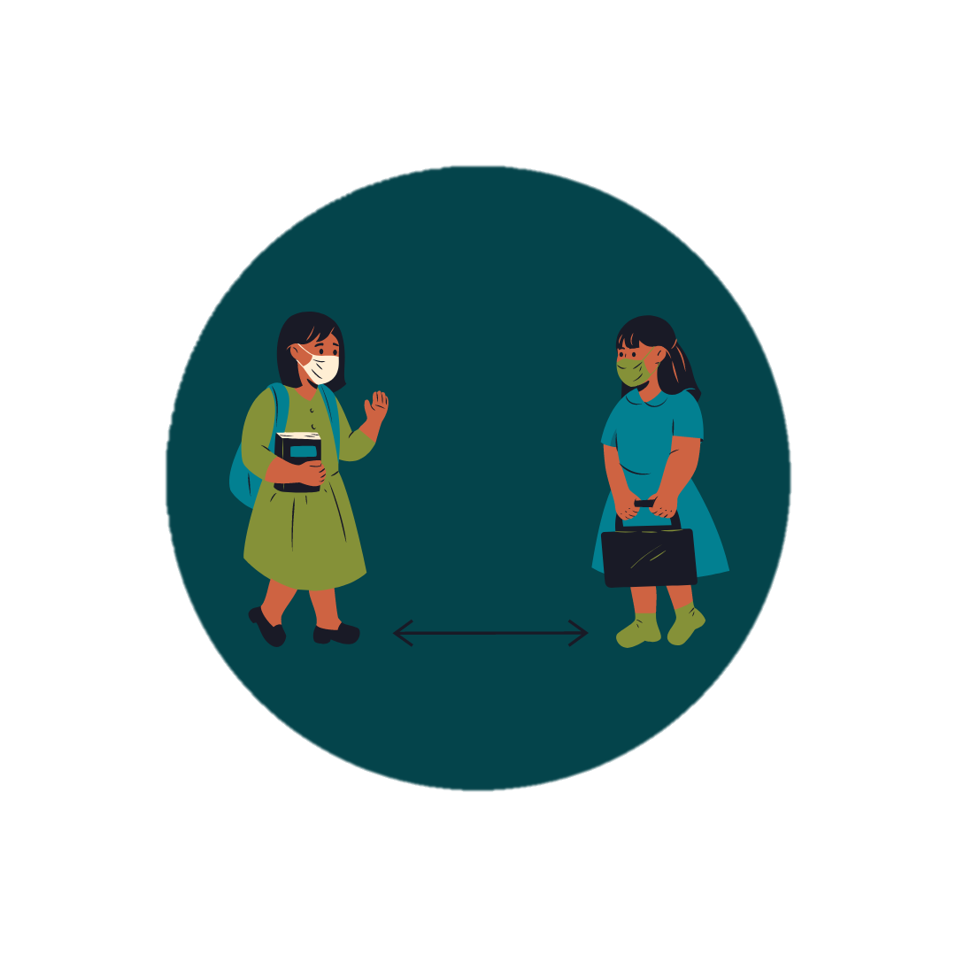
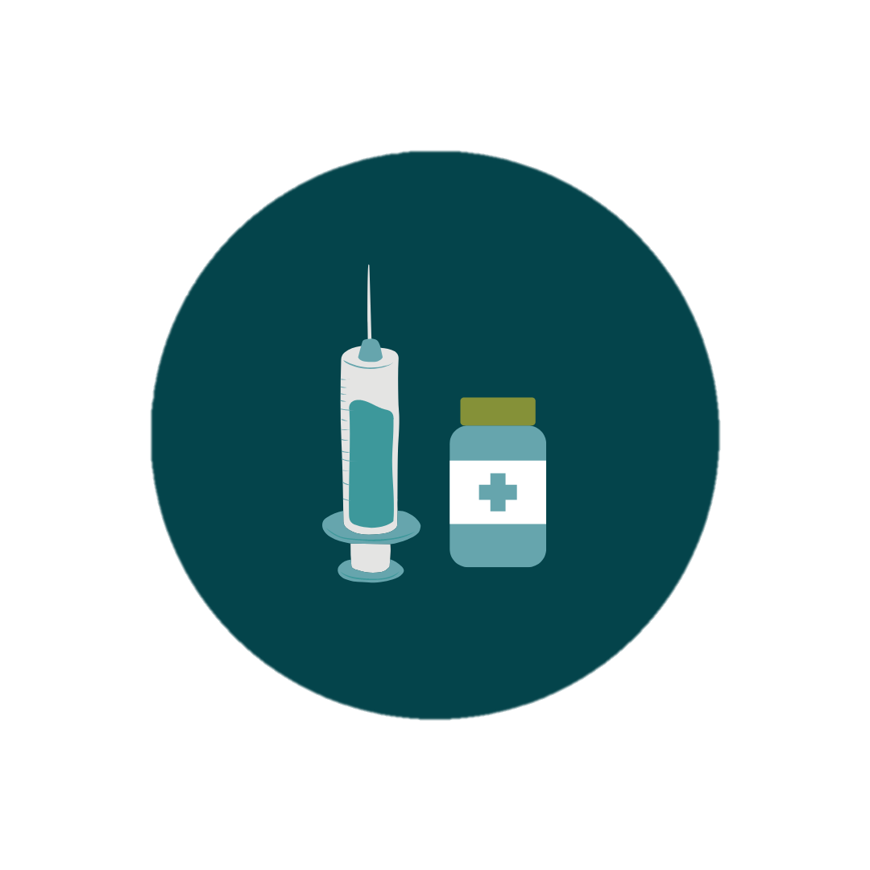
Protecting Yourself From Flu
Wash your hands
Wear your mask
Sanitize your hands
Keep your distance
  Get vaccinated
Notes:
There are healthy habits you can practice to protect yourself from the flu. Wash your hands well and often with soap and water for at least 20 seconds. Wear a mask in public places. If soap and water are not available, use alcohol-based hand sanitizer. To be even safer, consider carrying hand sanitizer with you and using it after touching doors and surfaces. You can also keep your distance from people you know are sick with the flu or when in a public place. Another effective way to protect yourself from the flu is by getting the flu vaccine. In order to protect our communities, it is important that everyone aged 6 months and above get the flu shot.

Slide 11
How Flu Vaccines Work
Notes:
Next, we will talk about how flu vaccines work.

Slide 12
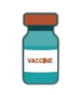
How Flu Vaccines Work
We all have warrior cells that protect us from illnesses
The flu vaccine tells our warrior cells how to recognize and fight flu
Notes:
Within our bodies, each of us has warrior cells that stand guard and attack diseases when they try to infect us.
The flu shot provides instructions to our warrior cells on how to identify and fight the flu.

Slide 13
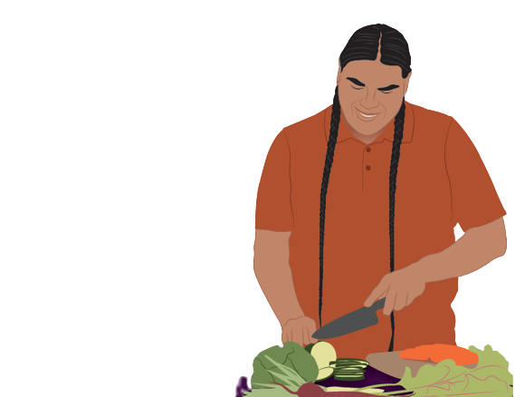
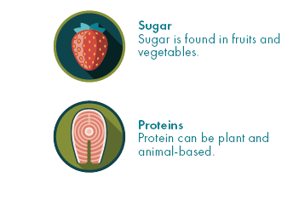
Flu Vaccines Work Naturally
Flu vaccines contain natural ingredients – including sugars and proteins
Notes:
Flu vaccines contains natural ingredients that are common in the foods we eat, including sugars and proteins.
After the vaccine helps prepare your body to identify and fight the flu, it leaves your body.
Note to presenter: If someone asks how the vaccine leaves your body, respond with “once the vaccine ingredients provide instructions to your warrior cells, the vaccine is cleared from your body the same way other ‘wastes’ may be cleared from your body – through urination and sweat.”

Slide 14
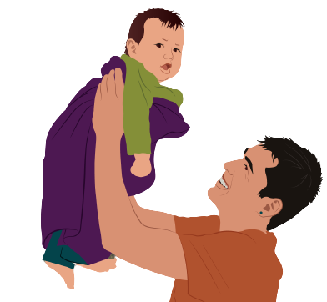
Flu Vaccines
Make it less likely you get sick
Reduce the seriousness of illness if you do get sick
Protect our communities
Notes:
We are less likely to get sick with the flu when we get the flu vaccine. In fact, the flu vaccine reduces the chances of you getting sick with the flu by 50%.
Getting vaccinated against the flu can also reduce the seriousness of illness if you happen to get sick.
The flu vaccine doesn’t only protect us; it protects our must vulnerable, like our Elders and children. The vaccine protects us, our families, and our communities for generations to come.

Slide 15
Why Do I Need to Get the Flu Shot Every Year?
Notes:
Let’s talk about why it’s important to get the flu shot every year.

Slide 16
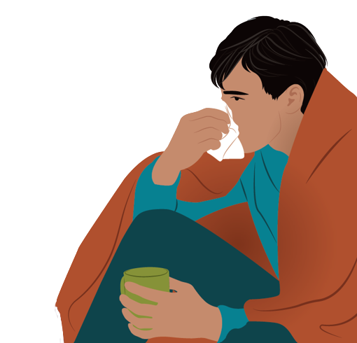
Flu is a Trickster
The flu is sneaky
Flu changes how it looks each year to fool your body
Notes:
The flu is sneaky. About once a year, the flu changes how it looks to try to fool your body.
Note to presenter: If your community has a traditional trickster story that involves an animal, like a coyote or raven, you could add a “trickster image” of that animal to this slide.

Slide 17
We need to get a flu shot every year, so our body is up to date on how to recognize and fight the flu
Notes:
That’s why we need flu shots each year – so our bodies can stay up to date on how to recognize and fight the flu.
It’s also important to get a flu shot every year, because our warrior cells’ ability to fight flu decreases over time.

Slide 18
Flu Vaccine Safety
Notes:
There are many measures that are taken to ensure that the flu vaccine is safe for everyone.

Slide 19
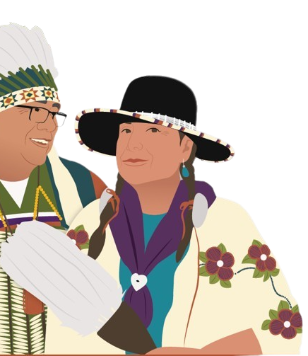
Flu Vaccine History
The flu shot has been around for 50+ years
Millions have safely received it– including American Indian and Alaska Native people
Notes:
But before we get into this topic, it’s important to quickly mention that the flu vaccine has been around for over 50 years. Millions of Americans have safely received the flu vaccine – including American Indian and Alaska Native people.

Slide 20
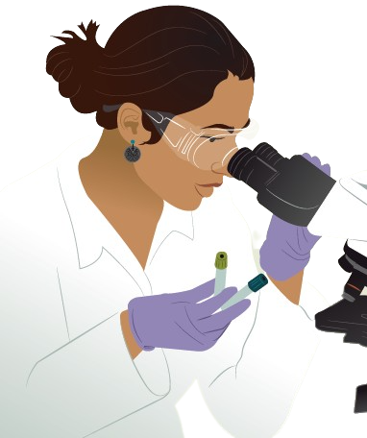
Flu Vaccine Testing
The flu vaccine goes through several rounds of testing
Testing helps us learn about side effects
Notes:
One reason we know flu vaccines are safe is because they go through several rounds of testing, which often takes thousands of volunteers. During vaccine testing, important questions are considered like “Is the vaccine safe?” and “How does the body react to it?”
This testing process also helps us learn about any possible vaccine side effects.

Slide 21
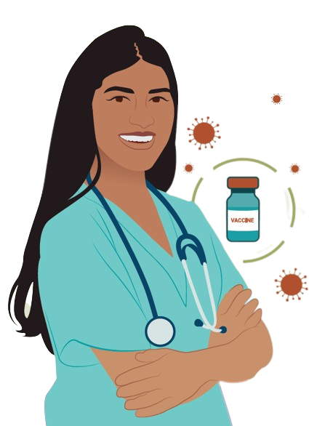
Flu Vaccine Approval
Flu vaccines are approved after:
They are proven to be safe and effective
Common side effects are shown to be mild
Notes:
Flu vaccines are only approved for public use after they go through thousands of hours of testing and are found to be safe and effective.
Any common side effects must be mild.
Side effects should not be confused for illness. We'll talk more about this later!

Slide 22
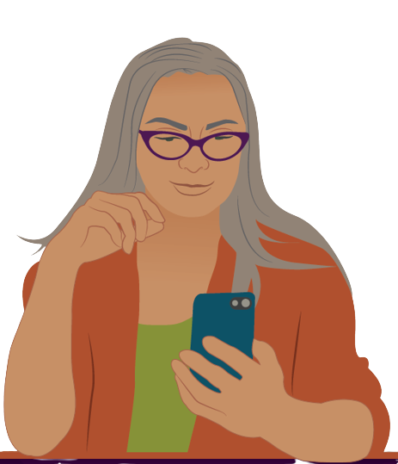
Flu Vaccine Monitoring
Everyday people share how the vaccine made them feel
Monitoring helps to quickly identify any vaccine risks and take action
Notes:
Making sure a vaccine is safe doesn't stop after vaccine approval. Once a vaccine is approved, everyday people who got the vaccine can share how it made them feel. We all have the power to contribute in this way.
The purpose of this kind of monitoring is to identify any possible vaccine risks quickly and take action.

Slide 23
Flu Vaccine Side Effects
Notes:
Next, we are going to discuss flu vaccine side effects.

Slide 24
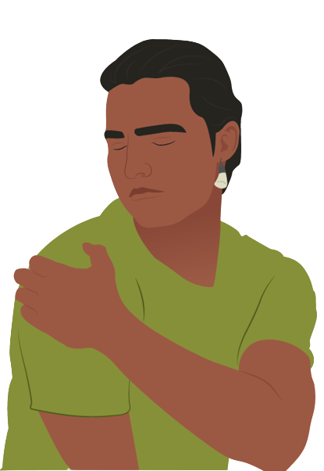
Flu Vaccine Side Effects
Common side effects may include:
  Soreness, redness, and swelling where you got the shot
  Fever
  Headache
  Muscle aches
Notes:
Common side effects from the flu vaccine include soreness, redness, and swelling where you got the shot, fever, headache, and muscle aches.

Slide 25
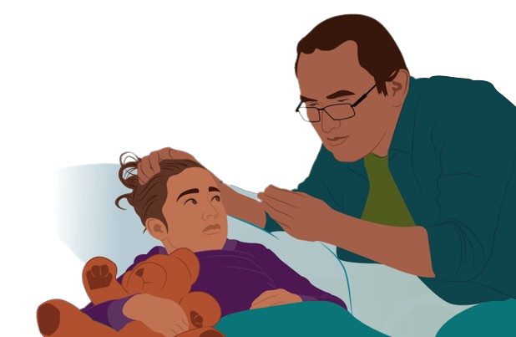
Flu Vaccine Side Effects
Typically go away in a few days
Are a sign your warrior cells are preparing to see and fight flu
Notes:
Side effects from the flu vaccine typically go away within a few days.
Mild side effects are a good sign that your warrior cells are preparing to recognize and fight the disease.

Slide 26
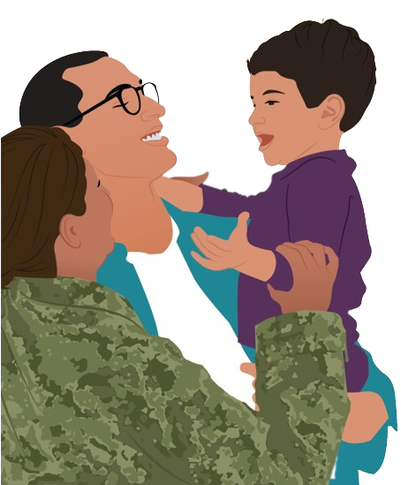
Side Effects Are Not “Sickness”
The flu vaccine does not make you sick
The vaccine strengthens your warrior cells by helping them see and fight the flu
Notes:
Sometimes people make the mistake of thinking that mild vaccine side effects are them "getting sick with the disease." This is not true. The flu vaccine does not make you sick with the disease you are getting vaccinated against. It strengthens our warrior cells by helping them see and fight disease.

Slide 27
Serious Side Effects Are Rare
If you experience anything beyond common side effects, please get medical attention
Report your experience to the Vaccine Adverse Event Reporting System (VAERS)- www.VAERS.hhs.gov
Notes:
Serious side effects from vaccines are very rare. However, if you experience anything beyond common side effects, please get medical attention. When you do, make sure that the health provider reports your experience to the Vaccine Adverse Event Reporting System (VAERS). If you are uncertain whether your experience was reported, you can file a report at www.VAERS.hhs.gov.

Slide 28
Getting Vaccinated
Notes:
Let’s talk about where you can get vaccinated against the flu.

Slide 29
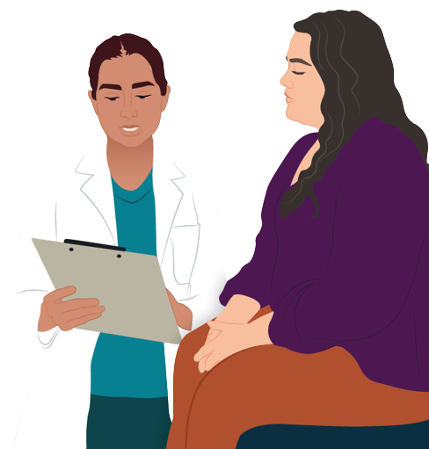
How to Get Vaccinated
Contact your local Tribal clinic or IHS facility
Visit a local pharmacy or clinic
Contact your state health department
Check local news outlets
Notes:
If you are uncertain about where to get your flu shot, you can contact your local Tribal clinic, IHS facility, or visit a local pharmacy or clinic. You can also check your local pharmacy’s website to see if vaccination appointments are available.
You can learn more information about where to find vaccine locations in your area by contacting your state health department. Finally, your local news outlets often have information on how to get a vaccination appointment.
Note to presenter: Personalize this slide with information specific to your community.

Slide 30

Finding Vaccine Locations
Visit Vaccines.gov
Text your ZIP code to 438829 or call 1-800-232-0233
Source: Vaccines.gov
Notes:
You can also visit Vaccines.gov to find vaccination providers near you. Another way to find vaccination providers near you is by texting your zip code to 438829 or by calling 1-800-232-0233.

Slide 31
Any Questions?
Notes:
Does anyone have any questions about what we’ve discussed today? Was anything unclear?

Slide 32
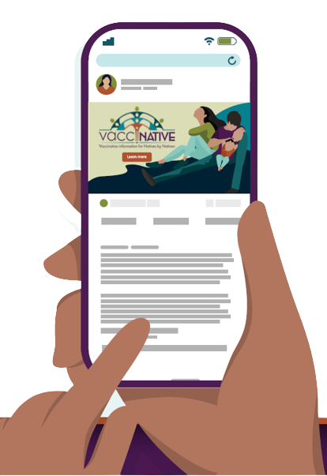
For More Vaccine Information
Visit
www.IndianCountryECHO.org/VacciNative
Notes:
Please visit the VacciNative website at: www.IndianCountryECHO.org/VacciNative
VacciNative is a project dedicated to creating accurate vaccine information for Native people by Native people. VacciNative does this by gathering info from trusted Elders, Native health professionals, and other experts. Plus, all of VacciNative’s materials are reviewed by the VacciNative Alliance, a collaboration of staff from Tribal Epidemiology Centers across the nation.

Slide 33
For more information
Org/Tribal
Logo
Title
Organization
Email Address
Notes:
Thank you for the time you’ve spent listening to this presentation. If you’d like more information about what we’ve discussed today or if you have any additional questions about anything we’ve discussed, please feel free to contact me. My contact information is listed in the slide above.

Slide 34
Notes:
Thank you for taking the time to come together to discuss this important topic!

