Slide 1
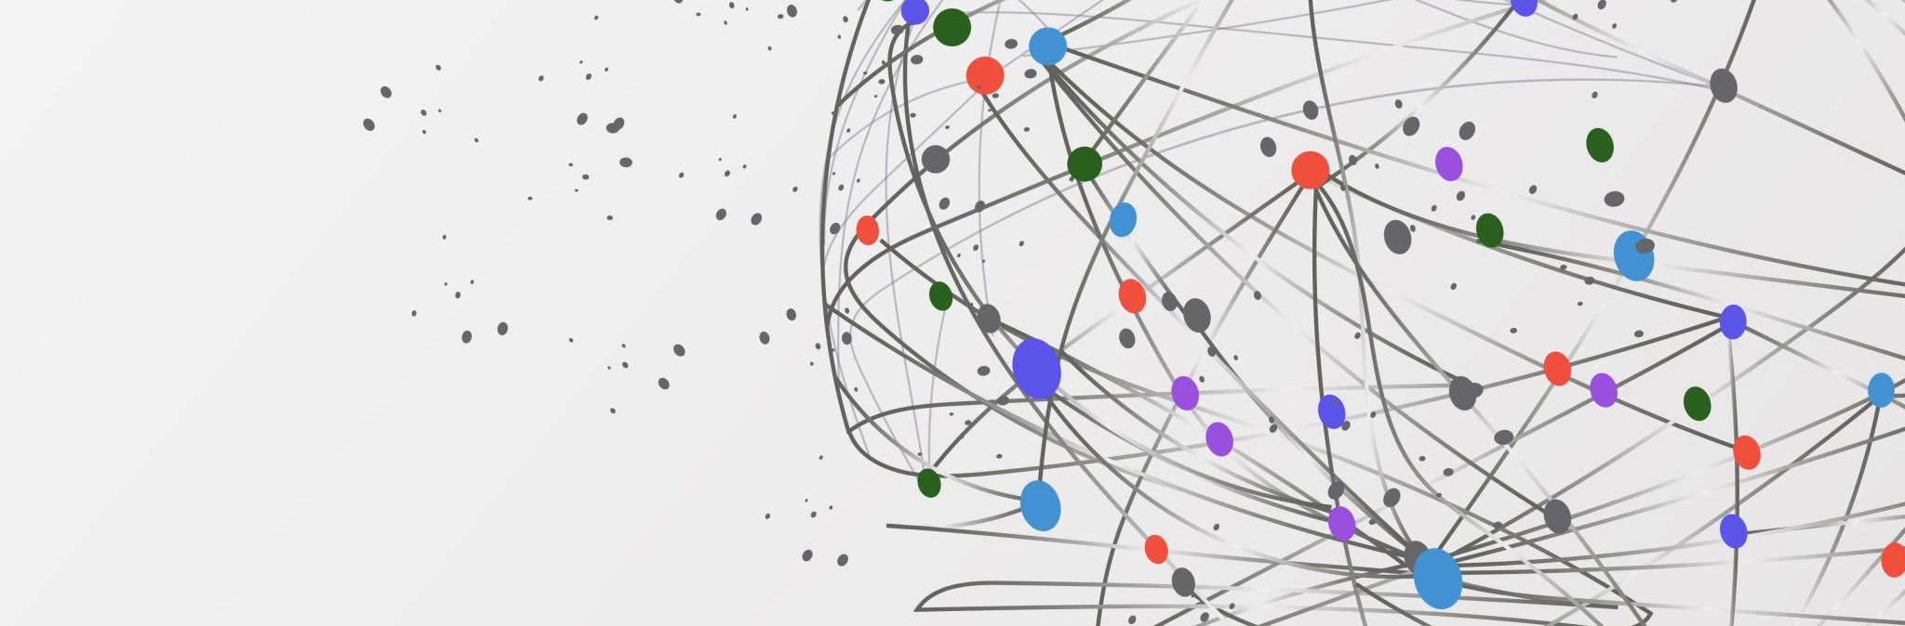
Tox Emergencies
Petter Overton-Harris, DO
University of New Mexico EMS Consortium

Slide 2
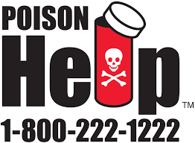
Poisonings, Overdoses, exposures! Oh my!
Toxic insults can make up to 10 % of EMS calls, range from intentional SI to accidents to environmental exposures
Huge topic, full of things we know and love (Narcan) and things that scare us (Peds)
A "poison" is defined as a substance that can produce harmful physiological or psychological effects when ingested, inhaled, injected or absorbed through the skin.
Notes:
So does anyone have any examples of tox calls or culprits they have seen?
You may notice a large image here, this is the poison control number for you no matter where you are and they can help with any tox concern, give treatment ideas, guide expectations etc

Slide 3

Approach to a general tox patient
Who is a potential tox patient? Well, everyone! must be considered if a patient’s condition cannot be attributed to other explainable causes
Common presentation: Altered, strange resp patterns, dysrhythmias (fast or slow), combative/intoxicated/delirious
Key EMS history points
Specific agent involved
Rule out hypoglycemia
Amount of substance ingested
Route of exposure
Time of ingestion
Signs/symptoms/overall condition
Reasons behind exposure (SI, etc)
Notes:
EMS many times is the only point of contact with the patient’s support system or the scene, this gives you a huge chance to impact care by simply finding a solid timeline, dose, intent and establishing initial symptoms

Slide 4
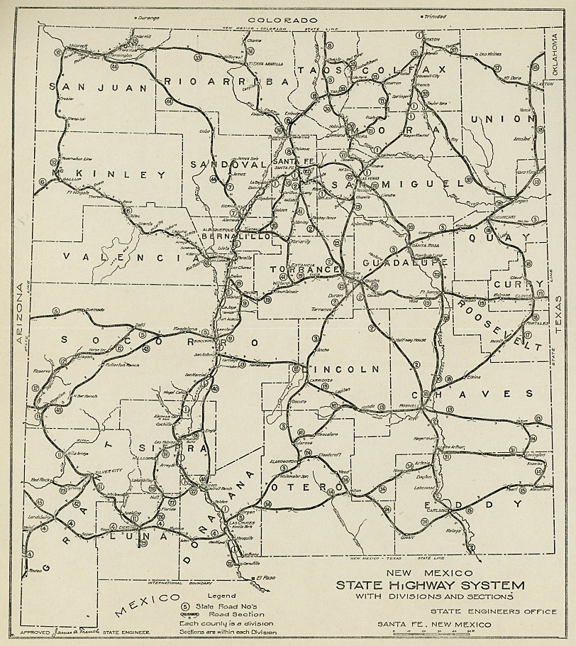
Roadmap
Opiates
Benzos
Antidepressants
Benadryl and friends (anticholinergic)
Cholinergic
Toxic Alcohols
Cardiac meds
Tylenol/Salicylates
Stimulants
CO/Cyanide
One pill can kill
This Photo by Unknown Author is licensed under CC BY-SA
Notes:
While the scope of this lecture may miss some potential toxic materials, which the poison center can help with, we are going to focus on some of the more common that have EMS interventions and the peds one pill can kill campaign.

Slide 5
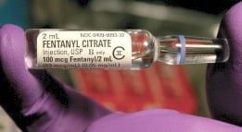
Opiates
Fentanyl is in everything! (heroin, methadone, suboxone, etc)
We know this one well – decreased and shallow respirations, pinpoint pupils, altered
Kids will not always follow these rules, if an infant is not acting right must consider opiates
Treatment: Narcan, more importantly respiratory/ventilation support
Notes:
An important point here is the key intervention for opiate overdose is actually ventilation and not Narcan, Narcan is a way to reverse the effect of the drug but what saves lives is ventilation and respiratory support. Please give resp support while you get access/prepare your narcan

Slide 6
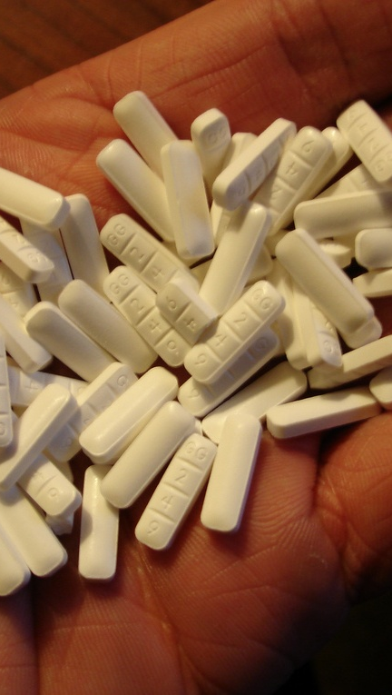
Benzos
Xanax (Alprazolam), Versed (Midazolam), Valium (Diazepam), Klonopin (Clonazepam) all common
Acts via GABA as a central depressant very similarly to EtOH, leading to a toxidrome like EtOH intoxication. Can lead to respiratory depression.
Treatment: ABCs, supportive
This Photo by Unknown Author is licensed under CC BY
Notes:
The lam or pam ending is a good hint to a benzo. Presents like a drunk person but can have more respiratory depression depending on route of admin
You may have heard of flumazenil, not used commonly, mainstay of tx is ABCs and supportive

Slide 7
Antidepressants
Commonly prescribed, commonly used in intentional self harm OD
SSRIs, SNRIs, TCAs
Basic pharmacologic principle is to increase available “happy” neurotransmitters like serotonin – too much of a good thing can be very dangerous
Serotonin syndrome (SSRI, SNRI, TCA) – looks like agitated delirium, think fast, hot and wet (sweaty), with myoclonus and hyperreflexia
Tx: avoid further triggers, ABCs, supportive care
TCAs – Sodium channel poison, can cause fatal dysrhythmias, monitor QRS duration
Tx: EKG! Fluids, consider sodium bicarb, consider benzos for agitation
Notes:
Serotonin syndrome: Mental status changes can include anxiety, restlessness, disorientation, and agitated delirium [15]. Patients may startle easily. Autonomic manifestations can include diaphoresis, tachycardia, hyperthermia, hypertension, vomiting, and diarrhea [3]. Neuromuscular hyperactivity can manifest as tremor, myoclonus, hyperreflexia, and bilateral Babinski sign. Hyperreflexia and clonus are particularly common; these findings, as well as rigidity, are more often pronounced in the lower extremities
The myoclonus and diaphoresis are more specific in the agitated pt for serotonin vs anticholinergic vs NMS
TCA: Sodium bicarb helps overwhelm the poisoned sodium channel, likely need MCEP for this, fluids are key as hypotension in TCA is very dangerous

Slide 8
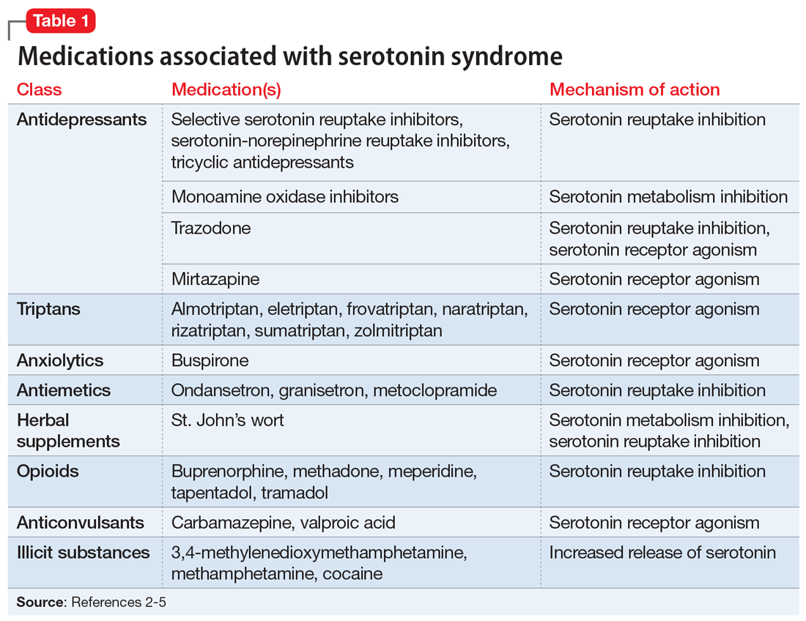
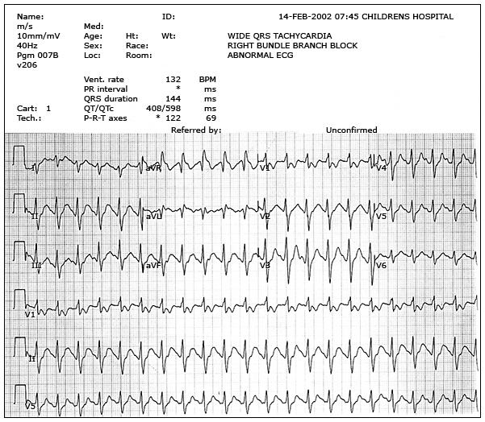


Notes:
From Serotonin syndrome: how to keep your patients safe. Current Psychiatry. 2019 July;18(7):38-42. Zick et al.
https://www.mdedge.com/psychiatry/article/203694/depression/serotonin-syndrome-how-keep-your-patients-safe
And EKG from
https://www.uptodate.com/contents/tricyclic-antidepressant-poisoning?search=tricyclic%20overdose&source=search_result&selectedTitle=1~50&usage_type=default&display_rank=1
Key notes: Broad serotonin meds, even Zofran so be careful and TCA morphology in aVR, QRS longer than 100ms

Slide 9
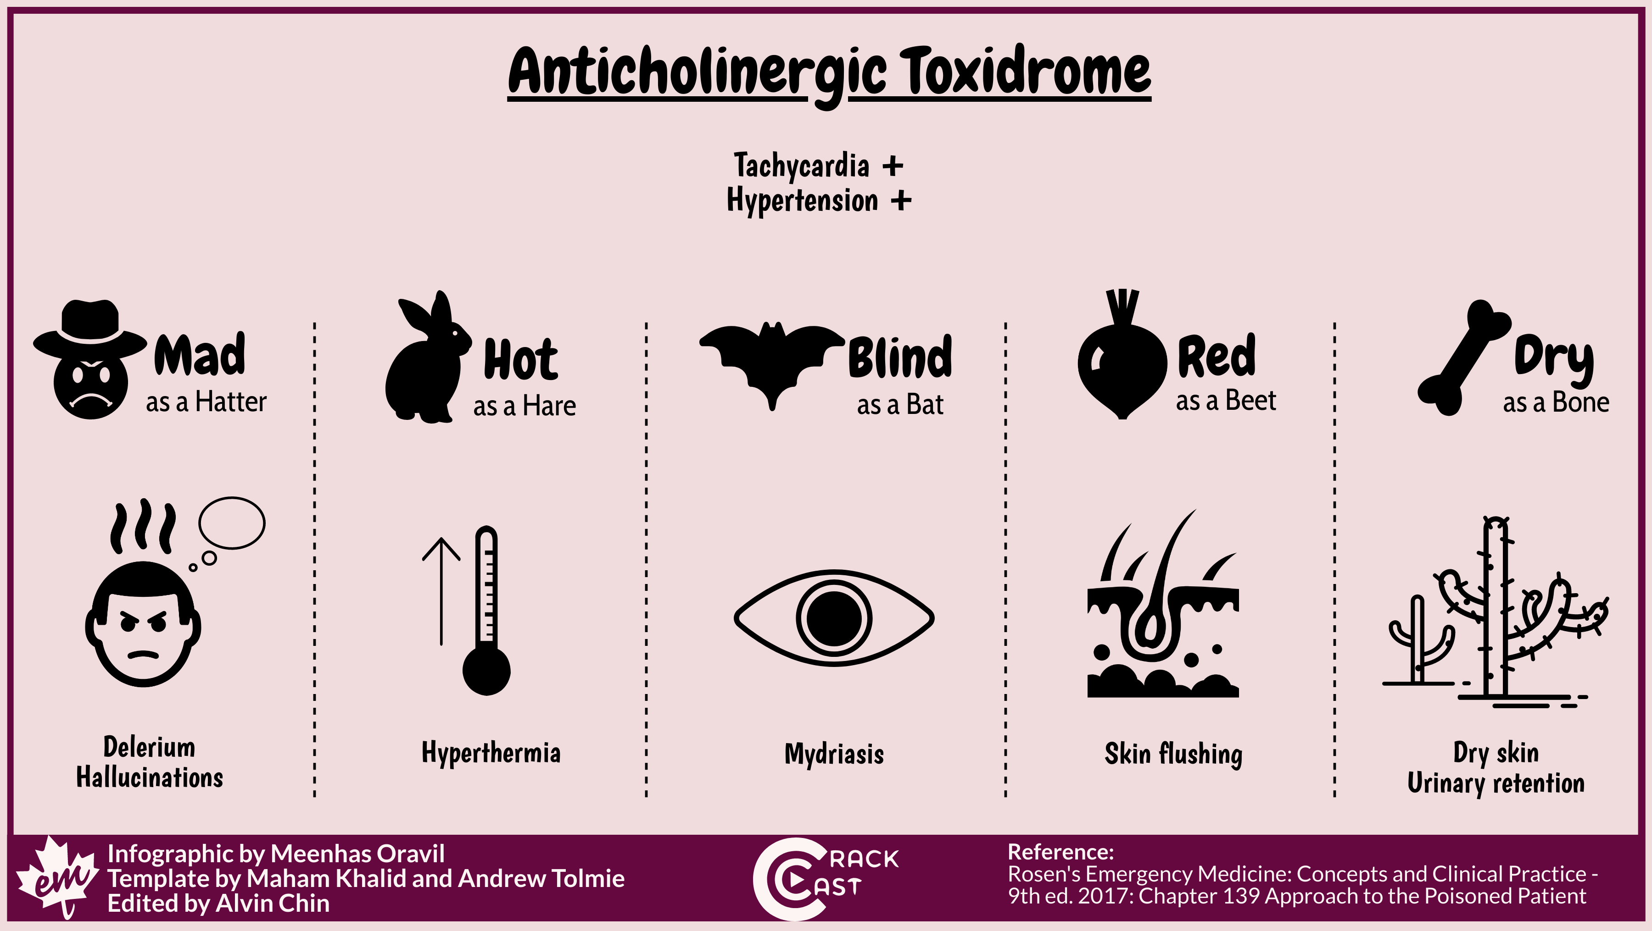
Benadryl/Anticholinergic
Common and accessible, included in many OTC cough medicines, herbal remedies etc
Tx: ABCs, supportive, benzos for agitation/seizures
This Photo by Unknown Author is licensed under CC BY-SA-NC
Notes:
In hospital consideration for physostigmine, in consultation with poison/tox specialist
Unlike serotonin syn, sympathomimetics these patients are dry not wet!

Slide 10
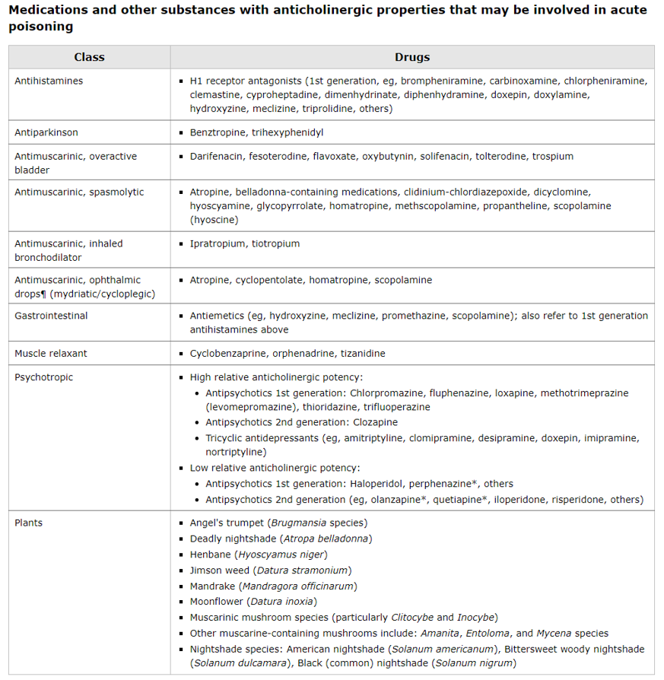
Notes:
https://www.uptodate.com/contents/anticholinergic-poisoning?search=anticholinergic%20toxicity&source=search_result&selectedTitle=1~150&usage_type=default&display_rank=1

Slide 11
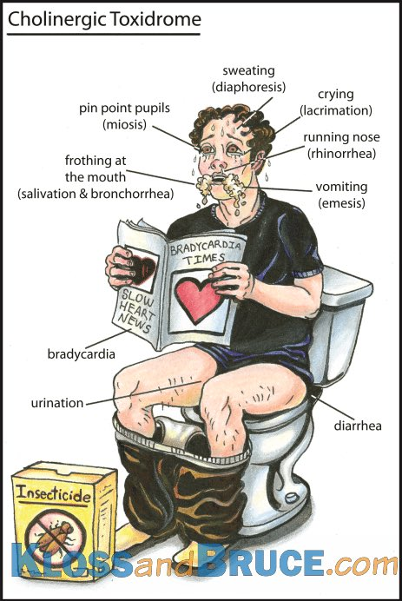
Cholinergic
Most commonly found in pesticides, farming exposures. Basically, exact opposite of anticholinergic toxidrome, everything is slow and wet.
Key tx difference is manage the killer Bs (bronchorrhea, bradycardia, bronchospasm) with atropine and decontamination is paramount.
Notes:
You need to avoid becoming a patient, decon is essential, remove all clothing and do as much decon as possible, additionally warn hospital so decon can be prioritized
Tx goal is to give atropine until bronchorrhea resolves. In hospital will give large atropine doses and possible pralidoxime therapy

Slide 12
Toxic alcohols
Methanol, Ethylene glycol, Isopropanol – essentially look like EtOH intoxication on initial exam
Methanol is found in many household products/moonshine, leads to profound metabolic acidosis and eye complaints, body converts methanol into toxic formaldehyde
Ethylene Glycol is found in automotive products/antifreeze, one mouthful can be highly toxic, leads to cardiopulmonary and renal issues, hypocalcemia and seizures
Isopropanol is usually found in rubbing alcohol and household products

Slide 13

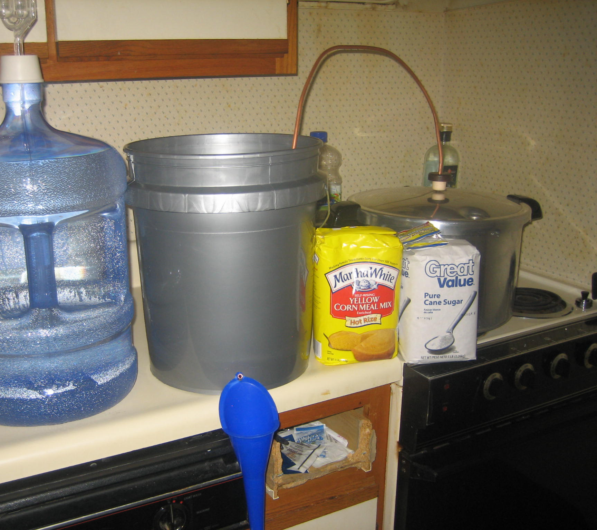


Treatment of toxic alcohols
Methanol – ABCs, supportive care (respiratory support key to aid in compensation for acidosis), IVF, consider MCEP for bicarb
Ethylene glycol – ABCs, supportive care, IVF (to help prevent renal injury), consider MCEP for bicarb, benzos for seizures
Isopropanol – ABCs, supportive care, consider IVF
This Photo by Unknown Author is licensed under CC BY-SA-NC
This Photo by Unknown Author is licensed under CC BY-SA-NC
Notes:
Image: we are not talking about this fancy pro shine, we are talking about the bathtub stuff
Methanol/ethylene glycol in hospital gastric decon, HD, sodium bicarb – helps some with acidosis, ethanol therapy – yup we give them booze to outcompete the toxic alcohols
Can be hard to tell which alcohol is culprit so ABCs, supportive care and fluids remain mainstay therapy for all, if seizing use benzos but yall are rockstars and do that very well already

Slide 14
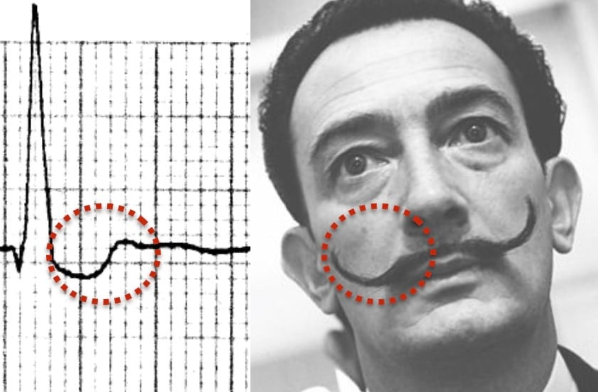
Cardiac meds
Beta blockers, Calcium channel blockers and Digoxin are your main players
BB – bradycardia, hypotension, AMS, hypoglycemia
CCB – bradycardia and hypotension, but far less likely to have AMS and usually are hyperglycemic
Digoxin – any type of dysrhythmias, save for fast atrial, GI + neuro + visual symptoms, can be hyperkalemic, classic scooped ST segment on EKG (Dali moustache)
This Photo by Unknown Author is licensed under CC BY-SA-NC
Notes:
Many times if history is unclear glycemic measure help determine beta vs CCB
Pts on dig with new vision changes or neuro/GI symptoms not explained by other causes may be toxic. Yellow hue on vision is common

Slide 15
Cardiac Med tx
All toxicities needs good ABCs, supportive care, EKG and glucose check.
BB – replete glucose if needed, IVF, atropine for symptomatic bradycardia, consider MCEP for calcium salts/glucagon
CCB – IVF, consider atropine, consider calcium salts (effectively overwhelms the blocker), consider MCEP for glucagon
Digoxin – IVF, consider atropine, does not usually need calcium salts
Notes:
BB watch for seizures but tx is benzos, and fix the sugar.
Consider pressors if in scope and refractory hypotension/bradycardia
CCB/BB now get high dose insulin therapy in hospital interestingly
Good rule of the thumb is to call MCEP for glucagon/calcium salts outside of defined protocols
Dig has an effect of displacing K out of cells, however it is paired with an increased Ca level as well, studies show no benefit at this point to Ca for dig toxicity. Digifab in hospital

Slide 16
Tylenol (APAP)/salicylates (ASA)
Very common and readily available. Common in SI. Both can have acute vs chronic toxicities
APAP is metabolized by the liver, most toxic effects are via liver damage and include GI upset, N/V, liver failure, coagulopathy but patients are usually asymptomatic initially
Tx: ABCs, IV access, supportive care, avoid hepatotoxins
Notes:
As with all discussed toxins history and timeline are key! Which usually falls onto the talented shoulders or our prehospital colleagues

Slide 17
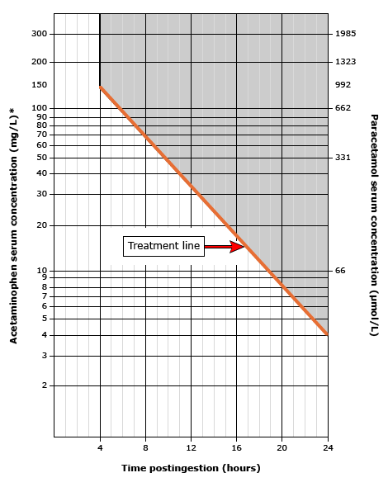
Notes:
In hospital significant APAP OD is treated with N-acetylcysteine based on this chart as most patients will present asymptomatic and tx is designed to prevent liver damage

Slide 18
Tylenol (APAP)/salicylates (ASA) cont
ASA works through a wide range of mechanisms:
Inhibition of cyclooxygenase results in decreased synthesis of prostaglandins, prostacyclin, and thromboxanes. This contributes to platelet dysfunction and gastric mucosal injury.
Stimulation of the chemoreceptor trigger zone in the medulla causes nausea and vomiting.
Activation of the respiratory center of the medulla results in hyperventilation and respiratory alkalosis.
Interference with cellular metabolism (eg, Krebs cycle, oxidative phosphorylation) leads to metabolic acidosis.
Symptoms include tinnitus, vertigo, nausea, vomiting, and diarrhea; more severe toxicity include altered mental status, hyperpyrexia, noncardiac pulmonary edema, and coma
Tx: ABCs, IVF, Bicarb
Notes:
Fatal dose 10-30 g in adults
In hospital, alkalization of serum and urine, consider HD, avoid intubation if possible.
Chronic toxicity of both lead to milder symptoms that need careful history to uncover.

Slide 19
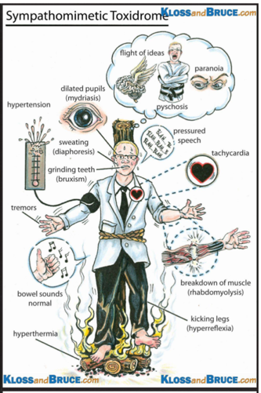
Stimulants
Speed everything up, meth, cocaine, caffeine, other sympathomimetics
Pts usually altered, agitated, tachycardic, diaphoretic, hypertensive, febrile – may progress to seizures
Tx: ABCs, benzos for psychomotor agitation/seizures
Notes:
Maintaining pt and provider safety is key in all altered patients but an important note during sympathomimetic toxidromes

Slide 20
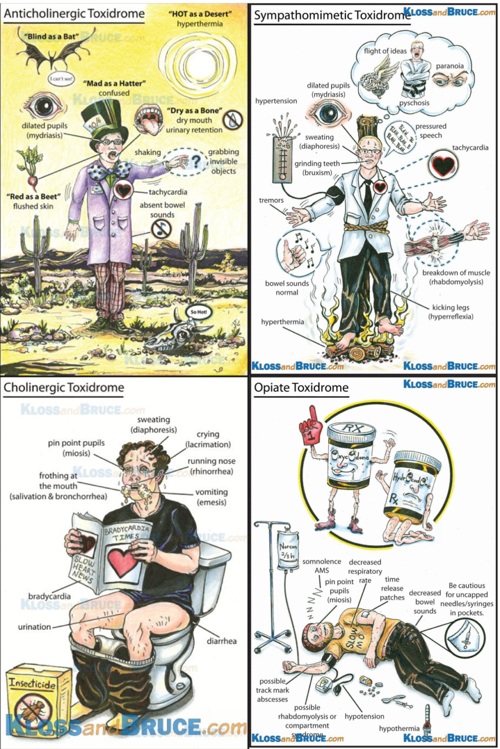
This Photo by Unknown Author is licensed under CC BY-NC
Notes:
Review of different toxidromes

Slide 21
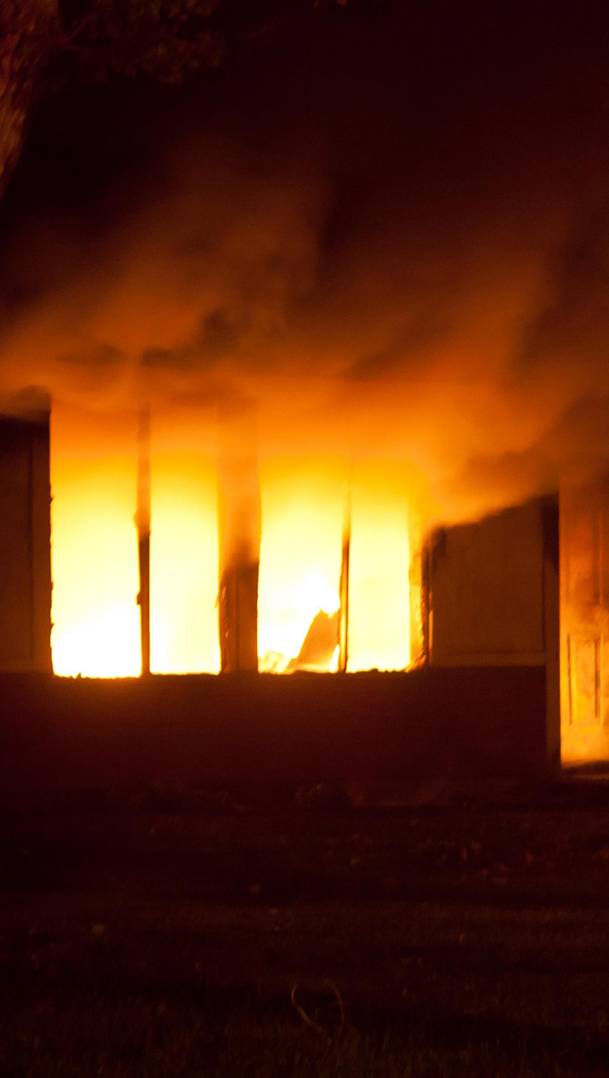
CO/Cyanide
Common in combustion exposure, house fire, propane heaters etc.
CO (carbon monoxide) gas binds hemoglobin much tighter than O2, effectively making tissue delivery of O2 quite low. Pts may have HA, dizziness, weakness/malaise, nausea, confusion, SOB, CP.
Tx: remove from noxious environment, give 100% oxygen to outcompete CO on Hgb
This Photo by Unknown Author is licensed under CC BY

Slide 22

CO/Cyanide cont
Cyanide maybe a result of combustion or ingestion. It is a potent mitochondrial poison, which switches cellular metabolism to produce large quantities of lactic acid. This prevents adequate use of O2 by the tissues. Pts can have HA, AMS, seizures, GI issues, flushed skin.
Tx: antidote kit (cyanokit) if in protocol/available, ABCs, O2, IVF, supportive care, decontamination is key.

Slide 23
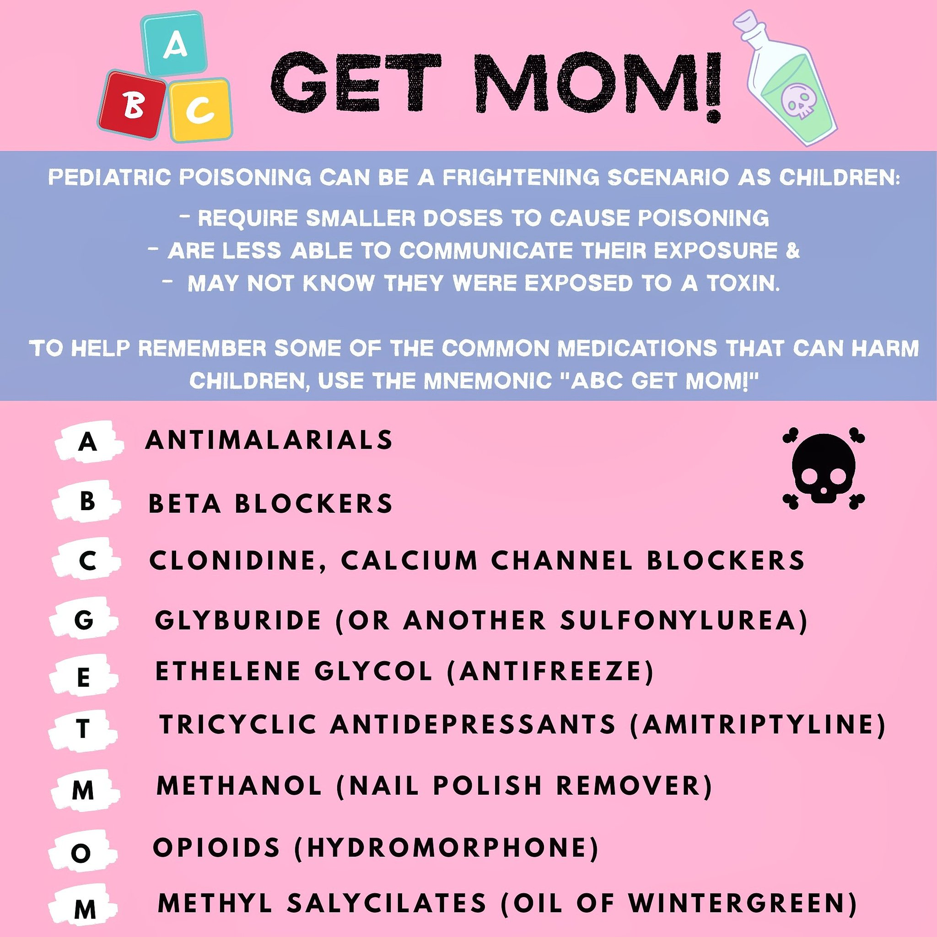
One pill can kill
Many accidental ingestions are by children under 3, one pill can kill aims to ID high risk and highly toxic medications in this group.
Fentanyl is everywhere!
Notes:
https://www.hmpgloballearningnetwork.com/site/emsworld/article/1224498/one-pill-can-kill-advancing-your-knowledge-pediatric-toxicology
Courtesy of UNC.

Slide 24
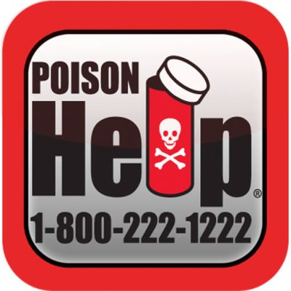
Summary
History is key, substance, timeline, amount plays huge role in downstream tx
Most ingestions need good ABCs, IVF, EKG and always check a sugar
If any question please decontaminate as much as possible for both pt and yourself
When in doubt call for help
Pay close attention to peds ingestions as many normal meds can be toxic in small doses.

Slide 25

Questions
https://www.uptodate.com/contents/acute-opioid-intoxication-in-adults?search=opiate%20overdose&source=search_result&selectedTitle=1~115&usage_type=default&display_rank=1
https://www.uptodate.com/contents/benzodiazepine-poisoning-and-withdrawal?search=benzodiazepine%20overdose&source=search_result&selectedTitle=1~50&usage_type=default&display_rank=1#H1369026413
https://www.uptodate.com/contents/serotonin-syndrome-serotonin-toxicity?search=serotonin%20syndrome&source=search_result&selectedTitle=1~150&usage_type=default&display_rank=1
https://www.uptodate.com/contents/methanol-and-ethylene-glycol-poisoning-management?search=methanol%20poisoning&source=search_result&selectedTitle=2~41&usage_type=default&display_rank=2#H255409132
https://www.uptodate.com/contents/methanol-and-ethylene-glycol-poisoning-management?search=methanol%20poisoning&source=search_result&selectedTitle=2~41&usage_type=default&display_rank=2#H255409132
https://www.uptodate.com/contents/beta-blocker-poisoning?search=beta%20blocker%20overdose&source=search_result&selectedTitle=1~26&usage_type=default&display_rank=1
https://www.uptodate.com/contents/calcium-channel-blocker-poisoning?search=beta%20blocker%20overdose&source=search_result&selectedTitle=3~26&usage_type=default&display_rank=3
https://www.uptodate.com/contents/digitalis-cardiac-glycoside-poisoning?search=beta%20blocker%20overdose&topicRef=330&source=see_link#H15
https://www.uptodate.com/contents/organophosphate-and-carbamate-poisoning?search=cholinergic%20toxicity&source=search_result&selectedTitle=1~150&usage_type=default&display_rank=1
https://www.uptodate.com/contents/acute-amphetamine-and-synthetic-cathinone-bath-salt-intoxication?search=sympathomimetic%20toxicity&source=search_result&selectedTitle=2~150&usage_type=default&display_rank=2
https://www.uptodate.com/contents/acetaminophen-paracetamol-poisoning-in-adults-treatment?search=tylenol%20overdose&source=search_result&selectedTitle=1~144&usage_type=default&display_rank=1#H4
Notes:
https://www.uptodate.com/contents/acute-opioid-intoxication-in-adults?search=opiate%20overdose&source=search_result&selectedTitle=1~115&usage_type=default&display_rank=1
https://www.uptodate.com/contents/benzodiazepine-poisoning-and-withdrawal?search=benzodiazepine%20overdose&source=search_result&selectedTitle=1~50&usage_type=default&display_rank=1#H1369026413
https://www.uptodate.com/contents/serotonin-syndrome-serotonin-toxicity?search=serotonin%20syndrome&source=search_result&selectedTitle=1~150&usage_type=default&display_rank=1
https://www.uptodate.com/contents/methanol-and-ethylene-glycol-poisoning-management?search=methanol%20poisoning&source=search_result&selectedTitle=2~41&usage_type=default&display_rank=2#H255409132
https://www.uptodate.com/contents/methanol-and-ethylene-glycol-poisoning-management?search=methanol%20poisoning&source=search_result&selectedTitle=2~41&usage_type=default&display_rank=2#H255409132
https://www.uptodate.com/contents/beta-blocker-poisoning?search=beta%20blocker%20overdose&source=search_result&selectedTitle=1~26&usage_type=default&display_rank=1
https://www.uptodate.com/contents/calcium-channel-blocker-poisoning?search=beta%20blocker%20overdose&source=search_result&selectedTitle=3~26&usage_type=default&display_rank=3
https://www.uptodate.com/contents/digitalis-cardiac-glycoside-poisoning?search=beta%20blocker%20overdose&topicRef=330&source=see_link#H15
https://www.uptodate.com/contents/organophosphate-and-carbamate-poisoning?search=cholinergic%20toxicity&source=search_result&selectedTitle=1~150&usage_type=default&display_rank=1
https://www.uptodate.com/contents/acute-amphetamine-and-synthetic-cathinone-bath-salt-intoxication?search=sympathomimetic%20toxicity&source=search_result&selectedTitle=2~150&usage_type=default&display_rank=2
https://www.uptodate.com/contents/acetaminophen-paracetamol-poisoning-in-adults-treatment?search=tylenol%20overdose&source=search_result&selectedTitle=1~144&usage_type=default&display_rank=1#H4
https://medictests.com/units/the-quick-dirty-guide-to-poisonings

