Slide 1


Welcome!
Measuring and Monitoring:
How to Assess RA Disease Activity
Mimi Margaretten, MD
March 9, 2023
RAE Initiative| Spring 2023

Slide 2
DISCLOSURES
AMA Designation Statement
The University of California, San Francisco School of Medicine (UCSF) is accredited by the Accreditation Council of Continuing Medical Education (ACCME) to provide continuing medical education for physicians. UCSF designates this live activity for a maximum of 1 AMA PRA Category 1 Credit™. Physicians should claim only the credit commensurate with the extent of their participation in the activity.
Disclosure Statement
Planners Jennifer Mandal, MD, Leslie Dexheimer Gleason, RN, and Tabitha Carroway, MPH have stated they have no relationships to disclose. Speaker Mimi Margaretten, MD has stated she has no relationships to disclose.
RAE Initiative| Spring 2023

Slide 3
Assessment of RA Disease Activity
General Principles
Patients should be seen on a regular basis for clinical and laboratory monitoring of RA and for screening for drug toxicities
Patients starting new medications or with severely active disease may be seen at 1-2 month intervals, while those with mildly active or well-controlled disease could be seen every 3-6 months, with appropriate laboratory monitoring in the interim
Clinic visits should include a quantitative composite measure of disease activity
RAE Initiative| Spring 2023

Slide 4
Clinical Assessment of RA Disease Activity
History
Physical Exam
Laboratory Monitoring of Disease Activity
Imaging
Structured Measures of Disease Activity
RAE Initiative| Spring 2023

Slide 5
Case 1. 27 yo woman with RF+/CCP+ erosive RA on methotrexate presents to clinic for routine follow-up. All of the following are symptoms about which you should ask in order to assess her RA disease activity EXCEPT:
Degree of joint pain
Duration of morning stiffness
Fever
Fatigue
Function (work-related activities, household chores, hobbies, sports, etc.)
RAE Initiative| Spring 2023
Notes:
Poll Question

Slide 6
Case 1. 27 yo woman with RF+/CCP+ erosive RA on methotrexate presents to clinic for routine follow-up. All of the following are symptoms about which you should ask in order to assess her RA disease activity EXCEPT:
Degree of joint pain
Duration of morning stiffness
Fever
Fatigue
Function (work-related activities, household chores, hobbies, sports, etc.)
RAE Initiative| Spring 2023
Notes:
Fever is not a common feature of RA in adults, infection should be excluded before ascribing fever to RA

Slide 7

Case 2. 42 yo woman with seronegative RA typically well controlled on methotrexate reports that her RA has been ”out of control” for the last 3 months. You ask her to obtain labs. All of the following could be consistent with active RA EXCEPT:
ESR > 125 mm/hr (ref <30 mm/h)
CRP 3.2 mg/L (ref <8.1 mg/L)
Hgb 9.8 g/dL (ref 11.7-15.7 g/dL)
Platelets 89 K/uL (ref 150-400 K/uL)
RAE Initiative| Spring 2023
Notes:
Poll Question

Slide 8
Case 2. 42 yo woman with seronegative RA typically well controlled on methotrexate reports that her RA has been ”out of control” for the last 3 months. You ask her to obtain labs. All of the following could be consistent with active RA EXCEPT:
ESR > 125 mm/hr (ref <30 mm/h)
CRP 3.2 mg/L (ref <8.1 mg/L)
Hgb 9.8 g/dL (ref 11.7-15.7 g/dL)
Platelets 89 K/uL (ref 150-400 K/uL)
RAE Initiative| Spring 2023

Slide 9
Disease Activity Measures
Use a disease activity measure to guide treatment decisions
  RA remission → taper immunosuppression
  RA low disease activity → no change
  RA moderate/high disease activity → increase immunosuppression
Disease Activity Score for 28 joints (DAS28) = includes patient & provider data & labs (ESR or CRP)
Clinical Disease Activity Index (CDAI) = includes patient & provider data
Routine Assessment of Patient Index Data 3 (RAPID3) = requires only patient-reported data
All of the measures accurately reflect disease activity; are sensitive to change; discriminate well between low, moderate, and high disease activity; have remission criteria; and are feasible to perform in clinical settings
RAE Initiative| Spring 2023

Slide 10
Disease Activity Measures
Use a disease activity measure to guide treatment decisions
  RA remission → taper immunosuppression
  RA low disease activity → no change
  RA moderate/high disease activity → increase immunosuppression
Disease Activity Score for 28 joints (DAS28) = includes patient & provider data & labs (ESR or CRP)
Clinical Disease Activity Index (CDAI) = includes patient & provider data
Routine Assessment of Patient Index Data 3 (RAPID3) = requires only patient-reported data
All of the measures accurately reflect disease activity; are sensitive to change; discriminate well between low, moderate, and high disease activity; have remission criteria; and are feasible to perform in clinical settings
RAE Initiative| Spring 2023

Slide 11
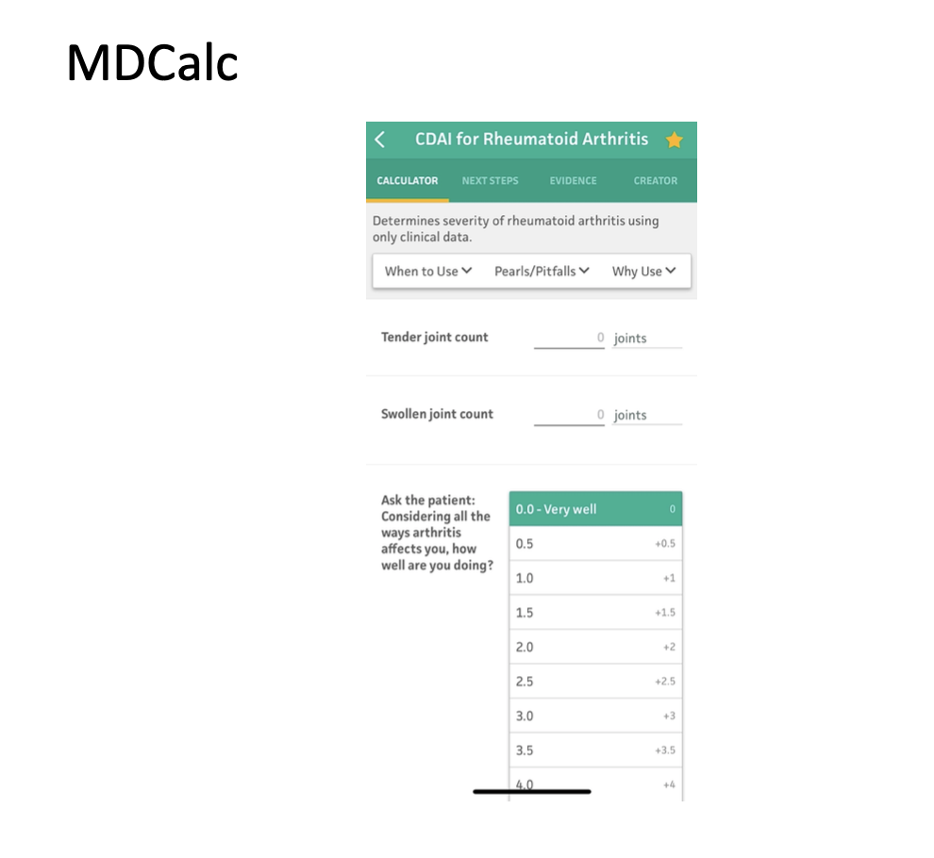
RAE Initiative| Spring 2023

Slide 12
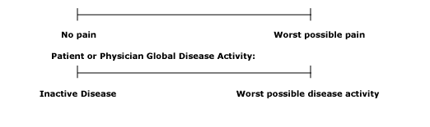
CDAI Components
Patient Global assessment (visual analog scale 0-100 mm)
Provider Global Assessment (visual analog scale 0-100 mm)
Tender Joint Count
Swollen Joint Count
Considering all the ways your arthritis affects you, how well you are doing on this scale:
RAE Initiative| Spring 2023

Slide 13
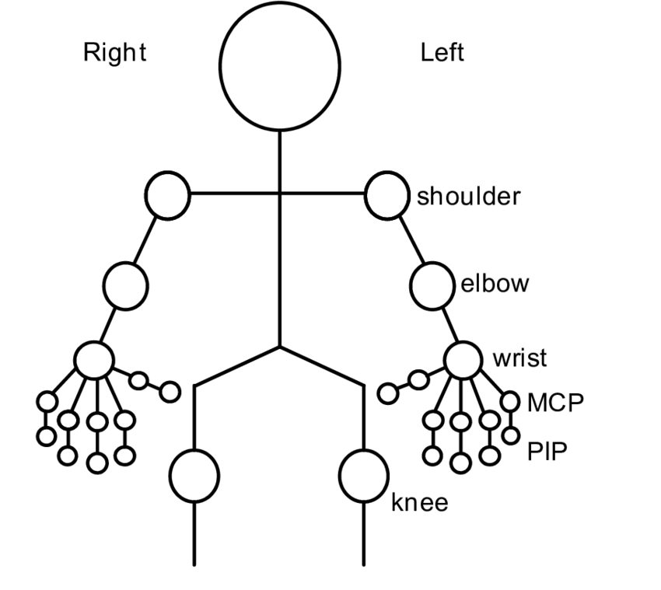
CDAI Components Cont.
Patient Assessment
Provider Assessment
Tender Joint Count
Swollen Joint Count

Slide 14
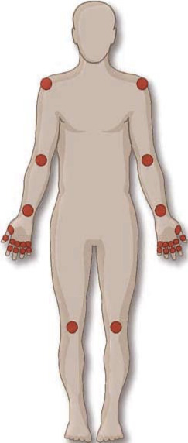
Case 4. 44 yo woman on hydroxychloroquine and methotrexate with RA presents to clinic and reports her pain from arthritis is 6/10. Exam reveals 2 swollen & tender wrists, 3 swollen & tender PIPs, MTPs tender to squeeze. You think her arthritis is pretty active 5/10. How active is her RA?
CDAI =
RAE Initiative| Spring 2023
Notes:
Enthesopathy = inflammation at the site where a tendon inserts into a bone, i.e. the insertion point of the Achilles tendon into the calcaneus

Slide 15
Case 4. 44 yo woman on hydroxychloroquine and methotrexate with RA presents to clinic and reports her pain from arthritis is 6/10. Exam reveals 2 swollen & tender wrists, 3 swollen & tender PIPs, MTPs tender to squeeze. You think her arthritis is pretty active 5/10. How active is her RA?
CDAI = 21 (moderate/high borderline)
RAE Initiative| Spring 2023
Notes:
Enthesopathy = inflammation at the site where a tendon inserts into a bone, i.e. the insertion point of the Achilles tendon into the calcaneus

Slide 16
Case 4 con’t. You add Humira 40 mg Q 2 weeks to her regimen and she returns 6 weeks later reporting 50% improvement and has 1 swollen and tender wrist and 2 tender PIPs on exam. You think she is better and rate her arthritis as 3/10. What is her CDAI?
CDAI =
RAE Initiative| Spring 2023
Notes:
Enthesopathy = inflammation at the site where a tendon inserts into a bone, i.e. the insertion point of the Achilles tendon into the calcaneus

Slide 17
Case 4 con’t. You add Humira 40 mg Q 2 weeks to her regimen and she returns 6 weeks later reporting 50% improvement and has 1 swollen and tender wrist and 2 tender PIPs on exam. You think she is better and rate her arthritis as 3/10. What is her CDAI?
CDAI = 10 (moderate/low borderline)
Patient VAS = 3
Provider VAS = 3
Swollen Joint = 1
Tender Joint = 3
RAE Initiative| Spring 2023
Notes:
Enthesopathy = inflammation at the site where a tendon inserts into a bone, i.e. the insertion point of the Achilles tendon into the calcaneus

Slide 18

CME Credit Link:
RAE Initiative| Spring 2023
Notes:
https://ucsf.co1.qualtrics.com/jfe/form/SV_4TI2IekZ54FJBC6

