Slide 1
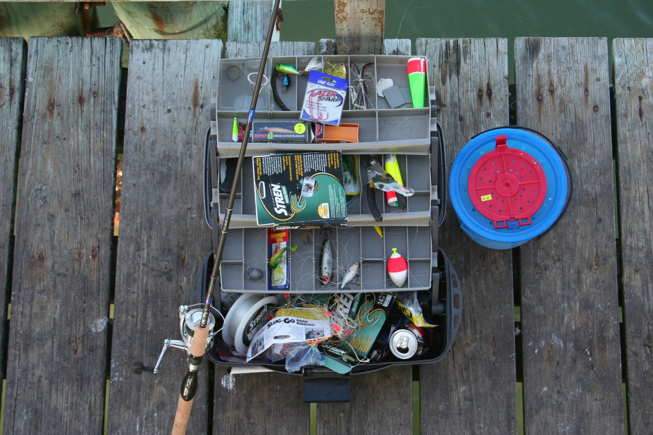
The bottom
of the box
Drugs you
rarely
use
Clint Kalan
PA-C

Slide 2

Drugs you
rarely
use
Clint Kalan
PA-C
Notes:
Why this random talk

Slide 3

Drugs you
rarely
use
Clint Kalan
PA-C
Notes:
Because all of these emergencies still happen here.
Not only that, but your treatment lasts longer, and so some of the medications that are simply “push” medications in the urban setting require also a “drip”

Slide 4
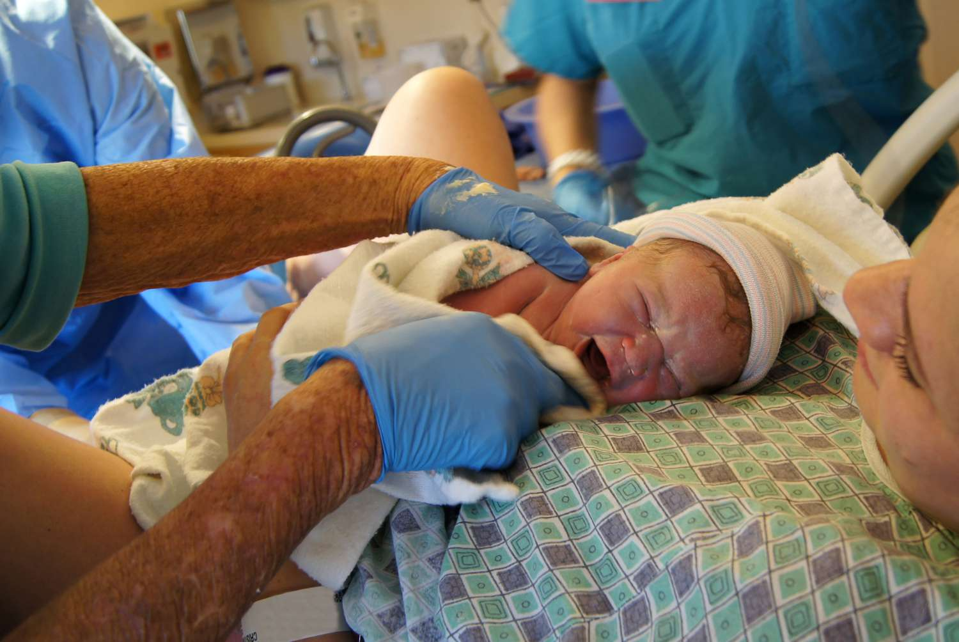
Drugs you
rarely
use
Clint Kalan
PA-C
Notes:
And there are certain medications you are just more likely to give than your urban colleagues. I know far more rural EMS providers to have attended to a field delivery than urban providers

Slide 5
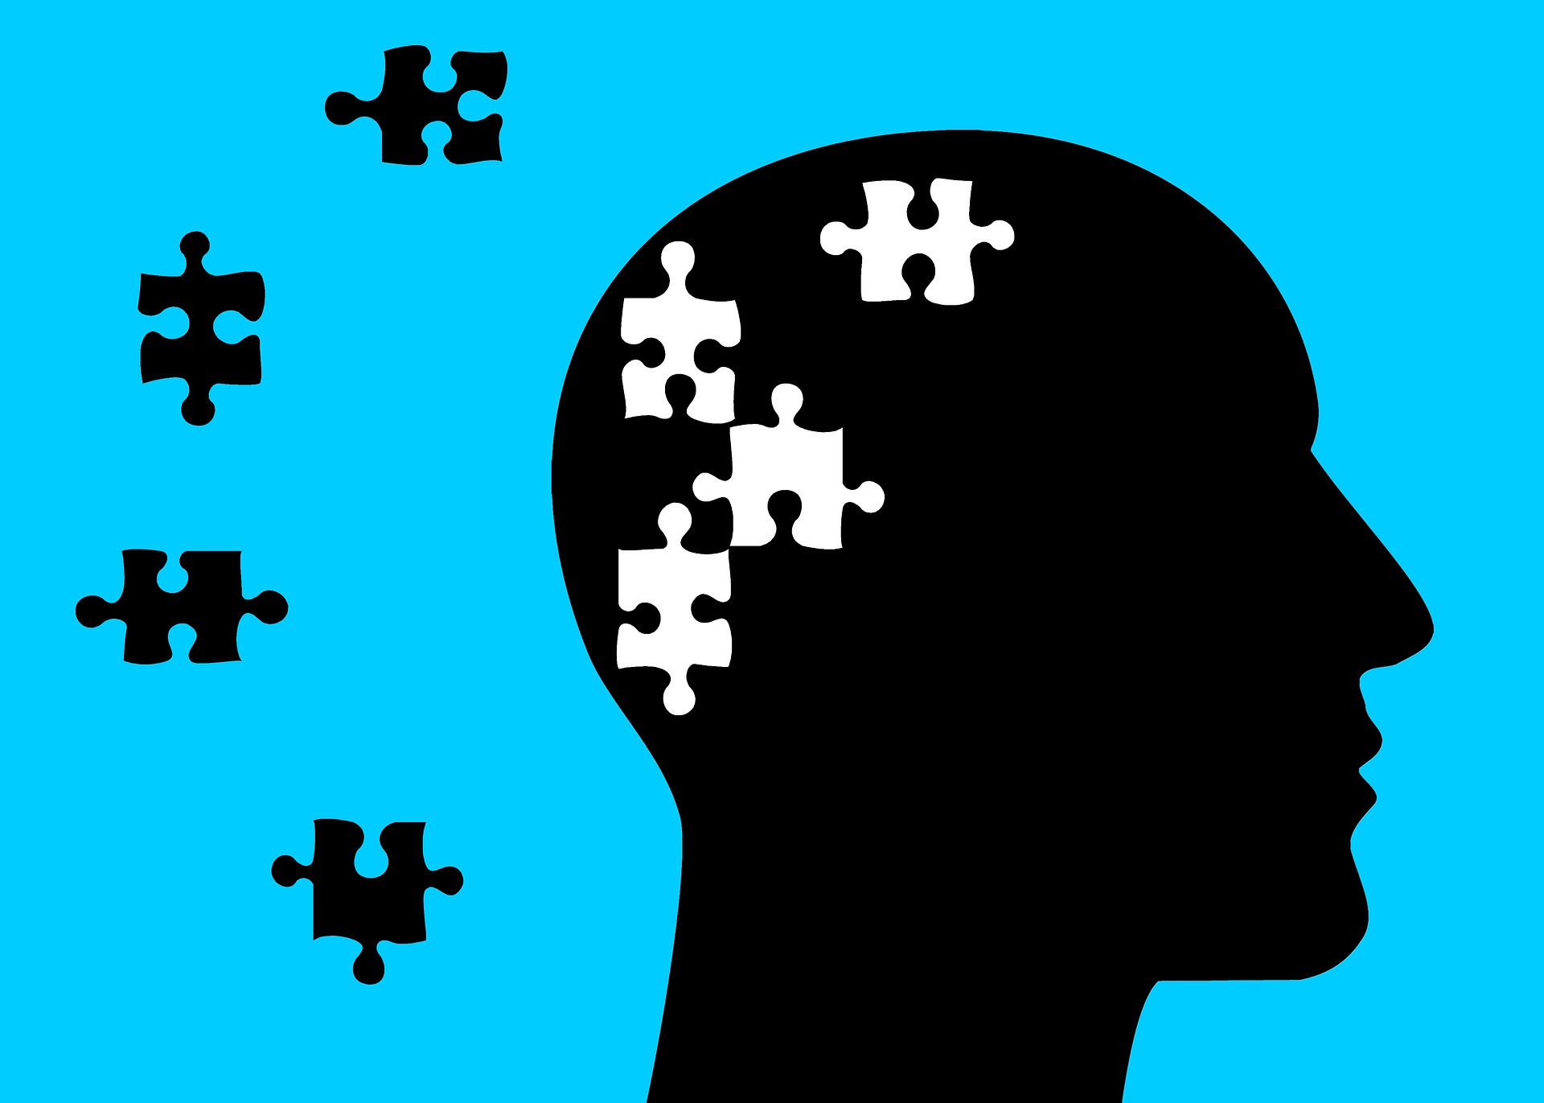
You will forget
Things you don’t
Do often
PA-C
Notes:
But there are certain medication we all don’t do often enough to really remember well

Slide 6
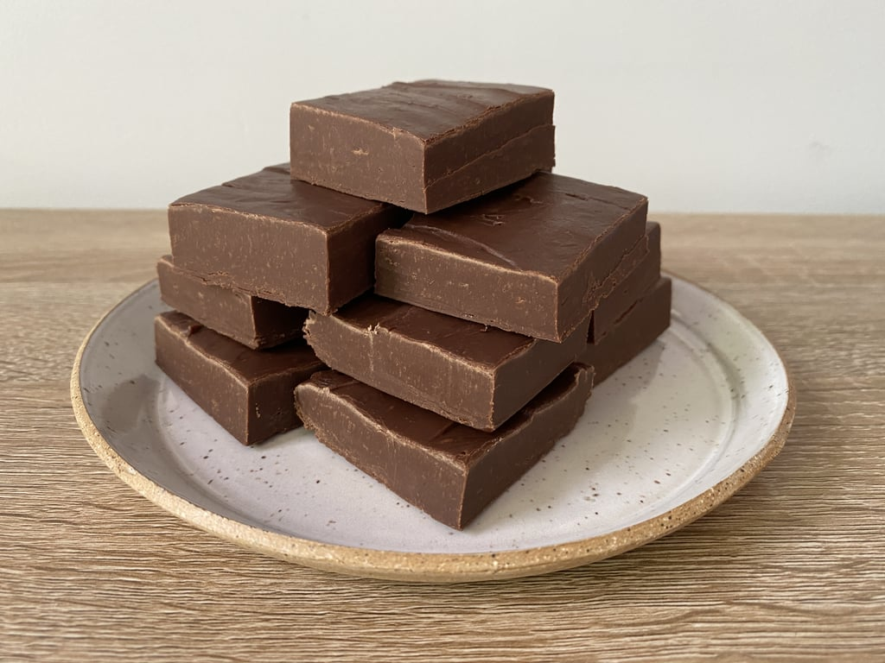

Notes:
#1) Don’t fudge it: A lot of the medications we use infrequently have some significant side effects if we don’t give them right, but also:
#2) Don’t feel like you have to do it from your head, and keep it all up there

Slide 7
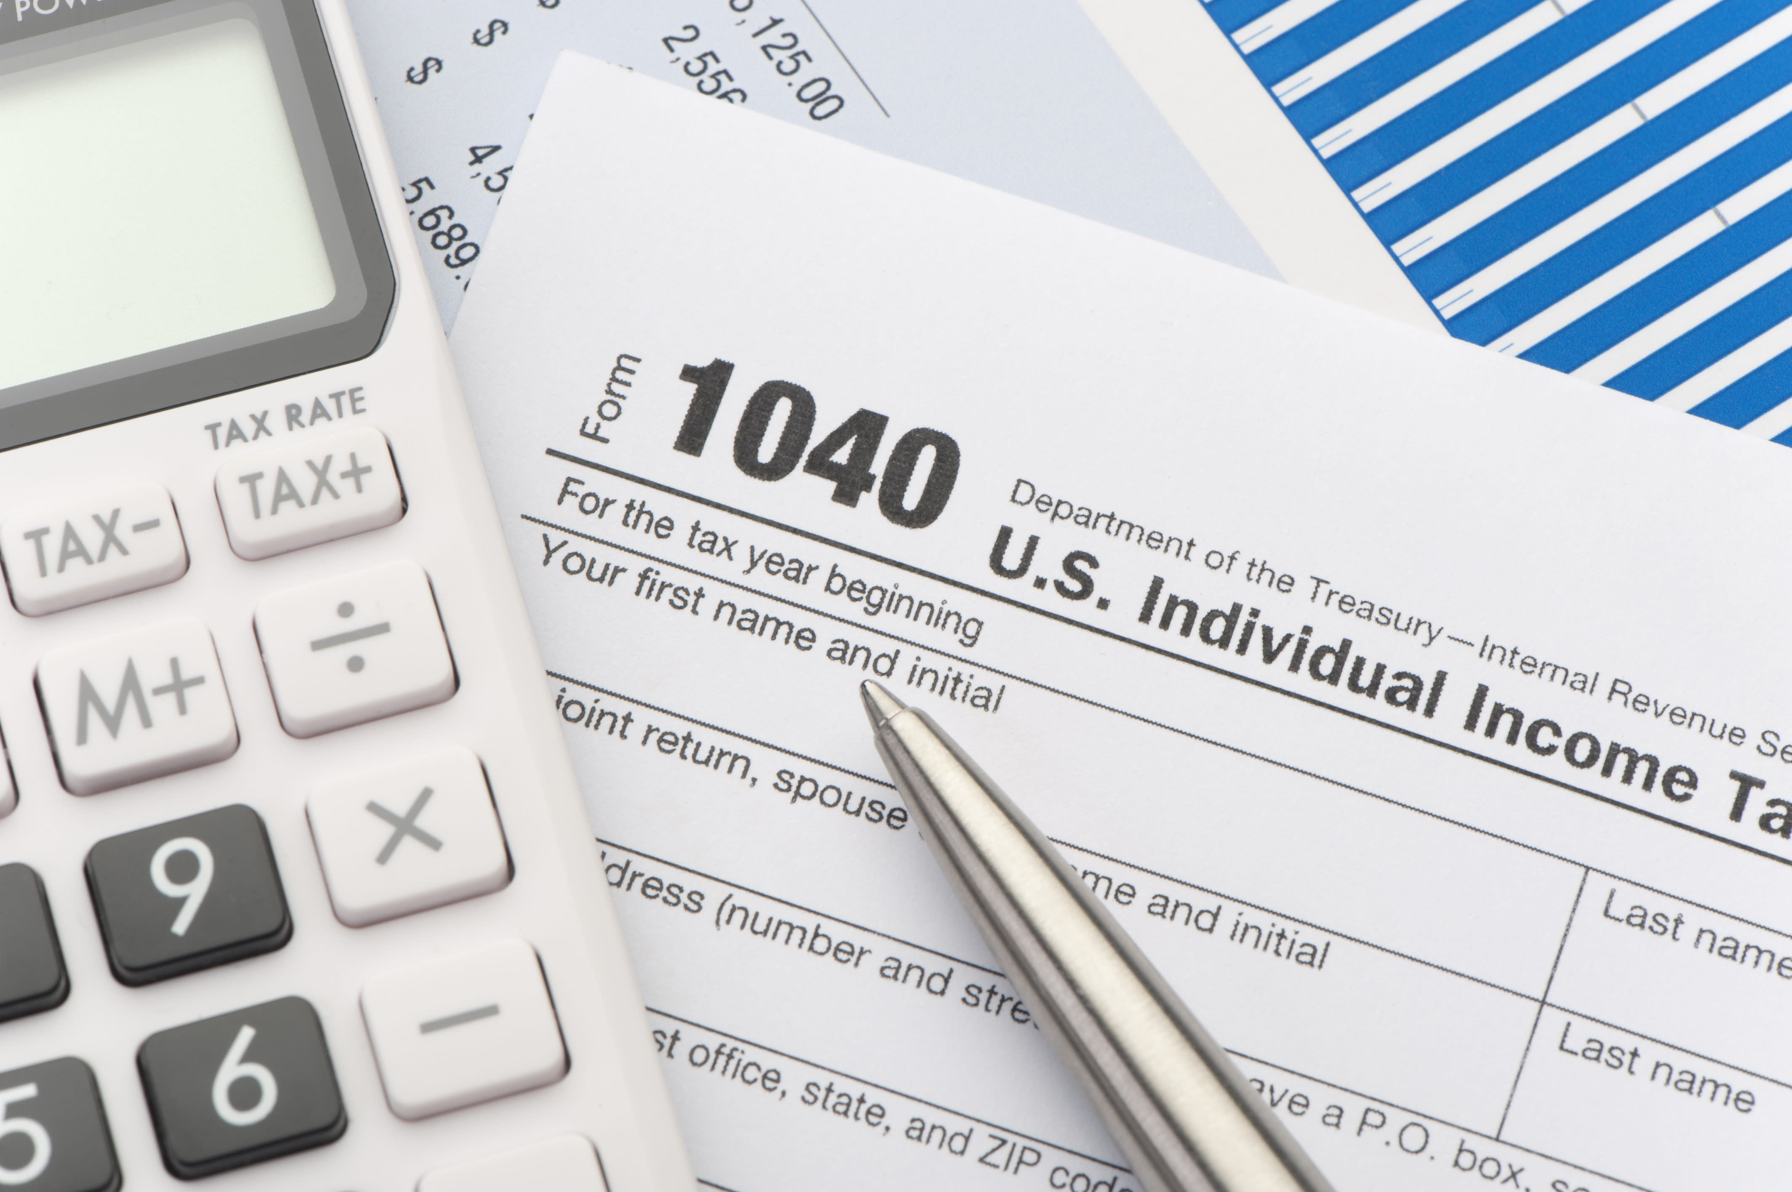
Notes:
If you told someone you were going to do your taxes without a calculator, because someone once told you to had to be able to check your work
Malcolm Gladwell: 10k hours.
It’s hard to accept that NO ONE will be an expert at delivering these medications expertly in the field, and having that humility is paramount

Slide 8
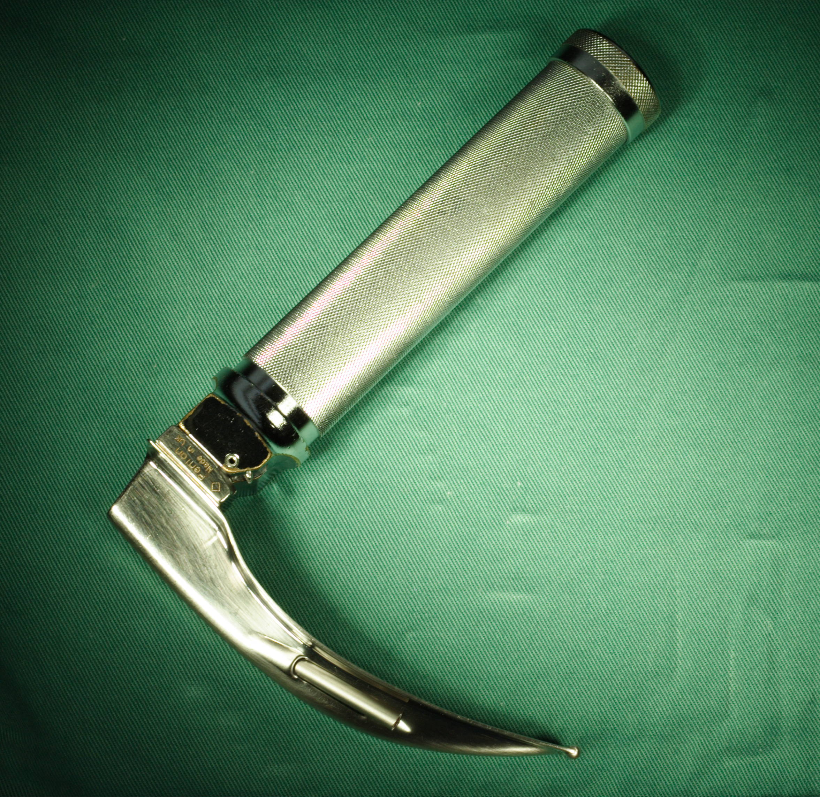
50-75
tubes
Notes:
Generally, the most applicable dataset is for intubation. To achieve a 90% success rate, average is 50-75 times
Is a 10% failure rate mastery?
Malcolm Gladwell: 10k hours.
It’s hard to accept that NO ONE will be an expert at delivering these medications expertly in the field, and having that humility is paramount

Slide 9
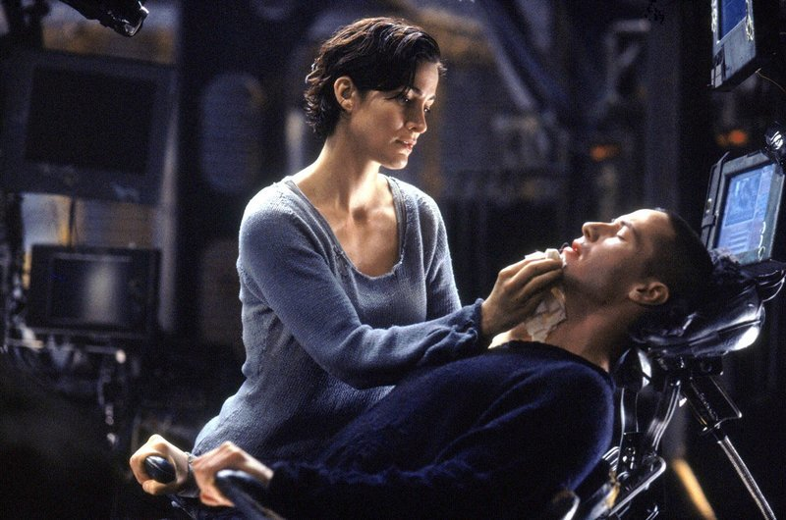

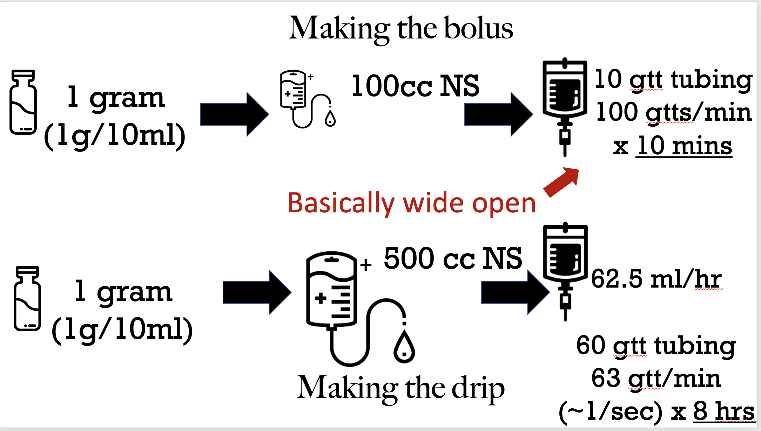
Notes:
So don’t freak out, because there are some ways to maximize your success, and this is the key to surviving in a rural practice environment, with low volume and high acuity:
-Practice in your mind
-Significant data behind folks who visualize success and practice
-Run calls with your partner
-Put sheets up in the bathroom
-Place just in time cognitive aids
Is a 10% failure rate mastery?
Malcolm Gladwell: 10k hours.
It’s hard to accept that NO ONE will be an expert at delivering these medications expertly in the field, and having that humility is paramount

Slide 10
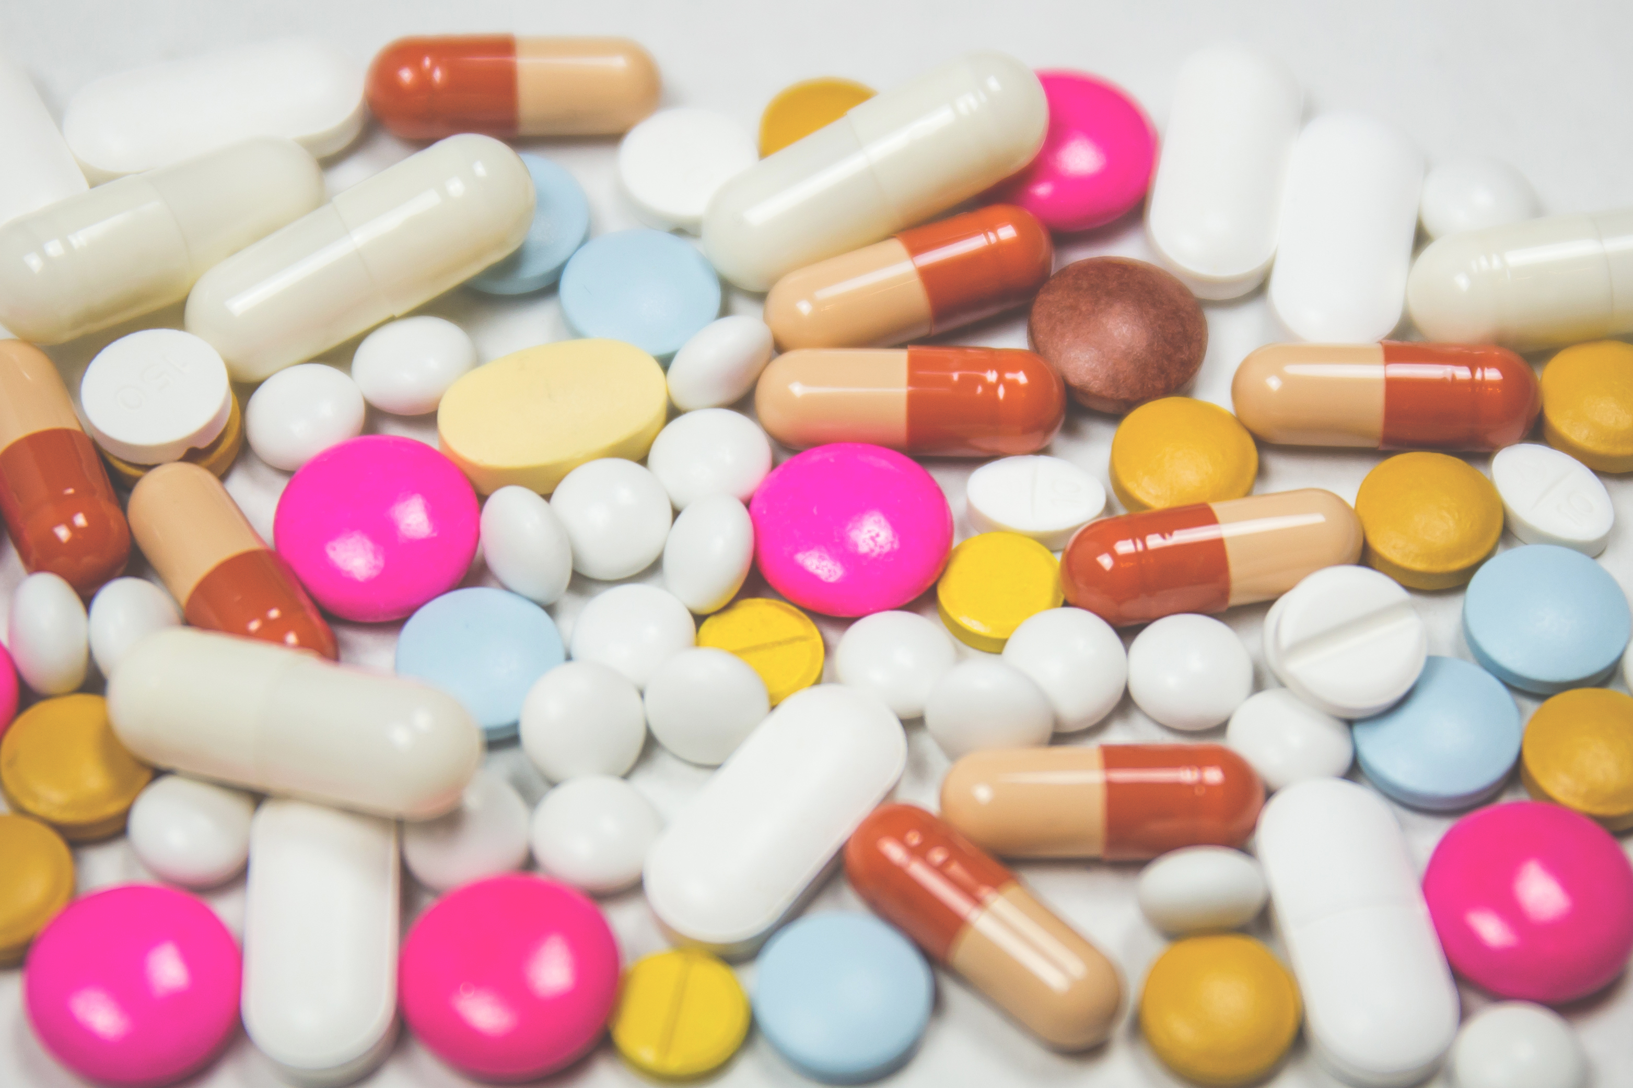
2.2 (lb/kg)
10 or 15
(mg/kg)
No IBU <6mo
Kids Ibuprofen and Kids
Acetaminophen
Notes:
First practice is one of the hardest: Kids Tylenol and Ibuprofen
Two things to remember: 2.2 Kg/lb and 10/15

Slide 11
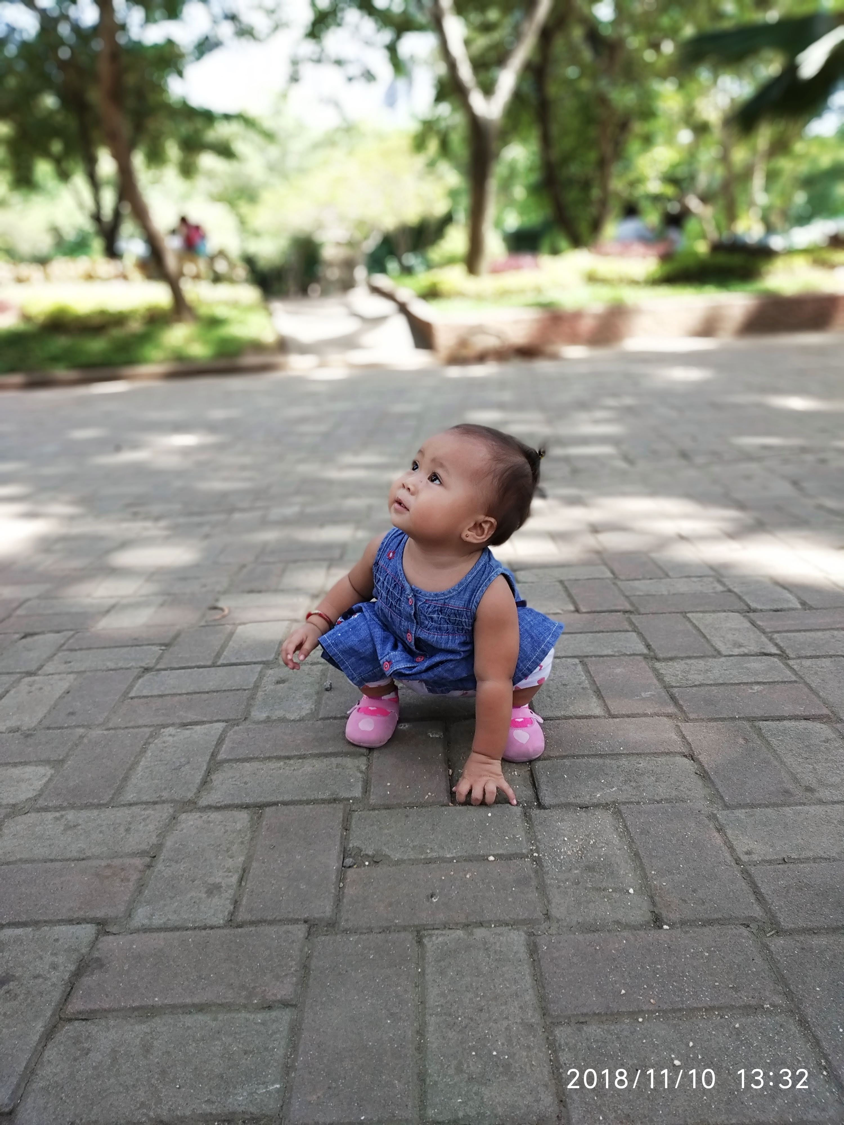
How much of each for this 13 month old?
Notes:
First practice is one of the hardest: Kids Tylenol and Ibuprofen
Two things to remember: 2.2 Kg/lb and 10/15

Slide 12
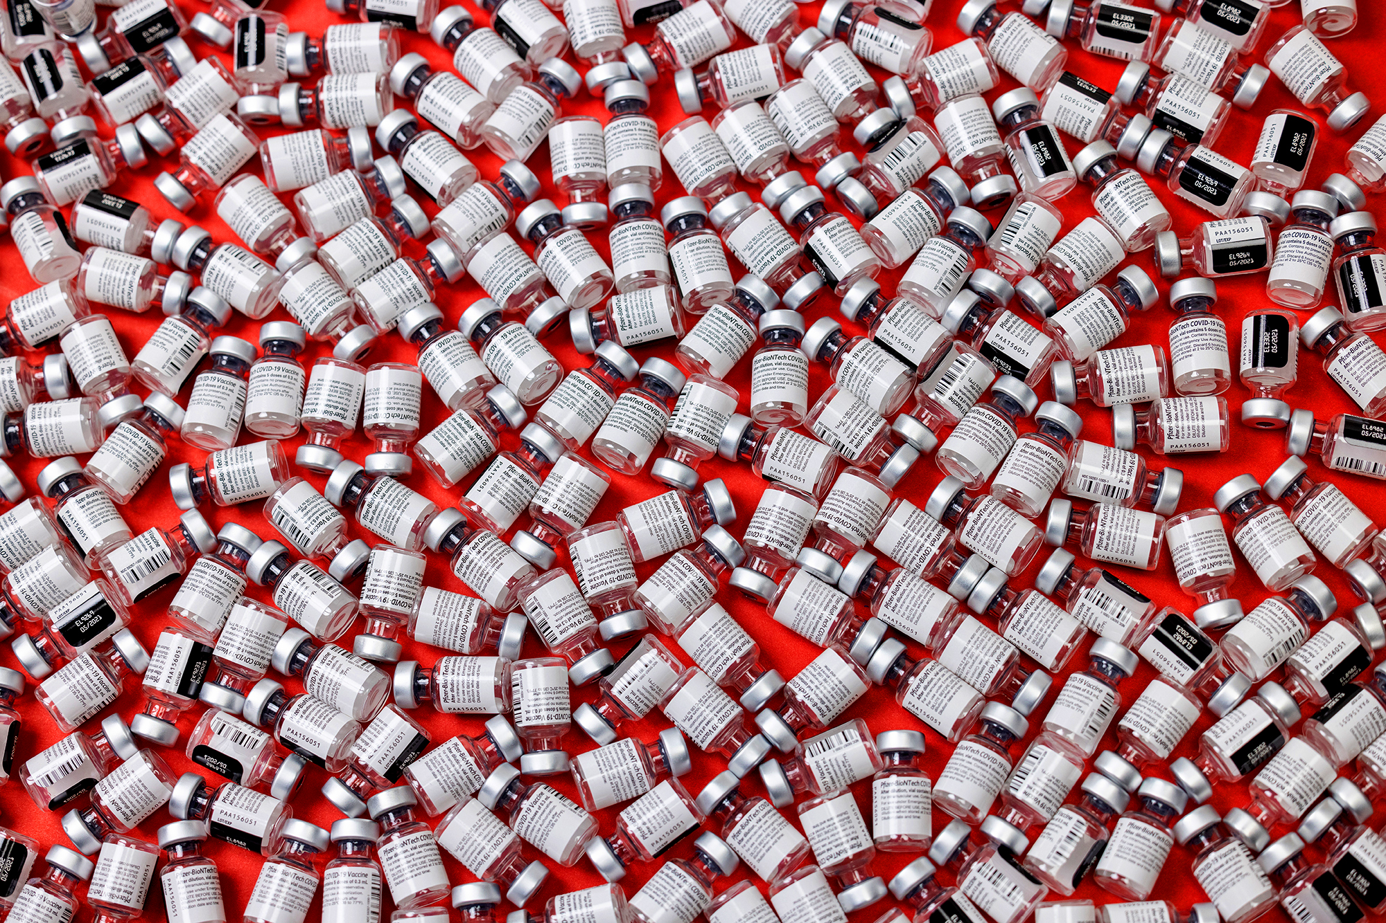
Dummy check
Notes:
If you are giving more than one vial, or lots of vials, or under a cc of fluid (in some circumstances), question if it’s the right dose. Still might be, but a good cognitive stop
Two things to remember: 2.2 Kg/lb and 10/15

Slide 13
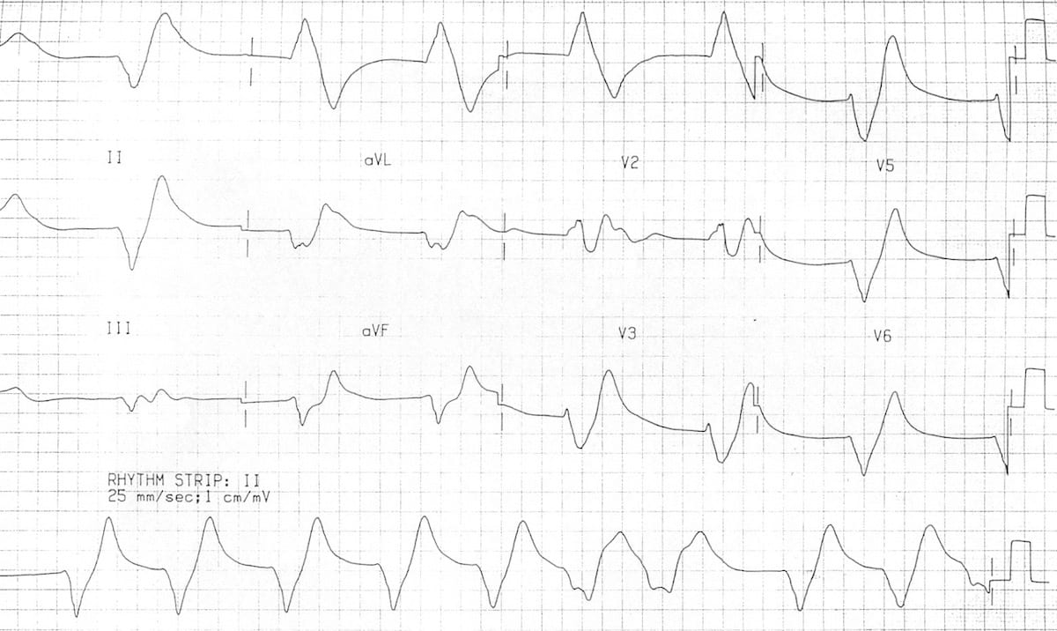
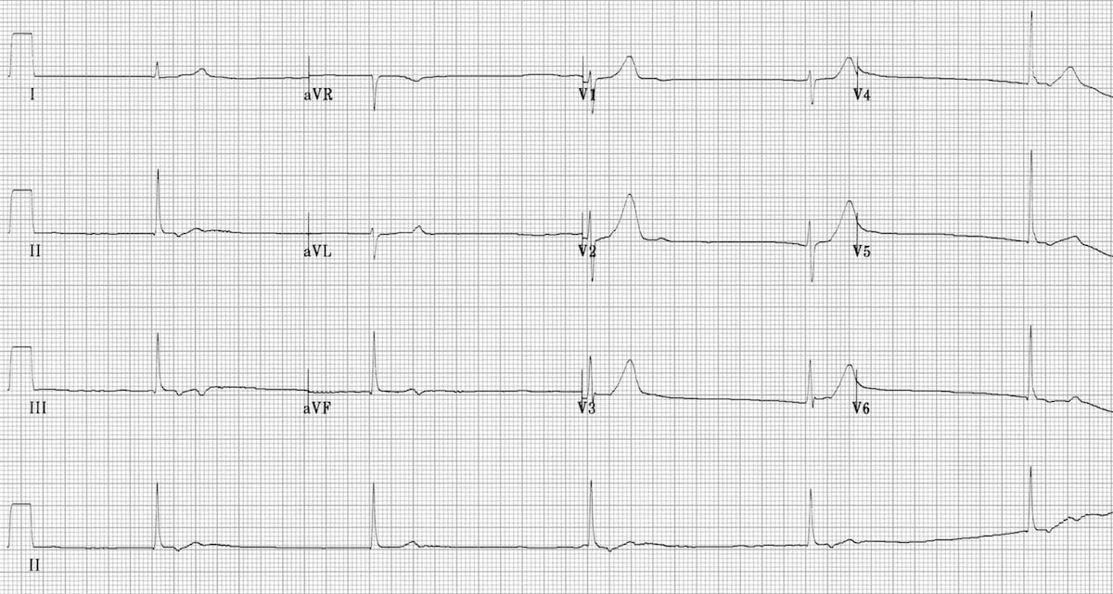
Calcium
Indication?
Notes:
First practice is one of the hardest: Kids Tylenol and Ibuprofen
Two things to remember: 2.2 Kg/lb and 10/15

Slide 14
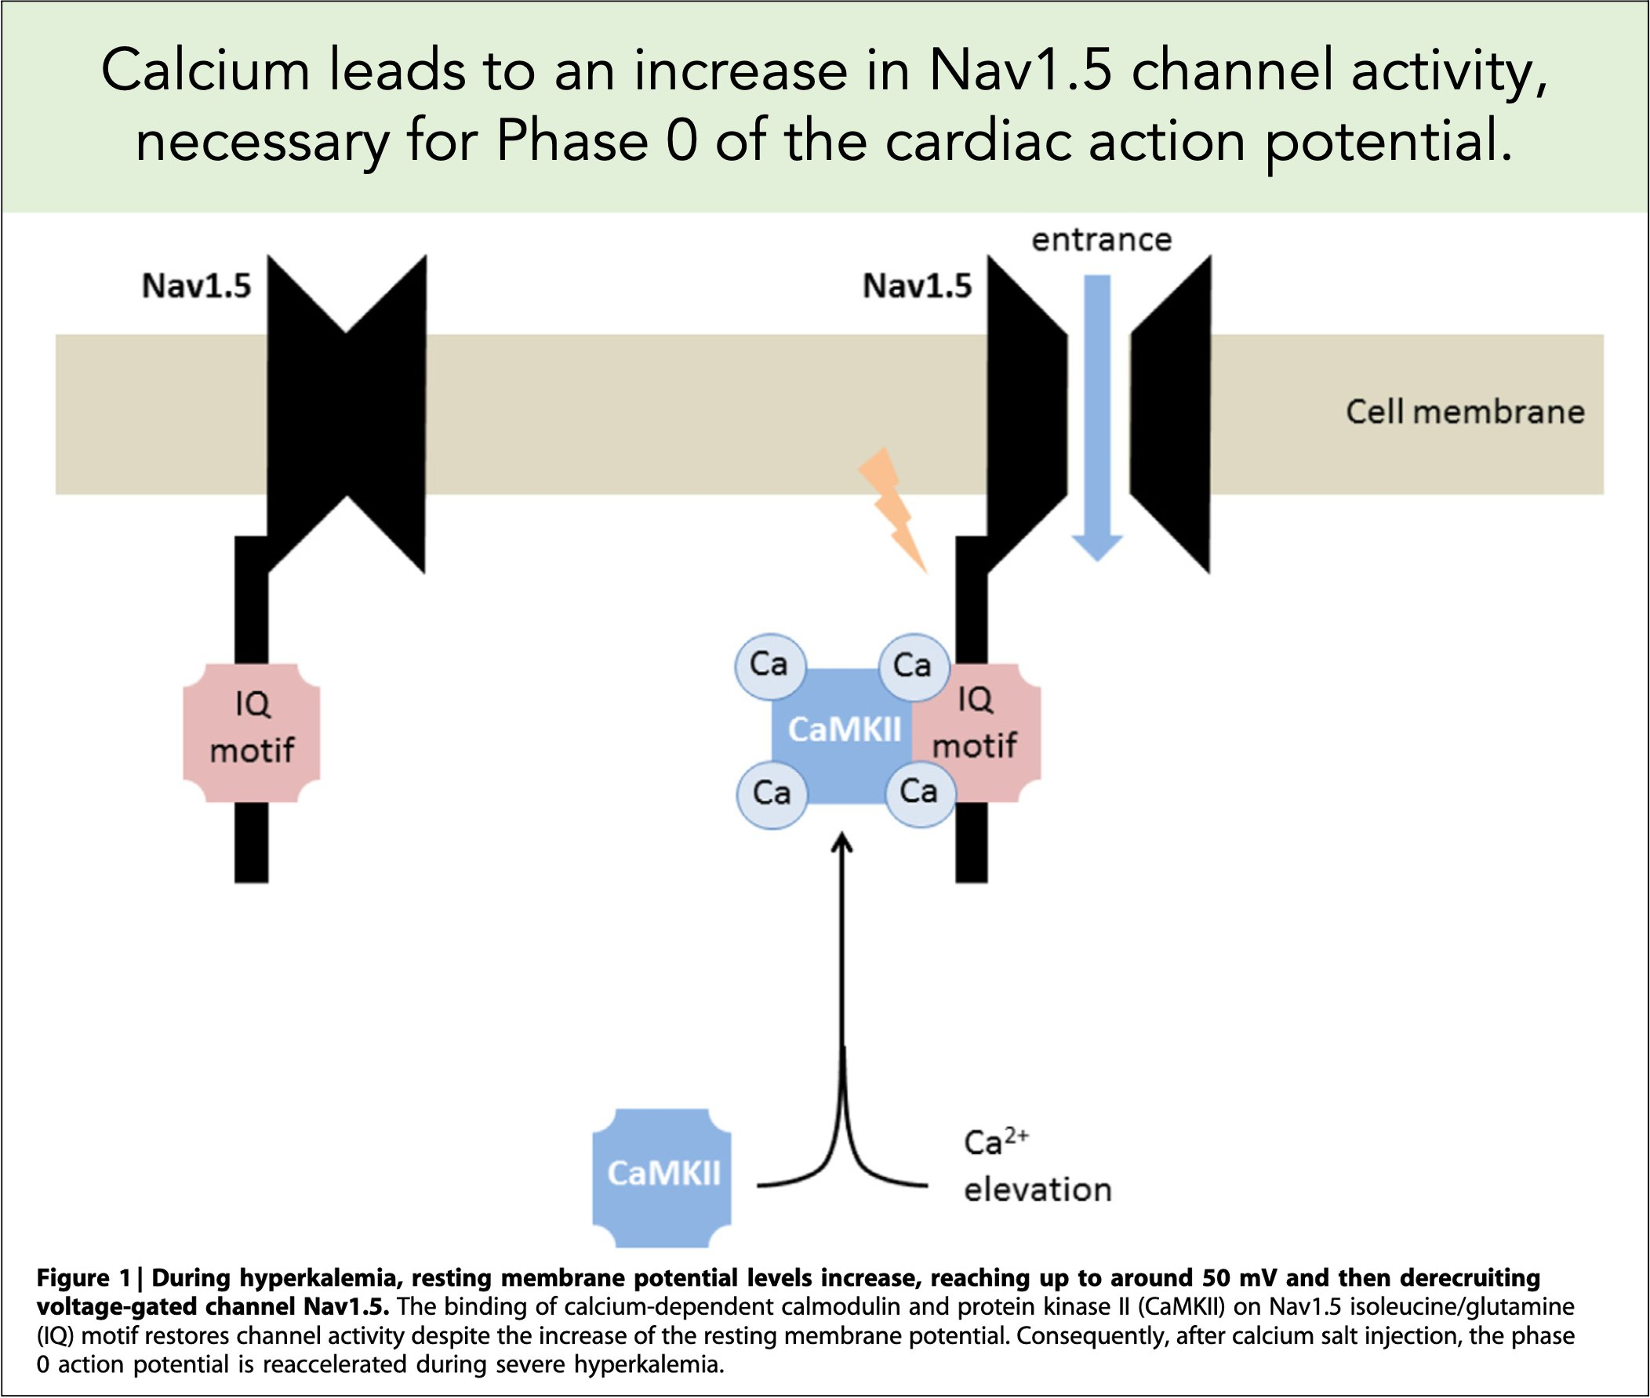
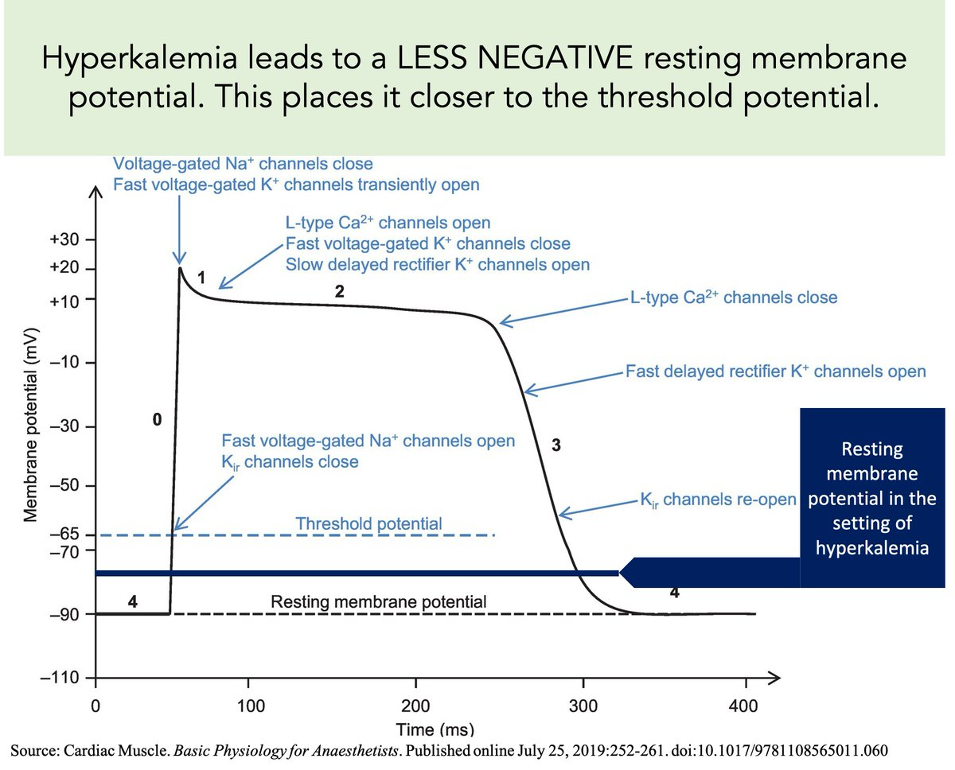
Calcium
Mechanism?
pubmed.ncbi.nlm.nih.gov/27418095/
Notes:
First practice is one of the hardest: Kids Tylenol and Ibuprofen
Two things to remember: 2.2 Kg/lb and 10/15

Slide 15
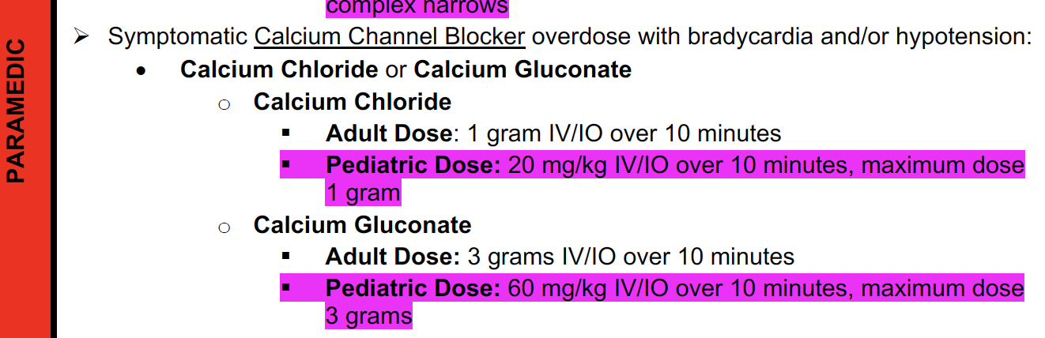
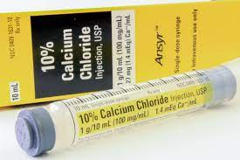
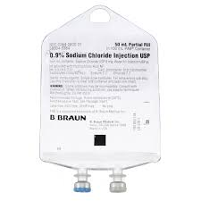
Calcium
How?
?
Notes:
First practice is one of the hardest: Kids Tylenol and Ibuprofen
Two things to remember: 2.2 Kg/lb and 10/15

Slide 16
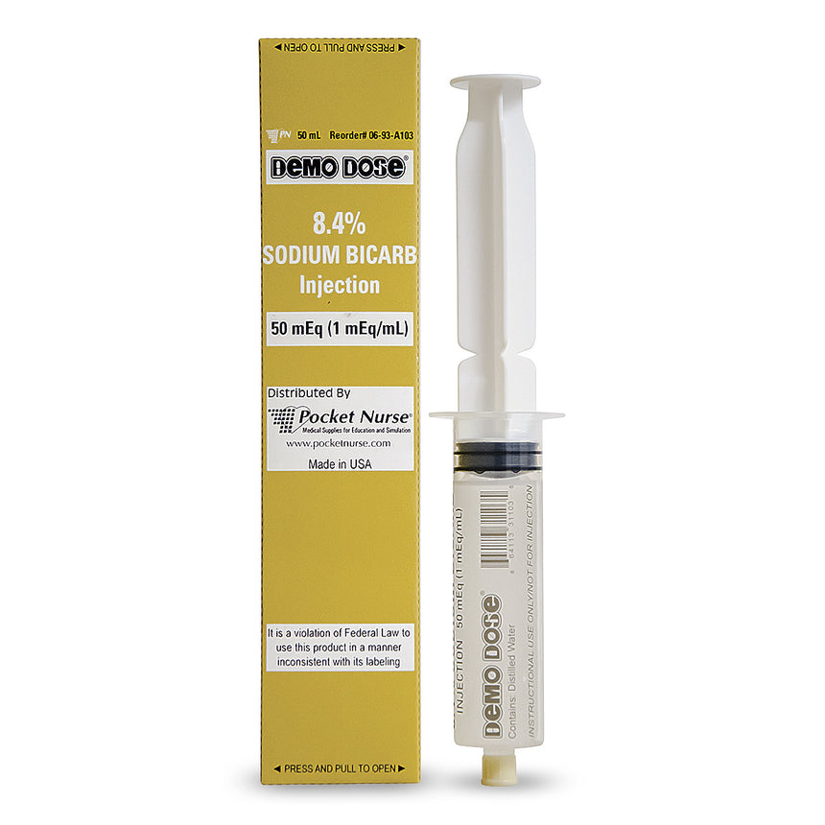
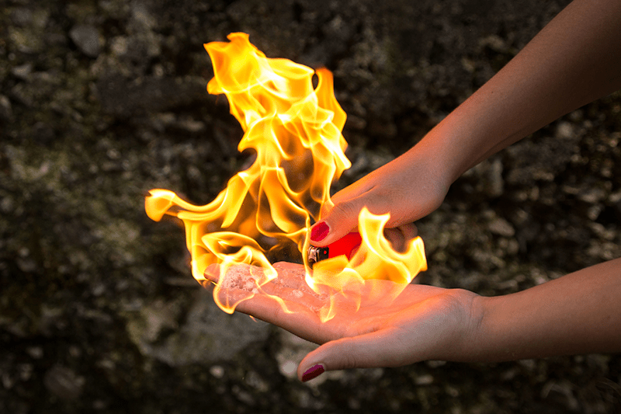
Calcium
Cautions
Notes:
First practice is one of the hardest: Kids Tylenol and Ibuprofen
Two things to remember: 2.2 Kg/lb and 10/15

Slide 17
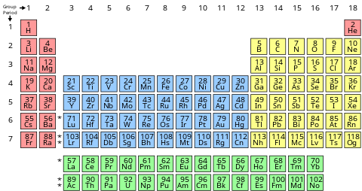
Magnesium
Same column, chemically similar
Notes:
First practice is one of the hardest: Kids Tylenol and Ibuprofen
Two things to remember: 2.2 Kg/lb and 10/15

Slide 18
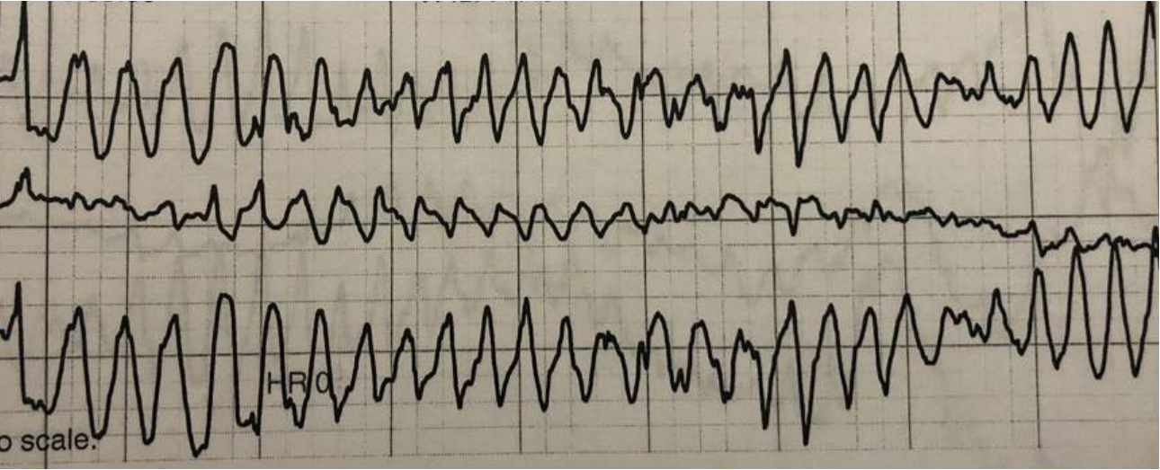
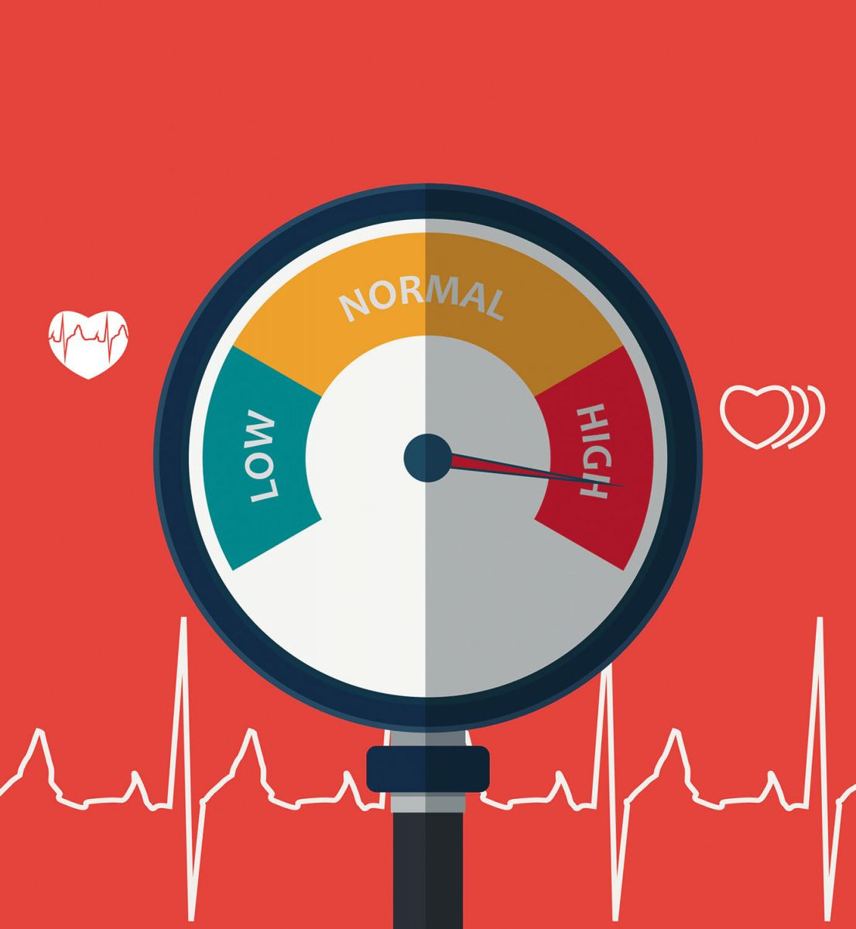
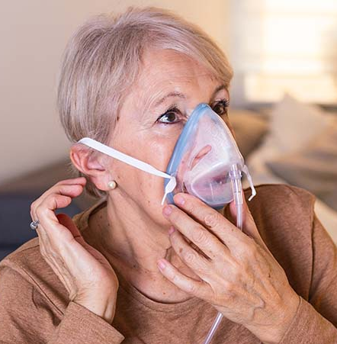
Magnesium
Indication?
Notes:
First practice is one of the hardest: Kids Tylenol and Ibuprofen
Two things to remember: 2.2 Kg/lb and 10/15

Slide 19
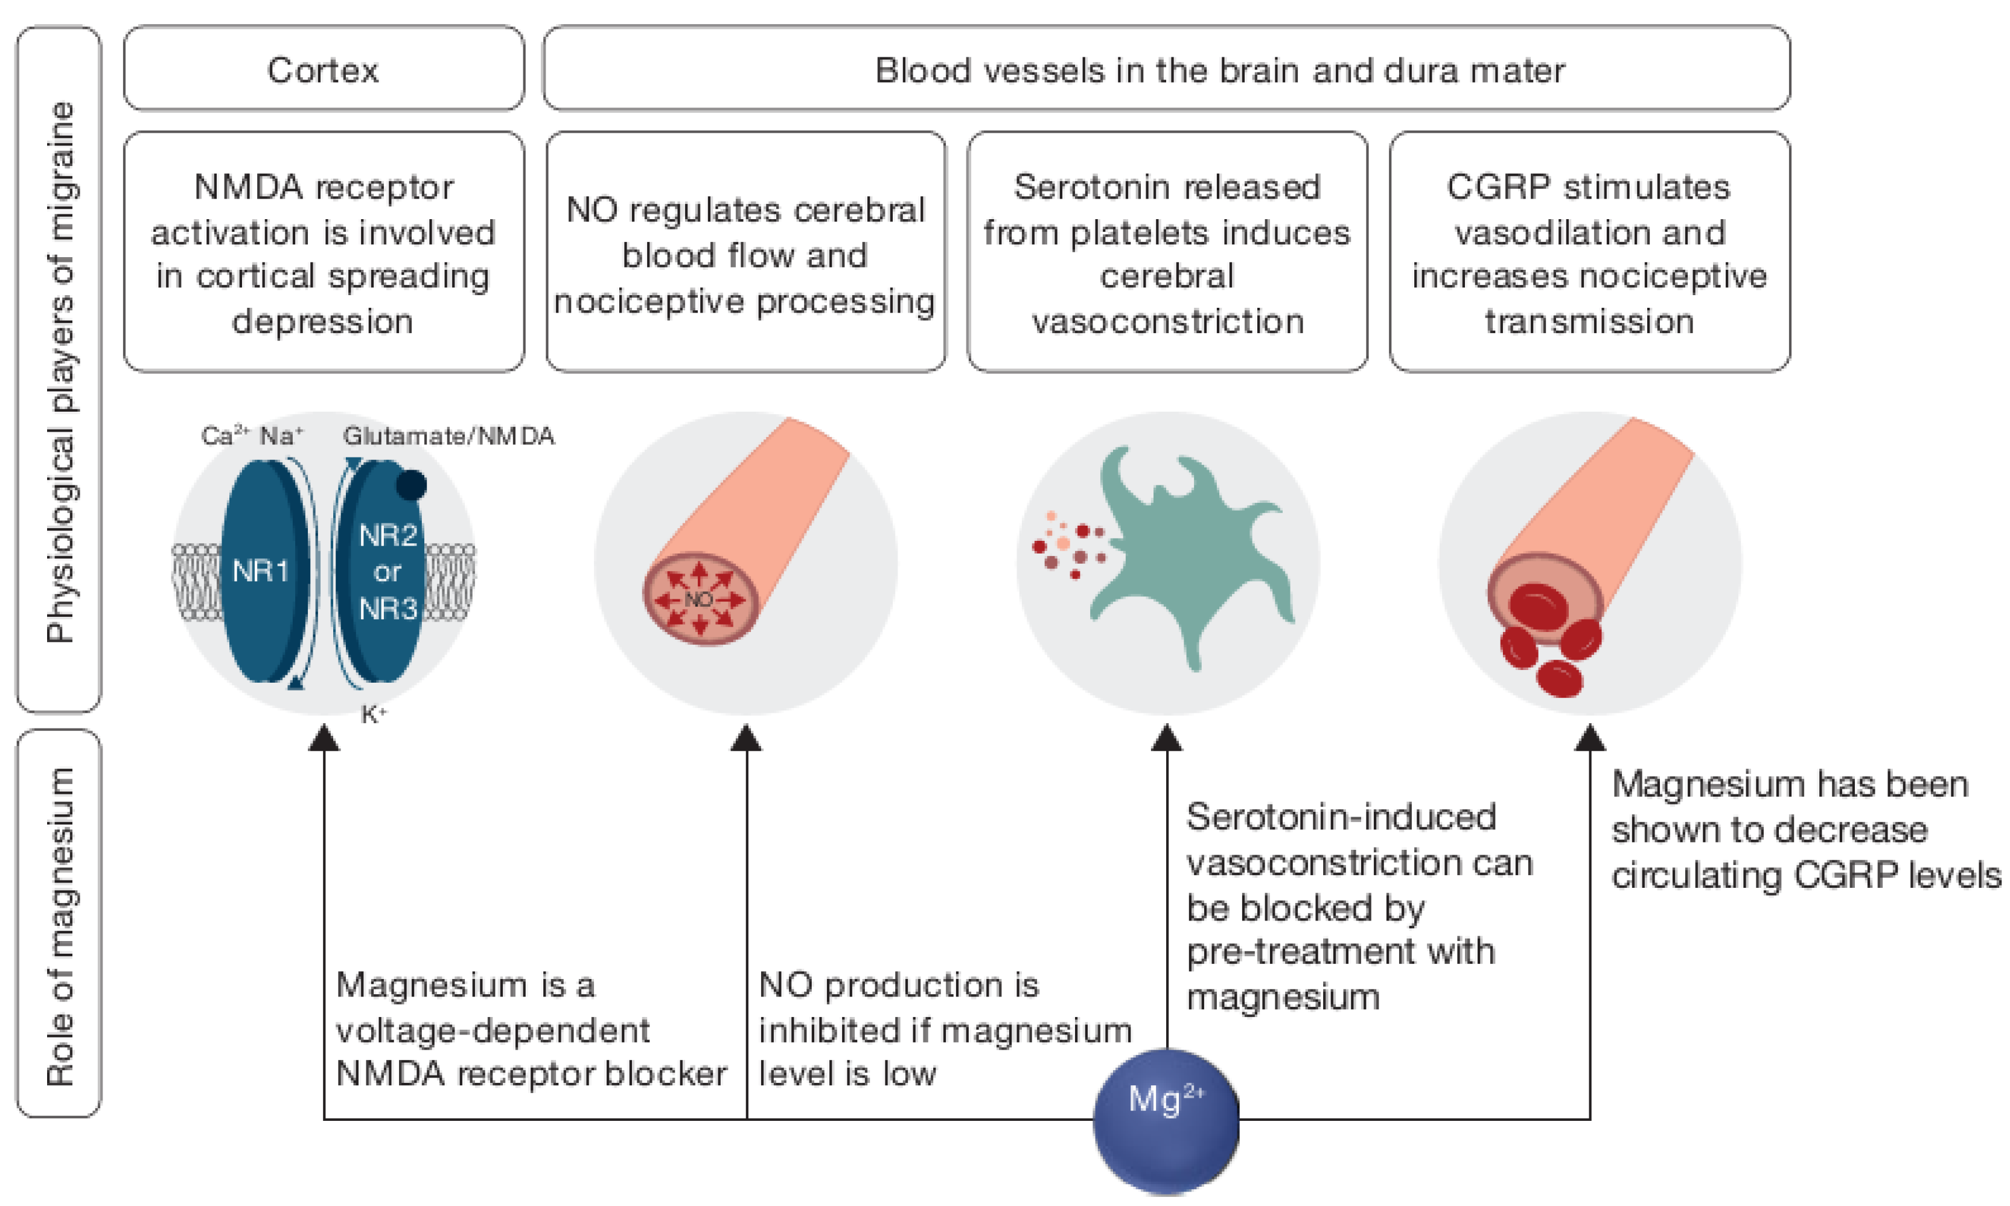
Magnesium
Mechanism?
https://doi.org/10.3390/nu12092660
Notes:
First practice is one of the hardest: Kids Tylenol and Ibuprofen
Two things to remember: 2.2 Kg/lb and 10/15

Slide 20
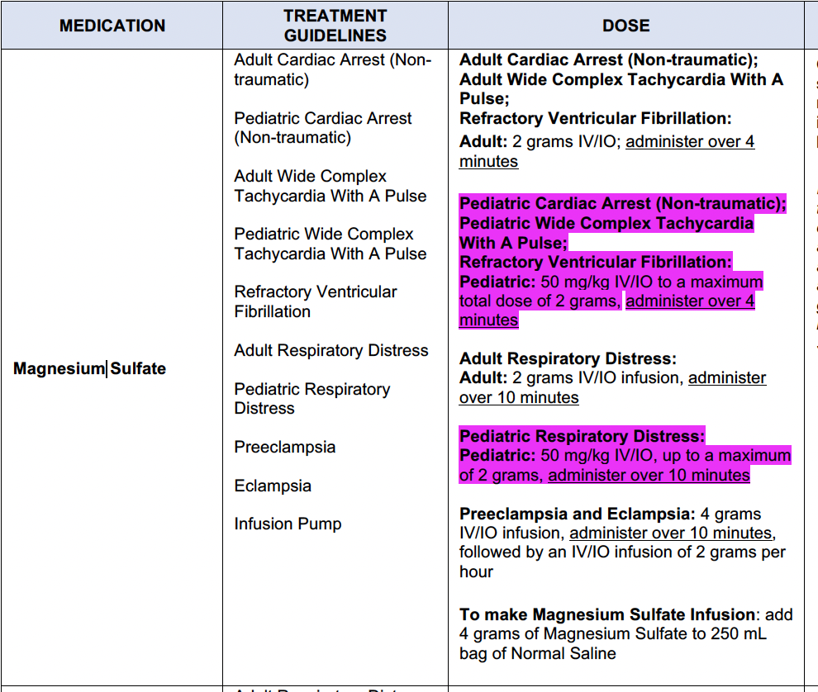
Magnesium
How?
Notes:
First practice is one of the hardest: Kids Tylenol and Ibuprofen
Two things to remember: 2.2 Kg/lb and 10/15

Slide 21
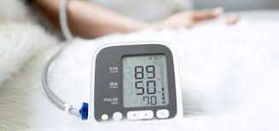
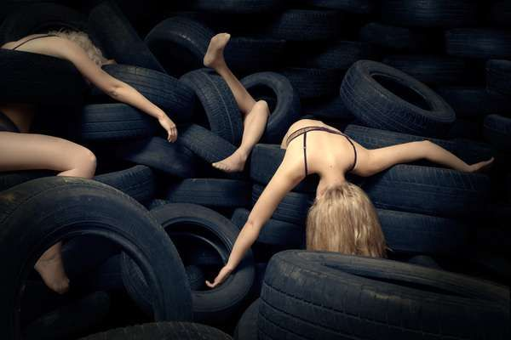
Magnesium
Cautions
Notes:
Hypotension, flaccid paralysis loss of reflexes

Slide 22

BUT WAIT, HOW DO I GIVE 2 G OVER AN HOUR?
Notes:
Hypotension, flaccid paralysis loss of reflexes

Slide 23
UNIVERSAL TRUTHS
“GTT” IS DROPS PER CC
60 = 60 GTT PER CC
15=15 GTT PER CC
Notes:
Hypotension, flaccid paralysis loss of reflexes

Slide 24
UNIVERSAL TRUTHS
Volume X Gtt set conv
= gtts/min
Time in mins
500cc X 60 gtt/cc
= 500
gtts/min
60 mins
Notes:
Hypotension, flaccid paralysis loss of reflexes

Slide 25
UNIVERSAL TRUTHS
500 gtts/min
= 8.33 gtt/sec!
60 sec/min
100 gtts/min
= 1.6 gtt/sec
60 sec/min
We’ll come back to this
Notes:
Hypotension, flaccid paralysis loss of reflexes

Slide 26
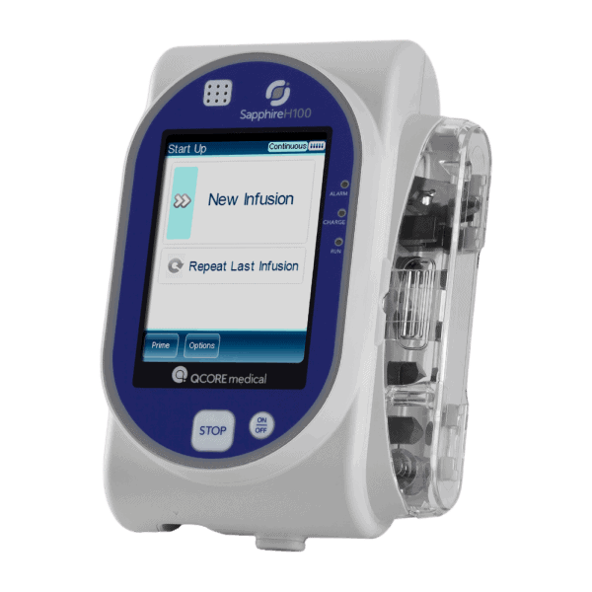
UNIVERSAL TRUTHS
(easy button)
We’ll come back to this
Notes:
Hypotension, flaccid paralysis loss of reflexes

Slide 27
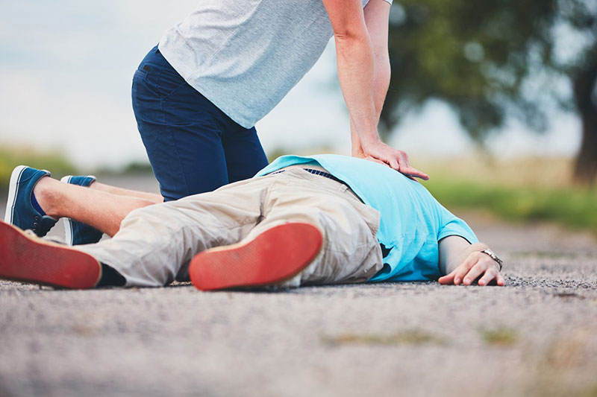
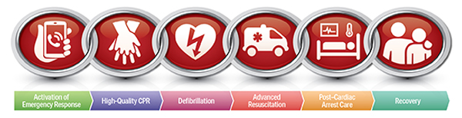
Amiodorone
Indication?
Notes:
First practice is one of the hardest: Kids Tylenol and Ibuprofen
Two things to remember: 2.2 Kg/lb and 10/15

Slide 28
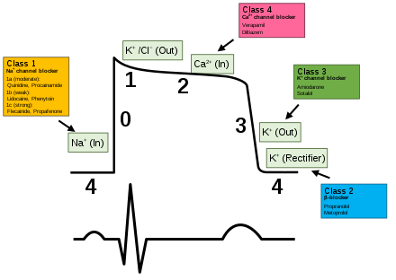
Amiodorone
Mechanism?
Notes:
First practice is one of the hardest: Kids Tylenol and Ibuprofen
Two things to remember: 2.2 Kg/lb and 10/15

Slide 29

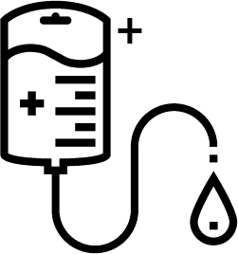
Amiodorone
300mg
250cc NS
How?
1.2mg/cc
Notes:
First practice is one of the hardest: Kids Tylenol and Ibuprofen
Two things to remember: 2.2 Kg/lb and 10/15

Slide 30
UNIVERSAL TRUTHS
Volume X Gtt set conv
= gtts/min
Time in mins
0.83 (~1)cc X 60 gtt/cc
= 50 (~60)
gtt/min
1 mins
Notes:
Hypotension, flaccid paralysis loss of reflexes

Slide 31
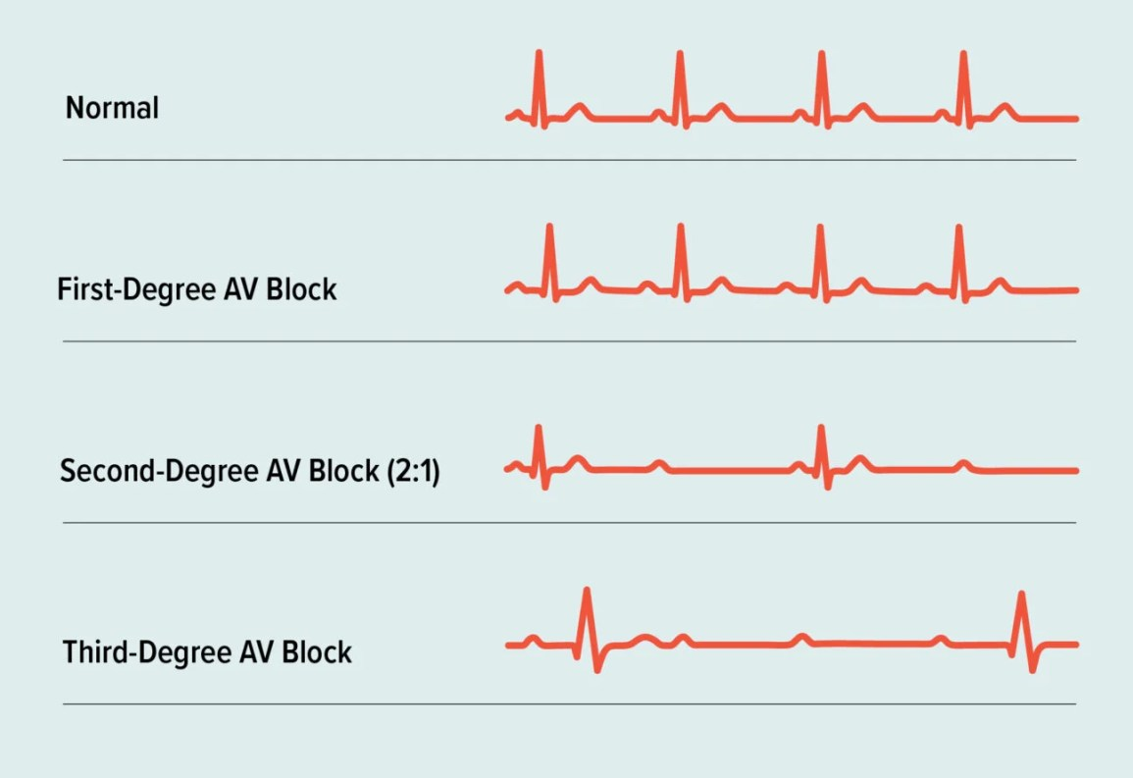
Amiodorone
Cautions?
Notes:
First practice is one of the hardest: Kids Tylenol and Ibuprofen
Two things to remember: 2.2 Kg/lb and 10/15

Slide 32
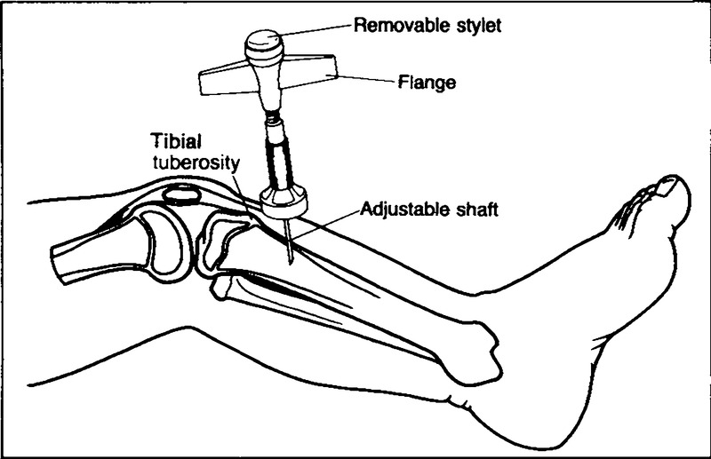
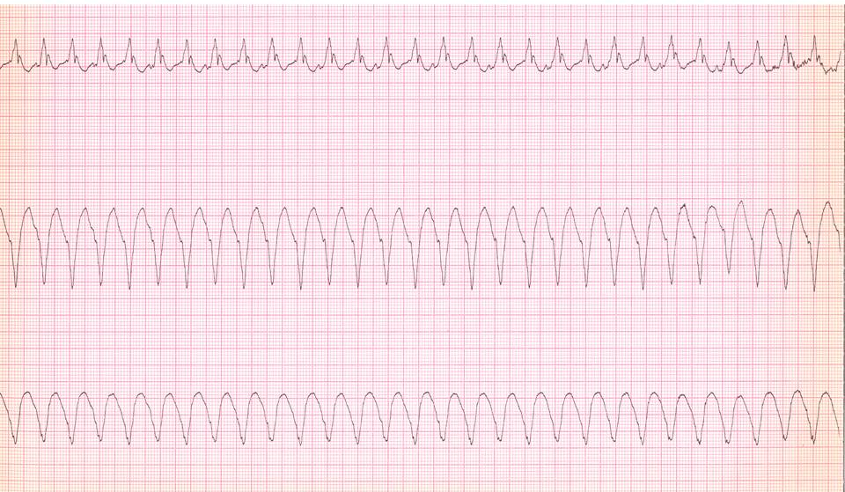
Lidocaine
Indication?
Notes:
First practice is one of the hardest: Kids Tylenol and Ibuprofen
Two things to remember: 2.2 Kg/lb and 10/15

Slide 33
Lidocaine
Mechanism?
Notes:
First practice is one of the hardest: Kids Tylenol and Ibuprofen
Two things to remember: 2.2 Kg/lb and 10/15

Slide 34
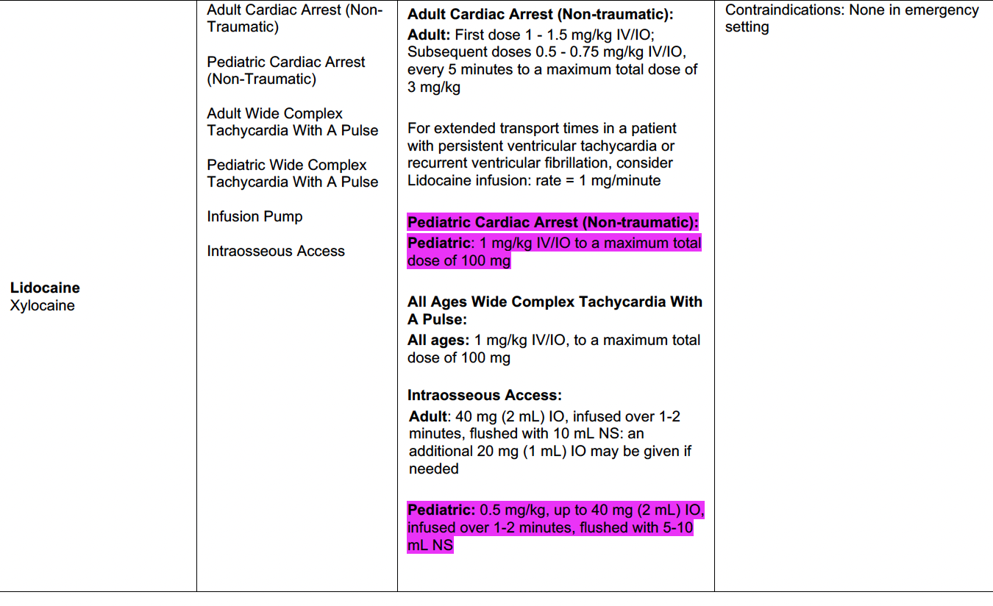
Lidocaine
How?
Notes:
First practice is one of the hardest: Kids Tylenol and Ibuprofen
Two things to remember: 2.2 Kg/lb and 10/15

Slide 35
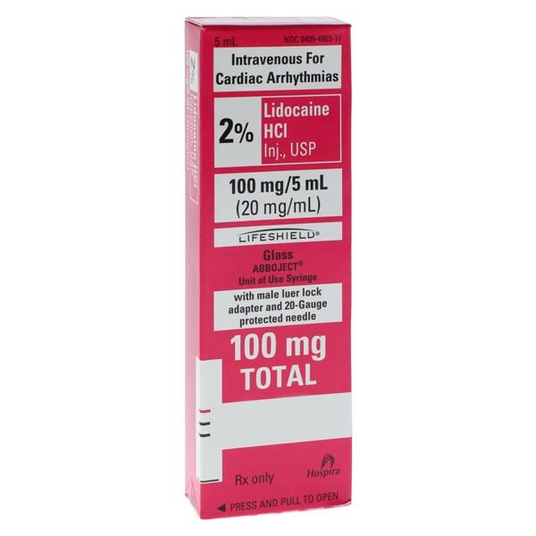
Lidocaine
How?
Notes:
First practice is one of the hardest: Kids Tylenol and Ibuprofen
Two things to remember: 2.2 Kg/lb and 10/15

Slide 36
Lidocaine
100cc NS
(take 5 cc out)
(Drip) How?
100mg/
100 cc
(1mg/cc)
Notes:
First practice is one of the hardest: Kids Tylenol and Ibuprofen
Two things to remember: 2.2 Kg/lb and 10/15

Slide 37
UNIVERSAL TRUTHS
Volume X Gtt set conv
= gtts/min
Time in mins
1mg cc X 60 gtt/cc
= 60
gtt/min
1 mins
Notes:
Hypotension, flaccid paralysis loss of reflexes

Slide 38
UNIVERSAL TRUTHS
In anti-arrythmics, a good rule of thumb is to give a milligram a minute as maintenance dose
Notes:
Hypotension, flaccid paralysis loss of reflexes

Slide 39
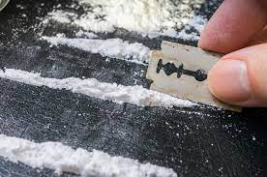
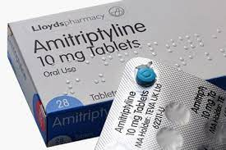
Lidocaine
Cautions?
Notes:
First practice is one of the hardest: Kids Tylenol and Ibuprofen
Two things to remember: 2.2 Kg/lb and 10/15

Slide 40
Epi/Norepi
Indication?
Notes:
First practice is one of the hardest: Kids Tylenol and Ibuprofen
Two things to remember: 2.2 Kg/lb and 10/15

Slide 41
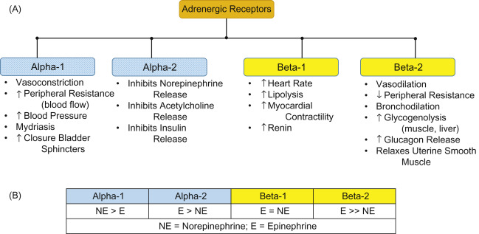
Epi/Norepi
Mechanism?
https://www.ncbi.nlm.nih.gov/books/NBK305894/
Notes:
First practice is one of the hardest: Kids Tylenol and Ibuprofen
Two things to remember: 2.2 Kg/lb and 10/15

Slide 42
Epi/Norepi
Both:
2-10 mcg/min
How?
Weight based:
0.1-1 mcg/kg/min
Notes:
First practice is one of the hardest: Kids Tylenol and Ibuprofen
Two things to remember: 2.2 Kg/lb and 10/15

Slide 43
Epi/Norepi
“Dirty”
1000cc NS
1 mg
How?
1mcg/cc
“Standard”
250cc NS or D5
#4 x
1 mg
16mcg/cc
Notes:
First practice is one of the hardest: Kids Tylenol and Ibuprofen
Two things to remember: 2.2 Kg/lb and 10/15

Slide 44
UNIVERSAL TRUTHS
Volume X Gtt set conv
= gtts/min
Time in mins
1cc (16mcg) X 60 gtt/cc
= 60
gtt/min
1 mins
Notes:
Hypotension, flaccid paralysis loss of reflexes

Slide 45
The clock
16 mcg/min
60 gtt/min
15
gtt/min
45
gtt/min
12 mcg/min
4 mcg/min
30
gtt/min
8 mcg/min
Notes:
Hypotension, flaccid paralysis loss of reflexes

Slide 46
QUESTIONS????
Notes:
First practice is one of the hardest: Kids Tylenol and Ibuprofen
Two things to remember: 2.2 Kg/lb and 10/15

Slide 47
Review
Lots of things to remember
Set yourself up for success by using cognitive aids, placed in the right place, at the right time
No one is above checking a resource and using their partner as a cross check
Good to refresh on each of the medications and make sure you continually remind yourself
Make some “fake drug” with sterile saline and practice the actual mechanics
Notes:
First practice is one of the hardest: Kids Tylenol and Ibuprofen
Two things to remember: 2.2 Kg/lb and 10/15

