Slide 1


Welcome!
Initial Therapy:
Glucocorticoids and NSAIDs
Wendy Grant, MD
March 2, 2023
RAE Initiative| Spring 2023

Slide 2
DISCLOSURES
AMA Designation Statement
The University of California, San Francisco School of Medicine (UCSF) is accredited by the Accreditation Council of Continuing Medical Education (ACCME) to provide continuing medical education for physicians. UCSF designates this live activity for a maximum of 1 AMA PRA Category 1 Credit™. Physicians should claim only the credit commensurate with the extent of their participation in the activity.
Disclosure Statement
Planners Jennifer Mandal, MD, Leslie Dexheimer Gleason, RN, and Tabitha Carroway, MPH have stated they have no relationships to disclose. Speaker Wendy Grant, MD has stated she has no relationships to disclose.
RAE Initiative| Spring 2023

Slide 3
NSAIDs: The Basics
NSAIDs - Key Points
  They are widely used in RA and are effective for treating inflammation and pain
  They do not reduce levels of acute phase reactants or prevent radiographic progression (ie, they are not DMARDs)
  All work by blocking production of prostaglandins via the cyclo-oxygenase enzyme (COX)
  Prostaglandins play a key role in the inflammatory response BUT are also protective in certain tissues
RAE Initiative| Spring 2023

Slide 4
NSAIDs: The Basics
NSAIDs - Key Points
  COX-1: expressed under basal conditions
    Platelets (thromboxane A2 is a PG that signals platelet aggregation)
    GI mucosa (PGs have a protective effect)
    Kidney (renal tubules; PGs help maintain perfusion)
  COX-2: expressed during inflammation/stress
RAE Initiative| Spring 2023

Slide 5
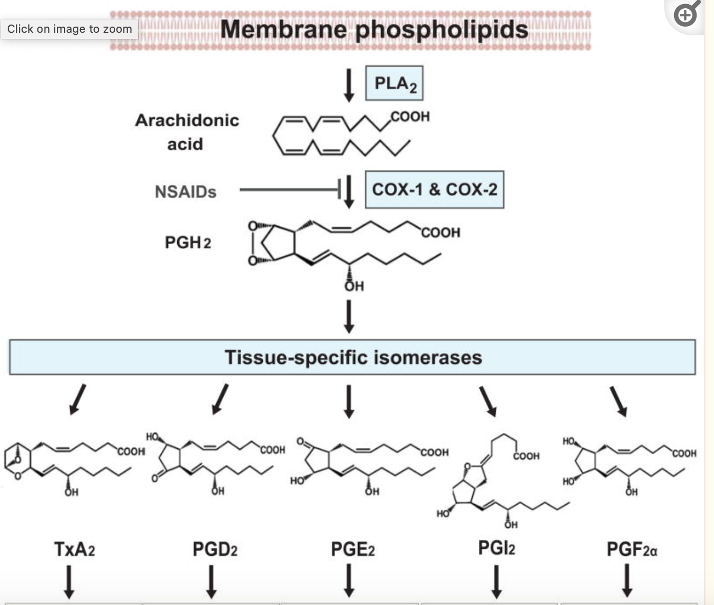
RAE Initiative| Spring 2023

Slide 6
NSAIDs: The Basics
NSAIDs - Key Points
NSAIDs are grouped according to:
- chemical structure
- half life
”short acting” (< 6 hrs): IBU, diclofenac, ketoprofen, indomethacin
“long acting” (> 6 hrs): naproxen, celecoxib, meloxicam, nabumetone, piroxicam
- COX-1 vs COX-2 selectivity
RAE Initiative| Spring 2023

Slide 7
NSAIDs: The Basics
NSAIDs - Key Points
Most NSAIDs inhibit both COX-1 and COX-2, with variable relative potency for these targets
NSAIDs tend to accumulate in synovial fluid; anti-inflammatory effect may last longer than the ½ life suggests
Overall, efficacy of different NSAIDs is about equal although individual responses may vary
Toxicities are largely related to COX-1 effects but also to bioavailabilty, individual patient risk factors
RAE Initiative| Spring 2023

Slide 8
NSAIDs
The Basics
Major Structural Class | Subclass | Examples
Carboxylic Acids | Acetylated | ASA
 | Acetic Acids | indomethacin, sulindac, diclofenac
 | Propionic Acids | ibuprofen, naproxen
 | Pyrollizine Derivatives | ketorolac
Enolic Acids | Oxicams | meloxicam
COX-2 Inhibitors |  | celecoxib
RAE Initiative| Spring 2023

Slide 9
NSAIDs
The Basics
Short acting (< 6 hrs)
IBU
diclofenac
ketoprofen
indomethacin
Long acting (> 6 hrs)
naproxen
celecoxib
meloxicam
nabumetone
piroxicam
RAE Initiative| Spring 2023

Slide 10
NSAIDs
The Basics
INHIBITION | Examples
COX-1 Specific | ASA (irreversibly binds/inhibits COX-1)
COX Nonselective | ibuprofen, naproxen, indomethacin
COX-2 Selective | meloxicam, diclofenac
COX-2 Highly Selective | celecoxib
RAE Initiative| Spring 2023

Slide 11
NSAIDs
The Basics
NSAIDs: Complications
GI: dyspepsia, esophagitis, ulcers, erosions, strictures, colitis
Renal: Na retention, edema, HTN, ARF, RTA, AIN, accelerated CKD
CV: CHF exacerbation, MI, stroke
Hepatic: transaminase elevations
CNS: headache, confusion, seizures, aseptic meningitis
Allergic: ASA-exacerbated asthma; rash
Bone: delayed healing
RAE Initiative| Spring 2023

Slide 12
NSAIDs
The Basics
  NSAIDs: Mitigation Strategies
  < 65 years, uncomplicated (no GI, renal or CV risk; no ASA or anticoag)
  - traditional NSAID; short acting and lowest dose possible
  > 65 years, intermediate risk
    Traditional NSAID + PPI or misoprostol or high dose H2 blocker
    If on ASA→ Celecoxib + PPI
RAE Initiative| Spring 2023

Slide 13
NSAIDs
The Basics
  NSAIDs: Mitigation Strategies
  > 65 years, or otherwise high risk
    intermittent, low-dose, short half-life
    avoid chronic NSAIDs if possible
    if required:
    CV risk > GI risk: use naproxen + PPI
    GI risk > CV risk: use Celecoxib + PPI
    - acetaminophen < 3 gm/day
    - Consider topical NSAIDs (diclofenac gel)
RAE Initiative| Spring 2023

Slide 14
NSAIDs
The Basics
NSAIDs in RA
  Avoid concomitant use with glucocorticoids
  MTX & NSAIDs: theoretically NSAIDs may increase MTX plasma concentrations. However, a 2012 Cochrane review concluded that NSAID + MTX was safe
  Monitor CMP/CBC annually in chronic use
RAE Initiative| Spring 2023

Slide 15
NSAIDs
The Basics
NSAIDs in Pregnancy
Safe up to 20 weeks
Possible increased risk of oligohydramnios at 20-30 weeks
Avoid > 30 weeks (premature closure of the PDA)
RAE Initiative| Spring 2023

Slide 16
Glucocorticoids:
The Basics
Glucose metabolism + adrenal cortex + steroid structure =
Glucocorticoids
”Corticosteroids” = glucocorticoids + mineralocorticoids
GCs bind to intracellular GC receptor and inhibit a broad range of immune responses; inhibit synthesis of almost all pro-inflammatory cytokines
Addison used adrenal extracts in the 19th C to treat “Addison’s disease”
1940’s push to isolate active compounds from adrenals
1948: first therapeutic use of glucocorticoids (compound E) in human disease
RAE Initiative| Spring 2023

Slide 17
Glucocorticoids:
The Basics
GCs - Key Points
- both ACR and EULAR’s guidelines advocate for using the lowest dose ( 10 mg or 7.5 mg) for the shortest time possible
- recommended to use with initiation of DMARD therapy with plan for taper off by 3 months (US) or 6 months (EU) and for flares
= clear data that GCs reduce disease activity in the short term
- medium and long term benefit? Some studies show decreased radiographic progression at 2 years in GC + MTX vs PBO + MTX
RAE Initiative| Spring 2023

Slide 18
Glucocorticoids:
The Basics
DURATION | GLUCOCORTICOID | POTENCY | MINERALOCORTICOID
Short Acting | Hydrocortisone | 1 | 1
Intermediate Acting | Prednisone | 4 | 0.25
 | Prednisolone | 4 | 0.25
 | Methylprednisolone | 5 | +/-
Long Acting | Dexamethasone | 40 | +/-
RAE Initiative| Spring 2023

Slide 19
Glucocorticoids:
The Basics
GCs - RA
  Initial: 10 - 15mg QD, then taper to 5 mg while introducing DMARD therapy
  For flares:
    Multiple options but if treating for 3-10 days, no need to taper
    Unusual to require > 15 mg for flare
    Consider IM methylpred at 80-120 mg; self-taper over 2 weeks
  Chronic low-dose (5mg or less) used, rarely, as chronic therapy
RAE Initiative| Spring 2023

Slide 20
Glucocorticoids:
The Basics
Toxicities are generally related to dose and duration
Very low dose GC (3 mg/d) = no increased risk of toxicities at 7 years
  Endocrine: osteoporosis
  Infectious: any infection
  GI: gastritis/erosion/ulcers
  Endo: Risk of adrenal insufficiency at 3-5wks
  Endo: Risk of insulin resistance incr. at >10 pred/day
  CV: Fluid retention/hypertension; cardiovascular events
  Integument: skin fragility
RAE Initiative| Spring 2023

Slide 21
Glucocorticoids:
The Basics
Glucocorticoids: Mitigation Strategies
Lowest dose, shortest duration
Ca/Vit D supplementation
Screening/treatment for osteoporosis (bone loss is most pronounced in the first few months of treatment; GCs associated with higher fracture risk and at higher BMD)
GI protection
PJP prophylaxis for prednisone > 20 mg x 4 weeks
increased risk with baseline lymphopenia, pulse steroids, cyclophosphamide use
RAE Initiative| Spring 2023

Slide 22
GCs and NSAIDs
The Basics
SUMMARY
  NSAIDs treat pain and inflammation - but are NOT effective DMARDs in RA
  GCs at low dose may have some DMARD effects but are generally not used in this fashion, given other effective therapies
  NSAID and GC treatment-related AEs common but often manageable with proper screening/mitigation
RAE Initiative| Spring 2023

Slide 23
Opioids and RA
Any benefit in treating RA pain?
Trials are of short duration
Benefit is neutral/modest in these trials
Most evidence does not support the use of opioids in chronic non-cancer pain
RAE Initiative| Spring 2023
Notes:
r

Slide 24
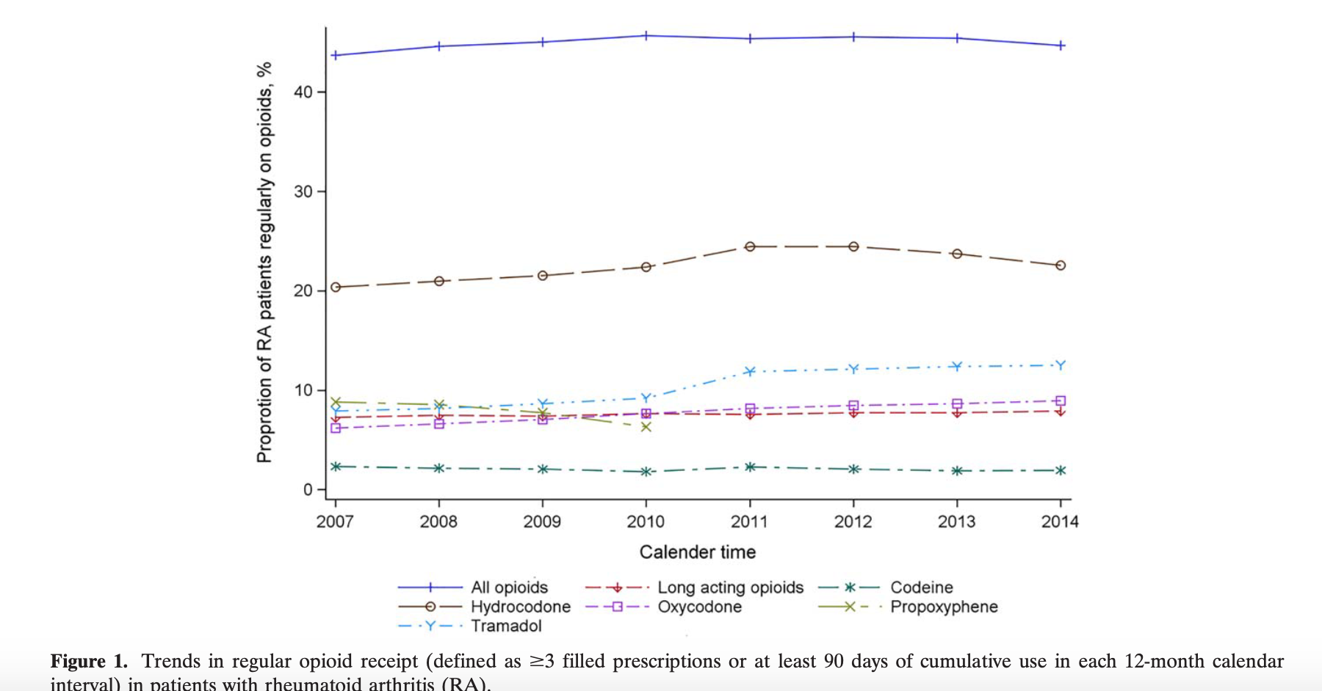
Opioids and RA
Curtis et al. Arthritis and Rheumatology. Vol 69, No 9, Sept 2017; 1733-1740
RAE Initiative| Spring 2023

Slide 25
Opioids and RA
Regular opioid use was associated with
- female sex
- fibromyalgia
- depression/anxiety
- back pain
- use of durable medical equipment
In a separate study, 25% of regular opioid use among RA patients was associated with obesity
Curtis et al. Arthritis and Rheumatology. Vol 69, No 9, Sept 2017; 1733-1740
RAE Initiative| Spring 2023
Notes:
r

Slide 26
What about Diet?
Altered microbiome postulated as possible etiology in pathogenesis of RA
Foods purported to promote/exacerbate inflammation:
refined sugar/sugary drinks
preservatives
saturated and trans fats
red/processed meats
highly processed foods
1
RAE Initiative| Spring 2023

Slide 27
What about Diet?
Most trials of diet in RA are small (15-30 patients)
Short term benefits found in:
Subtotal fasting → vegan diet
Vegan diet
Mediterranean diet
- ITIS diet (Mediterranean plus)
1
RAE Initiative| Spring 2023

Slide 28
Obesity and RA
Higher disease activity scores
Higher pain scores
Reduced remission rates
Decreased response to c/b DMARDs
Weight loss effects
In 53 patients who underwent bariatric surgery, 68% achieved remission at 6 months
RAE Initiative| Spring 2023

Slide 29
References
Crofford, LJ. Use of NSAIDs in treating patients with rheumatoid arthritis. Arth Res Ther, 2013; 15 (Suppl 3)
Colebatch AN. Safety of NSAIDs in people receiving methotrexate for inflammatory arthritis. J Rheum Suppl 2012; 15: 62-73
Hua C. Glucocorticoids in rheumatoid arthritis: current status and future studies. RMD Open 2020; 6:e000536
Corras R. RA Improvement after exposure to ITIS diet. ACR 2020 Abstract
Khanna S. Managing Rheumatoid Arthritis with Dietary Interventions.
Front Nutr 2017; 4: 52
https://www.uptodate.com/contents/nsaids-therapeutic-use-and-variability-of-response-in-adults
https://www.uptodate.com/contents/nsaids-therapeutic-use-and-variability-of-response-in-adults?search=nsaids&sectionRank=1&usage_type=default&anchor=H8&source=machineLearning&selectedTitle=2~147&display_rank=1#H8
Dalen. RMD Open 2015:1:e000012
RAE Initiative| Spring 2023

Slide 30

CME Credit Link
RAE Initiative| Spring 2023
Notes:
https://ucsf.co1.qualtrics.com/jfe/form/SV_eOPgvdZ819vTPp4

