Slide 1
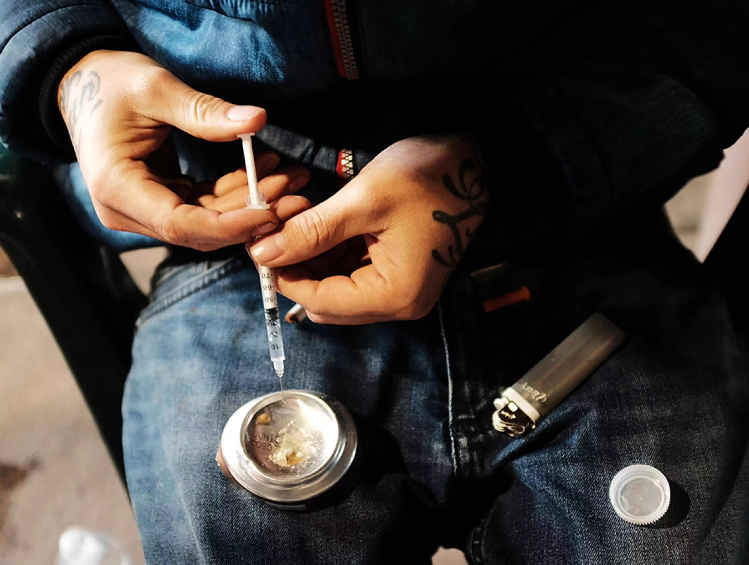
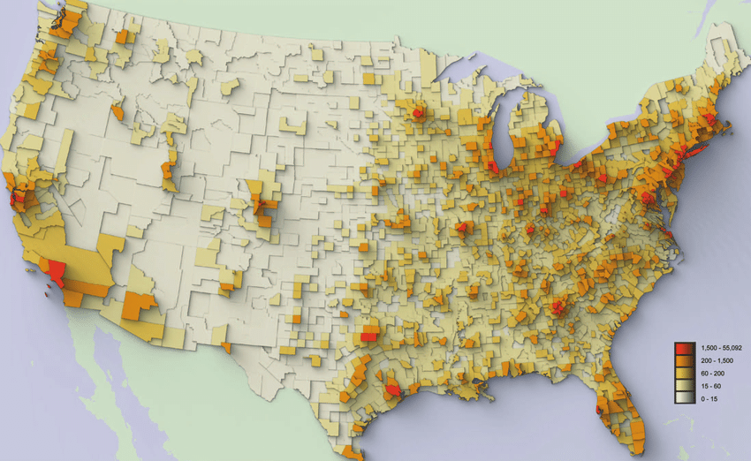


Substance Use Data Among American Indian/Alaska Natives
Michael Mudgett
Northwest Portland Area Indian Health Board (NPAIHB)
Indian Country SUD Presentation
Notes:
30,000ft overview

Slide 2
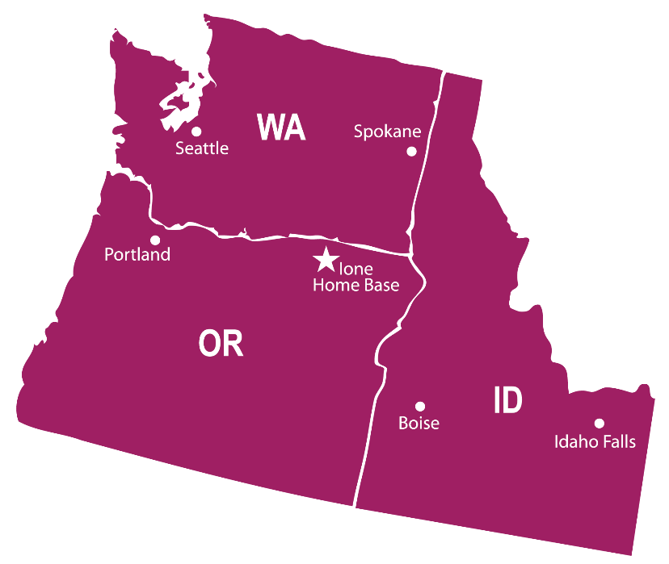

Introduction
Northwest Tribal Epidemiology Center (NWTEC)
Housed within the Northwest Portland Area Indian Health Board (NPAIHB)
Our organization serves the 43 federally recognized tribes in a three state region: Washington, Oregon, and Idaho (~300,000 AI/AN)
If you are located outside of the NW region, you can easily locate your tribal epidemiology center: https://tribalepicenters.org/
Michael Mudgett, MPH
Substance Use Epidemiologist (Spirit Lake Tribe)
mmudgett@npaihb.org
Northwest Portland Area Indian Health Board

Slide 3
Overview
Review prevalence estimates of various drug usage among AI/AN’s in U.S.
Compare type of drug utilization among AI/AN’s compared to other racial groups
Examine state, regional, and U.S. rates of drug overdose among AI/AN’s
Examine longitudinal trends of key drug mortality rates
Compared IHS regional data for various drug overdose trends
Briefly discuss racial misclassification of AI/AN data
Northwest Portland Area Indian Health Board

Slide 4
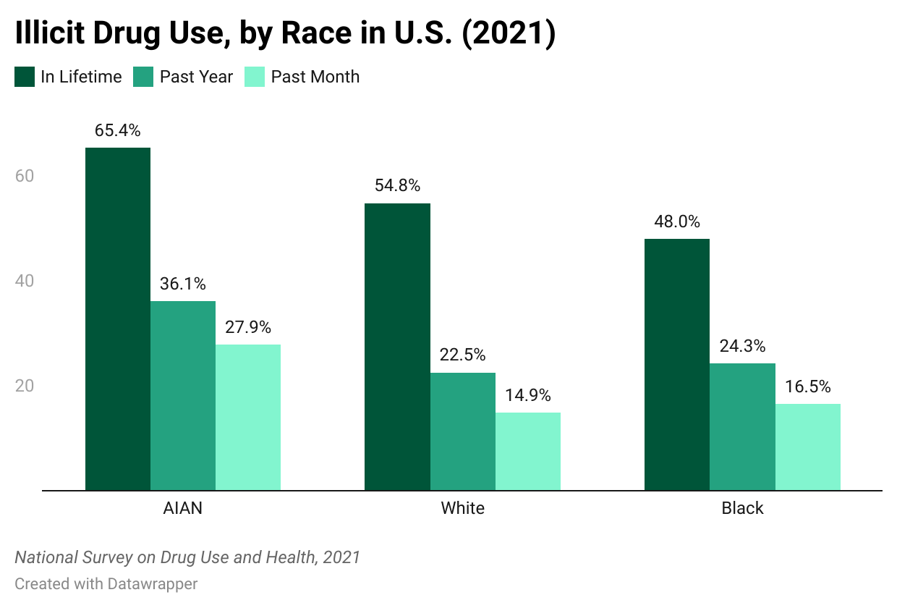
Northwest Portland Area Indian Health Board
Notes:
NSDUH is a comprehensive household interview survey of substance use, substance use disorders, mental health, and the receipt of treatment services for these disorders in the United States
NSDUH AIAN definition: self-reported

Slide 5
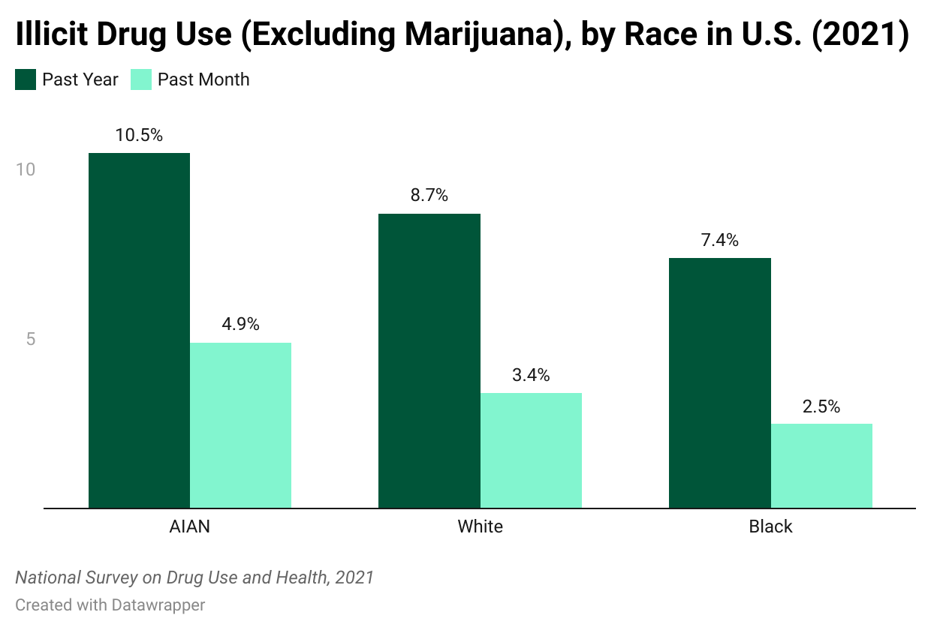
Northwest Portland Area Indian Health Board

Slide 6
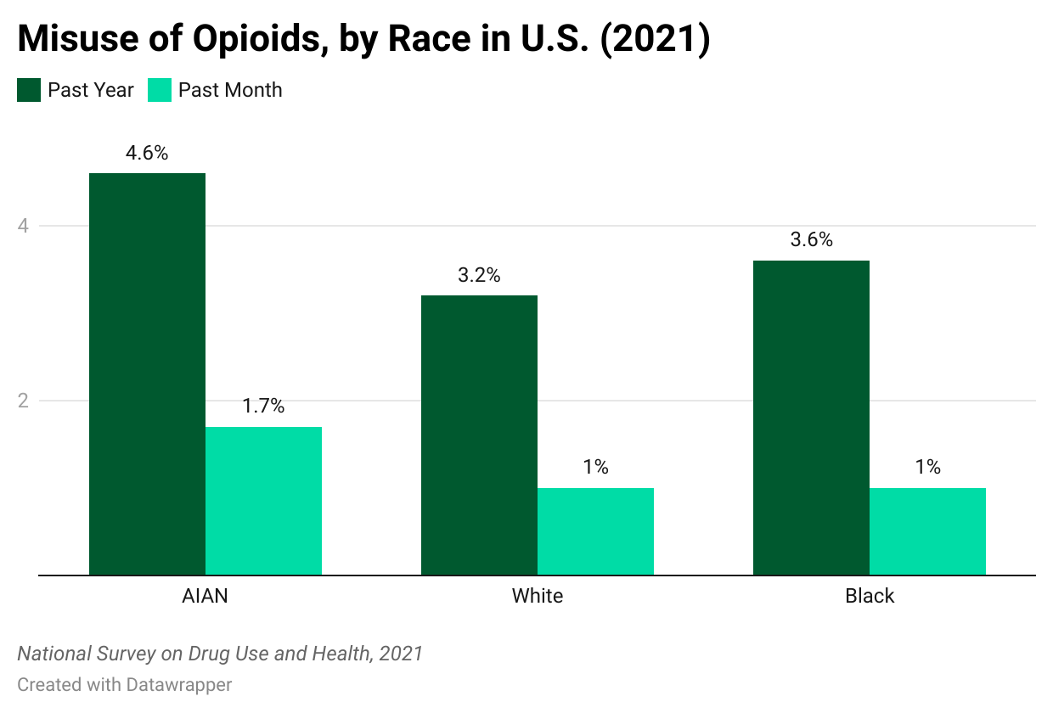
Northwest Portland Area Indian Health Board

Slide 7
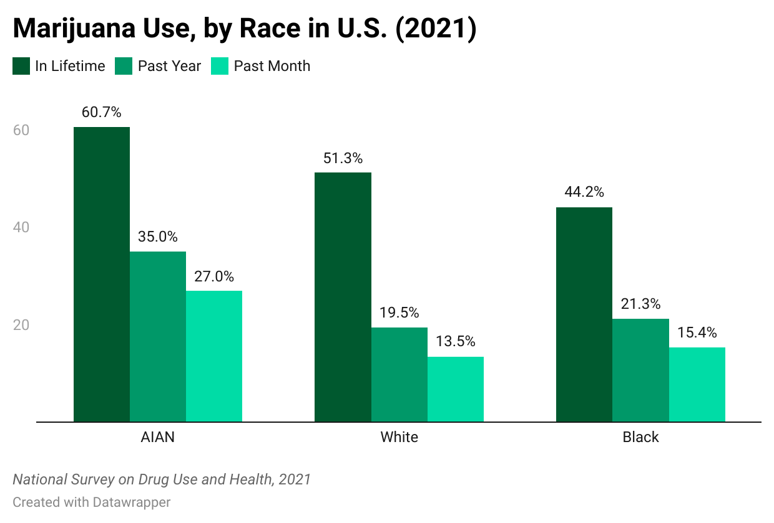
Northwest Portland Area Indian Health Board

Slide 8
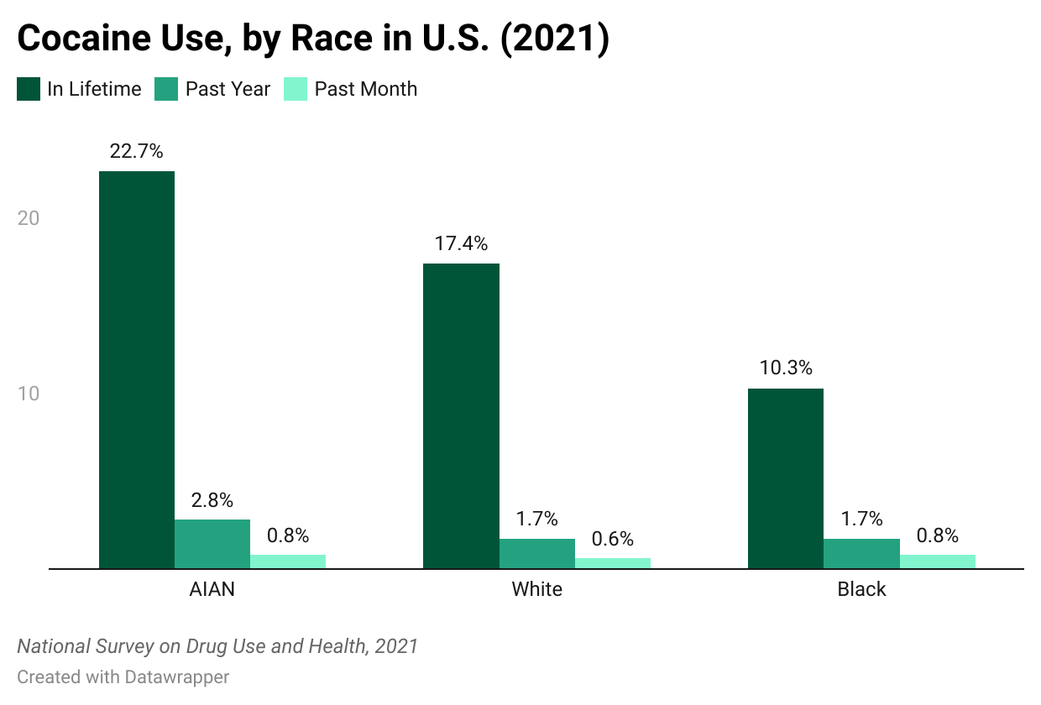
Northwest Portland Area Indian Health Board

Slide 9
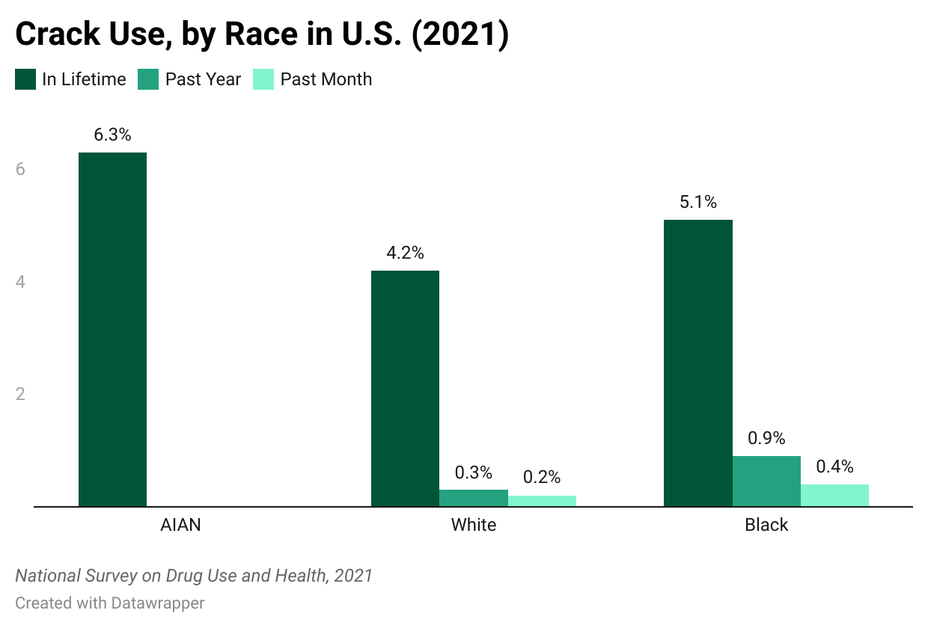
* *
Northwest Portland Area Indian Health Board
Notes:
* Low precision for past year and past month AIAN crack use.

Slide 10
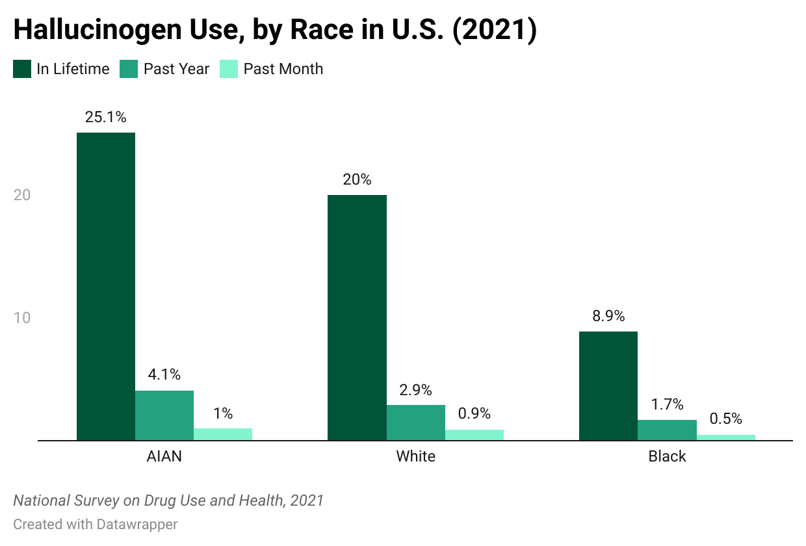
Northwest Portland Area Indian Health Board

Slide 11
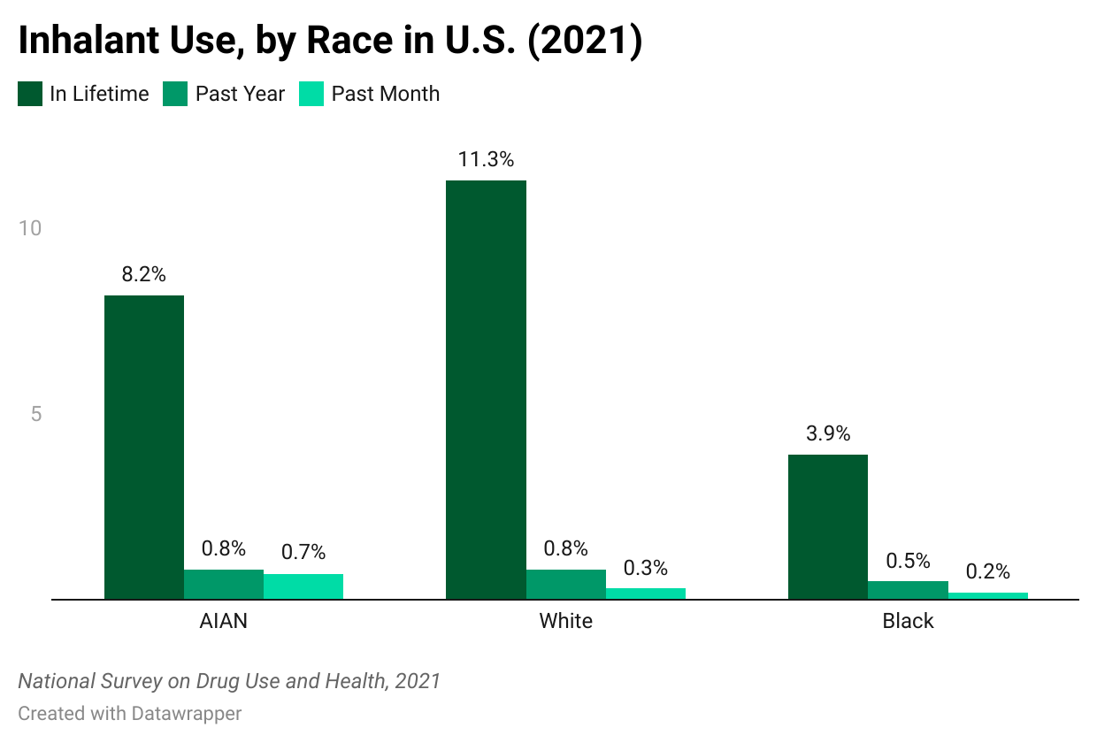
Northwest Portland Area Indian Health Board

Slide 12
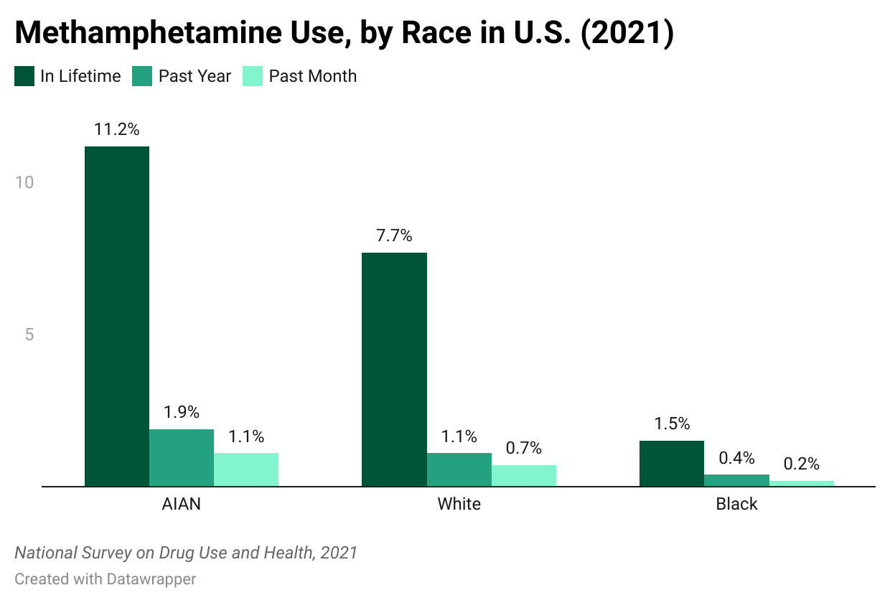
Northwest Portland Area Indian Health Board

Slide 13
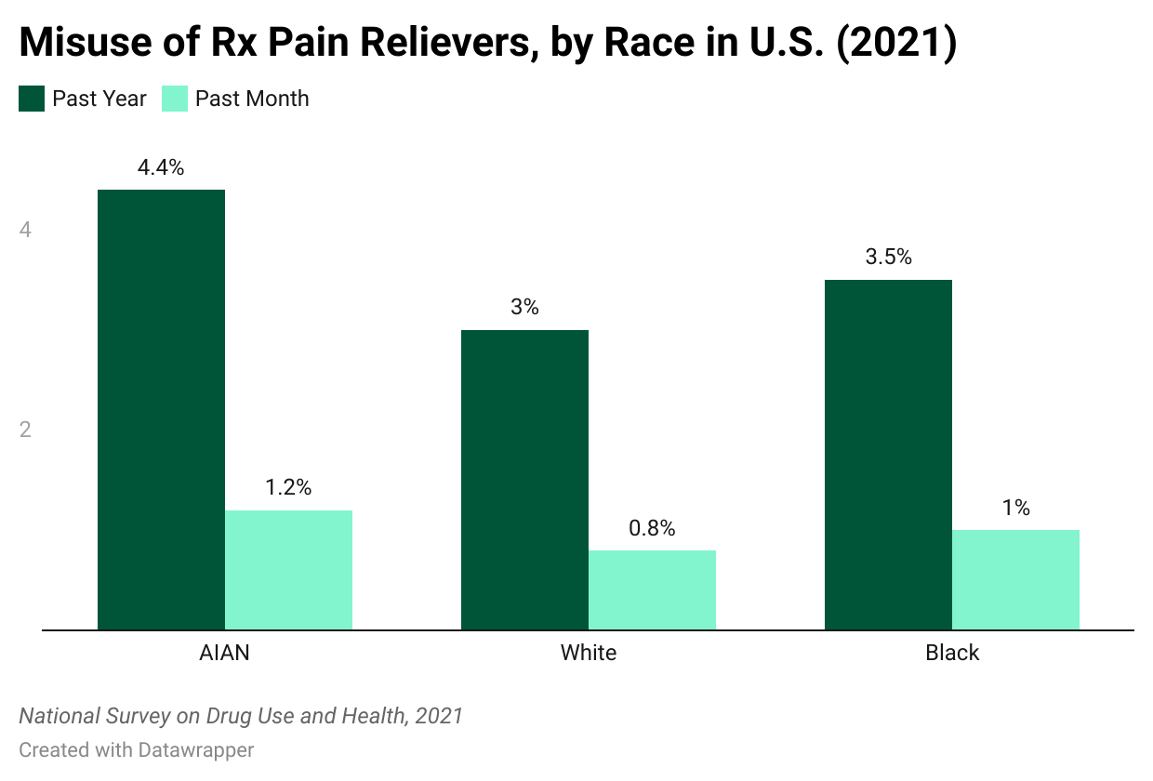
Northwest Portland Area Indian Health Board

Slide 14
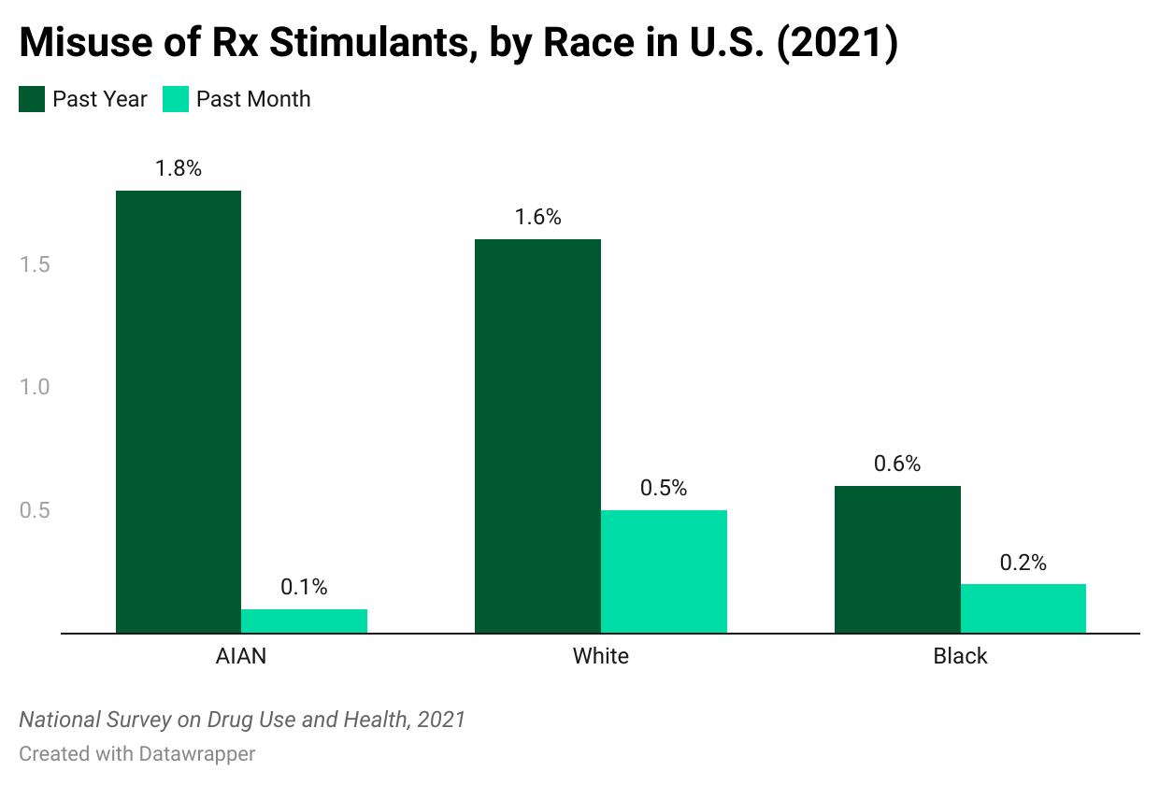
Northwest Portland Area Indian Health Board

Slide 15
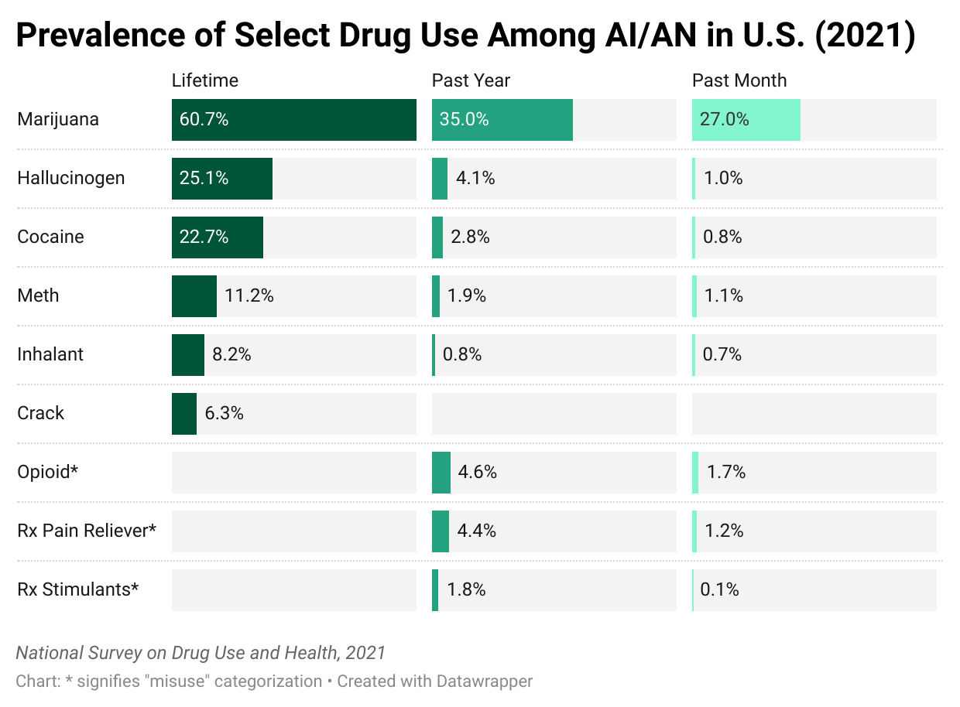
Northwest Portland Area Indian Health Board

Slide 16
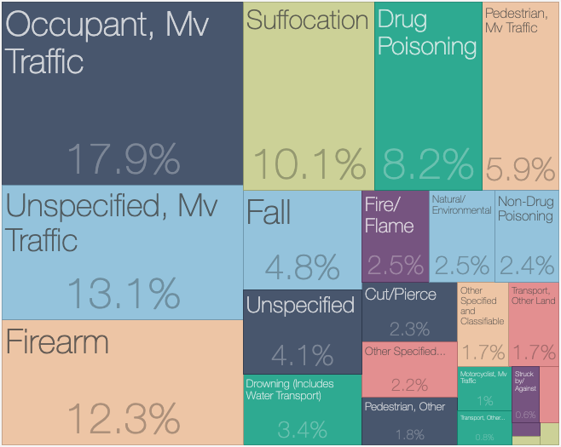
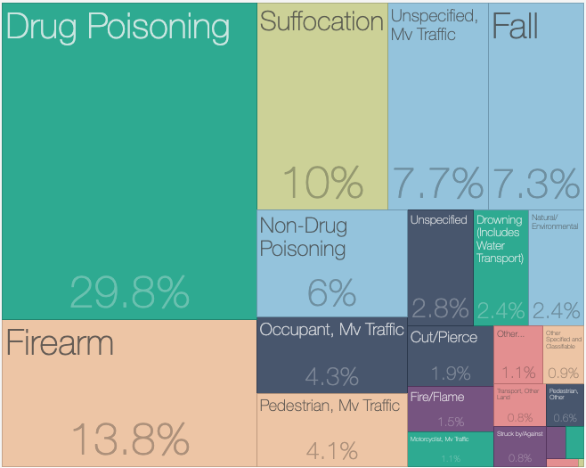
Injury Related Deaths Among AI/ANs
2001
2020
CDC WISQAR: causes of injury related deaths
Northwest Portland Area Indian Health Board

Slide 17
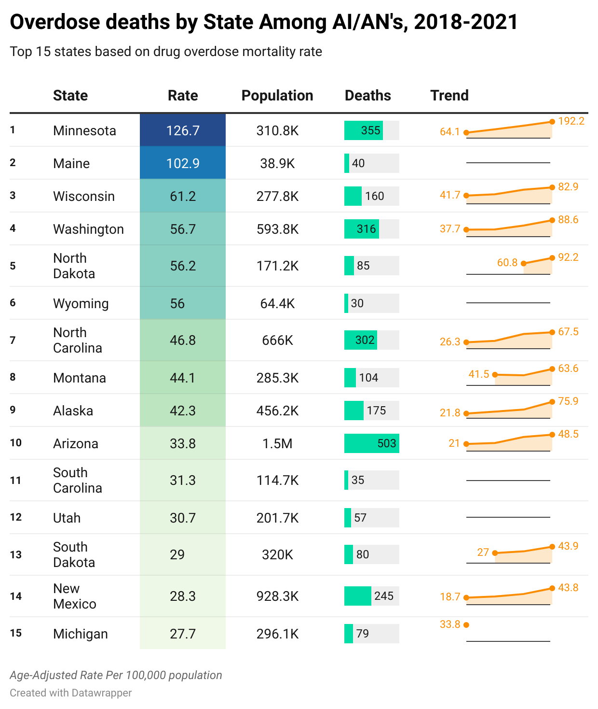
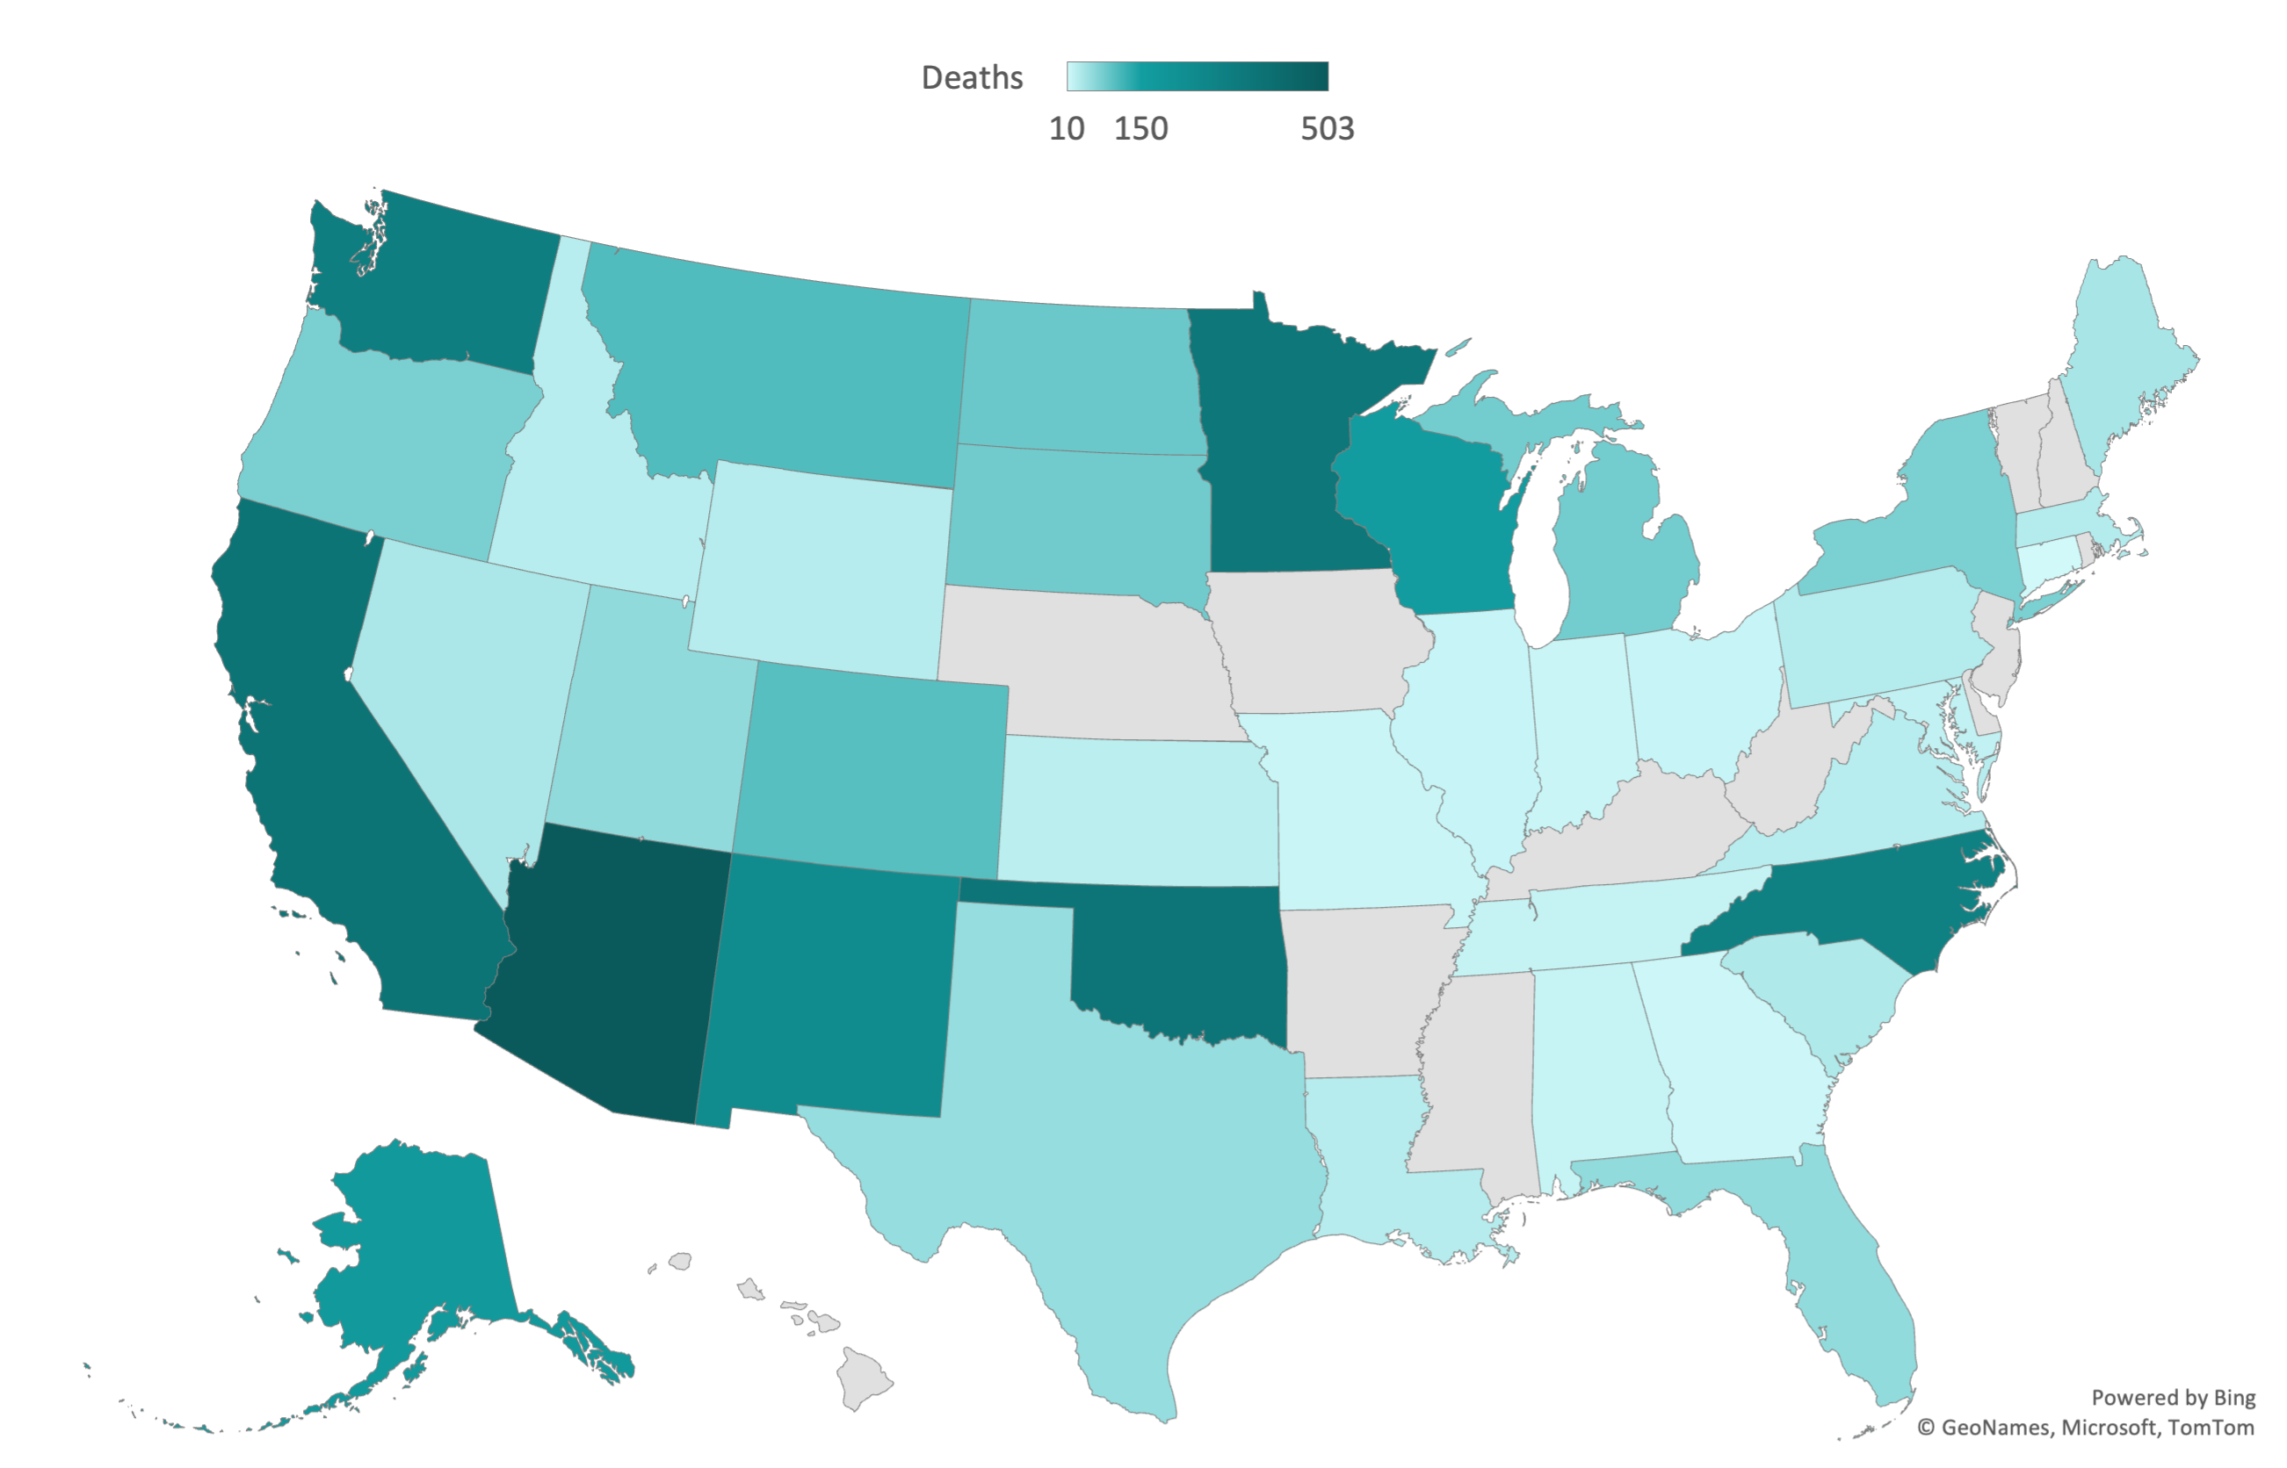
CDC NCHS Multiple Cause of Death Files 2018-2021 on CDC WONDER Online Database
Northwest Portland Area Indian Health Board
Notes:
Map:
Data: rate is aggregate, trend is single years --- keep in mind “Population” is AIAN population per state

Slide 18
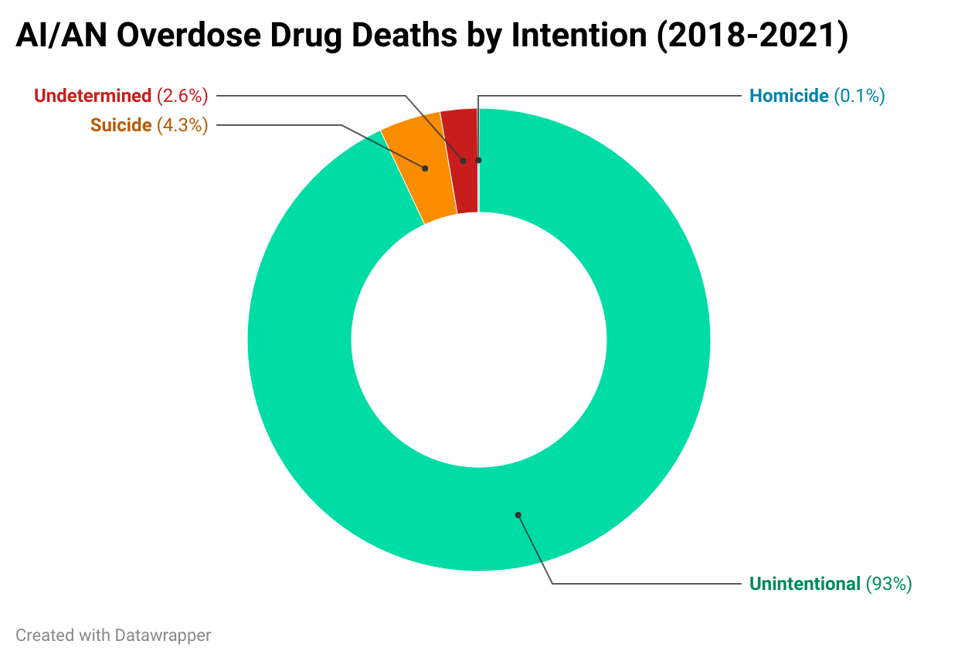
Characteristics of AI/AN Drug Overdose Deaths, US, 2018-2021
AI/AN male deaths about 1.5 times higher than female deaths (US average for males is 2.2 times higher)
Young adults between 30-50 most affected
CDC NCHS Multiple Cause of Death Files, 1999-2020 bridged race & 2018-2021 single race on CDC WONDER Online Database
Northwest Portland Area Indian Health Board
Notes:
Overdose death by intention: death codes X40–X44 (unintentional), X60–X64 (suicide), X85 (homicide), or Y10–Y14 (undetermined intent)

Slide 19
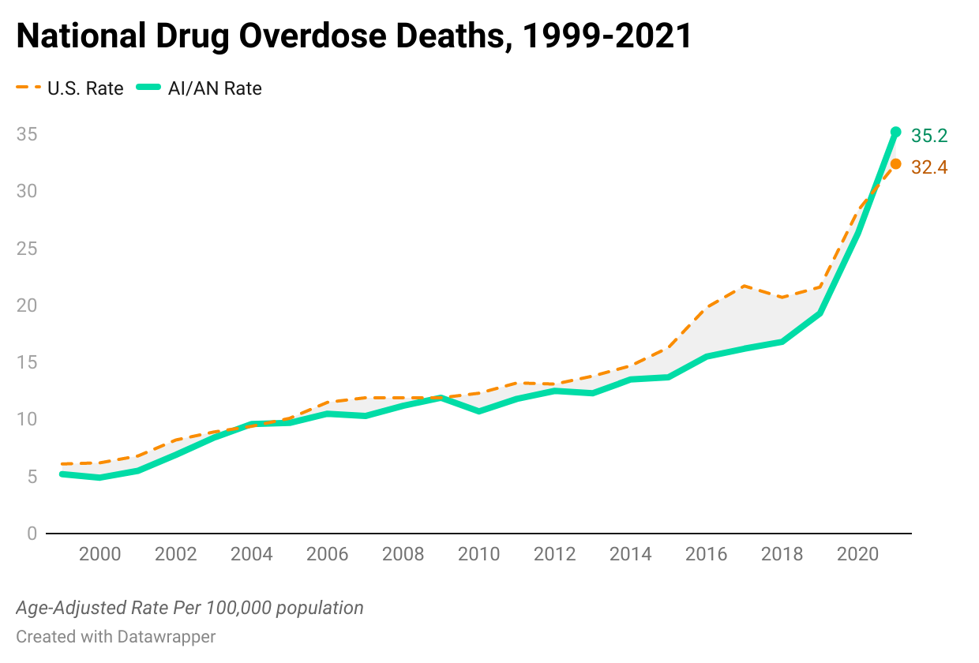
CDC NCHS Multiple Cause of Death Files, 1999-2020 bridged race & 2018-2021 single race on CDC WONDER Online Database
Northwest Portland Area Indian Health Board
Notes:
All drug related overdose deaths

Slide 20
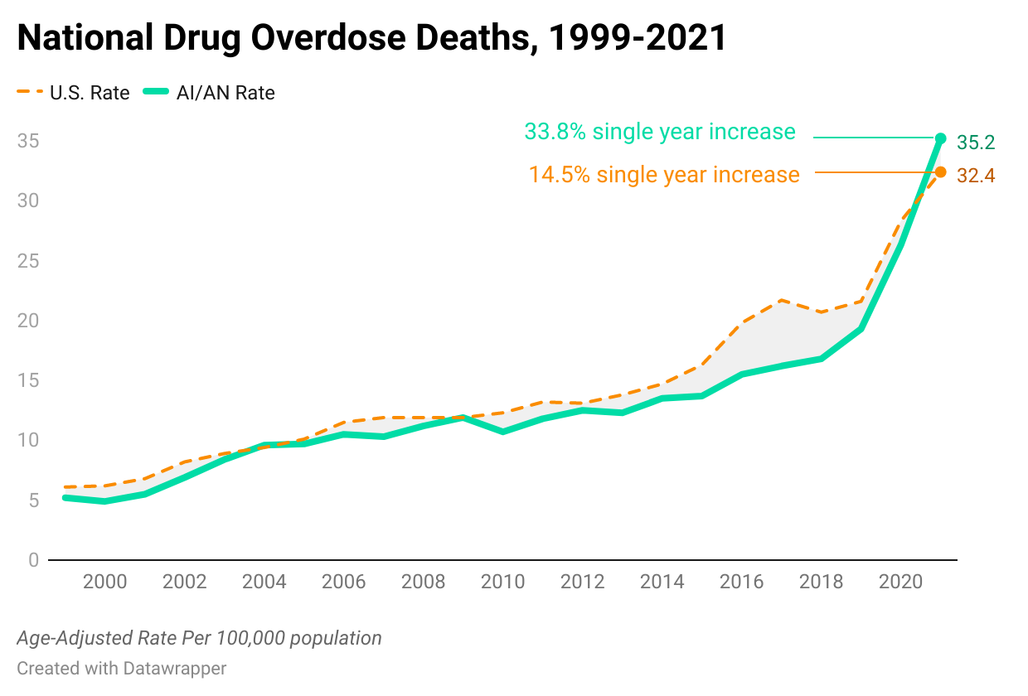
CDC NCHS Multiple Cause of Death Files, 1999-2020 bridged race & 2018-2021 single race on CDC WONDER Online Database
Northwest Portland Area Indian Health Board
Notes:
All drug related overdose deaths

Slide 21
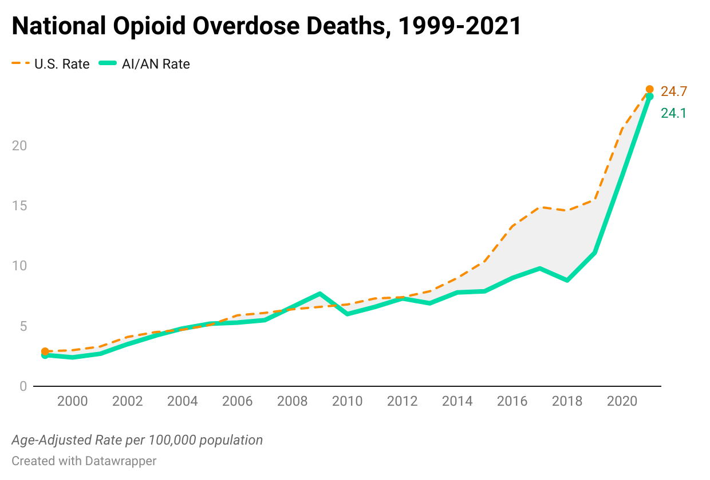
CDC NCHS Multiple Cause of Death Files, 1999-2020 bridged race & 2018-2021 single race on CDC WONDER Online Database
Northwest Portland Area Indian Health Board

Slide 22
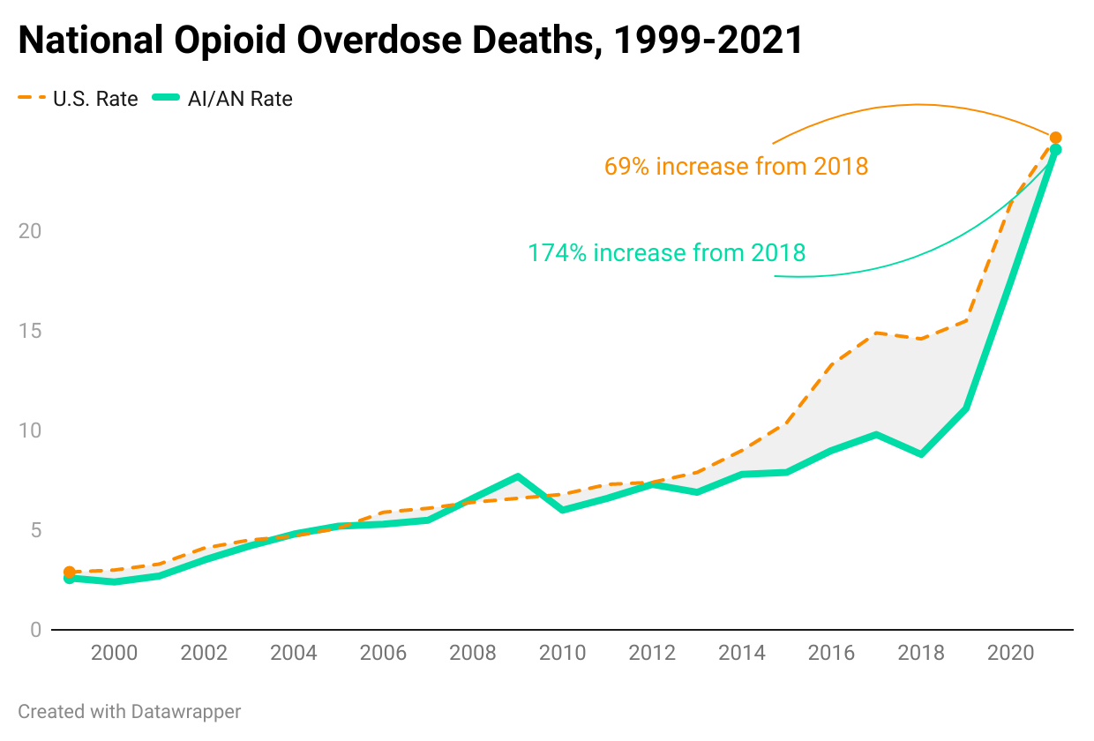
CDC NCHS Multiple Cause of Death Files, 1999-2020 bridged race & 2018-2021 single race on CDC WONDER Online Database
Northwest Portland Area Indian Health Board

Slide 23
Traffic fatality rate
CDC NCHS Multiple Cause of Death Files, 1999-2020 bridged race & 2018-2021 single race on CDC WONDER Online Database
Northwest Portland Area Indian Health Board
Notes:
Adjust leader lines to be thinner and black

Slide 24
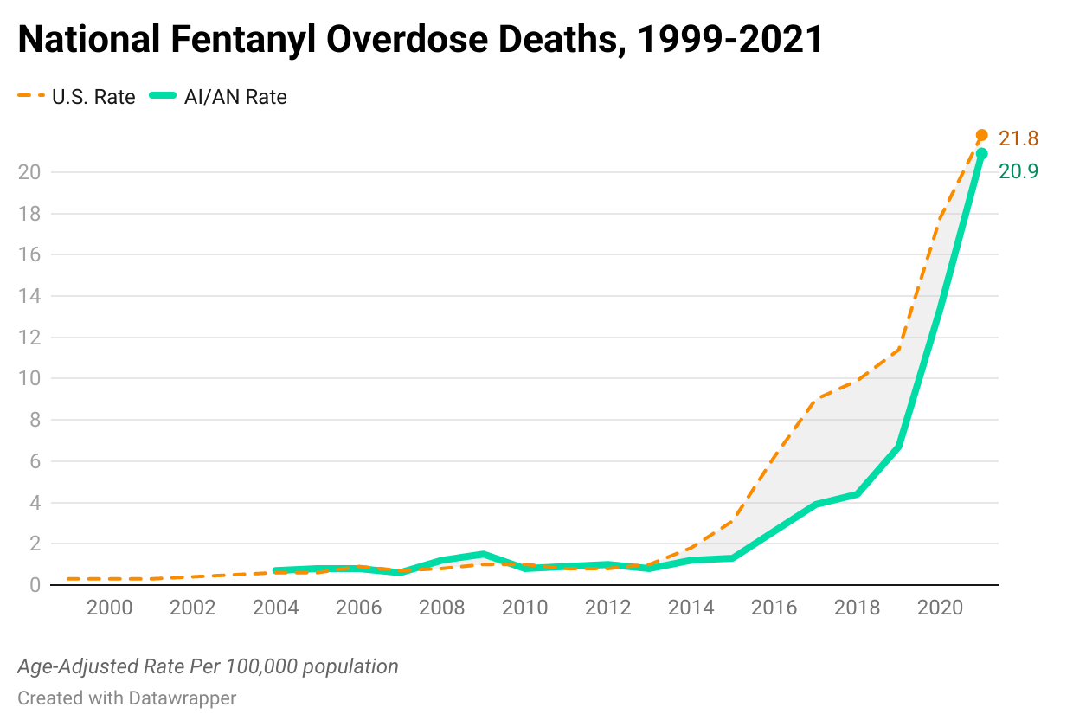
*
* Data include anything synthetic opioid, including fentanyl
CDC NCHS Multiple Cause of Death Files, 1999-2020 bridged race & 2018-2021 single race on CDC WONDER Online Database
Northwest Portland Area Indian Health Board
Notes:
Note: not just fentanyl, but anything synthetic opioid

Slide 25
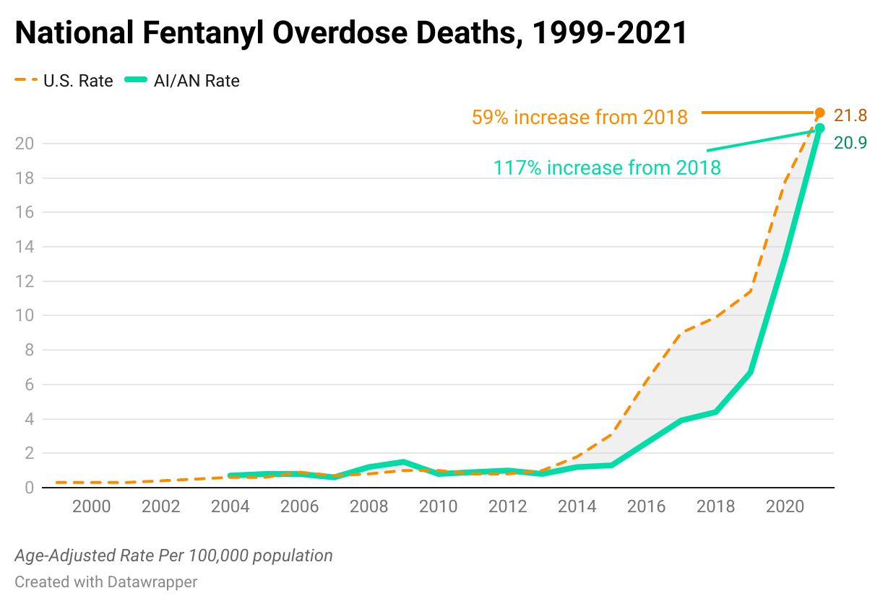
*
* Data include anything synthetic opioid, including fentanyl
CDC NCHS Multiple Cause of Death Files, 1999-2020 bridged race & 2018-2021 single race on CDC WONDER Online Database
Northwest Portland Area Indian Health Board
Notes:
Adjust leader lines to be thinner and black

Slide 26
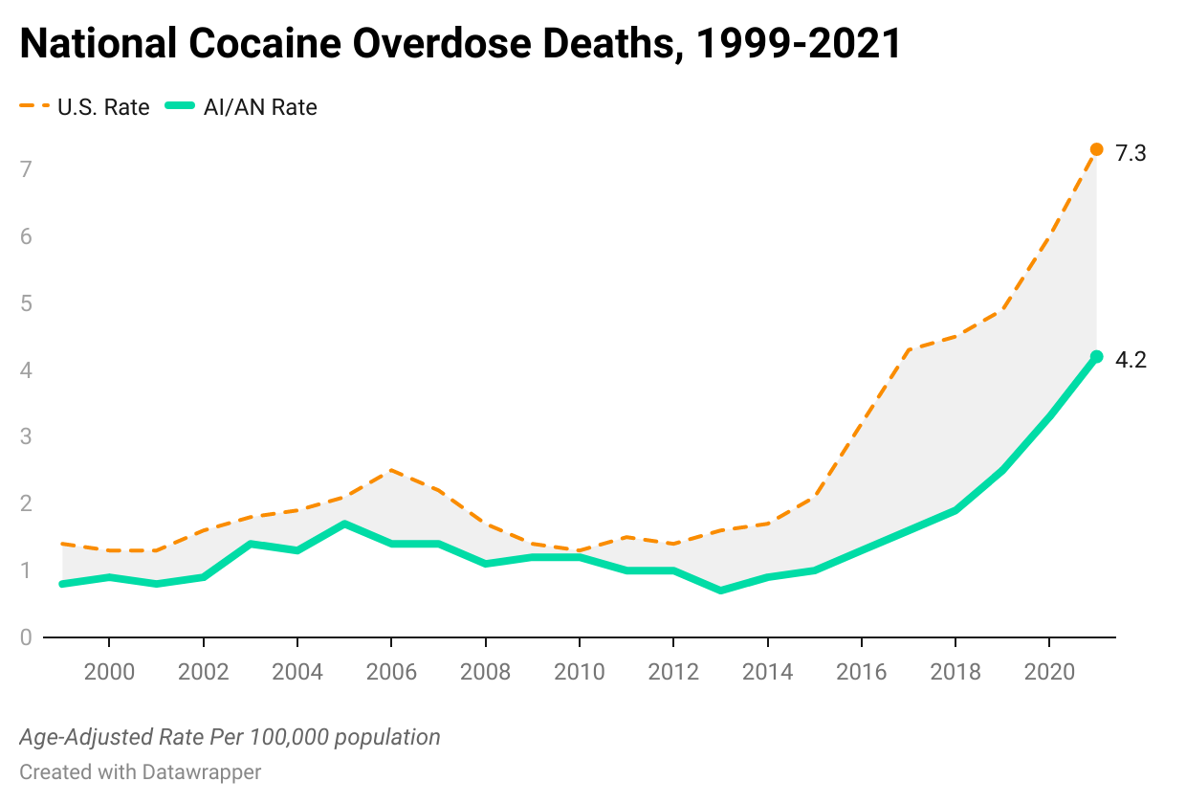
CDC NCHS Multiple Cause of Death Files, 1999-2020 bridged race & 2018-2021 single race on CDC WONDER Online Database
Northwest Portland Area Indian Health Board
Notes:
By drug type

Slide 27
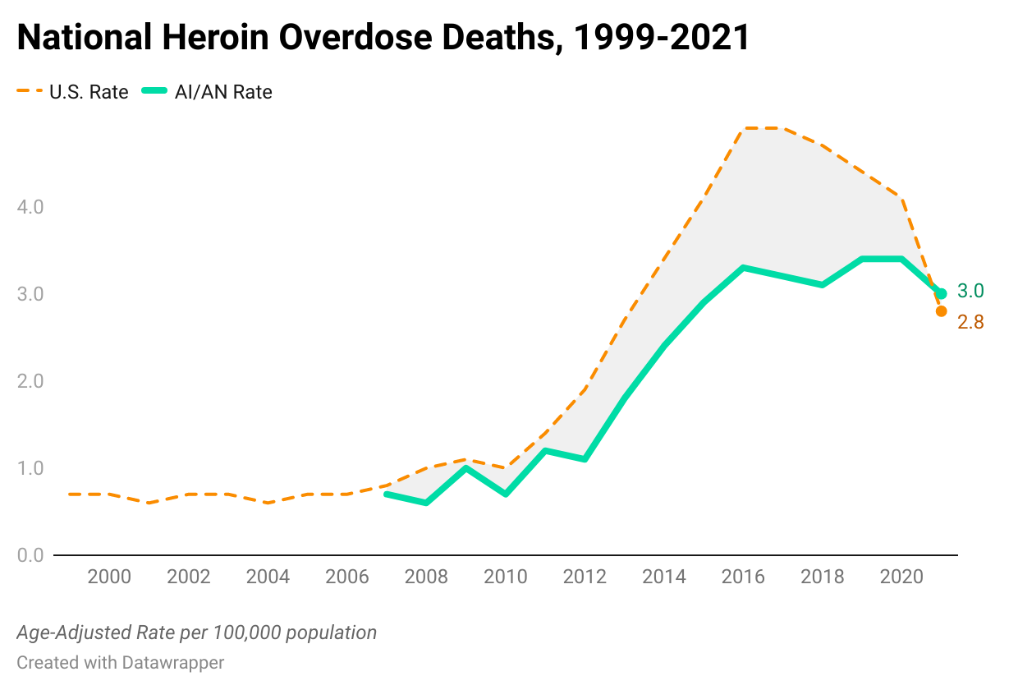
CDC NCHS Multiple Cause of Death Files, 1999-2020 bridged race & 2018-2021 single race on CDC WONDER Online Database
Northwest Portland Area Indian Health Board
Notes:
By drug type

Slide 28
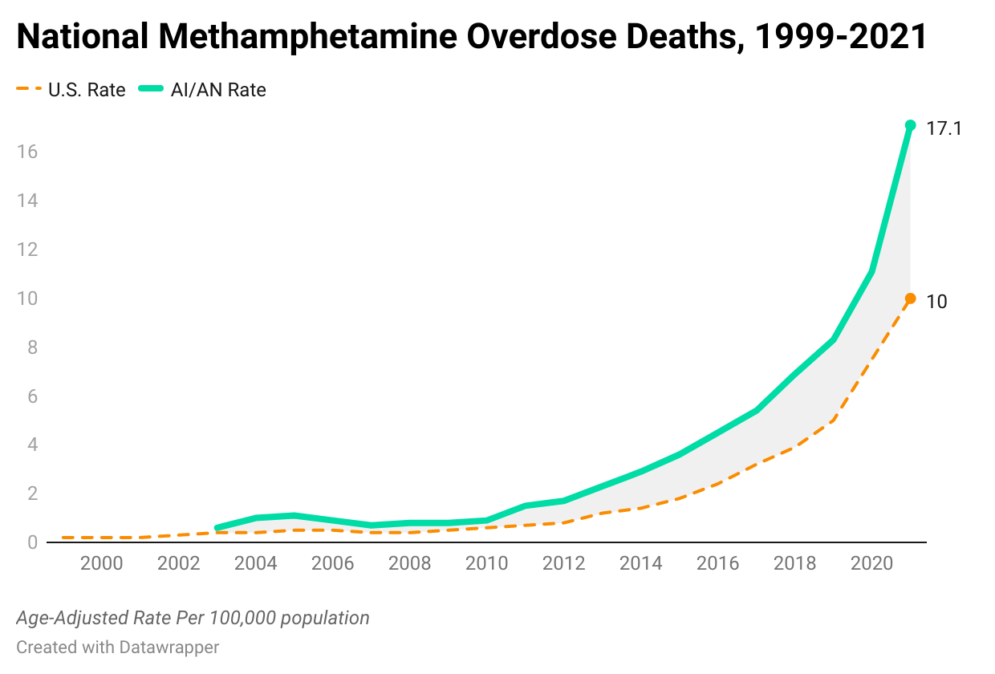
CDC NCHS Multiple Cause of Death Files, 1999-2020 bridged race & 2018-2021 single race on CDC WONDER Online Database
Northwest Portland Area Indian Health Board
Notes:
By drug type

Slide 29
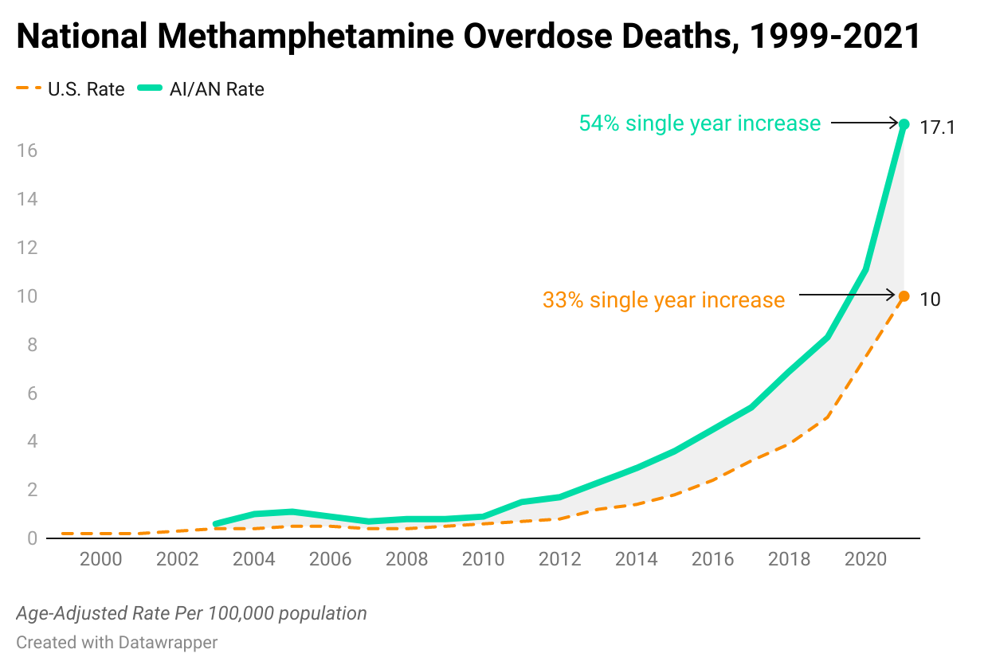
CDC NCHS Multiple Cause of Death Files, 1999-2020 bridged race & 2018-2021 single race on CDC WONDER Online Database
Northwest Portland Area Indian Health Board
Notes:
By drug type

Slide 30
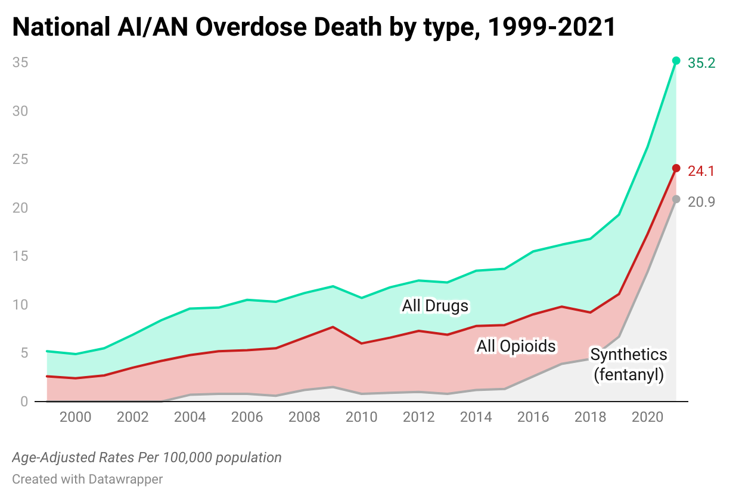
60% male; 60% 25-45yrs old
62% male; 70% 25-45yrs old
CDC NCHS Multiple Cause of Death Files, 1999-2020 bridged race & 2018-2021 single race on CDC WONDER Online Database
Northwest Portland Area Indian Health Board
Notes:
By drug type

Slide 31
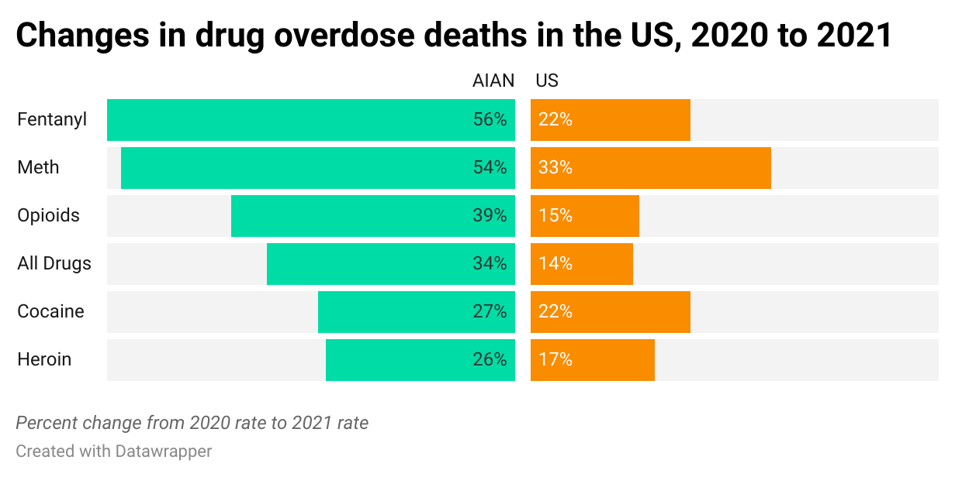
CDC NCHS Multiple Cause of Death Files, 1999-2020 bridged race & 2018-2021 single race on CDC WONDER Online Database
Northwest Portland Area Indian Health Board
Notes:
By drug type

Slide 32
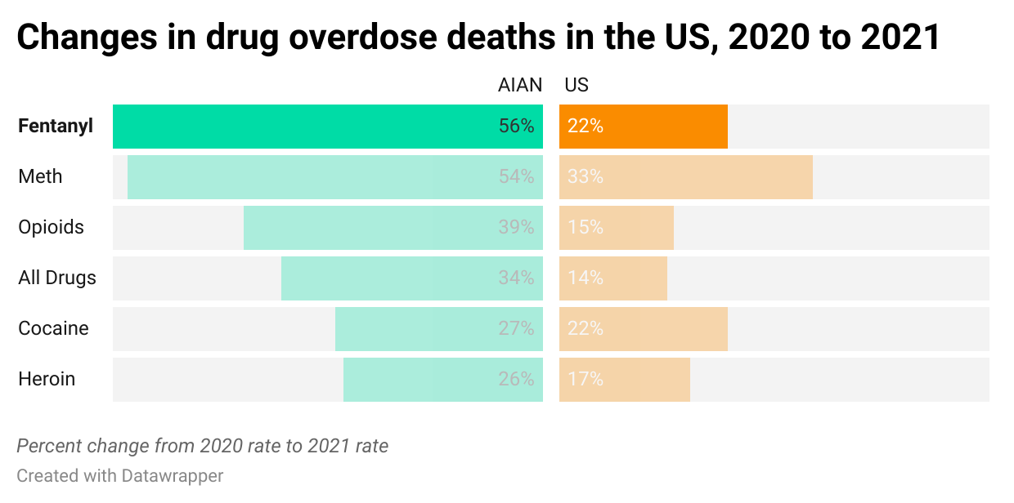
CDC NCHS Multiple Cause of Death Files, 1999-2020 bridged race & 2018-2021 single race on CDC WONDER Online Database
Northwest Portland Area Indian Health Board
Notes:
AI/AN highest Percentage change from 2020 = Fentanyl -> 60% were 20-40 years old
U.S. highest percentage change from 2020 = Methamphetamine

Slide 33
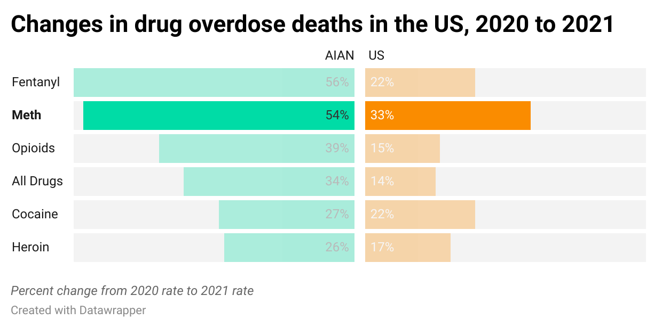
CDC NCHS Multiple Cause of Death Files, 1999-2020 bridged race & 2018-2021 single race on CDC WONDER Online Database
Northwest Portland Area Indian Health Board
Notes:
AI/AN highest Percentage change from 2020 = Fentanyl
U.S. highest percentage change from 2020 = Methamphetamine

Slide 34
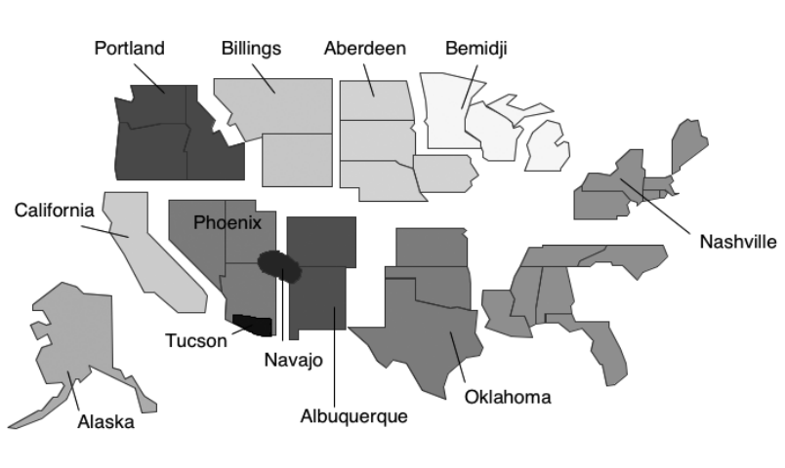
IHS Region Data
Northwest Portland Area Indian Health Board
Notes:
Data excludes Navajo HIS region + Tucson

Slide 35
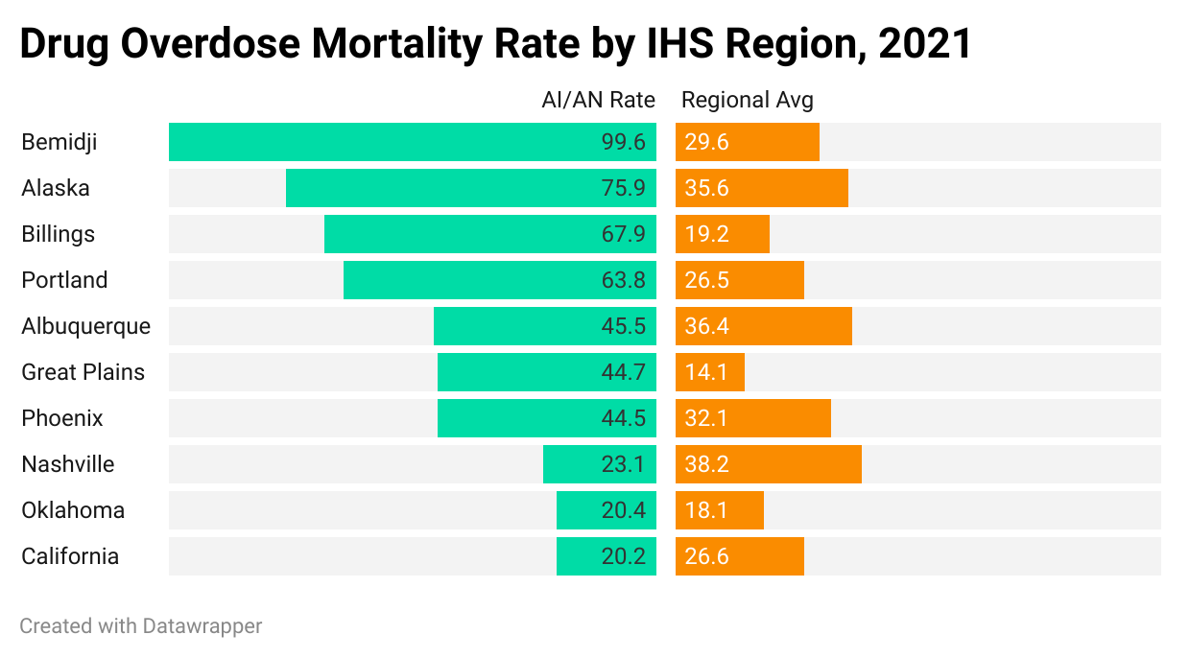
IHS Region Data
3.5x
3.4x
2.4x
3.2x
2.1x
(Age-Adjusted Rate Per 100,000) CDC NCHS Multiple Cause of Death Files 2018-2021 on CDC WONDER Online Database
Northwest Portland Area Indian Health Board
Notes:
Nashville has half the rate of AI/AN : Regional Rate

Slide 36
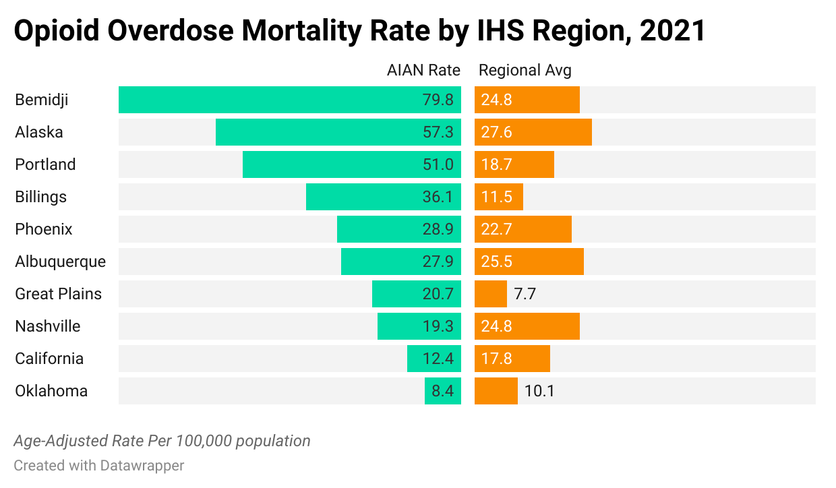
IHS Region Data
3.1x
3.2x
2.7x
2.7x
2.0x
(Age-Adjusted Rate Per 100,000) CDC NCHS Multiple Cause of Death Files 2018-2021 on CDC WONDER Online Database
Northwest Portland Area Indian Health Board
Notes:
Nashville has half the rate of AI/AN : Regional Rate

Slide 37
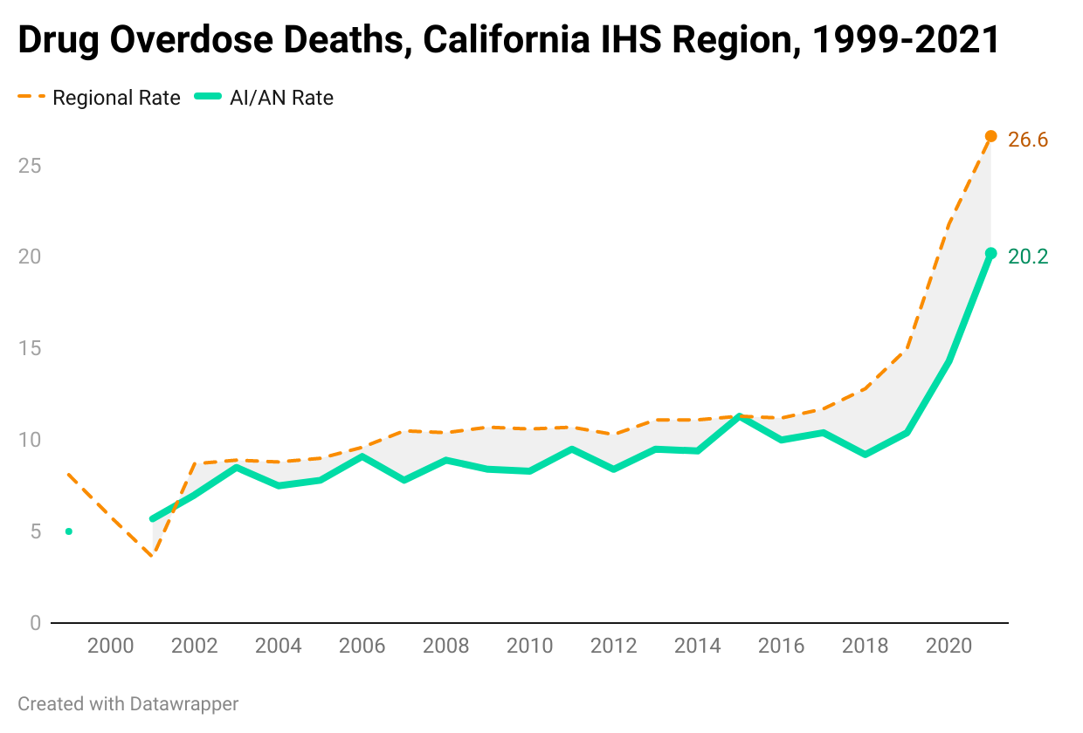
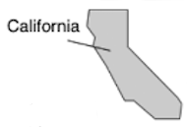
CDC NCHS Multiple Cause of Death Files, 1999-2020 bridged race & 2018-2021 single race on CDC WONDER Online Database
Northwest Portland Area Indian Health Board

Slide 38
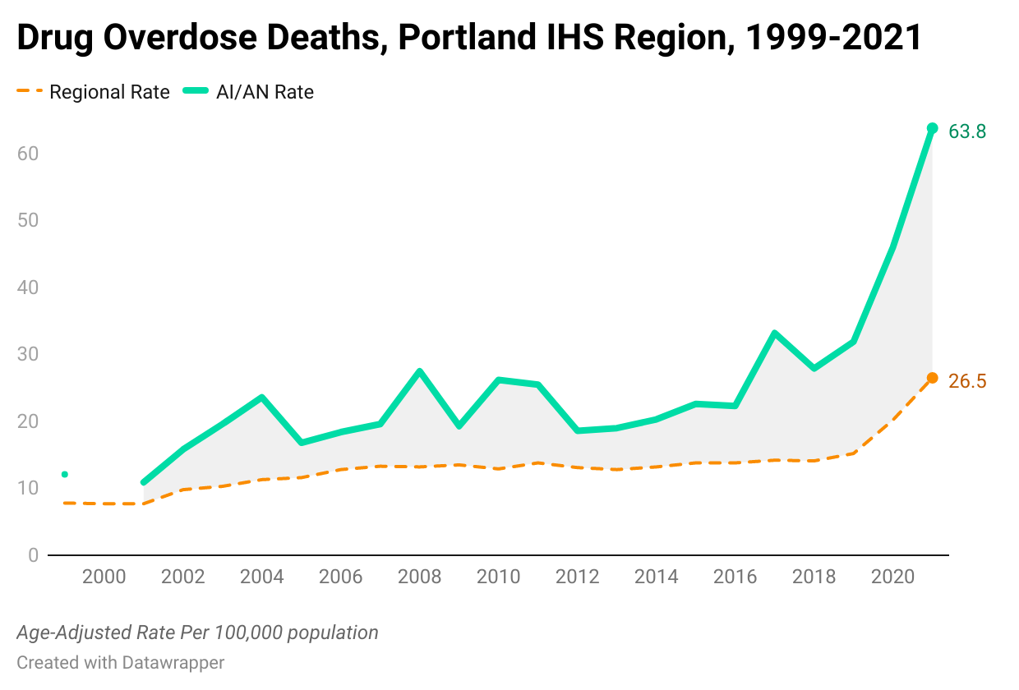
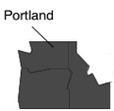
CDC NCHS Multiple Cause of Death Files, 1999-2020 bridged race & 2018-2021 single race on CDC WONDER Online Database
Northwest Portland Area Indian Health Board

Slide 39
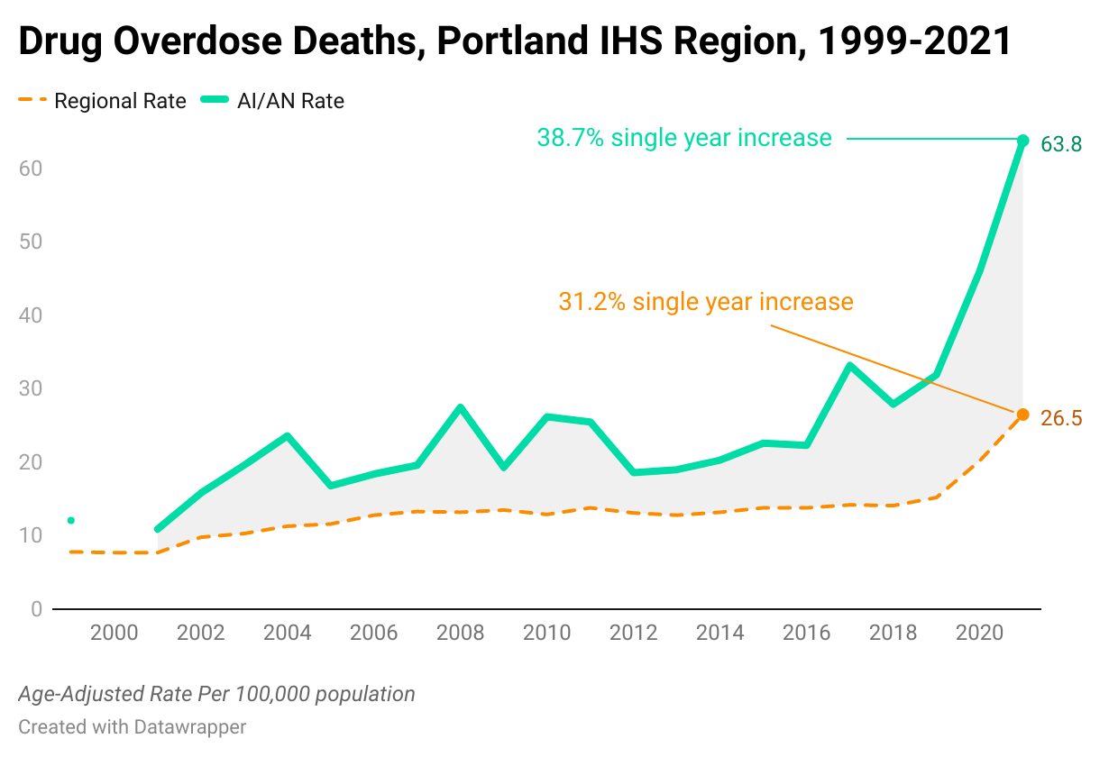
CDC NCHS Multiple Cause of Death Files, 1999-2020 bridged race & 2018-2021 single race on CDC WONDER Online Database
Northwest Portland Area Indian Health Board

Slide 40
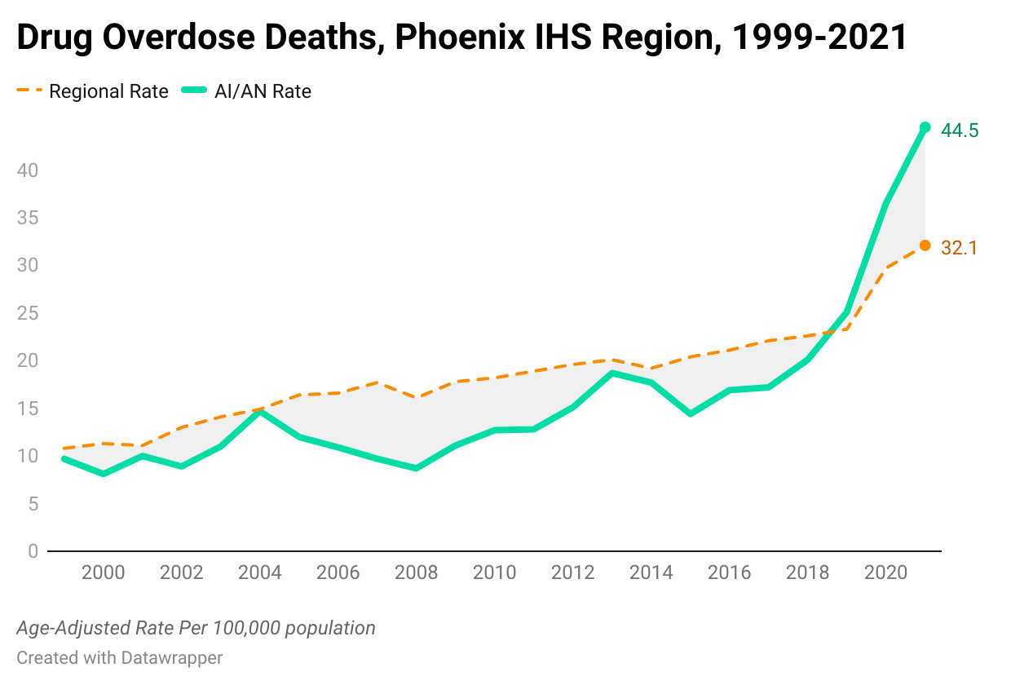

CDC NCHS Multiple Cause of Death Files, 1999-2020 bridged race & 2018-2021 single race on CDC WONDER Online Database
Northwest Portland Area Indian Health Board

Slide 41
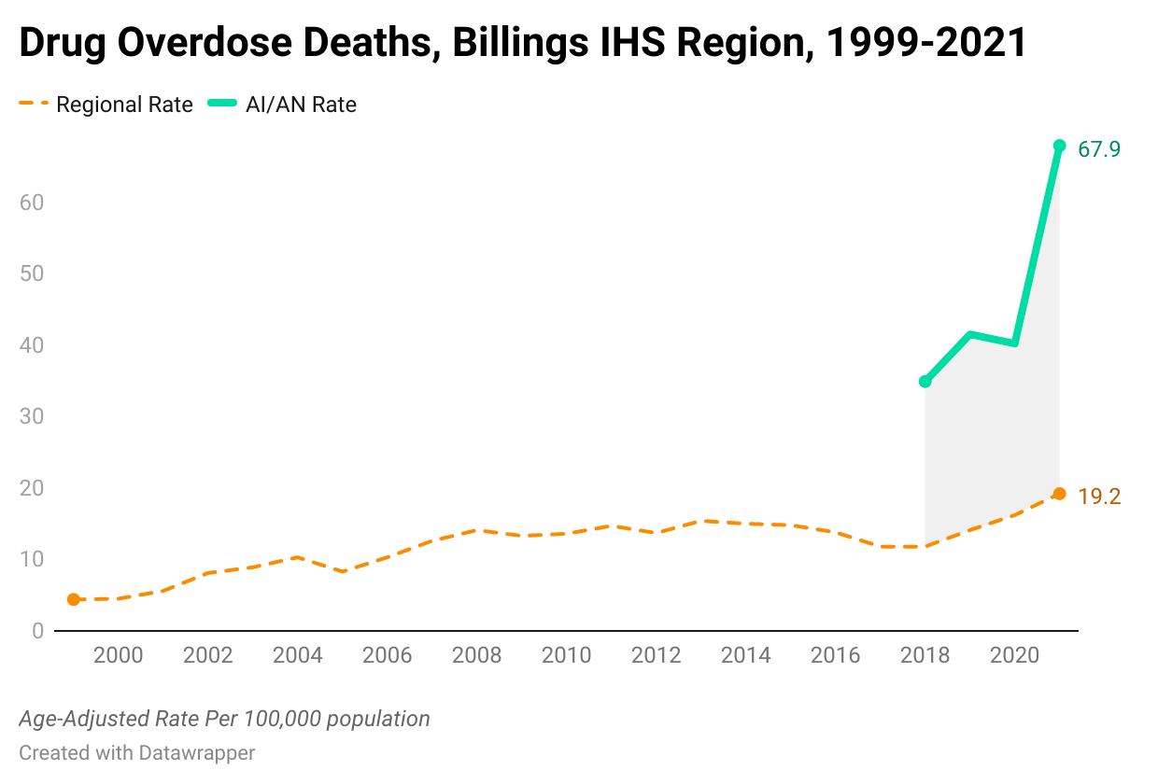
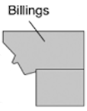
CDC NCHS Multiple Cause of Death Files, 1999-2020 bridged race & 2018-2021 single race on CDC WONDER Online Database
Northwest Portland Area Indian Health Board

Slide 42
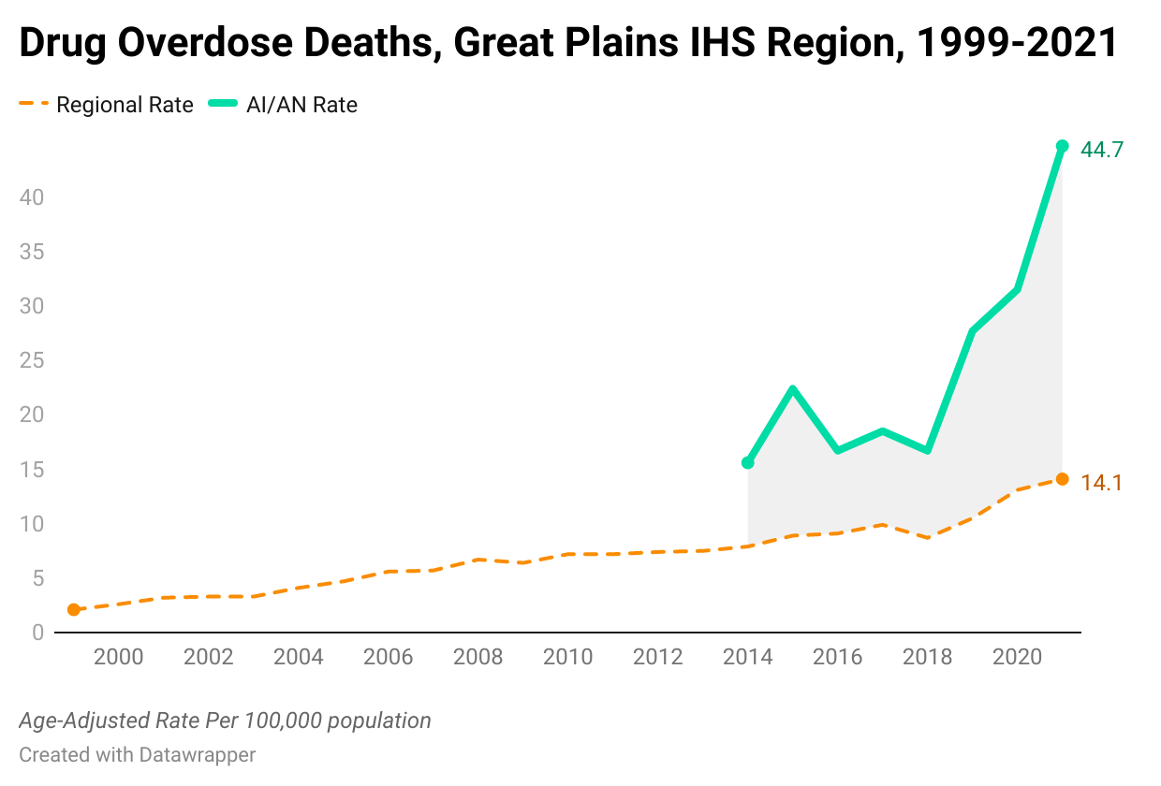
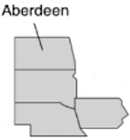
CDC NCHS Multiple Cause of Death Files, 1999-2020 bridged race & 2018-2021 single race on CDC WONDER Online Database
Northwest Portland Area Indian Health Board

Slide 43
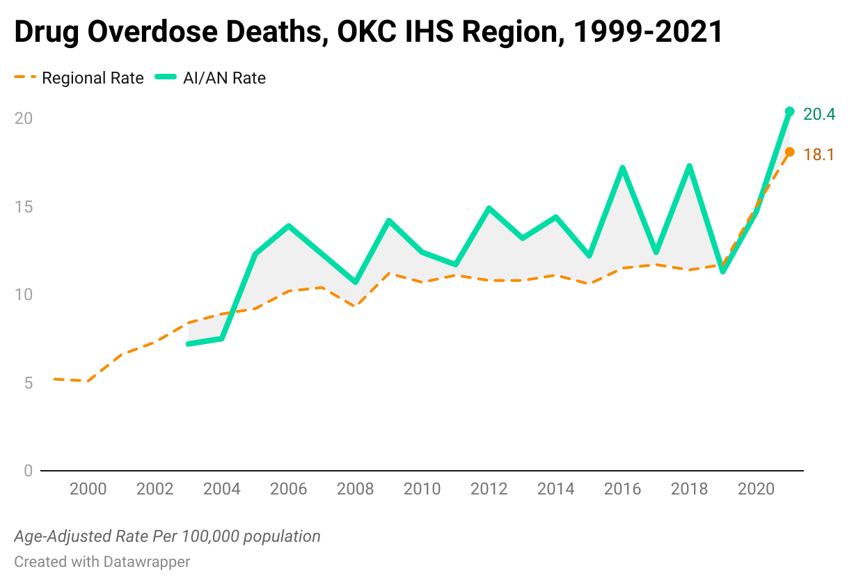
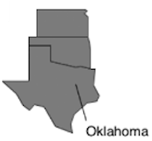
CDC NCHS Multiple Cause of Death Files, 1999-2020 bridged race & 2018-2021 single race on CDC WONDER Online Database
Northwest Portland Area Indian Health Board

Slide 44
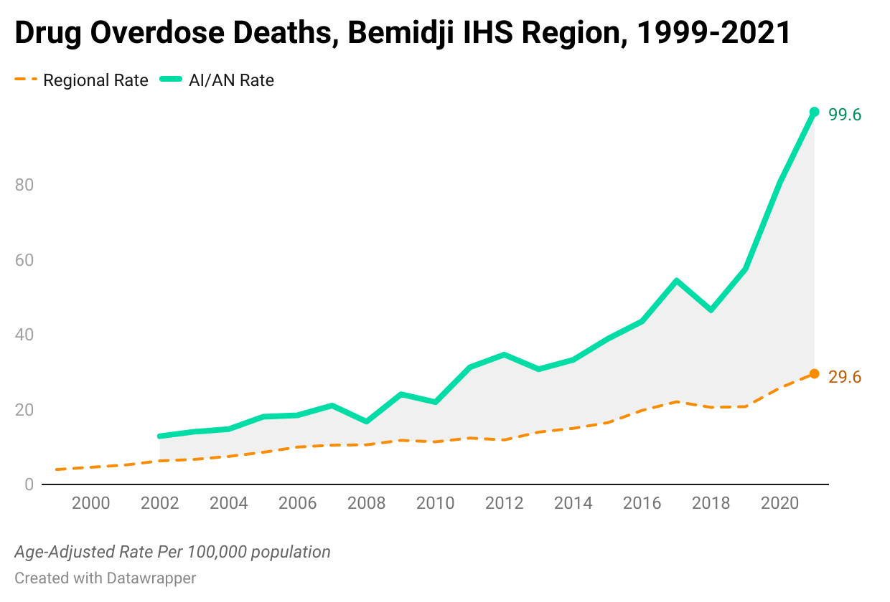

CDC NCHS Multiple Cause of Death Files, 1999-2020 bridged race & 2018-2021 single race on CDC WONDER Online Database
Northwest Portland Area Indian Health Board

Slide 45


CDC NCHS Multiple Cause of Death Files, 1999-2020 bridged race & 2018-2021 single race on CDC WONDER Online Database
Northwest Portland Area Indian Health Board

Slide 46


CDC NCHS Multiple Cause of Death Files, 1999-2020 bridged race & 2018-2021 single race on CDC WONDER Online Database
Northwest Portland Area Indian Health Board

Slide 47


CDC NCHS Multiple Cause of Death Files, 1999-2020 bridged race & 2018-2021 single race on CDC WONDER Online Database
Northwest Portland Area Indian Health Board

Slide 48
Racial Misclassification
An incorrect recording of a person’s race in a data or surveillance system
Misclassified AI/AN’s are not properly accounted for in health statistics, public health surveillance, and other key areas of population metrics
Incomplete health data for decision making
NPAIHB routinely performs data linkages in order to obtain “race-corrected” data in key databases (e.g., vital statistics, death certificate, birth data, STD data, etc.)
Northwest Portland Area Indian Health Board

Slide 49
Thank You!
Questions?
Northwest Portland Area Indian Health Board

