Slide 1
Managing Opioid Use Disorder in the Era of Fentanyl
Julie Byler, DO
Addiction Medicine Fellow
Oregon Health & Science University
Date: Feb. 19, 2023

Slide 2
disclosures
No financial disclosures to report
Disclaimers
  Will be discussing use of buprenorphine outside FDA approved package insert
  Tried to use best available evidence – literature changing rapidly in this domain and is often limited to clinical experience, and case reports/series.

Slide 3
Learning objectives
Explain unique characteristics of fentanyl and how they contribute to challenges in OUD management
Describe novel buprenorphine induction techniques and the evidence for each
Discuss the evidence behind dose limits for buprenorphine and how/when to consider using higher doses
Discuss use of XR buprenorphine in individuals using fentanyl
Identify how current methadone induction guidelines might be modified to improve care for individuals using fentanyl
Recognize areas for further research and why this is important

Slide 4
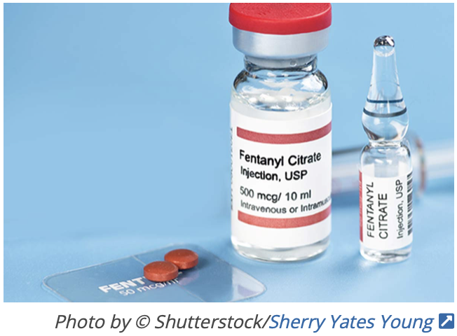
Background
Pharmaceutical fentanyl synthesized in 1960’s
Overdose deaths from non-pharmaceutical fentanyl first in mid-2000’s, but rare before mid 2010’s (and usually an adulterant)
Since around 2013, use has progressively increased and now widespread
In almost all states, fentanyl is primary opioid used and leading cause of opioid related deaths
Notes:
Pharmaceutical fentanyl synthesized in the 1960’s and there were reports of misuse of it since its production similar to all other pharmaceutical opioids, but reports of use of non-pharmaceutical fentanyl really didn’t start until the 2000’s and prior to 2013, it was limited to sporadic outbreaks of fentanyl analogues that could be traced to individual labs and was being used as an adulterant. Really wasn’t until 2013 and after that use started to drastically increase. Now, fentanyl is the primary opioid used and the leading cause of opioid related deaths in almost every state.

Slide 5
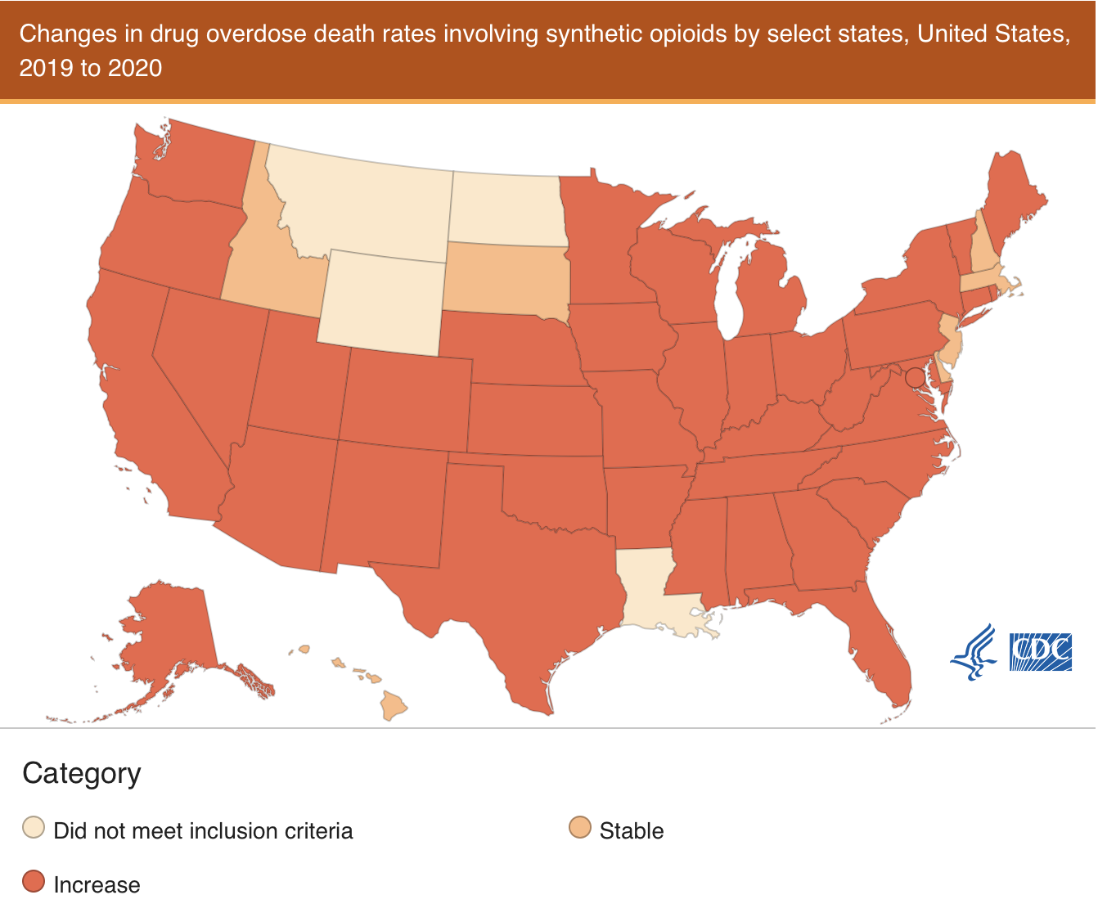
background
In 2020 - 82% of all opioid-involved deaths involved synthetic opioids, and death rates from synthetic opioids increased by over 56% nationally from 2019 to 2020¹
In Oregon – increased by 160.9% from 2019 to 2020¹
¹CDC/NCHS 2021
²Volkow 2021
Notes:
Easier to synthesize and manufacture, easier to traffic than heroin

Slide 6
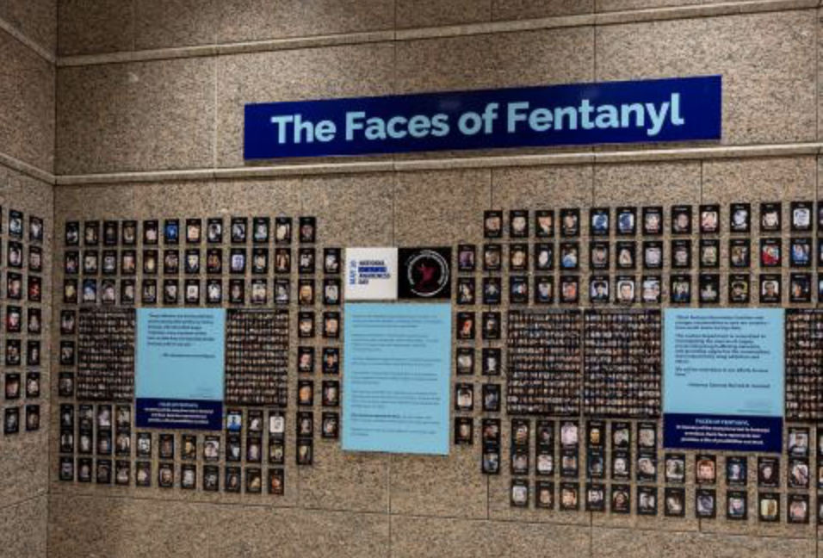
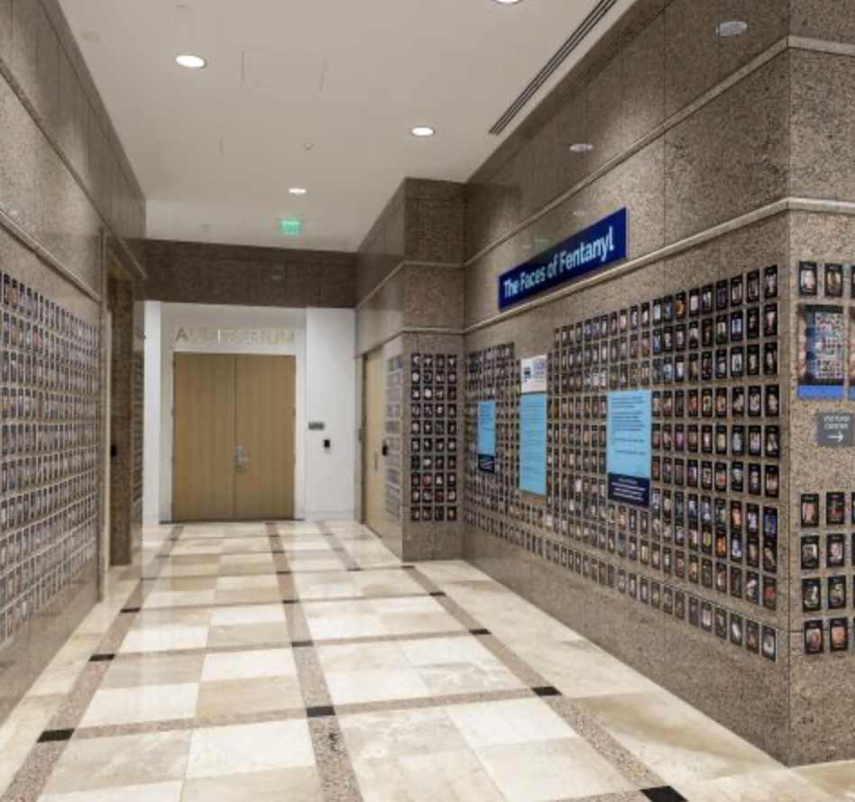
Source: DEA “Faces of Fentanyl” Exhibit. DEA Fentanyl Awareness. https://www.dea.gov/fentanylawareness
Notes:
This is a commemorative exhibit with pictures of individuals who have died 2/2 to fentanyl. According to CDC, 107,375 people in the US died of drug overdoses in the 12 month period ending in Jan 2022, which is the most ever reported. 67 percent of these involved synthetic opioids like fentanyl.

Slide 7
background
Why?
Easier to transport and traffic, requires more frequent use²
¹CDC/NCHS 2021
²Volkow 2021

Slide 8
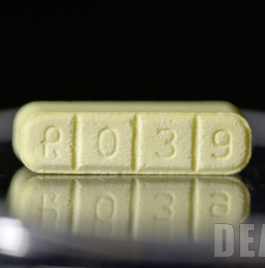
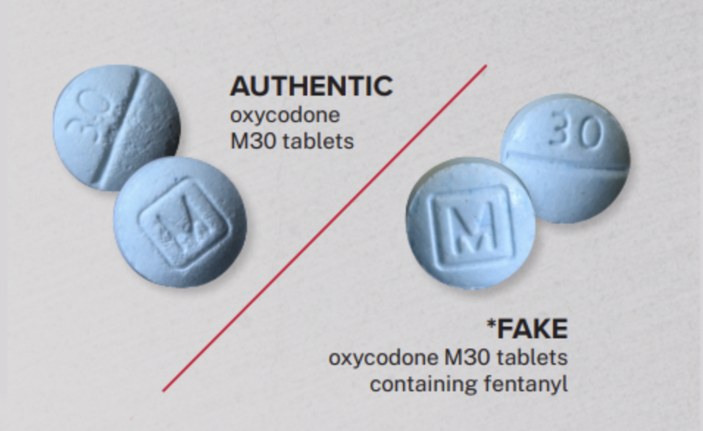
background
Most fentanyl being used is non-pharmaceutical and from a wide variety of fentanyl analogues with different potencies, pharmacokinetics
Data on specific analogues limited – testing is hard and infrequently performed
Source: DEA One Pill Can Kill. https://www.dea.gov/onepill
³Armenian et al. 2018
⁴Pichini et al. 2018
Notes:
One of the many challenges with the fentanyl epidemic is that the fentanyl being used is from a huge variety of different fentanyl analogues that we know very little about because testing is challenging, there is limited availability of accurate testing, and suppliers continue to manufacture new analogues in a way that is nearly impossible to keep up with.
Standard immunoassay screening in the clinical setting does not detect synthetic opioids. More complex methods such as gas chromatography mass spectrometry (GC-MS) or liquid chromatography tandem mass spectrometry (LC-MS/MS) are required for definitive detection. Disadvantage of GC-MS and LC-MS/MS is that the methods are often targeted in nature or limited by the availability of pre-established mass spectral libraries. Results are seldom available rapidly enough to contribute to the immediate care of a patient. Pichini et al. did a review in 2018 on different fentanyl analogues, toxicity, deaths and list some of the more common analogues (not all) and they list 48

Slide 9
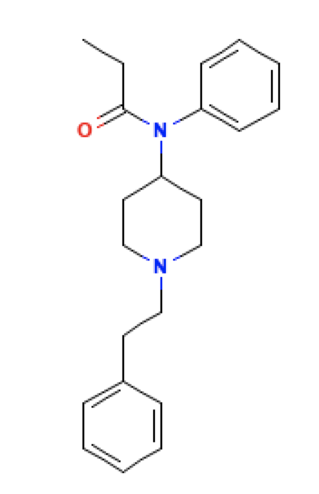
Pharmacology
Full agonists at mu-opioid receptor
Pharmacokinetics differ from analogue to analogue
Generally, very high affinity for receptors and very potent
Pharmaceutical fentanyl 80-100 fold higher potency than morphine and 30-50 fold higher than heroin
  Carfentanil 10,000 times more potent than morphine
⁵National Center for Biotechnology Information. PubChem Compound Summary for CID 3345, Fentanyl. https://pubchem.ncbi.nlm.nih.gov/compound/Fentanyl.
²Volkow 2021
⁶Ahmed et al. 2020
Notes:
-Increased uptake into CNS→more rewarding, higher risk of addiction, may also cause more severe/abrupt resp effects

Slide 10
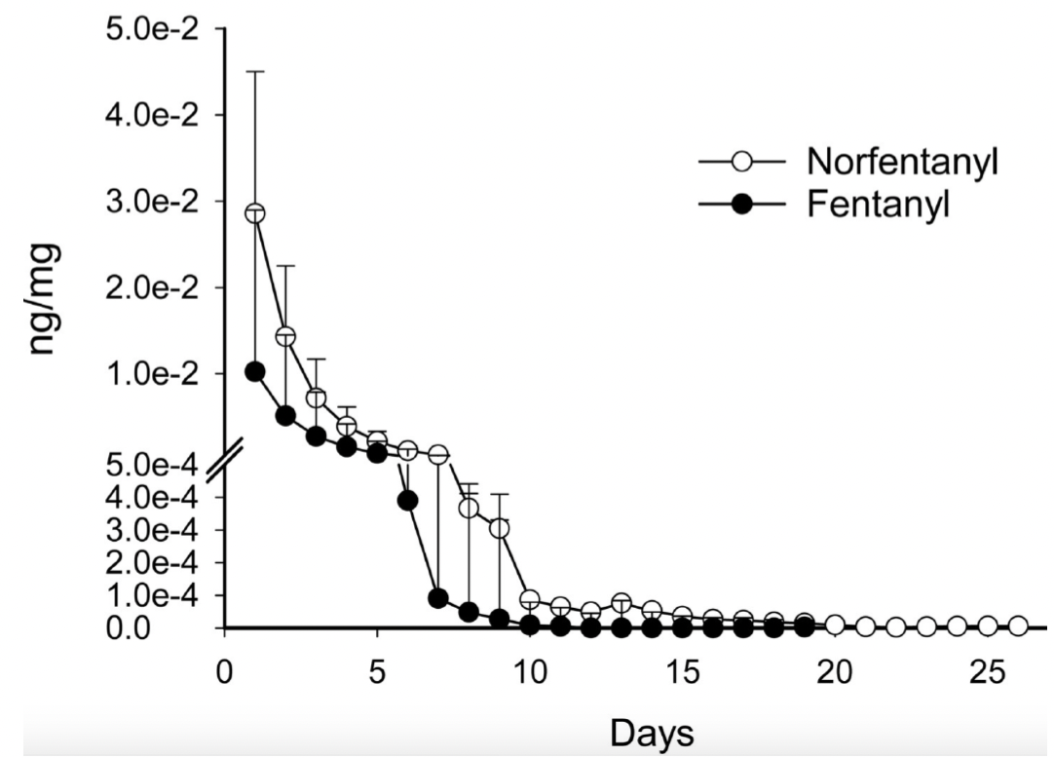
pharmacology
More lipophilic →
  Higher and faster uptake into CNS
  Implications re: reward value, respiratory effects
  Larger volume of distribution, prolonged clearance rates with regular use
With regular use
  7.3 days=mean clearance for fentanyl⁷
  13.3 days=mean clearance for norfentanyl⁷
⁷Huhn et al. 2020
²Volkow 2021
⁶Ahmed et al. 2020

Slide 11
Current Treatment Guidelines
Treatment guidelines the same
  Pharmacotherapy with buprenorphine, methadone or XR naltrexone
Clinical experience → more challenging
  Harder to induce on buprenorphine, more precipitated withdrawal
  Ongoing cravings and withdrawal despite typical doses of buprenorphine and methadone
Because of this, novel techniques for treatment are increasingly being explored
²Volkow 2021

Slide 12
buprenorphine

Slide 13
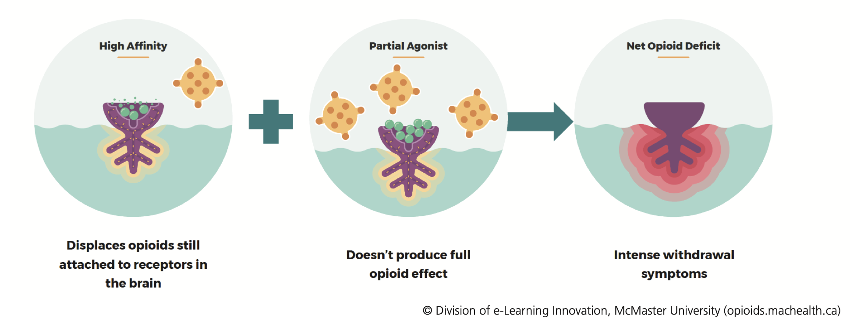
Buprenorphine inductions
Inductions more difficult
  More precipitated withdrawal (even after waiting > 24 hours)
  Withdrawal symptoms described as more severe, prolonged and difficult to manage with typical adjuncts
Notes:
Thought is that with prolonged use of fentanyl → high volume of distribution→ accumulates in fat stores → prolonged clearance rates → precipitated withdrawal even long after use

Slide 14
Buprenorphine inductions
Emerging strategies:
  Use higher COWS (i.e. 16)
  Schedule adjuncts. Consider using benzodiazepines in select patients (usually in the inpatient setting)
  Lower threshold to refer to inpatient setting
  Novel induction protocols
    Low-dose (“micro”) induction
    High dose induction
    “Micro/Macro” induction

Slide 15
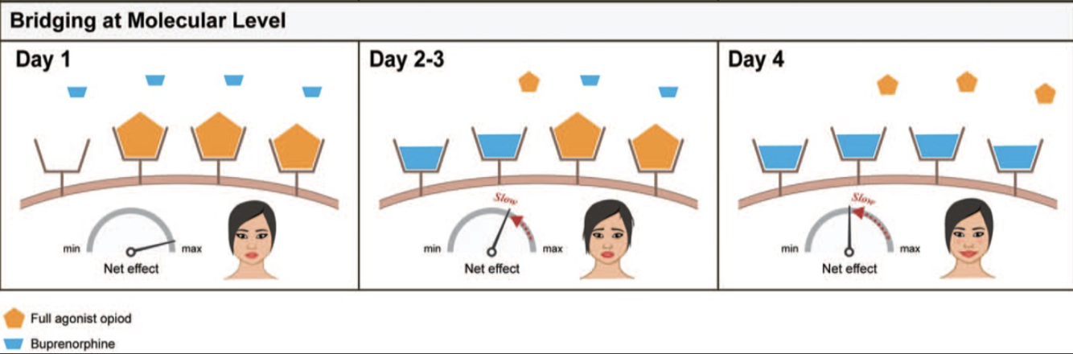
Low Dose (“Micro”) inductions
Start at low doses and slowly increase
Patient continues full agonist during induction process, stops once at therapeutic dose
Idea is to gradually introduce onto receptors to avoid precipitated withdrawal
A lot of different protocols
Most evidence limited to case reports/series, anecdotal evidence
⁸Ghosh et al. 2019

Slide 16
Low dose buprenorphine inductions
Advantages
Patients don’t need to go into withdrawal before induction
Avoids precipitated withdrawal
Allows ongoing full agonists for pain if needed
Disadvantages
Time (esp. in inpatient setting. More rapid inductions can help)
Can be complex for patients
Not perfect. Some patients still have withdrawal
More data/evidence needed on effectiveness
Many different protocols, unclear if some are better than others

Slide 17
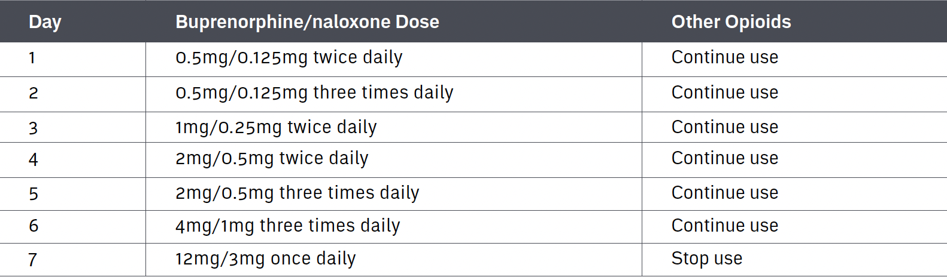
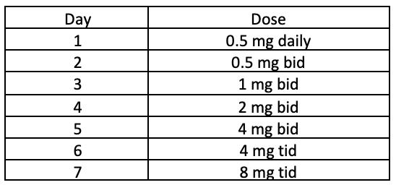
Low dose buprenorphine induction Protocols
Many different protocols
  Initial protocol “Bernese Method”
  Usually started at 0.2 mg – 0.5 mg
  Often 7-10 days
  No universally accepted regimen
⁹Opioid Use Disorder Practice Update (2022)
British Columbia Centre on Substance Use
Adapted from Yale protocol

Slide 18
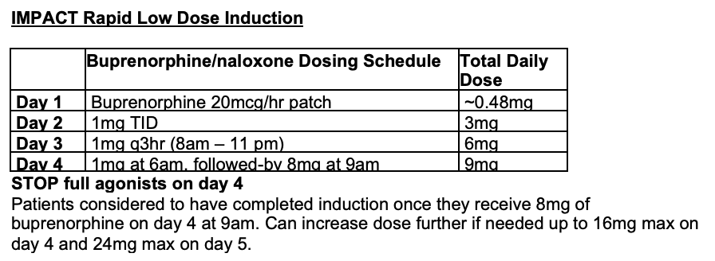
Rapid low Dose inductions

Slide 19
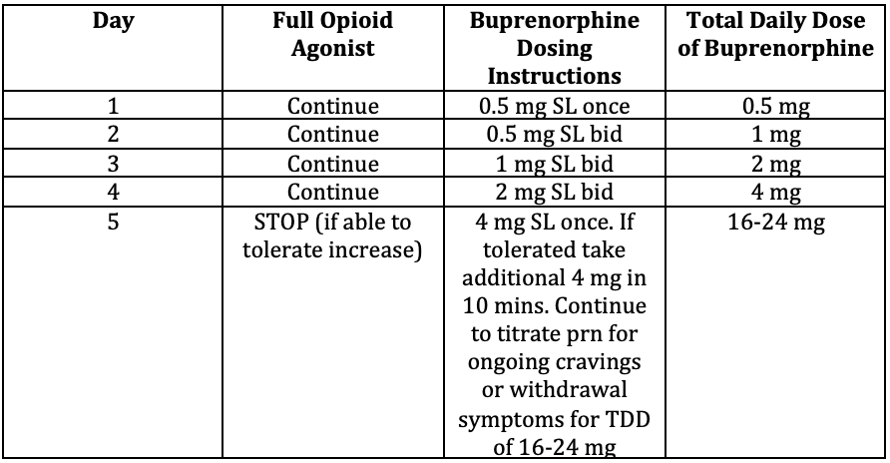
Rapid low dose inductions
Hooper Outpatient Rapid Low Dose Induction

Slide 20
Low Dose Inductions - Evidence
2021 Moe et al. Systematic Review¹⁰
  19 case studies/series and one feasibility study (n=57)
  26 different regimens
  About half (46%) were co-prescribed full agonists, the rest continued to use non prescribed opioids
  All patients got to desired maintenance dose
  Precipitated withdrawal only reported in 3 patients (5%)
  Return to use in 5 patients (9%)
  They were unable to comment on effectiveness or safety in comparison to standard inductions due to lack of studies
¹⁰Moe J et al. 2021
Notes:
Sixteen included studies were from North America and four from Europe. Where reported, 57.3% (33/57) of included patients were male and their mean age was 38 years (SD 12.0). Studies differed in selection criteria for including patients into a micro-induction intervention (n = 7 unspecified; n = 4 patient concerns for withdrawal; n = 3 difficulty weaning from fentanyl; n = 2 failed standard induction; n = 2 patient choice; n = 1 provider deemed most indicated; n = 1 study allocation by convenience then randomization). Studies differed in specified overlapping opioid agonists during the micro-induction: among 57 patients described, 26 had an overlapping agonist prescribed by a healthcare provider (n = 9 methadone; n = 5 fentanyl; n = 5 hydromorphone; n = 3 morphine; n = 4 multiple), and 31 were not prescribed a specific overlapping opioid and used illicit opioids during the induction period. Included studies described different patient outcomes. All were reported to have successfully achieved the maintenance dose, although some patients took multiple attempts and subsequent relapse was reported among 5/57 (8.8%) patients. All but one study described opioid withdrawal symptoms among included patients. Most studies (n = 14) did not specify how withdrawal was determined or indicated patient self-report; only six studies used standardized methods to ascertain withdrawal (n = 5 clinical opiate withdrawal scale; n = 1 short opiate withdrawal scale). Although difficult to disentangle withdrawal symptoms due to buprenorphine under-dosing from the occurrence of precipitated withdrawal, 19 studies (n = 54 patients) did not report precipitated withdrawal, and three studies (n = 3 patients) specifically reported that precipitated withdrawal occurred.

Slide 21
Low Dose Inductions - Evidence
“Highlights a paucity of high-quality evidence on buprenorphine micro-induction and a lack of understanding of the patient characteristics and clinical settings in which this method is likely to provide most benefit” (Moe J et al., 2021)
“Application of this method without clear evidence-based guidance on optimization of dosing regimens, nor on characteristics of patients and setting in which micro-induction is likely beneficial, risks wide use of unstandardized, suboptimal regimens and “indication creep”” (Moe J et al., 2021)
“Only by generating high-quality evidence will we be able to implement low-barrier and effective approaches to buprenorphine initiation as a key component of the response to the ongoing opioid crisis.” (Moe J et al., 2021)
Notes:
Findings are promising BUT quality of evidence is not good.

Slide 22
Low dose buprenorphine induction
Tips and tricks
  Complex dosing - good patient instructions helpful. Consider visual aids
Notes:
If having withdrawal stay at current day and repeat.

Slide 23
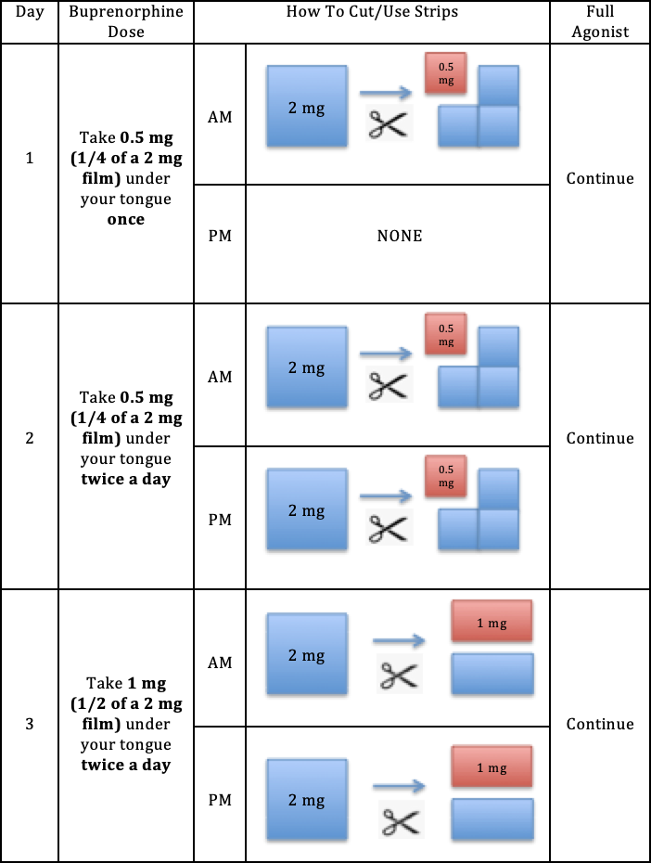
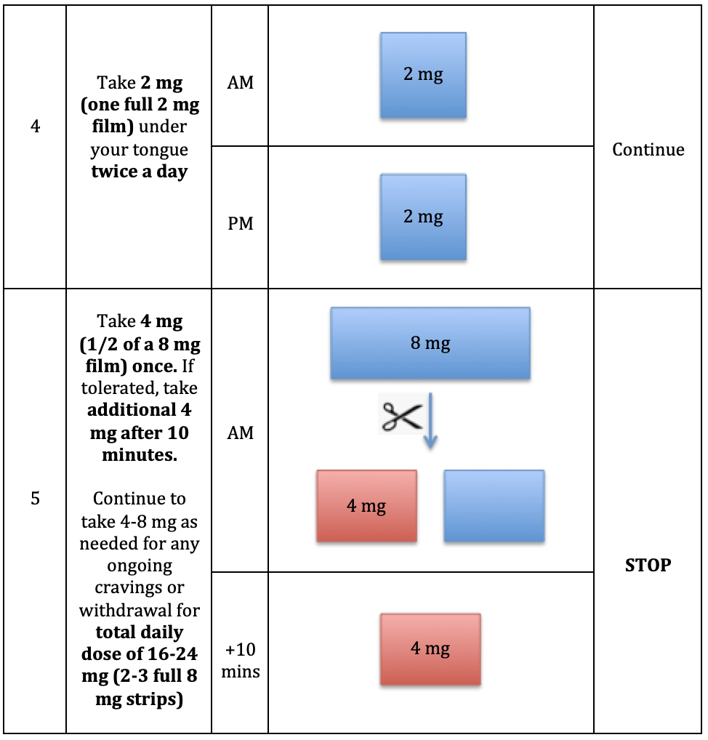
low Dose Buprenorphine induction
Patient instructions for our Hooper rapid low dose induction protocol

Slide 24
Low dose buprenorphine induction
Tips and tricks
  Complex dosing - good patient instructions helpful. Consider visual aids
  Specifically outline what adjunct meds you are giving and for what
  Instruct patients to take AM buprenorphine before their full agonist
  Close follow up
  Modify or slow protocol as needed (i.e. repeat days)
  Give naloxone to every patient
Notes:
If having withdrawal stay at current day and repeat.

Slide 25
High Dose “Macro” Buprenorphine induction

Slide 26
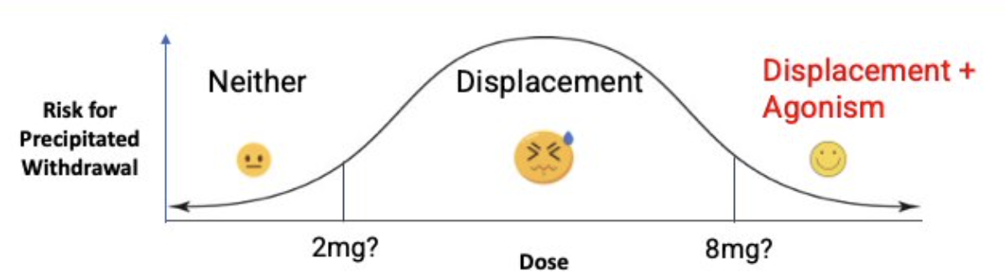
High Dose “Macro” Buprenorphine induction
What is it?
  Higher doses than used in standard inductions
  Wait until patient in withdrawal, same as standard inductions
Start with 8-16 mg
Idea is to get to agonism/relief of withdrawal symptoms quicker
Source: ¹¹Chen C. Buprenorphine Strategies in the Age of Fentanyl. Lecture presented at Rutgers New Jersey Medical School SUD MAT ECHO; April 1, 2022

Slide 27
High dose buprenorphine inductions
Advantages
Faster process
Disadvantages
Only evidence case study/series
Reduced risk of precipitated withdrawal
Beneficial in scenarios where only short contact with health care system (i.e. post-overdose/EMS, ED care)
Still some concerns re: risks, particularly in patients with co-morbidities, other centrally acting or sedating medications

Slide 28
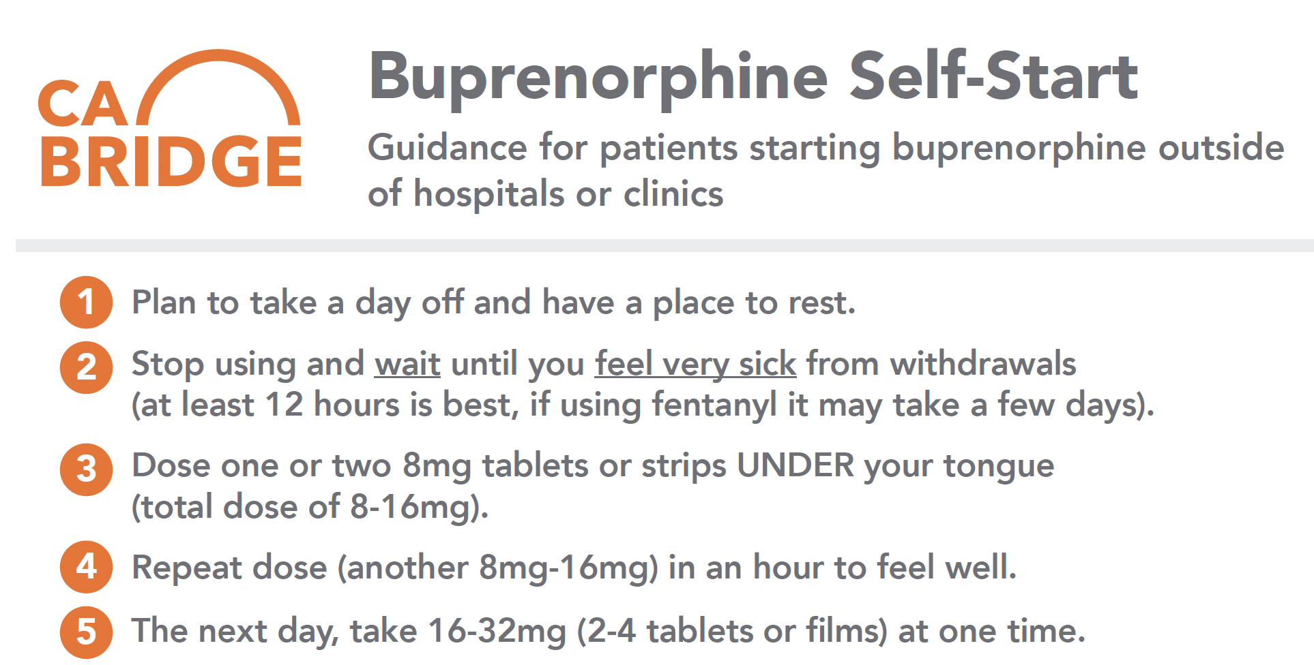
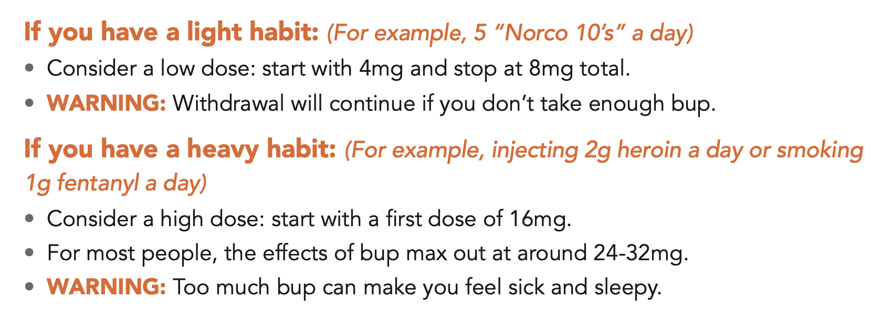
High Dose “Macro” Buprenorphine induction
¹²CA Bridge Self-Start. https://cabridge.org/resource/rapid-guidance-for-patients-starting-buprenorphine-outside-of-hospitals-or-clinics/

Slide 29
High dose buprenorphine induction
What is the data?
Is it safe?

Slide 30
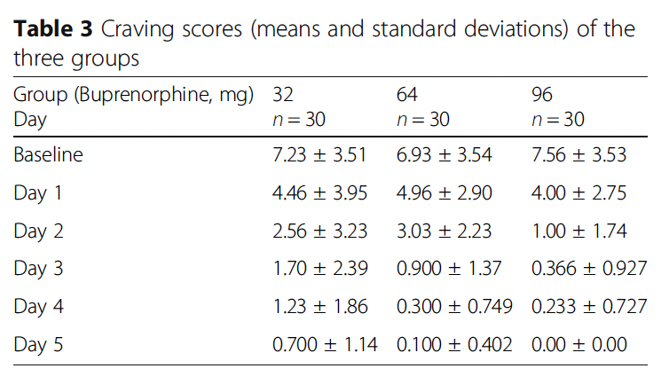
High Dose induction literature
  Single, high dose buprenorphine¹⁶
    Safety and efficacy on cravings
    90 patients (all men) randomized to 3 groups and received either a single 32, 64 or 96 mg dose
    Craving decreased from baseline in all, groups with higher doses had greater reduction in cravings
    No severe resp or GI adverse effects
    2 patients in 96 mg group developed hypotension
Ahmadi et al. 2020¹⁶
Notes:
Patients were excluded if they had substance use disorders involving drugs other than opioids (excluding tobacco), organic mental disorders, major medical diseases (hepatic, renal, cardiovascular, pulmonary, gastrointestinal, or malignant diseases), or any type of psychosis.

Slide 31
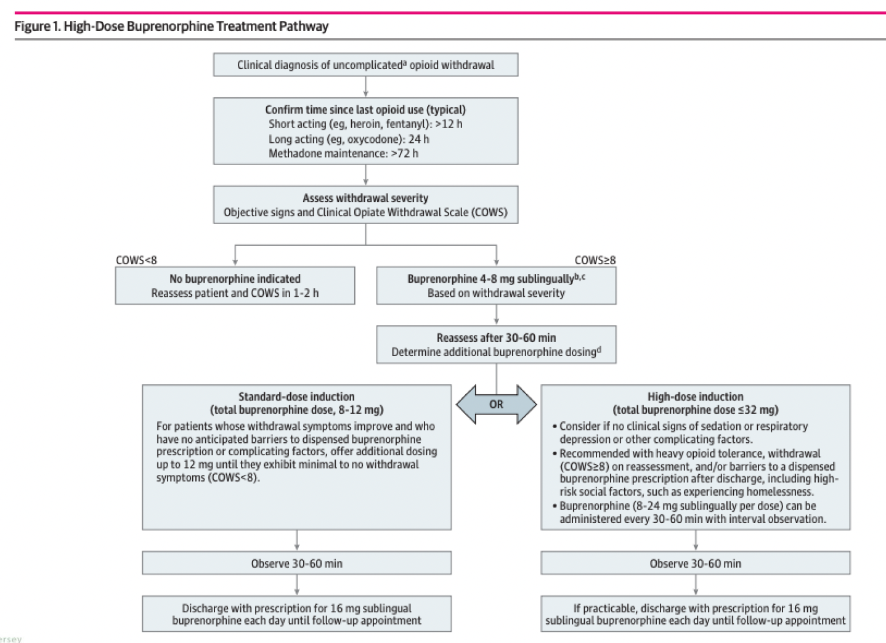
Herring et al. 2021¹⁷
Notes:
Using high dose in patients presenting to ED to help increase safety between ED discharge and outpatient follow up
371 unique cases
High doses considered if: no sedation, respiratory depression or other co-morbidities such as advanced age
No resp depression or sedation
Precipitated withdrawal did occur but was rare (0.8%) and not associated with dosing. Urban safety net hospital in California

Slide 32
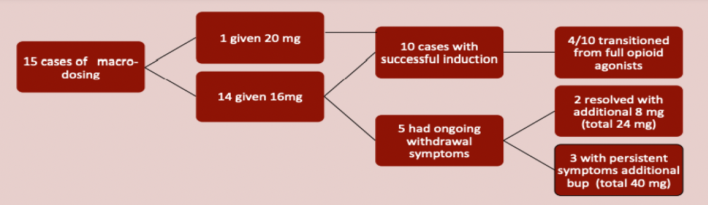
High dose Induction Literature
Rutgers case series¹⁵
  Inpatient consult service
  10 had successful induction, 5 had ongoing withdrawal symptoms
  2 of these resolved with additional 8 mg (total of 24 mg)
  3 had persistent symptoms and were given additional bupe (total of 40 mg)
Monteiro C et al. 2021 cited in Chan 2022¹⁵
Notes:
most of the literature in this Inpatient consult service

Slide 33
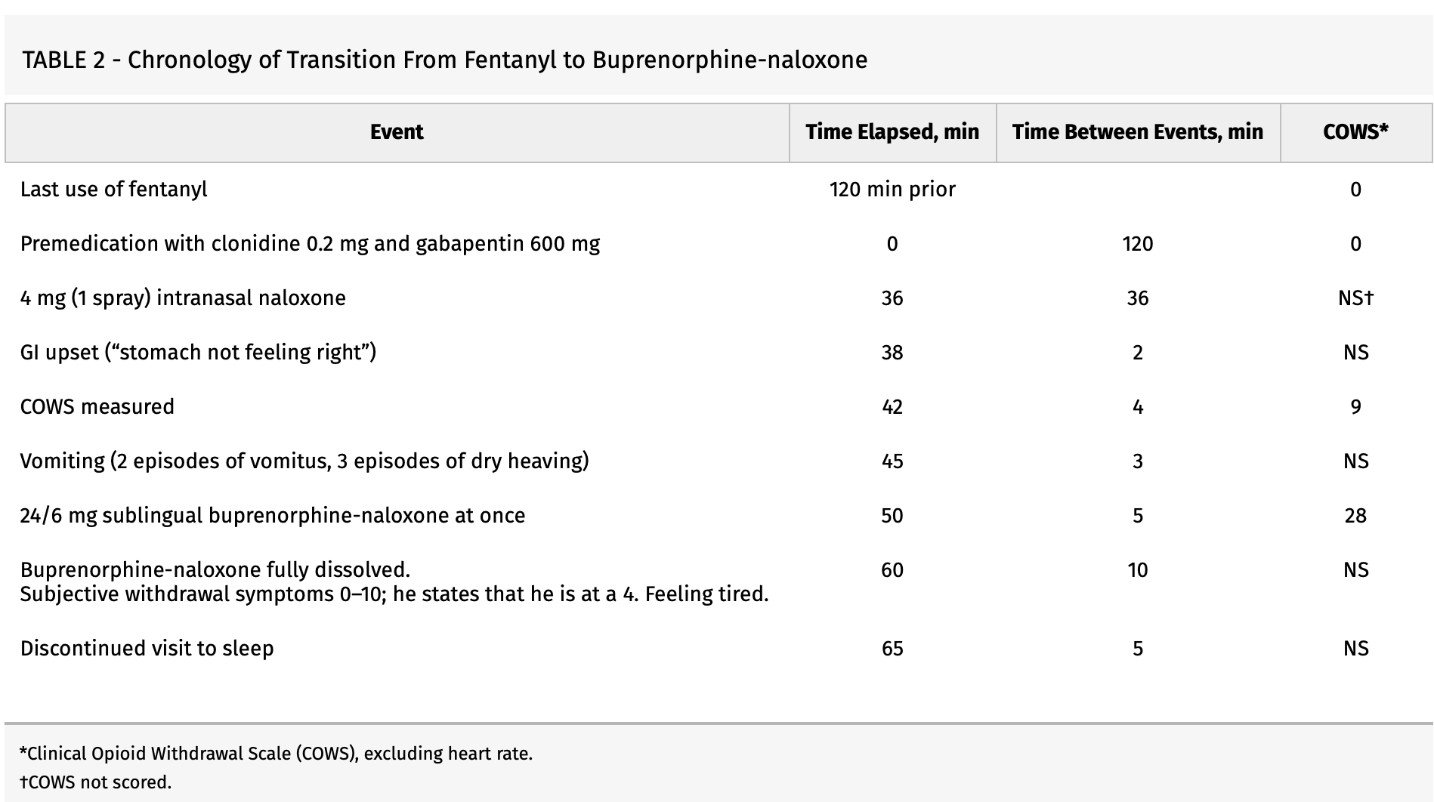
High dose Induction
Boulder Care “QuickStart”¹⁴
  Can start anytime after last use
  Self administer naloxone → withdrawal → give SL buprenorphine 24 mg
  Expect withdrawal and may be severe, but predictable and short
  Must be able to tolerate withdrawal
  Case report recently published
Randall A et al. 2022¹³
Notes:
A 33-year-old man with 2 years of daily fentanyl use presented to our telehealth addiction medicine program. His daily use averaged 2, ranging up to 20, pressed fentanyl tablets, which he crushed and inhaled. He occasionally used cannabis but denied other substance use and any chronic medical or psychiatric conditions. His past OUD treatment included extended-release naltrexone injection for 1 month on 2 separate occasions. He had not yet tried BUP-NX or methadone treatment. The patient's last use of 2 pressed fentanyl tablets was 2 hours before the appointment. He empirically took 0.2 mg of oral clonidine and 600 mg of gabapentin to mitigate the anticipated precipitated withdrawal from naloxone.

Slide 34
“Micro/Macro” Inductions
Low dose → high dose
Idea is to utilize advantages of both low dose and high dose inductions
Get some buprenorphine onto receptors → reduce risk of precipitated withdrawal
Then rapidly increase
Examples
  Day 1: 1 mg qid
  Day 2: 8-16 mg, additional prn up to 24-32 mg

Slide 35
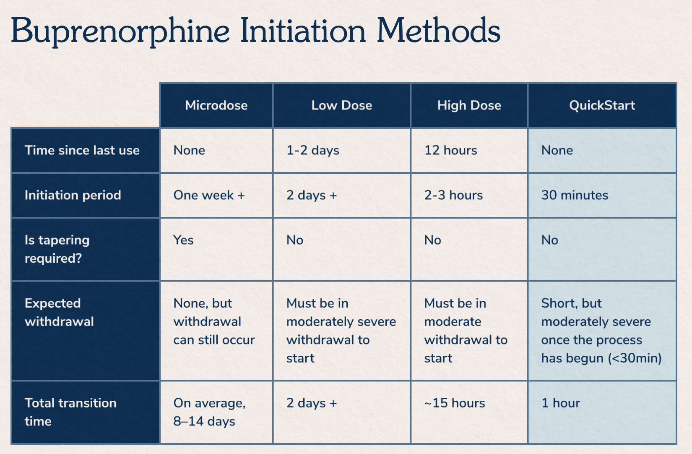
Comparing inductions
Source: Boulder Care. https://www.boulder.care/quickstart¹⁴

Slide 36
Buprenorphine - Maintenance
Many patients continue to have cravings and withdrawal symptoms at typical doses (16-24 mg)
Becoming more common to up titrate to 28-32 mg which seems to be helpful for some patients
What is the data?
Is it safe?

Slide 37
Evidence for buprenorphine dose limits
Most data for 24 mg ceiling dose came out in early 2000’s (before fentanyl) → FDA package insert recommendations
  Doses higher than this “not found to have clinical benefit” BUT hard to know how applicable this is in today’s environment
Studies consistently show dose dependent increase in mu opioid receptor occupancy, with near max occupancy at 32 mg/day
Cundiff et al. 2022¹⁸
Greenwald et al. 2003¹⁹

Slide 38
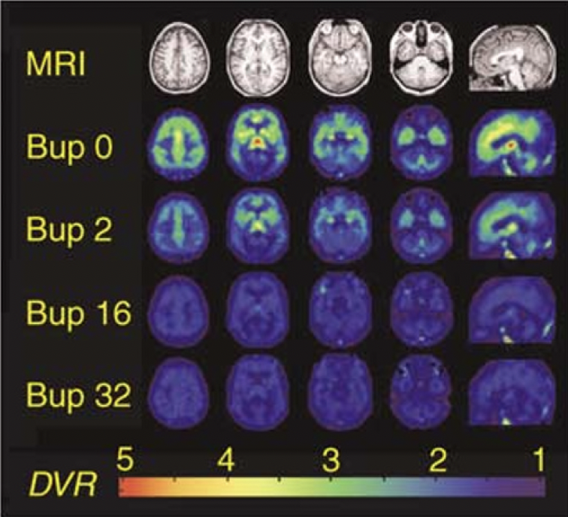
Evidence for buprenorphine dose limits
  2003 Greenwald Study on mu receptor occupancy
    80-92% occupancy at 16 mg/day
    89-98% occupancy at 32 mg/day
  Dose related improvement in withdrawal symptoms
Greenwald et al. 2003¹⁹
Notes:
Studies even prior to fentanyl (this was 5 heroin dependent volunteers)

Slide 39
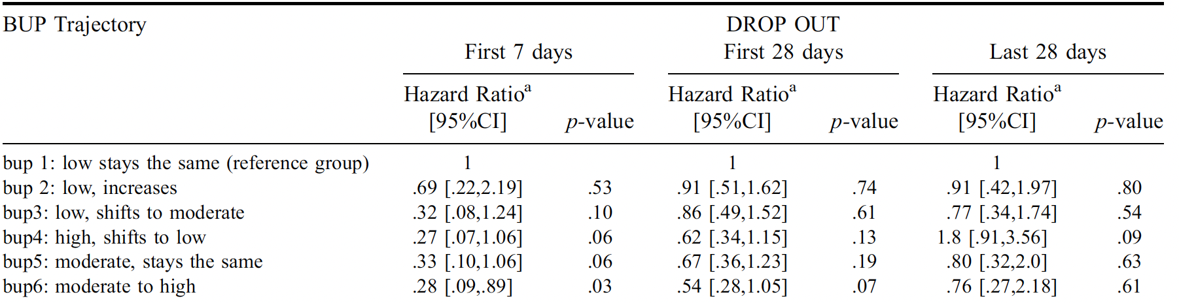
Buprenorphine maintenance doses
Effect of buprenorphine dose during induction and maintenance.
  Patients started on moderate dose (8-24 mg) and shifted to high dose (>24 mg) were less likely to drop out in first 7 days of treatment.
  No significant difference in adverse effects across groups
Jacobs et al. 2015²¹
Notes:
They looked at 6 different induction protocols (control was start low and stay low, and then protocol six was start moderate and then go to high). Looked at retention in treatment both in the first 7 days, first 28 days and last 28 days. Only found difference between protocols with protocol six at 7 days. Also looked at adverse events between all and there was no significant difference between any of the protocols

Slide 40
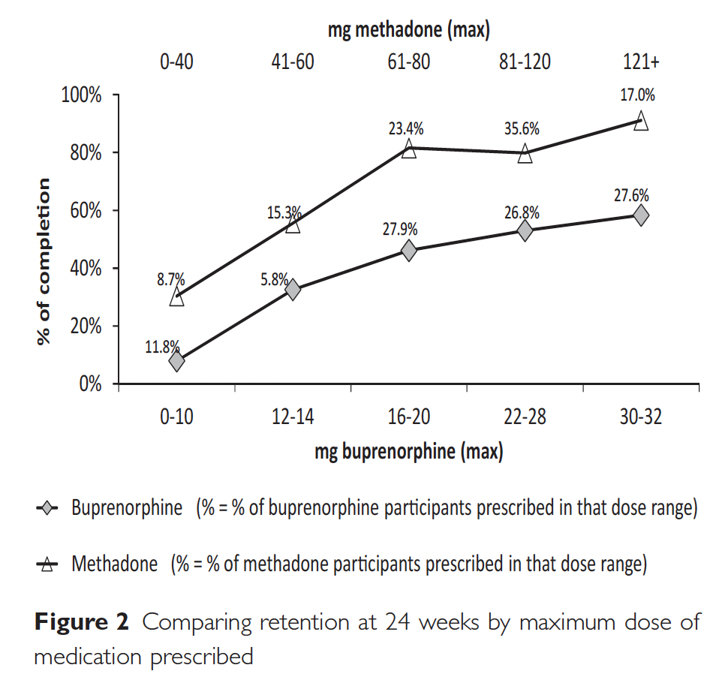
Buprenorphine maintenance doses
2014 open label RCT - treatment completion with buprenorphine vs methadone, also looked at treatment completion with different doses.
Hser et al. 2014²⁰
Notes:
Found that treatment completion increased linearly with higher doses and was highest (60%) with doses of 30-32 mg/day, higher doses also associated with lower opioid use
N=1,267 at 9 OTP’s in US. Bpe n=738, methadone n=529

Slide 41
Buprenorphine maintenance dose take-aways
Available evidence suggests it is probably safe to increase to 32 mg
New data also shows a trend towards improved withdrawal symptoms and treatment retention with higher doses
But again, more data is needed

Slide 42
Buprenorphine maintenance doses in the real world
How and when to increase
  Are goals being met?
  Make sure taking correctly
  Up titrate as needed
  Increase dose slowly by 4-8 mg until cravings and withdrawal improved
What about insurance?
  Can submit prior authorization
  For CareOregon: many providers prescribe combination of formulations
Notes:
Goals: patients feels dose is adequate, withdrawal and cravings are treated, opioid use is decreased
ASAM 2020 Guidelines: treatment goals are: suppress opioid withdrawal, block effects of illicit opioids, reduce opioid craving and stop or reduce the use of illicit opioids, promote and facilitate patient engagement in recovery oriented activities including psychosocial intervention
CareOregon knows about this and are keeping track of it, many physicians (like Amanda Risser leading the way at CCC) are actively working with CareOregon re: this and trying to get this barrier removed.
Prior auth criteria: For > 32 mg "Does the member meet one of the following scenarios? a. Recent acute pain while already established on 24mg b. Induction dosing for patients coming off Fentanyl c. Clear clinical rationale that 32mg is necessary (i.e., continues to have withdrawal symptoms despite 24mg dosing)"
Care Oregon: they will cover max three doses daily of each (i.e. could do buprenorphine-naloxone 8 mg tid plus buprenorphine 8 mg once daily for total of 32 mg daily).

Slide 43
Buprenorphine maintenance dosing
What if ongoing cravings and withdrawal even at 32 mg?
  Going above 32 mg? No good studies, although based on data showing linear improvement in treatment retention, some think that higher doses may provide even more benefit²⁰
  Could try XR buprenorphine (Sublocade)
  OR methadone

Slide 44
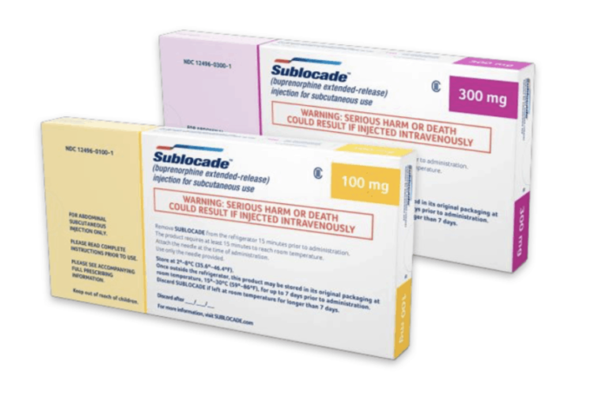
XR-Buprenorphine
Clinical trials have shown non-inferiority to SL buprenorphine and potentially some advantages²²
Studies have compared serum levels → higher with XR buprenorphine compared to typical SL doses
Australia study had higher patient satisfaction, convenience and quality of life (although no significant different in outcomes)²³
Evidence re: what patients benefit most is limited and still evolving
Source: American Addiction Foundation. https://www.americanaddictionfoundation.com/getting-help/medication-assisted-treatment-mat/sublocade/
Lofwall et al. 2018²²
Lintzeris et al. 2021²³
Notes:
Lofwall study: RESULTS: A total of 428 participants (263 men [61.4%] and 165 women [38.6%]; mean [SD] age, 38.4 [11.0] years) were randomized to the SL-BPN/NX group (n = 215) or the SC-BPN group (n = 213). The response rates were 31 of 215 (14.4%) for the SL-BPN/NX group and 37 of 213 (17.4%) for the SC-BPN group, a 3.0%difference (95%CI, -4.0%to 9.9%; P < .001). The proportion of opioid-negative urine samples was 1099 of 3870 (28.4%) for the SL-BPN/NX group and 1347 of 3834 (35.1%) for the SC-BPN group, a 6.7%difference (95%CI, -0.1%to 13.6%; P < .001). The CDF for the SC-BPN group (26.7%) was statistically superior to the CDF for the SL-BPN/NX group (0; P = .004). Injection site adverse events (none severe) occurred in 48 participants (22.3%) in the SL-BPN/NX group and 40 (18.8%) in the SC-BPN group. CONCLUSIONS AND RELEVANCE: Compared with SL buprenorphine, depot buprenorphine did not result in an inferior likelihood of being a responder or having urine test results negative for opioids and produced superior results on the CDF of no illicit opioid use. These data suggest that depot buprenorphine is efficacious and may have advantages
For this study had 24 week retention of 73%
Lintzeris study: Question Are patient-reported outcomes, such as treatment satisfaction with medication, higher among patients treated with weekly and monthly subcutaneous buprenorphine depot formulations vs daily sublingual buprenorphine?
Findings In this open-label randomized clinical trial of 119 participants, the mean Treatment Satisfaction Questionnaire for Medication global score was significantly higher in the group receiving depot buprenorphine than in the group receiving sublingual buprenorphine at week 24.
Meaning These findings suggest that treatment satisfaction and other patient-reported outcomes may serve as alternative end points to traditional markers of substance use when comparing different medications in addiction outcome studies.
Objective To compare patient satisfaction between depot buprenorphine and sublingual buprenorphine in adult outpatients with opioid dependence.
Design, Setting, and Participants This open-label, randomized clinical trial was conducted among adult patients with opioid dependence at 6 outpatient clinical sites in Australia from October 2018 to September 2019. Data analysis was conducted from October 2019 to May 2020.
Interventions Participants were randomized to receive treatment with weekly or monthly depot buprenorphine or daily sublingual buprenorphine over 24 weeks.
Main Outcomes and Measures The primary end point was the difference in global treatment satisfaction, assessed by the Treatment Satisfaction Questionnaire for Medication (TSQM) version 1.4 (range, 0-100; higher score indicates greater satisfaction) at week 24. Secondary end points included other patient-reported outcomes, including quality of life, treatment burden, and health-related outcomes, as well as measures of opioid use, retention in treatment, and safety.
Results A total of 119 participants (70 [58.8%] men; mean [SD] age, 44.4 [10.5] years) were enrolled, randomized to, and received either depot buprenorphine (60 participants [50.4%]) or sublingual buprenorphine (59 participants [49.6%]). From the initial sample of 120, a participant (0.8%) in the sublingual buprenorphine group withdrew consent and did not receive study treatment. All participants were receiving sublingual buprenorphine when enrolled. The mean TSQM global satisfaction score was significantly higher for the depot group compared with the sublingual group at week 24 (mean [SE] score, 82.5 [2.3] vs 74.3 [2.3]; difference, 8.2; 95% CI, 1.7 to 14.6; P = .01). Improved outcomes were also observed for several secondary end points after treatment with depot buprenorphine (e.g., mean [SE] treatment burden assessed by the Treatment Burden Questionnaire global score, on which lower scores indicate lower burden: 13.2 [2.6] vs 28.6 [2.5]; difference, −15.4; 95% CI, −22.6 to −8.2; P < .001). Thirty-nine participants (65.0%) in the depot buprenorphine group experienced 117 adverse drug reactions, mainly injection site reactions of mild intensity following subcutaneous administration, and 12 participants (20.3%) in the sublingual buprenorphine group experienced 21 adverse drug reactions. No participants withdrew from the trial medication or the trial due to adverse events.
Conclusions and Relevance In this study, participants receiving depot buprenorphine reported improved treatment satisfaction compared with those receiving sublingual buprenorphine. The results highlight the application of patient-reported outcomes as alternative end points to traditional markers of substance use in addiction treatment outcome studies.

Slide 45
XR-BUprenorphine
Current recommendation → stabilized on SL buprenorphine first for 7 days
Push towards starting earlier – rapid induction case series²⁴ Patients using high potency synthetic opioids
  Given injection once tolerated at least 16 mg x 2 days
Mariani et al. 2020²⁴
Notes:
Increased risk of relapse, loss to follow up during these first few days, especially with fentanyl users– more withdrawal and difficulty getting on buprenorphine as we have discussed
Idea of stabilization is to ensure can tolerate 300 mg and ensure no precipitated withdrawal

Slide 46
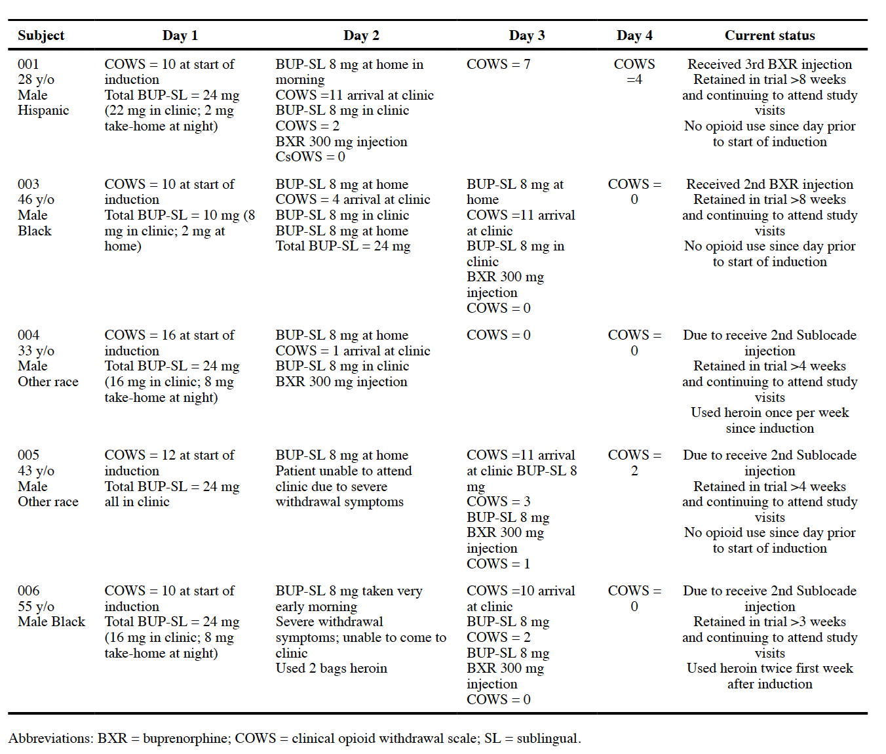
2 patients got injection on 2nd day of induction and 3 on the third day
Within 24 hours withdrawal sx were controlled
All five retained at least 1 month
Mariani et al. 2020²⁴

Slide 47
XR-Buprenorphine
Need for SL supplementation
  Research still in progress
  Anecdotally, often needing additional SL for first weeks to months of treatment
  Study in low-barrier Boston bridge clinic – 55% needed supplementation for varying time periods³¹
  Patients not stabilized on SL buprenorphine may be more likely to require
  Can give prn, close follow up to see what needing

Slide 48
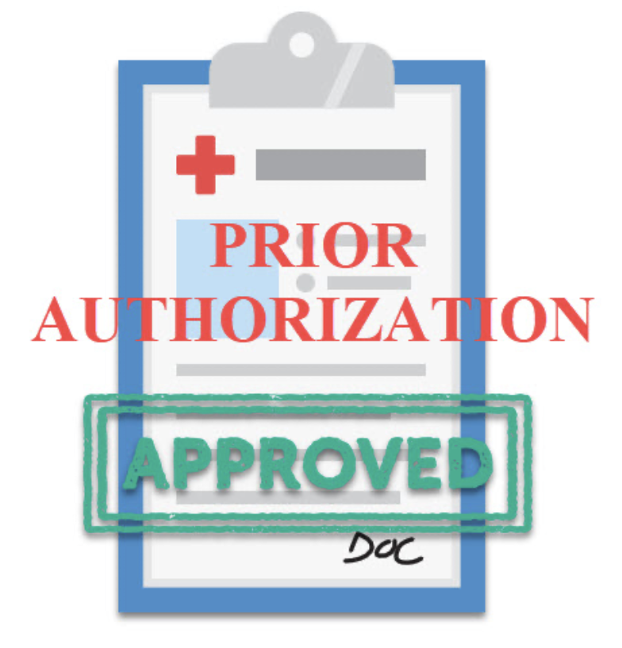
XR-Buprenorphine
In Oregon need prior authorization
  Overdose, hospitalization history
  Difficulties with maintenance, evidence of re-inductions
  Unable to tolerate SL
  Document as much detail as possible (i.e. with dates)
Photo credit: https://www.psychiatryatlanta.com/medication/prior-authorization/

Slide 49
methadone

Slide 50
Methadone
Often used if unable to tolerate buprenorphine induction or withdrawal symptoms or not meeting treatment goals on buprenorphine
Or patient preference
Concerns re: safety and risk profile, as well as concerns regarding availability → often leads to methadone being more of a second line recommendation for providers
However, numerous studies have shown that methadone has better retention than buprenorphine
Hemmons et al. 2019²⁵
Notes:
-Why second line? Concerns regarding safety/risk and that it is not as safe as buprenorphine. More difficult to get since can only get through OTP’s
-However numerous studies that methadone has better retention
-Why low and slow up-titration? due to concerns regarding adverse effects, accumulation
-Subtherapeutic dosing → continue to have cravings/withdrawal, often continue to use, risk of overdose, increased risk of drop out – very problematic, risk of overdose actually highest 4 weeks after methadone discontinuation, really want to keep people in treatment

Slide 51
methadone
Hser et al. 2014²⁰

Slide 52
Methadone
Current protocols re: methadone initiation based on expert consensus and data mostly prior to fentanyl
Start low, and increase slowly
  Usually no more than 30 mg daily, increasing by 5-10 mg every 3-5 days
Unfortunately, often leads to period of subtherapeutic dosing during initiation (can be months)
Hemmons et al. 2019²⁵
Notes:
-Why second line? Concerns regarding safety/risk and that it is not as safe as buprenorphine. More difficult to get since can only get through OTP’s
-However numerous studies that methadone has better retention
-Why low and slow up-titration? due to concerns regarding adverse effects, accumulation
-Subtherapeutic dosing → continue to have cravings/withdrawal, often continue to use, risk of overdose, increased risk of drop out – very problematic, risk of overdose actually highest 4 weeks after methadone discontinuation, really want to keep people in treatment

Slide 53
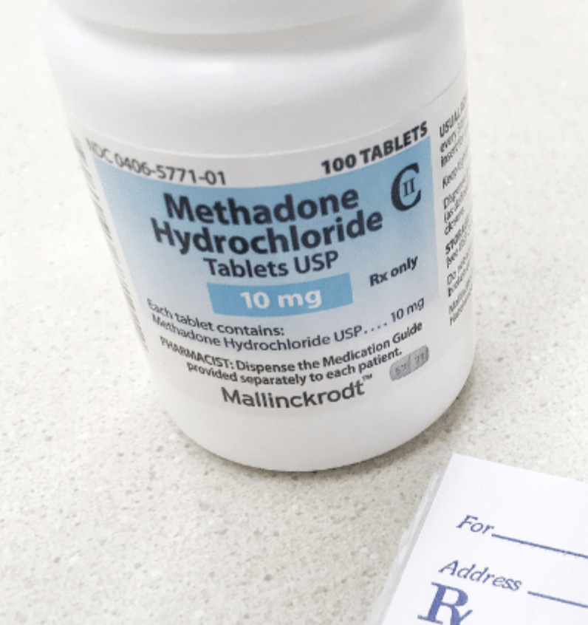
Methadone
Risk of overdose higher until achieve dose stabilization
Overdose highest in the 4 weeks after discontinuing methadone
How can we improve?
Photo Credit: https://www.healthaffairs.org/do/10.1377/forefront.20220524.911965
Modesto-Lowe et al. 2010²⁶
Buresh M et al. 2022²⁷

Slide 54
methadone
More Rapid Titration
Is it safe?
Notes:
-Methadone usually started at low (subtherapeutic) doses and very slowly uptitrated over weeks to months. Problematic because people are then undertreated for that first period→ more cravings, withdrawal and risk of return to use.
-In inpatient setting, able to assess more frequently, good opportunity to potentially increase rate of titration

Slide 55
Methadone
OTP’s starting to come out with new guidelines
Updated Meta:Phi guideline (Ontario, CA)
  Attempt to reach adequate dose as quickly as safely possible
  Start at 30 mg
  Increase by 10-15 mg every 3-5 days (for most) until at 75-80 mg
  Then increase by 10 mg every 5-7 days
  Add slow-release oral morphine if needed while getting to therapeutic dose**
  Methadone doses of 100-120 mg or higher often needed
  Increase as needed if ongoing use
Bromley et al 2021²⁸
Notes:
If not at risk for methadone toxicity – ie concurrent use of alcohol or benzodiazepines, high risk medical co-morbidities

Slide 56
methadone
Rhode Island Cohort
  Started 30 mg on day 1
  Increased by 10 mg/day up to 50 mg
  Increase by max of 20 mg per week
  Evaluated outcomes at 12 months
  53% retention rate
  Had frequent ongoing fentanyl exposure (about 70%)
  Median methadone dose 100 mg
  No deaths in any that completed full 12 months
Stone et al. 2020²⁹
Notes:
Objectives: Measure 12-month treatment outcomes for methadone maintenance treatment (MMT) in a fentanyl endemic area.
Outcomes: Primary: 1) Treatment retention; 2) sustained remission (defined as 3 consecutive negative screens); 3) return to use; 4) methadone dosage required; and 5) number of days to achieve remission. Secondary: Mortality.
Methods: A naturalistic follow-up study and retrospective review of consecutive patients newly admitted to a single methadone maintenance treatment program in Rhode Island.
Results: We observed 154 unique intake events (representing 151 patients). Eighty percent (n = 121) tested positive for fentanyl at intake. Seventy-five percent of patients achieved remission within the 12-month study period. One-year retention was 53% for fentanyl-exposed individuals and 47% for those not exposed. The majority (99%) of patients who remained in treatment at 12 months achieved remission. We saw prolonged, sustained remission in 44% of patients exposed to fentanyl at intake and 47% of those who were not. Dose and time to remission were similar. Unfortunately, 4 patients died after leaving MMT prematurely.
Conclusions: This study suggests MMT is safe despite repeated exposure to fentanyl while taking methadone. Remission is achievable, and MMT is protective against death among fentanyl-exposed patients while in treatment.

Slide 57

methadone
Still somewhat limited in speed, particularly in the outpatient setting, in order to ensure safety
In-patient - more monitored setting and potential to go even faster

Slide 58
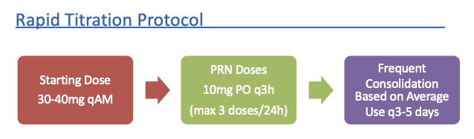
methadone
British Columbia Case Study – got up to 70 mg in 48 hours in an inpatient without adverse effects²⁵
British Columbia (St. Paul’s Hospital) retrospective cohort study on rapid inpatient methadone titration (N=98)
Klaire et al 2022³⁰
Notes:
-Hammons Case Study: One patient. Used smaller but more frequent dosing in patient using 1gm of heroin (not even, received total of 130 mg methadone in first 48 hours. NO AE’s in 9 day f/u (Hemmons)
-BC cohort study
British Columbia Rapid Methadone Titration
2 major adverse events (1 sedation requiring naloxone and 1 transfer to ICU)
Mild adverse events – 9 patients with dose held due to sedation, 1 dose held due to nausea
Overall, fairly safe

Slide 59
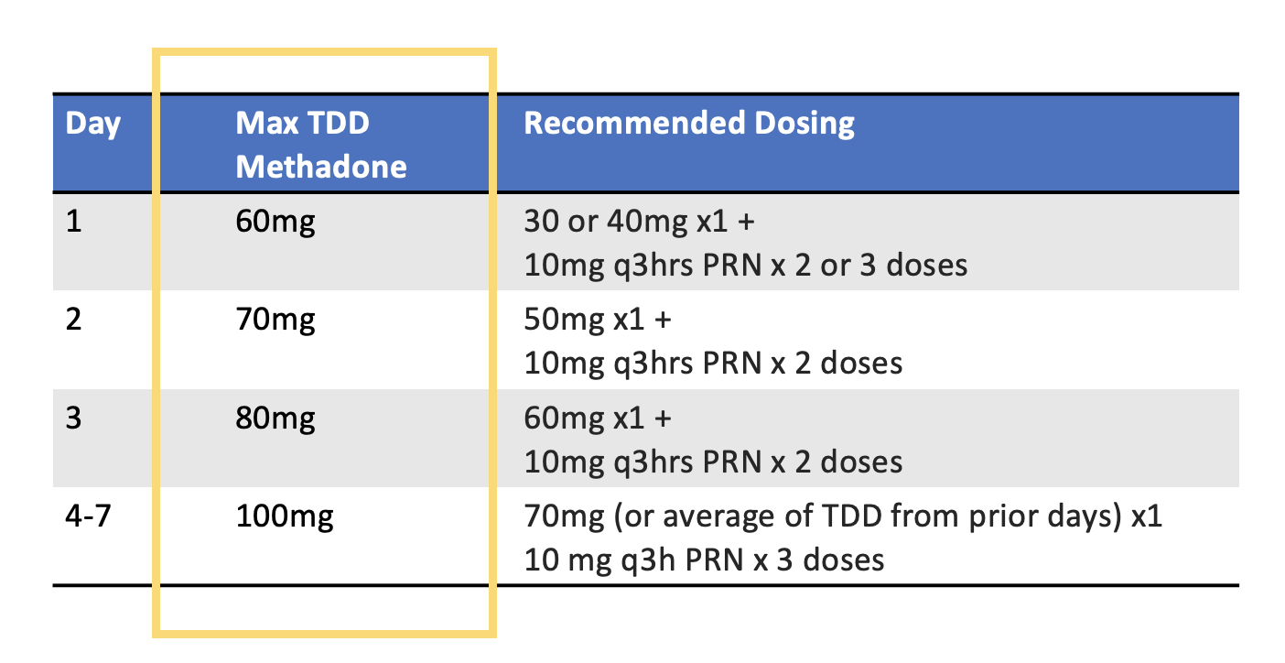
methadone
Current OHSU inpatient rapid methadone titration protocol
Courtesy Pat Liu, MD OHSU Addiction Medicine Fellow

Slide 60
methadone
Take Homes
  Ongoing advocacy re: regulations needed
  More data needed on outcomes and safety for new protocols – increase acceptability and allow for standardization
  Recommend starting MOUD in the hospital, incl. methadone, and consider using opportunity to increase more rapidly

Slide 61
Final thoughts
Fentanyl use has created new, unique challenges in the management of OUD
Have been trying new, creative protocols to try to mitigate these challenges
Is a role for flexibility and modifying in a patient centered way
BUT we still need more, high-quality data on various protocols
  Ensure patient safety
  Know which protocols might be best for different patients
  Get standardized recommendations to ensure access for all patients - not just those with access to experts

Slide 62
Questions?
Comments?
Contact Info:
Julie Byler, D.O.
byler@ohsu.edu

Slide 63
References
1) CDC/NCHS National Vital Statistics System, Mortality. CDC WONDER, Atlanta, GA: US Department of Health and Human Services, CDC; 2021. Accessed Jan 3, 2022. https://wonder.cdc.gov/
2) Volkow ND. The epidemic of fentanyl misuse and overdoses: challenges and strategies. World Psychiatry. 2021;20(2):195-196. doi:10.1002/wps.20846
3) Armenian P, Vo KT, Barr-Walker J, Lynch KL. Fentanyl, fentanyl analogs and novel synthetic opioids: A comprehensive review. Neuropharmacology. 2018;134:121-132. doi:10.1016/j.neuropharm.2017.10.016
4) Pichini S, Solimini R, Berretta P, Pacifici R, Busardo F. Acute intoxications and fatalities from illicit fentanyl and analogues: an update. Ther Drug Monitor. February 2018. 40:1
5) National Center for Biotechnology Information. PubChem Compound Summary for CID 3345, Fentanyl. https://pubchem.ncbi.nlm.nih.gov/compound/Fentanyl. Accessed Jan. 16, 2023.
6) Ahmed S, Bhivandkar S, Lonergan B, Suziki J. Microinduction of buprenorphine/naloxone: a review of the literature. The American Journal on Addictions. 2020;1-11. doi:10.1111/ajad.13135
7) Huhn AS, Hobelmann JG, Oyler GA, Strain EC. Protracted renal clearance of fentanyl in persons with opioid use disorder. Drug Alcohol Depend. 2020;214:108147. doi:10.1016/j.drugalcdep.2020.108147

Slide 64
references
8) Ghosh, Sumantra Monty MD, MSc, FRCPC, ISAM¹; Klaire, Sukhpreet MD, CCFP²; Tanguay, Robert MD, FRCPC, ISAM³; Manek, Mandy MD, CCFP⁴; Azar, Pouya MD, FRCPC, ISAM⁵. A Review of Novel Methods To Support The Transition From Methadone and Other Full Agonist Opioids To Buprenorphine/Naloxone Sublingual In Both Community and Acute Care Settings. The Canadian Journal of Addiction. 10(4):p 41-50, December 2019. | DOI: 10.1097/CXA.0000000000000072
9) Opioid Use Disorder Practice Update. British Columbia Centre on Substance Use. January 2022. https://www.bccsu.ca/wp-content/uploads/2022/02/Opioid-Use-Disorder-Practice-Update-February-2022.pdf
10) Moe J, O'Sullivan F, Hohl CM, et al. Short communication: Systematic review on effectiveness of micro-induction approaches to buprenorphine initiation. Addict Behav. 2021;114:106740. doi:10.1016/j.addbeh.2020.106740
11) Chen C. Buprenorphine Strategies in the Age of Fentanyl. Lecture presented at Rutgers New Jersey Medical School SUD MAT ECHO; April 1, 2022
12) CA Bridge Buprenorphine Self-Start. https://cabridge.org/resource/rapid-guidance-for-patients-starting-buprenorphine-outside-of-hospitals-or-clinics/
13) Randall, Adam DNP, FNP-C; Hull, Ilana MD, MSc; Martin, Stephen A. MD, EdM, FASAM, FAAFP. Enhancing Patient Choice: Using Self-administered Intranasal Naloxone for Novel Rapid Buprenorphine Initiation. Journal of Addiction Medicine ():10.1097/ADM.0000000000001073, September 23, 2022. | DOI: 10.1097/ADM.0000000000001073
14) Quick Start Boulder Care. https://www.boulder.care/quickstart

Slide 65
references
15) Monteiro C, Golden R. ASAM Poster. Buprenorphine macro-dosing induction for OUD in the inpatient setting: a case series. 2021
16) Ahmadi, J., Jahromi, M.S., Ghahremani, D. et al. Single high-dose buprenorphine for opioid craving during withdrawal. Trials 19, 675 (2018). https://doi.org/10.1186/s13063-018-3055-z
17) Herring AA, Vosooghi AA, Luftig J, et al. High-Dose Buprenorphine Induction in the Emergency Department for Treatment of Opioid Use Disorder. JAMA Netw Open. 2021;4(7):e2117128. doi:10.1001/jamanetworkopen.2021.17128
18) Cundiff D, Grande L, Murray M, Wright T. Buprenorphine Dose Limits: What is the Evidence? Lecture presented at ASAM 53rd Annual Conference. April 1, 2022.
19) Greenwald M, Johanson C, Moody D, Woods J, Kilbourn M, Koeppe R, Schuster C and Zubieta J. Effects of buprenorphine maintenance dose on u-opioid receptor availability, plasma concentrations and antagonist blockade in heroin-dependent volunteers. Neuropsychopharmacology. 2003;28:2000-2009
20) Hser YI, Saxon AJ, Huang D, et al. Treatment retention among patients randomized to buprenorphine/naloxone compared to methadone in a multi-site trial. Addiction. 2014;109(1):79-87. doi:10.1111/add.12333

Slide 66
references
21) Jacobs P, Ang A, Hillhouse MP, et al. Treatment outcomes in opioid dependent patients with different buprenorphine/naloxone induction dosing patterns and trajectories. Am J Addict. 2015;24(7):667-675. doi:10.1111/ajad.12288
22) M.R. Lofwall, S.L. Walsh, E.V. Nunes, G.L. Bailey, S.C. Sigmon, K.M. Kampman, et al.Weekly and monthly subcutaneous buprenorphine depot formulations vs daily sublingual buprenorphine with naloxone for treatment of opioid use disorder: A randomized clinical trial. JAMA Internal Medicine, 178 (6) (2018), pp. 764-773
23) Lintzeris N, Dunlop AJ, Haber PS et al. Patient-reported outcomes of treatment of opioid dependence with weekly and monthly subcutaneous depot vs daily sublingual buprenorphine: a randomized clinical trial. JAMA Netw Open. 2021:4(5):e219041
24) Mariani JJ, Mahony A, Iqbal MN, Luo SX, Naqvi NH, Levin FR. Case Series: Rapid Induction Onto Long Acting Buprenorphine Injection for High Potency Synthetic Opioid Users. Am J Addict. 2020;29(4):345-348. doi:10.1111/ajad.13018
25) Hemmons P, Bach P, Colizza K, Nolan S. Initiation and Rapid Titration of Methadone in an Acute Care Setting for the Treatment of Opioid Use Disorder: A Case Report. J Addict Med. 2019;13(5):408-411. doi:10.1097/ADM.0000000000000507
26) Modesto-Lowe V, Brooks D, Petry N. Methadone deaths: Risk factors in pain and addicted populations. Journal of General Internal Medicine. 2010;25(4):305–309
27) Buresh M, Nahvi S, Steiger S, Weinstein Z. Adapting methadone inductions to the fentanyl era. Journal of Substance Abuse Treatment. 2022. 141.

Slide 67
References
28) Bromley L, Kahan M, Regenstreig L, Srivastava A, Wyman J. Methadone treatment for people who use fentanyl: Recommendations. Toronto, ON: Meta:Phi; 2021. www.metaphi.ca
29) Stone A, Carroll J, Rich J, Green T. One year of methadone maintenance treatment in a fentanyl endemic area: safety, repeated exposure, retention and remission. Journal of Substance Abuse Treatment. 2020;115:108031. doi:10.1016/j.jsat.2020.108031
30) Klaire S, Fairbairn N, Ryan A, Nolan S. Safety and Efficacy of rapid Methadone Titration for Opioid Use Disorder in an Inpatient Setting. British Columbia Centre on Substance Use Conference 2022.
31) Peckham AM, Kehoe LG, Gray JR, Wakeman SE. Real-world outcomes with extended-release buprenorphine (XR-BUP) in a low threshold bridge clinic: A retrospective case series. J Subst Abuse Treat. 2021;126:108316. doi:10.1016/j.jsat.2021.108316

