Slide 1
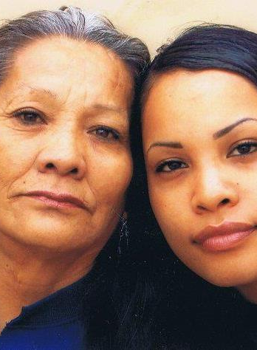
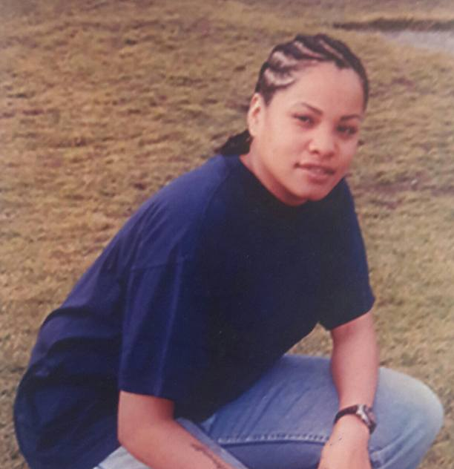
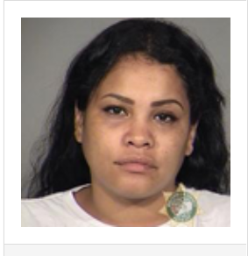
A PEERS Perspective to Harm Reduction Day 1
ONesha Cochran- My Story
Notes:
Here we can add our photos and introduce ourselves.

Slide 2
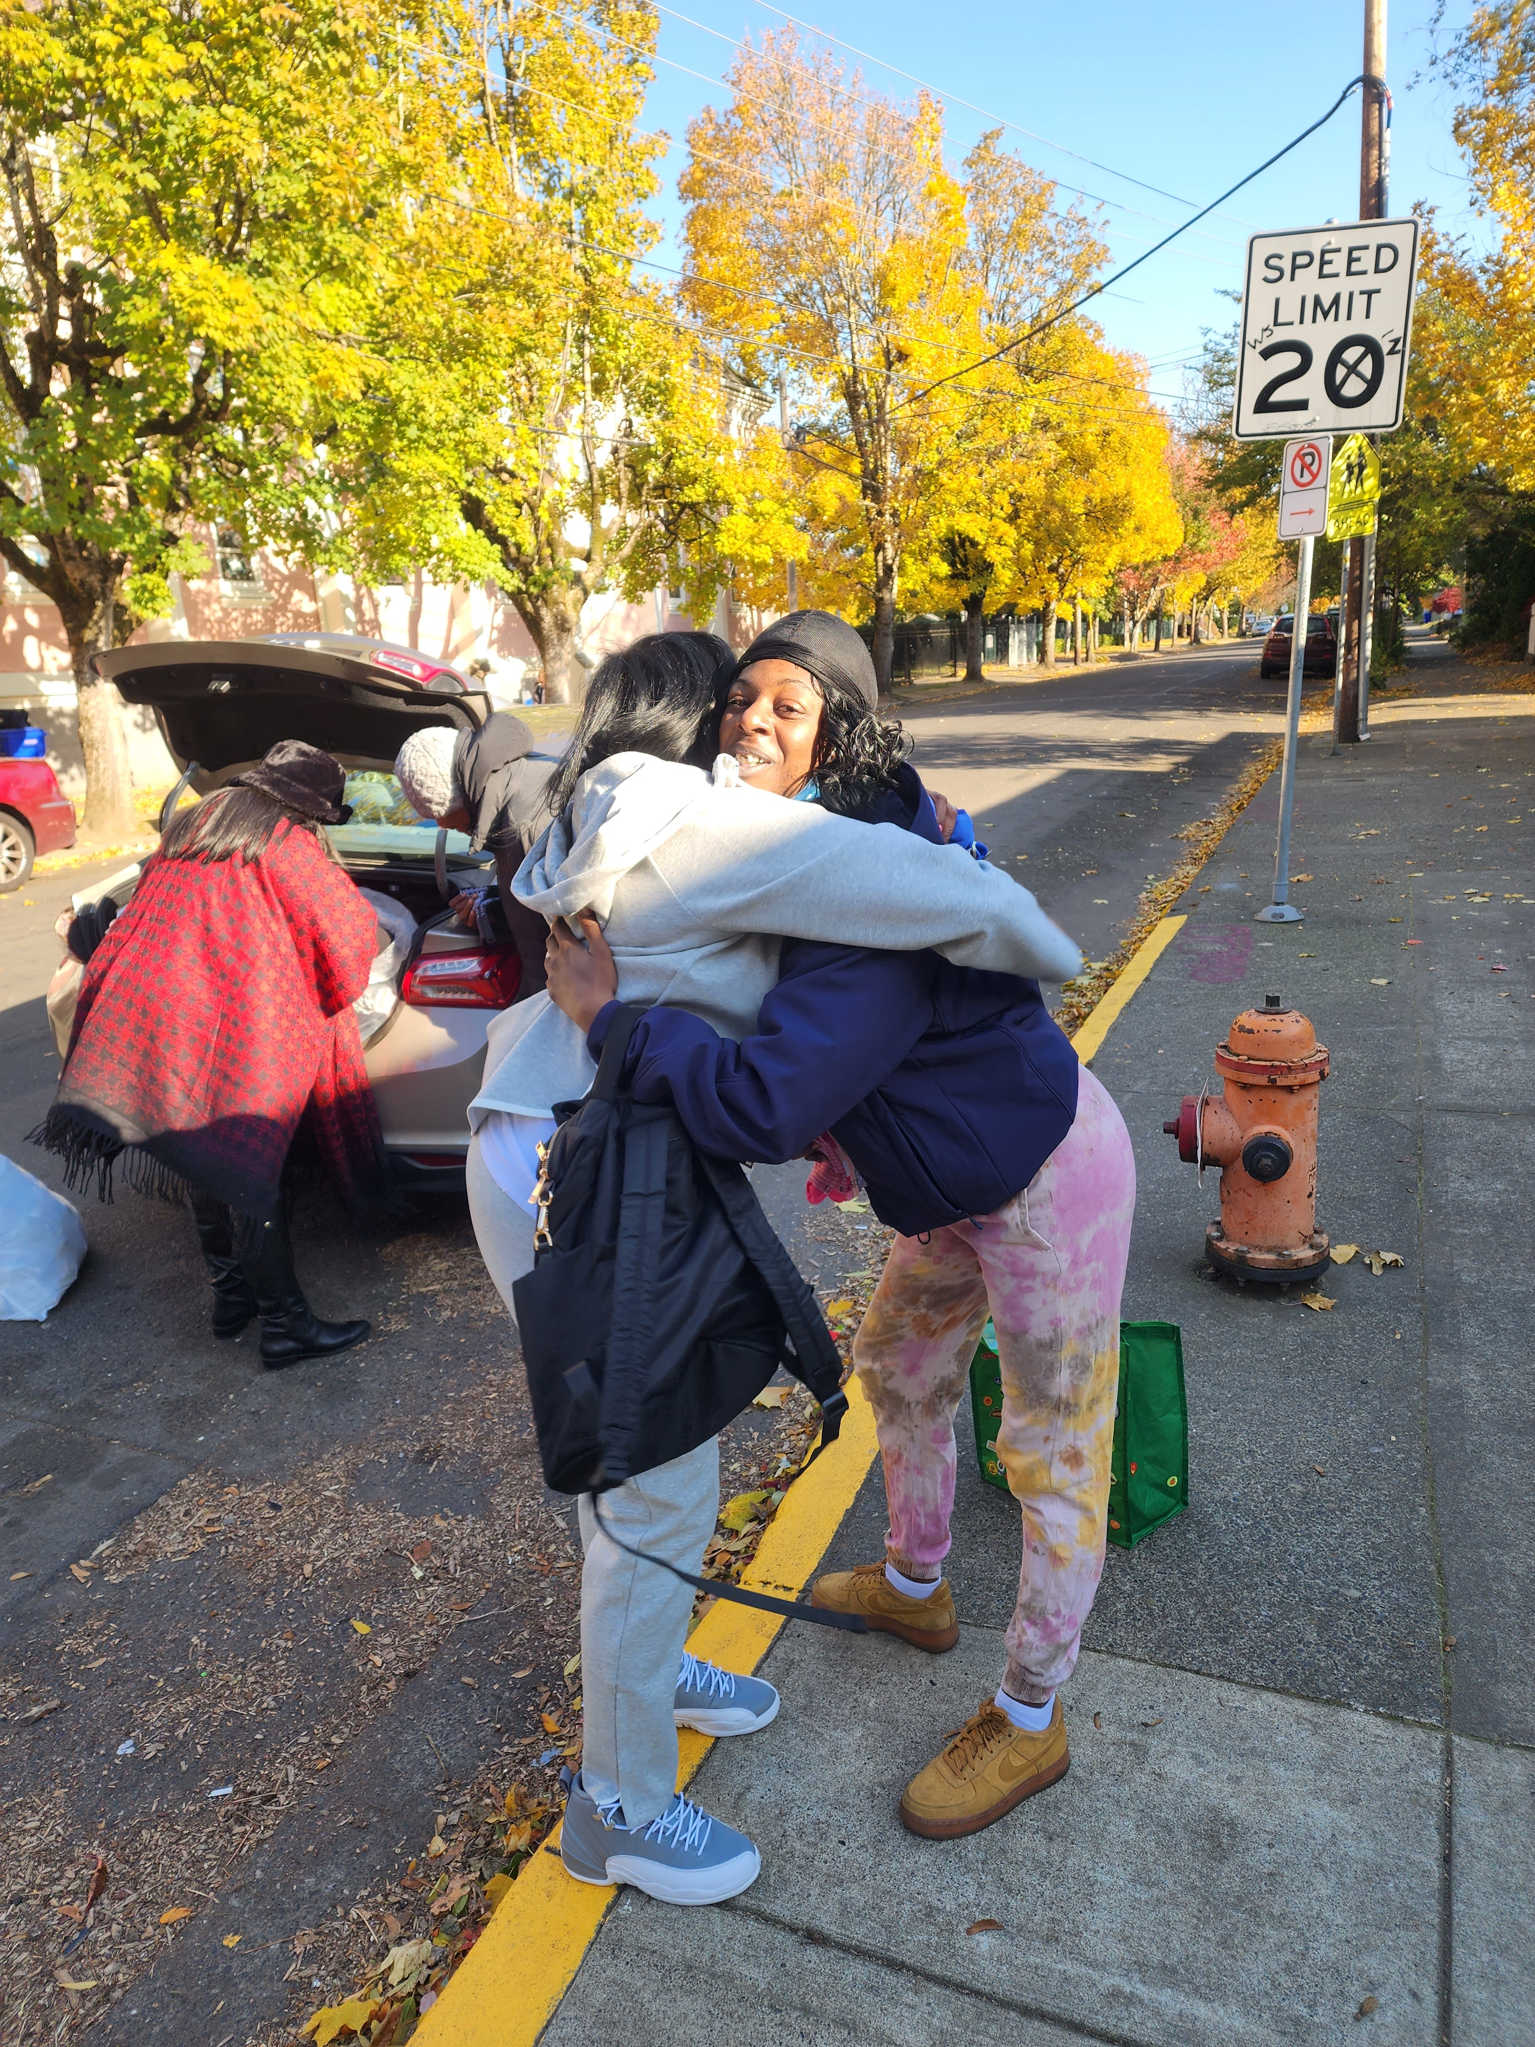
Why is Harm Reduction Important?
Notes:
Reducing harm promotes healing Meeting people where they are, radically accepting they may not want to be abstinent. Accepting the cultural challenges and stigma people are facing in their lives and sitting with the fact that it may never be our idea standard however it can always be safer and improved

Slide 3
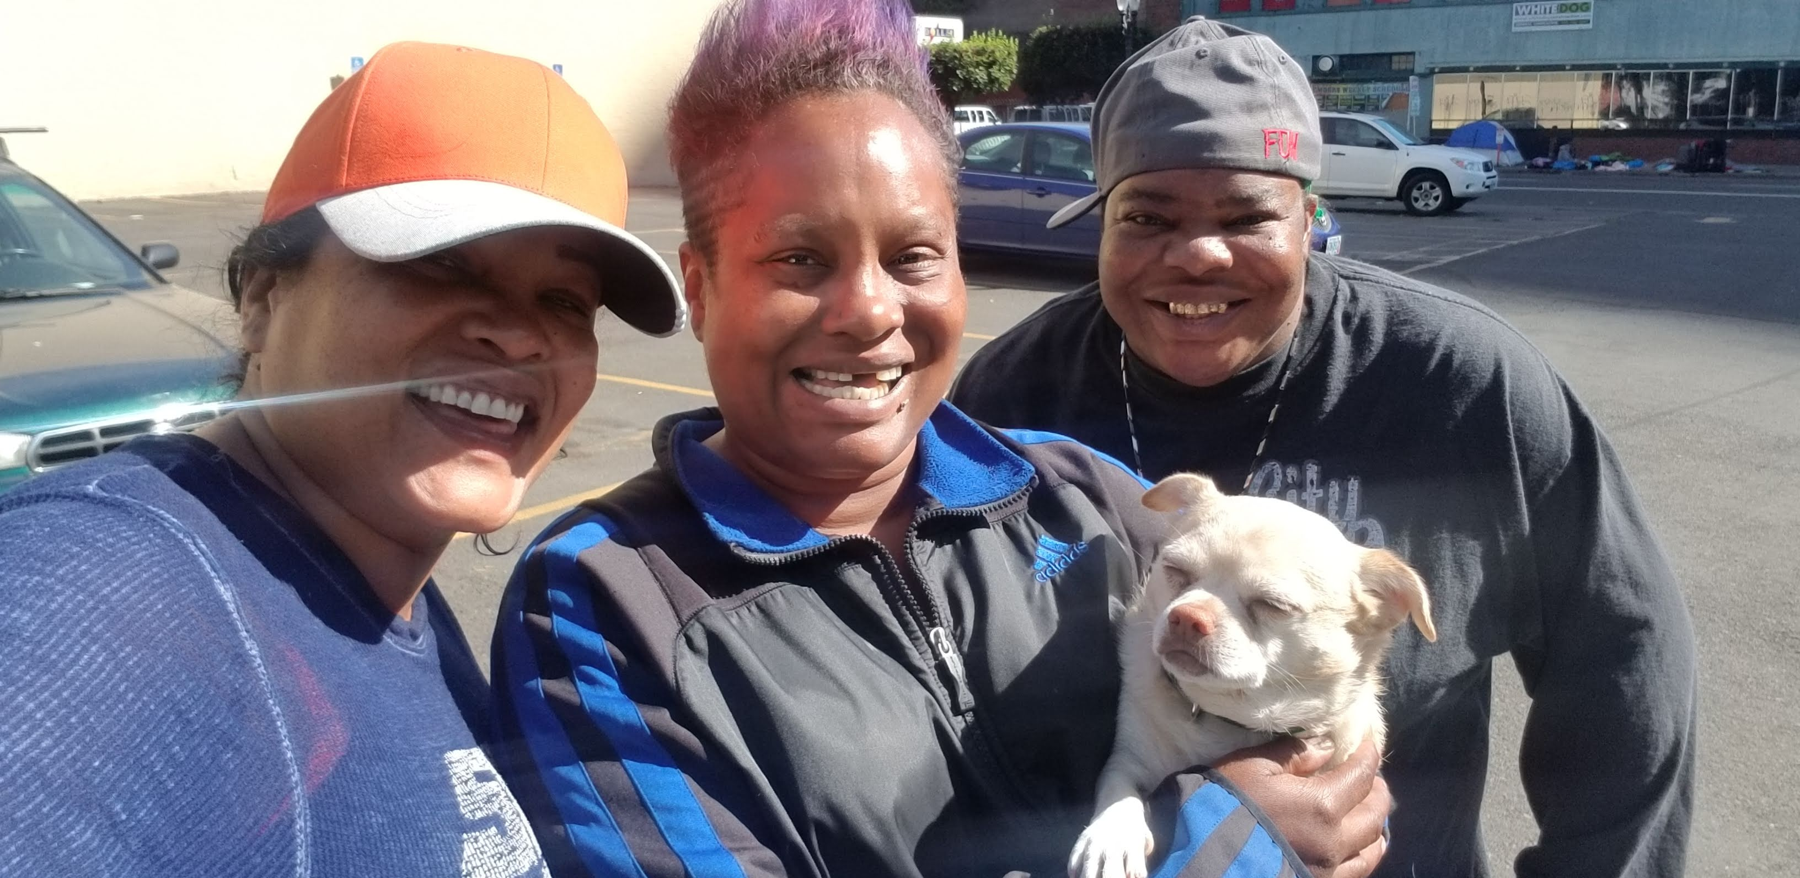
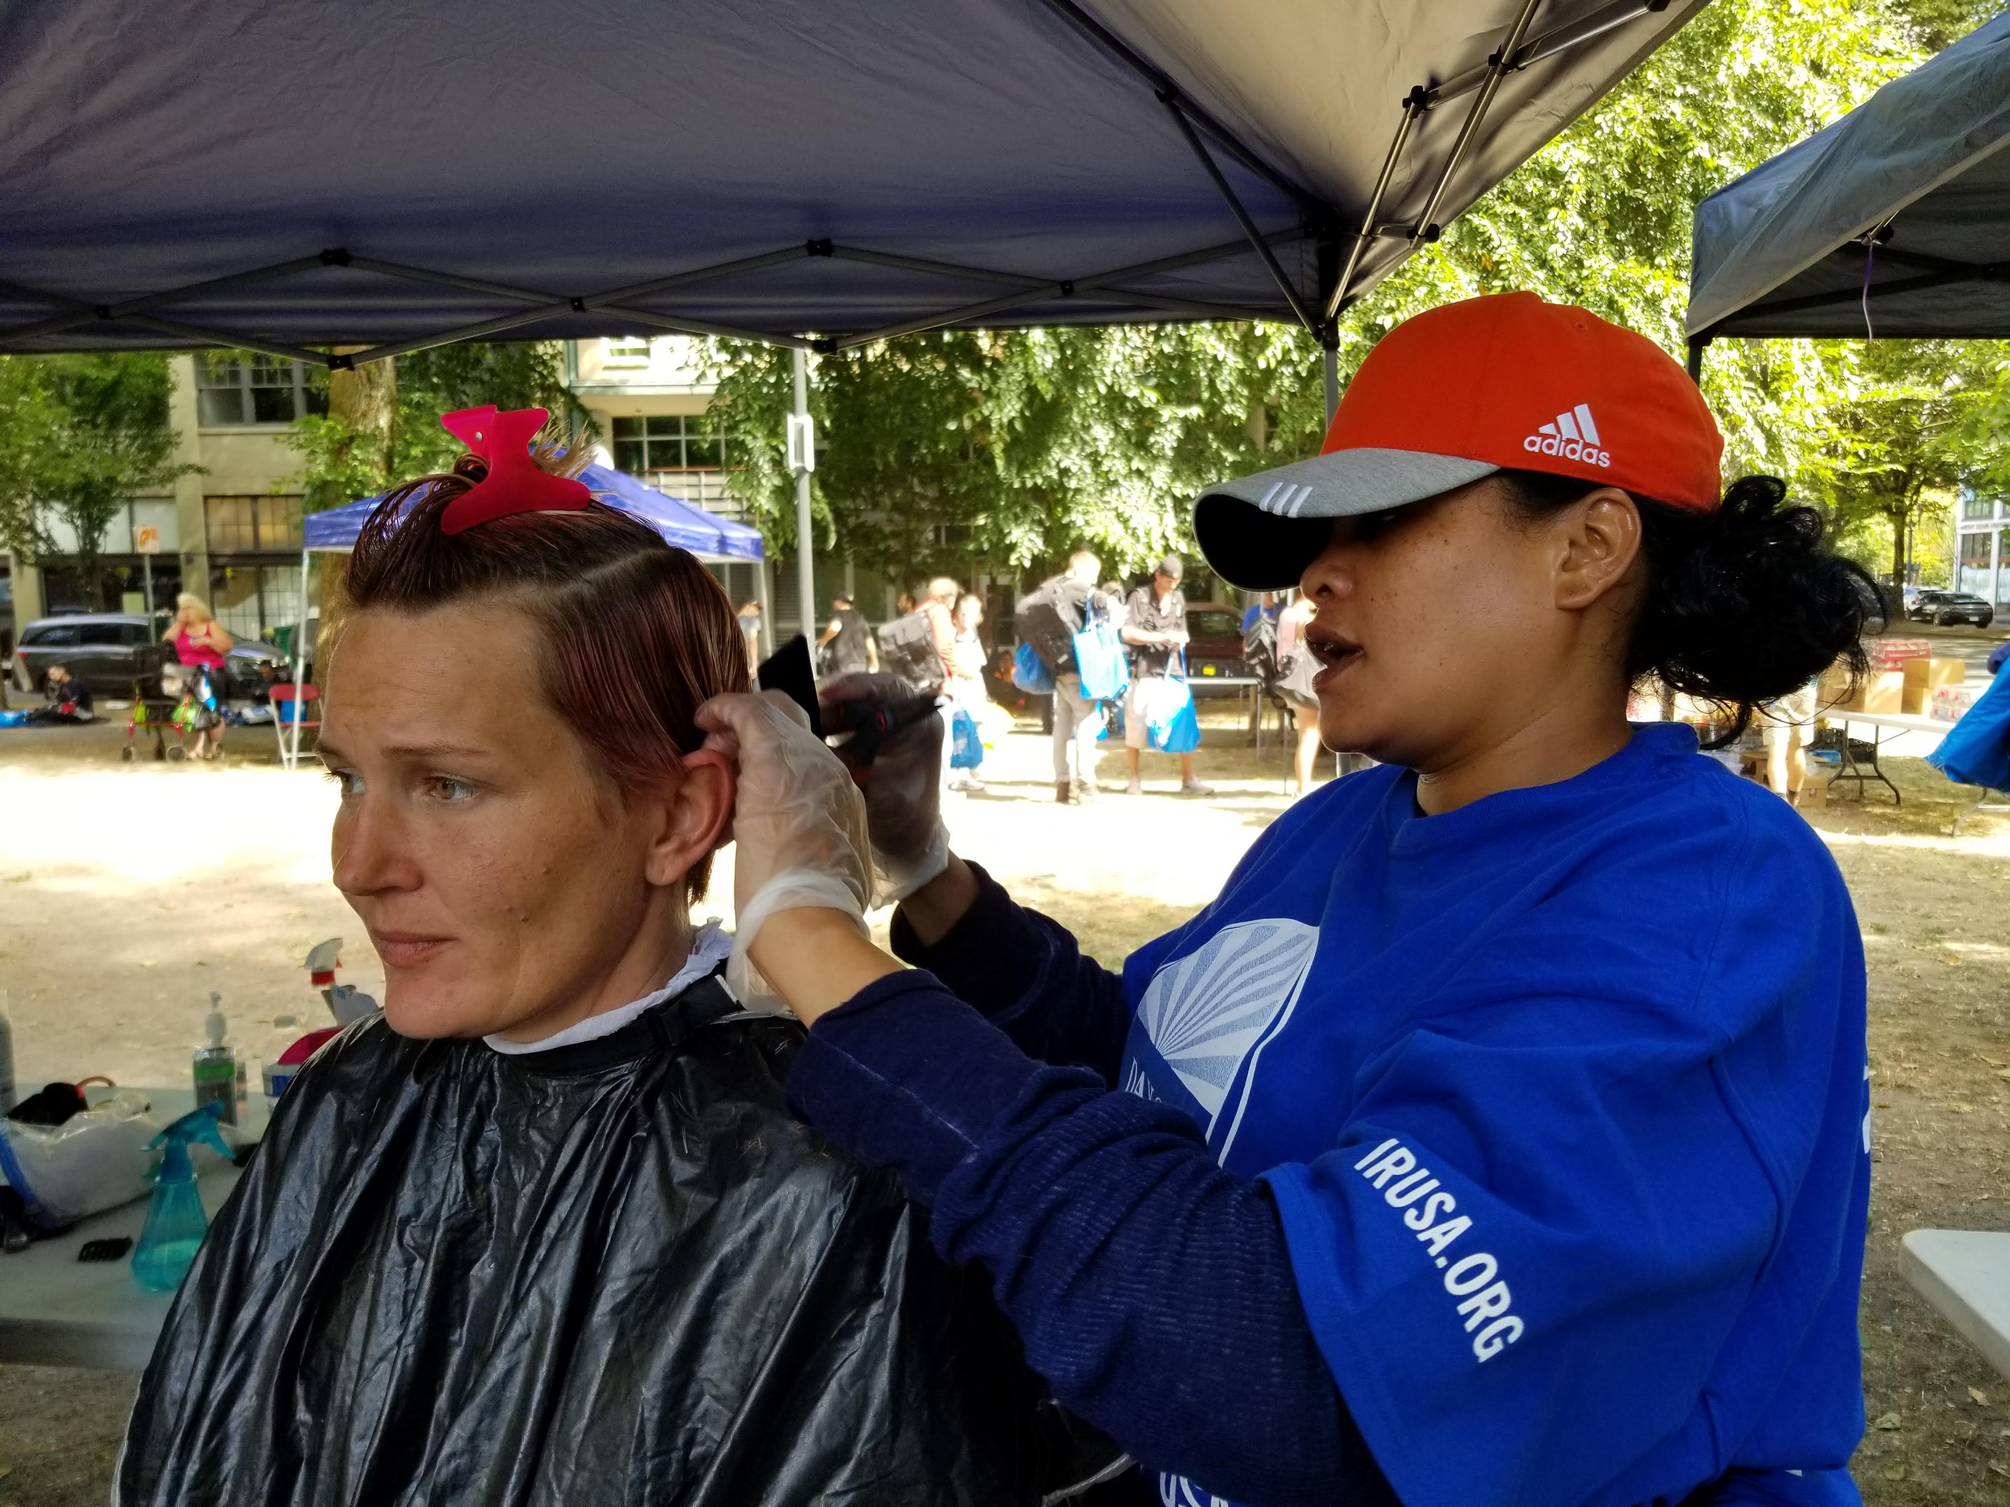
Outreach the Heart of Harm reduction
Notes:
Services and Supplies

Slide 4
What I put in the bag
FOOD/Cell ph
DOG/CAT FOOD
NARCAN
NEEDLES
GIFT CARDS
WARM CLOTHES/COATS
TENTS
WATER/REUSABLE BOTTLES
BALNKETS
PIPES
BAR B Q GRILLS
LOTS OF SOCKS
BACK PACKS
Notes:
Cell phones are lifelines

Slide 5
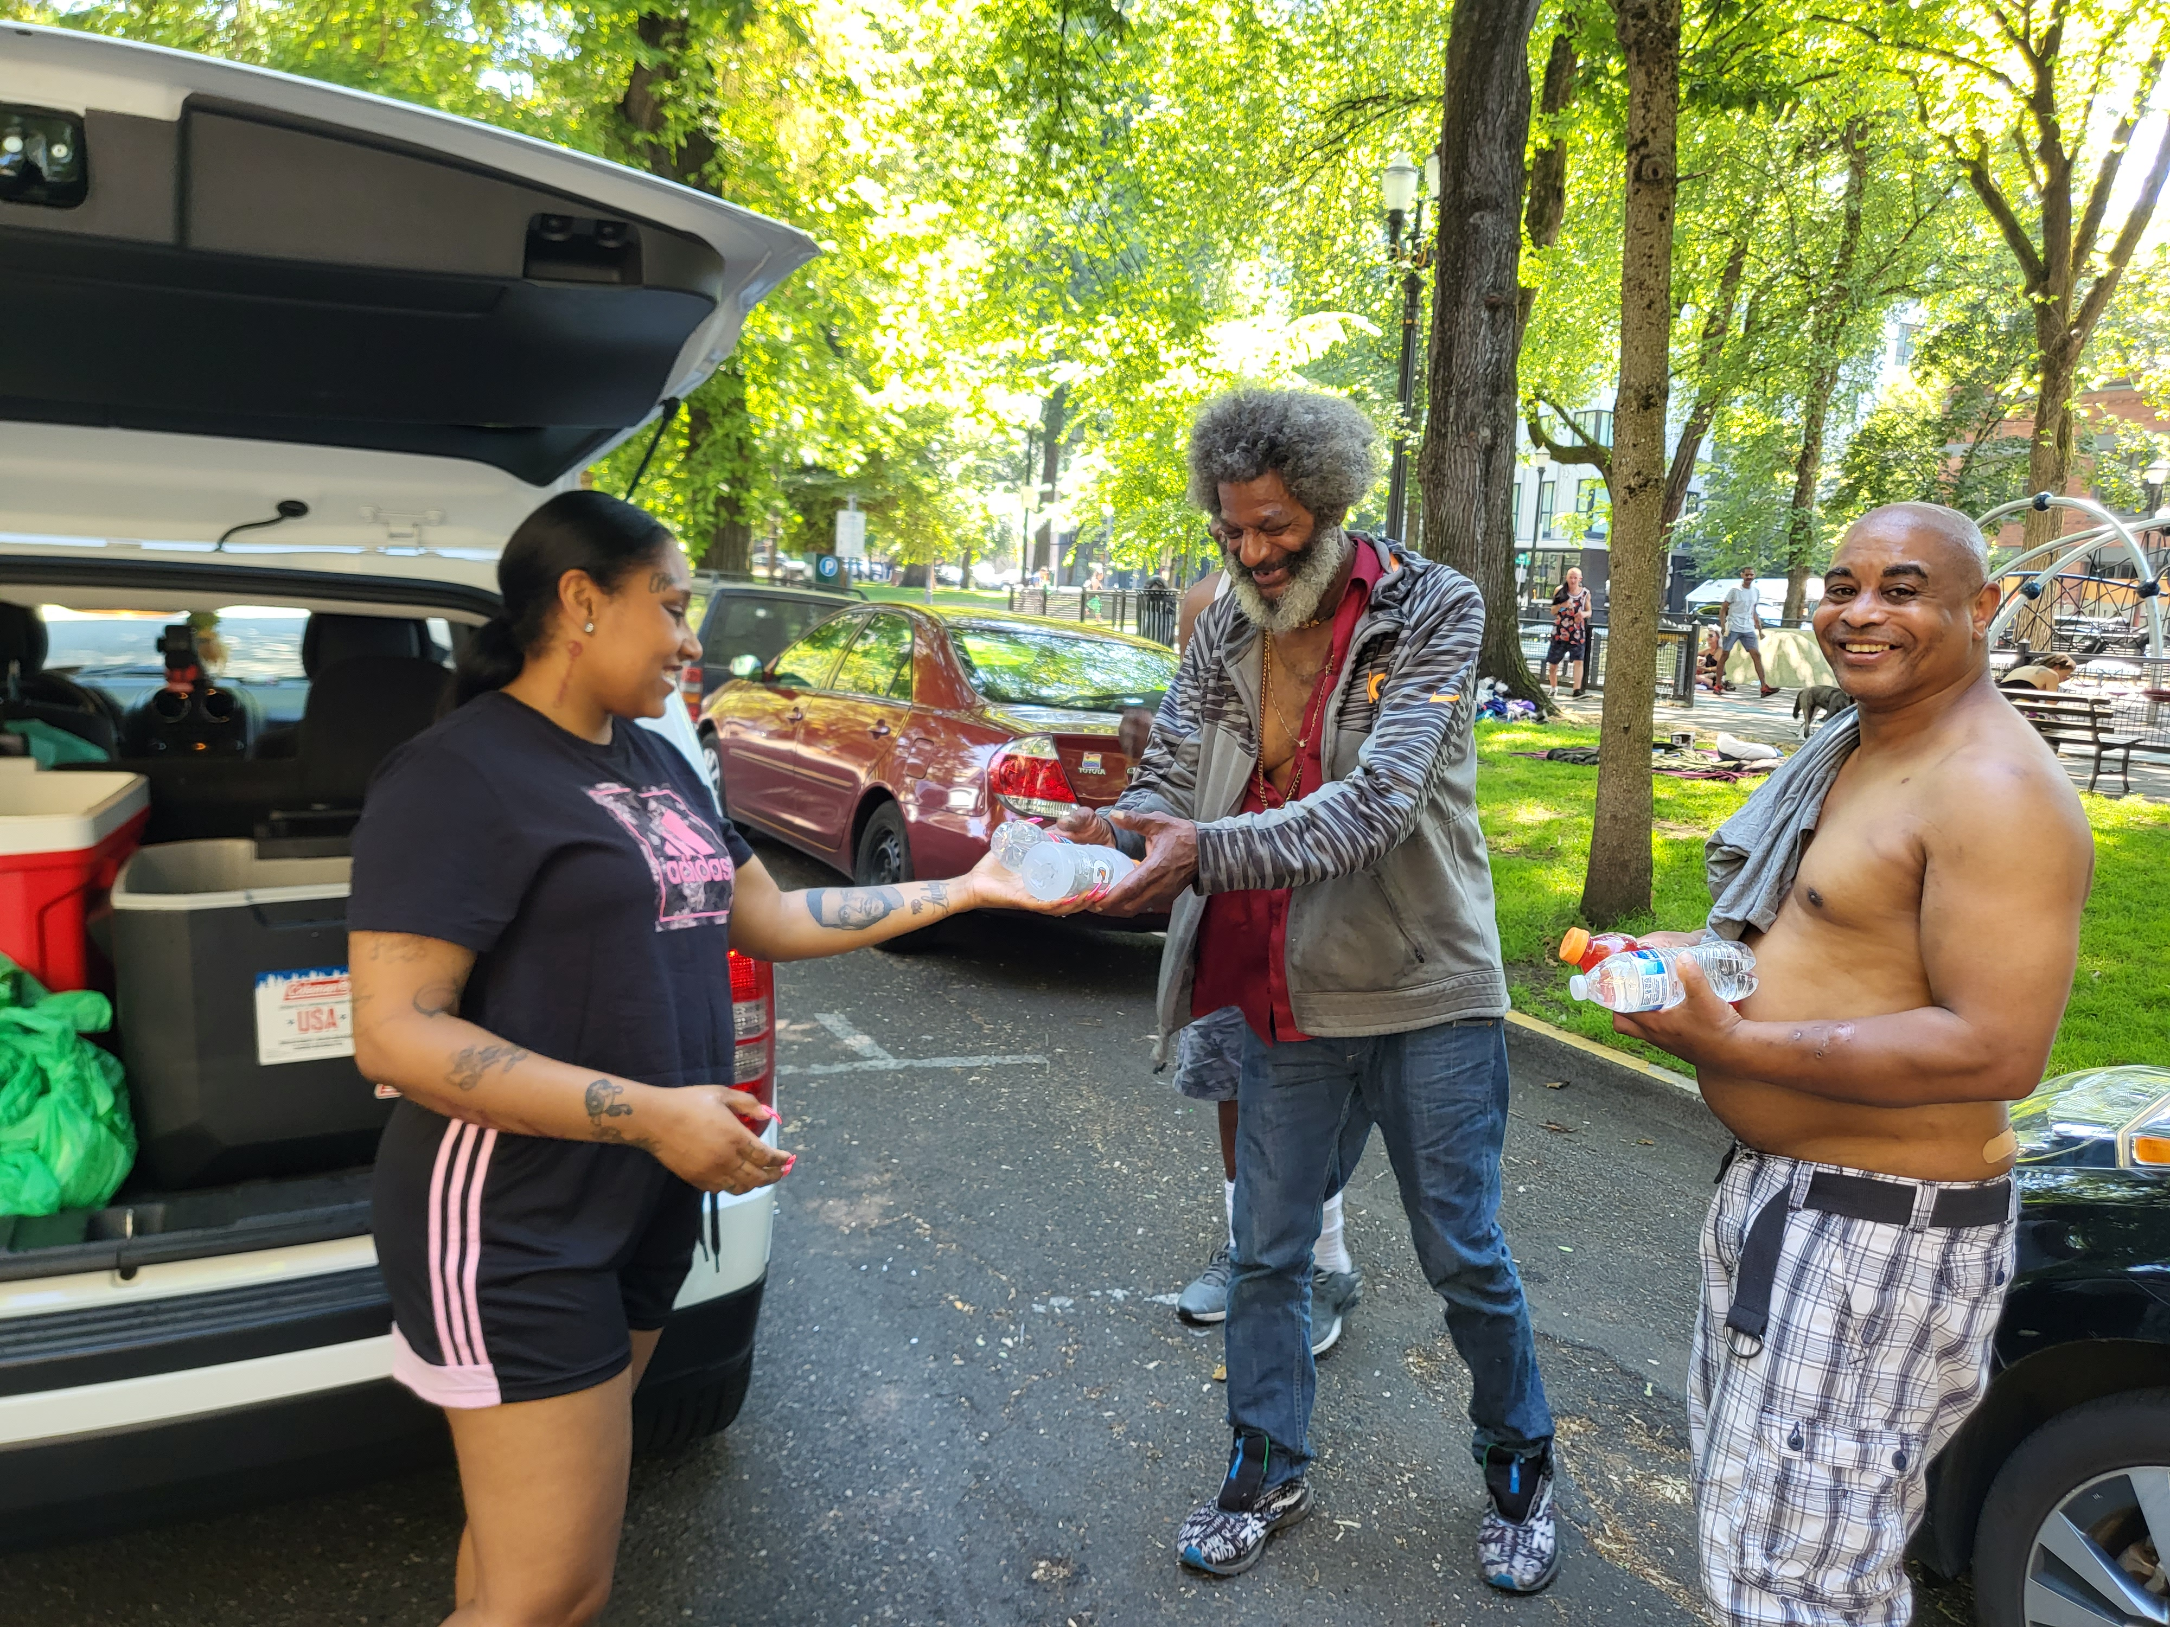
Facing stigma With Needle Exchange
Notes:
Am I willing to love people where they are, Am I willing to see the beauty in their existence

Slide 6
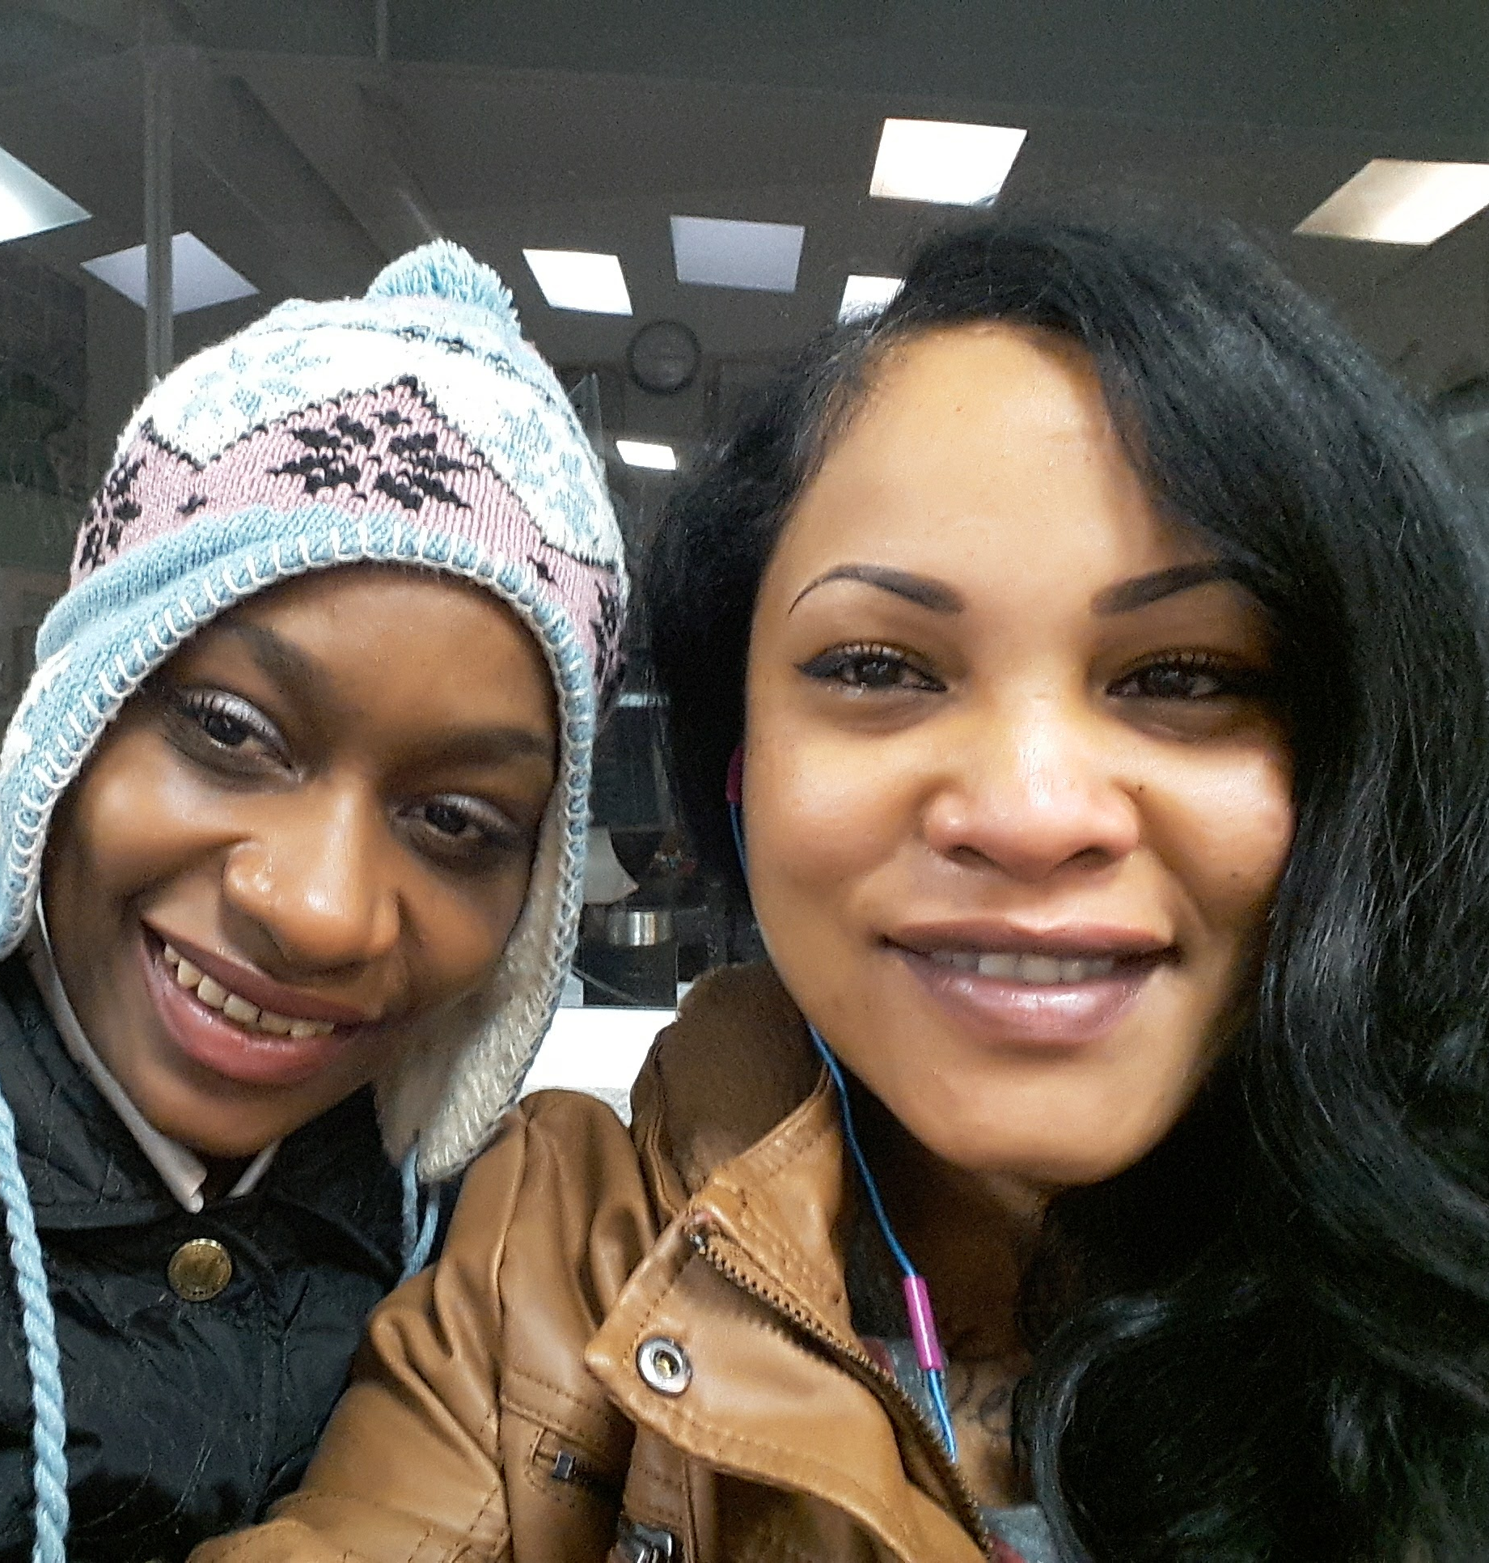
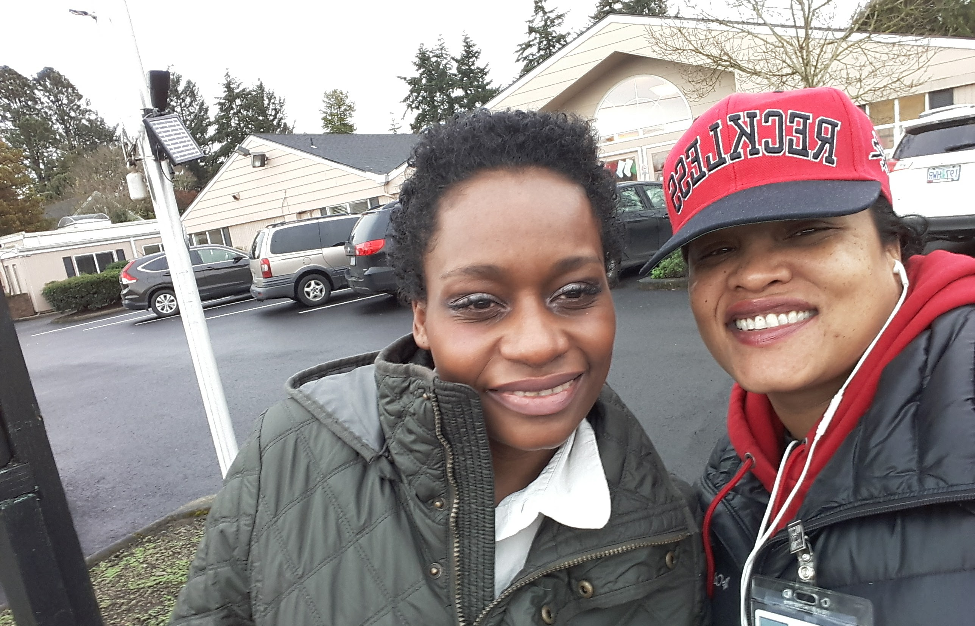
Can Harm Reduction Help People change?
Notes:
chris

Slide 7
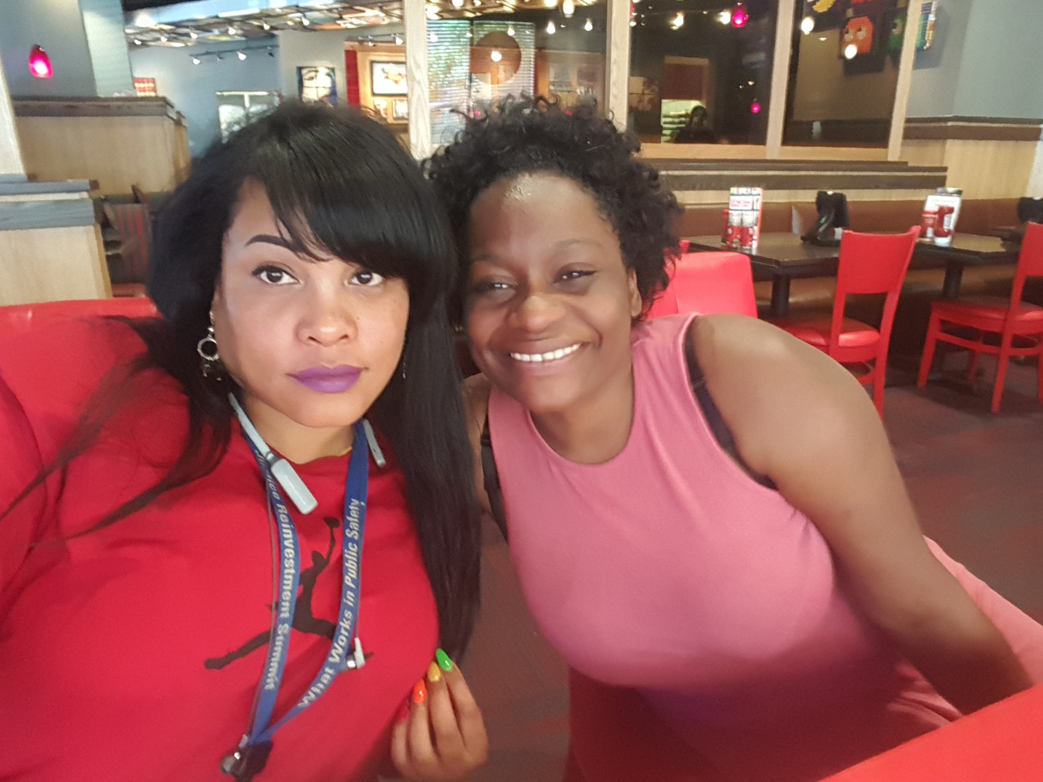
When Harm Reduction is Implemented without Judgement the Person may gradually change

Slide 8

The Hard Part is to Include Culture Agility Wherever Possible and to Encourage Participants to believe change is possible

Slide 9
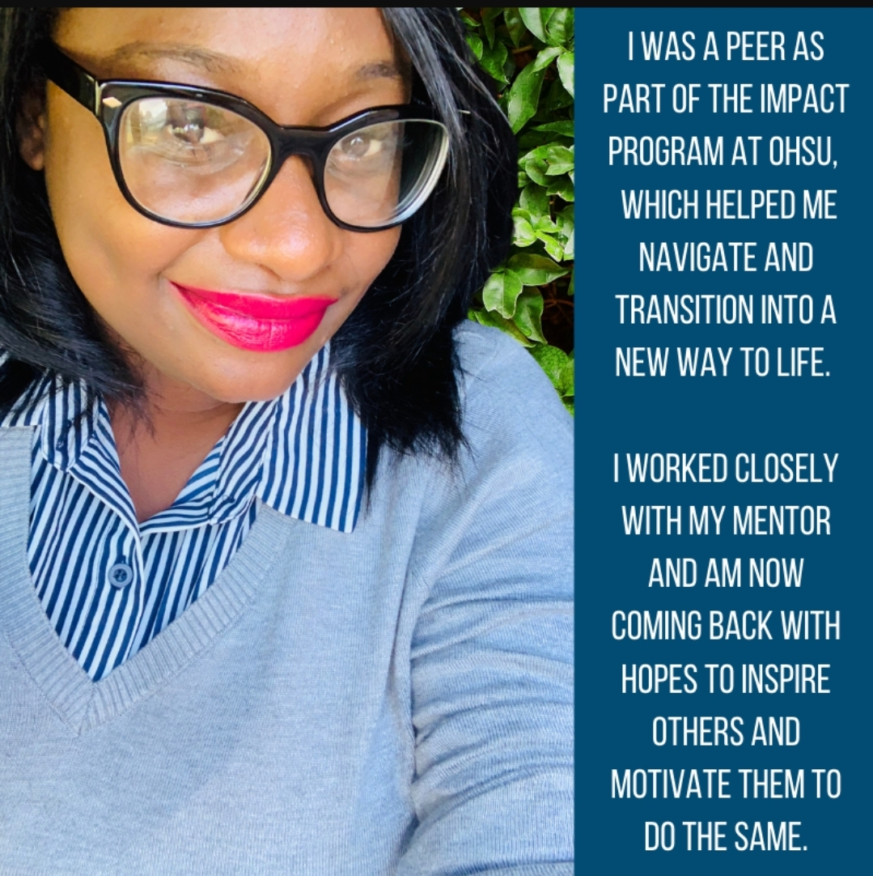
And When They Believe…..
Notes:
Today Amee is a Regional Manager at the youth 4th Dimension Recovery Center and a Lead Intake Coordinator at Brown Hopes Black Resilience Program Everyone's outcome is not the same but with hope anything is possible

Slide 10
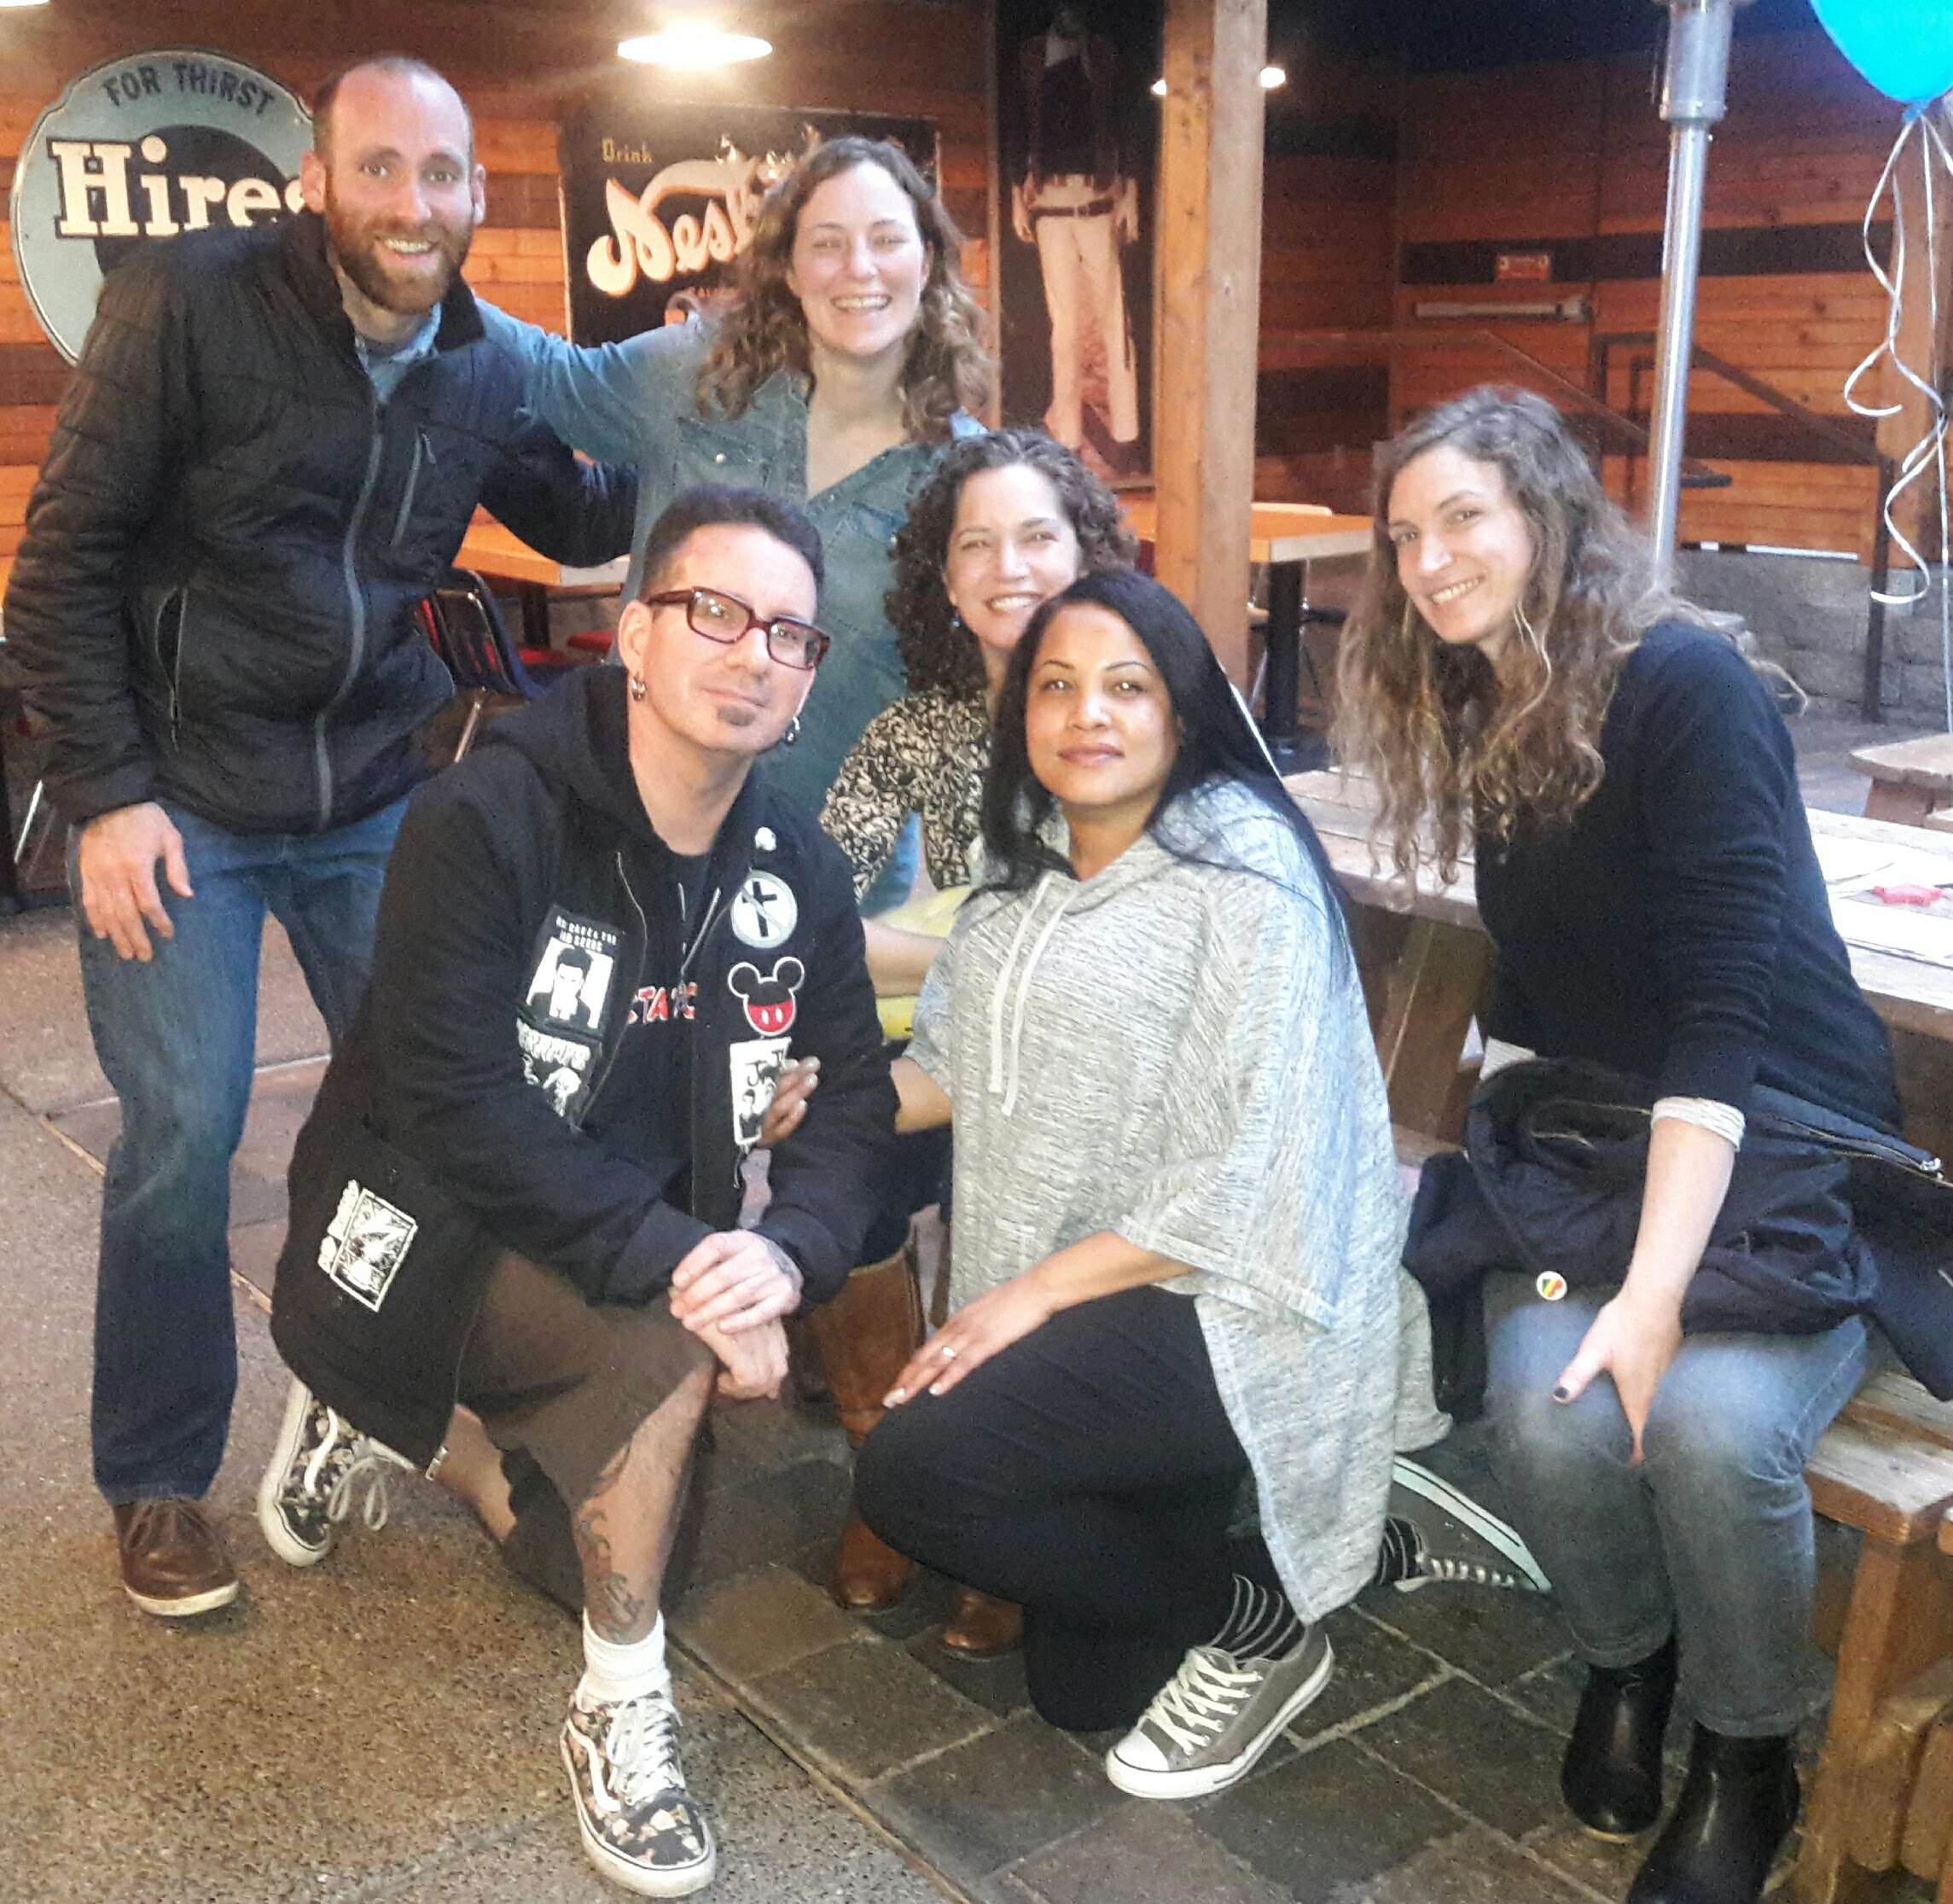
Harm Reduction in Non traditional Settings
Notes:
these services are constantly changing a peer will know this and may even have direct contacts for each of these resources.
Peers can navigate through systems like DHS, Probation, and Parole and homeless services. From a personal lens and walk Patients through the entire process
clinicians are busy. allowing peers to take the lead on relationship building can be freeing.
peer mentor teach the patient how to receive care respectfully. How to ask for what they need and be kind when they do it.

Slide 11
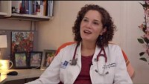
The IMPACT TEAM

Slide 12
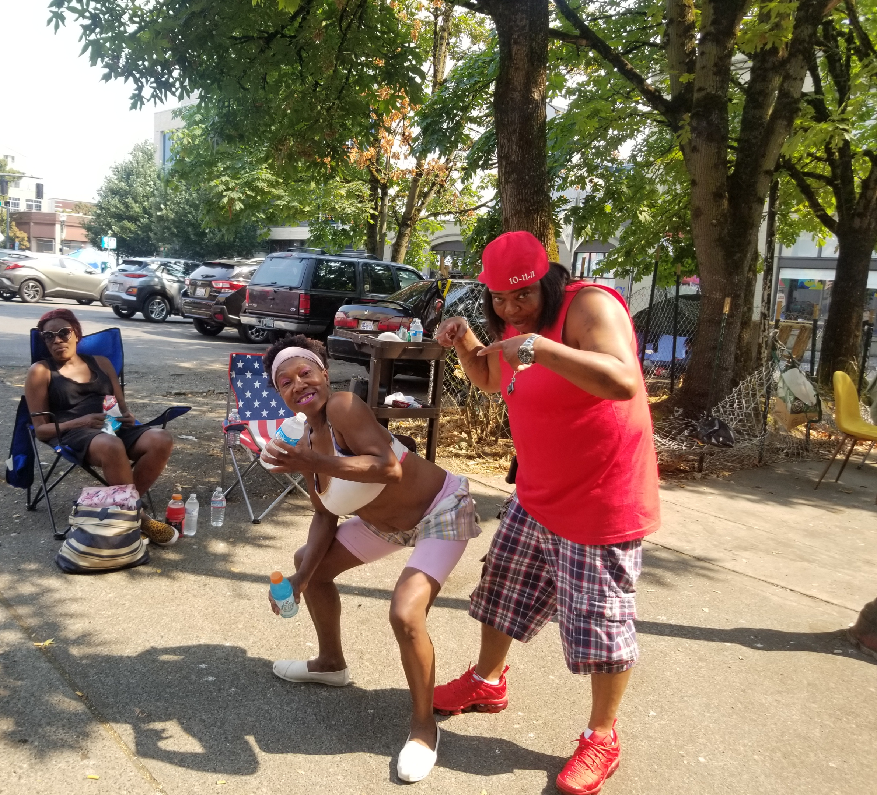
Ways to safe

Slide 13

Let's Review

Slide 14
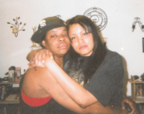
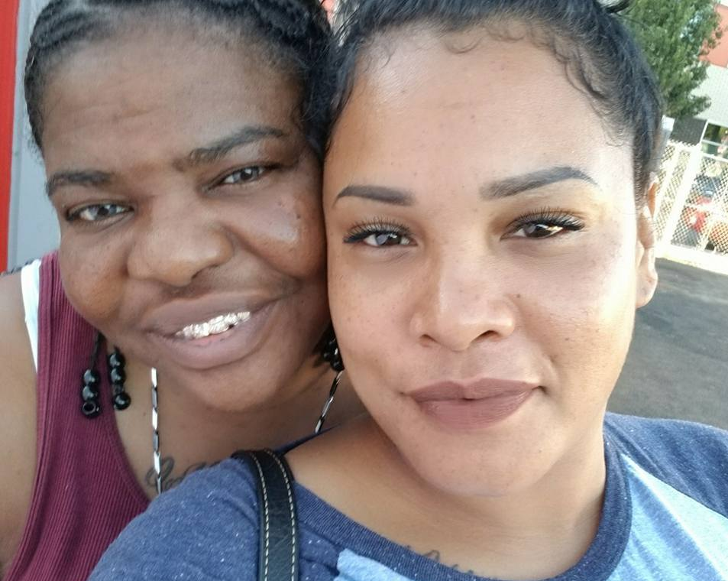
QUESTIONS

