Slide 1

The Laboring Patient:
Northwest Portland Area Indian Health Board
Indian Country Emergency Medicine for Rural
and Indigenous Communities (EMRIC) ECHO
February 22, 2023
Evaluation, Disposition, and Complications
Presenters:
Michael Henry
Dominick Maggio
Discussant:
Kelly Bogaert

Slide 2

Goals for Today
Prepare the ED for obstetric patients
Prepare to make judgements about transfer vs. ED delivery
Review routine delivery and postpartum care
Prepare for common delivery complications

Slide 3




Introductions
Kelly
Michael B. Henry
Dominick Maggio, MD
Kelly Bogaert, MD
Emergency Physician
and Clinical Quality Advisor
IHS Colorado River Service Unit
Parker AZ
Director, Emergency Department
IHS Whiteriver Service Unit
Whiteriver AZ
OB/GYN,
UCSF HEAL Fellow
IHS Northern Navajo Medical Center Shiprock NM
The Laboring Patient

Slide 4
What about you?
Poll Question 1: When was a baby last delivered in your ED?
Within the past week
Within the past month
Within the past 6 months
Within the past year
Over a year ago

Slide 5
What about you?
Poll Question 2: If you have no L&D support at your facility,
how far away is the nearest OB-capable facility by ground?
Less than 30 minutes away
30-60 minutes away
1-2 hours away
More than 2 hours away

Slide 6
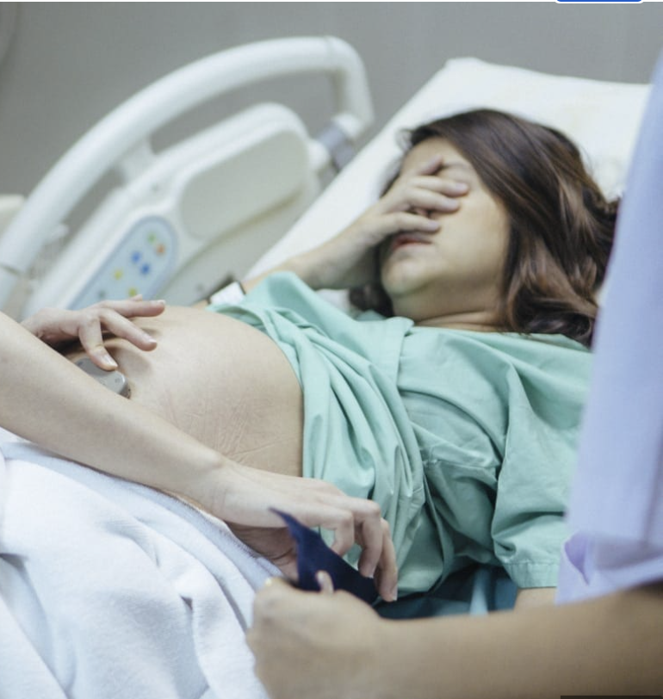
Yikes, the Patient is in Labor
Image: Baby Chick

Slide 7
Setting
Solo-covered rural ED
No FM or Obstetric backup
ED physician is primary caregiver for OB patients
Nearest OB-capable facility is 30 minutes away by ground
On hand:
  Neonatal Warmer
  OB Delivery Kit
  Blood products
The Laboring Patient

Slide 8
EMS Patch
Patient – Age 26; 37 weeks
Transporting due to frequent contractions (5 minutes apart)
Reports water breaking 4 hours prior
Unknown previous gestations
Unknown current pregnancy history
EMS Vitals
HR | 105
BP | 112/76
O2 Sat | 94% on ra
RR | 20
T | 98.8f
The Laboring Patient

Slide 9
Resource Question
Even with the limited information we have about this inbound patient, what equipment and medications would you hope we have on hand in the emergency department?
The Laboring Patient

Slide 10
OB Resources
Minimum Equipment:
Sterile gloves
Sterile towels
Scissors
Umbilical cord clamps
Gauze
Also nice to have…
Sterile drapes
Needle driver
Suture or packing
Baby blanket and hat
TXA
Minimum Medications:
Mom:
Oxytocin
Infant:
Vitamin K
Erythromycin ointment
Image: https://images.app.goo.gl/FoHGKTnxr87k18KU8

Slide 11
Arrival
26 yo F; no PMH, G4P3003
No history of complications with current or prior pregnancies
Frequent contractions for 4 hours since water breaking
Prenatal care – low-risk
OB at nearby community hospital
No access to outpatient labs
ER Vitals
HR | 105
BP | 112/76
O2 Sat | 94% on RA
RR | 20
T | 98.8F
The Laboring Patient

Slide 12
Initial Exam
Uncomfortable
Contractions 3 minutes apart
Card/Resp unremarkable
Abd – gravid, fundal height well above umbilicus
GU – deferred at this time
The Laboring Patient

Slide 13
Procedural Questions
What are the next steps in clinical assessment?
What are the best resources for learning how to perform a cervical exam?
If I don’t have access to records, should I be checking specific labs at this time?
What’s the best way to determine gestational age?
The Laboring Patient

Slide 14
Cervical Exam
Patient is 7 cm dilated, head feels low in the pelvis
Contractions now 2 minutes apart
OB at community hospital will accept the patient, but questions whether transport can be accomplished prior to delivery
The Laboring Patient

Slide 15
More Procedural Questions
How do you define “active labor”?
How do you estimate likely time of delivery?
Are there national, state, or local guidelines on transport of patients in labor?
Would you transfer this patient?
The Laboring Patient

Slide 16
Stages of Labor
Labor Curves
Nulliparous:
4 to 10cm – roughly 4 hours
Median for each cm beyond 6cm takes ~30 mins
95th percentile for time to dilate from 4 to 6 cm is almost 10 hours
Multiparous:
4 to 10cm- roughly 2.5 hours
Median for each cm beyond 6cm takes ~15 minutes
Image: https://images.app.goo.gl/o4p9H8Zd9vf1A4N46

Slide 17
What about you?
Poll Question 3: Thinking about the agency or agencies you rely on for transfers, which of the following best describes their approach to laboring patients?
(a) I don't know
(b) Agency will not transfer patient in labor
(c) Agency will transfer to us (ED) only
(d) Agency will transfer from our facility to OB facility, but only with ED or OB staff on board
(e) Agency will transfer from ED to OB facility on advice from ED and/or receiving facility
The Laboring Patient

Slide 18
Emergency Medical Treatment and Labor Act (EMTALA)
“Labor” is defined to mean the process of childbirth beginning with the latent or early phase of labor and continuing through the delivery of the placenta.¹

Slide 19
EMTALA Guidance
If a woman is in labor, the hospital must deliver the baby and the placenta or transfer appropriately. She may not be transferred unless she, or a legally responsible person acting on her behalf, requests a transfer and a physician or other qualified medical personnel, in consultation with a physician, certifies that the benefits to the woman and/or the unborn child outweigh the risks associated with the transfer.¹

Slide 20
American College of Obstetricians and Gynecologists (ACOG)
The medical condition of a woman having contractions is not considered an emergency if there is adequate time for her safe transfer before delivery or if the transfer will not pose a threat to the health or safety of the woman or the fetus.²

Slide 21

ACOG Guidance
A woman in labor is considered unstable from the latent phase through delivery of the placenta if there is inadequate time to safely transfer her to another hospital before delivery or if that transfer may pose a threat to her or her fetus’s health or safety.²

Slide 22

Suggestion
Consider arranging a meeting with representatives from your receiving OB facility and local EMS service(s) to discuss and agree on indications and contraindications for transfer.

Slide 23
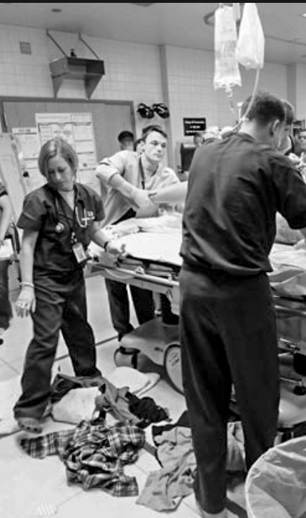
Status Update
Decision has been made not to transfer patient
Contractions still 2 minutes apart
Patient has dilated to 9 cm
The Laboring Patient

Slide 24
Questions
What pathologies are you thinking about and preparing for during delivery?
What about after delivery?
The Laboring Patient

Slide 25

Delivery
Patient delivers without complications
Mom and baby are healthy
Image Source: The Conversation

Slide 26
More Questions
Are there post-delivery checklists guiding care for the parent and the newborn?
Should everyone be trained in ALSO or NRP? What is the evidence to support this?
Does anyone have additional questions for Kelly regarding transfer decisions or preparedness for ED delivery?
The Laboring Patient

Slide 27
Standard Post Delivery Care
Mother:
Deliver and inspect placenta to ensure intact
Massage fundus
Fundal and pad checks
Give oxytocin 10U IM or 10-40U IV in 1000cc Saline
Inspect perineum for bleeding and tears
Infant:
Warm and dry
If okay, place on mom’s chest (skin to skin)
Unless resuscitation needed, delay cord clamping 30 to 60 seconds
Mother and Infant:
Closely monitor vitals for the first hour
Support breast feeding as desired
More at https://www.ncbi.nlm.nih.gov/books/NBK326674/#childbirth.s24

Slide 28
The patient is in labor, and it’s complicated
Image: Baby Chick

Slide 29
Presentation
32-year-old female in active labor
No significant past medical history
Patient recalls something problematic with last delivery,
but has no details

Slide 30
+ 20 Minutes
While patient is pushing, the baby’s head emerges and then seems to pull back into the vagina.
Poll Question 4: What is this sign called and what condition is it concerning for?
Prairie Dog Sign / Uterine Rupture
Turtle Sign / Shoulder Dystocia
Super Mario Sign / Nuchal Chord

Slide 31
Poll Question 4: Correct Answer
Turtle Sign / Shoulder Dystocia

Slide 32
Dystocia Epidemiology
0.2 – 3.0 % of births (somewhat subjective determination)
1% hypoxic encephalopathy due to shoulder dystocia
Increasing prevalence (obesity, DM)
The Laboring Patient

Slide 33
Risk Factors
ED Relevant:
Macrosomia (over 4000g) – more likely with obesity, diabetes, >40 weeks, excessive weight gain
Prior dystocia (repeat rate can be over 15%)
Precipitous deliveries
Other:
Prolonged second stage of labor
Operative deliveries

Slide 34
Poll Question 5: Can we accurately predict which patients are at high risk for dystocia?
Yes
No

Slide 35
Poll Question 5: Correct Answer
No. There are some associated risk factors, but the majority of cases have none of these risk factors present. Dystocia must be anticipated in all pregnancies.

Slide 36
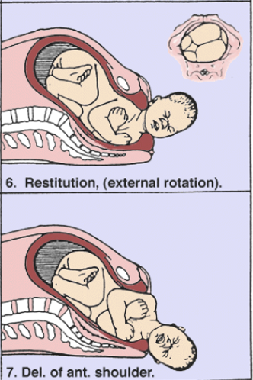
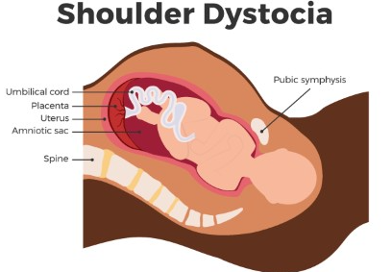
Normal Descent v. Dystocia
Normal Descent
It’s a swivel.
https://images.agoramedia.com/wte3.0/gcms/Shoulder-Dystocia.gif?width=414
It’s bone-on-bone
impaction.

Slide 37
Diagnosis
Turtle Sign: Retraction of Head
Gentle traction of head cannot deliver anterior shoulder
OBSTETRIC EMERGENCY

Slide 38
OB Complications
Infant (95% no injury)
Iatrogenic injury; clavicle and humerus fractures
Hypoxic encephalopathy
Death
Stretch and injury to brachial plexus (usually temporary)
Asphyxia
  Umbilical cord compression
  Cerebral venous obstruction from neck pressure
  Excess vagal stimulation and bradycardia
Maternal
Hemorrhage
Fourth degree perinatal lacerations

Slide 39
Initial Action Steps
SHOUT FOR HELP
Delegate a timer to note time dystocia started and call out every 60 seconds
Tell patient to stop pushing and follow your direction
Call for back-up, if available
Move patient buttocks to edge of bed
Reduce nuchal cord (avoid cutting, prolong oxygenation)
Avoid excessive head traction
Do not give fundal pressure
  Drain bladder

Slide 40
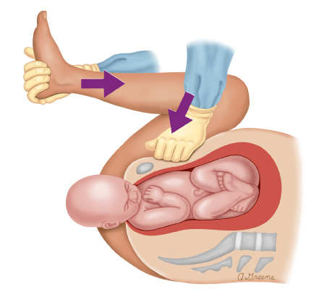
McRoberts & Suprapubic Pressure
Two assistants each grab and flex maternal leg against abdomen
Lessens obstruction caused by sacrum
Complications rare
Suprapubic pressure by assistant in the direction of the fetal face
Always start with these two! Will resolve 95% within 4 minutes.

Slide 41
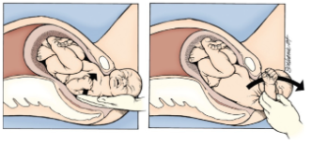
Deliver Posterior Arm
Hand into vagina, locate posterior shoulder and arm
Follow it to the elbow
If elbow flexed, grasp forearm and pull out the arm
If elbow extended, push on antecubital to flex and pull it out

Slide 42
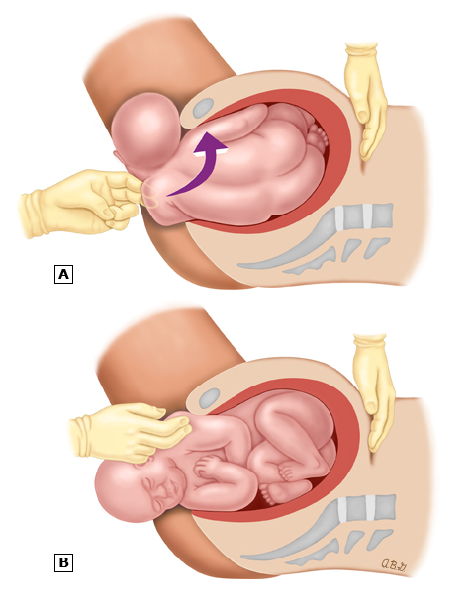
Wood’s Screw
Press on anterior surface of posterior shoulder (front flip)

Slide 43
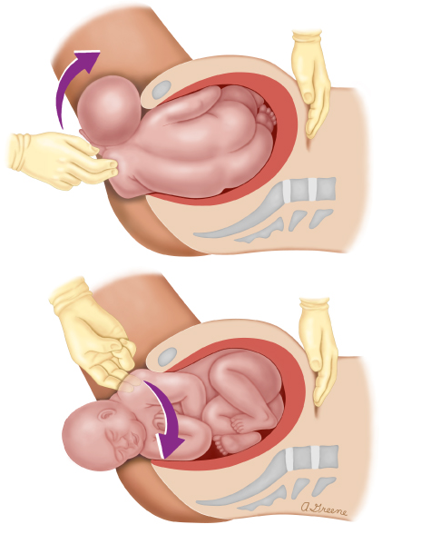
Rubin
Opposite of Wood’s Screw
Place hand on back of posterior shoulder and rotate towards face (anteriorly) – back flip

Slide 44
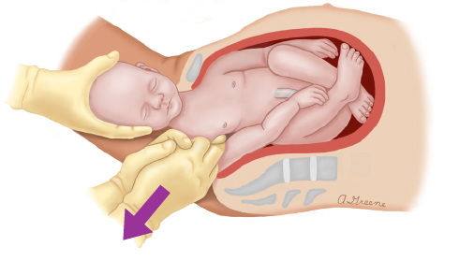
Axial Traction
Assistant flexes head towards anterior shoulder
Hook both middle fingers through the posterior axilla
Pull shoulder posteriorly until posterior arm can be grasped and delivered
While pulling, attempt rotations to free up anterior shoulder

Slide 45
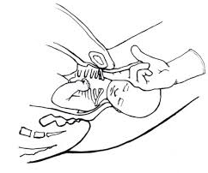
Fracture Clavicle
Use fingers to pull outwards on middle of clavicle until it breaks
Can damage underlying vascular/lung structures
https://encrypted-bn0.gstatic.com/images?q=tbn:ANd9GcReGTDdILJBJ0ANkVKTsoR92IRtJ631M80qmA&usqp=CAU

Slide 46
Demo
https://www.youtube.com/watch?v=7Je4I5acpDM&t=146s
The Laboring Patient

Slide 47
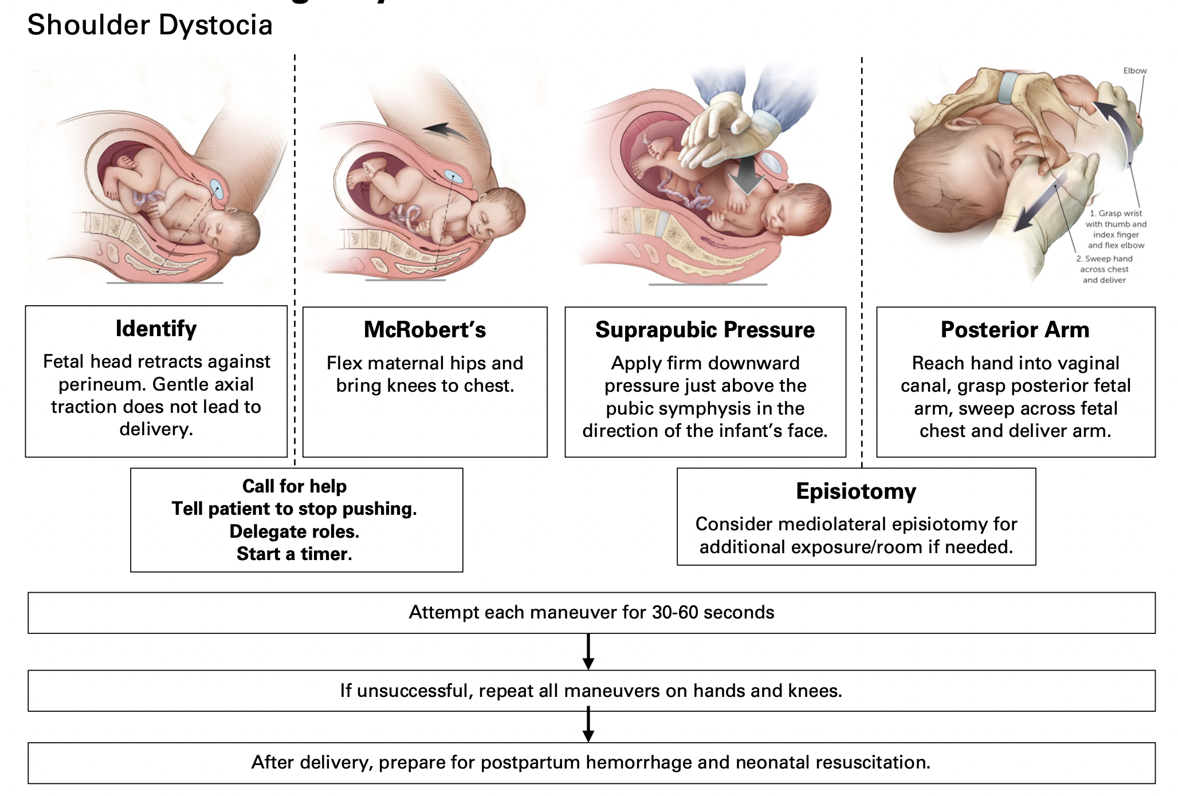
Overview

Slide 48
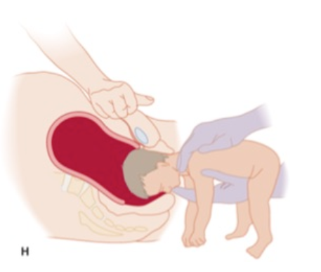
Other Mechanical Complications
Not discussed today, but worth preparing for:
Breech Presentation
Umbilical Cord Prolapse

Slide 49

After Delivery
  Cord clamped and cut
  Placenta delivered
  Contact nearest hospital able to accept mom and baby
  Send mother and baby
  Promote mom/infant bonding if possible

Slide 50

Summary
Make sure your staff are ready and supplies are on hand for standard and complicated deliveries.
Rehearse and have a plan for the most common delivery complications.
Know the resources available at your facility.
Know your transfer partners’ laboring patient protocols.

Slide 51
Thank you
Northwest Portland Area Indian Health Board
Indian Country Emergency Medicine for Rural and Indigenous Communities (EMRIC) ECHO
February 22, 2023
Presenters:
Michael Henry
Dominick Maggio
Discussant:
Kelly Bogaert

Slide 52
Contact Information
Michael Henry
Dominic Maggio
Kelly Bogaert
Mhenry12@gmail.com
dominick.maggio@ihs.gov
Kelly.c.Bogaert@gmail.com
The Laboring Patient

Slide 53
Sources
1. Emergency Medical Treatment and Labor Act (EMTALA). 42 U.S.C. Section 1395dd. 1986.
2. American College of Obstetricians and Gynecologists, Committee on Obstetric Practice. Hospital-Based Triage of Obstetric Patients. Committee Opinion No. 667 July 2016 (Reaffirmed 2020).
The Laboring Patient

