Slide 1


A Call to Action: Embracing a New Era for Pharmacists in Substance Use Disorder Treatment and Recovery Services
National Committee on Heroin, Opioids, and Pain Efforts
(HOPE Committee)
CAPT Ted hall, PharmD BCPP
IHS National HOPE Committee
CDr Teresa Grund r.ph. NCPS. BCPS. BCPP.
IHS National HOPE Committee treatment
And recovery Co-chair

Slide 2
OBJECTIVES
Identify resources to support new clinicians treating opioid use disorders
Demonstrate the pharmacist’s role in the treatment of opioid use disorders
Propose clinician resiliency strategies to support work-life balance
Outline avenues for pharmacists to deploy naloxone as a harm reduction strategy

Slide 3
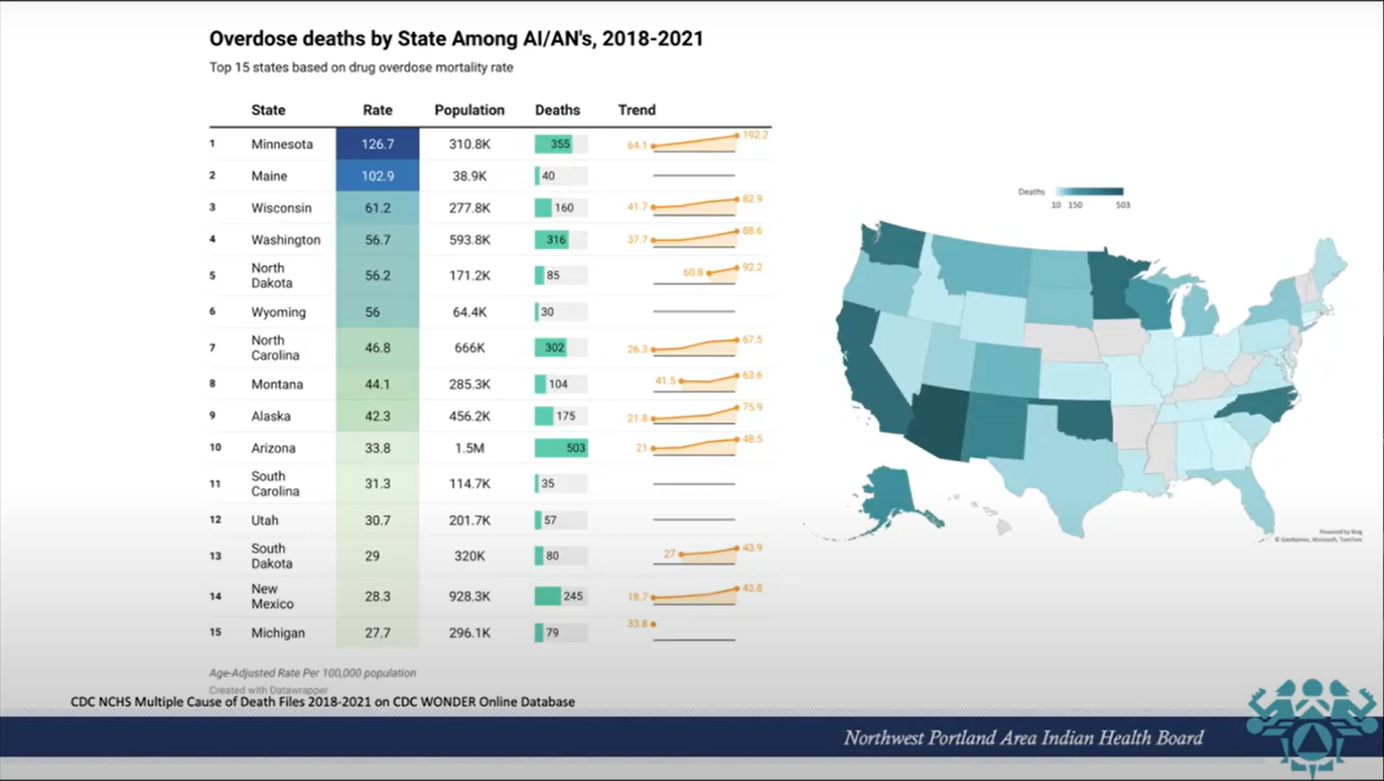
SCOPE OF THE PROBLEM
DATA
Link to muggett presentation
Michael Mudgett February 21,2023, Substance Use Data Among American Indian/Alaska Natives, Northwest Portland Area Indian Health Board
https://www.indiancountryecho.org/resources/substance-use-data-among-american-indian-alaska-natives-february-21-2023/

Slide 4
PHARMACIST BASED NALOXONE DISPENSING
Standing Orders
HOPE Website Toolkit
Co-Prescribing
Available by OTC 2023
https://prescribetoprevent.org/wp2015/wp-content/uploads/naloxone-access.pdf

Slide 5
OPIOID STEWARDSHIP
TOOLS AND RESOURCES
IHS Opioid Surveillance Dashboard
https://www.ihs.gov/opioids/opioidresponse/techassistance/
Opioid stewardship plan templates HOPE Website
https://www.ihs.gov/sites/opioids/themes/responsive2017/display_objects/documents/opioidstewardshipwb.pdf
Notes:
-moud is a part of opioid stewardship
-assess for safe prescribing of opioids, patients may be identified as having developed and opioid use disorder
-removal of restrictions to prescribe controlled substances now allow for the treatment of OUD by any provider with a DEA license
- In some states this includes pharmacist.

Slide 6
Evolution of MOUD Legislation
1970 - Controlled Substance Act | Controlled Substances Import and Export Act
These laws are a consolidation of numerous laws regulating the manufacture and distribution of narcotics, stimulants, depressants, hallucinogens, anabolic steroids, and chemicals used in the illicit production of controlled substances.
1974 – Narcotic Addict Treatment Act of 1974 - Public Law 93-281
Amends the Controlled Substance Act of 1970 to provide for the registration of practitioners conducting narcotic treatment programs. [methadone clinics] It also provides legal definitions for the phrases “maintenance treatment” and “detoxification treatment”.
2000 - The Drug Addiction Treatment Act of 2000 (DATA 2000)
Amends the Controlled Substances Act to waive the requirement that practitioners who dispense narcotic drugs to individuals for maintenance or detoxification treatment annually obtain a separate registration for that purpose, It enables qualified physicians to prescribe and/or dispense narcotics for the purpose of treating opioid dependency
2005 - Public law 109-56
Amends the Controlled Substances Act to eliminate the 30-patient limit for medical group practices allowed to dispense narcotic drugs in schedules III, IV, or V for maintenance or detoxification treatment (retains the 30-patient limit for an individual physician).
2006 - Bill H.R.6344
This allows physicians who have been certified to prescribe certain drugs for the treatment of opioid dependence under DATA2000 to treat up to 100 patients (up from 30) by submitting an "intent" notification to the Dept of Health and Human Services. n
2016/2018 - Comprehensive Addiction and Recovery Act of 2016 (CARA) and Substance Use Disorder Prevention thath Promotes Recovery and Treatment of Patients and Communities Act of 2018 (SUPPORT)
SUPPORT ACT: Amends the Controlled Substance Act - to allow Nurse Practitioners and Physician Assistants to become eligible to prescribe buprenorphine for the treatment of opioid use disorder. See the entire laws for more details
2023 - Consolidated Appropriations Act of 2023 – Amends the Control-led Substance Act of 1970 to eliminate the “DATA-Waiver requirement”
The Mainstreaming Addiction Treatment (MAT) Act (H.R. 1384 / S. 445) eliminates the need for a separate waiver to dispense buprenorphine, a medication to treat OUD
The Medication Access and Training Expansion (MATE) Act (H.R. 2067 / S. 2235) requires all prescribers of federally controlled substances to complete 8 hours of training on treating and managing patients with opioid use disorder (OUD) and substance use disorder (SUD)
The Collaborate in an Orderly and Cohesive Manner Act (H.R. 5218) provides grants and technical assistance for using the Collaborative Care Model to integrate behavioral health into primary care
Notes:
THE SUBSTANCE ABUSE AND MENTAL HEALTH SERVICES
ADMINISTRATION STOPS ACCEPTING WAIVER APPLICATIONS AND STATES THE FOLLOWING ON THEIR WEBSITE
DATA -WAIVER NO LONGER REQUIRED TO PRESCRIBE BUPRENORPHINE FOR OPIOID USE DISORDER
THE DRUG ENFORCEMENT AGENCY
Controlled Substance ACT 1970-
The CSA places all substances that are regulated under existing federal law into one of five schedules. This placement is based upon the substance's medicinal value, harmfulness, and potential for abuse or addiction. Schedule I is reserved for the most dangerous drugs that have no recognized medical use, while Schedule V is the classification used for the least dangerous drugs. The act also provides a mechanism for substances to be controlled, added to a schedule, decontrolled, removed from control, rescheduled, or transferred from one schedule to another.
DATA 2000 . For the first time, physicians are able to treat this disease from their private offices or other clinical settings.
This presents a very desirable treatment option for those who are unwilling or unable to seek help in drug treatment clinics. Patients can now be treated in the privacy of their doctor’s office, as are other people being treated for any other type of medical condition. One medicine doctors may now prescribe is Buprenorphine. The major downfall of this Act is the limitation of 30 patients per practice – which means that large facilities, no matter how many physicians are there, can only treat 30 patients at a time.
2005 This amendment removes the 30-patient limit on group medical practices that treat opioid dependence with buprenorphine. The restriction was part of the original Drug Addiction Treatment Act of 2000 (DATA) that allowed treatment of opioid dependence in a doctor's office. With this change, every certified doctor may now prescribe buprenorphine up to his or her individual physician limit of 30 patients.
2006-This is a major step forward in both fighting the stigma and allowing access to treatment previously not available to some
2016- Increased availability of anti-overdose medication Naloxone, increased available resources to provide evidence-based treatment to incarcerated individuals, expanded safe disposal sites for unused medication, strengthened prescription drug monitoring programs to prevent diversion for illicit purposes, launched evidence-based heroin and opioid treatment programs through Federal funding allocations to local and State agencies to support pre-existing education, prevention, and recovery support programs
2018- Substance Use-Disorder Prevention that Promotes Recovery and Treatment of Patients and Communities (SUPPORT) Act; removed restrictions for Medicare and Medicaid patients in need of opioid addiction treatment, aimed to stop the overprescribing of medications, expanded authority for NP’s, PA’s, and Nurse Mid-wives to prescribed buprenorphine with an X-waiver, expanded limit from 100 to 275 patients per prescriber
2023- Established the Mainstreaming Addiction Treatment (MAT) Act of 2021/2022 that removes the requirement that a healthcare practitioner apply for a separate waiver through the DEA to dispense buprenorphine for maintenance or detoxification treatment, expands telemedicine prescribing of buprenorphine, and directs SAMHSA to conduct a National campaign to educate healthcare practitioners and encourage them to integrate SUD treatment into their practices. Also established the Medication Access and Training Expansion (MATE) Act of 2021 that requires healthcare providers, as a condition of receiving or renewing a registration to prescribe controlled substances, to complete a one-time training on managing patients with substance use disorders and DHHS must award grants to health professional associations and education programs for integrating substance use disorder training into relevant curricula.

Slide 7
PHARMACISTS ROLES IN MOUD
The ASAM National Practice Guideline for the Treatment of Opioid Use Disorder: 2020 Focused Update
“Completion of all assessments should not delay or preclude initiating pharmacotherapy for opioid use disorder”
“A patient’s decision to decline psychosocial treatment or the absence of available psychosocial treatment should not preclude or delay pharmacotherapy”
Direct services CPA/DEA
Buprenorphine
Antagonists-naltrexone
Resources
HOPE Website
Inductions support- WARMLINE
Advancing Pharmacist Roles in Substance Use Disorder Treatment and Recovery ECHO
Co-management
Assessment
Induction
Follow up care
Documentation
Dose adjustments
http://eguideline.guidelinecentral.com/i/1224390-national-practice-guideline-for-the-treatment-of-opioid-use-disorder-2020-update/5?
Notes:
The ASAM guideline is included here to support medication use for opioid use disorder as a first line option.
There are a lot of protocols available on starting both naltrexone and buprenorphine
Decision on which ones to use should be based on provider comfort and customized to the patients needs.
Co management- my practice. CPA – I do the initial assessment, inductions, dose adjustments , and follow-up. I document the encounters and attach the referring provider to the note for signature and review.
Direct services- Ted’s CPA- diagnose and treat SUD with prescriptive authority for supportive care medications and psychiatric medications. Expanding in April to include Hep. C, STI, PrEP, and Controlled Substances (including buprenorphine).

Slide 8
Medications for Opioid Use in the Primary Care Setting
Controlled substances under schedules III, IV, and V, approved to treat opioid use disorders can now be provided by primary care and general health care providers with a DEA number.
The changes to the controlled substance act to not pertain to methadone as it is a schedule II-controlled substance.
Naltrexone is not a controlled substance and remains appropriate for use in primary care settings
Harm Reduction Model
No requirement for psychosocial and behavioral health services
Psychosocial and behavioral service should be made available via referral

Slide 9
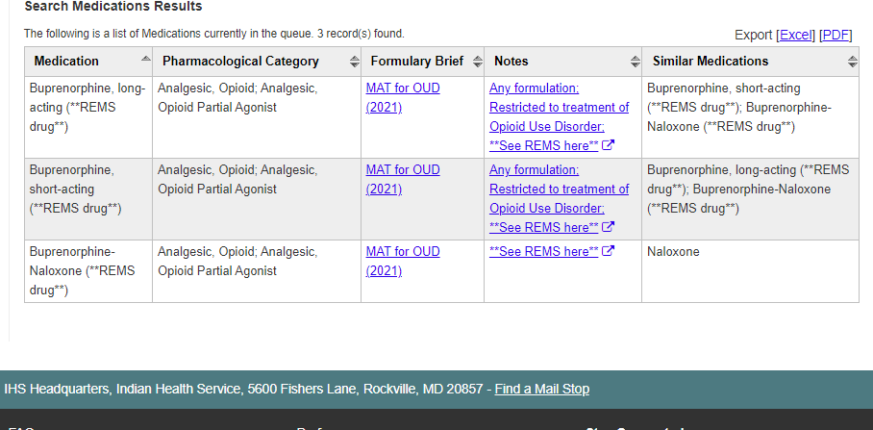
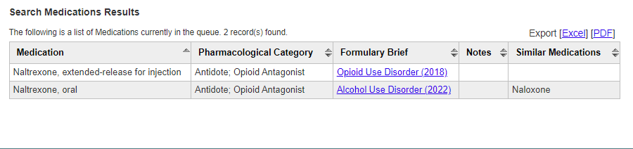
IHS NATIONAL FORMULARY
FOLLOW LOCAL POLICIES AND PROCEDURE RELATED TO DISPENSING CONTROLLED SUBSTANCES.

Slide 10
Provider Resiliency
Aim: In this qualitative study, we aimed to identify factors associated with burnout and, conversely, resilience among multidisciplinary providers working on Addiction Consultation Services (ACS).
Methods: We completed 26 semi-structured interviews with clinicians working on ACS, including physicians, social workers, and advanced practice providers.
Results: Providers described factors contributing to burnout and strategies for promoting resilience, and three main themes arose:
  (1) Systemic barriers contributed to provider burnout, (2) Engaging in meaningful work increased resilience, and (3) Team dynamics influenced perceptions of burnout and resilience.
Conclusion: Our results suggest that hospital-based addiction medicine work is intrinsically rewarding for many providers and that engaging with other addiction providers to debrief challenging encounters or engage in advocacy work can be protective against burnout. However, administrative and systemic factors are frequent sources of frustration for providers of ACS. Structured debriefings may help to mitigate burnout. Furthermore, training to enhance providers' ability to engage effectively in advocacy work within and between hospital systems has the potential to promote resilience and protect against burnout among ACS providers.
Bredenberg, Erin, et. al. “Identifying factors that contribute to burnout and resiliency among hospital-based addiction medicine providers: A qualitative study”. Journal of Substance Abuse Treatment. Vol. 144, 108924 (January 2023) Accessed 03/15/2023 at https://www.jsatjournal.com/article/S0740-5472(22)00206-9/fulltext

Slide 11
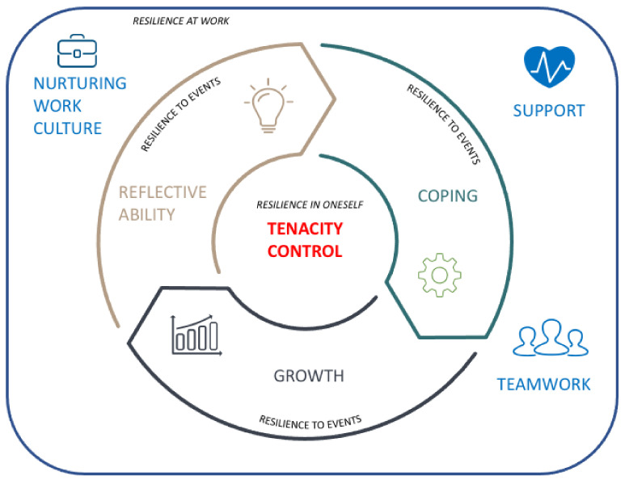
Provider Resiliency
Six Themes:
  1. Tenacity
    Aspiration and Commitment
  2. Resources
    Support, Teamwork, and Institutional Culture
  3. Control
    Professional Boundaries, Acknowledging One’s Own Limitations, and Work-Life Balance
  4. Adaptive Coping
  5. Reflective Ability
  6. Growth
Roslan, N.S.; Yusoff, M.S.B.; Morgan, K.; Ab Razak, A.; Ahmad Shauki, N.I. “What Are the Common Themes of Physician Resilience? A Meta-Synthesis of Qualitative Studies.” Int. J. Environ. Res. Public Health 2022,19, 469. https://doi.org/10.3390/ijerph19010469
Notes:
-Tenacity is defined as the determination to continue one’s actions.
-Aspiration- deriving deep meaning from work or patient contact made physicians engage with their professional calling despite its struggles and challenges as well as “the right thing to do”.
-Commitment- “showing interest in the person behind the symptom “empathy” and “connecting with patients” were important elements of resilience. These often led to good doctor–patient relationships and patients’ appreciation, which was a continuous source of resilience in physicians
- Resources: resilience development was not derived only from the individuals but also from their surroundings in the workplace and at home.
-Support: The participants referred to family and friends as effective buffers that counterbalanced their hectic work lives; “non-medicine people” to help monitor burnout
-Teamwork: the role of “teamness” at work, which facilitated heavy workloads, gave feedback, and provided professional input.
-Institutional Culture: determinant of either promoting or impeding resilience
-Control: Participants in different studies emphasized that, in addition to tenacity, physician’s needed to have control of their professional lives to be more resilient.
-Professional Boundaries: Participants emphasized that a clear understanding of the professional boundaries could provide prophylactic and symptomatic relief because physicians consciously understand the line between endless expectations and professional standards.
-Limitation Acknowledgement: important for physicians to be self-aware of having realistic expectations, accepting personal limitations, and forgiving themselves for making errors
-Work-life Balance: important element
-Adaptive Coping: role of proactively anticipating stress or problems and dealing with them in a timely manner as a means of maintaining resilience
-Reflective Ability: was found to encourage physicians to consciously think about their professional growth
-Growth: important theme for resilience that was fostered by being flexible and optimistic in facing challenges; engaging with professional development opportunities
helped physicians in the face of adversity by maintaining their interest in medicine and improving their professional efficacy

Slide 12
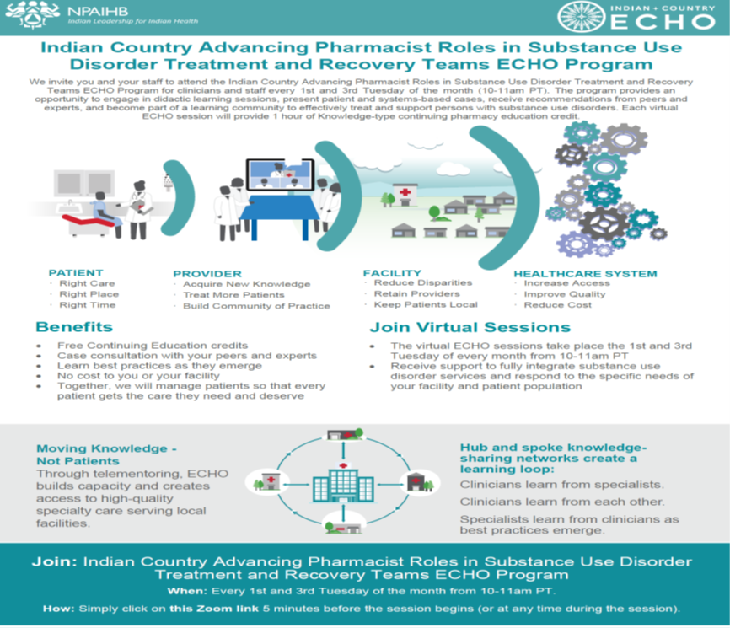
Resources

Slide 13
CLINICIAN-TO-CLINICIAN
SUBSTANCE USE WARMLINE
(855) 300-3595
6am - 5pm PST (Mon-Fri) or submit cases online at nccc.ucsf.edu
Free, confidential, on-demand tele-consultation service for IHS/Tribal/Urban Indian clinicians seeking expert recommendations on evaluation and management of opioid, alcohol, and other substance use.
We welcome calls from all healthcare providers in IHS, tribal, and urban facilities.
We can help:
Assess cases
no matter how straightforward or complex—and help guide treatment planning.
Build your capacity
to assist people with, or vulnerable to, use disorders and develop safer medication strategies.
Communication Strategies
to improve rapport with patients.
Our knowledgeable, compassionate physicians, clinical pharmacists, and advanced practice nurses are available to providers of all experience levels.
This National Clinician Consultation Center program is supported by the Health Resources and Services Administration (HRSA) of the U.S. Department of Health and Human Services (HHS) as part of an award totaling $2,633,756 with 0% financed with non-governmental sources.

Slide 14
Resources
Michael Mudgett February 21,2023, Substance Use Data Among American Indian/Alaska Natives, Northwest Portland Area Indian Health Board
https://www.indiancountryecho.org/resources/substance-use-data-among-american-indian-alaska-natives-february-21-2023/
https://prescribetoprevent.org/wp2015/wp-content/uploads/naloxone-access.pdf
https://www.ihs.gov/opioids/opioidresponse/techassistance/
https://www.ihs.gov/sites/opioids/themes/responsive2017/display_objects/documents/opioidstewardshipwb.pdf
http://eguideline.guidelinecentral.com/i/1224390-national-practice-guideline-for-the-treatment-of-opioid-use-disorder-2020-update/5?

Slide 15

Panel Discussion/Questions

