Slide 1


Welcome!
Lab and Xray Findings
in RA
Mimi Margaretten, MD
February 2, 2023
RAE Initiative| Spring 2023

Slide 2
DISCLOSURES
AMA Designation Statement
The University of California, San Francisco School of Medicine (UCSF) is accredited by the Accreditation Council of Continuing Medical Education (ACCME) to provide continuing medical education for physicians. UCSF designates this live activity for a maximum of 1 AMA PRA Category 1 Credit™. Physicians should claim only the credit commensurate with the extent of their participation in the activity.
Disclosure Statement
Planners Jennifer Mandal, MD, Leslie Dexheimer Gleason, RN, and Tabitha Carroway, MPH have stated they have no relationships to disclose. Speaker Mimi Margaretten, MD has stated she has no relationships to disclose.
RAE Initiative| Spring 2023

Slide 3
A diagnosis of RA is largely based on a patient’s History & PE
Laboratory Data:
  Rheumatoid Factor (RF)
  Anti-citrullinated peptide antibodies (ACPA; anti-CCP)
X-rays
  Support diagnosis
  Prognosticate
  Baseline to monitor disease progression
  Rule out alternative diagnoses (gout, CPPD, OA, Psoriatic arthritis, etc.)
RAE Initiative| Spring 2023
Notes:
Outline for today’s didactic – case-based learning

Slide 4
Case #1
A 32 yo woman with an IUD in place presents to your clinic reporting pain and stiffness in her hands that last all day. On physical examination she has no joint deformities and tenderness to palpation over PIPs without synovitis. Lab studies show RF+/CCP- and X-rays of her hands are read as “normal.” The next best step is to:
Obtain CBC with diff, complete metabolic panel ESR, CRP, and hepatitis serologies
Obtain CBC with diff, complete metabolic panel, QF and hepatitis serologies in anticipation of starting DMARD such as methotrexate
Start prednisone 5 mg daily
Start Plaquenil 200 mg daily
RAE Initiative| Spring 2023

Slide 5
Case #1
A 32 yo woman with an IUD in place presents to your clinic reporting pain and stiffness in her hands that last all day. On physical examination she has no joint deformities and tenderness to palpation over PIPs without synovitis. Lab studies show RF+/CCP- and X-rays of her hands are read as “normal.” The next best step is to:
Obtain CBC with diff, complete metabolic panel ESR, CRP, and hepatitis serologies
Obtain CBC with diff, complete metabolic panel, QF and hepatitis serologies in anticipation of starting DMARD such as methotrexate
Start prednisone 5 mg daily
Start Plaquenil 200 mg daily
RAE Initiative| Spring 2023
Notes:
Answer A
A & B are similar but clinical reasoning is different!

Slide 6
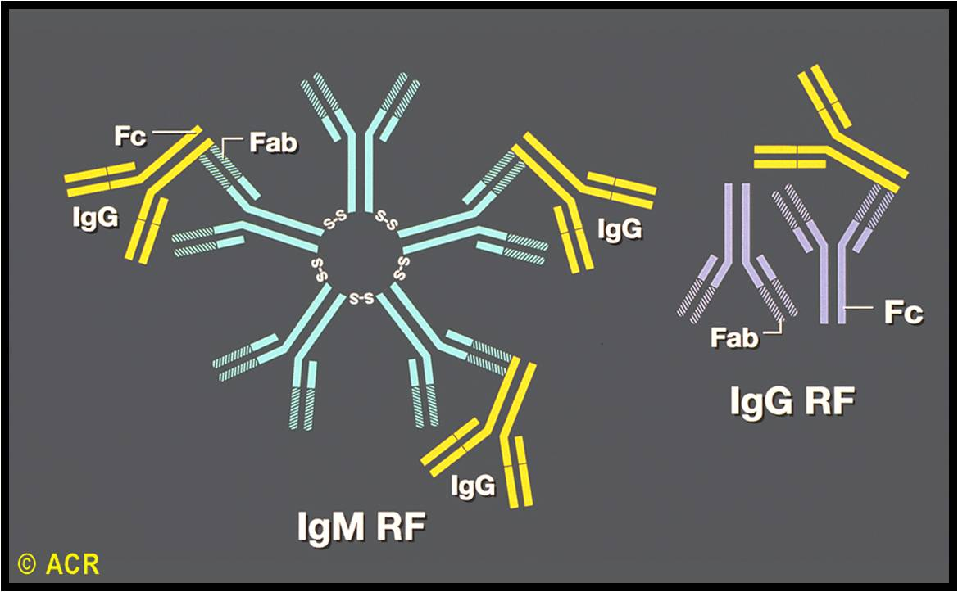
Rheumatoid Factors
RF are autoantibodies directed against the Fc portion of immunoglobulin G
70-80% sensitivity
Lack specificity but high titer is more specific for RA in a patient with polyarthritis
RAE Initiative| Spring 2023

Slide 7
RF+ “Mimics”
Positive RF can (and often does) occur in the following conditions:
  Chronic viral infections i.e. HCV
  Chronic Bacterial Infections i.e. SBE, Osteomyelitis, Dental abscess
  Other Autoimmune Conditions i.e. SLE, Sjogren’s, Cryoglobulinemia
  Other Disease i.e. IPF, Cirrhosis, Sarcoidosis
  Malignancy i.e. lymphoma
  5-10% of healthy US population; prevalence in healthy individuals rises with age
RAE Initiative| Spring 2023

Slide 8
Case #1 Conclusion
A 32 yo woman with an IUD in place presents to your clinic reporting pain and stiffness in her hands that last all day. On physical examination she has no joint deformities and tenderness to palpation over PIPs without synovitis. Lab studies show RF+/CCP- and X-rays of her hands are read as “normal.”
Her Hepatitis C antibody is positive and she has a high viral load. You start her on Hep C therapy and her arthralgias resolve with treatment.
RAE Initiative| Spring 2023

Slide 9
Case #2
A 58 yo man presents to your clinic reporting morning stiffness and joint pain with swelling in hands, wrists, elbows, knees and feet x 6 months. Physical examination demonstrates right wrist, bilateral MCP, & L 3rd PIP synovitis, L ankle effusion and MTP tenderness to squeeze. Labs show elevated ESR & CRP, and RF-/CCP-. Is this RA?
Yes/No
RAE Initiative| Spring 2023

Slide 10
Case #2
A 58 yo man presents to your clinic reporting morning stiffness and joint pain with swelling in hands, wrists, elbows, knees and feet. Physical examination demonstrates right wrist, bilateral MCP, & L 3rd PIP synovitis, L ankle effusion and MTP tenderness to squeeze. Labs show elevated ESR & CRP, and RF-/CCP-. Is this RA?
Yes*
*Real answer is probably – you would obtain Xrays to r/o crystal arthritis, psoriatic arthritis, OA, etc. but given history and PE findings (joint distribution!) RA is top of your ddx
RAE Initiative| Spring 2023
Notes:
Real answer is probably – you want to obtain Xrays to r/o crystal arthritis, psoriatic arthritis, OA, etc. but given history and PE findings (joint distribution!) RA is top of your ddx

Slide 11
Seronegative (RF-/CCP-) RA
Approximately 30% of patients with RA will be RF-/CCP-
Patients with seronegative RA have same clinical presentation as those with RF+/CCP+ RA = inflammatory polyarthritis of PIPs, MCPs, wrists, elbows, knees, ankles, MTPs
Can have erosive, severe RA requiring DMARDs
Rule out alternative diagnoses (i.e. crystal arthritis, psoriatic arthritis, reactive arthritis, OA, fibromyalgia, . . .)
RAE Initiative| Spring 2023

Slide 12
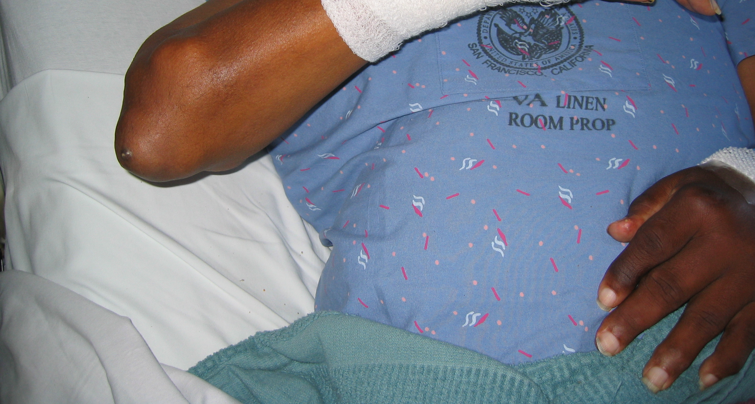
Case #2.5
A 58 yo man presents to your clinic reporting morning stiffness and joint pain with swelling in hands, wrists, elbows, knees and feet. Physical examination demonstrates right wrist, PIP synovitis, L ankle effusion and a non-tender subcutaneous nodule at the R olecranon. Labs show elevated ESR & CRP, and RF-/CCP-. Is this RA?
RAE Initiative| Spring 2023

Slide 13
Case #2.5
A 58 yo man presents to your clinic reporting morning stiffness and joint pain with swelling in hands, wrists, elbows, knees and feet. Physical examination demonstrates right wrist, L 3rd PIP synovitis, L ankle effusion and a non-tender subcutaneous nodule at the R olecranon. Labs show elevated ESR & CRP, and RF-/CCP-. Is this RA?
No
RAE Initiative| Spring 2023
Notes:
Slightly different joint distribution (no MCP or MTP involvement) and nodule

Slide 14
RF have prognostic value with disease manifestations and severity
  RF+ RA is associated with more aggressive joint disease compared to seronegative RA
  Extraarticular manifestations always occur in the setting of RF+ RA
  Nodules do not occur in patients who are RF-
RF titers are not followed over time; do not correlate with disease activity
RAE Initiative| Spring 2023

Slide 15
Case #3
A 26 yo woman presents to your clinic with bilateral wrist and hand pain. Her Aunt was diagnosed with RA at age 62. She does not drink EtOH. She smokes 5-10 cigarettes/week. Her exam shows bilateral wrist, MCP and PIP synovitis. She is RF+/CCP+. X-rays demonstrate an erosion at R ulnar styloid. Is this RA?
RAE Initiative| Spring 2023
Notes:
Answer: B

Slide 16
Case #3
A 26 yo woman presents to your clinic with bilateral wrist and hand pain. Her Aunt was diagnosed with RA at age 62. She does not drink EtOH. She smokes 5-10 cigarettes/week. Her exam shows bilateral wrist, MCP and PIP synovitis. She is RF+/CCP+. X-rays demonstrate an erosion at R ulnar styloid. Is this RA?
Yes (not a trick question)
RAE Initiative| Spring 2023
Notes:
Answer: B

Slide 17
Anti-CCP antibody in RA
Anti-cyclic-citrullinated peptide antibodies are directed against amino acids formed by post-translational modification of arginine
Sensitivity 65-75%
Specificity is >95%
CCP+ RA portends worse prognosis with increased risk of joint damage and erosions compared to patients with CCP- RA
Cigarette smoking induces citrullination of peptides in the lungs
RAE Initiative| Spring 2023

Slide 18
RF and CCP in rheumatoid arthritis
Be suspicious!
RAE Initiative| Spring 2023

Slide 19
Additional Labs
Can see elevation of acute phase reactants (ESR, CRP, platelets)
Normal acute phase reactants may occur in untreated patients with RA, but such findings are infrequent.
Anemia of chronic disease often co-exists with RA
When considering RA obtain CBC with differential, Chemistry Panel (baseline Cr and LFTs), Hepatitis serologies (HBV sAb, sAg, coreAb, & HCV ab)
RAE Initiative| Spring 2023

Slide 20
Case #4
A 34 yo woman with an IUD in place presents to your clinic with bilateral hand (R>L) pain x 4 months. Her exam demonstrates mild R wrist and bilateral 3rd PIP synovitis. She is RF+/CCP+. You obtain baseline labs in anticipation of starting a DMARD and:
Obtain bilateral hand Xrays
Obtain bilateral hand and wrist Xrays
Obtain bilateral hand, wrist, and foot Xrays
Obtain bilateral hand and foot Xrays
RAE Initiative| Spring 2023

Slide 21
Case #4
A 34 yo woman with an IUD in place presents to your clinic with bilateral hand (R>L) pain x 4 months. Her exam demonstrates mild R wrist and bilateral 3rd PIP synovitis. She is RF+/CCP+. You obtain baseline labs in anticipation of starting a DMARD and:
Obtain bilateral hand Xrays
Obtain bilateral hand and wrist Xrays
Obtain bilateral hand, wrist, and foot Xrays
Obtain bilateral hand and foot Xrays
RAE Initiative| Spring 2023
Notes:
Hand Xray contain wrists so do not need separate wrist and hand Xrays. Always want to obtain foot Xrays which can show first signs of erosions and need to escalate therapy
Pearl – I have patient get a chest Xray as well given high prevalence of LTBI in our patient population and possible future anti-TNF therapy

Slide 22
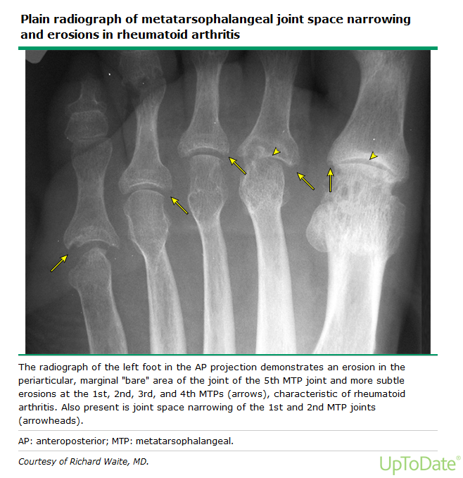
RAE Initiative| Spring 2023

Slide 23
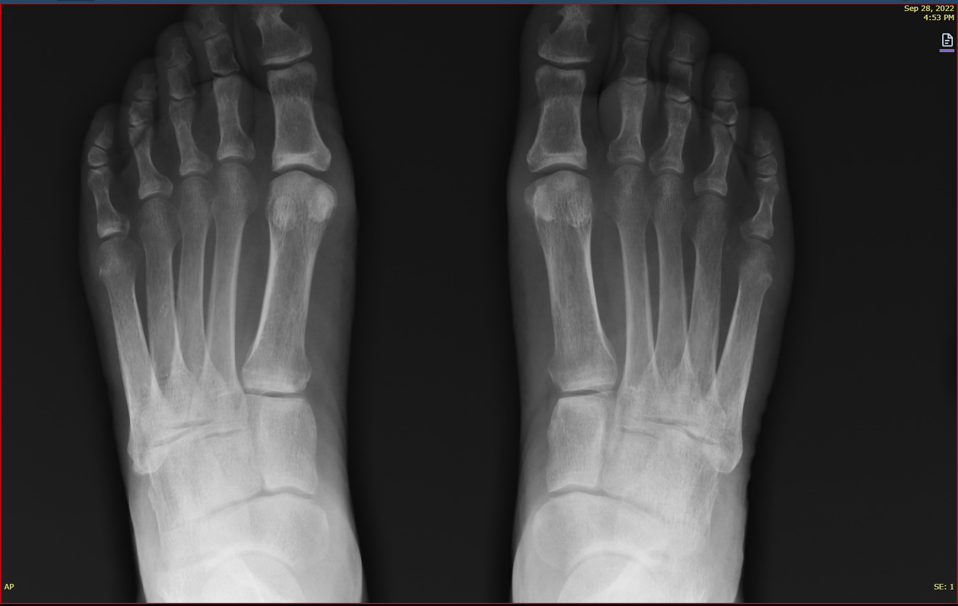
RAE Initiative| Spring 2023
Notes:
Another example of 5th MTP erosion

Slide 24
X-rays
Obtain bilateral hand and foot X-rays
5 things to look at on hand X-rays:
  Soft tissue swelling
  Bone density (periarticular osteopenia)
  Alignment
  Absence (erosions) of bone
  Deposition (chondrocalcinosis, osteophytes) of bone
Feet: look at 5th MTP
RAE Initiative| Spring 2023

Slide 25
Early RA
RAE Initiative| Spring 2023
Notes:
Soft-tissue swelling of the proximal interphalangeal and metacarpophalangeal joints is most apparent in the index and middle fingers. Moderate osteopenia is present, primarily periarticularly. Thinning of the radial cortices of the metacarpal heads is noted, but no erosions are seen. These are early pre-erosive changes of rheumatoid arthritis.

Slide 26
Progressive X-ray Changes MCP
RAE Initiative| Spring 2023
Notes:
Progressive changes can be seen in this metacarpophalangeal joint, beginning with (A) soft-tissue swelling, but with intact underlying cortex and no erosions. This is followed by (B) thinning of the radial side of the cortex with minimal disturbance of underlying trabeculae and minimal joint space narrowing. A marginal erosion (C) appears on the radial aspect of the metacarpal head. There is loss of bone substance and joint space narrowing.

Slide 27
Ulnar Styloid
RAE Initiative| Spring 2023
Notes:
Soft-tissue swelling is adjacent to the radial and ulnar styloid processes. Irregularity of the tip of the ulnar styloid process results from early erosive change (arrow). Right, Magnification of the ulnar styloid process shows erosive changes

Slide 28
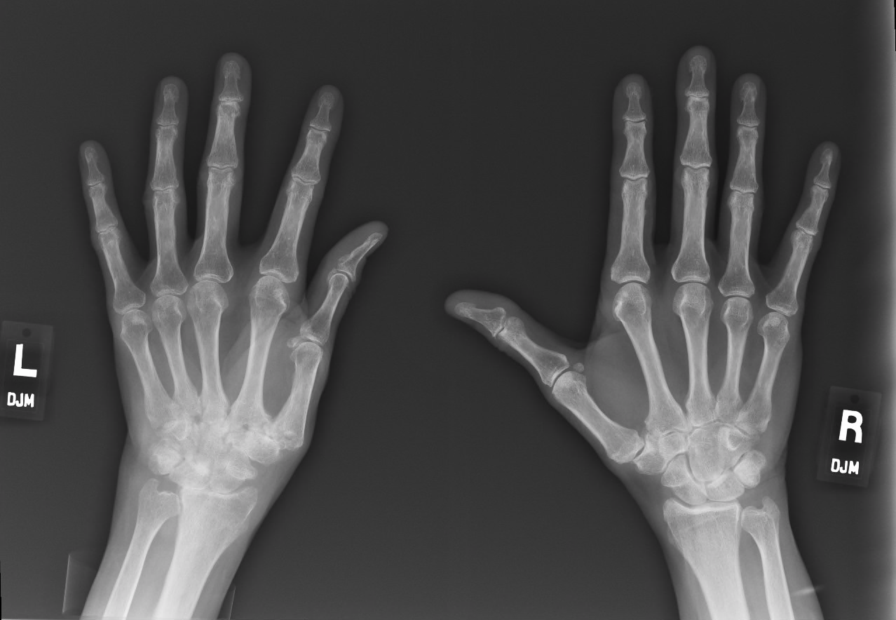
RA
RAE Initiative| Spring 2023
Notes:
Here you can use patient as her own control. Right hand relatively well preserved carpal bones, periarticular osteopenia. Left hand soft tissue swelling, carpal destruction with erosions, subluxation MCPs

Slide 29
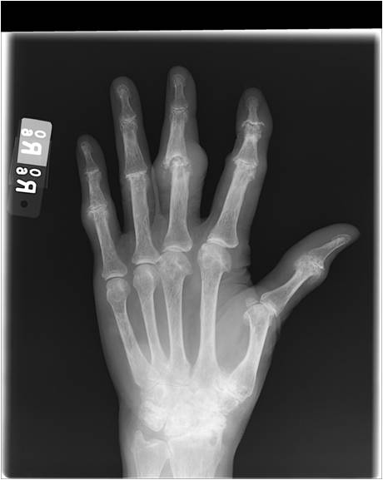
Not RA
RAE Initiative| Spring 2023
Notes:
Changes consistent with CPPD, gout and osteoarthritis. Triangular fibrocartilage calcification, scapholunate advanced collapse (SLAC) and narrowing of the 1st-3rd metocarpophalangeal joints with drooping osteophytes are characteristic of CPPD. Narrowed remaining proximal and distal interphalangeal joints with osteophyte formation are consistent with osteoarthritis.

Slide 30

CME Credit Link:
RAE Initiative| Spring 2023
Notes:
https://ucsf.co1.qualtrics.com/jfe/form/SV_9BmFMayeCjigRYq

