Slide 1


Welcome!
RA Foundations
Wendy Grant, MD
January 19, 2023
RAE Initiative| Spring 2023

Slide 2
DISCLOSURES
AMA Designation Statement
The University of California, San Francisco School of Medicine (UCSF) is accredited by the Accreditation Council of Continuing Medical Education (ACCME) to provide continuing medical education for physicians. UCSF designates this live activity for a maximum of 1 AMA PRA Category 1 Credit™. Physicians should claim only the credit commensurate with the extent of their participation in the activity.
Disclosure Statement
Planners Jennifer Mandal, MD, Leslie Dexheimer Gleason, RN, and Tabitha Carroway, MPH have stated they have no relationships to disclose. Speaker Wendy Grant, MD has stated she has no relationships to disclose.
RAE Initiative| Spring 2023

Slide 3
Session 1 Agenda
Introductions
Overview of Course Objectives
RA in AI/NA populations
RA treatment outline
Classification criteria for RA
Cases: RA or not?
RAE Initiative| Spring 2023

Slide 4
Session 1 Agenda
Introductions
Overview of Course Objectives
RA in AI/NA populations
RA treatment outline
Classification criteria for RA
Cases: RA or not?
RAE Initiative| Spring 2023

Slide 5
Session Format
Thursdays, 12-1PM PST:
1-1:30PM:
Case-Based Group Discussion
Optional 30min
“Office Hours”
High-Yield Didactic
~30 minute didactic
Taught by a rheumatologist
Brief case presentation
Interactive discussion with learners, facilitated by expert RA Panel
Held every other week
RAE Initiative| Spring 2023

Slide 6
Cohort Demographics
CHR/CHW – 14
RN - 11
MD – 8
NP - 5
Pharmacist – 2
DO - 1
LPN – 1
LMT – 1
Youth Counselor – 1
DrPH– 1
Tribal Member - 1
RAE Initiative| Spring 2023

Slide 7
Cohort Demographics
RAE Initiative| Spring 2023

Slide 8
Case Presentations:
Please use the RA ECHO Case Presentation form
Feel free to submit more than one case!
Patient Confidentiality: Please do not include any protected health information (PHI)
  Applies to Case Presentation forms, live discussions, office hours, and email communication
  PHI includes patient name, date of birth, MRN, address, and any photos in which the patient is potentially identifiable
RAE Initiative| Spring 2023

Slide 9
Nuts & Bolts
Please keep your video on (if your internet bandwidth allows)
Please mute yourself when not speaking
Sign in with email using the chat for attendance
Fill out evaluation each session for CE credit
We strongly encourage you to ask questions and offer your comments and insights to the group!
Safe space for discussion and learning
RAE Initiative| Spring 2023

Slide 10
Curriculum
01/19 - RA Foundations
01/26 - Distinguishing Rheumatoid Arthritis from Osteoarthritis
02/02 - Lab and Xray Findings in RA
02/09 - Extra-Articular Manifestations of RA
02/16 - RA Mimics: Other Forms of Inflammatory Arthritis
02/23 - Baseline Studies and Considerations Prior to Treatment
03/02 - Initial Therapy: Glucocorticoids and NSAIDs
03/09 - Measuring and Monitoring: How to Assess RA Disease Activity
03/16 - Initial Therapy: Methotrexate
03/23 - Other Conventional DMARDs
03/30 - Advanced Therapy: Biologic DMARDs
04/06 - RA Key Pearls + Wrap Up
RAE Initiative| Spring 2023

Slide 11
Benefits of Consistent Participation in the RA ECHO:
A well-rounded understanding of the diagnosis and management of RA
The knowledge and confidence you need to change your practice and enhance the care of Navajo patients living with RA
A supportive community of colleagues with a shared interest in rheumatology
CE Credit (must fill out very short questionnaire at the end of each session)
For those who attend at least 9 of 12 sessions
A formal Certificate of Participation issued by the American College of Rheumatology (ACR)
RAE Initiative| Spring 2023

Slide 12
Contact information
Program & Logistical Questions:
raeinitiative@gmail.com
aday@npaihb.org
RA/Rheumatology Questions:
Gwendolyngrant@centura.org
Jennifer.mandal@ucsf.edu
Mary.margaretten@ucsf.edu
RAE Initiative| Spring 2023

Slide 13
Session 1 Agenda
Introductions
Overview of Course Objectives
RA epidemiology, pathogenesis, clinical spectrum
RA in AI/NA populations
RA treatment outline
Classification criteria for RA
Cases: RA or not?
RAE Initiative| Spring 2023

Slide 14
RA: the basics
  RA is a systemic autoimmune disease characterized primarily by a symmetric inflammatory polyarthritis
  The US prevalence is 0.5-1%, with some populations having significantly higher rates of disease
  Women:men 2:1
  Age of onset: 30-50 most common
  1st degree relative confers 3X higher odds
  2nd degree relative confers 2X higher odds

Slide 15
Extra-Articular Manifestations of RA

Slide 16
Rheumatoid Arthritis: the basics
RA: pathogenesis
  Likely a combination of genetic and environmental factors
  Genetics:
  HLA-DRB1 genes are most closely associated with RA
  Environmental:
  smoking (strongest known environmental RF for RA)
  chronic mucosal inflammation (periodontitis) and possibly gut dysbiosis are potential RF
  others: silica/other inhalants, sugary drinks, obesity, pollution
  2 copies of the HLA-DRB1 gene + smoking = RR of 21

Slide 17
RA in Native American Populations
The worldwide prevalence of RA is about 1%
The prevalence of RA in AI/AN populations is incompletely characterized but some epidemiologic surveys that define the prevalence and characteristics of RA in specific populations are available
RAE Initiative| Spring 2023

Slide 18
RA in Native American Populations
Tlingit 2.4% (1991)
  1.3% male
  3.5% female
Yakima (1973)
  N/A male
  3.4% female
Boyer et al. Rheumatic Diseases in Alaskan Indians of the Southeast Coast. JRheum1991;18:1477-84
Beasley et al. High prevalence of rheumatoid arthritis in Yakima Indians. Arth Rheum 1973; 16:743-8
RAE Initiative| Spring 2023

Slide 19
RA in Native American Populations
Pima (1989)
  3.2% male
  7.0% female
Chippewa (1981,1983)
  4.8% male
  8.2 % female
DelPuente et al. High incidence and prevalence of rheumatoid arthritis in Pima Indians. Am J Epidemiol 1989; 129: 1170-8
Harvey et al. Rheumatoid arthritis in a Chippewa Band. Arthritis Rheum 1981; 24: 717-21
RAE Initiative| Spring 2023

Slide 20
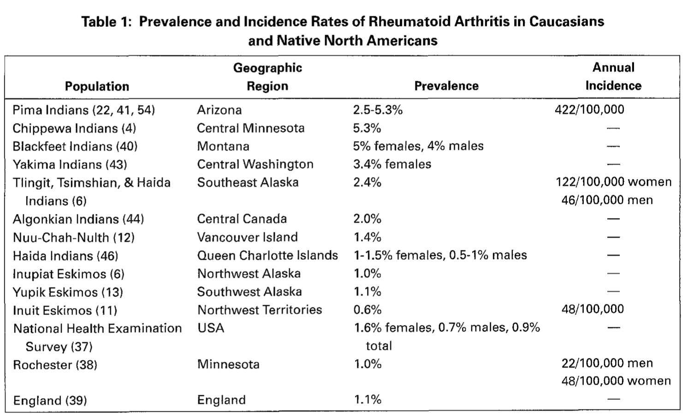
RA Epidemiology Among
American Indians/Alaska Natives
Peschken CA, Esdaile JM. Seminars in Arthritis and Rheum 1999;28:368–391.
Notes:
Estimated I&P 2-3x that of Anglo populations

Slide 21
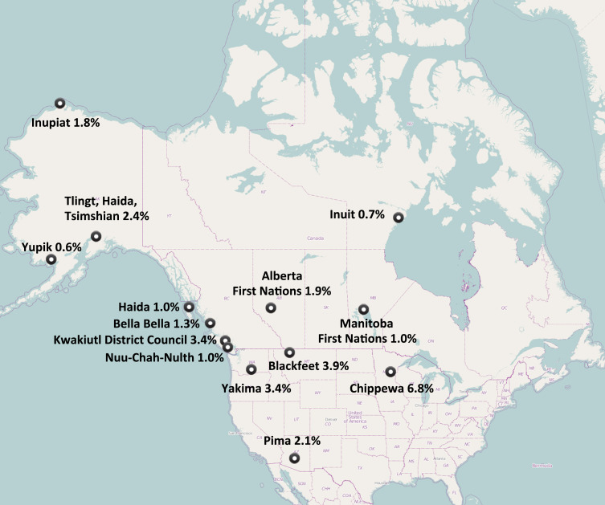
RA in Native American populations
RA in Native American populations
RAE Initiative| Spring 2023

Slide 22
RA in Native American Populations
  2010 study comparing NAN patients (Cree, Ojibway, Metis, Sioux, Dakota) to white patients with RA
  20 years of follow up
  In the NAN group:
      Younger age of onset in NAN
      Higher rate of RF positivity
      Higher rate of ANA positivity
      Higher lifetime number of DMARDs
      More frequent combination therapy
      More frequent prednisone use
Peschken et al. Rheumatoid arthritis in a North American Native population: longitudinal followup and comparison with a white population. JRheum 2010; 37: 1589-95
RAE Initiative| Spring 2023

Slide 23
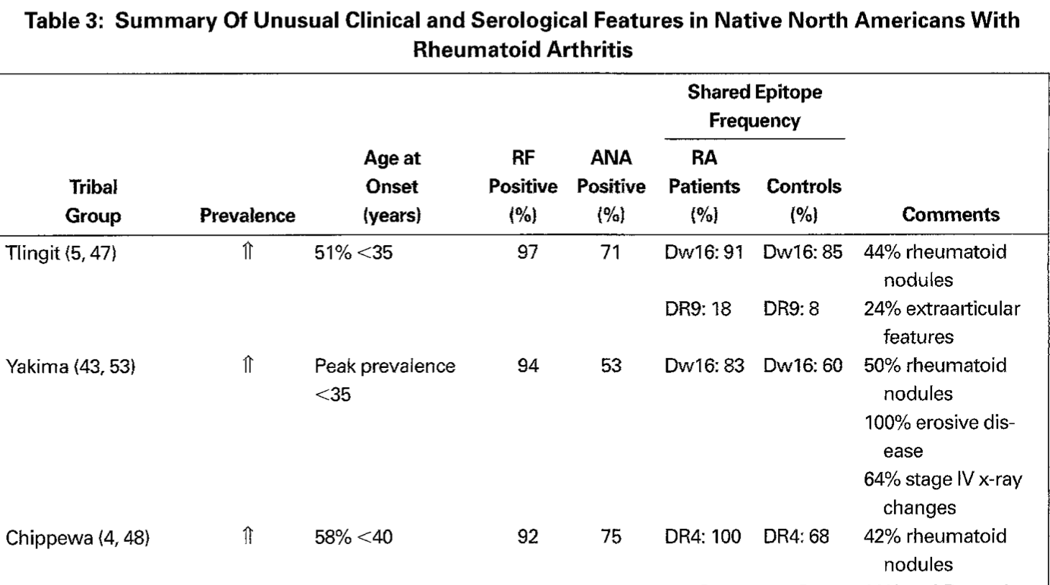
Peschken CA, Esdaile JM. Seminars in Arthritis and Rheum 1999;28:368–391.
RAE Initiative| Spring 2023

Slide 24
Session 1 Agenda
Introductions
Overview of Course Objectives
RA in AI/NA populations
RA treatment outline
Classification criteria for RA
Cases: RA or not?
RAE Initiative| Spring 2023

Slide 26
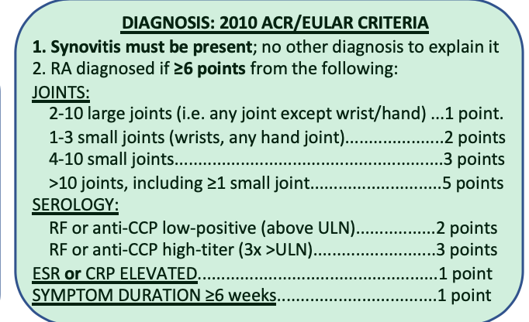

Slide 27
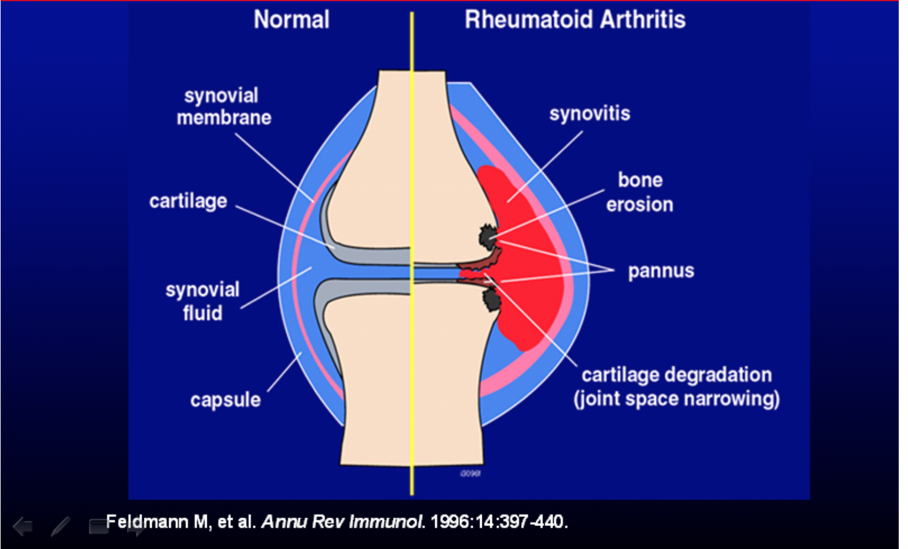
Synovitis
RAE Initiative| Spring 2023

Slide 28
Scenario #1
34 year old woman
  2-3 months joint pain, stiffness in hands, feet, wrists
  Better with movement, NSAIDs; worse in the morning or after inactivity
  Exam: swelling and tenderness of both wrists, left index and third finger PIP joints
  RF negative
  CCP > 250
  CRP 15
RAE Initiative| Spring 2023

Slide 29
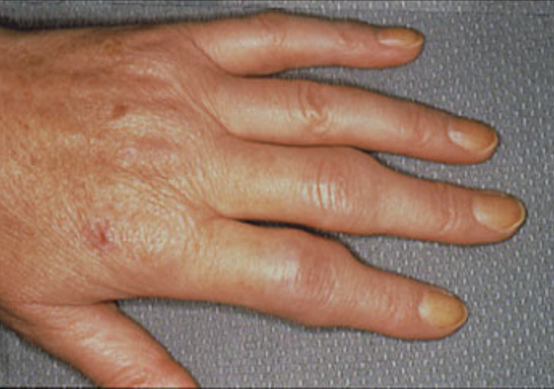
RAE Initiative| Spring 2023

Slide 30
Scenario #1
34 year old woman
  2-3 months joint pain, stiffness in hands, feet, wrists 1 point
  Exam: swelling and tenderness of both wrists, 3 points
  Left index and third PIP joints
  RF negative
  CCP > 250 3 points
  CRP 15 1 point
  This person has rheumatoid arthritis
RAE Initiative| Spring 2023

Slide 31
Scenario #2
68 year old man
10 years of joint pain in the hands
Exam: enlarged PIP and DIP joints; decreased flexion
RF 34
CCP negative
Normal CRP
RAE Initiative| Spring 2023

Slide 32
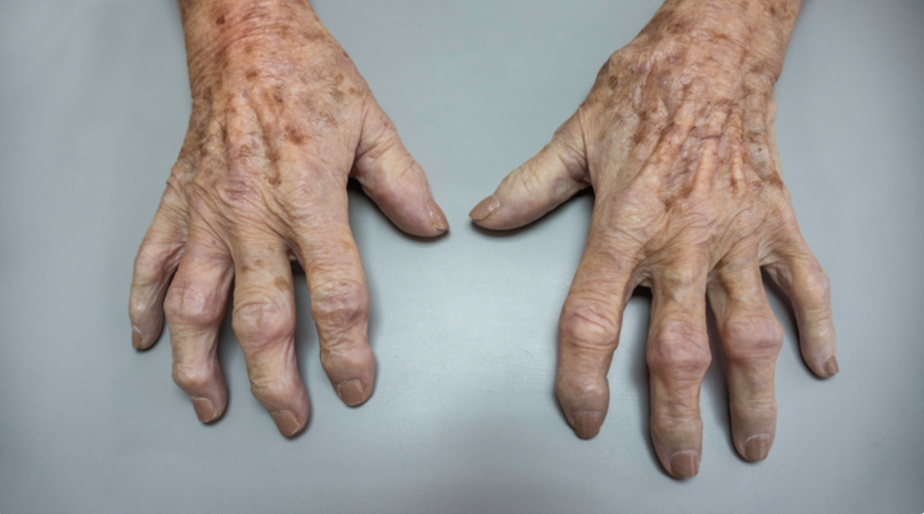
RAE Initiative| Spring 2023

Slide 33
Scenario #2
68 year old man
10 years of joint pain in the hands 1 point
Exam: enlarged PIP and DIP joints; decreased flexion 0 points
no synovitis
RF 34 2 points
CCP negative 0 points
Normal CRP 0 points
This person has osteoarthritis
RAE Initiative| Spring 2023

Slide 34
Scenario #3
50 year old woman
3 months of pain in hands
Exam: tenderness in several PIP and MCP joints; no obvious synovitis
RF negative
CCP 50 (normal < 20)
CRP 12 (normal < 10)
RAE Initiative| Spring 2023

Slide 35
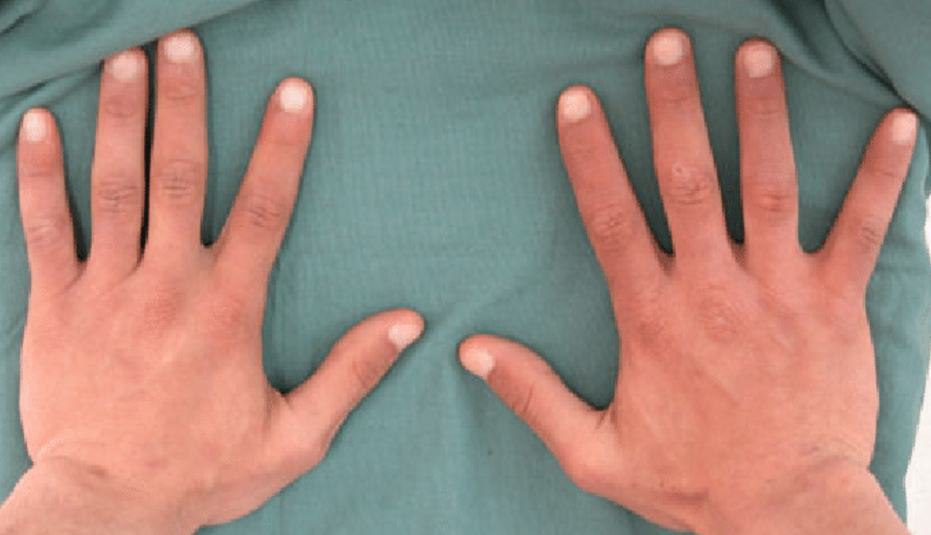
RAE Initiative| Spring 2023

Slide 36
Scenario #3
50 year old woman
3 months of pain in hands 1 point
Exam: tender joints; no obvious synovitis 0 points
RF negative
CCP 50 (normal < 20) 2 points
CRP 12 (normal < 10) 1 point
This person does not meet the criteria for RA, but should be followed closely
RAE Initiative| Spring 2023

Slide 37
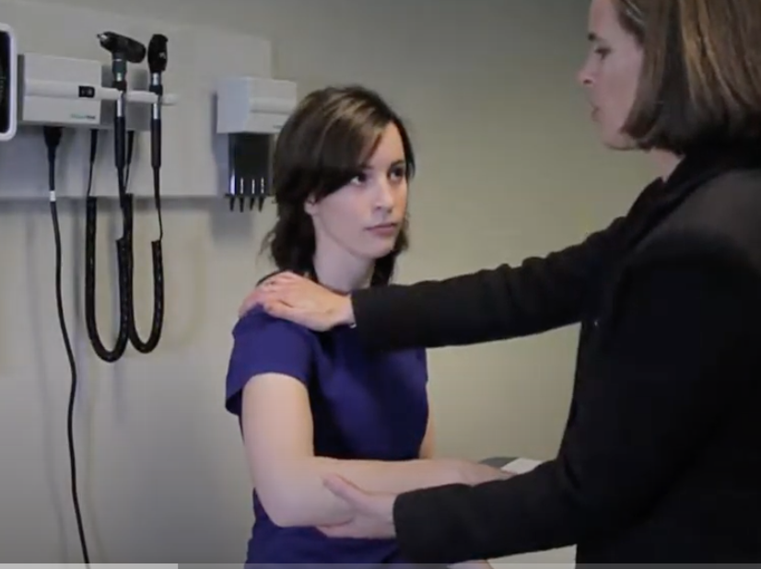
Joint exam videos

Slide 38
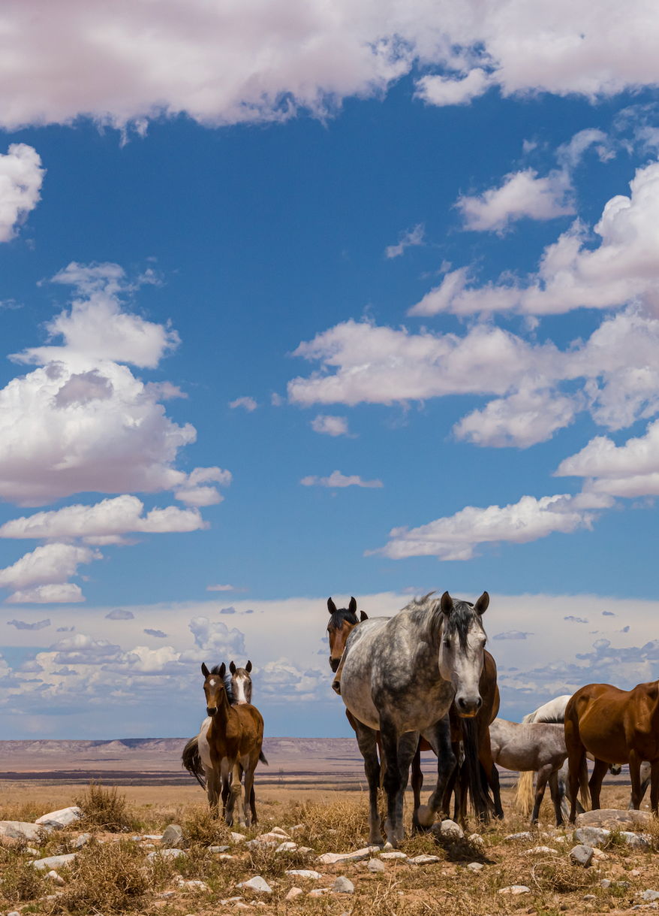
Thank
you all!
Please reach out to
raeinitiative@gmail.com
with any feedback or questions.
RAE Initiative| Spring 2023

Slide 39
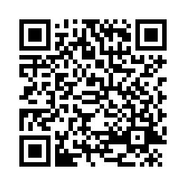
CME Credit Link:
RAE Initiative| Spring 2023
Notes:
https://ucsf.co1.qualtrics.com/jfe/form/SV_8hKHnuNiXBbK3Z4

