Slide 1
Environmental Emergencies
Paul Craven, MD
UNM EMS Consortium
Some slides courtesy of Dr. Mateo Garcia

Slide 2
Objectives
Discuss bites and envenomation
Discuss management of hypo and hyperthermia and its components.
Define heat exhaustion, heat stroke & hyponatremia.
Discuss what can occur at altitude
Awareness of other environmental hazards

Slide 3
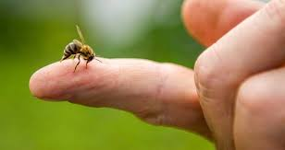
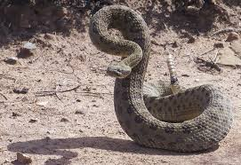
Bites/Envenomations

Slide 4
Epidemiology
75-100 Rattlesnake bites a year in New Mexico.
7,000-8,000 venomous snake bites in the US every year.
Large majority ~98% of documented bites, involve extremities.
Men aged 17- 27 years old make up ~80% of bite victims.
Almost all bites occur annually between April and September.

Slide 5
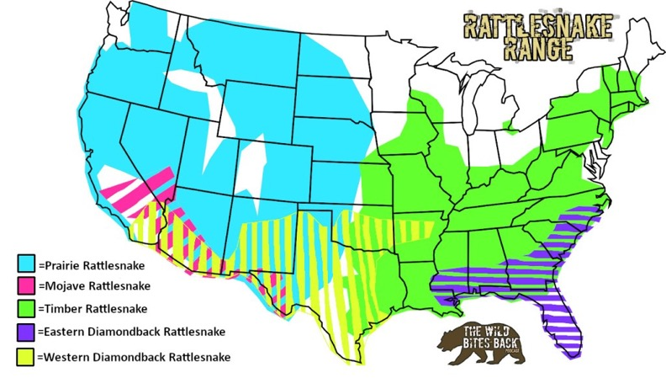
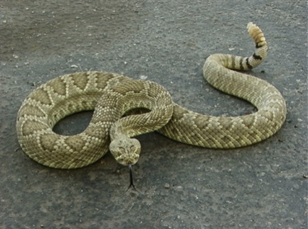
Venomous snakes in the US
Crotalidea (Pit Vipers)

Slide 6
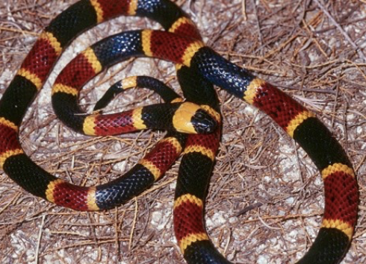
Elapidea
Coral snake

Slide 7
Scene Safety

Slide 8
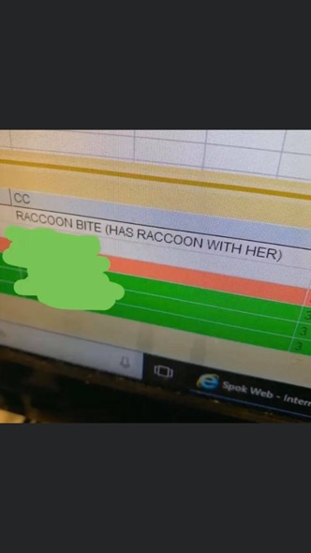
Scene Safety
Please do not try to catch or kill.
If unsure of species of snake, can always grab a photo from safe distance.
Please no more animals the ER.

Slide 9
Transport and Treatment Do’s and Don'ts

Slide 10
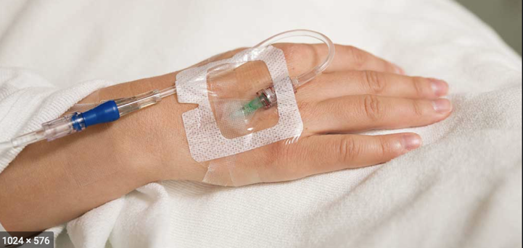
Transport/ Treatment : Do’s
IV Access if possible and pain management
Oral pain medications are OK

Slide 11
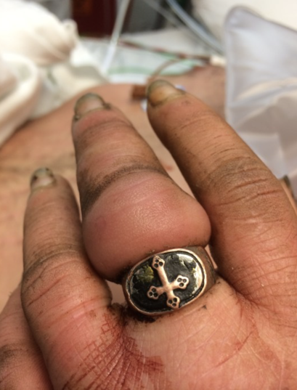
Transport/ Treatment : Do’s
Remove any jewelry, rings or constrictive clothing from near the site.

Slide 12
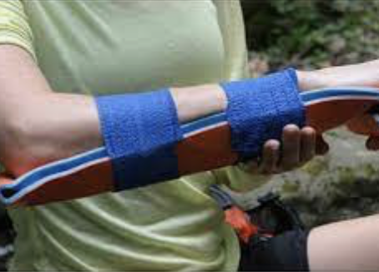
Transport/ Treatment : Do’s
Loosely Splint - if bite wound is on an extremity

Slide 13
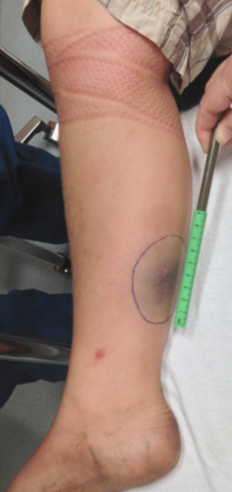
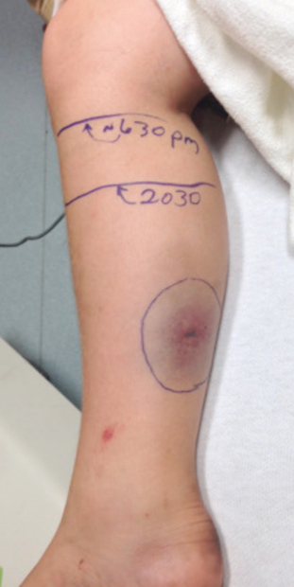
Transport/ Treatment : Do’s
Mark bite are and time
Monitor and mark progression during transport

Slide 14
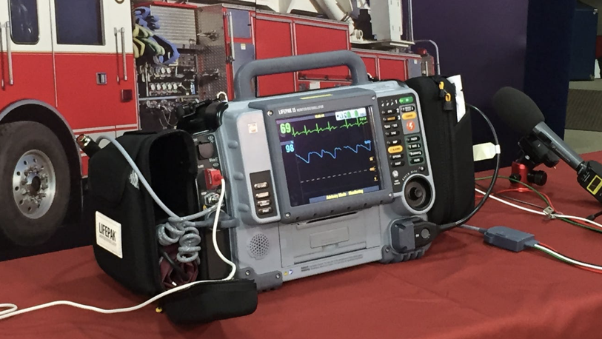
Transport/ Treatment : Do’s
Monitor vitals

Slide 15
Transport/ Treatment : Do’s
Summary
Loosely Splint - if bite wound is on an extremity
Remove any jewelry, rings or constrictive clothing from near the site.
Keep patient Calm to keep heart rate down - Monitor vitals
IV access
Pain medications if indicated
Mark and monitor leading edge of edema and erythema

Slide 16
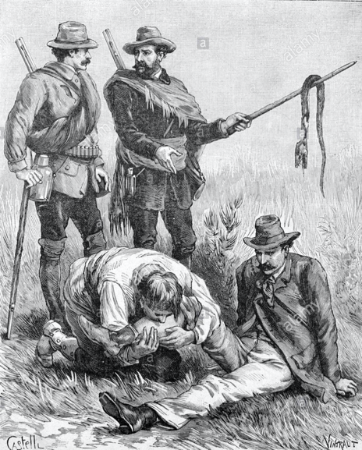
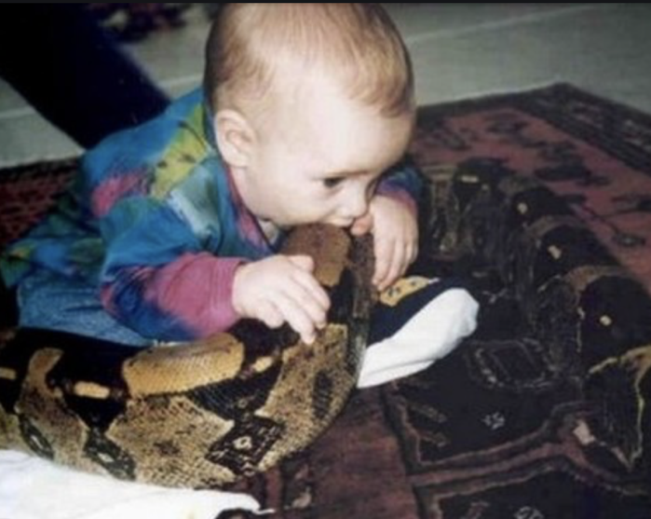
Transport/ Treatment : DON’Ts

Slide 17
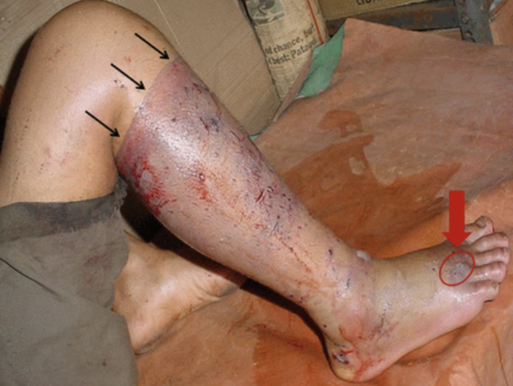
Transport/ Treatment : DON’Ts
Do not place a tourniquet
***Only exception is bleeding to death.

Slide 18
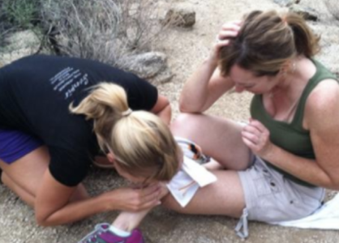
Transport/ Treatment : DON’Ts
Do not cut or try to remove Venom
Are you Crazy?

Slide 19
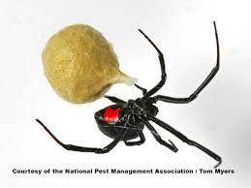
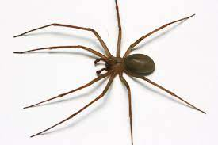
Crawley things that Bite
Painful vs painless
Supportive care

Slide 20
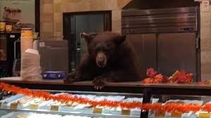
Common Bites
Dogs, cats and homo sapiens
Tx: hemorrhage control, clean and irrigate

Slide 21
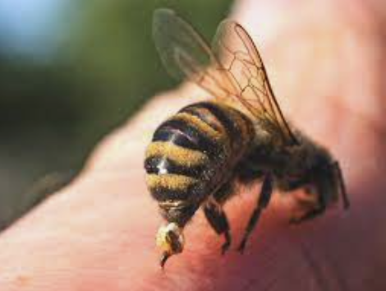
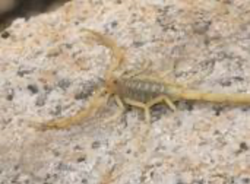
Stings

Slide 22
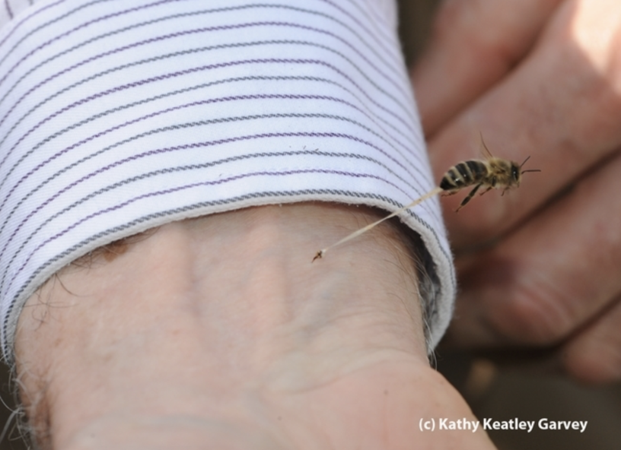
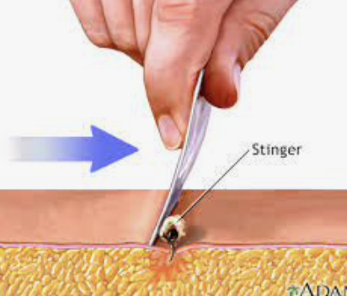

Slide 23
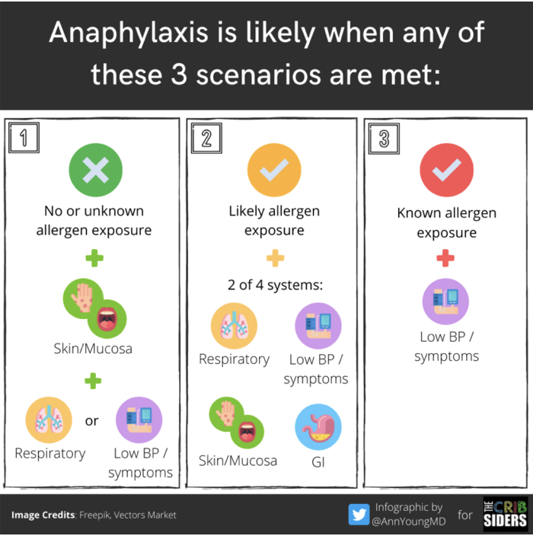
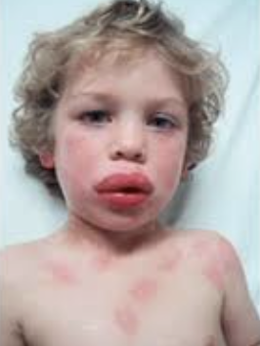
Anaphylaxis

Slide 24
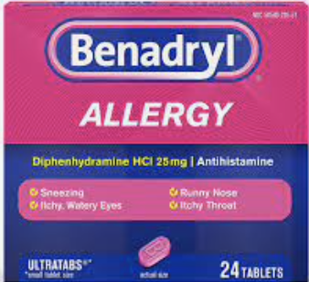
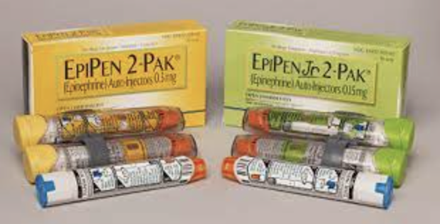
Anaphylaxis

Slide 25
Anaphylaxis
Diphenhydramine 25-50 mg
Epinephrine 0.3mg (epipen or epipen Jr. for pediatrics)
0.15mg for peds
Be aware some agencies draw up their epinephrine
Albuterol for wheezing if available.
Steroids will be given by ALS or hospital.

Slide 26
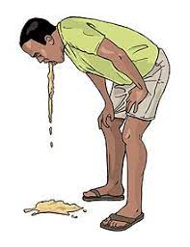
Altitude
What happens when we take people from sea level to the mountains of New Mexico?
Why?

Slide 27
Physiology at altitude
Lower air density and pressure
Hypoxia – Increased ventilation, lowering PaCO2 and increased pH, chemoreceptors respond to pH culminating in ventilation inhibition
Kidneys excrete bicarb to counter rising pH, leading to dehydration
Cardiac stroke volume down from renal excretion, increasing cardiac burden and hypotension
Increased ventilation leads to hypocapnia followed by vasoconstriction, competing vasodilation in setting of hypoxia
Hypothesis that severe vasoconstriction and vascular pressure culminates in edema and hemorrhage

Slide 28
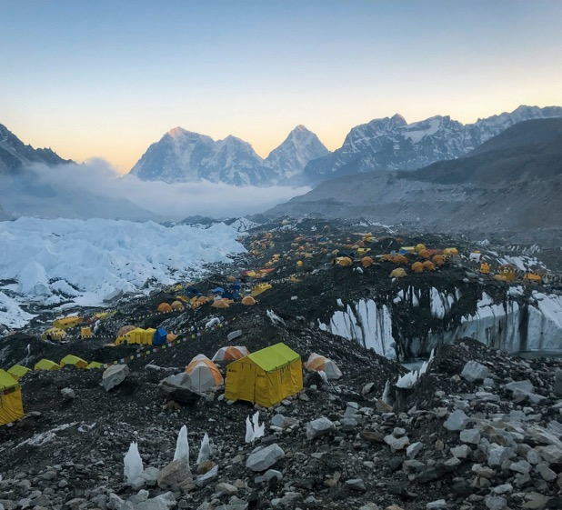
Acute Mountain Sickness
Typically above 8000 ft
Mountaineers Hangover:
Headache, fatigue, nausea, vomiting
Prevention with slow ascent and acclimation

Slide 29
High Altitude Cerebral Edema
HACE
Vasogenic brain edema
Ataxic gait, lethargy, irritable, confusion, poor coordination, stupor, coma

Slide 30
High Altitude Pulmonary Edema
HAPE
Accumulation of plasma and RBC in lung secondary to blood-gas barrier breakdown
Cough, SOB, pink frothy sputum, febrile, crackles on exam
Rapidly progressive and worse with any exertion, making descent difficult

Slide 31
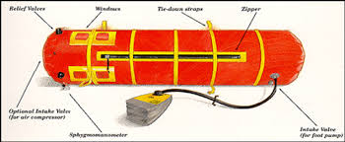
Altitude Treatments
Descend, descend, descend
Hydrate
Supplemental O2
Medications: some agencies may carry acetazolamide

Slide 32
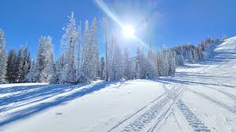

Cold and Hot

Slide 33
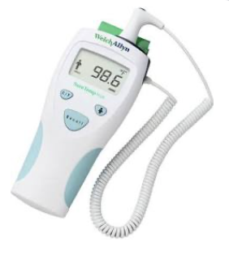
Hypothermia
Body temperature of < 35°C (95°F)
Can you become hypothermic in warmer weather…say 50°C?
What about water that is 60°-70°?
Notes:
Windshield factor

Slide 34
Who is at risk?
Extremes of age (elderly, infants)
Ethanol use
Lack of shelter (homeless persons)
Exposure (winter sports)
Underlying illness
Severe trauma

Slide 35
What does hypothermia look like?
Stage | Clinical Symptoms | Temp | Treatment
HT class I | Conscious, shivering | 35-32°C | Passive external
HT class II | Impaired conscious, not shivering | 32-28°C | Active external, minimally invasive
HT class III | Unconscious with VS | 28-24°C | As above + airway, invasive only if cardiac instability
HT class IV | No vital signs | <24°C | CPR (3 rounds epi +/- defib), ECMO/CPB, if no ECMO thoracic/peritoneal lavage

Slide 36
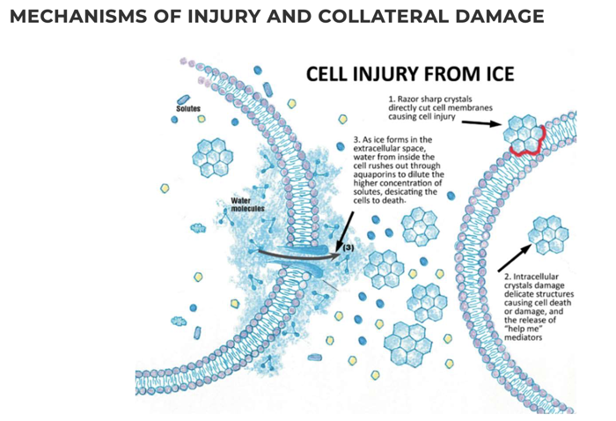
Assessment and vitals
HR: May be profoundly bradycardic.
BP: Normotensive to hypotensive.
RR: normal to slow respirations
Temperature: low
Imperative to check a blood sugar.

Slide 37
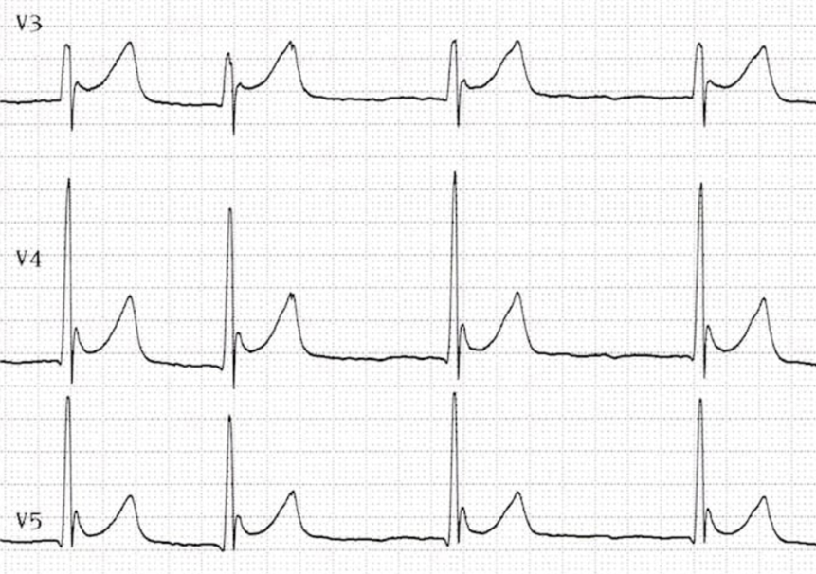
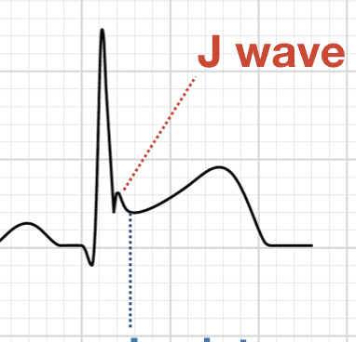
EKG
Notes:
Osborne wave

Slide 38
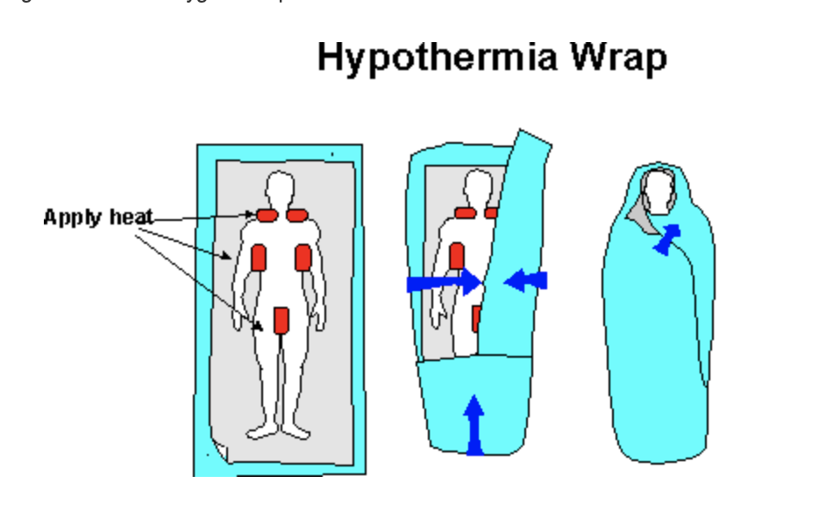
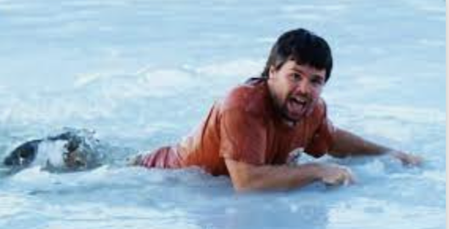
Prehospital management
Remove patient from the cold environment—handle gently.
Rough handling may precipitate V- Fib (a-fib is most common dysrhythmia)
Remove wet clothing
External rewarming - warm/dry blankets, radiant heat, warm packs.
Notes:
IV/IO - Warm crystalloid fluids of 20 mL/kg, if available, in 500 mL increments up to a total of 2L

Slide 39
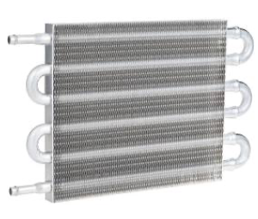
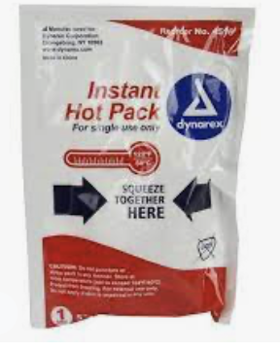
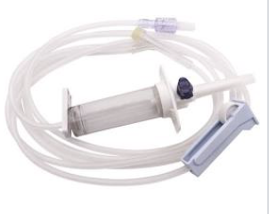
Warm IV fluids in pre hospital setting.
IV/IO - Warm crystalloid fluids of 20 mL/kg, if available, in 500 mL increments up to a total of 2L

Slide 40
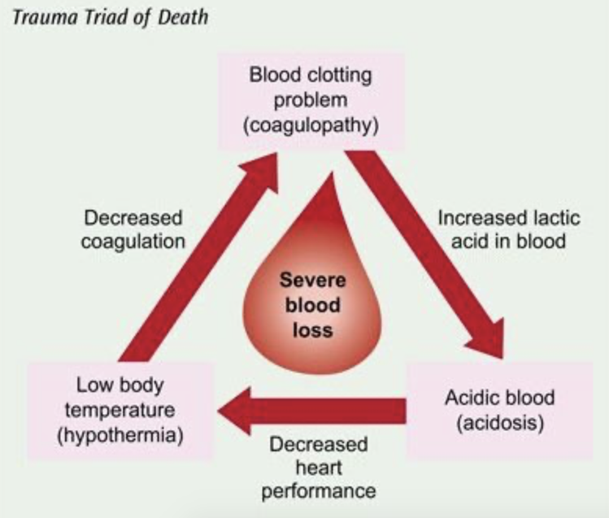
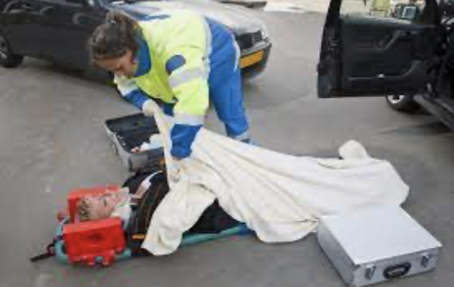
Trauma and hypothermia
Trauma patients at high risk of hypothermia .
Triad of death
Keep warm and dry.

Slide 41
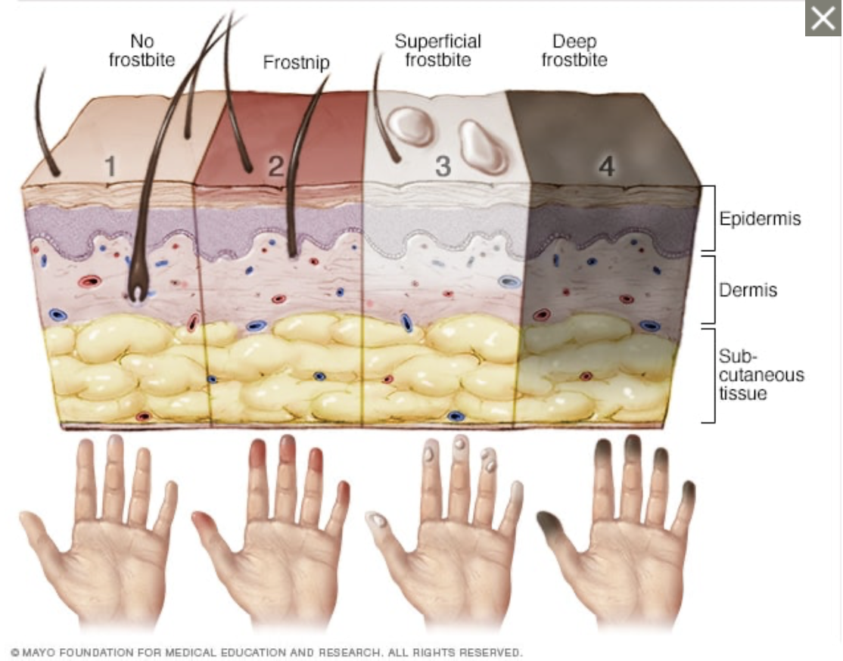
Notes:
Frostnip - mild form of frostbite. cold exposure leads to numbness, skin warms = may feel pain and tingling. No permanent damage
Superficial frostbite. Pale skin. The skin may begin to feel warm — a sign of serious skin involvement. If you treat frostbite with rewarming at this stage, the surface of the skin may appear mottled. And you may notice stinging, burning and swelling. A fluid-filled blister may appear 12 to 36 hours after rewarming the skin.
Deep (severe) frostbite. As frostbite progresses, it affects all layers of the skin as well as the tissues that lie below. The skin turns white or blue-gray and you lose all sensation of cold, pain or discomfort in the area. Joints or muscles may stop working. Large blisters form 24 to 48 hours after rewarming. The tissue turns black and hard as it dies.

Slide 42
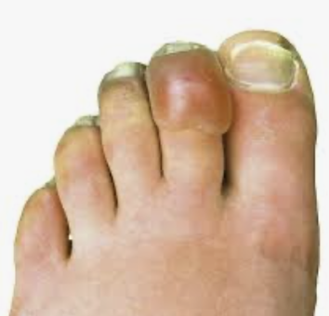
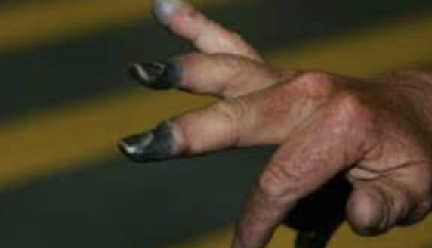
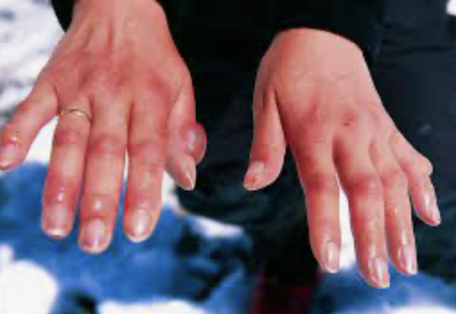
Frostbite
If frostbite present do not rub tissue - rewarm in warm water bath.
Stop further cold exposure.
If unable to keep re-warmed tissue warm then let stay cold until able to receive definitive care
If possible try to minimize use of affected extremity.

Slide 43
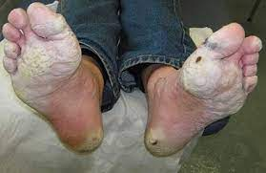
Trench Foot
Wet/muddy conditions
Poor foot care
Seen in homeless

Slide 44
In summary
If cold warm them up - be gentle and pay mind to cardiac monitor.
Removed from cold environment and remove wet clothing.
If in cardiac arrest be prepared for prolonged resuscitation.
Consider transport to hospital for profound hypothermia and cardiac arrest
For frostbite do not rub or aggravate tissue.
Do not rewarm if you cannot keep warm (particularly extrication from austere setting)
Continuous cardiac monitoring is imperative
Always check a glucose.

Slide 45
Heat Related Injuries

Slide 46
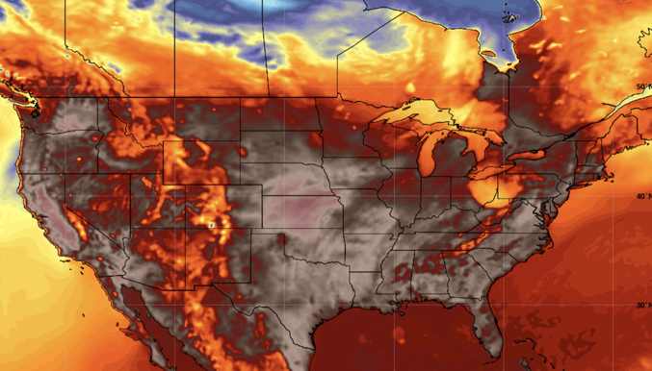
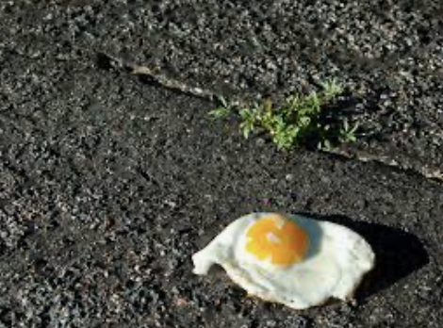
Hyperthermia
Defined as body temperature >38°C (100.4°F)
Spectrum that changes based on temperature and duration of exposure.
Notes:
Heat index: think of temperature and relative humidity

Slide 47
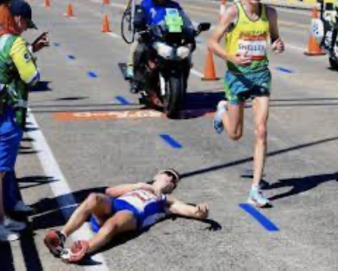
Heat Exhaustion
Significant dehydration
Often related to exertion
Defined: 1 organ system and >38ºC
PRESENTATION:
Hot
Sweaty
Faint
Orthostatic
Tachycardic
Muscle cramps
Nausea

Slide 48

Heat Exhaustion Treatment
Move to cool environment.
Remove excessive clothing.
Oral hydration preferred to IV hydration if possible.
Can utilize ice bath, cool misting with fanning, shade, ambulance AC

Slide 49

Heat Stroke (Severe Hyperthermia= life threat)
Temp Generally >40°C(104°F)
My be sweating but often not
By definition will have neurologic effects.
Delirium, AMS, focal deficits
Seizures
Temp can exceed 106°C within 10-15 minutes (thermal inertia)

Slide 50

Heat Stroke Treatment
Rapid aggressive cooling. (Mainstay)
Ice bath is most effective (obvious limitation in prehospital setting).
Second most effective is spray bottles of cool water and fanning.
Cold IV fluids unclear if beneficial
Cold packs to axilla, neck, groin.
Aggressive temp reduction
Stop cooling measures at 38-39°C

Slide 51


Slide 52
Hyperthermia summary
Rapid aggressive cooling is imperative.
Move to cool area
Remove clothing
Ice bath, cool misting with fanning/air vent, and can augment with ice packs.
Stop cooling measures at ~38-39°C as not to overshoot or prompte shivering.
Always check a blood sugar.

Slide 53

Hyponatremia
Salt loss
Often dilutional by just drinking water
Risk factors: decreased PO, ETOH
Symptoms
Nausea/Vomiting
Seizures
AMS/coma
Tx: Electrolyte replenishment

Slide 54

Odds and Ends
Radiation
Medical
Weapon and energy generation
Poison Gas
Grain silos
Chlorine
Chemical Exposure
Pesticides and herbicides
Tx: Remove from scene, decontaminate

Slide 55

Summary
Be mindful of your surroundings
New environments present different challenges
Make sure you are safe

Slide 56

What questions do you have?

