Slide 1

Alcohol Abuse And Withdrawal

Slide 2

We Have A Problem

Slide 3
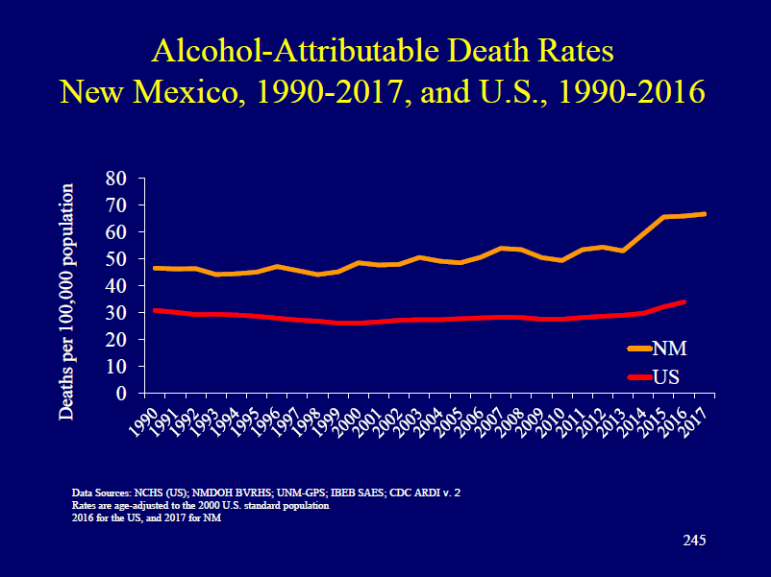

Slide 4
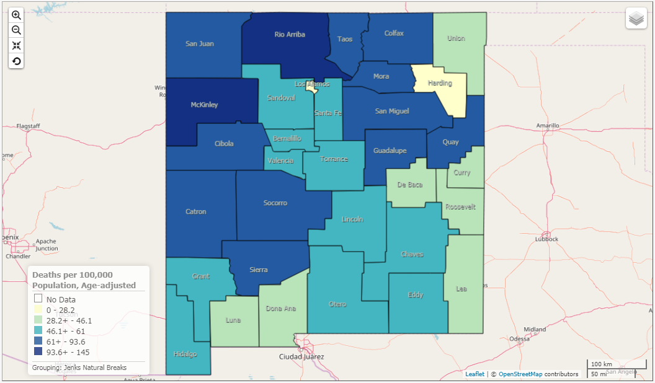
Alcohol Related Death by County

Slide 5
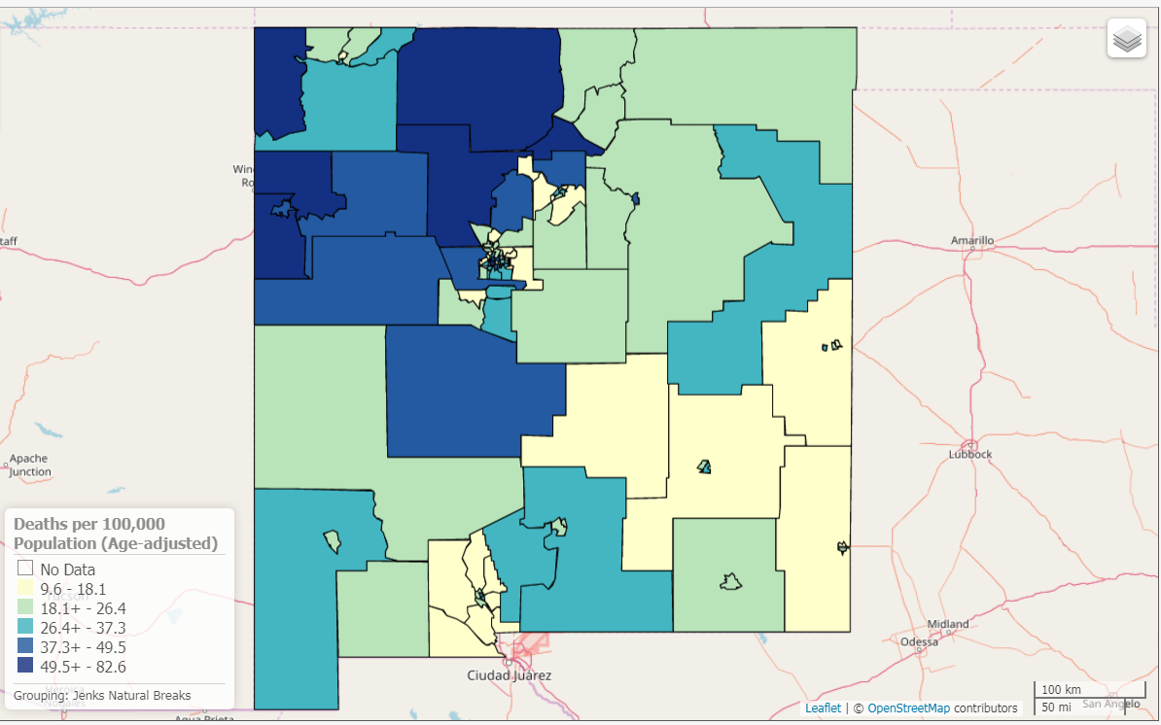
Alcohol Chronic Disease Death
Notes:
Chronic heavy drinking (defined as drinking, on average, more than two drinks per day for men, and more than one drink per day for women) often is associated with alcoholism or alcohol dependence, and can cause or contribute to a number of diseases, including alcoholic liver cirrhosis. For the past 15 years, New Mexico's death rate from alcohol-related chronic disease has consistently been first or second in the nation, and 1.5 to two times the national rate. The national death rate from alcohol-related chronic disease in 2015 (13.9) was the same as that in 1990. In contrast, New Mexico's rate increased 52 percent from 1990 to 2015.In general, males are more at risk than females for alcohol-related chronic disease death. Male rates are 2-3 times higher than female rates, across all racial/ethnic groups. American Indians are most at risk among the race/ethnic groups, with both total rates and male and female rates more than twice the corresponding state rates. As mentioned earlier, Hispanic males are also at elevated risk.
Rates are high in the American Indian and Hispanic populations in certain counties. It is worth noting the considerable variation across counties in American Indian alcohol-related chronic disease death rates.

Slide 6
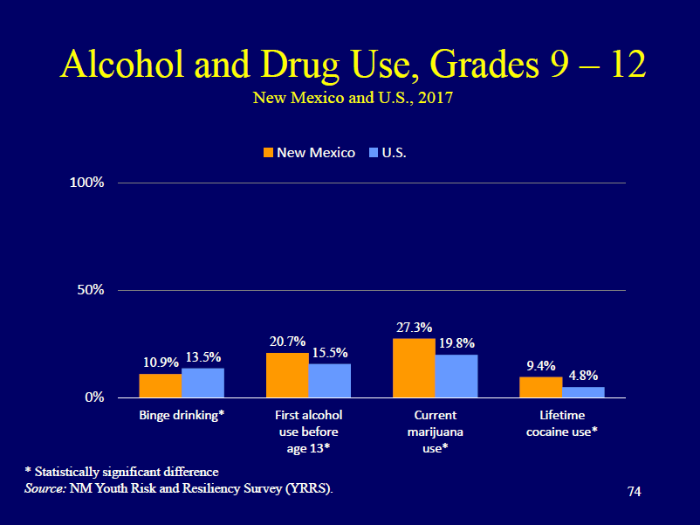

Slide 7
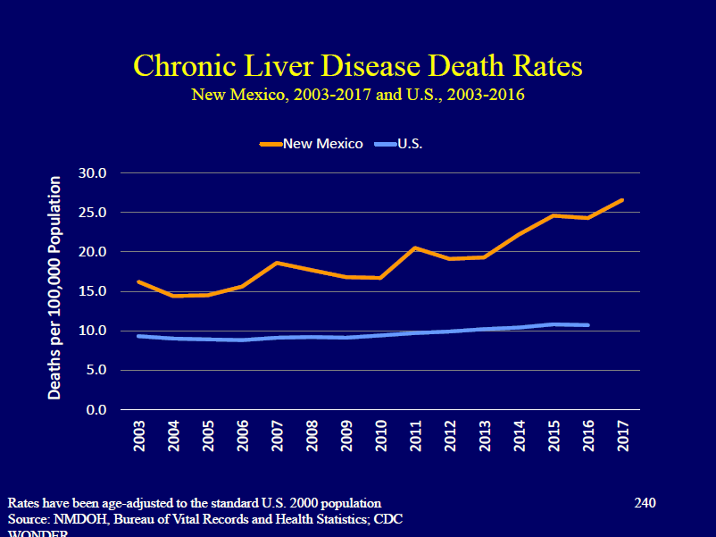

Slide 8
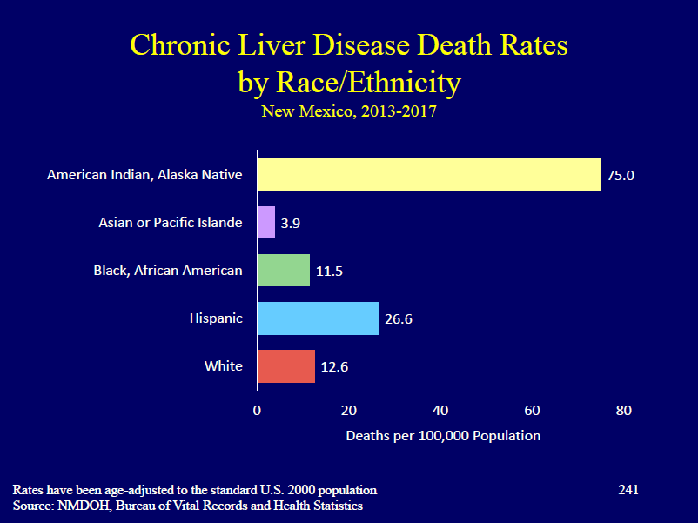

Slide 9

Definition of Abuse
7 drinks per week or 3+ drinks per occasion
14 drinks per week or 4+ drinks per occasion

Slide 10
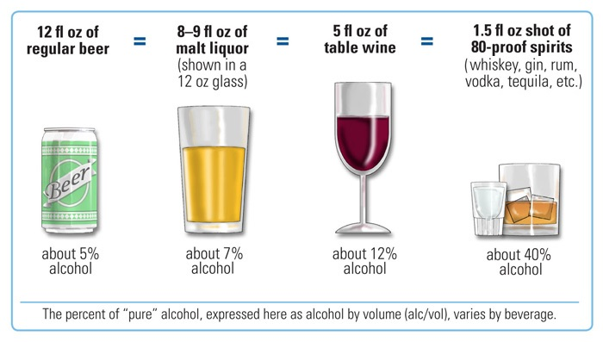
What Is A Drink?

Slide 11
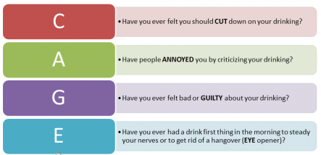
Screening Questions
Notes:
You have tried stopping using alcohol for a week or more, but can’t make it past a few days.
You can’t stop drinking once you start.
You recognize you need to stop or cut back.
You are unable to perform at work or home when you are drinking.
You feel guilty after drinking.
Others are telling you that you have a problem.
You have a drink in the morning to get yourself going after drinking too much the night before.
You have physically hurt someone else or yourself after drinking too much.
You hide your drinking or your alcohol.
You have blackouts and memory lapses after drinking too much.
You are depressed.
You are getting traffic or driving tickets while under the influence of alcohol.
Your drinking is interfering with your relationships.

Slide 12
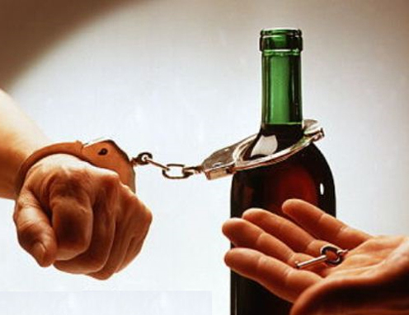
Alcohol Dependence Is A Disease

Slide 13
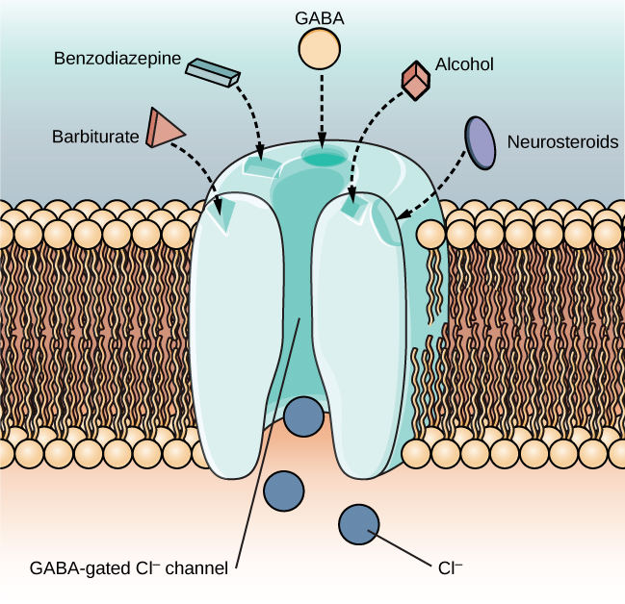
Alcohol Binds the GABA Receptor Which Is Inhibitory
Sluggish movement, slurred speech, slow reaction time
Notes:
Enhancement of this complex chloride channel system contributes to anticonvulsant, sleep-inducing, antianxiety, and muscle relaxation effects of all GABA-boosting drugs. Acutely administered alcohol produces a release of GABA, and continued use increases density of GABA_{A} receptors, whereas alcohol withdrawal states are characterized by decreases in GABA-related activity. Equally important is the ability of acute alcohol to inhibit postsynaptic N-methyl-D-aspartate (NMDA) excitatory glutamate receptors, whereas chronic drinking and desistance are associated with an upregulation of these excitatory receptor subunits. The relationships between greater GABA and diminished NMDA receptor activity during acute intoxication and diminished GABA with enhanced NMDA actions during alcohol withdrawal explain much of intoxication and withdrawal phenomena

Slide 14
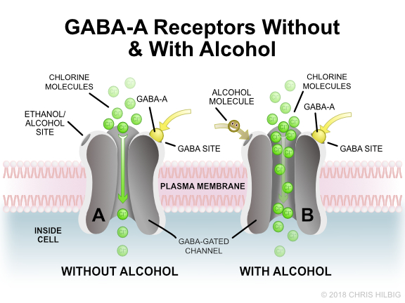

Slide 15
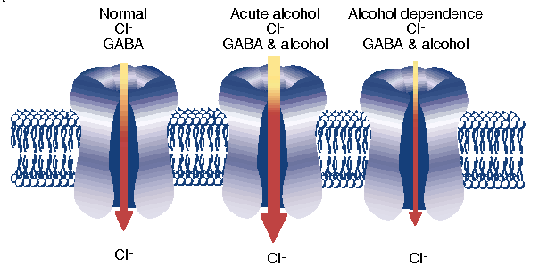
GABA Receptor Sensitivity Reduced By Continual Stimulation

Slide 16

It’s All About Balance

Slide 17
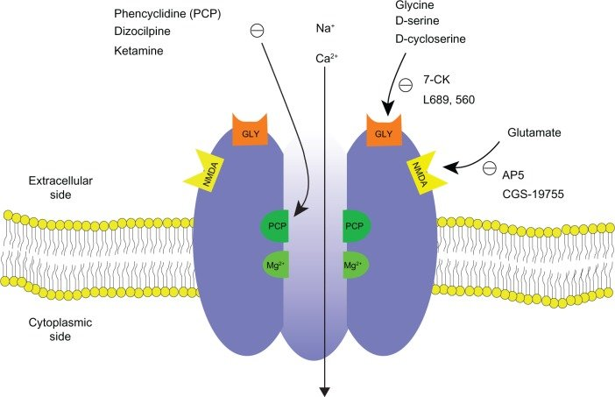
NMDA Receptors Are Excitatory
The Main Neurotransmitter is Glutamate
Glutamate

Slide 18
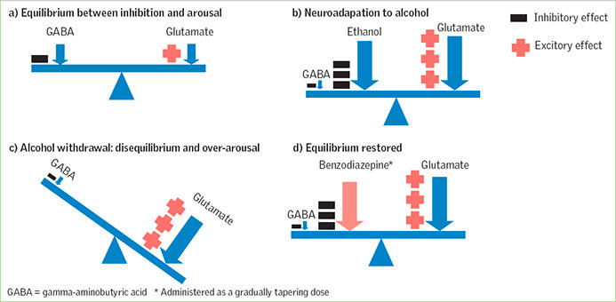
Homeostasis

Slide 19
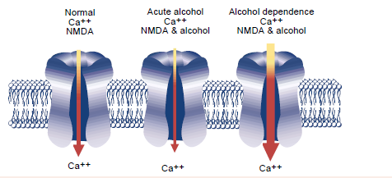
NMDA Receptor Becomes More Sensitive in Alcohol Dependence

Slide 20
Acute Withdrawal

Slide 21
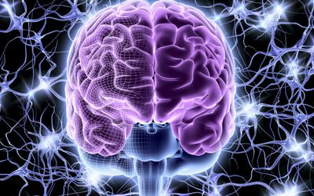
Alcohol Withdrawal Can Kill People
Agitation, Anxiety, Delirium, Seizures

Slide 22

Withdrawal Signs And Symptoms
Hypertension
Tachycardia
Diaphoresis
Tremulousness
Anxious
Agitated

Slide 23

Delirium Tremens
Confusion
Seizures
Hallucinations
Formication
Autonomic Hyperactivity
Fever
30% mortality if untreated

Slide 24
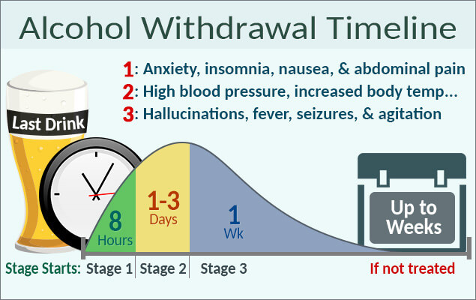
Patients Don’t Read The Textbook

Slide 25
Benzos Treat Withdrawal

Slide 26

Other Consequences Of Alcohol Abuse

Slide 27
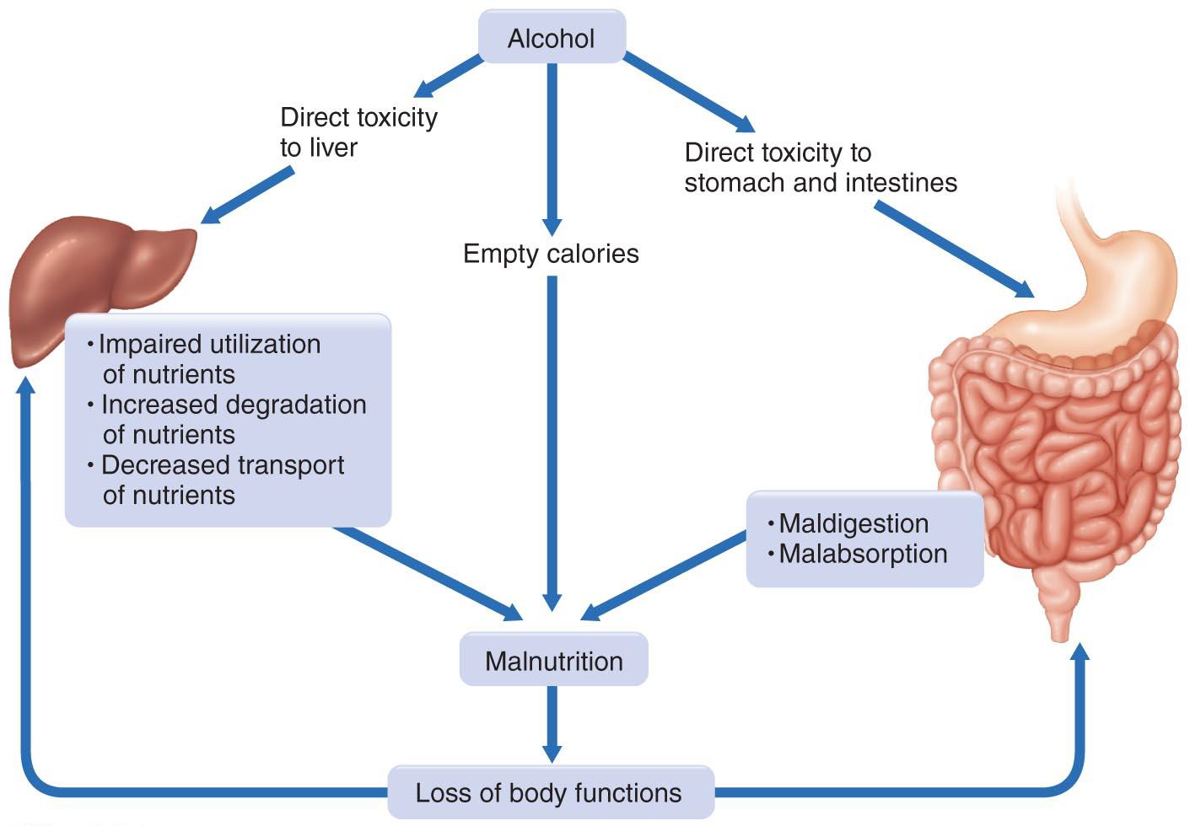
Chronic Alcohol Use Causes Nutritional Deficiencies
Direct Toxicity to Stomach and Intestines
Decreased nutrient metabolism and transport
Impaired digestion and absorption
Malnutrition

Slide 28
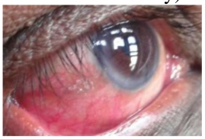
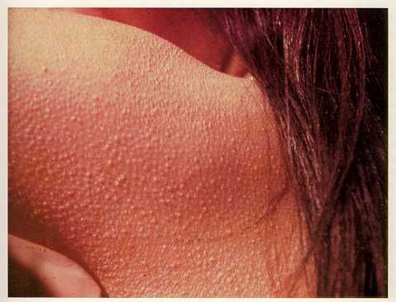
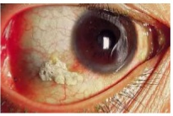
Vitamin A Deficiency
Hyperkeratosis
Night Blindness and Bitot’s Spots
Insomnia, Fatigue, Immune suppression

Slide 29
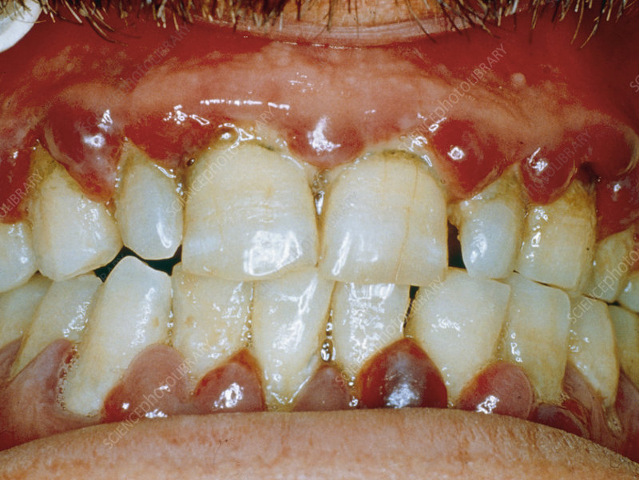
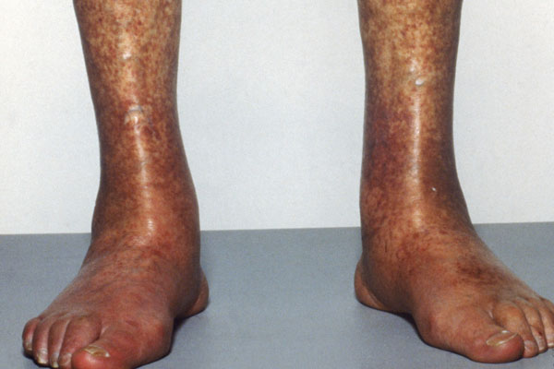
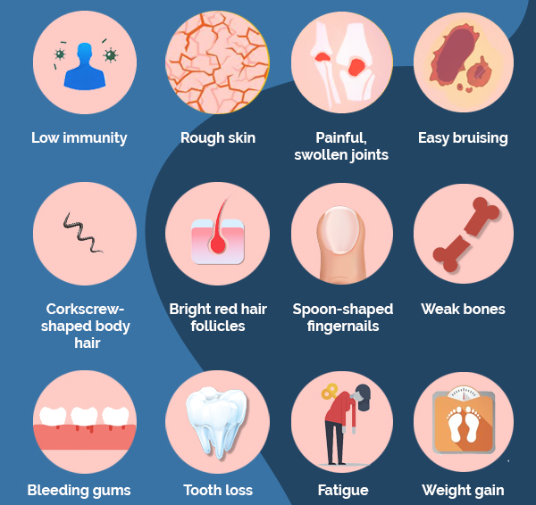
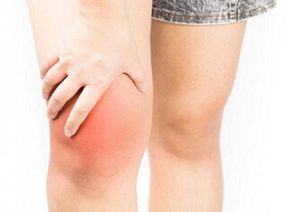
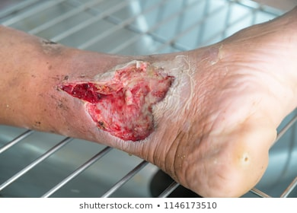
Vitamin C Deficiency
Collagen is important for blood vessels and bones
Easy Bruising and Bleeding
Capillary rupture and edema
Impaired wound healing and decreased immunity
Joint Pain and Swelling

Slide 30
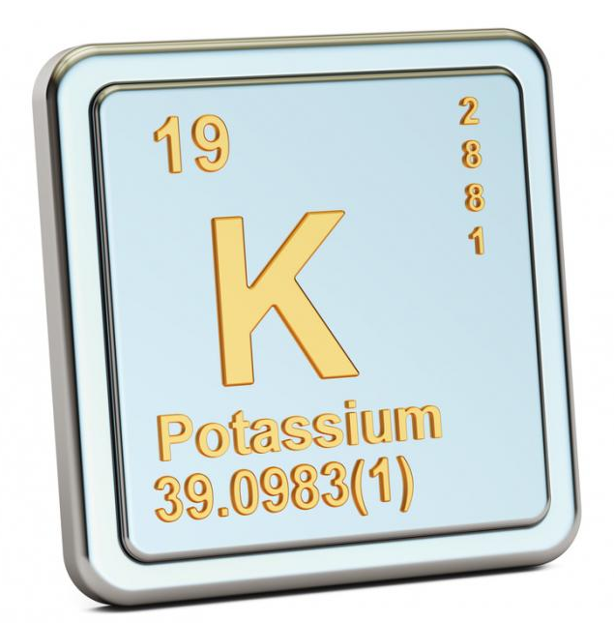
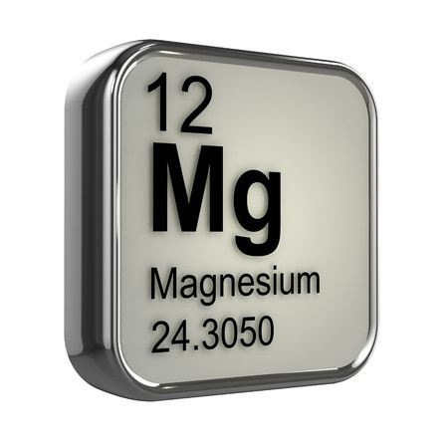
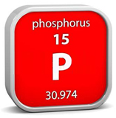
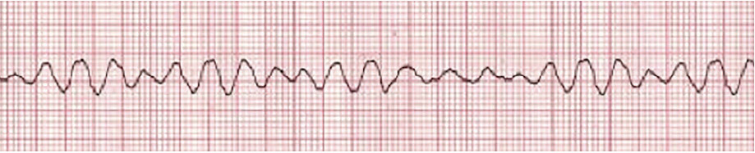
Electrolyte Deficiencies Can Cause Sudden Cardiac Death

Slide 31
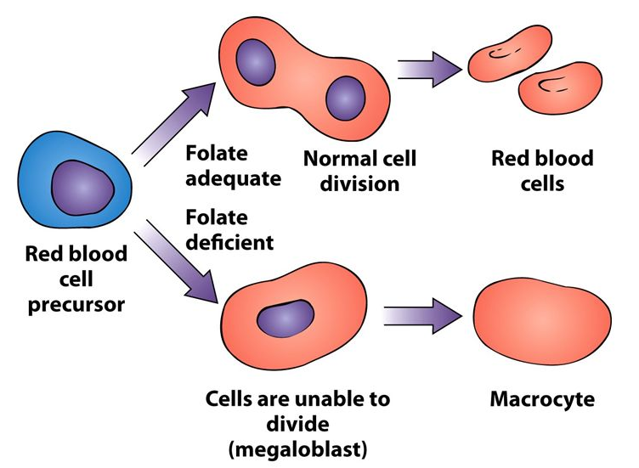
Folate Deficiency and Anemia
Folate is essential for DNA Synthesis and Cellular Function and Repair

Slide 32
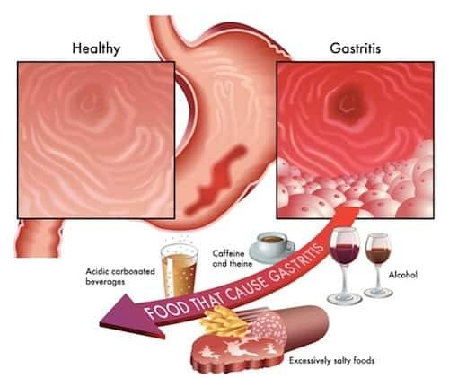
Gastritis and Peptic Ulcers
Causes GI bleeding, anemia, malabsorption

Slide 33
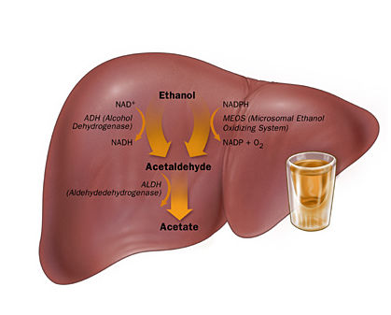
Alcohol Effects On The Liver
Direct Cell Death
Inflammation
Oxidative stress
Increased fatty acid production
Notes:
Alcholic hepatitis has a 4 year mortality of >60%

Slide 34
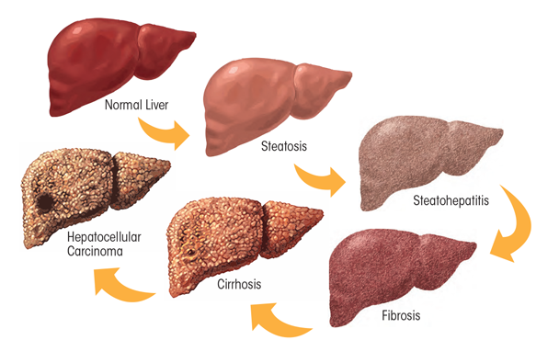
The Road To Liver Failure

Slide 35
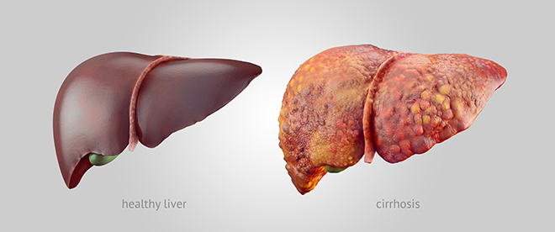
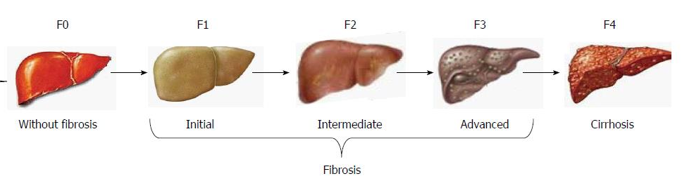
Cirrhosis Of The Liver

Slide 36
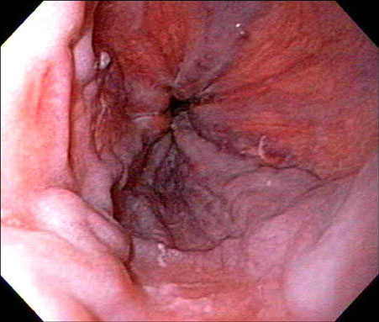
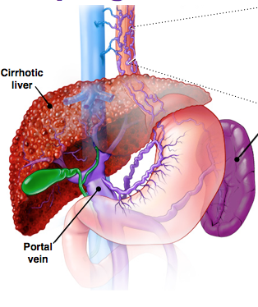
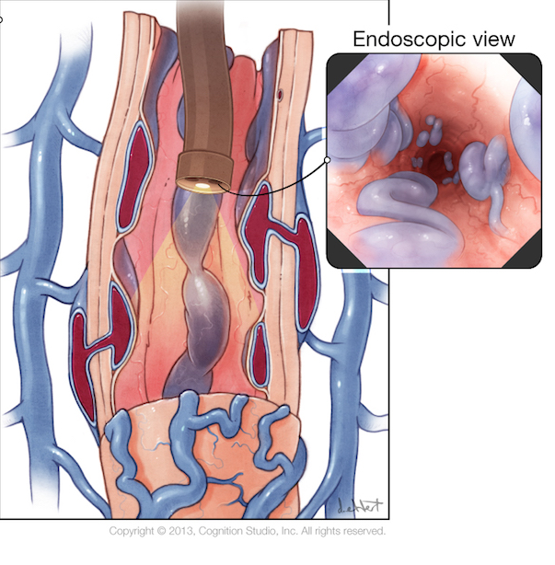
Esophageal Varices
Can Cause Life Threatening Bleeding

Slide 37
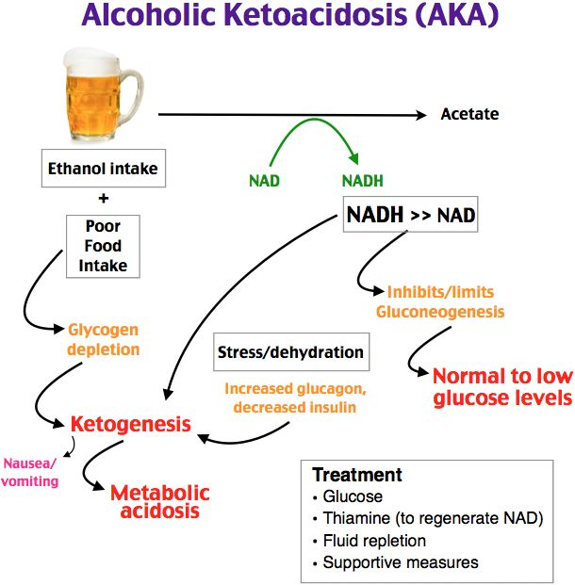
Alcoholic Ketoacidosis
Ethanol is oxidized
  Makes NADH and BHB
  Uses thiamine stores
Reduced nutrient intake
  Sugar stores are used up
  Ketones are produced
Dehydration impairs ketone excretion
  Acid build up in blood

Slide 38
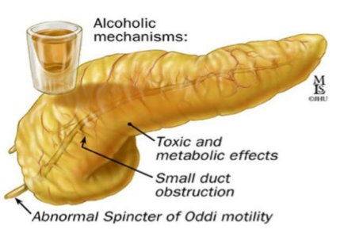
Pancreatitis
Epigastric pain with nausea and vomiting

Slide 39
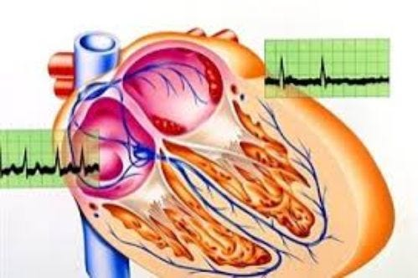
Holiday Heart Syndrome
Binge Drinking Can Cause Arrhythmias In Otherwise Healthy Hearts

Slide 40
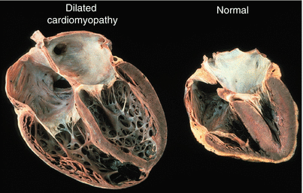
Dilated Cardiomyopathy

Slide 41
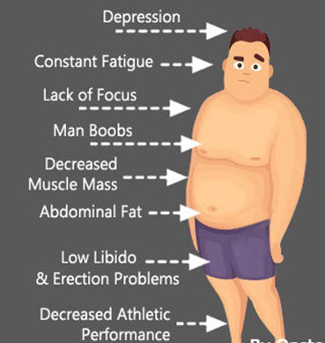
Alcohol Decreases Testosterone Levels
Directly toxic to testicular cells
  Testicular atrophy
  Low testosterone
  Low sperm counts
Disrupts hormone production in the hypothalamus
  Gynecomastia
  Increased estrogen

Slide 42
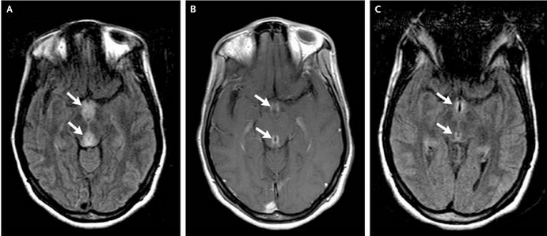
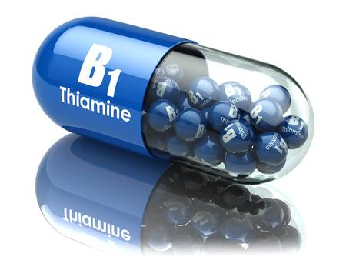
Wernicke’s Encephalopathy
Ataxia, double or blurry vision, Confusion, Impaired short term memory
Notes:
An initial magnetic resonance image (MRI) of the brain, with fluid-attenuated inversion recovery, demonstrated abnormal hyperintensity of the mamillary bodies and periaqueductal gray matter (Panel A, arrows), with associated abnormal enhancement on T₁-weighted images that were obtained with the use of contrast material (Panel B, arrows). The findings from the clinical examination and imaging suggested Wernicke's encephalopathy. The patient was given thiamine, with marked improvement in her confusion, memory loss, slurred speech, and extraocular movements during the next seven days. A follow-up MRI of the brain that was obtained with fluid-attenuated inversion recovery seven days after the initial MRI demonstrated near-complete resolution of the abnormal mamillary body and periaqueductal hyperintensity (Panel C, arrows).

Slide 43
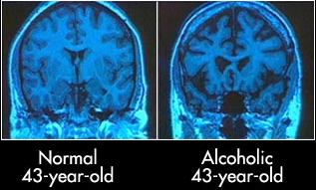
Chronic Alcohol Effects On The Brain
Cortical and cerebellar atrophy, neuron loss

Slide 44
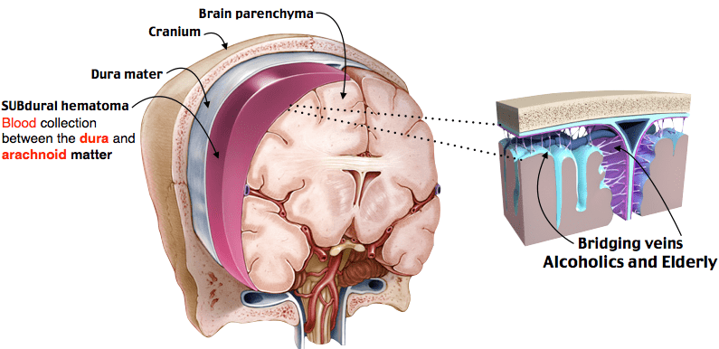
High Risk For Subdural Hemorrhage
Frequent Falls and Brain Atrophy Cause Tearing Of Bridging Veins

Slide 45

Chronic Alcohol Causes Insomnia and Sleep Disorders
Shown to worsen sleep apnea and interfere with sleep cycle

Slide 46

Chronic Alcohol Use Worsens Depression
People with alcohol dependence are 3.7 times more likely to have major depressive disorder
Notes:
Alcohol Res. 2019; 40(1): arcr.v40.1.01.
Published online 2019 Oct 21. doi: 10.35946/arcr.v40.1.01
PMCID: PMC6799954
PMID: 31649834
Alcohol Use Disorder and Depressive Disorders
R. Kathryn McHugh and Roger D. Weiss
Author information Copyright and License information Disclaimer

Slide 47
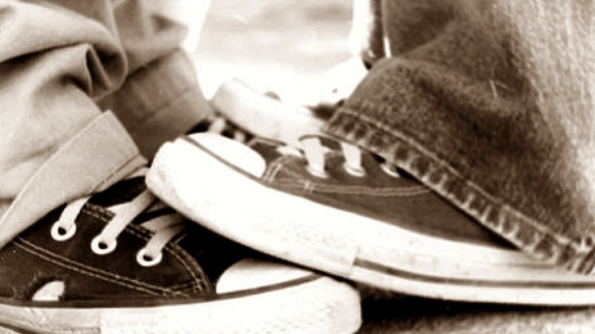
Am I Stepping On Toes?

Slide 48

Time For Introspection

Slide 49
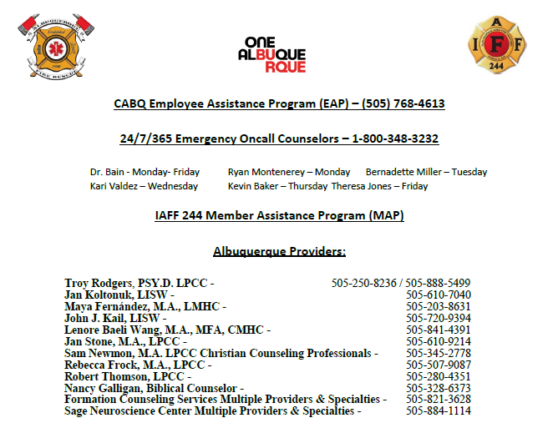
Please Use These Resources

Slide 50
Questions??

